Slide 1

2013 Update of NGS Products, Geodetic Services and Tools
Marti Ikehara: marti.ikehara@noaa.gov
California Geodetic Advisor
916-227-7325
geodesy.noaa.gov

Slide 2
Geodetic Topics
1.CORS
2.OPUS
3.Reference frames [IGS08, NAD83(2011)]
4.GEOID12A
5. Datasheet fields
  “Observed,” no orders
6. Tidal datums/VDATUM
7. DSWorld
  Retrievals, reporting

Slide 3
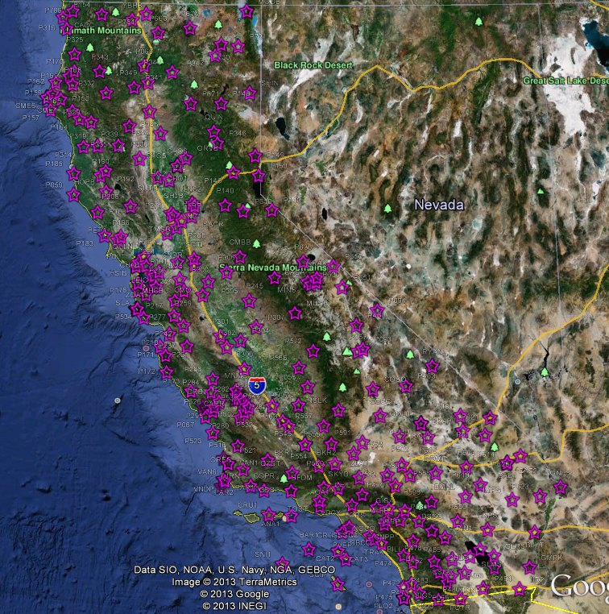
As
Of
6/
6/
12

Slide 4
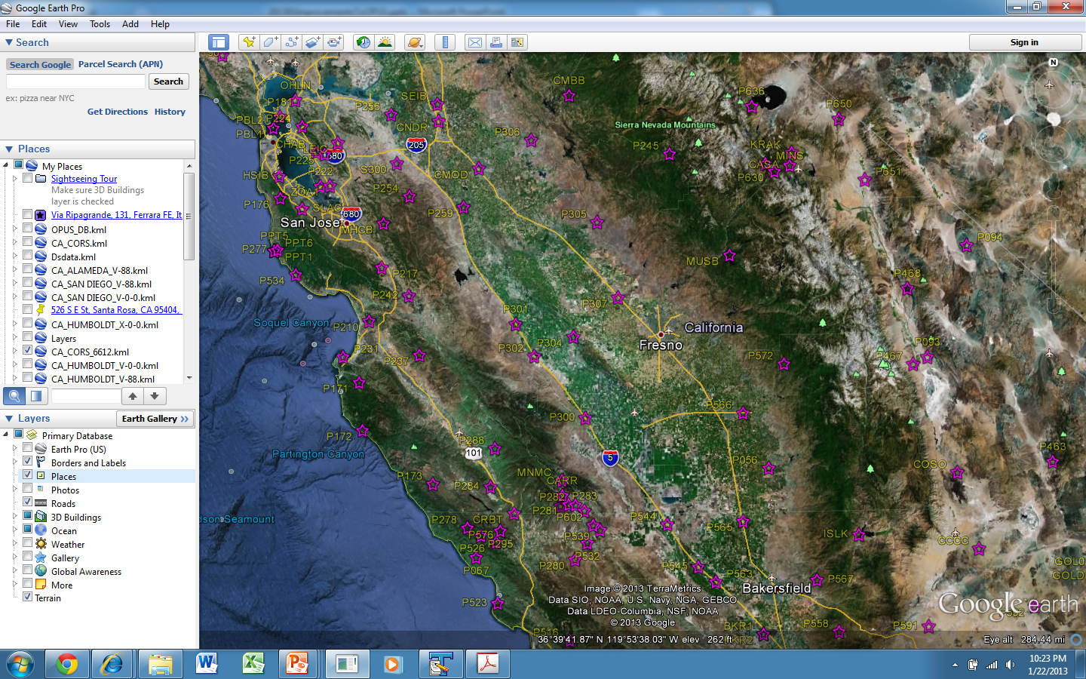

Slide 5
New CORS in CA
CSRC requested about 130 of the CRTN backbone sites to become NGS CORS; some already were
Essentially all but a handful were added to NGS CORS network in 2nd quarter, 2012
PBO Time Series Website Awesome
http://pbo.unavco.org/data/gps/plotviewer/P334/GPS

Slide 6
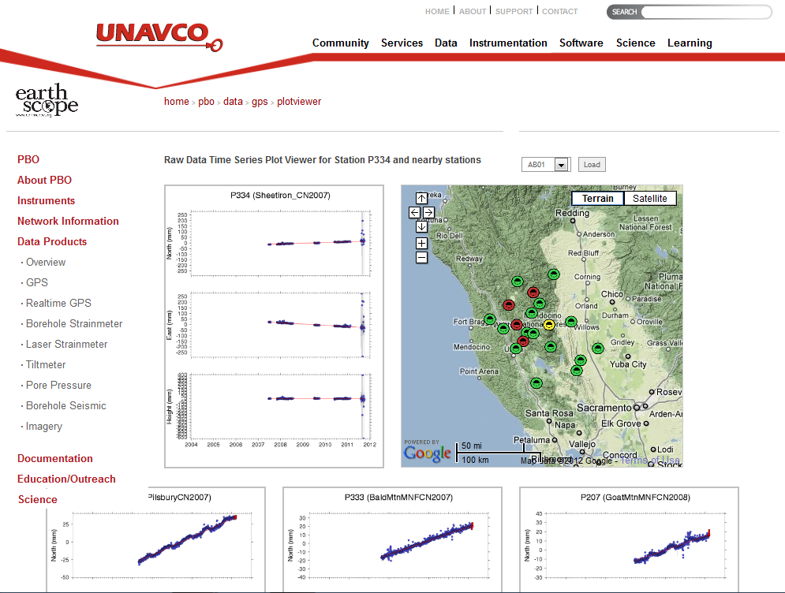

Slide 7
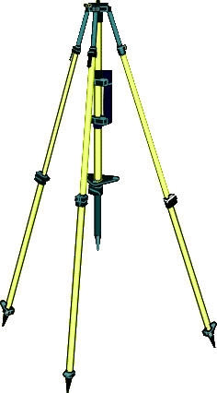
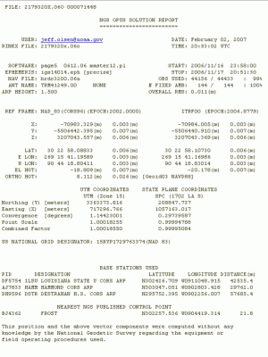
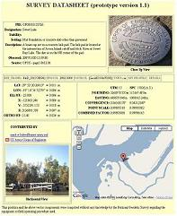

your
GPS data
IGS & NGS base stations
& site information files
IGS antenna calibrations
& satellite orbits
& reference frames
UNAVCO teqc converter
PAGES baseline processor
var. geophysical models
NGS geodetic toolkit
geodetic standard data
Online Positioning User Service
OPUS
geodesy.noaa.gov/OPUS/
→
→
→
→
free, fast, easy, consistent coordinates
JGE 2011v1
your
solution
options:
projects & publishing
mark description

Slide 8
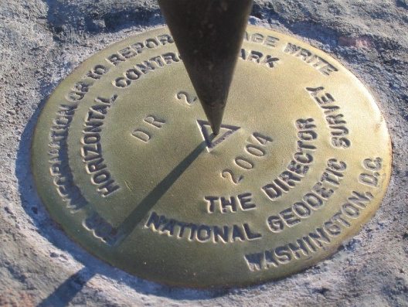
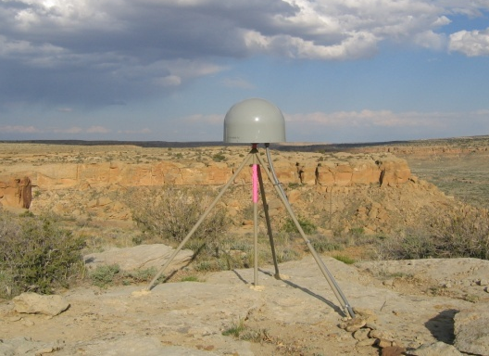
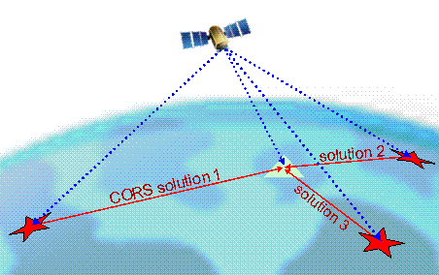
Online Positioning User Service (OPUS)
>15 min of L1/L2 GPS data >>> geodesy.noaa.gov/OPUS/
Processed automatically on NGS computers, tied to CORS
Solution via email - in minutes
Fast, easy, consistent access to NSRS

Slide 9
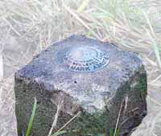
solution 2
=
h
your position:
averaged from the “best” 3 of 5 CORS solutions
φ
CORS solution #1
λ
=
=
solution 3
your peak-to-peaks:
scaled from the spread of the 3 CORS solutions
solution 5
=
=
solution 4

Slide 10
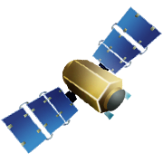


Rapid-static: OPUS first creates an atmospheric delay model from surrounding CORS data.
Your position is then determined by differential GPS static solutions from 9 CORS.

Slide 11
OPUS static vs. rapid static
 | static | rapid static
input (dual-frequency GPS) | 2-48 hours | 15 minutes-2 hours
output | normal, extended, XML datasheet, project | normal, extended, XML
accuracy (95%confidence) | 1-2 cm horizontal 2-6 cm ellipsoidal height | 1-2 cm horizontal 4-8 cm ellipsoidal height
network geometry | 3 CORS, preferably within 1000 km of rover | 3-9 CORS, surrounding & within 250 km of rover
availability | global | 90% of CONUS (subject to CORS configuration)

Slide 12
So, what’s different about the CORS coordinates?
Change to absolute antenna calibrations
  Use absolute cal. in your processing: DON’T MIX!
Better because 8 more years of:
  International CGPS sites
  CORS data: about 1600 total, ~1000 w/ >2.5 yrs
  Orbit determination sophistication
  CORS velocity data
Better processing algorithms
Better HTDP modeling, for those w/ <2.5 yrs

Slide 13
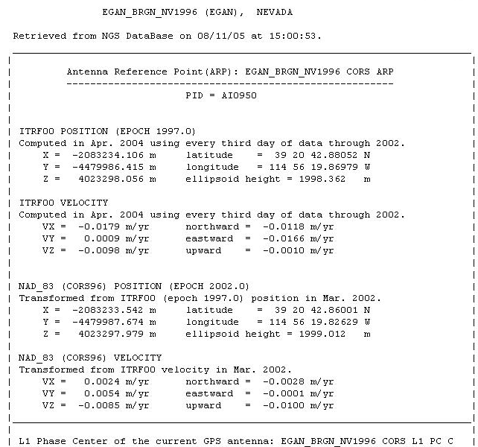
CORS Reference Frame Changes applied to OPUS
IGS08 epoch 2005,
IGS08 epoch of obs.
IGS08 = International GNSS Service 2008
(GPS-only realization of ITRF2008)
NAD83 (2011) epoch 2010.0
NAD83 (2011) = North American Datum 1983
(2011 Realization)

Slide 14
Notes:
NW quadrant is CA; NE is WA/OR; E is PR

Slide 15
median values, solution quality metrics:
 | original |  | new |  | improved
peak-to-peak LAT | 0.013 m |  | 0.004 m |  | 69 %
peak-to-peak LON | 0.015 m |  | 0.004 m |  | 73 %
peak-to-peak EL_HGT | 0.024 m |  | 0.008 m |  | 67 %
% ambiguities fixed | 93 % |  | 95 % |  | 2 %
% observations used | 95 % |  | 94 % |  | -1 %
RMS | 0.014 m |  | 0.014 m |  | 0 %
Notes:
Stats for OPUS solutions much tighter with new coordinates in place

Slide 16
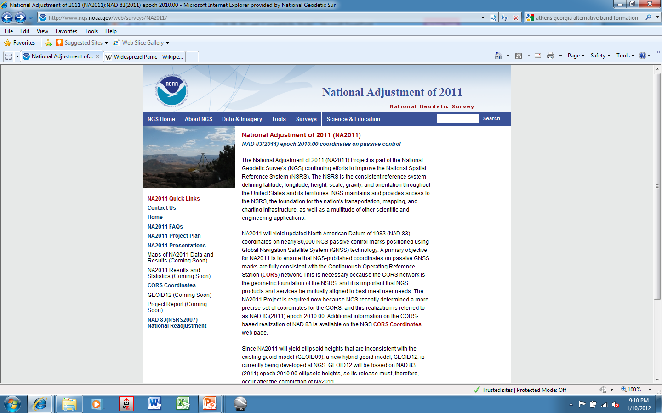

Slide 17
NAD83(2011) epoch 2010.00 Realization
Primary/secondary adjustment approach for CONUS
Projects older than 1994 (start of CORS program) in secondary except have included HARNs in primary
5321 stations common to both used as constraints
PRIMARY: 3472 projects; 62.4K unique stations;
343,482 vectors total; rejected reduced fr 6.4% to 3%
SECONDARY: 614 projects; 22.5K stns (pre-ant. modeling)
Downweighting vertical component (eht) in subs areas
99% of residuals <3cm horizontal and <4cm vertical
Alaska: 142 projects; Hawaii: 39 projects
Report as ….NAD83(2011) epoch 2004.50, for example

Slide 18
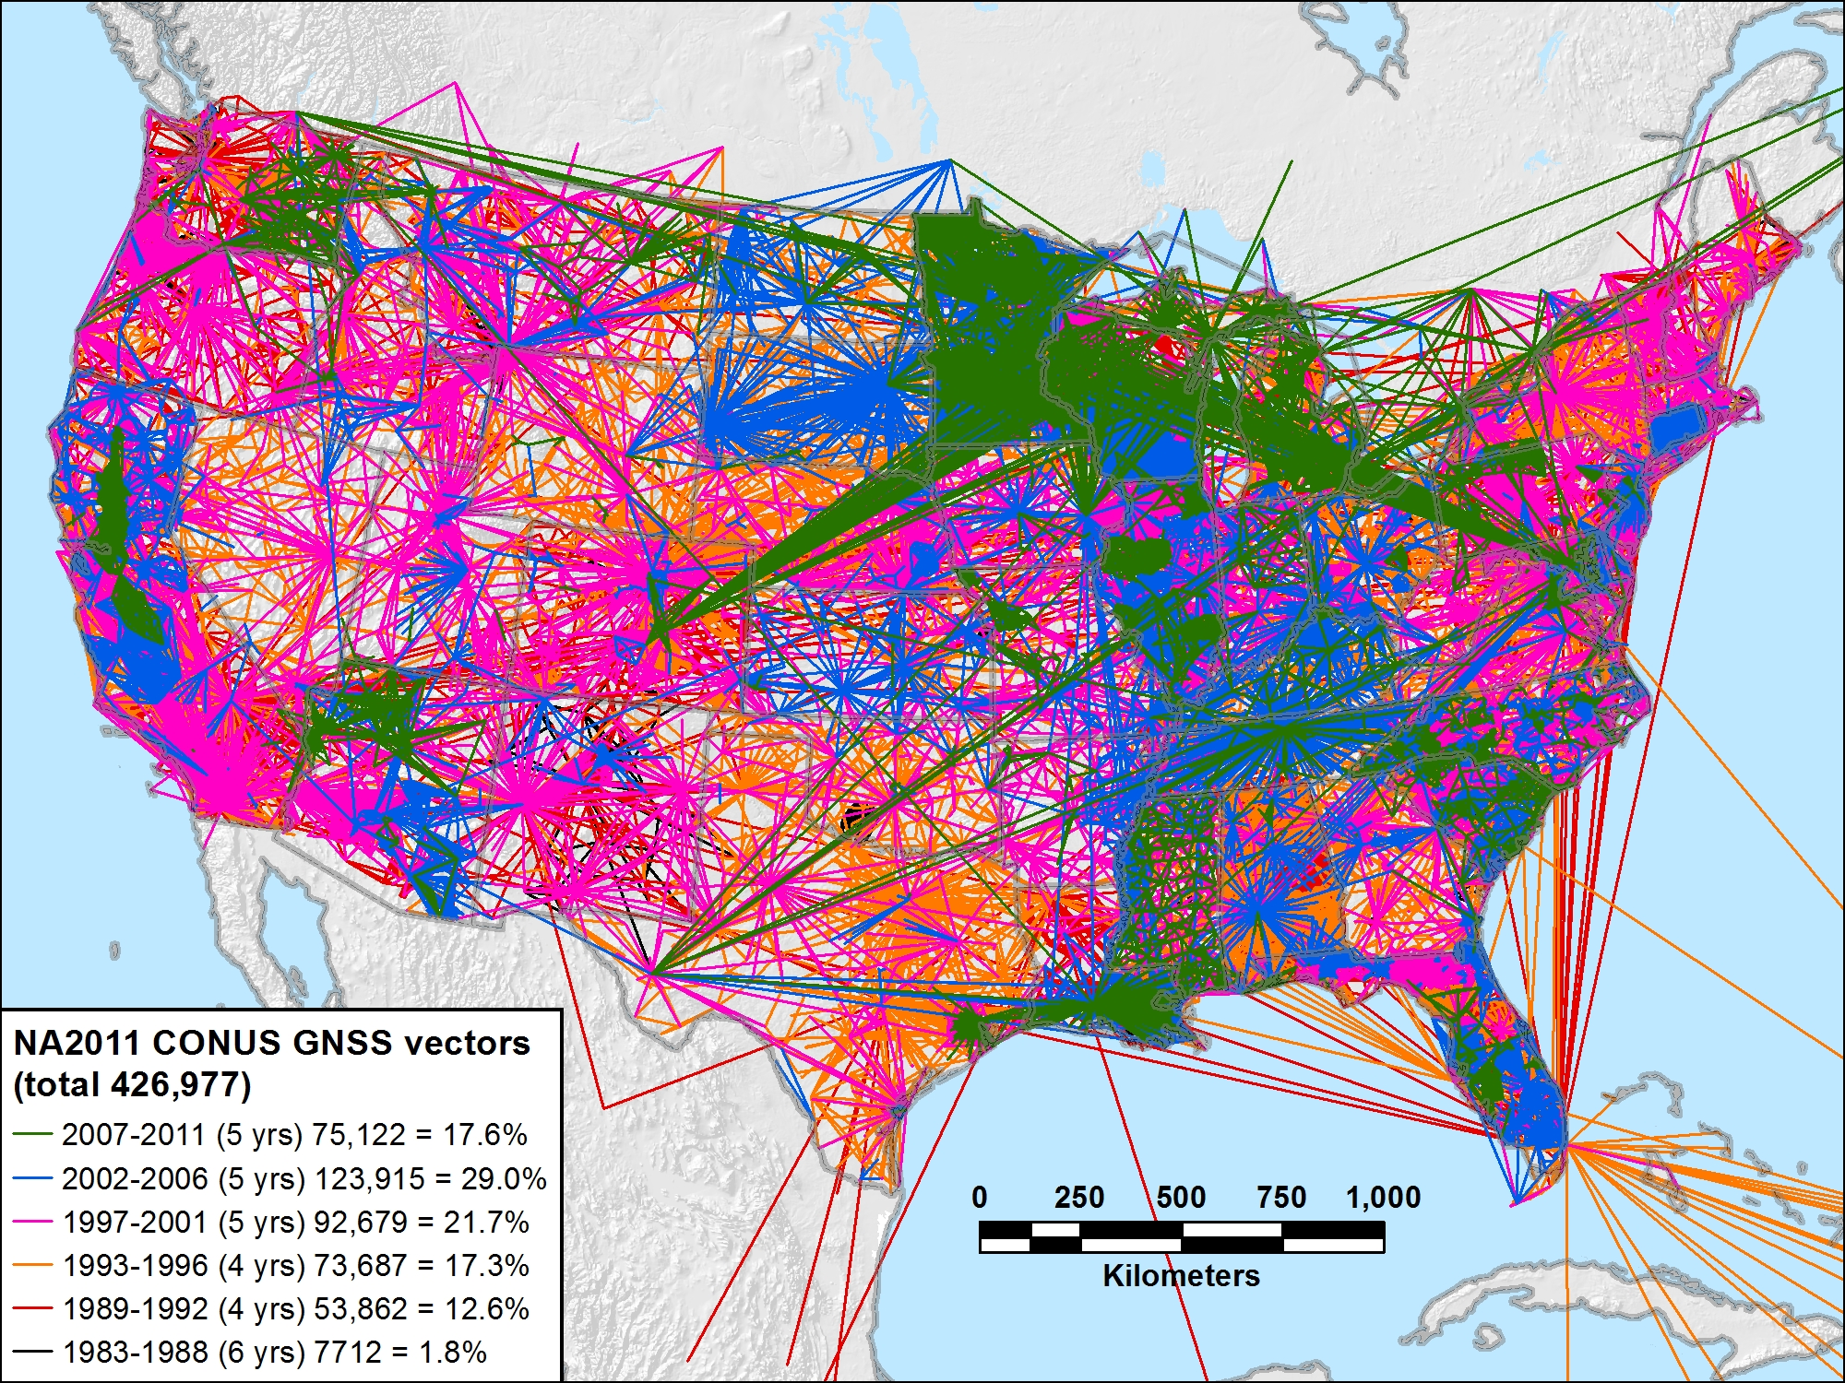
NA2011 CONUS 1983-2011 (29 yrs) 426,977 vectors (100.0%)

Slide 19
GEOID12A Development
Model is BASED on ellipsoid heights published from NA2011 project (and NAVD88 leveled hts)
Proposed stations, different than for GEOID09, for inclusion/exclusion distributed to geodetic advisors for review & acceptance/rejection
OPUS-DB results have been included
How you can help future modeling:
  Collect data on leveled bench marks which are likely to have been stable since they were leveled (1988) where gaps exist

Slide 20
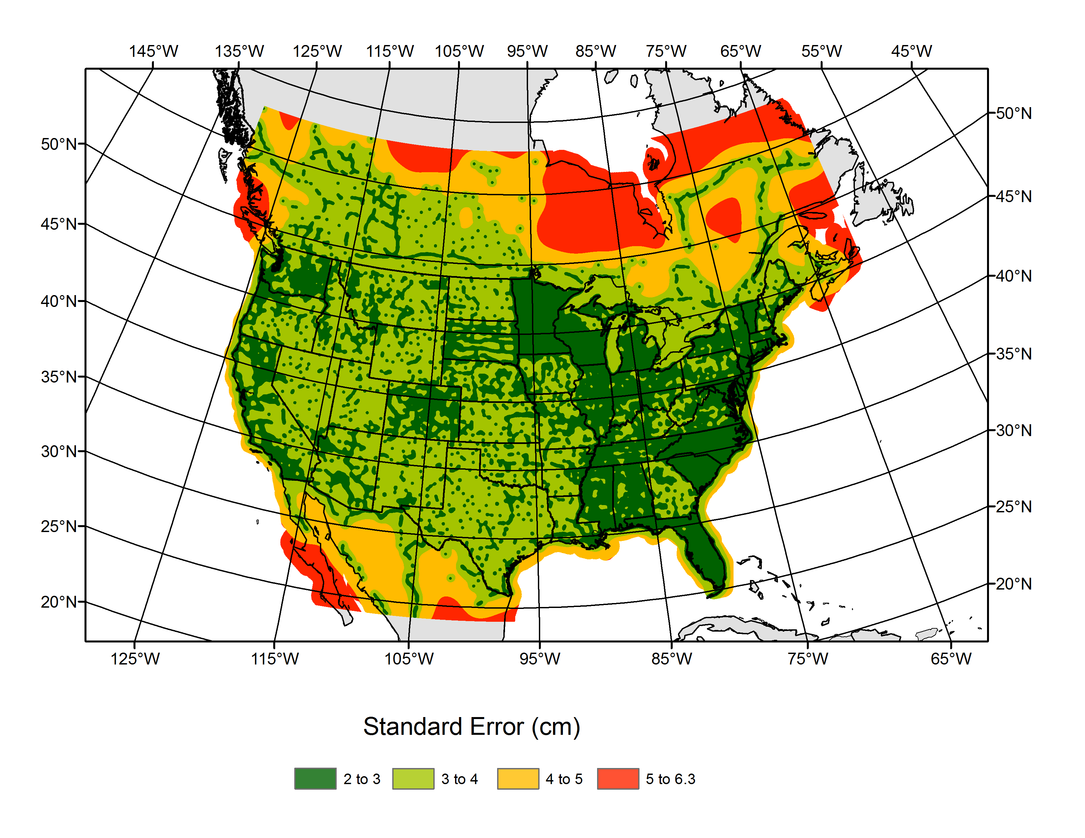
GEOID12A Error Grid
DRAFT, mid-Jan 2013

Slide 21
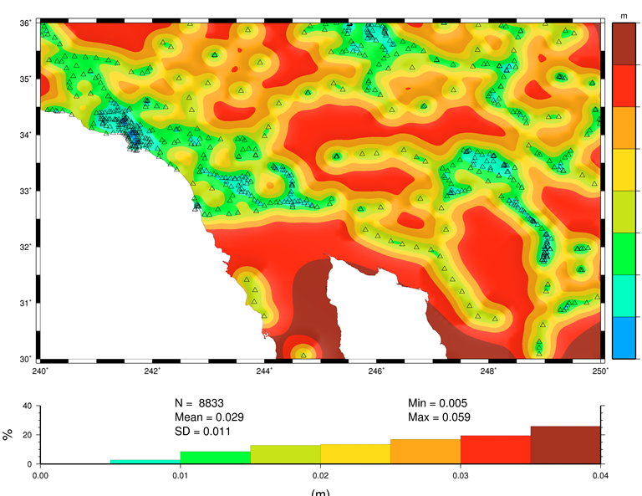

Slide 22
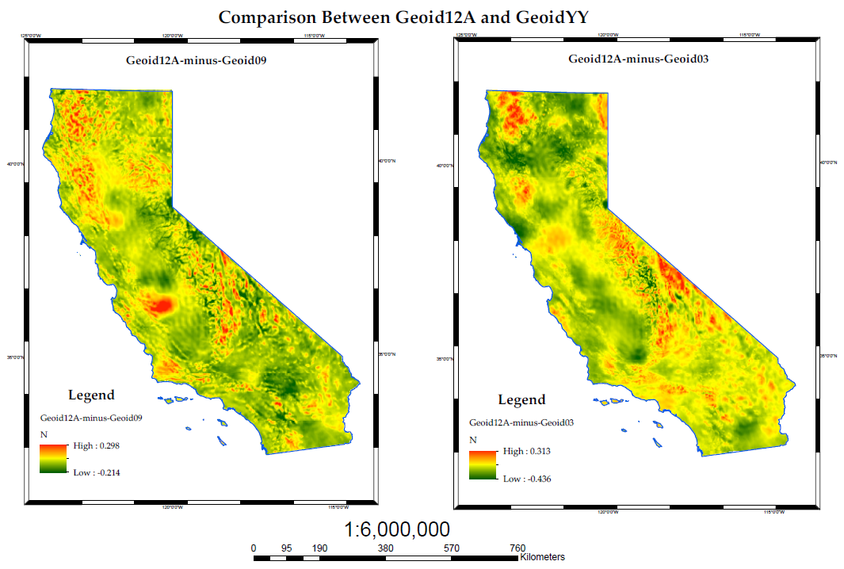
Courtesy of Kevin Kelly, ESRI

Slide 23
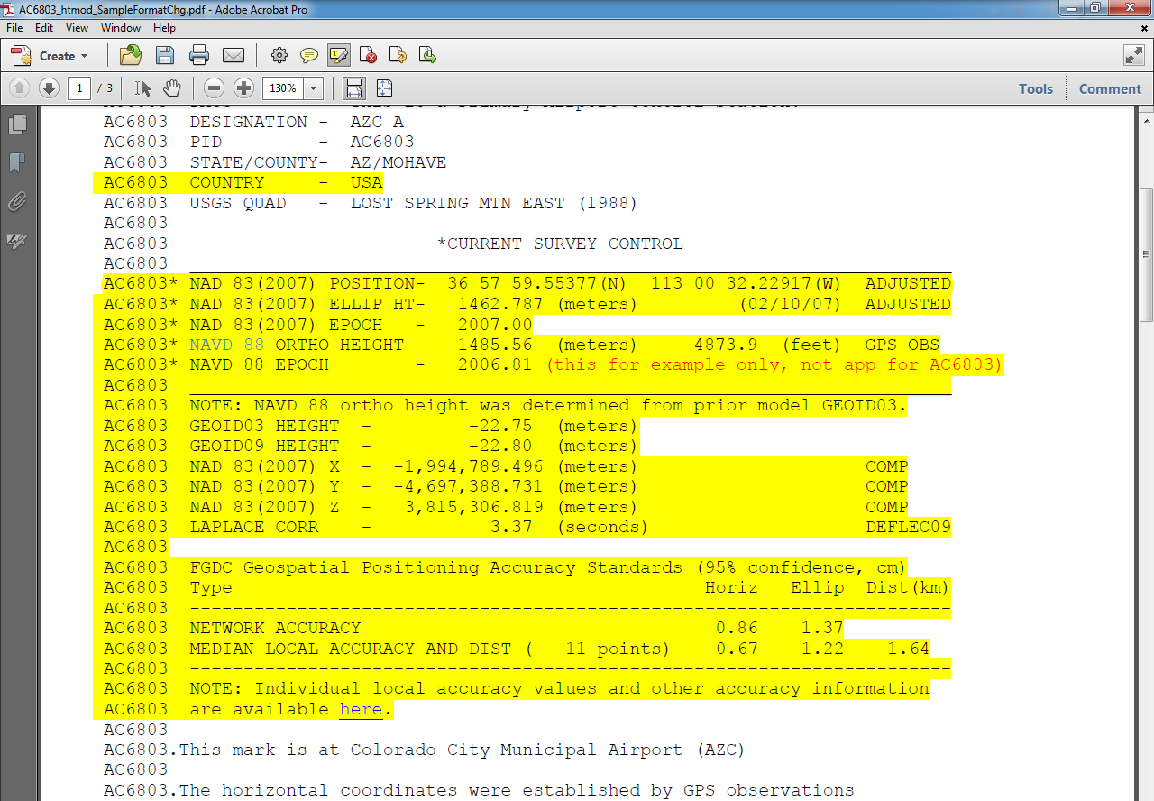
Datasheet Format/Content Changes
Move ell ht and epoch info into top box
Note when GPS Ortho Ht computed with previous geoid model, and provide that model ht
Better way to quantify accuracies

Slide 24
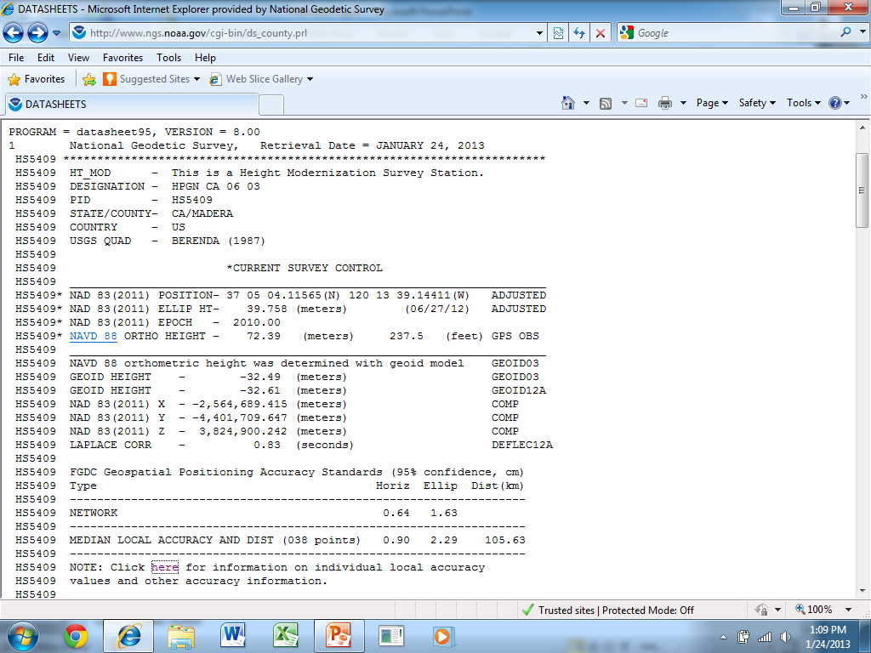
12 cm

Slide 25
Comments about DS Fields
Orders of accuracy have been superceded by linear, eg, cm; use and state the network accuracy. PRC says <2cm horizontal is CSRN (for SPC); 4cm ellipsoid height
No relation to superceded accuracies; dependent on quality of THAT survey
Observations NOT done at same time (year) of adjustment; look at superceded epoch and history

Slide 26
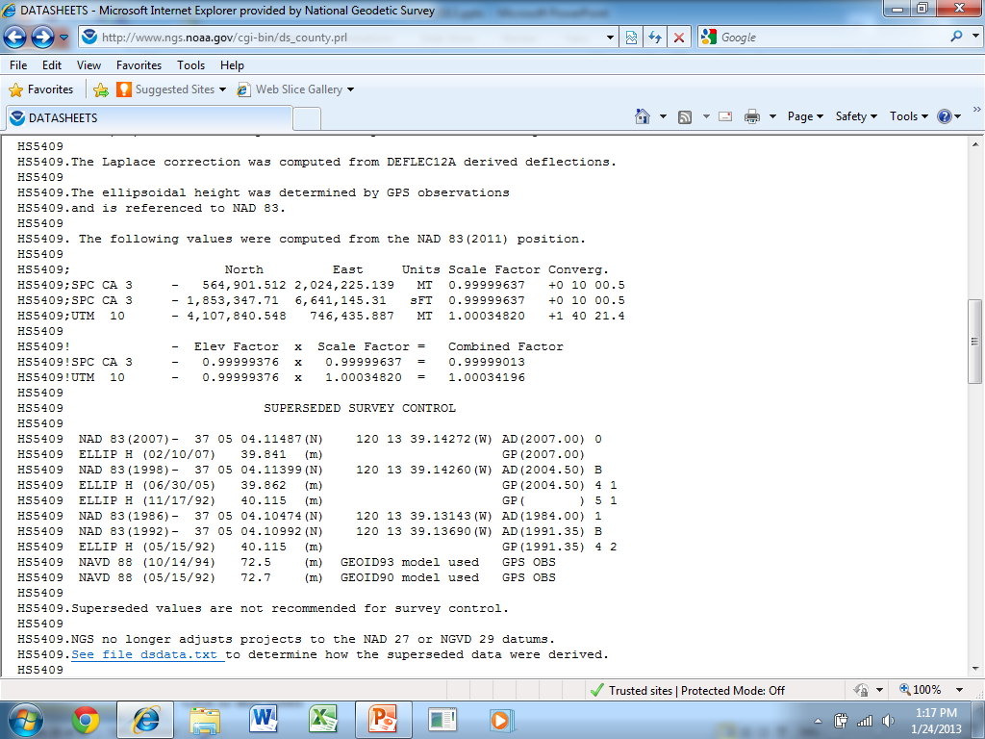

Slide 27
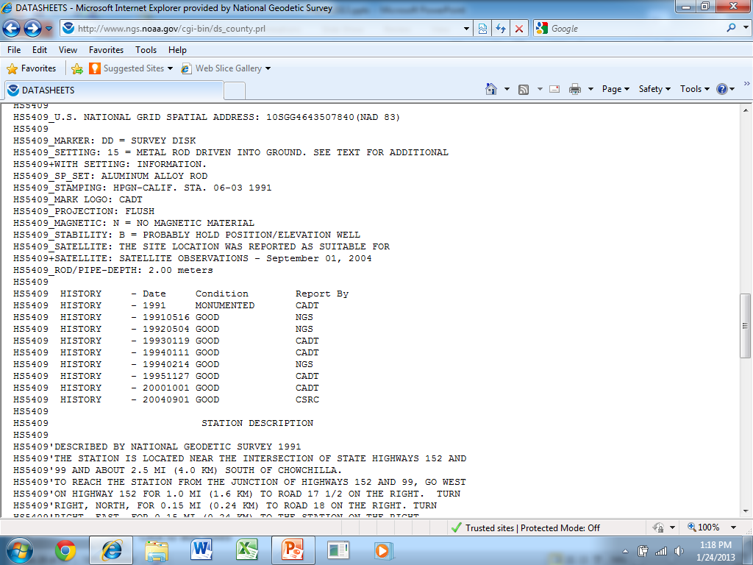

Slide 28
Comments about DS Fields
Orders of accuracy have been superceded by linear, eg, cm; use and state the network accuracy. PRC says <2cm horizontal is CSRN (for SPC); 4cm ellipsoid height
No relation to superceded accuracies; dependent on quality of THAT survey
Observations NOT done at same time (year) of adjustment; look at superceded epoch and history
Local accuracies akin to concept of orders: how good are the observations between neighbors?

Slide 29
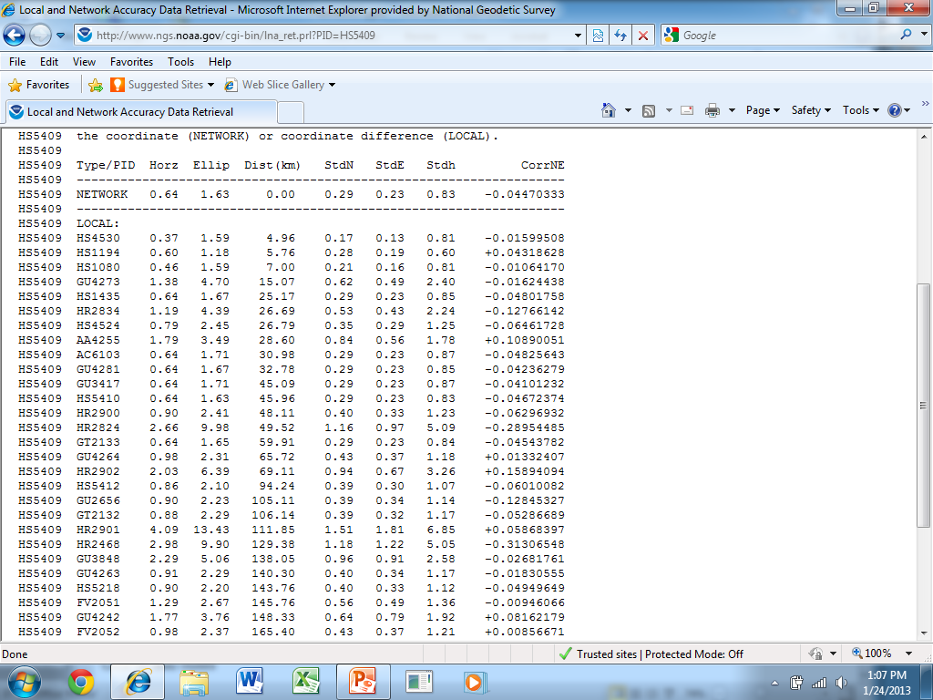

Slide 30
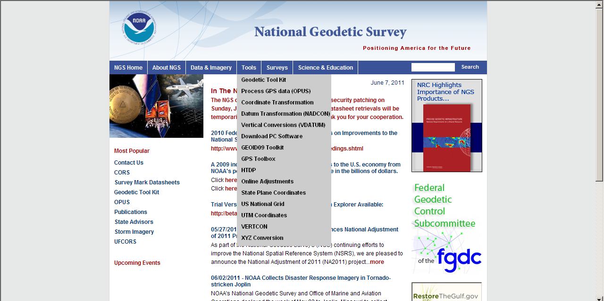

Slide 31
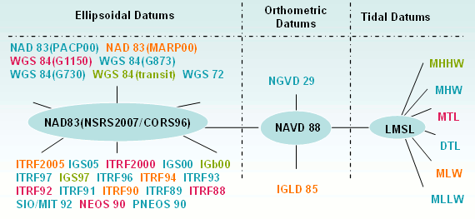
Datums available in VDATUM
Notes:
The most common datums are highlighted

Slide 32
VDATUM tips
Must choose Height rather than Sounding
Must choose Ht for Source AND Target
Longitude shown before latitude
Must use – for longitude
Improvements:
Do not need to select geographic region first
More streamlined interface for user

Slide 33

DSWorld: mapping tool and more
Need to have Google Earth installed
Tools, Download PC Software, USER-CONTRI-BUTED SOFTWARE, DSWorld
http://www.ngs.noaa.gov/PC_PROD/PARTNERS/index.shtml
FIRST: Tools, Update program
Enhancement enables you to distinguish VERTCON NAVD88 from other(control) NAVD88

Slide 34
The Changing Face of the Geodetic Advisor Program
Aging…Retiring; median age 50’s
Fewer cooperative partners (states)
can justify the financial agreement
Recommendation from some many years ago was for Fedgov to fully fund Advisor program
Advisors to be located at NOAA or Fed office
Fully implemented by FY16

Slide 35
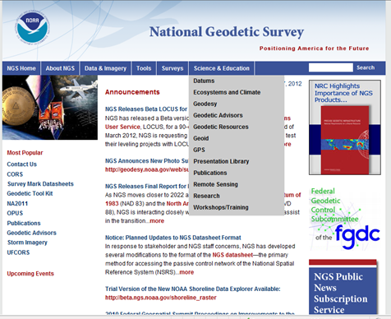

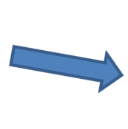

Slide 36
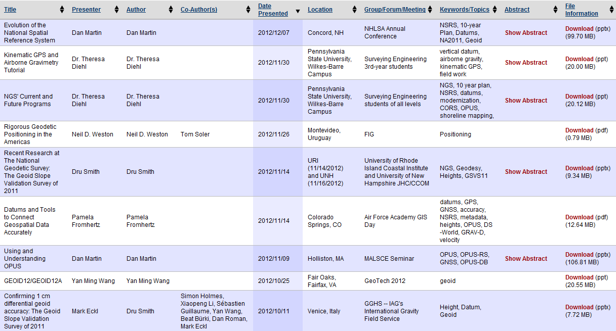
Presentation Library downloadable, sortable

Slide 37
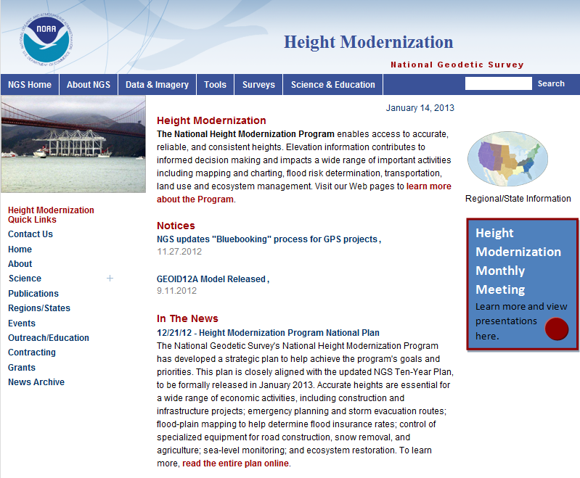
Height Modernization Program monthly meetings, presentations

Slide 38
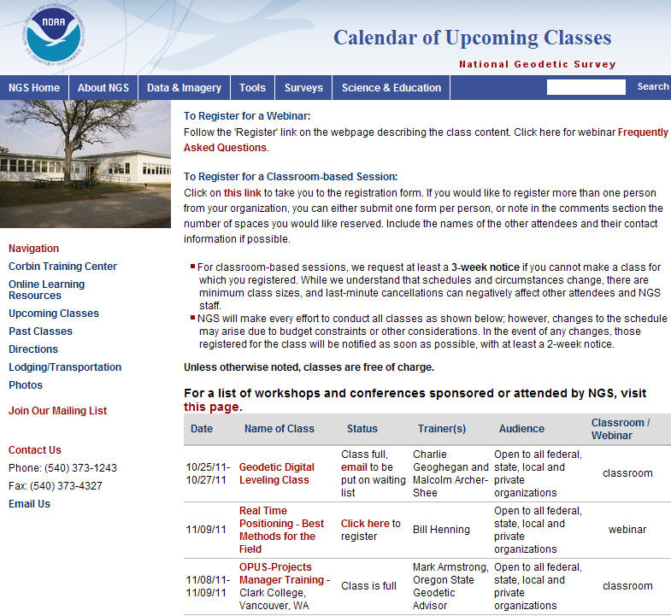
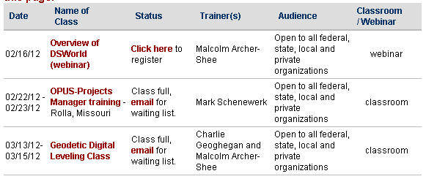
NGS Training Center

Slide 39
