Slide 1
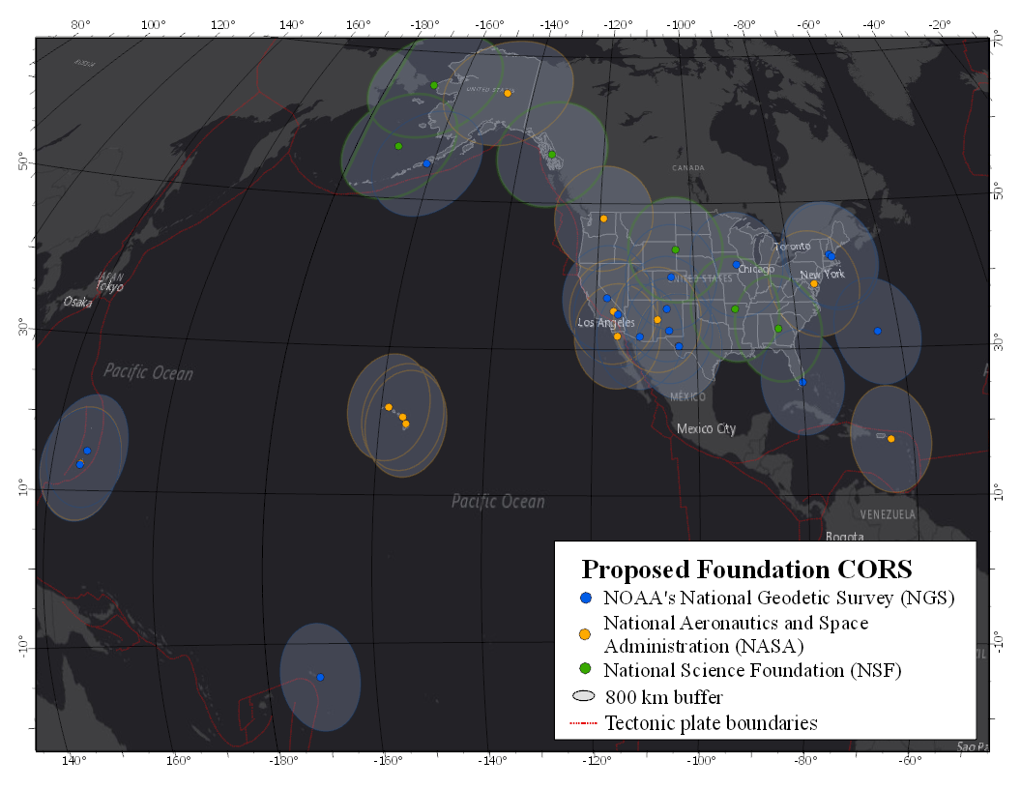
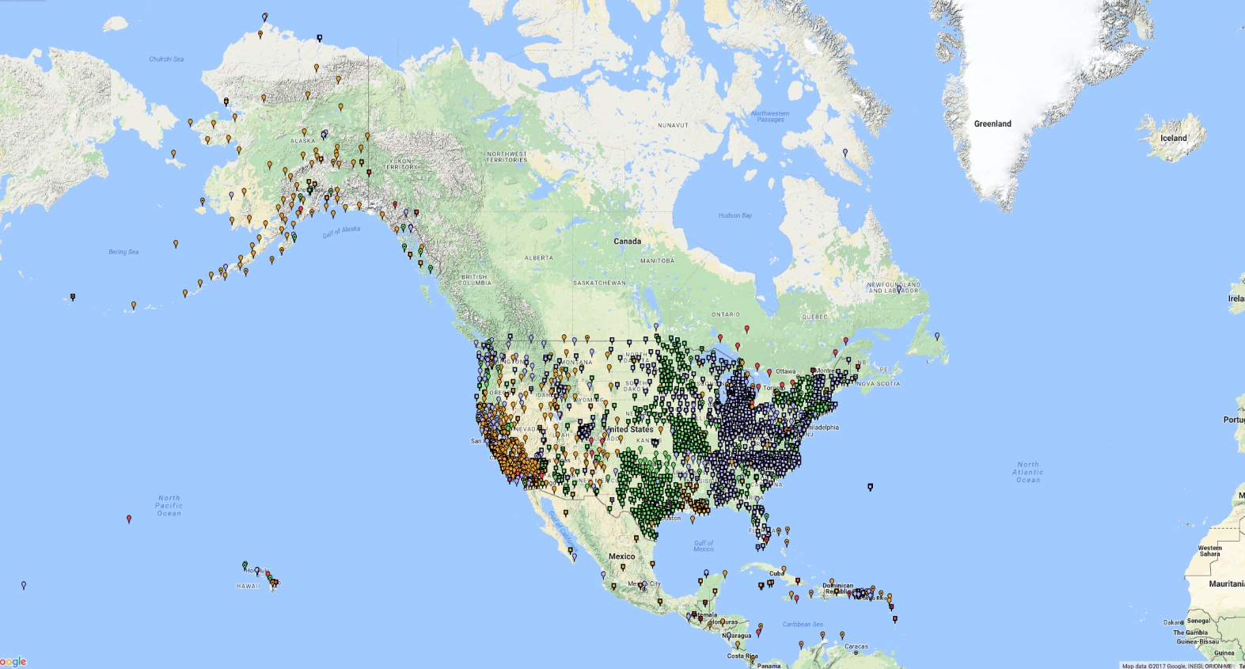
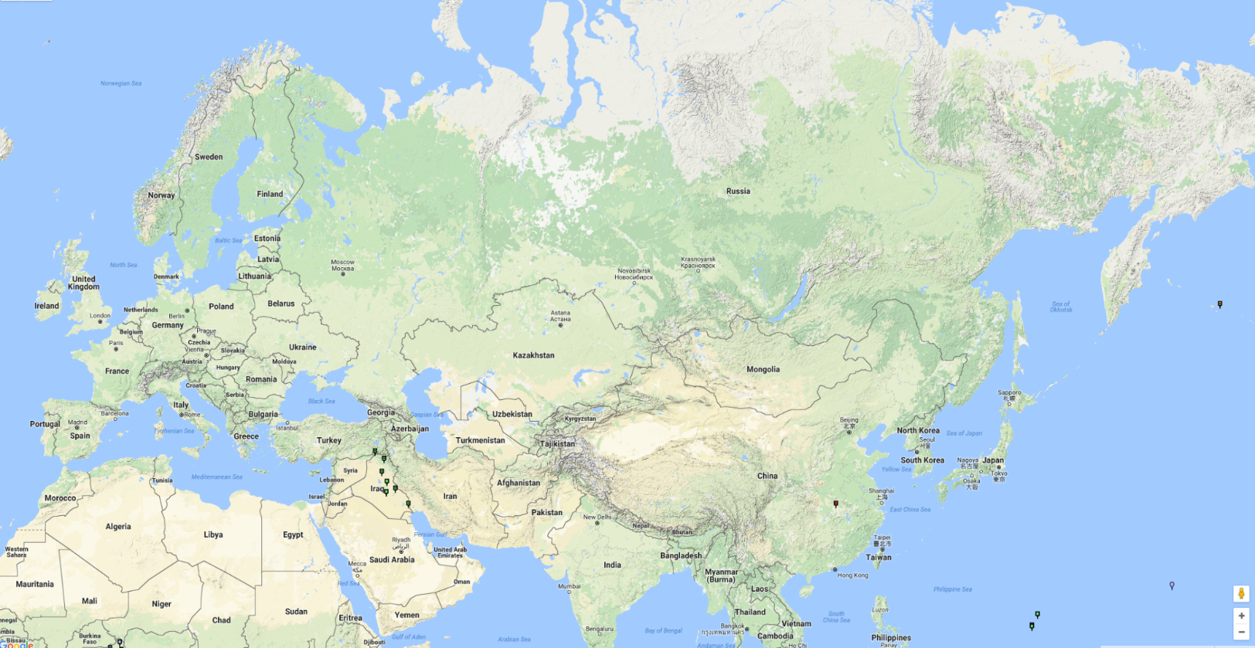
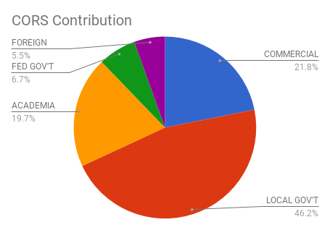
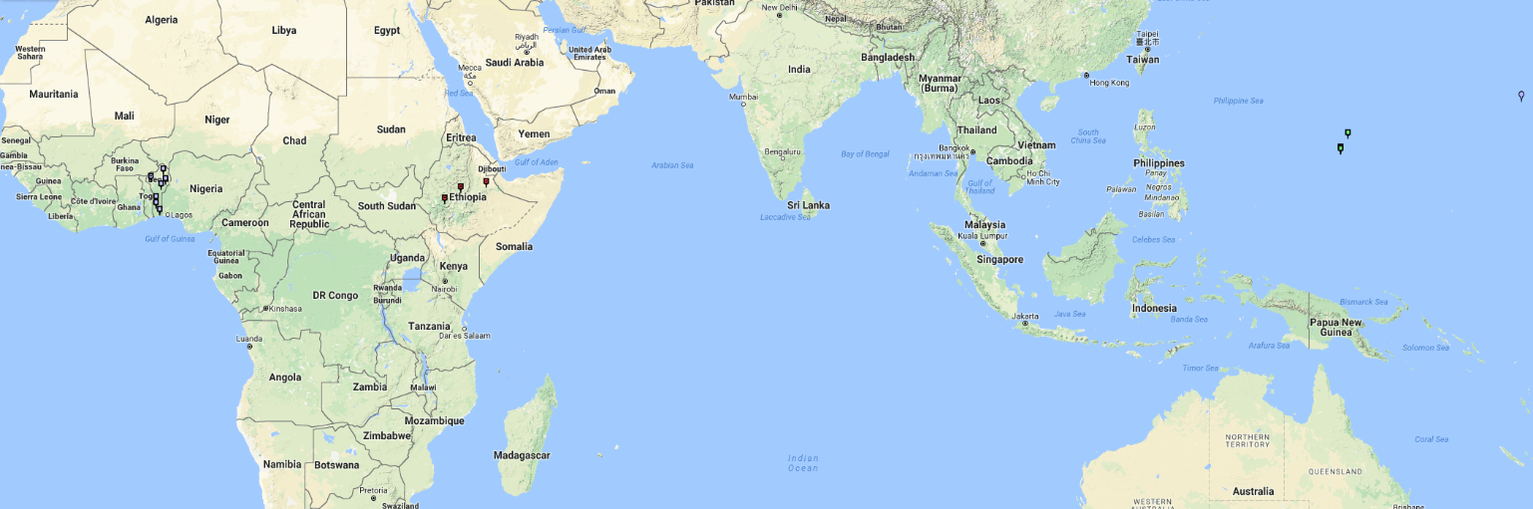
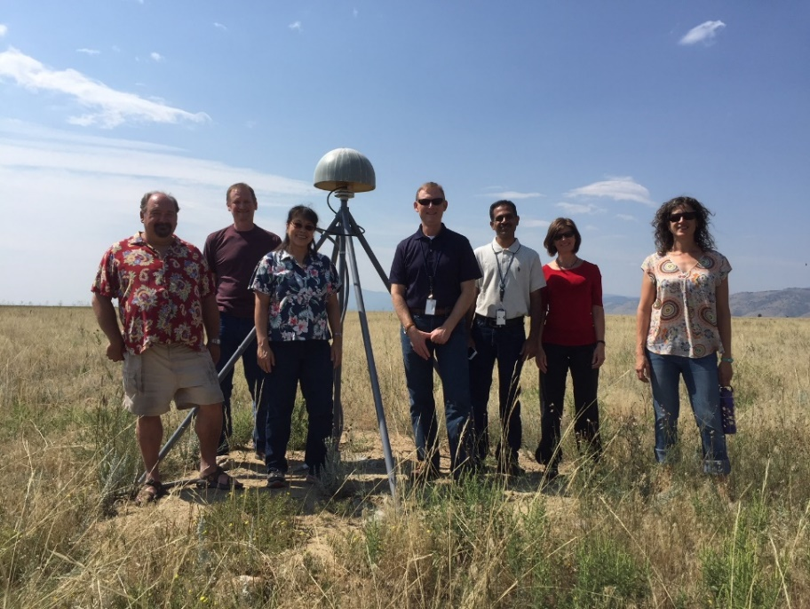
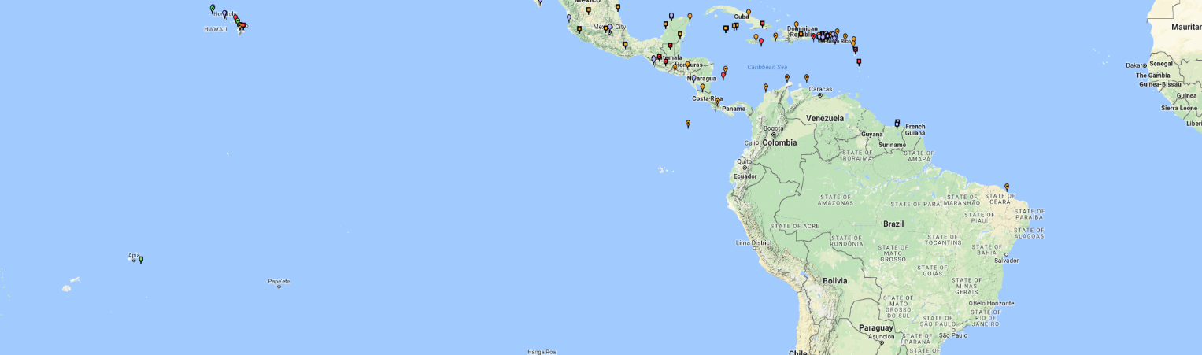
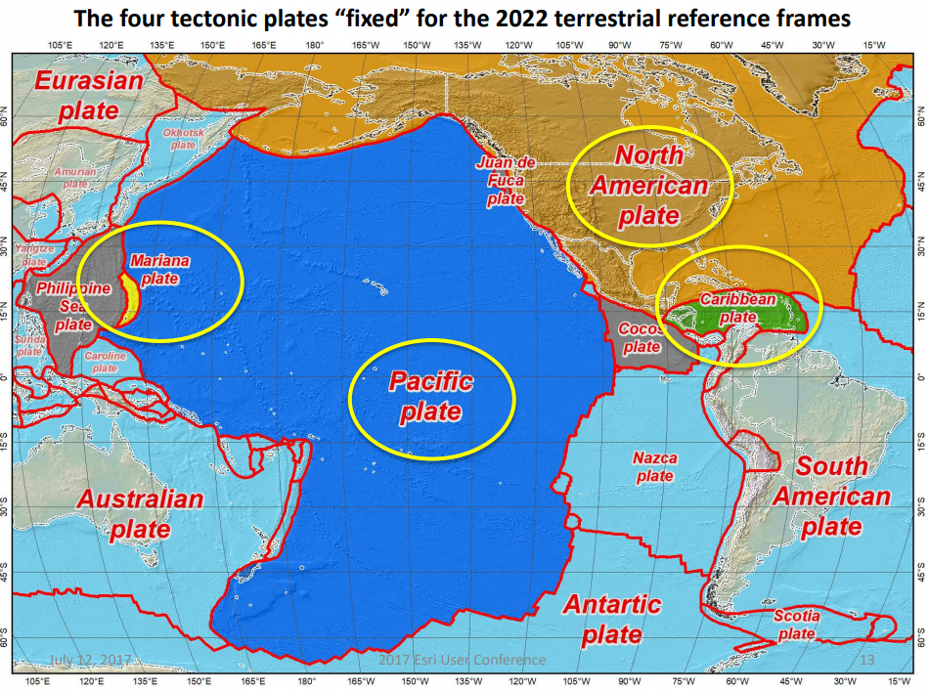
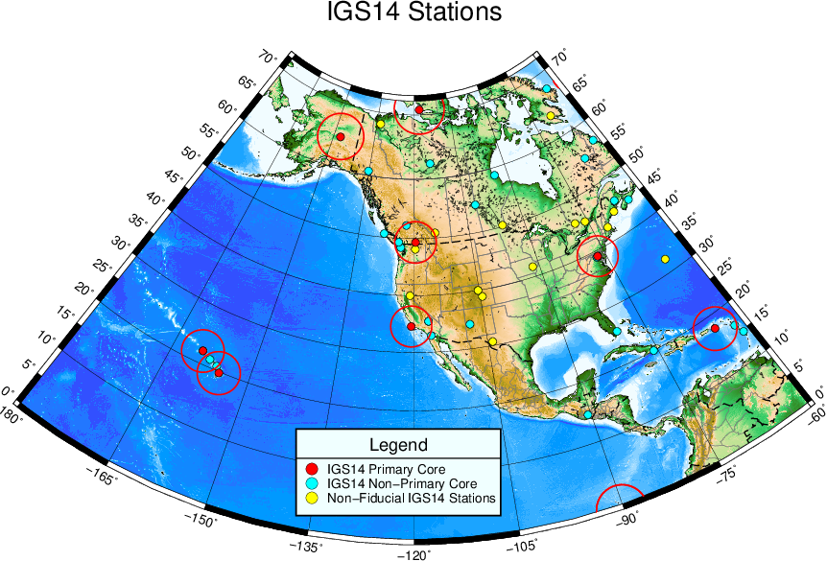
The NOAA Foundation CORS Network– An Ultra-Stable, Highly Reliable Backbone for the NOAA CORS Network
Theresa Damiani and the NGS CORS Team NOAA- National Geodetic Survey, Silver Spring, MD, USA
Background
NOAA Foundation CORS Network Target Sites
NFCN Project Highlights
Since 1994 the National Geodetic Survey has managed a collaborative network of permanently installed geodetic-grade GPS reference stations, known as Continuously Operating Reference Stations (CORS). The NOAA CORS network is a multi-purpose cooperative network of GNSS observations collected from over 200 of government, academic, and private organizations. Each agency owns and operates its own stations and shares the observation data with NGS. The primary objective of the CORS network is to enable GPS users by providing precise positioning relative to the U.S. National Spatial Reference System (NSRS)- the source of official U.S. coordinates. Each CORS shares its data with NGS, and NGS in turn analyzes and distributes the data to the general public free of charge.
Despite the large number of partner agencies and stations, the global reference frame stations in the US are limited due to density considerations and quality issues. In order to maintain long-term consistency between the NSRS and International Terrestrial Reference Frame (ITRF), it is desirable to maintain a set of reference frame sites to the highest standard.
The Proposed NOAA Foundation CORS Network (NFCN) Provides:
1. A geographic distribution no greater than 800 km apart to provide 1.5 cm accuracy ellipsoidal height results through NGS’ OPUS anywhere in the U.S.
2. Support for the ITRF by co-locating at existing space-based geodetic sites.
3. Favorable geometry to monitor tectonic plate (Euler Pole) rotation.
4. High quality stations that fill gaps in coverage.
The NOAA CORS Network
# Sites | Proposed Stations by Contributor
8 | Current NGS Stations
8 | New NGS Stations to Build
12 | NASA Stations
8 | NSF Stations
36 | Total Target Foundation CORS
All Foundation CORS were submitted by NGS and accepted by the IGN as stations to be included in the global reprocessing (Repro3) supporting ITRF2020.
GPS only | 24%
GPS+GLO | 56%
GPS+GLO+GAL | 20%
# Sites | Proposed Stations by Tectonic Plate
26 | North America
4 | Pacific
3 | Caribbean
3 | Marianas
36 | Total Target Foundation CORS
Motivation 1: Modernizing the U.S. NSRS
U.S. Federal Partners | GNSS Site ID | Location | Other Geodetic Equipment | Existing IGS or ITRF Site
National Science Foundation (NSF) Existing Sites Program: Network of the Americas (NOTA) | AB09 | Wales, AK
 | P777 | Dennard, AR
 | P804 | The Rock, GA
 | AB51 | Petersburg, AK
 | ATQK | Atqasuk, AK
 | P043 | New Castle, WY
NSF Existing Sites Program: COCONet | CN11 | Pedro Cay, Jamaica
 | SAN0 | San Andres Island, Colombia
National Aeronautics and Space Administration (NASA) Existing Sites Program: Global GNSS Network (GGN) | CRO1 | Saint Croix, VI | VLBI | ITRF
 | BREW | Brewster, WA | VLBI | ITRF
 | FAIR | Fairbanks, AK |  | IGS
 | TBD | Greenbelt, MD | DORIS, SLR, VLBI | IGS/ITRF
 | TBD | Goldstone, CA | VLBI | IGS/ITRF
 | MDO1 | McDonald Observatory, TX | SLR | ITRF
 | MONP | Mount Laguna, CA | DORIS, SLR | IGS/ITRF
 | PIE1 | Pie Town, NM | VLBI | IGS/ITRF
 | GUAM | Dededo, Guam |  | IGS
 | KOKB | Kauai, HI | DORIS, VLBI | IGS/ITRF
 | MKEA | Mauna Kea, HI | VLBI | IGS/ITRF
 | HAL1 | Haleakala, HI | SLR | IGS/ITRF
NOAA- National Geodetic Survey (NGS) Existing and New Sites Program: NOAA CORS Network | ASPA | Pago Pago, American Samoa |  | IGS
 | CNMR | Saipan, Northern Mariana Islands |  | IGS
 | GUUG | Mangilao, Guam | DORIS | IGS/ITRF
 | BRSG | St. George, Bermuda
 | FLF1 | Richmond, FL | DORIS | ITRF/Proposed IGS
 | WES2 | Westford, MA | VLBI | IGS/ITRF
 | TMG2 | Boulder, CO | Absolute Gravity | Proposed IGS
 | NEW | Apache Point, NM | SLR | ITRF
 | NEW | Fort Davis, TX | VLBI | ITRF
 | NEW | Fort Irwin, CA | DORIS | ITRF
 | NEW | Hancock, NH | VLBI | ITRF
 | NEW | Los Alamos, NM | VLBI | ITRF
 | NEW | Kitt Peak, AZ | VLBI | ITRF
 | NEW | Owens Valley, CA | VLBI | ITRF
 | NEW | Cold Bay, AK | DORIS | ITRF
 | NEW | North Liberty, IA* | VLBI | ITRF
The Foundation CORS built at NGS’ Table Mountain Geophysical Observatory (Boulder, CO). ID: TMG2
By 2022, the National Spatial Reference System (NSRS) will be modernized with the CORS network becoming its critical component for definition and access.
To ensure equal, high-quality access everywhere in the nation (including its holdings) NGS will establish a backbone for the NOAA CORS Network– called the NOAA Foundation CORS Network.
The Foundation CORS network will be made of 36 ultra-stable, highly reliabile, federally-controlled stations.
The NSRS will continue to be defined
in relation to the ITRF, with plate rotation models.
Four Reference Frames for Four Plates
NATRF2022 - North America
PATRF2022 - Pacific
CATRF2022 - Caribbean
MATRF2022 - Mariana
Project Goals
Project Phases
Collaboration
Stations are high-quality, stable, and chosen for longevity. They are deep or shallow drilled braced monuments where possible, especially for new stations NGS will build.
Target operational time:
Network availability > 90 % at all times.
Individual Station down time < 14 days, where possible
All NGS-owned Foundation CORS are submitted to the IGS for inclusion in their network. And as many partner Foundation CORS as possible.
Stations provide definitional support for the international frame and plate rotation model with densified ITRF stations.
There are at least 3 permanent marks at every site.
IERS-style site surveys are repeated on a 5-year cycle, even for GNSS-only sites.
GNSS equipment is multi-constellational and measures all existing systems’ signals.
RINEX3 files are available.
Prepared formal agreements with NASA and NSF for project support.
1. Incorporate partner stations
Existing NASA, NSF, and Caribbean partner stations brought into the Foundation CORS network.
2. Upgrade existing NGS CORS
Upgrades include fully-GNSS equipment, RINEX3, and submission to IGS Network to meet Foundation CORS requirements
3. Construct ~8 new stations
These NGS-owned stations will be co-located at sites with other existing space geodetic techniques and are expected to be installed by the end of 2023 at a rate of 2 per year.
.
Motivation 2: Increase the number of IGS Reference Stations in the U.S.
Possible Stretch Goals Under Consideration:
Co-location with terrestrial gravity measurements in support of the International Height Reference System and NGS’ proposed Geoid Monitoring Service.
Station participation in the IGS Real-Time Service (Many of NASA’s Foundation CORS already participate).
Installation of InSAR reflectors to provide geodetic control for NISAR (U.S. – India satellite) and other InSAR satellites.
Inclusion of meteorological systems
There were a low number of IGS14 stations available in the U.S. Increasing the number of IGS reference stations supports the NSRS and ITRF and also supports the Global Geodetic Observing System (GGOS). Therefore, the 16 NGS-owned Foundation CORS are intended to become IGS reference stations. Also, 11 of those 16 are at existing ITRF sites where they will be co-located with other geodetic reference frame observing techniques (VLBI, SLR, DORIS). These Foundation CORS will strengthen both the IGS and ITRF in the U.S. and its territories.

