Slide 1

Augmenting Data Exchange Formats for OPUS of the Future
Ryan A. Hardy, Ph.D.
NOAA National Geodetic Survey
Presented May 31, 2023
FIG Working Week
Notes:
Hey everyone! I’m Ryan Hardy, a geodesist with NOAA’s National Geodetic Survey. In 2020, we developed a system to measure deflections of the vertical with a total station, the Total Station Astrogeodetic Control System, or TSACS. This presentation is about how we’ve improved TSACS, assessed its performance, and expanded its capabilities over the past year.

Slide 2
Geodetic Data Exchange (GDX)
GDX is an XML-based data format that will be the input format for OPUS
GDX will be the successor to the GNSS Vector Exchange (GVX) format and is designed to be backwards-compatible with Bluebook
GDX currently supports GNSS, classical, and leveling measurements
GVX
GNSS
LVX
CVX
GVX
RGX
GDX
GNSS
Gravity
Classical
Leveling

Slide 3
GDX Structure
SOURCE_DATA
PROJECT_INFORMATION
PERSONNEL
UNITS
EQUIPMENT
POINTS
MEASUREMENT_SETTINGS
MEASUREMENTS
REDUCTIONS
OBSERVATIONS

Slide 4
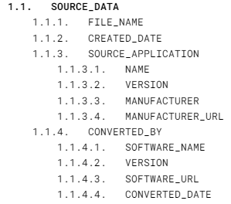
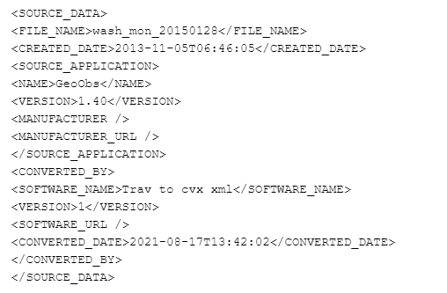
Source Data

Slide 5
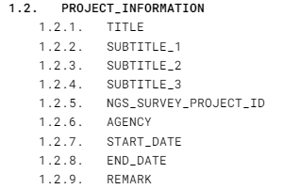
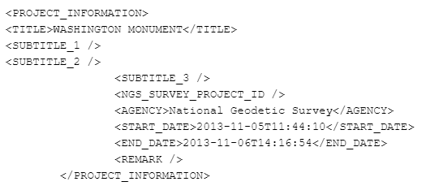
Project Information

Slide 6


Personnel

Slide 7
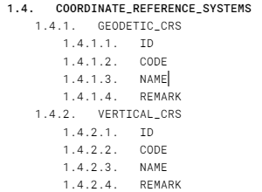
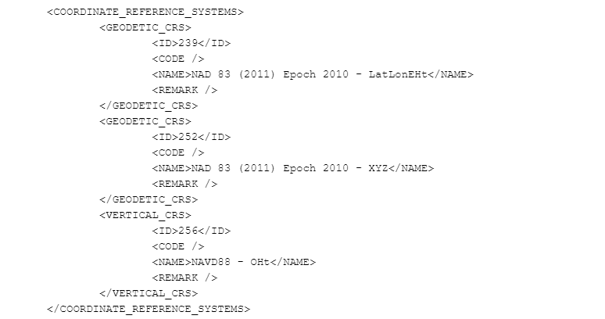
Coordinate Reference Systems

Slide 8
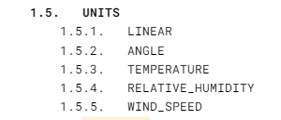
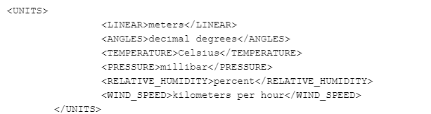
Units

Slide 9
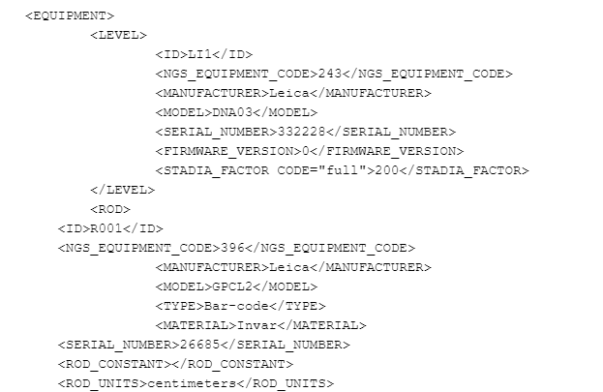
Equipment
Schema is a bit too detailed to show, but a snippet is shown here
Support for
  GNSS Antennas
  Levels
  Rods
  Total stations
  Targets
Will add support for measurement tapes, historical EDM equipment, and other instrument types

Slide 10
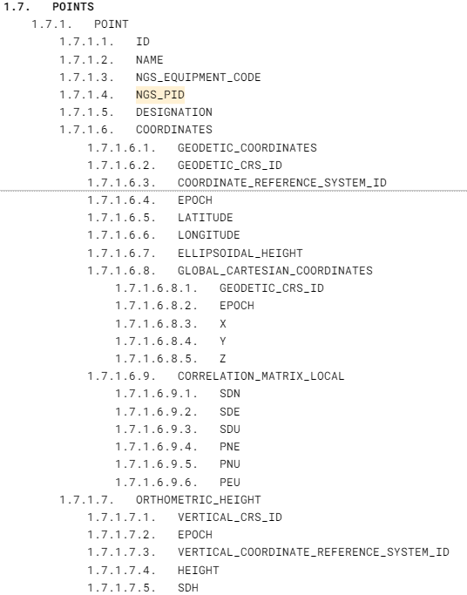
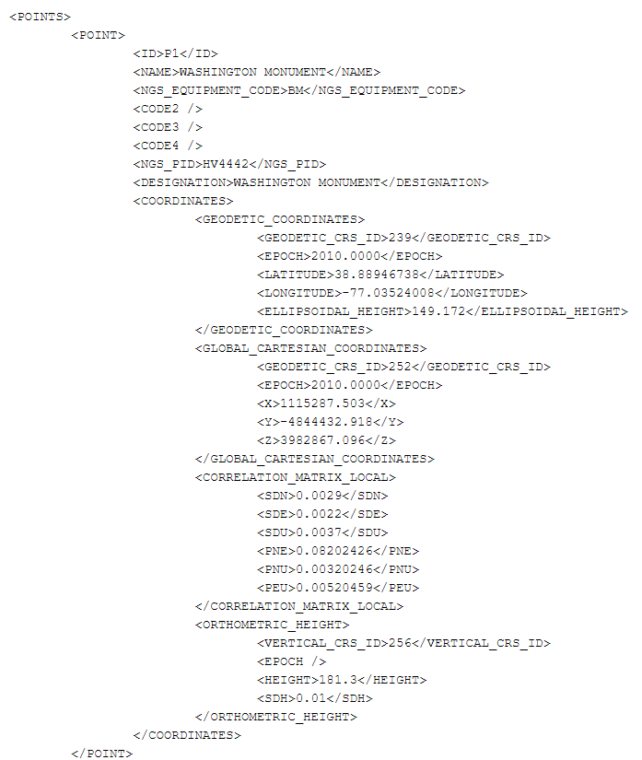
Points

Slide 11
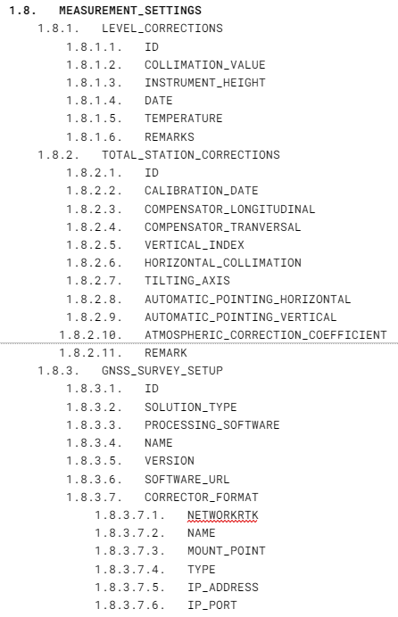
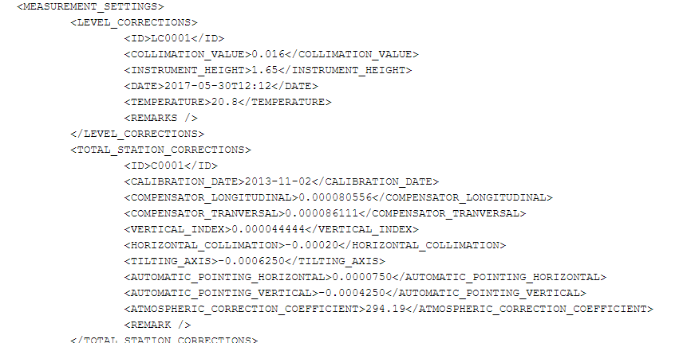
Measurement Settings

Slide 12
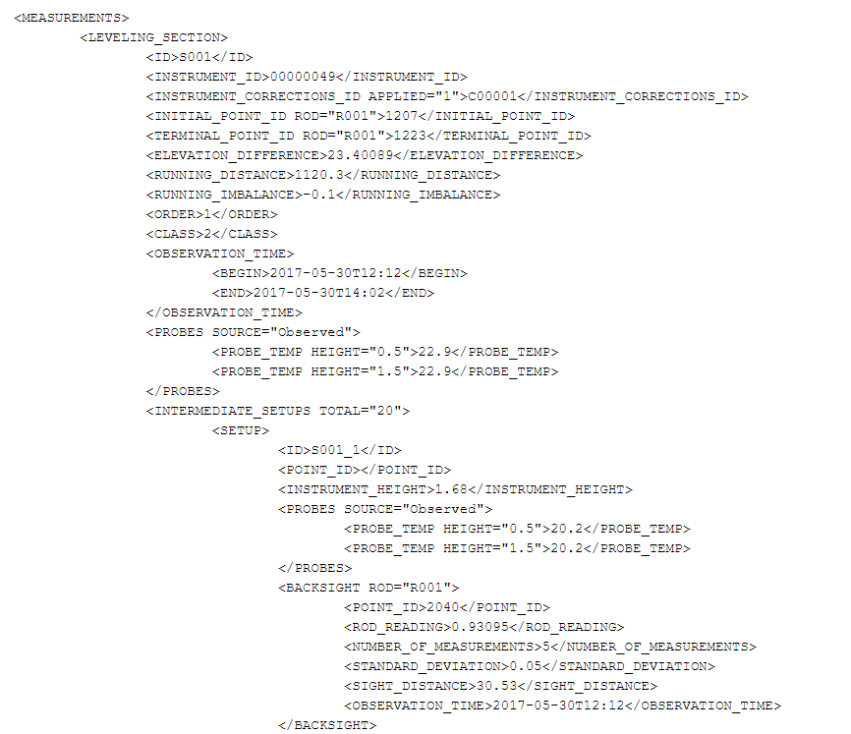
Measurements
Schema contains support for
  Leveling
  Vertical angles
  Horizontal directions
  Distances
  Meteorological metadata

Slide 13
Reductions
This section relates measurements (raw field data) to observations (data)
Contains corrections to measurements from atmospheric refraction, deflections of the vertical, instrument height, and target heights
Fields have not yet been defined and this section will not be part of the alpha release

Slide 14
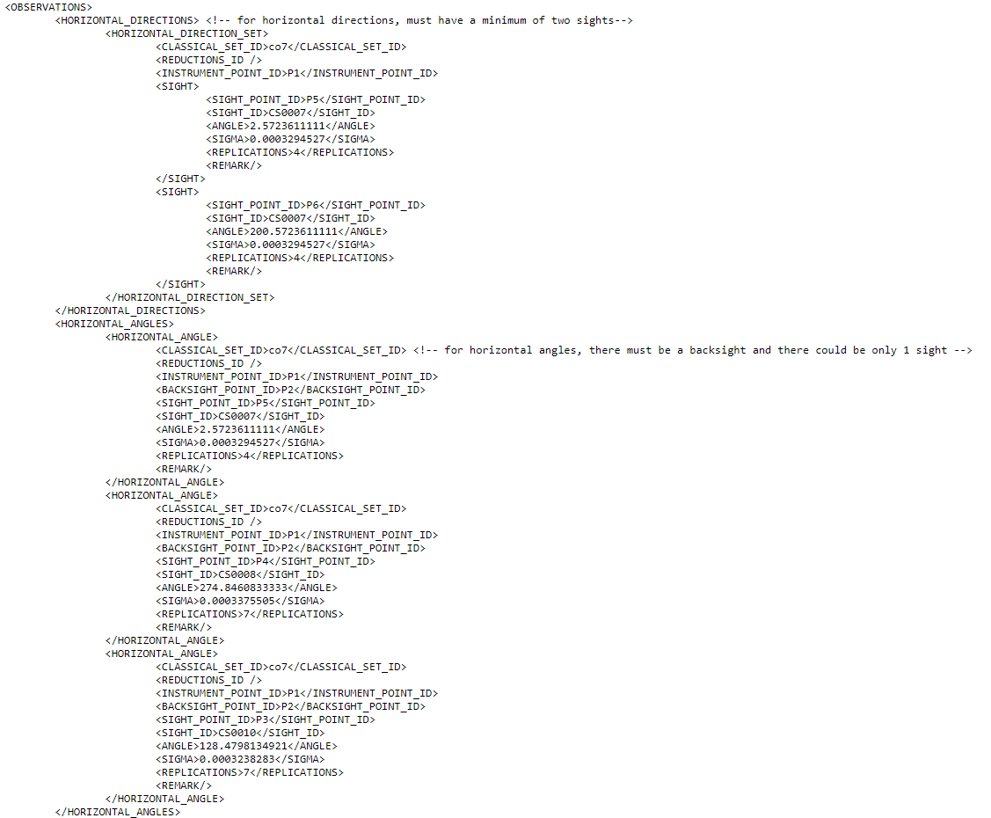
Observations
This section is intended for data that is ready for a three-dimensional least-squares adjustment
Observations should be mark-to-mark and corrected for deflections of the vertical and atmospheric refraction to the local geodetic frame
Supports
  GNSS vectors
  Vertical angles
  Distances
  Horizontal angles, directions, and azimuths
  Leveling

Slide 15
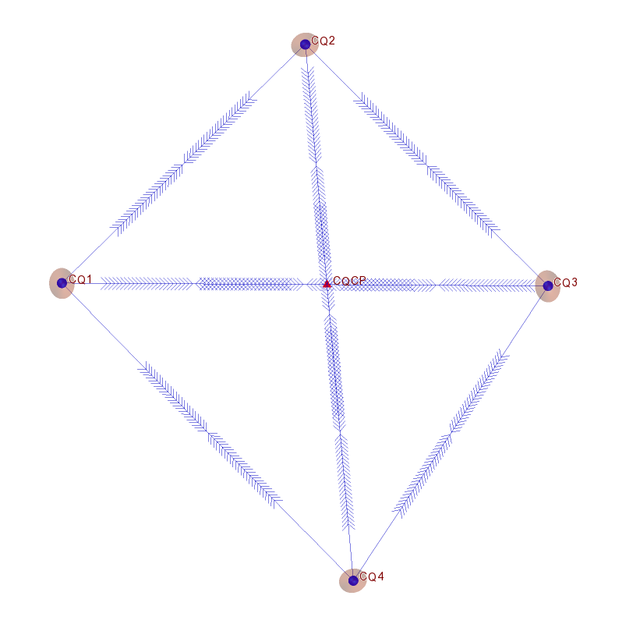
Corbin Quad Survey
NGS has executed a highly redundant survey conducted over multiple days on a set of five points at the NGS Testing and Training Center in Woodford, VA
Supports:
  Least-squares adjustment testing
  Atmospheric refraction research
  Geodetic astronomy research
Techniques used:
  Simultaneous GNSS
  Total station angles and distances
  Leveling
  Astronomic azimuths and deflections of the vertical
  Detailed vertical temperature profiles

Slide 16
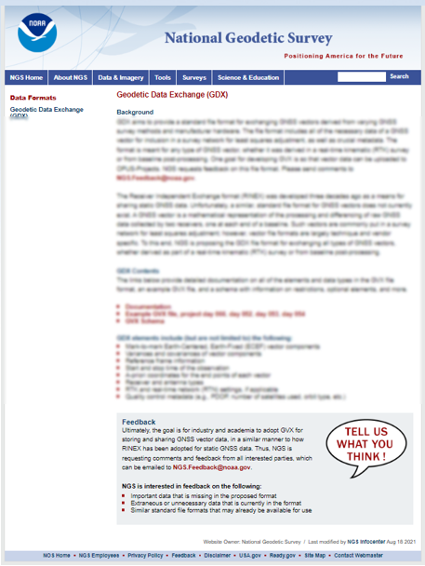
Alpha Release
The alpha version of GDX will be available on the NGS alpha website in the coming weeks
As an alpha product, this initial version will be incomplete but available for early feedback
This website will include documentation and example files, including the Corbin Quad Survey
alpha.ngs.noaa.gov

Slide 17
What’s Next
Support for measurement reductions
Support for tape and other classical measurement types
Support for astronomical measurements, including azimuths and deflections of the vertical
Support for relative gravity
Questions?
ryan.hardy@noaa.gov

