Slide 1
OPUS-Projects Training
Transitioning from Mandatory Instructor-Led to Online, Self-Paced
Daniel Martin, Erika Little, and Jeff Jalbrzikowski, U.S.A

Slide 2
Background
The National Geodetic Survey (NGS) has operated the Online Positioning User Service (OPUS) since March 2001, to provide end-users easy access to the National Spatial Reference System (NSRS) using GPS data
In 2011, NGS added OPUS-Projects as a new product available to the public
  OPUS-Projects became a highly integrated tool for managing GPS campaigns, including initial observational metdata and positions, session solution statistics and network adjustments, and a pathway for project submission to NGS

Slide 3
Background
A Mandatory training course of approximately 12 hours was instituted
  This was due to the complexity of OPUS-Projects and the ability of users to select options that would likely prouduce unintended outcomes.
Since 2014 when training began to be tracked, NGS has conducted training for over 4,000 participants.
  This training has been conducted by a staff of less than 20 instructors, with an average class size of approximately 20 students. It should also be noted that none of the instructors are on staff for the sole purpose of providing this training.

Slide 4
Is Mandatory Training Still Necessary/Desired?
OPUS-Projects has become much more intuitive and the process has been significantly streamlined.
NGS has developed a new User Guide
Required traning makes NGS a ”gatekeeper” and a barrier to the use of its own software
Some organizations canot afford the time/money for their staff to attend a two-day course
The popularity of the instructor-led training has grown

Slide 5
Lift Requirement for Mandatory Training When...
On-demand training videos are available on NGS Website
Tutorial lessons and example dataset are posted to NGS Website
Update to the User Guide to include content on how to work with vector data created outside of OPUS
Users have an easy-to-understand way to self-register and access training materials

Slide 6
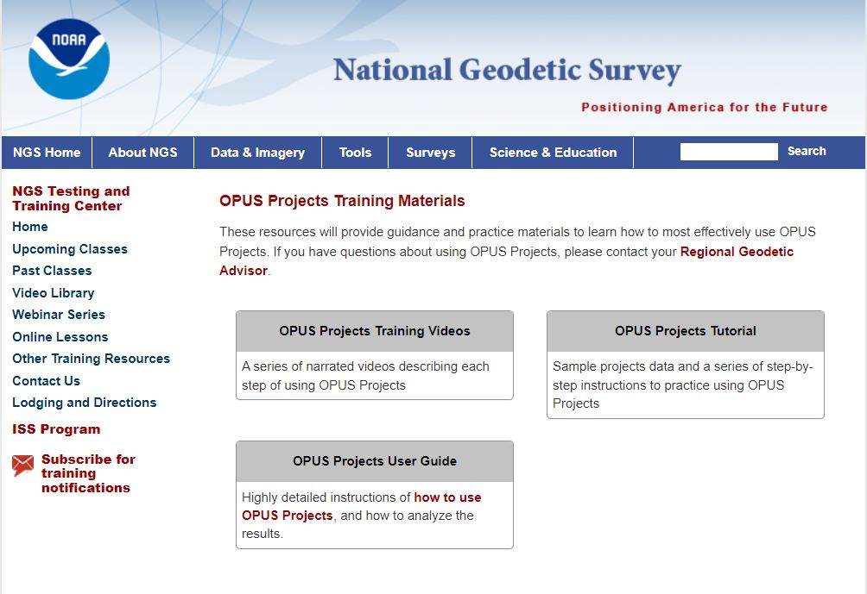
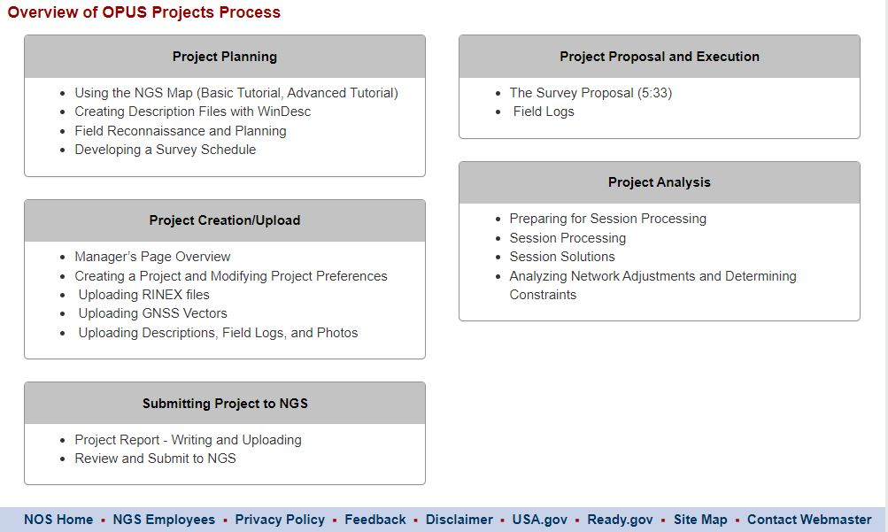
Draft OPUS-Projects Training Page

Slide 7
Challenges
Find, or create a comprehensive data set
Distill lecture content into small, bite-size lessons
Develop content that will answer Frequently Asked Questions
Update to the User Guide to include content on how to work with vector data created outside of OPUS
Users have an easy-to-understand way to self-register and access training materials

Slide 8
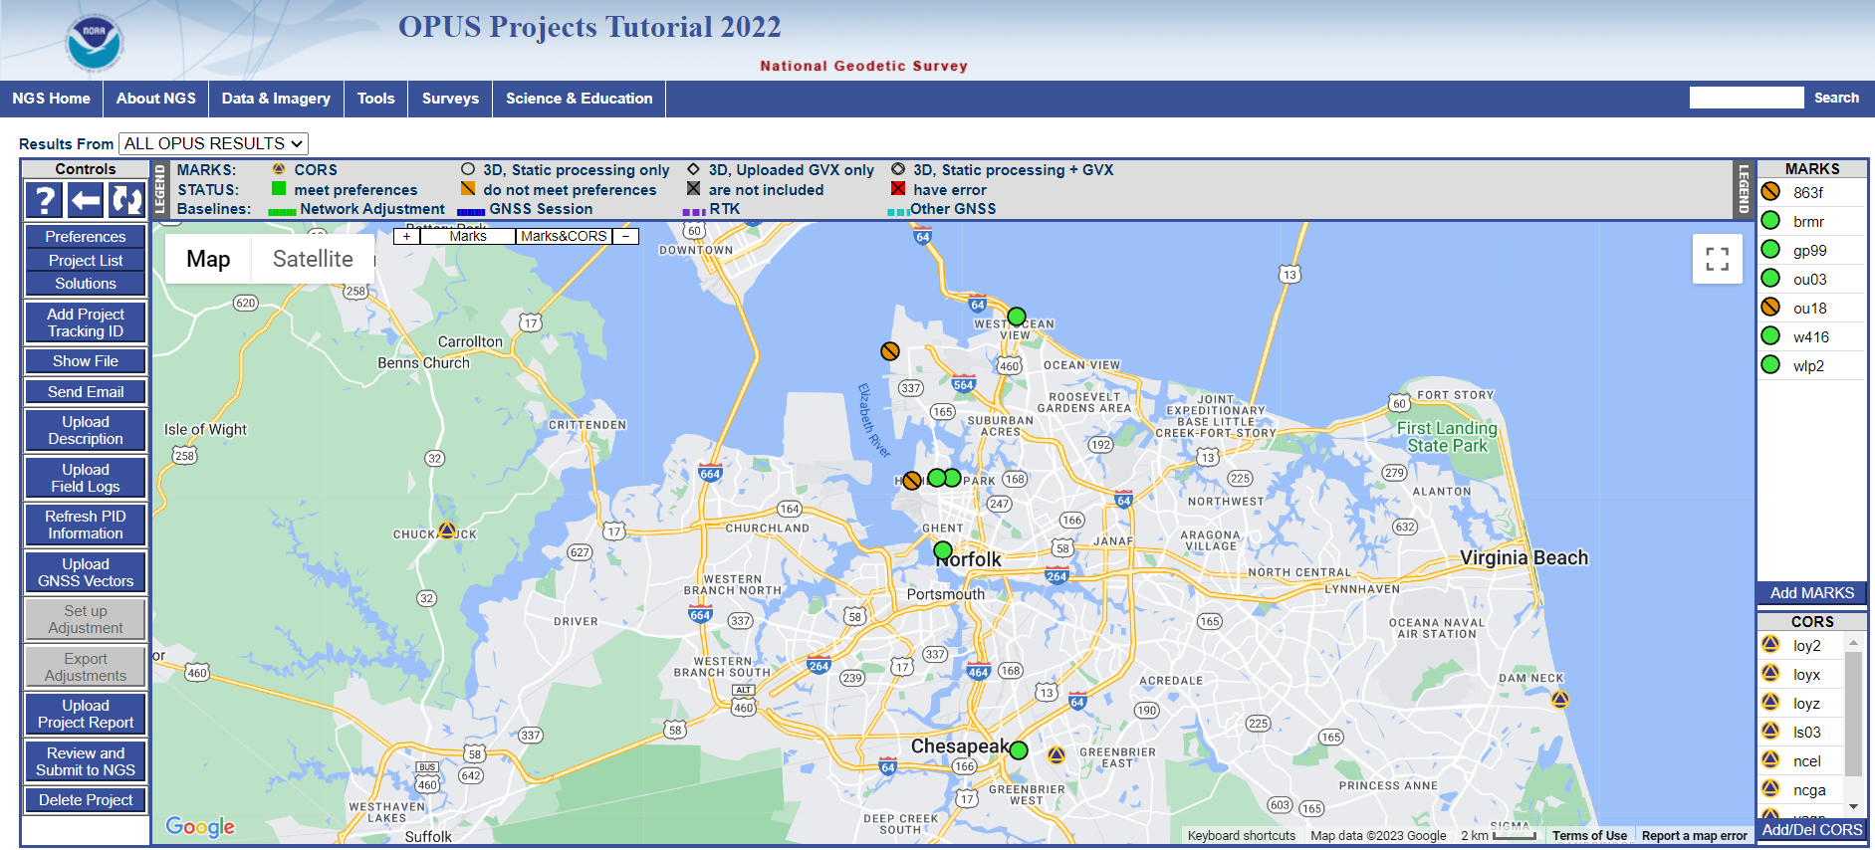
Summary
Current model for training is not sustainable
Online, self-paced training removes barriers associated with instructor-led training
Removing training requirement opens use to unlimited number of users
Instructor-led training will still be made available, will not be a requirement

