Slide 1



Changes Afoot
State Plane 2022 and
Retirement of the U.S. Survey Foot
FIG Working Week 2023
Orlando, Florida, USA
May 31, 2023
Michael L. Dennis, PhD, PE, PLS
SPCS2022 Project Manager
michael.dennis@noaa.gov

Slide 2

How surveyors and engineers see the Earth…
Credit: Scott Gelber, The Atlantic

Slide 3

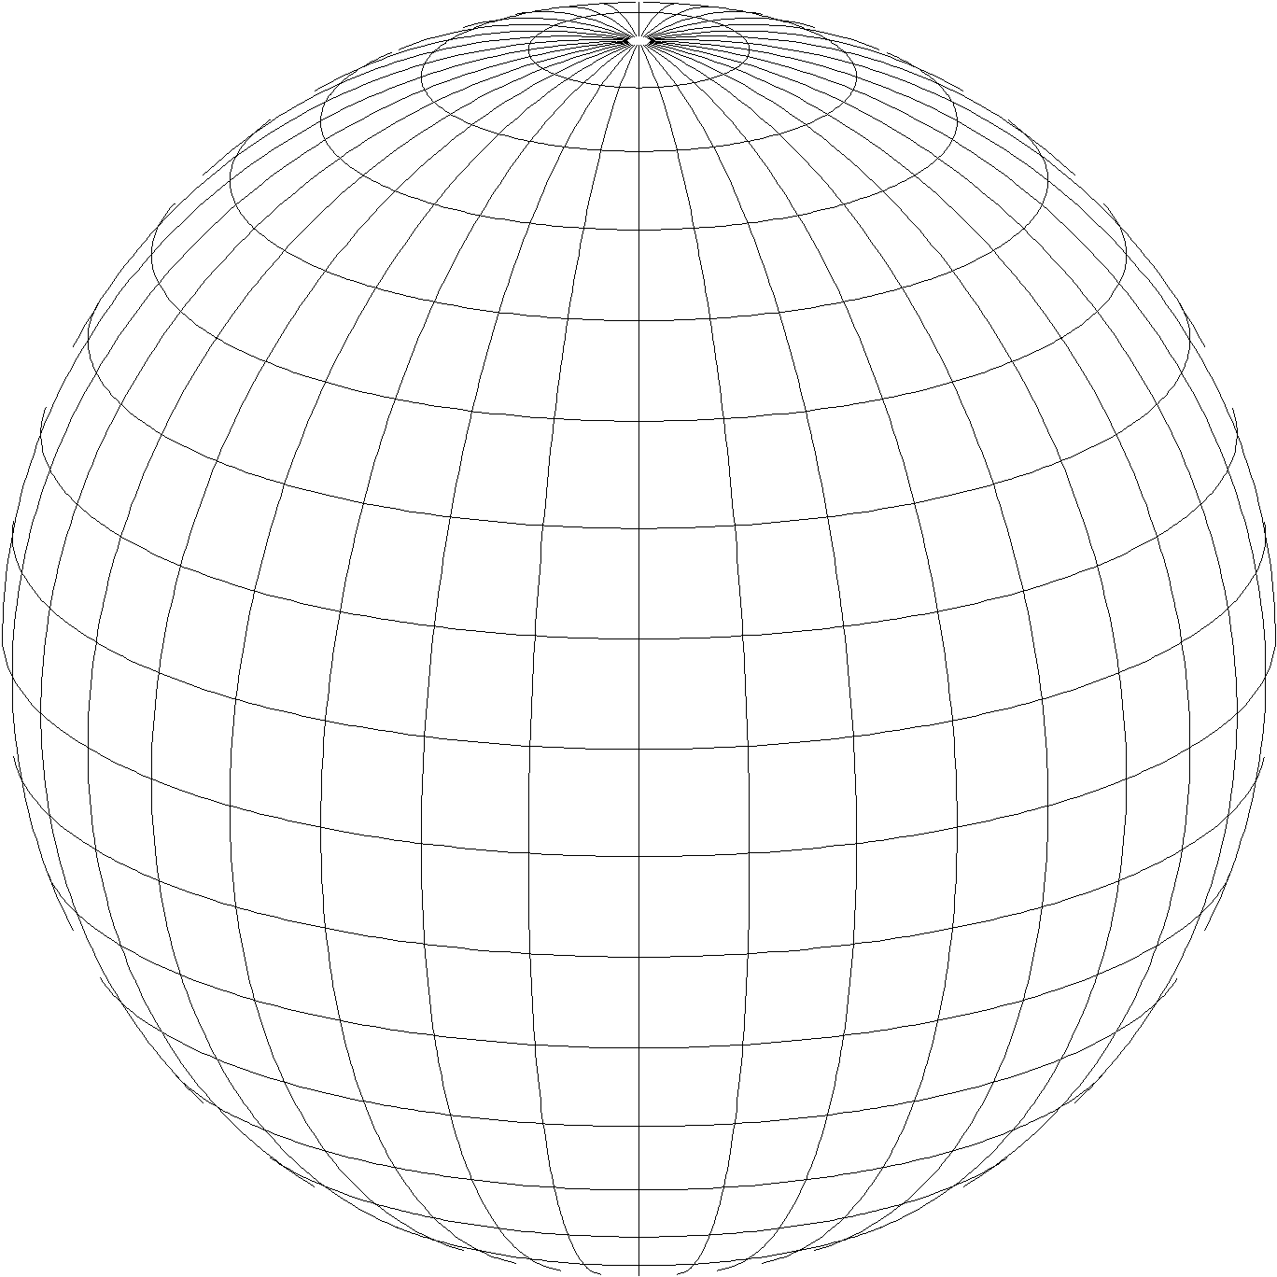
A “flat” Earth for the future
State Plane Coordinate System of 2022 (SPCS2022)
Third generation of State Plane
  First in 1930s, second in 1980s
  Same 3 map projection types
  Same ellipsoid as SPCS 83 (GRS 80)
Lambert Conformal Conic
Transverse Mercator
Hotine Oblique Mercator

Slide 4
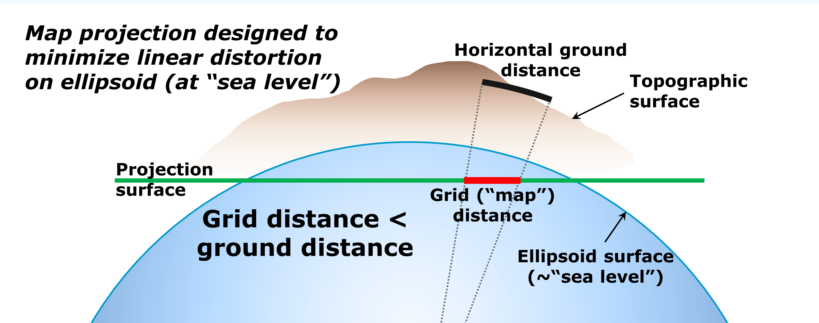
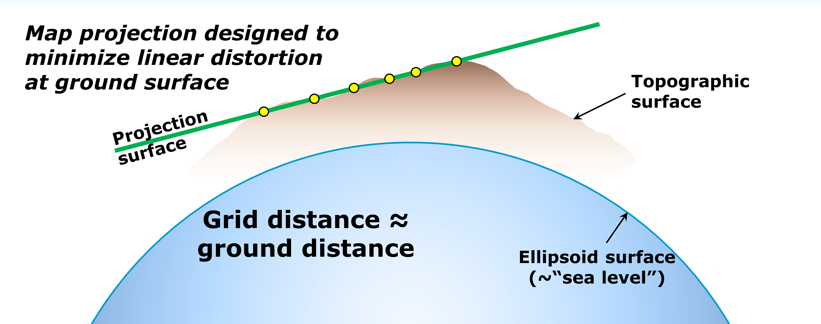
A “flat” Earth for the future
State Plane Coordinate System of 2022 (SPCS2022)
Same as existing State Plane, but different…
  Based on new terrestrial reference frames instead of NAD 83
  Designed to reduce linear distortion at topographic surface
  (i.e., reduce difference between “grid” and “ground” distances)
  More zones, most designed by state stakeholders
SPCS 83
SPCS2022

Slide 5
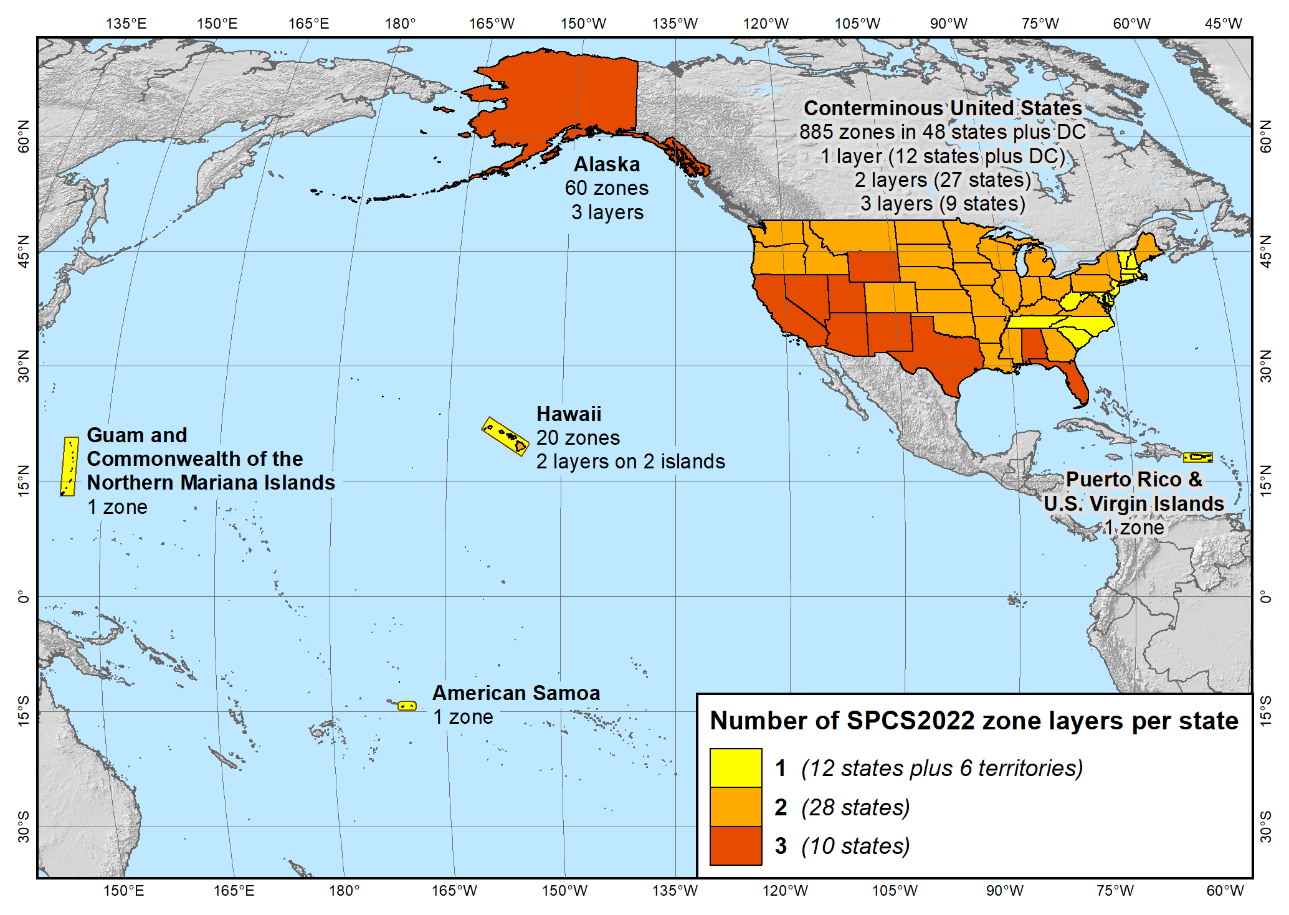
SPCS2022 zone layers
1 layer: 12 states plus 6 territories
2 layers: 28 states
3 layers: 10 states

Slide 6
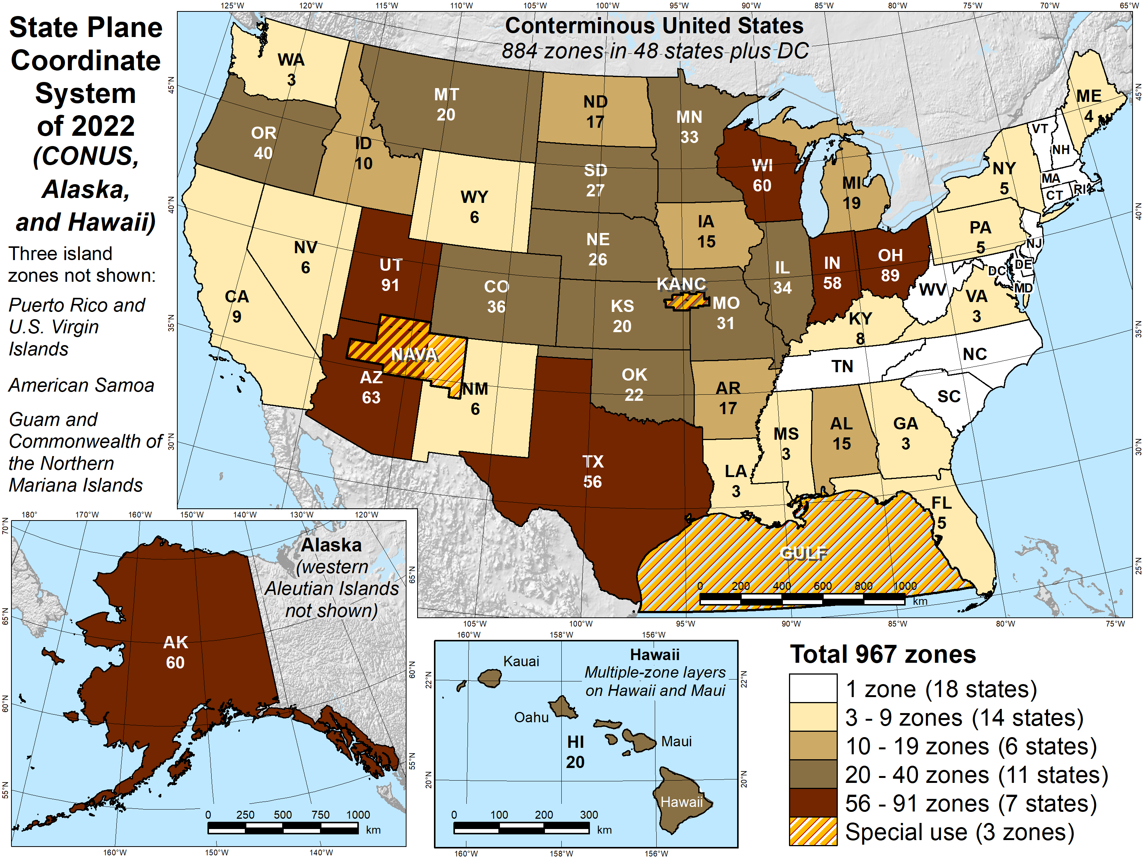
Number of SPCS2022 zones (preliminary)
Designs by NGS
  165 zones
  Includes 54 statewide zones…
  …and 3 “special use” zones
  (in more than one state)
Designs by state stakeholders
  802 zones in 28 states
Total = 967 zones
for 56 states
and territories
Compare to 125
zones in existing
State Plane

Slide 7
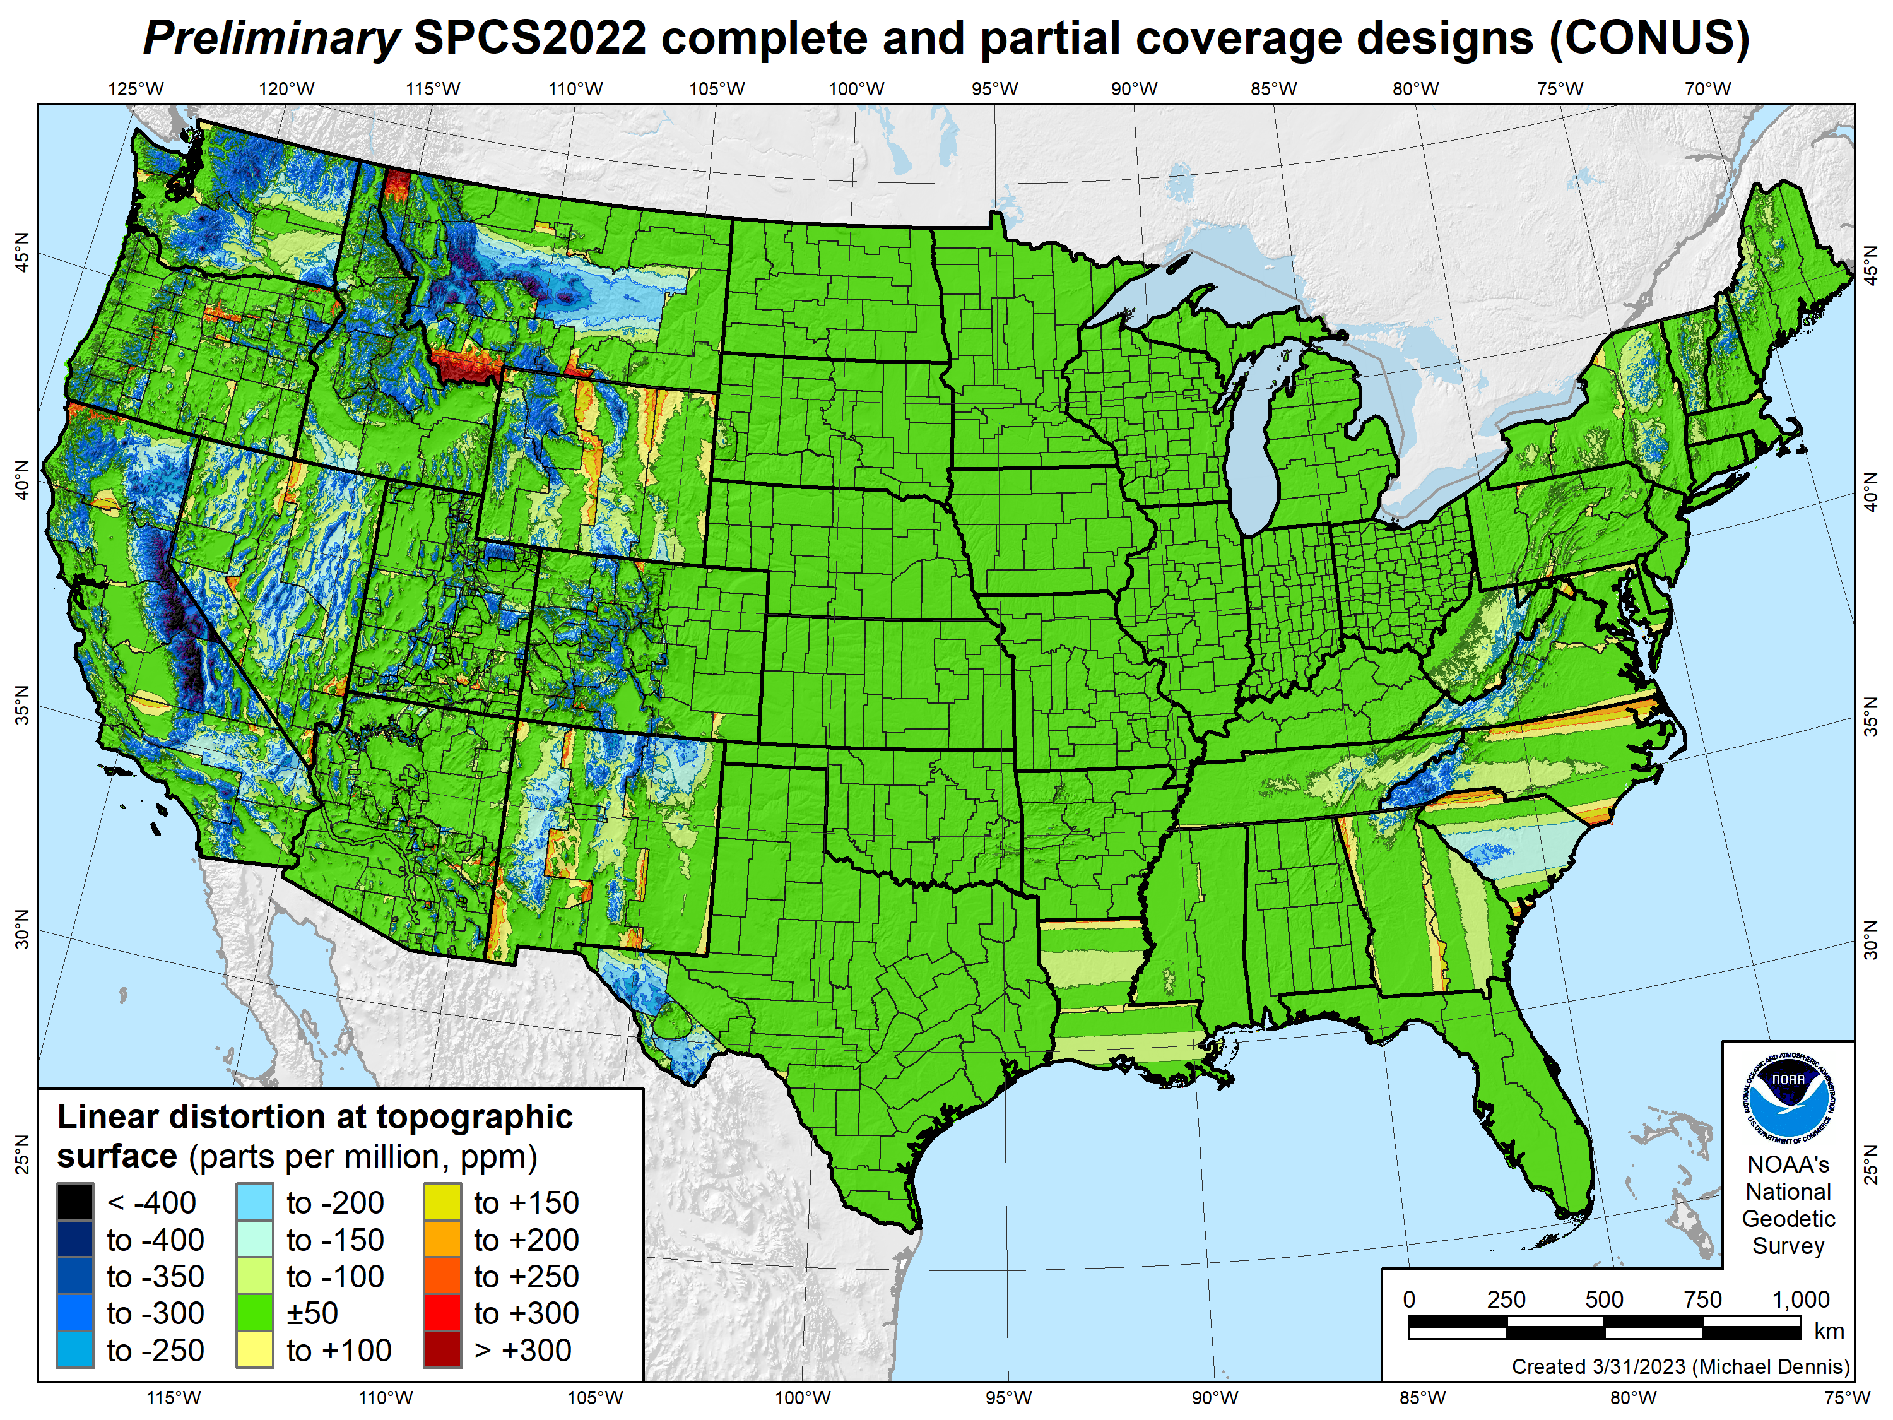
SPCS2022 linear distortion (preliminary)
846 zones (CONUS)
Green is ±50 ppm (±0.26 ft/mile)
Percent within ±50 ppm:
92% population
89% cities & towns
76% total area
Mean weighted by population: -4 ppm

Slide 8
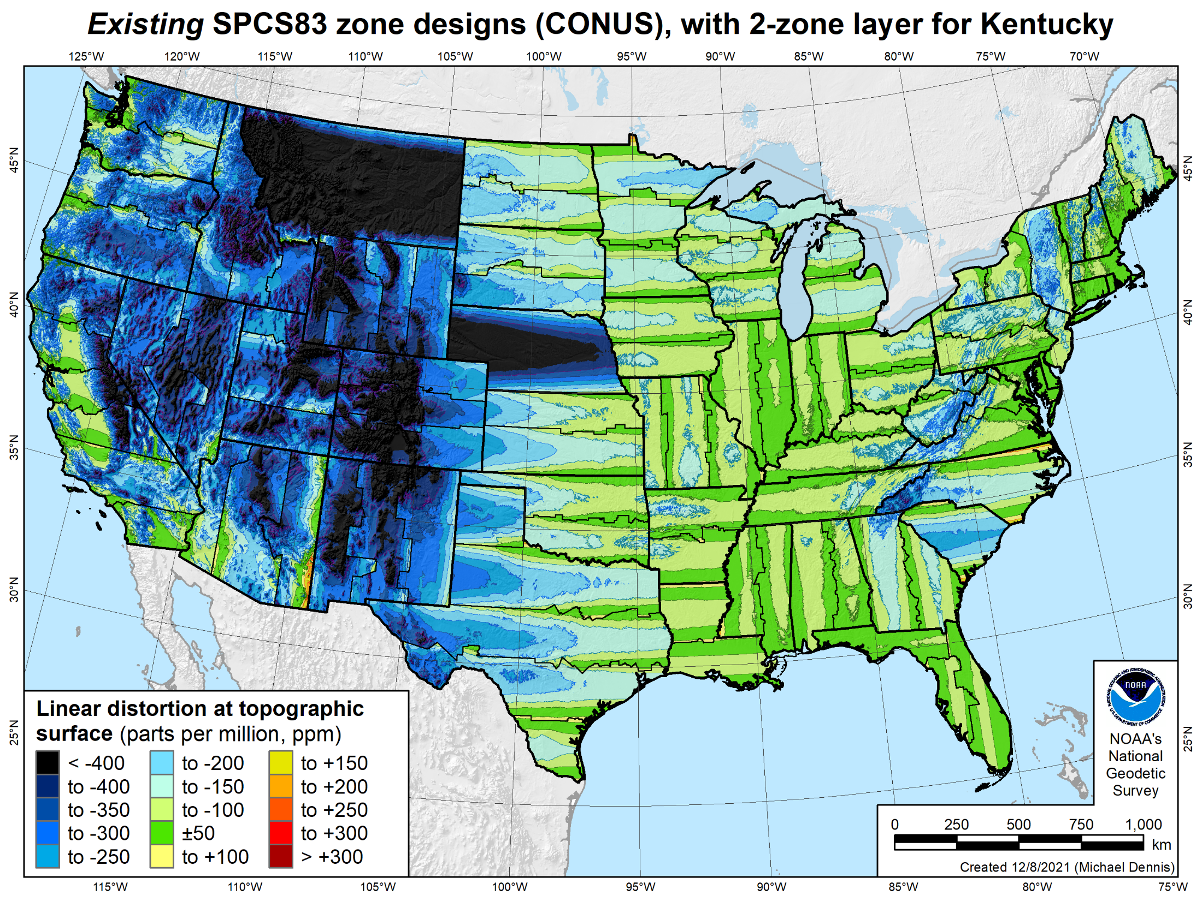
SPCS 83 linear distortion (existing)
106 zones (CONUS)
Green is ±50 ppm (±0.26 ft/mile)
Percent within ±50 ppm:
40% population
30% cities & towns
17% total area
Mean weighted by population: -75 ppm

Slide 9

When will SPCS2022 be done?
I want it NOW!

Slide 10



Alpha preliminary products

Slide 11
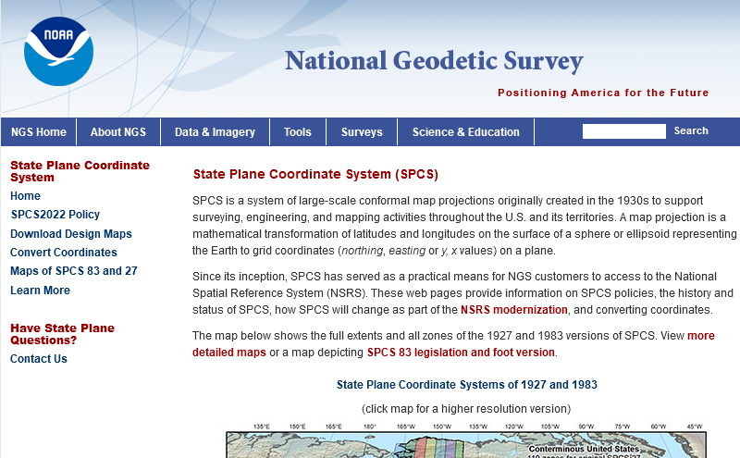

Slide 12
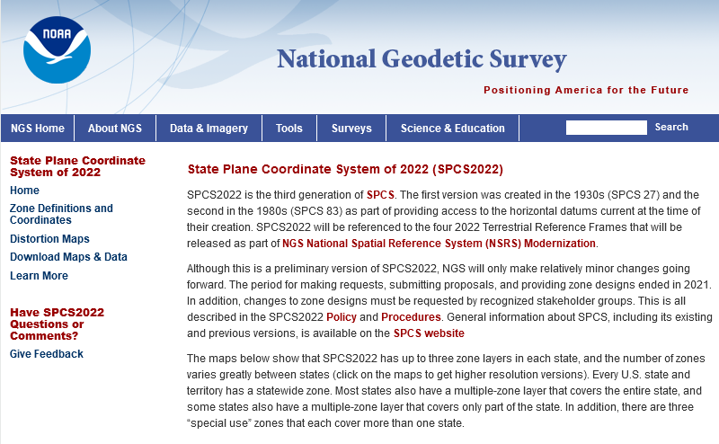

Slide 13
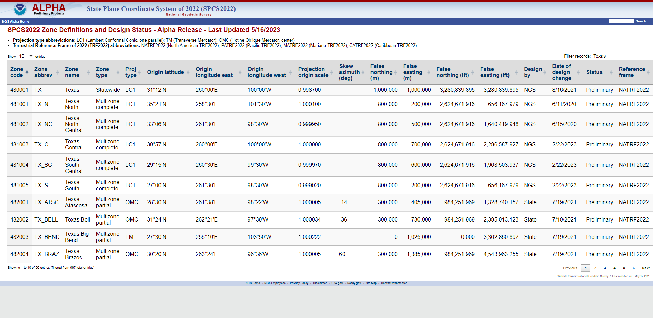

Slide 14
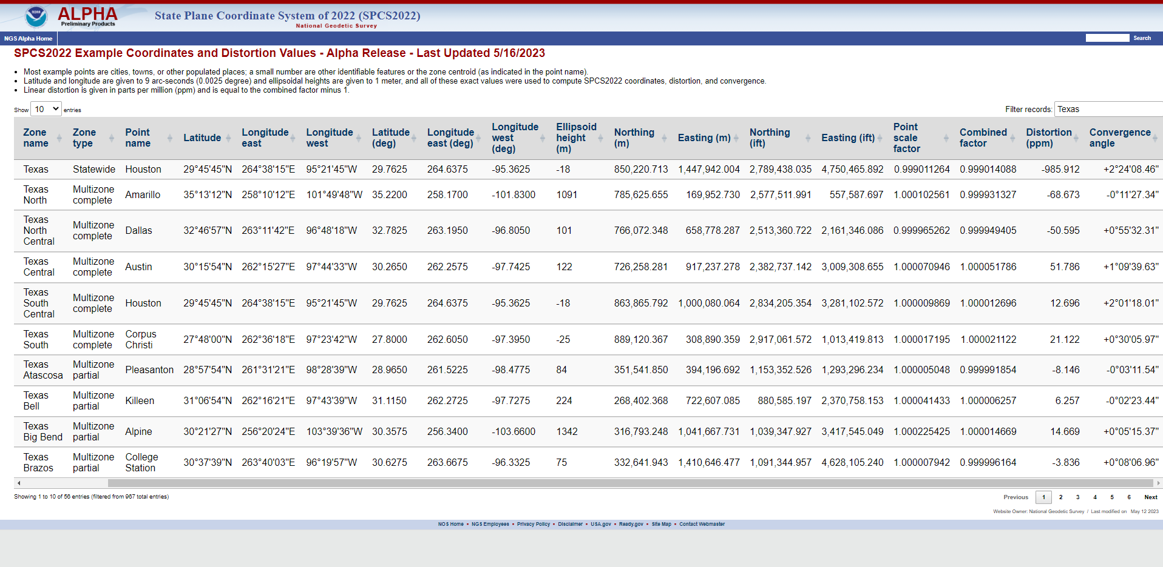

Slide 15
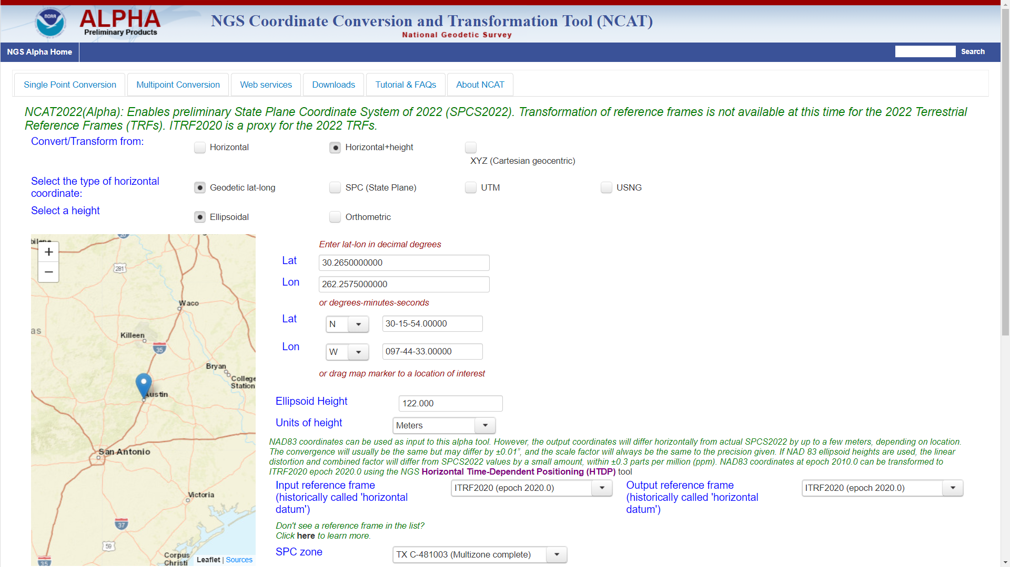

Slide 16
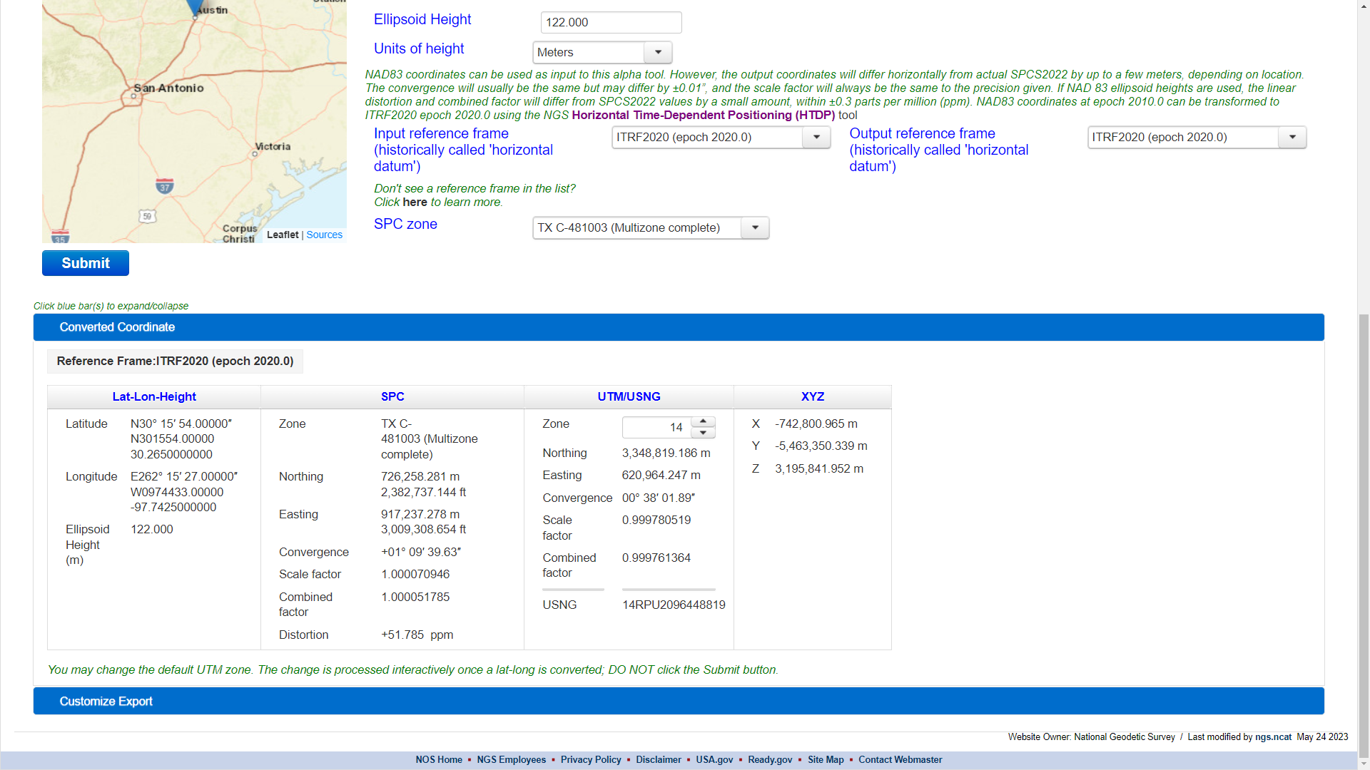

Slide 17
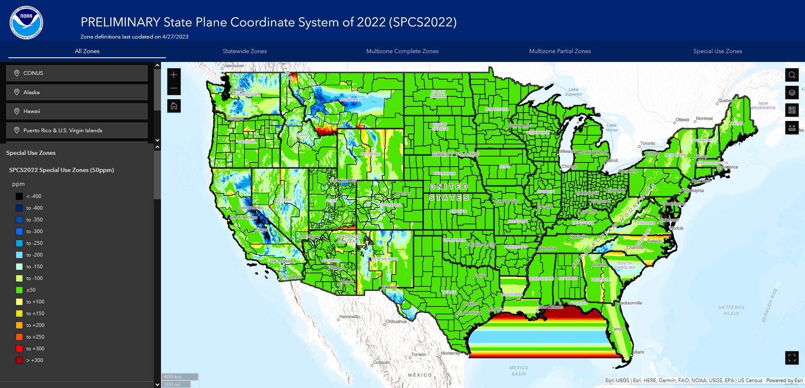

Slide 18
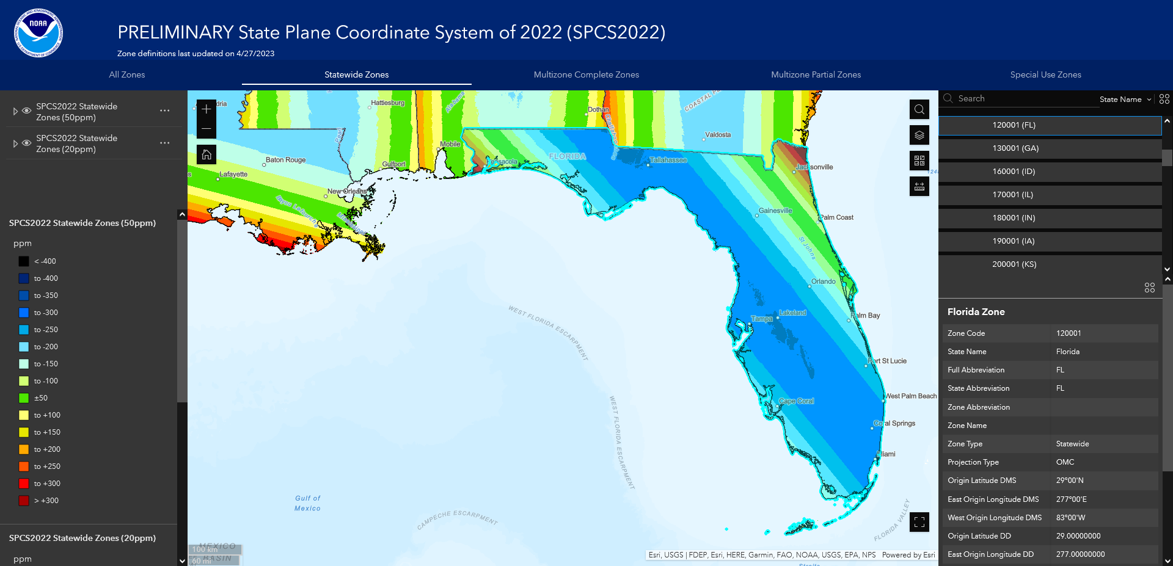

Slide 19
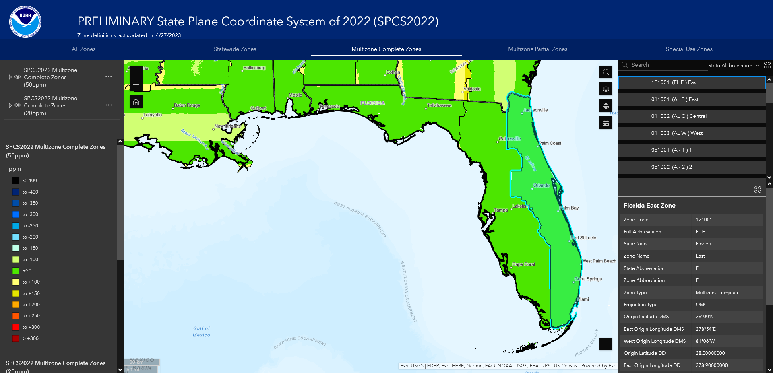
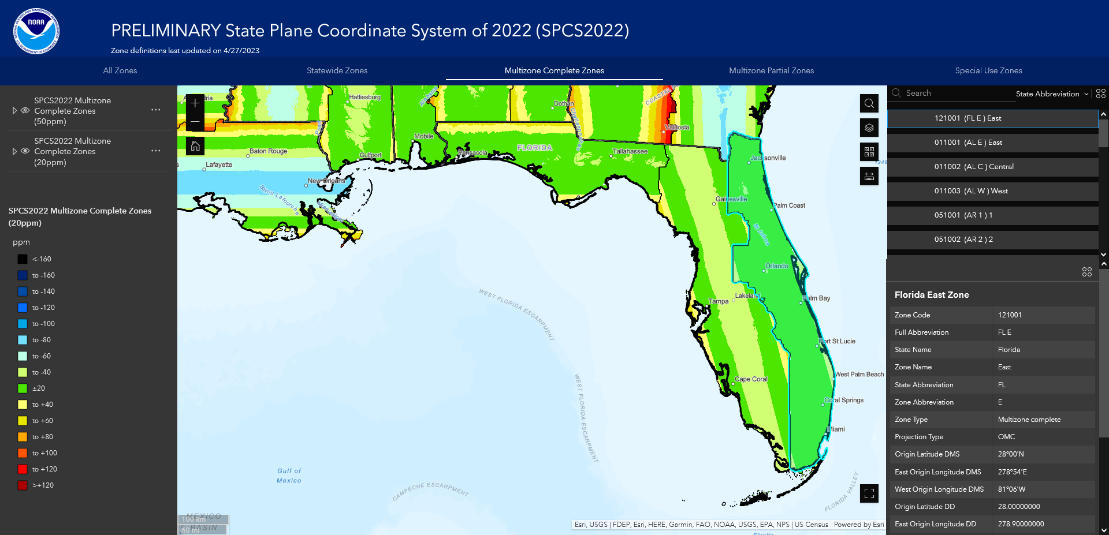

Slide 20
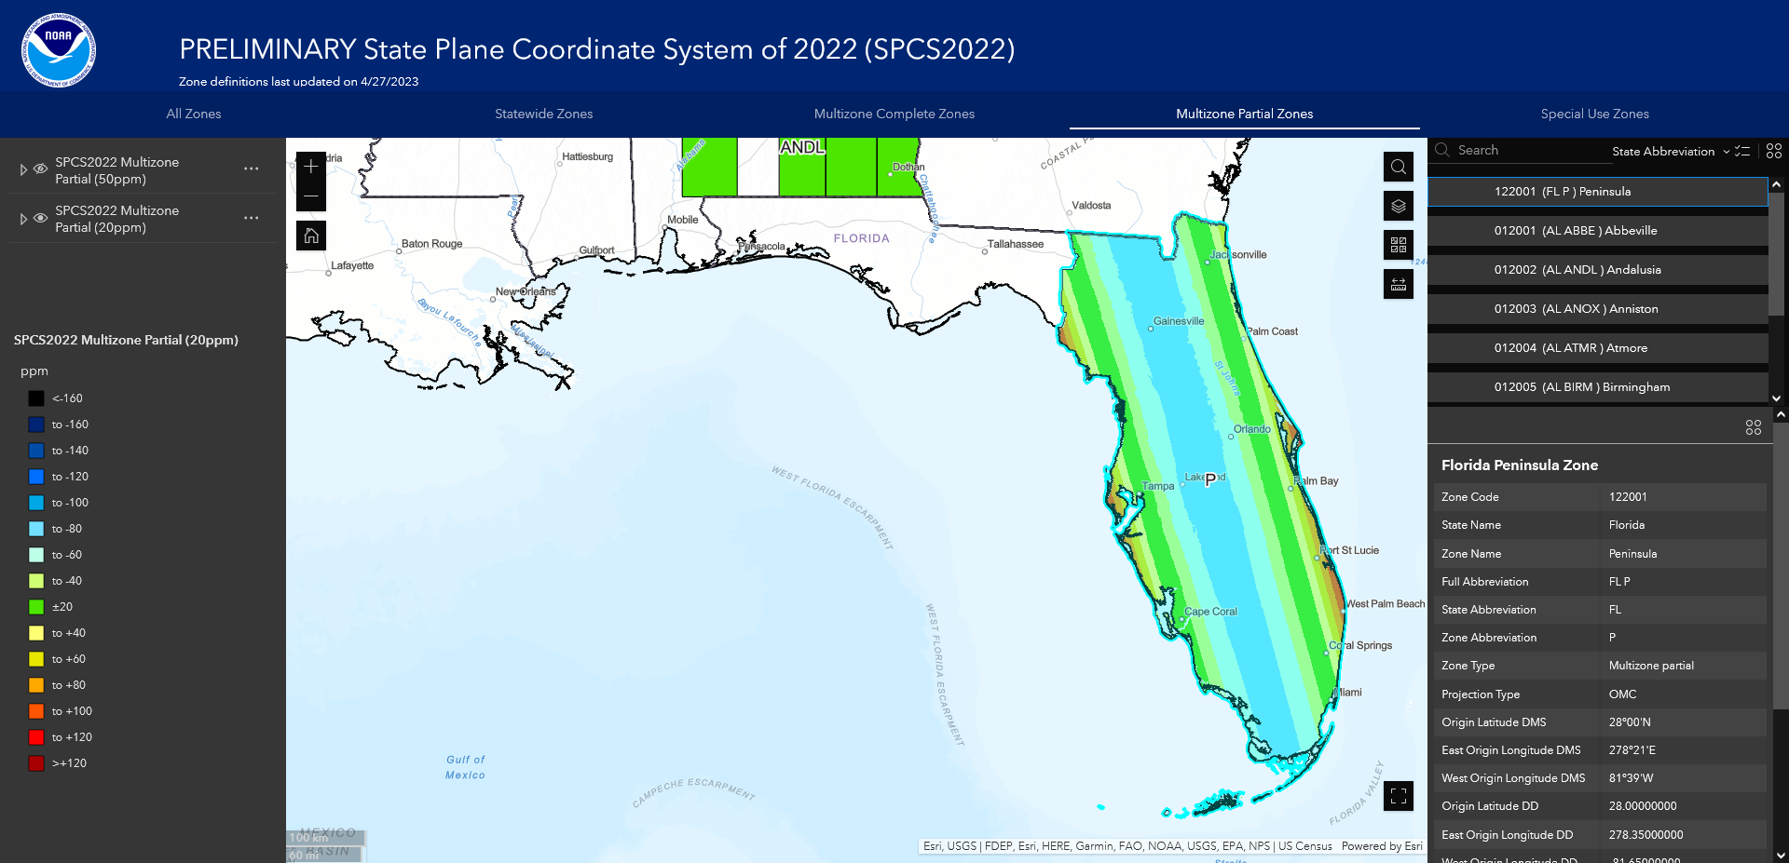

Slide 21
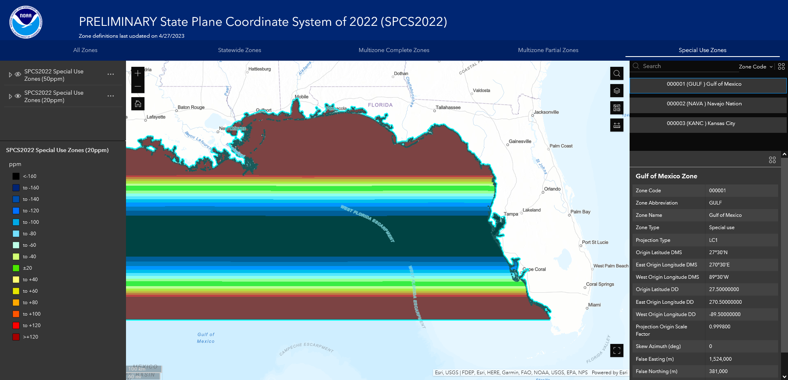
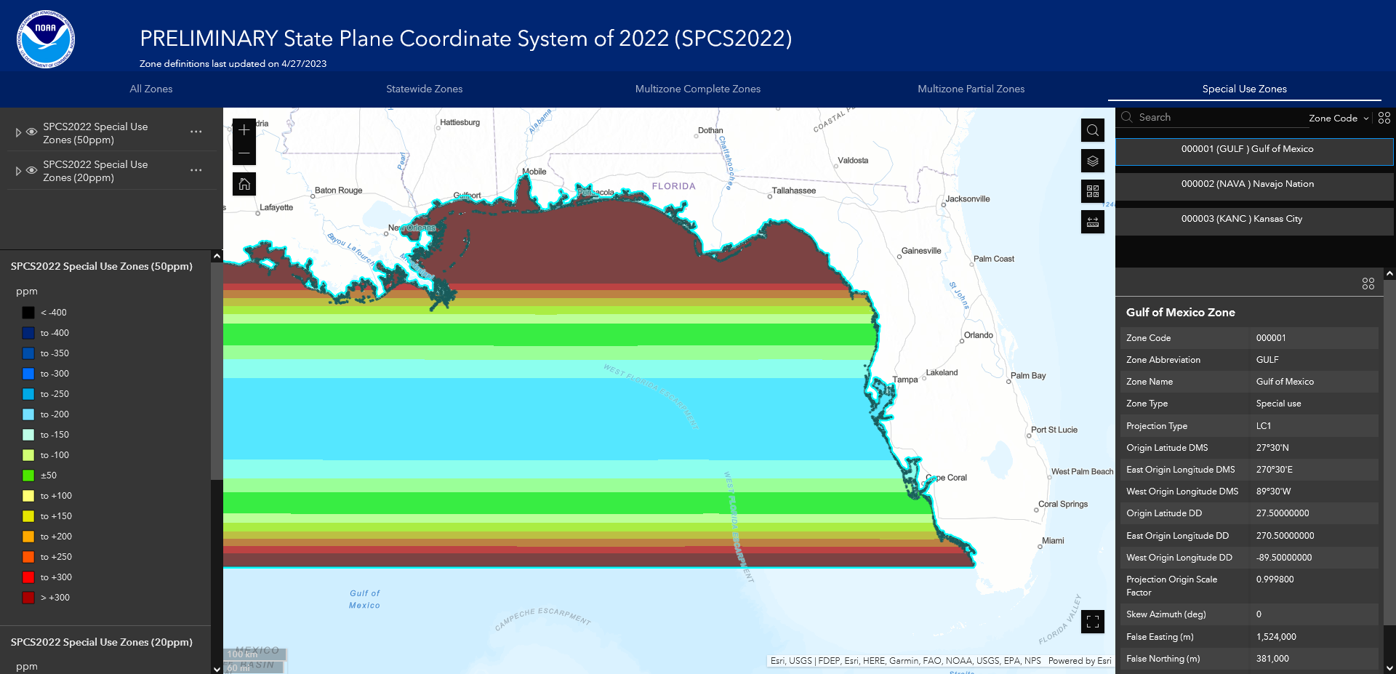

Slide 22
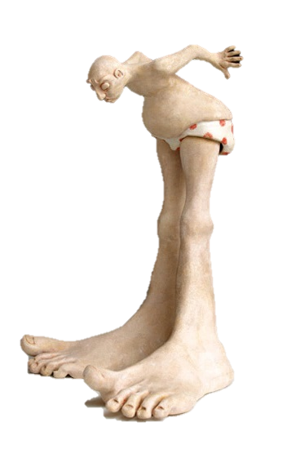
A tale of two feet
Two versions of the “foot” in U.S.
“Old” U.S. survey foot
(adopted 1893)
“New” international foot
(adopted 1959)
‭1 ft = 1200/3937 m
(0.3048006096…‬ m)
1 ft = 0.3048 m exactly
Differ by
2 parts per million (ppm) or ~0.01 ft (~1/8 inch) per mile
  A real problem with real costs
  (especially for State Plane of the NSRS)

Slide 23
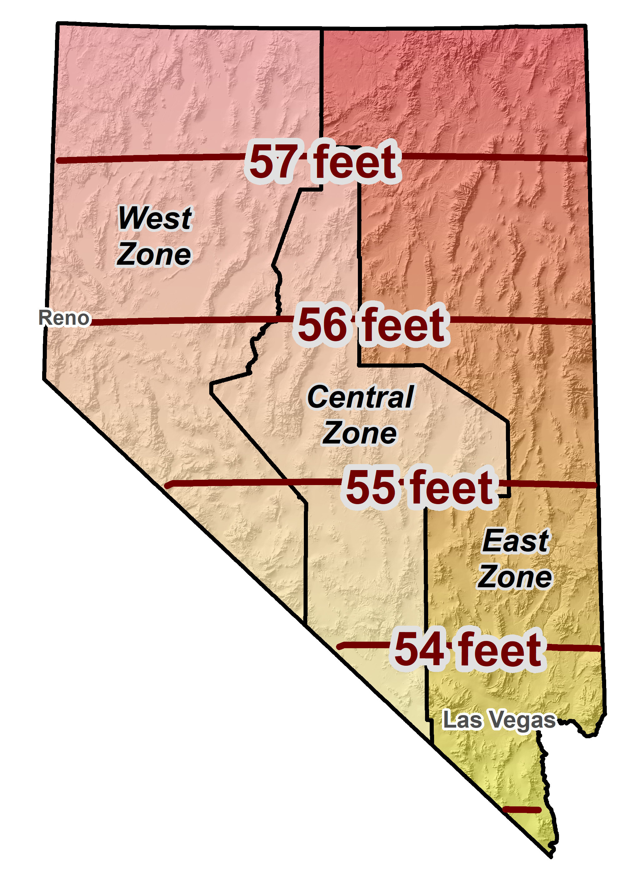
Horizontal error when mixing up feet…
SPCS 83 Nevada East Zone

Slide 24
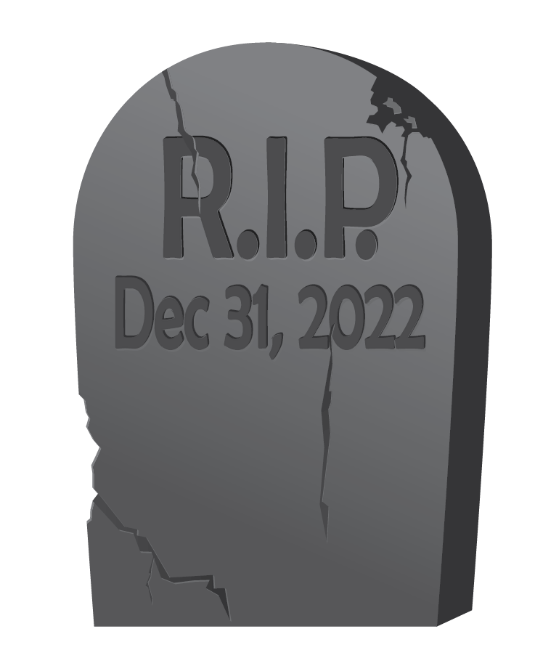
End of an era for the U.S. survey foot
U.S. survey foot has been “deprecated” (retired)
  Not supported for SPCS2022
  (or any part of modernized NSRS)
  Only international foot will be supported by NGS
Effective December 31, 2022
  But will support U.S. survey foot for legacy products
  (e.g., existing State Plane)
However, NGS will NOT support NAD 83 after NSRS Modernization rollout
NGS will always support
U.S. survey foot for SPCS 83 and 27
Thank you.

Slide 25
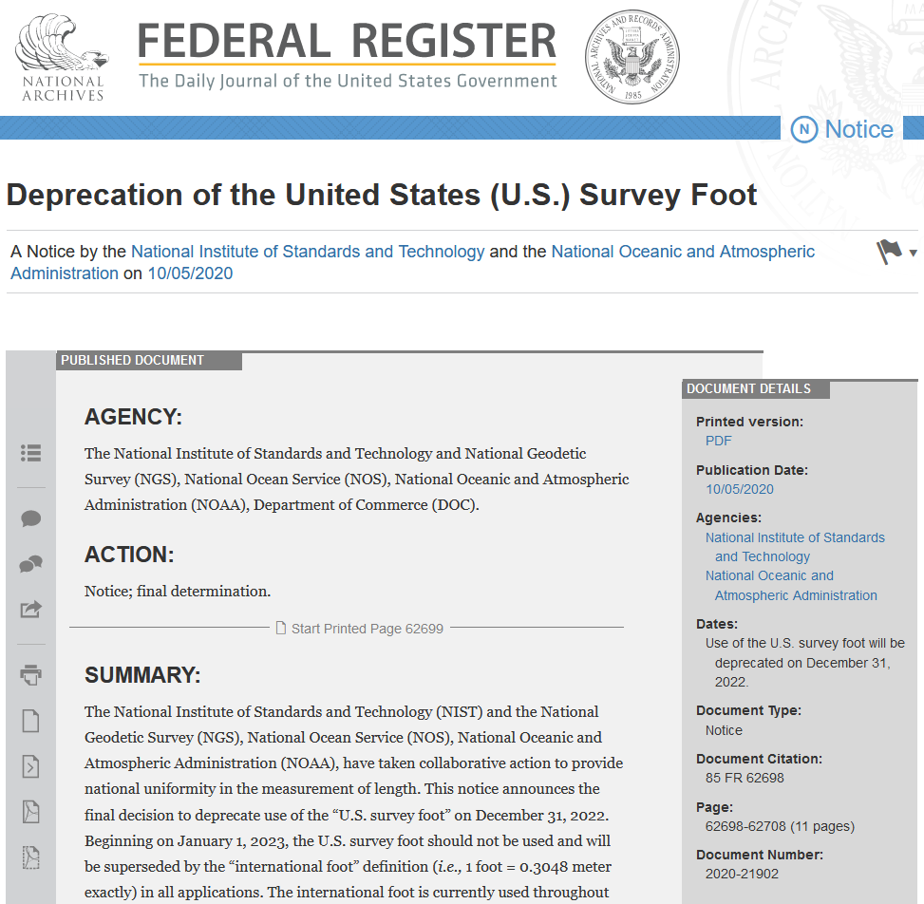

Requiem for the
U.S. survey foot
  Per final determination Federal Register Notice issued Oct 5, 2020
  Collaborative action by National Institute of Science and Technology (NIST) and NGS
  Describes public comments received, along with the plan, resources, training, and other information for an orderly transition with minimum disruption

Slide 26





Where to learn more…
geodesy.noaa.gov
Thank you!

