Slide 1

Practical Impacts of the Modernized NSRS
Dru Smith
NSRS Modernization Manager
NOAA’s National Geodetic Survey

Slide 2

Outline
A very brief overview of NSRS Modernization
Practical Impacts
Tools for a changing world

Slide 3
The National Spatial Reference System
The NSRS
Official coordinate system for the USA
Defined by the (USA) National Geodetic Survey
Required to be used by all (USA) Federal Government agencies
Often used by many (USA) state and local government agencies or private surveyors

Slide 4
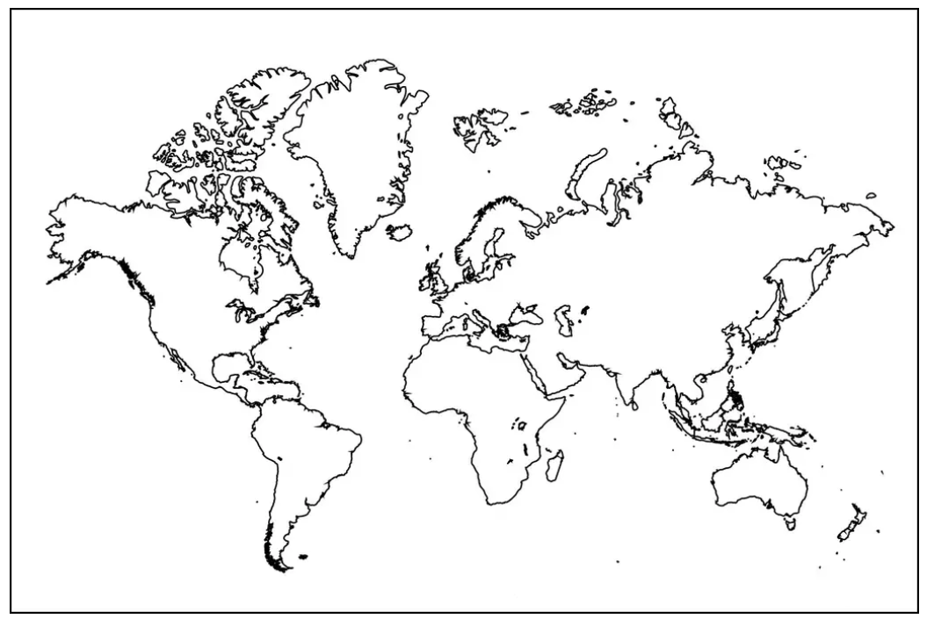
Extent of the current NSRS
Frames: Truly global but used regionally
Geoid/Vertical: Regional
Conterminous US (CONUS; “Lower 48”)
Alaska
Hawaii
Territories: Puerto Rico, U.S. Virgin Islands, American Samoa, Guam, CNMI

Slide 5
NSRS Modernization in (very) brief – Why?
The current NSRS was:
  Defined in the pre-GPS era
    Without GPS, the Earth’s center (frame origin) was very hard to detect
  Defined without aid of gravity-mission satellites
    Leveling, terrestrial gravity, disconnected from the geometric frame
  Defined right after punch-cards went away
    Tools relied upon 80-character ASCII files and FORTRAN
  Defined without a long-term strategy to acknowledge Earth’s dynamics
In short, the current NSRS has failed to keep up with emerging needs
  Sea level rise, floodplain mapping, coastal geohazards

Slide 6
NSRS Modernization in (very) brief
NATRF2022
NAD 83(2011)
NAD 83(PA11)
PATRF2022
Hybrid geoids
Gravimetric geoid
NAD 83(MA11)
CATRF2022
MATRF2022
NAVD 88
ASVD 02
PRVD 02
NAPGD2022
Bluebooking
FORTRAN
Disparate tools
Outdated manuals
GDX / OPUS 6
Modern coding
Integrated tools
Updated manuals
NMVD 03
GUVD 04
VIVD 09

Slide 7
Practical Impacts
Every latitude, longitude and ellipsoid height will change from its NAD 83 values in the +/- 2 meter range
Every orthometric height will change from its NAVD 88 (et al.) values in the +/-2 meters median range, with an unknown limit on change due to (as yet) unquantified subsidence impacts
Published coordinate functions at active control stations will be the primary geodetic control of the NSRS
Greater integration of NGS tools will improve consistency and reduce confusion

Slide 8
Practical Impacts
One day, every digital surveying instrument could be capable of providing direct input to OPUS 6 via GDX
  GDX: Geodetic Data Exchange format. Can hold raw measurements from GNSS receivers, levels, total stations, gravimeters
  OPUS 6: NGS’s future do-it-all geodetic survey project processing tool
Time-dependency will be built into the modernized NSRS. Users will need to actively disengage it.

Slide 9
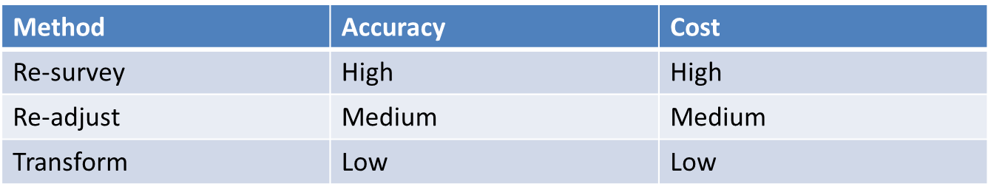
Tools for a changing world
Before working in the modernized NSRS, most users want to know how to get their decades of existing data into it
There are always three ways

Slide 10
Tools for a changing world
Re-survey
  Return to the field, and survey points of interest, relying on the modernized NSRS control
    Definitely can yield new “geodetic control” (for a while) for you to use
Re-adjust
  Using pre-existing observations, load them up to OPUS, and re-adjust them to modernized NSRS control
    Probably yields new “geodetic control” (for a while) for you to use
Transform
  Using tools like NADCON and VERTCON (NGS models) estimate mass-changes to your datasets.
    Does not yield new “geodetic control”

Slide 11
Re-survey or Re-adjust
The NOAA CORS Network will be improved
OPUS-S and OPUS-Projects 5.x will be available for GNSS only
  OPUS 6 (the do-it-all suite) will not be ready until after 2025
Multiple constellations (M-PAGES)
Coordinates in ITRF2020, N/M/P/CATRF2022, NAPGD2022, SPCS2022

Slide 12
Transform
Using all GNSS and leveling data ever provided to NGS, we will create updates to NADCON and VERTCON
  Available in NCAT and VDatum
Will get your data to the 2020.00 epoch in the new frames / new geopotential datum

Slide 13
Timeline
NGS will release all modernized NSRS data and many support tools on their BETA website over the 2024-2025 timeframe
  Because the creation of some data/tools are the prerequisites for creating other data/tools, some parts of the modernized NSRS will be on BETA for over a year, while others for only a few months
Once everything has been publicly available for 3 months, the FGCS will meet to decide on adopting the whole package
  FGCS: Federal Geodetic Control Subcommittee. Under the FGDC (Federal Geodetic Data Committee)
  With a positive vote, everything moves from BETA to the live NGS page
NGS expects this vote in late 2025

Slide 14
Early release
Some data/tools can and will be released early
  This was a request from industry partners
Such early-releases (“alpha products”) aren’t usually publicly available, so this will only be true for a handful of things
  SPCS2022
  EPP2022
  GEOID2022
  A few others

Slide 15
Early release
Alpha products are, by definition, any or all of the following:
  Incomplete
  Inaccurate
  Buggy
  Subject to change without notice
As such, their early release is primarily to see the “big picture” such as formats of data, a general direction that NGS is taking, etc.

Slide 16
What’s on deck?
Soon: M-PAGES in OPUS-S
Soon: GDX to replace GVX
Soon: The release of the State Plane Coordinate System of 2022
Late 2023: The first (“alpha”) set of RECs in N/P/C/MATRF2022 on 100,000+ marks
End of 2023: ITRF2020 coordinate functions on all NOAA CORS Network stations
End of 2023: First (“alpha”) release of GEOID2022 (“GEOID2022 Beta v. 0.1”)

Slide 17
Thank you!

Slide 18
Questions?

Slide 19
Extra Slides

Slide 20
What’s on deck?
Soon: M-PAGES in OPUS-S
Soon: GDX to replace GVX
Soon: The release of the State Plane Coordinate System of 2022
Late 2023: The first (“alpha”) set of RECs in N/P/C/MATRF2022 on 100,000+ marks
End of 2023: ITRF2020 coordinate functions on all NOAA CORS Network stations
End of 2023: First (“alpha”) release of GEOID2022 (“GEOID2022 Beta v. 0.1”)

Slide 21
Thank you!

Slide 22
Questions?

Slide 23
Extra slides

Slide 24
The path to full roll-out (1 of 2)
Complete data and tools that have been tested internally will be released on the beta website.
Once the complete package of modernized data and tools have been on beta for at least 3 months, NGS will ask FGCS to formally adopt the modenized NSRS
After that vote, all modernized data and tools on the beta website will be moved, en masse, up to the live website
We will all celebrate and relax because this process can’t possibly have any hiccups

Slide 25
The path to full roll-out
The next few slides show key elements, and their roll-out order, though with a purposefully vague timeline to allow some flexibility
To aid in readability, some details are omitted, but can be inferred, such as:
  All data will be loaded in the NSRS database
  A data delivery system will exist
  All tools will be incorporated into NCAT

Slide 26
The path to full roll-out: Frames
NCN
w/ ITRF2020
EPP2022
SPCS2022
2023
2024
2025
IFDM2022

Slide 27
The path to full roll-out: Geopotential
GRAV-D
Complete
DEFLEC2022 Beta v0.1
(alpha release)
GM2022
DEFLEC2022
2023
2024
2025
GEOID2022 Beta v0.1
(alpha release)
GEOID2022

Slide 28
The path to full roll-out: OPUS
OPUS-Projects
w/ LASER and
new adjustment
procedures
OPUS-S
w/ M-PAGES
OPUS-S
w/ ITRF2020
OPUS-Projects
w/ M-PAGES
OPUS-Projects
w/ ITRF2020
OPUS-S
w/ EPP2022
Initial GDX
release
2023
LASER
completed
2024
2025
OPUS-S
w/ Simultaneous
Processing
OPUS-S
w/ IFDM2022
(not HTDP)
OPUS-Projects
w/ IFDM2022
(not HTDP)
OPUS-Projects
w/ IFDM2022
(not HTDP)

Slide 29
The path to full roll-out: Passive control
NCN
w/ ITRF2020
DEFLEC2022 Beta v0.1
(alpha release)
EPP2022
DEFLEC2022
Geometric RECs
SPCS2022
NADCON
VERTCON
LASER
completed
Orthometric RECs
2023
2024
2025
IFDM2022
GEOID2022

