Slide 1

OPUS Projects 5: Supporting Real-Time Kinematic Measurements for Establishment of Geodetic Control
Dan Gillins, Ph.D., P.L.S.,
Nick Forfinksi-Sarkozi, Ph.D.,
Ira Sellars,
Weibing Wang

Slide 2
Real-Time Kinematic (RTK) Surveying
Single-base RTK
  Stationary single “base” station
  Transmits precise coordinates and GNSS observables to moving “rover”
  < 10-20 km baseline length
Network RTK
RTN Base
RTN Base
VRS
Control
Center
RTN Base
Base
Rover
(Landau et al. 2002)
http://www.gcfarm.com/siteart/precision-farming/case-accuguide.jpg
Notes:
Applications
Survey engineering
Mobile mapping
Precision agriculture
Mining
Construction

Slide 3
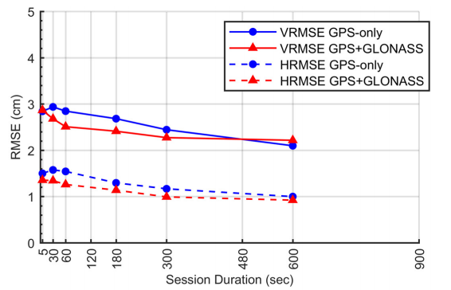
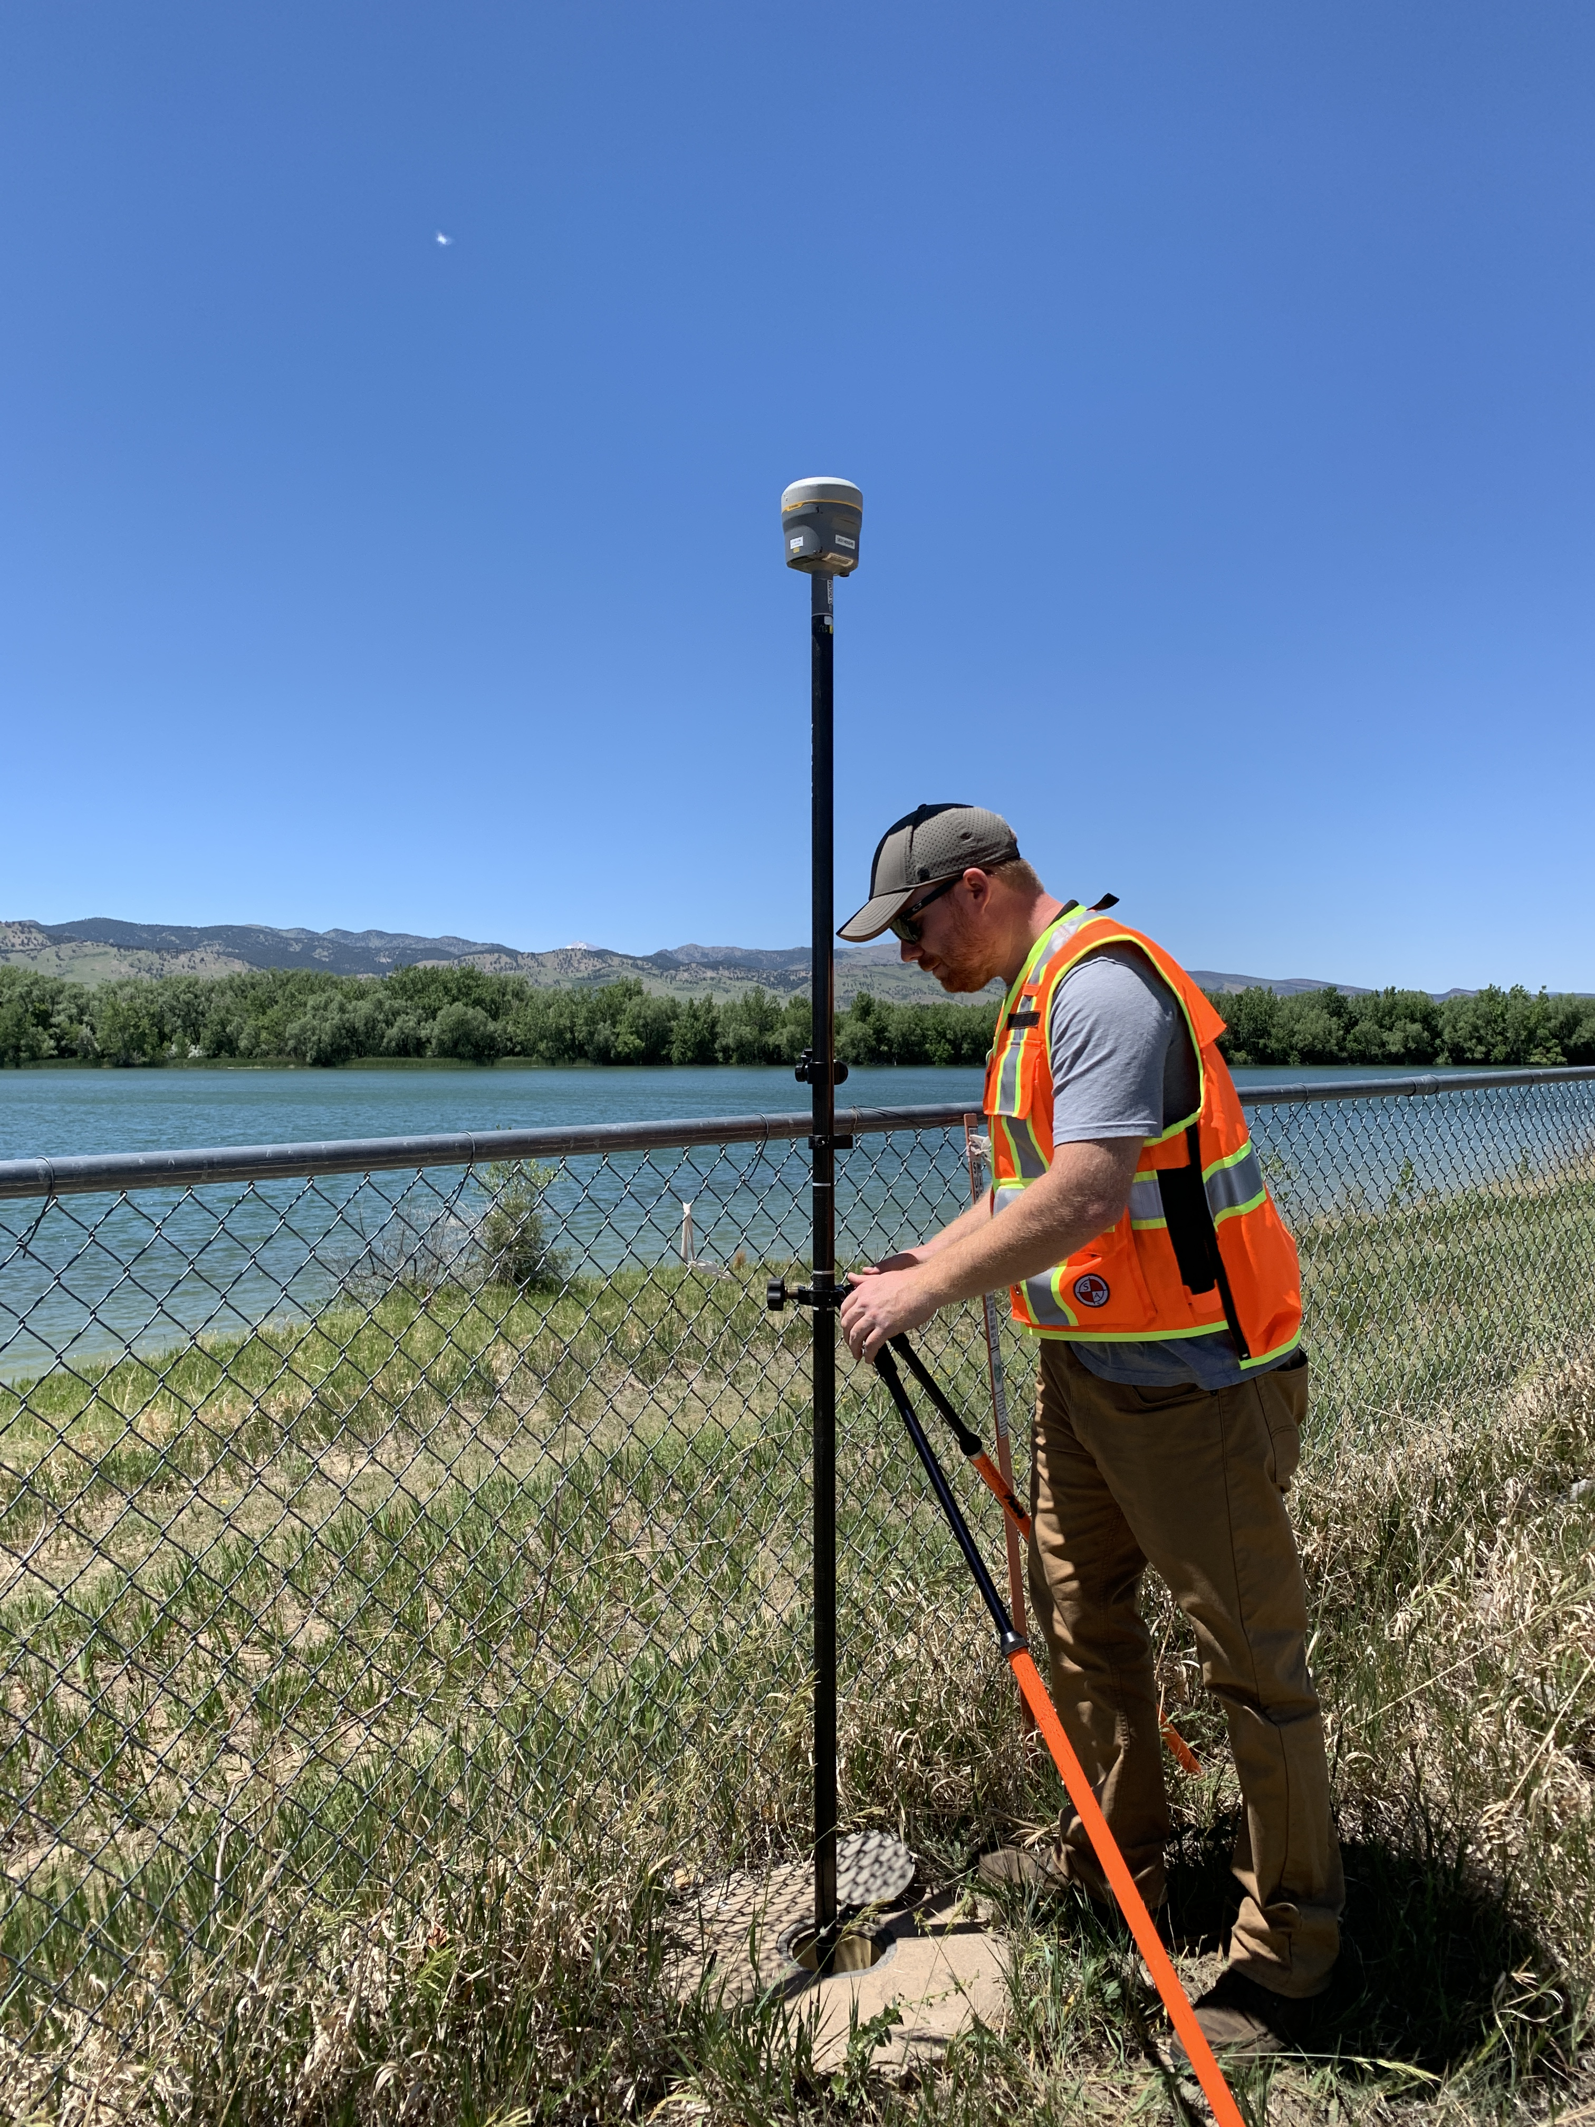
Empirical Evaluation of the Accuracy of Network RTK
Ellipsoid Height
Horizontal
[Allahyari et al. 2018]
3

Slide 4
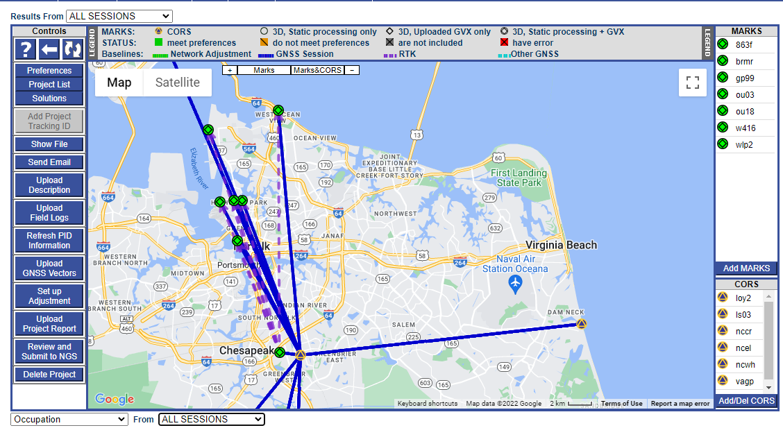
What is OPUS-Projects?
Free, web-based application
Upload static GPS data via OPUS-S
Supports campaign-style surveys
Custom survey network design
Easy addition of CORS’ data
Data management and visualization aids
Baseline processing using the PAGES engine
Survey network adjustments
Selection of reference frames , geoid models, State Plane Coordinates, etc.
4

Slide 5
Why use OPUS-Projects?
Organizes data for multiple occupations on more than one mark
  Campaign-style surveys for control
Performs least squares adjustments of control survey networks
  Estimate relative accuracy between marks
Constrains NAVD 88 bench marks – check/establish NAVD 88 heights
Ensures survey is tied to the National Spatial Reference System (NSRS)
  CORS data and published coordinates/heights
  Official models (HTDP, GEOID18)
Submits survey to NGS for review, loading in database, and publication on datasheets
  Establishment of geodetic control
  NGS will use data for making models (e.g., future transformation model for the new datums)

Slide 6

GNSS Vector Exchange (GVX) Flow Chart: https://www.ngs.noaa.gov/data/formats/GVX/index.shtml
Notes:
Explain URL has example files, details on the file format
XML based, open-source, machine and human readable

Slide 7
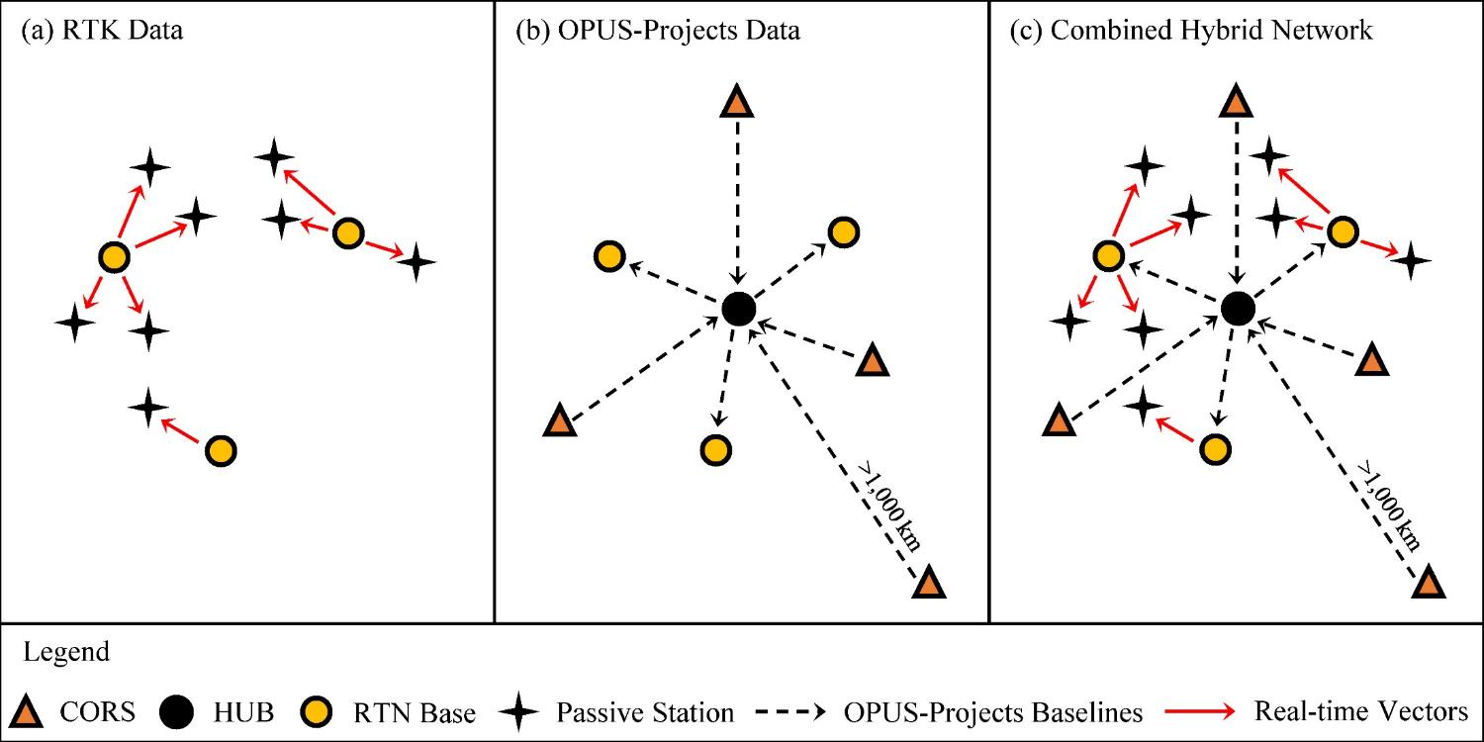
Design for OPUS-Projects and GVX
GVX file (from RTK survey or baseline processing in other software)
OPUS-Projects (from static GNSS session processing)
375-800 km
375-800 km
RTK Base or “From” Mark
RTK Rover or “To” Mark
7
Vector
Vector in GVX File
[Adapted from Weaver et al. 2018]

Slide 8
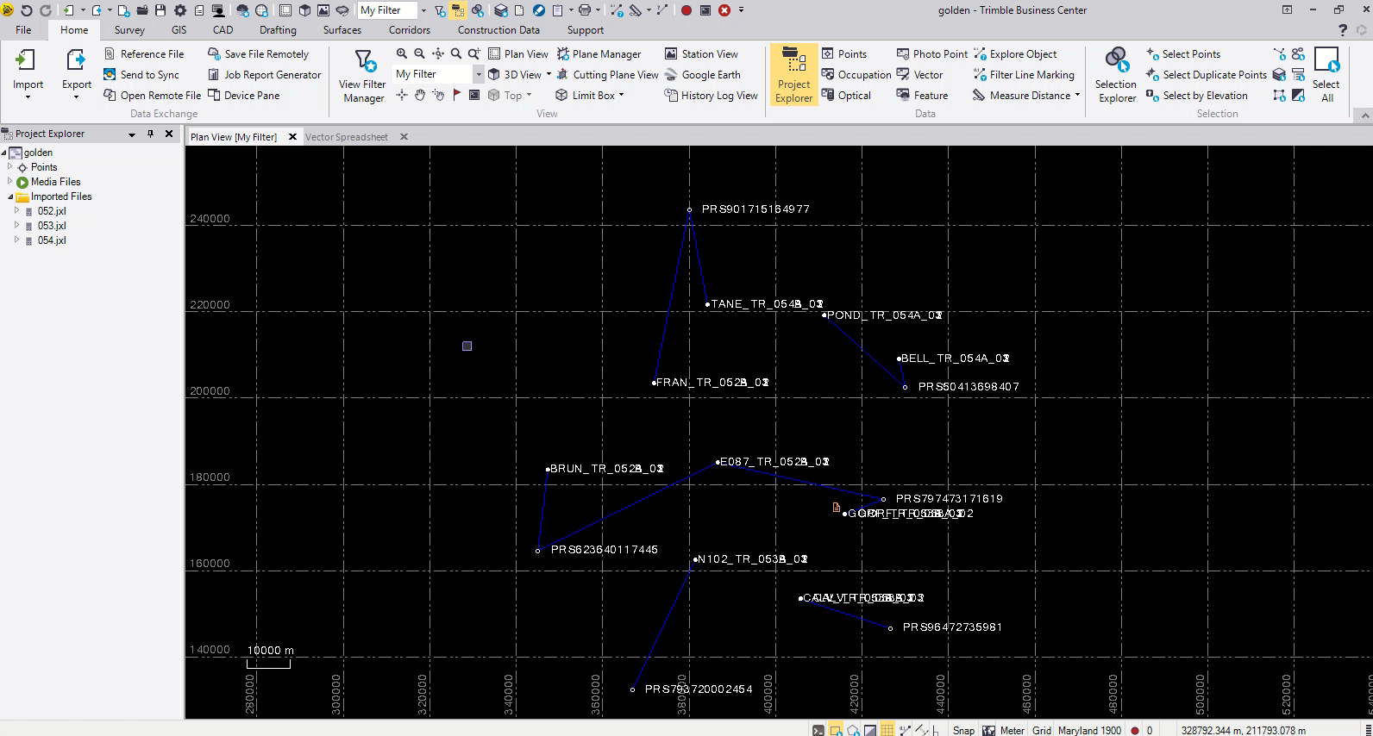
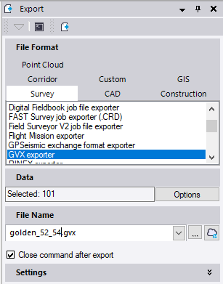
Example of GVX to OPUS-Projects
8

Slide 9
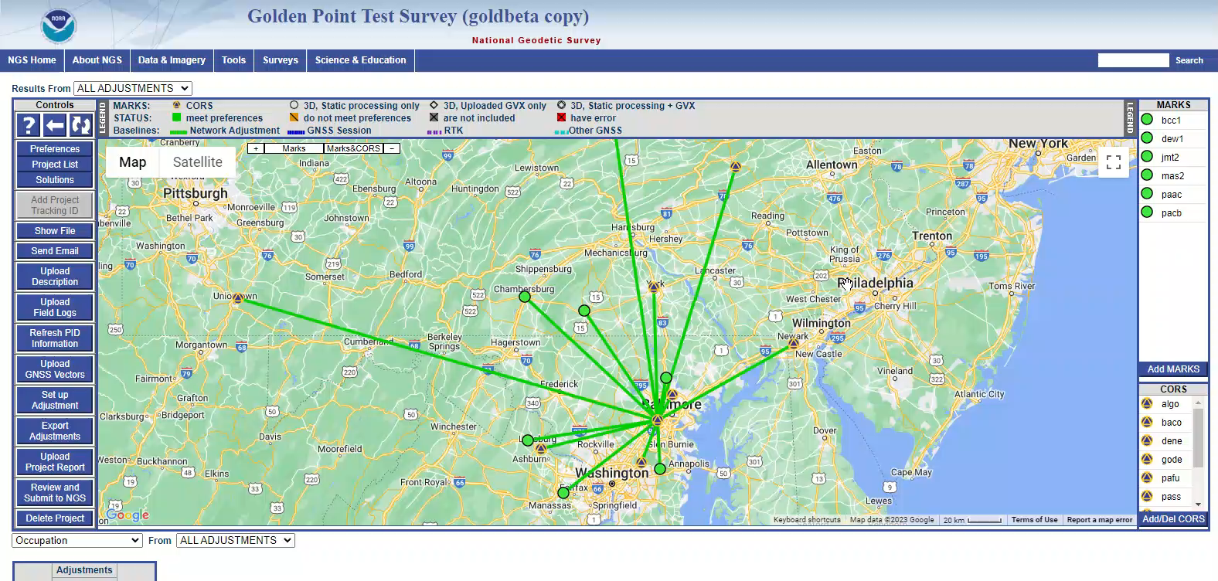
Example of GVX to OPUS-Projects (cont.)
https://geodesy.noaa.gov/OPUS-Projects/OpusProjects.shtml
9

Slide 10
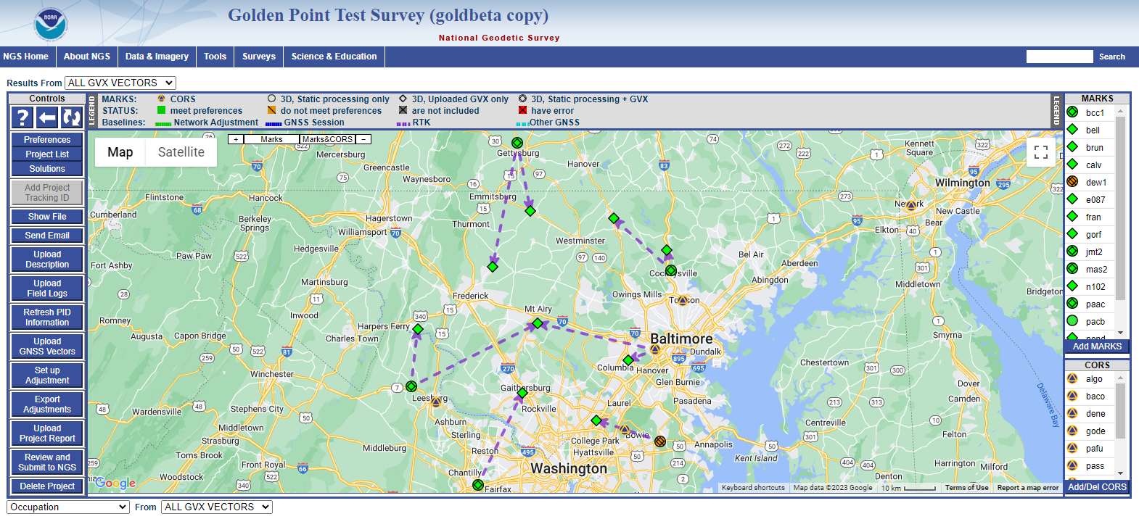
Example of GVX to OPUS-Projects (cont.)
10

Slide 11
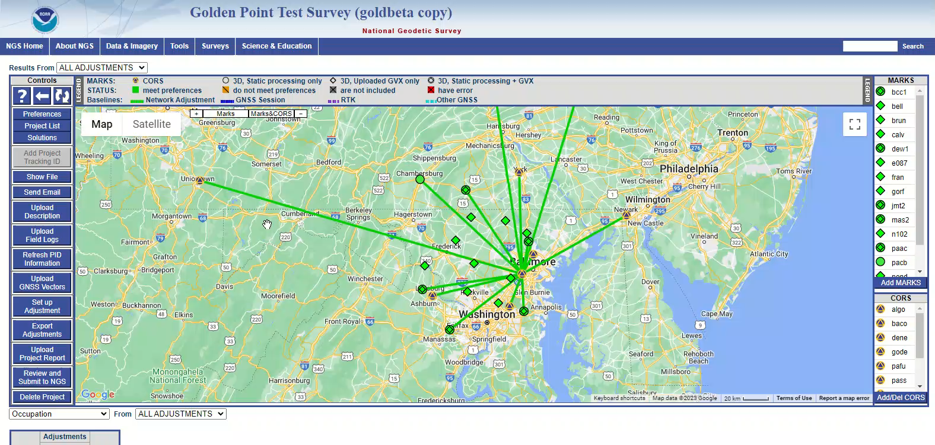
Example of GVX to OPUS-Projects (cont.)
https://geodesy.noaa.gov/OPUS-Projects/OpusProjects.shtml
11

Slide 12
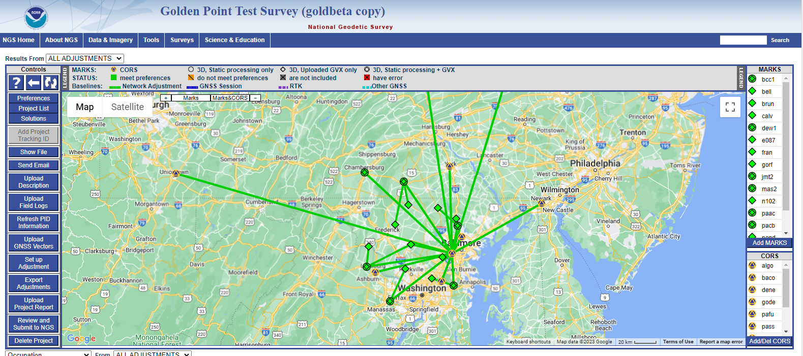
Example of GVX to OPUS-Projects (cont.)
12

Slide 13
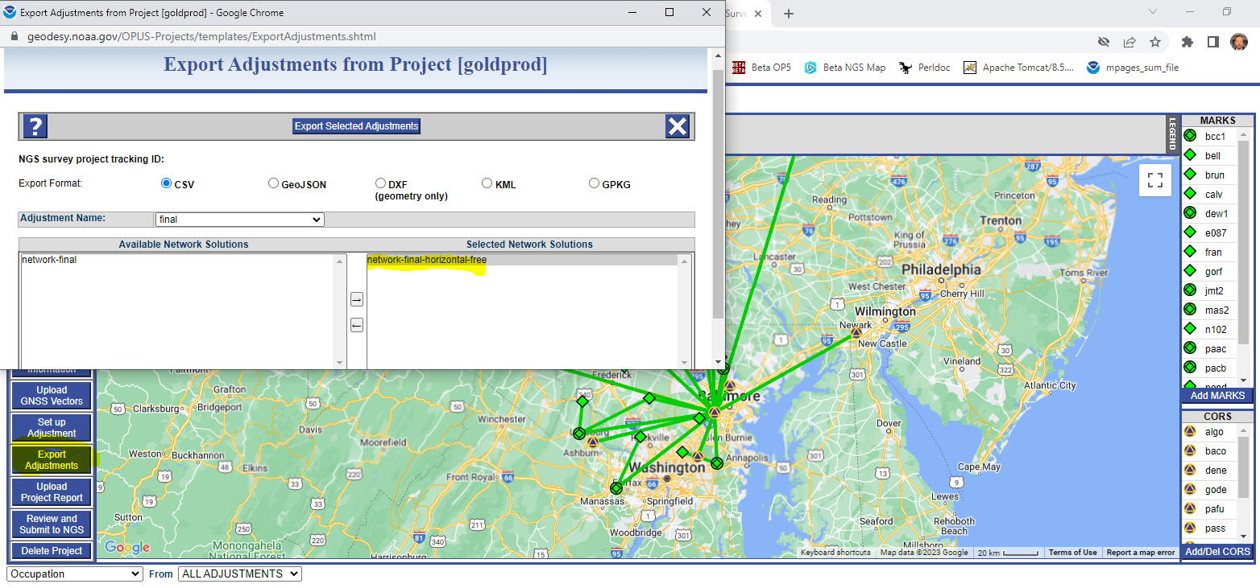
Example of GVX to OPUS-Projects (cont.)
13

Slide 14







Status of GVX Exporters
Available Now
Trimble Business Center (TBC) 5.80
Carlson SurvCE7
Topcon MAGNET Field v. 7.3
Leica Infinity 4.0.0
JAVAD in Triumph-LS device
Coming Soon
Reachview 3
i-Gage X-PAD
14
Notes:
Trimble Business Center (TBC) 5.60 (11/15/2021)→updated to 5.80 to fix bugs
Topcon MAGNET Field v. 7.2 (11/18/2021)→ updated to v.7.3 to fix bugs
JAVAD in Triumph-LS device
Leica Infinity 4.0.0 (05/2022)→runs well

Slide 15
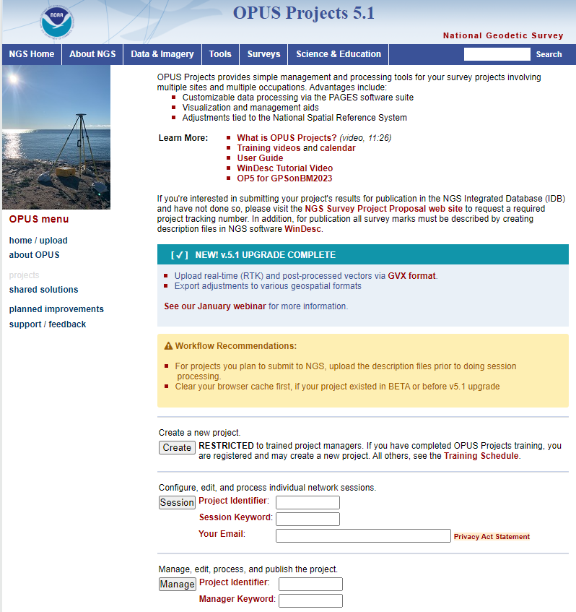

OPUS-Projects 5.1
Supports static GPS baseline processing & network adjustments
Uploader for GVX files
  RTK vectors; vectors from post-processing
Automatically “weights” uploaded vectors in a network least squares adjustment
Builds all necessary files for publication on datasheets

Slide 16
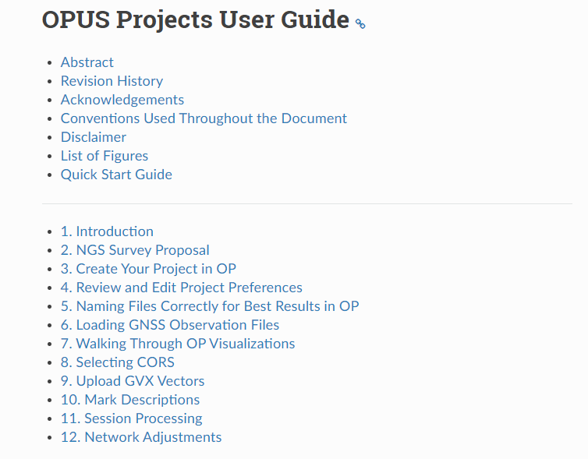
More Help with OPUS-Projects and GNSS Surveying
Completed Work:
New digital user guide
New web content for GPSonBM using network RTK and OPUS-Projects 5.1
Ongoing Work:
New GNSS surveying standards & specifications—NGS-92
Training videos to support independent learning
Tutorial lesson with example data
16

Slide 17
NGS 92: New Standards for GNSS Surveying
Description | Primary | Secondary | Local
Ellipsoid height (cm) | 2 cm | 3 cm | 5 cm
Horizontal (cm) | 1 cm | 1.5 cm | 2.5 cm
Orthometric height (cm) | 3 cm | 4 cm | 6 cm
All accuracies are at 95% confidence; network & local
Requirement for Network RTK method | Primary | Secondary | Local
Repeat number & duration of occupations | (6) 5 min. | (3) 5 min. | (3) 5 min.
Longest allowable vector | 40 km | 40 km | 40 km
Precision of repeat vectors | N/E: 3 cm Up: 6 cm | N/E: 4 cm Up: 8 cm | N/E: 5 cm Up: 10 cm
Maximum vector residuals (observed minus adjusted) | N/E: 1.5 cm Up: 3.0 cm | N/E: 2.0 cm Up: 4.0 cm | N/E: 2.5 cm Up: 5.0 cm
17

Slide 18
Key Takeaways
Software developers are adopting GVX as a standard file format for GNSS vectors
GVX facilitates uploading GNSS vectors to OPUS-Projects 5 for quality control, adjustment, and (optionally) submission to NGS for publication
OPUS-Projects 5.1 is now live and freely available for use
18

Slide 19
Questions?
Please feel free to contact me with any questions.
daniel.gillins@noaa.gov

