Slide 1

National Spatial Reference System:
Present and Future
Marti Ikehara, Geodetic Advisor
NOAA’s NGS, Sacramento
Marti.ikehara@noaa.gov

Slide 2
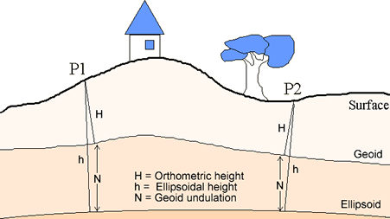
National Geodetic Survey Mission
To define, maintain and provide access to the National Spatial Reference System (NSRS)
to meet our Nation’s economic, social and environmental needs.
Latitude
Longitude
Height
Scale
Gravity
Orientation
Time Variations

Slide 3
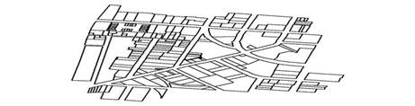
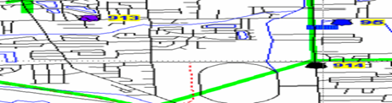
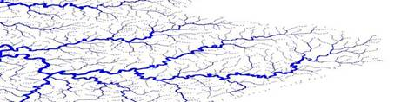

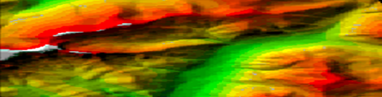

NOAA’s Geospatial Foundation
Land Ownership
Transportation
Surface Waters
Boundaries
Elevation
Aerial Imagery
Geodetic Control
NOAA’s National Geodetic Survey provides the geospatial underpinning that allows integration of all georeferenced data layers. The positional framework we provide is crucial to supporting the agency’s and the nation’s data collection, validation, and updating efforts.

Slide 4
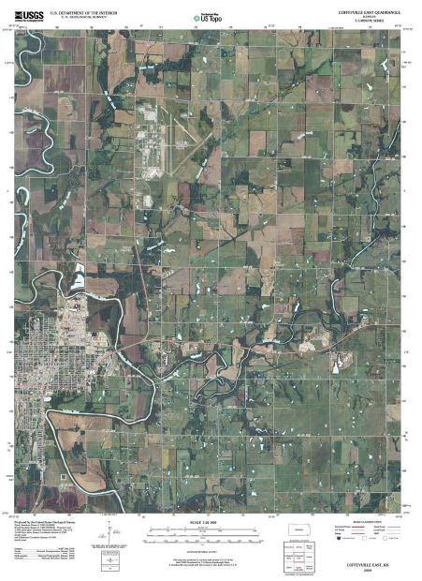

The NSRS Supports:
United States
Geological Survey
USGS uses the NSRS to geospatially reference their Topographic Maps
Notes:
The NSRS supports the United States Geological Survey (USGS) in the development of their topographic maps.

Slide 5
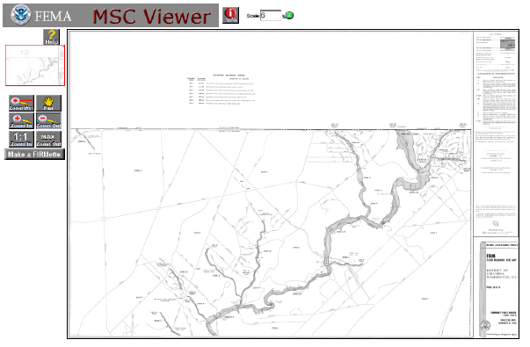

The NSRS Supports:
Federal Emergency Management Agency
FEMA uses NSRS elevations to determine flood zones for the National Flood Insurance Program
Notes:
The NSRS supports the Federal Emergency Management Agency (FEMA) in determining flood zones for the National Flood Insurance Program.

Slide 6

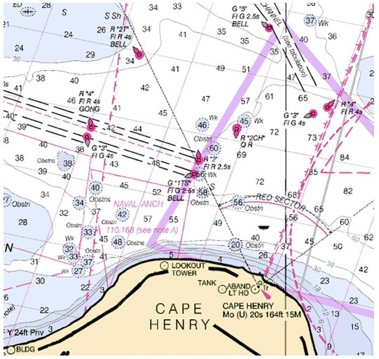
The NSRS Supports:
National Oceanic and Atmospheric Administration
NSRS positioning data provides the reference for NOAA’s Nautical Charts, among many other geospatial applications.
Notes:
The NSRS supports many offices in NOAA, particularly the other navigational services divisions of Center for Operational and Oceanographic Products and Services (CO-Ops) and Office of Coast Survey (OCS) in relation to Nautical Charts.

Slide 7
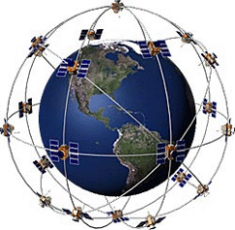
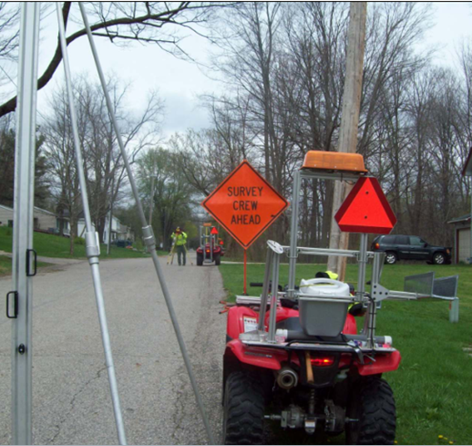
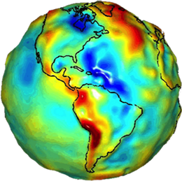
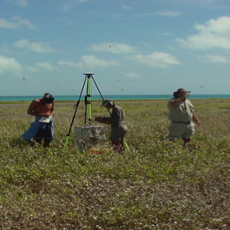
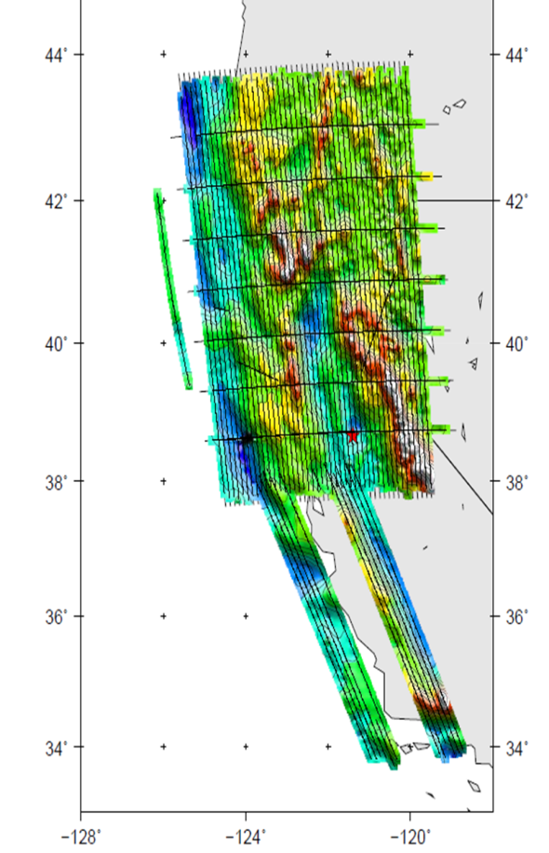
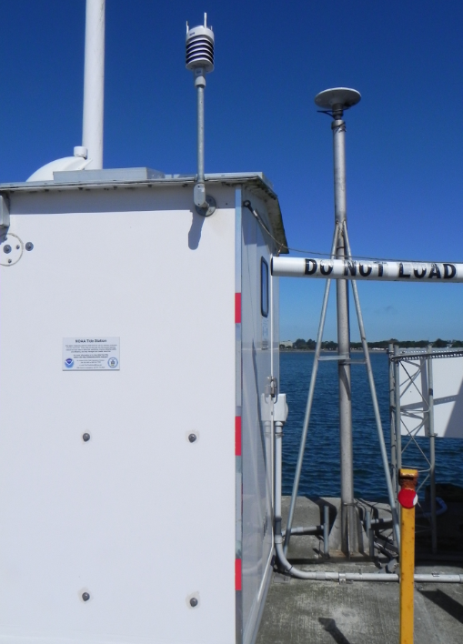
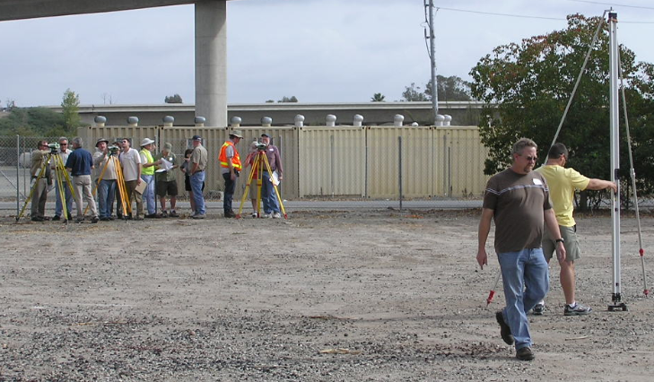
How We Maintain and Modernize the NSRS
GPS/GNSS Receivers
Leveling
Geoid Modeling

Slide 8
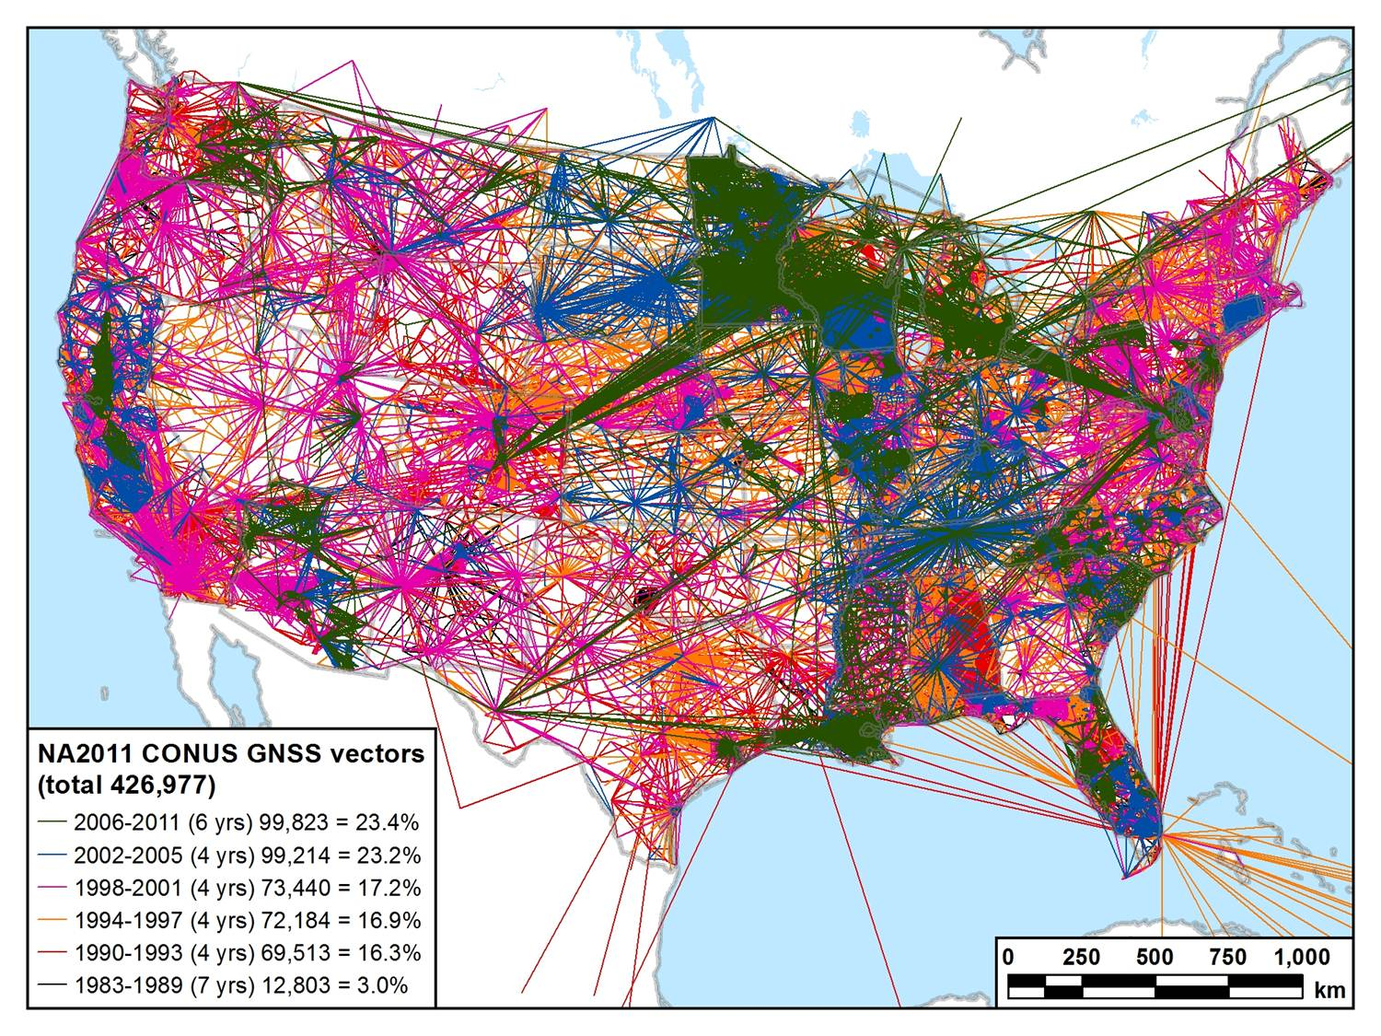
Updating the NSRS over Time
National Adjustment 2011: 1983-2011

Slide 9
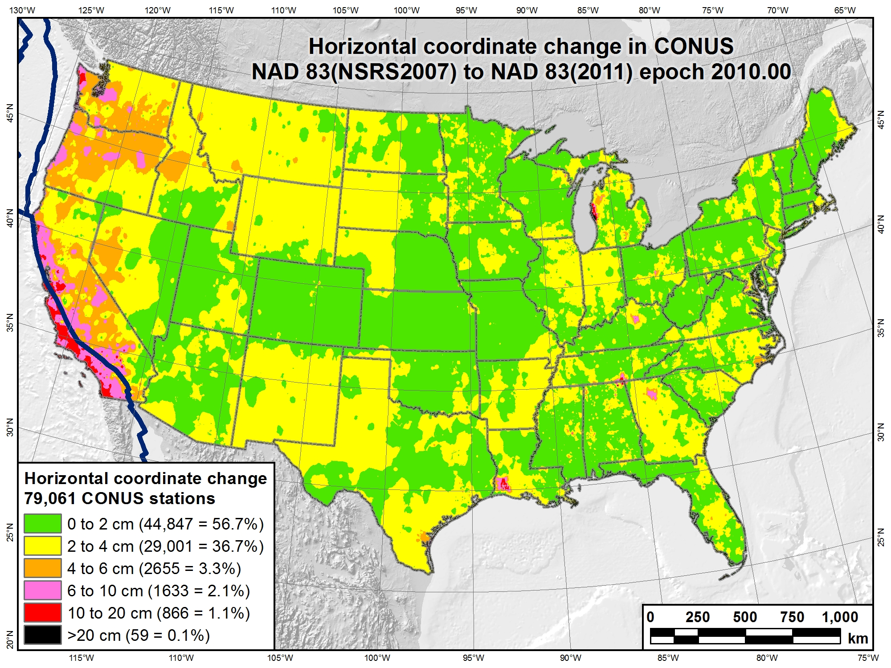
Epoch 2007.00
(only) 3 years

Slide 10
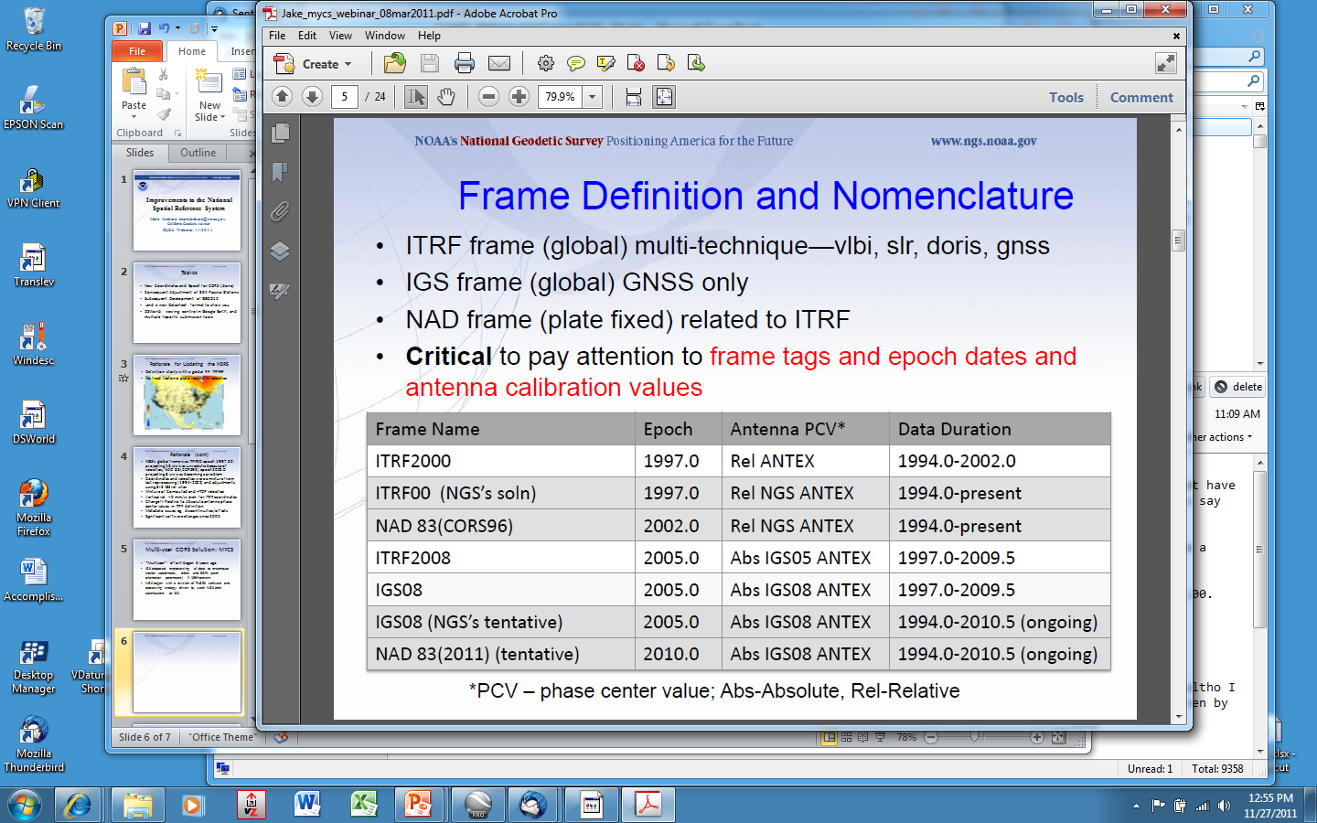
Geodetic Reference Frames past and present
xxxxxxxx
xxxxxxxxxxx

Slide 11
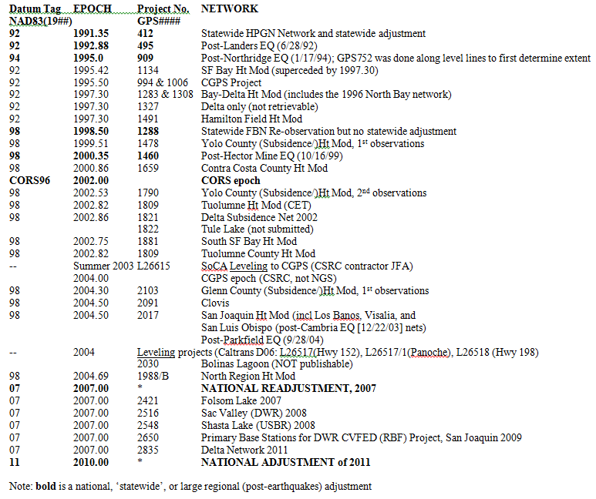
NAD83 (HARN) Datum Tags and Epochs in CA

Slide 12


National Geodetic Survey Mission
To define, maintain and provide access to the National Spatial Reference System (NSRS)
to meet our Nation’s economic, social and environmental needs.
Latitude
Longitude
Height
Scale
Gravity
Orientation
Time Variations
GNSS reference frame

Slide 13
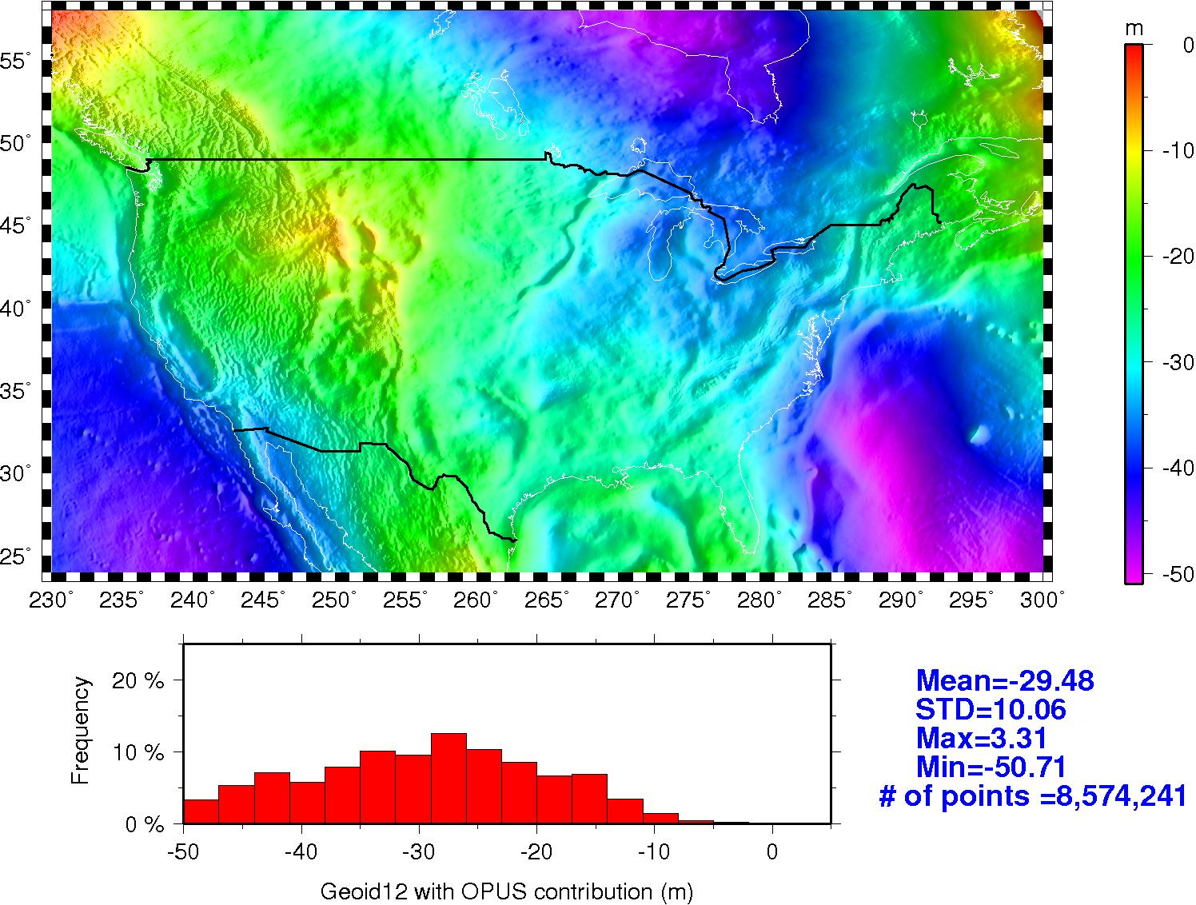
GEOID12 (with OPUS data) geoid heights

Slide 14
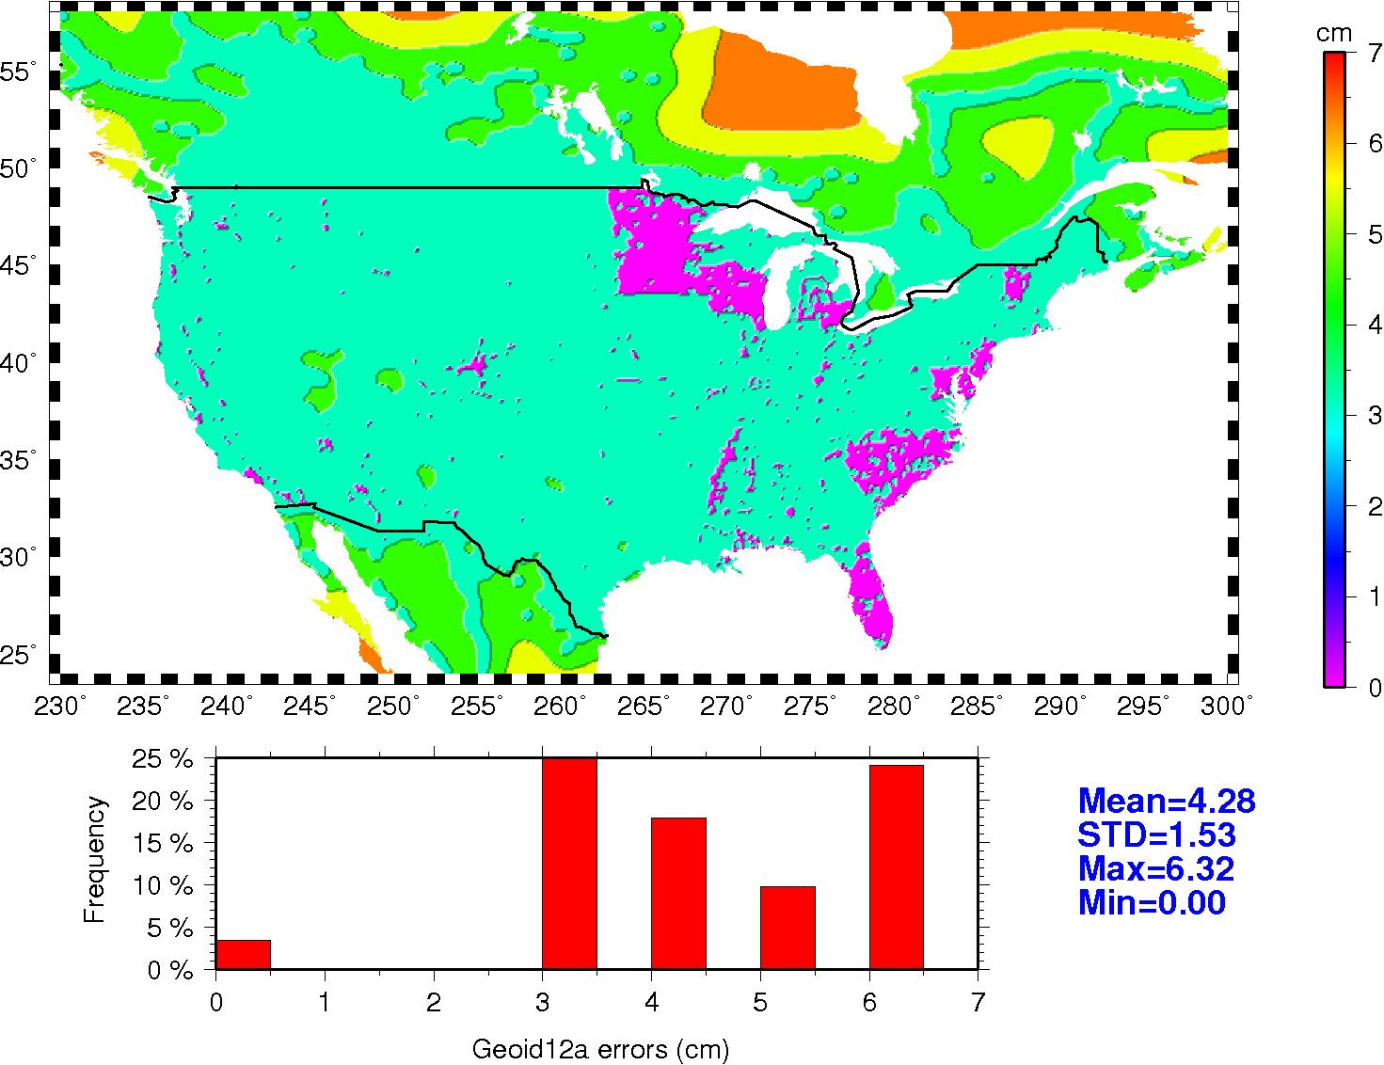
Coming Soon: Error Maps for GEOID12A
Rigorous LSC was used in GEOID12A
This ensured we had a var-cov matrix to estimate errors on a regular grid
This means errors can be provided with geoid heights

Slide 15
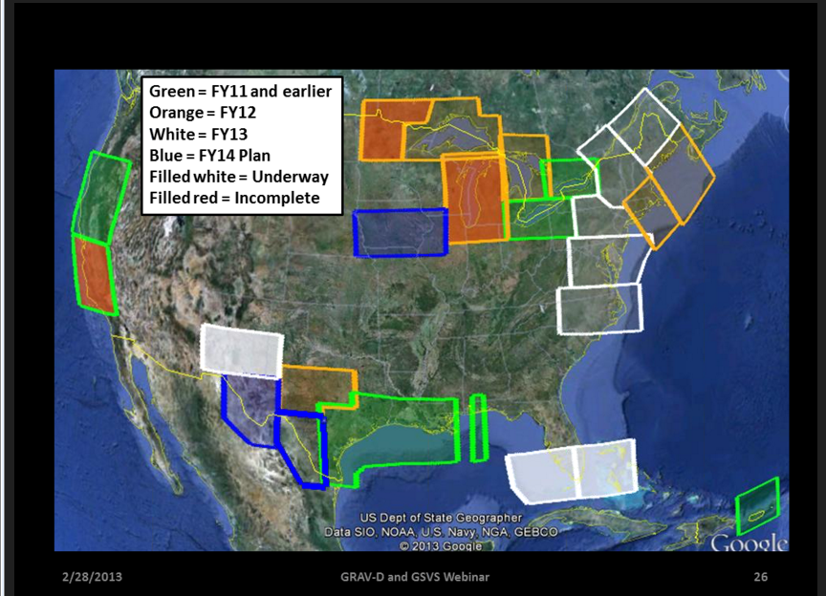
Gravity for the Redefinition of the American Vertical Datum (GRAV-D) Progress

Slide 16
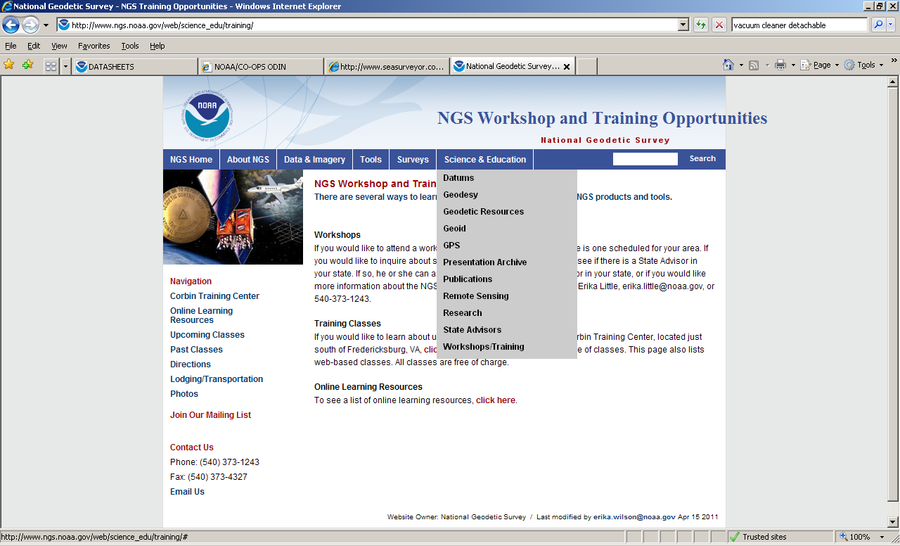
Geodesy.noaa.gov or ngs.noaa.gov

Slide 17

NGS 10-year Plan:
2013-2023
Support users of NSRS
Modernize and improve NSRS
Expand NSRS Stakeholder Base
Develop NGS Workforce
Marti Ikehara
Marti.ikehara@noaa.gov
(916) 227-7325

Slide 19

DSWorld: mapping tool and more
Need to have Google Earth installed
Tools, Download PC Software, USER-CONTRI-BUTED SOFTWARE, DSWorld
http://www.ngs.noaa.gov/PC_PROD/PARTNERS/index.shtml
FIRST: Tools, Update program
Enhancement enables you to distinguish VERTCON NAVD88 from other(control) NAVD88

