Slide 1
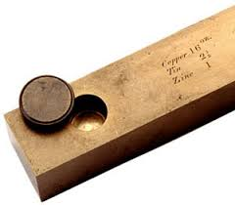
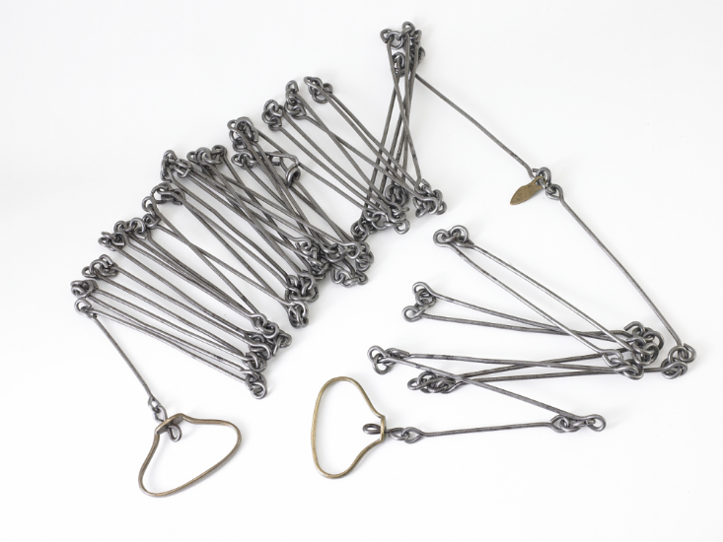
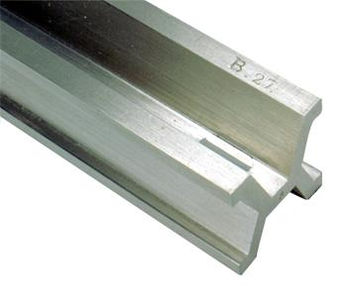
The Fate of the U.S. Survey Foot after 2022
A Conversation with NGS
Michael L. Dennis, PhD, RLS, PE
SPCS2022 Project Manager
NGS Webinar Series
April 25, 2019
Notes:
I’m a geodesist, but also a professional engineer and land surveyor (registered in Arizona). I worked in the private sector for many years, including ownership of a small surveying and consulting firm.
I gave a very similar presentation to the National Society of Professional Surveyors (NSPS) Board of Directors on April 12. It was well received, so much so that they wanted another presentation given that they could share with their members. So we expedited the preparation of this webinar.
This presentation is categorized for beginners, with the idea that it should be accessible to anyone. But it will get into a bit of surveyor esoterica.
Admittedly, a “conversation” is kind of awkward for a webinar. But NGS does want to know what you think. So please feel free to ask questions or make comments through the “chat” feature of the webinar. At the end of the webinar, I will also provide an email address (NGS.Feedback@noaa.gov) so that you can contact us about this topic at any time.

Slide 2

Putting our best “foot” forward
The Right & Lawful Rood
From geometry book of Jacob Köbel (1460-1533), 1608 edition
Notes:
Thanks to Harry Nelson of Maine DOT for making me aware of this wonderful engraving!
Shows 16 men randomly selected after church service to determine a “rood” (also known as “rod”, “perch”, or “pole”). It’s a unit that was commonly used in the past for measuring land in Europe and America.
The “rood” was determined as the length of their left feet, aligned toe to heel as they stood in a line.
Its length varied a lot, from 12 to 24 feet, depending on time and location. A rod is usually assumed to be 16.5 feet, but this is not always the case.
This is more than just a fun slide; it is important and relevant to this presentation.
The rood being determined here is specifically for the community that goes to this church. It is “their” rood.
A rood in another community (or determined at another time with other men) would most certainly be different.
It is not a national standard, not a state standard, not a county standard. It is at best a town standard, and may not even be that.
Although convenient and in some ways representative, the lack of standardization would later lead to problems. Hence this presentation…

Slide 3
The plan
More than a surveying problem: the Big Picture
Weights, measures, and the law
An epic history
Role of technology in where we are today
Choices and an NGS proposal for the future
Reasons to change (or not)
Taking a stand for standards
…plus the occasional digression…
Notes:
This is the overall plan for the webinar. Each item in the list features a specific word that is important to this presentation:
Surveying. I love surveying. It is a wonderful profession. Although it is part of this story, that is mainly because this topic mostly impacts surveyors. But there is much more to this story, as will become evident as we step back to look at the Big Picture.
Law. This story is also about the law. The law is an important part of land surveying. It is also an important part of establishing weights and measures, as will be shown.
History. Surveying and law go together, along with history. Surveying is very much about history, since boundary retracement involves research into historical documents. There is also an interesting history behind weights and measures.
Technology. Technology is also a big part of surveying, as any surveyor who has worked in the profession for very long well knows. Although boundary principles have not changed much in recent times, the tools used by surveyors have evolved tremendously, especially over the past couple of decades. Technology is also been a big part of the evolution of the standards, as our ability for ever more precise measurements continue to improve.
Standards. This is very much the topic of this story, of why standards are so vitally important to society.
Change. Although we don’t want to change just for the sake of change, sometimes change is necessary for progress. We adopt change to make the world better.
The future. Whatever is done about standardizing the foot, it will be for the future, and only the future. We cannot change the past. In the presentation I gave to NSPS on April 12, a group called The Young Surveyors Network (YSN) was present. These are the people who will inherit whatever is decided about the foot. And they have a preference, which is the same as what NGS proposes, as you will soon see.

Slide 4

The problem (and some questions)
Two versions of same unit in current use
  “New” international foot and “old” U.S. survey foot
  “New” shorter than “old” by 2 ppm (0.01 ft per mile)
  A real problem with real costs
What’s in a name?
  “U.S. survey” versus “international”
Who is using U.S. survey feet?
  Surveyors exclusively, in most (not all) states
  But it impacts everyone
What should we do?
  Begin with a conversation
Notes:
It’s likely everyone watching this webinar knows about the problem: there are two nearly identical versions of the foot in current use in the U.S.;
They differ by 2 parts per million (ppm), or only 0.01 ft per mile, or slightly more than a tenth of an inch in a mile.
Despite (or actually because of) the very small difference, it has become a REAL problem with REAL costs.
What’s in a name? That which we call a “foot” by any other word would smell as… sweet? Maybe that’s not he best analogy for the foot…
“U.S. survey foot” sounds patriotic, is surveyor-centric…
“International foot” sounds like a New World Order, UN sanctioned sort of thing, with perhaps a whiff of socialism…
Is the name really part of the problem? I hope note, but emotion does play a role. We are not entirely rational creatures after all (myself included).
Surveyors are really the only users of the U.S. survey foot (sft). They are also among the very few who even know of its existence. In schools and colleges they only teach students about the official international foot (ift). However, because people use the products created by surveyors, they end up using the sft without even knowing it.
Want to have a conversation about this, get all of us on the same page. So I will present facts to facilitate informed discussion (sprinkled with some opinions…)

Slide 5
What is this all about? The Big Picture
Science + Industry = COMMERCE
  Standards essential
  Without them we are lost
A history of change
  Not for own sake, but to make things better
  Vital component of progress
The law, and standards for weights & measures
  Taken for granted because things just “work”
  Many years of effort behind what we have today
  Legally binding and critical to functioning of society
Notes:
Let’s step away from surveying and consider the Big Picture.
This is about much more than surveying. When reading about the U.S. history of weights and measures, the words “science” and “industry” are often used together. And together they mean commerce. Business. Trade. Efficiency. Money. That’s really what this is about. All of those things are facilitated by uniform standards (and compromised without standards).
As stated earlier, change is an integral part of progress. We cannot stand still.
This is also about the law, because there is a powerful legal basis for weights and measures. We did not get here by accident.

Slide 6




Who is responsible for standards?
Today:
National Institute of Standards and Technology
Notes:
Today, the National Institute of Standards and Technology (NIST) is responsible for defining and establishing standards. It is within their authority.
NIST is a bureau of the Department of Commerce (DOC)
The National Oceanic and Atmospheric Administration (NOAA) is also a bureau of DOC.
The National Geodetic Survey (NGS) is a program office in NOAA. It’s actually within the National Ocean Service (NOS) in NOAA.
It may seem odd to show NGS here along with NIST, but there is a reason for it, as you will soon see.

Slide 7



Who is responsible for standards?
Before 1901:
U.S. Coast and Geodetic Survey
Office of Standard Weights and Measures
Superintendent of C&GS also Superintendent
of Office of Standard Weights & Measures
Notes:
Responsibility for standards was different before 1901.
In 1901, the National Bureau of Standards (NBS) was created, which later became in NIST (in 1988)
Department of Commerce was created in 1903, when NBS became part of it (initially in Department of the Treasury).
Before 1901, standards of weights and measures was handled by the U.S. Coast & Geodetic Survey (C&GS), the predecessor of NGS.
Operated under the authority of the Department of the Treasury, in the Office of Standard Weights and Measures.
Superintendent (same as “Director” today) of C&GS was also Superintendent of Weights and Measures – so that is the connection to NGS! But there is a later connection as well, which is also the reason we currently have two foot definitions.

Slide 8
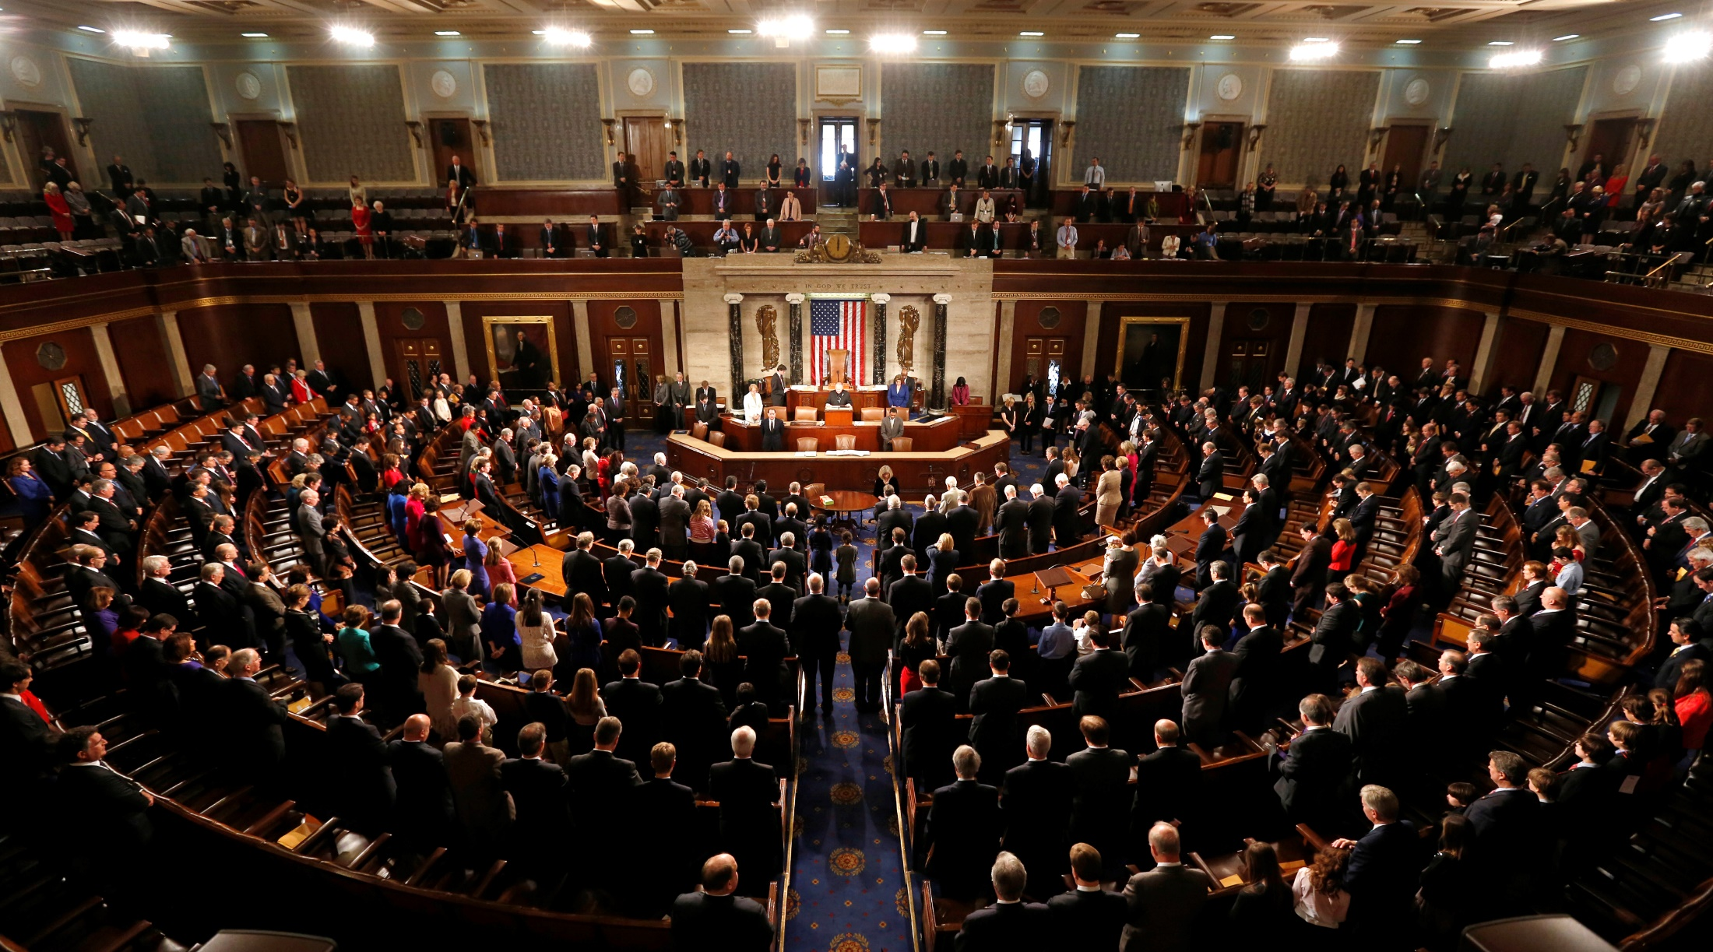
Congress is the Authority
Notes:
The ultimate authority on standards of weights and measures is the U.S. Congress.

Slide 9
Congress is the Authority
Per the U.S. Constitution
(Article I, Section 8, Clause 5)
“The Congress shall have
Power … To coin Money …
and fix the Standard
of Weights and Measures”
Why? To avoid the “toothbrush problem”
Notes:
The authority of Congress is given in the U.S. Constitution, Article I, Section 8, Clause 5.
Congress delegated its power to the Office of Weights and Measures in the Department of the Treasury.
NBS then got this authority as the successor to the Weights and Measures, and NBS became part of DOC.
Why was something like standards of weights and measures so important that it was specifically listed as a congressional power in the Constitution?
Because standards for weights and measures are tightly connected to commerce, including coining of money. We’re going to come back to this near the end of the presentation.
In short, it was to avoid the “toothbrush problem”…

Slide 10

The trouble with standards…
Without uniformity, standards are useless
Image from beyondplm.com
Notes:
It does not good to have a bunch of conflicting standards. That’s the same as having no standards at all.

Slide 11

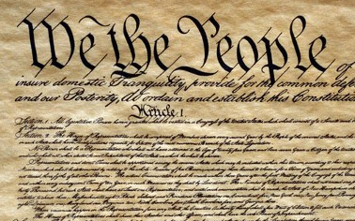


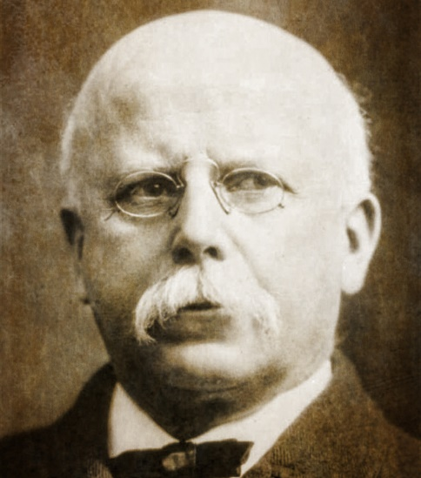
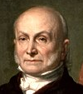
An epic tale and impressive cast
George Washington
Surveyors
Ferdinand Hassler
Thomas Jefferson
Thomas Mendenhall
John Quincy Adams
Notes:
The story of standards in the U.S. is an epic tale with an impressive cast of characters, some of who are very famous. Three are presidents:
George Washington, our first president, who was a surveyor
Thomas Jefferson, our third president, who was also a surveyor, and the founder of NGS (as the Survey of the Coast) in 1807.
John Quincy Adams, our sixth president. He was not a surveyor, but made a major contribution to standards. He was also the only president who had an alligator as a pet, in the White House (sadly, this fun “fact” is probably not true…)
Two other members of the cast are not as famous, at least outside NGS (both are also surveyors):
Ferdinand Hassler, first Superintendent of the C&GS, from 1807-1843 (although not continuously for that whole time, since all work was suspended when C&GS moved to Navy from 1818-1832).
Thomas Mendenhall, Superintendent of C&GS from 1889-1894. Not as well known as Hassler, but his importance in this story will soon become clear.
The last member of the cast is not really a “character”, but is a vital part of the story: the U.S. Constitution.

Slide 12
Weights & Measures: the early years
“Weights and Measures may be ranked among the necessaries of life to every individual of human society.”
Washington:
First messages to Congress
Articles of Confederation
1781
1789
1790
1821
U.S. Constitution
Jefferson: Proposes a decimal system
Adams:
Report on Weights and Measures
Article I, Section 8, Clause 5
Congress to “…fix Standard of Weights and Measures”
Notes:
1781. Articles of Confederation, Article 9, Paragraph 4, granting to Congress the “sole and exclusive right and power of…fixing the standard of weights and measures throughout the united states.”
1789. U.S. Constitution, Article I, Section 8, Clause 5, “The Congress shall have Power…To regulate Commerce…among the several States…To…fix the Standard of Weights and Measures.”
1790. Washington’s first message to Congress, January, 1790: “Uniformity in the currency, weights, and measures of the United States, is an object of great importance, and will, I am persuaded, be duly attended to.” Then again in December 1790, and yet again in 1791.
1790. Thomas Jefferson (then Secretary of State) submitted report on uniformity of weights and measures at request of House of Representatives. Consisted of two plans. The first plan retained the current system, but standardized. The second plan recommended use of a decimal system, which was also recommended by a Senate committee in 1792.
1821. John Quincy Adams (then Secretary of State), as instructed by the Senate, delivered a comprehensive report in standardized weights and measures. This was done in response to president Madison reminding Congress in 1816 that no laws on standardizing weights and measures had been enacted. The report was influential for later developments in standardization.

Slide 13

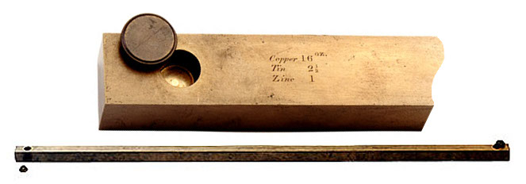
Hassler and the Empire
0.000 073 foot (0.022 mm) shorter than Troughton scale (24 ppm)
Congress Joint Resolution for uniform standards
Brings Troughton scale from England
Submits report
to Congress
1815
1830
1832
1834
1836
1855
“Exact” copy of British Imperial Yard
Directed to resolve weight and measure issues
In England: British Imperial Yard destroyed in a fire!
New Imperial Yard made: U.S. receives
2 copies
Bronze Yard No. 11 becomes official U.S. standard
Notes:
Ferdinand Hassler, first Superintendent of C&GS (1807-1843). All efforts were to make weights and measures consistent with the British Imperial system.
1815. Brings “Troughton Bar” from England (having been detained in Europe due to the War of 1812). That did not solve the problems, though. Still many people on different places in U.S. using different standards
1830. Secretary of the Treasury directs Hassler to resolve issues with weights and measures.
1832. Submits report to Congress. Resulted in adoption of uniform standards.
1836. Congress issues joint resolution for uniform standards, and directed Treasury to furnish state customhouses with a complete set of weights and measures. This is the first direct congressional action to create uniform standards for the U.S.
Now need to go backward in time a bit, by two years:
1834. Tragedy struck: House of Parliament in England burned down, irreparably damaging the official Imperial Yard, the basis for length throughout the Empire!
1855. A new Imperial yard was created and two copies were sent to the U.S.
Bronze Bar No. 11 was one of the copies that become the U.S. standard. It was square cross section was a "line standard"; when the bar was at 62° F the yard was defined by the distance between two fine lines ruled on gold "plugs" which were set into recesses in the ends of the bar to protect them. Protective caps fit in the holes. The reason for recessing the defining lines in holes in the bar is to locate them on the bar's "neutral plane", its axis of symmetry, where length error due to sag of the bar under its own weight is minimum.
Bronze Bar No. 11 was found to be 0.022 mm shorter than the previous standard, the Troughton scale (note that a human hair is on average about 0.1 mm in diameter).

Slide 14

Going metric, in fits and starts
Different length!
Congress legalizes use of metric system
Bronze Yard
No. 11 travels
to England
Standard Meters Nos. 21 and 27 sent from France
1866
1875
1876
1888
1890
U.S. Signs
“Treaty of the Meter”
Bronze Yard No. 11 travels to England, again
Different length - again!
Notes:
The start of the metric era:
1866. Congress legalized use of the metric system for commerce in the U.S. Included 4 conversion tables of metric to existing (nominally British Imperial).
1875. U.S. signs “Treaty of the Meter” or “Metric Convention”, along with 16 other nations, to establish an international bureau of weights and measures (ratified in 1878).
1876 and 1888. Bronze Yard No. 11 transported to England, and in both cases did not agree in length, and by different amounts. Could not be determined with the U.S. or British yards had changed in length. All were considered unstable.
1890. Copies of the international meter were made, with none being the “official” version. Bars no. 21 and 27 were randomly selected and shipped to the U.S.
Chaos: Two separate standards of length existed, one based on the British Imperial yard (as represented by Bronze Bar No. 11), the other as represented by Standard Meters Nos. 21 and 27, 90% platinum, 10% iridium, far superior in construction to the bronze bar (accurate to about 0.0001-0.0002 mm). They disagree at levels that are measurable. What can be done to remedy this problem?
As a related aside, the basis for defining the meter was later refined a few times. The last was in 1983, when it was defined as the distance light travels in a vacuum in 1/299,792,458 of a second. This basis is considered measurable to ab accuracy of 0.1 nm (0.000 0001 mm). That’s 1000-2000 times more accurate than Standard Meters Nos. 21 and 27, and this basis is unlikely to change again anytime soon.

Slide 15


Out of chaos, order
1893
The Mendenhall Order
Thomas Mendenhall
Superintendent C&GS and Office of Weights & Measures (1889-1894)
Embraced meter
Abandoned British Imperial Yard
Declared foot defined by meter:
1 foot = 1200/3937 meter
Provided tables of conversions
e.g., Gunter’s chain = 20.1168 m
66 ift EXACTLY
65.999868 sft
The U.S. officially became metric
Notes:
The Mendenhall Order (1893): When the U.S. officially became metric.
Officially adopted meter as basis of length, where 1 foot = 1200/3937 meter (per 1866 act of Congress), and with meter represented by Meter Bars No. 21 and 27.
Completely abandoned British Imperial Yard as basis for length (as represented by Bronze Bar No. 11).
Declared in Appendix 6 of C&GS Bulletin No. 26, including conversion tables.
Interesting to note that conversion showed 1 Gunter’s chain = 20.1168 m
That is EXACTLY 66 ift (vs. 65.999868 sft)
This is just a coincidence due to rounding, but it shows that for the precision of the chain, the distinction between the ift and sft is immaterial…

Slide 16

Gunter’s chain and retracement
Invented by Edmund Gunter in 1620
  66 ft long with 100 links… usually
  Distances mostly given in whole links
“Chained” to the U.S. survey foot?
  “Foot” varied in length by much
  more than ±2 ppm before 1893
  Not built to ±2 ppm accuracy
  (±0.000132 ft = 0.0016 inch)
    That’s 0.0002 link per chain
    or 0.016 link per mile
Notes:
Let’s talk about Gunter’s chain and retracement of boundary surveys in the context of sft vs. ift.
Invented in 1620, long before the sft definition was recognized (as 1 ft = 1200/3937 m), and even before the meter was defined (in 1798).
Each link 0.66 ft = 7.92 inches long; most measurements given to nearest whole link.
No meaningful connection between Gunter’s chain and sft, at the 2 ppm level
Foot definition varied by much more than 2 ppm before 1893
Setting 1 chain exactly equal to 66 sft is arbitrary; could just as readily be 66 ift (as shown in Mendenhall Order).
Chains not constructed to 2 ppm accuracy, not even close.
Even if constructed to 2 ppm accuracy, they could not be used in the field to anywhere near that accuracy.
Bottom line: it is not possible to perform a survey to 2 ppm accuracy with a Gunter’s chain. Even with modern technology and the most exacting methods, it would be extremely difficult to achieve that accuracy for a boundary survey.

Slide 17
A new foot for a new century
1 foot = 0.3048 meter exactly (1 yard = 0.9144 m)
New foot definition adopted by NASA predecessor
National Bureau of Standards created
Adopted as “new” foot for entire U.S.
1901
1933
1952
1954
1959
With one little exception…
New foot definition adopted by ANSI predecessor
International nautical mile
1,852 m exact
Notes:
With increasing measurement precision and global trade, it became necessary to adopt a more precise definition of the foot, and one that agreed with international usage.
A motivation for a new definition of the foot was in gage-block standardization for precise machine shop work used by industry. It was a practical solution to a practical problem. Note this has nothing whatsoever to do with surveying.
The new (international) foot definition was 1 ft = 0.3048 m (exact), and is the same to this day (it will not change). The adoption of the ift was a gradual process (as such things often are):
1933. Adopted by American Standards Association, now American National Standards Institute (ANSI).
1952. Adopted by National Advisory Committee for Aeronautics, now National Aeronautics and Space Administration (NASA).
1954. Adopted International Nautical Mile as exactly 1852 m. This is not related specifically to ift, but shows overall move toward adopting “exact” (non-ratio) relationships to the meter.
1959. NSB officially adopts ift for the entire U.S., with one little notable exception…

Slide 18
Kicking the can (Federal Register)
1959
“Any data expressed in feet derived from and published as a result of geodetic surveys within the United States will continue to bear the following relationship as defined in 1893:
1 foot = 1200/3937 meter
The foot unit defined by this equation shall be referred to as the U.S. Survey Foot and it shall continue to be used, for the purpose given herein, until such a time as it becomes desirable and expedient to readjust the basic geodetic survey networks in the United States, after which the ratio of a yard, equal to 0.9144 meter, shall apply.”
https://geodesy.noaa.gov/PUBS_LIB/FedRegister/FRdoc59-5442.pdf
Signed by NBS and C&GS directors, approved by Secretary of Commerce, June 25, 1959
Notes:
Federal Register Notice (1959) establishing ift and (temporary) sft
Official adoption of ift (1 ft = 0.3048 m) nationwide.
Temporary exception granted for geodetic surveys (including State Plane coordinates), to accommodate C&GS.
Mandates that ift shall be adopted after readjustment of U.S. geodetic network. This is not a “recommendation” or a “suggestion.” At the time this was published, “shall” was used in legal documents as mandatory (nowadays the usage of “shall” as mandatory is discouraged in legal documents).
Co-issued and signed by NBS and C&GS directors.
This FRN delayed full adoption of the ift, and promoted continued use of the sft for all surveying (not just geodetic surveys), and it is how we got into the situation we are in today.

Slide 19
More Federal Register Notices
Surveying and mapping only (pending analysis, never resolved)
Proposed permanent use of U.S. Survey Foot
Restatement that metric used for U.S.
International vs. U.S. Survey Foot
1975
1977
1988
1989
1990
NGS goes entirely metric (for NAD 83)
NAD 83 announced
International foot used for “engineering”
U.S. survey foot used for “mapping and land measurement”
Notes:
Other FRNs relevant to the ift vs. sft issue:
1975. Distinguishes between ift and sft, and gives both an exact (1200/3937 m) and approximate (0.304 800 61 m) definition of the sft. It states that the ift is used for “engineering” and the sft is used for “mapping and land measurement”, which by itself creates problems (since engineering and surveying are often done together for projects, so which should be used?). It also provides a clarification that the metric equivalents given in a previous (1968) FRN are approximate for lengths based on the sft. It gives an example of the U.S. survey mile = 1.609 347 km approximately, and the international mile = 1.609 344 km exactly.
1977. NGS policy on publication of plane coordinates based on NAD 83, stating that NGS will officially adopt the metric system. This effectively (but probably inadvertently) allowed NGS to side step the requirement of ending use of the sft, as required in the 1959 FRN.
1988. Proposal by NBS and NOAA/NGS to permanently retain U.S. survey foot for all surveying and mapping, pending analysis of public comment. It appears such a decision was never made.
1989. NGS announces adoption of NAD 83, with reference to publication of plane coordinates in 1977 FRN (and use of the metric system).
1990. A major FRN issued by NIST to reaffirm use and interpretation of the metric system (SI) in the U.S., partly in response to federal legislation on the metric system since the previous NIST FRN on this topic in 1982. Includes tables and descriptions that define the SI in the U.S. Does NOT include conversions between SI and U.S. customary units.
NOTE: In the webinar, I inadvertently mischaracterized the 1975 FR as saying the ift was “exact” and the sft was “approximate.” What that FRN actually says is that conversions in a previous (1968) FRN were only for the ift, and were therefore approximate for sft conversions. The 1975 FRN provides the exact sft conversions as a correction/clarification to the 1968 FRN. My apologies for any confusion this may have caused.

Slide 20
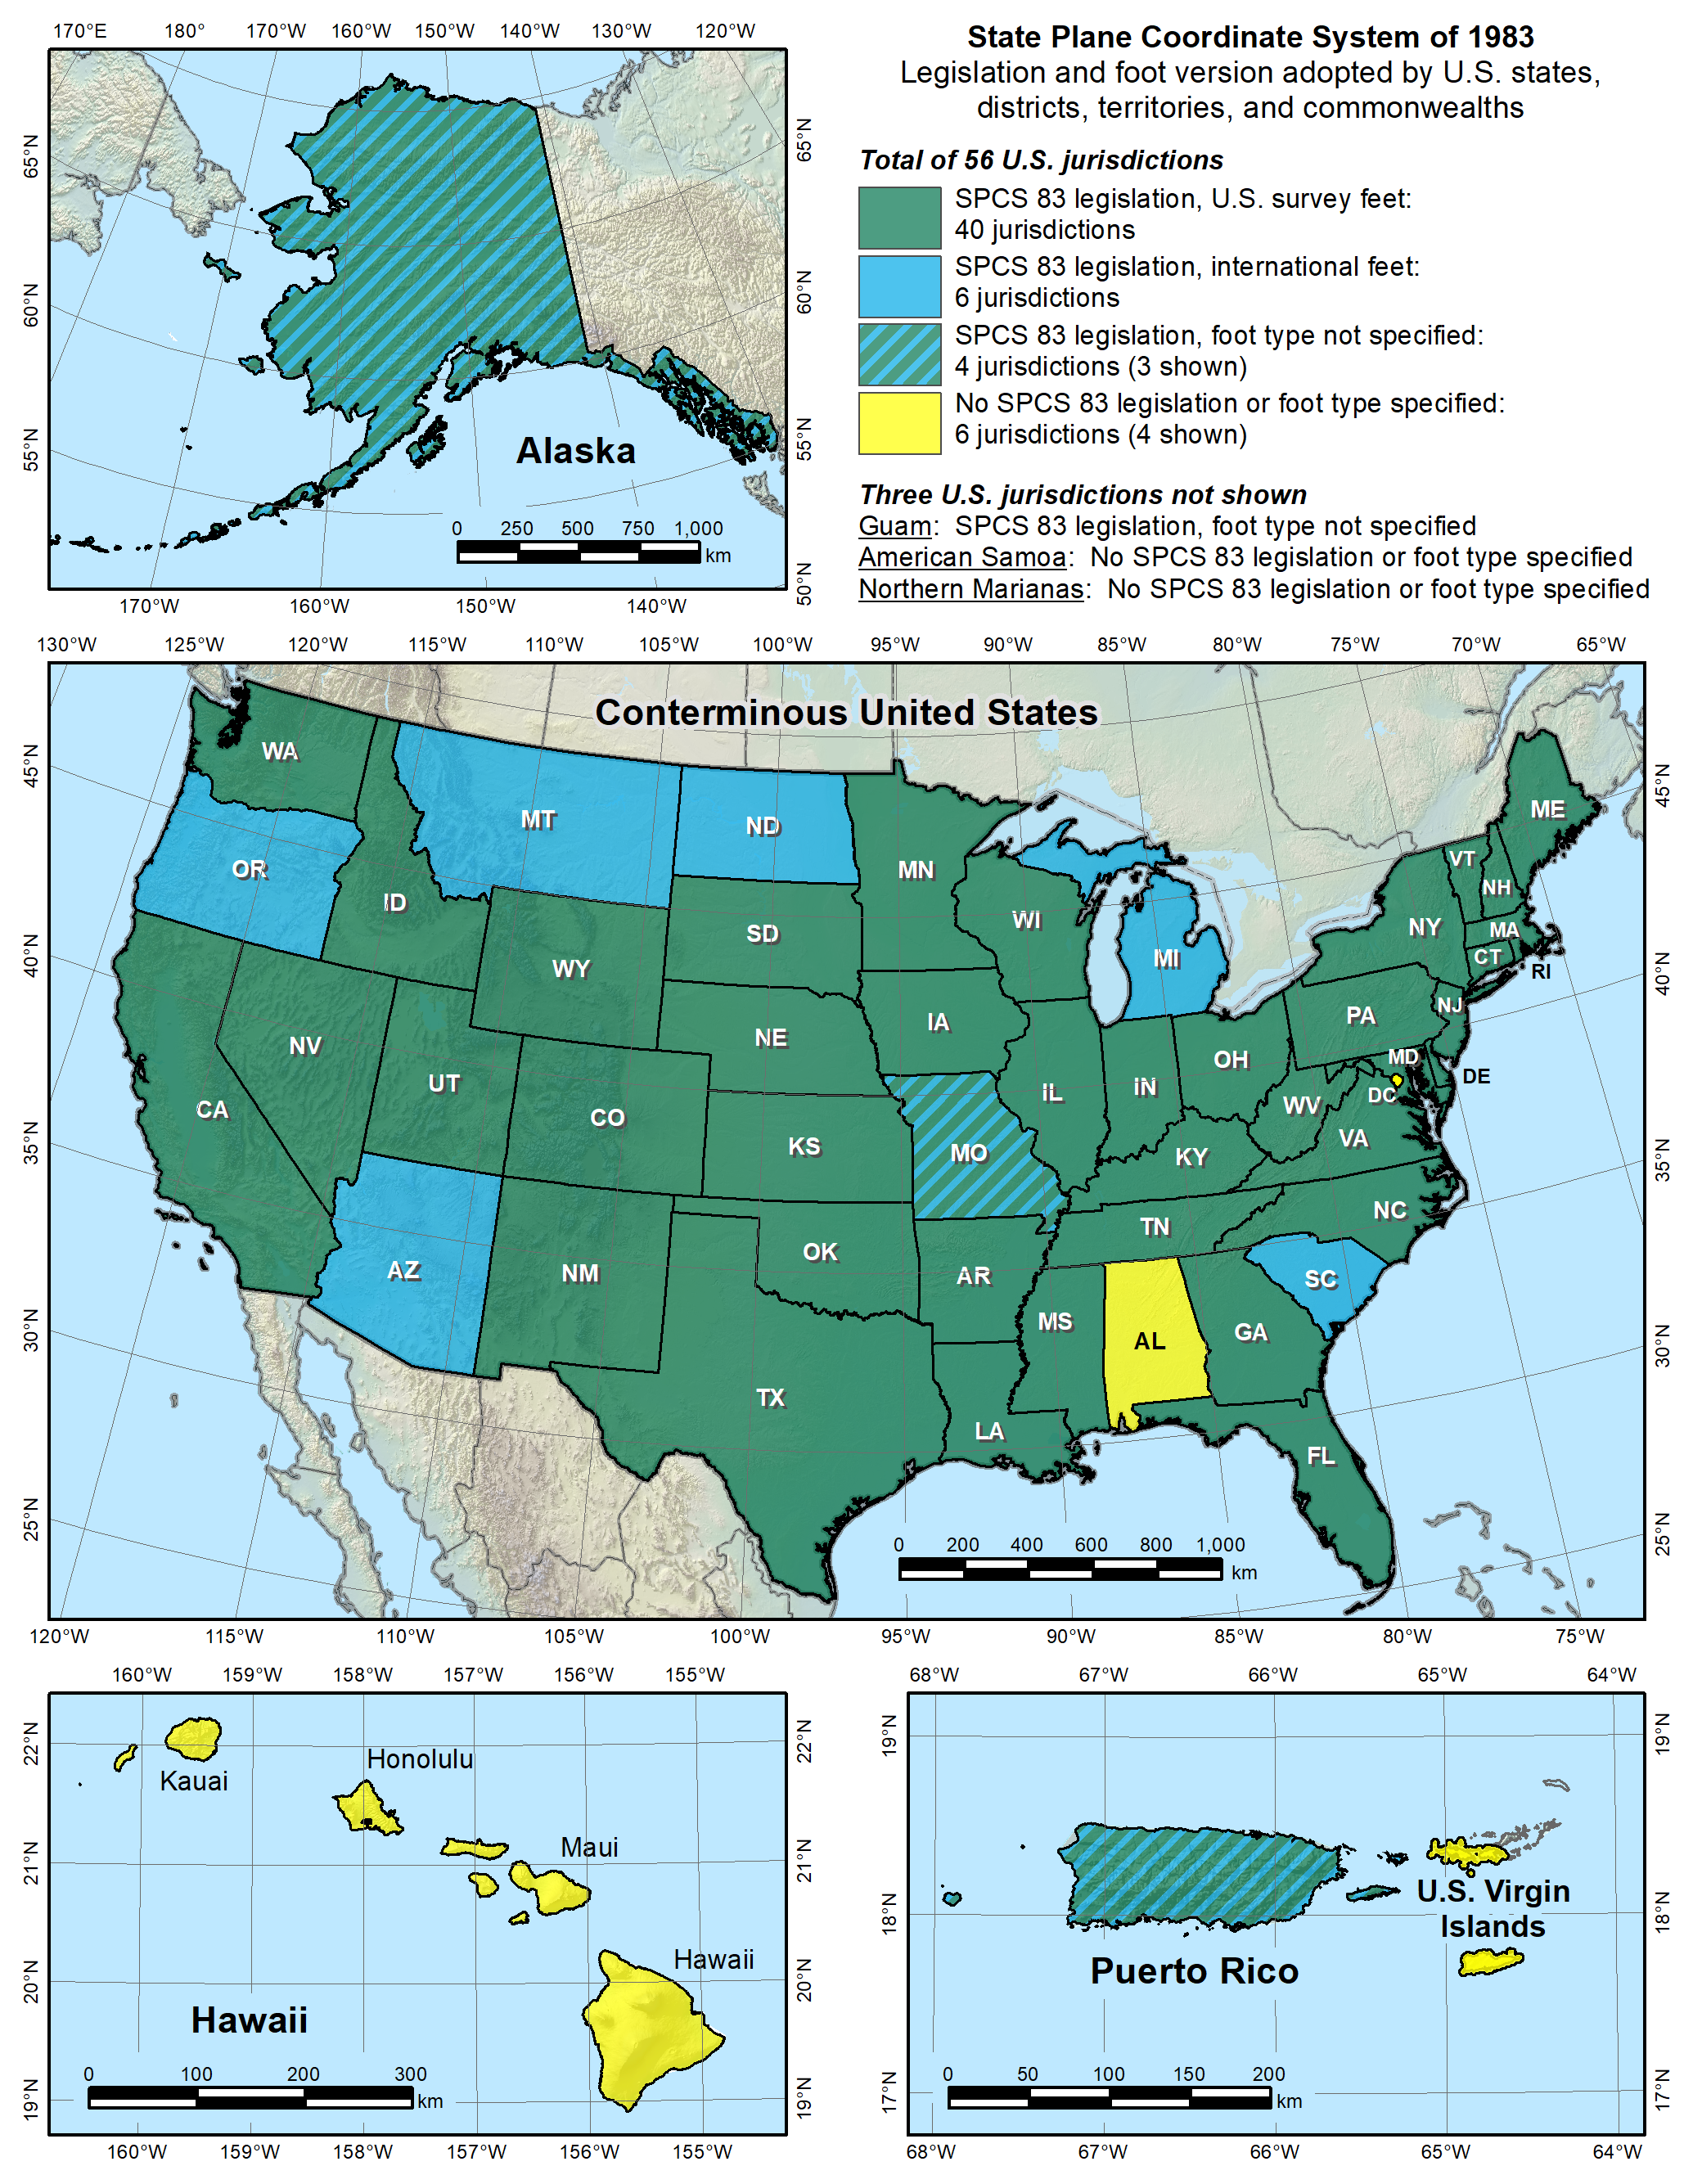


Notes:
Despite the mandate of the 1959 FRN, and the change to a new datum in 1986, NGS allowed states to choose whether they want State Plane coordinates in feet, including which type of foot.
Over time various states have taken actions to select the foot they want to use. Of the 40 states that have selected the sft, 28 have done so in statute, and 12 have done so by working with NGS to issue an FRN (the latest being in 2009, for Utah). So the situation with the 40 “green” states is more complicated than it appears.
Simply put, this is again chaos, just as it was before the Mendenhall Order of 1893. This is exactly the type of situation our five heroes wanted to avoid, having different standards of measure for different parts of the U.S. It is far worse than this map indicates, since jurisdictions within a state use a different foot than on this map. For example, Hawaii shows no foot selection (not even SPCS 83 legislation), yet it uses sft for most areas but ift on military bases. Arizona is shown as an ift state, yet the National Park Service uses sft within Arizona. It is a complete mess. There is no way for me to know for sure, but it is my opinion that our heroes would be spinning in their graves if they saw this.
Addendum: Some surveyors look at the CONUS map and ask why NGS is proposing the ift rather than the sft, since more states have officially selected the sft for SPCS 83 (40 vs. 6). It seems a reasonable question, but it is flawed, for the following reasons:
Minority vs. majority. This is not an issue of a minority overruling a majority. Although most states have adopted the sft (for SPCS 83), it’s important to recognize that surveying and mapping represents only a tiny fraction of overall economic activity in the U.S. Other major parts of the U.S. economy make use of the ift. For example, one of the reasons the ift was adopted in 1959 was for standardizing gauge blocks (the primary means of length standardization used by industry). So surveying is actually a small part of this issue. Because of that, there is essentially no chance that NIST will go back to the sft definition for the entire U.S. If there is going to be one foot, it will certainly be 1 ft = 0.3048 m (exact).
Uniformity. For standards to be useful, they must be uniform. That is why Congress is empowered by the U.S. Constitution to establish standards of weights and measures. Having two concurrent nearly identical definitions of the foot is inconsistent with the very idea of standards. And it is bad for business (i.e., commerce). Keeping the sft for surveying and mapping while using the ift for everything else would perpetuate the inconsistency.
Original intent. In the 1959 FRN that announced nationwide adoption of the ift, the previous foot was named the sft with the intent that it be temporary. It was an accommodation by NBS to C&GS, exclusively for geodetic work. The 1959 FRN mandated that the ift be adopted after readjustment of the U.S. geodetic networks. That occurred in 1986 with the change from NAD 27 to NAD 83. So use of the sft was supposed to end at that time, but it did not. It appears the main reason is that NGS side-stepped the issue by going metric in 1977, perhaps in the hope that the entire nation would go metric. Instead the “temporary” sft became embedded as part of how SPCS 83 is used (but not in how SPCS 83 is defined – the definitions for every zone are metric).
SPCS 83 vs. SPCS2022. In those states where the sft is specified (by state statute or FRN), it is associated with SPCS 83. Such specifications will not apply for SPCS2022. A state could legislate sft for SPCS2022, but if NIST mandates use of the ift, that would likely override state statute, per the U.S. Constitution.
Authority. Only NIST has the authority to deprecate the sft, not NGS. In the end, the fate of the sft will be up to NIST. The reason NGS is involved is that the existence of the sft is due entirely to NIST accommodating NGS in 1959. Because of that, NGS bears responsibility in trying to resolve the issue, as we should have done in 1986, and NGS will work with NIST to that end. If the decision is to deprecate the sft after 2022, it will be announced in an FRN, and NGS will also take other steps to inform our customers. But NGS will continue to support the sft for legacy applications in SPCS 83 and 27 in our products and services.

Slide 21
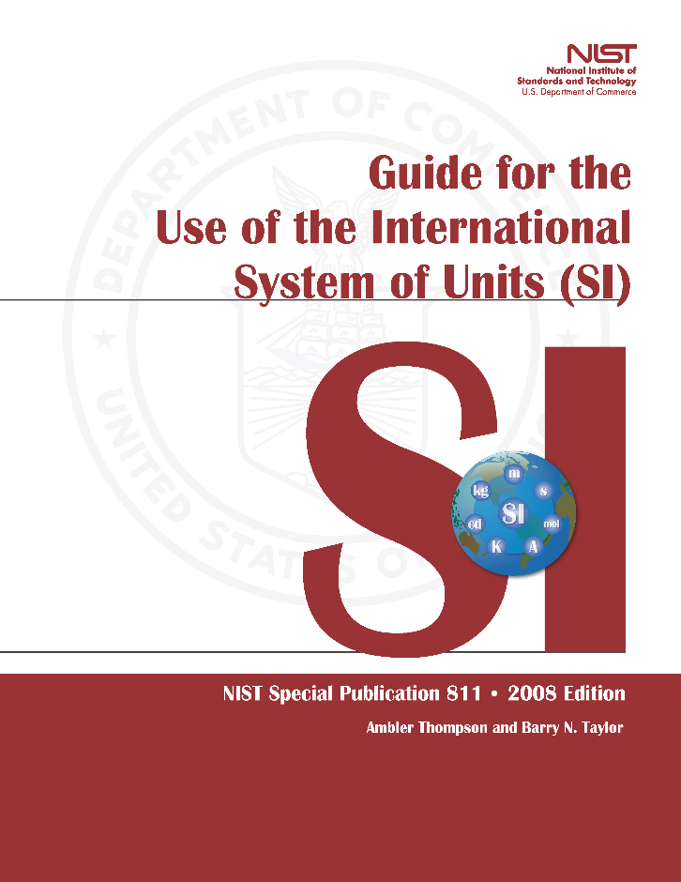
Out of order, chaos
A foot still in limbo
2008. NIST “Guide to the
Use of the SI”
U.S. survey foot still used
  but never officially permanently adopted
Repeats 1975 FRN ideas
about the two feet:
  International ft used for engineering
  U.S. ft used for surveying & mapping
At odds with very idea of “standards”
Notes:
After nearly 100 years of relative order in standards of measure (from the Mendenhall Order of 1893 to release of NAD 83 in 1986), a new chaotic situation was created by perpetuating the sft.
Despite a misguided effort in the 1988 FRN to make the sft “official”, it is still an unofficial nominally “temporary” unit, stuck in standards “limbo”
Latest NIST publication that discusses this (2008) notes that sft is still used, even though it has not been officially and permanently adopted.
Saying that ift is used for engineering and sft for surveying and mapping is absurd. The two are not mutually exclusive. Surveying is almost always a part of civil engineering projects.

Slide 22
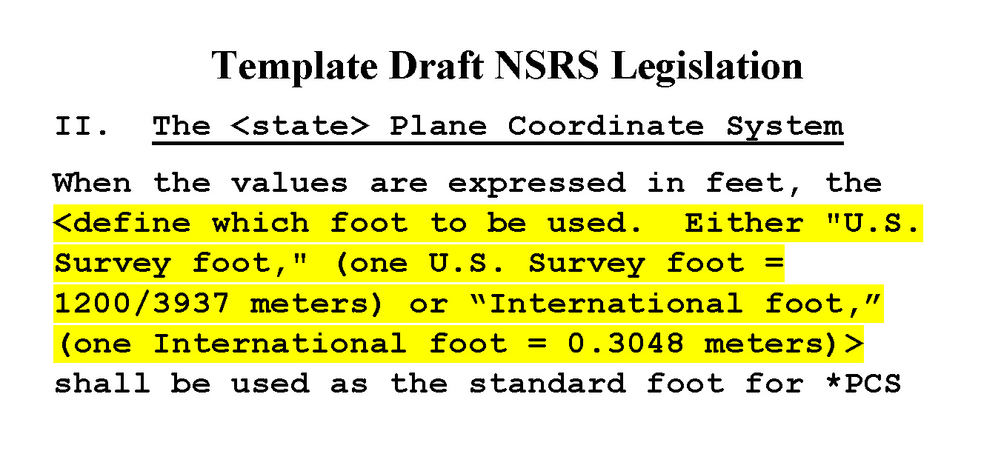
Mea culpa
Problem created and perpetuated by NGS
In 1959. Then in 1986. And again in 2016…
Notes:
NGS must take the bulk of responsibility for this situation.
NBS (NIST) accommodated us in 1959. Yes, NIST allowed it, but it was at the behest of NGS.
NGS perpetuated the problem by avoiding the required remedy in 1986.
We just recently perpetuated it again, in 2016, when we helped write template draft NSRS (National Spatial Reference System) legislation or “model law.”
Done cooperatively with NSPS and AAGS (American Association for Geodetic Surveying)
Explicitly allows selection of ift or sft for those states that want SPCS coordinates in feet.
This was a mistake. NGS went along with this mechanically because we had become inured to the absurd existence of dual feet. The idea of getting rid of the sft did not even occur to us at the time this draft legislation was prepared. Now we want to fix the problem we created.

Slide 23
Epilogue for an erstwhile foot?
The “old” foot defined in 1893 (actually 1866)
Foot officially redefined in 1959
  Old one named “U.S. survey foot” at that time
  Intended as temporary solution
  Supposed to switch to new foot with readjustment of “basic geodetic survey networks”
Kicked can down road in 1959, again in 1986
  Not done for NAD 27 → NAD 83 in 1986
  NGS sidestepped issue by going metric in 1977
What do we do now?
  Another chance with NAD 83 → NSRS2022
Notes:
We’ve come to the end of the epic tale on how the mighty U.S. ended up with two concurrently defined feet. This is a summary of where we are. The question is what do we do now? We missed out in the change from NAD 27 to NAD 83. But we now have another chance, in the switch from NAD 83 to the new 2022 Terrestrial Reference Frames (TRFs), collectively called “NSRS2022” for convenience.

Slide 24
What are the choices?
Do nothing (i.e., NGS stays “metric” only)
  States choose whatever foot they want
  The feet will creep back into NGS products & services
Officially adopt U.S. survey foot for specific things
  U.S. survey foot for surveying and mapping
  International foot for engineering (and everything else)
Use international foot for everything
  Support only foot = 0.3048 meter after 2022, period
Use U.S. survey foot for everything (highly unlikely)
Go entirely metric (good luck with that!)
Notes:
There are five options for moving forward:
Do nothing. This one is interesting, because a number of people have recently proposed a solution where NGS just goes metric, and every state uses whatever foot they want. What they don’t seem to realize is that is exactly what we are doing now! NGS went metric in 1977. But customers wanted to get coordinates in feet, so we provided them. Which meant we had to make sure and give them the type of foot they wanted (even though some locations within sates use a different foot than other parts of states, as mentioned previously). The same thing would most definitely happen again for SPCS2022 if we tried to only give metric coordinates. So the situation would be exactly the same as now.
Officially adopt U.S. survey foot for specific things. This was what was proposed in the 1988 FRN. It would formally perpetuate a dual foot system in the U.S., making it even more entrenched. We would be stuck with a dual foot anti-standard.
Use international foot for everything. This is what NGS proposes. Only one foot after 2022, with same definition as ift. It is the only viable means of using a single foot definition for future work. Legacy work will always use appropriate units (of which there are many types).
Use U.S. survey foot for everything. As discussed previously, this is extremely unlikely, so much so that it’s safe to say it is impossible. The ift is simply too well established in a vast majority of the economy. Surveying is a tiny minority, so it is not reasonable to expect the sft to prevail, even if the sft is used for surveying in most states.
Go entirely metric. This is my personal very strong preference! This is also the preference of most (all?) people at NGS and NIST. But alas it appears much too big a lift for NGS, and even for NIST at this time. Maybe some day in the not-too-distance future (but remember what happened when we tried to go metric in the late 70s). At least SPCS2022 parameters will all be defined in meters! On a positive note, of the people who have provided feedback so far on this topic, more are in favor of going metric than are of keeping the sft (although a large majority opted for the ift).

Slide 25
An NGS proposal
Only one foot after 2022 (1 foot = 0.3048 meter)
  Make official through NIST
  NO option for U.S. survey foot
NGS will help with the transition
  Will fully support backward compatibility
  Use “correct” foot for SPCS 83 and SPCS 27
  Automatically done by NGS products and services
Guiding ideas
  Best opportunity to make the change
  Of all changes in 2022, this is the least significant
  Will make things better
  About the future, not the past
Notes:
NGS proposes that there be only ONE official definition of the foot after 2022, and if done will be accomplished through NIST.
Considering getting rid of word “international”, and just call it the “foot” (that is how it is handled in some software, such Esri’s). People just seem to not like the “international” label. Maybe call if the “American freedom foot.” But seriously, dropping a descriptor solidifies the idea that there is only one foot in the U.S. Keeping the descriptor implies there is more than one foot.
Have NO option for sft after 2022. It will only be used for the past (legacy applications).
NGS will help!
We will try to make the change as simple and painless as possible.
Our products and services will automatically support backward compatibility.
Idea here is that we are trying to make things better by fixing a long-standing problem for the future (not the past). Yes, there will be some difficulties. But at least they will diminish over time. If we do nothing, these problems will never go away.
If you think changing from sft to ift is a big problem, then perhaps you don’t quite understand the other changes that are coming in 2022:
The change from sft to ift is really just a small (2 ppm) scale change. That is smaller than the change in scale for SPCS2022 zones, and that is only PART of the change that will occur for State Plane.
Coordinates in NSRS2022 will change with time. In fact, the entire frame will be time-dependent. Assumptions about control coordinates never changing will have to be abandoned.
The “vertical” datum will be replaced with a geopotential datum based on a gravimetric geoid (rather than leveling). This, too, will have a time-dependent component.
There will be changes in how GNSS, leveling, and total station survey surveys are performed, reduced, processed, and adjusted.
By comparison, the change from sft to ift is so miniscule that it is well within the noise of the other changes.
In short, if you think the change in foot definition is too difficult, then its hard to see how you could deal with these other much larger and vastly more complex changes.

Slide 26
Why make the change?
That was original intent (60 years ago!)
Two “feet” is inefficient and causes confusion
  Leads to errors that cost money
  Absurd to have “same” unit that differs by 2 ppm
  Defeats purpose of having a length standard
Notes:
But why make the change? There are several good reasons:
That was what was originally intended when the sft was named, 60 years ago!
It causes real problems that cost real money, through confusion, errors, and just plain old inefficiencies.

Slide 27
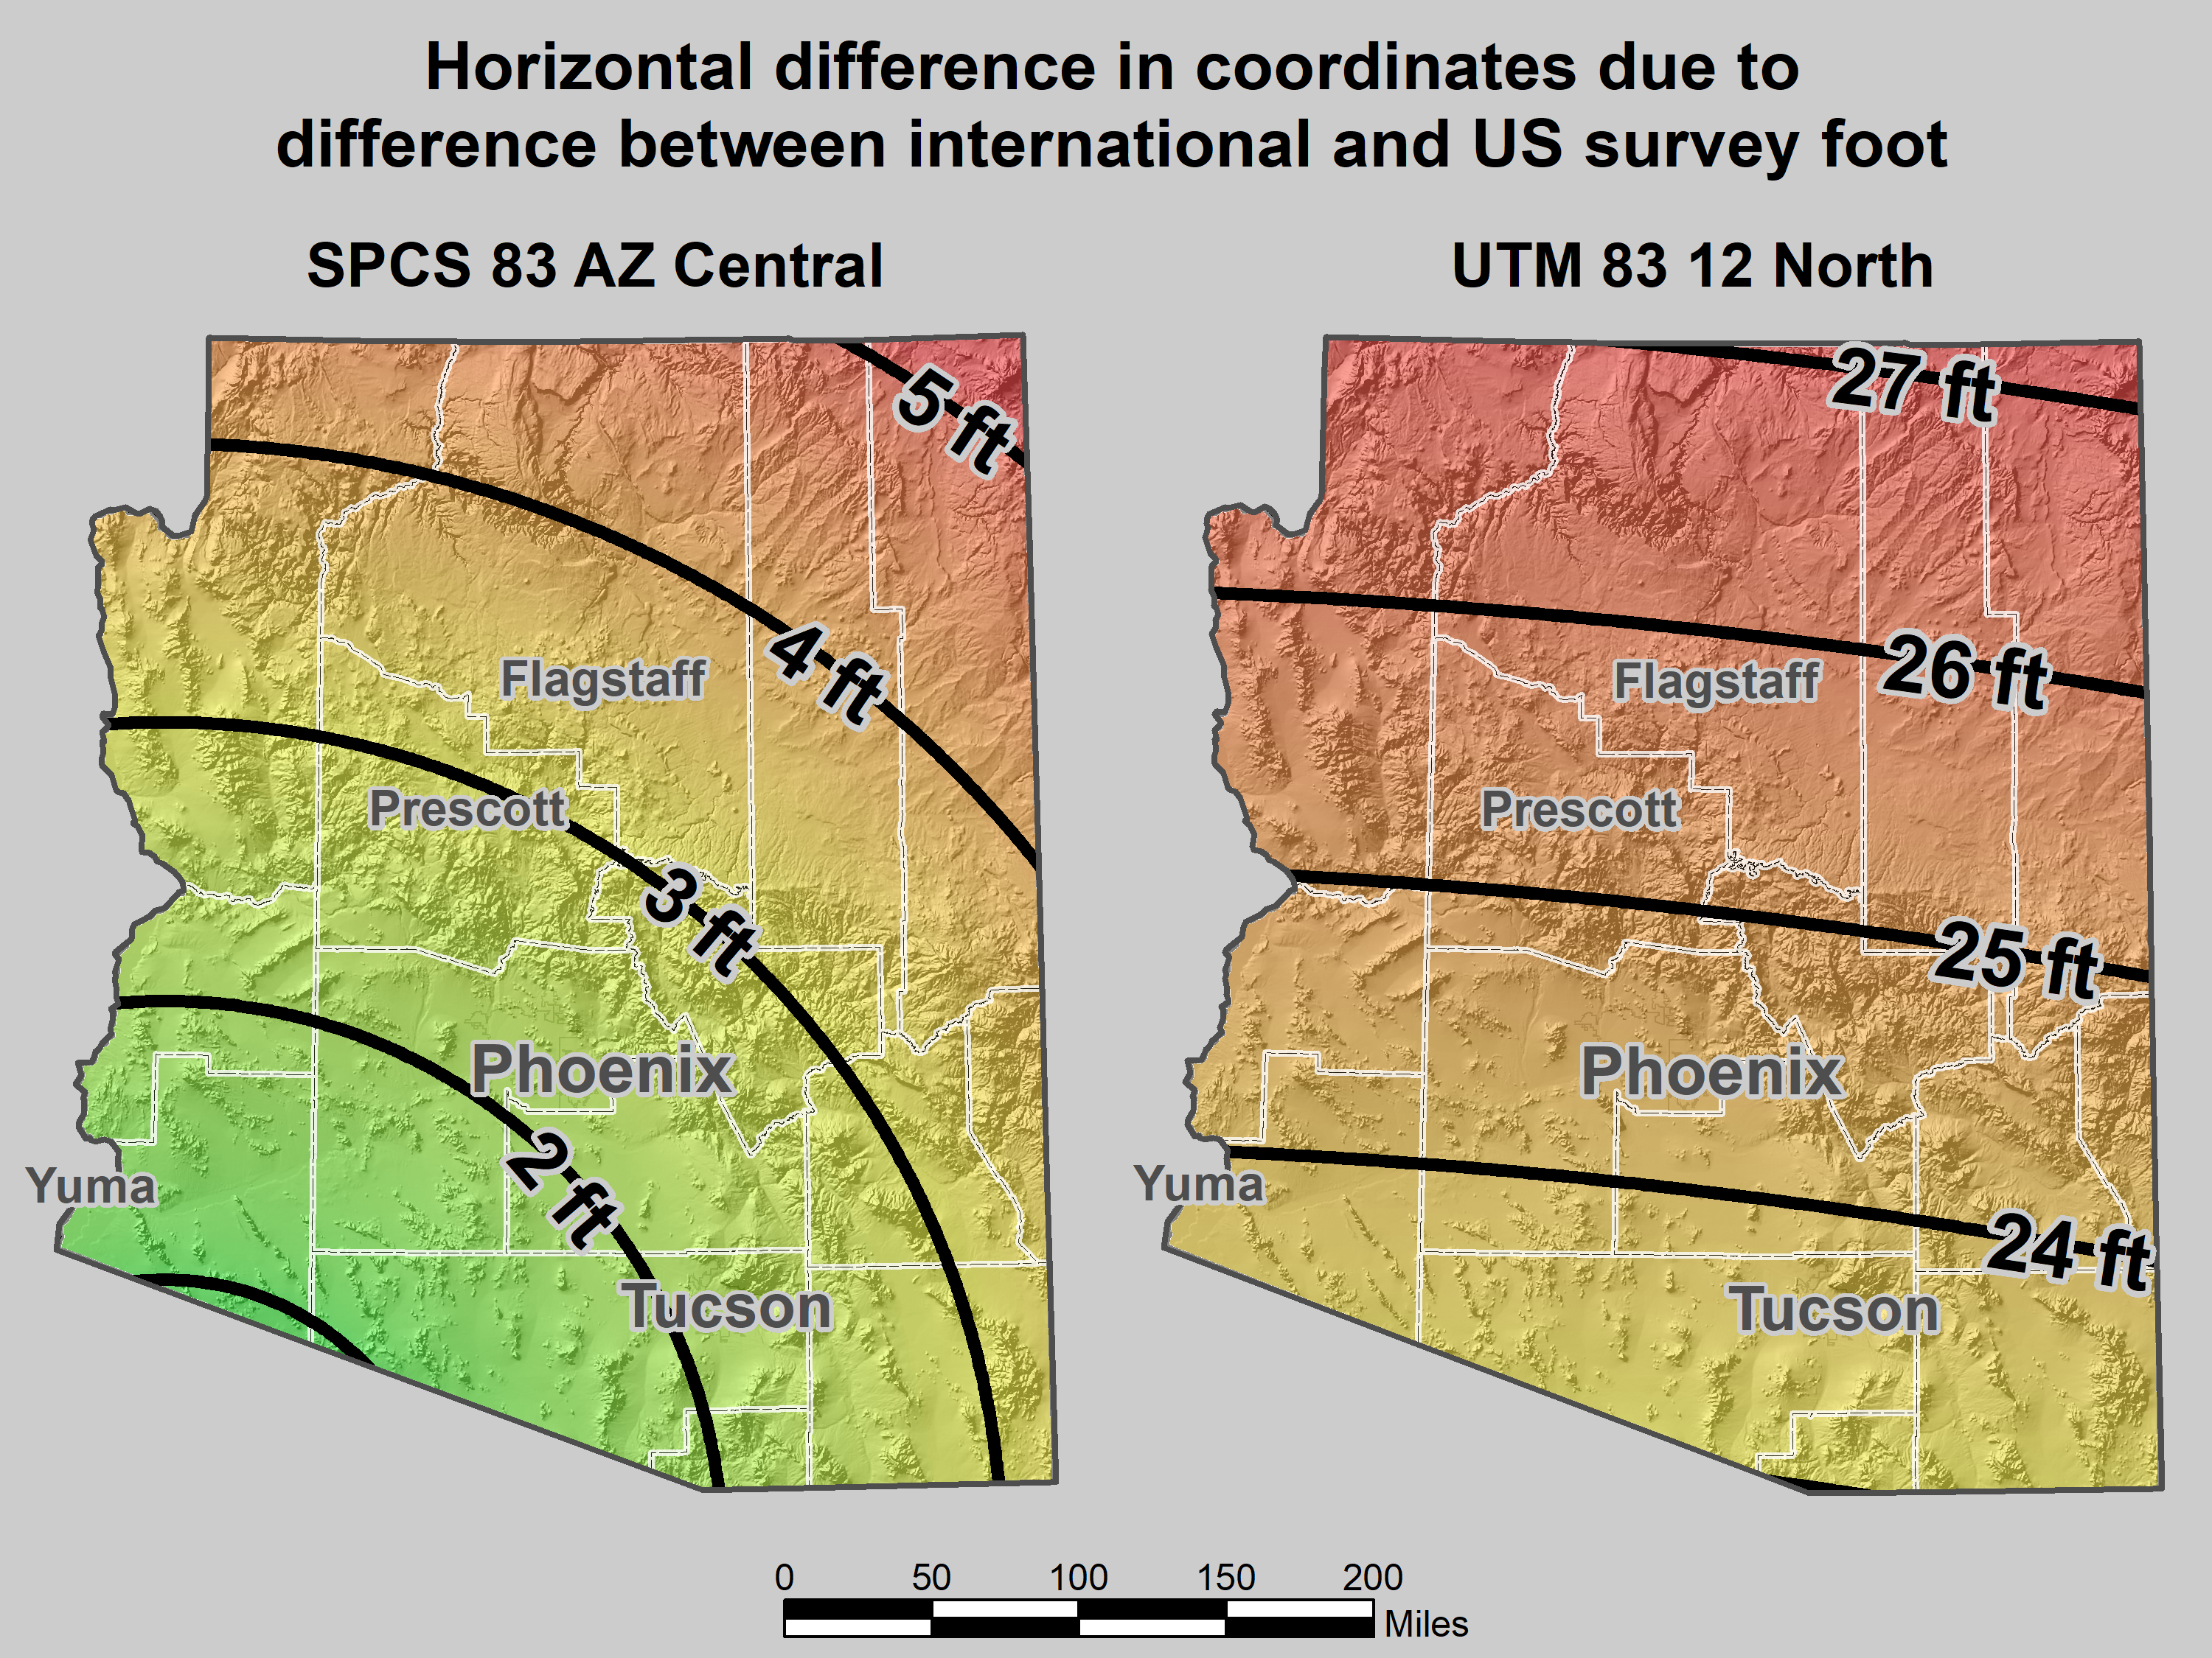
Map of error in mixing feet
Notes:
As an example of some of the problems, consider the state where I am registered, beautiful Arizona. It is an ift state, yet mix-ups with sft occur all the time:
The map on the left shows the horizontal difference in feet when ift and sft are interchanged for SPCS 83 AZ Central Zone.
I worked a lot in Flagstaff. This confusion occurred so often that whenever I saw a 3.5 ft horizontal discrepancy, I suspected it was this issue. And it usually was.
When the City of Flagstaff installed their GIS software, it defaulted to State Plane in sft (even though it’s supposed to be ift). When the City discovered this, they decided to just leave it in sft, which is part of the reason why the 3.5 ft error showed up so often in Flagstaff. But they also occur elsewhere.
I probably shouldn’t complain about ift/sft problems, because I’ve made money off of it. In one weekend I made a couple thousand dollars helping someone with a big survey near Prescott. One of the problems was a 3-ft horizontal discrepancy. Turned out it was due to an ift/sft mix-up, mainly because more than one company worked on the project.
It’s not just State Plane. I don’t know if they still do it, but a statewide electric utility (Arizona Public Service) uses UTM coordinates, in sft. This causes positional errors of 23 to more than 27 feet if ift are used, depending on location.
These problems are real. And they don’t just occur in ift states. They can (and do) occur in any state. I’ve heard more stories about such problems than I can keep track of. This is especially a problem for surveyors licensed in multiple states with different foot types. Or for projects with multiple companies (especially if from different states or countries). Or for anyone who uses software. In short, it has negatively impacted many people, but it can potentially impact anyone. Maybe it has never been a problem for you. But you won’t have to look very far to find someone who has war stories on this topic.

Slide 28
Why make the change?
That was original intent (60 years ago!)
Two “feet” is inefficient and causes confusion
  Leads to errors that cost money
  Absurd to have “same” unit that differs by 2 ppm
  Defeats purpose of having a length standard
Only recognized in part of U.S.
NGS software can support backward-compatibility
Now is the time
  Many changes already being made for 2022
  Change in foot trivial compared to other changes
  U.S. survey foot problems will never go way if not addressed
Notes:
Continuing with why we should make the change:
The sft is not recognized in the entire U.S. Only in parts of the U.S. And even for states where the ift or sft is specified, there are internal exceptions (a few of which I have already mentioned).
NGS can make the transition easier by automatically supporting backward-compatibility in our software. That way you would get sft for all SPCS 27 zones, and also for SPCS 83 in the 40 states that have specified the sft for SPCS 83.
To repeat: Now is the time. Otherwise this problem will never go away (unless the U.S. goes completely metric).

Slide 29

Reasons for adopting “new” foot
Helps prevent “foot confusion” problems
Sharing data
Variety of software
Cost
Notes:
Making the switch to the “new” foot (exactly 0.3048 m) helps prevent various “foot confusion” problems
Sharing data is a potential problem if the type of feet is not specified, or if it is wrongly specified (yes, that happens).
Data sharing is especially a problem for large projects with many players, especially if some come from other states or other countries. Apparently this very problem recently occurred in the high speed rail project in southern California, causing delays (and thus costing money).
Software is written all over the world, by all sorts of people. Some of them may not even know about the two type of feet. Some may know but incorrectly assign the foot type. Others won’t allow you to choose the sft if you’re in an ift state (and vice versa). That is a major problem because of numerous exceptions that occur (a few mentioned previously).
These types of problems cost money. Yes, I made money off such problems. But someone had to pay it, probably the surveyor in charge of the project. Often such costs get passed down to the surveyor.

Slide 30
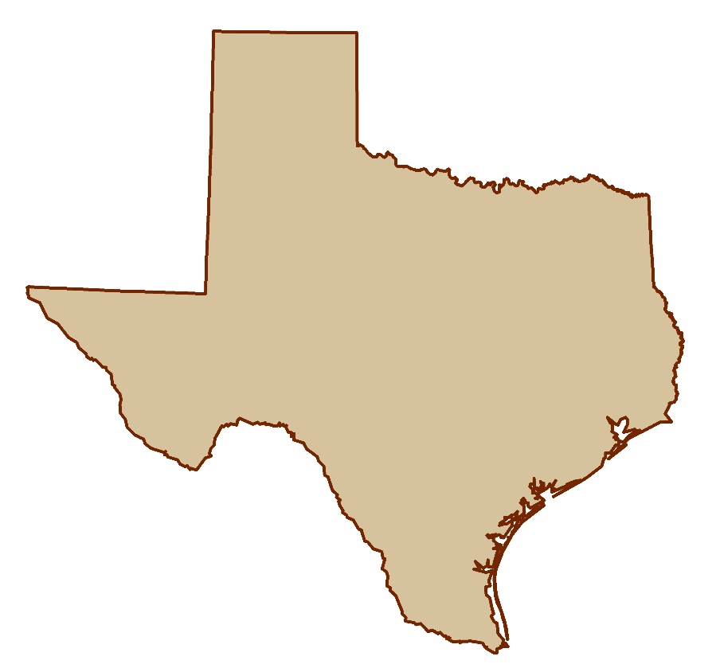
Reasons for adopting “new” foot
Texas will be even bigger…
4,092,414 sft
4,092,422 ift
Notes:
Yet another reason for adopting the “new” foot: Texas will get even bigger! It will increase in length by 8 feet – longer than the bed of my pickup truck! And the best part is that they additional 8 feet doesn’t come from its neighbors – all the sft states will get bigger! So I expect Texas to fully support this change…

Slide 31
Arguments for keeping “old” foot
Used for existing records and data
  Circular argument because issue never goes away
  Such logic means old foot will always be retained
  That’s how we got into this mess in the first place
Old foot in state legislation
  But statute is usually (always?) tied to NAD 83
  New statute for 2022 could break that connection
Necessary to convey real property…
Notes:
There are of course reasons for keeping the “old” foot. Let’s talk about those.
Keep using sft because it is used for a large volume of existing records and data.
This is true, there is a huge amount if information in sft. That would have to be dealt with if a change is made. It can be handled through metadata and most times simply by context (e.g., before a certain date, you know it is sft).
But mean weakness is that this is a circular argument. Because such data will always exist, this problem never goes away. With such logic we could have never moved ahead from the old Troughton scale, or made the switch from NAD 27 to NAD 83.
This point of view is pretty much how we got in this sft/ift mess in the first place (through the 1959 FRN “exception” for geodetic surveys). That shows how problematic this is, because there is now FAR more data in sft than there was in 1959. The problem just gets worse with time.
Keep using sft because it is specified in state statute (and FRNs).
This is also true, but it’s not really relevant, since the statute and FRNs are explicitly for SPCS 83. That means they won’t apply to SPCS2022.
On a positive note, new statute for 2022 could create a new precedent for adopting the new foot (but my opinion is it is better to leave technical details such as linear units out of statute and place them where they are easier to manage, such as in state administrative rules).
Keep using sft because it’s needed to convey real property, since deeds are in sft. This comes up now and again, so let’s take a closer look…

Slide 32
Coordinates, deeds, and distances
Foot issue is a coordinate problem
Deeds are concerned with distances
Bigger issues with distances than type of foot
  U.S. survey vs. int’l foot: 2 ppm = ±0.01 ft per mile
    “Standard” foot varied by tens of ppm before 1893
  French-settled areas: the “arpent”(±7 ft per mile)
  Spanish-settled areas: the “vara”(±30 ft per mile)
  English-settled areas: the “rod”, “pole”, “perch”
    Nominally 16 ½ ft, range 12-22 ft (±1760 ft per mile)
Notes:
The sft/ift issue is really a coordinate problem, whereas deeds are concerned with distances.
Of course, a coordinate is a distance, but it is a special type of distance, from an origin of a coordinate system that is usually very far from a survey site (especially for State Plane and UTM systems).
The distances on a deed are almost always short (usually less than 1 mile), and are given between real or computed objects that represent or reference property corners.
There are much bigger issues with distances than whether it is given in ift or sft.
The ift and sft differ by 2 ppm = 0.01 ft/mile. That difference is smaller than the accuracy of a boundary survey. I would argue that there is probably not a single boundary survey in the U.S. that has been performed to that accuracy, for all the distances on the survey. That’s an easy statement to make, because most surveys include some truly short distances (note that 2 ppm is 0.0001 ft in 200 ft). Also, the foot definition varied by much more than 2 ppm before 1893, so this becomes even less relevant for records prior to 1893.
In many areas, surveyors must contend with versions of the “same” unit that differ vastly more than the ift and sft. This includes different versions of the chain, but also the “arpent” (with versions that differ by up to 7 ft/mile), the “vara” (can vary by up to 30 ft/mile), and especially the “rod” or “pole” or “perch”, which can vary tremendously, up to 1760 ft/mile. So clearly surveyors must understand the context of the distances given on a deed, in situations that far exceed the difference between ift and sft.
For long distances (greater than a mile), bigger problems come into play than the 2 ppm difference between ift and sft. In such cases, what is even meant by a horizontal ground distance? Does it curve with the Earth? If so, how is that calculated (there is more than one way)? If it is a projected distance (e.g. State Plane), how much does the combined factor vary along the line? What is the difference in the height of the line end points? These types of issues typically introduce more than 2 ppm systematic differences in “distance.” In other words, the ift/sft is nit really relevant for long distances, either.

Slide 33

Arguments for keeping “old” foot
Used for existing records and data
  Circular argument because issue never goes away
  Such logic means old foot will always be retained
  That’s how we got into this mess in the first place
Old foot in state legislation
  But statute is usually (always?) tied to NAD 83
  New statute for 2022 could break that connection
Necessary to convey real property…
  Six states have new foot yet somehow convey property
  Is this just a red herring to avoid change…?
People don’t like change
Notes:
Continuing with conveyance if real property:
There are six ift states that somehow manage to convey real property, even though a large number of the deeds and plats in those states are in sft. Any prepared before about 1986 would almost certainly be in sft (and probably quite a few afterward), and all before 1959 would definitely be in sft. I am registered in an ift state, so I have often performed boundary surveys using records that were in sft. Yet this has NEVER caused a problem for me. The reason is simple: the difference is too small. If I can come within 1 foot of a record monument, I’m having a very good day, especially for surveys based on very old records. If you have a boundary survey and your biggest problem is the difference between ift and sft, then congratulations! You’ve got yourself an easy survey.
When surveyors bring up issues like conveyance of real property, I can’t help but wonder if they are (perhaps unwittingly) offering a red herring. The arguments certainly are not convincing. Could this simply be a presented because people don’t like change…?
Returning to the question of state legislation, there’s another problem even for cases where a state decides they are going to specify whatever linear unit they want, regardless of what NGS or NIST decide…

Slide 34
Supreme law of the land
U.S. Constitution, Article I, Section 8, Clause 5:
  “The Congress shall have Power… To coin Money, regulate the Value thereof, and of foreign Coin, and
  fix the Standard of Weights and Measures”
If NIST defines single foot, only it can be used
  State legislating different foot would be unconstitutional
  Same as state coining its own money
  Have two feet now only because 1959 issue not settled
Not a “states rights” issue
  10th Amendment (Bill of Rights): “The powers not delegated to the United States by the Constitution, nor prohibited by it to the States, are reserved to the States respectively, or to the people”
Notes:
Can a state simply choose whatever version of the foot they want? According the Supreme law of the land (the U.S. Constitution), it appears they cannot:
Article I, Section 8, Clause 5 exclusively gives Congress the power to “fix the standard of weights and measures.” Note that this is in the same sentence as the power to coin money
If NIST defines a single foot for the U.S., a state specifying a different foot may be wading into unconstitutional territory. It appears that doing so would be the same as a state coining its own money, and it seems highly unlikely that the federal government would sit idly by if that occurred. I suspect that the only reason it was ever possible for states to choose which foot they wanted is because the 1959 FRN issue was never settled. That is what we are trying to do now.
For those who view this as a “states rights” issue, please refer to the 10th Amendment (the last one in the Bill of Rights). It says that powers reserved to the state (or the people) are only those not delegated to Congress by the Constitution. Since fixing standards of weights and measures are delegated to Congress, they cannot also be reserved to the states.

Slide 35
Taking a stand for standards
The foot problem created for convenience
  Intended as temporary, for geodetic work only
  Boundary surveys were not considered
Keeping U.S. survey foot is an “anti-standard”
  U.S. survey foot currently in standards “limbo”
  Single definition efficient, clean, and right thing to do
Issue an “order” to adopt single foot = 0.3048 m?
  That’s what it took to fix mess in 1893
  A long overdue solution
  Within legal authority of federal government…
  …but prefer to persuade rather than coerce
Notes:
NGS wants you to join us in taking a stand for standards, for the reasons listed here that summarize what was discussed in this presentation.
An important point is that although it appears the federal government has the authority to mandate a single foot definition, we believe it is far better to persuade than coerce. Our hope is that you have found this presentation persuasive, and that you are at least considering the merits of a switch from the sft to the ift.

Slide 36
In closing…
NGS created problem, will help fix it
  Fully support backward compatibility
  Will make simple and painless as possible
  Foot change minor compared to other 2022 changes
  Contact us at NGS.Feedback@noaa.gov
This is about the future
  Remember our heroes and their hard-won victories…
Notes:
In closing, I want to reiterate that NGS essentially created this problem, and now we want to help fix it. Yes, we are coming at this some 30+ years late, but there is no better time to do this than when we are updating the entire NSRS. A change in the foot definition will be a minor part of the overall changes that will occur when we make the transition to a modernized NSRS in 2022. NGS will do everything we can to make a foot change – and all the other 2022 changes – as simple and painless as possible. Remember, the idea here is not change for its own sake, but change to make things better. And these changes will make things better.
I encourage you to provide questions and comments to NGS.Feedback@noaa.gov. If this change for the foot goes forward, there will also be opportunities for comments as part of issuing an FRN.
I remind you, again, that this is about the future, not the past. The past will always exist and will not change. But the future is something we can change, and make better. Please remember our heroes, and the incredible work they put into establishing standards for weights and measures. Their eyes were also on the future, and we are the beneficiaries of their vision.
For those of you who are surveyors (as I am), this is more than about how you practice surveying today, wherever you may work, and whatever type of surveying you do. For those who want to retain the U.S. survey foot, I implore you to please consider the larger picture, and the future. That future will be inherited by the young surveyors, GIS professionals, and all other U.S. citizens. We should strive to do well by them, and for them.

