Slide 1



Evolution of the NSRS
New Hampshire Land Surveyors Association
December 07, 2012
Dan Martin
NGS Vermont State Geodetic Advisor
Dan.martin@noaa.gov
802-828-2952
www.aot.state.vt.us/geodetic/Advisor/advisorpresent.htm

Slide 2
GEODETIC DATUMS
  HORIZONTAL
  2 D (Latitude and Longitude) (e.g. NAD 27, NAD 83 (1986))
  VERTICAL
  1 D (Orthometric Height) (e.g. NGVD 29, NAVD 88, Local Tidal)
  GEOMETRIC
  3 D (Latitude, Longitude and Ellipsoid Height)
  Fixed and Stable - Coordinates seldom change
  (e.g. NAD 83 (1996), NAD 83 (2007), NAD 83 (CORS96))
  also
  4 D (Latitude, Longitude, Ellipsoid Height, Velocities) Coordinates change with time
  (e.g. ITRF00, ITRF08)

Slide 3
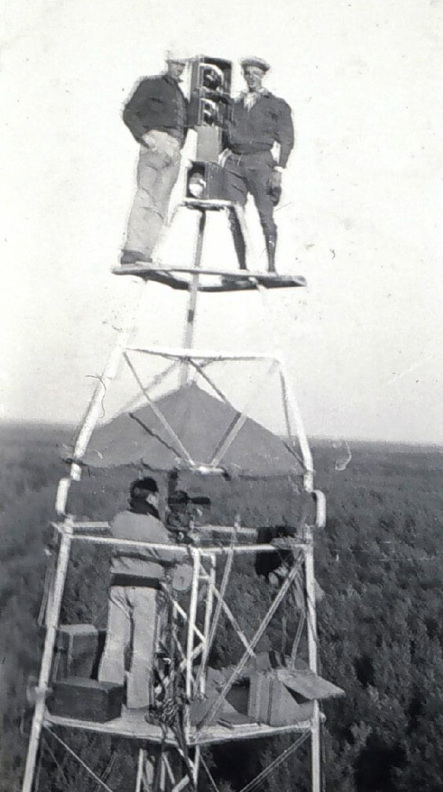
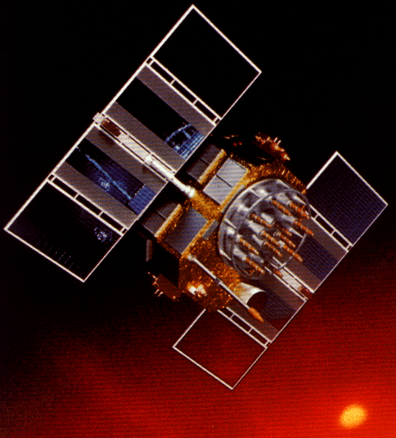
A (very) brief history of NAD 83
Original realization completed in 1986
  Consisted (almost) entirely of classical (optical) observations
“High Precision Geodetic Network” (HPGN) and “High Accuracy Reference Network” (HARN) realizations
  Most done in 1990s, essentially state-by-state
  Based on GNSS but classical stations included in adjustments
National Re-Adjustment of 2007
  NAD 83(CORS96) and (NSRS2007)
  Simultaneous nationwide adjustment (GNSS only)
New realization: NAD 83(2011) epoch 2010.00

Slide 4
Why change datums/Realizations
NAD27 based on old observations and old system
NAD83(86) based on old observations and new system
NAD83(92) based on new and old observations and same system
NAD83(96) based on better observations and same system
NAD83(NSRS2007) based on new observations and same system. Removed regional distortions and made consistent with CORS
NAD83(2011) based on new observations and same system. Kept consistent with CORS

Slide 5
Horizontal Datums/Coordinates…What do we (you) use in NH?
NAD 83 (Lat-Lon) SPC
  Which one???
    NAD 83 (1986)
    NAD 83 (1992)
    NAD 83 (1996)
    NAD 83 CORS96(2002)
    NAD 83 (NSRS2007)
    NAD 83 (2011)
NAD 27
WGS 84
  Which one???
    WGS 84 (1987)
    WGS 84 (G730)
    WGS 84 (G873)
    WGS 84 (G1150)
    WGS 84 (G1674)
ITRF00 (epoch 97)
IGS08

Slide 6
COORDINATE CHANGES
ADJUSTMENT YEARS LOCAL NETWORK
ACCURACY ACCURACY
NAD 27 1927 – 1986 1:100,000 10 m
NAD 83 (1986) 1986 – 1990 1:100,000 1 m
NAD 83 (1992) (HARN) 1990 – 1997 1:10,000,000 0.1 m
CORS 1994 -------- 0.01/0.02 m 0.02/0.04 m
NAD 83 (1996) (FBN/CBN) 1997 – 2007 0.05/0.05 m 0.05/0.05 m
NAD 83 (NSRS 2007) 2007 - 2012 0.01/0.02 m 0.02/0.04 m
NAD 83 (2011) epoch 2010.0 2012 - ------- 0.009/0.015m

Slide 7
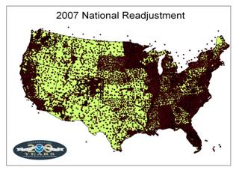

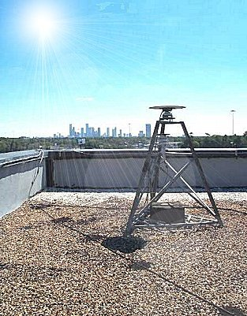
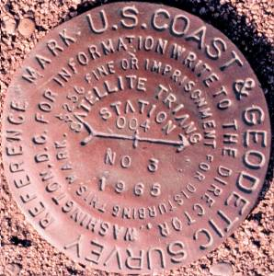
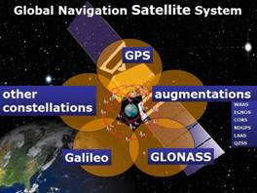
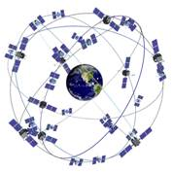
The NSRS has evolved
1 Million Monuments
(Separate Horizontal and Vertical Systems)
70,000
Passive Marks
(3-Dimensional)
→
Passive Marks
(Limited Knowledge of Stability)
1,693 GPS CORS
(Time Dependent System Possible;
4-Dimensional)
→
GPS CORS → GNSS CORS

Slide 8
ITRF2008, IGS08
And NAD 83(2011)

Slide 9
ITRF2008
For the geodesy, geophysics and surveying communities, the best International Terrestrial Reference Frame is the “gold standard.”
The global community recently adopted an updated expression for the reference frame, the ITRF2008.
9

Slide 10
International Earth Rotation and
Reference System Service
(IERS)
(http://www.iers.org)
The International Terrestrial Reference System (ITRS) constitutes a set of prescriptions and conventions together with the modeling required to define origin, scale, orientation and time evolution
ITRS is realized by the International Terrestrial Reference Frame (ITRF) based upon estimated coordinates and velocities of a set of stations observed by Very Long Baseline Interferometry (VLBI), Satellite Laser Ranging ( SLR), Global Positioning System and GLONASS (GNSS), and Doppler Orbitography and Radio- positioning Integrated by Satellite ( DORIS).
ITRF89, ITRF90, ITRF91, ITRF92, ITRF93, ITRF94, ITRF95, ITRF96, ITRF97, ITRF2000, ITRF2005, ITRF2008

Slide 11
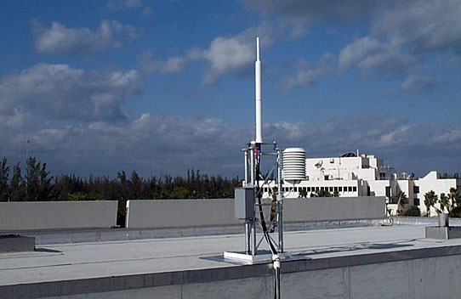
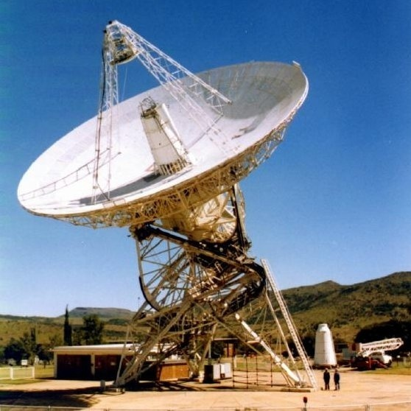
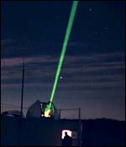
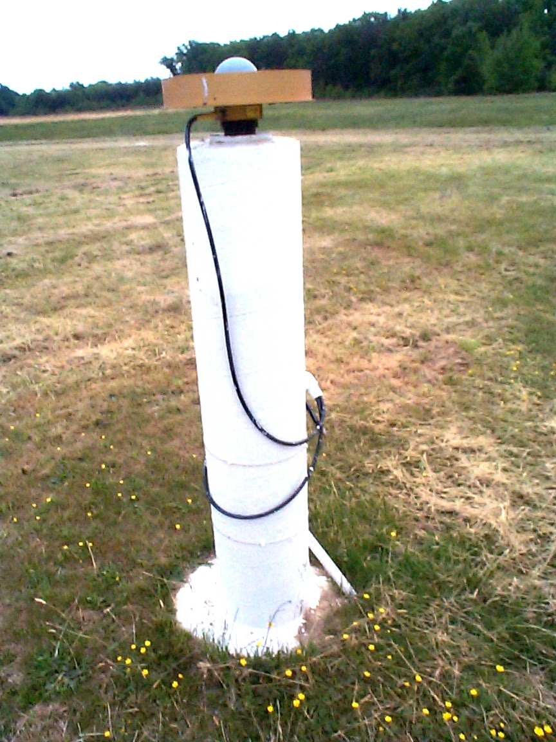
International Terrestrial Reference Frame
4 Global Independent Positioning Technologies
International Global Navigation Satellite Systems Service (IGS)
International Laser Ranging Service (ILRS)
International Very Long Baseline Service (IVS)
International DORIS Service (IDS)

Slide 12
Simplified Concept of NAD 83 vs. ITRF08
h₈₃
h₀₈
Earth’s
Surface
ITRF 08
Origin
2.2 meters
NAD 83
Identically shaped ellipsoids (GRS-80)
a = 6,378,137.000 meters (semi-major axis)
1/f = 298.25722210088 (flattening)
Origin
Notes:
ITRF (International Terrestrial Reference Frame) just has an origin; take NAD83 shaped ellipsoid centered at the ITRF origin to derive ITRF97 ellipsoid heights.
Ellipsoid heights NAD83 vs. ITRF97 - Defined origins are best estimate of the center of mass; NAD83 is not geocentric. Move origin; move ellipsoid surface as illustrated.
Ellipsoid height differences reflect the non-geocentricity of NAD83.

Slide 13
Densification
The ITRF2008 is expressed through the coordinates and velocities of marks on the ground plus ancillary data.
Other organizations can take that information, add additional marks, perform their own adjustment and align their results to the ITRF2008 (A.K.A. densifying).
The variants try to be as consistent with the ITRF2008 as possible, but in the most formal sense, they are unique from the ITRF2008. Therefore, they are given unique names.
13

Slide 14
The IGS08
The IGS has densified reference frame with much larger, global subset of GNSS tracking sites thereby creating a GNSS-only expression of the ITRF2008 called the IGS08. All IGS products have been recreated so as to be consistent with the IGS08 including GNSS ephemerides and antenna models. Information about the IGS08 can be found at the IGS web sites: igscb.jpl.nasa.gov. I would suggest starting with IGSMAIL‐6354, ‐6355 and ‐6356, all dated 2011‐03‐07.
14
Notes:
Many of the sites contributing to the IGS08 also contributed to the ITRF2008, but because other space geodesy techniques contributed to the ITRF2008 and because the IGS08 contains sites not included in the ITRF2008, it should not be called the ITRF2008.
Nonetheless, IGS08 has the same geocenter, orientation and scale as the ITRF2008.

Slide 15
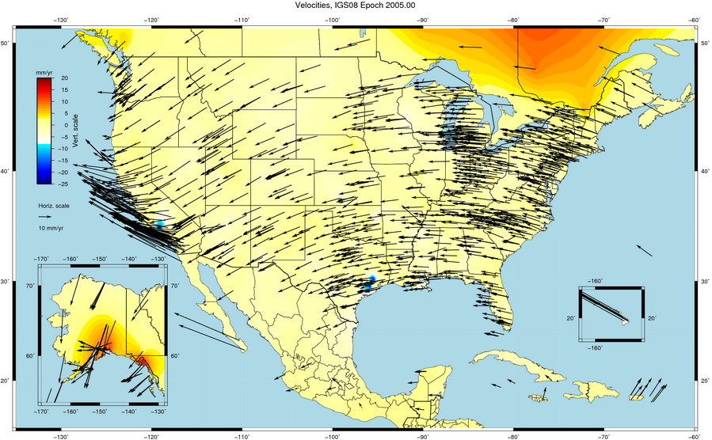

Slide 16
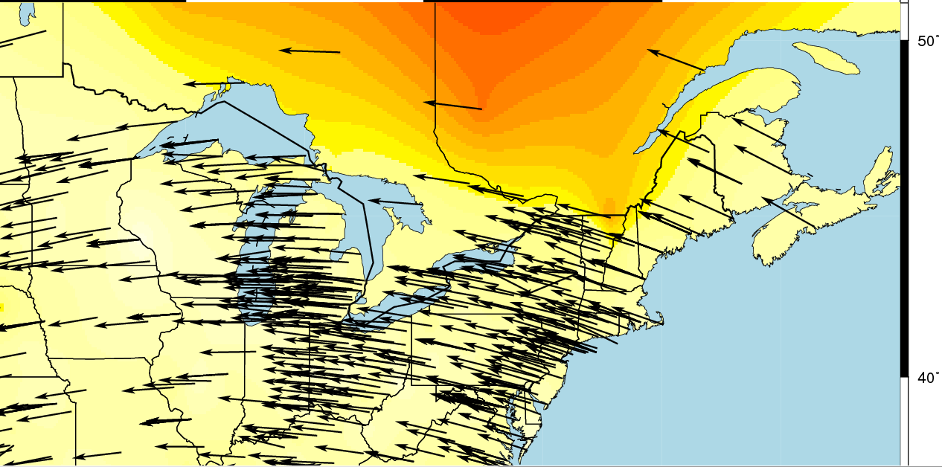
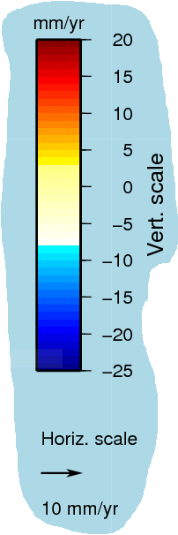

Slide 17
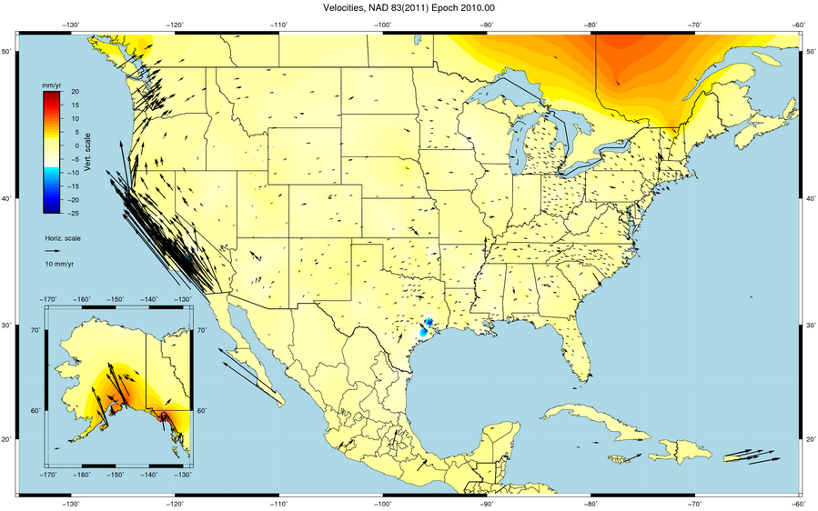

Slide 18
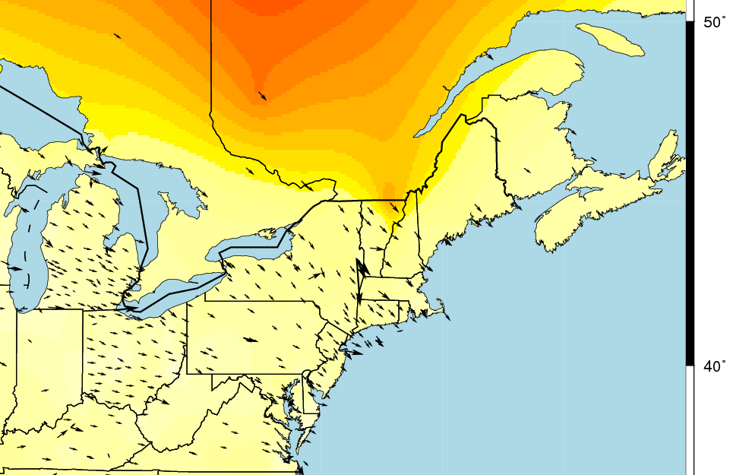
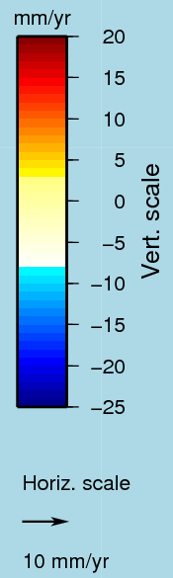

Slide 19
NAD 83 (2011)
NGS used its contribution to the IGS08 plus the additional CORS to produce improved IGS08 coordinates and velocities for the CORS network. From this, improved CORS coordinates and velocities in the NAD 83 frame were defined.
To distinguish this from earlier realizations, this reference frame is called the NAD 83 (2011). This is not a new datum: the origin, scale and orientation are the same as in the previous realization.
In September 2011, NGS formally released IGS08 and NAD 83 (2011) coordinates and velocities for the CORS. Information about the IGS08 and NAD 83 (2011) can be found at geodesy.noaa.gov/CORS/coords.shtml.
19

Slide 20
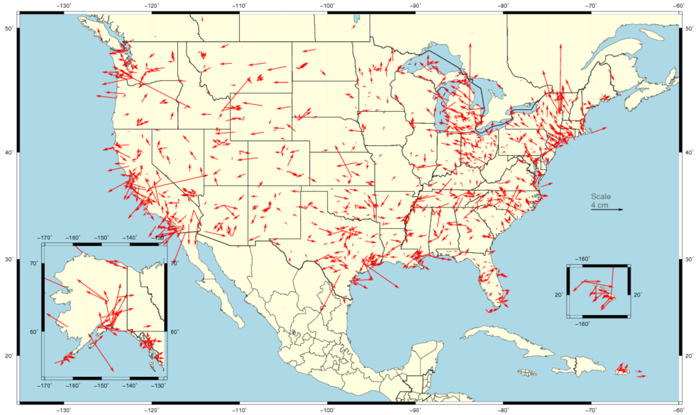
Horizontal Differences In CORS Positions
Horizontal difference in positions of NAD 83(2011) epoch 2002.00 minus NAD 83(CORS96) epoch 2002.00.
20

Slide 21
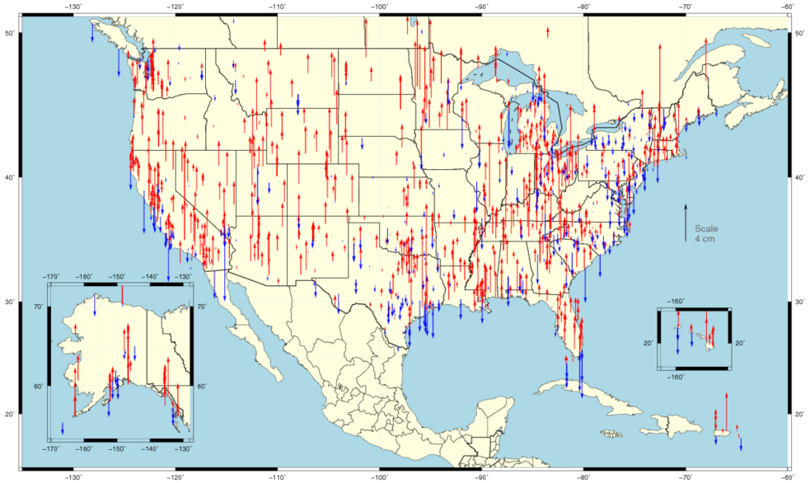
Vertical Differences In CORS Positions
Vertical difference in positions of NAD 83(2011) epoch 2002.00 minus NAD 83(CORS96) epoch 2002.00.
21

Slide 22
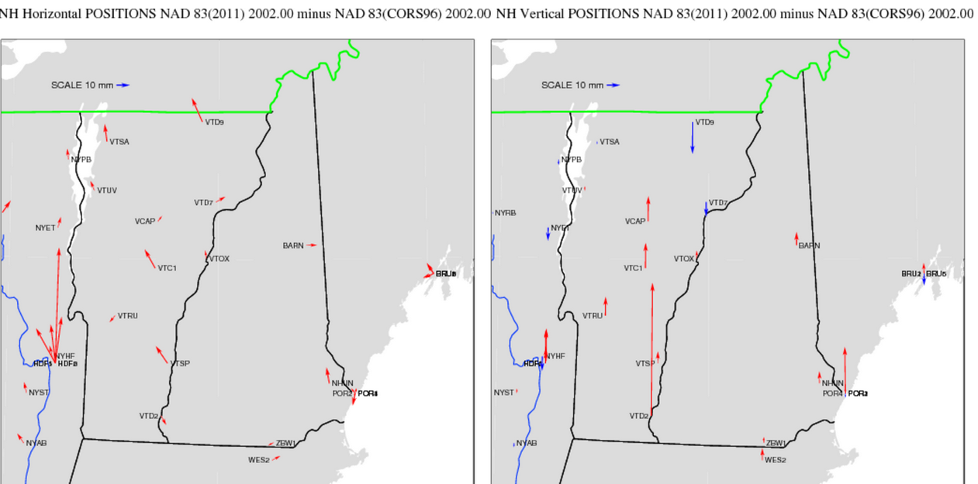

Slide 23
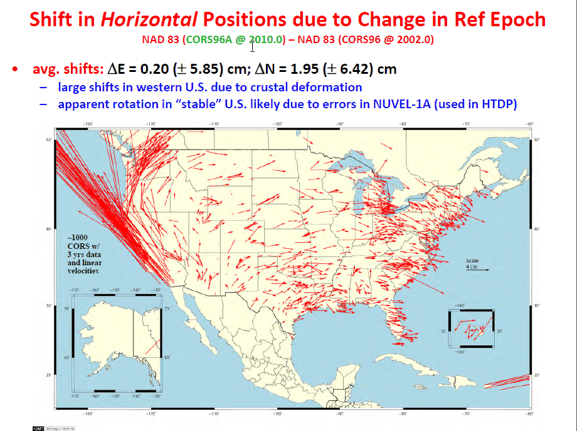
Change in horizontal NAD 83 CORS coordinates
NAD 83(CORS96) epoch 2002.00 → NAD 83(2011) epoch 2010.00
Avg shifts (cm): ΔN = 2.0 (±6.4); ΔE = 0.2 (±5.9); ΔU = -0.9 (±2.0)

Slide 25
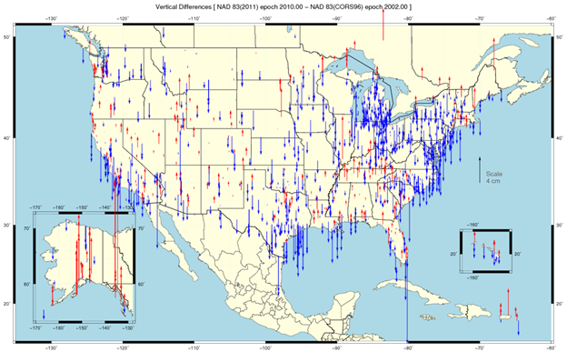

Slide 26
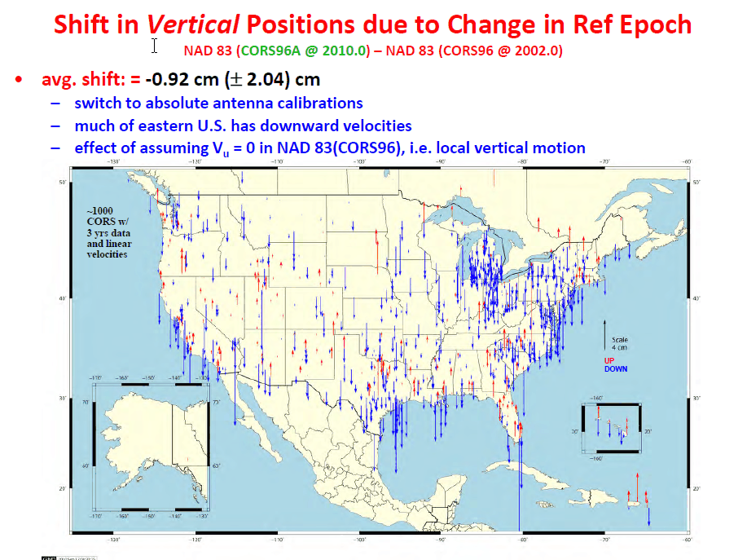

Slide 27
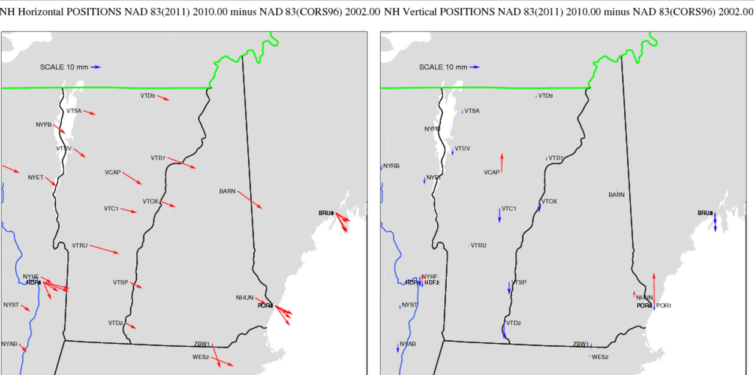

Slide 28
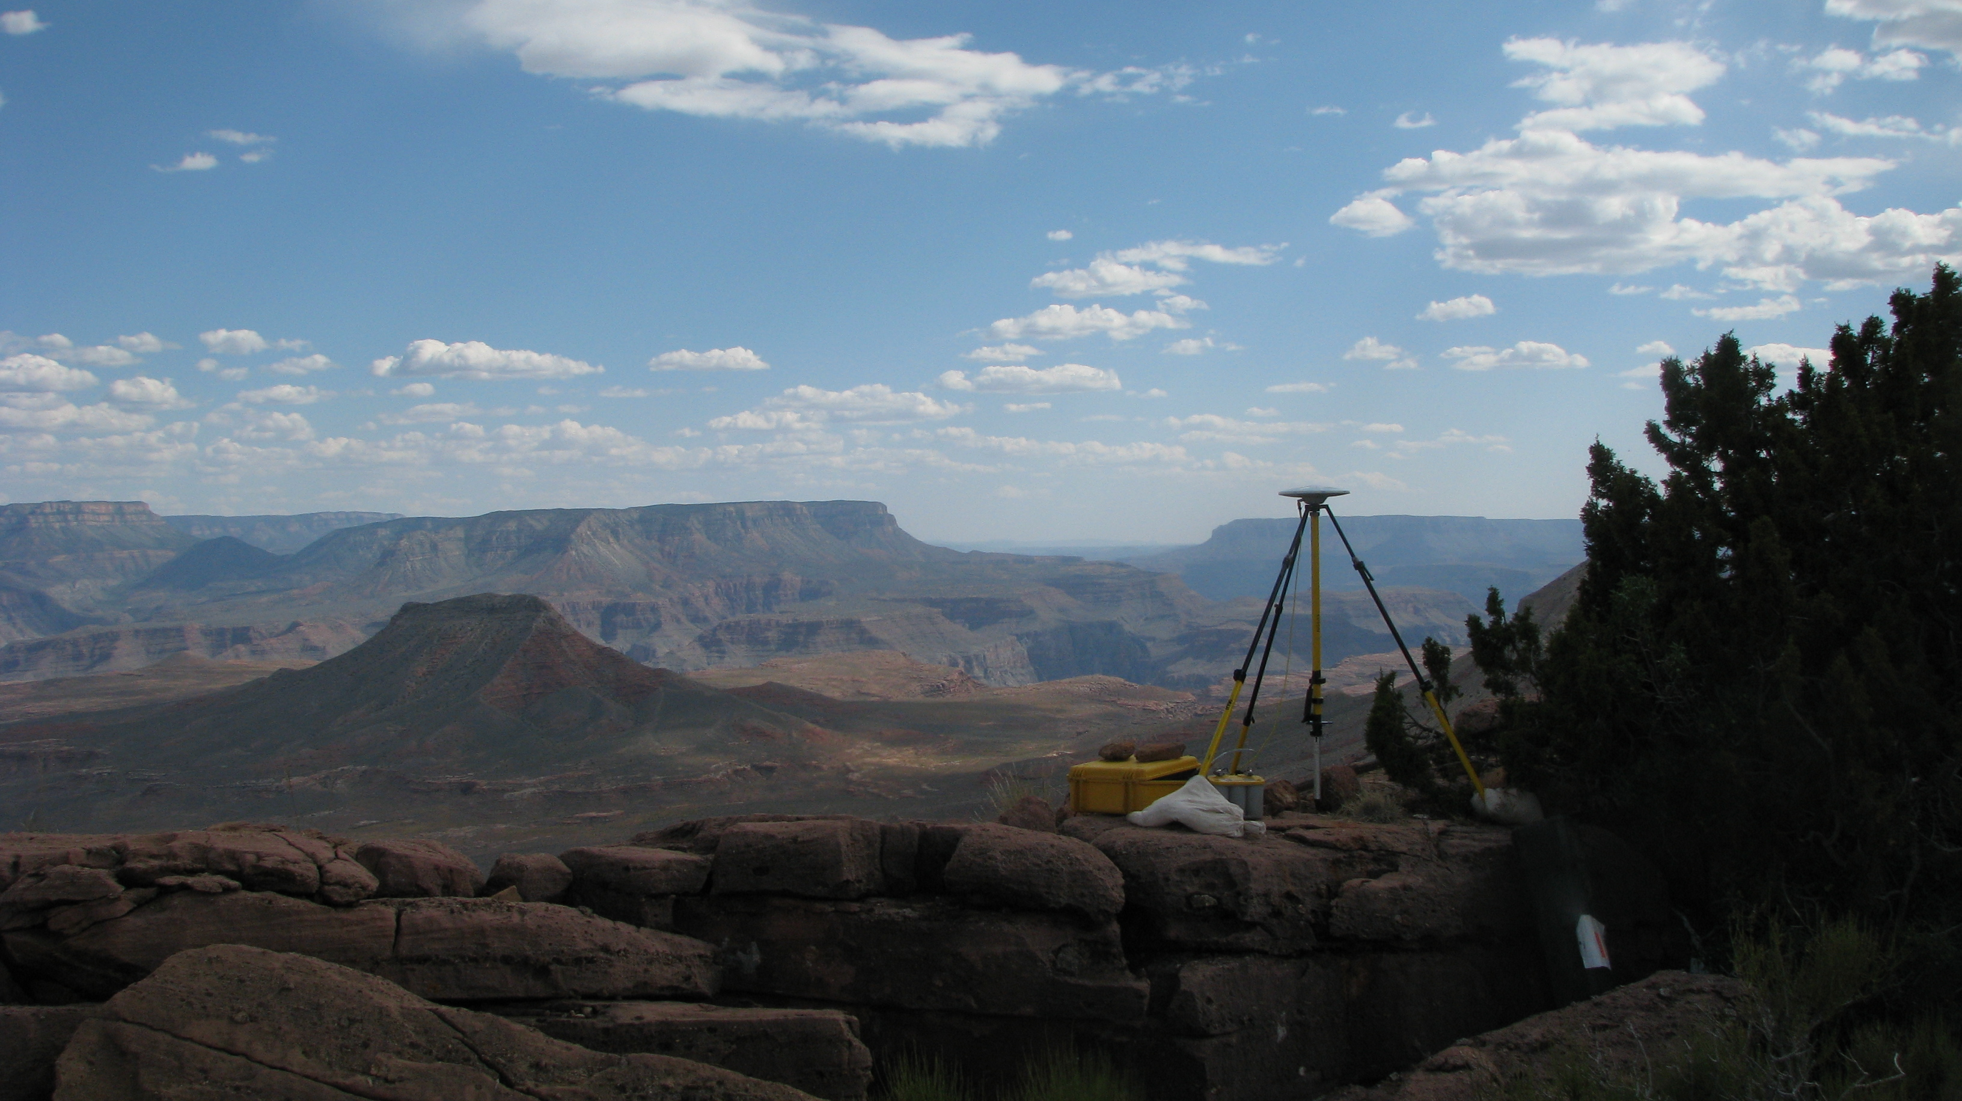
Update and Refinement of the North American Datum of 1983
NAD 83(2011/PA11/MA11) epoch 2010.00
The 2011 national adjustment of passive control and its impact on NGS products and services
National Geodetic Survey
Height Modernization Program monthly meeting
October 11, 2012 ● Silver Spring, MD
Michael Dennis, RLS, PE
michael.dennis@noaa.gov

Slide 29
The Plan
The National Spatial Reference System (NSRS)
  A (very) brief history of NAD 83
  The latest realization: NAD 83(2011/PA11/MA11) epoch 2010.00
National adjustment of passive control
Related and dependant NGS products & services
  The Multi-Year CORS Solution (MYCS)
  Online Positioning User Service (OPUS)
  New hybrid geoid model (GEOID12A)
  New process for Bluebooking GPS project
  New NAD 83 coordinate transformations
  Role of GIS in national adjustment (and leveling)
What about orthometric heights (aka “elevations”)?

Slide 30
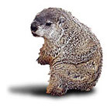
The Basics
When will it be done?
  Publication completed on June 30, 2012
    Intent: Simultaneous with release of GEOID12A
How many stations? 80,872
How much did the coordinates change?
  Median: 1.9 cm horiz, 2.1 cm vertical
How accurate are the results?
  Median: 0.9 cm horiz, 1.5 cm vertical
  (at 95% confidence level)
NGS Groundhog
Shadow
…6 more weeks until it’s done!

Slide 31

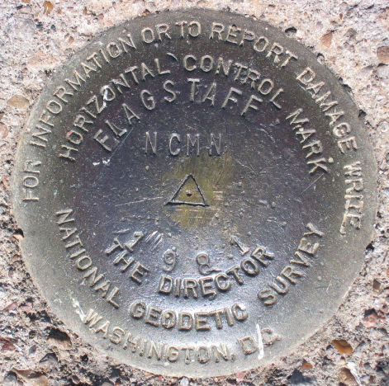
Introducing…
NAD 83(2011) epoch 2010.00
Multi-Year CORS Solution (MYCS)
  Continuously Operating Reference Stations
  Reprocessed all CORS GPS data Jan 1994-Apr 2011
  2264 CORS & global stations
  NAD 83 computed by transformation from IGS08
2011 national adjustment of passive control
  New adjustment of GNSS passive control
  GNSS vectors tied (and constrained) to
  CORS NAD 83(2011) epoch 2010.00
  Over 80,000 stations and
  400,000 GNSS vectors
Realization SAME for CORS
and passive marks
This is NOT a new datum! (still NAD 83)

Slide 32
Why a new NAD 83 realization?
Multi-Year CORS Solution
  Previous NAD 83 CORS realization needed many improvements
  Consistent coordinates and velocities from global solution
  Aligned with most recent realization of global frame (IGS 08)
  Major processing, modeling, and metadata improvements
    Including new absolute phase center antenna calibrations
National adjustment of passive control
  Optimally align passive control with “active” CORS control
    Because CORS provide the geometric foundation of the NSRS
  Incorporate new data, compute accuracies on all stations
  Better results in tectonically active areas
Bottom line
  Must meet needs of users for highly accurate and consistent coordinates (and velocities) using Best Available Methods

Slide 33

Approach
Used a Helmert blocking strategy for CONUS
  Over 80,000 points (> 240,000 unknowns)
  Over 400,000 GNSS vectors (> 1.2 million observations)
Individual projects weighted to account for variable error
  Horiz and vertical std deviation scale factors computed for all projects
Outlier detection (for rejecting vectors)
  Used threshold 4 cm horizontal, 5 cm up
Method for vector rejection
  Rejection by downweighting vs. removal
Challenges:
  Tectonic tribulations
  Mixing old and new observations (e.g., pre-1994)
  CORS complications
  Constraint conundrums (“weighted” vs. “rigid”)
  Subsidence
  No-check stations
  Duplicate stations, duplicate vectors

Slide 34
What’s in a name?
That which we call a datum
By any other name would smell as sweet…
NAD 83(2011) epoch 2010.00
  “2011” is datum tag → year adjustment complete
  “2010.00” is “epoch date” (January 1, 2010)
    Date associated with coordinates of control station
  Frame fixed to North America tectonic plate
    Includes California, Alaska, Puerto Rico, and US Virgin Islands
NAD 83(PA11) epoch 2010.00
  Frame fixed to Pacific tectonic plate (Hawaii and American Samoa)
NAD 83(MA11) epoch 2010.00
  Frame fixed to Mariana tectonic plate (Guam and CNMI)

Slide 35
National adjustment of passive control
4267 GPS projects; 80,872 stations; 424,711 vectors
  Observations from April 1983 thru Dec 2011
  Includes 1195 CORS with Multi-Year CORS Solution coordinates
CONUS and Caribbean adjusted together (79,364 stations)
  Both referenced to North America tectonic plate
  Split into Primary (62,024 stations) and Secondary (17,340 stations)
AK adjusted separate from CONUS and Caribbean (968 stations)
  No useable ties to CONUS
  Also referenced to North America tectonic plate
Pacific region also adjusted separately (540 stations)
  Referenced to different tectonic plates
    Hawaii, American Samoa, Marshall Is., etc. → Pacific plate (363 stations)
    Guam, Northern Mariana Islands, Palau → Mariana plate (177 stations)
  Pacific not included in 2007 national adjustment

Slide 36
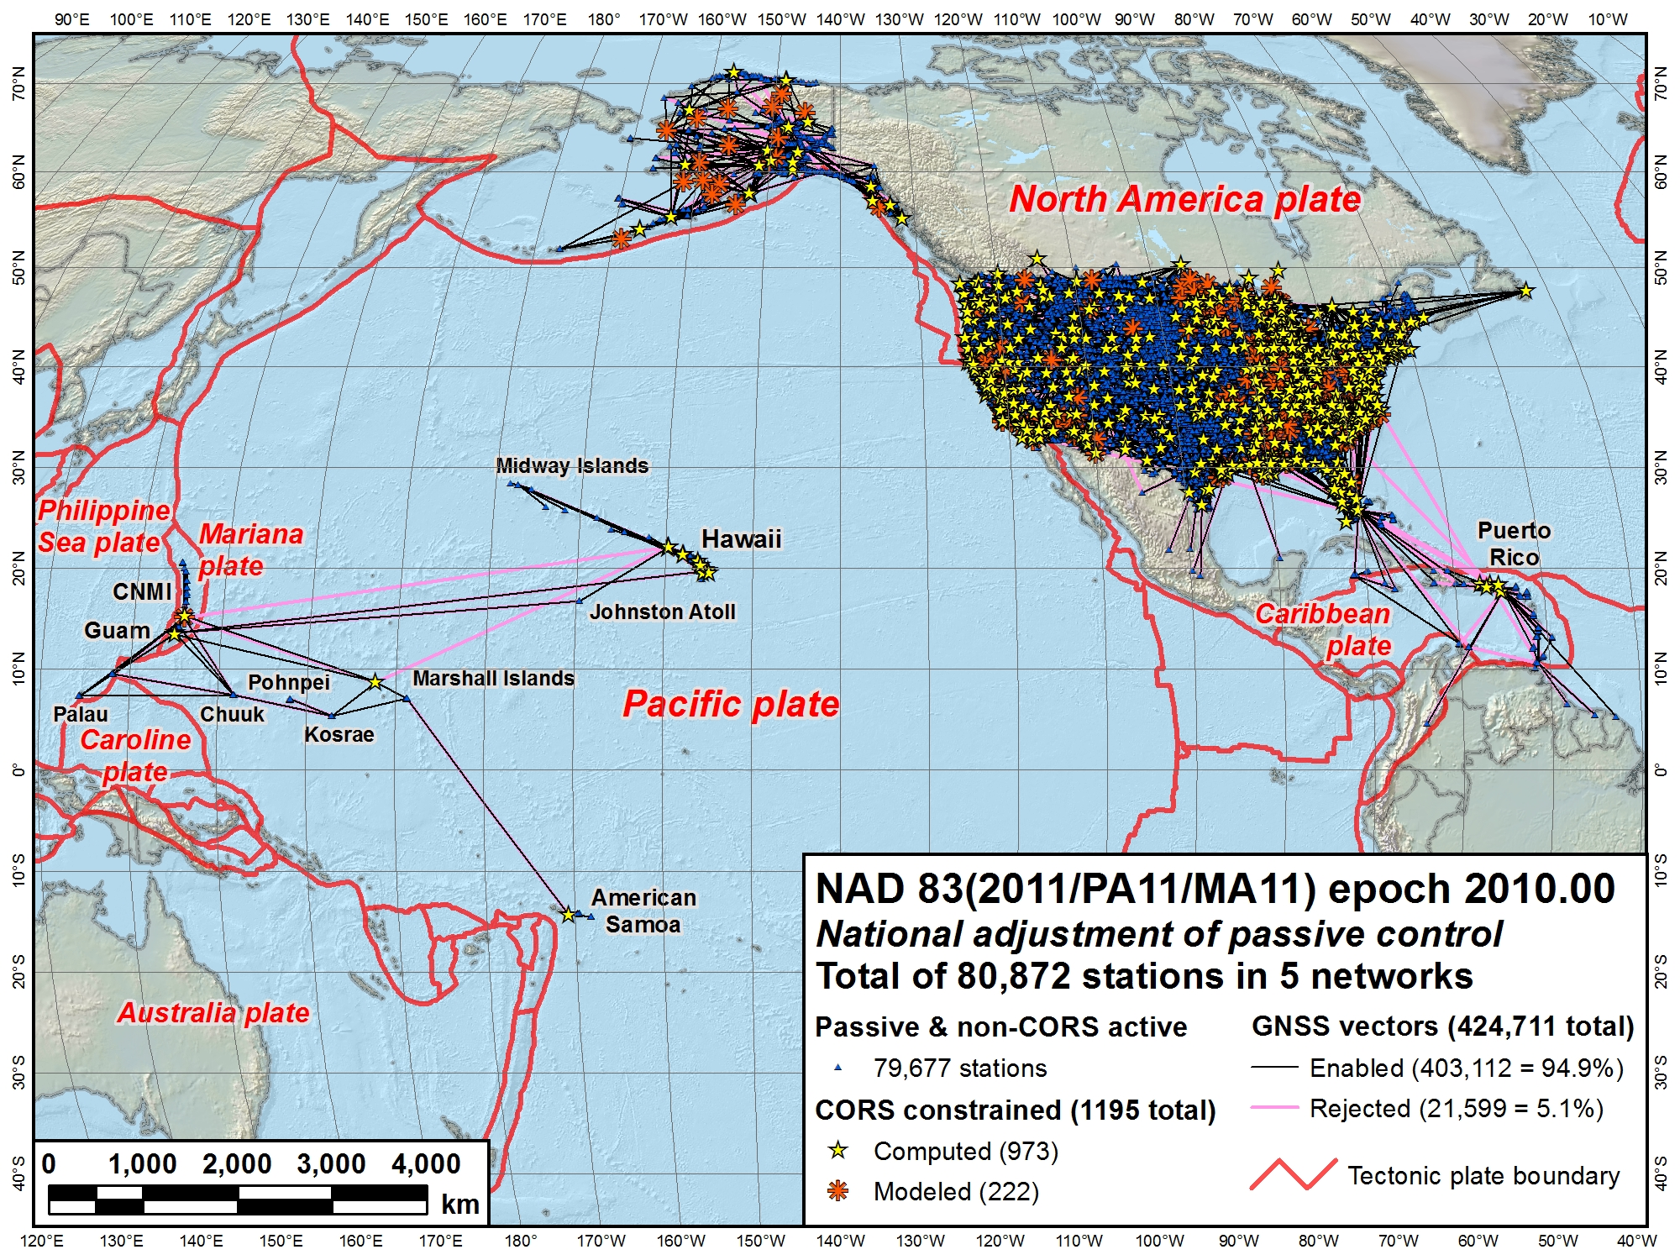
CONUS Secondary
Alaska
Pacific
(MA11)
CONUS Primary
Pacific (PA11)

Slide 37
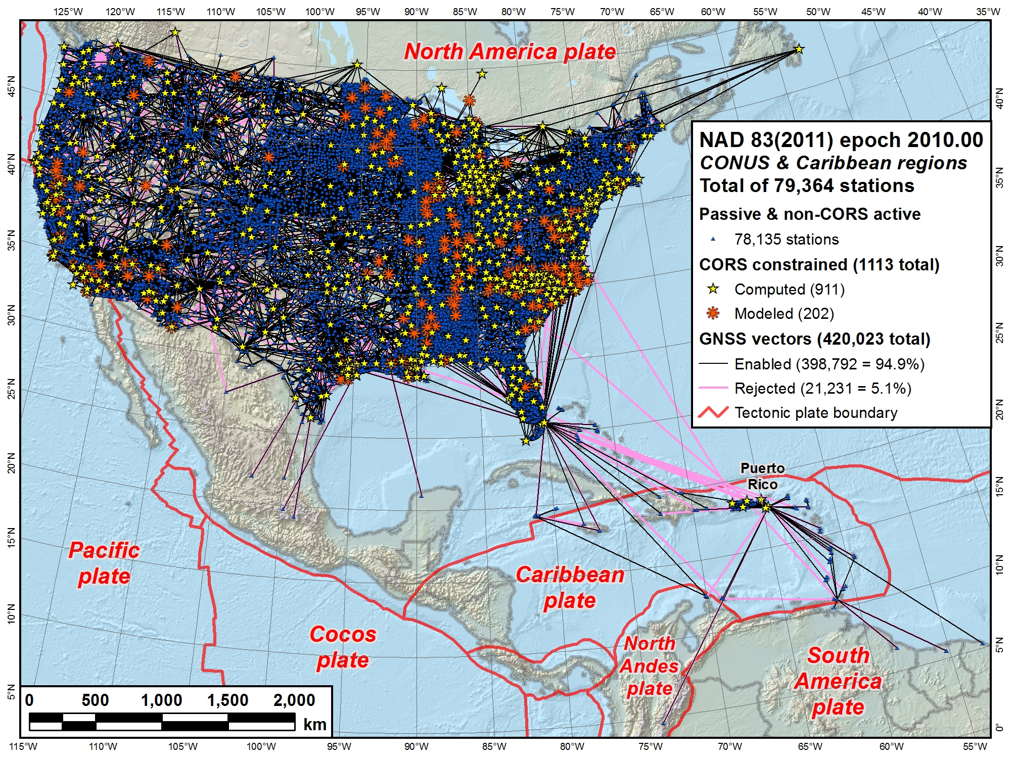

Slide 38
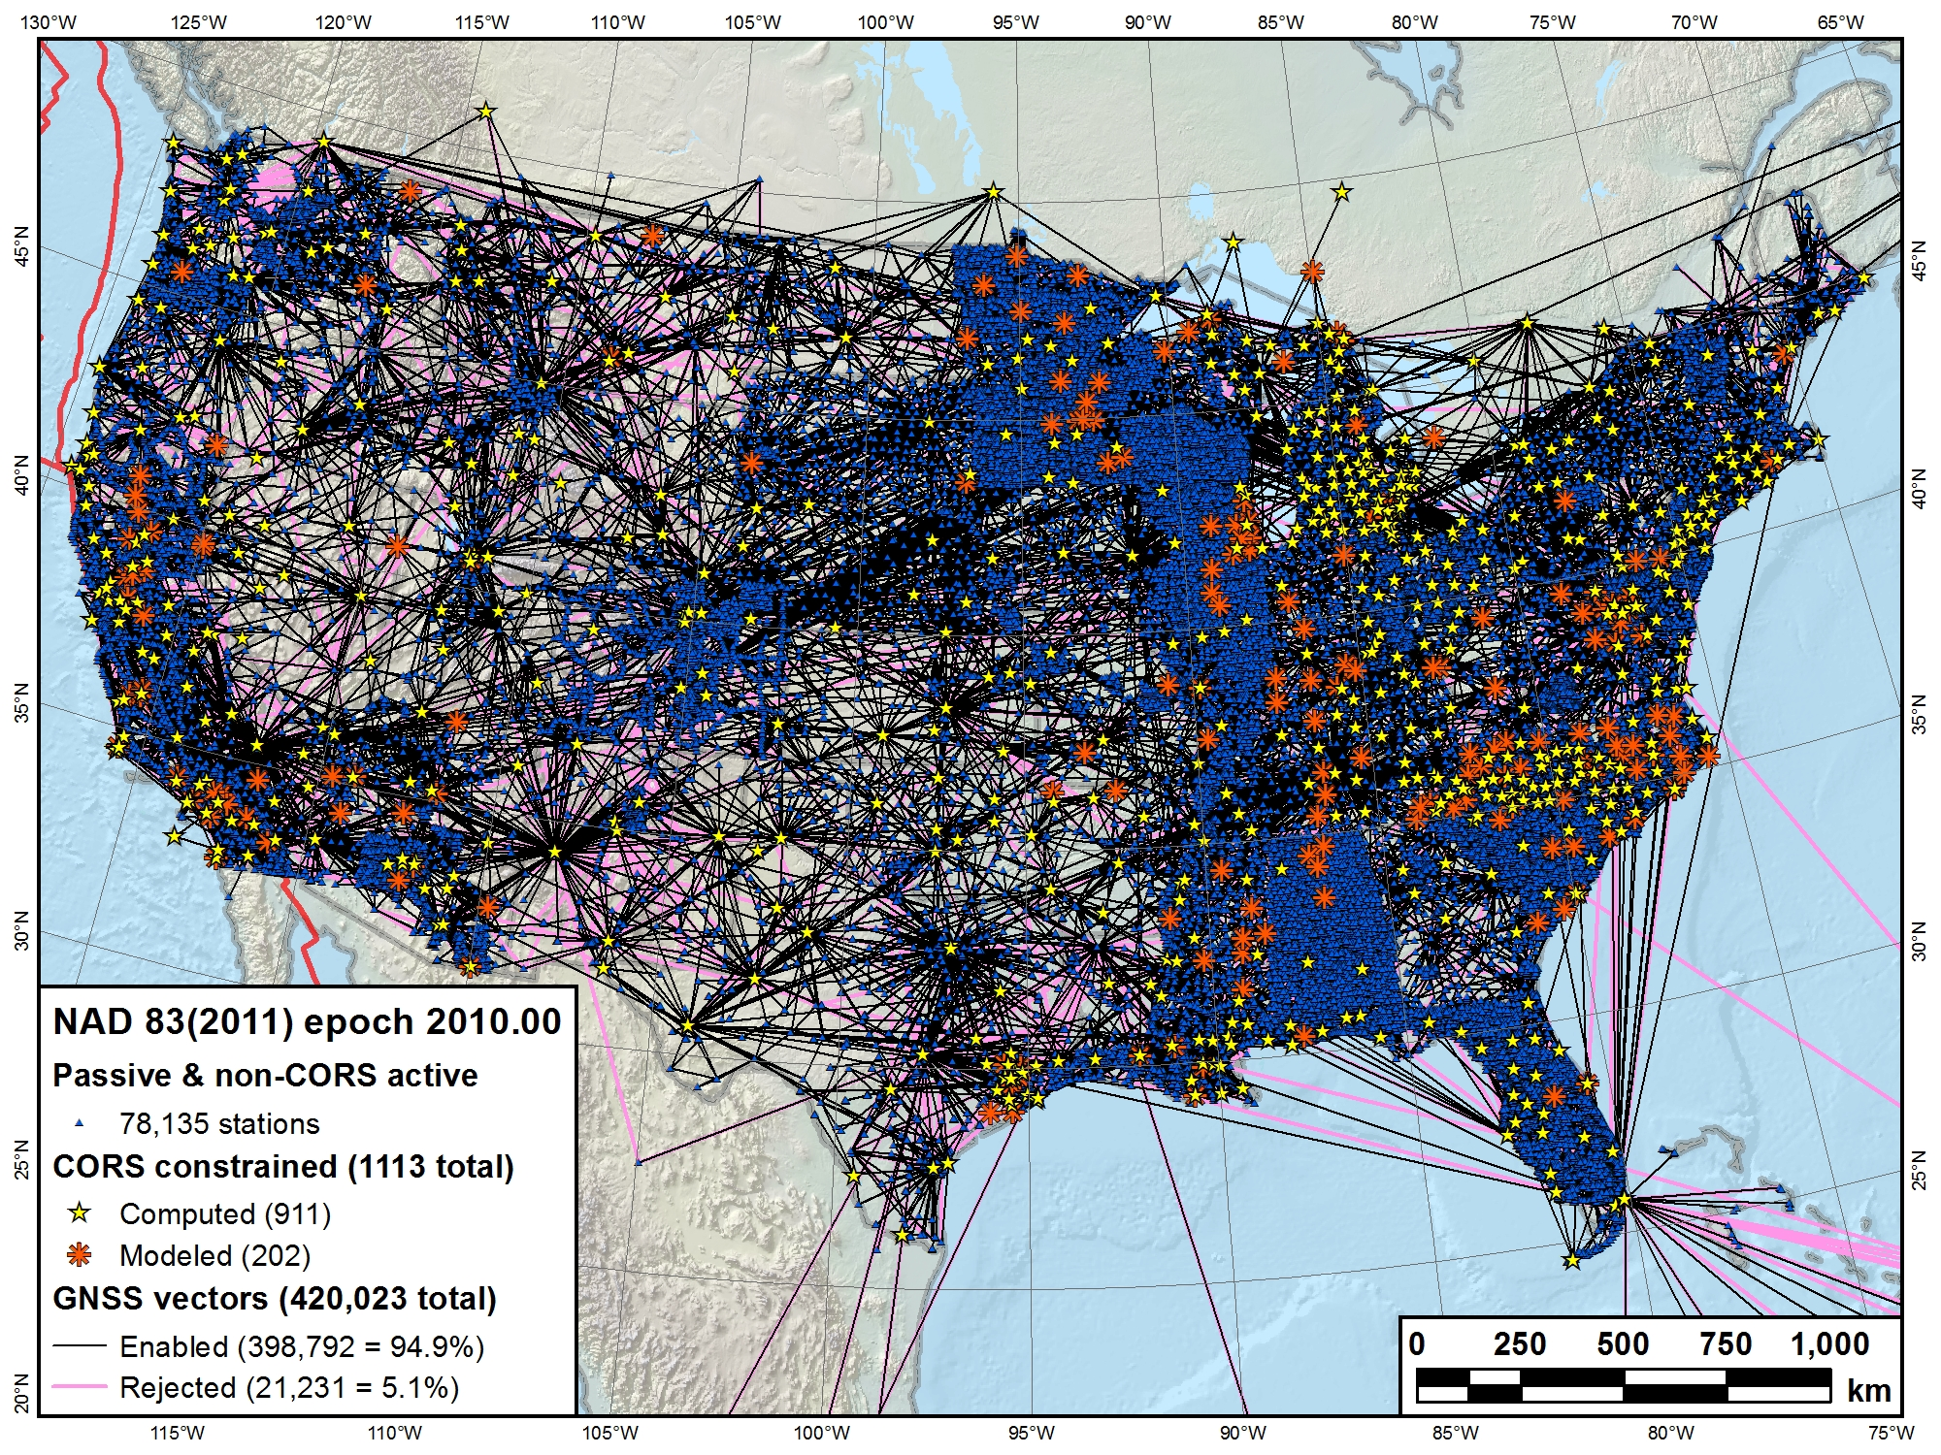

Slide 39
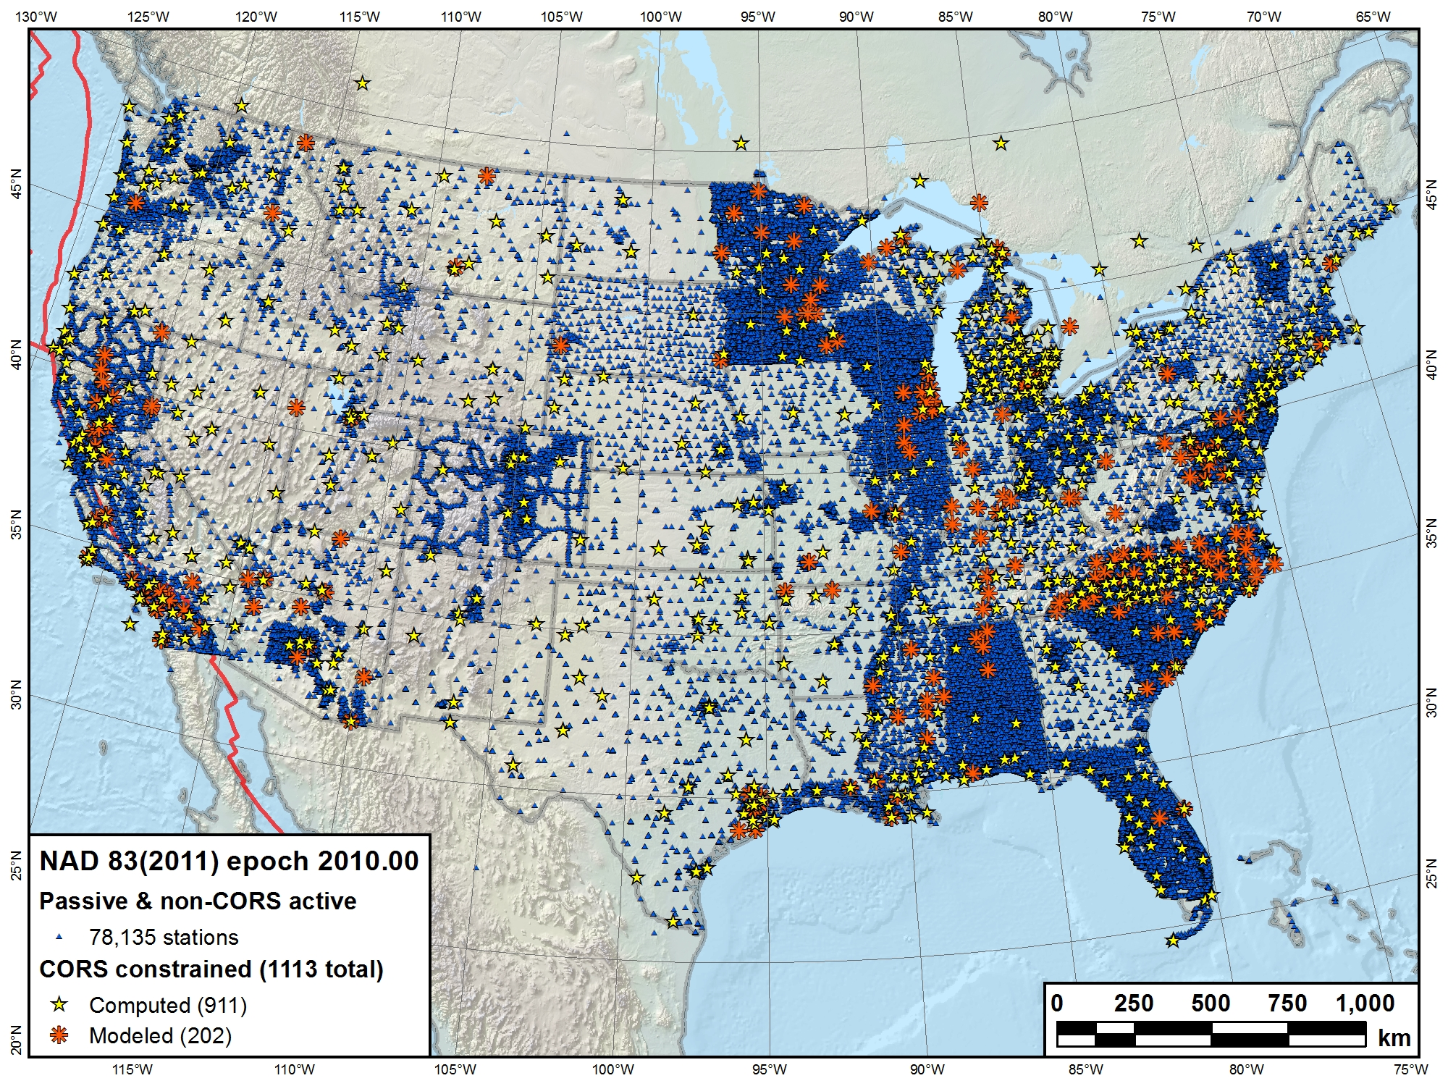

Slide 40
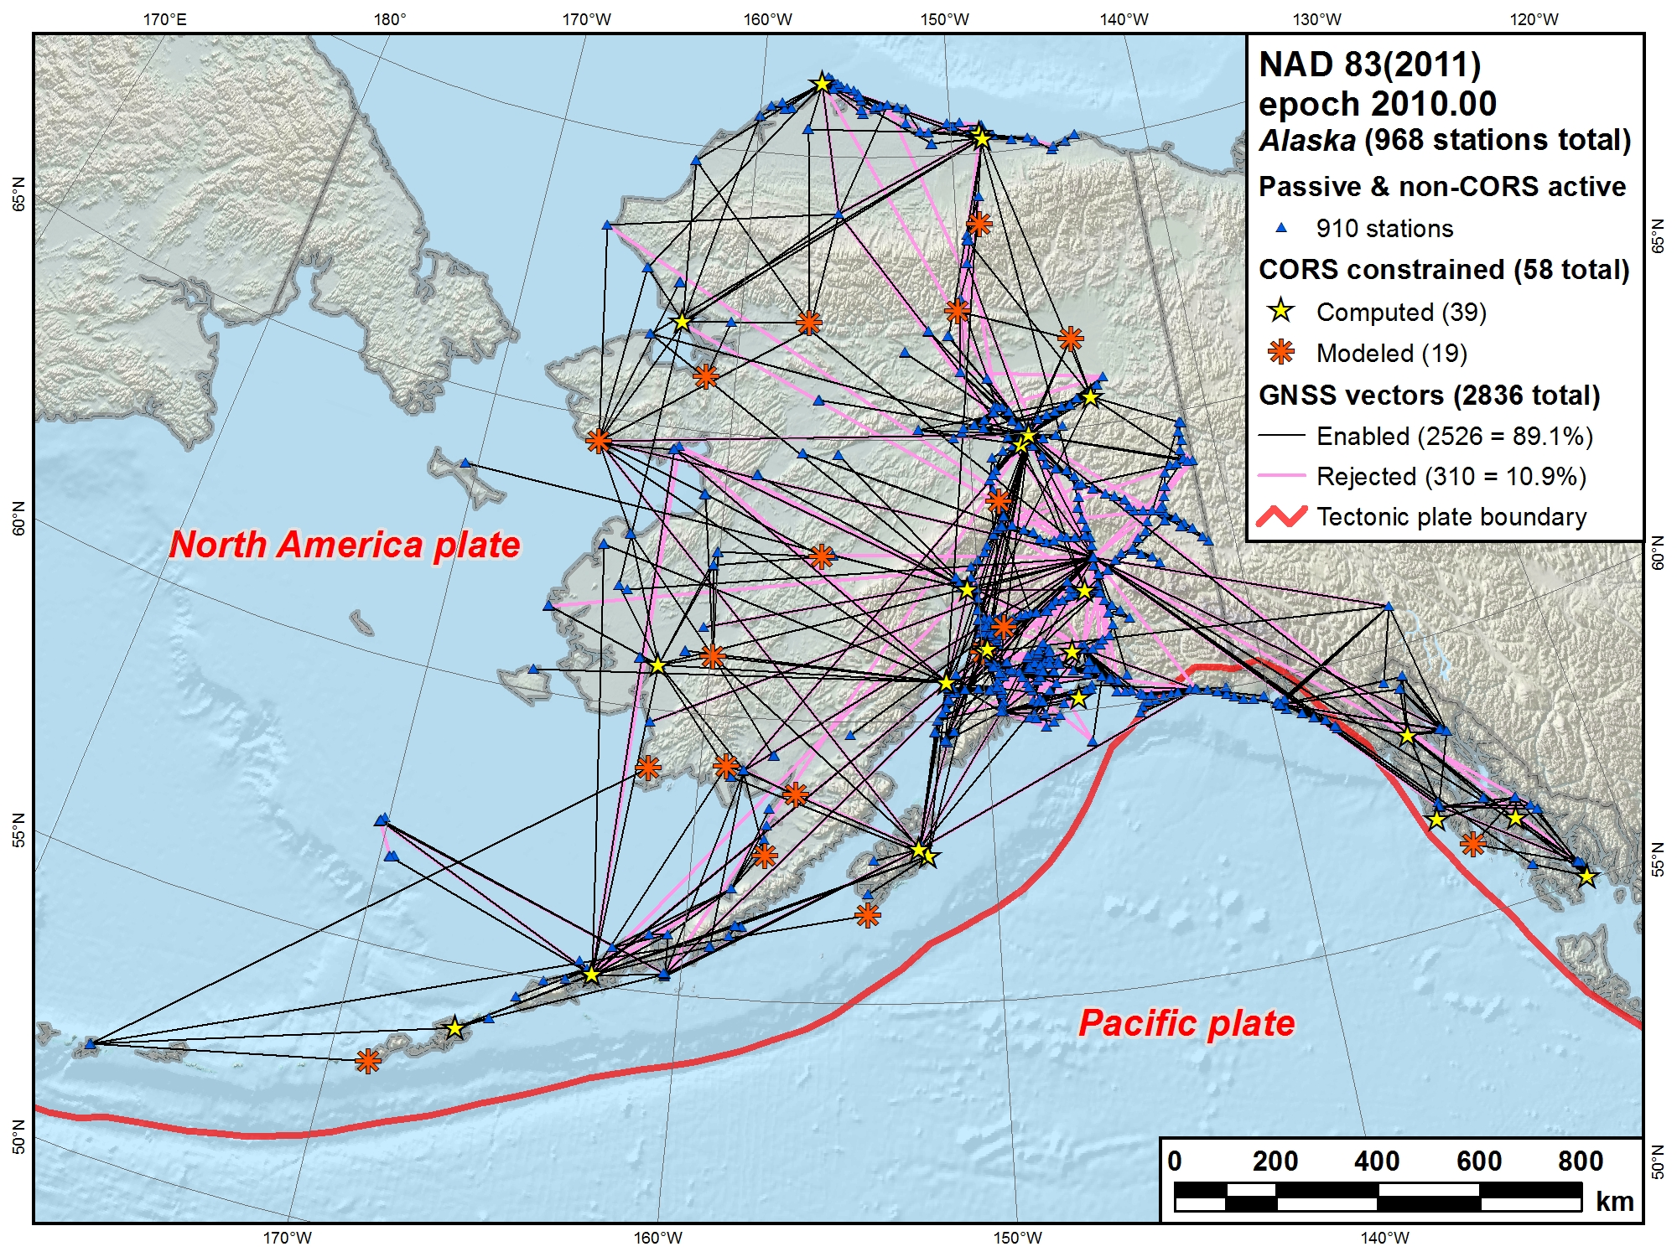

Slide 41
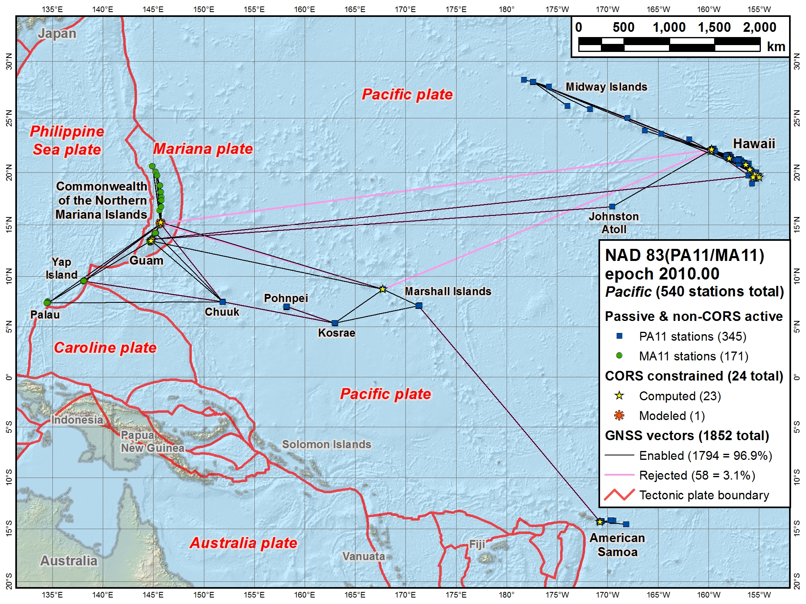

Slide 42
NAD 83(2011/PA11/MA11) epoch 2010.00
Passive control results summary
Station network accuracies (95% confidence)
  Overall median: 0.9 cm horiz, 1.5 cm height (78,709)
    90% < 2.3 cm horizontal and 4.8 cm ellipsoid height
    Does NOT include 2163 no-check stations
  Median accuracies by network
    CONUS Primary: 0.7 cm horiz, 1.2 cm height (61,049)
    CONUS Secondary: 1.6 cm horiz, 3.4 cm height (16,441)
    Alaska: 3.2 cm horiz, 5.7 cm height (814)
    Pacific (PA11): 2.2 cm horiz, 5.0 cm height (282)
    Pacific (MA11): 1.8 cm horiz, 3.8 cm height (123)

Slide 43
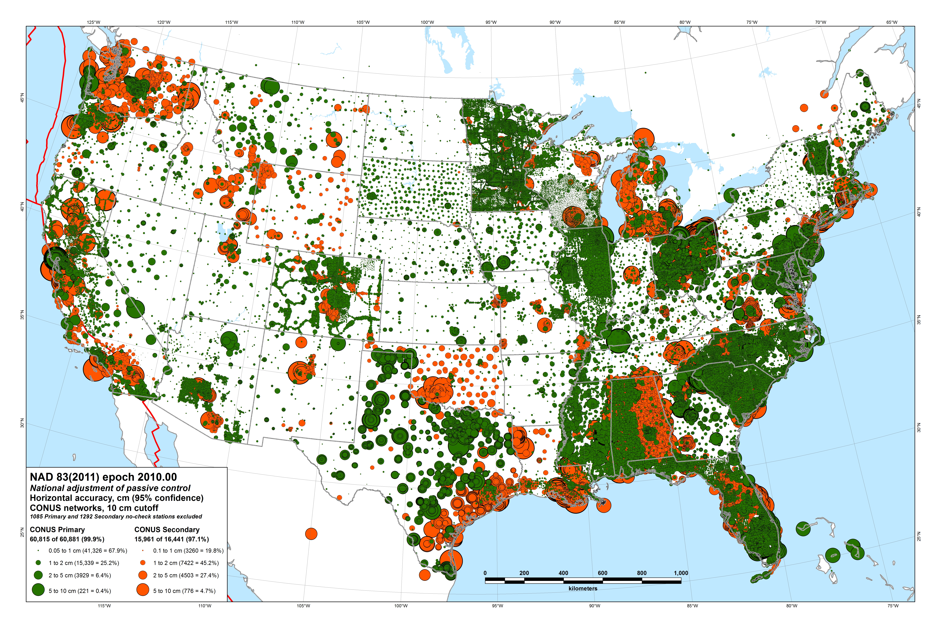

Slide 44
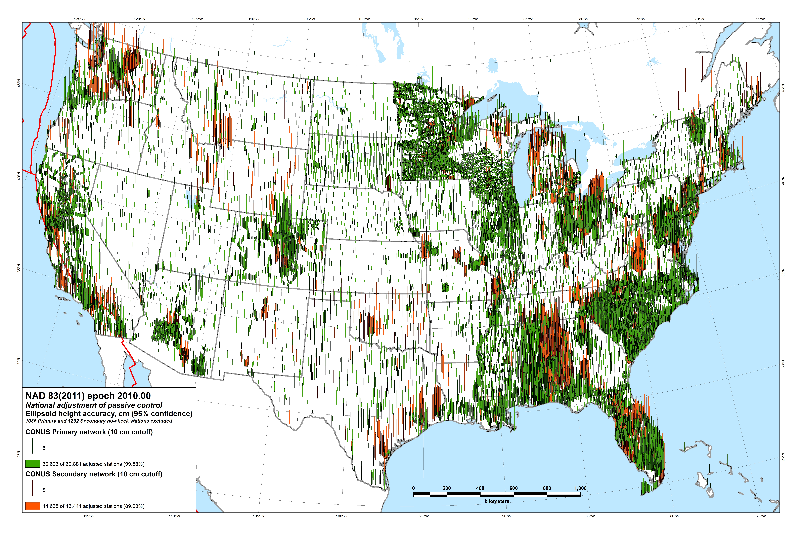

Slide 45
NAD 83(2011/PA11/MA11) epoch 2010.00
Passive control results summary
Station coordinate and height changes
  Overall median: 1.9 cm horiz, 2.1 cm height
    97% changed < 5 cm horizontally and vertically
  Median accuracies by network
    CONUS: 1.9 cm horiz, 2.1 cm height
    Alaska: 6.3 cm horiz, 2.8 cm height
    Pacific (PA11): 2.1 cm horiz, 2.3 cm height
    Pacific (MA11): 2.5 cm horiz, 6.8 cm height

Slide 46
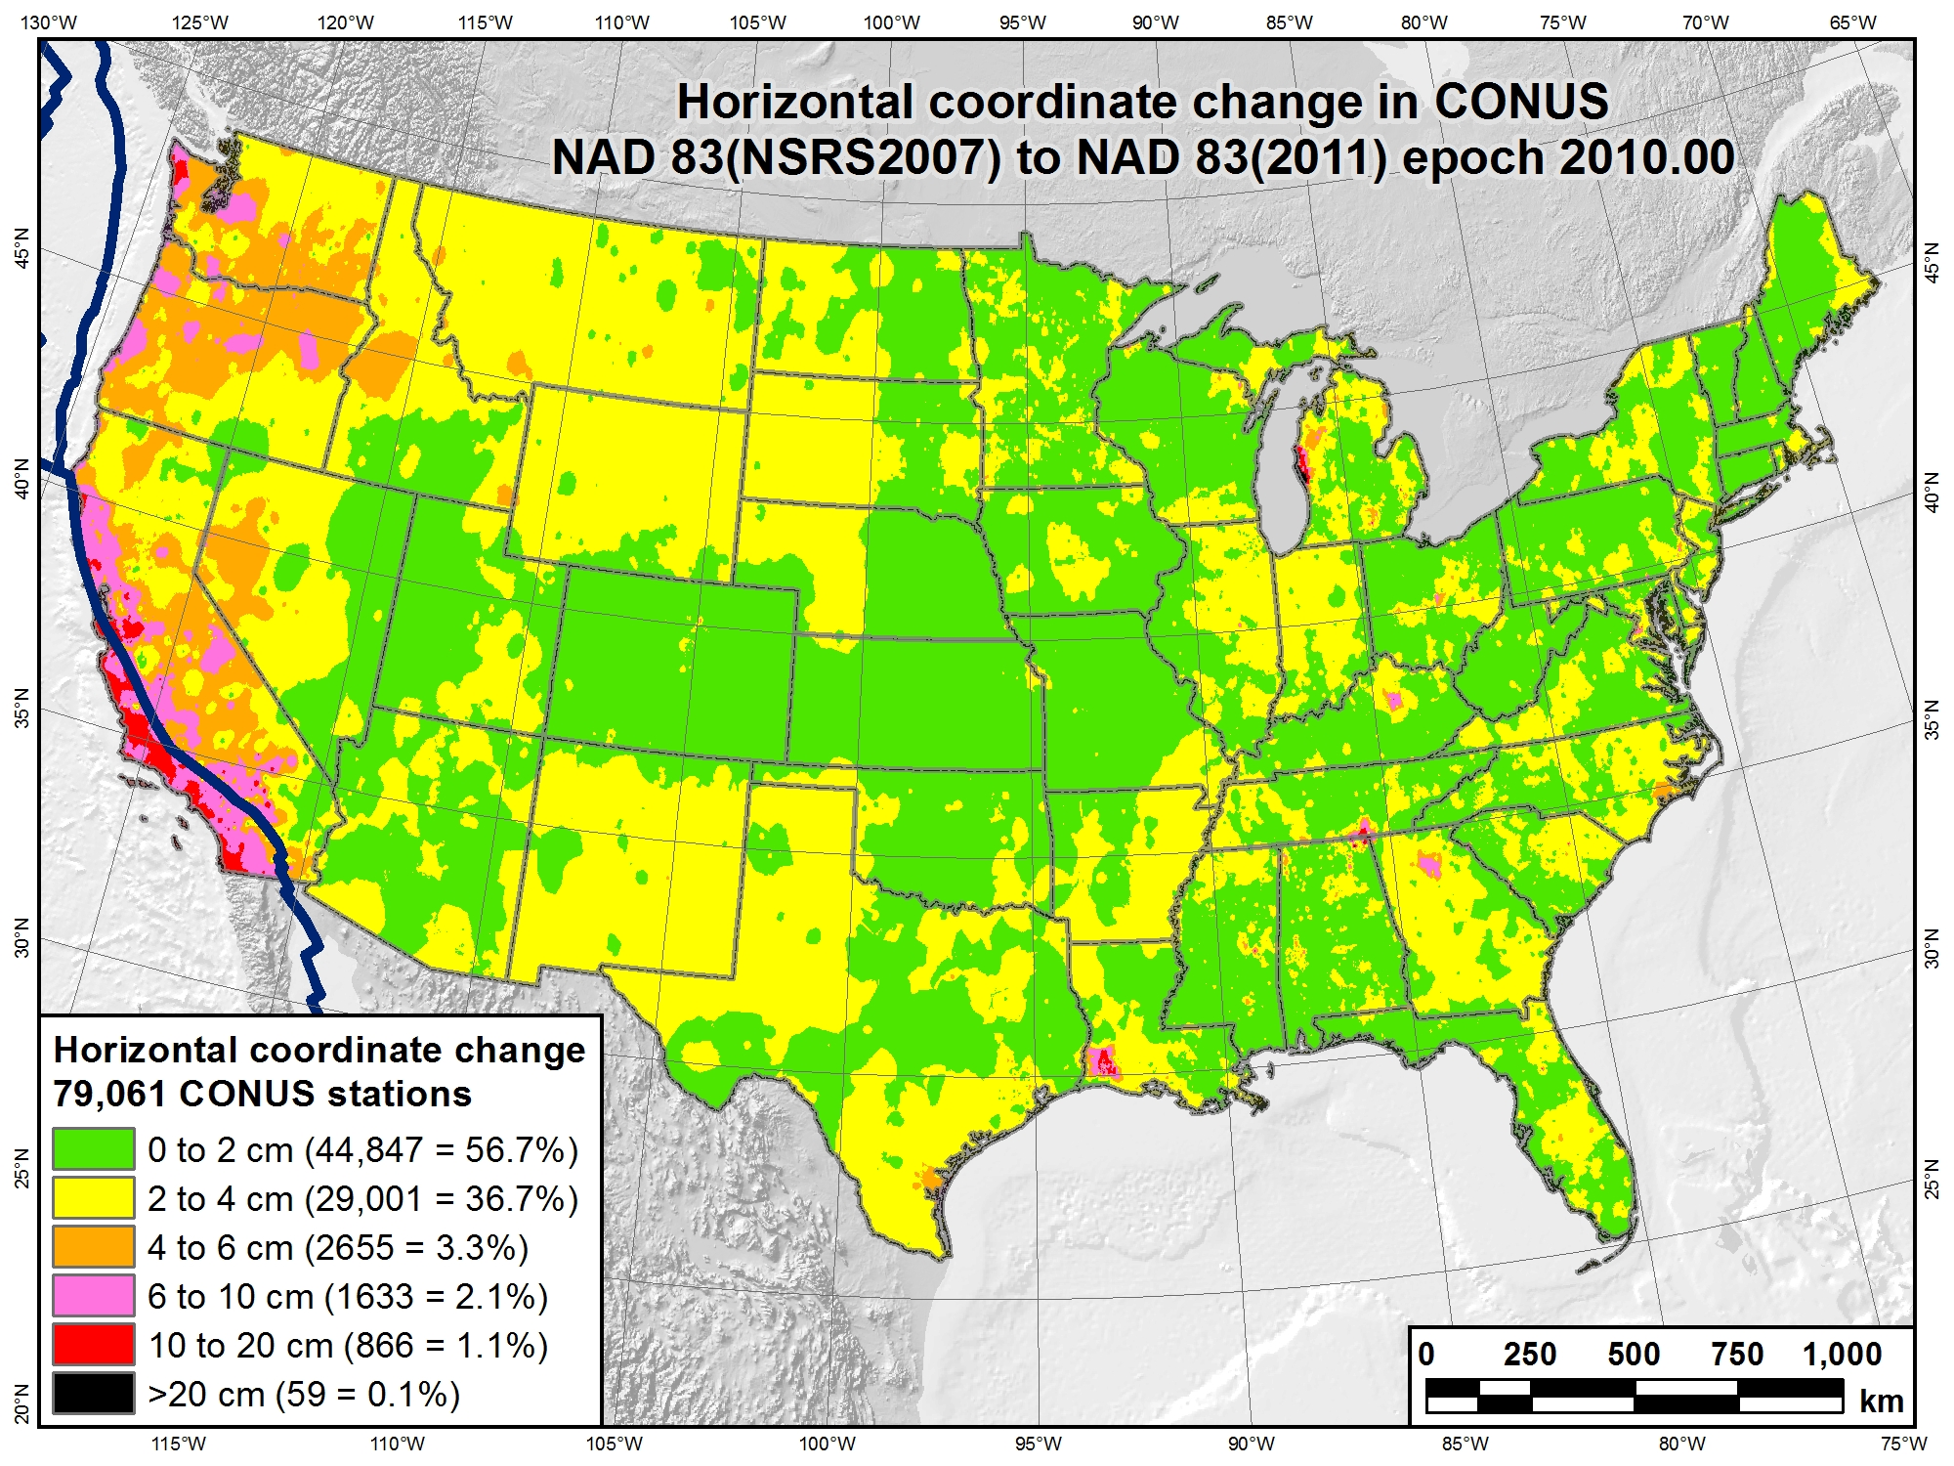

Slide 47
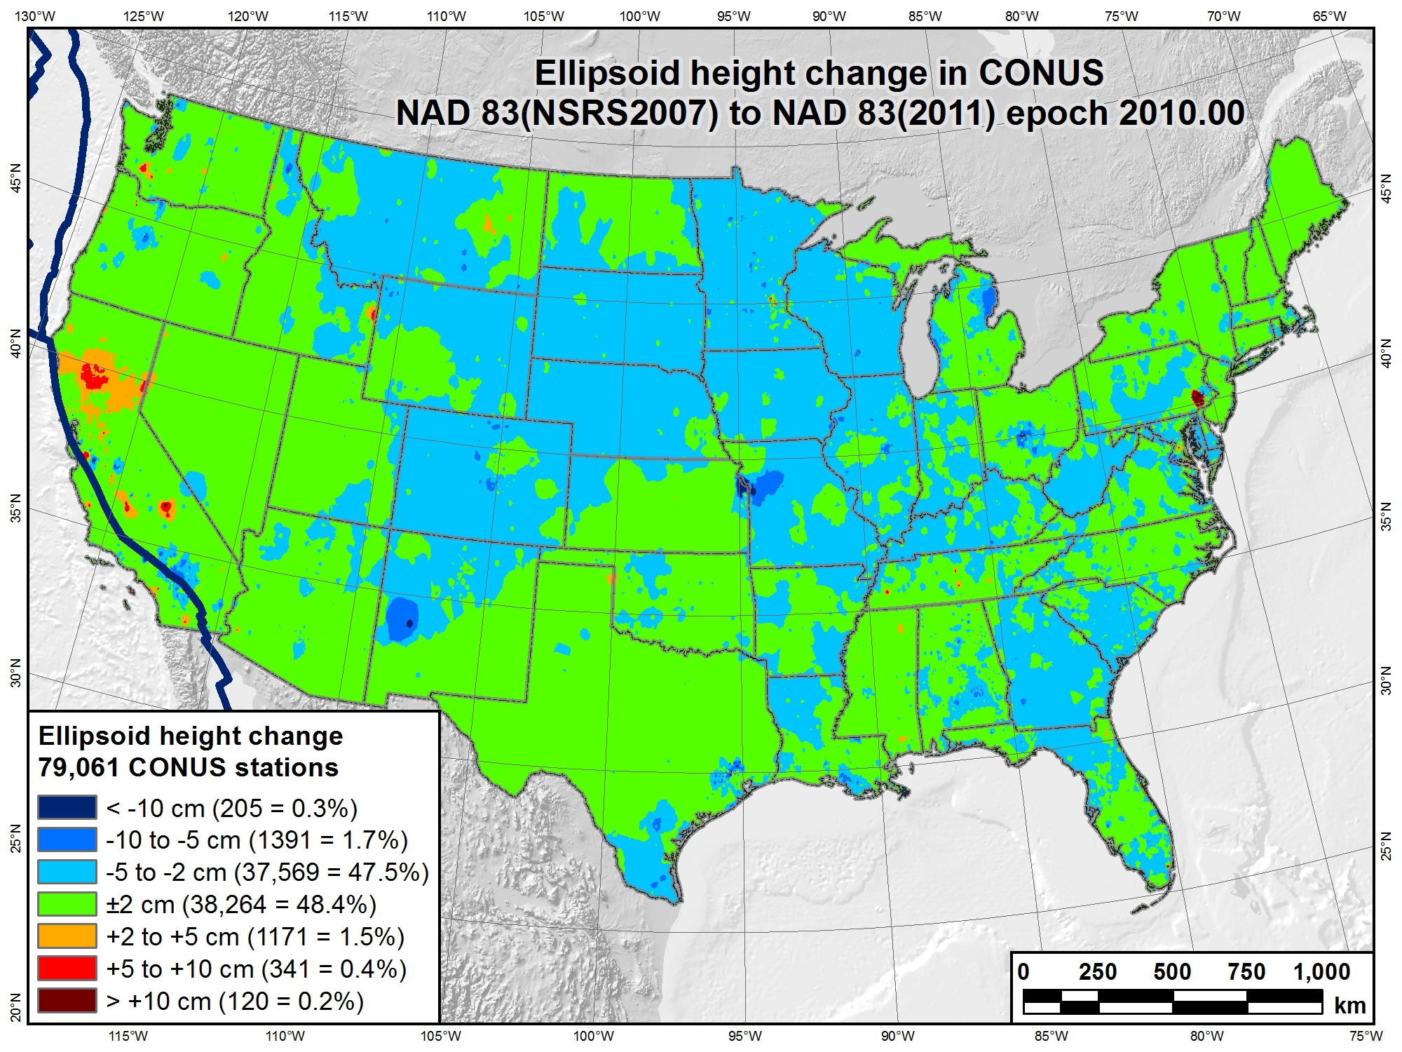

Slide 48
Change in horizontal NAD 83 CORS coordinates
NAD 83(CORS96) epoch 2002.00 → NAD 83(2011) epoch 2010.00
Avg shifts (cm): ΔN = 2.0 (±6.4); ΔE = 0.2 (±5.9); ΔU = -0.9 (±2.0)

Slide 49
Related Tasks, Products & Deliverables
OPUS (Online Positioning User Service)
  Solutions for NAD 83(2011/PA11/MA11) epoch 2010.00
New hybrid geoid model (GEOID12A)
  NAD 83(2011) ellipsoid heights on leveled NAVD 88 BMs
New process for Bluebooking GPS projects
  Currently under development
  New version of “ADJUST” program
  Includes new GIS tools as part of adjustment process
New NAD 83 coordinate transformation tools
  HARN ←→ NSRS2007 ←→ 2011
  Tools created but still needs to be implement
  Both horizontal AND “vertical” (i.e., ellipsoid height)
  Include output that indicates “quality” of transformation
    Quantified using station within grid cell that is worst match with model

Slide 50
Related Tasks, Products & Deliverables
New Geodetic GIS tools
  Use standard NGS ASCII output files as input
  Convert to point, line, and polygon features
  Attribute-rich features in standard GIS format
  Used for display and analysis of results
Two new GIS tools in development
  GPS and leveling network adjustment → GIS features
    GPS files: positions, vectors, error estimates, residuals
    Geodetic leveling: adjusted elevations, loop misclosures, residuals, etc.
  Add more analysis and display functionality
    Error ellipses, spatial analysis, displacement vectors
May provide other NGS products in GIS format
  Geoid models, transformation grids, variety of point datasets

Slide 51
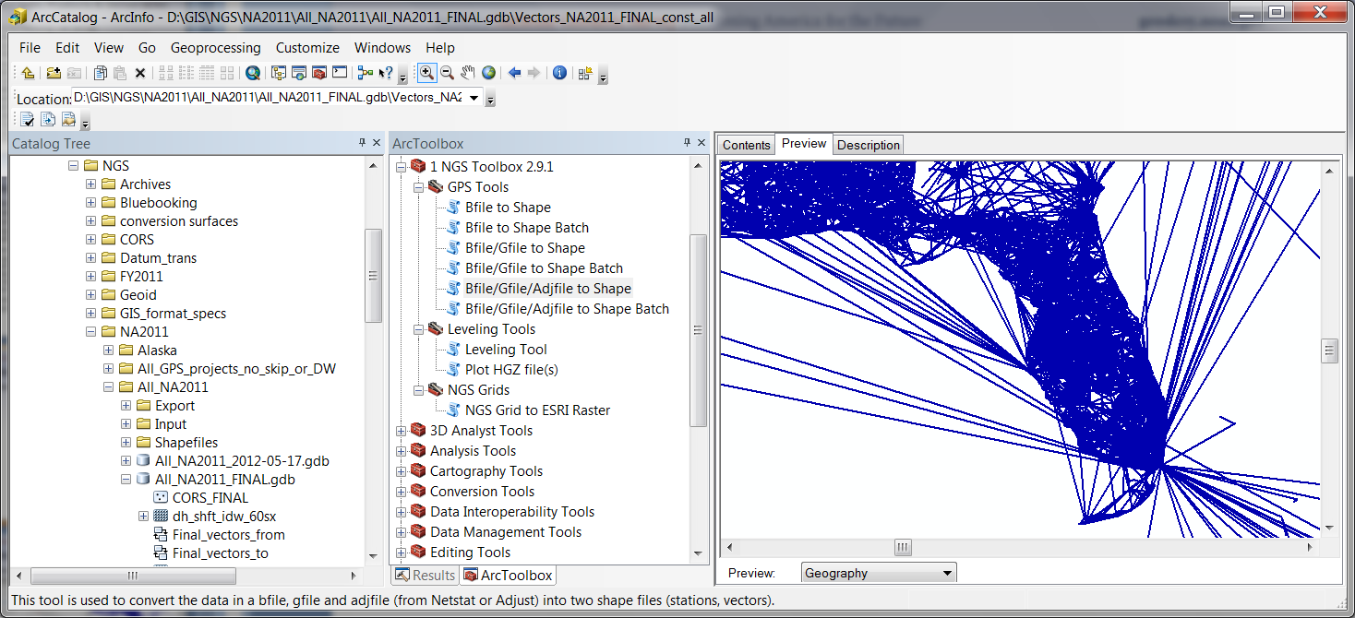
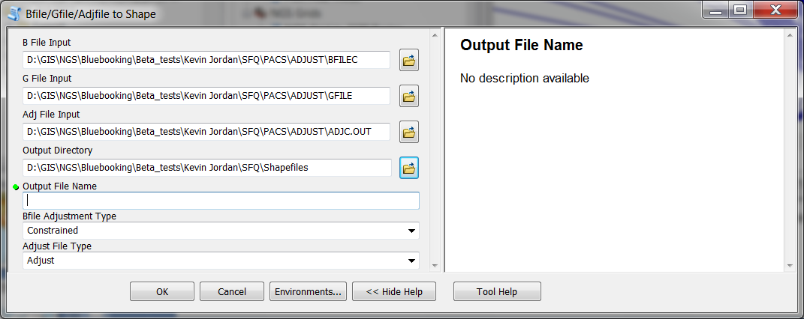
Related Tasks, Products & Deliverables
New Geodetic GIS tools

Slide 52
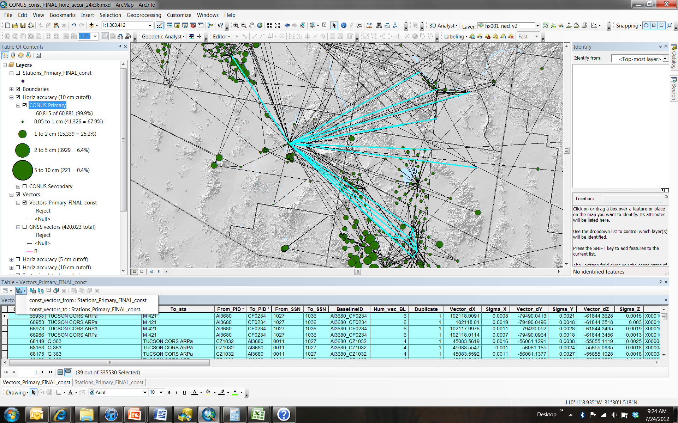
Network adjustment results as GIS features provide powerful analysis capabilities…

Slide 53
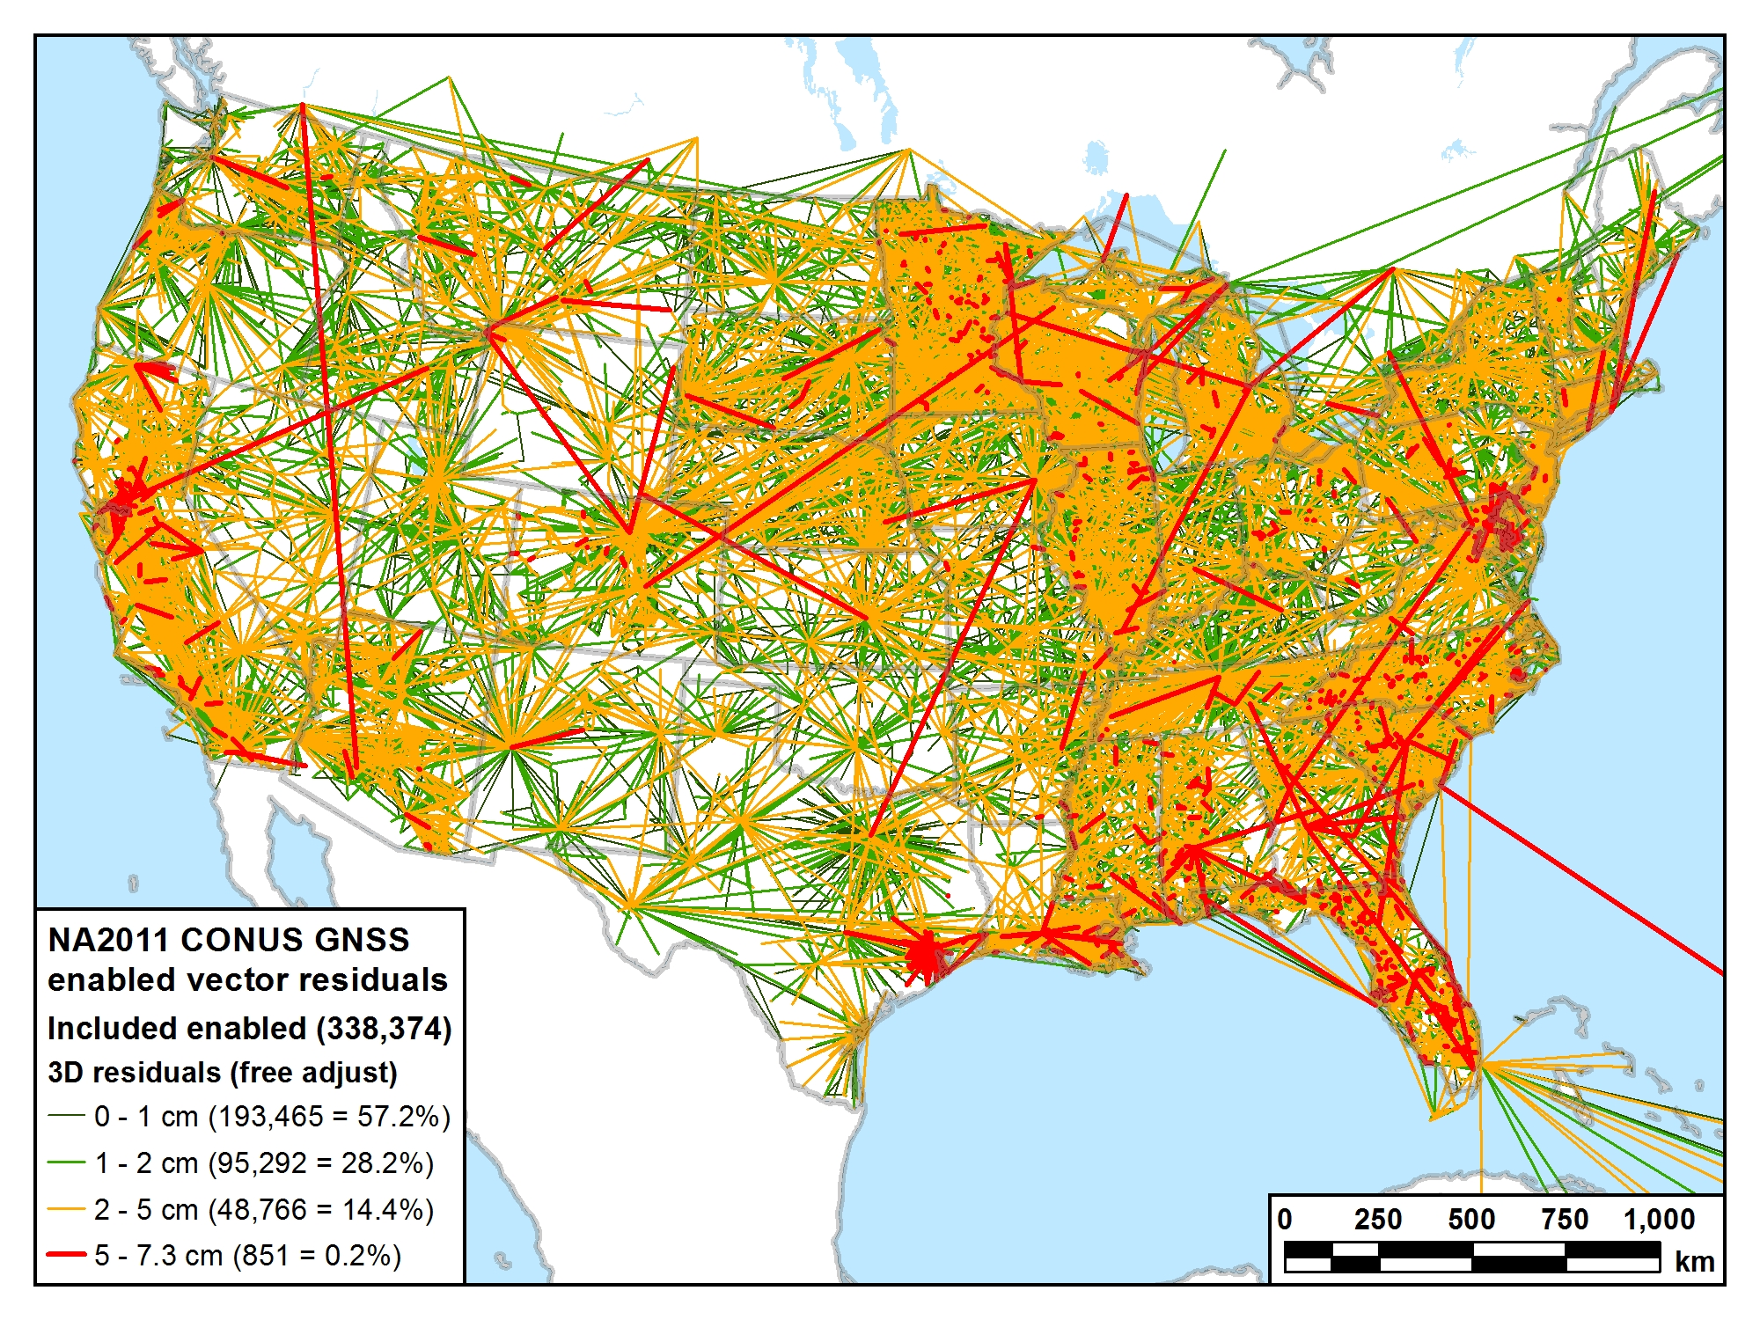
Residuals statistics (cm)
Max = 7.3 Mean = 1.1
Std dev = 0.9 Med = 0.9

Slide 54
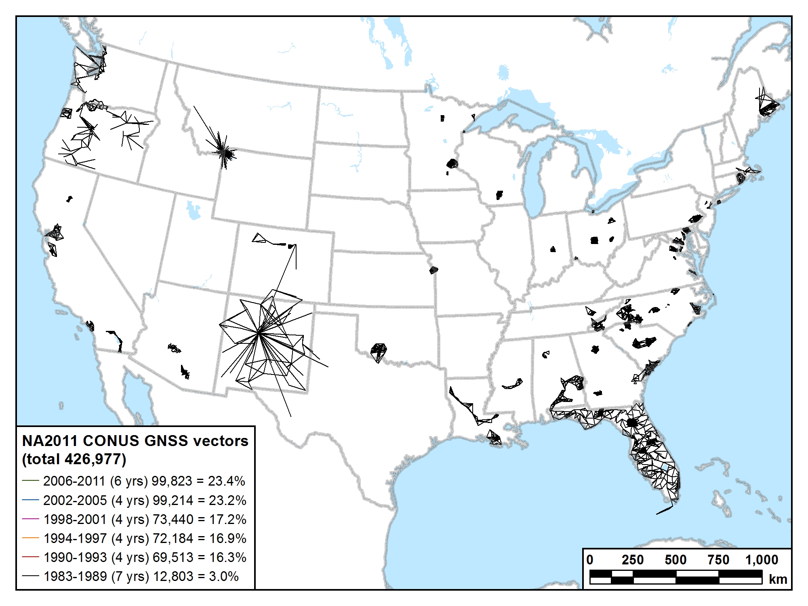
1983-1989 (7 years) 12,803 vectors (3.0%)

Slide 55
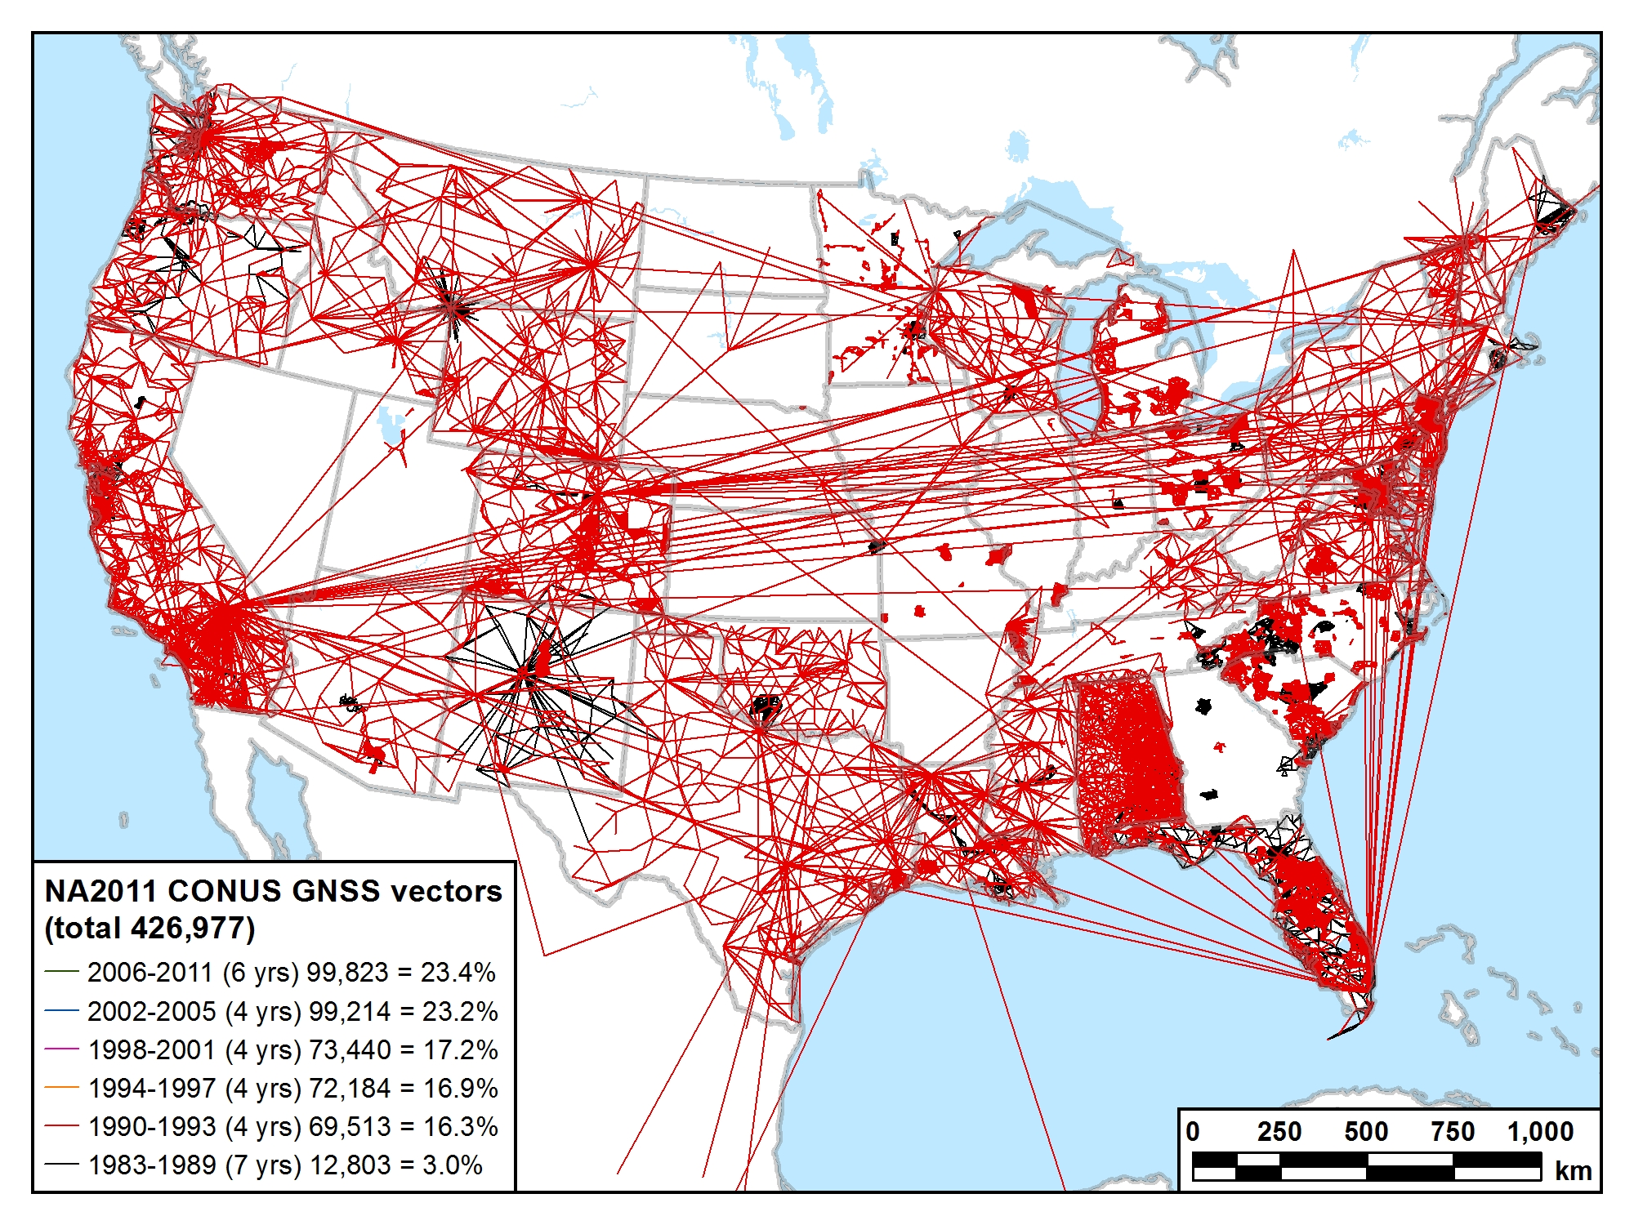
1983-1993 (11 years) 82,316 vectors (19.3%)

Slide 56
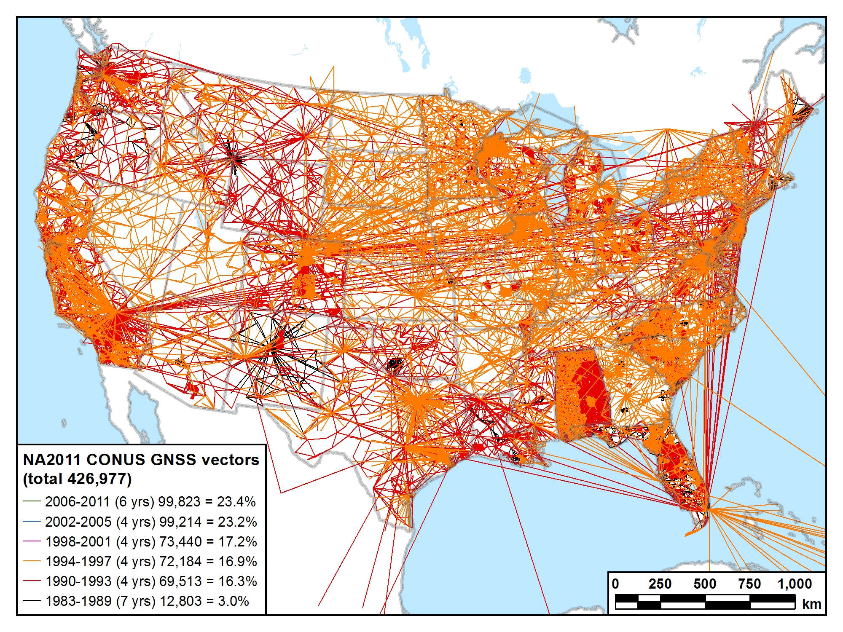
1983-1997 (15 years) 154,500 vectors (36.2%)

Slide 57
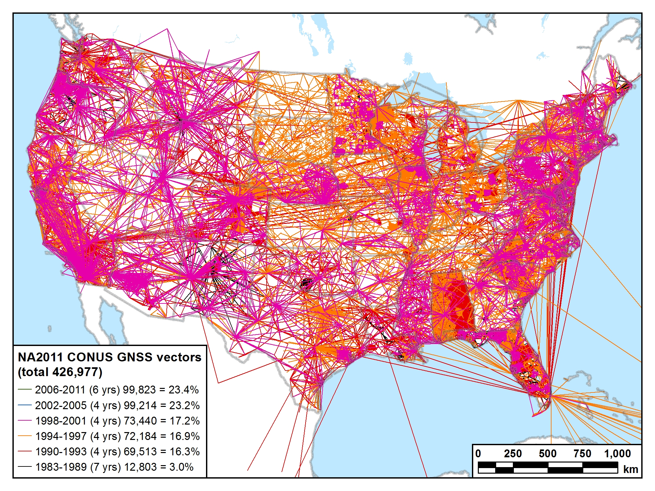
1983-2001 (19 years) 227,940 vectors (53.4%)

Slide 58
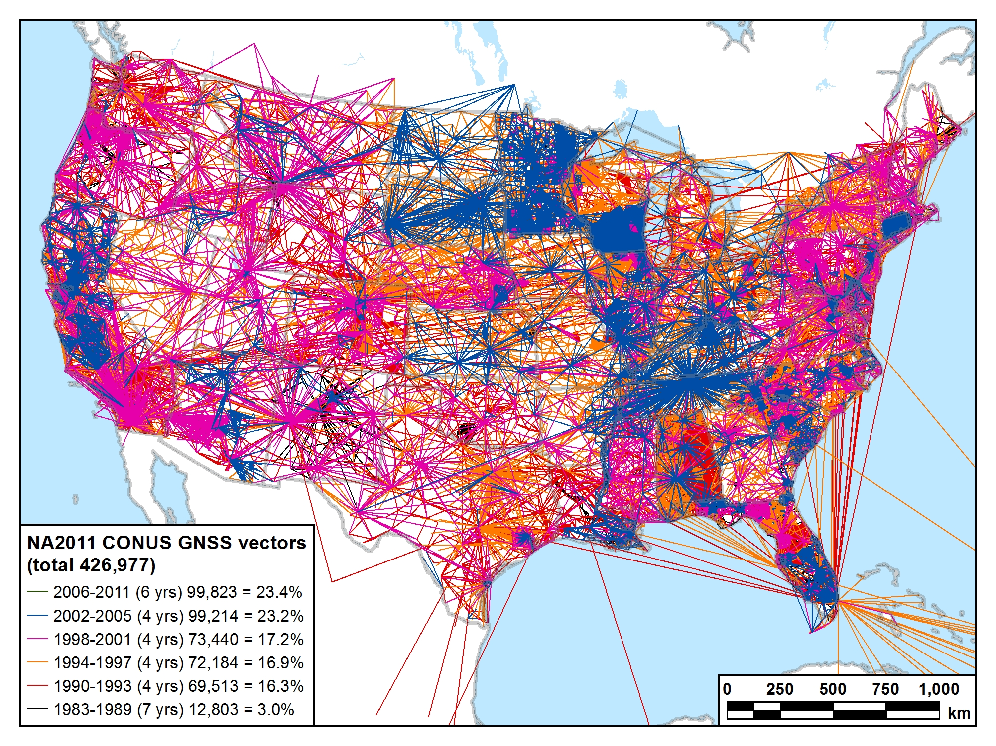
1983-2005 (23 years) 327,154 vectors (76.6%)

Slide 59
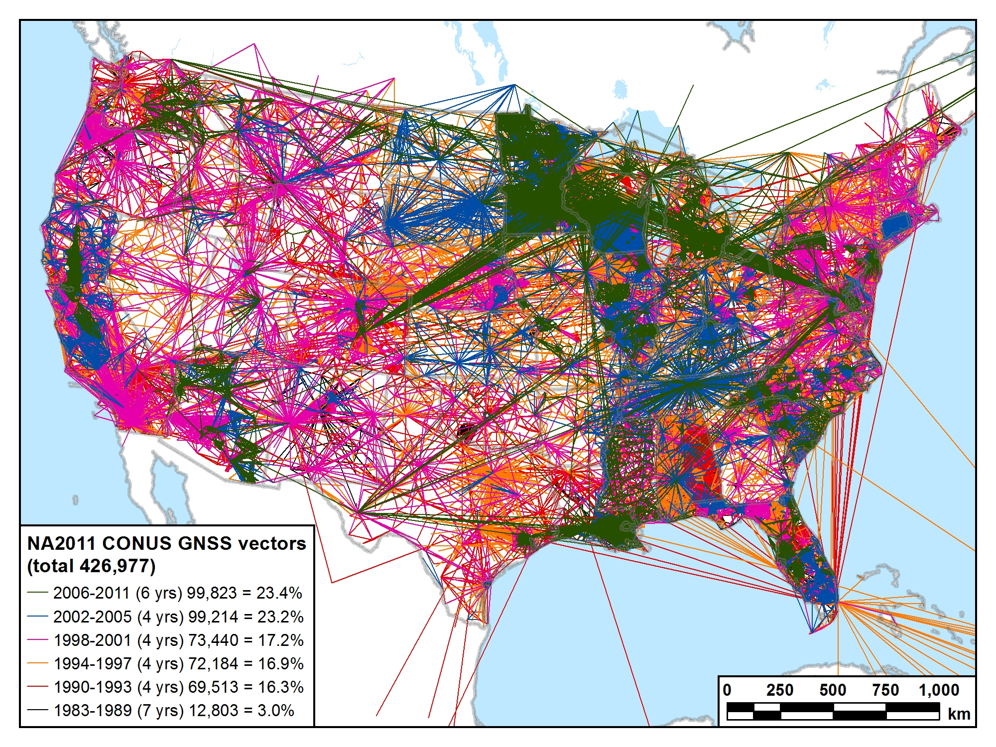
1983-2011 (29 years) 426,977 vectors (100.0%)

Slide 60
Recap: The fundamental questions
When was it done?
  Publication completed on June 30, 2012
    Intent: Simultaneous with release of GEOID12A
How many control stations? 80,872
How much did the coordinates change?
  Median: 1.9 cm horiz, 2.1 cm vertical
How accurate are the results?
  Median: 0.9 cm horiz, 1.5 cm vertical
  (at 95% confidence level)
How do I make use of the results?
  Key is metadata: Know and identify what you have
  Be consistent (i.e., don’t mix realizations)
  Understand your software (e.g., relationship to “WGS 84”)
    Latest WGS 84 is G1674 (week of Feb 5, 2012), epoch 2005.00

Slide 61
What about orthometric heights?
National adjustment of passive control
  NAD 83(2011/PA11/MA11) epoch 2010.00:
    Latitude, longitude, and ellipsoid height
    Network and “local” accuracies
Orthometric heights (“elevations”) NOT determined
  Question: Will GPS-derived heights based on previous
  NAD 83 realizations and geoid models be consistent with those based on NAD 83(2011) and GEOID12A?
    i.e., is the relative change in ellipsoid heights and/or geoid heights significant (too large to ignore)?
Should NGS perform nationwide vertical adjustment?
  Use GEOID12A model and national adjustment GNSS network
  Constrain to leveled NAVD 88 benchmarks
  Determine GPS-derived NAVD 88 heights on non-leveled marks
  Will require significant analysis

Slide 62
History of vertical datums in the USA
Pre-National Geodetic Vertical Datum of 1929 (NGVD 29)
  The first geodetic leveling project in the United States was surveyed by the Coast Survey from 1856 to 1857.
  Transcontinental leveling commenced from Hagerstown, MD in 1877.
  General Adjustments of leveling data yielded datums in 1900, 1903, 1907, and 1912. (Sometimes referenced as the Sandy Hook Datum)
  NGS does not offer a utility which transforms from these older datums into newer ones (though some users still work in them!)
Notes:
According to Dave Doyle, the USACE still maintains data relative to the 1912 4th General Adjustment!

Slide 63
History of vertical datums in the USA
NGVD 29
  National Geodetic Vertical Datum of 1929
  Original name: “Sea Level Datum of 1929”
  “Zero height” held fixed at 26 tide gauges
    Not all on the same tidal datum epoch (~ 19 yrs)
  Did not account for Local Mean Sea Level variations from the geoid
    Thus, not truly a “geoid based” datum

Slide 64
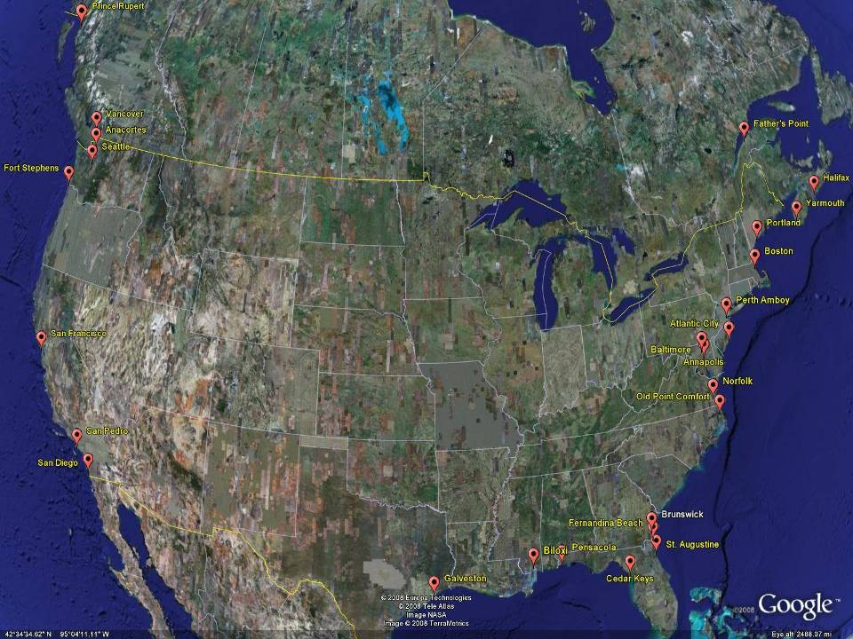
NGVD29
The National Geodetic Vertical Datum of 1929 is referenced to 26 tide gauges in the US and Canada
Notes:
It turns out that MSL is a close approximation to another surface, defined by gravity, called the geoid, which is the true zero surface for measuring elevations. Because we cannot directly see the geoid surface, we cannot actually measure the heights above or below the geoid surface. We must infer where this surface is by making gravity measurements and by modeling it mathematically. For practical purposes, we assume that at the coastline the geoid and the MSL surfaces are essentially the same. Nevertheless, as we move inland we measure heights relative to the zero height at the coast, which in effect means relative to MSL.
Definition: NGVD29 – The National Geodetic Vertical Datum of 1929…
The Sea Level Datum of 1929 was the vertical control datum established for vertical control surveying in the United States of America by the General Adjustment of 1929. The datum was used to measure elevation or altitude above, and depression or depth below, mean sea level (MSL).
Mean sea level was measured at 26 tide gauges: 21 in the United States and 5 in Canada. The datum was defined by the observed heights of mean sea level at the 26 tide gauges and by the set of elevations of all bench marks resulting from the adjustment. The adjustment required a total of 66,315 miles (106,724 km) of leveling with 246 closed circuits and 25 circuits at sea level.
Since the Sea Level Datum of 1929 was a hybrid model, it was not a pure model of mean sea level, the geoid, or any other equipotential surface. Therefore, it was renamed the National Geodetic Vertical Datum of 1929 (NGVD 29) in 1973. The NGVD 29 was subsequently replaced by the North American Vertical Datum of 1988 (NAVD 88) based upon the General Adjustment of the North American Datum of 1988.

Slide 65
History of vertical datums in the USA
NAVD 88
  North American Vertical Datum of 1988
  One height held fixed at “Father Point” (Rimouski, Canada)
  …height chosen was to minimize 1929/1988 differences on USGS topo maps in the eastern U.S.
  Thus, the “zero height surface” of NAVD 88 wasn’t chosen for its closeness to the geoid (but it was close…few decimeters)

Slide 66
History of vertical datums in the USA
NAVD 88 (continued)
  Use of one fixed height removed local sea level variation problem of NGVD 29
  Use of one fixed height did open the possibility of unconstrained cross-continent error build up
  But the H=0 surface of NAVD 88 was supposed to be parallel to the geoid…(close again)

Slide 67
NAVD88
The North American Vertical Datum of 1988 is referenced to a single tide gauge in Canada
Notes:
It turns out that MSL is a close approximation to another surface, defined by gravity, called the geoid, which is the true zero surface for measuring elevations. Because we cannot directly see the geoid surface, we cannot actually measure the heights above or below the geoid surface. We must infer where this surface is by making gravity measurements and by modeling it mathematically. For practical purposes, we assume that at the coastline the geoid and the MSL surfaces are essentially the same. Nevertheless, as we move inland we measure heights relative to the zero height at the coast, which in effect means relative to MSL.
Definition: NGVD29 – The National Geodetic Vertical Datum of 1929…
The Sea Level Datum of 1929 was the vertical control datum established for vertical control surveying in the United States of America by the General Adjustment of 1929. The datum was used to measure elevation or altitude above, and depression or depth below, mean sea level (MSL).
Mean sea level was measured at 26 tide gauges: 21 in the United States and 5 in Canada. The datum was defined by the observed heights of mean sea level at the 26 tide gauges and by the set of elevations of all bench marks resulting from the adjustment. The adjustment required a total of 66,315 miles (106,724 km) of leveling with 246 closed circuits and 25 circuits at sea level.
Since the Sea Level Datum of 1929 was a hybrid model, it was not a pure model of mean sea level, the geoid, or any other equipotential surface. Therefore, it was renamed the National Geodetic Vertical Datum of 1929 (NGVD 29) in 1973. The NGVD 29 was subsequently replaced by the North American Vertical Datum of 1988 (NAVD 88) based upon the General Adjustment of the North American Datum of 1988.

Slide 68
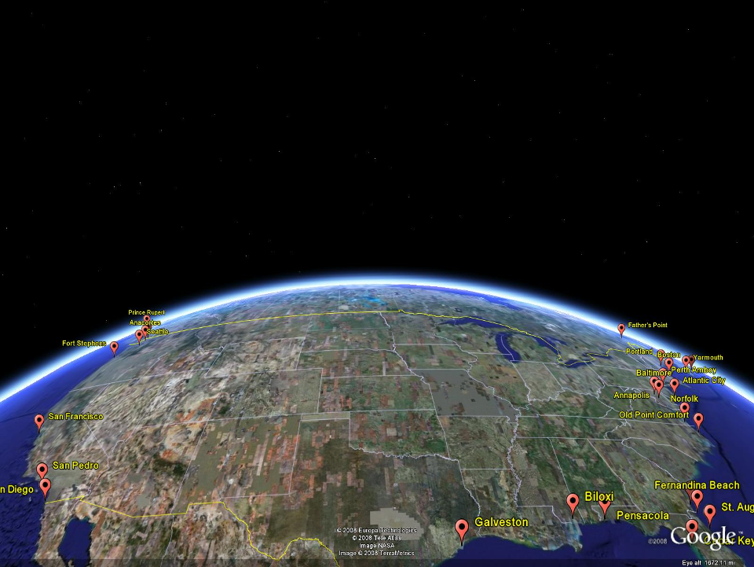
NAVD 88
Referenced to 1 Tide Gage
(Father’s Point)
NGVD 29
Referenced to 26 Tide Gages
-11 cm
125 cm
-23 cm
85 cm
102 cm
NAVD88 minus LMSL(1960-1978)
70 cm
-11 cm
4 cm
-23 cm
Notes:
NGVD29 consisted of the national vertical network referenced to 26 tide stations along the coast of North America
Click
That network was warped or twisted to fit those tide stations. The difference between the geoid (what we run levels on) and LMSL is not the same for every tide station due to prevailing winds, ocean current, etc. It is that difference that warped the network.
Click
NAVD88 utilized additional leveling data along with gravity measurements (to measure the geoid) and was referenced to only one tide station on the St. Lawrence Seaway. As you can see in the graphic, the network was unwarped which changes those reference mark’s elevations (differences between NAVD88 and the local mean sea level shown) This is not the difference between NAVD88 and NGVD29 but it is a representation of what happened.

Slide 69
Types and Uses of Geoid Height Models
Gravimetric (or Gravity) Geoid Height Models
  Defined by gravity data crossing the geoid
  Refined by terrain models (DEM’s)
  Scientific and engineering applications
Composite (or Hybrid) Geoid Height Models
  Gravimetric geoid defines most regions
  Warped to fit available GPSBM control data
  Defined by legislated ellipsoid (NAD 83) and local vertical datum (NAVD 88, PRVD02, etc.)
  May be statutory for some surveying & mapping applications

Slide 70

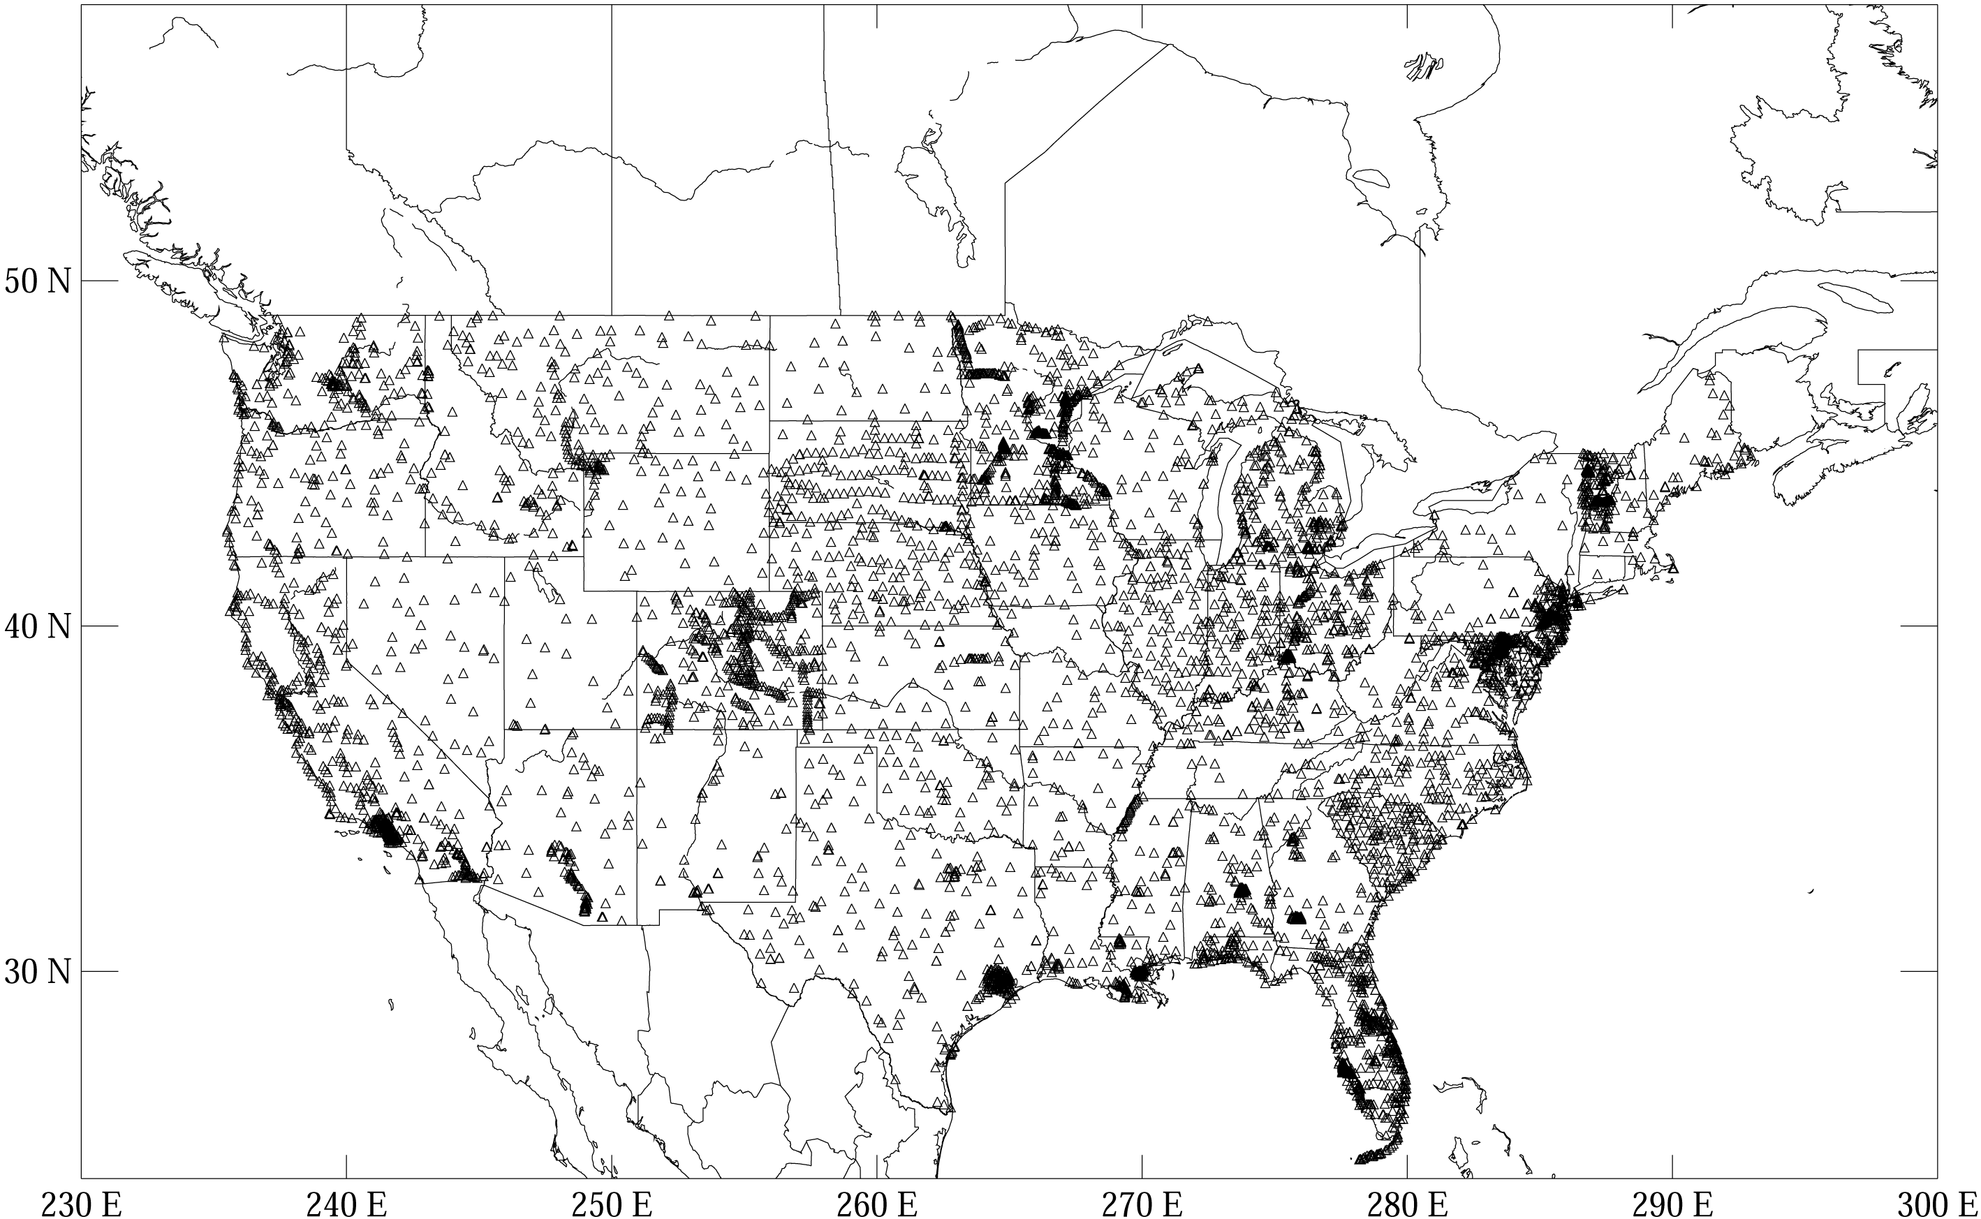

GGPSBM1999: 6,169 total 0 Canada STDEV 9.2 cm (2σ)
GGPSBM2003: 14,185 total 579 Canada STDEV 4.8 cm (2 σ)
Notes:
These are the control data used to make xGEOID06a, GEOID03 and GEOID99 (GPS on bench marks: GPSBM’s).
Improvements in Distribution are primarily due to obtaining data in Canada.
The bulk of the increase comes in one state: Minnesota (603 => 4161).
Note the inequitable distribution.
You could practically grid the GPSBM’s in South Carolina or Minnesota and get a good result.
Other places are not so fortunate…
Also note that this shows distribution but not quality of the points.
Some regions (e.g., Texas) have systematic quality problems (due to subsidence) that impact the GPSBM’s and the derived hybrid geoids.
Current techniques rely on creating models of the systematic effects at multiple wavelengths. If the spatial density doesn’t support the shorter wavelength models, then the quality of predictions will commensurately be reduced.
Note that a hyper-dense survey isn’t necessary to achieve optimal results. Later discussion on Minnesota will emphasize this.

Slide 71


GGPSBM2009: 18,398 STDEV 2.8 cm (2σ)

Slide 72



        GGPSBM2012A: 23,961 (CONUS)
        499 (OPUS on BM)
        574 (Canada)
        177 (Mexico)

Slide 73
Which Geoid for Which NAD 83?
NAD 83(2011)
NAD 83(2007)
NAD 83(1996) & CORS96
NAD 83(1992)
Geoid12A
Geoid09
Geoid06 (AK only)
Geoid03
Geoid99
Geoid96
Geoid93

Slide 74
Mission and Vision of NGS
To define, maintain and provide access to the National Spatial Reference System to meet our nation’s economic, social, and environmental needs
“Maintain the NSRS” means “NGS must track all of the temporal changes to the defining points of the NSRS in such a way as to always maintain the accuracy in the NSRS definition.”
Vision - Modernize the Geopotential (“Vertical”) and Geometric (“Horizontal”) datums

Slide 75
Problems with NAD 83 and NAVD 88
NAD 83 is not as geocentric as it could be (approx. 2 m)
  Surveyors don’t see this - Yet
NAD 83 is not well defined with positional velocities
NAVD 88 is realized by passive control (bench marks) most of which have not been releveled in at least 40 years.
NAVD 88 does not account for local vertical velocities (subsidence and uplift)
  Post glacial isostatic readjustment
  Subsurface fluid withdrawal
  Sediment loading
  Sea level rise
    Seavey Island, ME – 1.8 mm/yr (0.006 ft/yr) Since 1926
    Boston, MA– 2.6 mm/yr (.009 ft/yr) Since 1921

Slide 76

The National Geodetic Survey 10 year plan
Mission, Vision and Strategy
2008 – 2018
http://www.ngs.noaa.gov/INFO/NGS10yearplan.pdf
Official NGS policy as of Jan 9, 2008
  Modernized agency
  Attention to accuracy
  Attention to time-changes
  Improved products and services
  Integration with other fed missions
2018 Targets: (now 2022)
  NAD 83 and NAVD 88 re-defined
  Cm-accuracy access to all coordinates
  Customer-focused agency
  Global scientific leadership
Notes:
Realization and unification of NAD83 in Canada and the U.S. via the ITRF.
http://www.geod.nrcan.gc.ca > Geodetic Survey Division > Publications > Papers

Slide 77
Future Geometric (3-D) Datum
replace NAD83 with new geometric datum – by 2022
CORS-based, via GNSS
coordinates & velocities in ITRF and official US datum
  (NAD83 replacement: plate-fixed or “ITRF-like”?) & relationship
passive control tied to new datum; not a component of new datum
address user needs of datum coordinate constancy vs. accuracy
lat / long / ellipsoid height of defining points accurate to 1 mm, anytime
CORS coordinates computed / published daily; track changes
support development of real-time networks

Slide 78
Future Geopotential (Vertical) Datum
replace NAVD88 with new geopotential datum – by 2022
gravimetric geoid-based, in combination with GNSS
monitor time-varying nature of gravity field
develop transformation tools to relate to NAVD88
build most accurate ever continental gravimetric geoid model (GRAV-D)
determine gravity with accuracy of 10 microGals, anytime
support both orthometric and dynamic heights
Height Modernization is fully supported

Slide 79
Why New Datums?
NAD 83
  non-geocentric, i.e. inconsistent with GNSS positioning
  difficult to maintain consistency between CORS & passive network NAD 83 coordinates
  lack of velocities, i.e. NAD 83 does not report station motion for passive marks
NAVD 88
  cross-country build up of errors (“tilt” or “slope”) from geodetic leveling
  passive marks inconveniently located and vulnerable to disturbance and destruction
  0.5 m bias in the NAVD 88 reference surface from the (best) geoid surface approximating global mean sea level
  subsidence, uplift, freeze/thaw, and other crustal motions invalidate heights of passive marks, and can make it difficult to detect such motions
  marks lacking adequate geophysical models - complicate sea level change detection
  changes to Earth’s gravity field cause changes in orthometric heights, but NAVD 88 does not account for those changes (NAVD88 based on a static gravity model)
  gravity model and modeling techniques used to determine NAVD 88 are not consistent with those currently used for geoid modeling

Slide 80
Problems using traditional leveling (to define a National Vertical Datum)
Leveling the country can not be done again
  Too costly in time and money (Estimated ~ $1B)
Leveling yields cross-country error build-up; problems in the mountains
Leveling requires leaving behind passive marks
  Bulldozers and crustal motion do their worst

Slide 81
Why isn’t NAVD 88 good
enough anymore
NAVD 88 suffers from use of bench marks that:
  Are almost never re-checked for movement
  Disappear by the thousands every year
  Are not funded for replacement
  Are not necessarily in convenient places
  Don’t exist in most of Alaska
  Weren’t adopted in Canada
  Were determined by leveling from a single point, allowing cross-country error build up
Notes:
Clarification on the word “convenient” – this is used to mean “there isn’t always a bench mark around when you need one – sometimes you have to find one far away and level from it to your site of interest”

Slide 82
Why isn’t NAVD 88 good
enough anymore?
NAVD 88 suffers from:
A zero height surface that:
  Has been proven to be ~50 cm biased from the latest, best geoid models (GRACE satellite)
  Has been proven to be ~ 1 meter tilted across CONUS (again, based on the independently computed geoid from the GRACE satellite)

Slide 83

NGSIDB BM Status (1st, 2nd order)
 | CT | MA | ME | NH | RI | VT
In NGSIDB | 2599 | 1125 | 5401 | 1092 | 1380 | 2158
Poor | 31 | 24 | 118 | 20 | 19 | 17
Not Found | 281 | 150 | 1048 | 218 | 196 | 363
Not Rec since Monumented | 533 | 254 | 1659 | 216 | 160 | 461
Last Rec ≤ 1990 | 1570 | 584 | 4475 | 689 | 857 | 374
Last Rec ≤ 1980 | 160 | 499 | 3434 | 531 | 277 | 331

Slide 84

NE Vertical Control

Slide 85

Height-Mod means More Marks

Slide 86
1. Using GNSS is cheaper, easier than leveling
2. To use GNSS we need a good geoid model
Height Modernization Bottom line

Slide 87
Why isn’t NAVD 88 good
enough anymore?
Earth’s
Surface
H (NAVD 88)
H
NAVD 88 reference level
The Geoid
Errors in NAVD 88 : ~50 cm average,
100 cm CONUS tilt,
1-2 meters average in Alaska
Notes:
This slide shows what NGS now knows about the error in NAVD 88 itself. Using a continental geoid computed from the GRACE satellite, a bias and tilt in NAVD 88 has been computed using GPS derived ellipsoid heights on NAVD 88 bench marks. These are now known errors that exist in all NAVD 88 bench marks. This datum realization error, relative to the geoid, is over and above the errors from marks moving.

Slide 88


GRACE – Gravity Recovery
and Climate Experiment

Slide 89

Why isn’t NAVD 88 good
enough anymore?
Approximate level of geoid mismatch known to exist in the NAVD 88 zero surface:
Notes:
This map reflects the sort of height changes that users could expect if NAVD 88 were replaced with a geoid-based vertical datum.
This is only a large scale approximation and should not be used as an absolute guide. Each benchmark might have its own level
Of mismatch, say from uplift or subsidence, not captured by this broad brush.
Also, this is the difference between the zero level of NAVD 88 and the actual geoid. The difference between NAD 83 ellipsoid heights and
ITRF/GRS-80 ellipsoid heights has NO influence on this graph and should not be part of the story.
Updated October 2010

Slide 90
How accurate is a
GPS-derived Orthometric Height?
Relative (local) accuracy in ellipsoid heights between adjacent points can be better than 2 cm, at 95% confidence level
Network accuracy (relative to NSRS) in ellipsoid heights can be better than 5 cm, at 95% confidence level
Accuracy of orthometric height is dependent on accuracy of the geoid model – Currently NGS is improving the geoid model with more data, i.e. Gravity and GPS observations on leveled bench marks from Height Mod projects
Geoid09 can have an uncertainty in the 2-5 cm range.

Slide 91

New geometric datum minus NAD 83 (horizontal)

Slide 92

New geometric datum minus NAD 83
(ellipsoid height)

Slide 93

Transition to the Future – GRAV-D
Gravity for the Redefinition of the American Vertical Datum
Official NGS policy as of Nov 14, 2007
  $38.5M over 10 years
Airborne Gravity Snapshot
Absolute Gravity Tracking
Re-define the Vertical Datum of the USA by 2018
(2022 more likely due to funding issues)

Slide 94

What is GRAV-D?
Alaska
“CONUS”
Guam / Northern Marianas
Hawaii
Puerto Rico / U.S.Virgin Islands
American Samoa
GRAV-D
Planned
Coverage

Slide 95




Gravity Survey Plan
National Scale Part 1
  Predominantly through airborne gravity
  With Absolute Gravity for ties and checks
  Relative Gravity for expanding local regions where airborne shows significant mismatch with existing terrestrial

Slide 96
What is GRAV-D?
GRAV-D will mean:
  As the H=0 surface, the geoid will be tracked over time to keep the datum up to date
  The reliance on passive marks will dwindle to:
    Secondary access to the datum
    Minimal NGS involvement
      Maintenance/checking in the hands of users
    Use at your own risk

Slide 97


Geoid Slope Validation Survey of 2011
(GSVS11)

Slide 98
GSVS11 Components
Differential Leveling
Campaign GPS
RTN-based and OPUS_RS
Absolute Gravity
Gravity Gradients
Deflections of the Vertical
Airborne LIDAR
Airborne Imagery

Slide 99





