Slide 1
Evolution of the NSRS
Connecticut Association of Land Surveyors
May 21, 2013
Dan Martin
NGS Vermont State Geodetic Advisor
Dan.martin@noaa.gov
802-828-2952
www.aot.state.vt.us/geodetic/Advisor/advisorpresent.htm

Slide 2
GEODETIC DATUMS
HORIZONTAL
2 D (Latitude and Longitude) (e.g. NAD 27, NAD 83 (1986))
VERTICAL
1 D (Orthometric Height) (e.g. NGVD 29, NAVD 88, Local Tidal)
GEOMETRIC
3 D (Latitude, Longitude and Ellipsoid Height)
Fixed and Stable - Coordinates seldom change
(e.g. NAD 83 (1996), NAD 83 (2007), NAD 83 (CORS96))
also
4 D (Latitude, Longitude, Ellipsoid Height, Velocities) Coordinates change with time
(e.g. ITRF00, ITRF08)

Slide 3
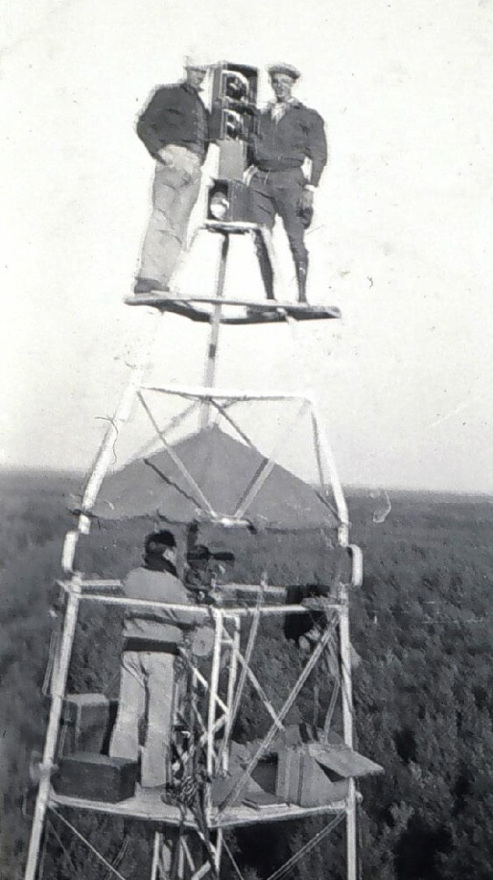
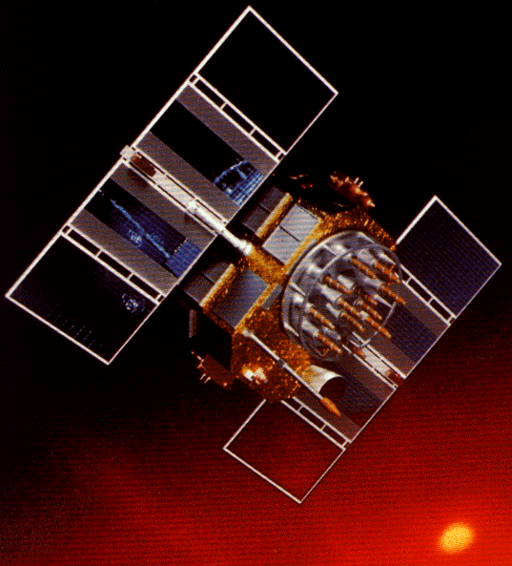
A (very) brief history of NAD 83
Original realization completed in 1986
Consisted (almost) entirely of classical (optical) observations
“High Precision Geodetic Network” (HPGN) and “High Accuracy Reference Network” (HARN) realizations
Most done in 1990s, essentially state-by-state
Based on GNSS but classical stations included in adjustments
National Re-Adjustment of 2007
NAD 83(CORS96) and (NSRS2007)
Simultaneous nationwide adjustment (GNSS only)
New realization: NAD 83(2011) epoch 2010.00

Slide 4
Why change datums/Realizations
NAD27 based on old observations and old system
NAD83(86) based on old observations and new system
NAD83(92) based on new and old observations and same system
NAD83(96) based on better observations and same system
NAD83(NSRS2007) based on new observations and same system. Removed regional distortions and made consistent with CORS
NAD83(2011) based on new observations and same system. Kept consistent with CORS

Slide 5
Horizontal Datums/Coordinates…What do we (you) use in CT?
NAD 83 (Lat-Lon) SPC
Which one???
NAD 83 (1986)
NAD 83 (1992)
NAD 83 (1996)
NAD 83 CORS96(2002)
NAD 83 (NSRS2007)
NAD 83 (2011)
NAD 27
WGS 84
Which one???
WGS 84 (1987)
WGS 84 (G730)
WGS 84 (G873)
WGS 84 (G1150)
WGS 84 (G1674)
ITRF00 (epoch 97)
IGS08

Slide 6
COORDINATE CHANGES
ADJUSTMENT YEARS LOCAL NETWORK
ACCURACY ACCURACY
NAD 27 1927 – 1986 1:100,000 10 m
NAD 83 (1986) 1986 – 1990 1:100,000 1 m
NAD 83 (1992) (HARN) 1990 – 1997 1:10,000,000 0.1 m
CORS 1994 -------- 0.01/0.02 m 0.02/0.04 m
NAD 83 (1996) (FBN/CBN) 1997 – 2007 0.05/0.05 m 0.05/0.05 m
NAD 83 (NSRS 2007) 2007 - 2012 0.01/0.02 m 0.02/0.04 m
NAD 83 (2011) epoch 2010.0 2012 - ------- 0.009/0.015m

Slide 7
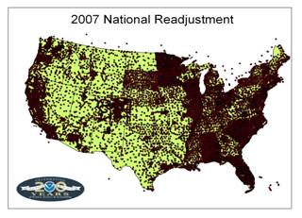
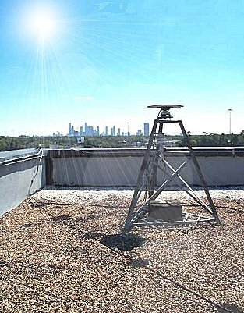
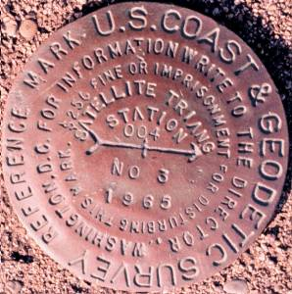
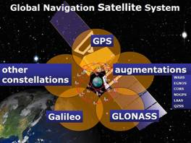
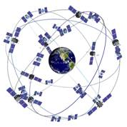
The NSRS has evolved
1 Million Monuments
(Separate Horizontal and Vertical Systems)
70,000 Passive Marks
(3-Dimensional)
→
Passive Marks
(Limited Knowledge of Stability)
1,897 GPS CORS
(Time Dependent System Possible; 4-Dimensional)
→
GPS CORS → GNSS CORS

Slide 8
ITRF2008, IGS08 And NAD 83(2011)

Slide 9
ITRF2008
For the geodesy, geophysics and surveying communities, the best International Terrestrial Reference Frame is the “gold standard.”
The global community recently adopted an updated expression for the reference frame, the ITRF2008.
9

Slide 10
International Earth Rotation and Reference System Service (IERS) (http://www.iers.org)
The International Terrestrial Reference System (ITRS) constitutes a set of prescriptions and conventions together with the modeling required to define origin, scale, orientation and time evolution
ITRS is realized by the International Terrestrial Reference Frame (ITRF) based upon estimated coordinates and velocities of a set of stations observed by Very Long Baseline Interferometry (VLBI), Satellite Laser Ranging ( SLR), Global Positioning System and GLONASS (GNSS), and Doppler Orbitography and Radio- positioning Integrated by Satellite ( DORIS).
ITRF89, ITRF90, ITRF91, ITRF92, ITRF93, ITRF94, ITRF95, ITRF96, ITRF97, ITRF2000, ITRF2005, ITRF2008

Slide 11
International Terrestrial Reference Frame
4 Global Independent Positioning Technologies
International Global Navigation Satellite Systems Service (IGS)
International Laser Ranging Service (ILRS)
International Very Long Baseline Service (IVS)
International DORIS Service (IDS)

Slide 12
Simplified Concept of NAD 83 vs. ITRF08
h₈₃
h₀₈
Earth’s
Surface
ITRF 08
Origin
2.2 meters
NAD 83
Identically shaped ellipsoids (GRS-80)
a = 6,378,137.000 meters (semi-major axis)
1/f = 298.25722210088 (flattening)
Origin
Notes:
ITRF (International Terrestrial Reference Frame) just has an origin; take NAD83 shaped ellipsoid centered at the ITRF origin to derive ITRF97 ellipsoid heights.
Ellipsoid heights NAD83 vs. ITRF97 - Defined origins are best estimate of the center of mass; NAD83 is not geocentric. Move origin; move ellipsoid surface as illustrated.
Ellipsoid height differences reflect the non-geocentricity of NAD83.

Slide 13
Densification
The ITRF2008 is expressed through the coordinates and velocities of marks on the ground plus ancillary data.
Other organizations can take that information, add additional marks, perform their own adjustment and align their results to the ITRF2008 (A.K.A. densifying).
The variants try to be as consistent with the ITRF2008 as possible, but in the most formal sense, they are unique from the ITRF2008. Therefore, they are given unique names.
13

Slide 14
The IGS08
The IGS has densified reference frame with much larger, global subset of GNSS tracking sites thereby creating a GNSS-only expression of the ITRF2008 called the IGS08. All IGS products have been recreated so as to be consistent with the IGS08 including GNSS ephemerides and antenna models. Information about the IGS08 can be found at the IGS web sites: igscb.jpl.nasa.gov. I would suggest starting with IGSMAIL‐6354, ‐6355 and ‐6356, all dated 2011‐03‐07.
14
Notes:
Many of the sites contributing to the IGS08 also contributed to the ITRF2008, but because other space geodesy techniques contributed to the ITRF2008 and because the IGS08 contains sites not included in the ITRF2008, it should not be called the ITRF2008.
Nonetheless, IGS08 has the same geocenter, orientation and scale as the ITRF2008.

Slide 15
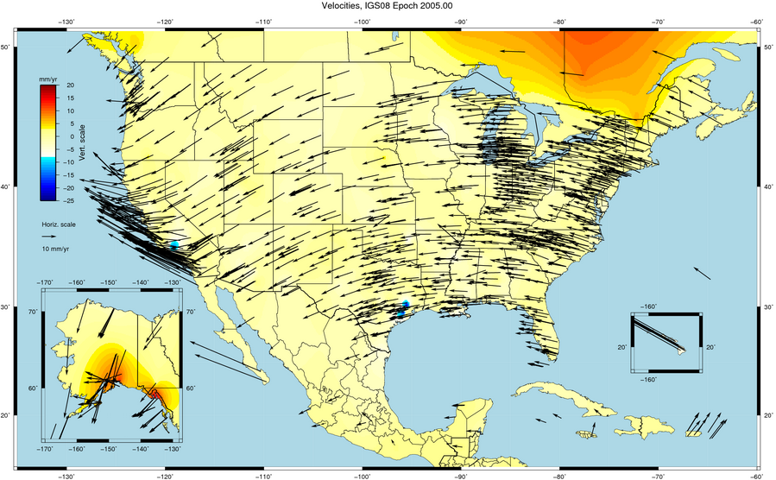

Slide 16
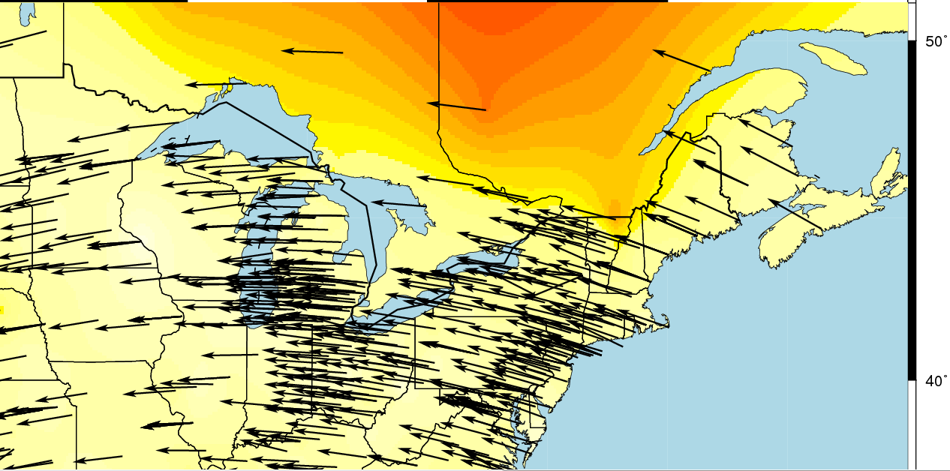
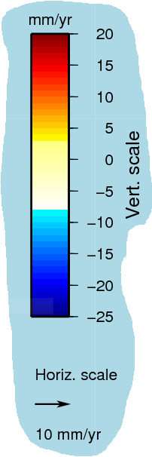

Slide 17
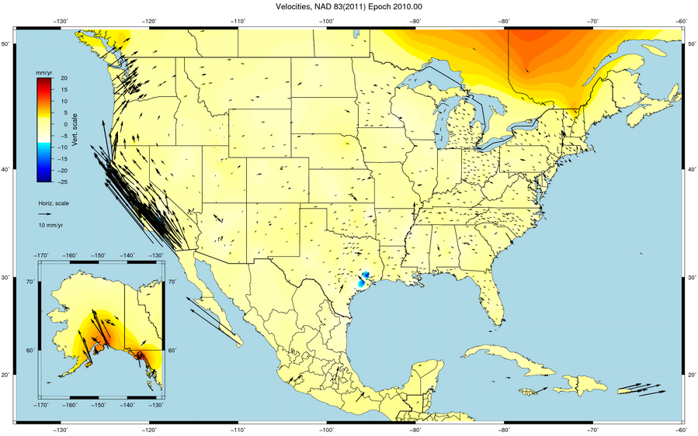

Slide 18
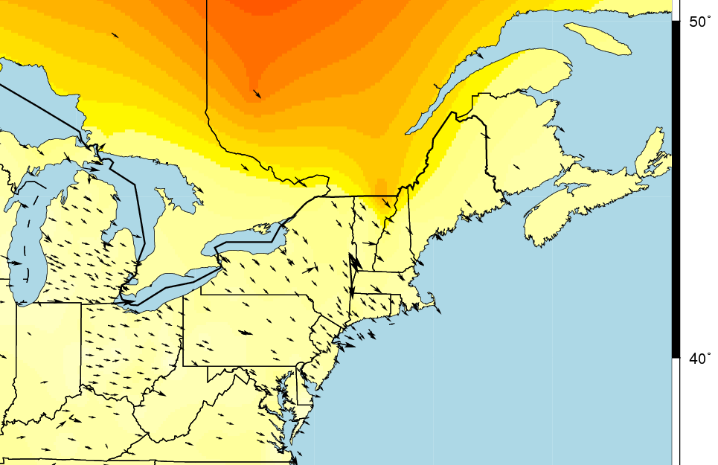

Slide 19
NAD 83 (2011)
NGS used its contribution to the IGS08 plus the additional CORS to produce improved IGS08 coordinates and velocities for the CORS network. From this, improved CORS coordinates and velocities in the NAD 83 frame were defined.
To distinguish this from earlier realizations, this reference frame is called the NAD 83 (2011). This is not a new datum: the origin, scale and orientation are the same as in the previous realization.
In September 2011, NGS formally released IGS08 and NAD 83 (2011) coordinates and velocities for the CORS. Information about the IGS08 and NAD 83 (2011) can be found at geodesy.noaa.gov/CORS/coords.shtml.
19

Slide 20
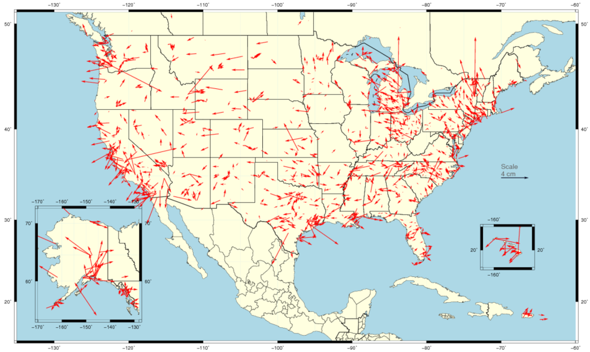
Horizontal Differences In CORS Positions
Horizontal difference in positions of NAD 83(2011) epoch 2002.00 minus NAD 83(CORS96) epoch 2002.00.
20

Slide 21
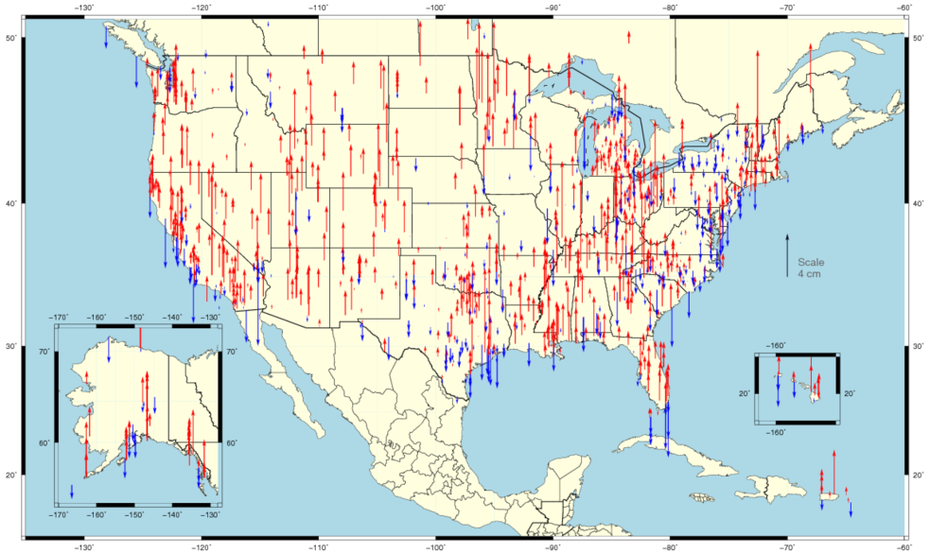
Vertical Differences In CORS Positions
Vertical difference in positions of NAD 83(2011) epoch 2002.00 minus NAD 83(CORS96) epoch 2002.00.
21

Slide 22
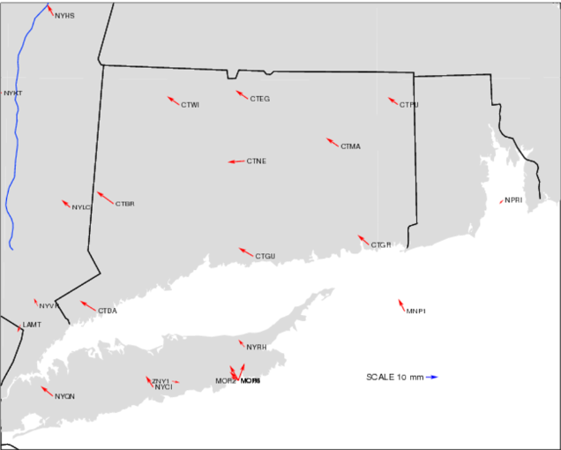
Horizontal
NAD 83(2011) epoch 2002.00 minus
NAD 83(CORS96) epoch 2002.00

Slide 23
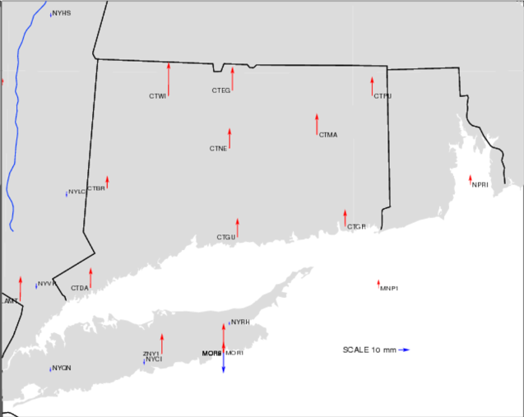
Vertical
NAD 83(2011) epoch 2002.00 minus
NAD 83(CORS96) epoch 2002.00

Slide 24
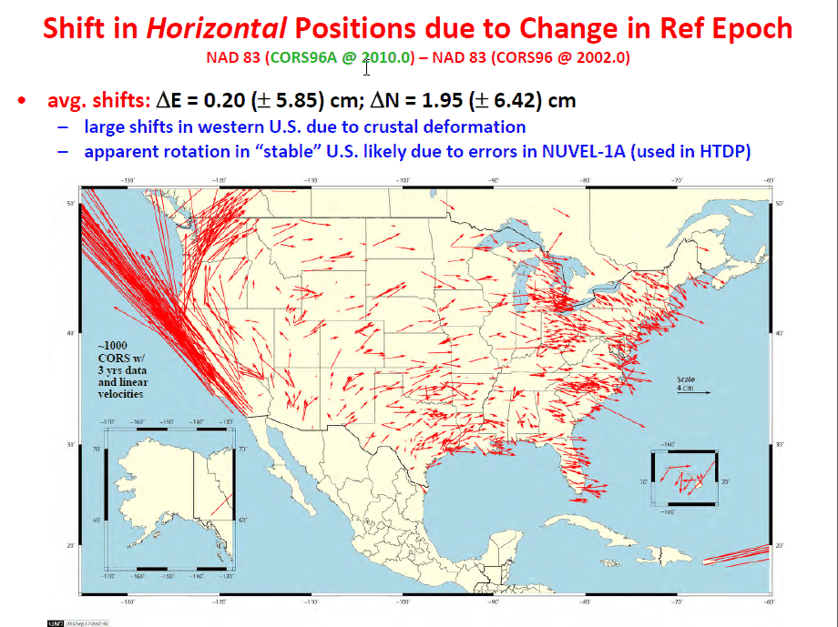
Change in horizontal NAD 83 CORS coordinates
NAD 83(CORS96) epoch 2002.00 → NAD 83(2011) epoch 2010.00
Avg shifts (cm): ΔN = 2.0 (±6.4); ΔE = 0.2 (±5.9); ΔU = -0.9 (±2.0)

Slide 26
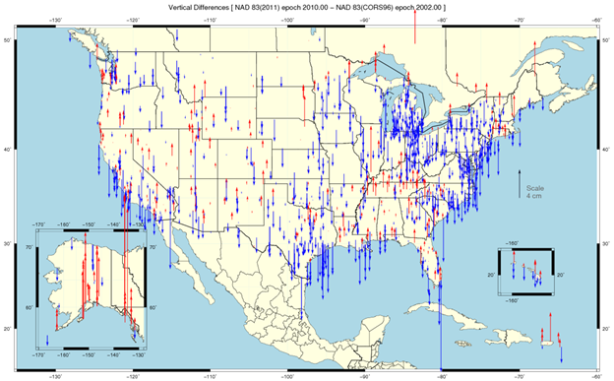

Slide 27
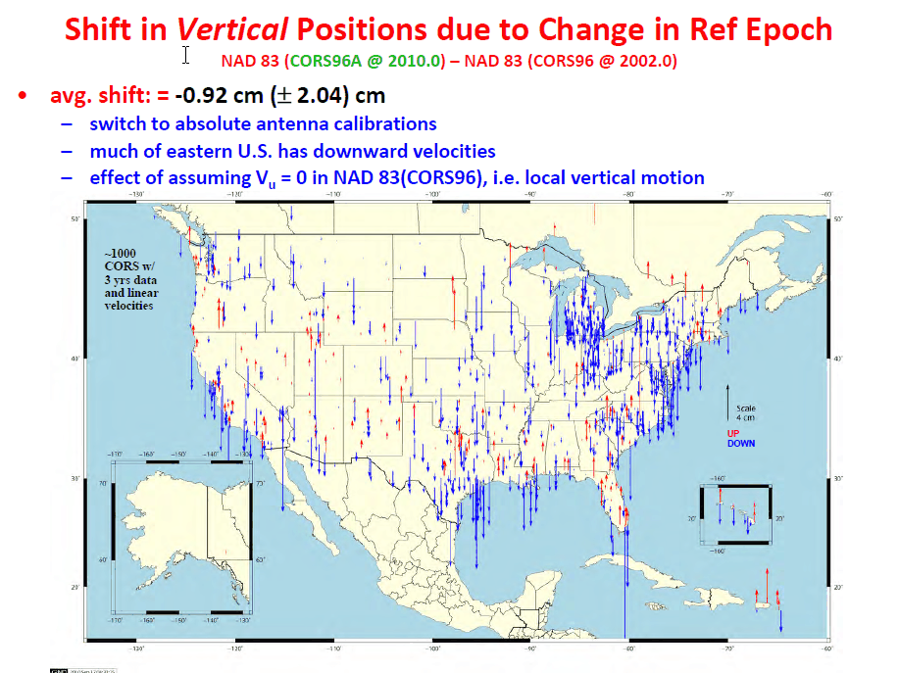

Slide 28
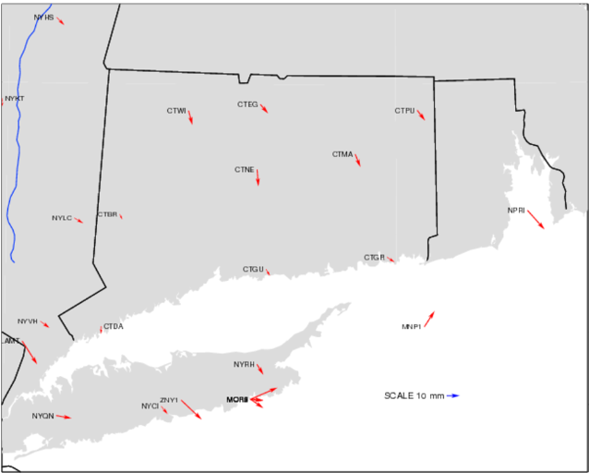
Horizontal
NAD 83(2011) epoch 2010.00 minus
NAD 83(CORS96) epoch 2002.00

Slide 29
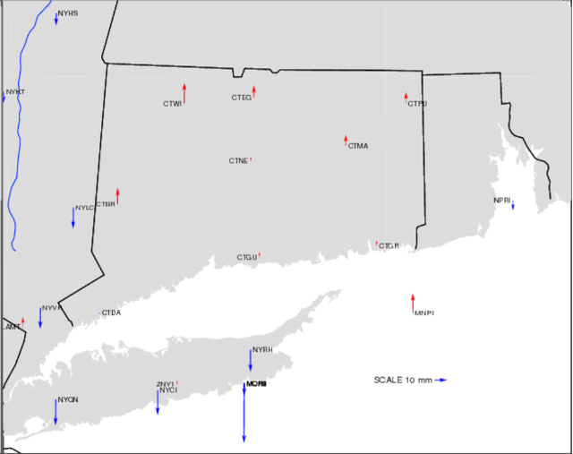
Vertical
NAD 83(2011) epoch 2010.00 minus
NAD 83(CORS96) epoch 2002.00

Slide 30
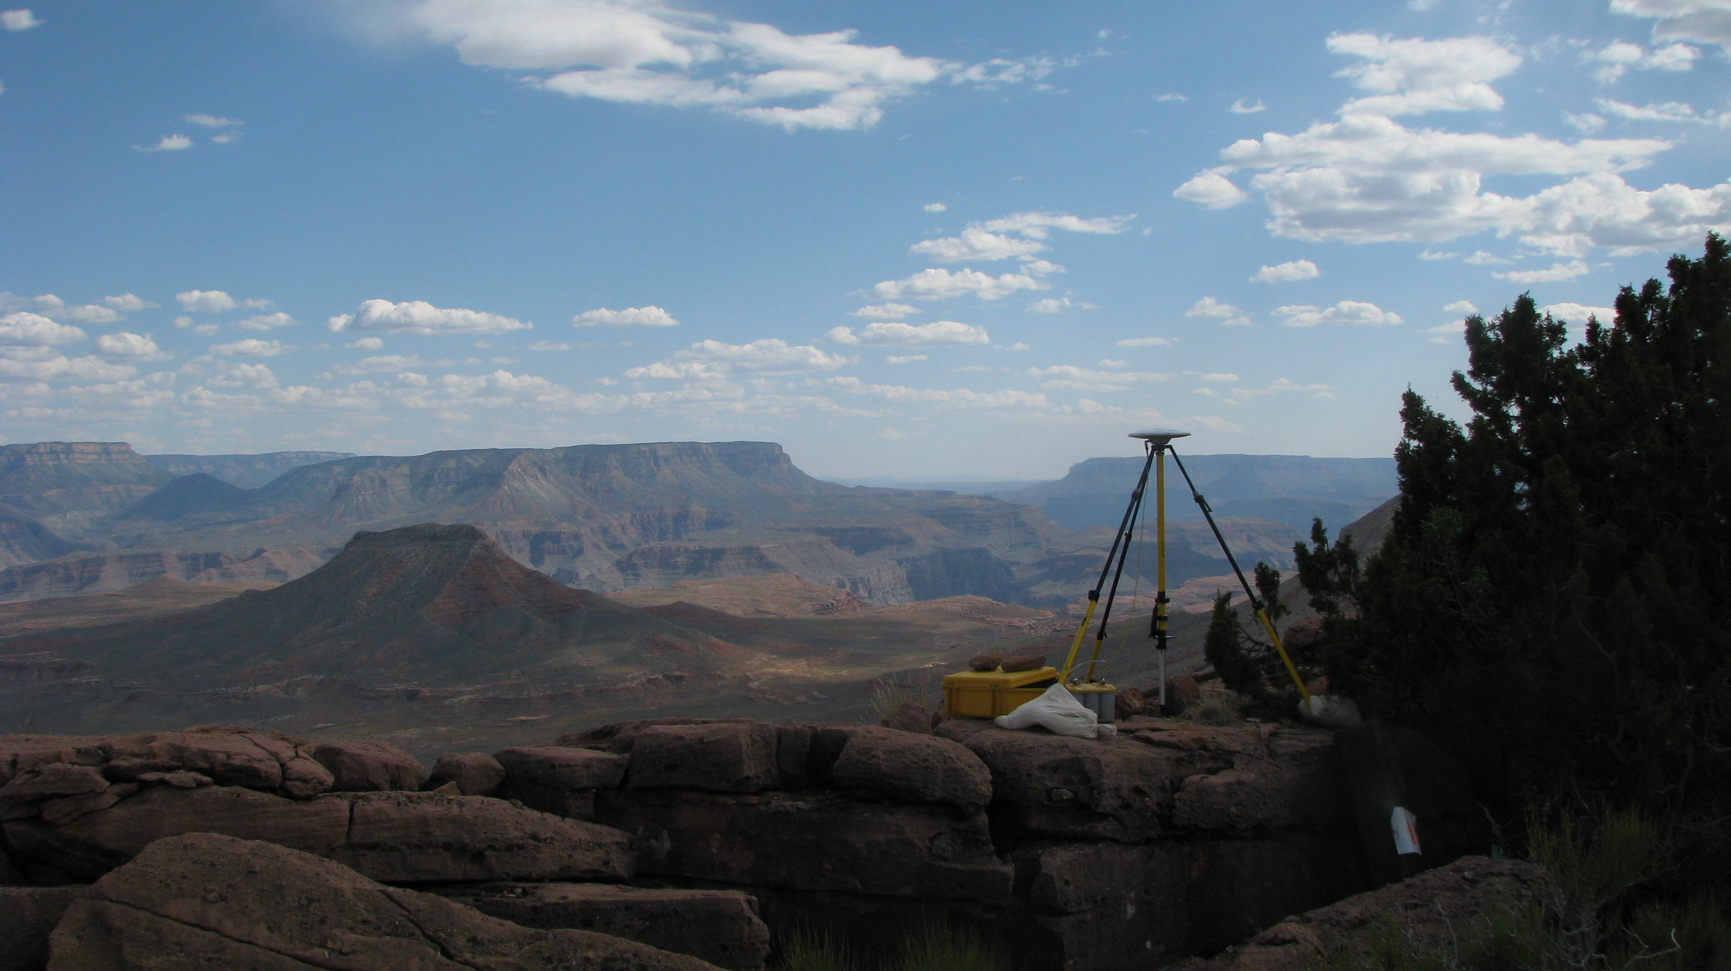
Update and Refinement of the North American Datum of 1983
NAD 83(2011/PA11/MA11) epoch 2010.00
The 2011 national adjustment of passive control and its impact on NGS products and services
National Geodetic Survey
Height Modernization Program monthly meeting
October 11, 2012 ● Silver Spring, MD
Michael Dennis, RLS, PE
michael.dennis@noaa.gov

Slide 31
The Plan
The National Spatial Reference System (NSRS)
A (very) brief history of NAD 83
The latest realization: NAD 83(2011/PA11/MA11) epoch 2010.00
National adjustment of passive control
Related and dependant NGS products & services
The Multi-Year CORS Solution (MYCS)
Online Positioning User Service (OPUS)
New hybrid geoid model (GEOID12A)
New process for Bluebooking GPS project
New NAD 83 coordinate transformations
Role of GIS in national adjustment (and leveling)
What about orthometric heights (aka “elevations”)?

Slide 32
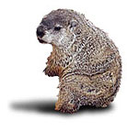
The Basics
When will it be done?
Publication completed on June 30, 2012
Intent: Simultaneous with release of GEOID12A
How many stations? 80,872
How much did the coordinates change?
Median: 1.9 cm horiz, 2.1 cm vertical
How accurate are the results?
Median: 0.9 cm horiz, 1.5 cm vertical (at 95% confidence level)
NGS Groundhog
Shadow
…6 more weeks until it’s done!

Slide 33
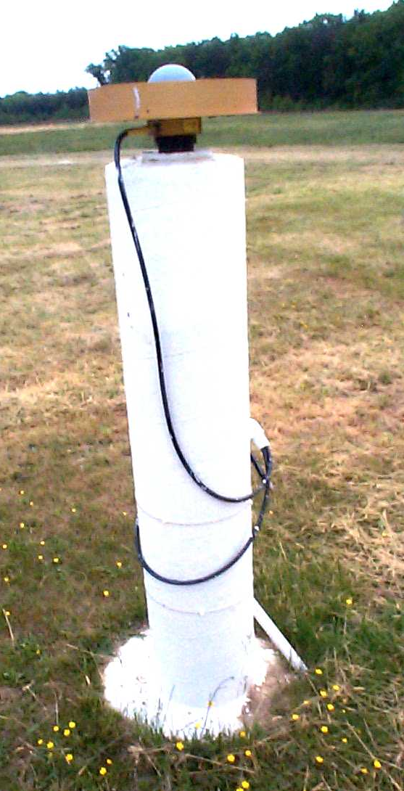
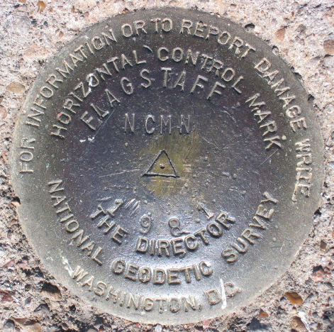
Introducing… NAD 83(2011) epoch 2010.00
Multi-Year CORS Solution (MYCS)
Continuously Operating Reference Stations
Reprocessed all CORS GPS data Jan 1994-Apr 2011
2264 CORS & global stations
NAD 83 computed by transformation from IGS08
2011 national adjustment of passive control
New adjustment of GNSS passive control
GNSS vectors tied (and constrained) to CORS NAD 83(2011) epoch 2010.00
Over 80,000 stations and 400,000 GNSS vectors
Realization SAME for CORS and passive marks
This is NOT a new datum! (still NAD 83)

Slide 34
Why a new NAD 83 realization?
Multi-Year CORS Solution
Previous NAD 83 CORS realization needed many improvements
Consistent coordinates and velocities from global solution
Aligned with most recent realization of global frame (IGS 08)
Major processing, modeling, and metadata improvements
Including new absolute phase center antenna calibrations
National adjustment of passive control
Optimally align passive control with “active” CORS control
Because CORS provide the geometric foundation of the NSRS
Incorporate new data, compute accuracies on all stations
Better results in tectonically active areas
Bottom line
Must meet needs of users for highly accurate and consistent coordinates (and velocities) using Best Available Methods

Slide 35
Approach
Used a Helmert blocking strategy for CONUS
Over 80,000 points (> 240,000 unknowns)
Over 400,000 GNSS vectors (> 1.2 million observations)
Individual projects weighted to account for variable error
Horiz and vertical std deviation scale factors computed for all projects
Outlier detection (for rejecting vectors)
Used threshold 4 cm horizontal, 5 cm up
Method for vector rejection
Rejection by downweighting vs. removal
Challenges:
Tectonic tribulations
Mixing old and new observations (e.g., pre-1994)
CORS complications
Constraint conundrums (“weighted” vs. “rigid”)
Subsidence
No-check stations
Duplicate stations, duplicate vectors

Slide 36
What’s in a name?
That which we call a datum By any other name would smell as sweet…
NAD 83(2011) epoch 2010.00
“2011” is datum tag → year adjustment complete
“2010.00” is “epoch date” (January 1, 2010)
Date associated with coordinates of control station
Frame fixed to North America tectonic plate
Includes California, Alaska, Puerto Rico, and US Virgin Islands
NAD 83(PA11) epoch 2010.00
Frame fixed to Pacific tectonic plate (Hawaii and American Samoa)
NAD 83(MA11) epoch 2010.00
Frame fixed to Mariana tectonic plate (Guam and CNMI)

Slide 37
National adjustment of passive control
4267 GPS projects; 80,872 stations; 424,711 vectors
Observations from April 1983 thru Dec 2011
Includes 1195 CORS with Multi-Year CORS Solution coordinates
CONUS and Caribbean adjusted together (79,364 stations)
Both referenced to North America tectonic plate
Split into Primary (62,024 stations) and Secondary (17,340 stations)
AK adjusted separate from CONUS and Caribbean (968 stations)
No useable ties to CONUS
Also referenced to North America tectonic plate
Pacific region also adjusted separately (540 stations)
Referenced to different tectonic plates
Hawaii, American Samoa, Marshall Is., etc. → Pacific plate (363 stations)
Guam, Northern Mariana Islands, Palau → Mariana plate (177 stations)
Pacific not included in 2007 national adjustment

Slide 38
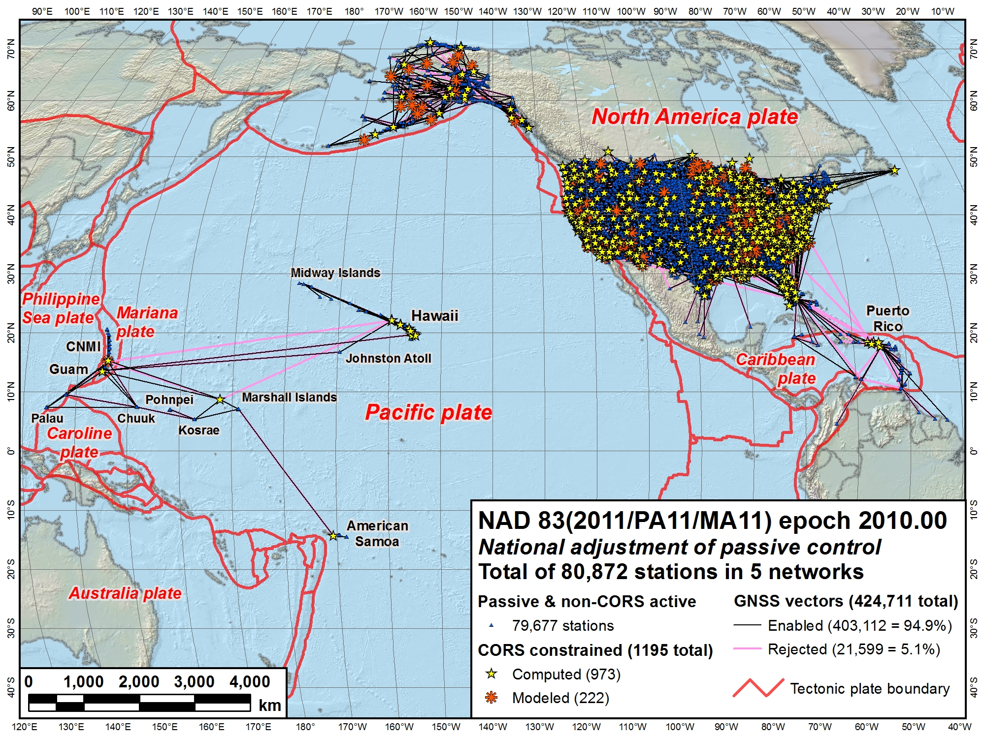
CONUS Secondary
Alaska
Pacific (MA11)
CONUS Primary
Pacific (PA11)

Slide 39
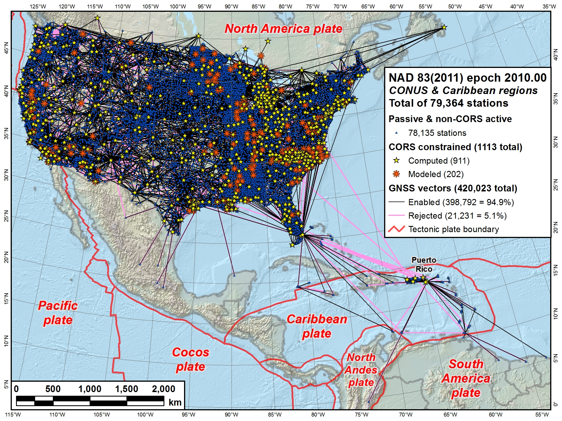

Slide 40
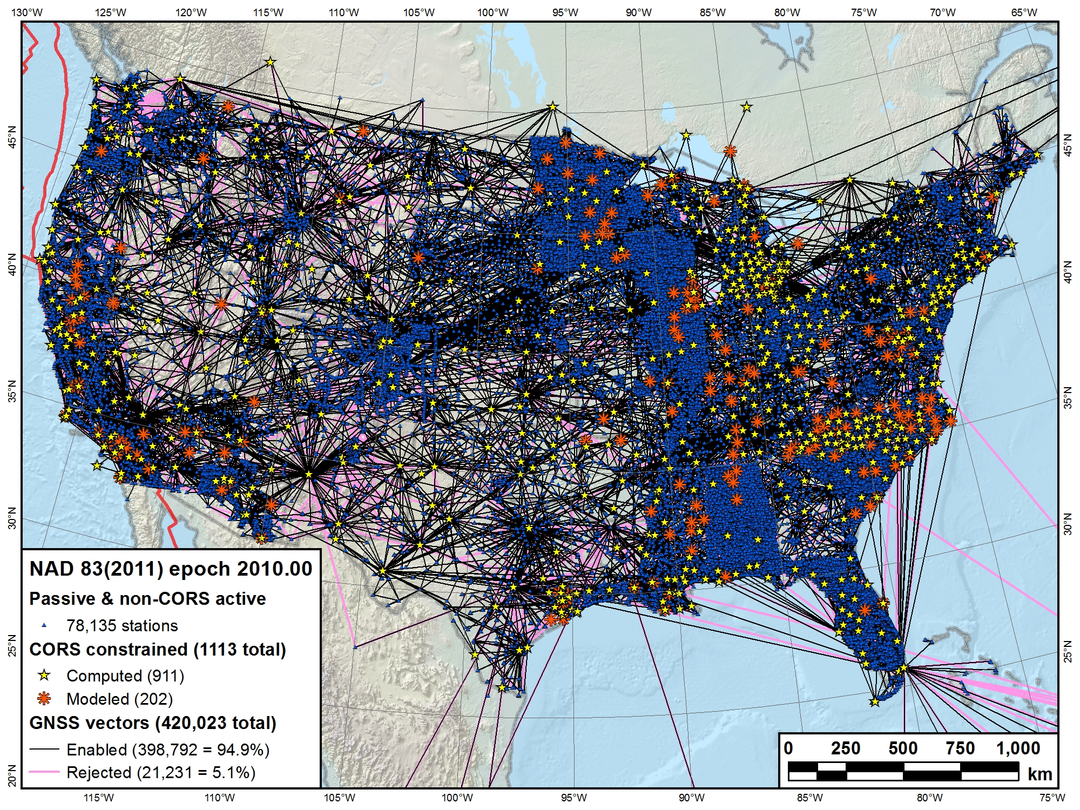

Slide 41
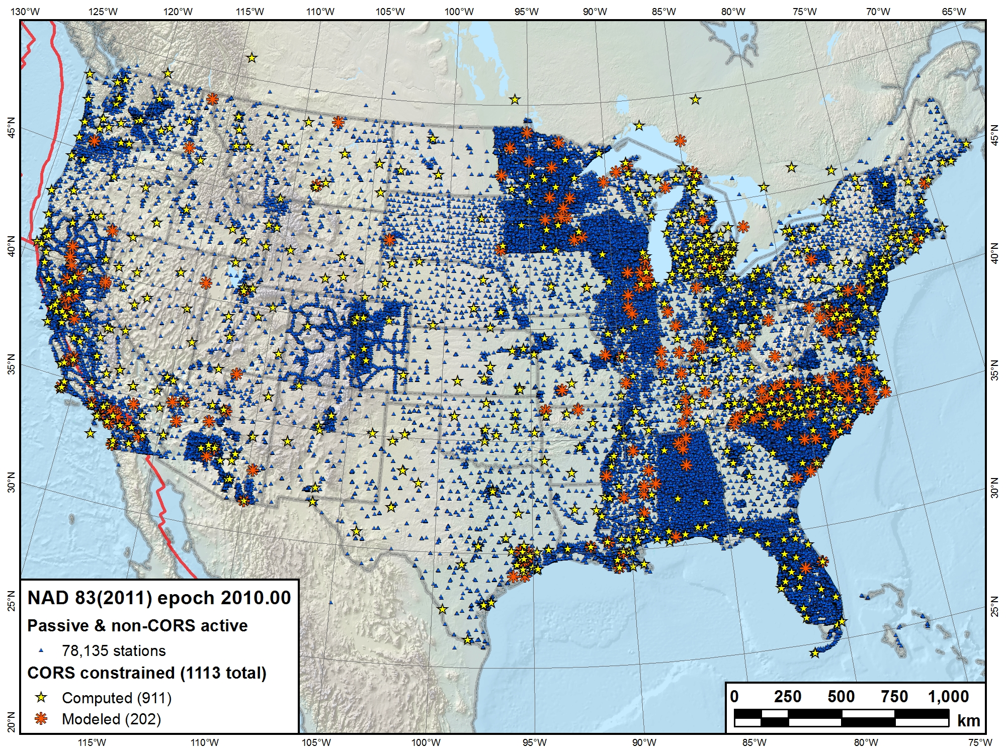

Slide 42
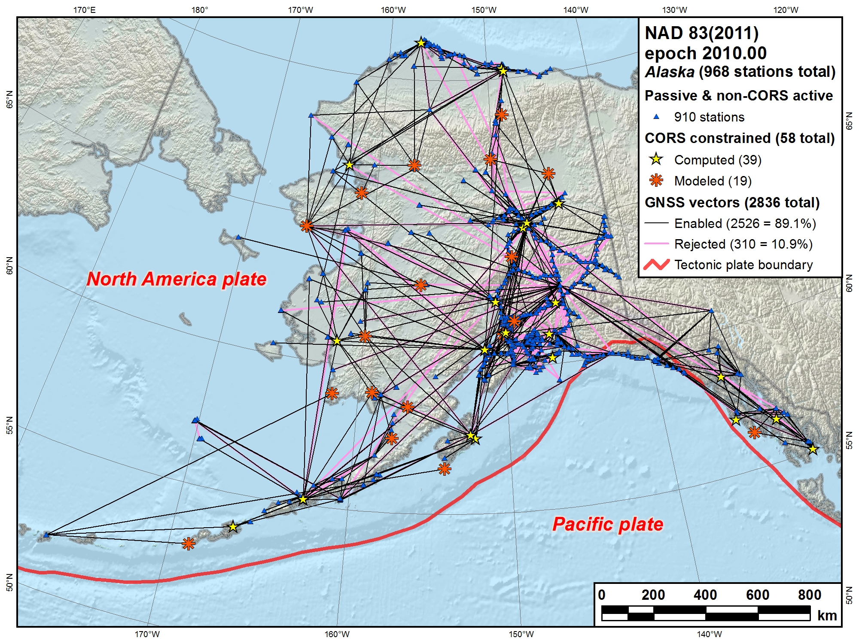

Slide 43
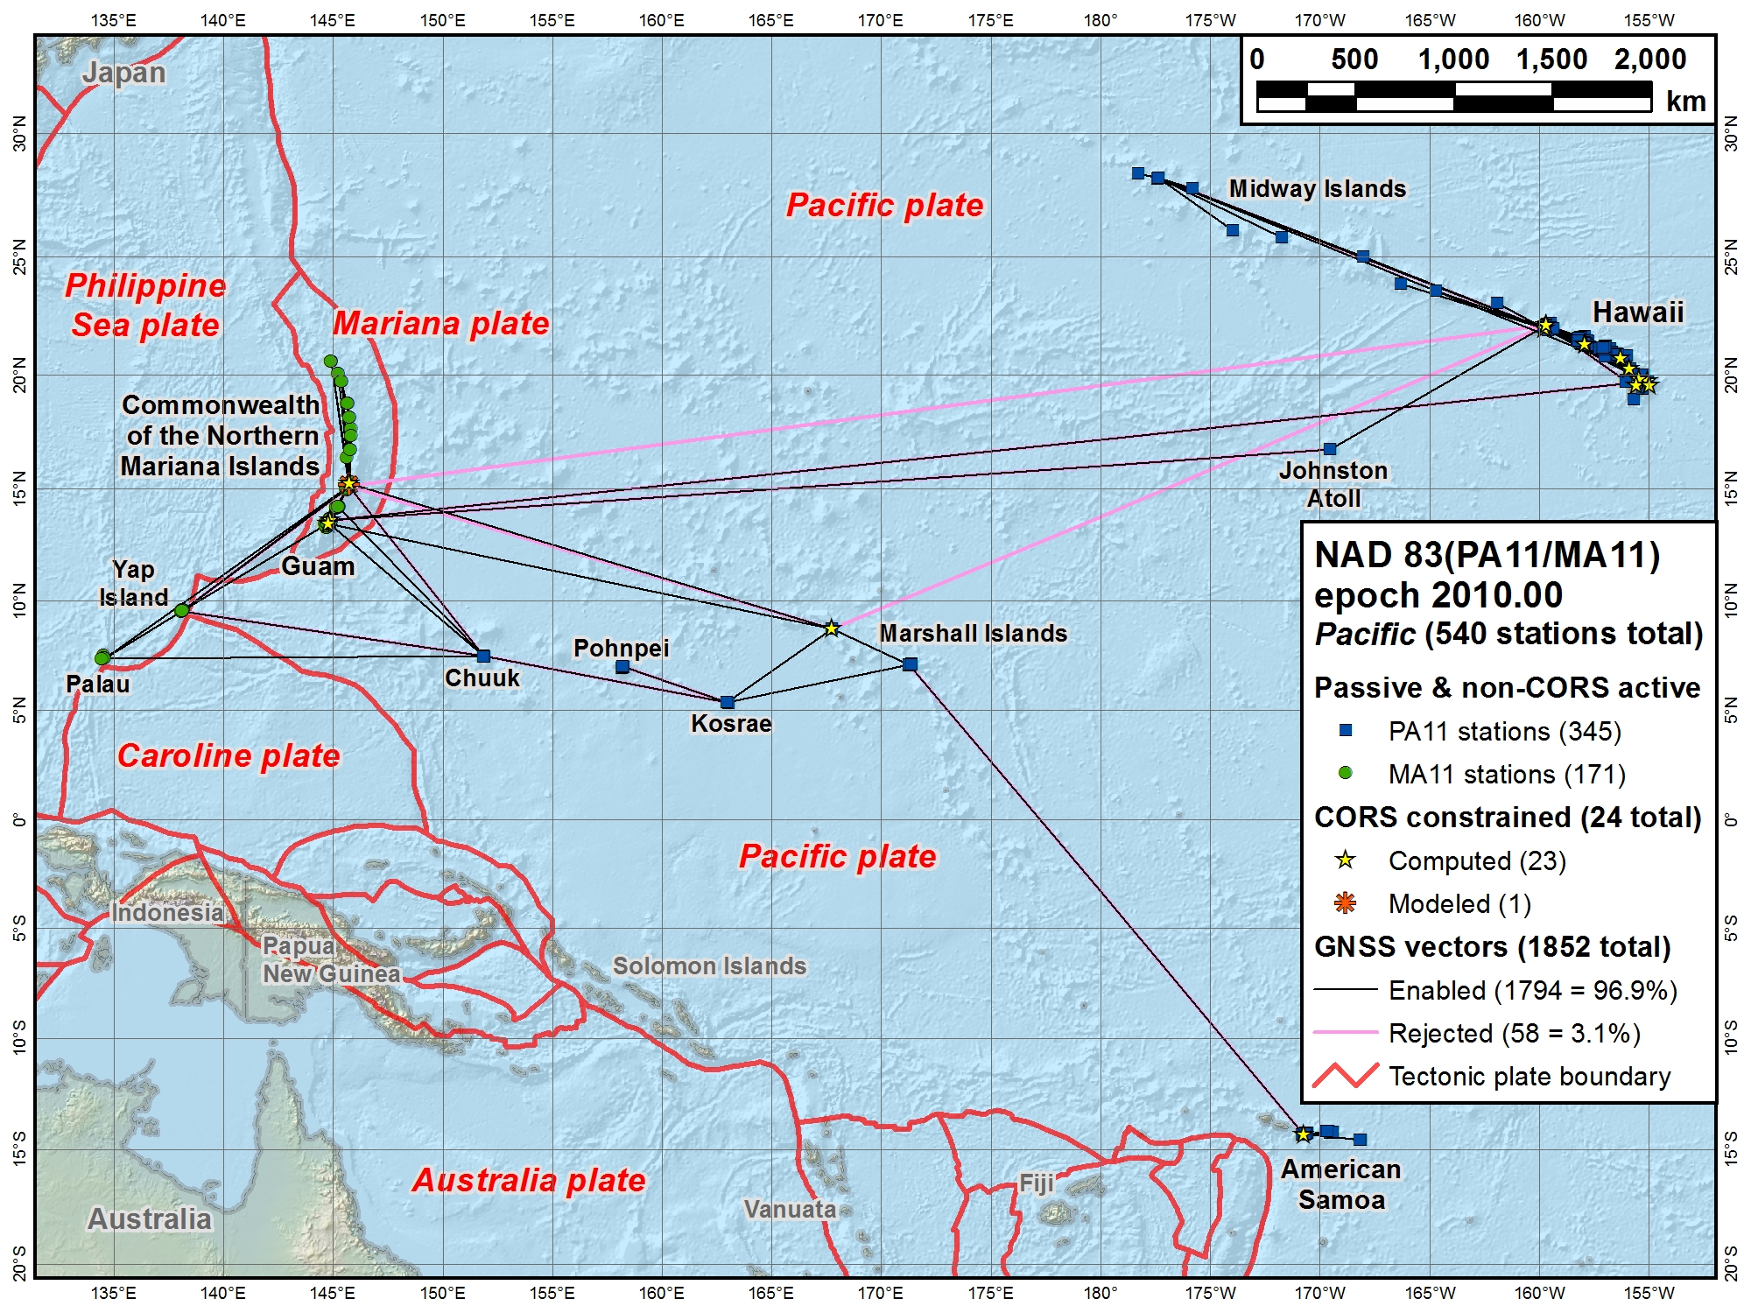

Slide 44
NAD 83(2011/PA11/MA11) epoch 2010.00 Passive control results summary
Station network accuracies (95% confidence)
Overall median: 0.9 cm horiz, 1.5 cm height (78,709)
90% < 2.3 cm horizontal and 4.8 cm ellipsoid height
Does NOT include 2163 no-check stations
Median accuracies by network
CONUS Primary: 0.7 cm horiz, 1.2 cm height (61,049)
CONUS Secondary: 1.6 cm horiz, 3.4 cm height (16,441)
Alaska: 3.2 cm horiz, 5.7 cm height (814)
Pacific (PA11): 2.2 cm horiz, 5.0 cm height (282)
Pacific (MA11): 1.8 cm horiz, 3.8 cm height (123)

Slide 45
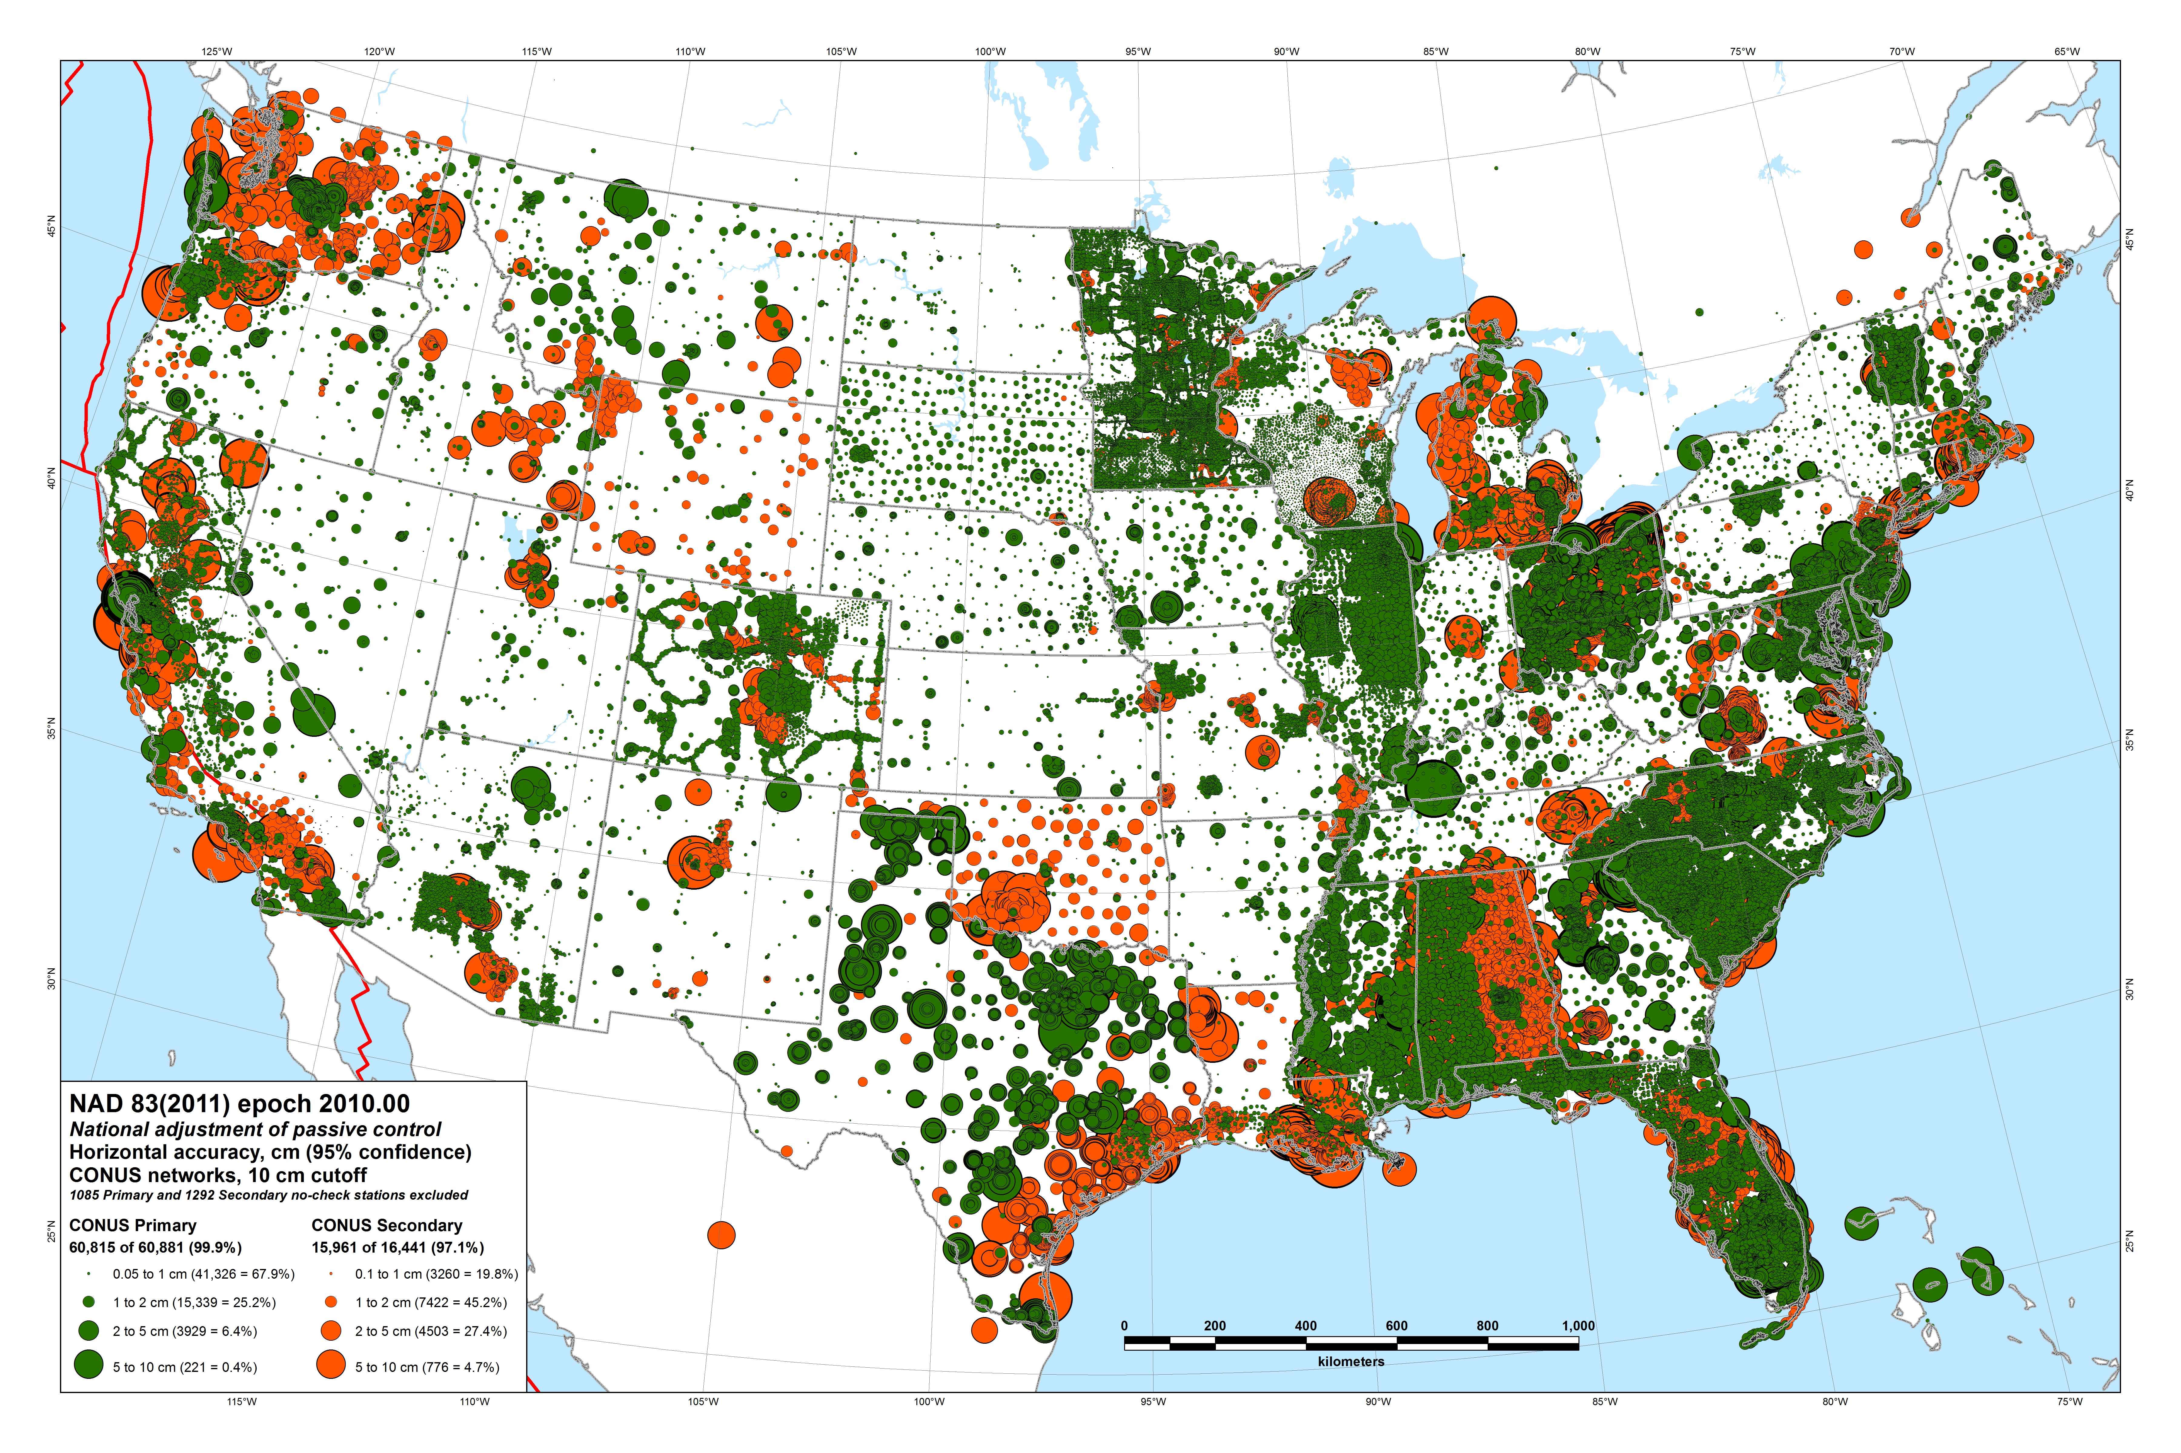

Slide 46
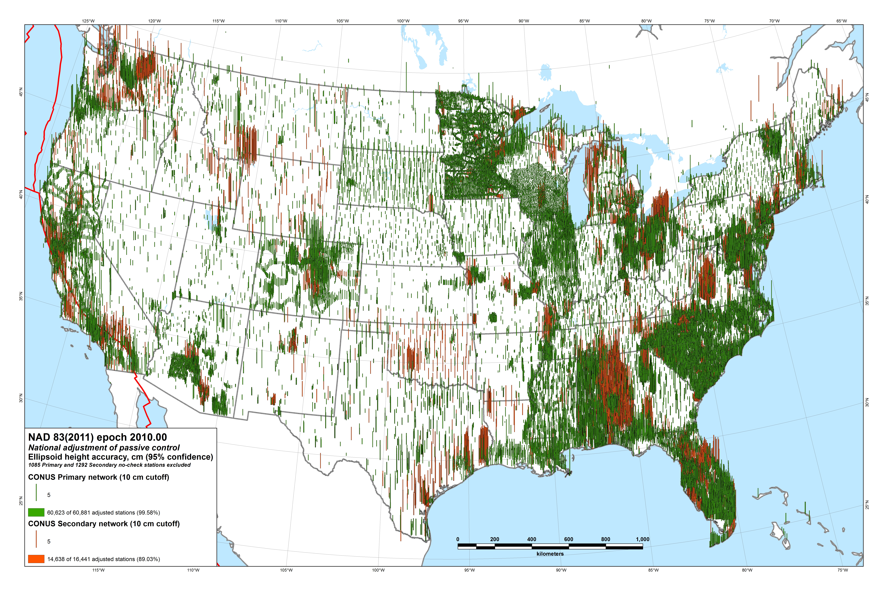

Slide 47
NAD 83(2011/PA11/MA11) epoch 2010.00 Passive control results summary
Station coordinate and height changes
Overall median: 1.9 cm horiz, 2.1 cm height
97% changed < 5 cm horizontally and vertically
Median accuracies by network
CONUS: 1.9 cm horiz, 2.1 cm height
Alaska: 6.3 cm horiz, 2.8 cm height
Pacific (PA11): 2.1 cm horiz, 2.3 cm height
Pacific (MA11): 2.5 cm horiz, 6.8 cm height

Slide 48
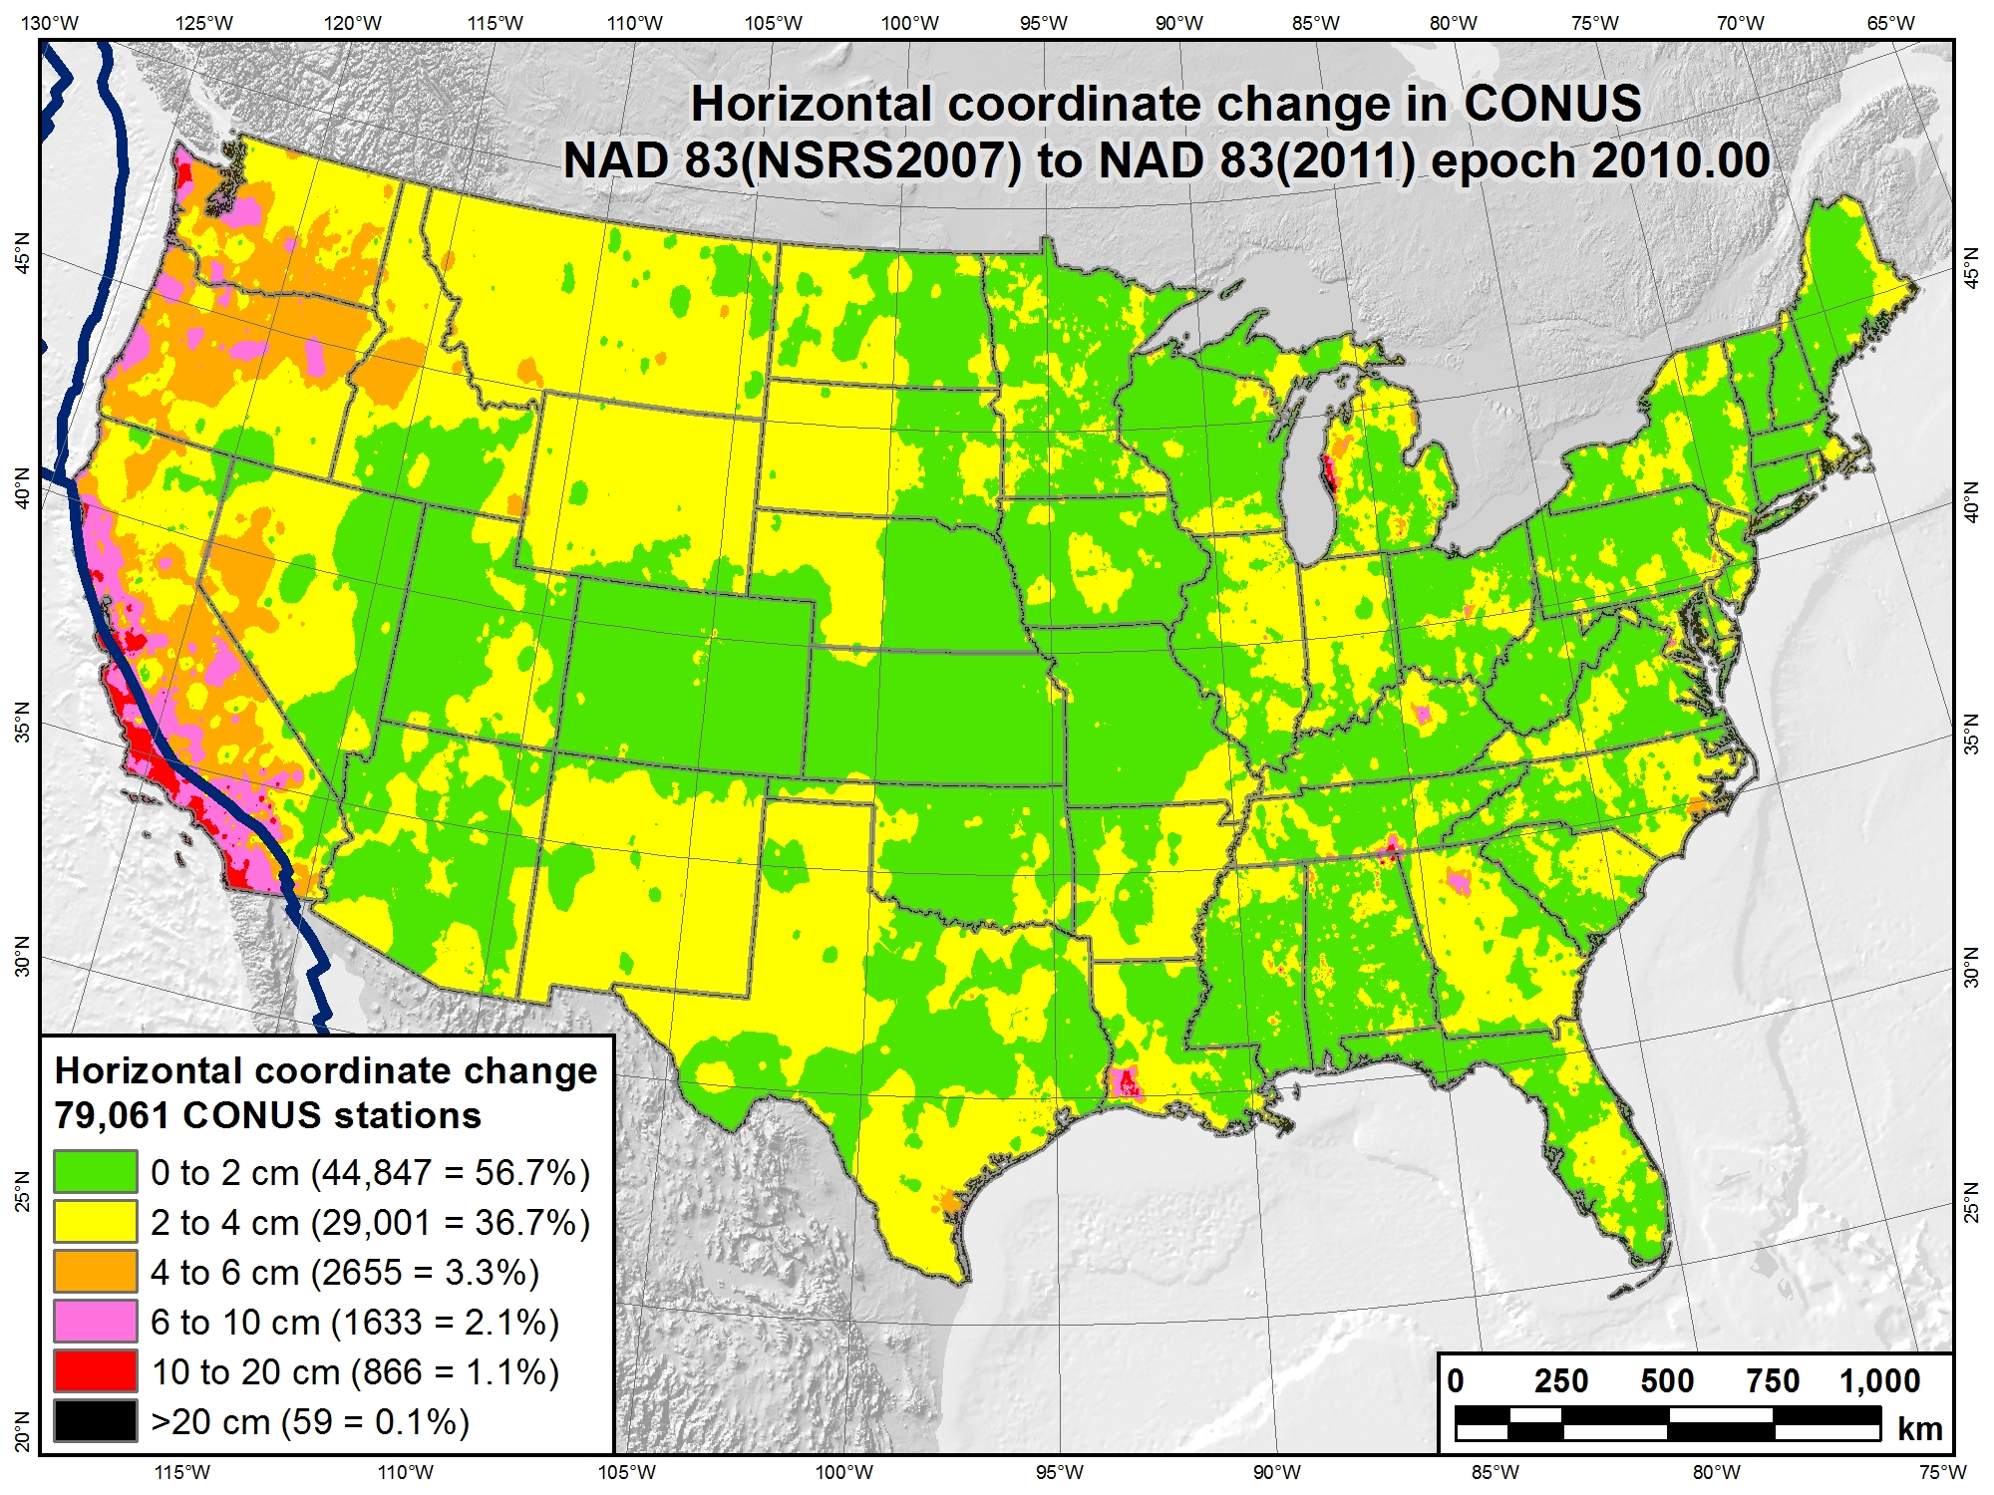

Slide 49
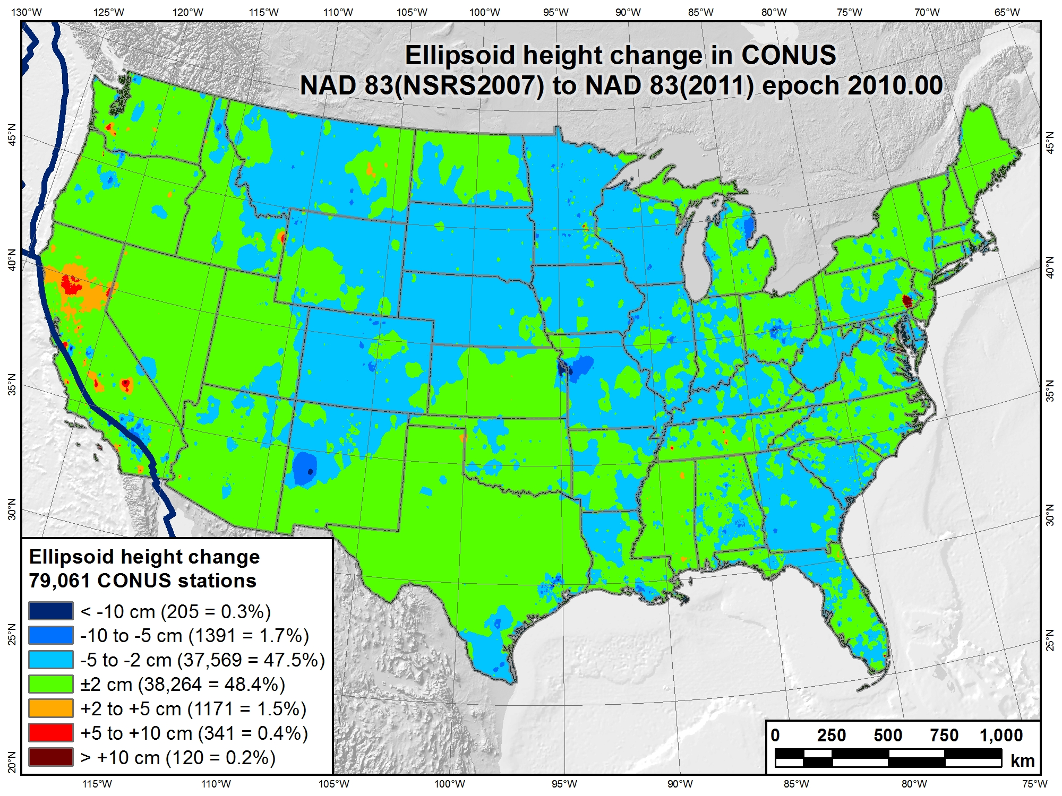

Slide 50
Change in horizontal NAD 83 CORS coordinates
NAD 83(CORS96) epoch 2002.00 → NAD 83(2011) epoch 2010.00
Avg shifts (cm): ΔN = 2.0 (±6.4); ΔE = 0.2 (±5.9); ΔU = -0.9 (±2.0)

Slide 51
Related Tasks, Products & Deliverables
OPUS (Online Positioning User Service)
Solutions for NAD 83(2011/PA11/MA11) epoch 2010.00
New hybrid geoid model (GEOID12A)
NAD 83(2011) ellipsoid heights on leveled NAVD 88 BMs
New process for Bluebooking GPS projects
Currently under development
New version of “ADJUST” program
Includes new GIS tools as part of adjustment process
New NAD 83 coordinate transformation tools
HARN ←→ NSRS2007 ←→ 2011
Tools created but still needs to be implement
Both horizontal AND “vertical” (i.e., ellipsoid height)
Include output that indicates “quality” of transformation
Quantified using station within grid cell that is worst match with model

Slide 52
Related Tasks, Products & Deliverables
New Geodetic GIS tools
Use standard NGS ASCII output files as input
Convert to point, line, and polygon features
Attribute-rich features in standard GIS format
Used for display and analysis of results
Two new GIS tools in development
GPS and leveling network adjustment → GIS features
GPS files: positions, vectors, error estimates, residuals
Geodetic leveling: adjusted elevations, loop misclosures, residuals, etc.
Add more analysis and display functionality
Error ellipses, spatial analysis, displacement vectors
May provide other NGS products in GIS format
Geoid models, transformation grids, variety of point datasets

Slide 53
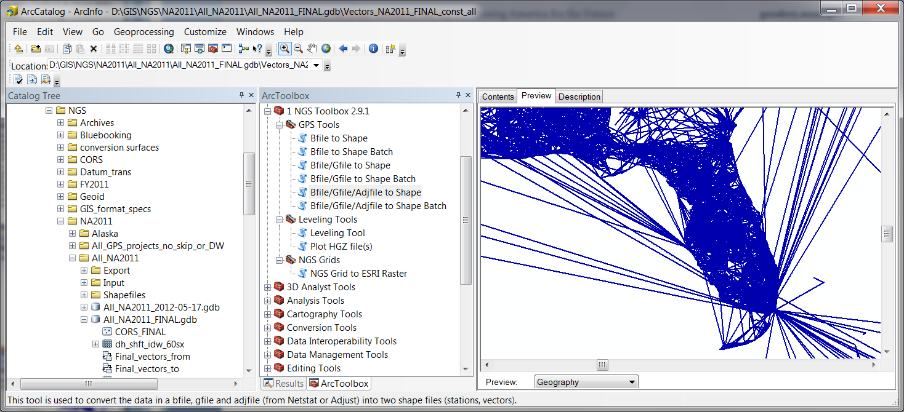
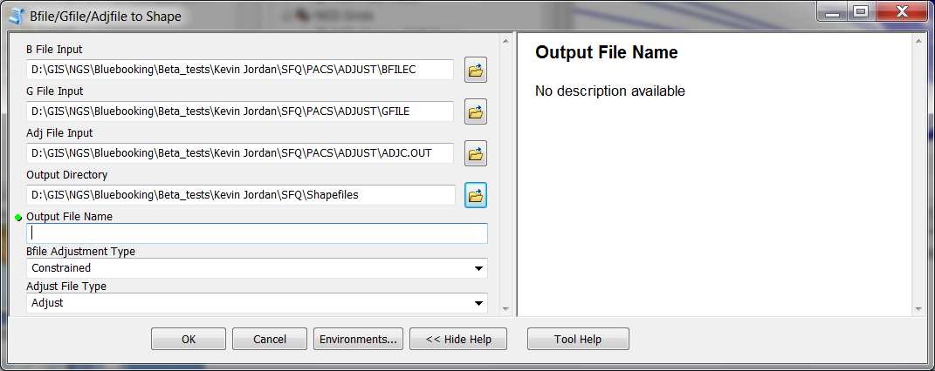
Related Tasks, Products & Deliverables
New Geodetic GIS tools

Slide 54
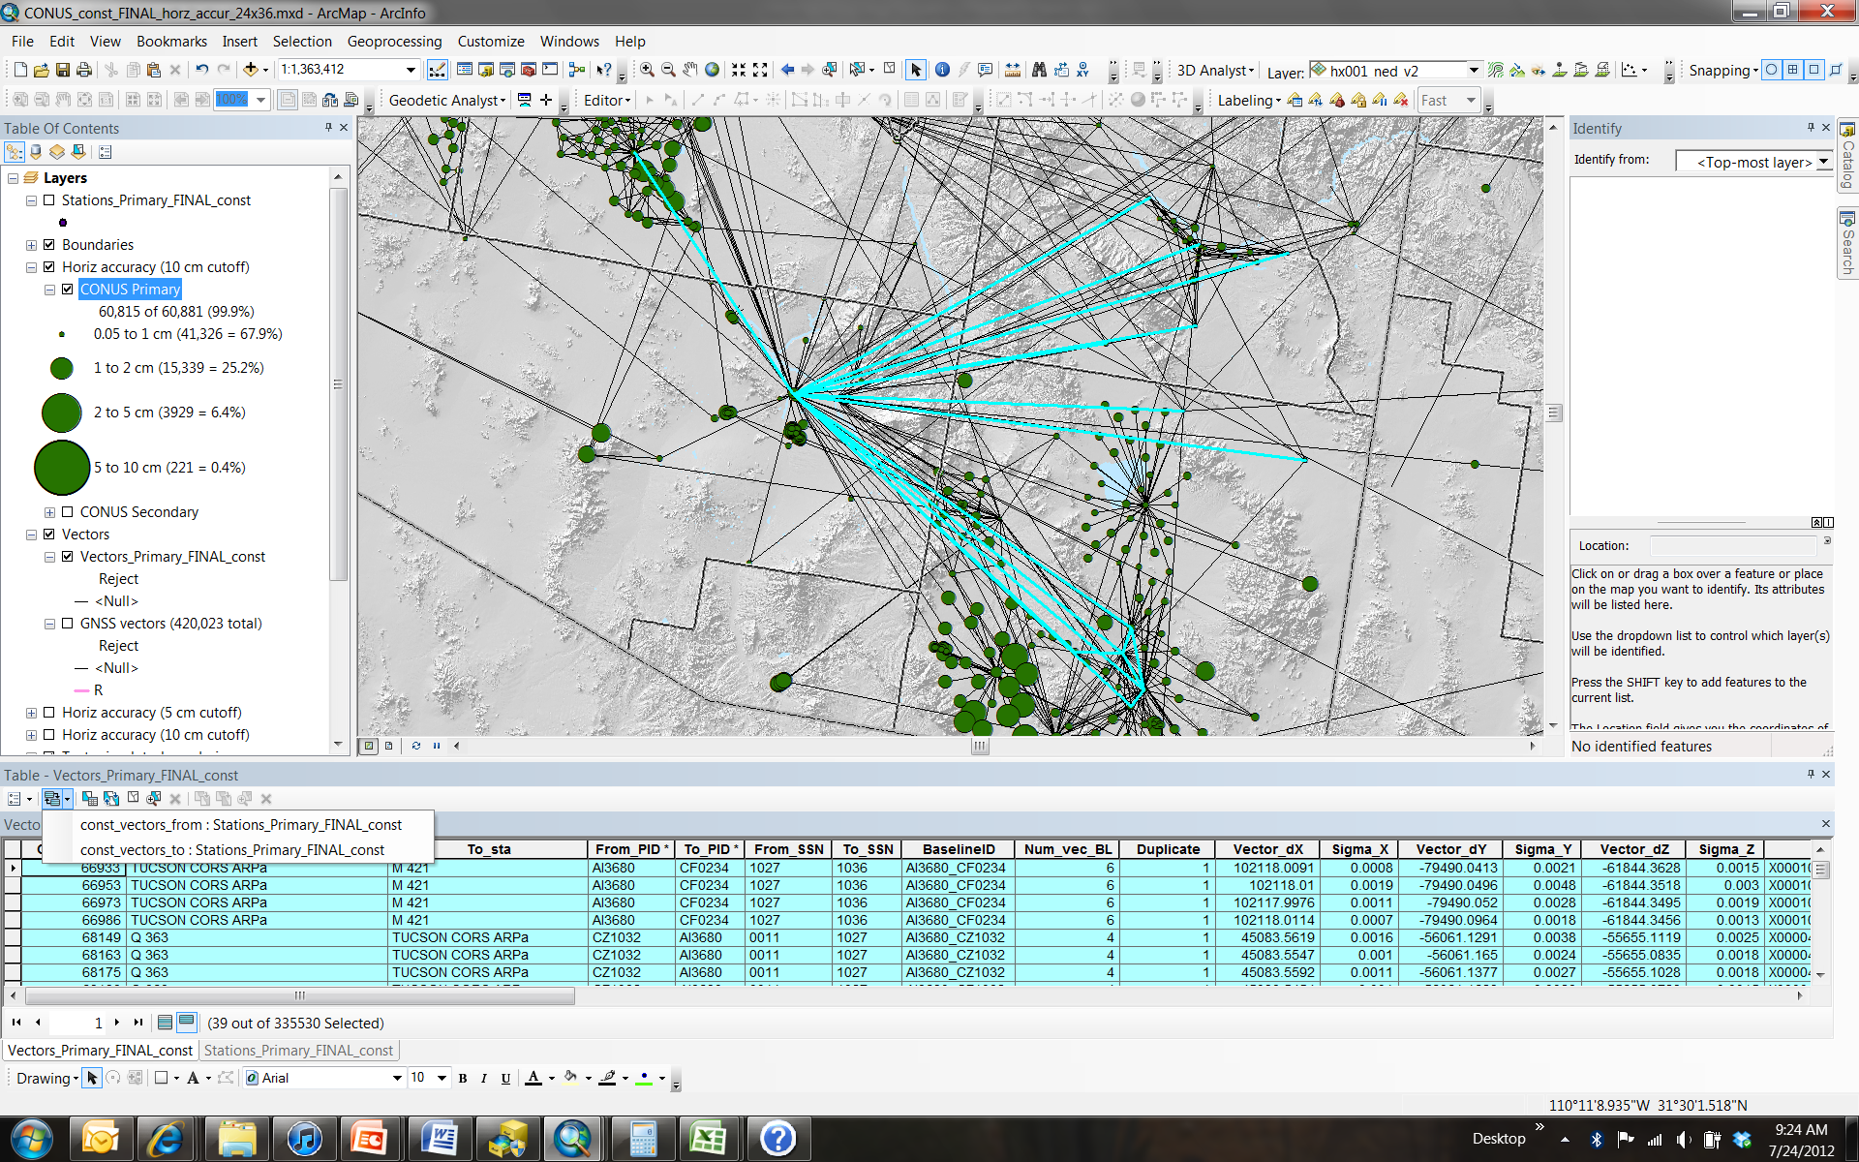
Network adjustment results as GIS features provide powerful analysis capabilities…

Slide 55
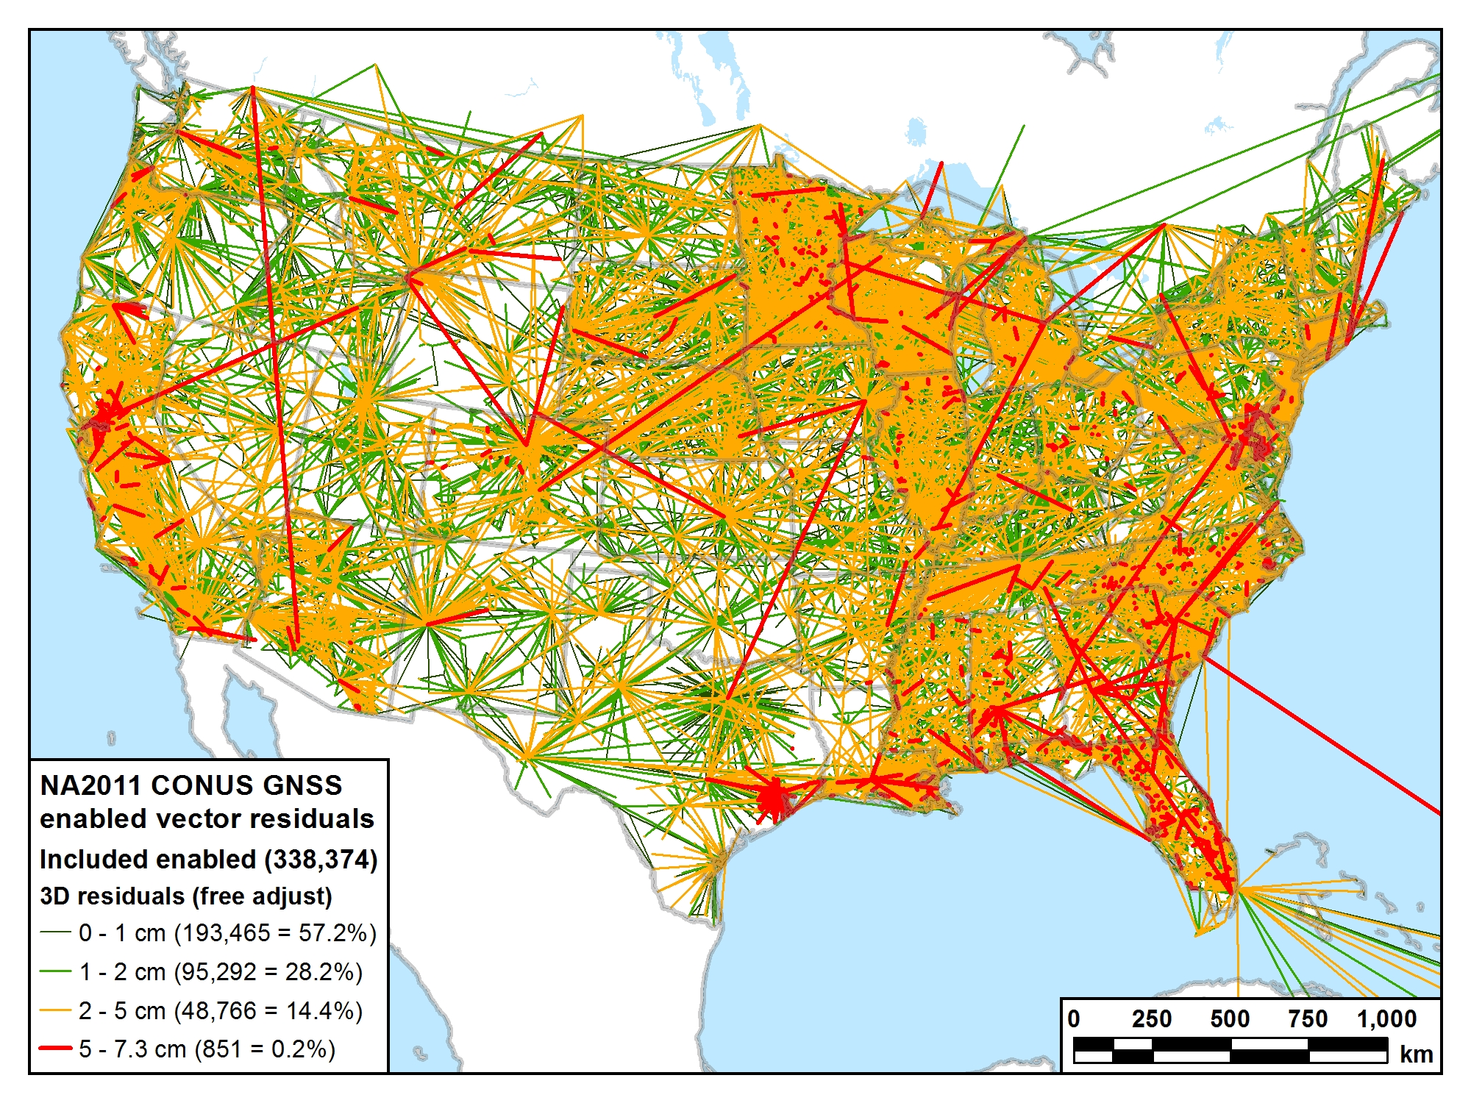
Residuals statistics (cm)
Max = 7.3 Mean = 1.1
Std dev = 0.9 Med = 0.9

Slide 56
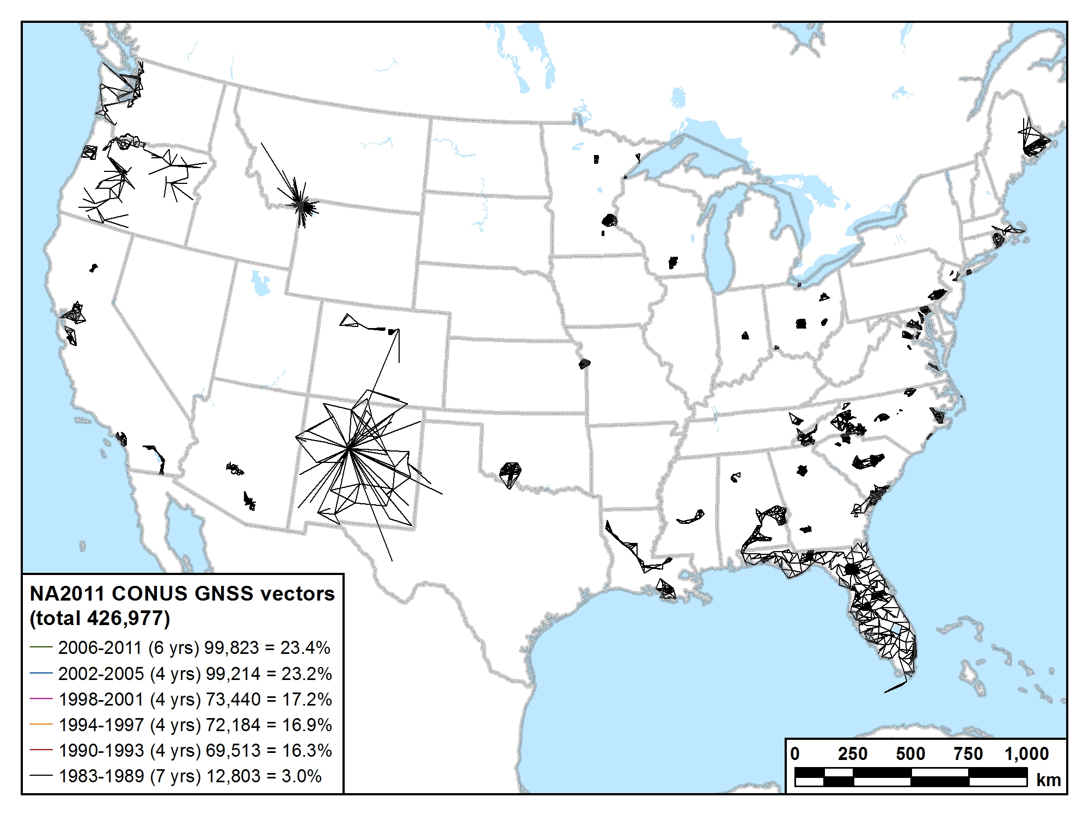
1983-1989 (7 years) 12,803 vectors (3.0%)

Slide 57
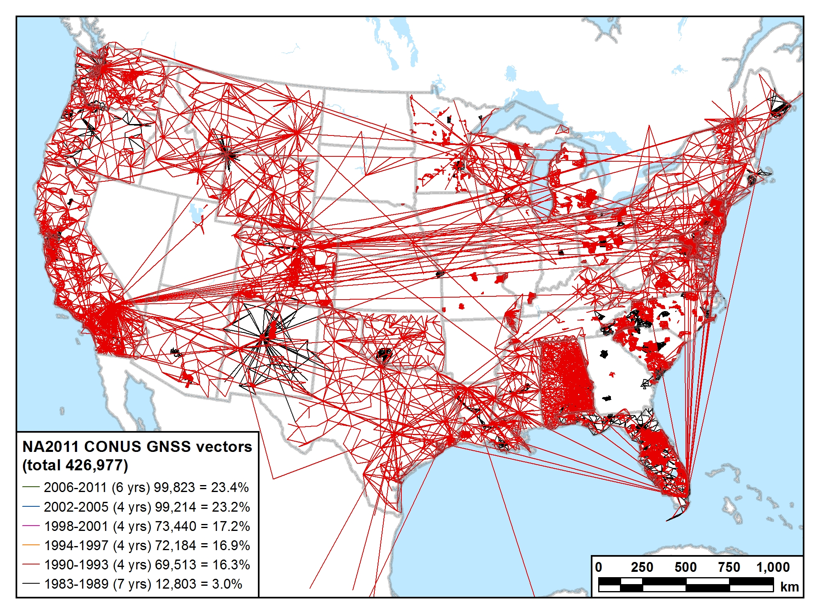
1983-1993 (11 years) 82,316 vectors (19.3%)

Slide 58
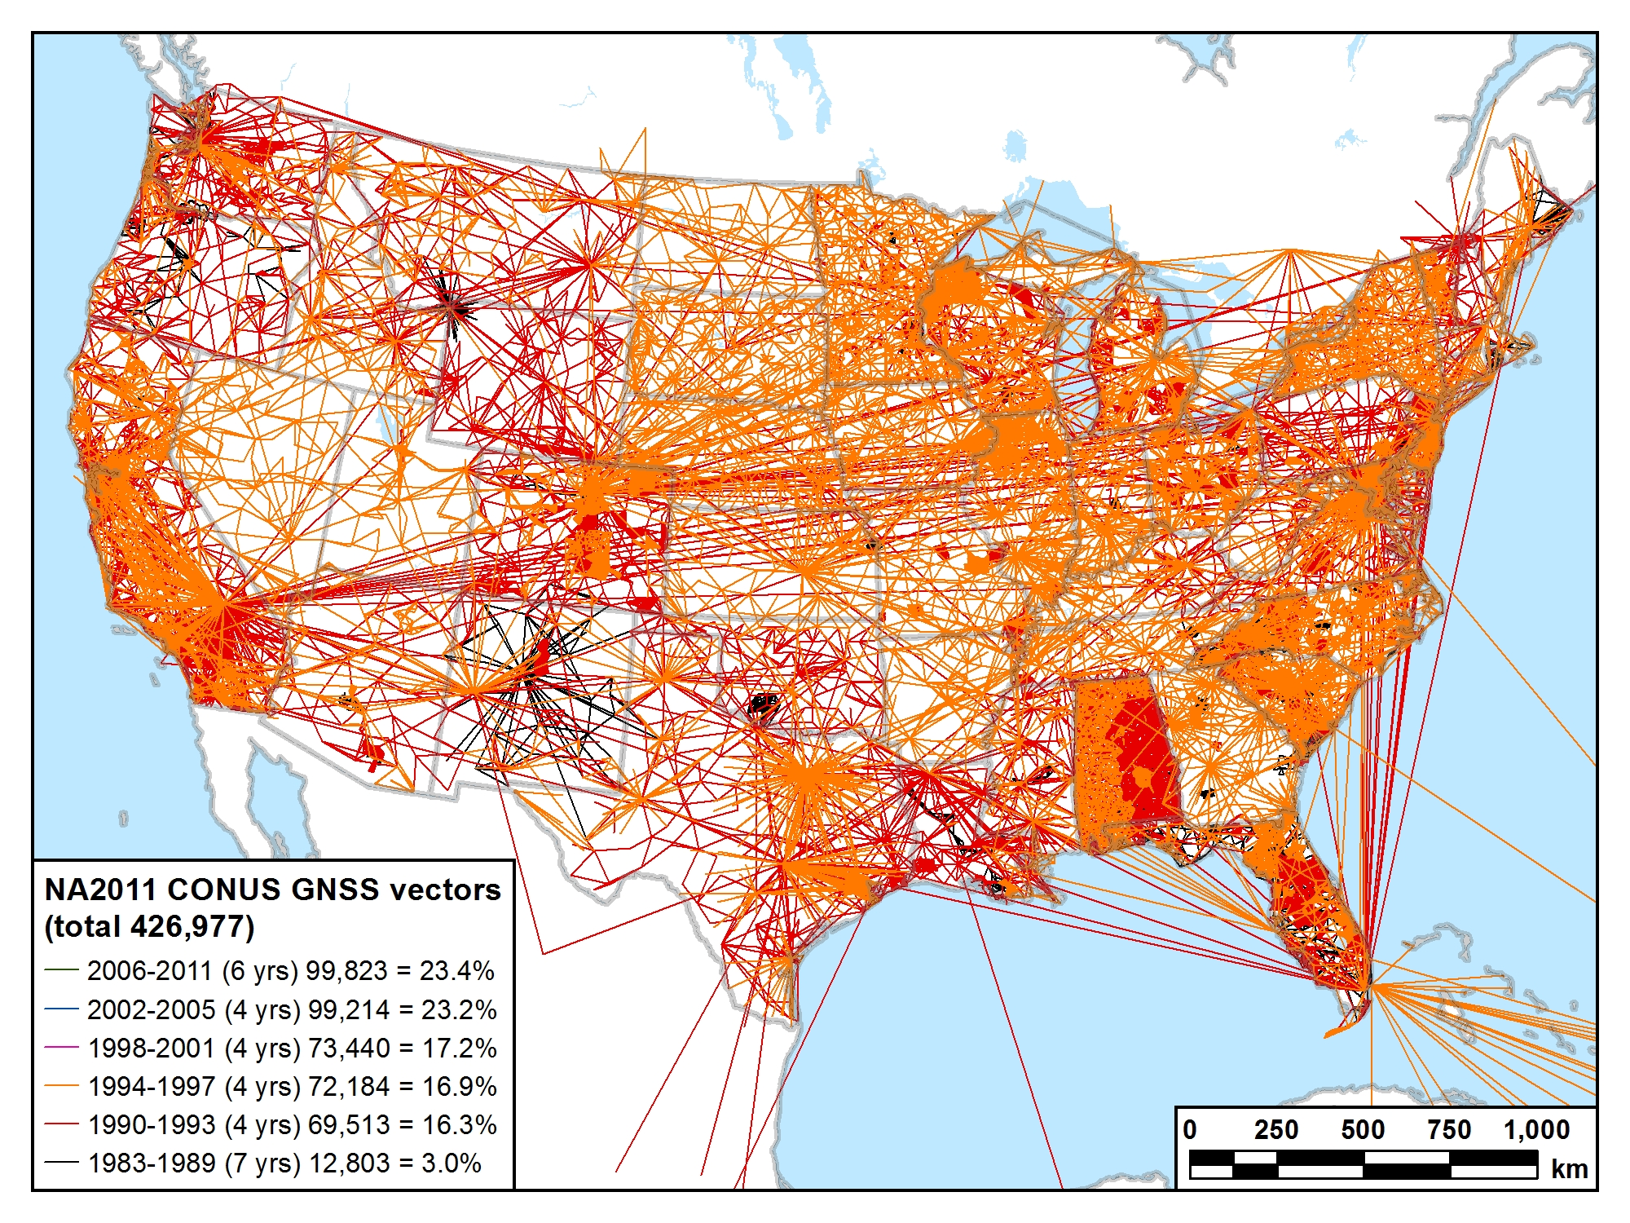
1983-1997 (15 years) 154,500 vectors (36.2%)

Slide 59
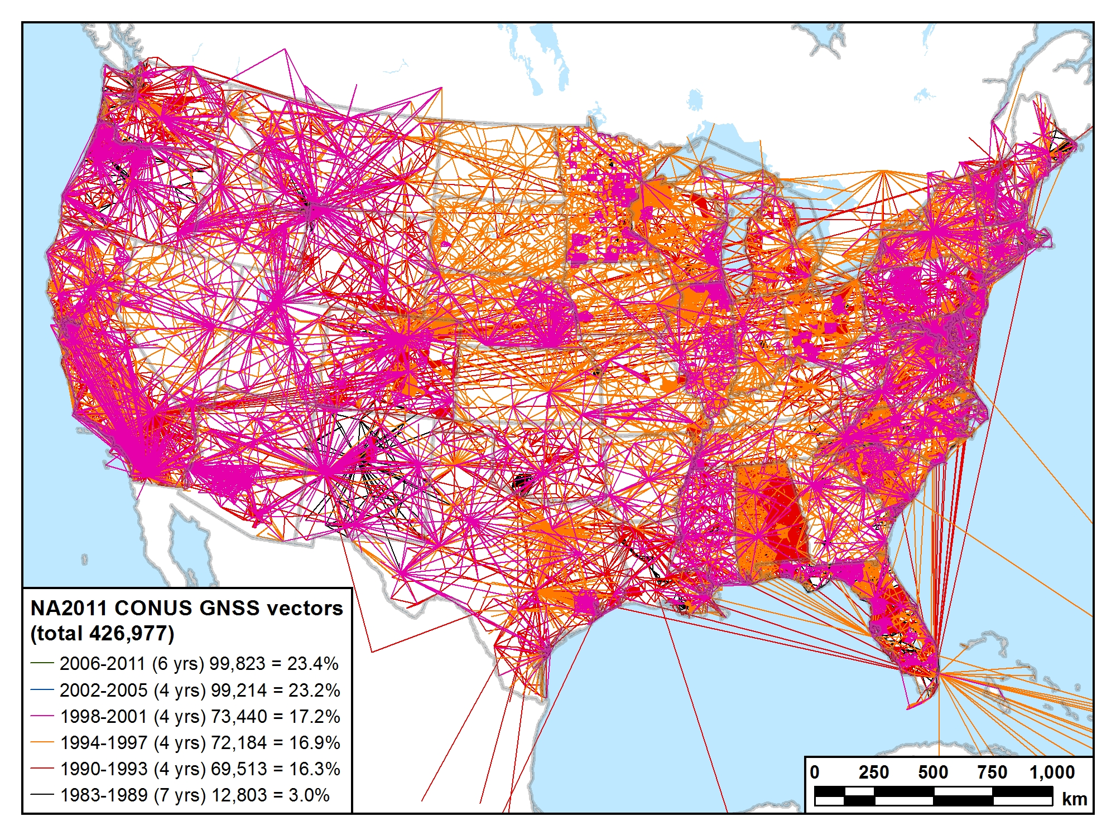
1983-2001 (19 years) 227,940 vectors (53.4%)

Slide 60
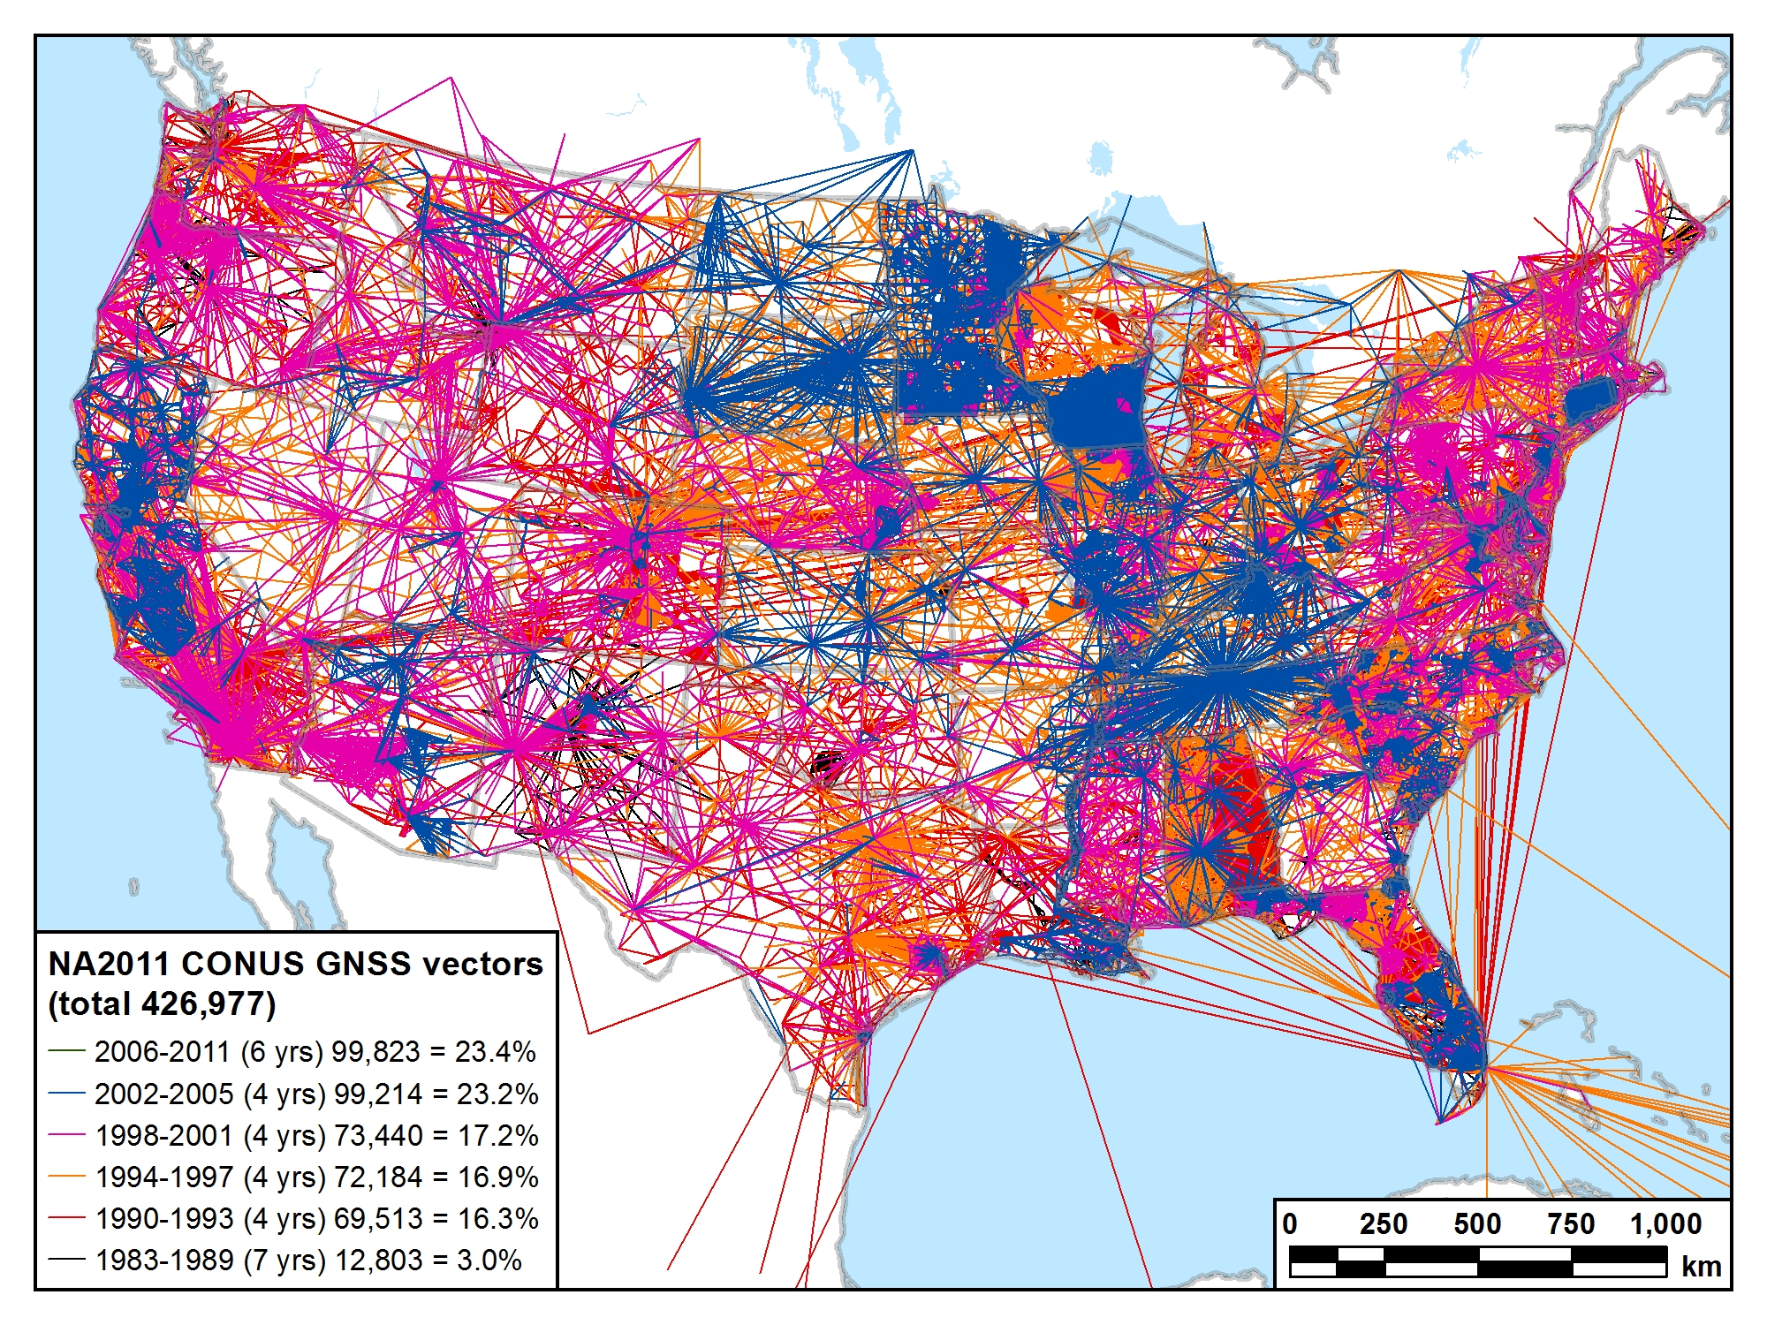
1983-2005 (23 years) 327,154 vectors (76.6%)

Slide 61
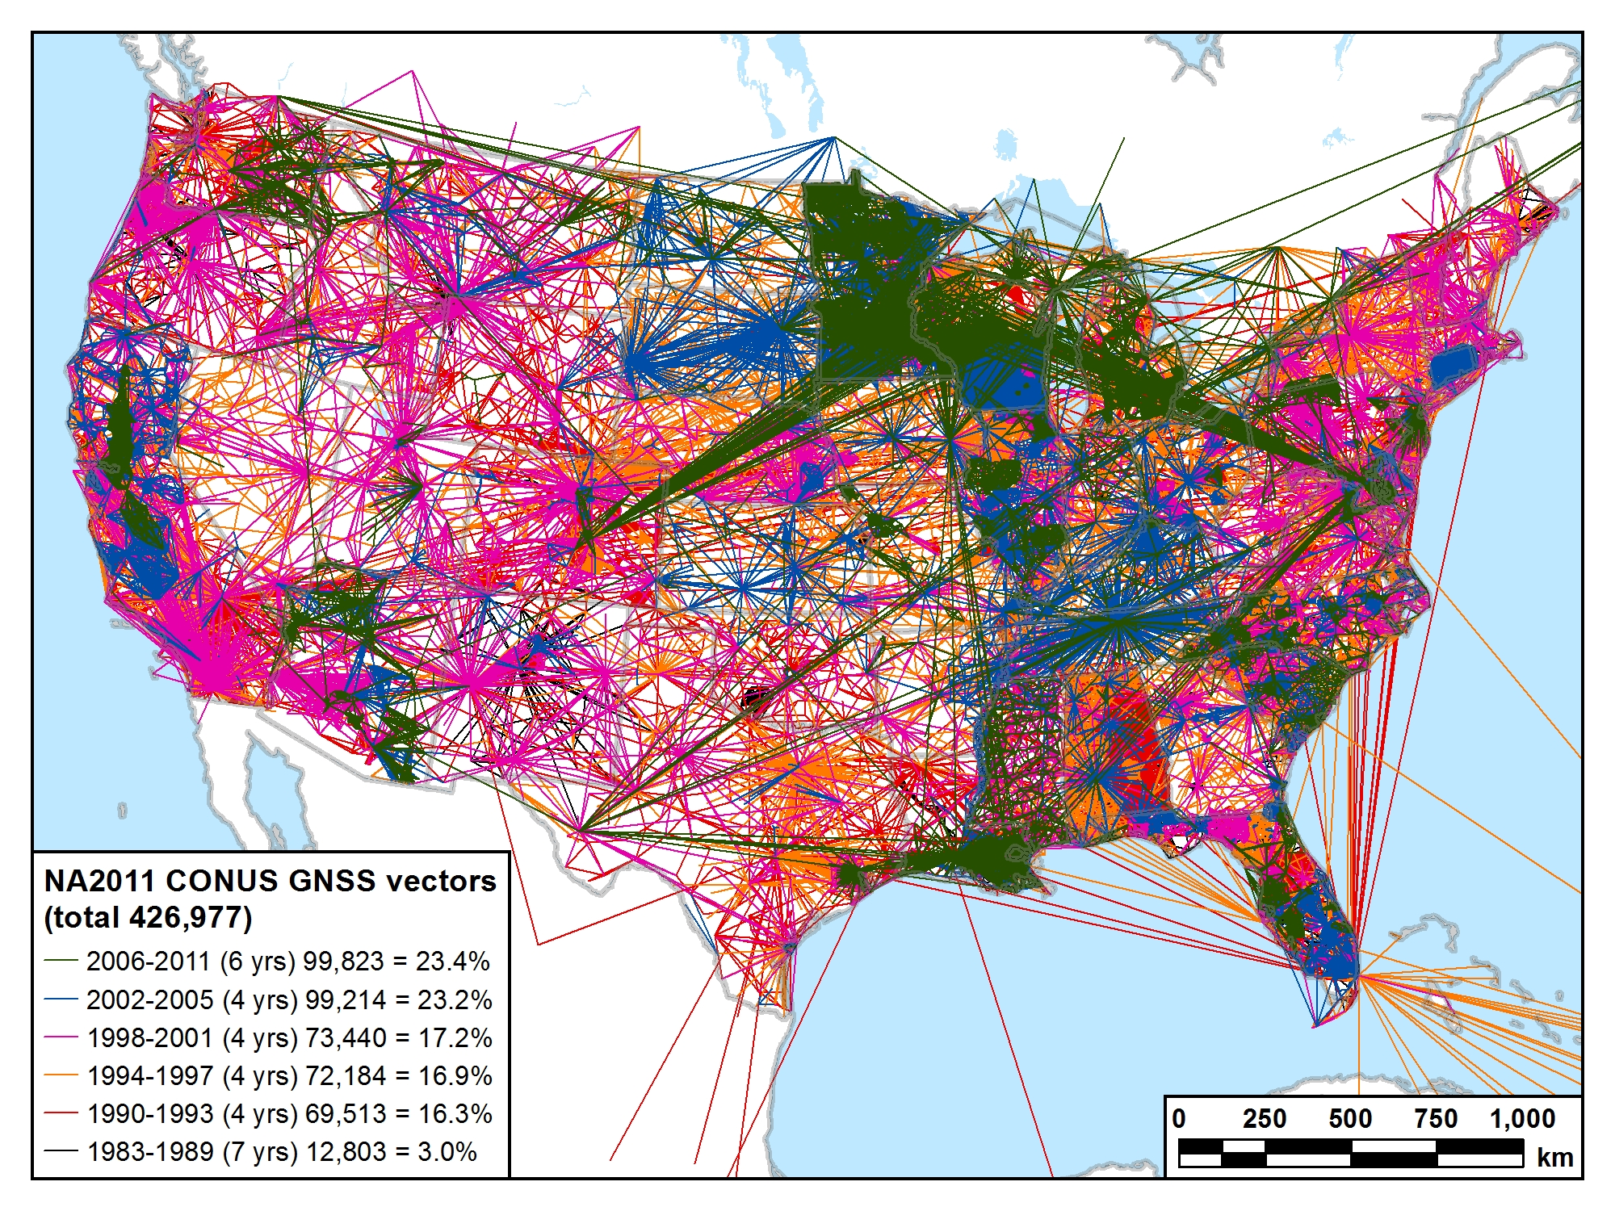
1983-2011 (29 years) 426,977 vectors (100.0%)

Slide 62
Recap: The fundamental questions
When was it done?
Publication completed on June 30, 2012
Intent: Simultaneous with release of GEOID12A
How many control stations? 80,872
How much did the coordinates change?
Median: 1.9 cm horiz, 2.1 cm vertical
How accurate are the results?
Median: 0.9 cm horiz, 1.5 cm vertical (at 95% confidence level)
How do I make use of the results?
Key is metadata: Know and identify what you have
Be consistent (i.e., don’t mix realizations)
Understand your software (e.g., relationship to “WGS 84”)
Latest WGS 84 is G1674 (week of Feb 5, 2012), epoch 2005.00

Slide 63
What about orthometric heights?
National adjustment of passive control
NAD 83(2011/PA11/MA11) epoch 2010.00:
Latitude, longitude, and ellipsoid height
Network and “local” accuracies
Orthometric heights (“elevations”) NOT determined
Question: Will GPS-derived heights based on previous NAD 83 realizations and geoid models be consistent with those based on NAD 83(2011) and GEOID12A?
i.e., is the relative change in ellipsoid heights and/or geoid heights significant (too large to ignore)?
Should NGS perform nationwide vertical adjustment?
Use GEOID12A model and national adjustment GNSS network
Constrain to leveled NAVD 88 benchmarks
Determine GPS-derived NAVD 88 heights on non-leveled marks
Will require significant analysis

Slide 64
History of vertical datums in the USA
Pre-National Geodetic Vertical Datum of 1929 (NGVD 29)
The first geodetic leveling project in the United States was surveyed by the Coast Survey from 1856 to 1857.
Transcontinental leveling commenced from Hagerstown, MD in 1877.
General Adjustments of leveling data yielded datums in 1900, 1903, 1907, and 1912. (Sometimes referenced as the Sandy Hook Datum)
NGS does not offer a utility which transforms from these older datums into newer ones (though some users still work in them!)
Notes:
According to Dave Doyle, the USACE still maintains data relative to the 1912 4th General Adjustment!

Slide 65
History of vertical datums in the USA
NGVD 29
National Geodetic Vertical Datum of 1929
Original name: “Sea Level Datum of 1929”
“Zero height” held fixed at 26 tide gauges
Not all on the same tidal datum epoch (~ 19 yrs)
Did not account for Local Mean Sea Level variations from the geoid
Thus, not truly a “geoid based” datum

Slide 66
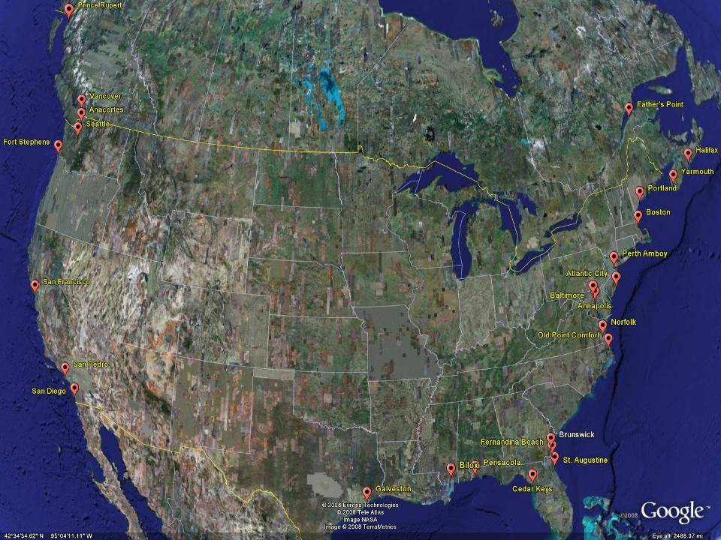
NGVD29
The National Geodetic Vertical Datum of 1929 is referenced to 26 tide gauges in the US and Canada
Notes:
It turns out that MSL is a close approximation to another surface, defined by gravity, called the geoid, which is the true zero surface for measuring elevations. Because we cannot directly see the geoid surface, we cannot actually measure the heights above or below the geoid surface. We must infer where this surface is by making gravity measurements and by modeling it mathematically. For practical purposes, we assume that at the coastline the geoid and the MSL surfaces are essentially the same. Nevertheless, as we move inland we measure heights relative to the zero height at the coast, which in effect means relative to MSL.
Definition: NGVD29 – The National Geodetic Vertical Datum of 1929…
The Sea Level Datum of 1929 was the vertical control datum established for vertical control surveying in the United States of America by the General Adjustment of 1929. The datum was used to measure elevation or altitude above, and depression or depth below, mean sea level (MSL).
Mean sea level was measured at 26 tide gauges: 21 in the United States and 5 in Canada. The datum was defined by the observed heights of mean sea level at the 26 tide gauges and by the set of elevations of all bench marks resulting from the adjustment. The adjustment required a total of 66,315 miles (106,724 km) of leveling with 246 closed circuits and 25 circuits at sea level.
Since the Sea Level Datum of 1929 was a hybrid model, it was not a pure model of mean sea level, the geoid, or any other equipotential surface. Therefore, it was renamed the National Geodetic Vertical Datum of 1929 (NGVD 29) in 1973. The NGVD 29 was subsequently replaced by the North American Vertical Datum of 1988 (NAVD 88) based upon the General Adjustment of the North American Datum of 1988.

Slide 67
History of vertical datums in the USA
NAVD 88
North American Vertical Datum of 1988
One height held fixed at “Father Point” (Rimouski, Canada)
…height chosen was to minimize 1929/1988 differences on USGS topo maps in the eastern U.S.
Thus, the “zero height surface” of NAVD 88 wasn’t chosen for its closeness to the geoid (but it was close…few decimeters)

Slide 68
History of vertical datums in the USA
NAVD 88 (continued)
Use of one fixed height removed local sea level variation problem of NGVD 29
Use of one fixed height did open the possibility of unconstrained cross-continent error build up
But the H=0 surface of NAVD 88 was supposed to be parallel to the geoid…(close again)

Slide 69
NAVD88
The North American Vertical Datum of 1988 is referenced to a single tide gauge in Canada
Notes:
It turns out that MSL is a close approximation to another surface, defined by gravity, called the geoid, which is the true zero surface for measuring elevations. Because we cannot directly see the geoid surface, we cannot actually measure the heights above or below the geoid surface. We must infer where this surface is by making gravity measurements and by modeling it mathematically. For practical purposes, we assume that at the coastline the geoid and the MSL surfaces are essentially the same. Nevertheless, as we move inland we measure heights relative to the zero height at the coast, which in effect means relative to MSL.
Definition: NGVD29 – The National Geodetic Vertical Datum of 1929…
The Sea Level Datum of 1929 was the vertical control datum established for vertical control surveying in the United States of America by the General Adjustment of 1929. The datum was used to measure elevation or altitude above, and depression or depth below, mean sea level (MSL).
Mean sea level was measured at 26 tide gauges: 21 in the United States and 5 in Canada. The datum was defined by the observed heights of mean sea level at the 26 tide gauges and by the set of elevations of all bench marks resulting from the adjustment. The adjustment required a total of 66,315 miles (106,724 km) of leveling with 246 closed circuits and 25 circuits at sea level.
Since the Sea Level Datum of 1929 was a hybrid model, it was not a pure model of mean sea level, the geoid, or any other equipotential surface. Therefore, it was renamed the National Geodetic Vertical Datum of 1929 (NGVD 29) in 1973. The NGVD 29 was subsequently replaced by the North American Vertical Datum of 1988 (NAVD 88) based upon the General Adjustment of the North American Datum of 1988.

Slide 70
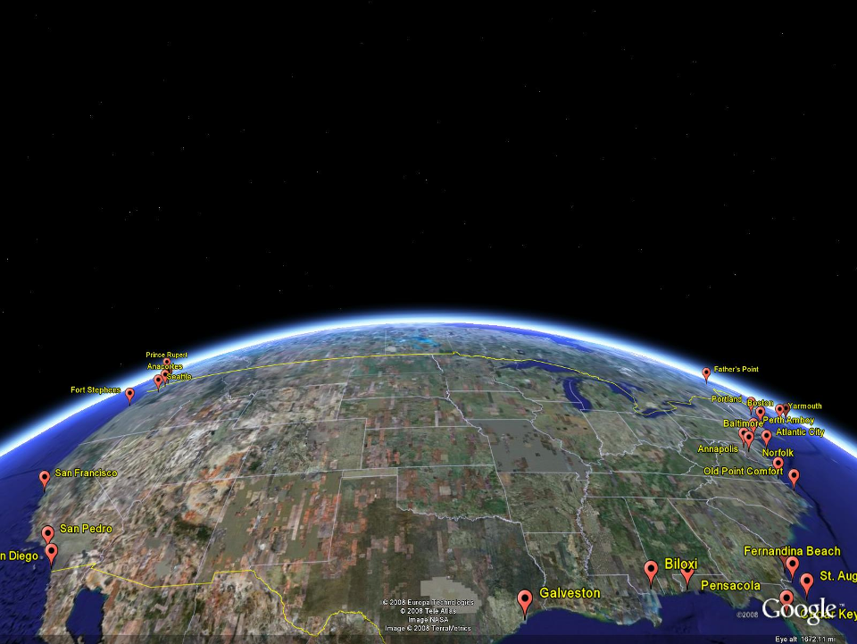
NAVD 88
Referenced to 1 Tide Gage
(Father’s Point)
NGVD 29
Referenced to 26 Tide Gages
-11 cm
125 cm
-23 cm
85 cm
102 cm
NAVD88 minus LMSL(1960-1978)
70 cm
-11 cm
4 cm
-23 cm
Notes:
NGVD29 consisted of the national vertical network referenced to 26 tide stations along the coast of North America
Click
That network was warped or twisted to fit those tide stations. The difference between the geoid (what we run levels on) and LMSL is not the same for every tide station due to prevailing winds, ocean current, etc. It is that difference that warped the network.
Click
NAVD88 utilized additional leveling data along with gravity measurements (to measure the geoid) and was referenced to only one tide station on the St. Lawrence Seaway. As you can see in the graphic, the network was unwarped which changes those reference mark’s elevations (differences between NAVD88 and the local mean sea level shown) This is not the difference between NAVD88 and NGVD29 but it is a representation of what happened.

Slide 71
Types and Uses of Geoid Height Models
Gravimetric (or Gravity) Geoid Height Models
Defined by gravity data crossing the geoid
Refined by terrain models (DEM’s)
Scientific and engineering applications
Composite (or Hybrid) Geoid Height Models
Gravimetric geoid defines most regions
Warped to fit available GPSBM control data
Defined by legislated ellipsoid (NAD 83) and local vertical datum (NAVD 88, PRVD02, etc.)
May be statutory for some surveying & mapping applications

Slide 72
GGPSBM1999: 6,169 total 0 Canada STDEV 9.2 cm (2σ)
GGPSBM2003: 14,185 total 579 Canada STDEV 4.8 cm (2 σ)
Notes:
These are the control data used to make xGEOID06a, GEOID03 and GEOID99 (GPS on bench marks: GPSBM’s).
Improvements in Distribution are primarily due to obtaining data in Canada.
The bulk of the increase comes in one state: Minnesota (603 => 4161).
Note the inequitable distribution.
You could practically grid the GPSBM’s in South Carolina or Minnesota and get a good result.
Other places are not so fortunate…
Also note that this shows distribution but not quality of the points.
Some regions (e.g., Texas) have systematic quality problems (due to subsidence) that impact the GPSBM’s and the derived hybrid geoids.
Current techniques rely on creating models of the systematic effects at multiple wavelengths. If the spatial density doesn’t support the shorter wavelength models, then the quality of predictions will commensurately be reduced.
Note that a hyper-dense survey isn’t necessary to achieve optimal results. Later discussion on Minnesota will emphasize this.

Slide 73
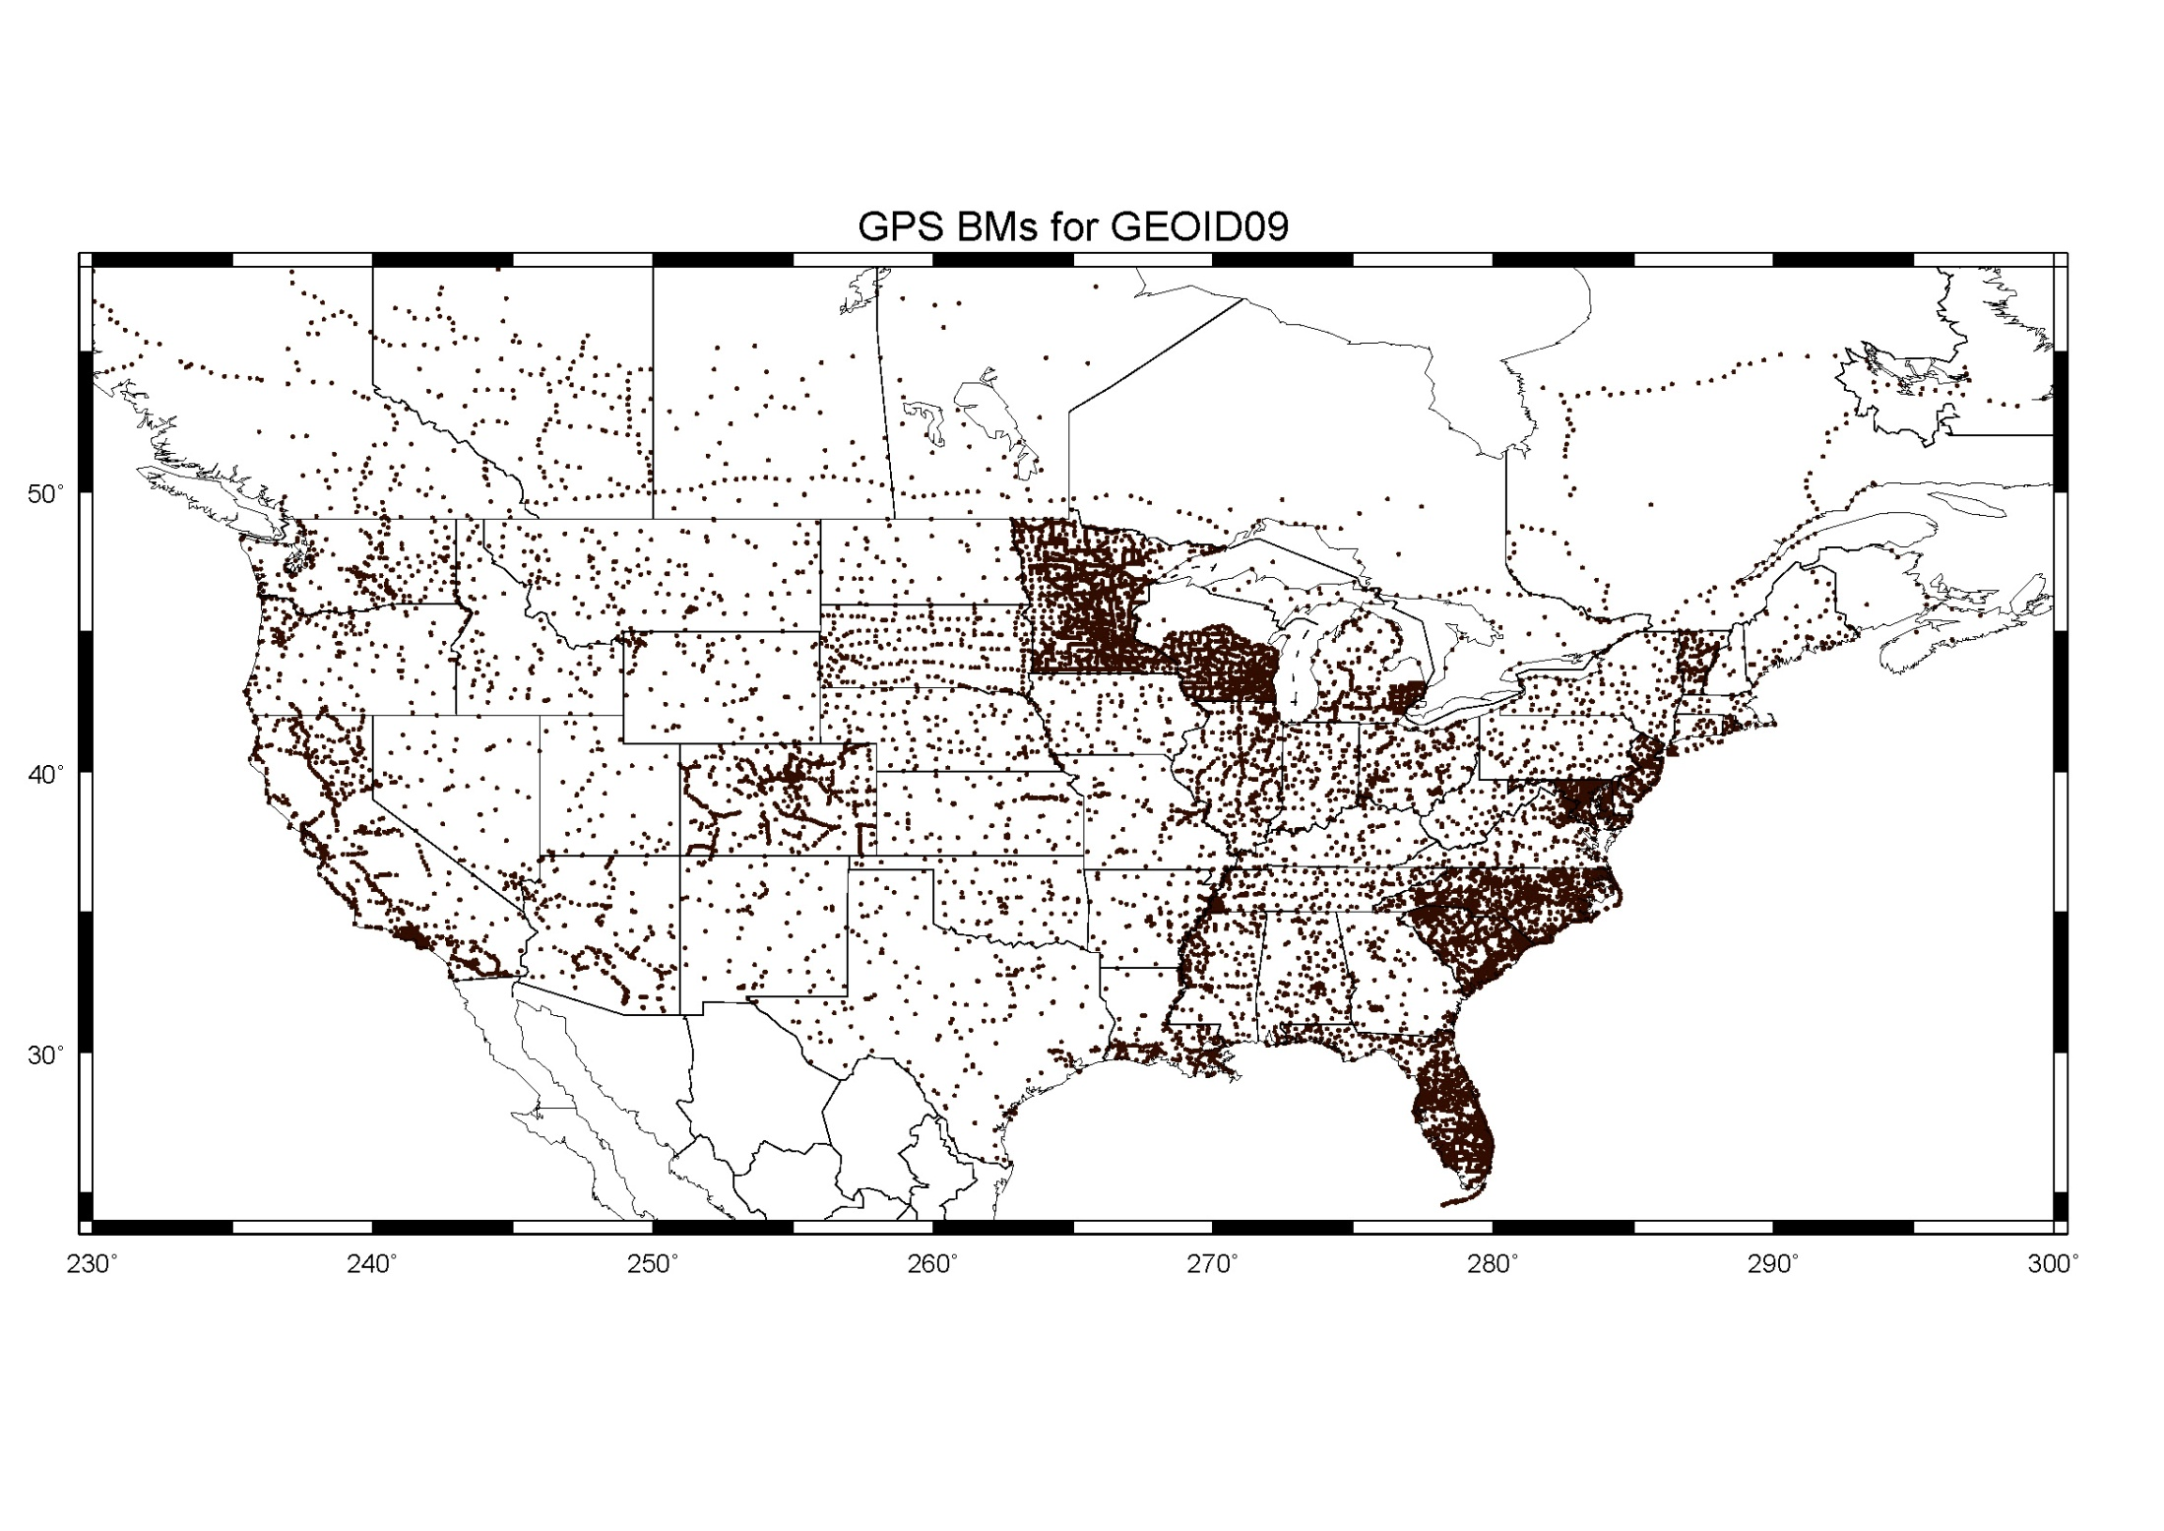
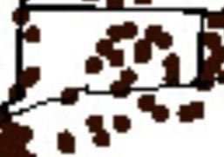
GGPSBM2009: 18,398 STDEV 2.8 cm (2σ)

Slide 74
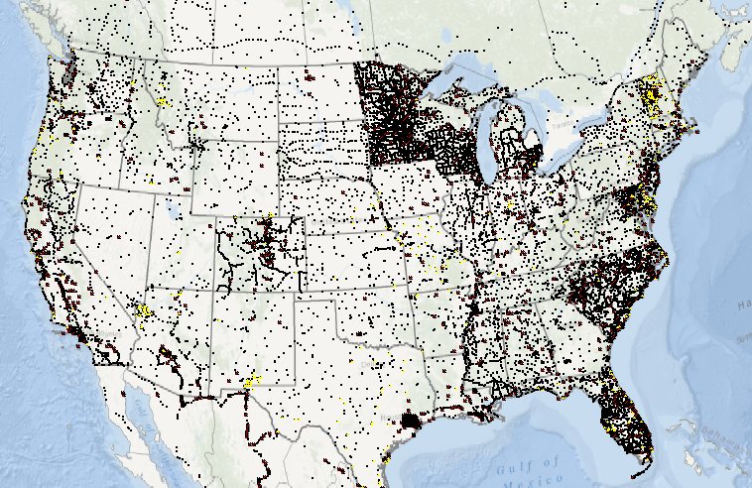
GGPSBM2012A: 23,961 (CONUS)
499 (OPUS on BM)
574 (Canada)
177 (Mexico)

Slide 75
Which Geoid for Which NAD 83?
NAD 83(2011)
NAD 83(2007)
NAD 83(1996) & CORS96
NAD 83(1992)
Geoid12A
Geoid09
Geoid06 (AK only)
Geoid03
Geoid99
Geoid96
Geoid93

Slide 76
Mission and Vision of NGS
To define, maintain and provide access to the National Spatial Reference System to meet our nation’s economic, social, and environmental needs
“Maintain the NSRS” means “NGS must track all of the temporal changes to the defining points of the NSRS in such a way as to always maintain the accuracy in the NSRS definition.”
Vision - Modernize the Geopotential (“Vertical”) and Geometric (“Horizontal”) datums

Slide 77
Problems with NAD 83 and NAVD 88
NAD 83 is not as geocentric as it could be (approx. 2 m)
Surveyors don’t see this - Yet
NAD 83 is not well defined with positional velocities
NAVD 88 is realized by passive control (bench marks) most of which have not been releveled in at least 40 years.
NAVD 88 does not account for local vertical velocities (subsidence and uplift)
Post glacial isostatic readjustment
Subsurface fluid withdrawal
Sediment loading
Sea level rise Ave in CT (0.79 ft per 100 years)
Bridgeport, CT 2.56 mm/yr (0.008 ft/yr) 1964-2006
New London, CT 2.25 mm/yr (0.007 ft/yr) 1938-2006

Slide 78
The National Geodetic Survey 10 year plan
Mission, Vision and Strategy
2008 – 2018
http://www.ngs.noaa.gov/INFO/NGS10yearplan.pdf
Official NGS policy as of Jan 9, 2008
Modernized agency
Attention to accuracy
Attention to time-changes
Improved products and services
Integration with other fed missions
2018 Targets: (now 2022)
NAD 83 and NAVD 88 re-defined
Cm-accuracy access to all coordinates
Customer-focused agency
Global scientific leadership
Notes:
Realization and unification of NAD83 in Canada and the U.S. via the ITRF.
http://www.geod.nrcan.gc.ca > Geodetic Survey Division > Publications > Papers

Slide 79
Future Geometric (3-D) Datum
replace NAD83 with new geometric datum – by 2022
CORS-based, via GNSS
coordinates & velocities in ITRF and official US datum
(NAD83 replacement: plate-fixed or “ITRF-like”?) & relationship
passive control tied to new datum; not a component of new datum
address user needs of datum coordinate constancy vs. accuracy
lat / long / ellipsoid height of defining points accurate to 1 mm, anytime
CORS coordinates computed / published daily; track changes
support development of real-time networks

Slide 80
Future Geopotential (Vertical) Datum
replace NAVD88 with new geopotential datum – by 2022
gravimetric geoid-based, in combination with GNSS
monitor time-varying nature of gravity field
develop transformation tools to relate to NAVD88
build most accurate ever continental gravimetric geoid model (GRAV-D)
determine gravity with accuracy of 10 microGals, anytime
support both orthometric and dynamic heights
Height Modernization is fully supported

Slide 81
Why New Datums?
NAD 83
non-geocentric, i.e. inconsistent with GNSS positioning
difficult to maintain consistency between CORS & passive network NAD 83 coordinates
lack of velocities, i.e. NAD 83 does not report station motion for passive marks
NAVD 88
cross-country build up of errors (“tilt” or “slope”) from geodetic leveling
passive marks inconveniently located and vulnerable to disturbance and destruction
0.5 m bias in the NAVD 88 reference surface from the (best) geoid surface approximating global mean sea level
subsidence, uplift, freeze/thaw, and other crustal motions invalidate heights of passive marks, and can make it difficult to detect such motions
marks lacking adequate geophysical models - complicate sea level change detection
changes to Earth’s gravity field cause changes in orthometric heights, but NAVD 88 does not account for those changes (NAVD88 based on a static gravity model)
gravity model and modeling techniques used to determine NAVD 88 are not consistent with those currently used for geoid modeling

Slide 82
Problems using traditional leveling (to define a National Vertical Datum)
Leveling the country can not be done again
Too costly in time and money (Estimated ~ $1B)
Leveling yields cross-country error build-up; problems in the mountains
Leveling requires leaving behind passive marks
Bulldozers and crustal motion do their worst

Slide 83
Why isn’t NAVD 88 good
enough anymore
NAVD 88 suffers from use of bench marks that:
Are almost never re-checked for movement
Disappear by the thousands every year
Are not funded for replacement
Are not necessarily in convenient places
Don’t exist in most of Alaska
Weren’t adopted in Canada
Were determined by leveling from a single point, allowing cross-country error build up
Notes:
Clarification on the word “convenient” – this is used to mean “there isn’t always a bench mark around when you need one – sometimes you have to find one far away and level from it to your site of interest”

Slide 84
Why isn’t NAVD 88 good
enough anymore?
NAVD 88 suffers from:
A zero height surface that:
Has been proven to be ~50 cm biased from the latest, best geoid models (GRACE satellite)
Has been proven to be ~ 1 meter tilted across CONUS (again, based on the independently computed geoid from the GRACE satellite)

Slide 85
NGSIDB BM Status (1st, 2nd order)
 | CT | MA | ME | NH | RI | VT
In NGSIDB | 2599 | 1125 | 5401 | 1092 | 1380 | 2158
Poor | 31 | 24 | 118 | 20 | 19 | 17
Not Found | 281 | 150 | 1048 | 218 | 196 | 363
Not Rec since Monumented | 533 | 254 | 1659 | 216 | 160 | 461
Last Rec ≤ 1990 | 1570 | 584 | 4475 | 689 | 857 | 374
Last Rec ≤ 1980 | 160 | 499 | 3434 | 531 | 277 | 331

Slide 86
NE Vertical Control

Slide 87
Height-Mod means More Marks

Slide 88
1. Using GNSS is cheaper, easier than leveling 2. To use GNSS we need a good geoid model
Height Modernization Bottom line

Slide 89
Why isn’t NAVD 88 good
enough anymore?
Earth’s
Surface
H (NAVD 88)
H
NAVD 88 reference level
The Geoid
Errors in NAVD 88 : ~50 cm average,
100 cm CONUS tilt,
1-2 meters average in Alaska
Notes:
This slide shows what NGS now knows about the error in NAVD 88 itself. Using a continental geoid computed from the GRACE satellite, a bias and tilt in NAVD 88 has been computed using GPS derived ellipsoid heights on NAVD 88 bench marks. These are now known errors that exist in all NAVD 88 bench marks. This datum realization error, relative to the geoid, is over and above the errors from marks moving.

Slide 90
GRACE – Gravity Recovery
and Climate Experiment

Slide 91
Why isn’t NAVD 88 good
enough anymore?
Approximate level of geoid mismatch known to exist in the NAVD 88 zero surface:
Notes:
This map reflects the sort of height changes that users could expect if NAVD 88 were replaced with a geoid-based vertical datum.
This is only a large scale approximation and should not be used as an absolute guide. Each benchmark might have its own level
Of mismatch, say from uplift or subsidence, not captured by this broad brush.
Also, this is the difference between the zero level of NAVD 88 and the actual geoid. The difference between NAD 83 ellipsoid heights and
ITRF/GRS-80 ellipsoid heights has NO influence on this graph and should not be part of the story.
Updated October 2010

Slide 92
How accurate is a GPS-derived Orthometric Height?
Relative (local) accuracy in ellipsoid heights between adjacent points can be better than 2 cm, at 95% confidence level
Network accuracy (relative to NSRS) in ellipsoid heights can be better than 5 cm, at 95% confidence level
Accuracy of orthometric height is dependent on accuracy of the geoid model – Currently NGS is improving the geoid model with more data, i.e. Gravity and GPS observations on leveled bench marks from Height Mod projects
Geoid09 can have an uncertainty in the 2-5 cm range.

Slide 93
New geometric datum minus NAD 83 (horizontal)

Slide 94
New geometric datum minus NAD 83 (ellipsoid height)

Slide 95
Transition to the Future – GRAV-D
Gravity for the Redefinition of the American Vertical Datum
Official NGS policy as of Nov 14, 2007
$38.5M over 10 years
Airborne Gravity Snapshot
Absolute Gravity Tracking
Re-define the Vertical Datum of the USA by 2018
(2022 more likely due to funding issues)

Slide 96
What is GRAV-D?
Alaska
“CONUS”
Guam / Northern Marianas
Hawaii
Puerto Rico / U.S.Virgin Islands
American Samoa
GRAV-D
Planned
Coverage

Slide 97
Gravity Survey Plan
National Scale Part 1
Predominantly through airborne gravity
With Absolute Gravity for ties and checks
Relative Gravity for expanding local regions where airborne shows significant mismatch with existing terrestrial

Slide 98
What is GRAV-D?
GRAV-D will mean:
As the H=0 surface, the geoid will be tracked over time to keep the datum up to date
The reliance on passive marks will dwindle to:
Secondary access to the datum
Minimal NGS involvement
Maintenance/checking in the hands of users
Use at your own risk

Slide 99
Geoid Slope Validation Survey of 2011 (GSVS11)

Slide 100
GSVS11 Components
Differential Leveling
Campaign GPS
RTN-based and OPUS_RS
Absolute Gravity
Gravity Gradients
Deflections of the Vertical
Airborne LIDAR
Airborne Imagery

Slide 102
GOOD COORDINATION BEGINS WITH
GOOD COORDINATES
GEOGRAPHY WITHOUT GEODESY IS A FELONY

