Slide 1


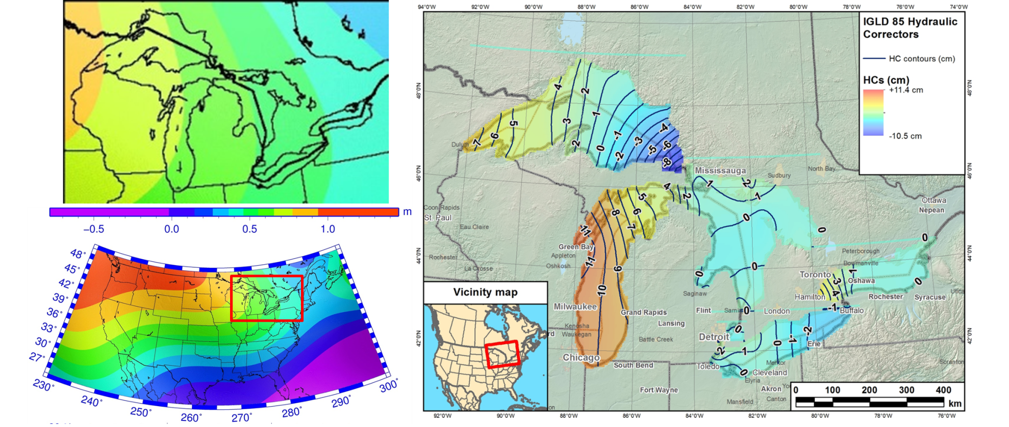
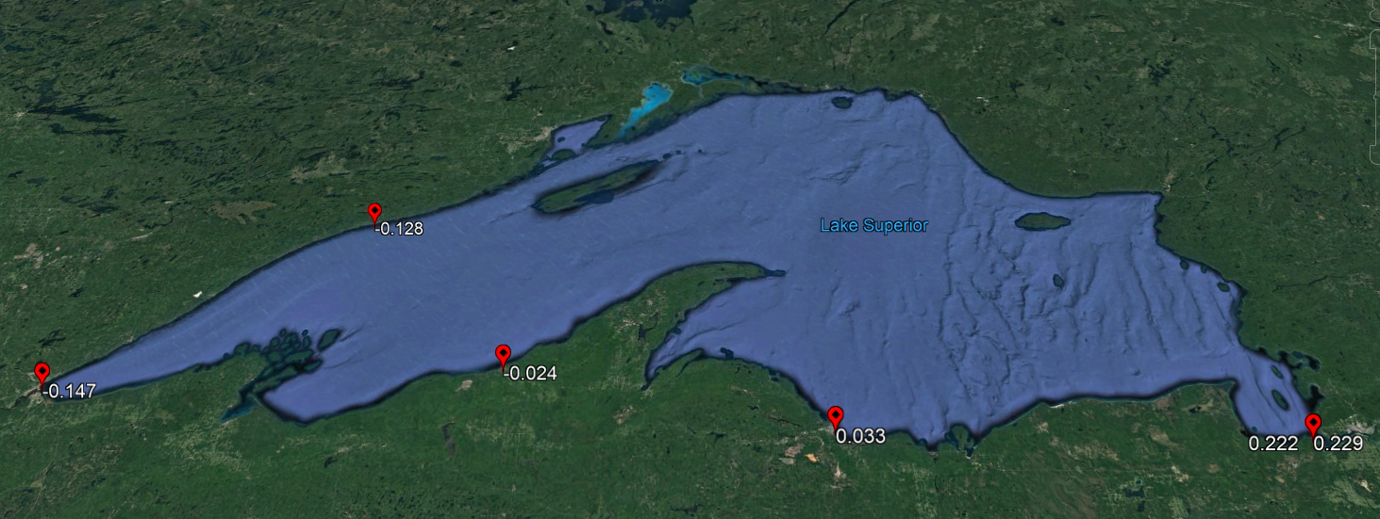
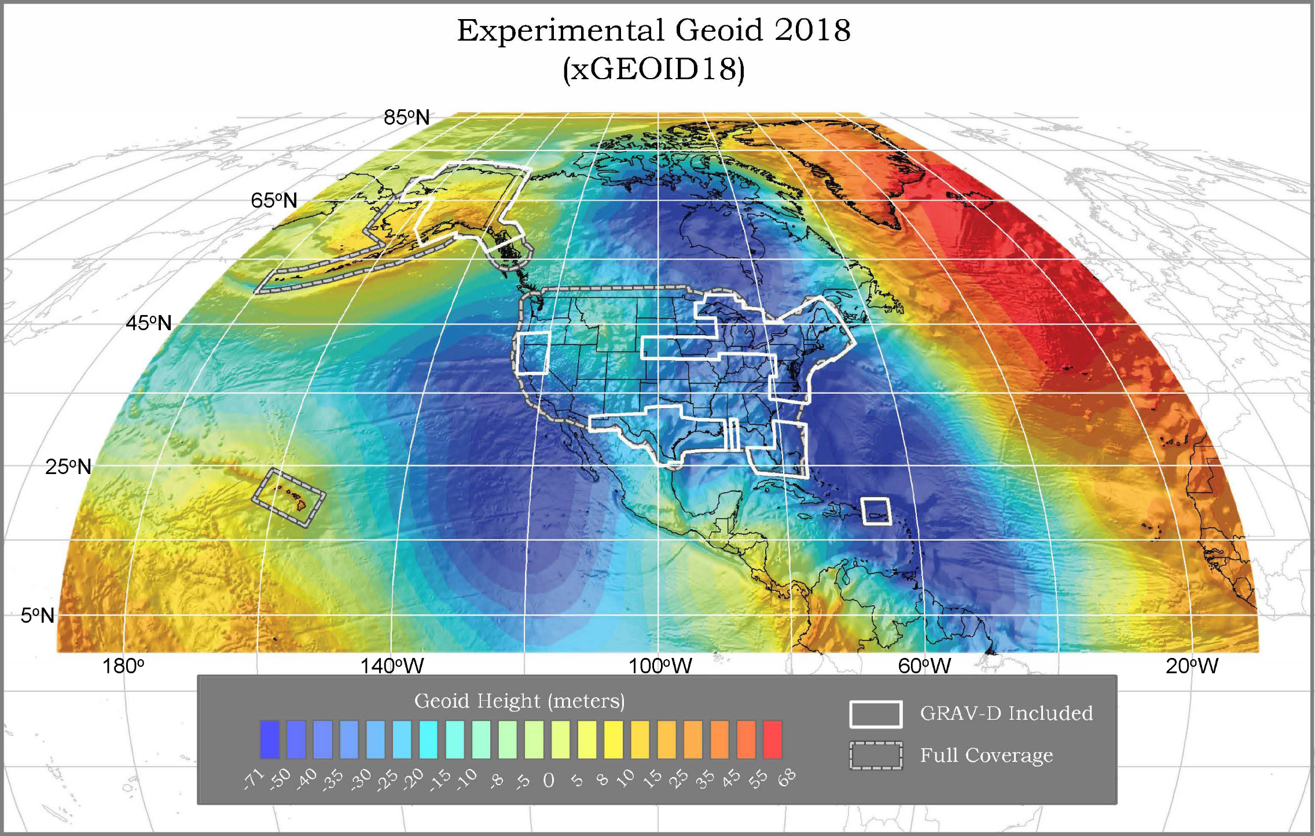
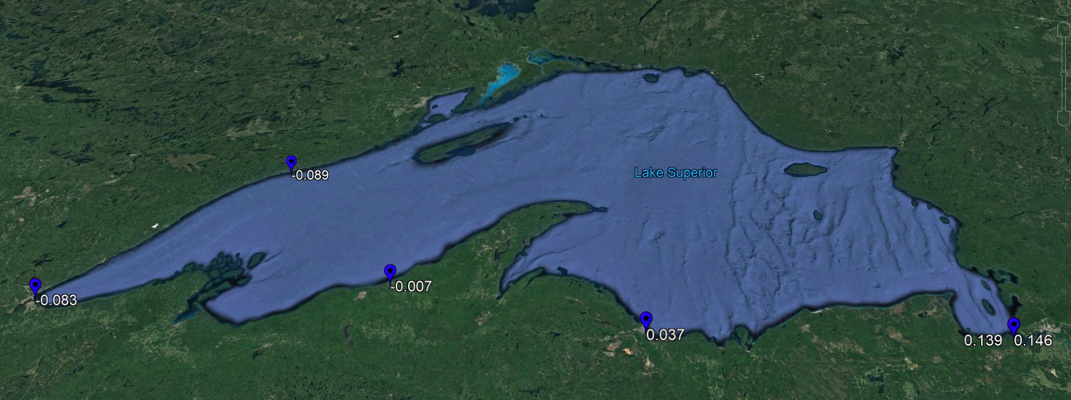
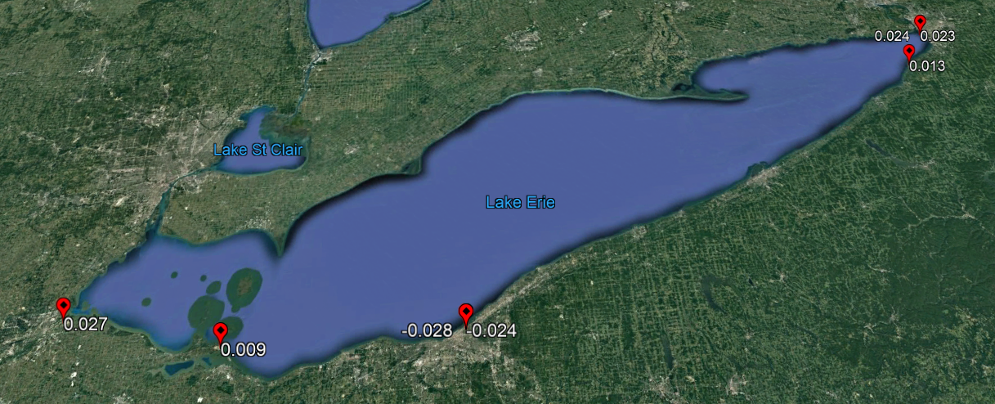
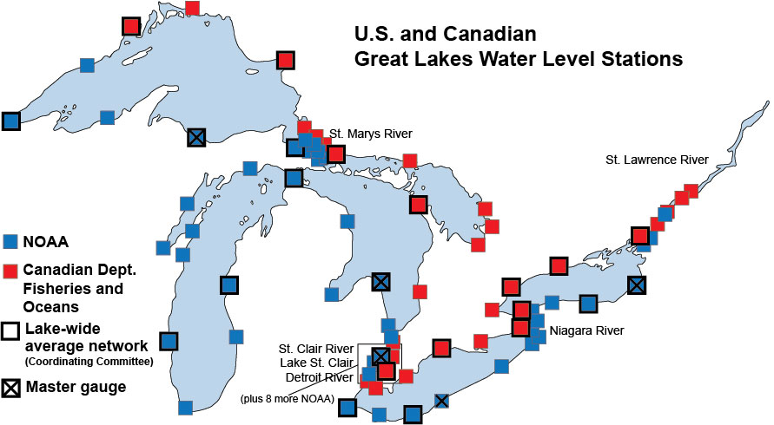
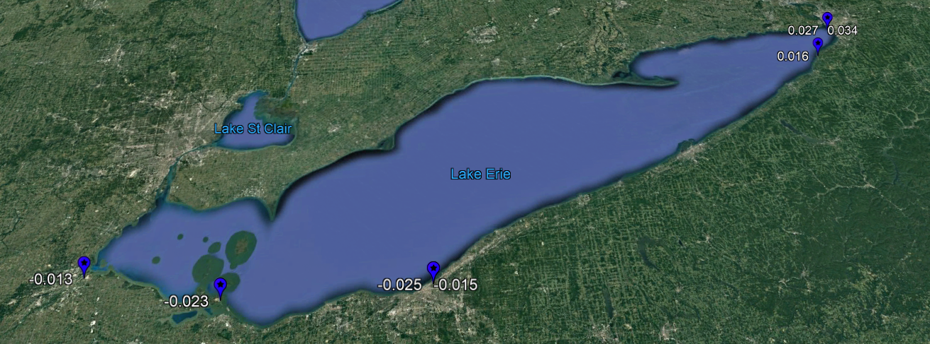
EGU2019-2315: Comparison of Geopotentially Implied Water Topography on the Great Lakes
Daniel R. Roman¹, Xiaopeng Li²
1. Headquarters, NOAA's National Geodetic Survey, Silver Spring, MD, United States. 2. Geosciences Research Division, NOAA's National Geodetic Survey, Silver Spring, MD, United States.
INTRODUCTION
The U.S. and Canada jointly maintain the Great Lakes through international treaty. The hydrologic and hydraulic signals are monitored via an established dynamic height datum, currently the International Great Lakes Datum of 1985. IGLD 85 was developed from the same geopotential numbers as the current vertical datum in the U.S., the North American Vertical Datum of 1988 (NAVD 88). NAVD 88 will be replaced in 2022 by a common geopotential model that will serve as the common vertical datum in North America - the North America-Pacific Geopotential Datum of 2022 (NAPGD 2022). Hence, IGLD 85 will be updated to IGLD 2020 in 2025. The US and Canada have entered into an intensive seven year program to collect data in order to develop the best model possible for this new dynamic height datum. However, this is not the only period in which data have been collected. Leveling data is collected every year at about half the sites. GPS data has been collected at five-year intervals to monitor regional deformation and to provide insight into the expected behaviors of the water surface of longer periods of time. GPS campaigns were conducted in 1997, 2005, 2010, and 2015 on bench marks in the vicinity of the approximate 100 water level stations (WLS) scattered around the Lakes. Comparisons will be made between the geometric coordinates over the four campaign epochs and compared to the recently completed Repro2 results to ensure consistency. Leveling is performed from these bench mark sites to connect to the WLS to the geometric frame. In turn, the WLS measurements of the water surface transfer the geometric heights to the water surface where geopotential models are applied to estimate the dynamic heights. The water surface of the Lakes can vary by many decimeters over the period of the year as water flows into and out of the Lakes. Additionally, significant storm events can trigger meter level shift of the water over a period of days. Hence, it is necessary to average over periods of time to mitigate these effects. Data gaps occur as the WLS sensors go down, and these must be taken into account when developing the smoothed average surface. Finally, a comparison is necessary at the four epochs to assess if the apparent water topography observed on a Lake is consistent at different Lake water level heights and over decades of observations.
BACKGROUND
The U.S. National Geodetic Survey (NGS) is responsible for maintaining the U.S. National Spatial Reference System (NSRS). The current version of the NSRS relies upon variants of the North American Datum of 1983 (NAD 83) and the North American Vertical Datum of 1988 (NAVD 88) for vertical control in the Conterminous United States (CONUS) and Alaska. NAVD 88 was completed as an adjustment of geopotential numbers, which were also used to define the International Great Lakes Datum of 1985 (IGLD 85). At the time that IGLD 85 was implemented, water level transfers determined that the dynamic heights developed for IGLD 85 had some type of systematic offset. Hydraulic Correctors (HC) were determined for each Lake to account for the non-uniformity of the Lake surfaces.
In the past decade, the Gravity for the Redefinition of the American Vertical Datum (GRAV-D) project was instituted to better determine to provide more contemporary gravity field across the country. Most of the data used to build earlier models for heights were 50-70 years old. As a part of the analysis, the long wavelengths of the gravity field and datum surfaces were examined. Comparison of the NAVD 88 datum surface to that estimated from modern Earth Gravity Models including GRACE and GOCE data established that there were significant (meter-level) errors in the NAVD 88. This was primarily a meter-level trend surface but also included regions with 0.500 m departures. Figure 1 shows the national trend and also highlights the Great Lake region. Also shown in Figure 1 are the HC for each Lake. Noting that each Lakes HC are independent from each other, the relationship between the HC and the NAVD 88 errors is clear. Hence, the need for updating the gravity models and moving to a gravimetric geoid based vertical datum.
Figure 2 shows the current experimental Geoid model for 2018 (xGEODI18). The white boxes highlight regions where GRAV-D was collected, processed and incorporated into the model. The Great Lakes. In this study, we actually relied upon xGEODI15. However, the Great Lakes GRAV-D were collected and used in that model as well, and there are no significant differences between them in the Great Lakes region. The use of xGEODI15 was based on collections of Campaign GPS in 2015 with the desire to have the geoid model be contemporary to the Campaign GPS. It should have no impact either way. Both xGEODI18 and xGEODI15 are based in ITRF2008.
APPROACH
Campaign GPS were collected on bench marks (BM) adjacent to the Water Level Stations (WLS) shown in Figure 3. The U.S. and Canada coordinated collection on both sides of the border to maximize efficiency and decrease errors. Leveling from the BM’s to the datum in the WLS was also completed. The WLS datum is, in effect, the table surface the Electronic Tape Gauge (ETG) sits on in each WLS building. Figure 4 highlights the layout of a WLS. Geometric height determined from adjustment of the campaign GPS is transferred to the ETG datum surface. A handheld GPS provided the latitude and longitude of the WLS building. While this might seem a crude approximation, keep in mind that the finest geoid grid being interpolated is only one arc-minute in resolution – about 2 km. So any 30 m errors in positioning of the WLS is negligible.
At a bout a dozen of the U.S. WLS, there are also collocated CORS. These provide an extra assessment on the quality of the GPS Campaign adjustment and leveling transfers. For these, an inverted rod measurement is made to connect the antenna ARP to the ETG datum. The CORS data were used as a part of the Campaign GPS adjustment and are, therefor part of a common solution. In many instances, the level of agreement was sub-cm. This will be highlighted in the comparisons later on.
Either from the BM or CORS, the ITRF2008 ellipsoidal height was transferred to the ETG datum. From there, a mean distance from the ETG to the water surface was determined from the continuous water surface observations of the WLS. A Summer (June-September) mean was selected, because the water surface is quasi-stationary for that part of the year. It falls precipitously in the Fall and is subject to blockages from ice jams in the Winter. Hence, the most stable part of the observations occurs over the Summer months. Averages have been previously shown for 2015 and are shown again here. A recent adjustment of campaign GPS for 2010 was also completed allowing a comparison between the Summer 2015 and Summer 2010 for Lakes Superior and Erie.
The Summer means are determined above the existing IGLD 85 datum for the U.S., Canada uses heights above the respective Lakes Low Water Datum, which is related but not the same. However, the ETG datum height is also given above IGLD 85, so the actual physical distance from the ETG datum to the mean water surface can be determined. When this is applied to the ellipsoidal height of the ETG datum, it yields the ellipsoidal height of the water surface in ITRF2008. Combining this with the handheld coordinates, permits the use of Reference EGM models to estimate components of the gravity field at five arcminutes. It also permits interpolation of the one arcminute geoid model.
In making xGEOID15 and xGEODI18, reference field models were necessarily generated. These models reflect the 5’ and longer gravity field. These are then used in a remove-compute-restore technique to generate the subsequent xGEOIDxx model at 1’ resolution. The xGEODI model then has the higher frequency component of the gravity field. By determining the residual geoid (dN = N[1’] – N[5’]) and converting that into a geopotential number base don the 5’ gravity value, a small correction (Dw) is determined for the 5’ geopotential number (W[5’]). Adding them together (yields an estimate of the complete geopotential number through 1’ (W[1’] =~ W[5’] + dW). This follows previous procedures. Use of interpolated 1’ gravity field data was also investigated, but no significant effects were noted from incorporating a better estimate of the local gravity field.
With a geopotential number determined for the mean water surface at a WLS, the adopted geopotential datum for North America was used. The U.S. and Canada have both agreed to use 62,636,856.00 m²/s² based on a previous analysis of tide gauges around the U.S. and Canada. By removing the individual WLS geopotential values (W) from the W0 value, a geopotential number (C) was determined. Dividing by gamma at 45 degrees latitude using GRS-80 values yields the dynamic height at each WLS. Note that where CORS are collocated at the WLS, two values were estimated. The difference primarily comes from the ellipsoid height as all other changes common mode.
DISCUSSION
Figure 5 shows the Dynamic Heights on Lake Superior for the 2015 Campaign. The WLS heights shown are relative to the mean of 183.053 m. This reflects the dynamic heights above W0. There is a pronounced 0.3 m trend from West to east. This was concerning until the 2010 Campaign data were compared (Figure 2), where a 0.2 m trend is also seen. Canadian data (w.r.t. Lake datum not W0) are also shown. These are also given in a relative sense, and they generally agree with the trend seen in the U.S. data.
Figure 7 shows Dynamic Heights on Lake Erie for the 2015 Campaign. The WLS heights shown are relative to the mean of 174.150 m again reflecting heights above W0. There is very little trend to be observed in these data with variations generally +/- 0.02 m and consistent with GPS Campaign adjustment errors. Figure 8 shows the 2010 data for Lake Erie, where the mean surface is 173.761 m. A small west-to-East trend can potentially be seen though again largely within the GPS Campaign adjustment errors. The Canadian data here also support a similar trend surface. This analysis does seem to point to the ability to use a gravimetric geoid model to estimate dynamic heights and establish a new IGLD in 2020.
Finally, it is also worth noting the differences between the Lake mean surfaces between the years. On Lake Superior, the water surface went up 0.526 m between 2010 and 2015. On Lake Erie, it went up 0.389 m. It is valid to assume that WLS observations on Lake surfaces behave similarly to those at ocean tide gauges. Significant variability can occur between Campaigns but also over just a few days. This confounds determining a “mean” surface and requires special care – something that will continue to be examined.
Mean Hd = 183.053 m
Figure 1. NAVD 88 trend with respect to GRACE-based EGM (bottom-left) with Great Lakes region detail (upper left) highlights datum defect in NAVD 88. Hydraulic Correctors (HC) correspond to these trends.
Figure 5. Residual dynamic heights for 2015 on Lake Superior about mean
of 183.053 m. Pronounced 0.30 m tilt to East possibly due to prevailing winds.
- 0.088
- 0.002
Mean Hd = 183.650 m
Mean Hd = 182.527 m
0.065
Figure 6. Residual dynamic heights for 2010 on Lake Superior about mean
of 182.527 m. Pronounced 0.20 m tilt to East possibly due to prevailing
winds. Canadian Data from CGS are available and overlaid. CGS uses
Lake datum not W0.
Figure 2.Experimental Geoid 2018 (xGEOID18). White boxes show regions where GRAV-D has been incorporated including the Great Lakes.
Mean Hd = 174.150 m
Figure 7. Residual dynamic heights for 2015 on Lake Erie about mean of
174.150 m. No significant tilt.
- 0.009
0.034
0.038
- 0.008
Mean Hd = 174.510 m
Figure 3. Distribution of 53 U.S. (NOAA) and 34 Canadian (CHS) Water Level Stations in the Great Lakes region. These sites collect continuous water level measurements. A few have collocated CORS.
- 0.013
Mean Hd = 173.761 m
Geometric coordinates of water surface
Figure 8. Residual dynamic heights for 2010 on Lake Erie about mean of
173.761 m. Some possible tilt to East possibly due to prevailing winds.
Canadian Data from CGS are available and overlaid. CGS uses Lake
datum not W0.
CORS Antenna
Inverted rod
WLS Housing
REFERENCES
Gruber T, Visser PNAM, Ackermann C, and Hosse M (2011) Validation of GOCE gravity field models by means of orbit residuals and geoid comparisons, Journal of Geodesy, 85(11):845-860.
Mayer-Gürr T, Eicker A, Kurtenbach E, and Ilk KH (2010) ITG-GRACE: Global Static and Temporal Gravity Field Models from GRACE Data, System Earth via Geodetic-Geophysical Space Techniques
Advanced Technologies in Earth Sciences 2010, pp 159-168.
Pavlis NK, Holmes SA, Kenyon SC, Factor JK (2008) An Earth Gravitational Model to degree 2160: EGM2008. Presented at the 2008 General Assembly of the European Geosciences Union, Vienna, Austria, April 13-18.
ETG Table
(datum)
ETG
Receiver
Great
Lake
leveling
BM
IGLD 85 Datum surface
Figure 4. Method for propagating geometric coordinates to the water surface. Leveling transfers are used to tie in the datum surface (ETG) and distances to the Summer mean Lake surfaces are applied.

