Slide 1

Dozen New Things in 2-0-Dozen!
Marti Ikehara: marti.ikehara@noaa.gov
California Geodetic Advisor
916-227-7325
www.ngs.noaa.gov

Slide 2
First 3 (of 12) Topics
New Coordinates and Epoch for CORS (done)
Consequent Adjustment of 80K Passive Stations (in progress)
Subsequent Development of GEOID12 (initial process)

Slide 3
Rationale for Updating the NSRS
Definition starts with a global RF: ITRF##
No fixed tectonic plate results in velocities

Slide 4
Rationale (cont)
NSRS’s global frame was ITRF00 epoch 1997.00. Projecting 13 yrs was unrealistic because of velocities; NAD 83(CORS96) epoch 2002.00 projecting 8 yrs was becoming a problem
Coordinates and velocities were a mixture from last reprocessing (1994-2002) and adjustments using 8 to 3 IGS ref. sites
Mixture of Computed and HTDP velocities
Assumed NAD83 vertical vel. = 0 mm/yr
Change fr Relative to Absolute antenna phase center values in ITRF definition
Metadata issues, eg, discontinuities/offsets
Significant software changes since 2002

Slide 5
Multi-year CORS Solution: MYCS
“Multiyear” effort began 6 years ago
IGS proposed re-processing all data to re-compute station coordinates, orbits, and EOPs (earth orientation parameters) fr 1994-present
NGS began with a revision of PAGES software and processing strategy driven by weak NGS orbit contributions to IGS
860 weekly (full history) CORS+ ~230 global SINEX files containing X,Y,Z positions and full variance-covariance information
Coordinates published (online) on Sept 6, 2011

Slide 6
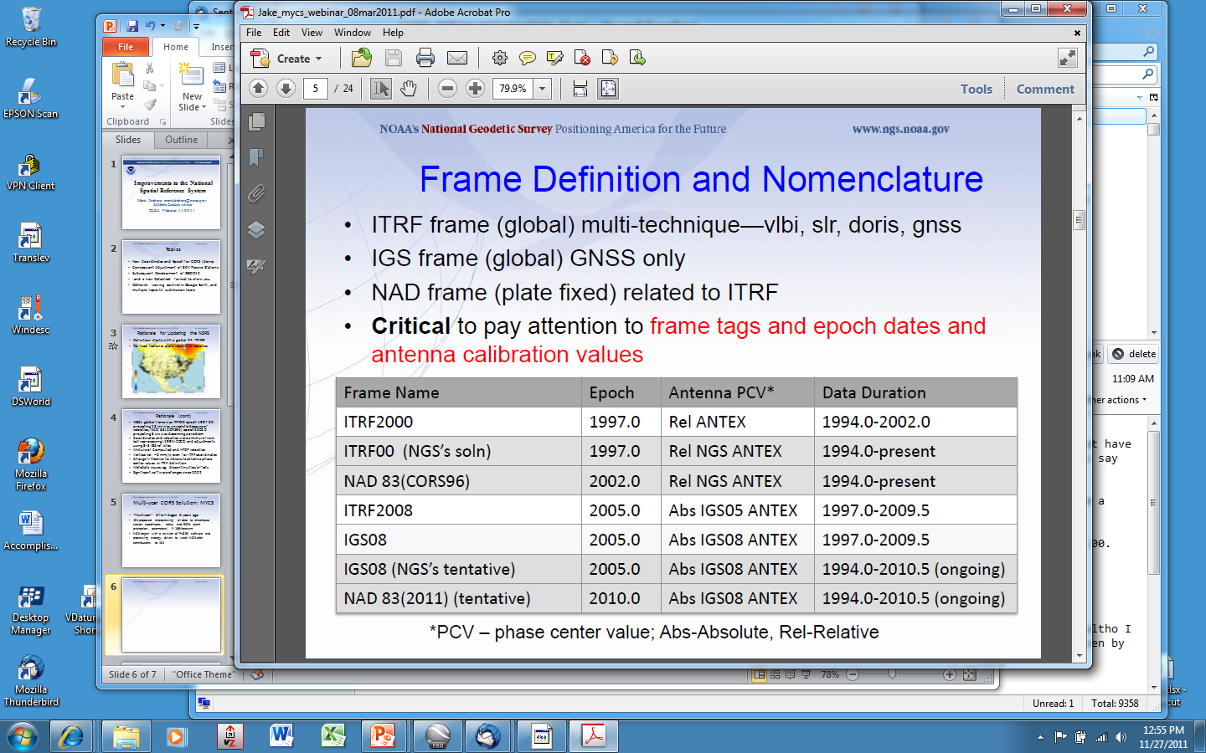
Geodetic Reference Frames past and present
xxxxxxxx
xxxxxxxxxxx

Slide 7
So, what’s different about the CORS coordinates?
Change to absolute antenna calibrations
  Use absolute cal. in your processing: DON’T MIX!
Better because 8 more years of:
  International CGPS sites
  CORS data: about 1600 total, ~1000 w/ >2.5 yrs
  Orbit determination sophistication
  CORS velocity data
Better HTDP modeling for those w/ <2.5 yrs
Better processing algorithms

Slide 8
How do I find the coordinates?
Individual CORS Coordinate page, as before
On CORS page, Data Products, Coordinates Explained, Table 1, left column hotlinks
http://www.ngs.noaa.gov/CORS/coords.shtml
TWO basic divisions:
  One with COMPUTED velocities, one MODELED
TWO basic Ref Frames: IGS08, NAD83
Two types of coordinates/vel for each of those:
  X,Y,Z AND lat/long/ht (N,E,U)
Recommend using only CORS w/ computed velocities

Slide 9
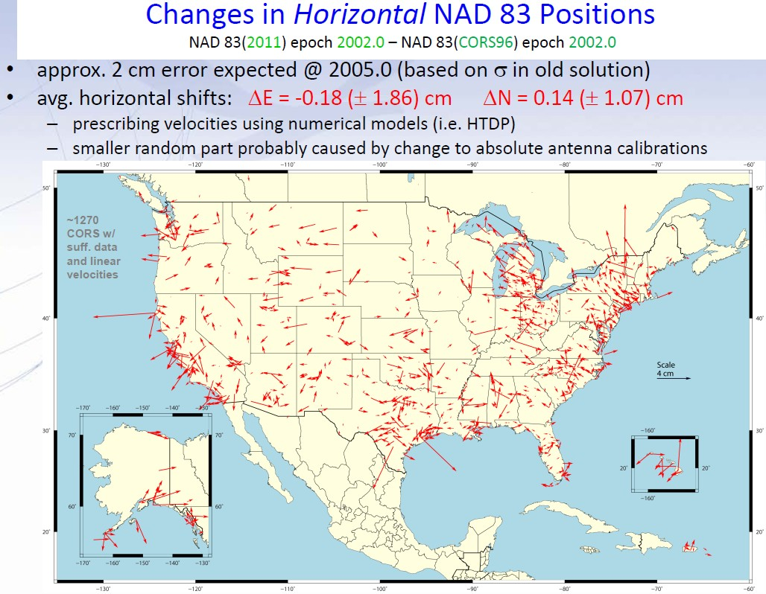

Slide 10
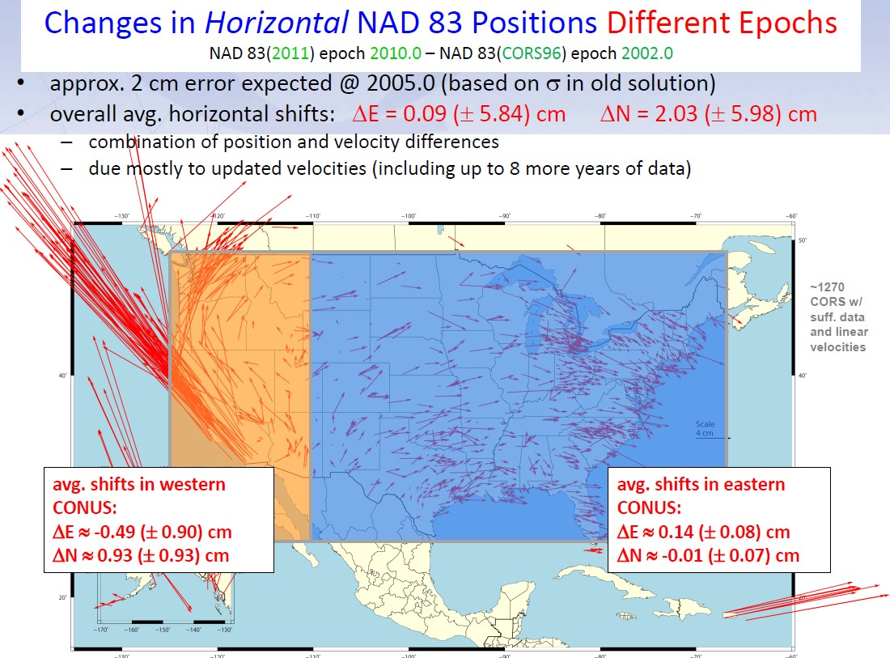

Slide 11
New CORS in CA
CSRC requested about 130 of the CRTN backbone sites to become NGS CORS; some already were
About 70 CORS added this past quarter
PBO Time Series Website Awesome
http://pbo.unavco.org/data/gps/plotviewer/P334/GPS

Slide 12
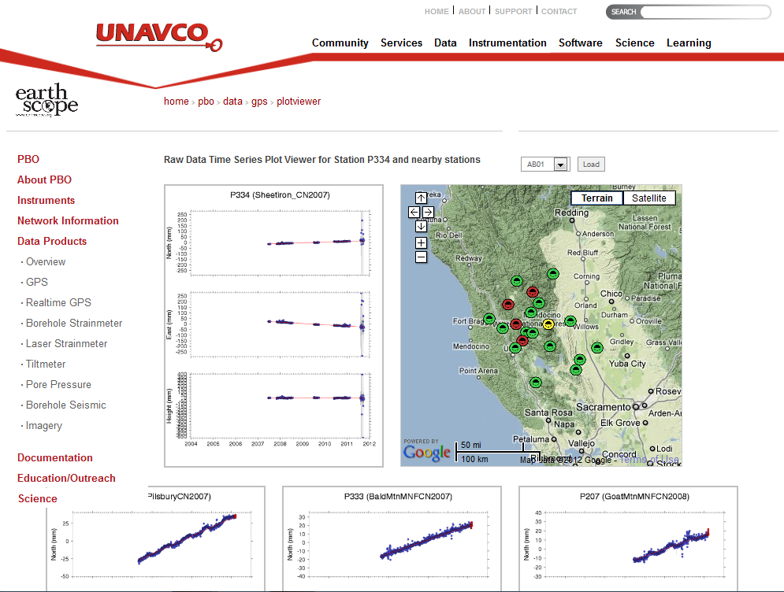

Slide 13
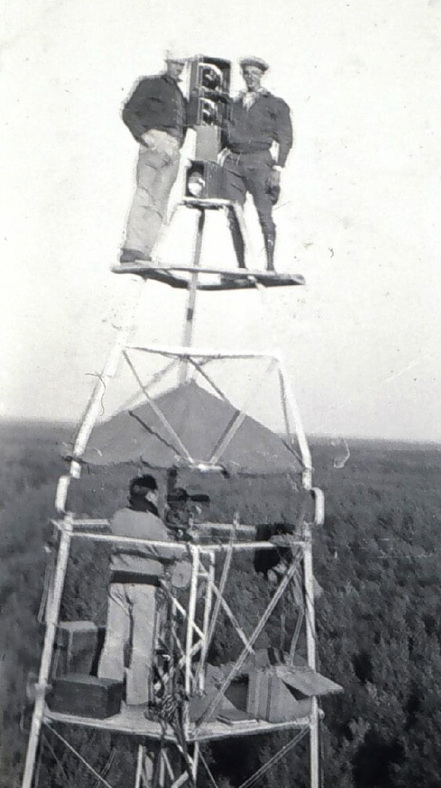
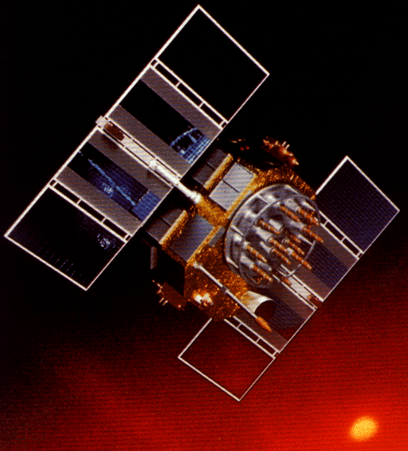
A Cryptic Evolution of NAD 83
Original realization completed in 1986
  Consisted (almost) entirely of classical (optical) observations
“High Precision Geodetic Network” (HPGN) and “High Accuracy Reference Network” (HARN) realizations
  Most done in 1990s, essentially state-by-state
  Based on GPS data but classical stations included in adjustments
  Did NOT use CORS as constraints
Partial HARN/FBN Obs, late 1990’s
  Used CORS as control, but not statewide adjustment; in CA, only ~200 stns
National Re-Adjustment of 2007
  ITRF00 and NAD 83(CORS96) basis for CORS constraints and (NSRS2007) for passive
  Simultaneous nationwide adjustment, first since 1986; no classical stations

Slide 14
NEED for a new national adjustment, NA2011 project, for passive geodetic stations
Optimally align passive control with CORS
>1000 projects submitted since 2007 NatlReadj
  Number of stations increased by 1/3 in just 5 years!
  Plus Observations for Hawaii & other Pacific islands
More consistent results in tectonically active areas
  Longer time series for CORS as well as
  More current data for passive, and better tectonic modeling for applying HTDP to obs back 20+ years.

Slide 15
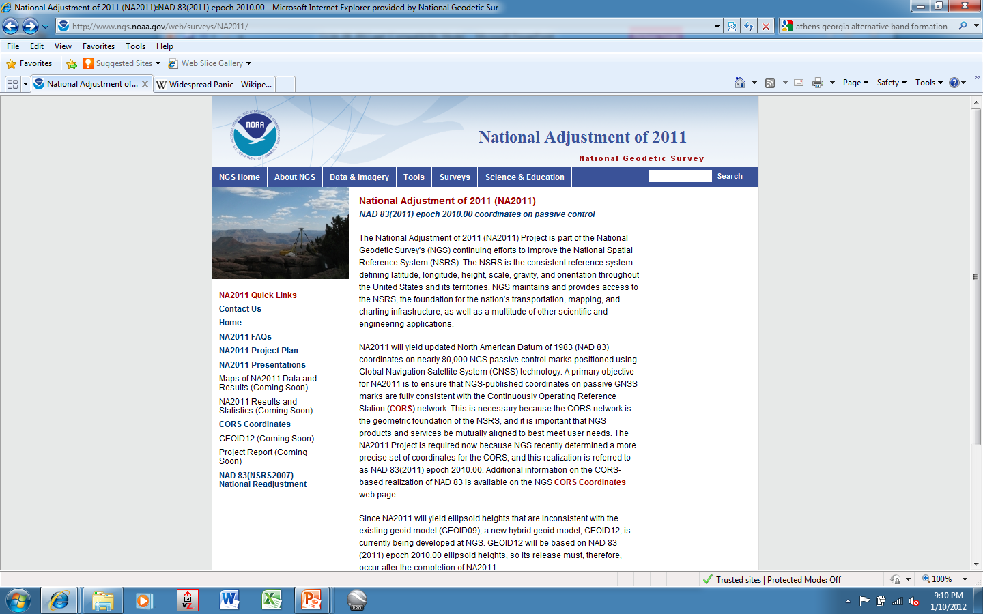

Slide 16
Current status of NA2011, late-Mar 2012
Primary/secondary adjustment approach for CONUS
Projects older than 1994 (start of CORS program) in secondary except have included HARNs in primary
5321 stations common to both used as constraints
PRIMARY: 3472 projects; 62.4K unique stations;
343,482 vectors total; rejected reduced fr 6.4 to 3%
SECONDARY: 614 projects; 22.5K
Downweighting vertical component (eht) in subs areas
99% of residuals <3cm horizontal and <4cm vertical
Alaska: 142 projects; Hawaii: 39 projects
Completion mid-May; handed over to Geoid team

Slide 17
Next steps, final phases
NA2011 Adjustment thought to be completed in mid-May
Until NA2011 Adjustment is complete and ready to be published:
  OPUS solutions will continue to produce coordinates in both former and current ref frames
  Transform tool will be available
  Next Geoid model cannot be finalized

Slide 18
GEOID12 Development
Model will be based on ellipsoid heights published from NA2011 project
Proposed stations, different than for GEOID09, for inclusion/exclusion just distributed to geodetic advisors for review
Currently being developed using preliminary NA2011 “results”
OPUS-DB results will be included
  Collect data on leveled bench marks which are likely to have been stable since they were leveled (1988)

Slide 19
Second 3 (of 12) Topics
4. Geoid slope Validation results
5. Completely new datums in a decade
  --Geospatial (datums) Summit in San Diego, July 22 (6 hrs), open; and 24 (2 hrs) @ ESRI Conference
6. RTN Validation program
--CSRC’s CRTN shifting to NTRIP
http://sopac.ucsd.edu/ubbcgi/ultimatebb.cgi?category=6
Notes:
4. Fieldwork in Texas; GRAV-D flights in northern CA a year ago

Slide 20
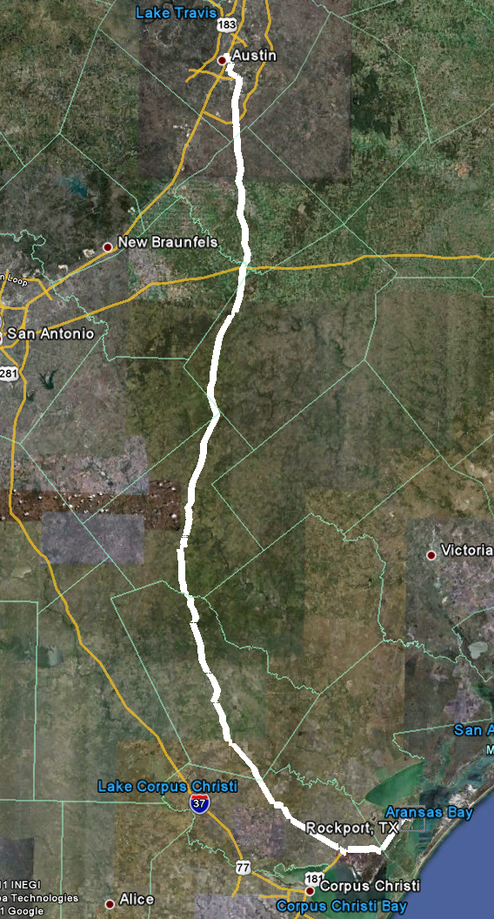
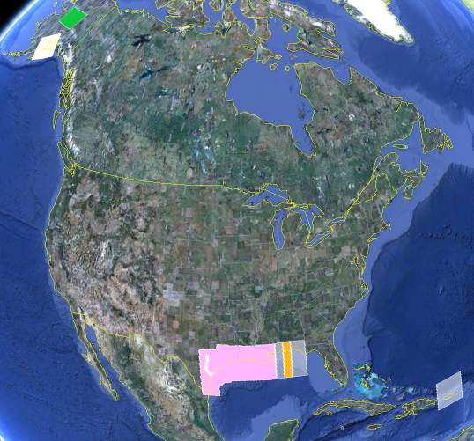
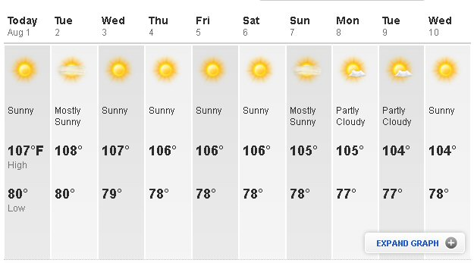
Level Line for Geoid Slope Validation Project
325 km
218 points
1.5 km spacing
South Texas
July-October, 2011
hot…Hot…HOT!
Notes:
The final line was a 325 km stretch from downtown Austin, Texas (North end) to Rockport, Texas (South end). There were 218 official survey points along the line, with an average spacing of 1.5 km between them. The shaded areas in the above picture were the existing GRAV-D data at the time of planning GSVS11 (since expanded). Although the weather report looks extreme, most surveying was done in the milder times of day.

Slide 21
Surveys Performed
GPS: 20 identical. units, 10/day leapfrog, 40 hrs ea.
Leveling: 1st order, class II, digital barcode leveling
Gravity: FG-5 and A-10 anchors, 4 L/R in 2 teams
DoV: ETH Zurich DIADEM GPS & camera system
LIDAR: Riegl Q680i-D, 2 pt/m² spacing, 0.5 km width
Imagery: Applanix 439 RGB DualCam, 5000’ AGL
Other:
  RTN, short-session GPS, extra gravity marks around Austin, gravity gradients

Slide 22
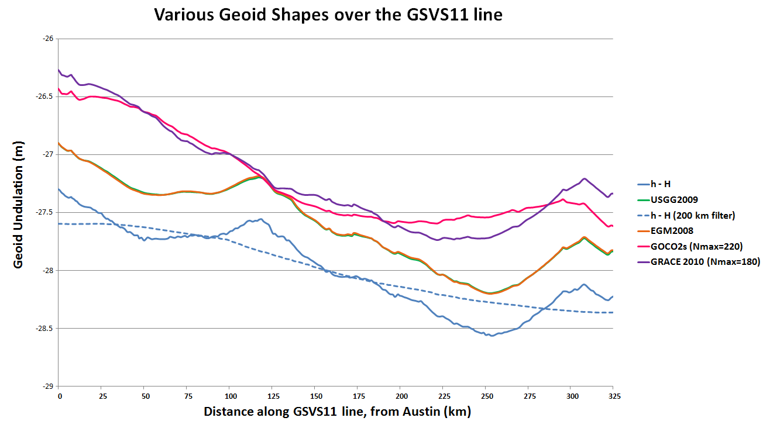
Existing Geoids vs GSVS11
Austin (North end)
Rockport (South end)
Notes:
The shapes in this plot are various forms of the geoid shape over the GSVS11 line. Of primary interest is the blue line (h-H) which represents (at the time of this presentation) the very best differential ellipsoid heights and differential orthometric heights from the new GPS and leveling of GSVS11. The blue dashed line is a smoothed (200 km filter) version of this. Note that this survey was about geoid slopes, so the absolute offsets seen here are immaterial to the goal of this survey.
The green and orange lines almost on top of each other are the latest gravimetric geoid from NGS (USGG2009) and EGM2008. Note how closely they appear to follow the h-H blue line.
The purple and pink lines are SHMs ITG-GRACE2010s and GOCO02s. Note their general inability to track even the largest details (except the more or less upward slope from Rockport to Austin) of the geoid. One would presume this is from omission error, but the failure to match the filtered h-H values (blue dashed line) calls into question whether there is commission, not omission error going on here. If EGM2008 were only given to maximum degree 220, it follows closely to these two models.

Slide 23
Notes:
This slide shows RMS error (disagreement) between h, H and N for various geoid models as compared to the best GPS and leveling on GSVS11. Note first the black bars, which are the allowable h and H error build up over further distances. Compare these to the total error of the h-H-N values. USGG2009 and EGM2008 have similar patterns, with EGM2008 being slightly better behaved. The new model, USGG2012x01 has patterns of improvement and degradation relative to EGM2008 and USGG2009, showing the need to keep working on theory and software. However, the geoid model with airborne data, USGG2012x02 shows clear improvement over all models, and even begins to approach the level of accuracy of h-H at medium wavelengths.

Slide 24
The “1 cm
geoid”
Notes:
This slide is a companion to the previous one, but the h-H errors have been removed, in an RMS sense, from the total h-H-N errors, leaving, ostensibly, gravimetric geoid errors only. As seen previously, the airborne geoid is the best performer, by far. In fact, as a general statement, it could be said that USGG2012x02, an airborne gravity data enhanced geoid model, is effectively at the 1 cm differential geoid undulation accuracy level across all distances, in the region of GSVS11.

Slide 25
Rationale for new Datums
What? Terminology:
  Horizontal becomes GEOMETRIC
  Vertical becomes GEOPOTENTIAL
When? 2018, if GRAV-D program is complete
Why? But why?!
  Primarily needed a better vertical datum for “vertical” data(geoid, ortho ht) not obtained by traditional leveling
    Airborne gravity observations will be used to develop next geoid
  Geodetic Data collection relies upon navigation (GNSS) satellites orbiting around the mass center of the Earth
  NAD83 reference frame/datum is not geocentric
  NAD83 is not defined to include vertical velocities
  Earth is not stable in all directions; reference frame must account for this to be as geodetically accurate as possible

Slide 26
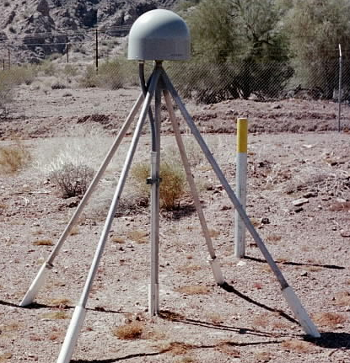
Evolution of Geodetic Datums: from NAD27/NGVD29 to NAD83/NAVD88 to ?/ ?
H + V
2 + 1
27, 29
H + V
2 + 1
83(86), 88
GPS
H + V_{E} + V_{O}
2 + 1 + 1
83(92), 88
+VELOCITIES (time)
H + H_{t} + V_{E} + V_{O}
2 + 2 + 1+ 1
83(07)+HTDP, 88
H + H_{t} +V_{E}+ V_{Et}
2 + 2 + 1+ 1
GEOMETRIC
V_{E} + G_{t}
1 + 1
GEOPOTENTIAL
H + H_{t} +V_{E}+ V_{Et}
2 + 2 + 1+ 1
ITRF00 (2002.00)
+ GRAVITY
(geoid model)
Notes:
Conceptual: Generally, Orange represents ‘horizontal’ or NAD83 at present; yellow represents orthometric vertical.
1)moved fr non-geocentric to 2)geocentric as well as we knew at the time from early satellite technology (DOPPLER). And leveling efforts resulted in a national vertical datum with only one constraint, rather than 26 (tide gauges). 3)Static GPS exploded on the scene which 4) led to 5)the HARN networks and state-specific adjustment. With GPS surveying, we got V(E), vertical ellipsoid and V(O), vertical orthometric. 6)With the results of repeat static surveys and the advent of CGPS (Continuous CGPS), such as NGS’ National CORS, 7)the velocity of the earth’s crust relative to a reference frame, could be determined over time. 8)Using the crustal motion model HTDP for horizontal velocities on the West Coast, eg, the Pacific-North American Plates interface, NGS produced 9) a National Re-adjustment in the NAD83 (NSRS2007) datum. (No change to ortho.) However, 10)underlying the NAD83 adjustment are data and analysis referenced to ITRF00, epoch 2002.00, which does take into account both horizontal AND vertical ellipsoid velocities. (velocity=time related terms shown as italicized.) This is what we have now. 11) With better global gravity models and airborne gravity data collected by NGS, we will 12) move forward with 13) new datums BOTH referenced to an ECEF, earth-centered, earth-fixed datum which we are calling 14) Geometric, for the horizontal and ellipsoid height values, and Geopotential for the orthometric height values which will be based on a a geoid model and changes in gravity over time (G(t).

Slide 27



Notes:
Radically different H and V datums, in a decade: geometric and geopotential
July 2012 2nd geospatial summit to be held at ACSM/ESRI conference time, at nearby hotel
6 hours on Sunday or 2 hours on Tues within the ESRI main User Conference

Slide 28
RTN Validation by NGS
Desire to have all RTNs—public, commercial—tied to/based on the NSRS
Developing a procedure for RTNs to follow
Results submitted/reviewed
Periodic (annual?) check
ORGN RTN (OR DOT) is pilot study
CSRC’s CRTN RTCM data streams available for testing thru NTRIP protocol as of 1/5/12
http://gpsmail.ucsd.edu/mailman/listinfo/crtn-l

Slide 29
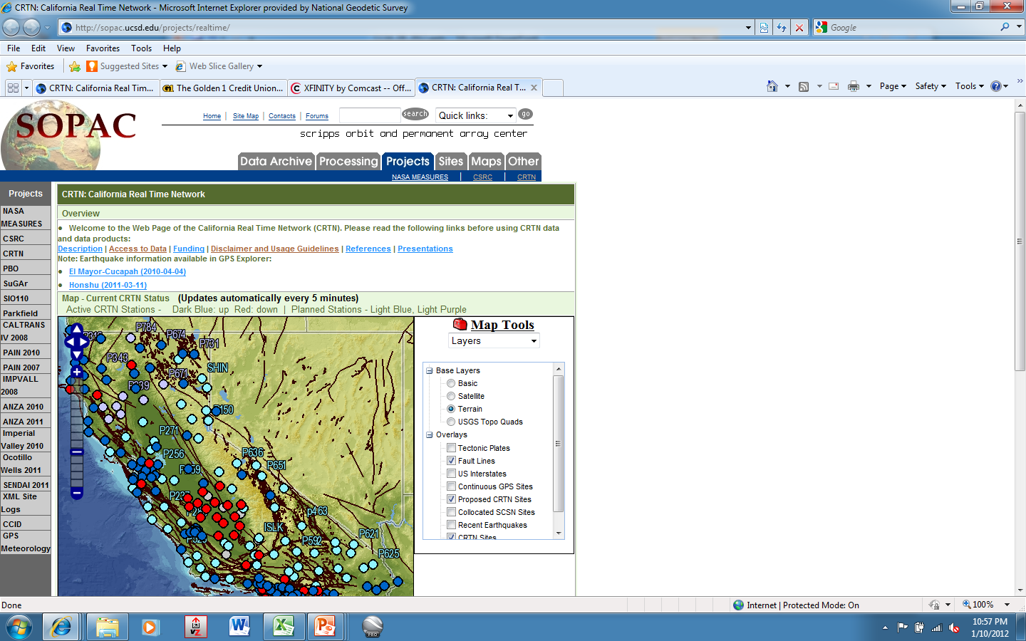

Slide 30
Third 3 (of 12) Topics
TOOLS
7. HTDP, deci-year format
BETA VERSIONS:
8. OPUS-P (Projects)
9. LOCUS (Leveling OPUS)

Slide 31
HTDP, v. 3.1.2
4th option: Interactively transform positions between reference frames and/or dates.
Epoch date format now includes deci-year
All NAD83 realizations are treated the same
After new realization published, will have transforms available between 2007 & 2011
  Changes due to RF very small—mm—versus changes due to velocity (time)—dm to m

Slide 32
OPUS-Projects
In beta status but not found on webpage
Need to have training before being given Username/ProjectID access
Will eventually eliminate bluebooking
Working out bugs; not great with short times
Using PAGE-NT processing engine

Slide 34
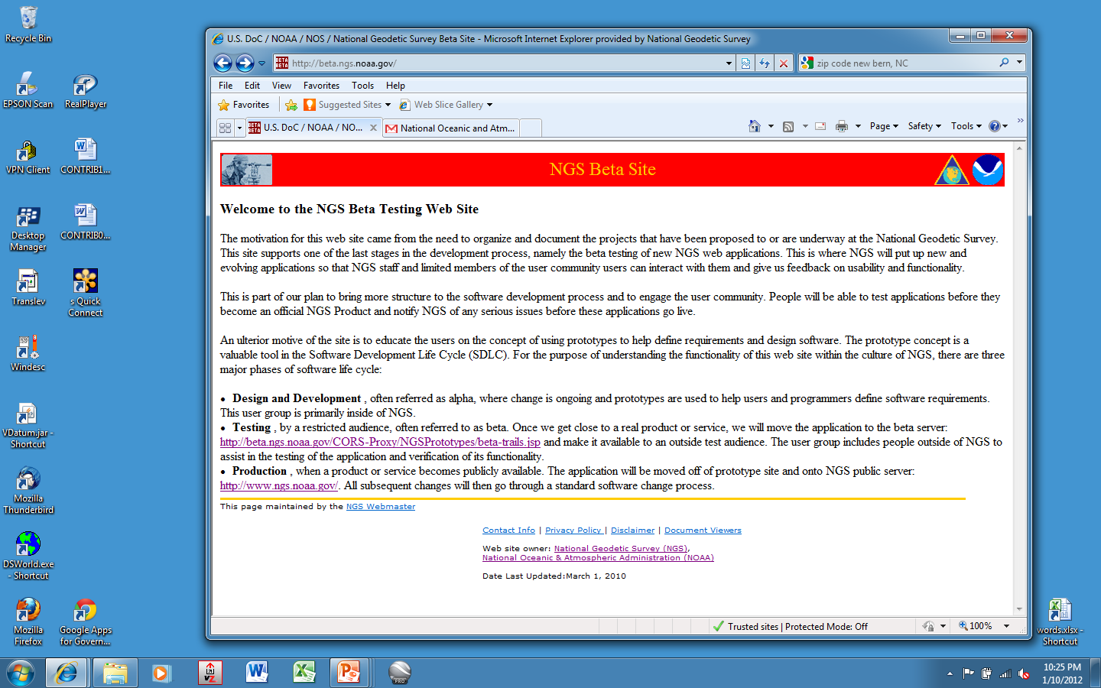
http://beta.ngs.noaa.gov

Slide 35
Fourth 3 (of 12) Topics
10. Datasheet format: major changes
11. CGAR: CA Geodetic Advisor Resources
http://www.dot.ca.gov/hq/row/landsurveys/geodetic/geodetic_control.html
12. DSWorld map retrievals and updates demo

Slide 37
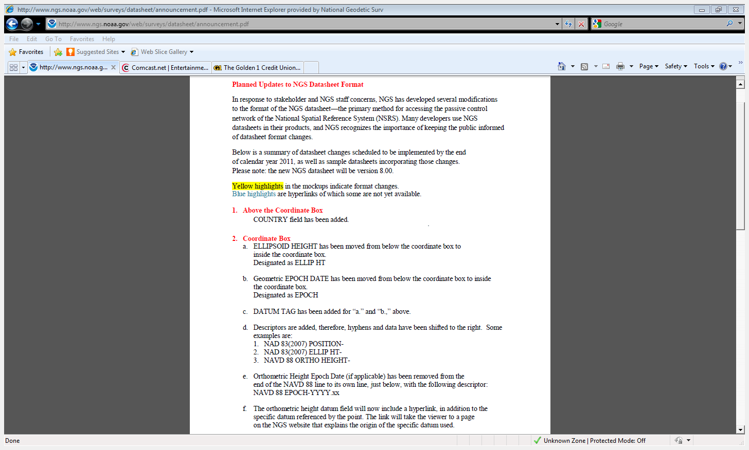

Slide 38
Change highlights
Better grouping of geometric elements, eg, ellipsoid height and epoch date
CLARITY about geoid model usage, including for superceded ortho height data
Note: last year, NGS started publishing superceded GPS-derived ortho heights
Inclusion (hyperlink) to Local Ties & Accuracies
Changes should go live on May 1st or 2nd

Slide 39
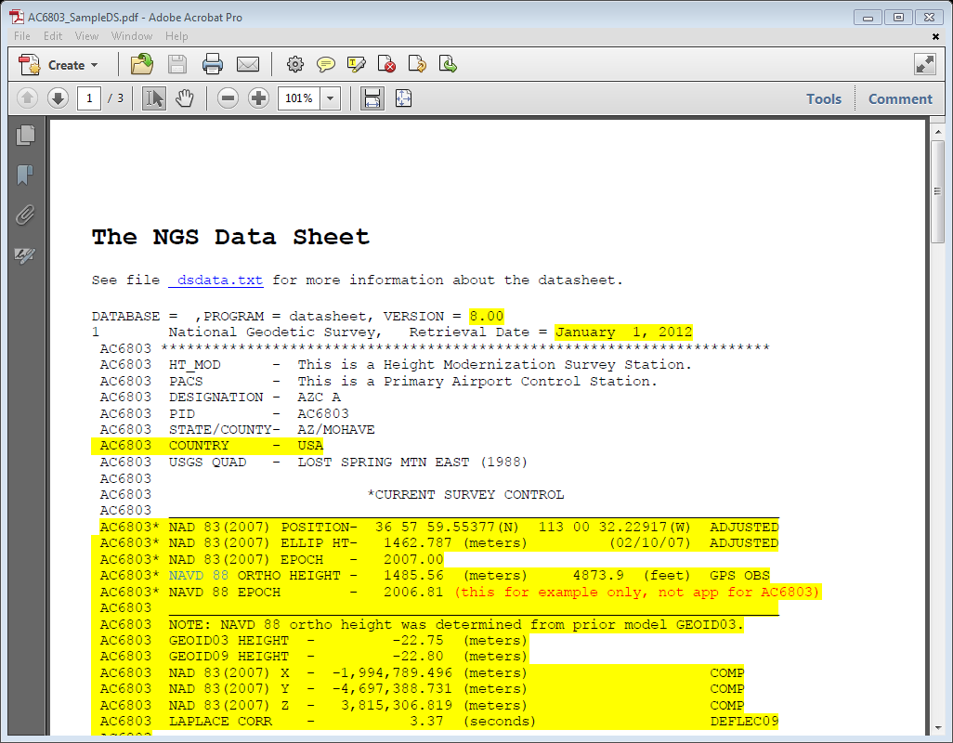

Slide 40
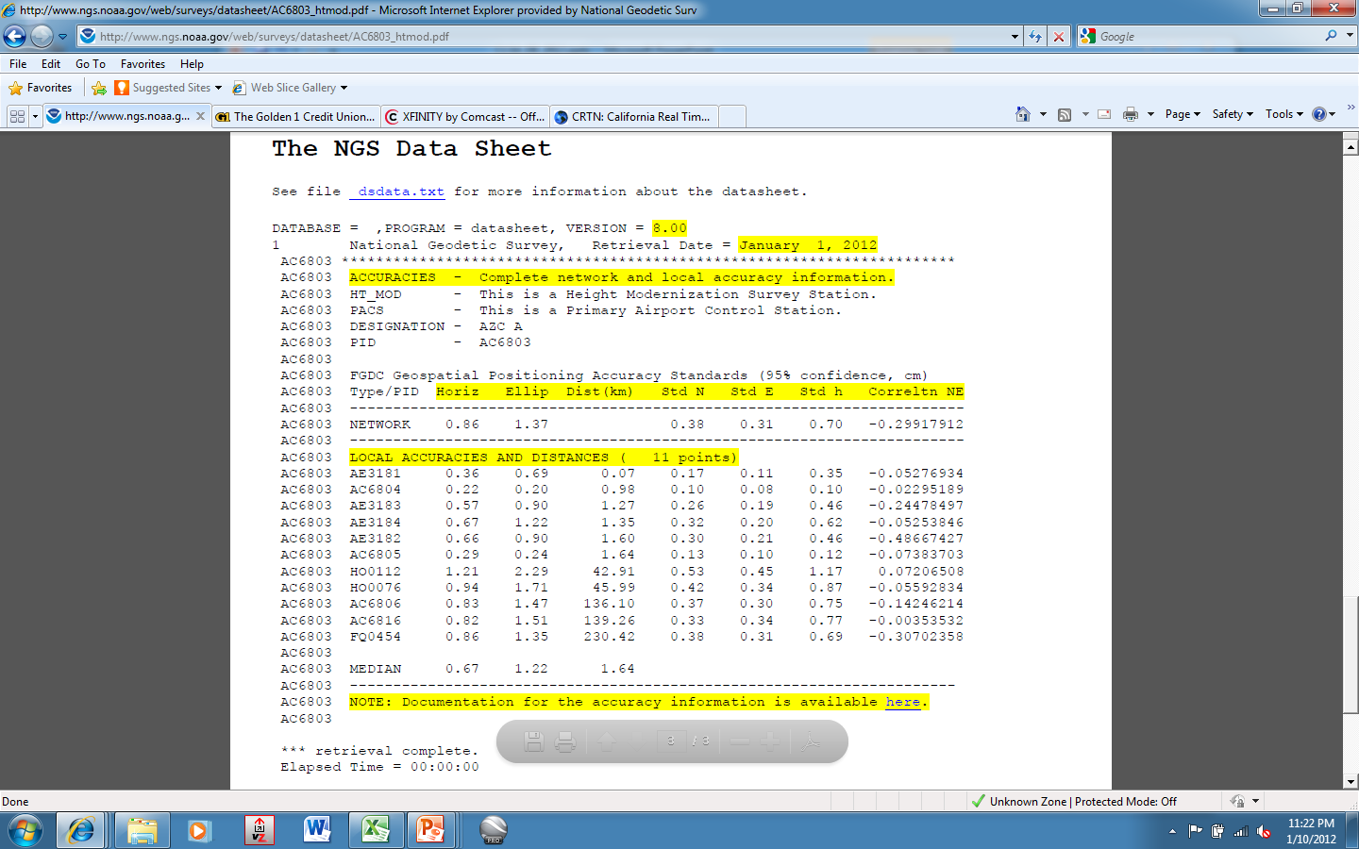
Local Accuracies

Slide 41
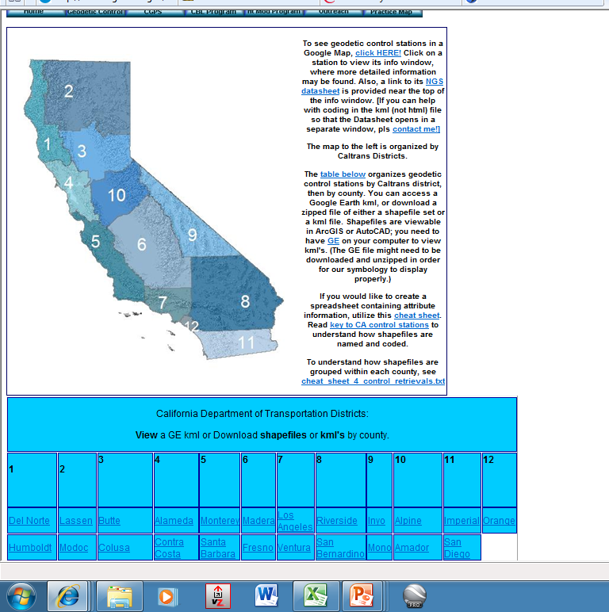
http://www.dot.ca.gov/hq/row/landsurveys/geodetic/geodetic_control.html

Slide 42

DSWorld: mapping tool and more
Need to have Google Earth installed
Tools, Download PC Software, USER-CONTRI-BUTED SOFTWARE, DSWorld
http://www.ngs.noaa.gov/PC_PROD/PARTNERS/index.shtml
FIRST: Tools, Update program to 4.10.16
Enhancement enables you to distinguish VERTCON NAVD88 from other(control) NAVD88
Firewall/Windows7 could preclude easy updates; call me

Slide 43
Updating Malcolm software, workaround for W7
Change permissions for folders, as follows:
1) Log into the PC as an administrator.
2) Right-click on the DSWorld [WinDESC/Translev] folder.
3) Left-click on 'Properties'
4) Click the 'Read-only' box to remove the check mark.
5) Click the 'Security' tab.
6) Scroll down and click on 'Users'.
7) In the 'Permissions for Users' window, click 'Modify' (or 'Full control‘)
Modify allows users to read, write, execute, delete. Full control allows
users to take ownership and change permissions.
8) Click 'Apply'.
9) Click the radio button that says 'Apply changes to this folder,
subfolders and files.'
10) Click 'OK', 'OK'.
11) log out of .la [local administrator] account.

Slide 44
Workaround, cont
http://www.ngs.noaa.gov/web/tools/updates
Select the folder of the pertinent software:
WinDESC, DSWorld, or Translev
Download the .exe file, at the least. All the others can be as well.
If permissions not changed, then cannot download directly to any folder under C:\Program Files (x86) EVEN logged in as admin; put in Downloads or other folder, then—as Administrator-- move into appropriate software folder.

Slide 45
Demonstration
Mapping
County example, Toggle between V & V-88only
CORS: Tools/Options/4char; OPUS-DB
All NGSIDB: color represents CONDITION
Submissions
Recovery Notes, incl Destroyed; Photo Naming Convention, Editing Tools; Correct County, Photo

Slide 47

Marti.ikehara@noaa.gov

