Slide 1
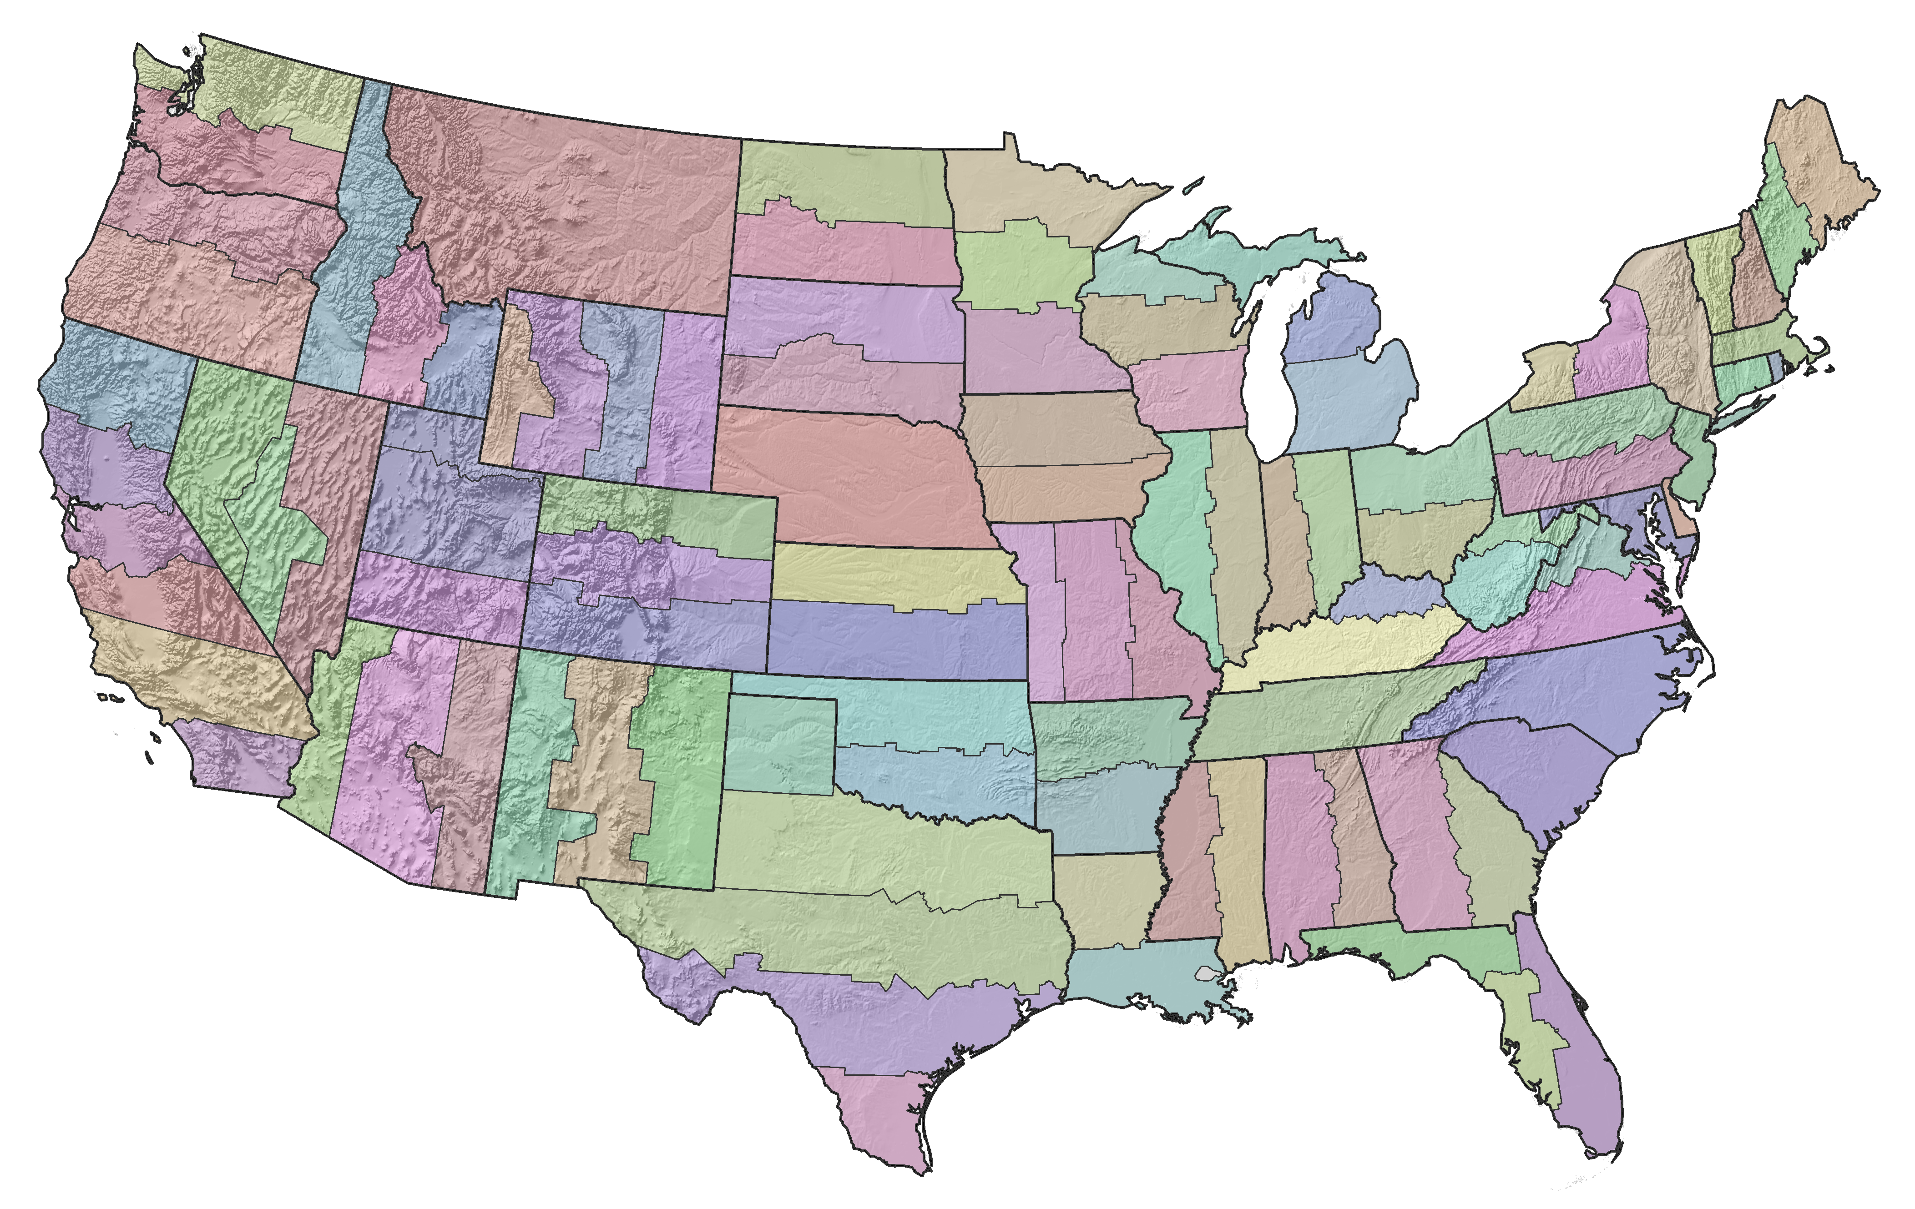
The State Plane
Coordinate System of 2022
Making It Your Way
2019 Geospatial Summit
Silver Spring, Maryland
May 6, 2019
Michael Dennis, PhD, RLS, PE
SPCS2022 Project Manager
Michael.Dennis@noaa.gov

Slide 2
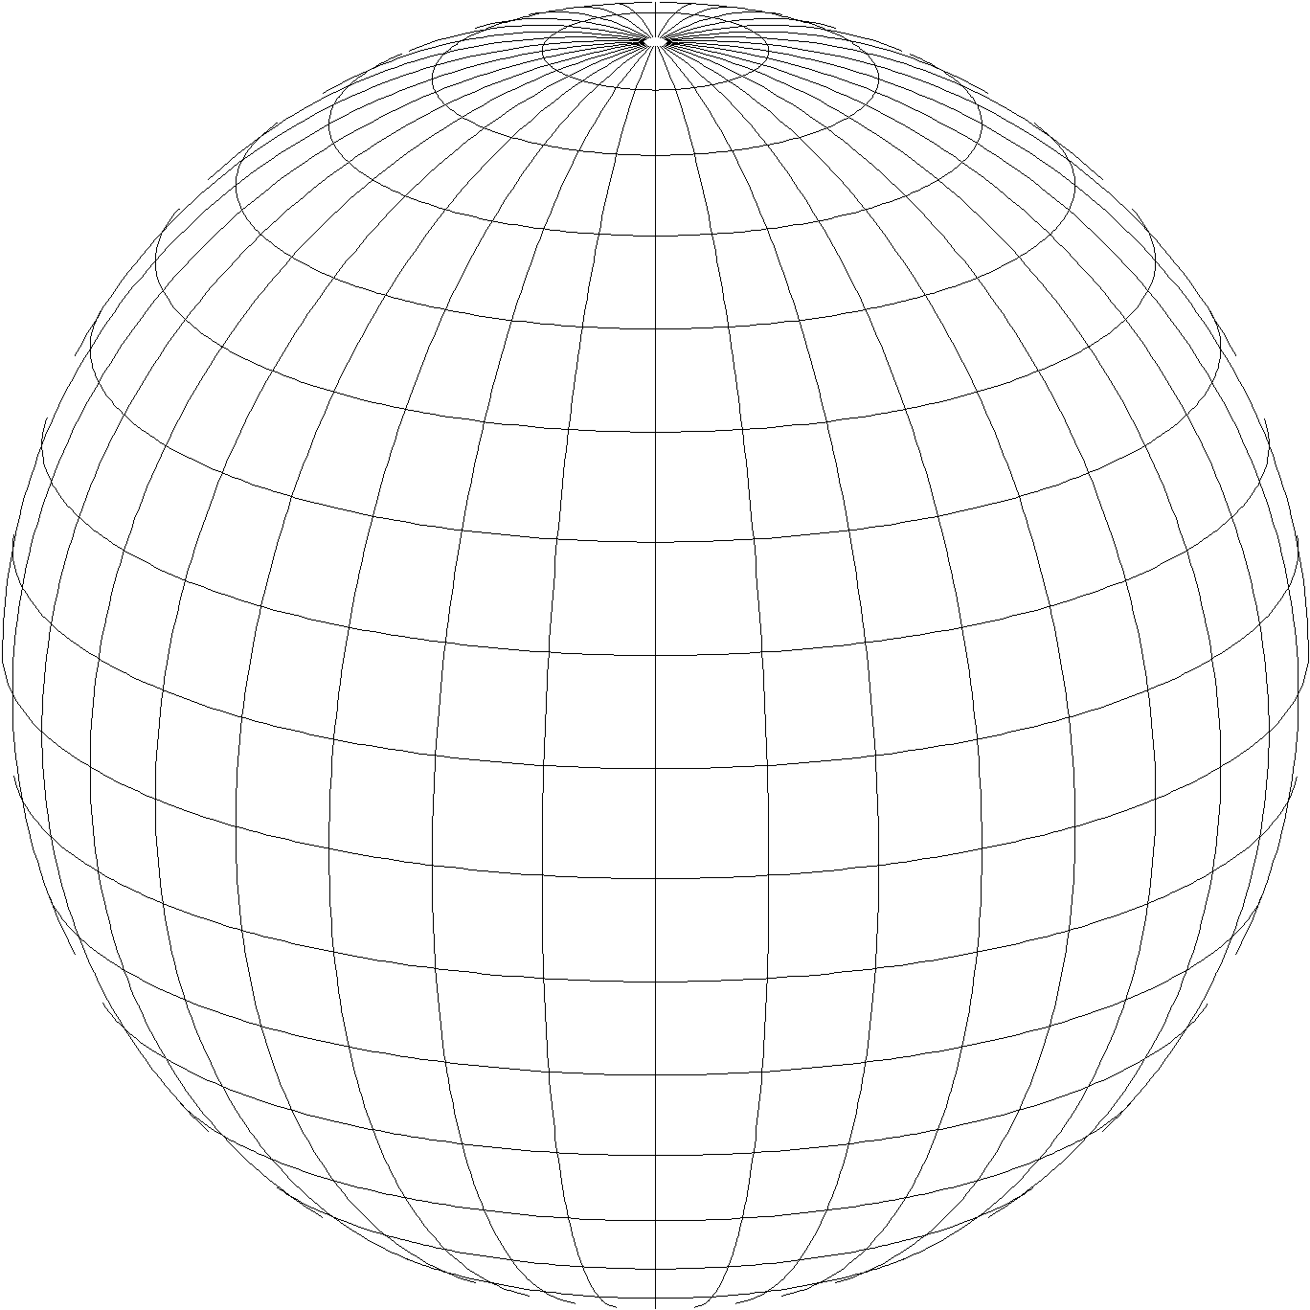
A New State Plane for 2022
State Plane Coordinate System of 2022 (SPCS2022)
  Referenced to 2022 Terrestrial Reference Frames (TRFs)
  Based on same reference ellipsoid as SPCS 83 (GRS 80)
  Same 3 conformal projection types as SPCS 83 and 27:
Lambert Conformal Conic (LCC)
Transverse Mercator (TM)
Oblique Mercator (OM)

Slide 3
Creating SPCS2022 for You
Like existing State Plane, but different
  Zones designed “at ground”
  Can have zone “layers”
    Statewide zone for every state
    Allow “low distortion projections” (LDPs)
You are the users of State Plane
  Make SPCS2022 useful as possible
  Design zones based on stakeholder input

Slide 4
SPCS2022 Stakeholders
State groups that formally interface with NGS
  Departments of transportation, Cartographer/GIS office
  Professional surveying, engineering, GIS societies
  Colleges/universities with geospatial curriculum
  Federal agencies can “sign on” with states
Can submit requests and proposals for designs
  Requests are for designs by NGS
  Proposals are designs by stakeholders
Stakeholder input must be unanimous
  Not all must provide input, but all who do must agree

Slide 5
Poll Question
Are you associated with any state stakeholder groups that can provide SPCS2022 input to NGS? (select all that apply)
  Department of transportation
  Office of GIS (or equivalent)
  Professional surveyor, engineer, or GIS society
  University or college with geospatial focus
  Not associated with any of these groups

Slide 6
SPCS2022 outreach activity
About 2500 attendees for the 3 State Plane webinars
State Plane report
1st webinar
New web pages
Federal Register Notice responses received
3rd webinar
Mar
Apr
Aug
Oct
2018
2019
Mar
Apr
2nd webinar
Federal Register Notice issued
1st preliminary design maps released
Final policy, procedures, and forms
U.S. survey foot webinar

Slide 7
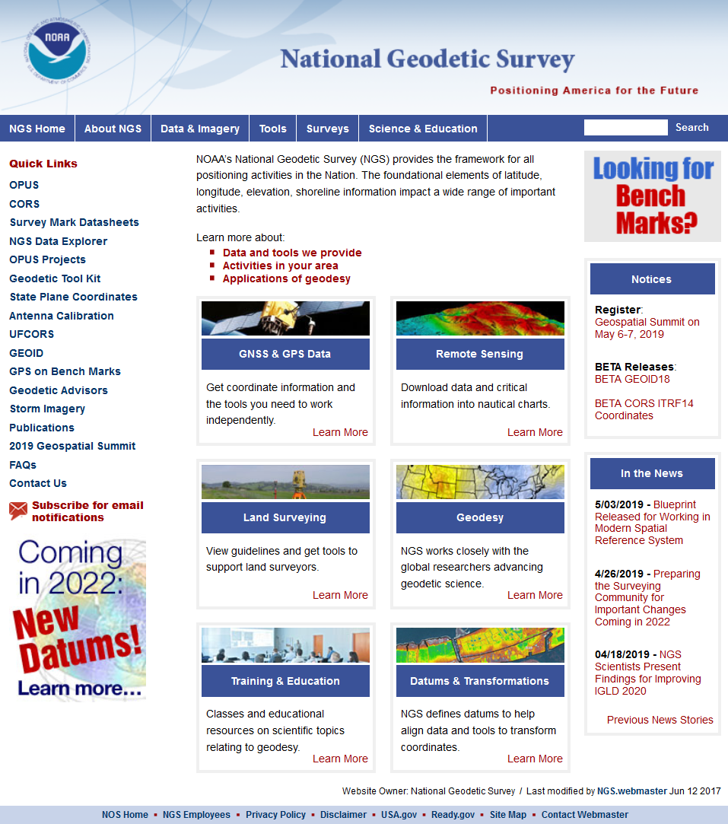
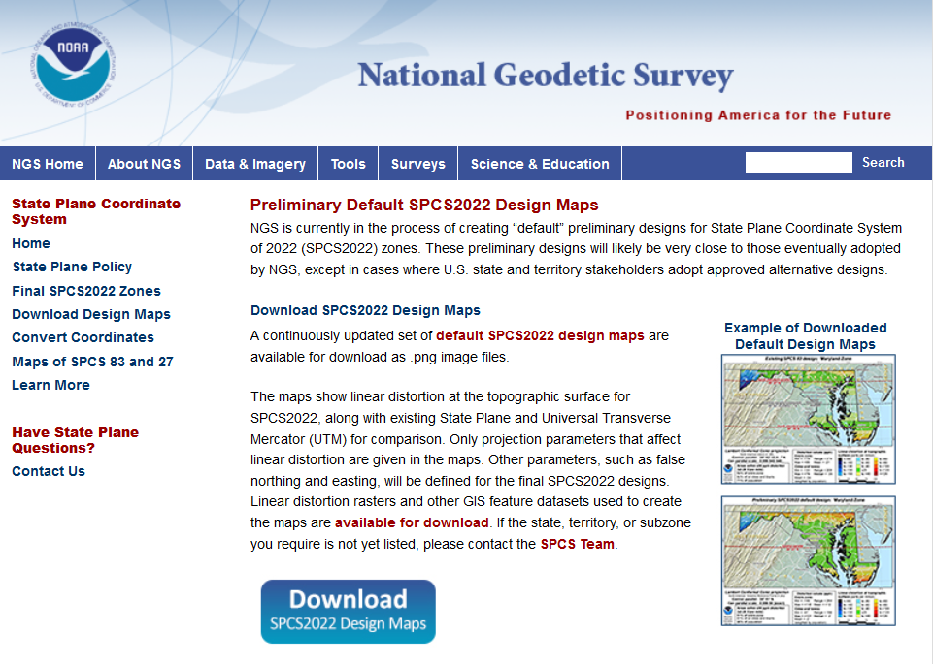
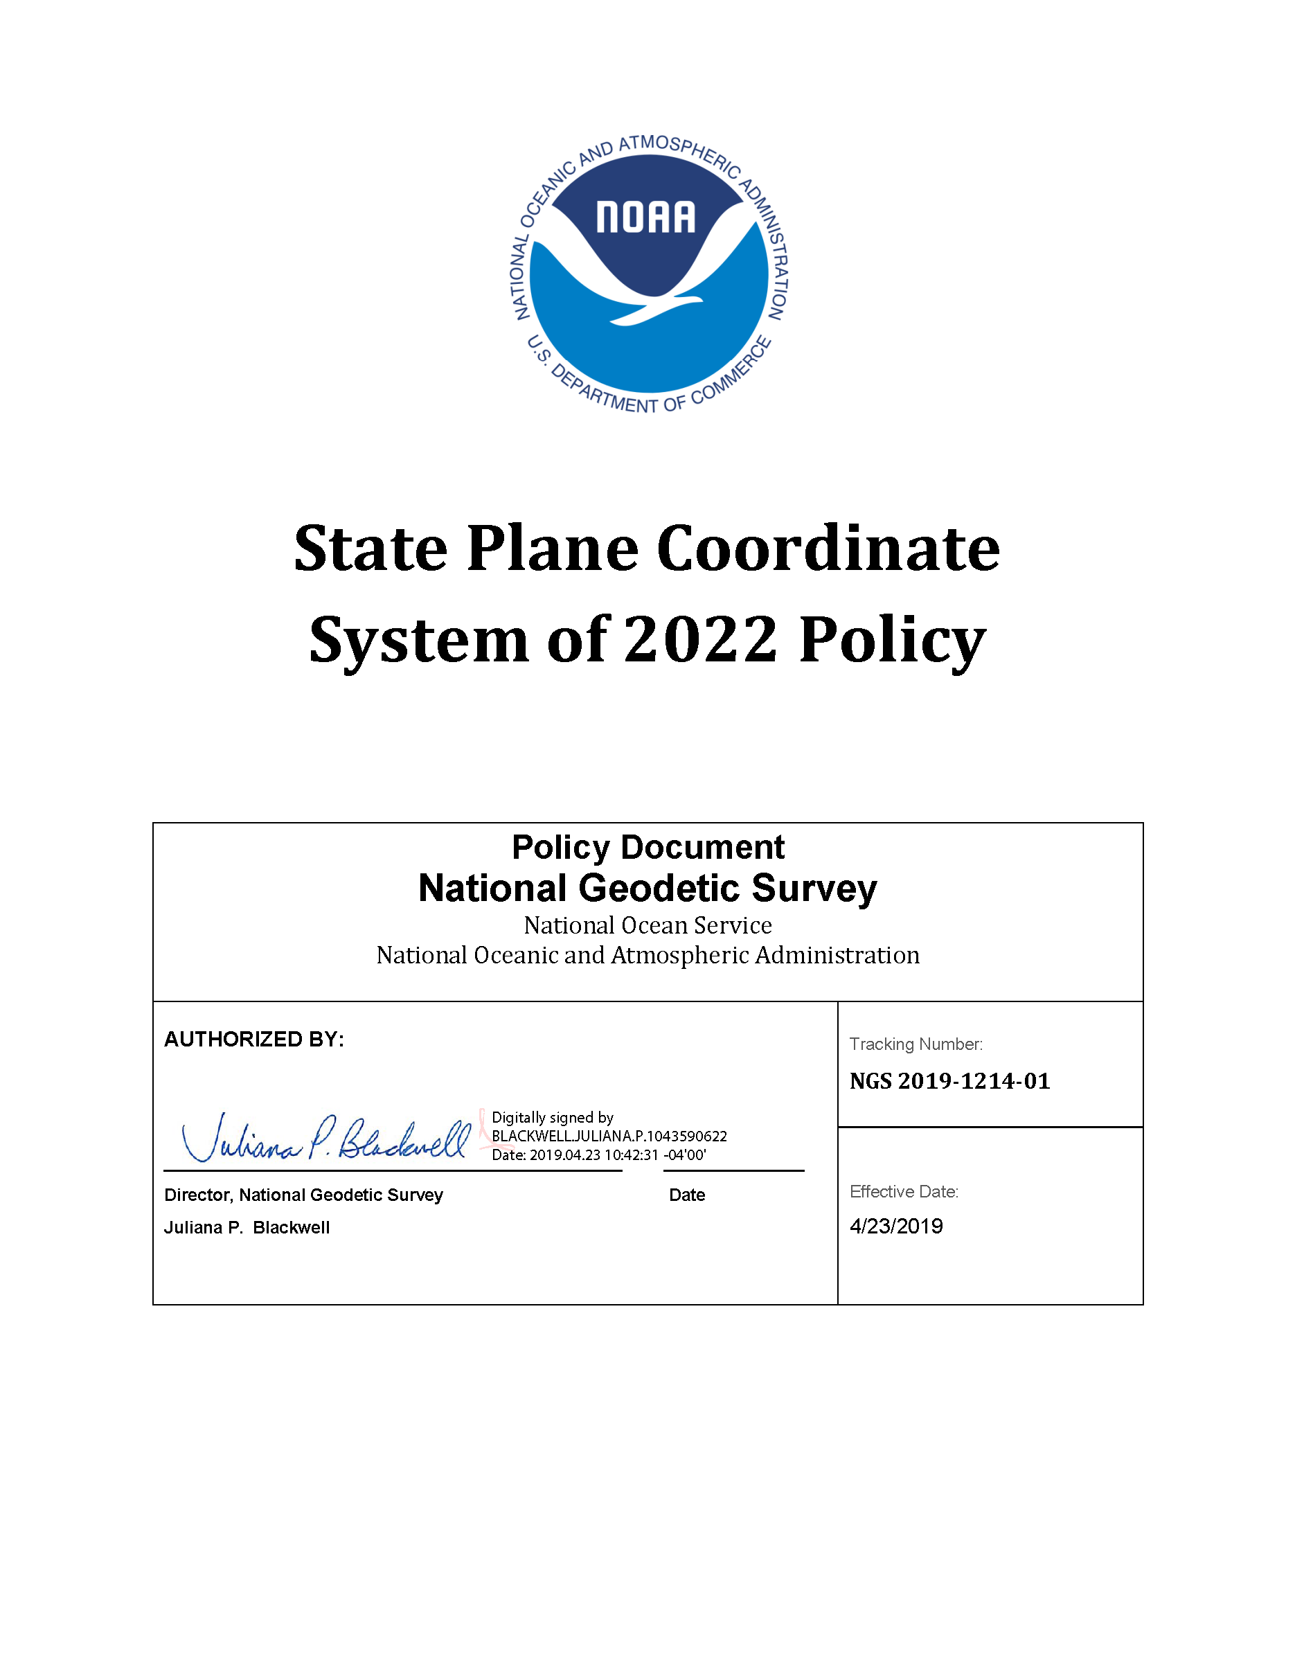
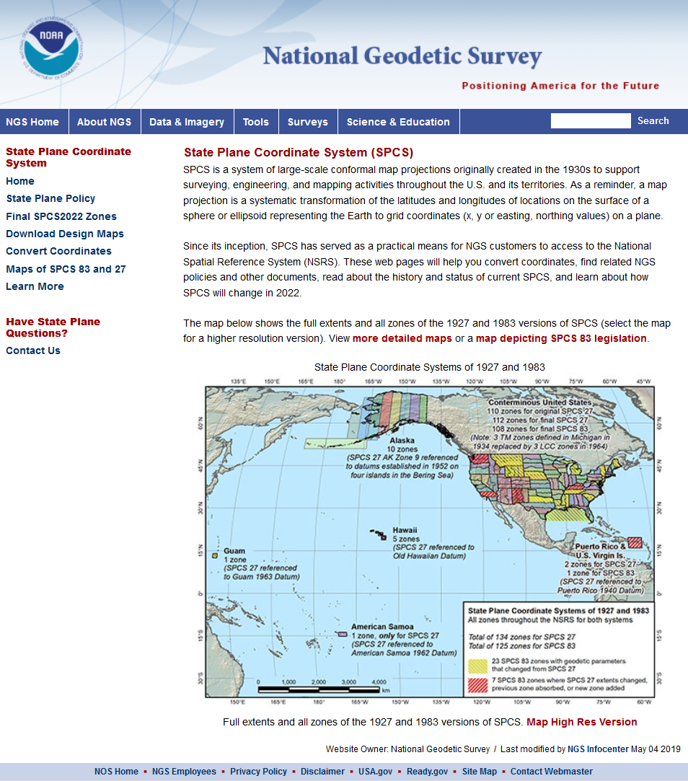
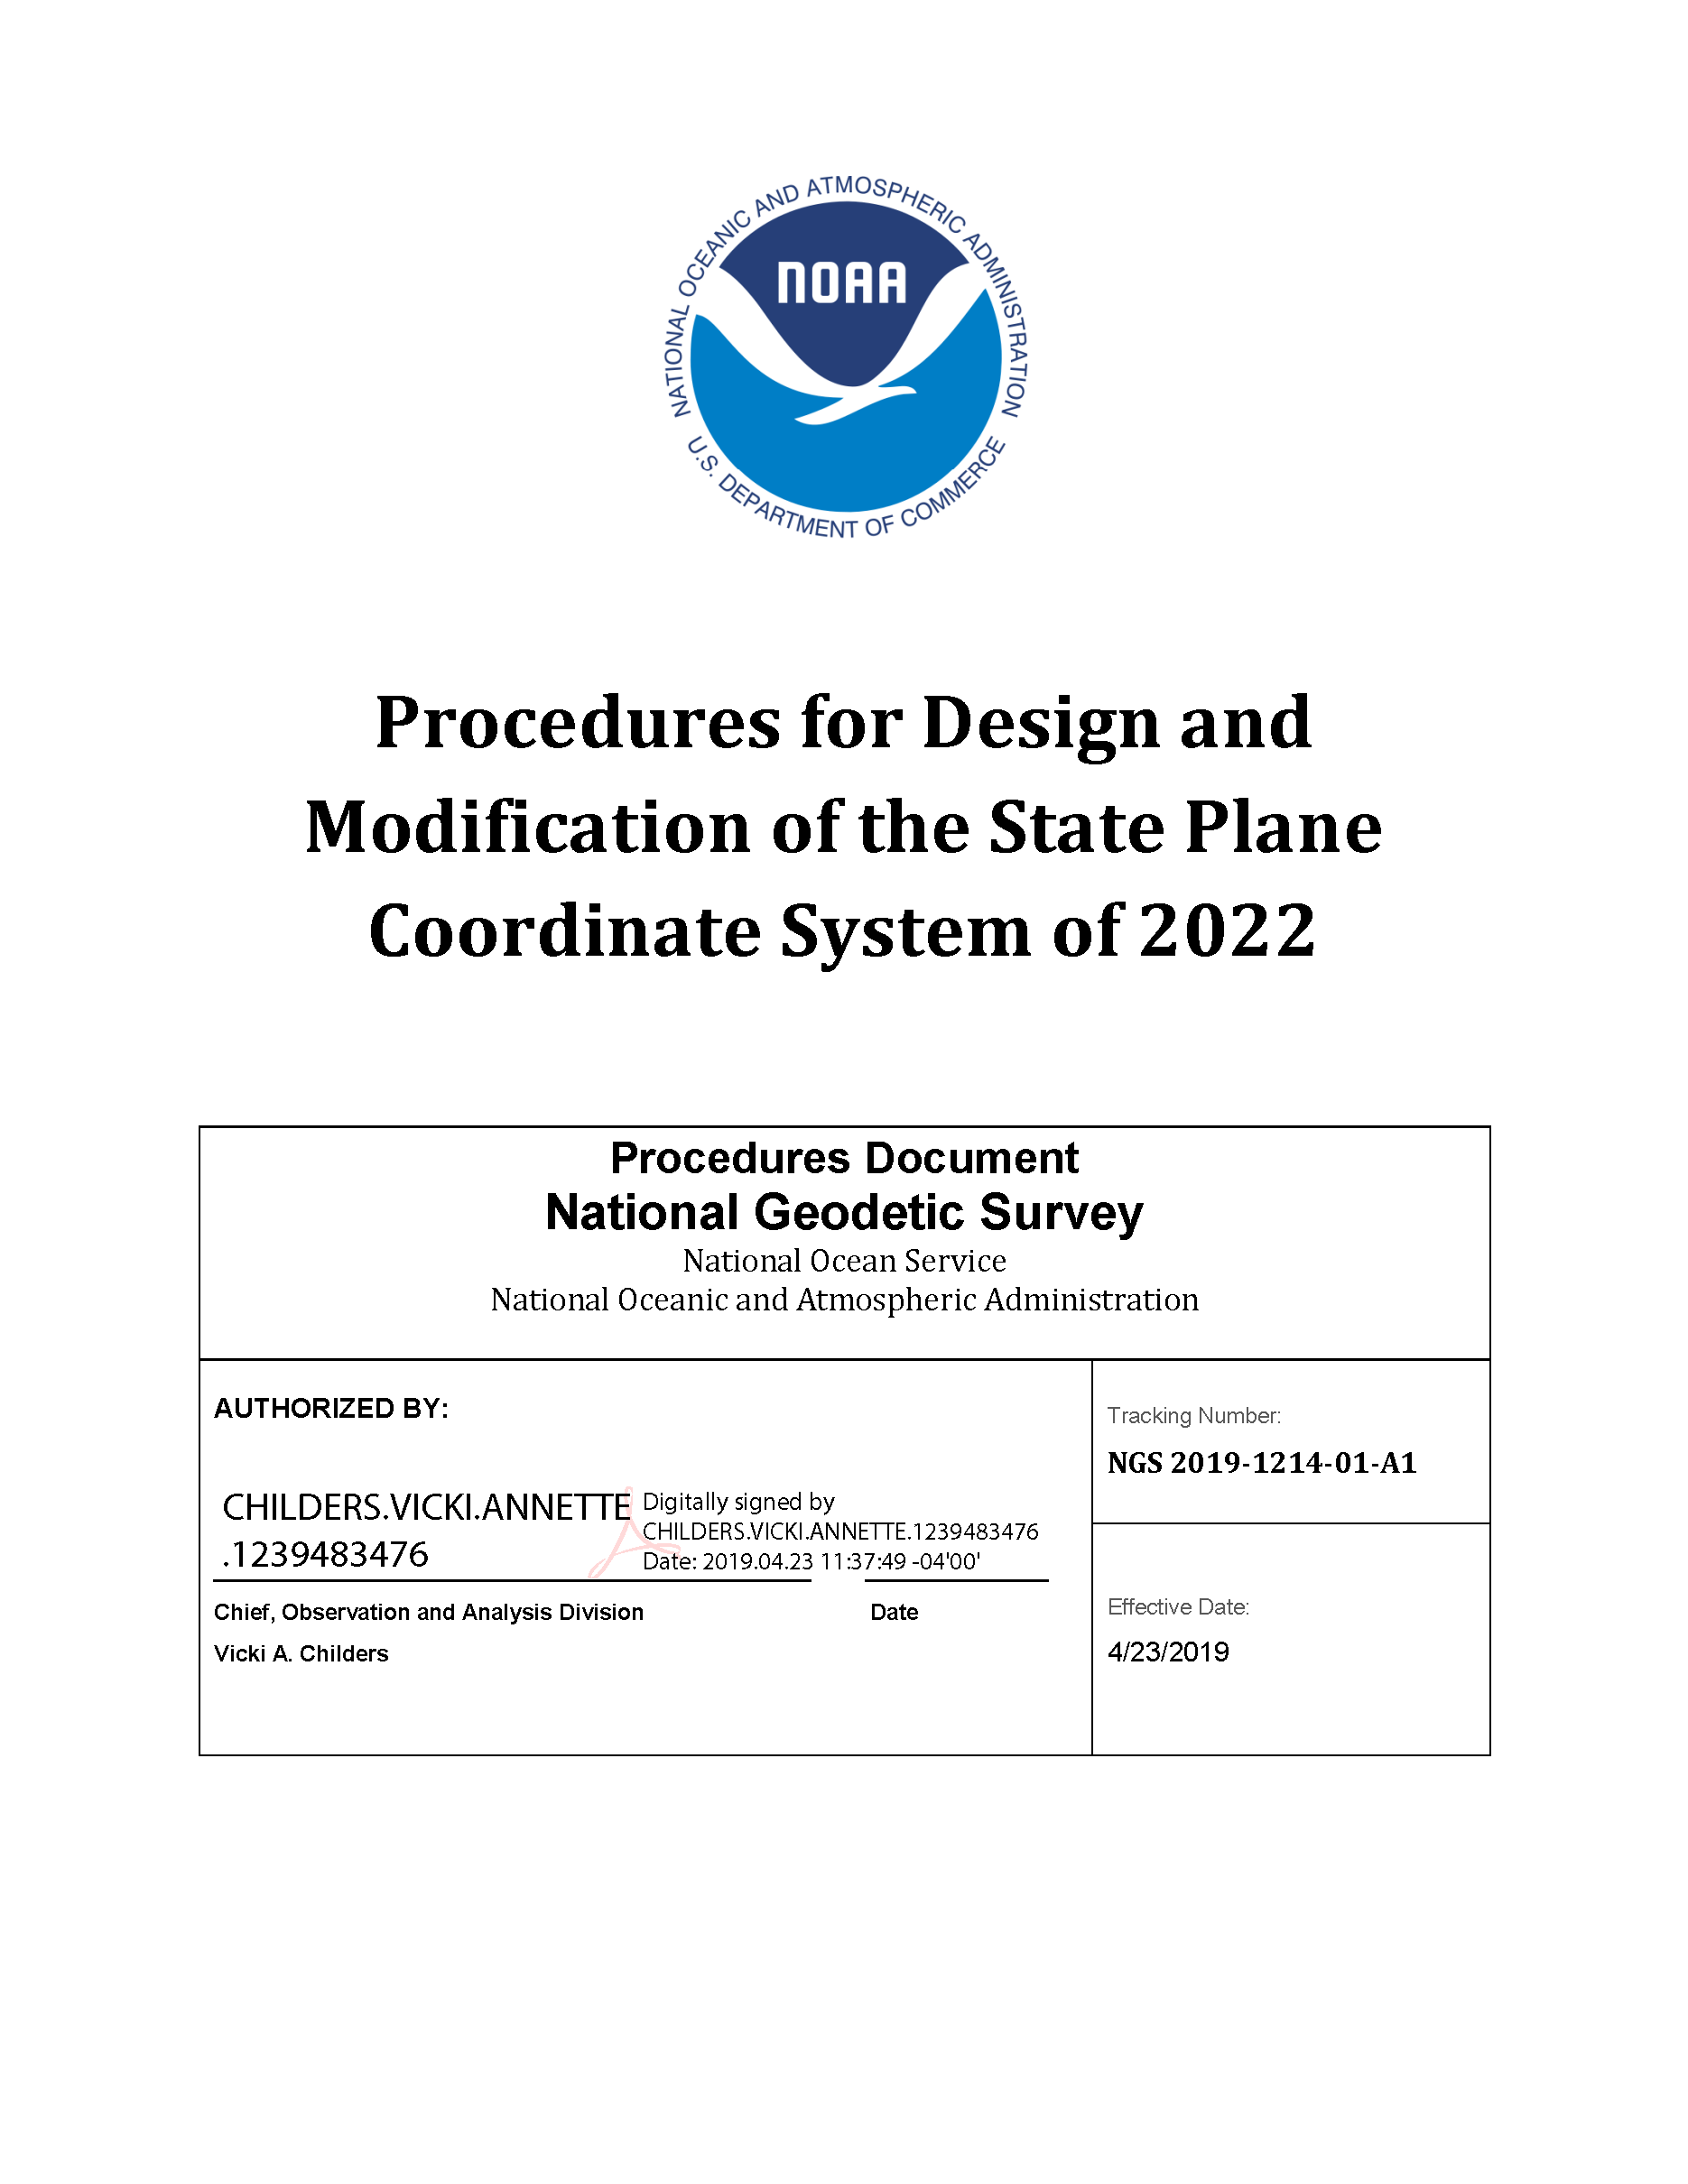
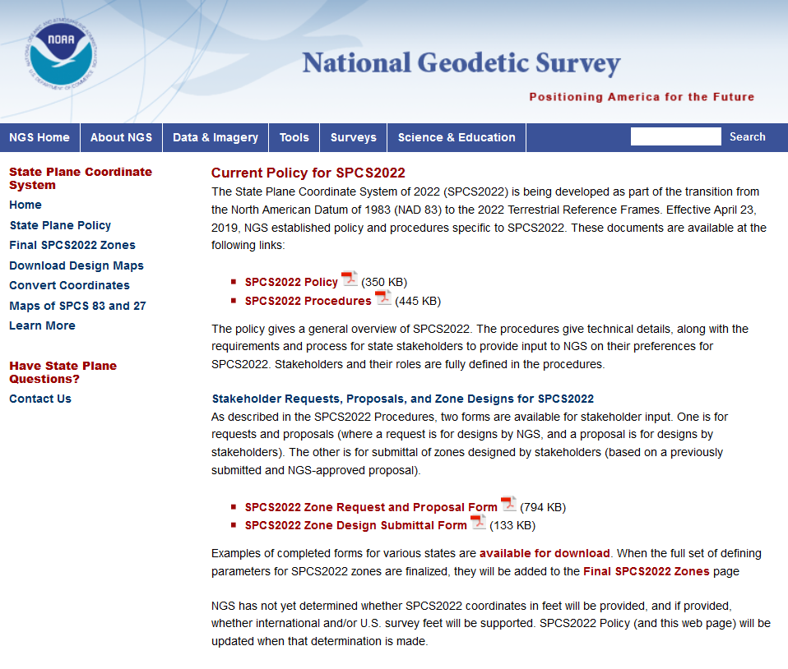

geodesy.noaa.gov
Notes:
A lot of information is available on the NGS website, including:
2022 policy changes
Supporting information (old policy and manuals, new report on SPCS history)
Maps of preliminary SPCS2022 designs available for download
Not all states yet available, but designs are in progress
Includes maps of existing SPCS 83 for comparison

Slide 8
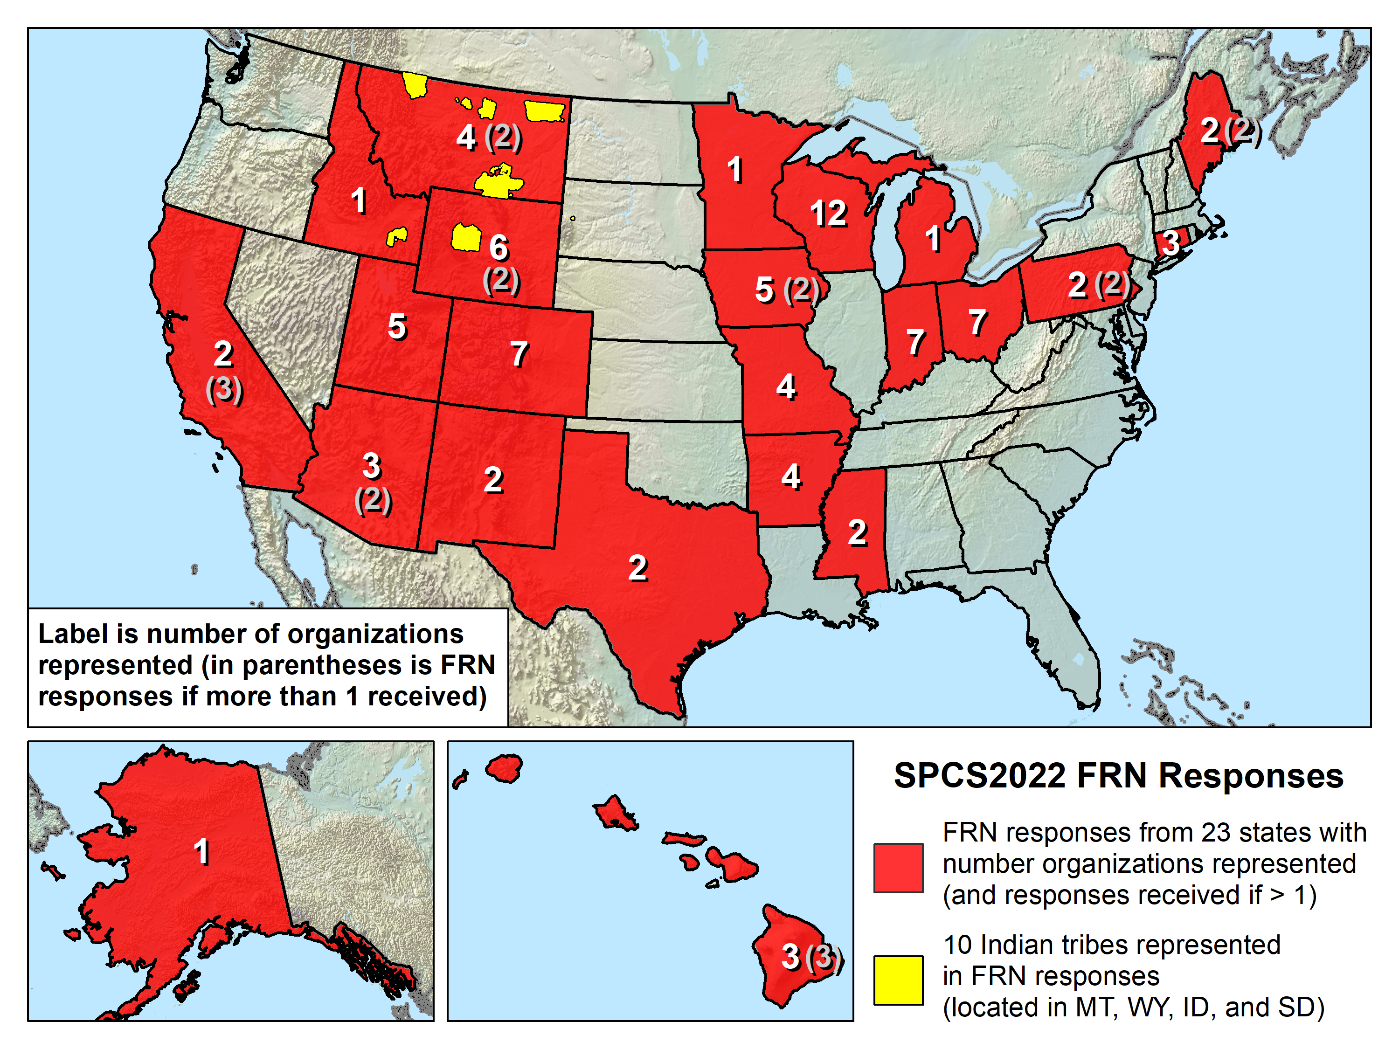
Federal Register Notice Feedback
41 responses:
  1 federal agency (USGS)
  10 Native American tribes
  23 states (includes state and private organizations)
105 people
97 organizations

Slide 9
SPCS2022 characteristics
Default zone designs
  Created by NGS if get no input; similar to SPCS 83
Layered zones (e.g., Kentucky in existing State Plane)
  A statewide zone plus 1 or 2 layers of multiple zones
Low distortion projections (LDPs)
  Can be part of SPCS2022, but with minimum size limits
  Must be designed by others (not by NGS)
Special purpose zones
  For regions that span multiple states/zones
  e.g., Navajo Nation (3 states, 5 SPCS 83 zones)

Slide 10
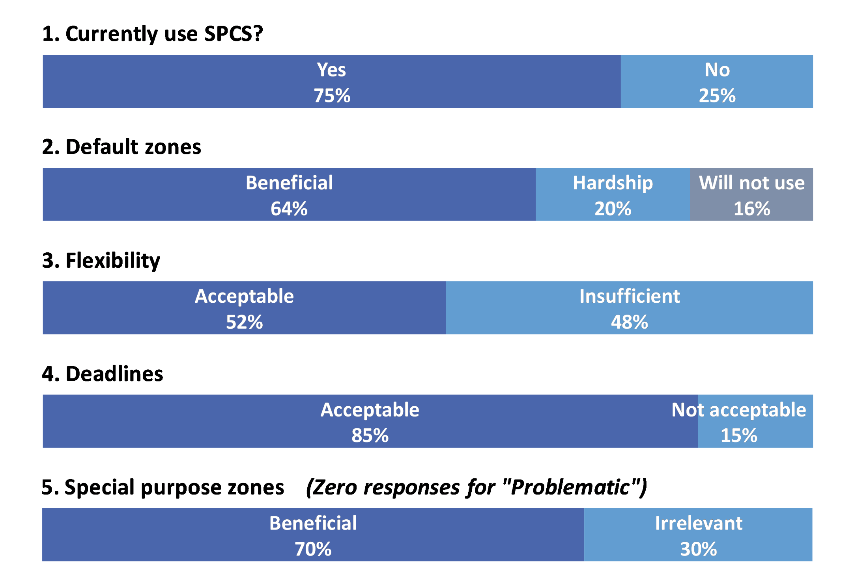
Responses to FRN questions

Slide 11
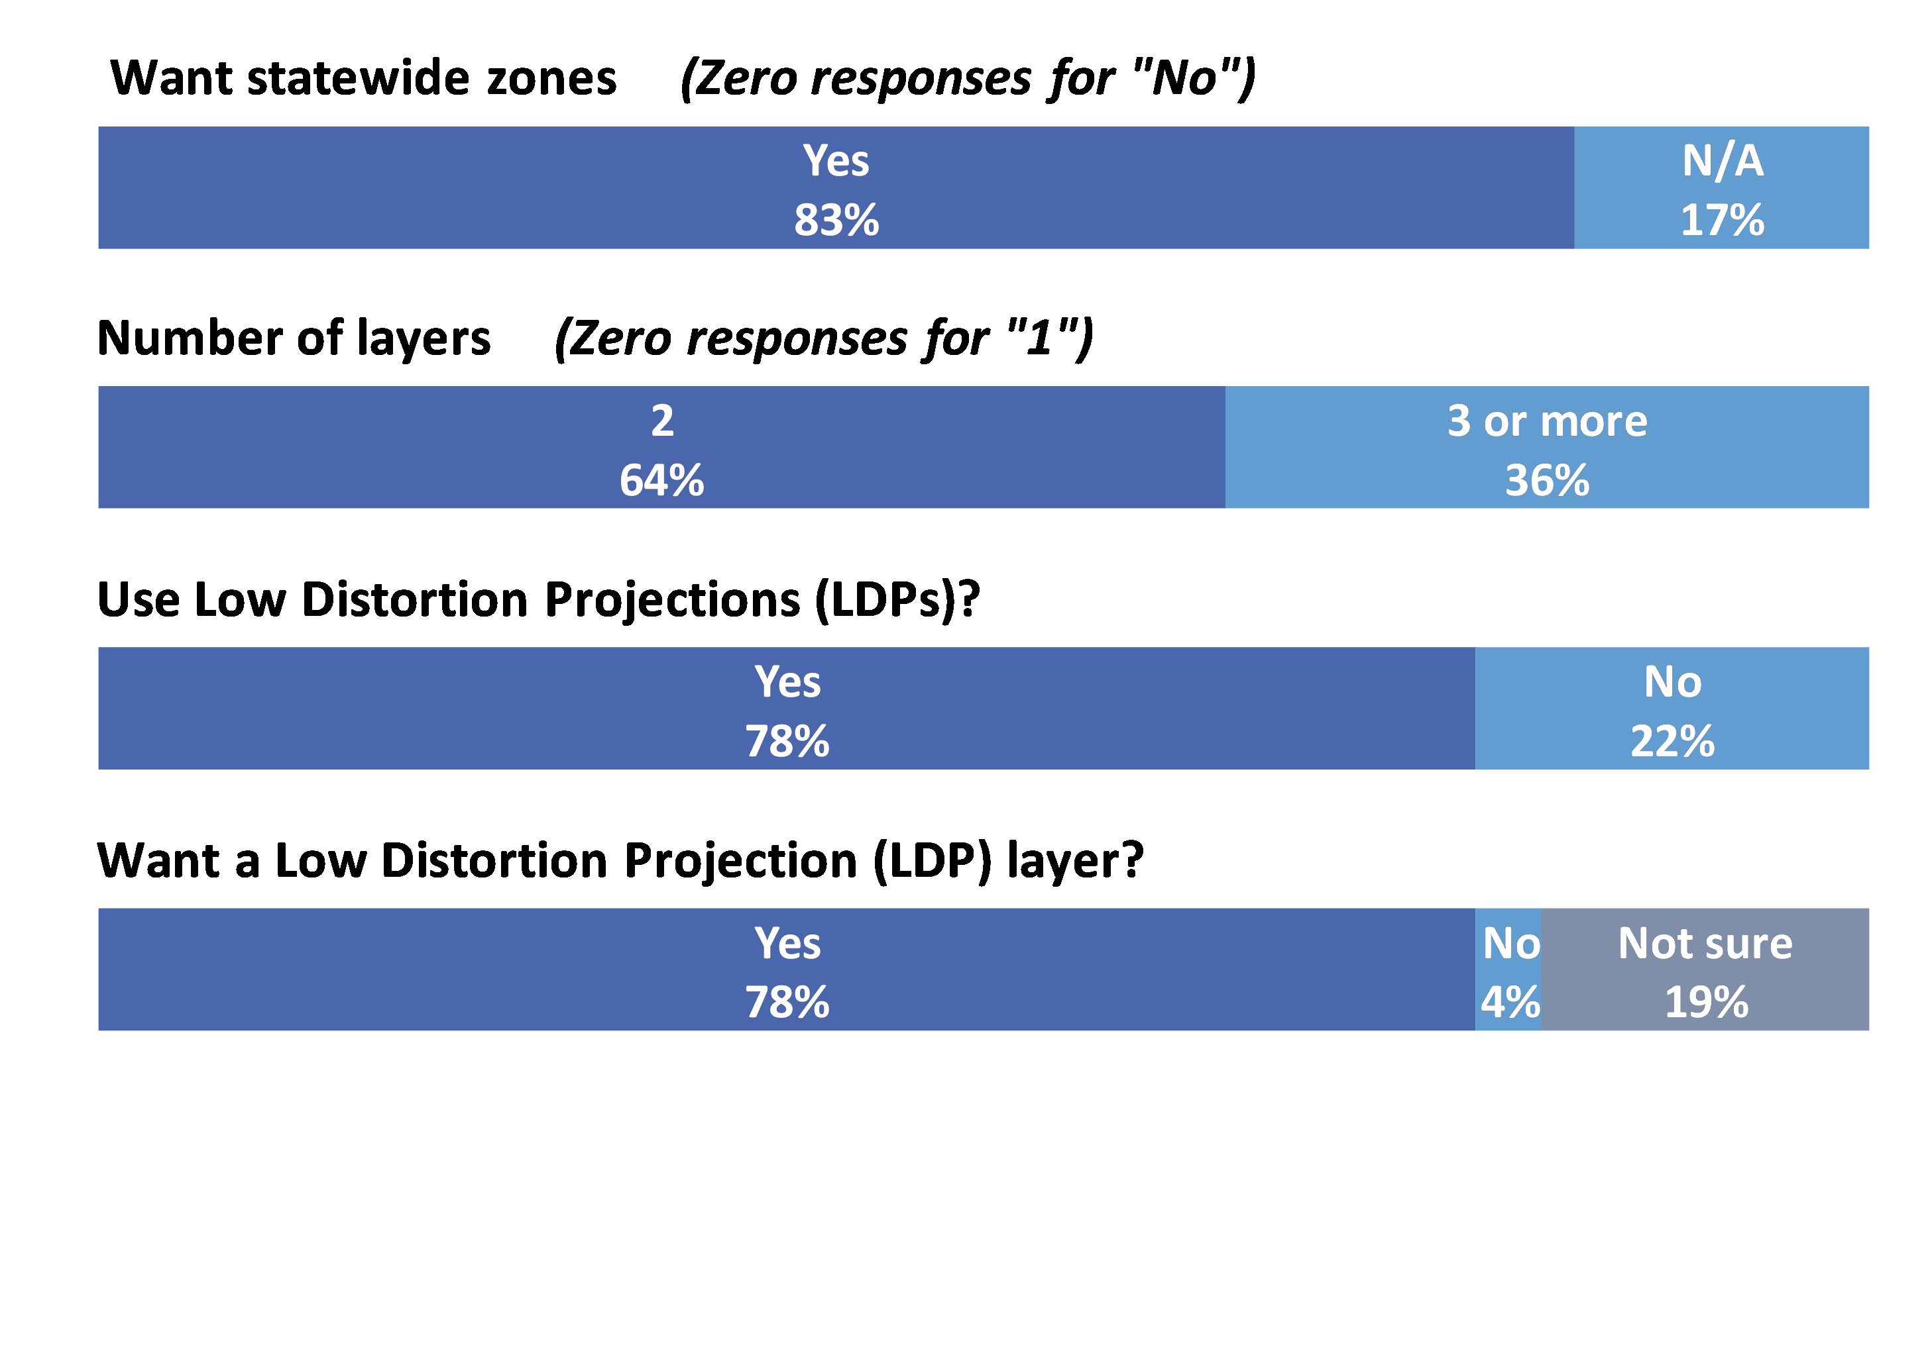
Summary of other FRN input

Slide 12
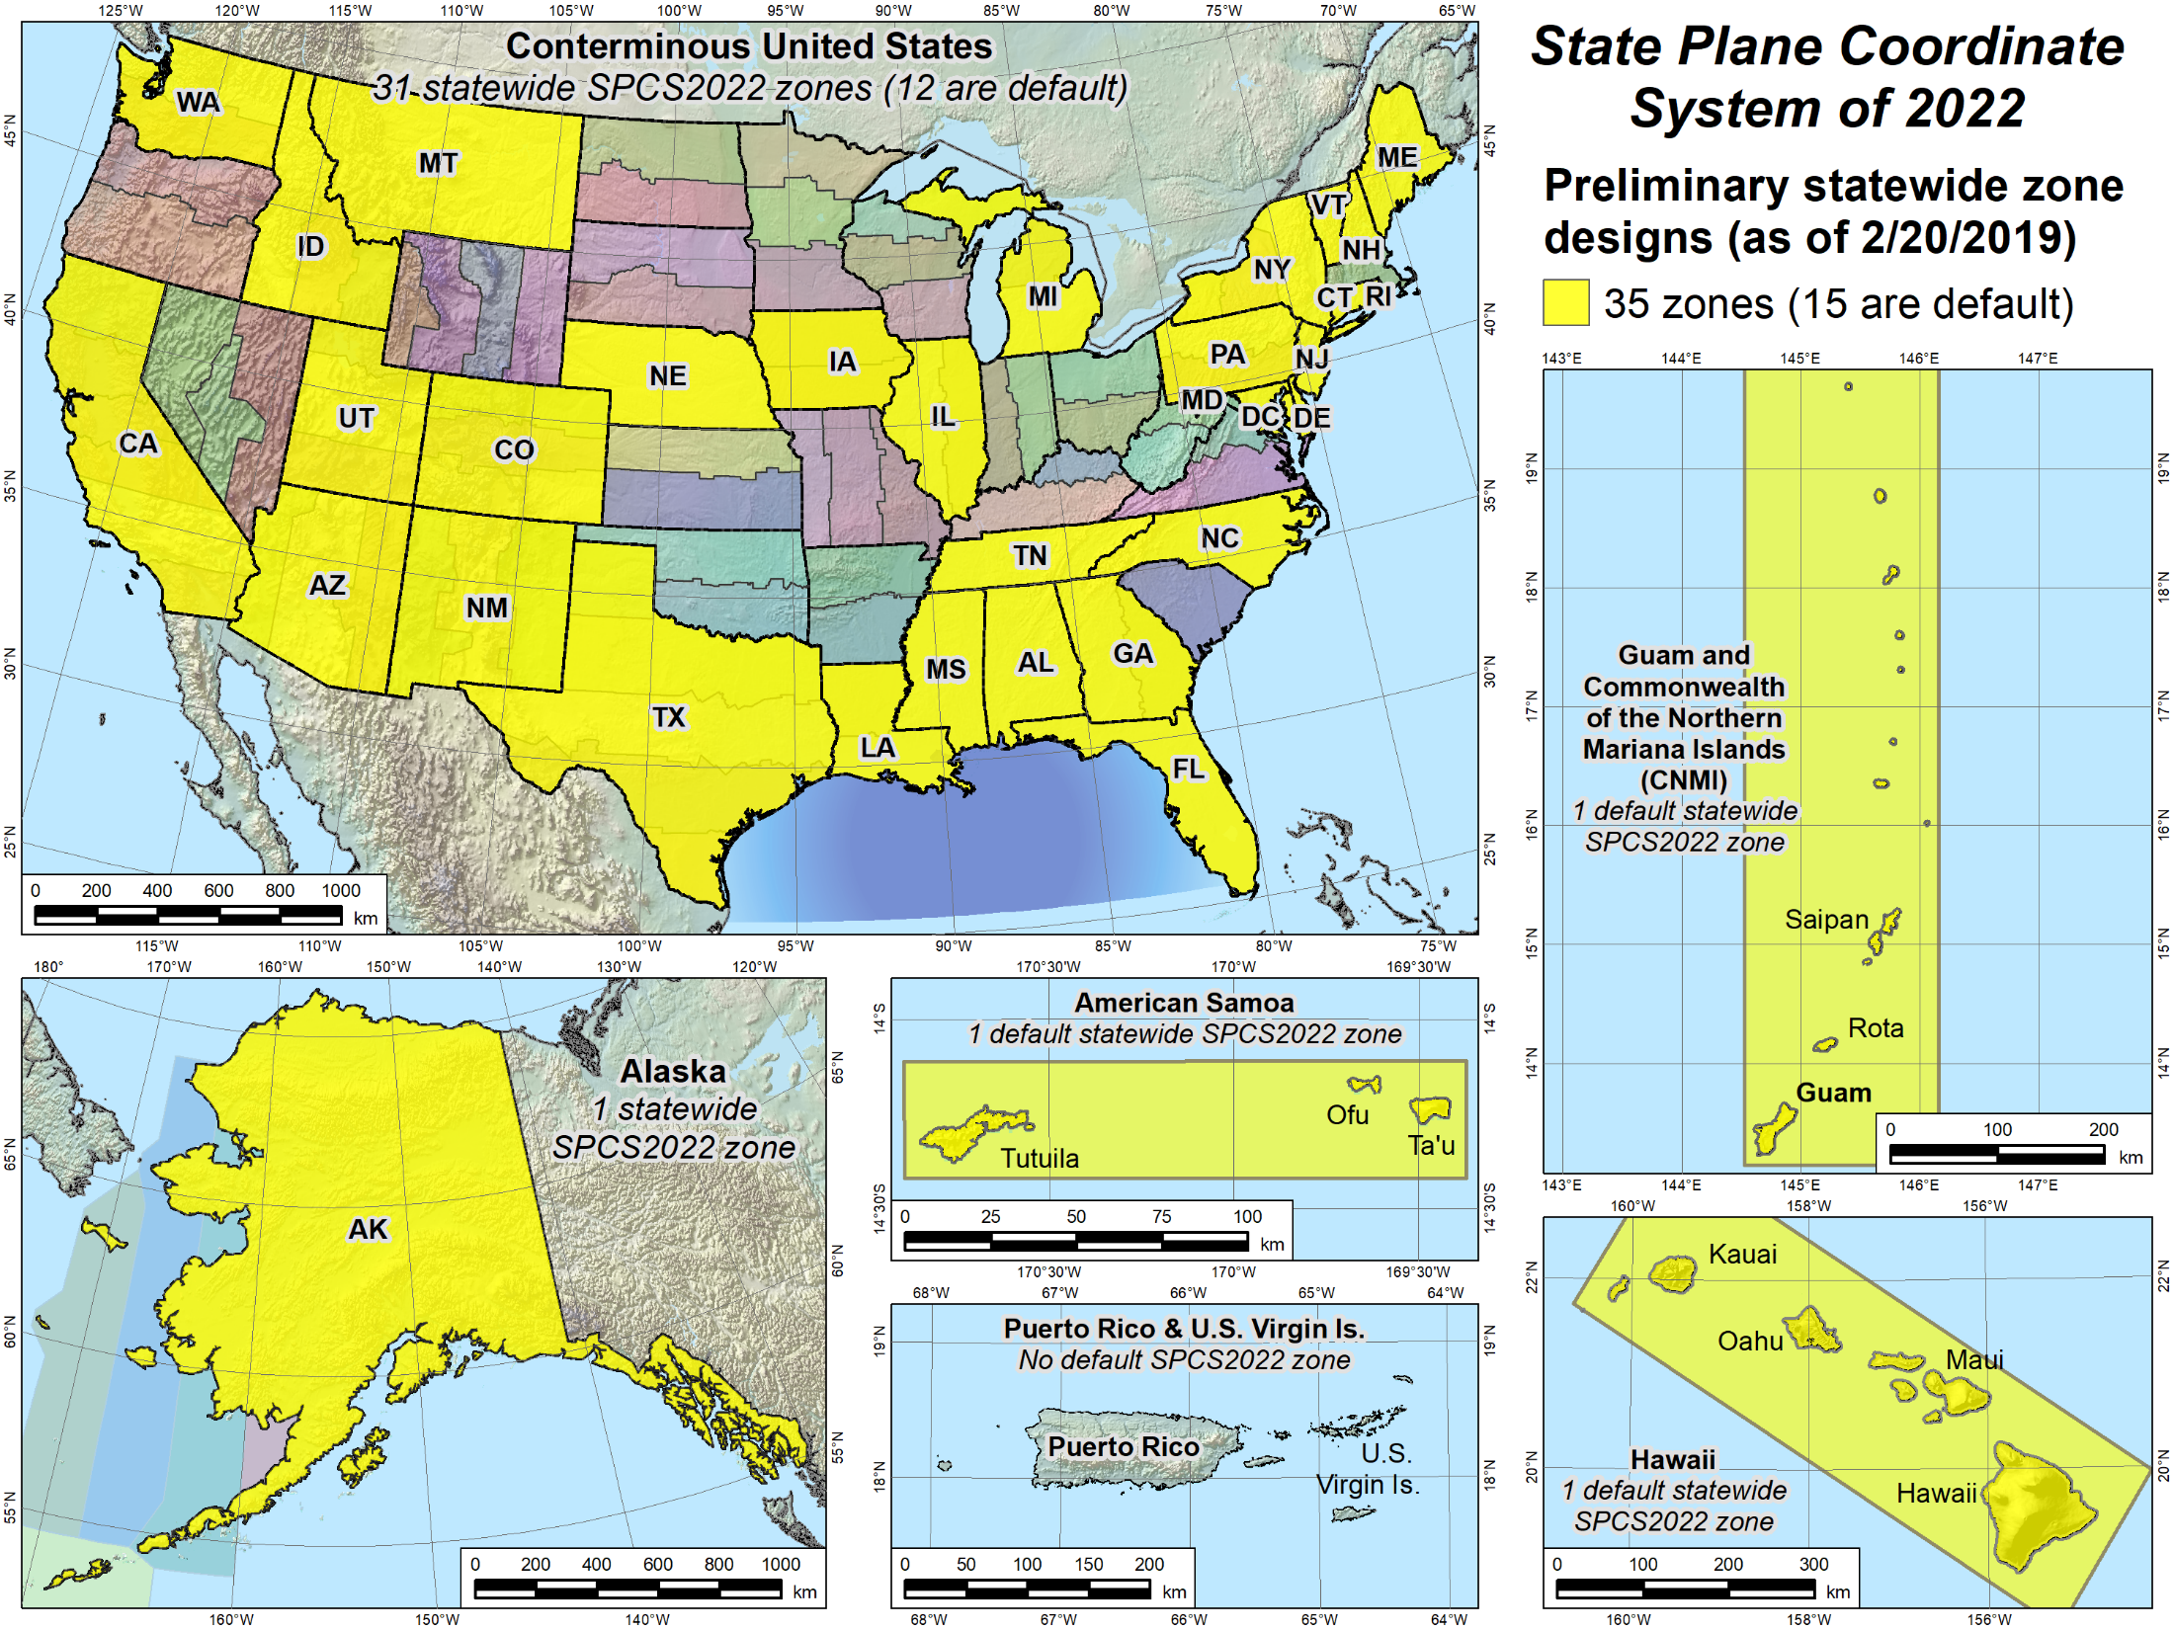
Statewide zones
Preliminary design maps
Show projection axis and linear distortion
Notes:
Similar to previous slide, but showing statewide SPCS2022 zones that have preliminary designs and maps available for download.
Note that some of the statewide zones are the same as the default zones in the previous slide
Note also that some states have a preliminary statewide zone design but no default zone design (e.g., Iowa).
States with no default design are ones that will design their own LDP system that provides statewide coverage and will not use the NGS default designs (that correspond to the existing SPCS 83 zones)
Reminder: All sates will get a statewide zone

Slide 13
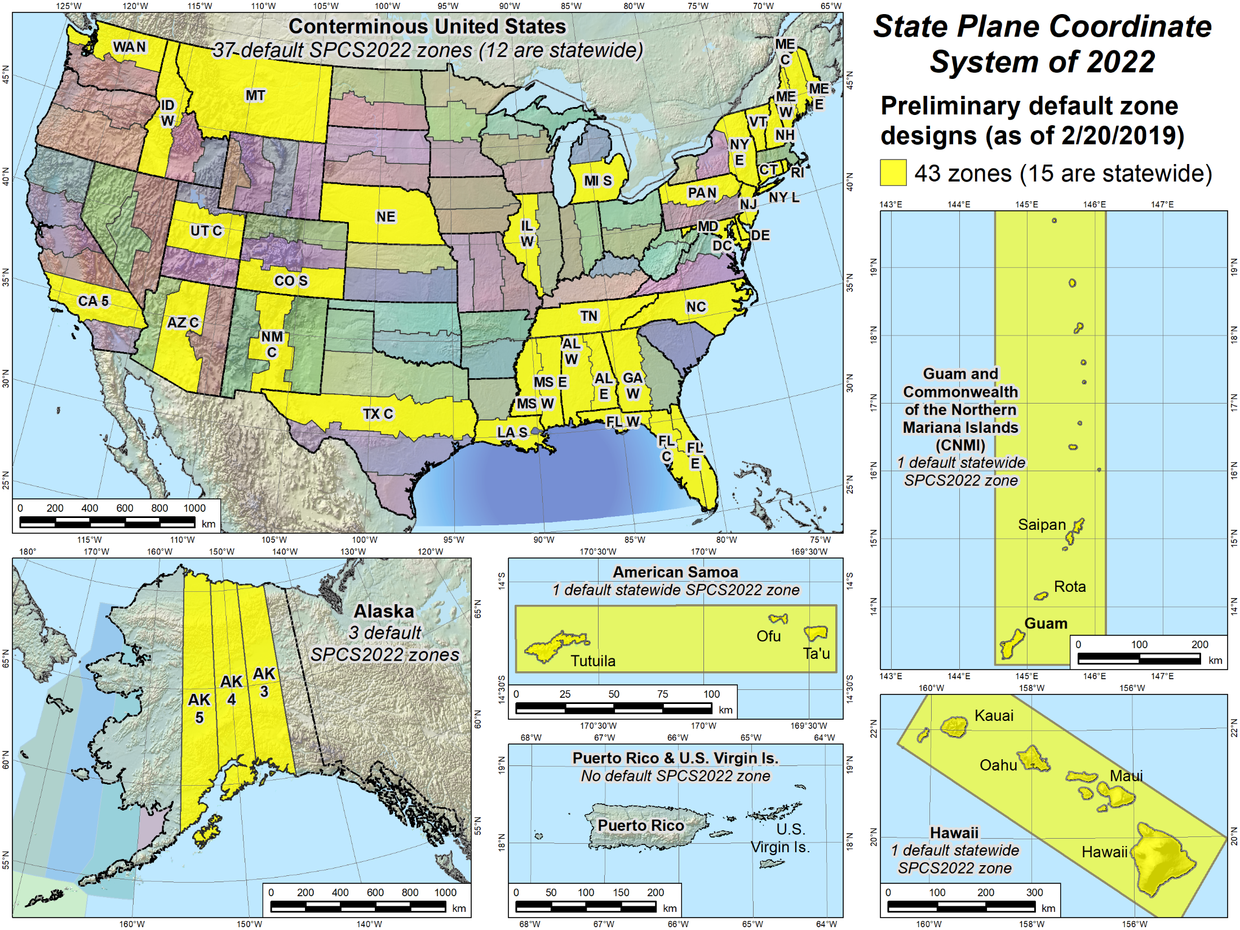
Default zones
Default zones
Preliminary design maps
Show projection axis and linear distortion
Notes:
Larger scale maps of the areas included in the NSRS where SPCS2022 zones will be established
Yellow zones are preliminary designs of SPCS2022 default zones that have been completed.
Some of the default zones are statewide (or territory-wide, as the case may be)
Maps for (most of) these designs are currently available for download, along with maps of the corresponding SPCS 83 zones for comparison (will show examples).

Slide 14
State Plane Zone Layers
Allow maximum of THREE layers
  One must be statewide layer (designed by NGS)
0, 1, or 2 multiple-zone layers can exist
However:
  Only ONE layer can have complete state coverage
  Only ONE layer can have partial state coverage
Result: ONE multi-zone layer in most states
  Partial coverage layer intended for mountainous states

Slide 15
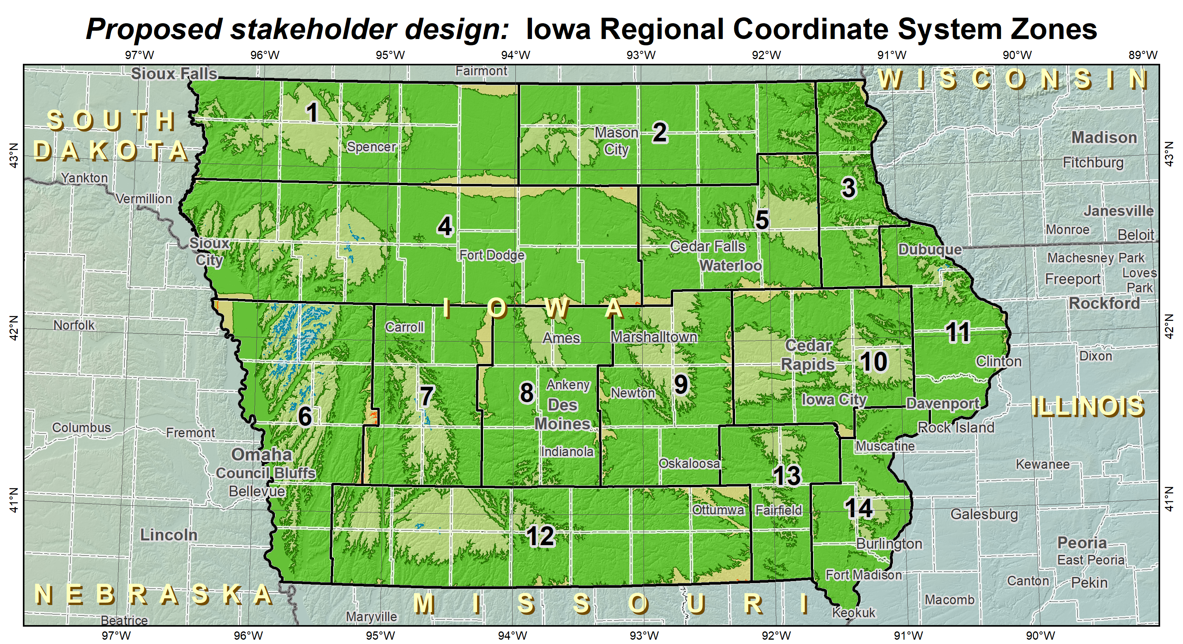
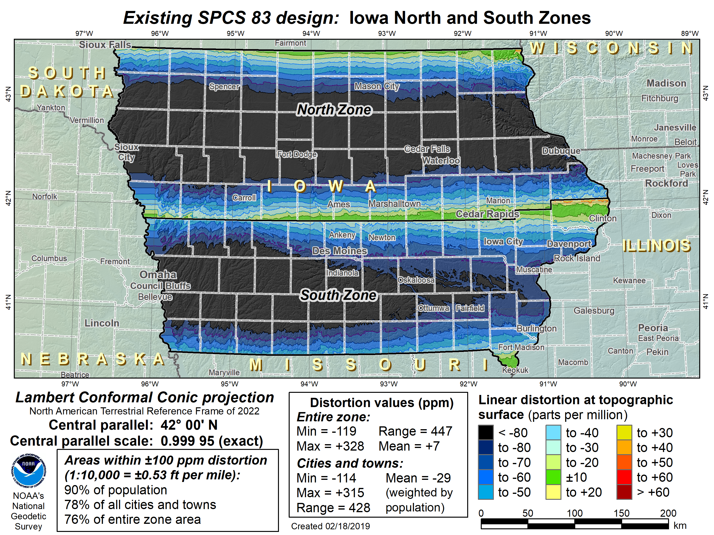
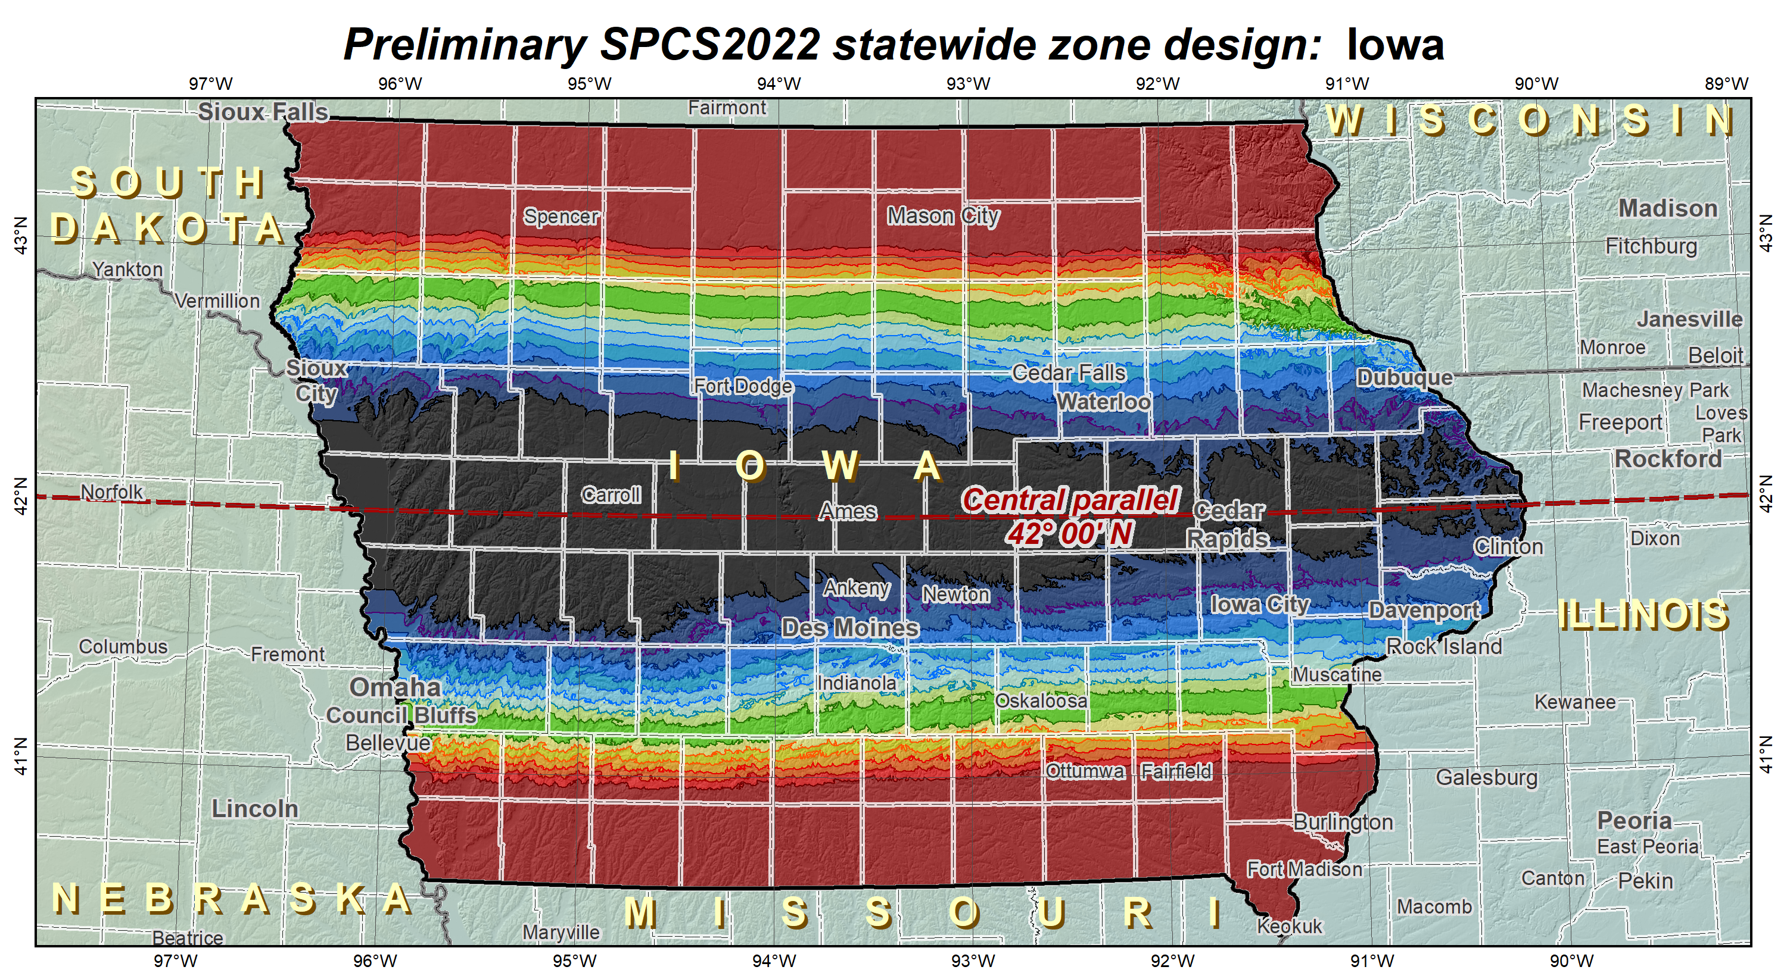
Iowa SPCS2022 layers
LDP multiple-zone layer
(COMPLETE state coverage)
OR
SPCS 83-like multiple-zone layer
(COMPLETE state coverage)
Only ONE multi-zone layer with complete state coverage
Statewide layer for EVERY state

Slide 16
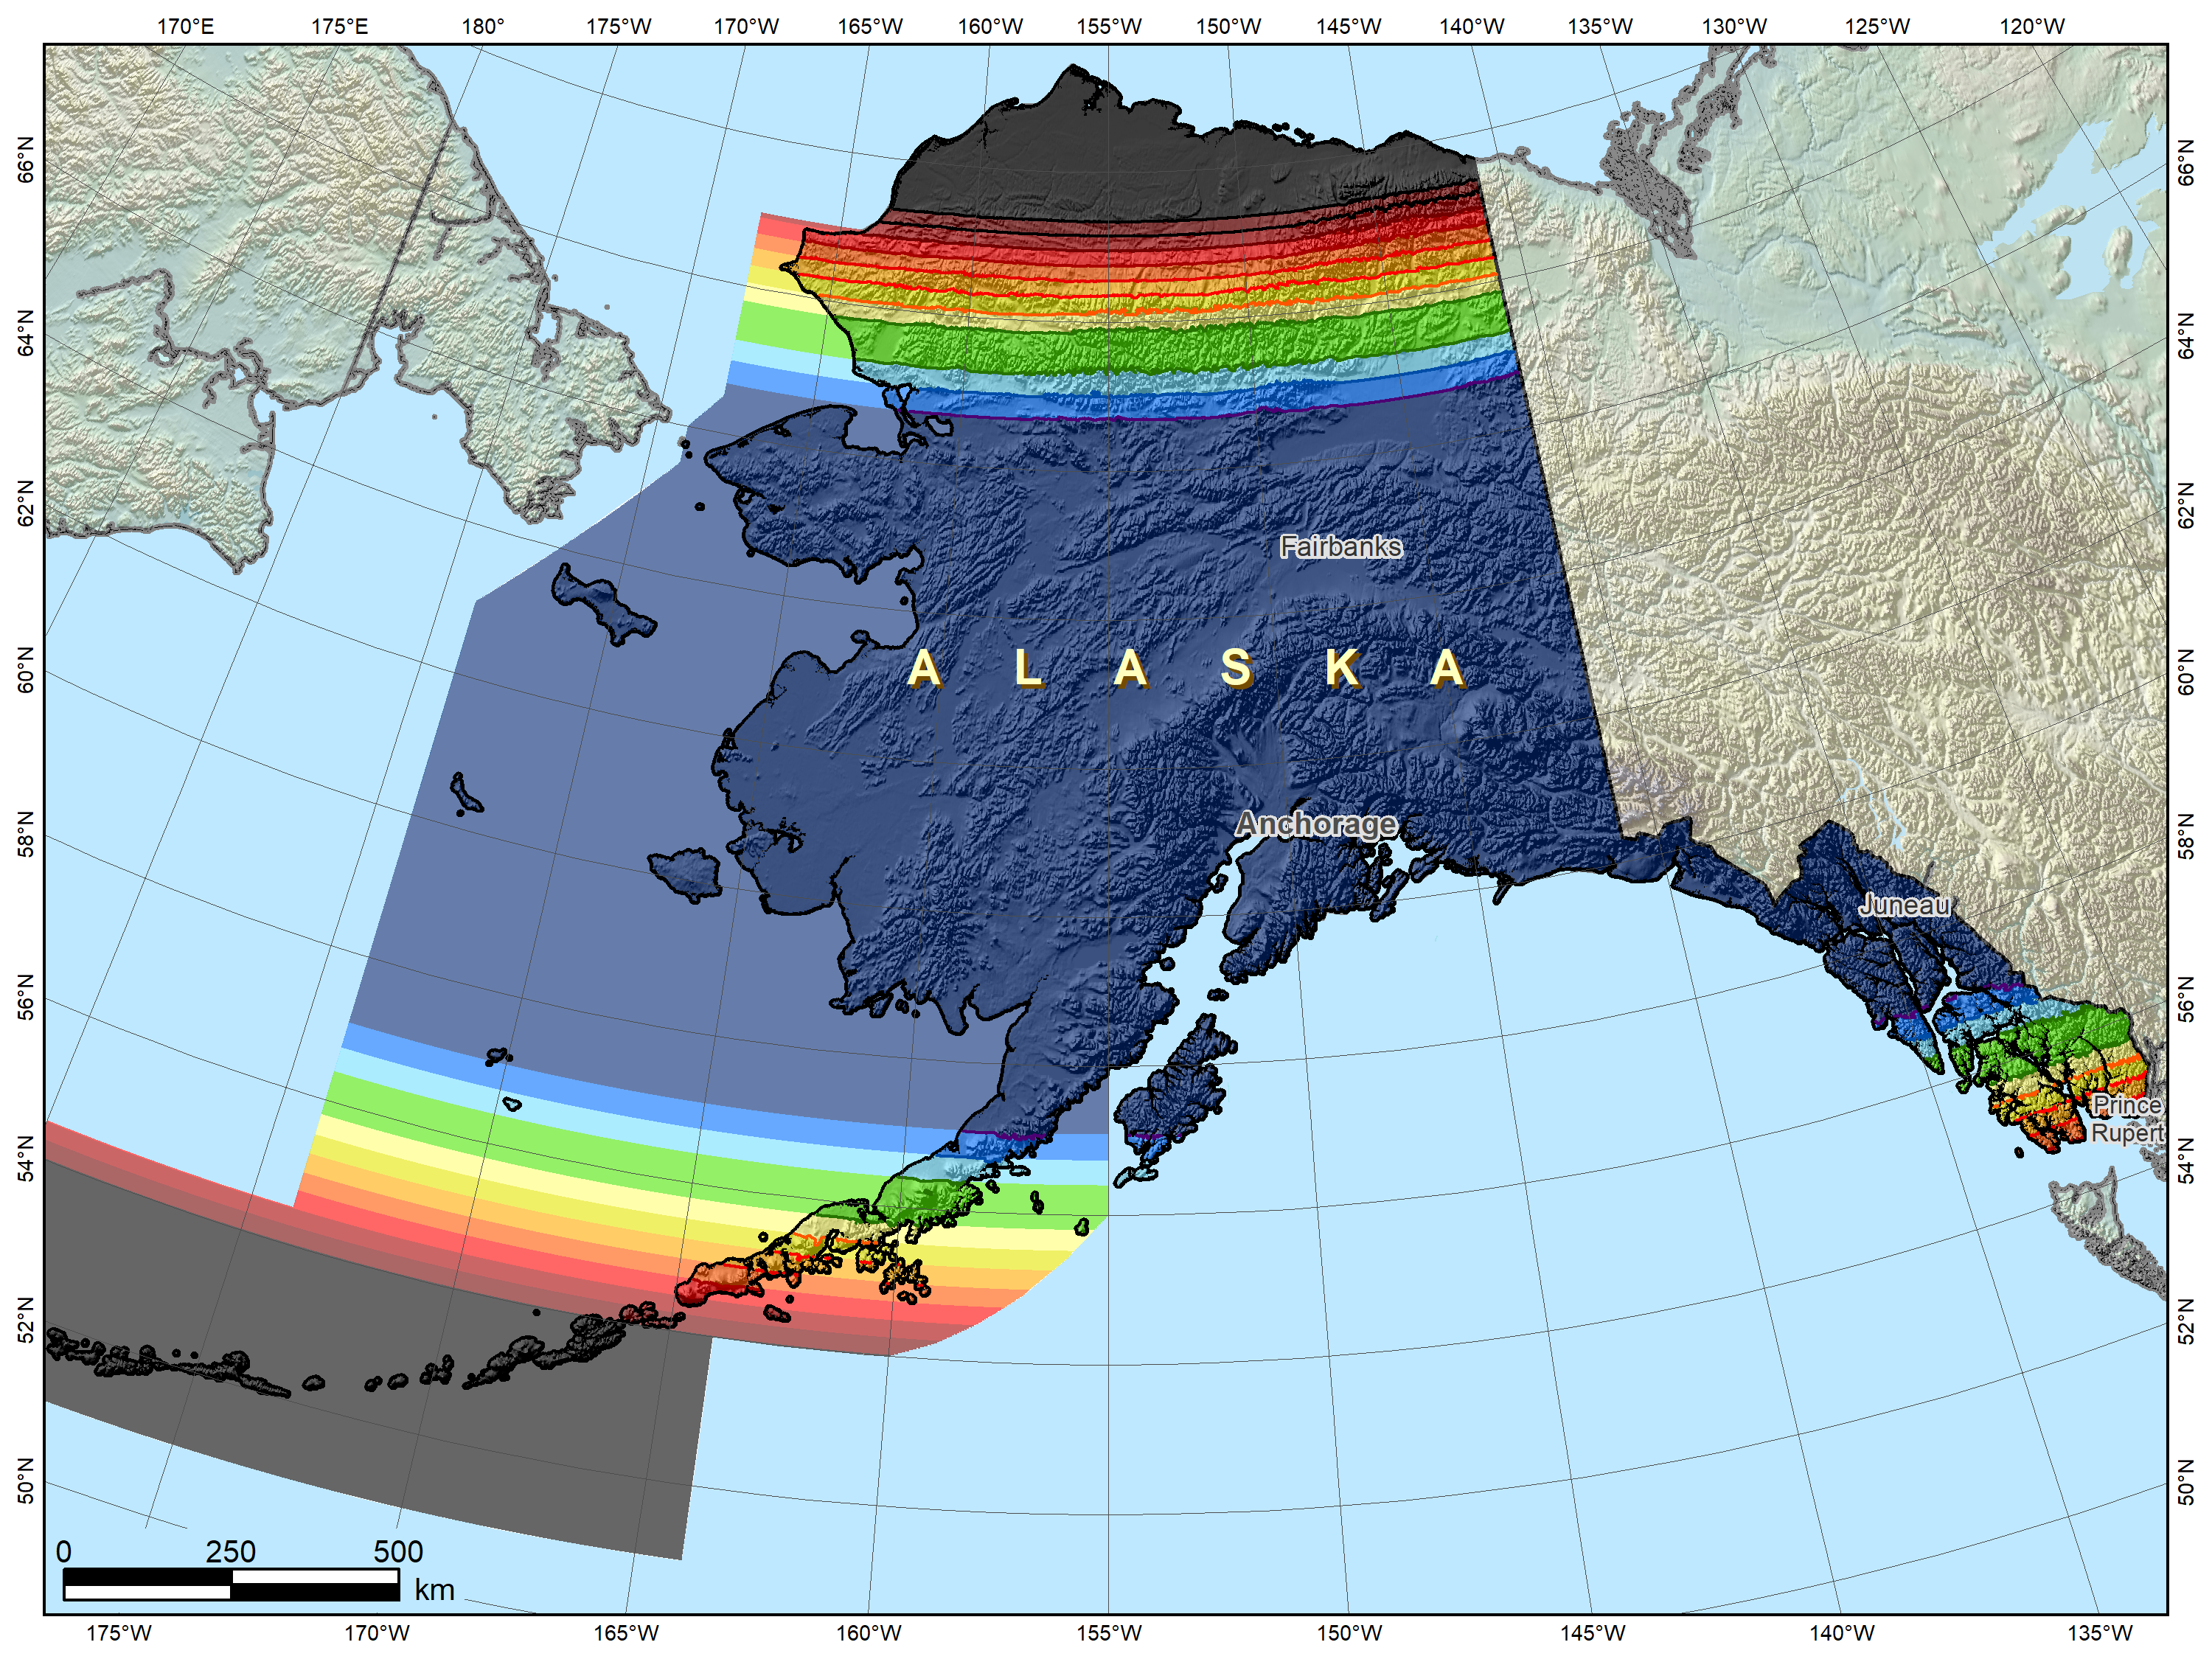
Possible Alaska zone layer configuration
Alaska statewide
layer

Slide 17
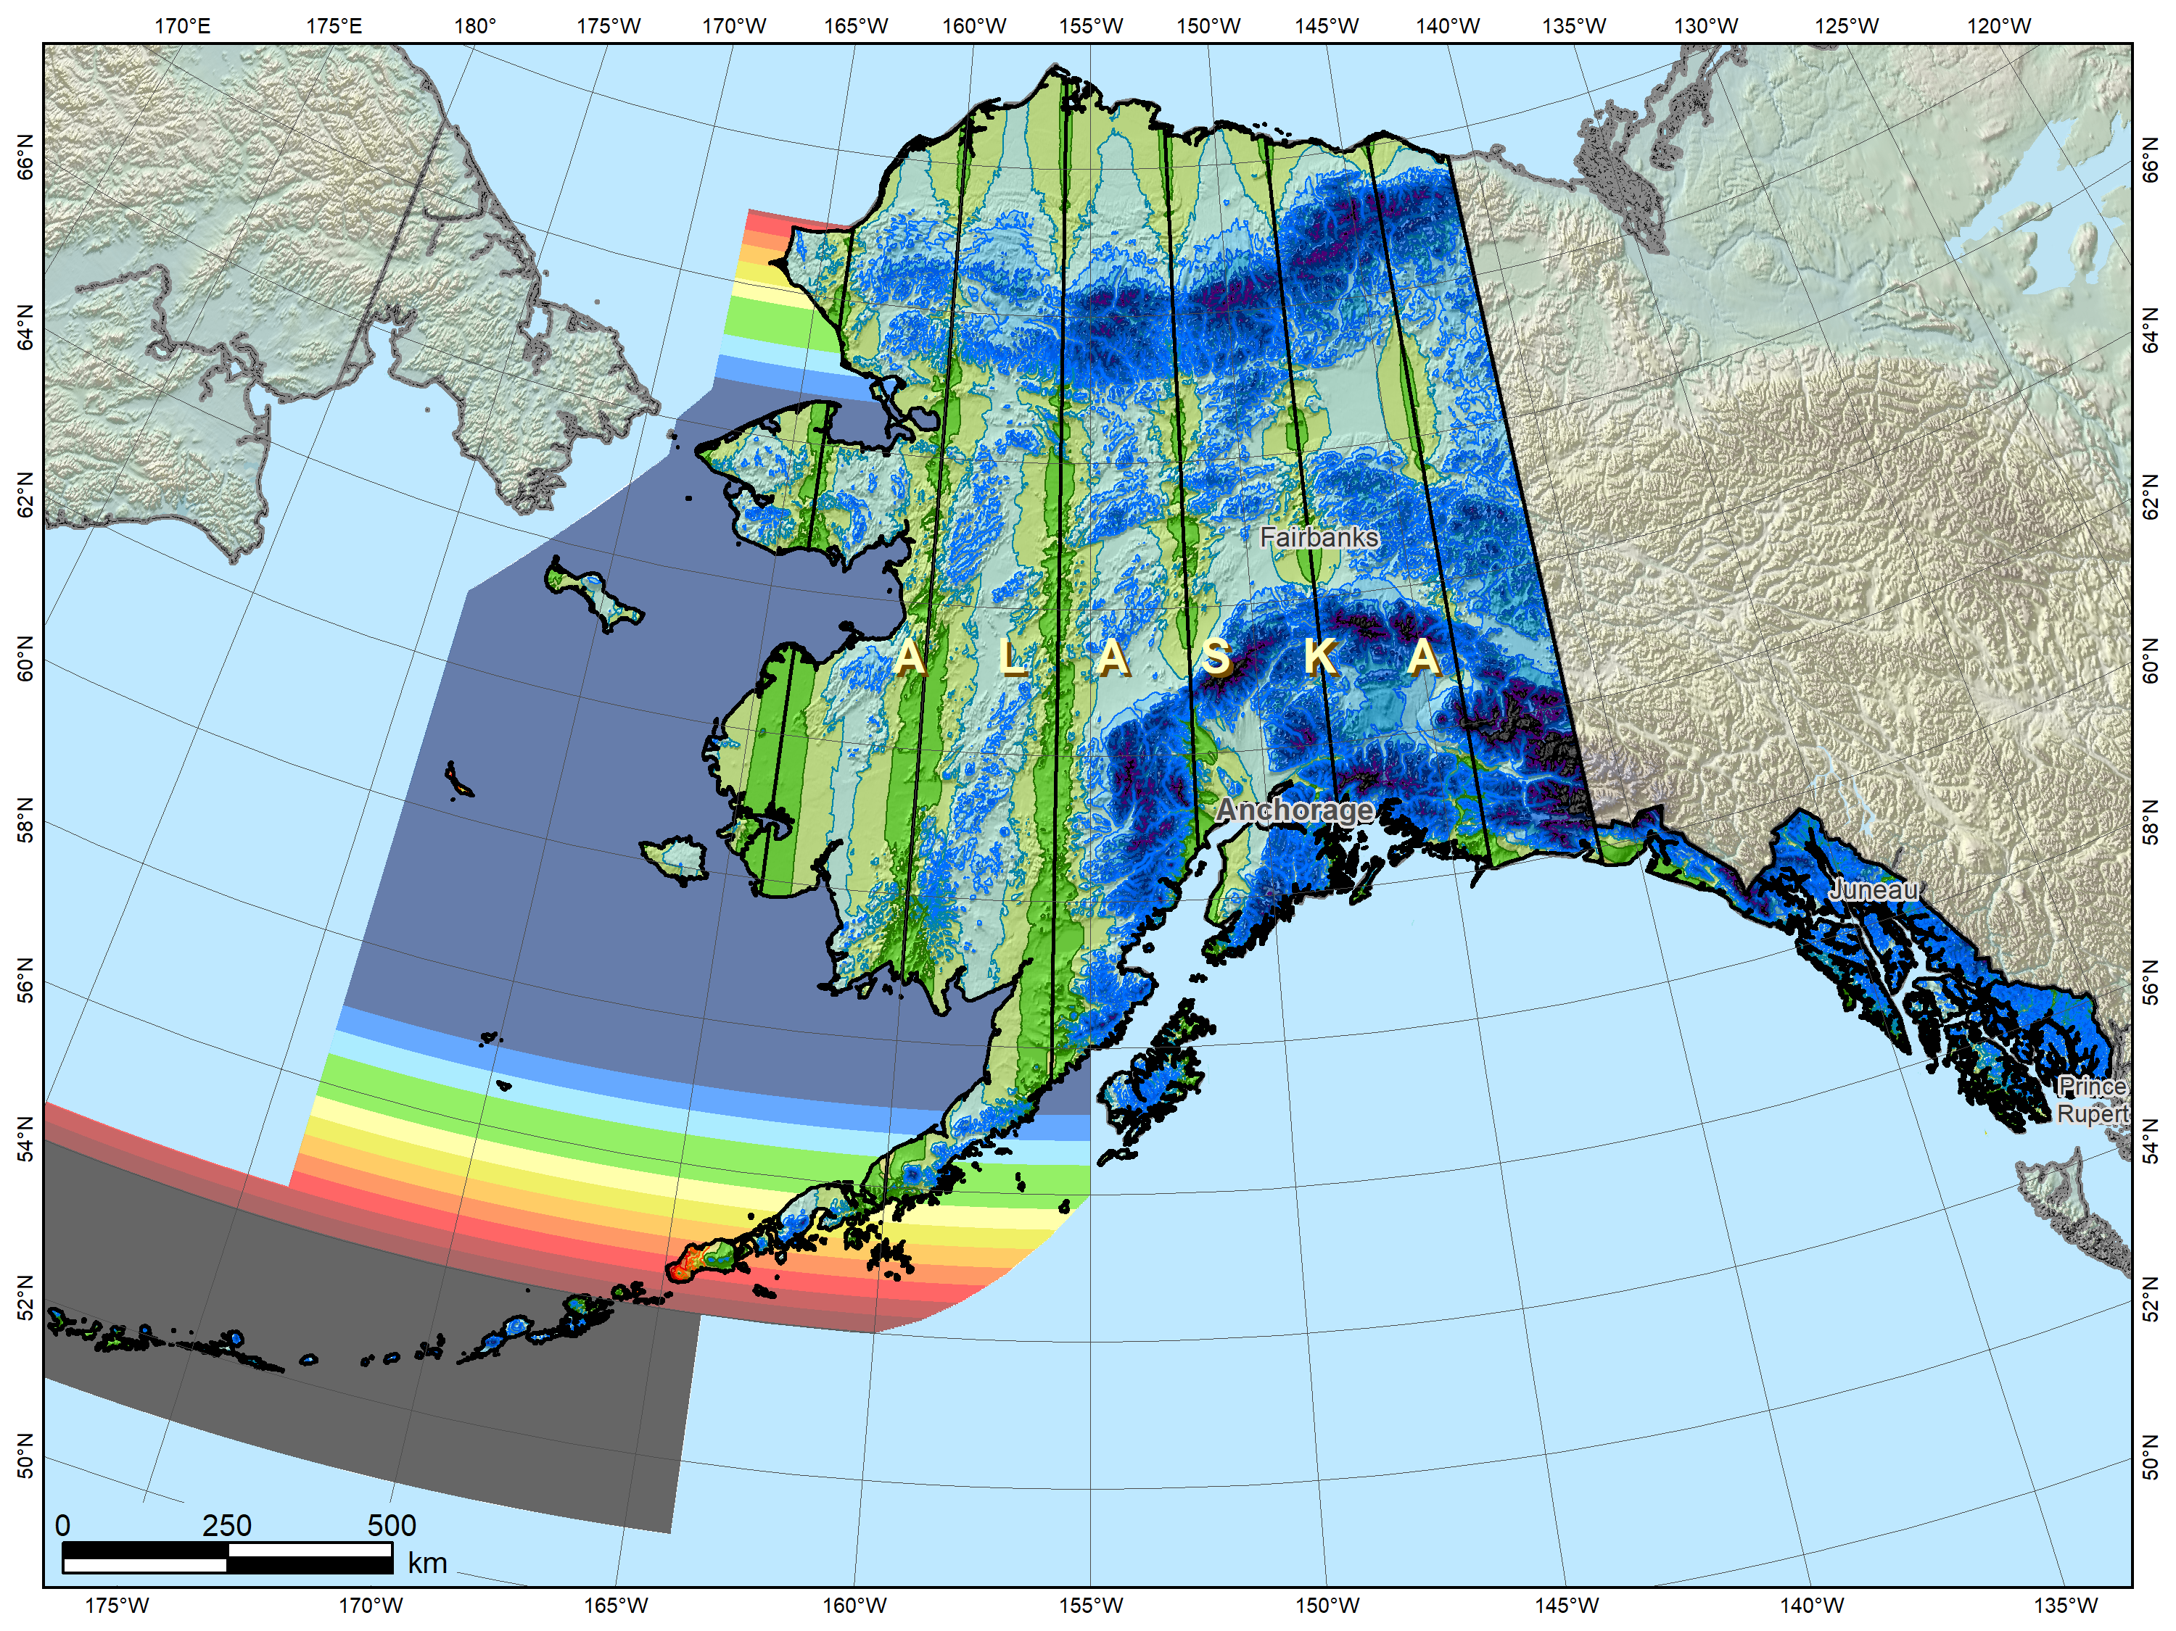
Alaska complete “intermediate” layer
Possible Alaska zone layer configuration
Alaska statewide
layer
+
Multi-zone layer with complete coverage

Slide 18
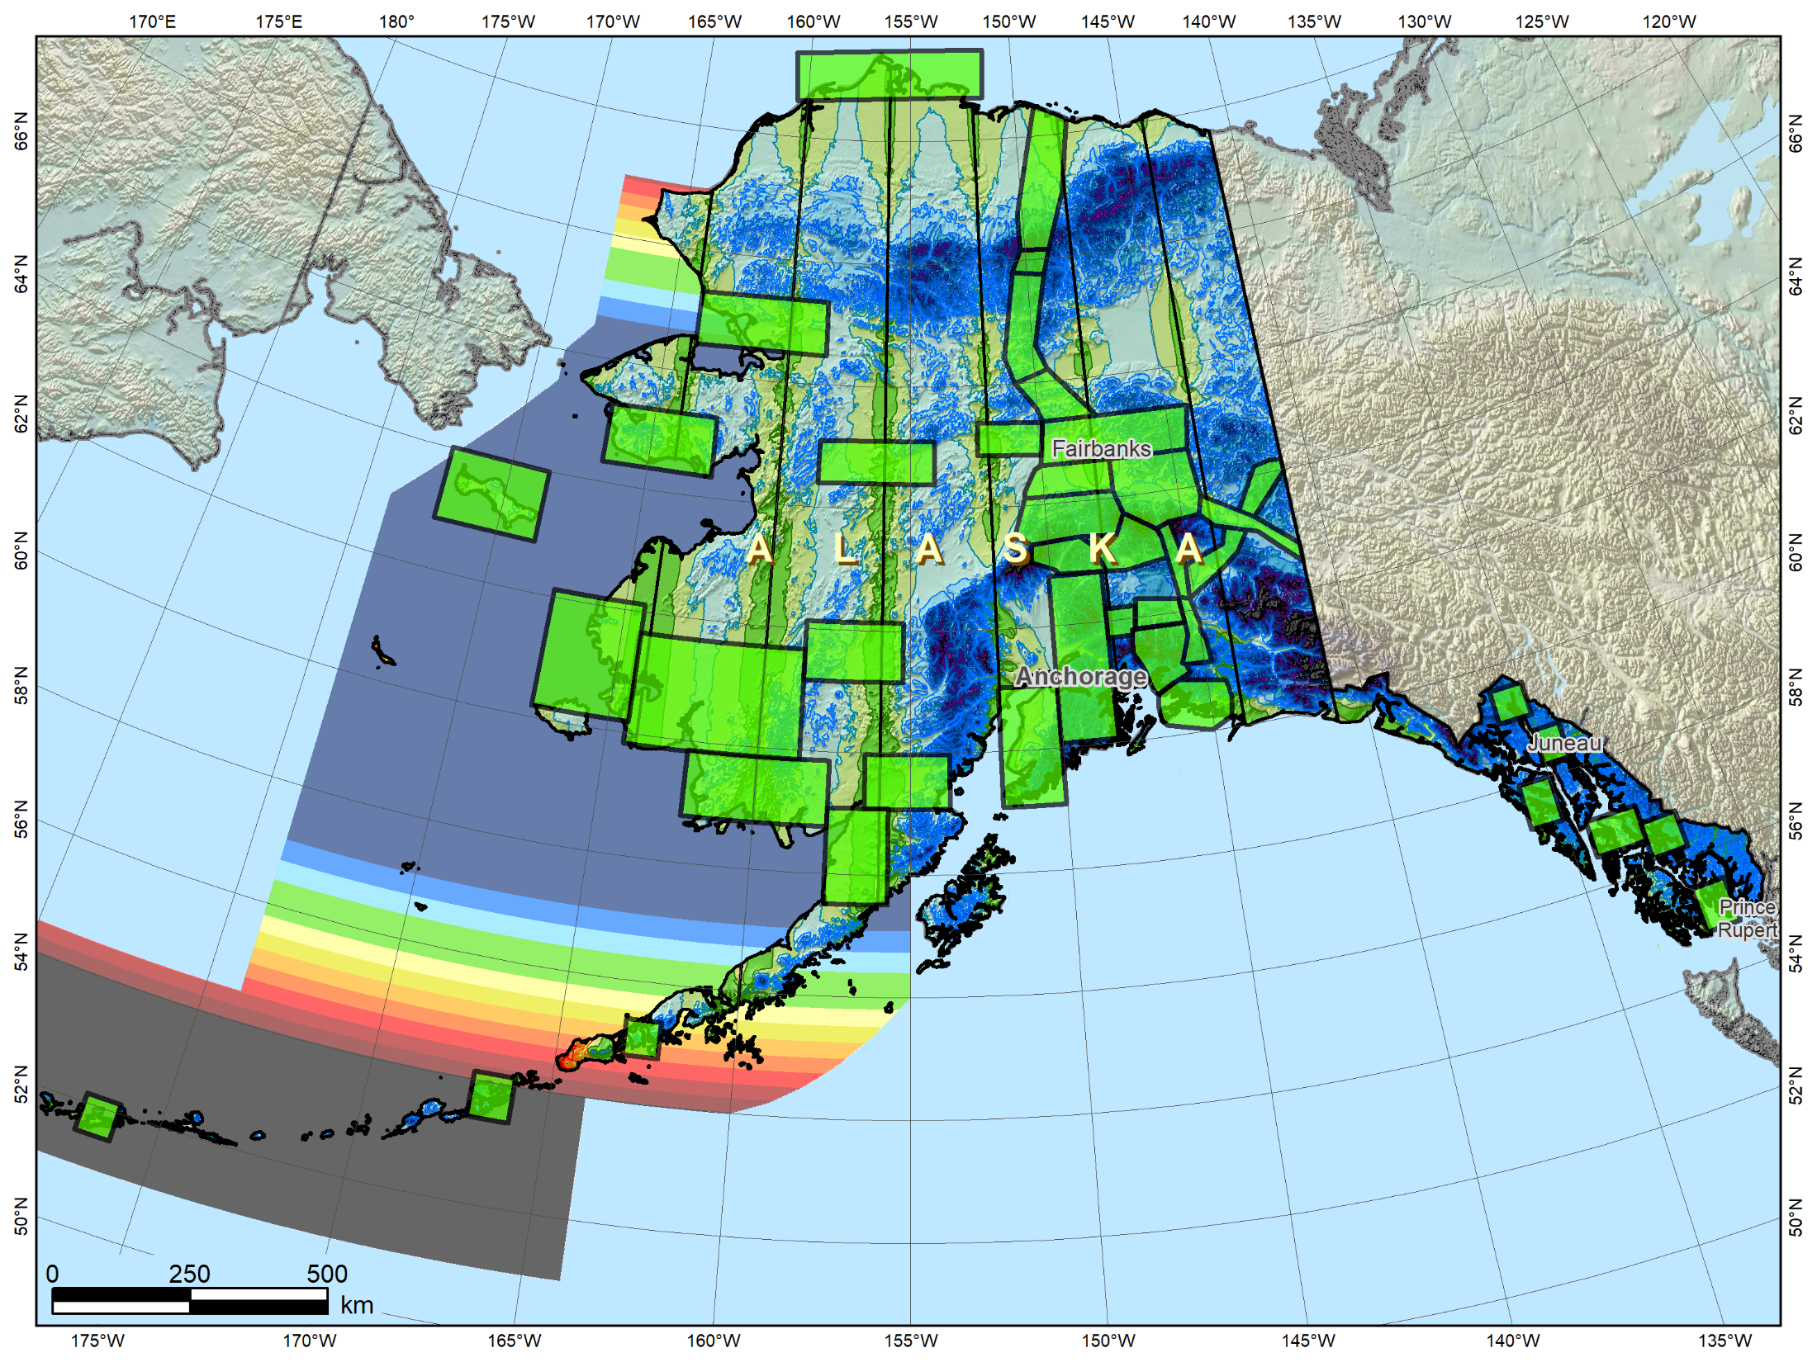
Alaska with THREE SPCS2022 layers
Possible Alaska zone layer configuration
Alaska statewide
layer
+
Multi-zone layer with complete coverage
+
LDP
multi-zone layer with partial coverage
Multi-zone layers:
ONE with complete coverage ONE with partial coverage

Slide 19
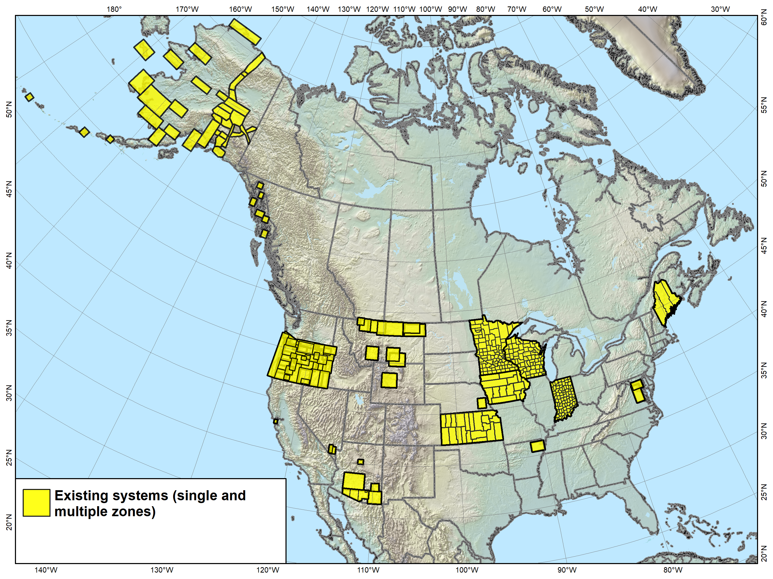
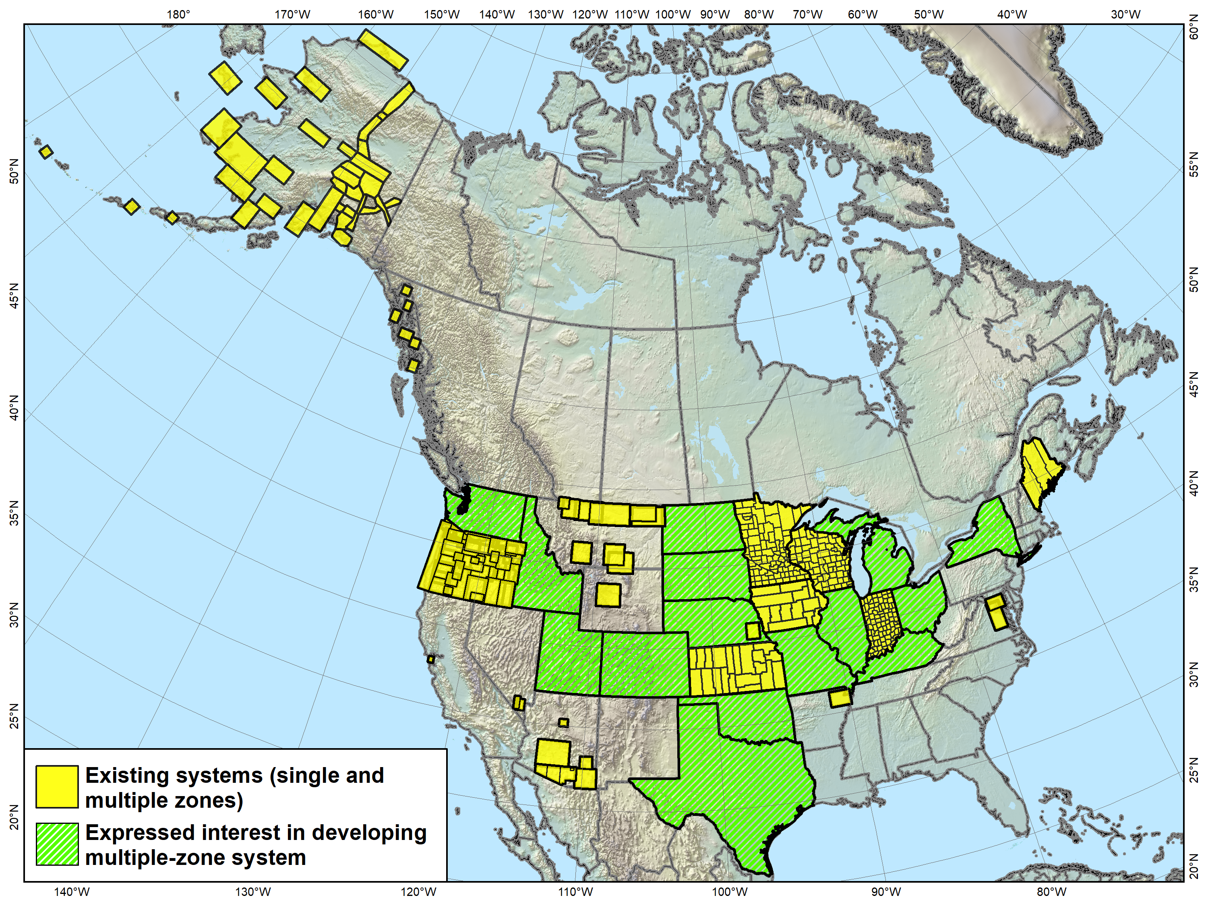
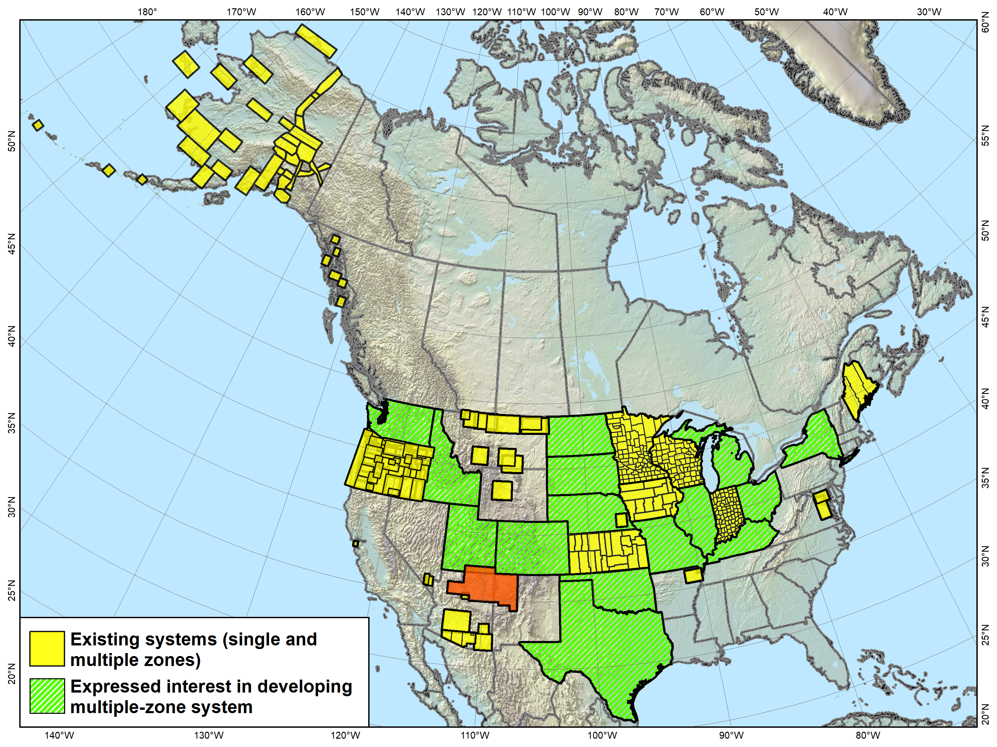
Low distortion projections
Versions of most of the LDP systems shown (as well as others) will likely become part of SPCS2022, both with complete and partial state coverage.
Navajo Nation Coordinate System not actually an LDP, and it falls in
3 states. It is something “special”…
Notes:
Map showing LDP systems adopted by government agencies and currently in use throughout the U.S. (there are likely quite a few others).
Note that discontinuous systems like that in Montana exist in other states, most notably Alaska
States with compete LDP zone coverage also exist, and it is expected that all shown will propose an LDP SPCS2022 layer, with no default layer corresponding to their existing SPCS 83 zones (i.e., they will have only 2 layers, statewide and LDP)
One zone shown is for the Navajo Nation
Too large (with too much distortion) to realistically be considered an LDP zone
Falls in 3 states (Arizona, New Mexico, and Utah)
Because it is in more than 1 state, it is a candidate for a “special purpose” zone, which is the topic of the next slide…

Slide 20
“Special use” SPCS2022 zones
Formerly “special purpose” zones
Zones for regions in more than one state
Categories:
  Major urban areas (e.g., New York, Chicago, St. Louis)
  Large American Indian reservations (e.g., Navajo Nation)
  Large federal jurisdictions or applications (e.g., Yellowstone National Park, mapping of Atlantic Coast)
Requires NGS Director approval (case-by-case basis)
Notes:
Special use zones were not included in the draft SPCS2022 policy & procedures, but were asked about in the FRN
Most FRN responses indicated this zone type was desirable. Some had no preference, but none were opposed
Specification restricted to areas in more than 1 state (since 3 zone layers allowed in new policy & procedures)
Allowed for large urban areas in more than one zone under initial (1977) SPCS 83 policy (but never used)
Requires approval of NGS Director on case-by-case basis
Mainly because if more than 1 state, difficult to deal with under state stakeholder structure of all other SPCS2022 zones

Slide 21
Poll Question
Do you expect your state to propose and design a low distortion projection (LDP) layer for SPCS2022?
  Yes, with complete coverage of the entire state
  Yes, with only partial coverage of the state
  No
  Not sure

Slide 22
SPCS2022 deadlines
Consensus input per SPCS2022 procedures
  Requests for designs done by NGS
  Proposals for designs by contributing partners
Submittal of approved designs
  Proposal must first be approved by NGS
  Designs must be complete for NGS to review
Later requests will be for changes to SPCS2022
Form for making requests and proposals
Form for submitting stakeholder designs
NGS.SPCS@noaa.gov
by March 31, 2020 for requests and proposals
by March 31, 2021 for submittal of approved designs
Notes:
Deadlines for requests, proposals, and submittal of approved designs
Designs by “contributing partners” must first be approved as proposals by NGS
Contributing partners can be the stakeholders, or an individuals or organizations designing the zones for the stakeholders
It is expected that most (all?) proposed designs will be for LDP systems (with design criterion < ±50 ppm), since NGS will not design those
Any requests, proposals, or submittals that are not received by the deadlines will not be included in the initial release of SPCS2022 (in 2022)
However, these could still become part of SPCS2022 at a later time
Policy & procedures provide mechanism for changing SPCS2022, so there will still be an opportunity to change/add SPCS2022 layers even after 2022

Slide 23
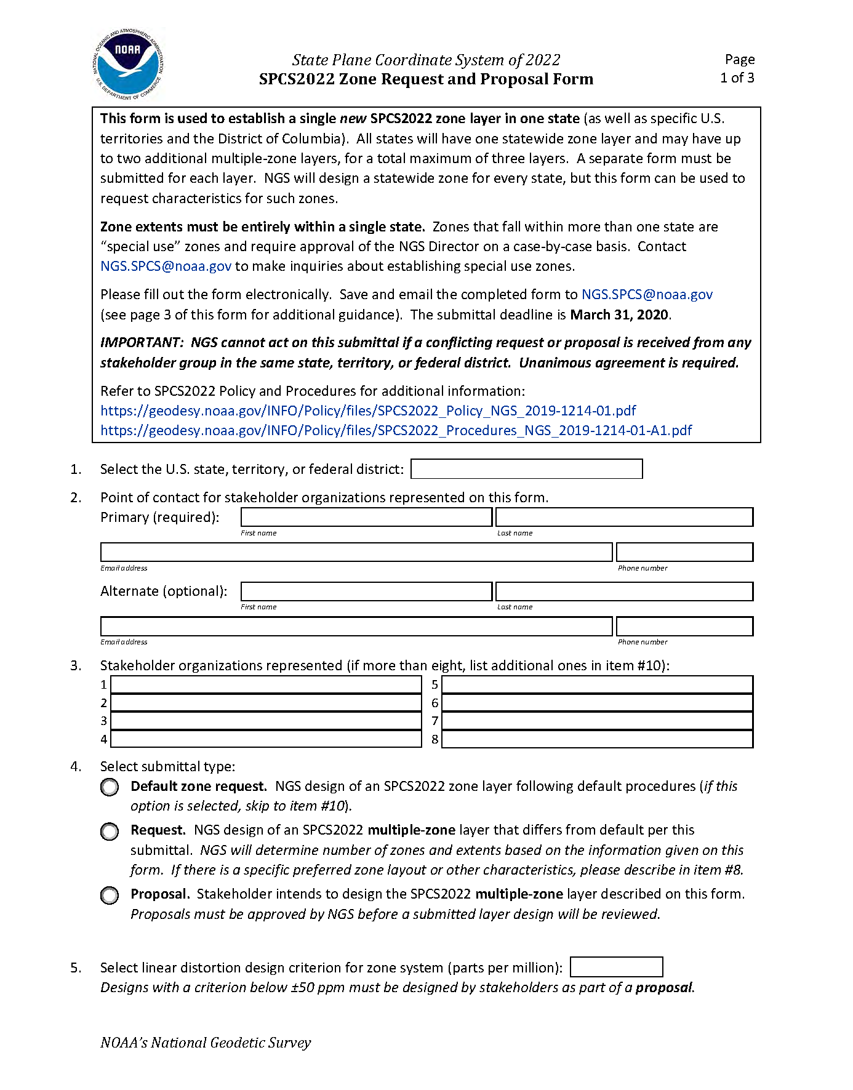
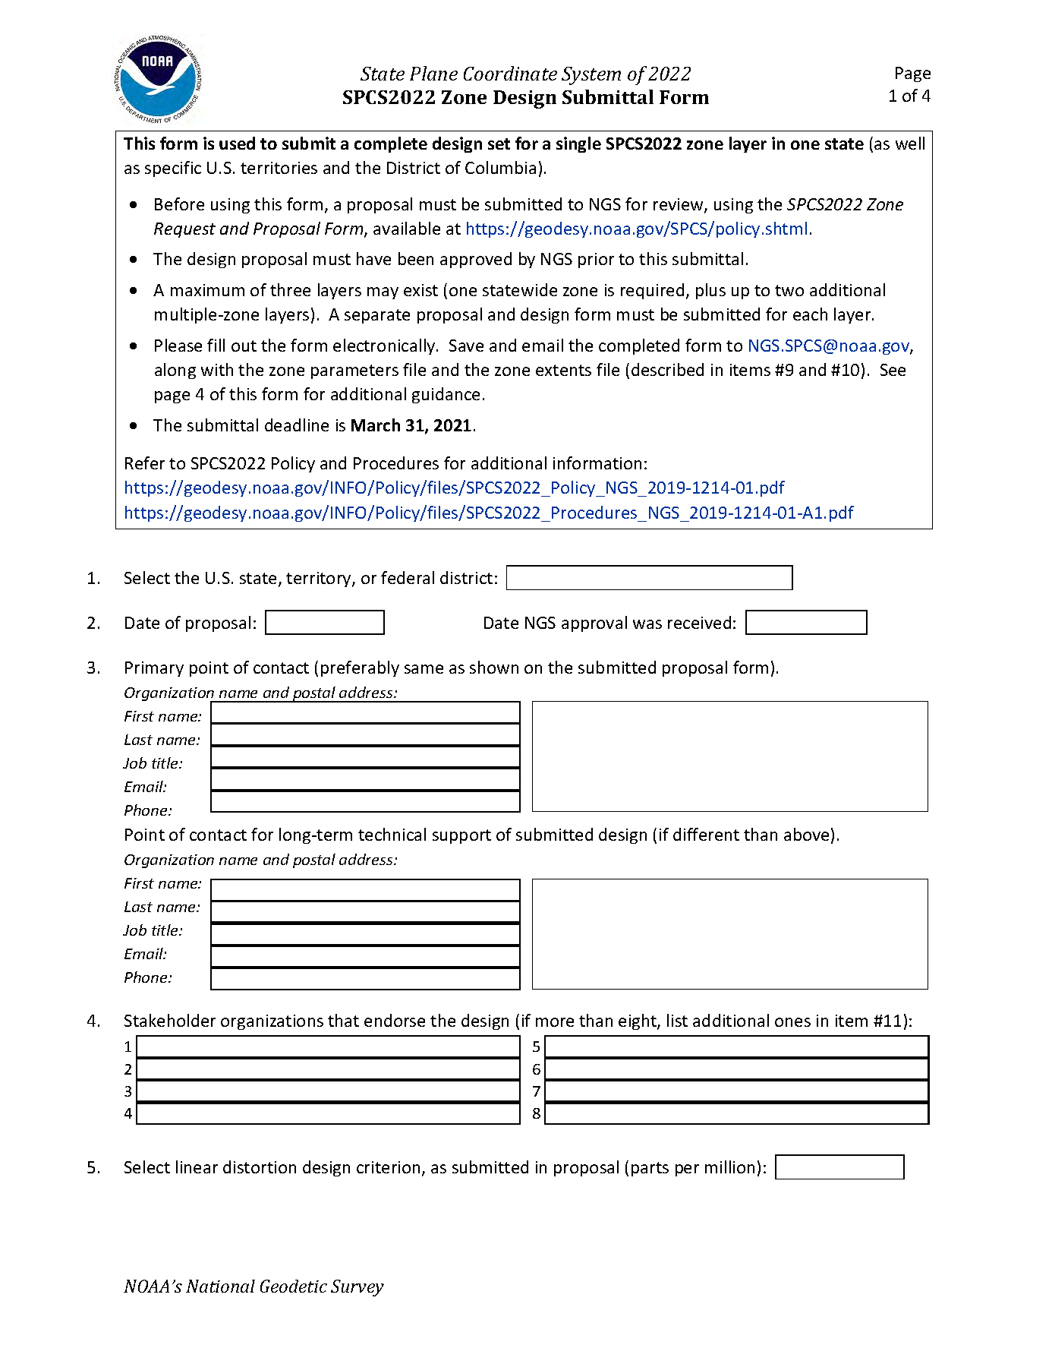
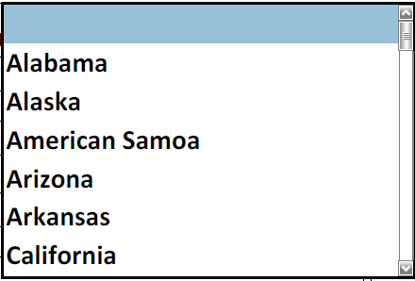
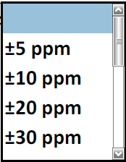
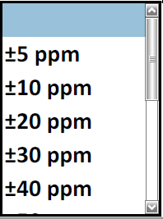

Slide 24
SPCS2022 design with you in mind
Characteristics based on customer input
  Minimize distortion at ground, not ellipsoid
  NGS will design statewide and default zones
  2 or 3 zone “layers” allowed (including an LDP layer)
  Allow “special use” zones (if in multiple states)
Stakeholders can request and propose preferences
  For SPCS2022 zone requests, proposals, and designs
  Consensus state stakeholder input required
Can still change/add/remove zones after 2022

