Slide 1

Down to Earth, part II
Datums and Reference Systems
Marti Ikehara: marti.ikehara@noaa.gov
California Geodetic Advisor
Sacramento, CA
916-227-7325

Slide 2
Table of Contents
CURRENT DATUM REALIZATIONS
CORS reference frame now IGS08 (2005.00)
CSRC CGPS, Basis of bearings, Real-Time Networks
Passive stations adjustment, NAD83(2011), 2010.00 (BREAK)
GEOIDS and FUTURE DATUM REALIZATIONS/REVAMPING
GEOID12 Development
GRAV-D—airborne data for geoid modeling
GSVS Project(s)
Realizing new Geometric/geopotential datums (BREAK)
DATASHEET format change
NGS ONLINE TOOLS/SOFTWARE DEMOS:
OPUS, HTDP, DSWORLD, VDATUM, WinDESC/Translev

Slide 3
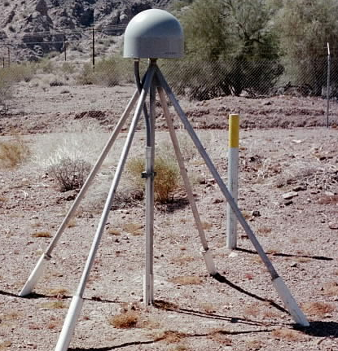
Evolution of Geodetic Datums: from NAD27/NGVD29 to NAD83/NAVD88
H + V
2 + 1
27, 29
H + V
2 + 1
83(86),88
GPS
H + V_{E} + V_{O}
2 + 1 + 1
83(92), 88
Geometric
+VELOCITIES (time)
H + H_{t} + V_{E} + V_{O}
2 + 2 + 1+ 1
83(2007)+HTDP, 88
H + H_{t} + V_{E} + V_{O}
2 + 2 + 1+ 1
83(2011)+HTDP, 88
H + H_{t} +V_{E}+ V_{Et}
2 + 2 + 1+ 1
ITRF00 (2002.00)
H + H_{t} +V_{E}+ V_{Et}
2 + 2 + 1+ 1
IGS08 (2010.00)
T O D A Y
Notes:
Conceptual: Generally, Orange represents ‘horizontal’ or NAD83 at present; yellow represents orthometric vertical.
1)moved fr non-geocentric to 2)geocentric as well as we knew at the time from early satellite technology (DOPPLER). And leveling efforts resulted in a national vertical datum with only one constraint, rather than 26 (tide gauges). 3)Static GPS exploded on the scene which 4) led to 5)the HARN networks and state-specific adjustment. With GPS surveying, we got V(E), vertical ellipsoid and V(O), vertical orthometric. 6)With the results of repeat static surveys and the advent of CGPS (Continuous CGPS), such as NGS’ National CORS, 7)the velocity of the earth’s crust relative to a reference frame, could be determined over time. 8)Using the crustal motion model HTDP for horizontal velocities on the West Coast, eg, the Pacific-North American Plates interface, NGS produced 9) a National Re-adjustment in the NAD83 (NSRS2007) datum. (No change to ortho.) However, 10)underlying the NAD83 adjustment are data and analysis referenced to ITRF00, epoch 2002.00, which does take into account both horizontal AND vertical ellipsoid velocities. (velocity=time related terms shown as italicized.) This is what we have now. 11) With better global gravity models and airborne gravity data collected by NGS, we will 12) move forward with 13) new datums BOTH referenced to an ECEF, earth-centered, earth-fixed datum which we are calling 14) Geometric, for the horizontal and ellipsoid height values, and Geopotential for the orthometric height values which will be based on a a geoid model and changes in gravity over time (G(t).

Slide 4
Recent and near-future changes to the horizontal datum(s) realization
New Coordinates and Epoch for CORS (done)
Consequent Adjustment of 80K Passive Stations (in progress)
Subsequent Development of GEOID12 (initial process)

Slide 5
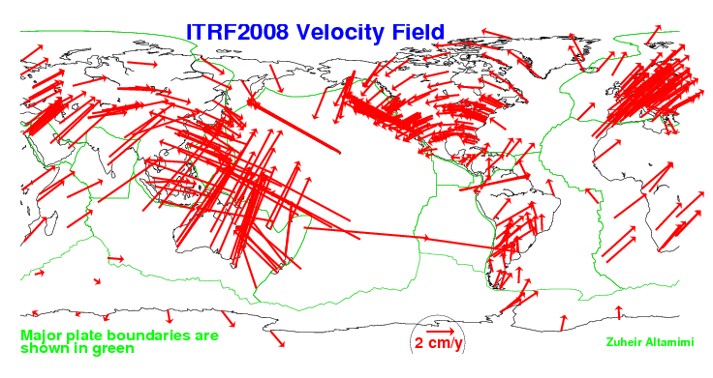
Rationale for Updating the NSRS (CORS)
Definition starts with a global RF: ITRF##
No fixed tectonic plate results in velocities

Slide 6
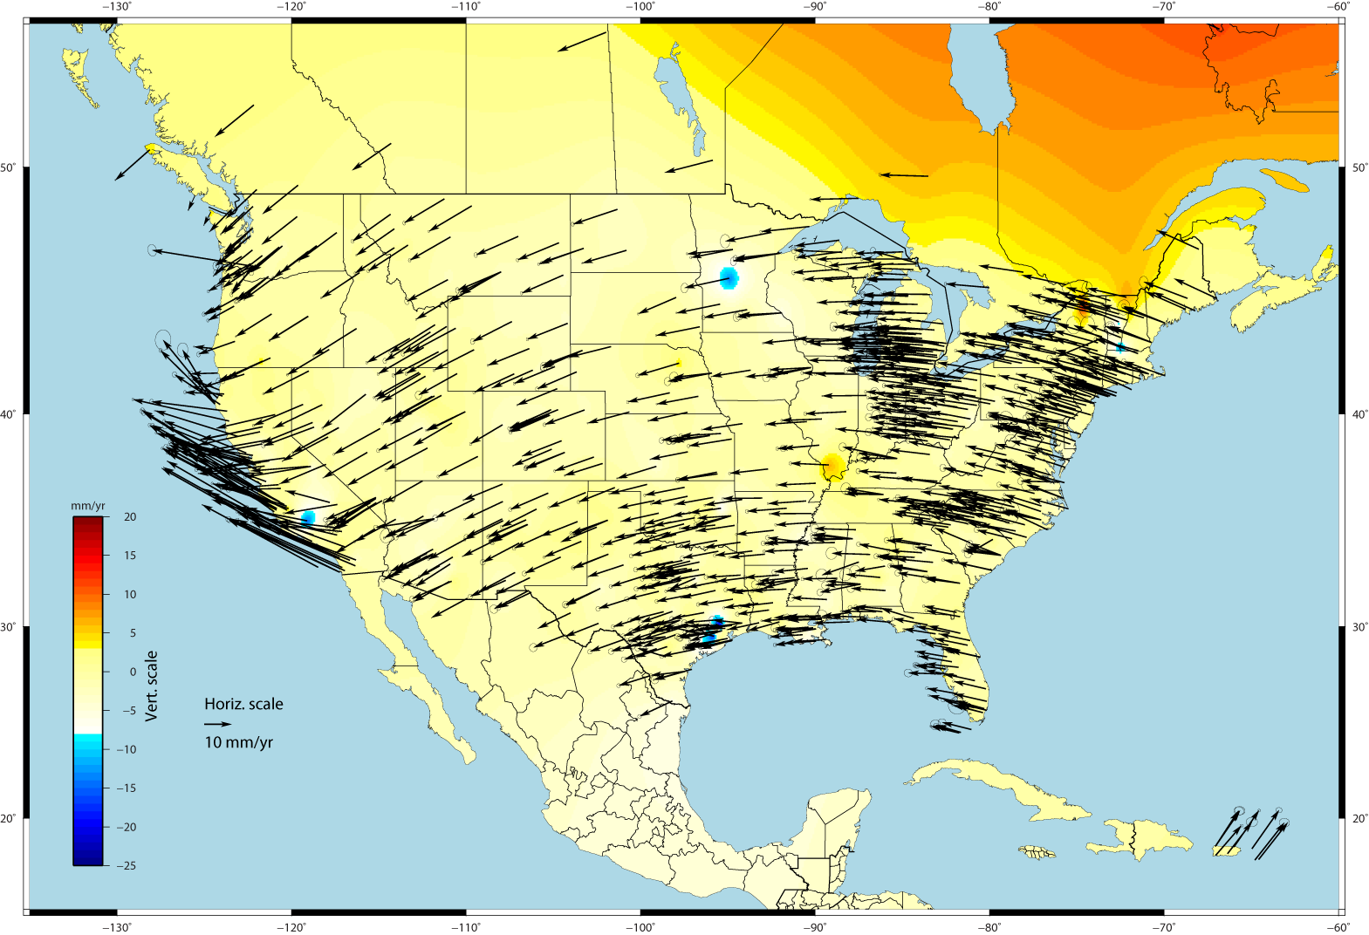
U.S. CORS Velocity Field – ITRF2008
Notes:
Color shading represents vertical velocities; Canadian shield is experiencing glacial isostatic rebound and going up.

Slide 7
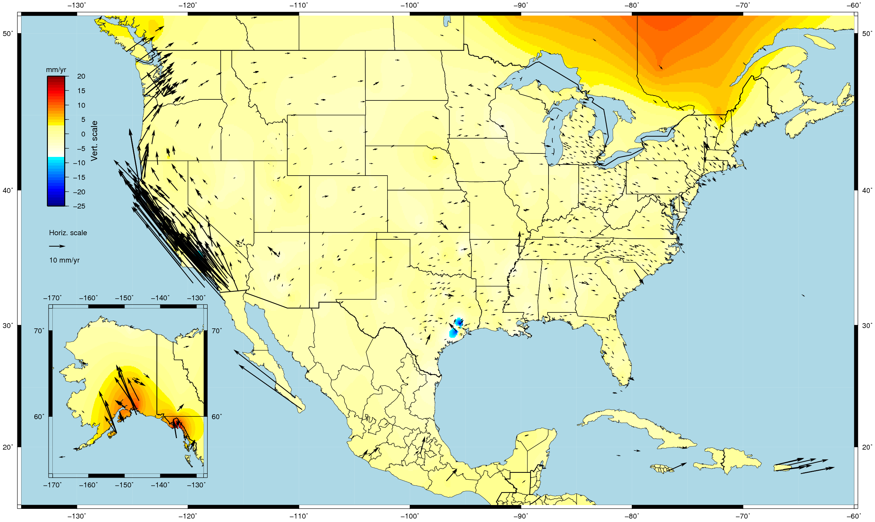
U.S. CORS Velocity Field - NAD83(2011) epoch 2010.0

Slide 8
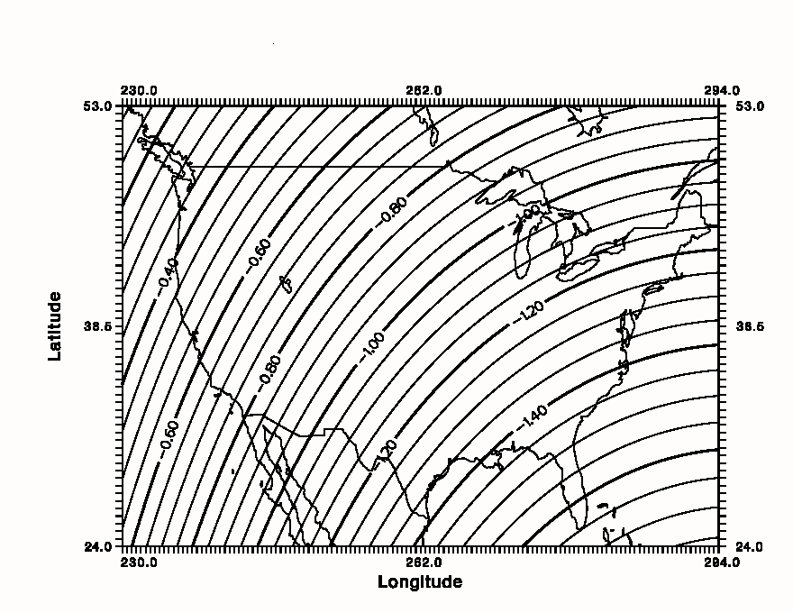
Simplified Concept of NAD 83 vs. ITRF
In California - NAD83 & ITRF
differences range from ~0.4 to ~0.9 m
h_{NAD83}
h_{ITRF}
Earth’s
Surface
ITRF 00
Origin
2.2 meters
Ellipsoid for both NAD83 and ITRF:
Geodetic Reference System 1980 (GRS80)
a = 6,378,137.000 meters (semi-major axis)
1/f = 298.25722210088 (flattening)
NAD 83
Origin
Notes:
ITRF (International Terrestrial Reference Frame) just has a different origin than NAD83; take NAD83 shaped ellipsoid centered at the ITRF origin to obtain ITRF97 ellipsoid heights. WGS84 (G1150) ~ ITRF2000; ITRFs have been updated, WGS84 has not, since
Ellipsoid heights NAD83 vs. ITRF97 - Defined origins are best estimate of the center of mass; NAD83 is not geocentric. Move origin; move ellipsoid surface as illustrated.
Ellipsoid height differences reflect the non-geocentricity of NAD83.

Slide 9
Rationale for updating CORS RF
NSRS’s global frame was ITRF00 epoch 1997.00. Projecting 13 yrs was unrealistic because of velocities; NAD 83(CORS96) epoch 2002.00 projecting 8 yrs was becoming a problem
Coordinates and velocities were a mixture from last reprocessing (1994-2002) and adjustments using 8 to 3 IGS ref. sites
Mixture of Computed and HTDP velocities
Assumed NAD83 vertical vel. = 0 mm/yr
Change fr Relative to Absolute antenna phase center values in ITRF definition
Metadata issues, eg, discontinuities/offsets
Significant software changes since 2002
Notes:
Computed velocities from those CORS with >2.5 yrs data stored at NGS

Slide 10
Multi-year CORS Solution: MYCS
“Multiyear” effort began 7 years ago
IGS proposed re-processing all data to re-compute station coordinates, orbits, and EOPs (earth orientation parameters) fr 1994-present
NGS began with a revision of PAGES software and processing strategy driven by weak NGS orbit contributions to IGS
860 weekly (full history) CORS+ ~230 global SINEX files containing X,Y,Z positions and full variance-covariance information
Coordinates published (online) on Sept 6, 2011

Slide 11
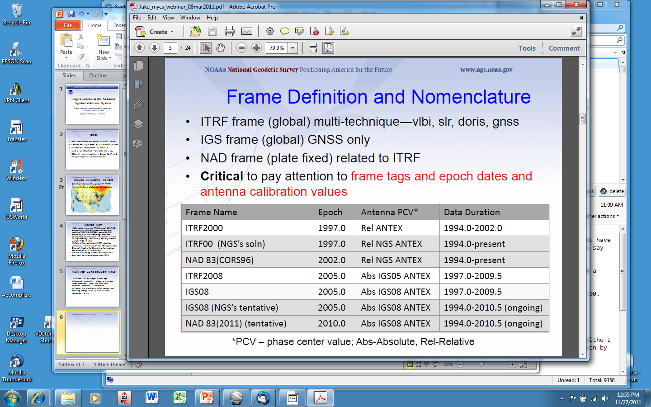
Geodetic Reference Frames past and present
xxxxxxxx
xxxxxxxxxxx

Slide 12
So, what’s different about the CORS coordinates?
Change to absolute antenna calibrations
  Use absolute cal. in your processing: DON’T MIX!
Better because 8 more years of data for:
  International CGPS sites
  CORS: about 1600 total, ~1000 w/ >2.5 yrs
  Orbits and sophistication for processing them
  CORS velocity
Better HTDP modeling for those w/ <2.5 yrs
Better processing algorithms

Slide 13
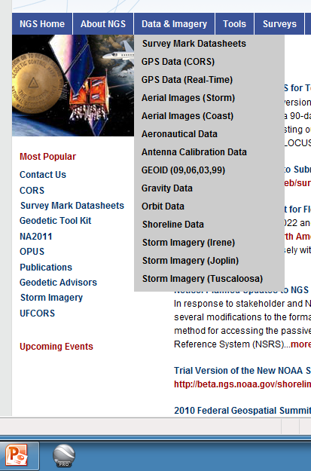
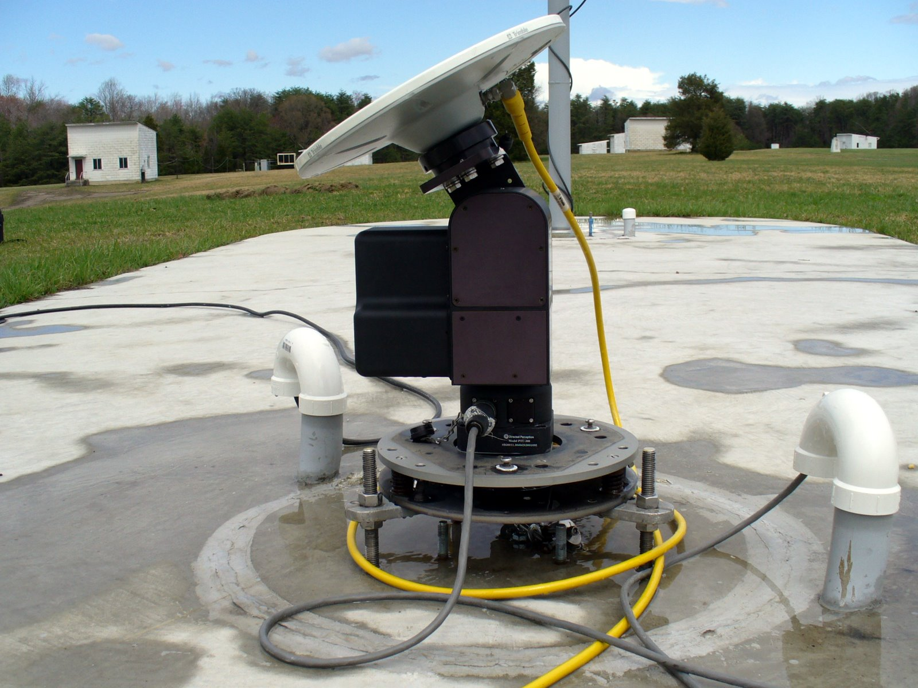

Antenna calibrations, ANTEX is new

Slide 14
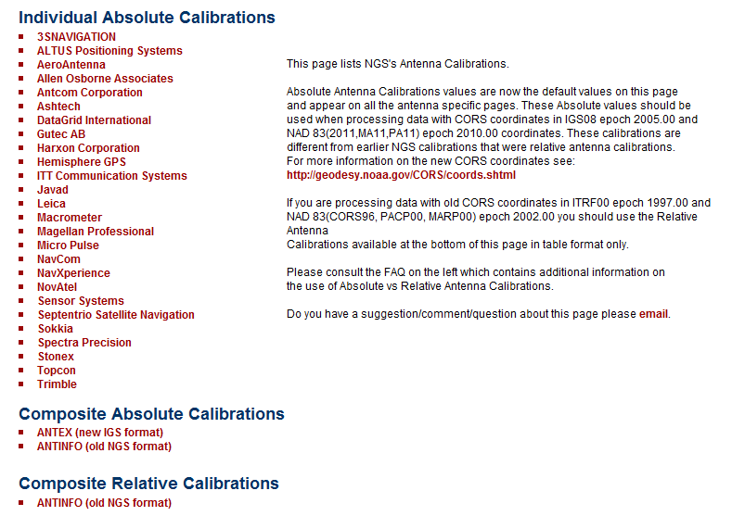
multiple Satellite Navigation Systems
>2 signal frequencies (L1, L2, L5, etc)
satellite and ground calibrations azimuthal dependencies

Slide 15
How do I find the coordinates?
Individual CORS Coordinate page, as before
On CORS page, Data Products, Coordinates Explained, Table 1, left column hotlinks
http://www.ngs.noaa.gov/CORS/coords.shtml
TWO basic divisions for the tables:
  One with COMPUTED velocities, one MODELED
TWO basic Ref Frames: IGS08, NAD83
Two types of coordinates/vel for each of those:
  X,Y,Z AND lat/long/ht (N,E,U)
Recommend using only CORS w/ computed velocities
Notes:
If you’re going to select

Slide 16
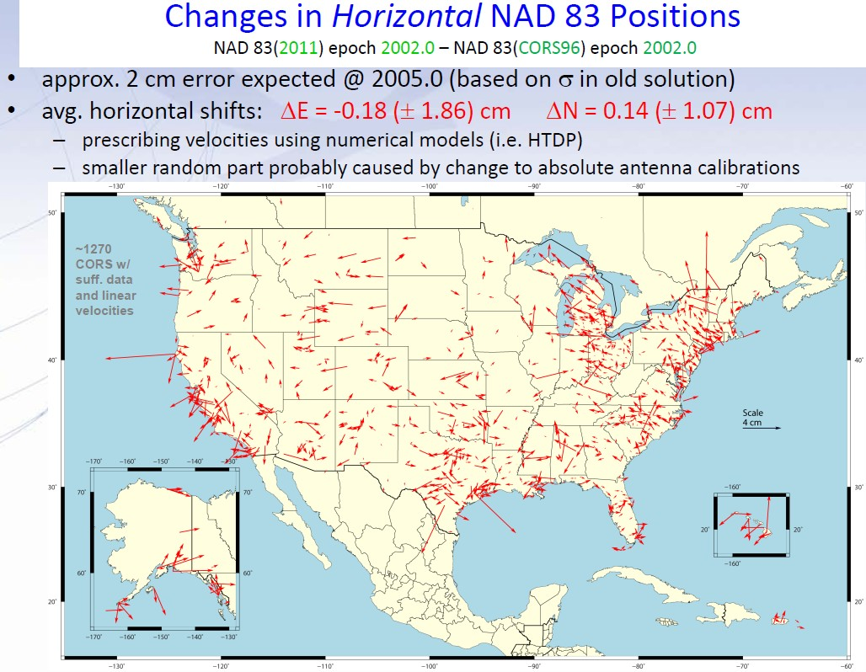

Slide 17
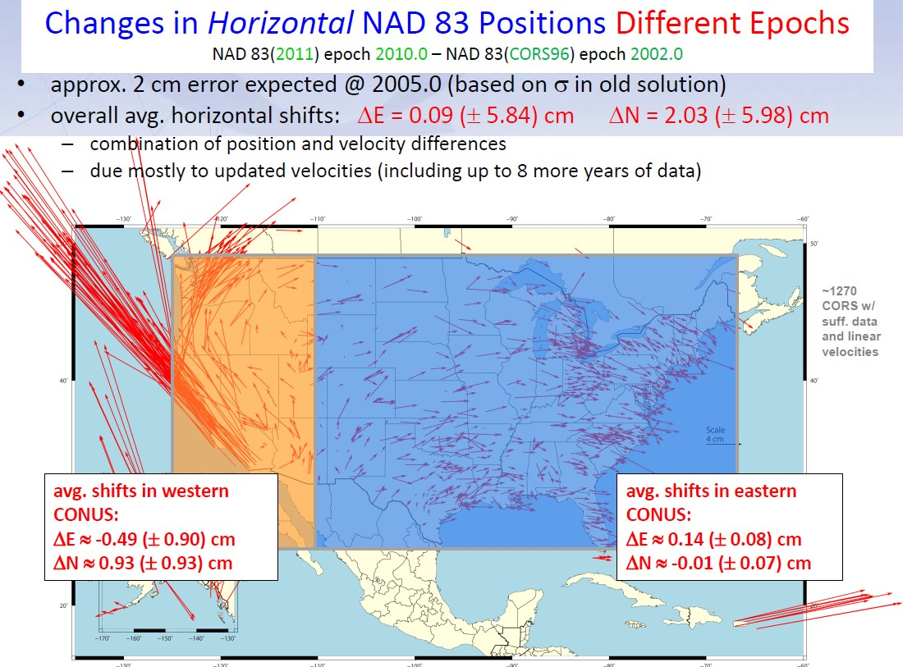
-4.9(+/-9.0)cm
9.3(+/-9.3)cm
1.4(+/-1.6)cm
0.1(+/-0.7)cm

Slide 18
CSRC coordinates for CGPS and Central Coast Ht Mod project
Epochs: 2007.00, 2009.00 and 2011.00 for post-El Mayor-Cucapah EQ, April 2010
Velocity model SECTOR based on data @ CGPS sites, so more accurate for those locations
No version number so document exact date of your calculations; old versions not archived
Portal Resources button, Utilities, SECTOR
CENCHM: coords/heights not in NGS database

Slide 19
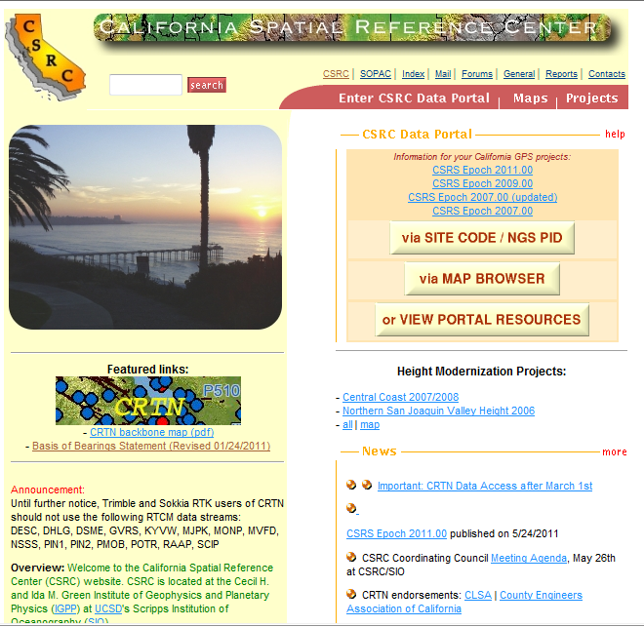


Slide 20
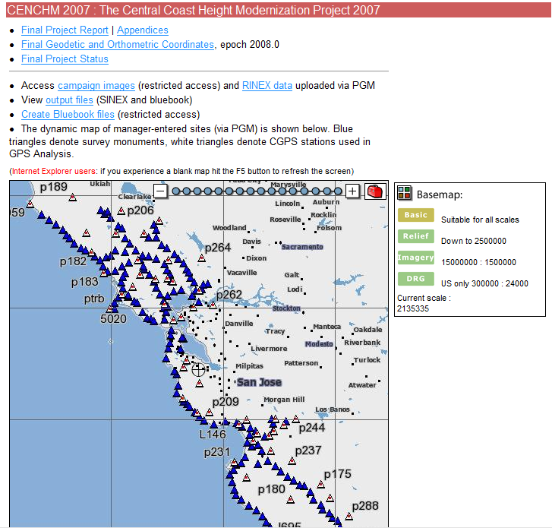

Slide 21
Basis of Bearings, using CGPS
Found on CSRC website; csrc.ucsd.edu
The Basis of Bearings for this Survey is the California Coordinate System, Zone NAD 83 (Epoch ) as determined locally by a line between Continuous Global Positioning System (CGPS) Stations and/or Continuous Operating Reference Stations (CORS) Sta. Name and Sta. Name being Bearing as derived from geodetic values published by the California Spatial Reference Center (CSRC) and/or National Geodetic Survey (NGS), respectively.
Be specific about ‘derivation’ and what source

Slide 22
CSRC’s CRTN news
CSRC’s CRTN RTCM data streams available for testing thru NTRIP protocol as of 1/5/12
Deadline changed from Feb 17 to March 1
To utilize: click on Access to Data spreadsheet; email ybock@ucsd.edu
To get CRTN updates, join the list serve:
http://gpsmail.ucsd.edu/mailman/listinfo/crtn-l
To be informed, read the forums:
http://sopac.ucsd.edu/ubbcgi/ultimatebb.cgi?category=6

Slide 23
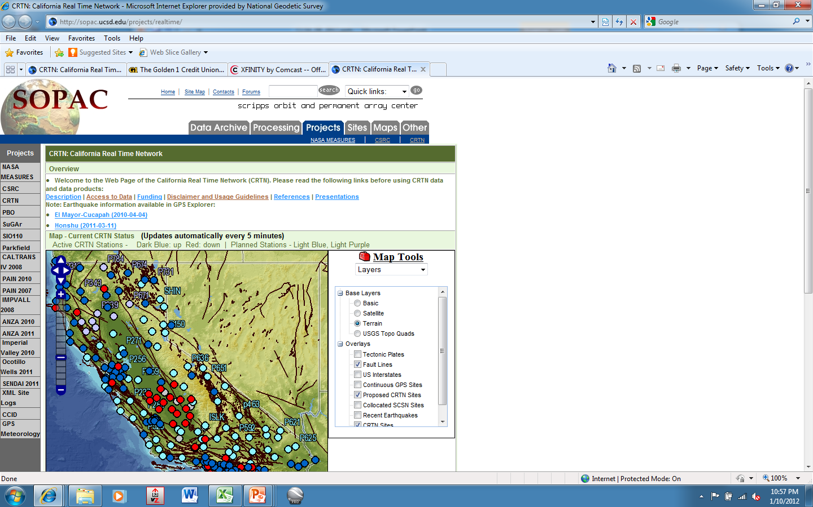

Slide 24
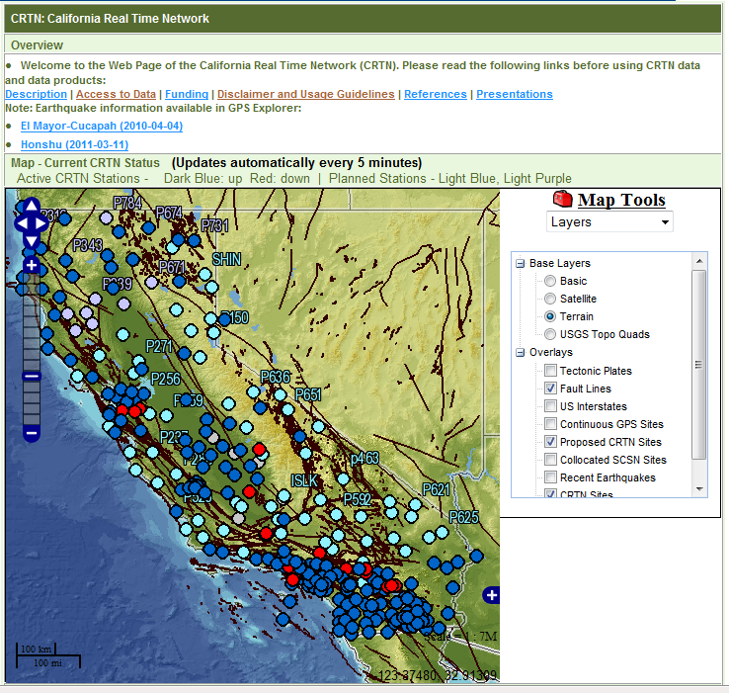

Slide 25
RTN Validation by NGS
Desire to have all RTNs—public, commercial—tied to/based on the NSRS
Developing a procedure for RTNs to follow
Results submitted/reviewed
Periodic (annual?) check
ORGN RTN (OR DOT) is pilot study

Slide 26
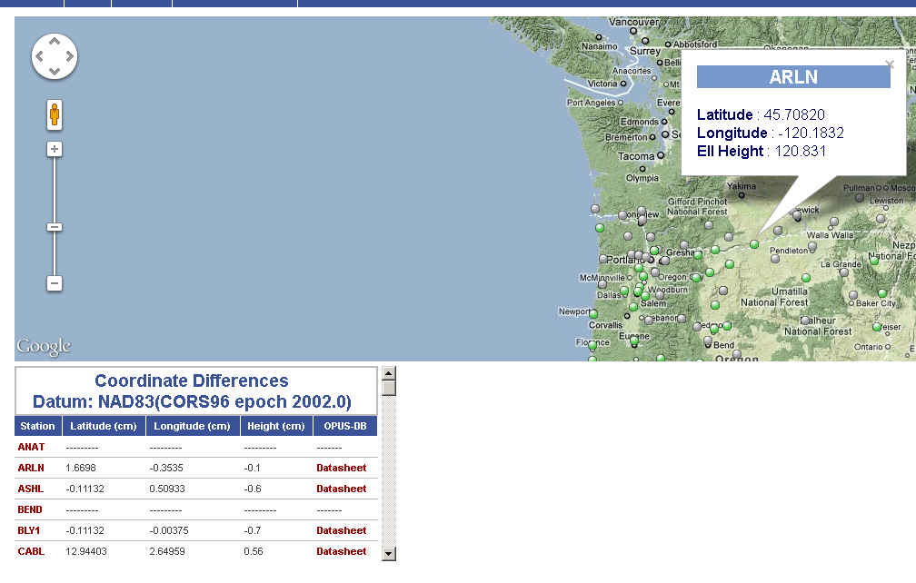
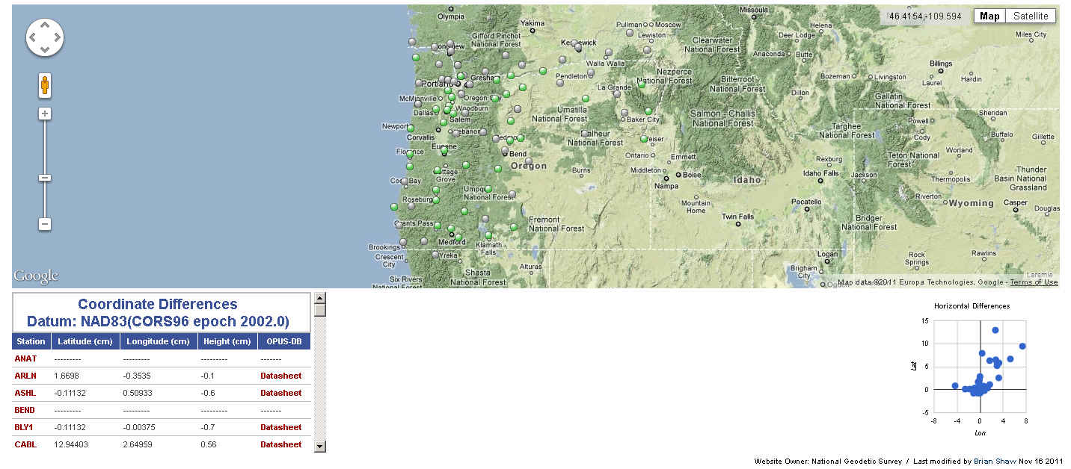
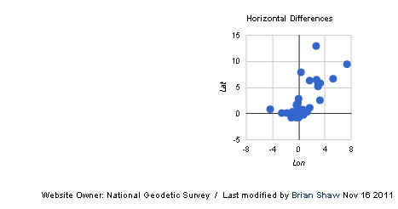
ON-LINE VALIDATION TOOL WOULD PROVIDE NSRS RTN COMPLIANCE

Slide 27
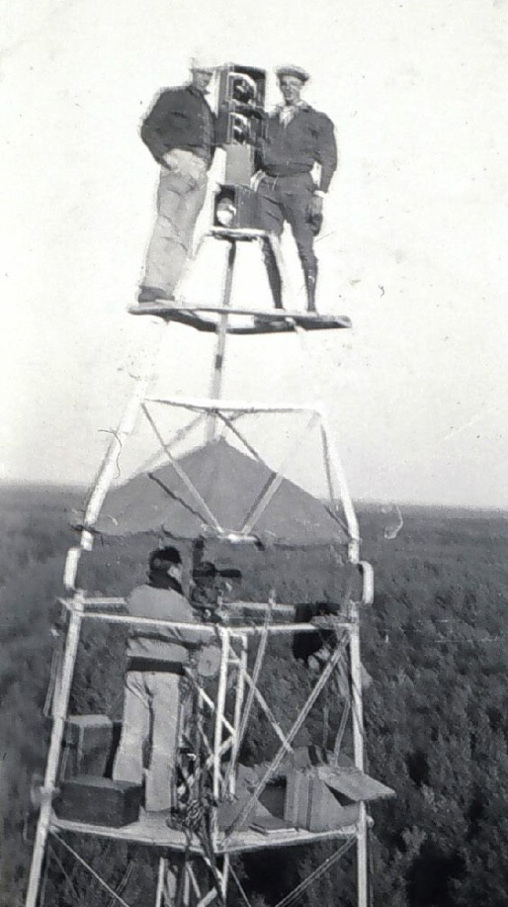
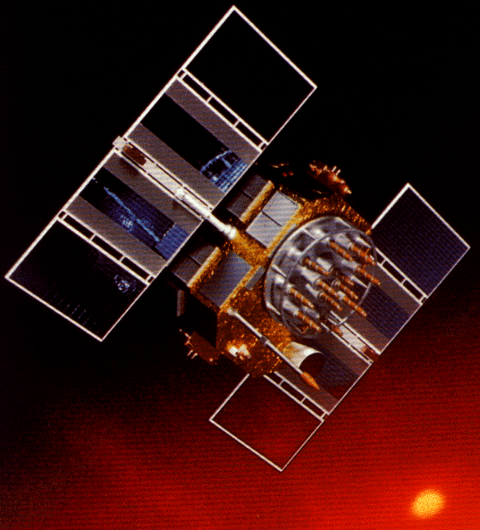
A Cryptic Evolution of NAD 83
Original realization completed in 1986
  Consisted (almost) entirely of classical (optical) observations
“High Precision Geodetic Network” (HPGN) and “High Accuracy Reference Network” (HARN) realizations
  Most done in 1990s, essentially state-by-state
  Based on GPS data but classical stations included in adjustments
  Did NOT use CORS as constraints
Partial HARN/FBN Obs, late 1990’s
  Used CORS as control, but not statewide adjustment; in CA, only ~200 stns
National Re-Adjustment of 2007
  ITRF00 and NAD 83(CORS96) basis for CORS constraints and (NSRS2007) for passive
  Simultaneous nationwide adjustment, first since 1986; no classical stations

Slide 28
NEED for a new national adjustment, NA2011 project, for passive geodetic stations
Optimally align passive control with CORS
>1000 projects submitted since 2007 NatlReadj
  Number of stations increased by 1/3 in just 5 years!
  Plus Observations for Hawaii & other Pacific islands
More consistent results in tectonically active areas
  Longer time series for CORS as well as
  More current data for passive, and better tectonic modeling for applying HTDP to obs back 20+ years.

Slide 29


Slide 30
Recent status of NA2011, mid-Jan 2012
Truly Final pull was Dec 14 2011
Passive obs use HTDP velocities NATIONWIDE
Minimal constraint adjs have run successfully
4067 projects; 79,304 unique stations; and 426,977 vectors total (excluding Alaska)
Includes 954 CORS w/ >2.5 yrs data
404,332 vectors enabled (22,645 rejected)
std error unit wt = 1.367
Starting constrained adjustments, using errors from CORS solution (not ‘perfect’, not 0 error)

Slide 31
Current status of NA2011, late-Feb 2012
Primary/secondary adjustment approach
Projects older than 1994 (start of CORS program) in secondary except have included HARNs in primary
5400 stations common to both used as constraints
Excluding Alaska, which has 111 Primary, 23 Secondary
PRIMARY: 3568 projects; 63.2K unique stations;
353,327 vectors total; 22,782 rejected (6.4%)
SECONDARY: 499 projects; 16.3K, 78K (18% of all vectors)
Checking a few other projects, eg, FL, AK, AL
std error unit wt = 1.38

Slide 32
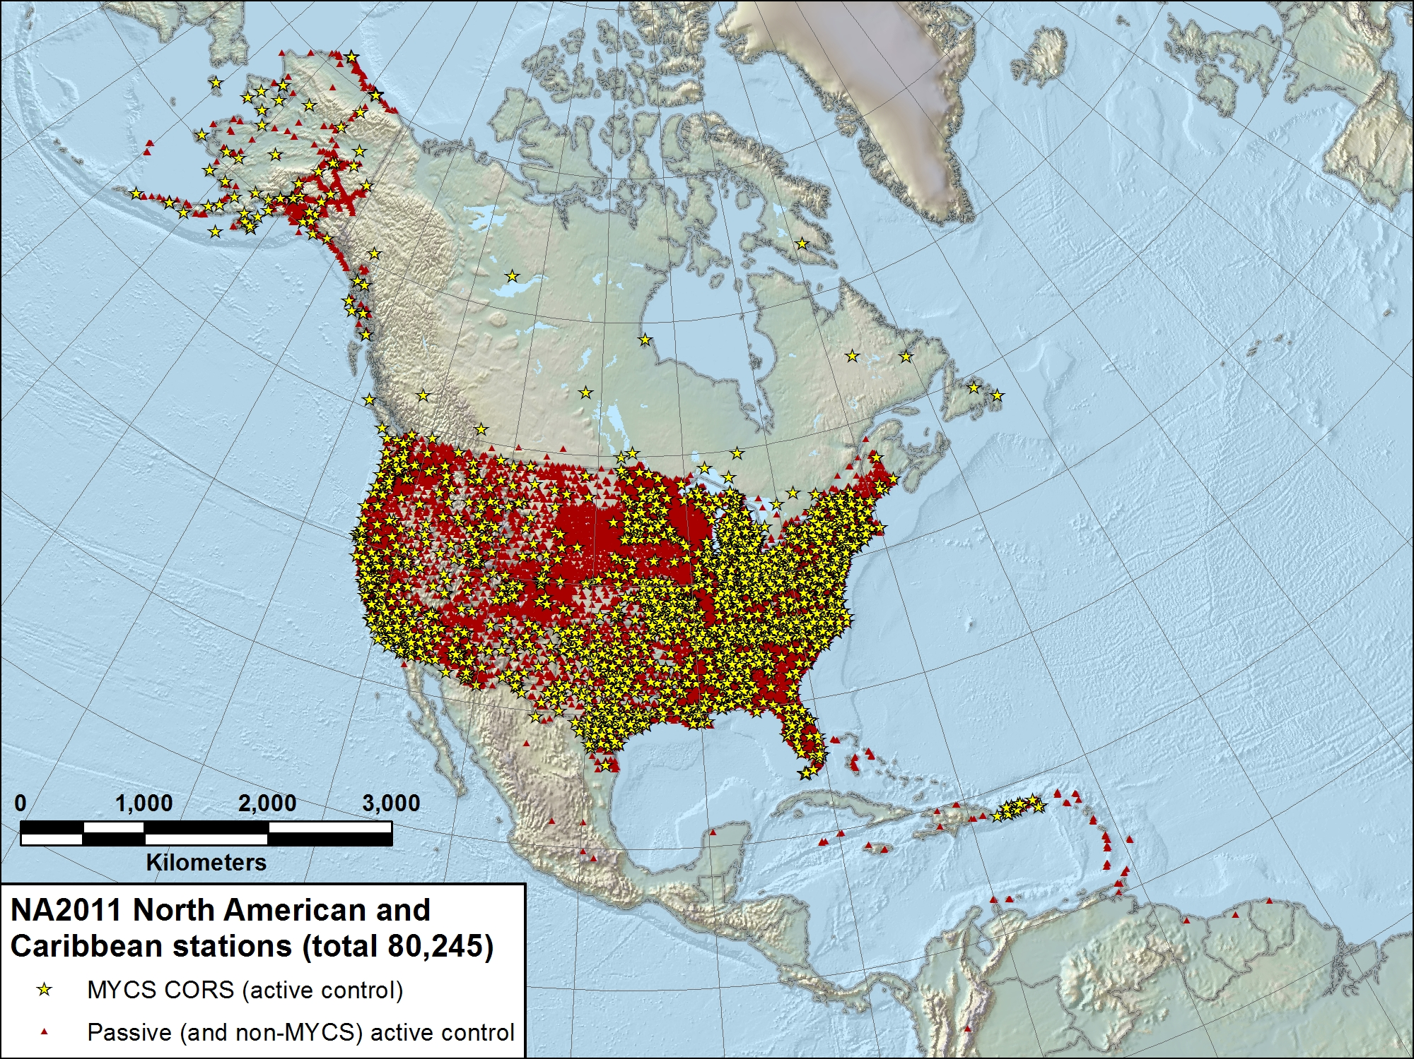

Slide 33
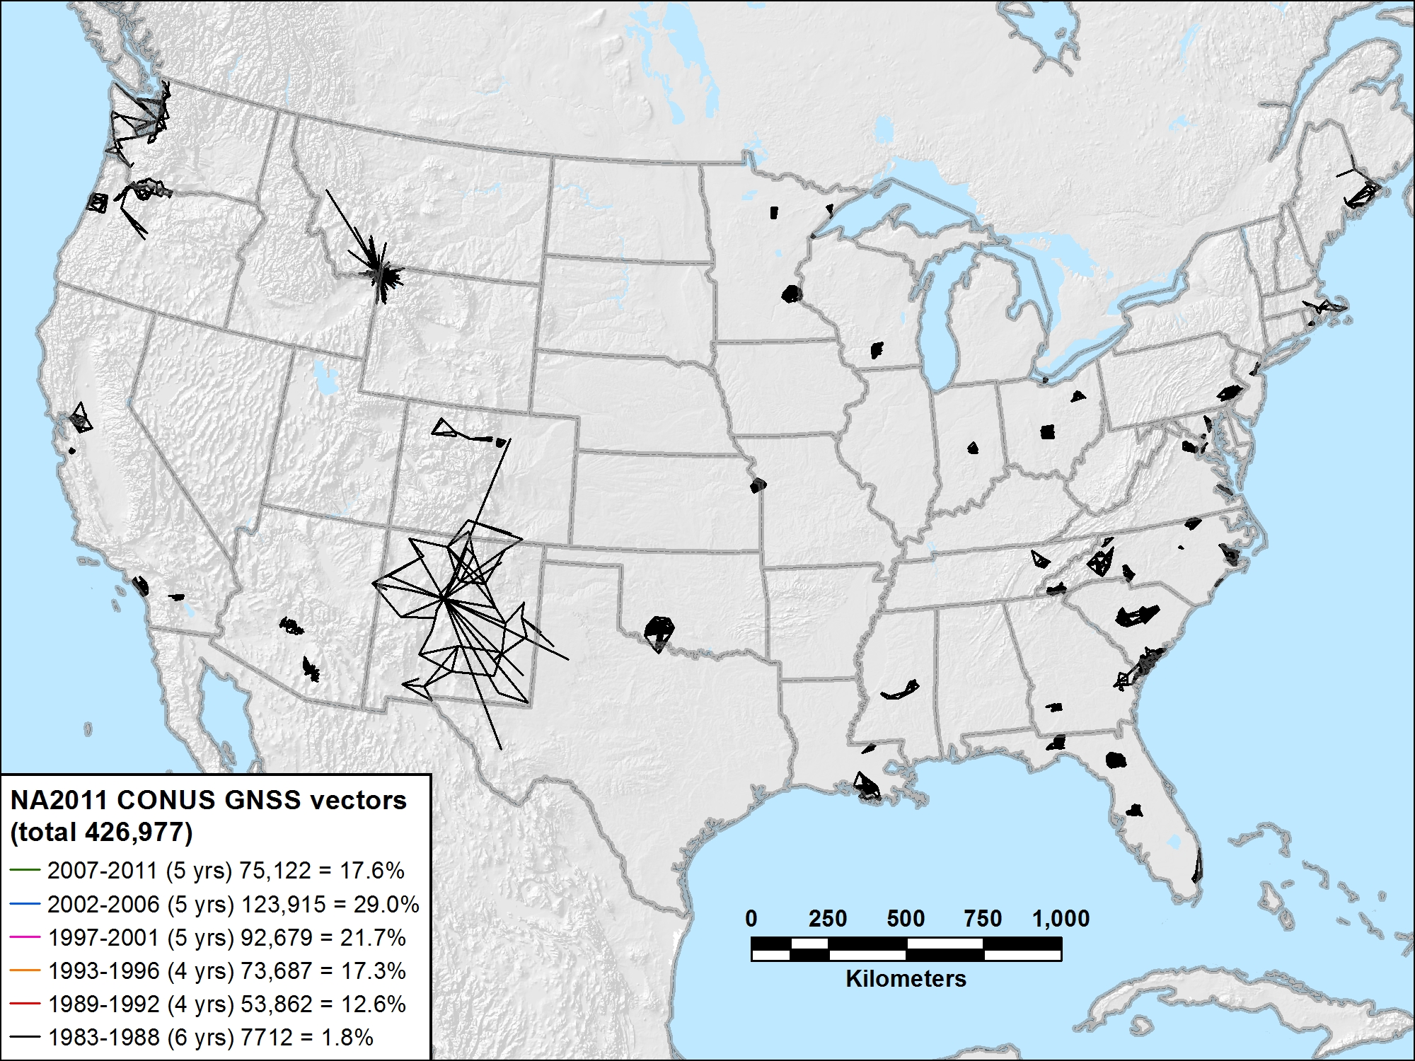
NA2011 CONUS 1983-1988 (6 yrs) 7712 vectors (1.8%)

Slide 34
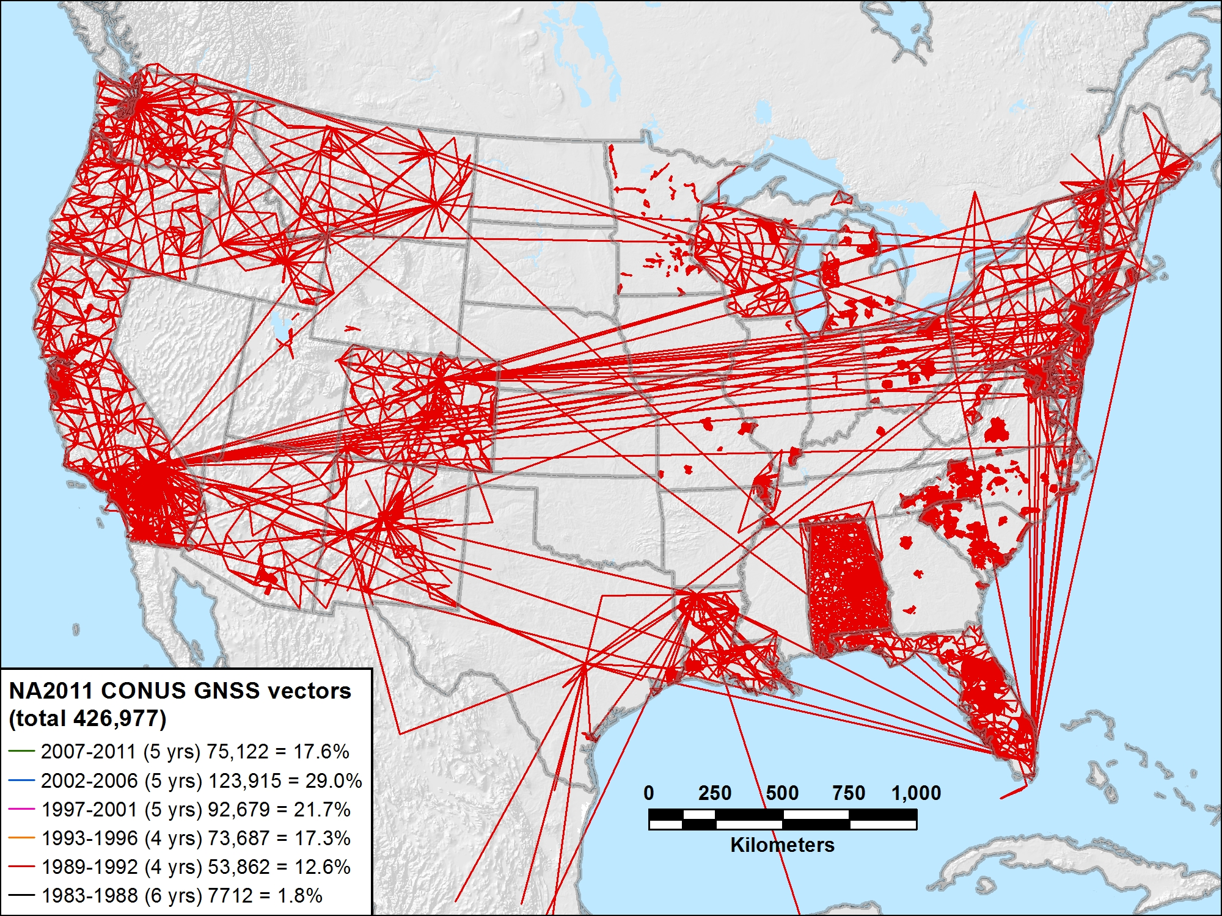
NA2011 CONUS 1989-1992 (4 yrs) 53,862 vectors (12.6%)

Slide 35
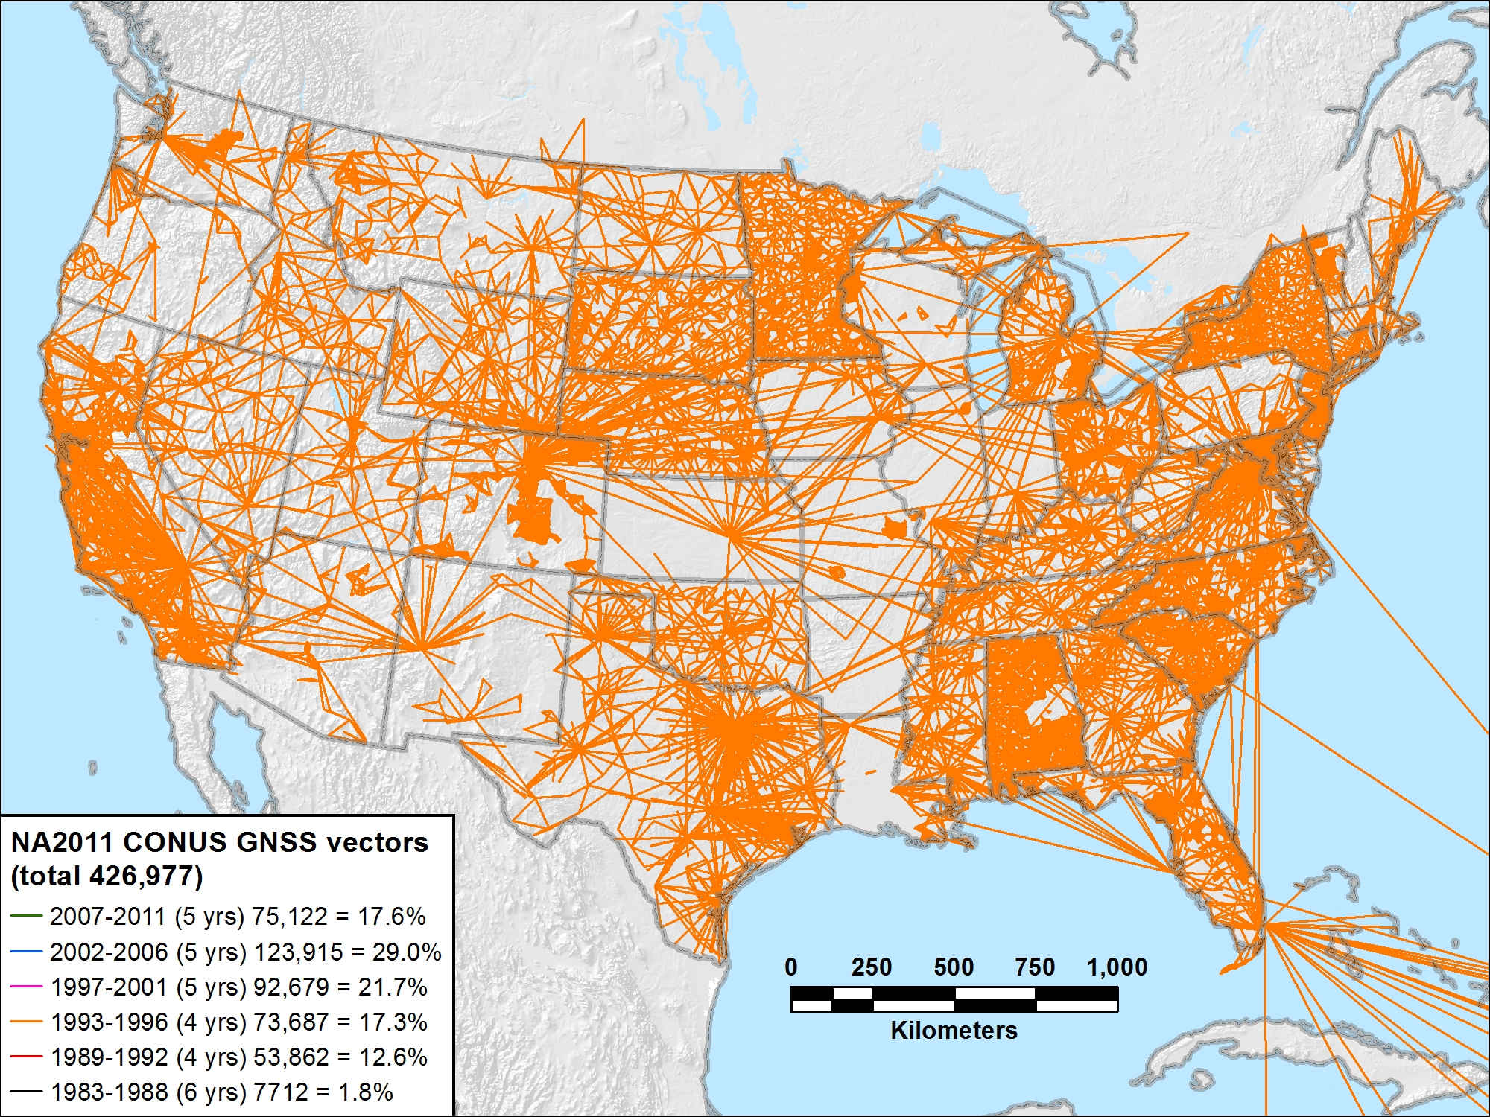
NA2011 CONUS 1993-1996 (4 yrs) 73,687 vectors (17.3%)

Slide 36
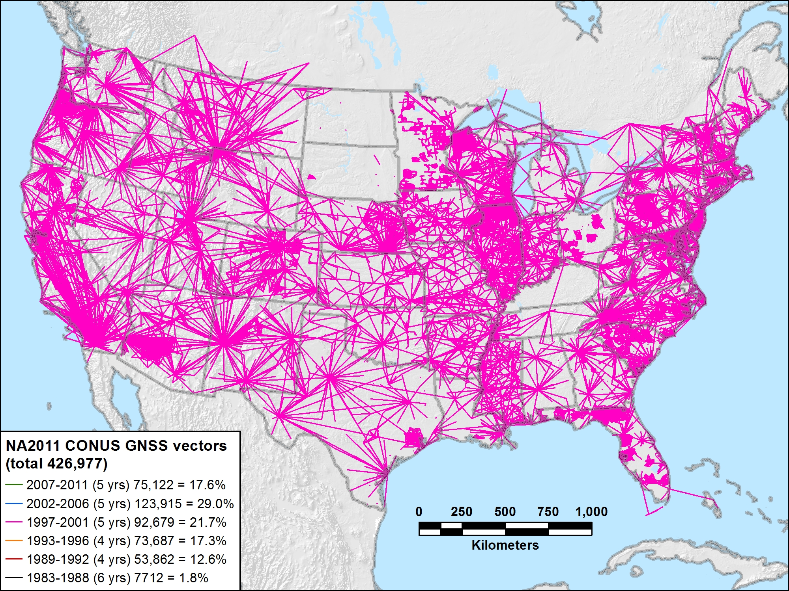
NA2011 CONUS 1997-2001 (5 yrs) 92,679 vectors (21.7%)

Slide 37
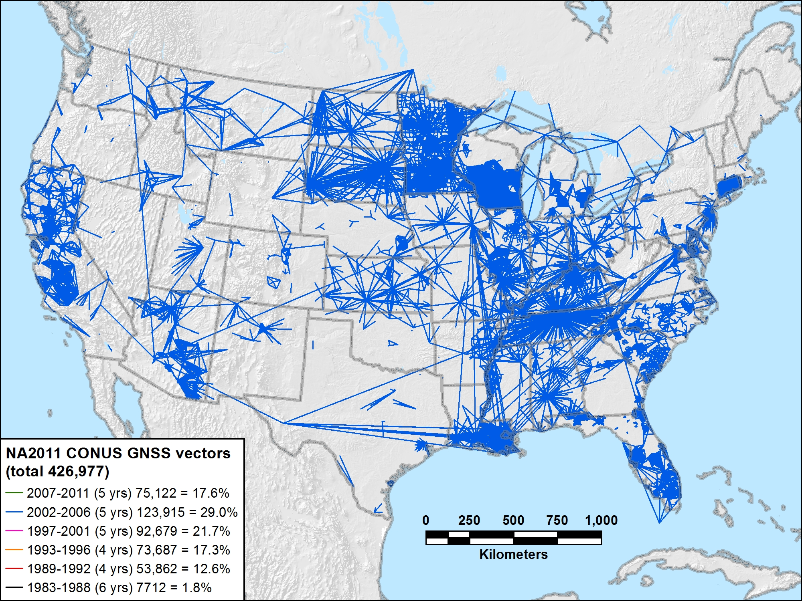
NA2011 CONUS 2002-2006 (5 yrs) 123,915 vectors (29.0%)

Slide 38
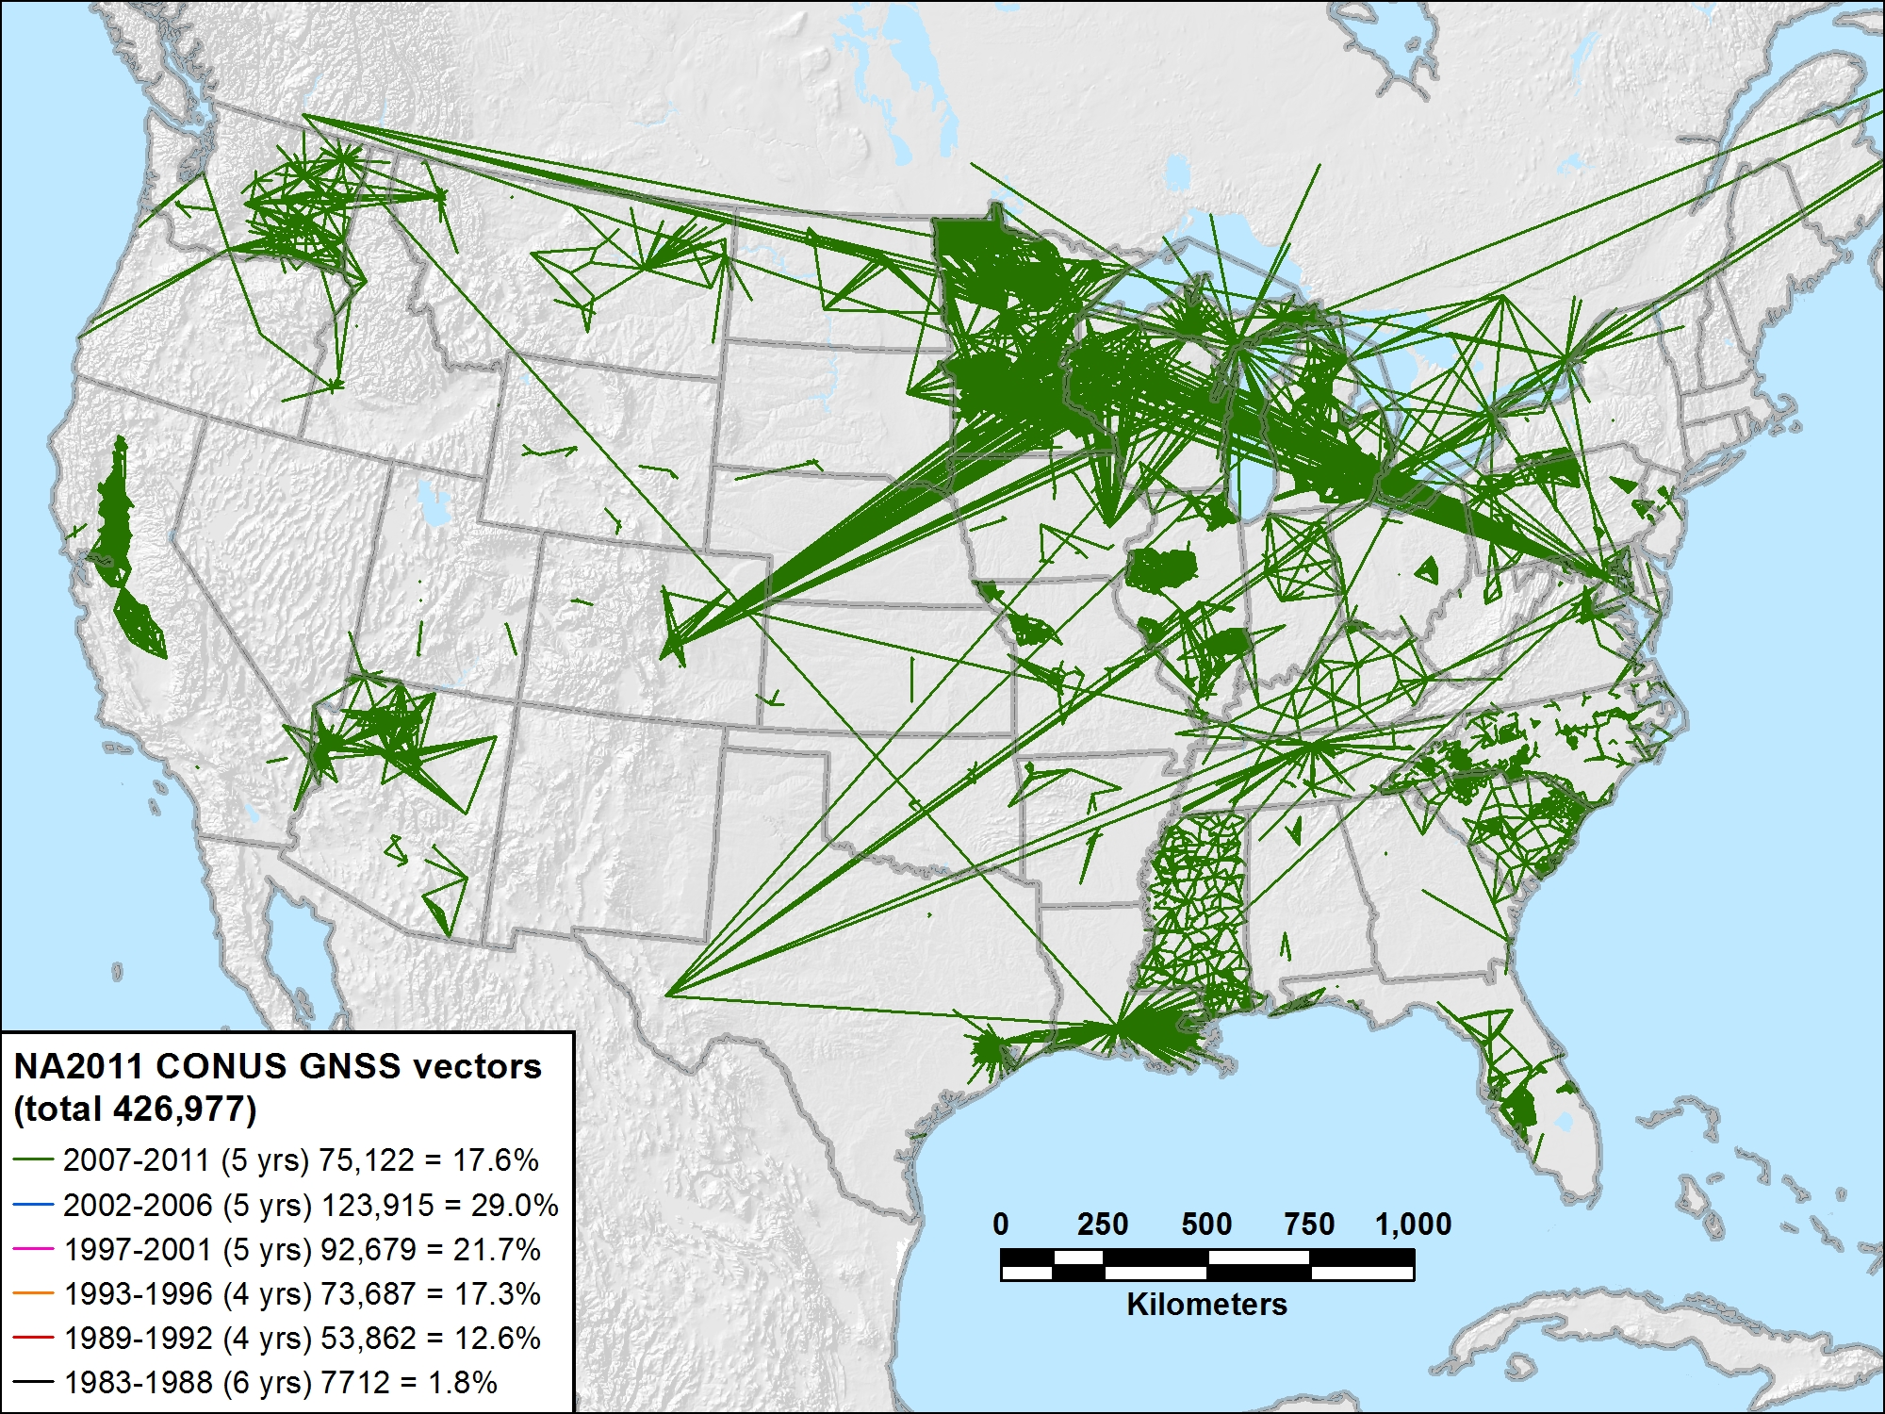
NA2011 CONUS 2007-2011 (5 yrs) 75,122 vectors (17.6%)

Slide 39
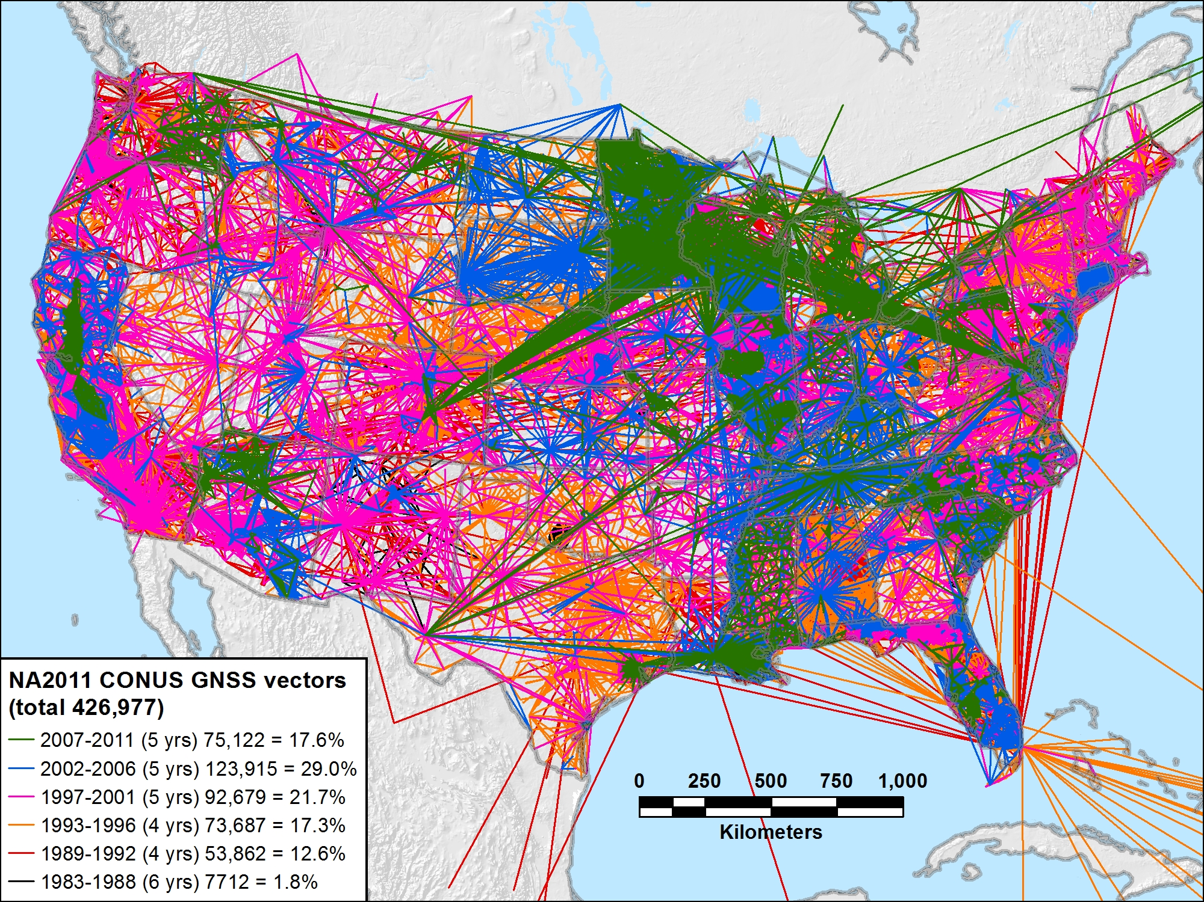
NA2011 CONUS 1983-2011 (29 yrs) 426,977 vectors (100.0%)

Slide 40
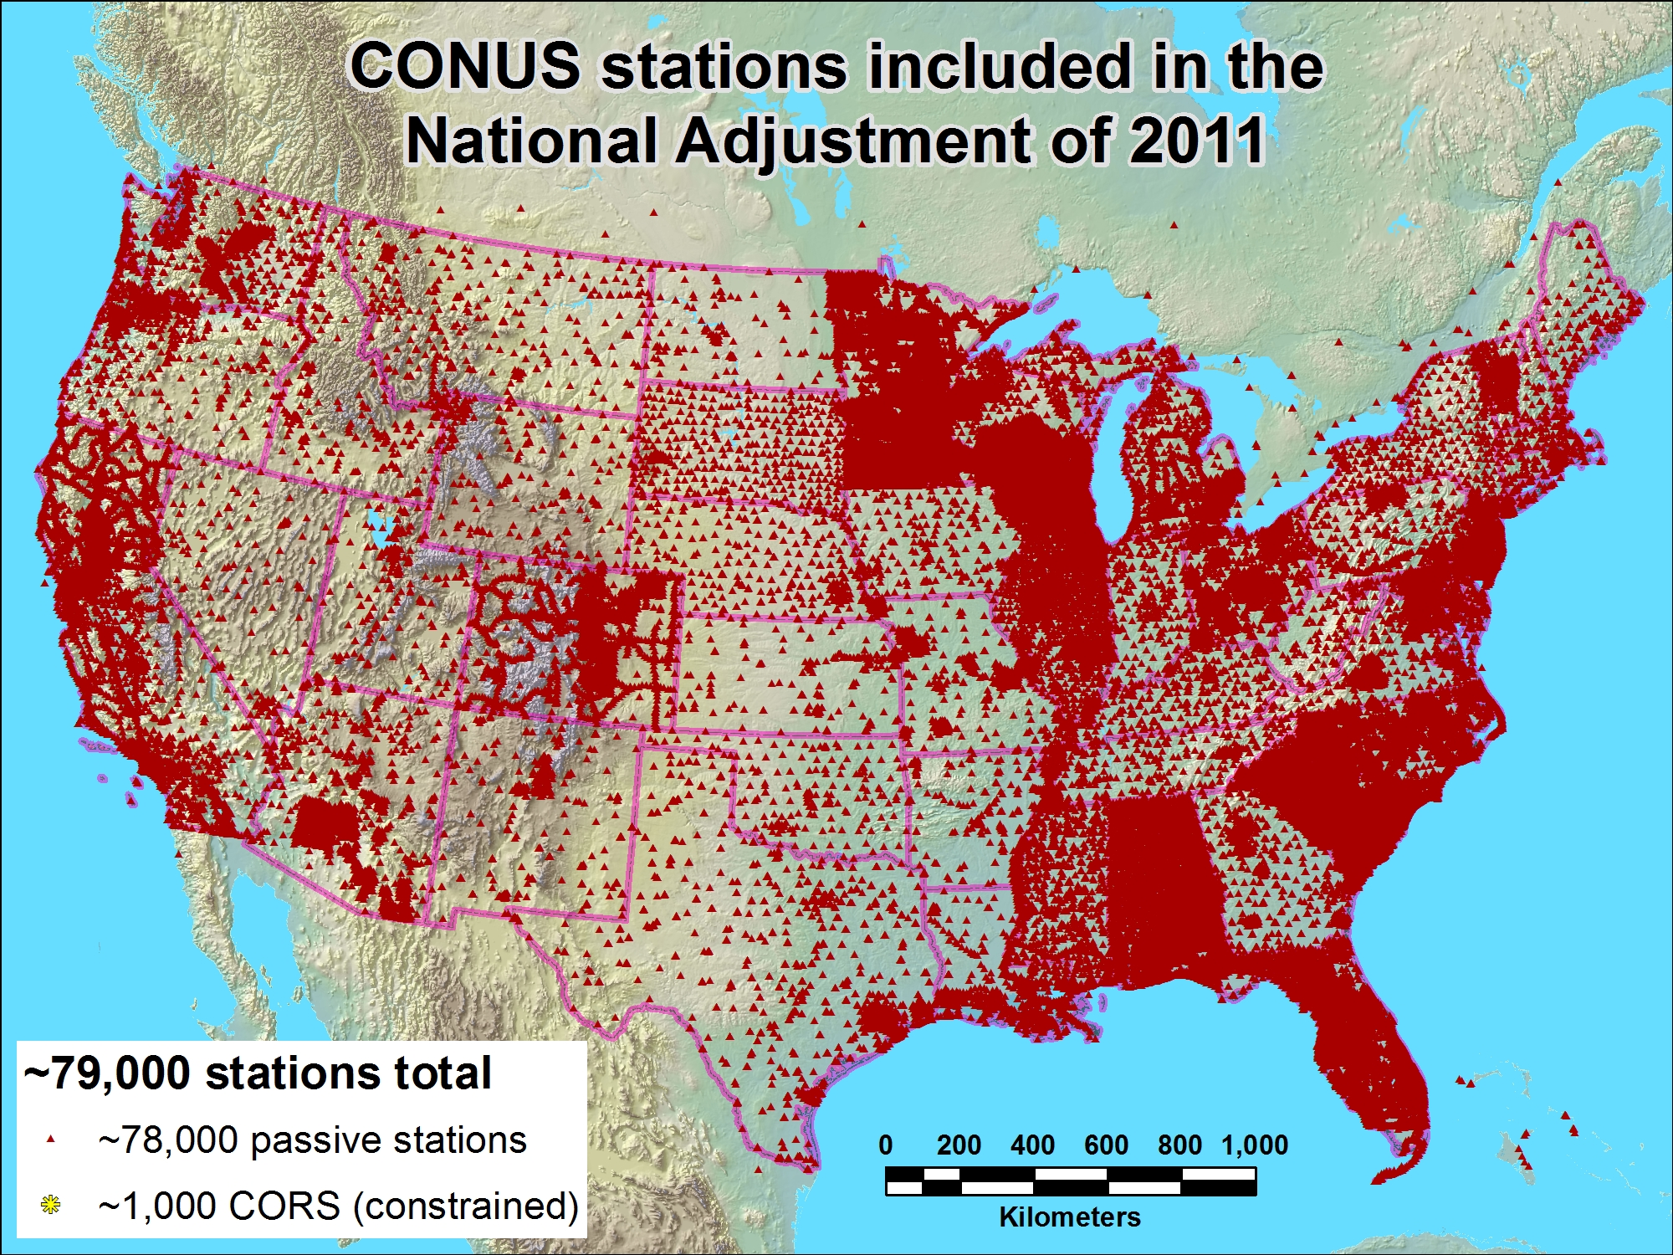
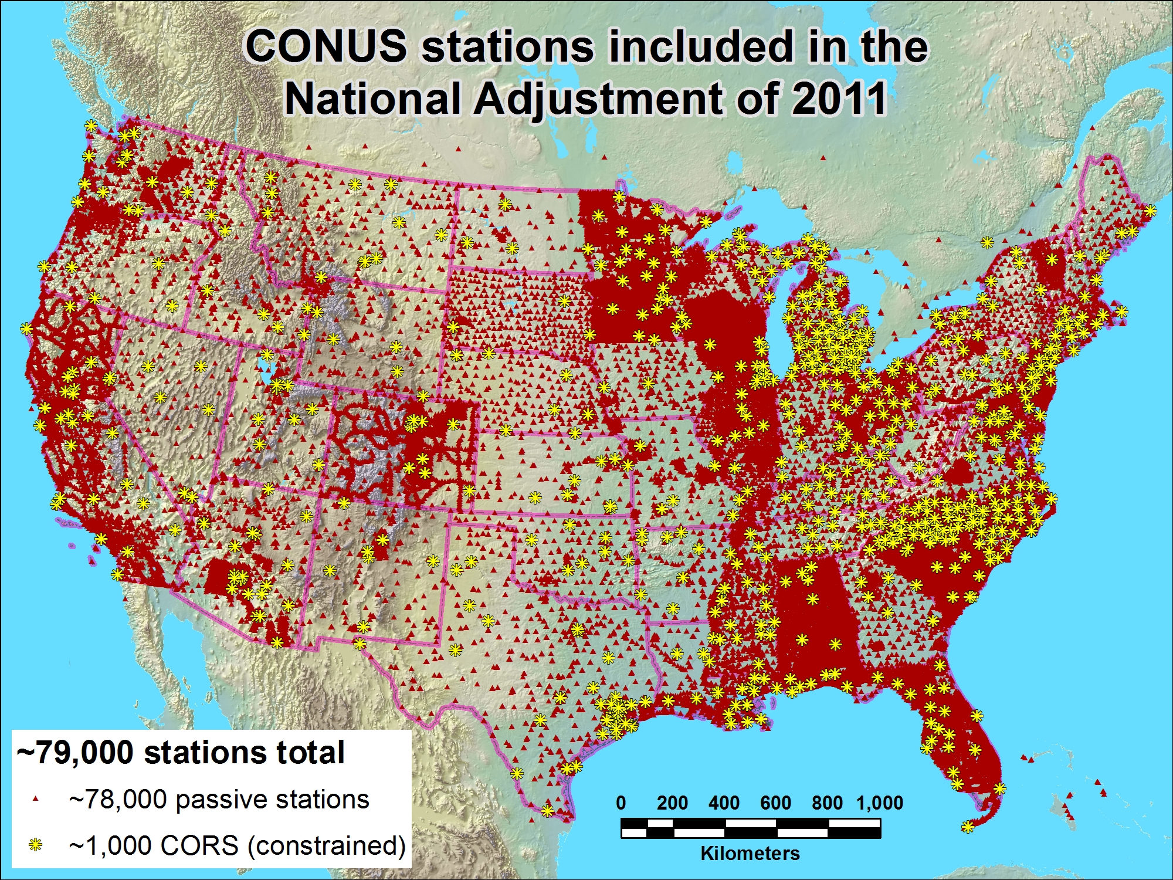
Notes:
Only about half the CORS (those with >2.5 yrs velocities) are ‘included’ ie, used as constraints. The other—newer– ones are included in adjustment but postitions determined by adjustment will not override those determined in MYCS. Many of the older observations (projects) have been excluded, as they were in the 2007 national adjustment.
Altho the newer CORS

Slide 41
Next steps, final phases
NA2011 Adjustment thought to be completed, fully published in/by April
Testing network accuracy calcs for subsequent submitted projects and database procedures
Until NA2011 Adjustment is ready to be published:
  OPUS solutions will continue to provide coordinates in both former (2007) and current (2010) ref frames
  Next Geoid model cannot be finalized
Transform tool will become available:
NAD 83 (HARN)←→(NSRS2007/CORS96) ←→(2011)

Slide 42
Possible NGS plans
Might perform national vertical adjustment
  Constrain vertically to NAVD 88 benchmarks
    Perform as simultaneous nationwide adjustment
  GNSS-derived orthometric heights
    NAD 83(2011) ellipsoid heights with GEOID12
    NOT a readjustment of NAVD 88 leveling
Your thoughts??

Slide 43
BREAK

Slide 44
Second Wind!
4. GEOID12
5. GRAV-D initiative update
6. Geoid slope Validation results
7. Completely new datums in a decade
  --Geospatial (datums) Summit in San Diego, July 22 (6 hrs), open; and 24 (2 hrs) @ ESRI Conference
Notes:
4. Fieldwork in Texas; GRAV-D flights in northern CA a year ago

Slide 45
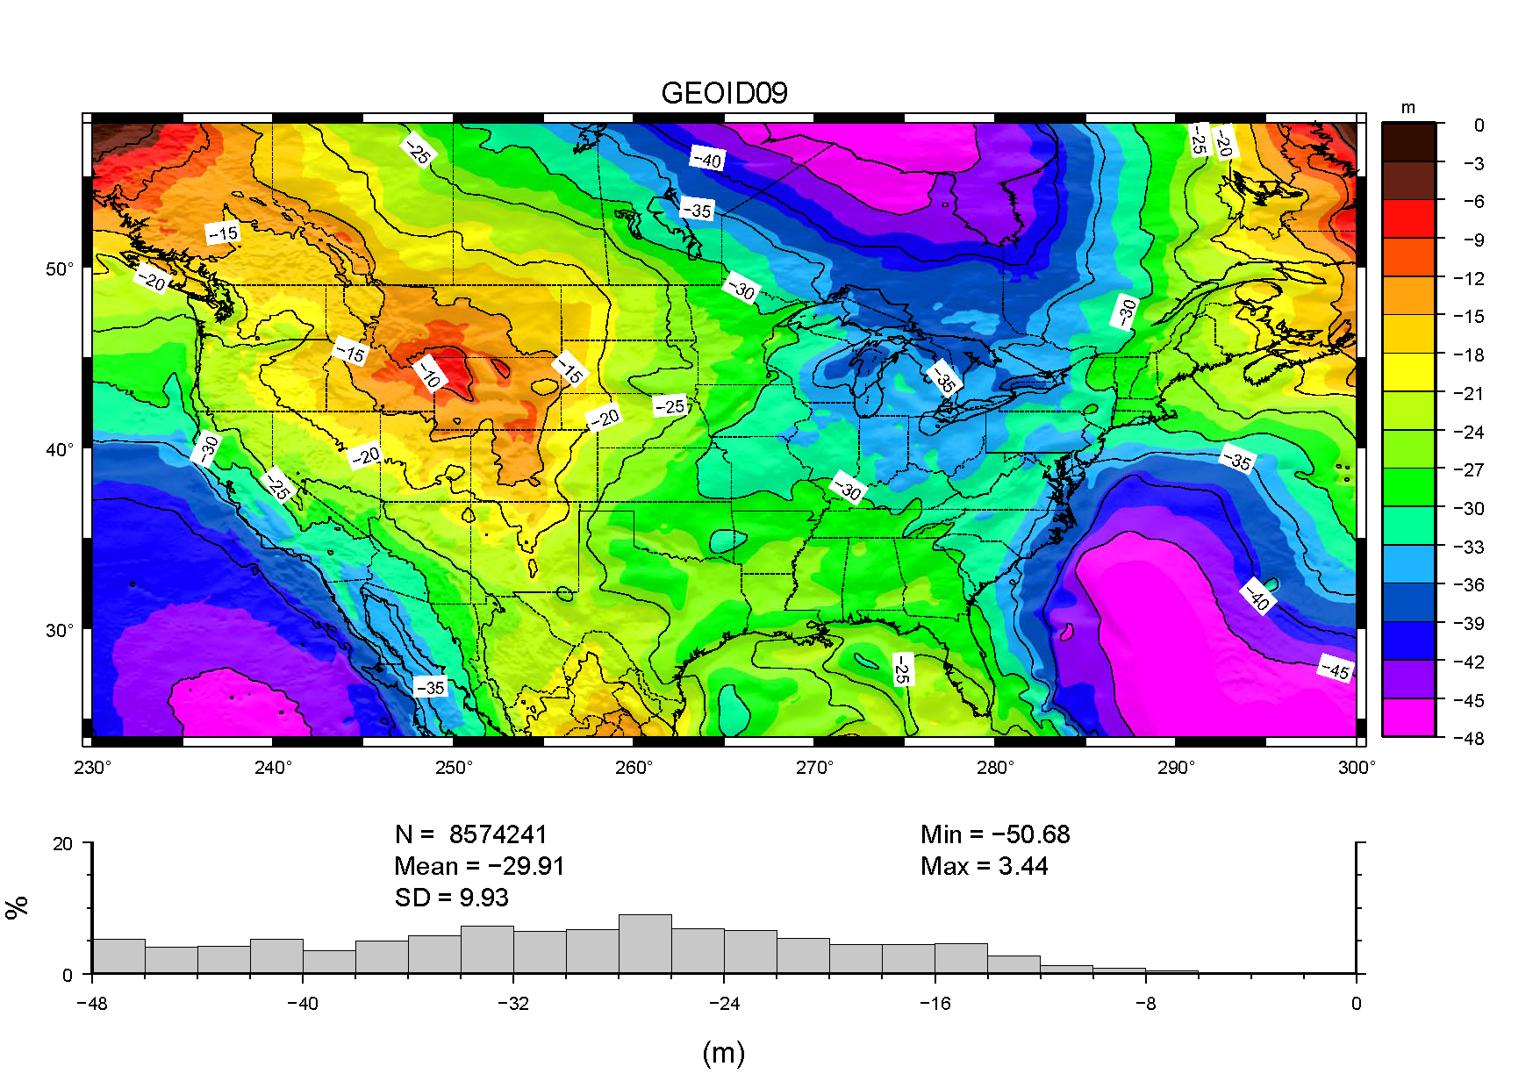
GEOID09:
relates NAD83 (ellipsoid heights) to NAVD88 (orthometric heights)
GEOID09:
+/- 2.8cm @ 95%

Slide 46
GEOID12 Development
Model will be based on ellipsoid heights published from NA2011 project
Proposed stations, different than for GEOID09, for inclusion/exclusion just distributed to geodetic advisors for review, checking:
Stations rejected in NAD83(07) included in (11)
Stations with new data or new stations
Stations that should have been rejected in G09
NOTE: Two months after GEOID12 released, project submissions must use NAD83(2011)

Slide 47

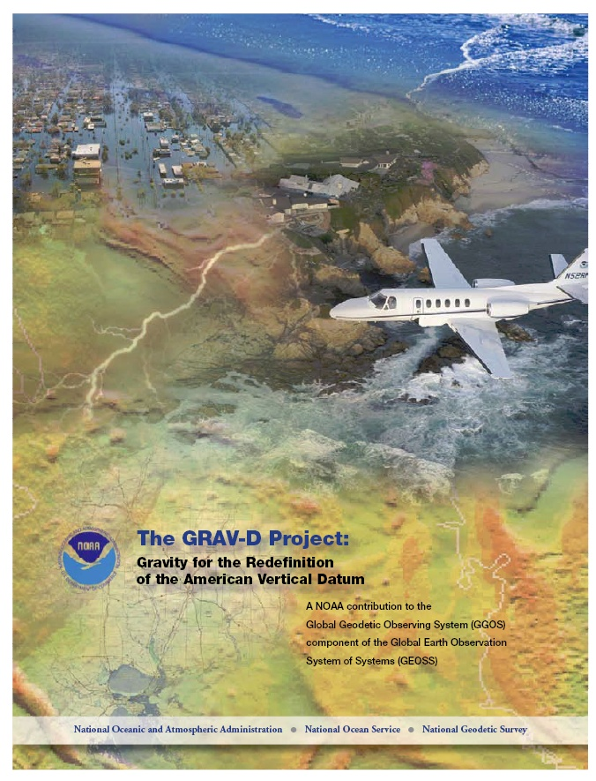
Gravity for the Redefinition of the American Vertical Datum (GRAV-D)
Replace the Vertical Datum of the USA by 2022 (at today’s funding) with a gravimetric geoid accurate to 1 cm
Orthometric heights accessed via GNSS accurate to 2 cm
Three thrusts of project:
  Airborne gravity survey of entire country and its holdings
  Long-term monitoring of geoid change
  Partnership surveys
Working to launch a collaborative effort with the USGS for simultaneous magnetic measurement
Gravity and Heights are
inseparably connected
Notes:
GRAV-D is the NGS project designed to replace NAVD88 with a vertical datum based upon a gravimetric geoid accurate to 1 cm. Heights above this datum will be accessed via GNSS measurements. Three thrusts of project. Launch USGS collaboration for simultaneous mag measurement.

Slide 48
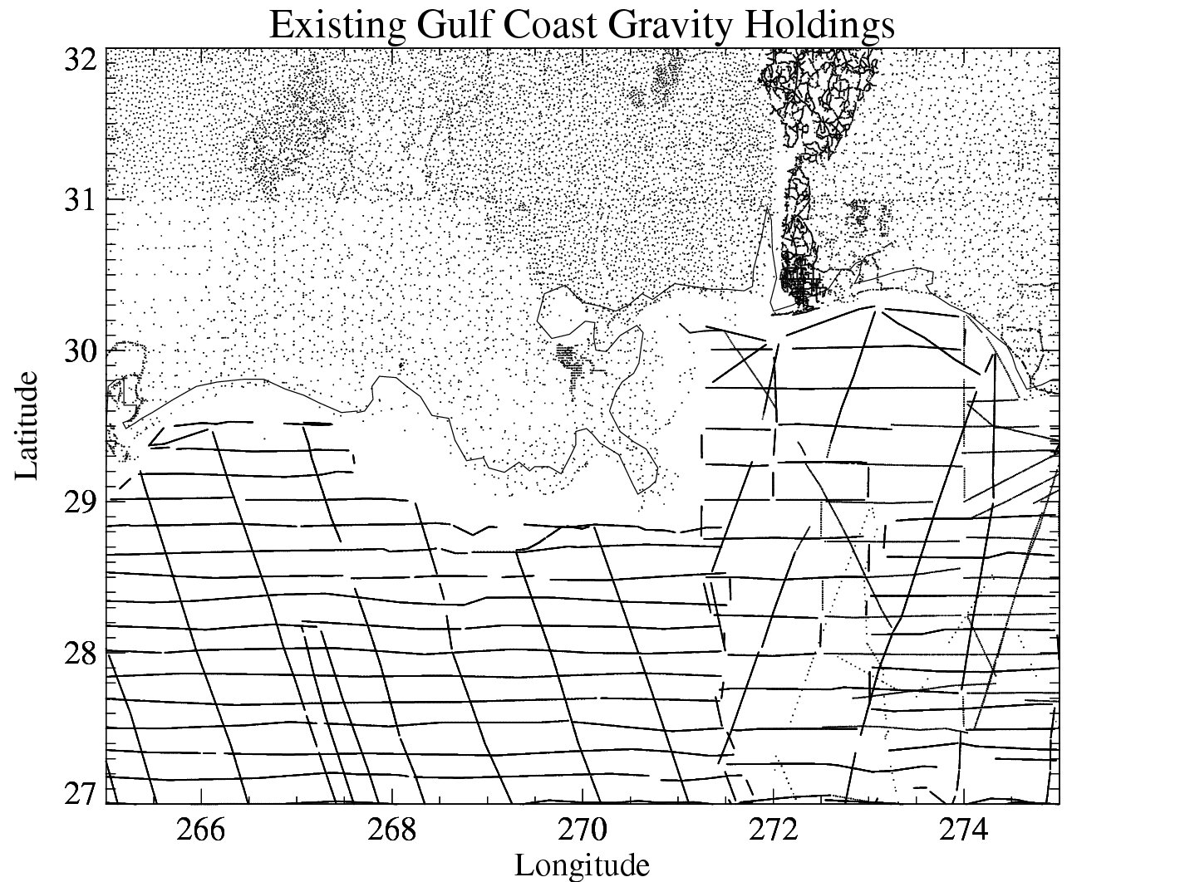
Problems with Gravity Holdings
Terrestrial gravity
20-100 km gravity gaps along coast
Field is not sampled uniformly
Data range in age and quality, some w/o metadata
Some surveys have systematic errors
Data gaps in littoral areas
Ship gravity
New Orleans

Slide 49
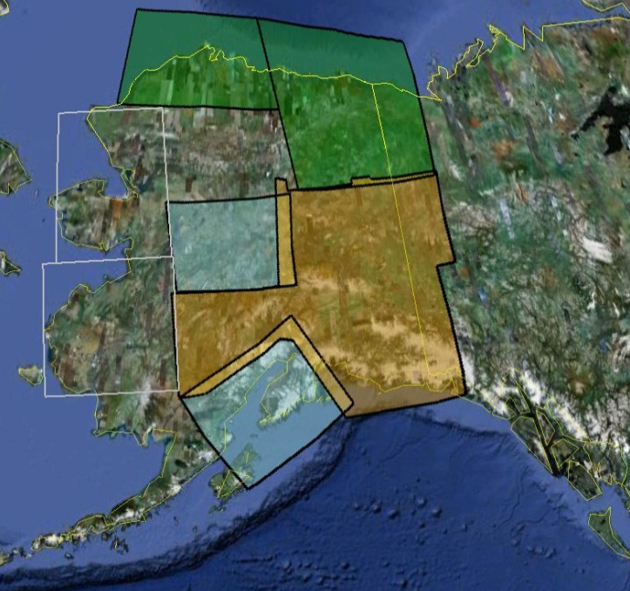
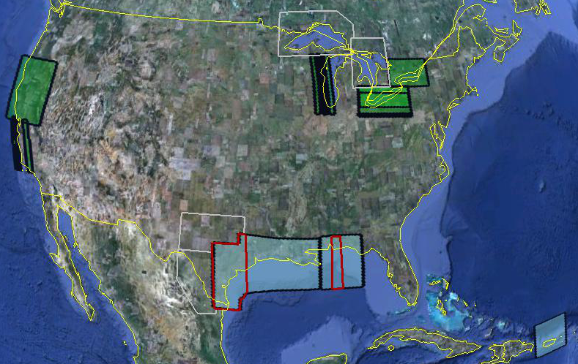
GRAV-D Status
In FY 11 airborne surveys were conducted in Alaska, California/Oregon, and the Great Lakes
15.60% of the country completed
Potential locations for flights in FY 12 include southern portions of Alaska, the Great Lakes, Texas
TX and AL data available, all Gulf of Mexico data to be released by Q3
Data and metadata at: http://www.ngs.noaa.gov/GRAV-D/data_products.shtml
Potential FY 2012
FY 2011
FY 2010
Pre-FY 2010
Data Released

Slide 50
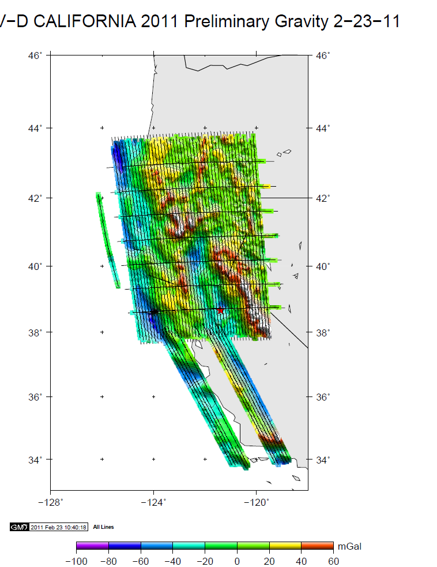
GRAV-D Survey in California, Jan-Feb 2011
Look for article written by Ikehara in next CA Surveyor issue
Notes:
The “tails” in central CA are data collected after the original data acquisition plan was completed ahead of schedule.

Slide 51
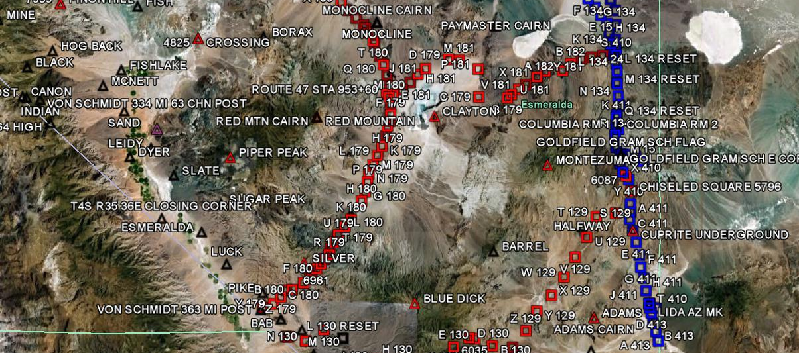
GRAV-D Goals
2 cm accuracy orthometric heights -
  from GNSS (1 cm) + geoid model (1 cm)
fast, accurate, consistent orthometric heights -
everywhere in the USA

Slide 52
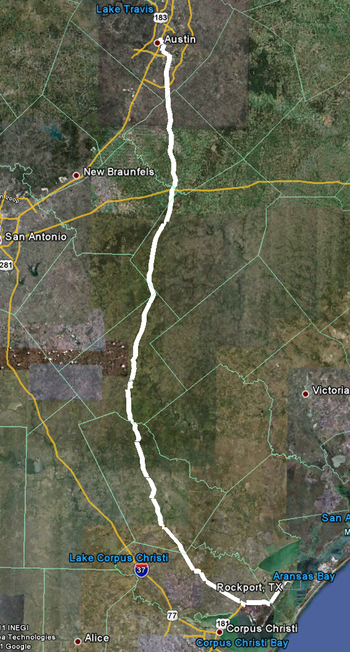
Geoid Slope Validation Survey
Austin
Observe geoid shape (slope) using multiple independent terrestrial survey methods
  GPS + Leveling
  Deflections of the Vertical
Compare observed slopes (from terrestrial surveys) to modeled slopes (from gravimetry or satellites)
  With / Without new GRAV-D airborne gravity
325 km
218 points
1.5 km apart
Rockport
Notes:
But will this method produce a sufficiently accurate geoid?
This summer, we conducted an experiment to determine the accuracy of our geoid. We selected a line that extended 325 km from downtown Austin, Texas (North end) to Rockport, Texas (South end). There were 218 official survey points along the line, with an average spacing of 1.5 km between them. We compared the slope of the geoid along the line determined with GPS + leveling with deflections of the vertical as measured by the ETH Zurich DIADEM zenith camera. We also compared the observed geoid slope with slopes calculated from various geoid models to evaluate the their quality. As for NGS models, we tested geoids that both included and didn’t include new GRAV-D airborne gravity.

Slide 53
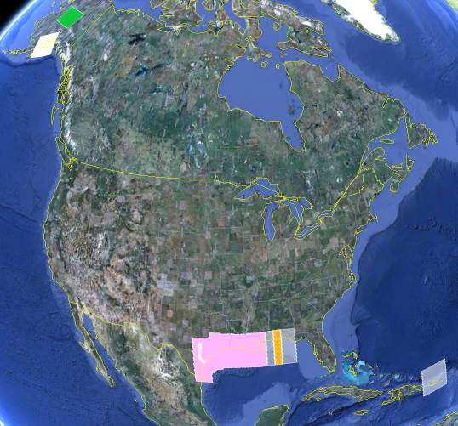
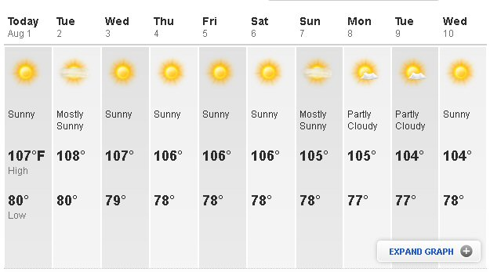
Level Line for Geoid Slope Validation Project
325 km
218 points
1.5 km spacing
South Texas
July-October, 2011
hot…Hot…HOT!
Notes:
The final line was a 325 km stretch from downtown Austin, Texas (North end) to Rockport, Texas (South end). There were 218 official survey points along the line, with an average spacing of 1.5 km between them. The shaded areas in the above picture were the existing GRAV-D data at the time of planning GSVS11 (since expanded). Although the weather report looks extreme, most surveying was done in the milder times of day.

Slide 54
Surveys Performed
GPS: 20 identical. units, 10/day leapfrog, 40 hrs ea.
Leveling: 1st order, class II, digital barcode leveling
Gravity: FG-5 and A-10 anchors, 4 L/R in 2 teams
DoV: ETH Zurich DIADEM GPS & camera system
LIDAR: Riegl Q680i-D, 2 pt/m² spacing, 0.5 km width
Imagery: Applanix 439 RGB DualCam, 5000’ AGL
Other:
  RTN, short-session GPS, extra gravity marks around Austin, gravity gradients

Slide 55
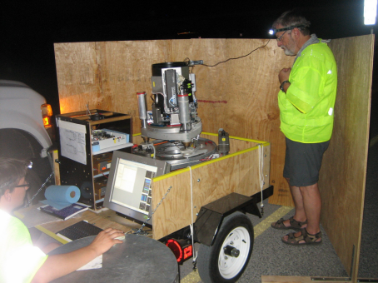
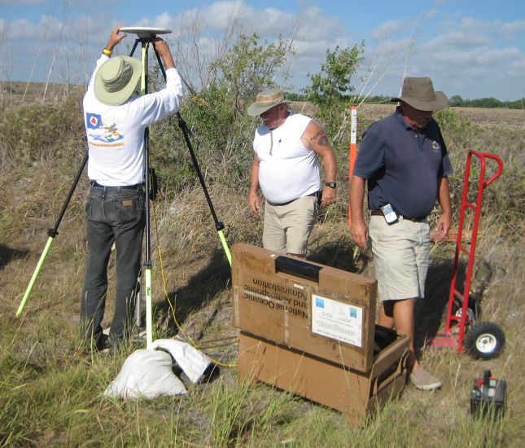
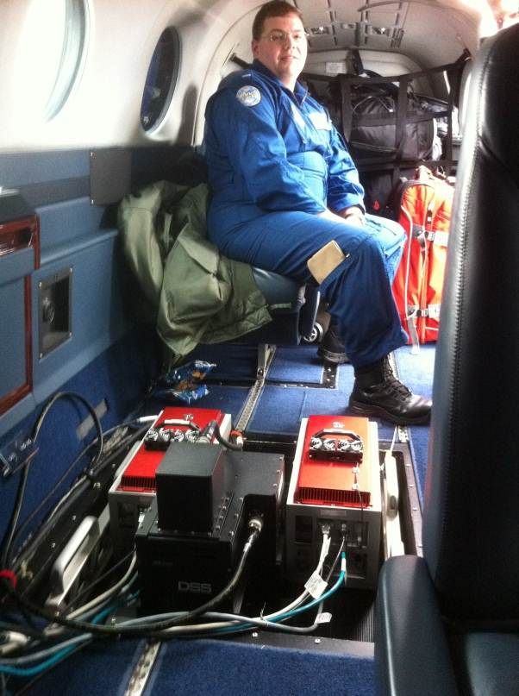
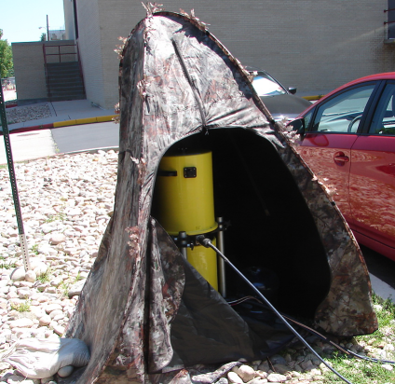
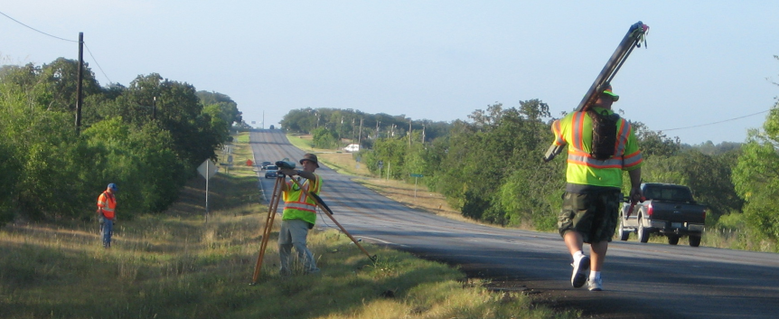
GPS
LIDAR/
Imagery
DoV
Gravity
Leveling
Notes:
These are just a small sampling of the field crews in action. Not shown are the RTN, FG-5, short-session GPS, relative gravity and mark setting crews.

Slide 56
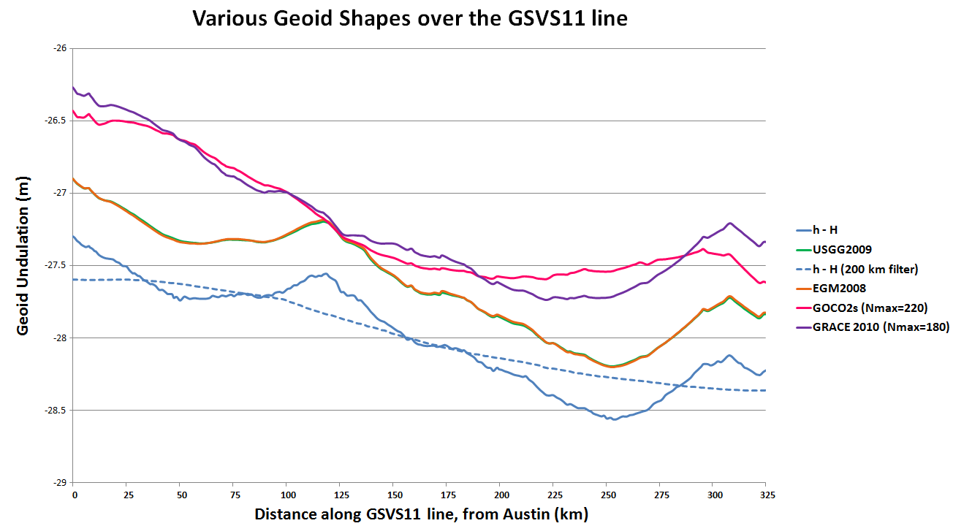
Existing Geoids vs GSVS11
Austin (North end)
Rockport (South end)
Notes:
The shapes in this plot are various forms of the geoid shape over the GSVS11 line. Of primary interest is the blue line (h-H) which represents (at the time of this presentation) the very best differential ellipsoid heights and differential orthometric heights from the new GPS and leveling of GSVS11. The blue dashed line is a smoothed (200 km filter) version of this. Note that this survey was about geoid slopes, so the absolute offsets seen here are immaterial to the goal of this survey.
The green and orange lines almost on top of each other are the latest gravimetric geoid from NGS (USGG2009) and EGM2008. Note how closely they appear to follow the h-H blue line.
The purple and pink lines are SHMs ITG-GRACE2010s and GOCO02s. Note their general inability to track even the largest details (except the more or less upward slope from Rockport to Austin) of the geoid. One would presume this is from omission error, but the failure to match the filtered h-H values (blue dashed line) calls into question whether there is commission, not omission error going on here. If EGM2008 were only given to maximum degree 220, it follows closely to these two models.

Slide 57
Notes:
This slide shows RMS error (disagreement) between h, H and N for various geoid models as compared to the best GPS and leveling on GSVS11. Note first the black bars, which are the allowable h and H error build up over further distances. Compare these to the total error of the h-H-N values. USGG2009 and EGM2008 have similar patterns, with EGM2008 being slightly better behaved. The new model, USGG2012x01 has patterns of improvement and degradation relative to EGM2008 and USGG2009, showing the need to keep working on theory and software. However, the geoid model with airborne data, USGG2012x02 shows clear improvement over all models, and even begins to approach the level of accuracy of h-H at medium wavelengths.

Slide 58
The “1 cm
geoid”
Notes:
This slide is a companion to the previous one, but the h-H errors have been removed, in an RMS sense, from the total h-H-N errors, leaving, ostensibly, gravimetric geoid errors only. As seen previously, the airborne geoid is the best performer, by far. In fact, as a general statement, it could be said that USGG2012x02, an airborne gravity data enhanced geoid model, is effectively at the 1 cm differential geoid undulation accuracy level across all distances, in the region of GSVS11.

Slide 59
Geoid Slope Survey Conclusions
Including airborne gravity data improves geoid slope accuracy at nearly all distances <325 km
The NGS geoid in the TX survey meets the 1 cm accuracy objective only if airborne data are included
  No other model achieved 1 cm accuracy
Gravimetric geoid models and GPS are a viable alternative to long-line leveling
Notes:
The Survey verified that the inclusion of the GRAV-D airborne survey improved the geoid slope accuracies at all distances measured by the survey.

Slide 60
Rationale for new Datums
What? Terminology:
  Horizontal becomes GEOMETRIC
  Vertical becomes GEOPOTENTIAL
When? 2018, if GRAV-D program is complete
Why? But why?!
  Primarily needed a better vertical datum for “vertical” data(geoid, ortho ht) not obtained by traditional leveling
    Airborne gravity observations will be used to develop next geoid
  Geodetic Data collection relies upon navigation (GNSS) satellites orbiting around the mass center of the Earth
  NAD83 reference frame/datum is not geocentric
  NAD83 is not defined to include vertical velocities
  Earth is not stable in all directions; reference frame must account for this to be as geodetically accurate as possible

Slide 61
Evolution of Geodetic Datums: from NAD27/NGVD29 to NAD83/NAVD88 to ?/ ?
H + V
2 + 1
27, 29
H + V
2 + 1
83(86),88
GPS
H + V_{E} + V_{O}
2 + 1 + 1
83(92), 88
Geometric
+VELOCITIES (time)
H + H_{t} + V_{E} + V_{O}
2 + 2 + 1+ 1
83(2011)+HTDP, 88
H + H_{t} +V_{E}+ V_{Et}
2 + 2 + 1+ 1
GEOMETRIC
V_{E} + G_{t}
1 + 1
GEOPOTENTIAL
H + H_{t} +V_{E}+ V_{Et}
2 + 2 + 1+ 1
IGS08 (2010.00)
+ GRAVITY
(geoid model)
Notes:
Conceptual: Generally, Orange represents ‘horizontal’ or NAD83 at present; yellow represents orthometric vertical.
1)moved fr non-geocentric to 2)geocentric as well as we knew at the time from early satellite technology (DOPPLER). And leveling efforts resulted in a national vertical datum with only one constraint, rather than 26 (tide gauges). 3)Static GPS exploded on the scene which 4) led to 5)the HARN networks and state-specific adjustment. With GPS surveying, we got V(E), vertical ellipsoid and V(O), vertical orthometric. 6)With the results of repeat static surveys and the advent of CGPS (Continuous CGPS), such as NGS’ National CORS, 7)the velocity of the earth’s crust relative to a reference frame, could be determined over time. 8)Using the crustal motion model HTDP for horizontal velocities on the West Coast, eg, the Pacific-North American Plates interface, NGS produced 9) a National Re-adjustment in the NAD83 (NSRS2007) datum. (No change to ortho.) However, 10)underlying the NAD83 adjustment are data and analysis referenced to ITRF00, epoch 2002.00, which does take into account both horizontal AND vertical ellipsoid velocities. (velocity=time related terms shown as italicized.) This is what we have now. 11) With better global gravity models and airborne gravity data collected by NGS, we will 12) move forward with 13) new datums BOTH referenced to an ECEF, earth-centered, earth-fixed datum which we are calling 14) Geometric, for the horizontal and ellipsoid height values, and Geopotential for the orthometric height values which will be based on a a geoid model and changes in gravity over time (G(t).

Slide 62
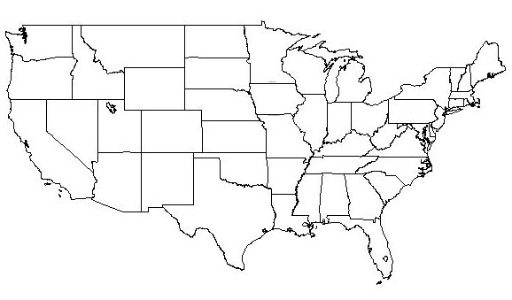
Changing the Datum
1927
“Picking the Grid”
Everything gets a
New coordinate!!
1927-1983: 100’s of meters
1983-2022: 1-2 meters
1983

Slide 63
Adjusting Coordinates within the Datum
1 cm
Modifying each point for its own ”issues”, eg, velocity:
Actual Motion
Error correction
New Information/Obs
On the order of centimeters
Done regularly: Next 2011
1983

Slide 64
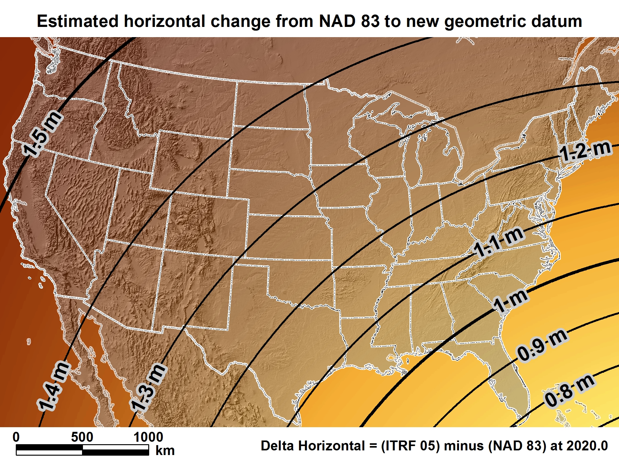
New geometric datum minus NAD 83 (horizontal)

Slide 65
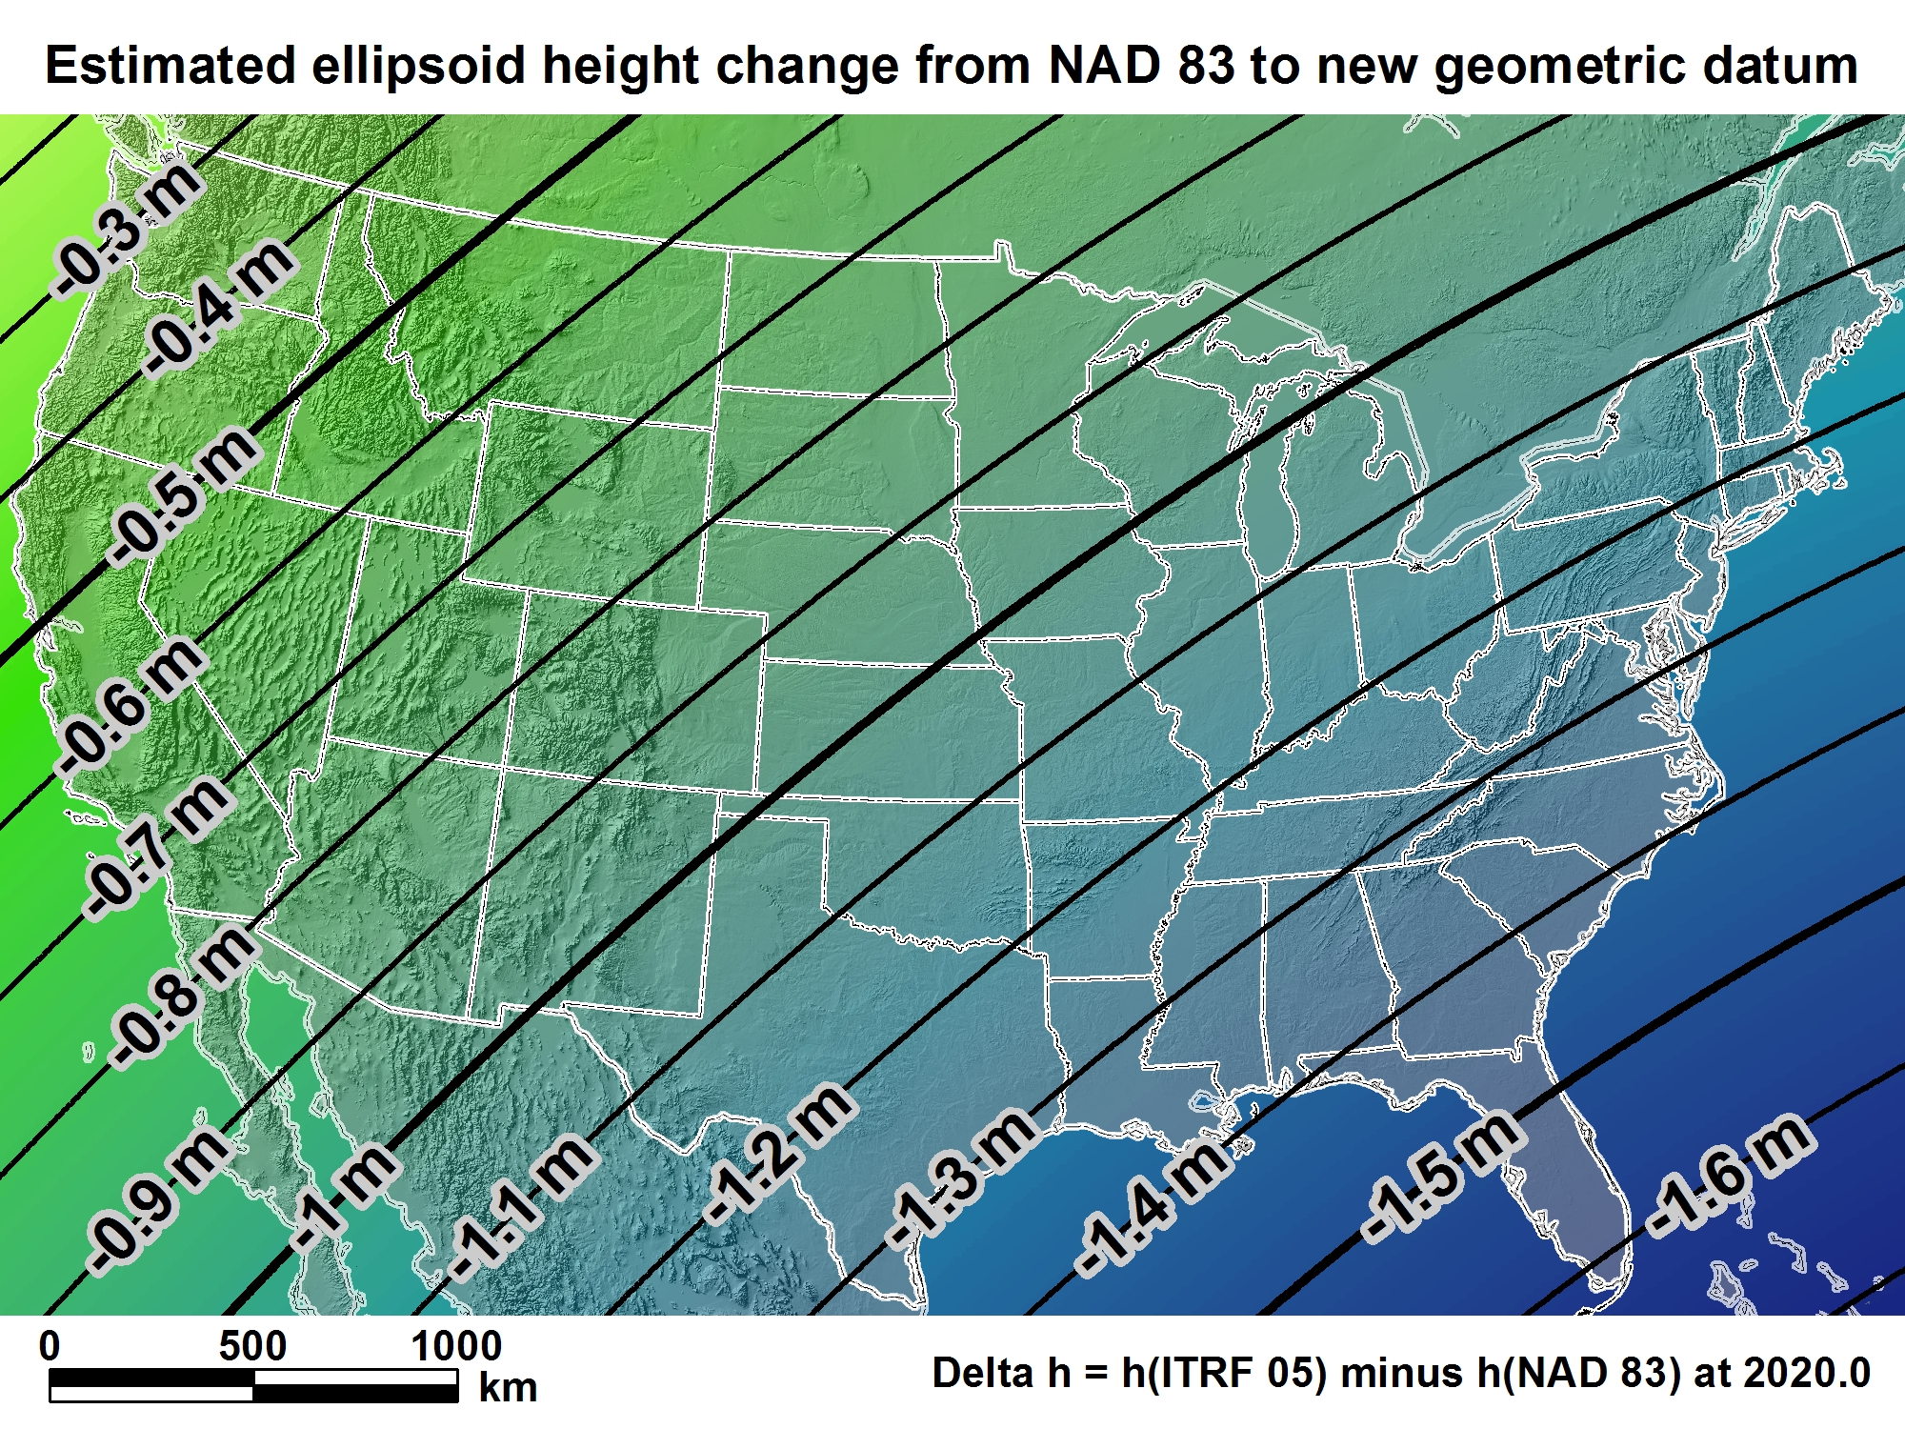
New geometric datum minus NAD 83
(ellipsoid height)

Slide 66
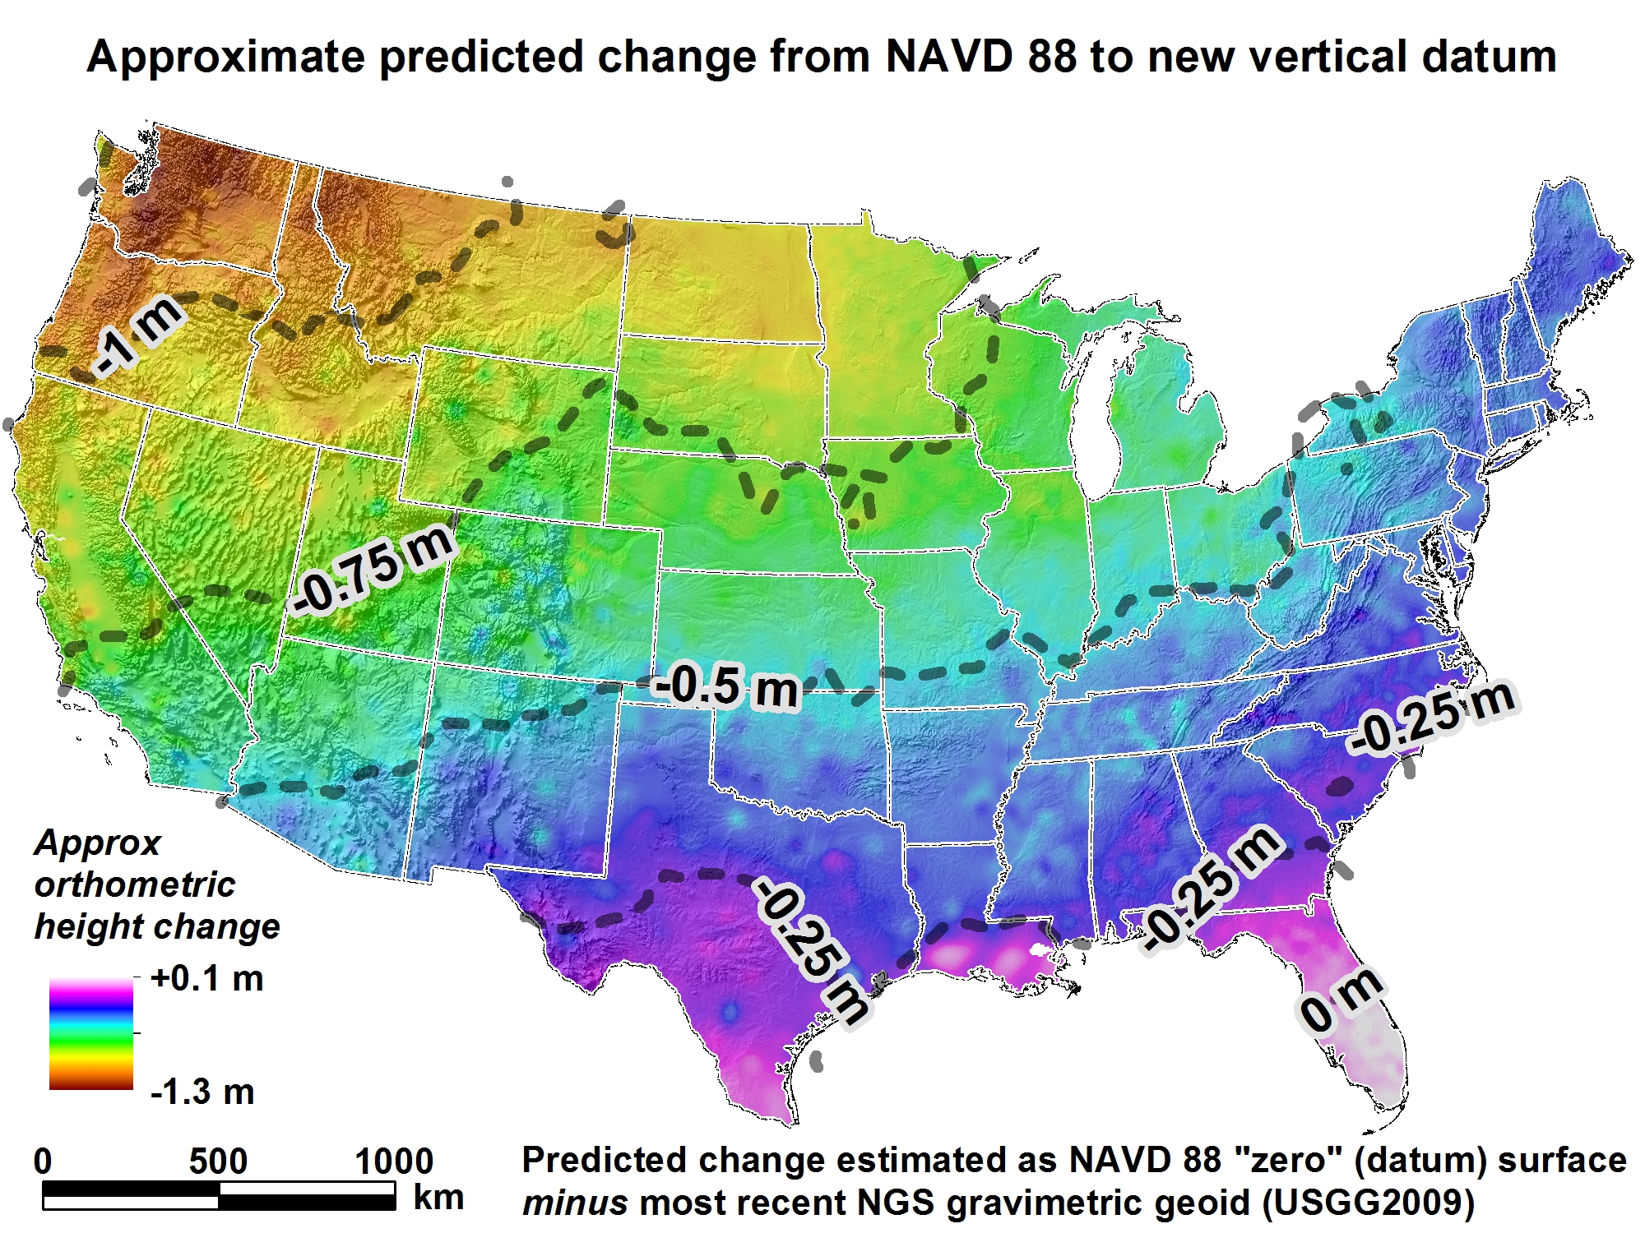

Slide 67

Notes:
Radically different H and V datums, in a decade: geometric and geopotential
July 2012 2nd geospatial summit to be held at ACSM/ESRI conference time, at nearby hotel
6 hours on Sunday or 2 hours on Tues within the ESRI main User Conference

Slide 68
How to Plan for the Future
Move to newest realization, i.e. NAD 83(2011) epoch 2010.00
  NAD 83(HARN) <-> NAD 83(NSRS2007) &
  NAD 83(NSRS2007) <-> NAD 83(2011) tools under development
Obtain precise ellipsoid heights on NAVD 88 bench marks (use of OPUS-DB, contact NGS Geodetic Advisor)
  Improves hybrid geoid models and provides “hard points” in new vertical datum
Move off of NGVD 29 to NAVD 88
  Understand the accuracy of VERTCON in your area
Move away from passive marks to CGPS
  Especially move off of classical passive geodetic control
Require/provide complete metadata for all mapping contracts
  How did they (you) get the positions/heights? DOCUMENT!!

Slide 69
Milestones for Improving the NSRS
Multi-Year CORS Solution (MYCS) –
  Completed and available, but not yet fully implemented
National Adjustment (geometric) of passive control
  Underway, expected completion by April 2012
Hybrid Geoid Model (GEOID12) using new ellipsoid heights
  Underway, expected completion by April, 2012
Simultaneous release of MYCS, NAD 83(2011) epoch 2010.00, and GEOID12
National Adjustment (vertical) of GPS passive marks
  Under consideration
  This is not adjusting the leveling network
Adoption of new datums
  Vertical, requires completion of GRAV-D
  Geometric, could happen at any time but will be delayed until definition of new vertical datum is complete
  Crystal ball says completion in 2022 (Good luck to you all!)

Slide 70
BREAK

Slide 71
Down to Earth, part II
NGS Tools and Software Demo
Marti Ikehara: marti.ikehara@noaa.gov
California Geodetic Advisor
Sacramento, CA
916-227-7325
Notes:
71

Slide 72
Home Stretch: Table of Contents
NGS ONLINE TOOLS
OPUS: S, RS, DB, Projects
HTDP
Datasheet Format/Content Changes
SOFTWARE DEMOS
DSWORLD
VDATUM
CONTINUING EDUCATION
Upcoming Events
Past Events

Slide 73



Online Positioning User Service (OPUS)
>15 min of L1/L2 GPS data >>> www.ngs.noaa.gov/OPUS
Processed automatically on NGS computers
Solution via email - in minutes
Fast, easy, consistent access to NSRS
Notes:
73

Slide 74

OPUS Reference Frame Choices

Slide 75

e-mail
GPS file
antenna
antenna height
(OPTIONS)
OPUS-RS or OPUS-Static
(15 min-2 hr) (2-48 hr)

Slide 76
How Does OPUS-RS Work?
OPUS-RS selects three to nine “best” CORS based upon:
    Common satellite visibility with the user data.
    Distances from the user’s site being <250 km.
The star represents the user’s
site. The triangles are CORS.
The three CORS minimum is shown.
No more than nine are used.
s
>250km
250km

Slide 77

How Does OPUS-RS Work?
In addition, user’s site must be no more than 50 km from the (convex) polygon created by the selected CORS.
Again in this figure, the star represents the user’s site; the
triangles are CORS. Five CORS and their resulting polygon are shown in this example.
If the user’s site, the star, is
more than 50 km outside
this polygon, alternate
CORS will be considered.
If none can be found,
the processing will abort.
Schwarz et al., “Accuracy assessment of the National Geodetic Survey's OPUS-RS utility”, 2009, GPS Solutions, 13(2), 119-132.

Slide 78

Horizontal accuracy, 1sigma, 2/27/12

Slide 79

Ellipsoid ht accuracy, 1sigma, 2/27/12

Slide 80

OPUS-DB

Slide 81

OPUS –
Datasheet Publishing
Publishing Criteria:
NGS-calibrated GPS antenna
> 4 hour data span
> 70% observations used
> 70% fixed ambiguities
< 0.04m H peak-to-peak
< 0.08m V peak-to-peak
Uses:
  GPS on BMs
  PLSS / GCDB
  Data archive
  Data sharing

Slide 82

OPUS-DB (DataBase Publishing)

Slide 83


Slide 84

OPUS-Projects: BETA phase

Slide 85
OPUS-Projects: BETA
Need to have training before being given Username/ProjectID access
Will eventually eliminate bluebooking
Working out bugs; has not been great with short times, using PAGE-NT processing engine
Critical that Ht Mod Guideline durations, eg, 30 minutes, work well in OPUS-P
In-person training now, maybe webinar later

Slide 86


Slide 87



Process the session’s data.
Notes:
87

Slide 88

And at the bottom are summary plots and tables for comparison of different solutions.
The orange parts of the plots indicate regions outside the thresholds set by the project manager.
Notes:
88

Slide 89



see The American Surveyor vol 8 (no. 5,6,7)

Slide 90
OPUS DB solutions
Results comparison:941 4509 H TIDAL
DISCUSSION:
Should OPUS-DB solution be acceptable for control? ie, published coordinates?

Slide 91
HTDP, v. 3.1.2
4th option: Interactively transform positions between reference frames and/or dates.
Epoch date format now includes deci-year
All NAD83 realizations are treated the same
After new realization published, will have transforms available between 2007 & 2011
  Changes due to RF very small—mm—versus changes due to velocity (time)—dm to m

Slide 92

HTDP
v 3.1.2

Slide 93
HTDP examples
1991.35 to 2012.21
38 38 38; 121 21 21 | Sacramento
38 38 38; 122 21 21 | nw of Lake Berryessa
38 38 38; 123 21 21 | e of Stewart’s Point
N, E, Up, meters:
.192, -.180; -.028
.270, -.266; -.029
.687, -.444, -.029

Slide 95
DATASHEET Change highlights
Better grouping of geometric elements, eg, ellipsoid height and epoch date
CLARITY about geoid model usage, including for superceded ortho height data
Note: last year, NGS started publishing superceded GPS-derived ortho heights
Inclusion (hyperlink) to Local Ties & Accuracies
http://www.ngs.noaa.gov/web/surveys/datasheet/AC6803_htmod.pdf

Slide 96

Datasheet Format/Content Changes
Move ell ht and epoch info into top box
Note when GPS Ortho Ht computed with previous geoid model, and provide that model ht
Better way to quantify accuracies
Notes:
96

Slide 97

Local Accuracies

Slide 98
CGAR: CA Geodetic Advisor Resources
http://www.dot.ca.gov/hq/row/landsurveys/geodetic/geodetic_control.html
Superceded by DSWorld now that “Vertical-NAVD88 only” is an available Datatype (IF you update downloaded version)

Slide 99

http://www.dot.ca.gov/hq/row/landsurveys/geodetic/geodetic_control.html

Slide 100

DSWorld: mapping tool and more
Need to have Google Earth installed
Tools, Download PC Software, USER-CONTRI-BUTED SOFTWARE, DSWorld
http://www.ngs.noaa.gov/PC_PROD/PARTNERS/index.shtml
FIRST: Tools, Update program to 4.10.22
Enhancement enables you to distinguish VERTCON NAVD88 from other(control) NAVD88
Windows7 could (will) preclude easy updates

Slide 101
Updating Malcolm software, workaround for W7
FIRST Change permissions for folders, as follows:
1) Log into the PC as an administrator.
2) Right-click on the WinDesc folder.
3) Left-click on 'Properties'
4) Click the 'Read-only' box to remove the check mark.
5) Click the 'Security' tab.
6) Scroll down and click on 'Users'.
7) In the 'Permissions for Users' window, click 'Modify' (or 'Full control‘)
Modify allows users to read, write, execute, delete. Full control allows
users to take ownership and change permissions.
8) Click 'Apply'.
9) Click the radio button that says 'Apply changes to this folder,
subfolders and files.'
10) Click 'OK', 'OK'.
11) log out of .la account.

Slide 102
Workaround, cont
http://www.ngs.noaa.gov/web/tools/updates
Select the folder of the pertinent software:
WinDESC, DSWorld, or Translev
Download the .exe file, at the least. All the others can be as well.
If permissions not changed, then cannot download directly to any folder under C:\Program Files (x86) EVEN logged in as admin; put in Downloads, then move into appropriate software folder.

Slide 103
DSWorld Demonstration
Mapping
County example, Toggle between V & V-88only
CORS: Tools/Options/4char; OPUS-DB
All NGSIDB: color represents CONDITION
Submissions
Recovery Notes, incl Destroyed; Photo Naming Convention, Editing Tools; Correct County, Photo

Slide 104

Vdatum.noaa.gov
Example: Chesapeake Bay uncertainties
MCU is dependent on how many transformations

Slide 105


Slide 106




NGS Training Center

Slide 107


Slide 108


Slide 109

With knowledge comes clarity

Slide 110

Marti.ikehara@noaa.gov

