Slide 1

Evaluating Aircraft Positioning Methods for Airborne Gravimetry: Results from GRAV-D’s
“Kinematic GPS Processing Challenge”
Theresa M. Damiani, Andria Bilich, and
Gerald L. Mader
NOAA- National Geodetic Survey,
Geosciences Research Division
ION GNSS+ 2013, Nashville
Session E6: Clock/Timing and Scientific Applications

Slide 2
Overview
Motivation and Background
Gravity and GRAV-D
Positioning for Airborne Gravimetry
Kinematic GPS Processing Challenge
Submitted Position Solutions
Position Analysis
Position Comparisons to Ensemble Average
Stationary Time Periods- Kinematic vs. OPUS
Closure Errors
Conclusions

Slide 3
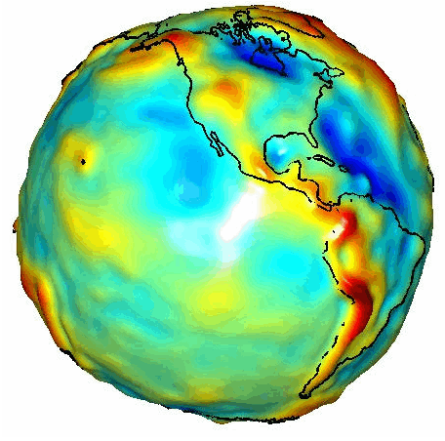
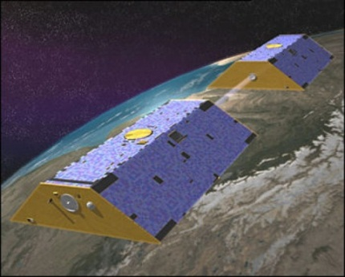
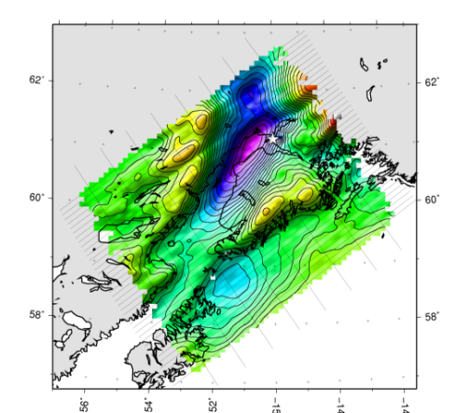
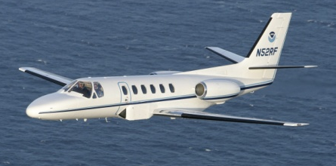
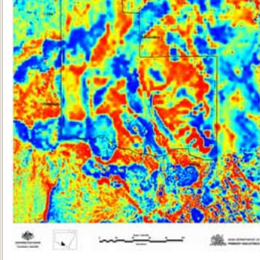
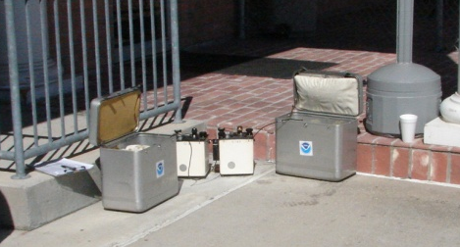
Building a Gravity Field
Long Wavelengths
(≥ 250 km)
GRACE/GOCE/Satellite Altimetry
+
Intermediate Wavelengths
(500 km to 20 km)
Airborne Measurement
+
NGS’ GRAV-D Project (Gravity for the Redefinition of the American Vertical Datum): 2007-2022
The new vertical datum will be based on a gravimetric geoid model– this is the best approximation of mean sea level
Short Wavelengths
(< 100 km)
Surface Measurement and
Predicted Gravity from Topography

Slide 4
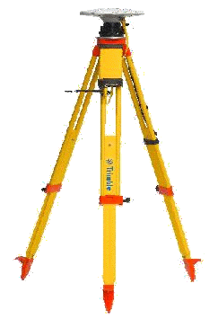
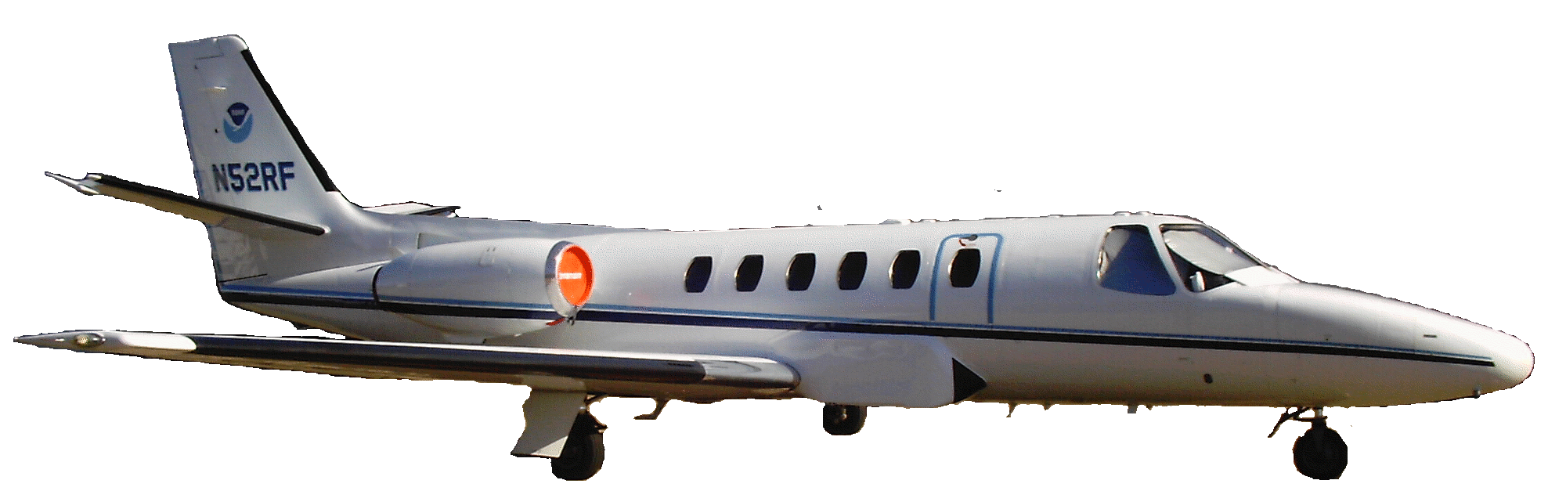
Positioning for Aerogravity
Geodetic quality results require accurate aircraft positions, velocities, and accelerations
High-altitude, high-speed, long baseline flights for gravimetry
No base stations = Precise Point Positioning
1 base station = Differential Single Baseline
Multiple base stations = Differential Network
INS
GPS Antenna
Gravimeter
Absolute Gravity Tie

Slide 5
Positioning Questions
What are the precision and accuracy of available kinematic positioning software packages for challenging flight conditions?
Bruton, et al. 2002- eight solutions; low and medium altitudes
Now have better processing: dual-frequency, PPP, antenna calibrations, ephemeris, tropospheric models, and equipment.
International Data Release 1 (GPS only, August 2010)

Slide 6
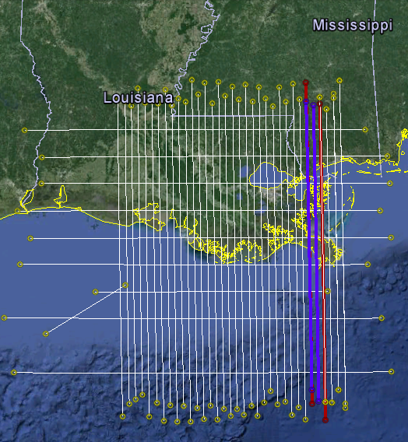
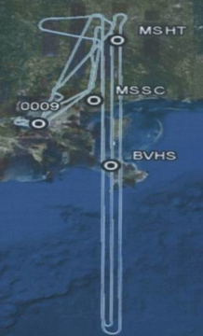
Kinematic GPS Processing Challenge
Louisiana 2008
Two days: 297 (blue, noisy conditions) and 324 (red, stable conditions)
GPS Data, 1 Hz:
  Trimble and NovAtel DL4+ receivers sharing aircraft antenna
  NovAtel DL4+ and Ashtech Z-Extreme base stations
  CORS: MSHT, MSSC, BVHS
New Orleans

Slide 7
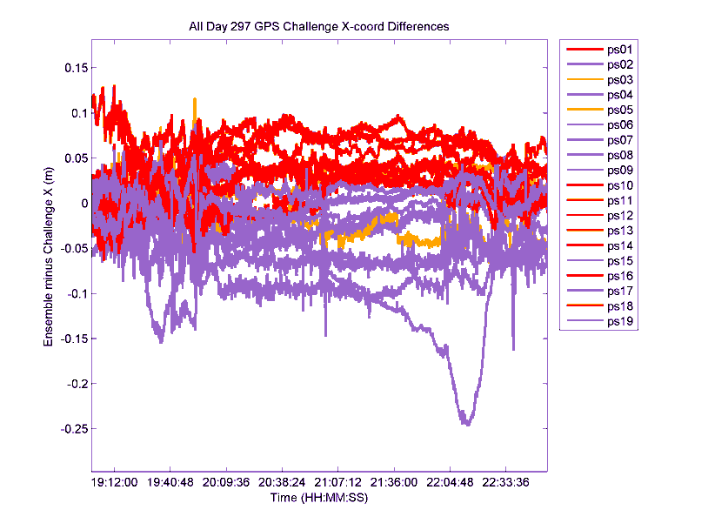
Submitted Position Solutions
19 solutions
11 Institutions: U.S., Canada, Norway, France, and Spain
10 kinematic processing software packages
XYZ coordinates submitted, transformed to LLH
Anonymous position solution numbers (ps01-ps19)

Slide 8
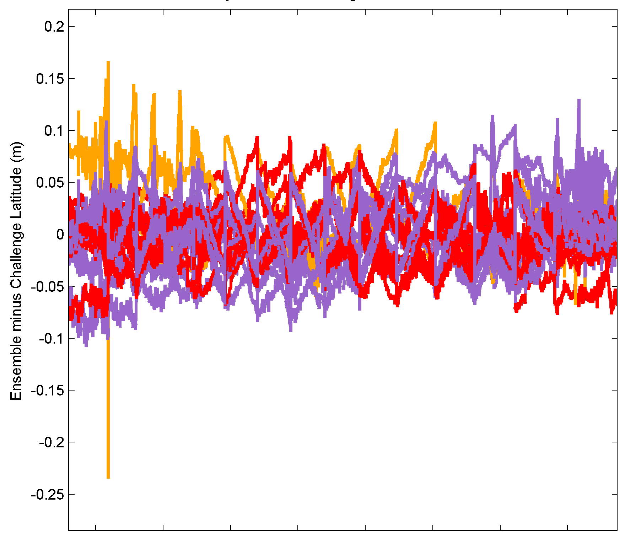
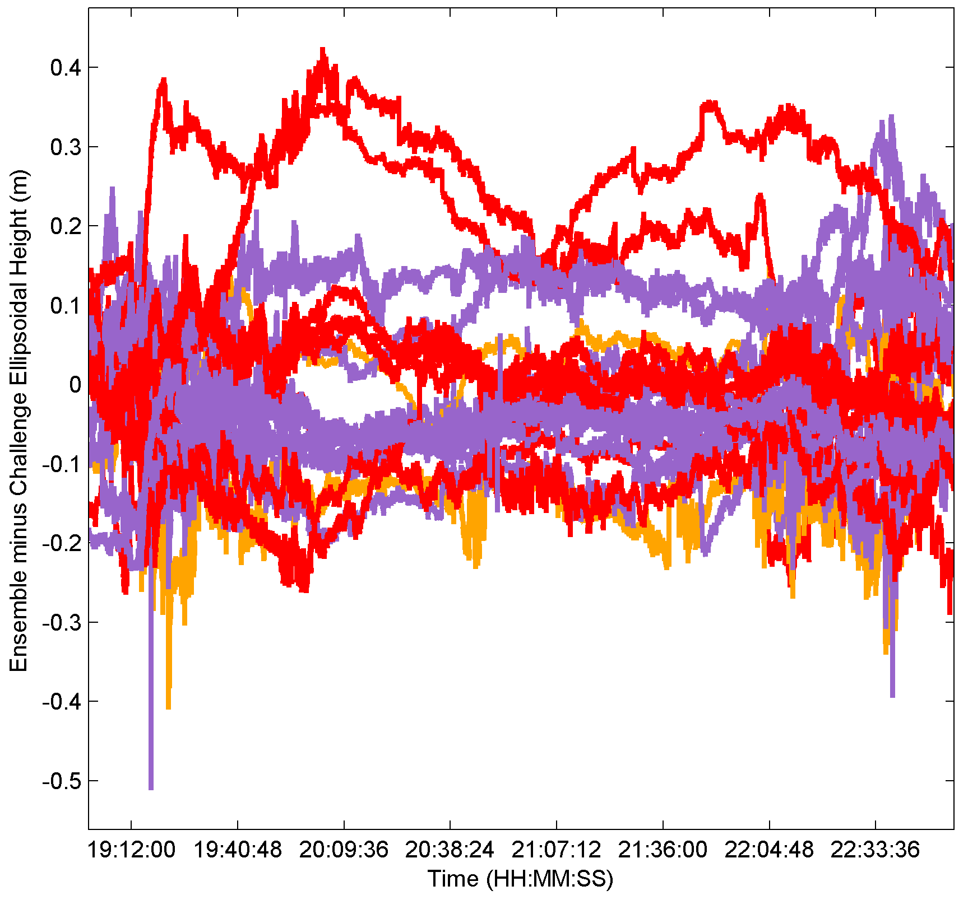
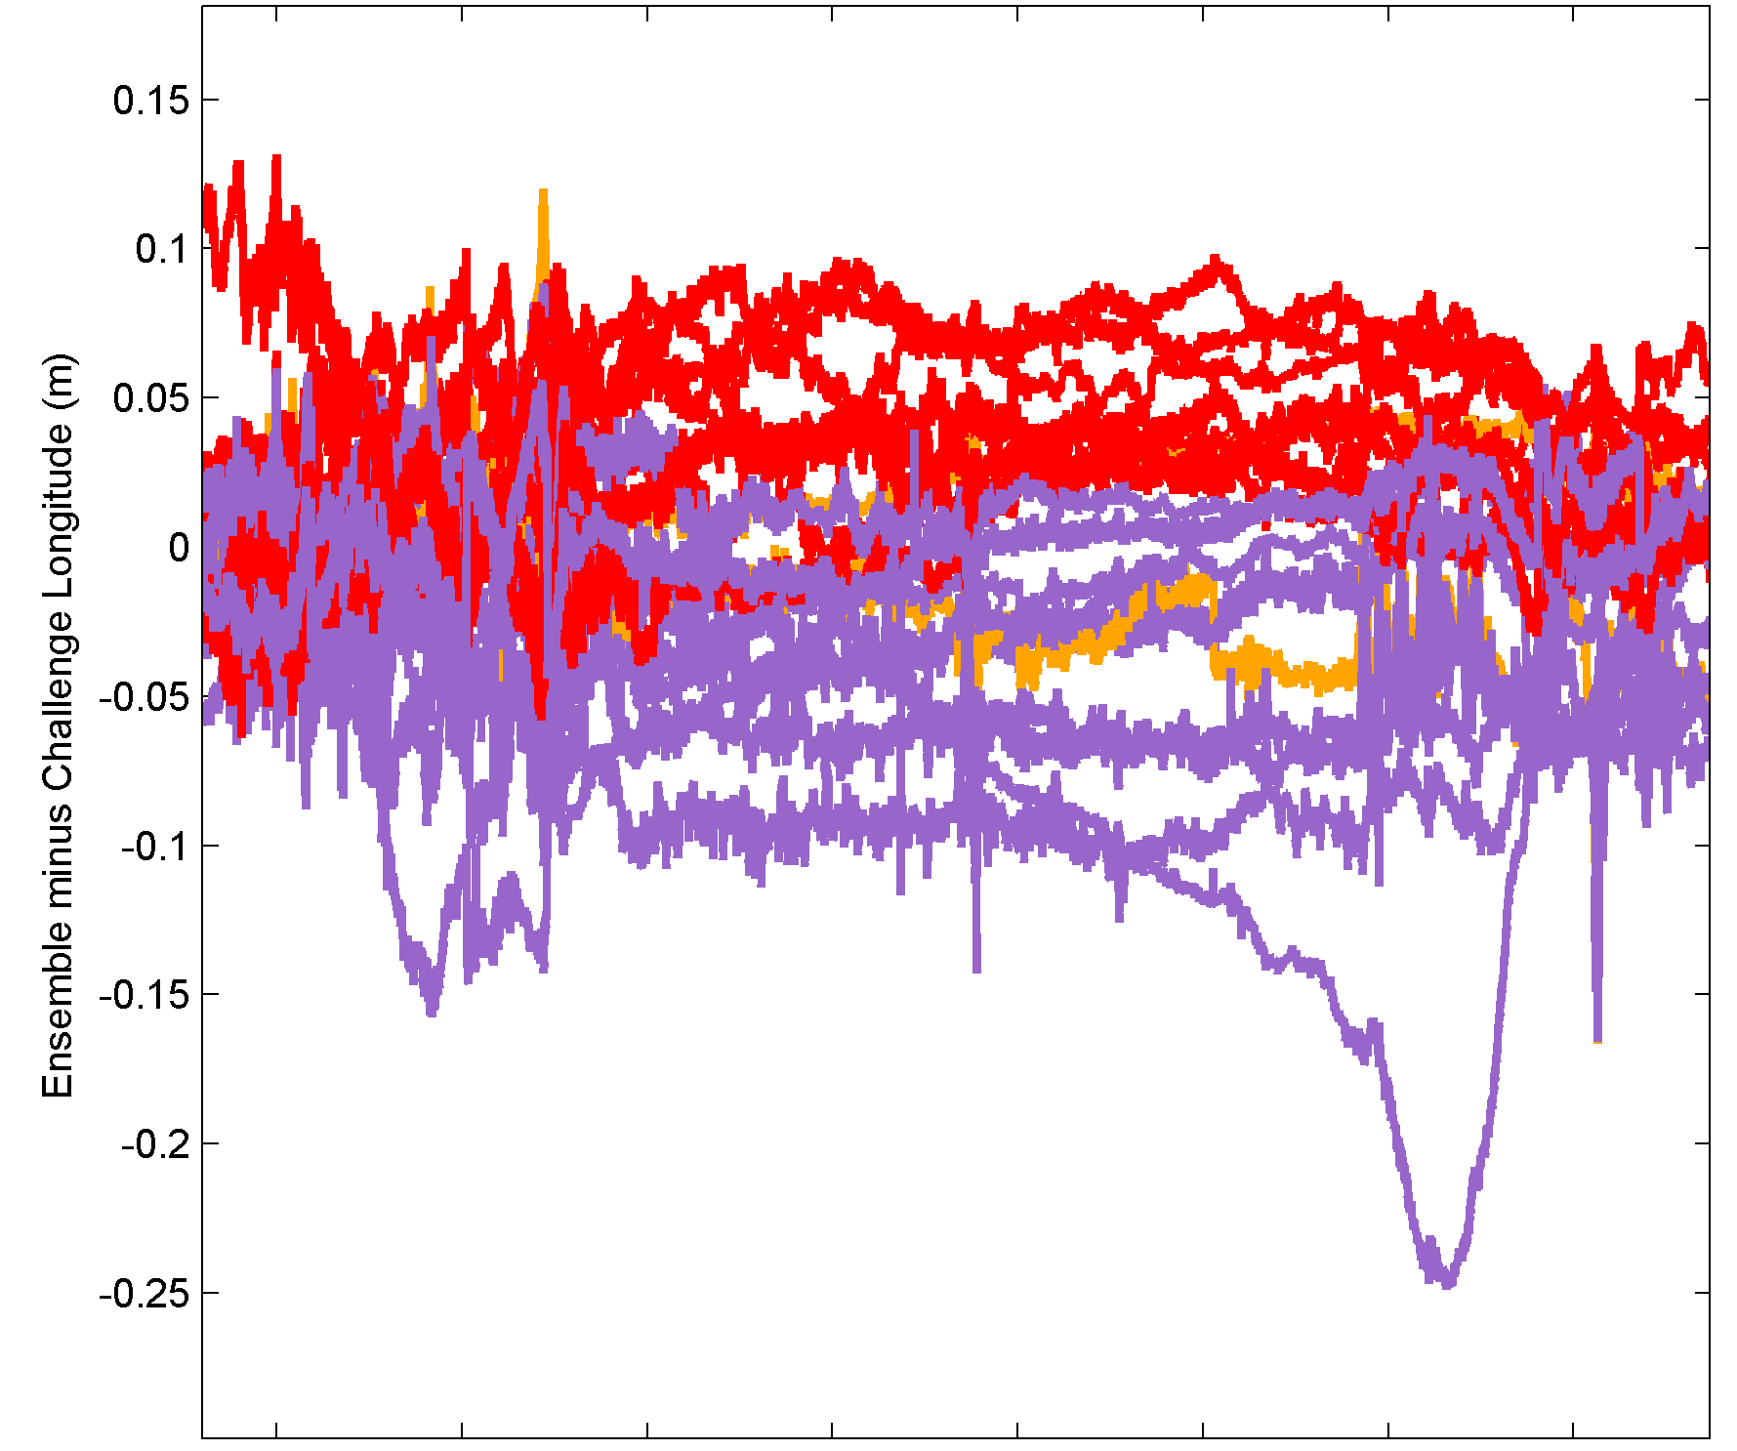
Comparison to Ensemble Average
Latitude
Ellipsoidal Height
Longitude
Single Baseline Differential
Network Differential
PPP

Slide 9
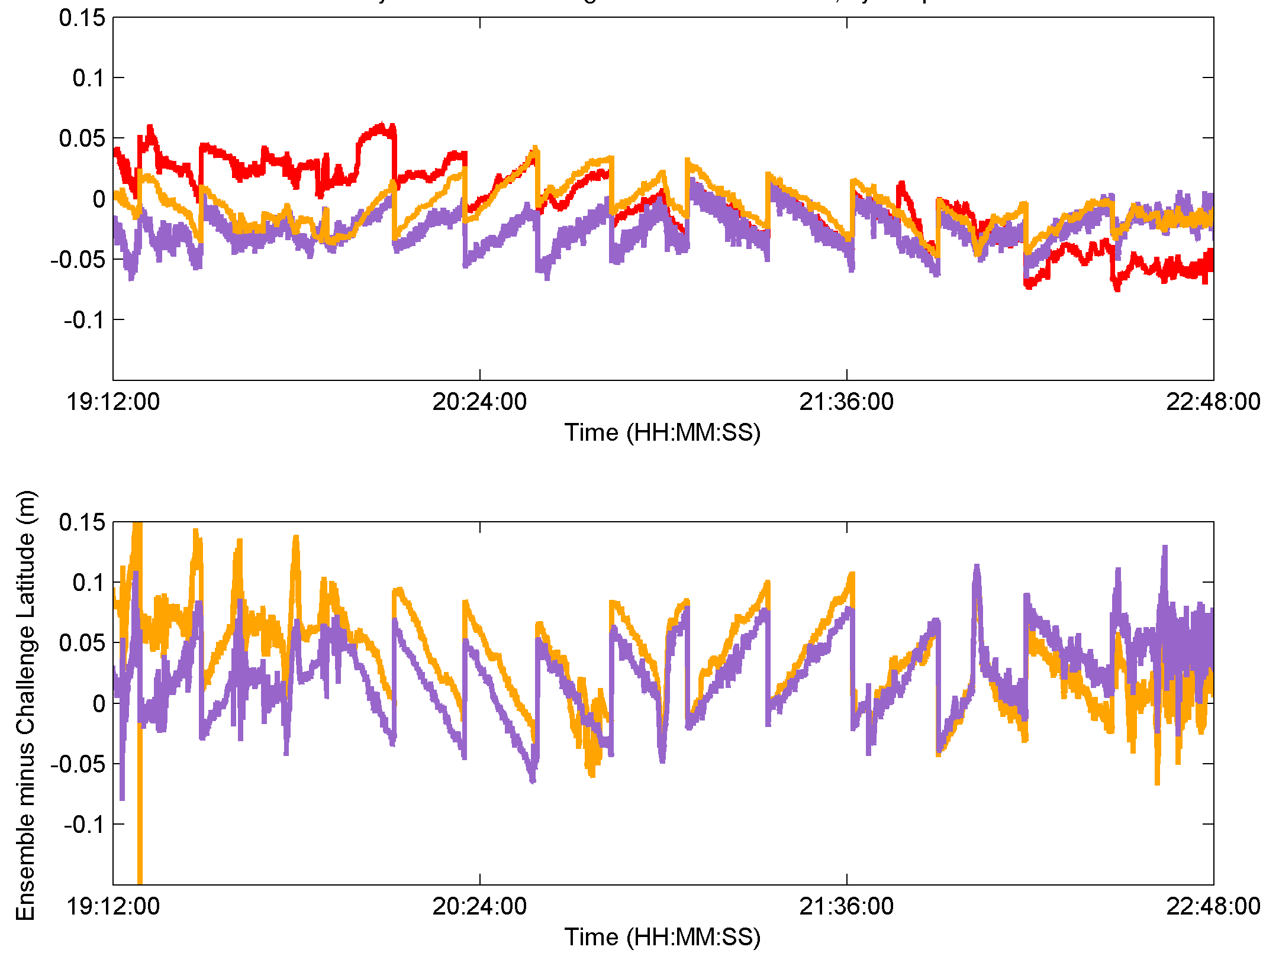
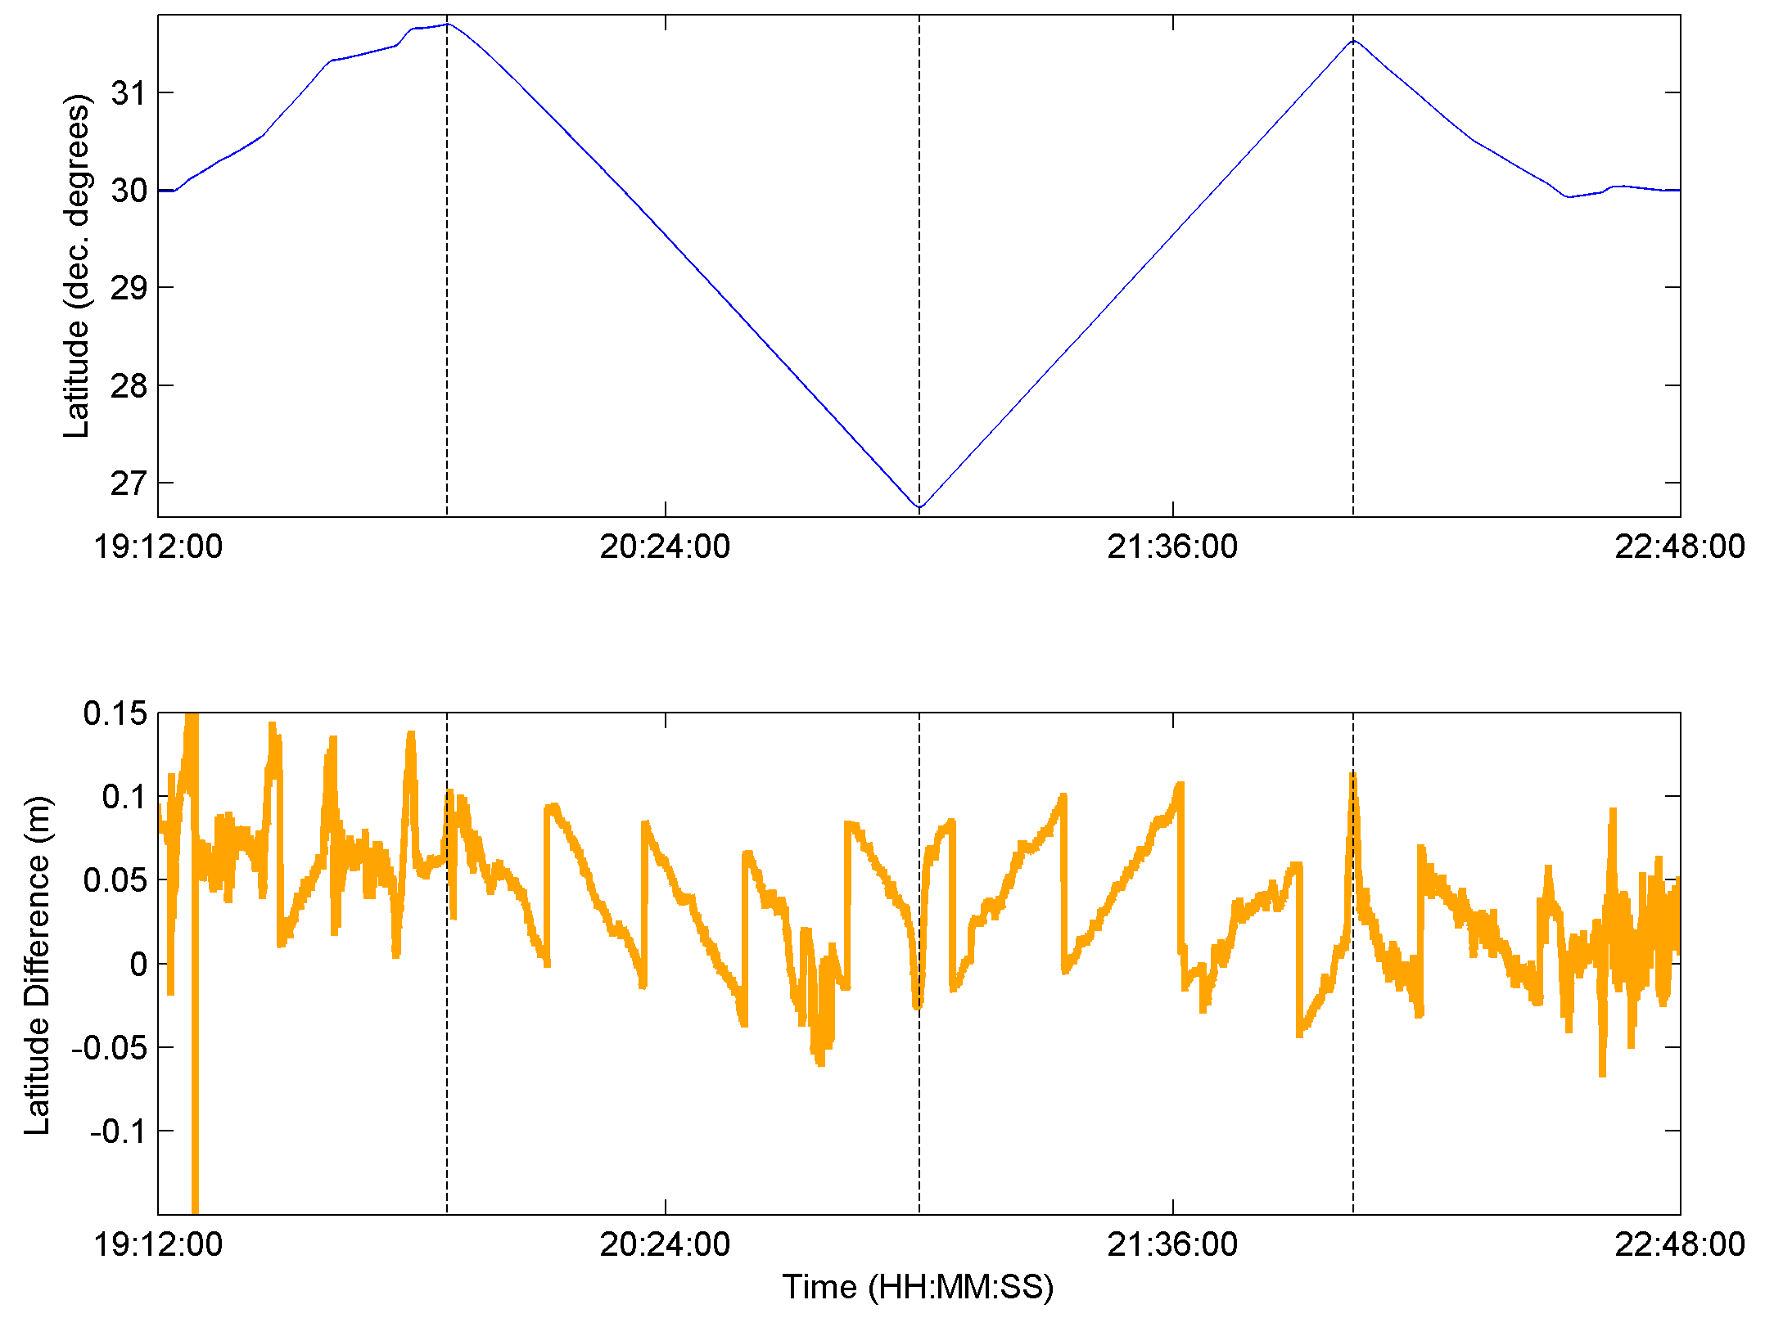
Sawtooth Pattern and Spikes
South
North
North-East
South-West
Difference with Ensemble:
  13 falling sawtooth
  6 rising sawtooth
4 sections, alternating saw shape
Intervals of sections, and each step function not equal
The six have no sawtooth in position
Cause of sawtooth: aircraft receiver (Trimble) clock jumps
Circumstance of saw shape change:
change in aircraft heading
Unsolved: Why clock jumps did not affect six of the solutions; why the shape is related to aircraft heading

Slide 10
Confidence Intervals
99.7% points for any position solution of a GRAV-D flight,
created with modern kinematic software and an experienced user,
should be precise to within +/- 3-sigma.
Latitude most precise, Ellipsoidal Height least precise

Slide 11
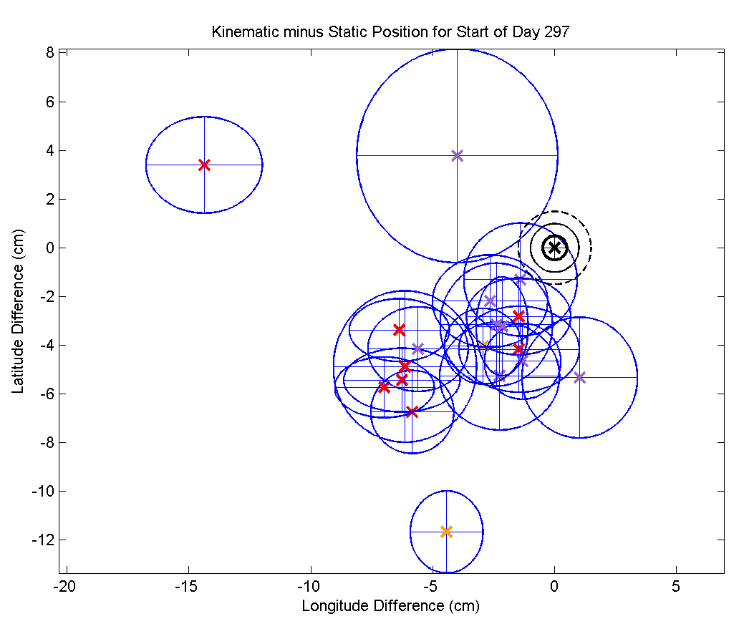
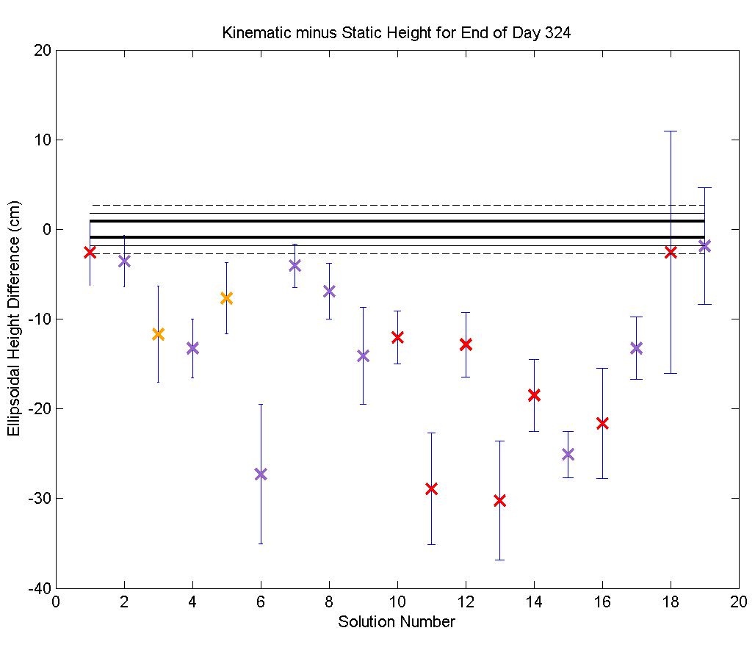
Stationary Time Periods- Accuracy
Truth: NGS’ OPUS positions for start and end of flight stationary time period
Kinematic Solutions averaged during stationary time; 3-sigma error ellipses
Two examples of significant average biases below.
If the mean difference is significant, kinematic solutions tend to be to SW and at lower heights than OPUS.
No consistent pattern in accuracy based on solution type
-3.7
-13.6
Longitude vs. Latitude
Day 297
Ellipsoidal
Height
Day 324
-4.1

Slide 12
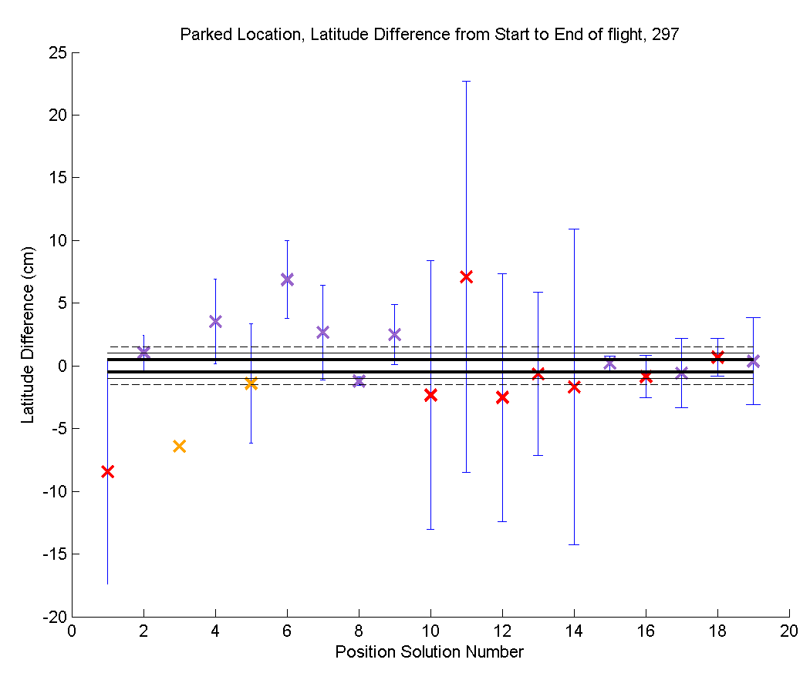
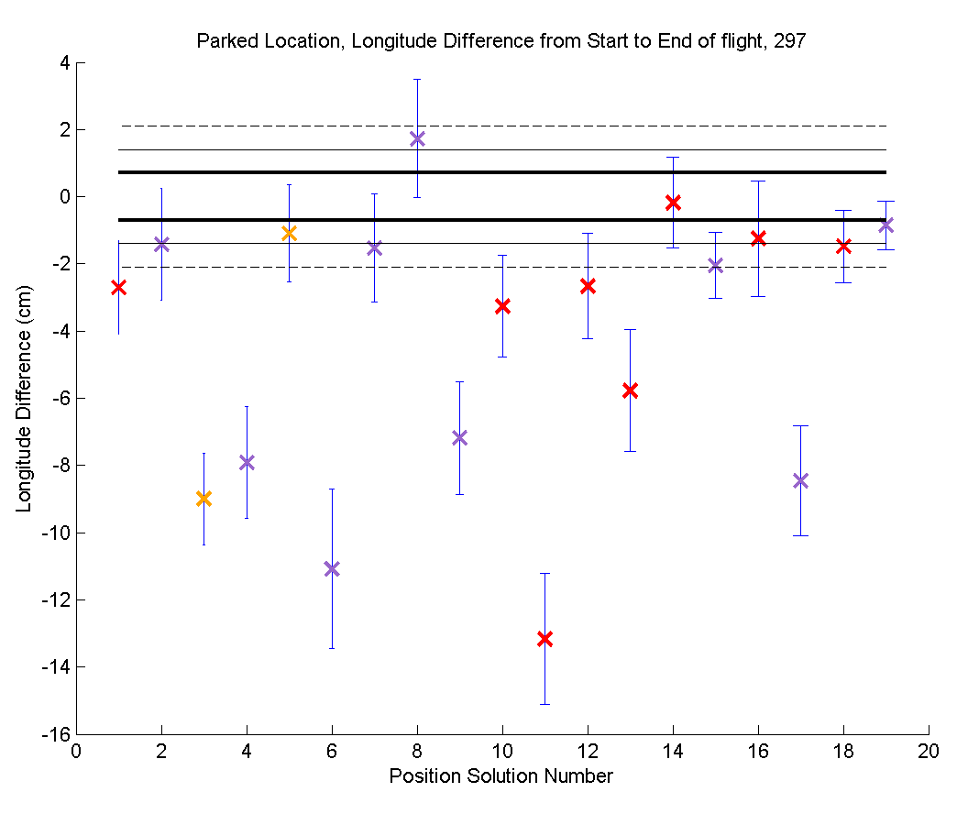
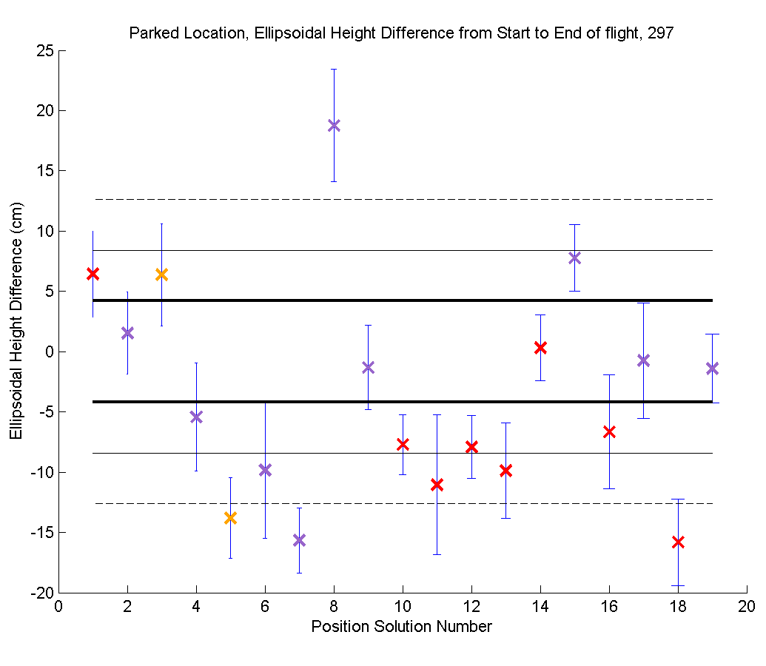
Closure Error
Measure of internal solution precision, independent of other solutions
Difference of the start of flight position to end of flight position
Normalized so that OPUS closure is zero
For all coordinates on both days, > half the solutions (1-sigma error) fall within the OPUS 3-sigma closure error.
Even more solutions for Day 324 are within the OPUS Error

Slide 13
Conclusions
With modern software and an experienced processor, 99.7% of positions are precise to: +/- 8.9 cm Latitude, 14.3 cm Longitude, and 34.8 cm Ellipsoidal Height.
Results are independent of processing type
Accuracy of kinematic solutions while stationary is either within OPUS error, or biased to the SW and negative ellipsoidal height
Internal precision, from closure error, is within OPUS closure error for the majority of solutions.
Sawtooth pattern in the majority of solutions is due to clock jumps in the Trimble aircraft receiver, which change shape when the aircraft changes heading. Six solutions were immune.
Recommend using clock-steered receivers

Slide 14
Thank You
More Information:
  http://www.ngs.noaa.gov/GRAV-D
Contact:
  Dr. Theresa Damiani
  theresa.damiani@noaa.gov
Participant Name | Affiliation
Oscar L. Colombo | NASA- Goddard Space Flight Center, Geodynamics Branch
Theresa M. Damiani | NOAA-National Geodetic Survey, Geosciences Research Division
Bruce J. Haines | NASA- Jet Propulsion Laboratory
Thomas A. Herring and Frank Centinello | Massachusetts Institute of Technology, Department of Earth, Atmospheric and Planetary Sciences
Aaron J. Kerkhoff | University of Texas at Austin, Applied Research Laboratory
Narve Kjorsvik | TerraTec, Inc. Norway
Gerald L. Mader | NOAA- National Geodetic Survey, Geosciences Research Division
Flavien Mercier | Centre National d’Etudes Spatiales (CNES), Space Geodesy Section, France
Ricardo Piriz | GMV, Inc., Spain
Pierre Tetreault | Natural Resources Canada
Detang Zhong | Fugro Airborne Surveys, Canada
Wolfgang Ziegler | GRW Aerial Surveys, Inc.

