Slide 1

Use of High-Rate CORS for Airborne Positioning
Theresa M. Damiani
NOAA- National Geodetic Survey,
Geosciences Research Division
CGSIC 2013, Nashville
1b. Surveying, Mapping, and Geosciences Session

Slide 2



Aerial Surveying
All types of aircraft (helicopter, fixed wing, balloon, UAS)
Many tools for surveying, mapping, and geosciences.
  Photogrammetry, (Topo-Bathy) LIDAR, Gravity, Magnetics, Hyperspectral or Multispectral, Radiometric, etc.
Advantages: Cover a lot of ground quickly and with consistent sampling
Positioning is crucial!

Slide 3
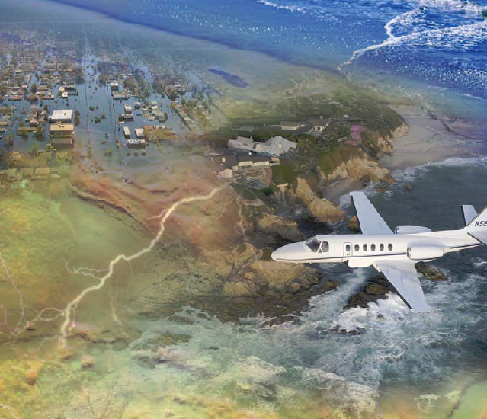
NGS Airborne Programs
Critical to U.S. National Geodetic Survey’s (NGS’) mission to define, maintain, and provide access to the U.S. National Spatial Reference System
Gravity for the Redefinition of the American Vertical Datum (GRAV-D)
2007 – 2022 (9 years remaining)
Airborne Gravity Snapshot
Target: 2 cm accuracy orthometric heights
Coastal Mapping Program
Photogrammetry and Topo-Bathy LIDAR
Emergency Response Imagery
Notes:
Full funding was estimated at approximately $5.5M / year. Although full funding was not approved, partial funding was approved in 2010 at $3M/year. As such, the initially hoped for 2018 target date will almost certainly not be met.
Current best target for completion of airborne surveys and implementation of the new vertical datum is is 2022 (updated October 2010).

Slide 4
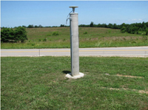
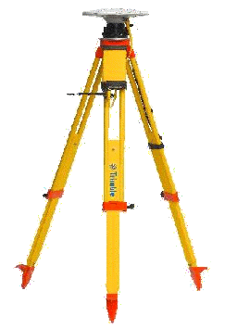
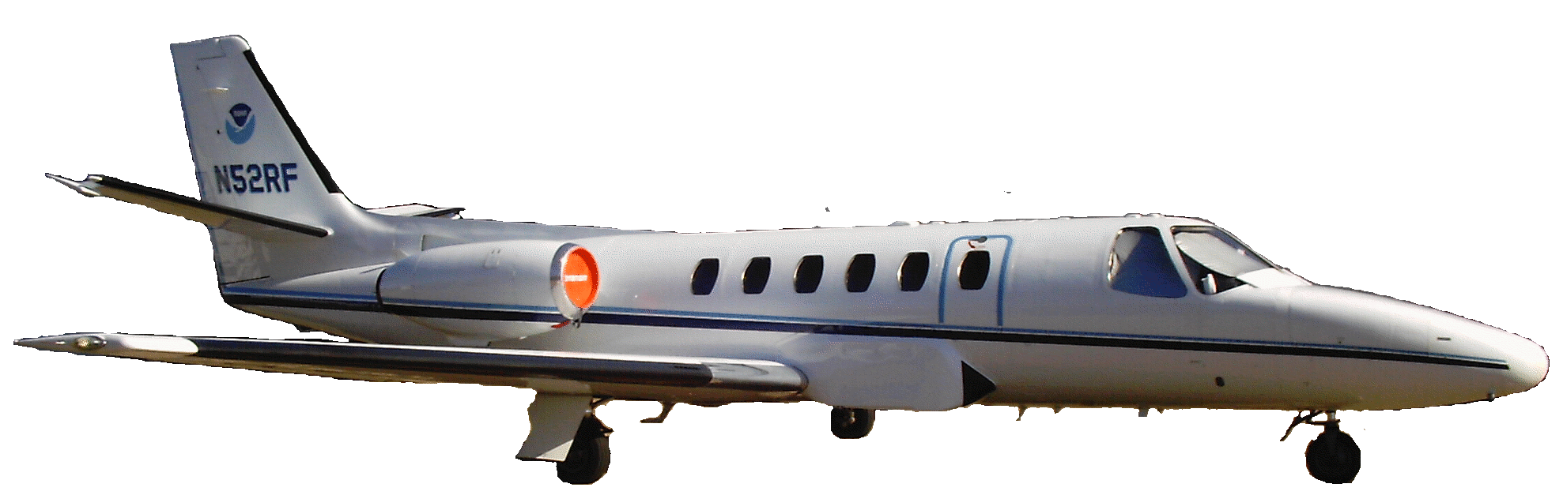
Positioning
CORS
High-altitude, high-speed, long duration flights for gravimetry
Low-altitude, slow-speed, short duration for coastal mapping
Traditionally, Differential Single Baseline or Differential Network
Consecutive epochs at 1 Hz required
Inertial measurements for aircraft orientations
IMU
GPS Antenna
Instrumentation

Slide 5
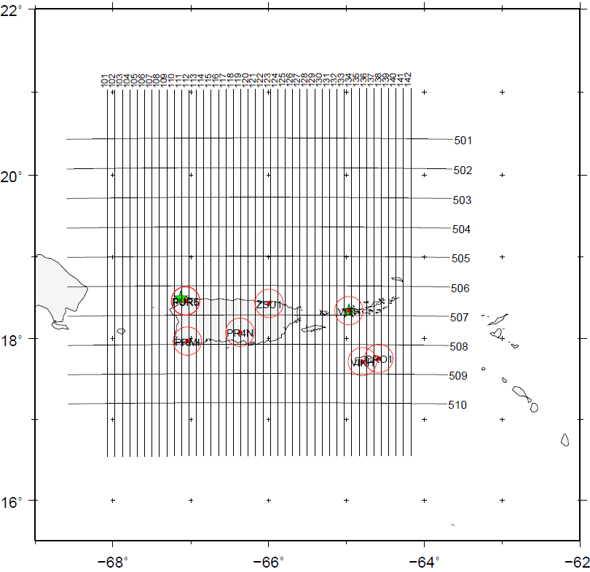
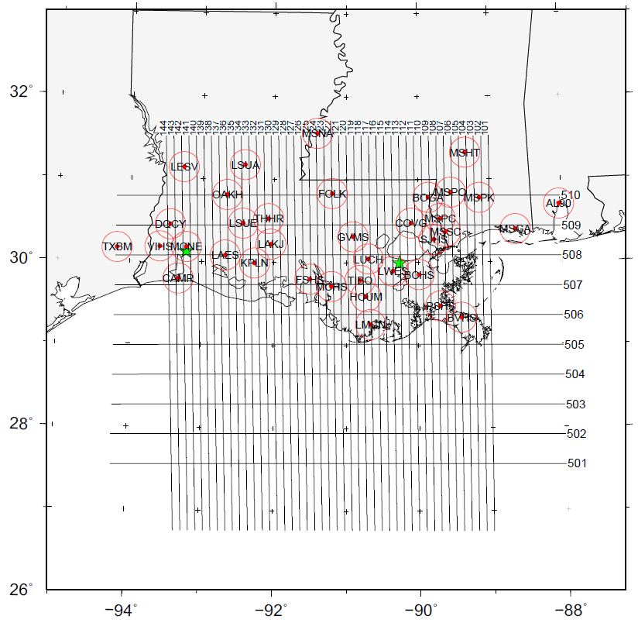
Differential Positioning and CORS
Puerto Rico and Virgin Islands
Louisiana
Two GRAV-D surveys completed in 2008/2009

Slide 6
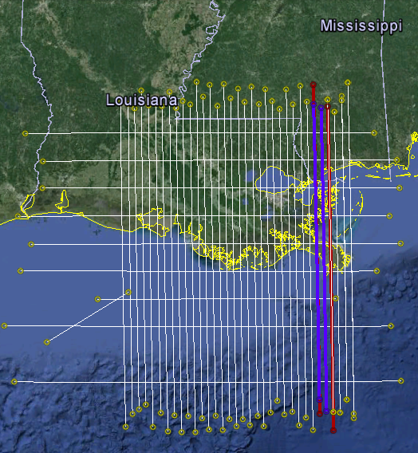
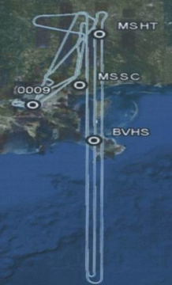
Kinematic GPS Processing Challenge
Louisiana 2008
Two days
Altitude: 35k ft. (~10 km)
Longest Baseline: 400 km
Flight Time: 3.5 Hours
Network and Single Baseline Differential positions are equivalent, no matter which station is used as the base
Precise Point Positioning (PPP) is equivalent
New Orleans
Post-Processing
Not Applicable to Low-Altitude

Slide 7
Immediate Positioning
PPP cannot be used for immediate processing of airborne data, since it requires precise IGS ephemeris (Lag time: 12 days)
For quality control during a survey, you must have one or more bases. How many? Where located?
For rapid response or easy logistics, can you use one?
Single point of failure; high risk for long duration missions; Use CORS as a backup station

Slide 8
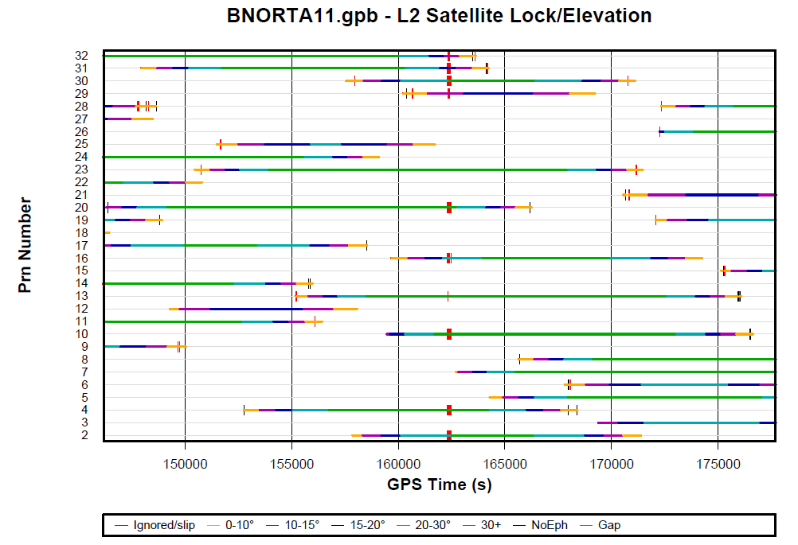

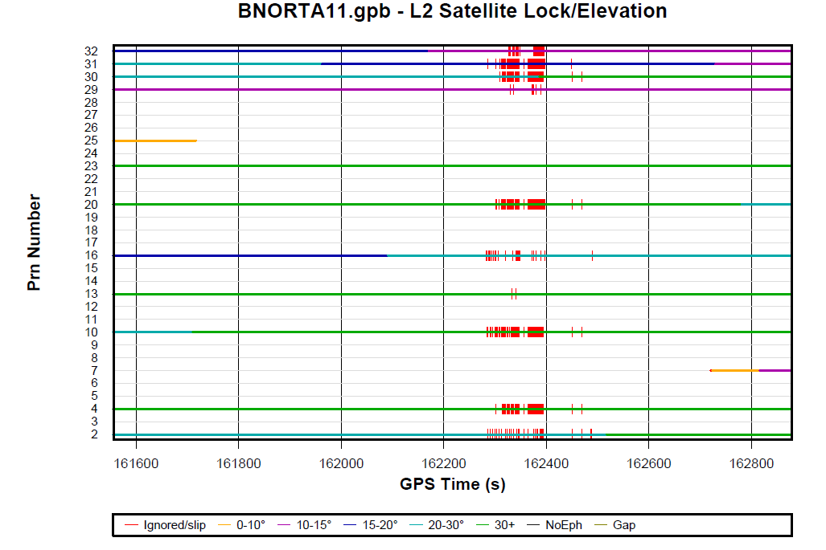
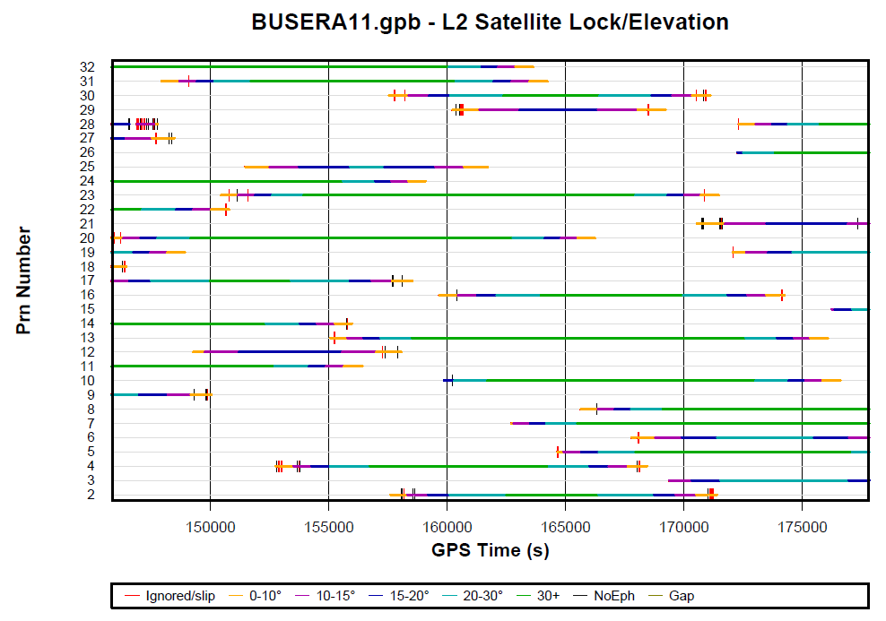
Causes of GPS Failures at Airports
Jamming
Occlusions
Other broadcasts
Hardware breaks
Batteries don’t last
Data card fails
Human error

Slide 9
UAS
Unmanned Aerial Systems (UAS) of great interest to surveying and mapping in U.S.
Logistically desirable- less equipment, less personnel, less fuel
Fast, easy deployment
In-field quality control without setting up your own base stations would be advantageous- can CORS support that?

Slide 10
High-Rate CORS Available Now
1 Hz data rate necessary
Restriction for use as a base station in airborne positioning: Located within ~15 km of the airport
Pros: Managed, permanent site; low effort
Cons: No control over quality and continuity
~670 1s stations in network
Concentrated in eastern 1/3 of U.S. and West Coast

Slide 11
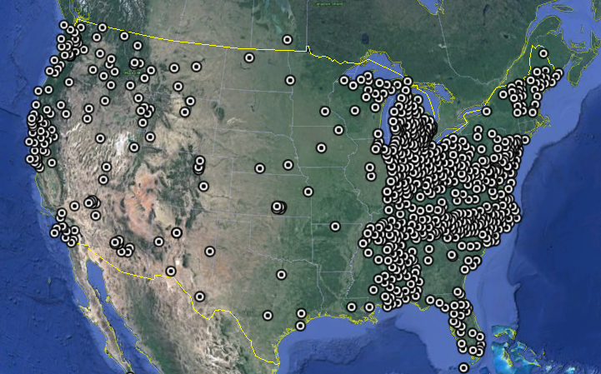
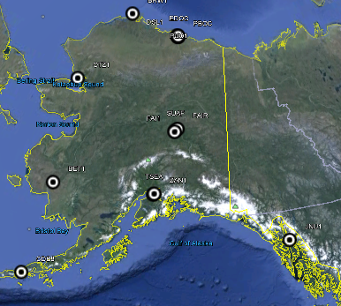
Map of Operational 1s CORS

Slide 12
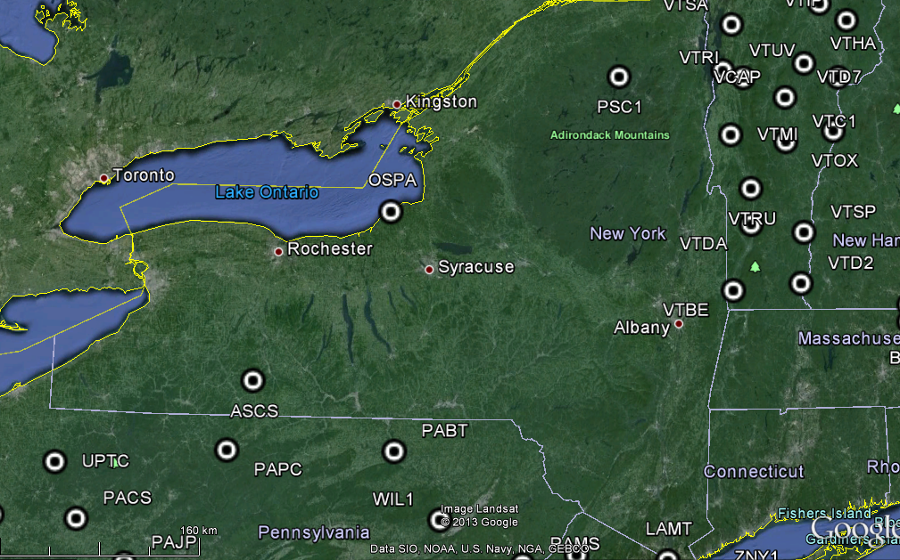
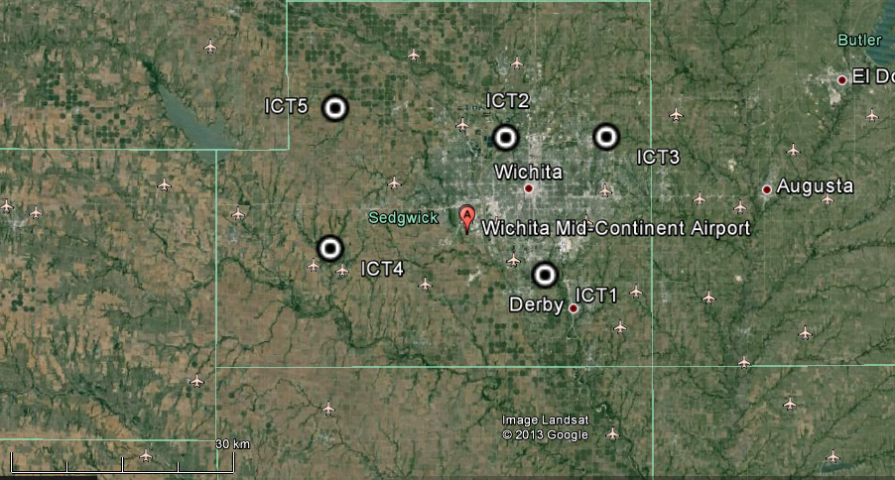
Co-location with airports

Slide 13
Conclusions
Airborne positioning for geoscience applications benefits from the co-location of high-rate CORS with U.S. airports
With potential increase in UAS surveying, low-effort and rapid aerial deployments are of continuing interest
Over most of the U.S., airborne operators currently have to run at least 1 of their own base stations.
Some places (like Wichita, KS) are CORS-ready for rapid deployment.
NGS Programs Information:
  http://www.ngs.noaa.gov/GRAV-D http://www.ngs.noaa.gov/RSD
Contact:
  Dr. Theresa Damiani
  theresa.damiani@noaa.gov

