Slide 1
Inclusion of Dynamics in the new Reference System
Dr. Theresa Damiani
Chief, Spatial Reference System Division
CGSIC
September 24, 2018

Slide 2
Latitude, Longitude
& Ellipsoid Heights

Slide 3
Replacing the NAD 83’s
Four plate-fixed reference frames
  N. Amer., Pacific, Mariana, Caribbean(new!)
Fixed: NAD 83 doesn’t rotate properly with its plates
Method: Define each of the 4 new frames equal to IGS14 @ 2020
  Define each frame’s movement by a plate rotation only
  Put another way: “The frame rotates so your coordinates don’t have to”

Slide 4
The relation of five global reference
frames through time.
NATRF2022
MATRF2022
Rotations are not to scale
CATRF2022
Rotation of North American Plate
PATRF2022
Rotation of Pacific Plate
IGS14 frame
IGS14 frame through time
IGS14 frame
Rotation of Caribbean Plate
PATRF2022
CATRF2022
Rotation of Mariana Plate
NATRF2022
Time “t ” when
all four TRFs and
IGS14 are identical.
(2020.0)
MATRF2022
0
t=t - Δt
(“the past”)
t=t + Δt
(“the future”)
0
0

Slide 5
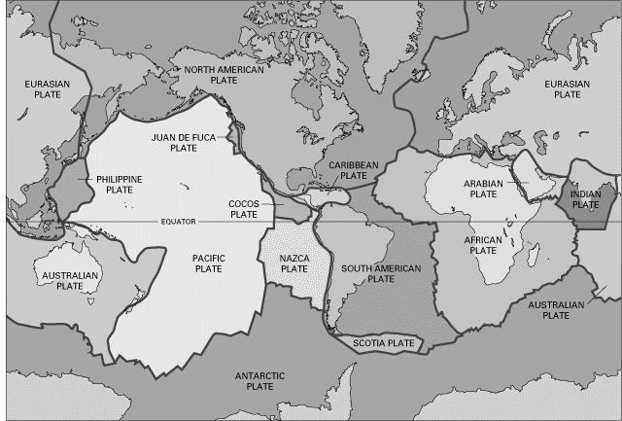
BSMK (North Dakota)

Slide 6
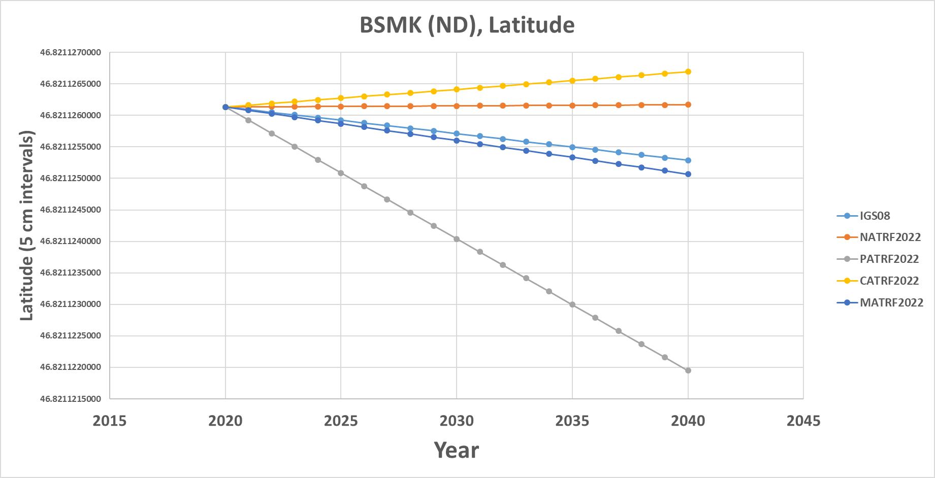
BSMK (North Dakota)
As per NGS policy decision circa 2018:
t₀ = 2020.0
NATRF2022 Latitude is CONSTANT over time

Slide 7
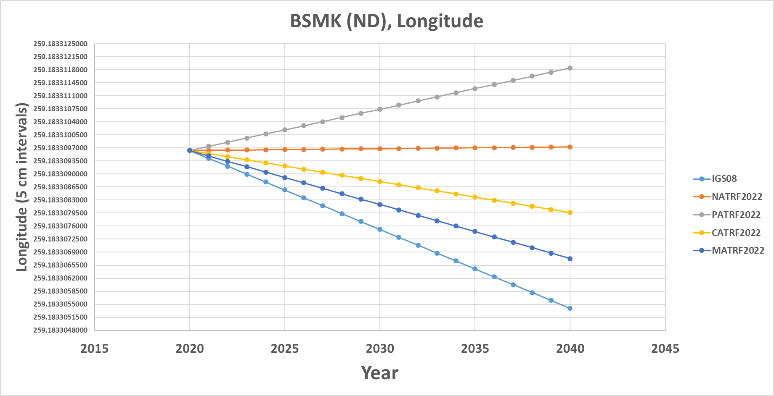
BSMK (North Dakota)
NATRF2022 Longitude is constant over time

Slide 8
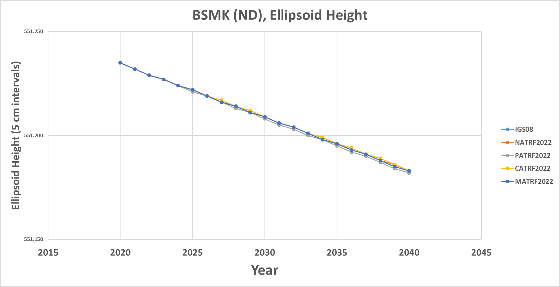
BSMK (North Dakota)
No matter WHAT frame, the ellipsoid height is dropping over time

Slide 9
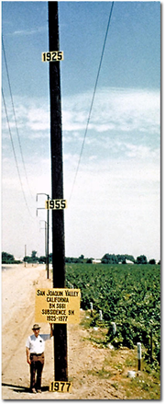
Residual Vertical Motion
Crust uplifts and subsides
  Wide variety of spatial and temporal scales
  GIA is uplifting much of the North half of CONUS
  Modern ice loss of melting glaciers affects AK
  Agricultural water withdrawal subsides the crust (see left)
  Earthquakes, Volcanic Eruptions, Etc

Slide 10
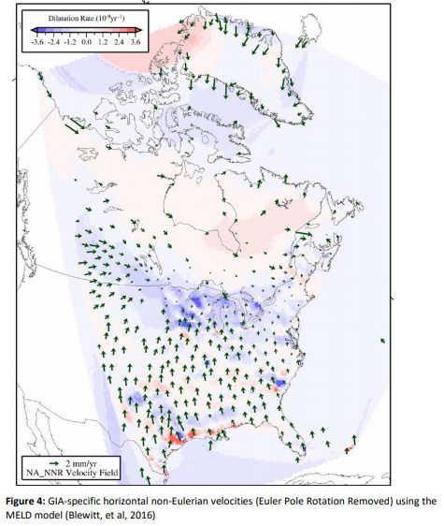
Residual Horizontal Motion
“Intra-frame velocities”
GIA, earthquakes, deformation (esp. CA & AK)

Slide 11
Definitional Relationships- Geometric
User provides
GNSS survey data on epoch
+
NGS provides
CORS data on epoch
Geodetic Control
a. Position in IGS/ITRF at epoch of survey
b. Position in *TRF2022 at epoch of survey
→ OPUS →
↓
IFVM
↓
2. All other epochs
Corrected for dynamics
a. Position in *TRF2022 at any epoch or a common epoch
Time-dependent Geometric Positions are Latitude, Longitude, Ellipsoidal Height

Slide 12
IFVM
Historically, NGS has provided a model of horizontal motions (both plate rotational velocities and horizontal intra-frame velocities) through the Horizontal Time Dependent Positioning (HTDP) computer program. However, HTDP has never supported vertical velocities, except in central Alaska.
New *TRF2022s will already take into account plate motion and remove it from your geodetic control.
IFVM will provide a model of remaining geometric horizontal AND vertical motion over time not accounted for my plate motion (GIA, subsidence, earthquakes, etc.)
Data-driven solutions are easier to maintain for all epochs and spatial scales needed to accomplish this task.
Available now: a model of gridded CORS motion for NATREF2022
Researching: InSAR and other methods for creating an IFVM

Slide 13
Orthometric Heights

Slide 14
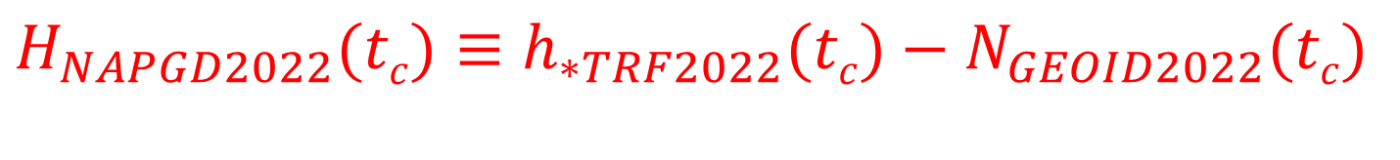
Definitional Relationship- Geopotential
$H_{NAPGD2022}(tc)≡h_{∗TRF2022}(tc)−N_{GEOID2022}(tc)$
Time-dependent orthometric heights
Time-dependent ellipsoid heights
come from time-dependent
CORS coordinates which serve as control for your time-dependent GNSS survey.
They will be modeled in the Intra-Frame Velocity Model, or IFVM
Time-dependent geoid undulations
come from the dynamic component of GEOID2022 (“DGEOID2022”)
They will be modeled by the Geoid Monitoring Service, or GeMS.

Slide 15
Geoid Monitoring Service
Goal: Track all changes to the geoid which would prevent 1 cm accuracy
Geoid changes are due to very large mass movements
Three major aspects:
  Continuous Shape Changes: e.g. Ice Loss Response
  Episodic Shape Changes: e.g. Massive Earthquakes
  Definition of Geoid: e.g. Global Sea Level Change

Slide 16
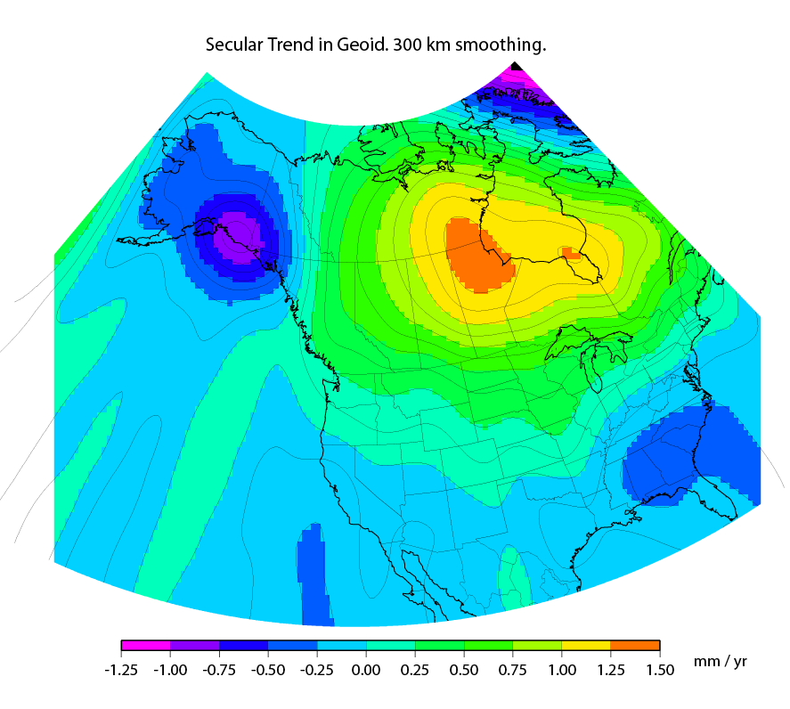
Continuous Shape Change
Available now: GRACE and GRACE-Follow On satellite gravity and geoid models
Pros: Global model with proven accuracy, easy to obtain, GRACE-Follow On launched this year so new data is likely available through 2023, Good first estimate for next 30 years of change
Con: Resolution is not sufficient to provide full geoid monitoring
Need: Ground gravity surveys to identify what we don’t know yet
Notes:
There are two manifestations of the growing mass in the deep mantle under Hudson Bay:
Geometric – a GPS receiver will see the crust uplifting as the increase in mantle mass pushes the crust up in a displacement.
Geopotential – a gravimeter on the surface will sense the growing mass as an increase in the acceleration of gravity, BUT this will be slightly tempered by a reduction in gravity as well (because the gravimeter on the surface is getting farther from the Earth’s center). Still, the gain (from mass increase) is larger than the loss (from geometric movement) for a net gain. Because the net gain in gravity is not caused purely by being at a new crustal height, this translates into an increase in geoid undulations, or a “swelling” of the geoid in this region.
This is different than a purely geometric change caused by a compression of the crust. In that case, no significant mass is entering or leaving the region so, while GPS might sense a subsidence and a surface gravimeter might sense a slight increase as it moves closer to the Earth’s center, the geoid would not actually change.

Slide 17
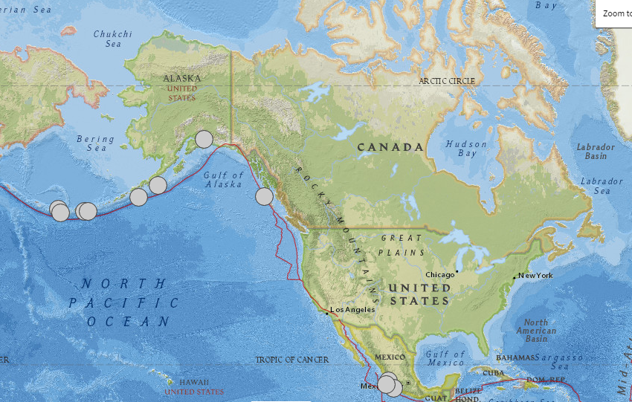
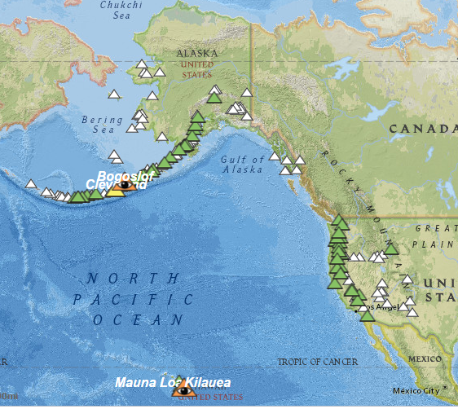

Episodic Geoid Changes
Massive, or cataclysmic, size events only.
Magnitude 8+ earthquakes, Magnitude 6+ explosive eruptions
Possible: Responsive, local re-surveys for geoid change?
All Recorded Magnitude 8 + Earthquakes, Last 110 Years

Slide 18
Geoid Monitoring Service
A new project since January 2017, planned to be operational and produce NGS’ first “D” dynamic geoid by 2022.
NGS will likely work with satellite gravity experts to build on in-house NGS expertise and to create the geoid change model.
We are currently doing research to determine which signals need to be added to the satellite gravity models and how best to estimate/measure those.
There is a need to create a realistic plan for response to cataclysmic earthquakes and explosive volcanic eruptions.
Although all of North America will be monitored, most change occurs in: Alaska, volcanic areas of the Western US, and Canada.

Slide 19
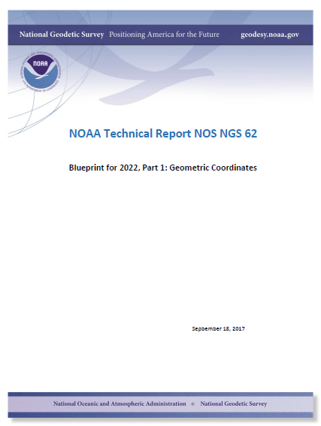
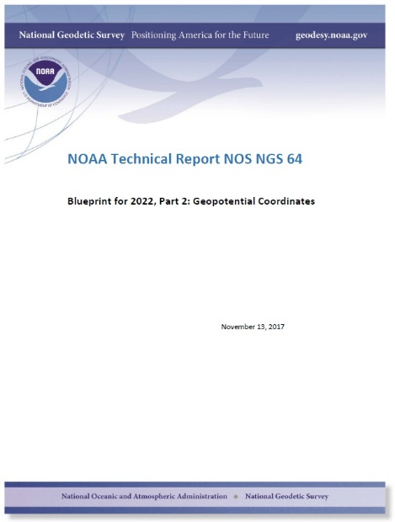
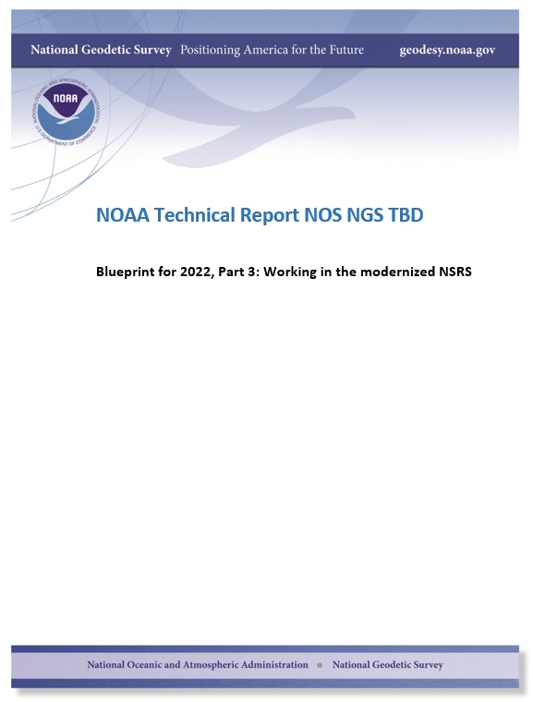
Thank You
The “blueprint” documents: Your best source for information
Geometric:
Sep 2017
Geopotential:
Nov 2017
Working in the
modernized NSRS:
~May 2019

