Slide 1


The Role of GNSS in Modern Reference Frames
GNSS replacing classical methods on non-local scales
new space-based reference frame paradigm driven by major
technology advances
GNSS now dominates International Terrestrial Reference
Frame (ITRF) combination
only technique that gives autonomous user access to global frame
but some GNSS datum weaknesses remain
Easy user access to reference frame enables many
applications
example of studying surface pressure loads discussed
Jim Ray, NOAA/National Geodetic Survey
China Satellite Navigation Conference, Wuhan, China, 15 May 2013

Slide 2
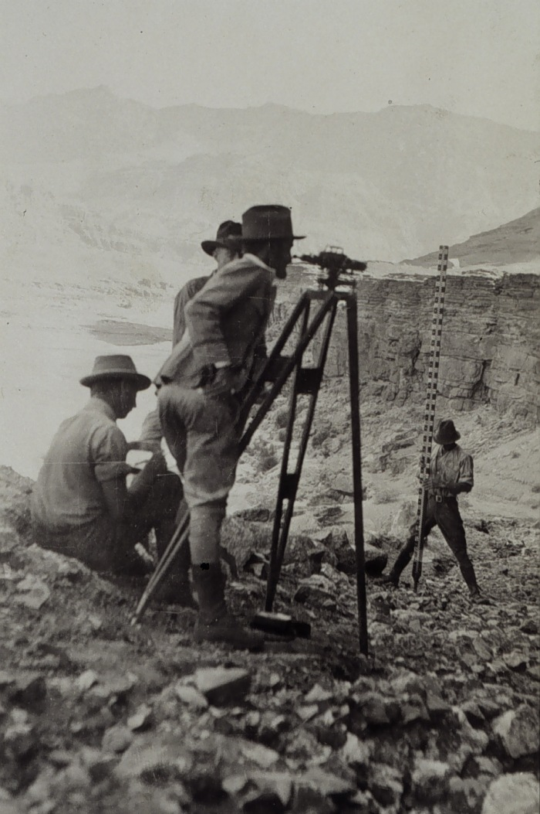
Classical Terrestrial Surveys
Since ancient times, positions measured with respect to nearby visible points
angles & distances allow triangulation
& trilateration of small networks
spirit leveling used for relative heights
simultaneous adjustment of redundant
observations gave rise to Gauss’
least-squares method
accuracies can attain <~1 mm over
<~1 km distances
Horizontal & vertical components
normally treated separately
driven by measurement technologies
& by applications
horizontal control for property bounds
vertical control for gravity variations &
water flow
02

Slide 3
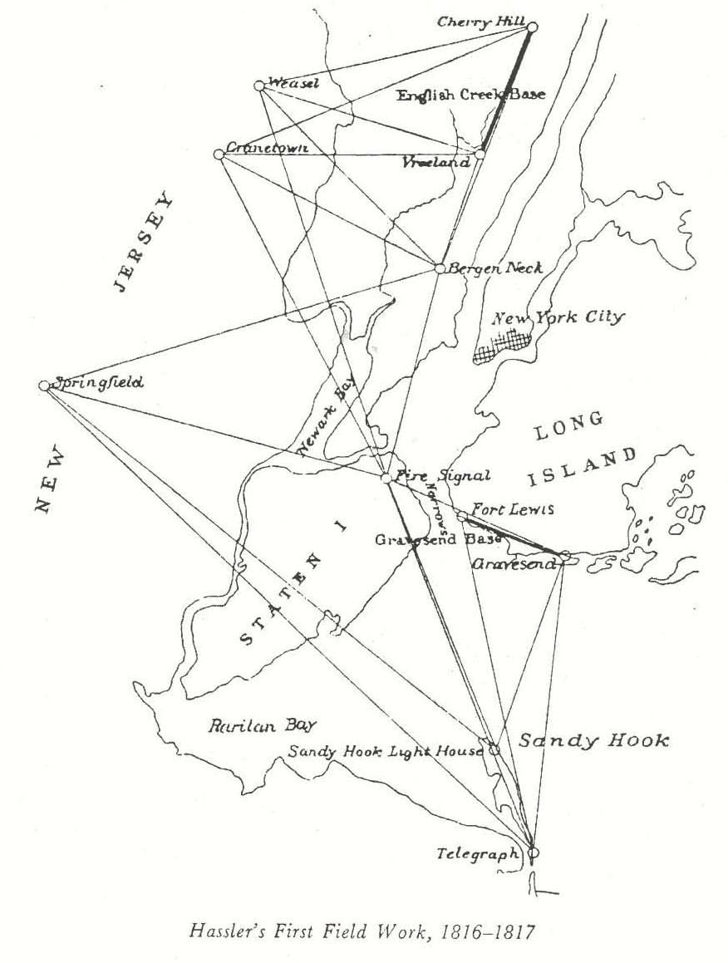
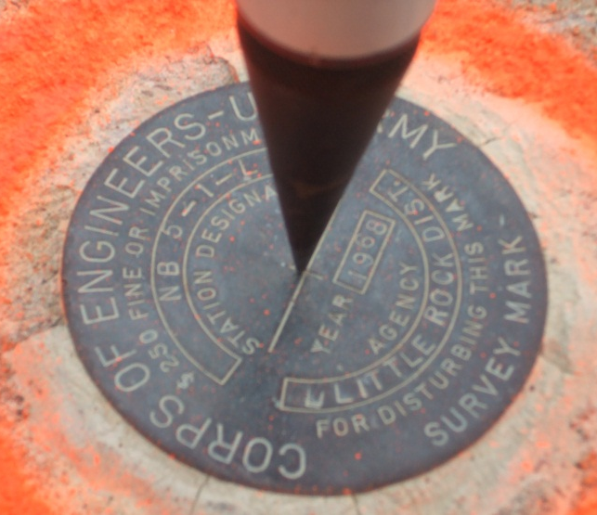
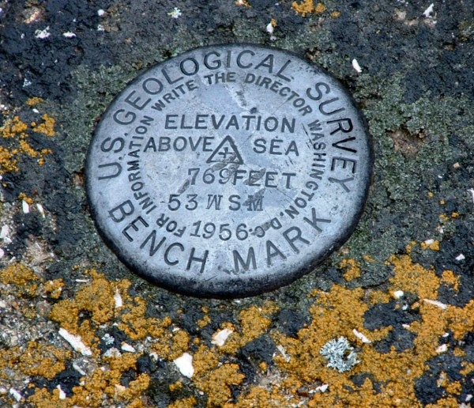
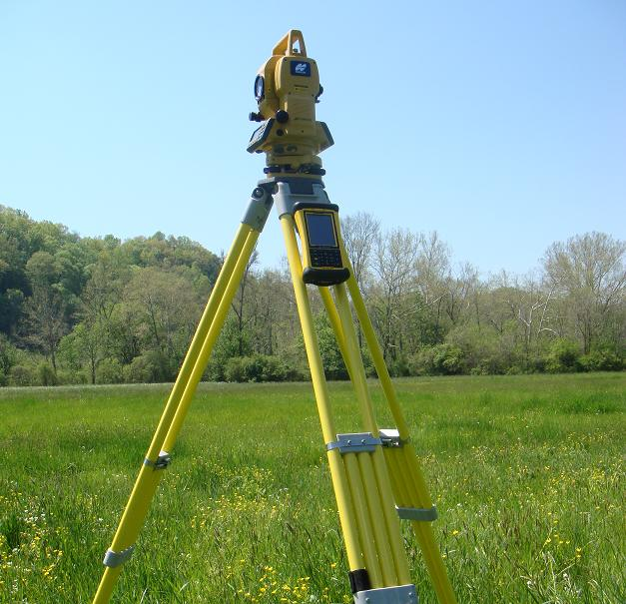
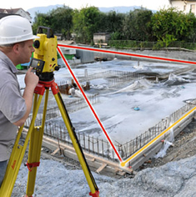
Classical Survey Components
Control Mark
Control Mark
Theodolites & Total Stations
Angle, Distance &
Height Measurements
Survey Network
(inter-visible stations)
03

Slide 4
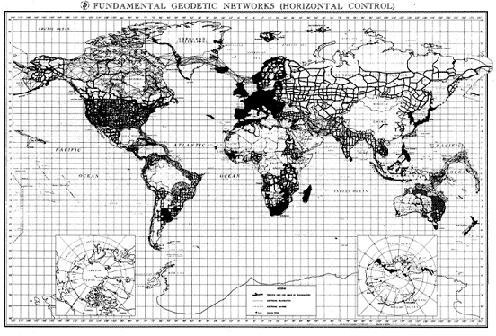
Extension to National Reference Frames
For larger regional/national reference frames
must aggregate many local survey networks
not always well connected to each other (especially across oceans)
gives rise to network distortions, inhomogeneous coverage, &
variable accuracies
local survey errors accumulate over distance
frames not consistent between different authorities
International standards
began in 1875
Metre Convention led
to SI physical units
1884 Conference led to
Greenwich prime meridian
for longitudes
but accurate geocentric
global frame not possible
till nearly 100 yr later
Main Triangulation (Horizontal) Networks
(early 1980s)
04

Slide 5
New Geodetic Paradigm: Technological Elements
Digital electronics & computers:
fast switches
broadband sampling
massive data storage
cross-correlators
efficient data analysis
Atomic clocks:
coherent obs >1 s
accurate short-interval
timing
remote synchronization
simplified modeling
Artificial satellites:
continental scale
inter-visibility
geocenter sensitivity
forced international
cooperation for
global tracking
New, high-accuracy techniques enabled on global scale:
interferometry
phase tracking at cm →
dm wavelengths
precise unambiguous
group delays
wide station separation
inter-station clock offsets
estimated in data analysis
global timekeeping <~1 µs
accurate data time tags
Kepler’s 3rd law constrains
satellite radial dynamics
measure accurate
geopotential
allow GNSS positioning
anywhere, anytime
eliminate dependence
on dense ground nets
absolute geocentric
positions
→ Era of space geodesy! ←
05

Slide 6
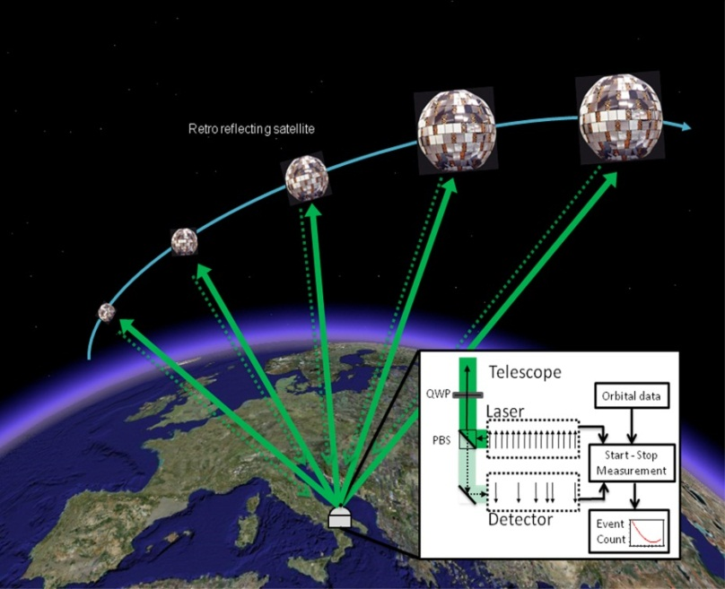
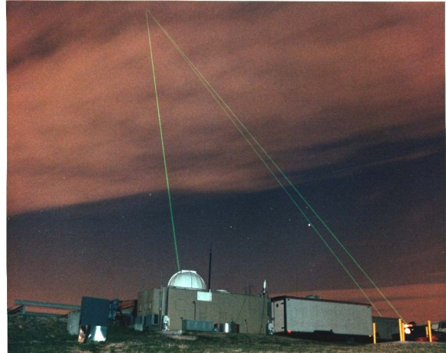
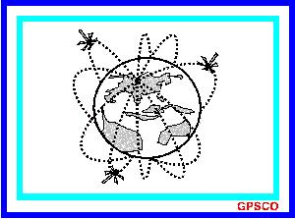
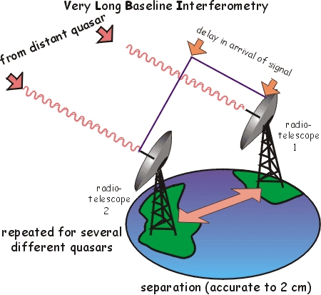
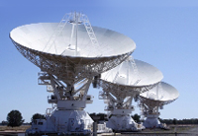
Brief History of Space Geodetic Techniques (1/3)
Key inventions & early technology development ~1950s
Practical implementation phase
1960s → 1970s
Satellite Laser Ranging (SLR)
TRANSIT Doppler
Very Long Baseline (Radio) Interferometry
(VLBI)
06

Slide 7
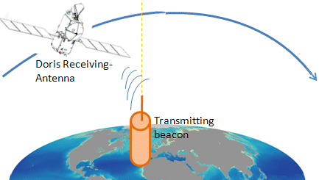
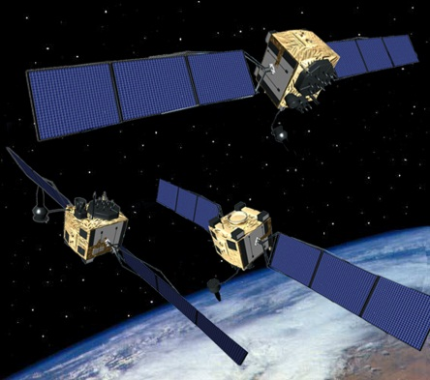
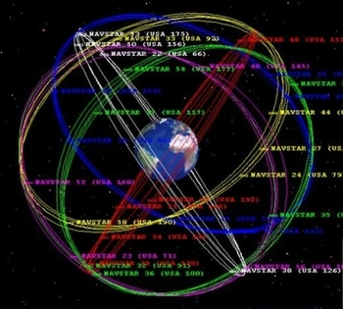
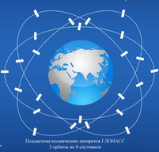
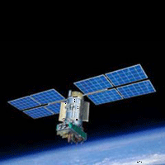
Brief History of Space Geodetic Techniques (2/3)
Maturation phase 1980s → 1990s
Doppler Orbitography & Radiopositioning
by Satellite (DORIS)
Global Navigation Satellite Systems
(GNSS):
· GPS
· GLONASS
07

Slide 8
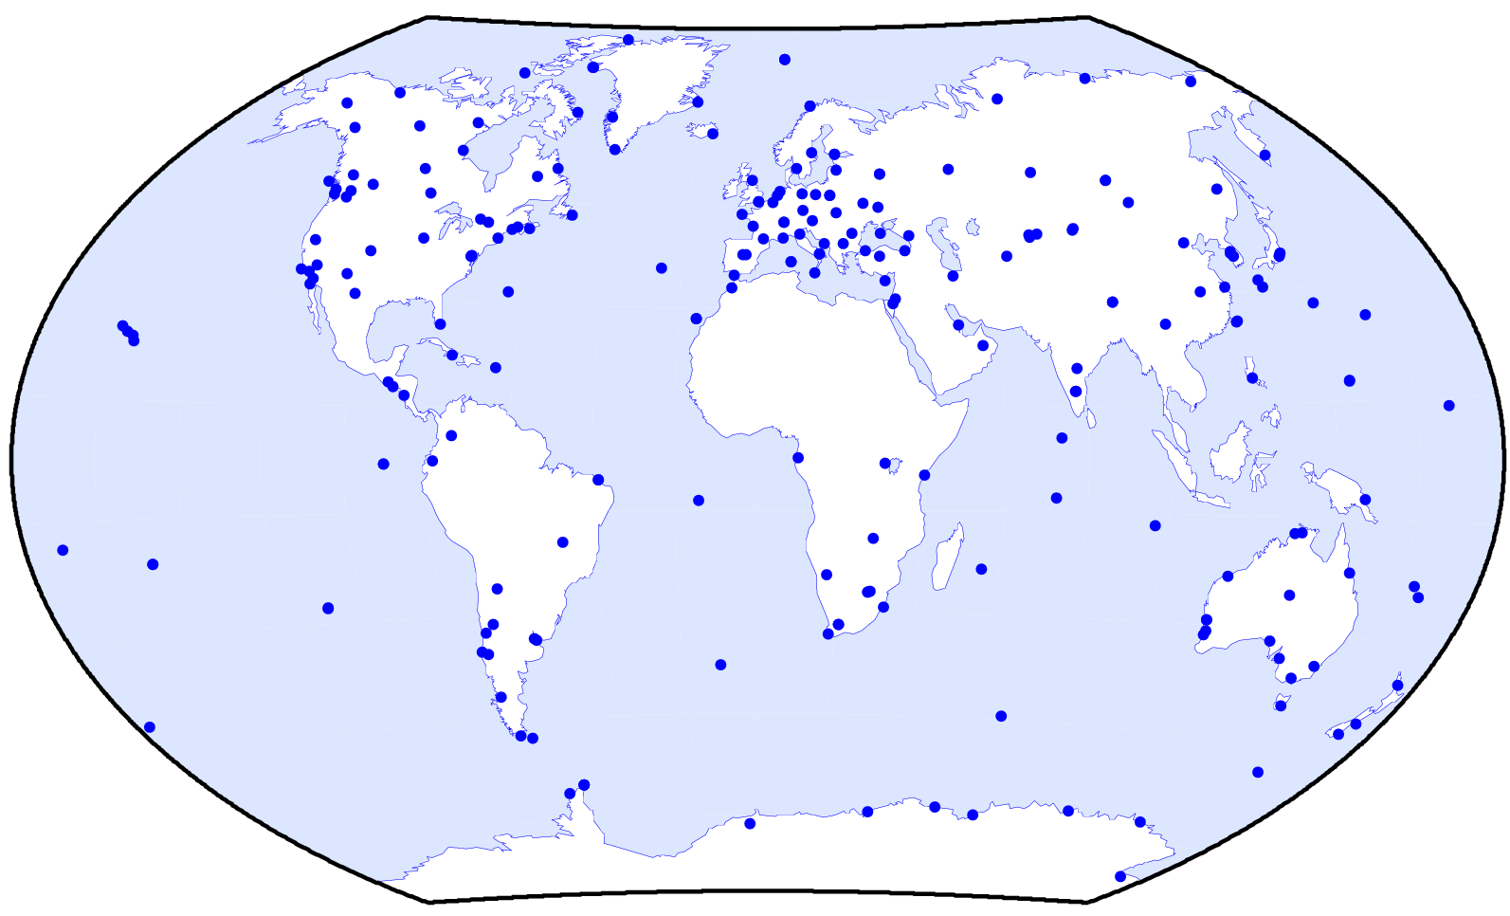
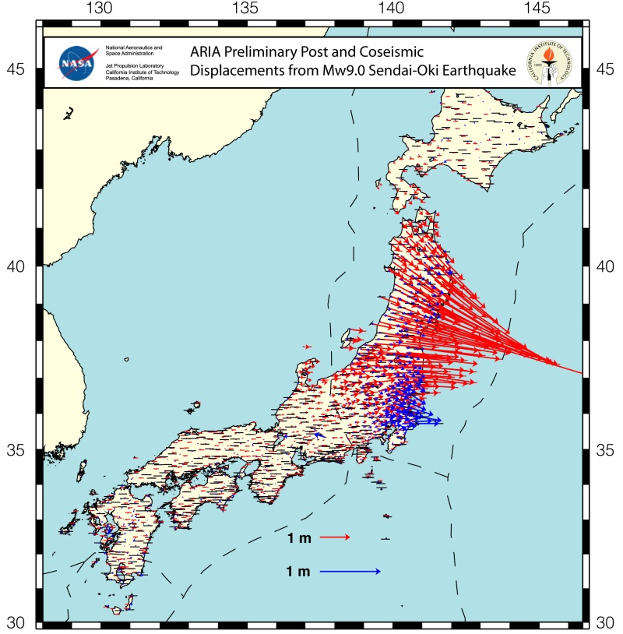
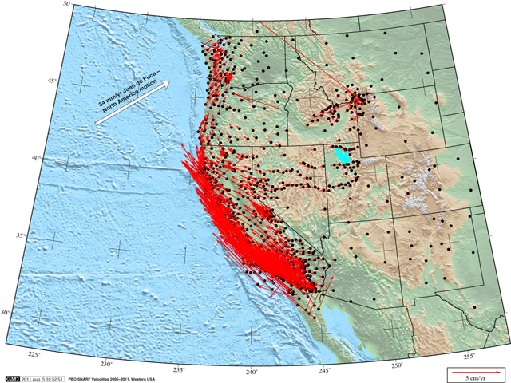
Brief History of Space Geodetic Techniques (3/3)
Expansion & exploitation phase 1990s/2000s →
new GNSS: · BEIDOU · GALILEO · Regional augmentations
routine national & international
services established (e.g., IGS)
many scientific/geophysical
networks installed
GEONET displacements after
11 Mar 2011 Tohoku earthquake
Global Reference Network of
International GNSS Service (IGS)
Plate Boundary
Observatory (PBO)
in western USA
08

Slide 9
Unique Advantages of GNSS
relatively low user costs (not including GNSS itself)
service available for anybody, anywhere, anytime
user can operate autonomously
inherently designed for real-time operations
low-accuracy mode via GNSS broadcast open service
high-accuracy mode via augmentation services (e.g., IGS)
user positions reach ~1 cm accuracy in post-processing mode (24 hr data)
real-time positions reach ~1 dm level (absolute geocentric mode)
differential positions attain sub-cm precision over regional scales
GNSS networks can serve many objectives simultaneously, e.g.:
geodynamics, water vapor sensing, ionosphere monitoring,
geodetic/survey referencing, time transfer, land cover probe, . . .
09

Slide 10
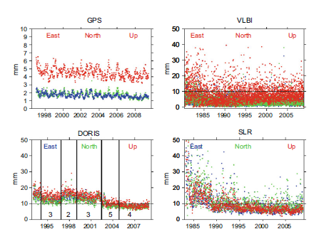
GNSS Contributions to ITRF
GPS frame dominates International Terrestrial Reference Frame
latest ITRF realization is 2008
GPS co-locations link all techniques
GPS is 60% of all ITRF stations
(560 out of 934)
GPS results very homogeneous &
stable in time
WRMS accuracy of weekly points:
dN, dE ~ 1.5 mm; dU ~ 4.5 mm
But GNSS weaknesses remain
GNSS cannot observe geocenter
accurately due to parameter correlations
→ so ITRF origin based on SLR (stable at ~0.5 mm/yr)
GNSS frame scale fixed to ITRF scale to estimate satellite antenna offsets
→ so ITRF scale based on SLR + VLBI (stable at ~0.2 mm/yr)
GNSS position time series have many breaks due to equipment changes
draconitic harmonics abound due to orbit-related mismodeling
Station Position WRMS
[Z. Altamimi et al., 2011]
10

Slide 11
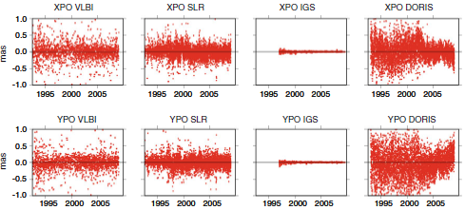
GNSS Contributions to Earth Orientation
GPS dominates daily Polar Motion results since mid-1990s
due to robust global
tracking network
WRMS daily accuracy:
~ 30 µas
equals ~1 mm global shift
at Earth’s surface
But systematic errors
remain significant
errors in international model for EOP 12h & 24h tidal variations
→ errors alias into orbital & other parameters
mismodeling of orbital dynamics (empirical solar radiation pressure)
→ propagates draconitic signals & harmonics
mishandling of frame rotational stability by Analysis Centers
non-linear motions at most GNSS stations
possible instabilities in ITRF realization
Length-of-day (LOD) also measured (but not UT1 or nutations)
Polar Motion x,y Residuals
PMx: VLBI SLR GPS DORIS
PMy: VLBI SLR GPS DORIS
[Z. Altamimi et al., 2011]
11

Slide 12
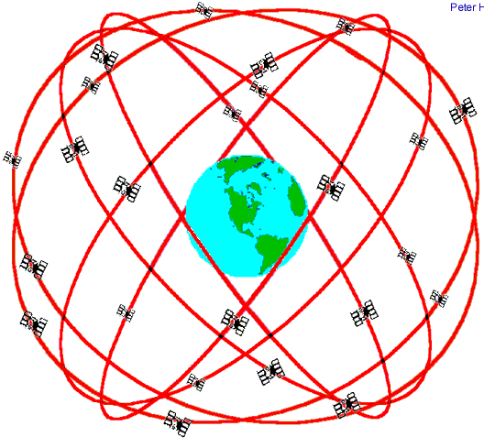
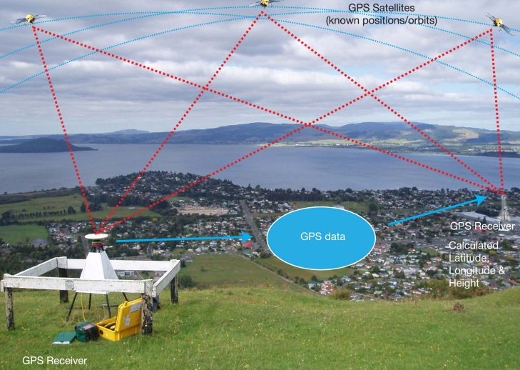

GNSS User Access to ITRF
IGS tracks GNSS globally:
reference frame of
ITRF ground stations
transferred to satellite
positions & clocks
User tracks GNSS locally:
reference frame
transferred to user
position
Positioning in ITRF using GNSS
IGS Reference Network in ITRF
Two approaches used for frame transfer:
Precise Differential Positioning
user + other nearby GNSS data
+ precise GNSS orbits (IGS)
→ user relative location
Absolute Positioning (PPP)
user data
+ precise GNSS orbits & clocks (IGS)
→ user geocentric (ITRF) location
12

Slide 13
Merits of Two GNSS Positioning Approaches
Advantages:
Precise Differential Positioning
data analysis is easier due to
common mode error rejection
very precise relative positions
few mm precision, depending on
distance of reference stations
easier to implement in real-time
over regional/local scales
infrastructure requirements
adjustable to user application
Absolute Positioning (PPP)
autonomy of operation
works for anybody, anywhere,
anytime
absolute geocentric positions
daily accuracies: ~4-5 mm N,E
~10 mm U
Disadvantages:
user accuracy depends on errors in
reference positions & data
best performance requires dense
ground networks
not practical over global scales
many operations are private
major global infrastructure required,
both ground network & data analysis
user data analysis must be highly
consistent with models used to make
global orbit & clock products
13

Slide 14
Example of Crustal Loading Studied with GNSS
Surface mass load displacement time series for all GPS stations
6-hr NCEP atmosphere model
12-hr ECCO non-tidal ocean model
monthly GLDAS surface ice/water, cubic detrended to remove model drift
all computed for center-of-frame (CF) origin
sum is linearly detrended & averaged to middle of each GPS week
load model data from 1998.0 to 2011.0 [courtesy of T. van Dam]
GPS station position time series from 1st IGS reprocessing
analysis generally consistent with IERS 2010 Conventions
combined results from up to 11 Analysis Centers
706 globally distributed stations, each with >100 weeks
data from 1998.00 to 2011.29
Helmert alignment (no scale) w.r.t. cumulative solution uses a well-distributed subnetwork to minimize aliasing of local load signals
care taken to find position/velocity discontinuities
Study dN, dE, dU non-linear residuals (1998.0 – 2011.0)
bias errors not considered here !
14

Slide 15
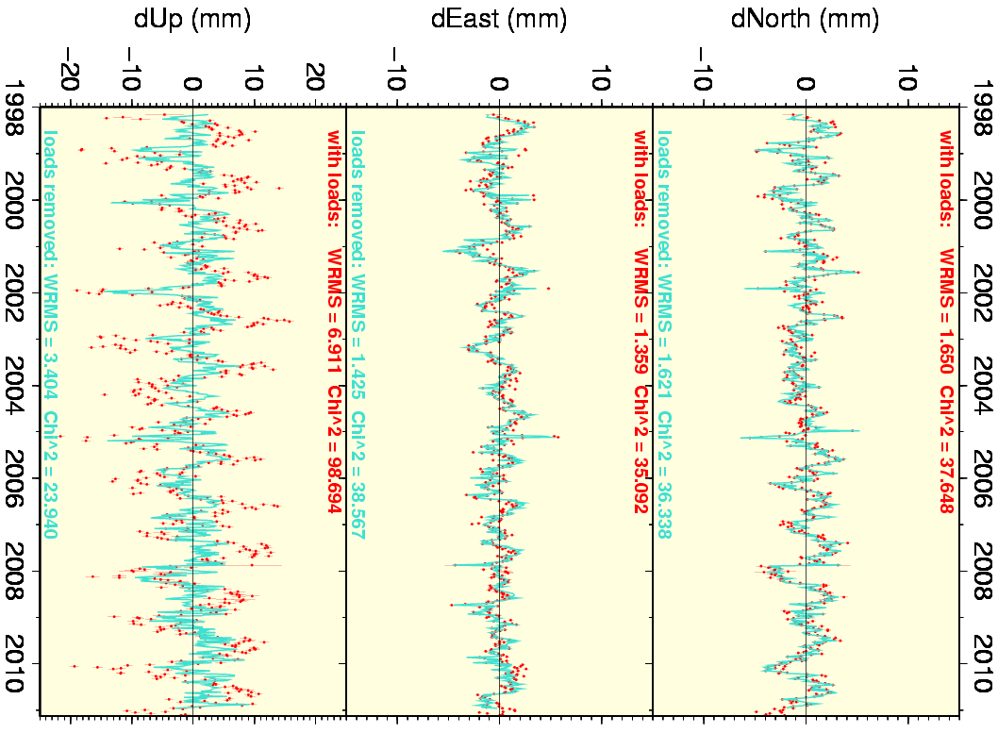
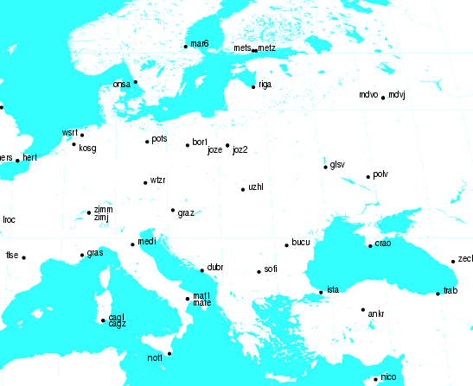
GPS Position Time Series – “Best” Load Fit
Load models most effective in
height for GLSV (Kiev)
reduce dU scatter by 51%
reduce annual dU amplitude
by 73%
model not effective for dN, dE
inland continental site
relatively large atmosphere
pressure variations
GLSV (Kiev)
15

Slide 16
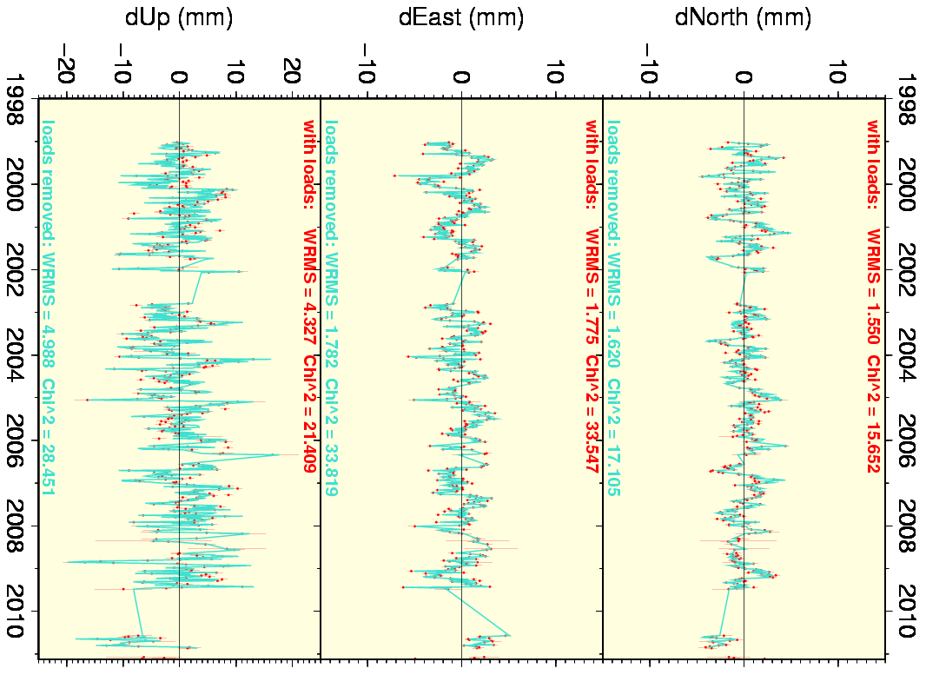
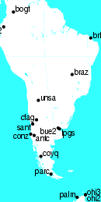
GPS Position Time Series – “Worst” Load Fit
Load models least effective in
height for PARC (S. Chile)
increase dU scatter by 15%
reduce annual dU amplitude
by 38%
model not effective for dN, dE
coastal site
atmosphere pressure effects
damped by nearby oceans
PARC (S. Chile)
16

Slide 17
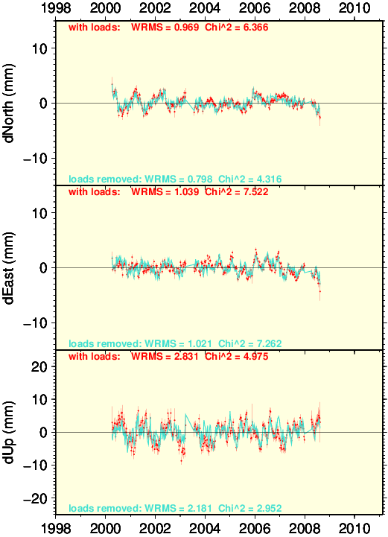
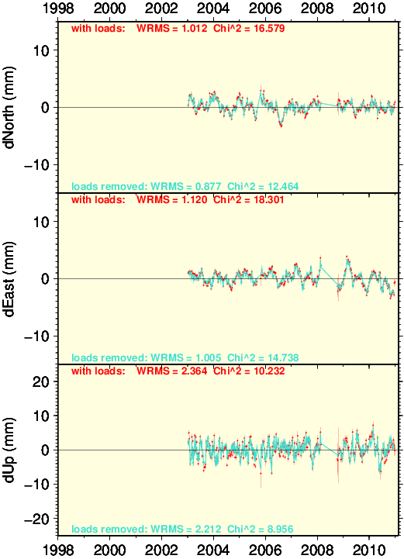
GPS Stations With Smallest Height Scatter
LAGO (coast)
GLPS (island)
dN & dE scatters (~1 mm) are not the “best” . . .
possibly related to weaknesses of IB assumption or load models
dU scatters have same WRMS but different characters
17

Slide 18
(GPS – Load) Comparison Statistics (706 stations)
WRMS Changes
 | median GPS WRMS (mm) | median Load RMS (mm) | median (GPS – Load) WRMS (mm) | median WRMS reduction (%) | % of stations with lower WRMS
dN | 1.4 | 0.5 | 1.3 | 3.8 | 72.0
dE | 1.45 | 0.4 | 1.4 | 1.6 | 62.9
dU | 4.6 | 2.6 | 3.8 | 15.2 | 87.4
Annual Amplitude Changes
 | median GPS annual (mm) | median Load annual (mm) | median (GPS – Load) annual (mm) | median annual (corr/no corr) ratio | % of stations with lower annual amp
dN | 0.9 | 0.45 | 0.65 | 0.8 | 70.7
dE | 0.8 | 0.4 | 0.7 | 0.9 | 59.3
dU | 3.6 | 2.4 | 1.7 | 0.5 | 87.1
Load corrections are effective to reduce WRMS & annual amps
for most stations, esp for dU – but less for dN & even less for dE
18

Slide 19
(GPS – Load) Comparison Statistics (706 stations)
WRMS Changes
 | median GPS WRMS (mm) | median Load RMS (mm) | median (GPS – Load) WRMS (mm) | median WRMS reduction (%) | % of stations with lower WRMS
dN | 1.4 | 0.5 | 1.3 | 3.8 | 72.0
dE | 1.45 | 0.4 | 1.4 | 1.6 | 62.9
dU | 4.6 | 2.6 | 3.8 | 15.2 | 87.4
Annual Amplitude Changes
 | median GPS annual (mm) | median Load annual (mm) | median (GPS – Load) annual (mm) | median annual (corr/no corr) ratio | % of stations with lower annual amp
dN | 0.9 | 0.45 | 0.65 | 0.8 | 70.7
dE | 0.8 | 0.4 | 0.7 | 0.9 | 59.3
dU | 3.6 | 2.4 | 1.7 | 0.5 | 87.1
Load corrections are effective to reduce WRMS & annual amp
But most residual variation remains, esp in dN & dE
19

Slide 20
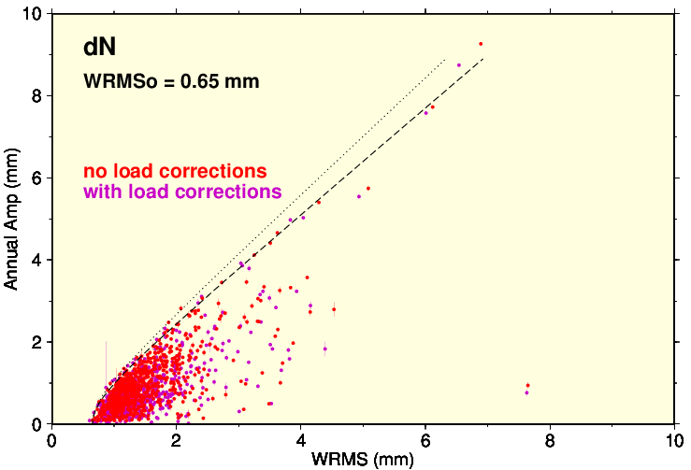
IGS Results – dN With/Without Loads
A² : 0.5 0.6
Error Model:
WRMS² = WRMS_{o}²
+ (A_{i} * AnnAmp_{i})²
+ WRMS_{i}²
WRMS_{o}² = noise floor
dN load corrections have no impact on noise floor assessment
local site & non-load errors overwhelmingly dominate
20

Slide 21
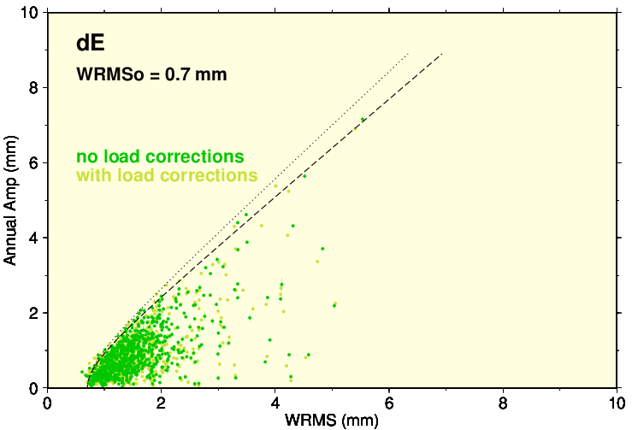
IGS Results – dE With/Without Loads
A² : 0.5 0.6
Error Model:
WRMS² = WRMS_{o}²
+ (A_{i} * AnnAmp_{i})²
+ WRMS_{i}²
WRMS_{o}² = noise floor
dE load corrections have no impact on noise floor assessment
local site & non-load errors overwhelmingly dominate
21

Slide 22
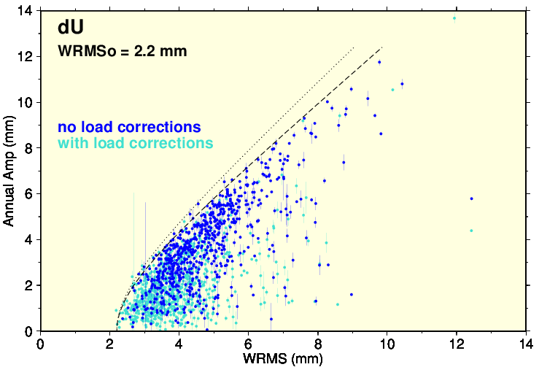
IGS Results – dU With/Without Loads
A² : 0.5 0.6
dU load corrections move results much closer to noise floor
but local site & non-load errors still dominate
22

Slide 23
IGS Results – dU With/Without Loads
A² : 0.5 0.6
Error Model:
WRMS² = WRMS_{o}²
+ (A_{i} * AnnAmp_{i})²
+ WRMS_{i}²
WRMS_{o}² = noise floor
GLPS
LAGO
“Best” 2 stations in dU (WRMS = 2.2 mm) are:
LAGO (S. coast, Portugal) & GLPS (island, Pacific Ocean)
23

Slide 24
Decomposition of Weekly GPS Position Errors
IGS Error Budget for Weekly Integrations
 | WRMS_{o} (mm) |  |  | median Annual Amps (mm) |  | median site WRMS_{i} (mm) | median total WRMS (mm)
 | thermal (via pairs) | models + analysis | total | loads | total
dN | 0.4 | 0.5 | 0.65 | 0.45 | 0.9 | 1.0 | 1.4
dE | 0.4 | 0.6 | 0.7 | 0.4 | 0.8 | 1.1 | 1.45
dU | 1.3 | 1.7 | 2.2 | 2.4 | 3.6 | 2.9 | 4.6
Infer site WRMS_{i}² using:
WRMS_{o}² + (A * AnnAmp_{i})² + WRMS_{i}² = WRMS²
where A² = 0.6
Noise floor WRMS_{o} & local site errors WRMS_{i} dominate over loads
esp for N & E components
Non-load GPS annual errors are as large as annual load signals
unless load models missing ~half of total signal
24

Slide 25
Summary of Current GPS Position Errors
Load corrections reduce WRMS & annual amps for most stations
but most residual variation remains, esp for dN & dE
implies load models are inaccurate &/or other sources of scatter/error
Station weekly scatter can be decomposed into 3 categories:
dN dE dU
global average floor WRMS_{o} (mm) 0.65 0.7 2.2
median annual amp WRMS (mm) 0.7 0.6 2.8
(for A² = 0.6; about half due to loads)
median local site WRMS_{i} (mm) 1.0 1.1 2.9
total WRMS (mm) 1.4 1.45 4.6
Harmonics of GPS draconitic period are pervasive
strong spatial correlations imply a major orbit-related source
but significant draconitics in close pair differences imply smaller local contributions likely too
1.04 cpy signal must contribute to observed annual variations but magnitude is unknown
Major non-load technique improvements still badly needed!
25

Slide 26
Prospects for Future GNSS Evolution
GPS positioning accuracy now in plateau phase
future progress limited by known or suspected systematic errors :
• draconitic errors related to orbit modeling
• errors in IERS subdaily Earth orientation tide model
• unmodeled thermal expansion of antenna structures & Earth surface
• multipath errors (esp due to near-field) & antenna environment
• antenna calibration errors
• frequent position discontinuities (equipment changes)
New GNSS systems offer hope to reduce some current errors
different constellation designs & orbital resonances
some better signal structures (more resistant to multipath)
but also much greater multi-GNSS complexity (esp inter-system biases)
Major challenges for the future include:
understanding how best to use multi-GNSS systems together
much more robust & reliable international infrastructures
(ground tracking networks & data analysis)
large reduction in station discontinuities & disruptions
secure governmental support with strong international cooperation
26

Slide 27
Thank You!

