Slide 1

The National Spatial Reference System: a Consistent Framework for Land Development
Charles Geoghegan & Jacob Heck
5to Congreso Internacional de Agrimensura Catastro y Ciencias Geoespaciales
San Juan, Puerto Rico | 16 March 2024
Notes:
1 hour
Abstract: The National Spatial Reference System (NSRS) provides a common reference for geometric and geopotential coordinates across North America and the Caribbean. The National Geodetic Survey (NGS) is in the process of modernizing the NSRS to provide a better foundation for geospatial data, including through plate-fixed reference frames that connect directly with the International Terrestrial Reference Frame (ITRF), and with a common height system that works consistently across areas that previously required separate local datums. This presentation will discuss the present and future of the NSRS and practical considerations for its implementation in the Caribbean, showing how it enables innovation in land development.

Slide 2
The National Spatial Reference System: A Consistent Framework for Land Development
Abstract: The National Spatial Reference System (NSRS) provides a common reference for geometric and geopotential coordinates across North America and the Caribbean. The National Geodetic Survey (NGS) is in the process of modernizing the NSRS to provide a better foundation for geospatial data, including through plate-fixed reference frames that connect directly with the International Terrestrial Reference Frame (ITRF), and with a common height system that works consistently across areas that previously required separate local datums. This presentation will discuss the present and future of the NSRS and practical considerations for its implementation in the Caribbean, showing how it enables innovation in land development.

Slide 3
Overview
Background information on NGS and the Regional Geodetic Advisor Program
The current National Spatial Reference System (NSRS)
The modernized NSRS
Tools available through NGS
Practical impacts of NSRS modernization

Slide 4
Overview
Review of NSRS including current datums (NAD 83 (2011), PRVD 02, VIVD 09
Jacob - New Geometric frames (ITRF and CATRF2022 and how they are connected)
Jacob - New Geopotential Datum (NAPGD2022 including coverage in Caribbean)
  Cover difference between PRVD 02 and NAVD 88 (normal heights vs. geopotential numbers) Derek’s slides on geopotential explanation.
  How do we know GRAV-D works? Three GSVSs
  NAPGD2022 is consistent throughout the Caribbean and North America
Jacob-Show how modernized NSRS enables connection between geometric and geopotential datums
NSRS modernization progression, blueprint documents
Jacob: NGS/FIG capacity development in Caribbean (consult with Dan Roman on this) & SIRGAS
Charlie: GPS on Bench Marks - Congratulations and Looking Forward (time-dependent coordinates and continued data submission for the NSRS)
Charlie: Tools: VDATUM, OPUS Projects and NCAT
Charlie: How does modernization impact users on a daily basis?
  LDP zones, state plane, accessing NSRS/metadata
  NAD83 vs CATRF2020 SPCS differences
  Charlie-Touch on NTDE update as well (get help from Mike Michalski)
Charlie: Highlight online lessons in Spanish and French from NGS

Slide 5
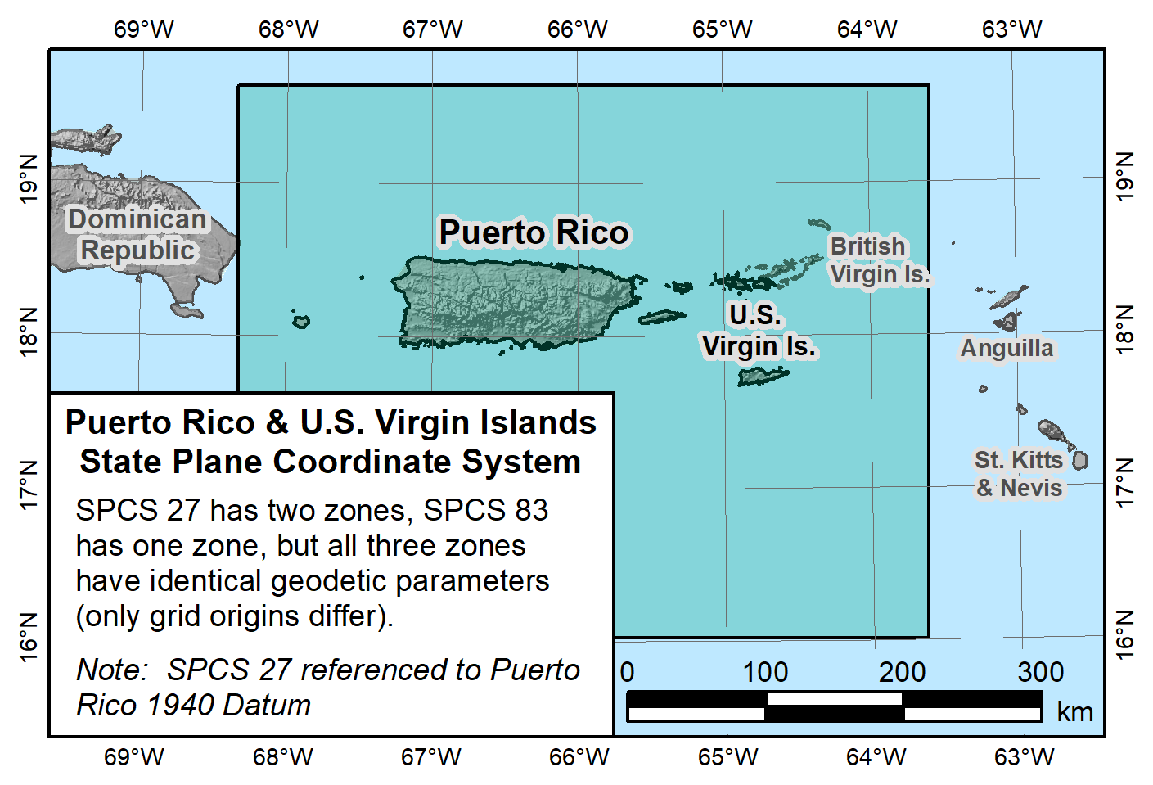

Slide 6
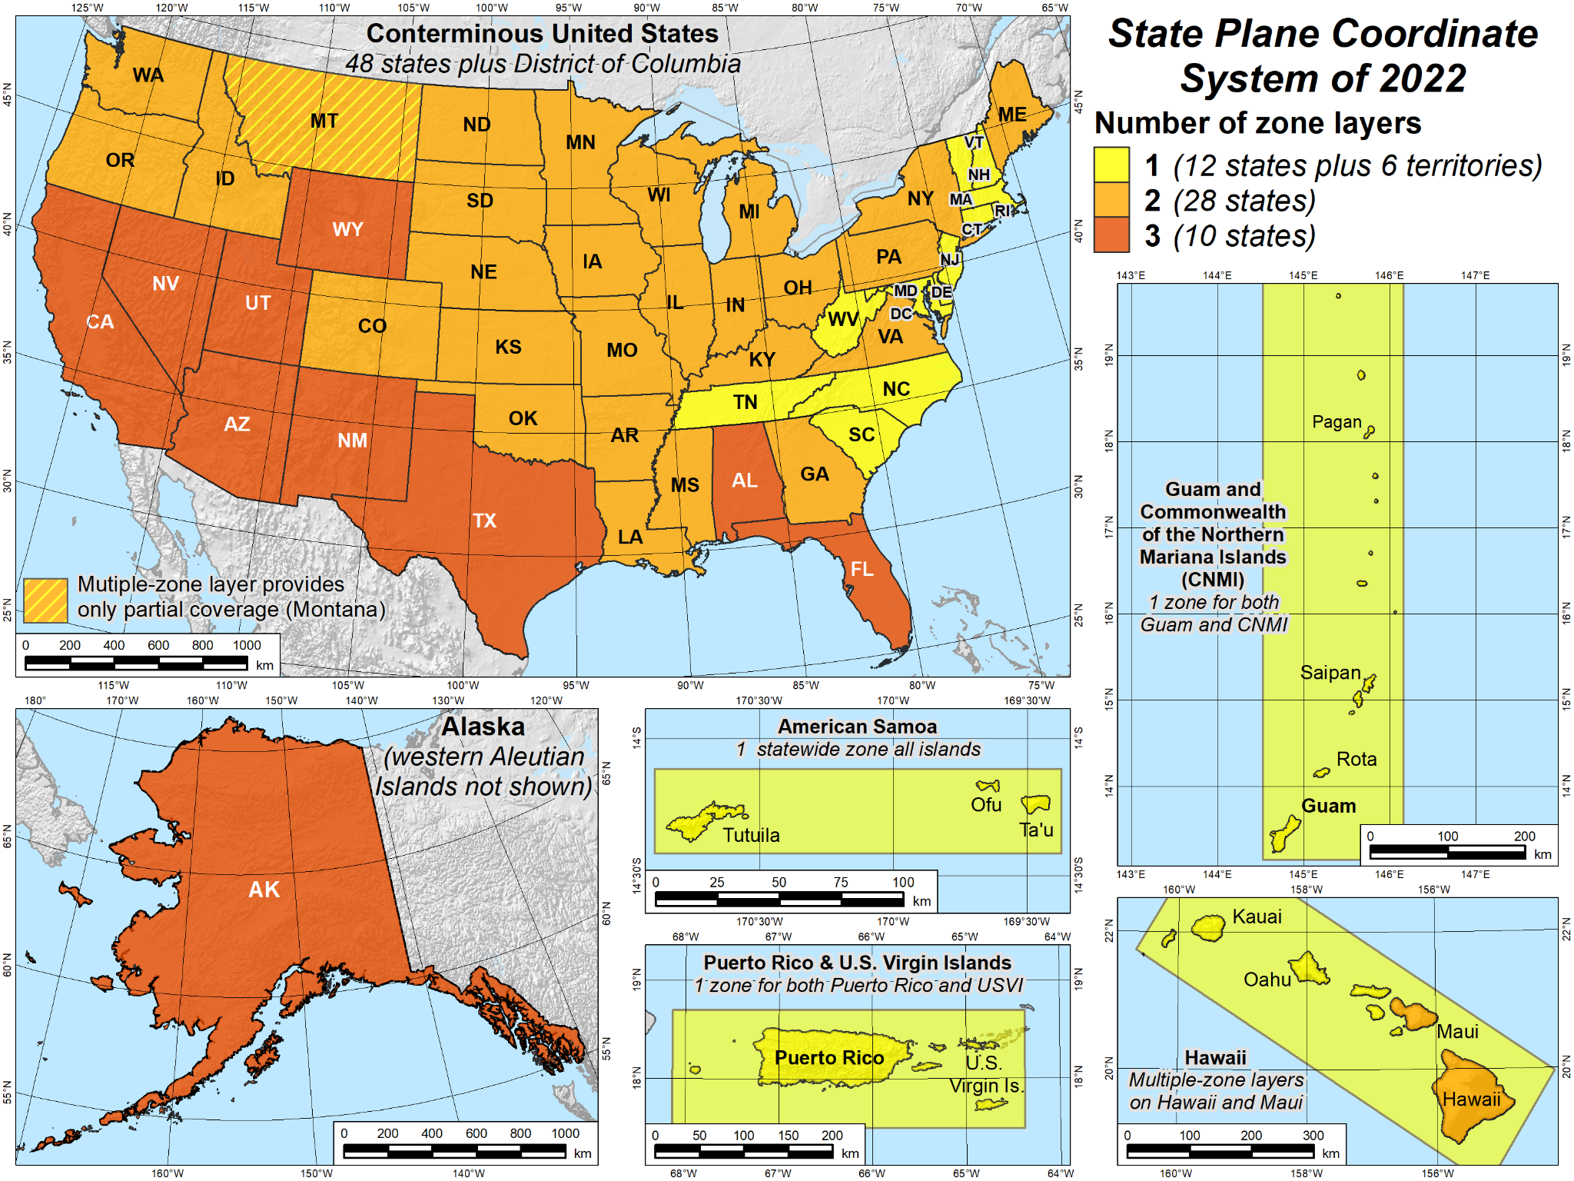

Slide 7
State Plane Coordinate Zone Definitions
Reference Frame: NAD83 CATRF2022
Code: 5200 720001
Abbreviation: PRVI PRVI
Name: Puerto Rico and USVI Puerto Rico and USVI
Type: Statewide Statewide
Projection: Lambert Conformal Conic Lambert Conformal Conic
Origin Latitude: 17°50’N 18°09'N
Origin Longitude: 66°26'W (293°34’E) 66°15'W (293°45'E)
Standard Parallel(s): 18°26’N and 18°02’N 18°09'N
Proj. Origin Scale: 0.9999944472 1.000000
False Northing: 200,000 m 200,000 m
False Easting: 200,000 m 500,000 m
Design By: NGS NGS
Updated: January 1989 7/2/2023
Status: Final Preliminary
Notes:
Two zones used for SPCS 27 combined into a single zone for SPCS 83 (SPCS 27 zones identical except for false northing).
American National Standard Institute (ANSI) numeric code for Puerto Rico = 72
Standard parallels reduced to a single parallel and equal to Origin Latitude.

Slide 8
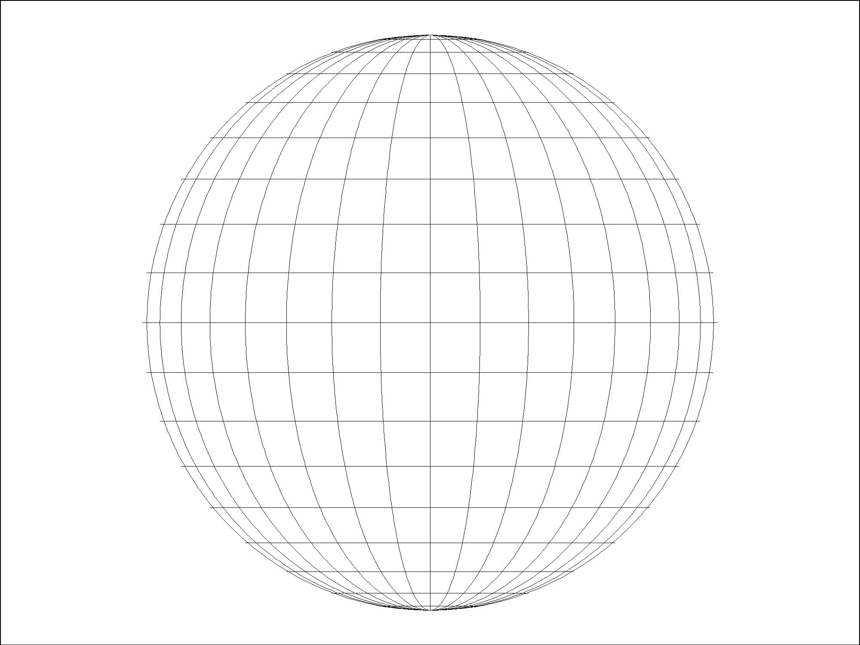
Consider PRVI SPCS 83 Zone
Secant Lambert Conformal Conic projection, 2-parallel definition:
Standard parallels
North = 18°26’N (exact)
South = 18°02’N (exact)
It is EXACTLY the same as this 1-parallel definition:
Central standard parallel
18°14’00.00000”N
Scale = 1
Ellipsoid
Scale = 1
North standard parallel
Scale =
0.9999 9444…
Central “standard” parallel
(projection axis)
(1:7849)
Scale = 1
South standard parallel
An LCC projection is defined by its projection axis, which is ALWAYS the central standard parallel

Slide 9
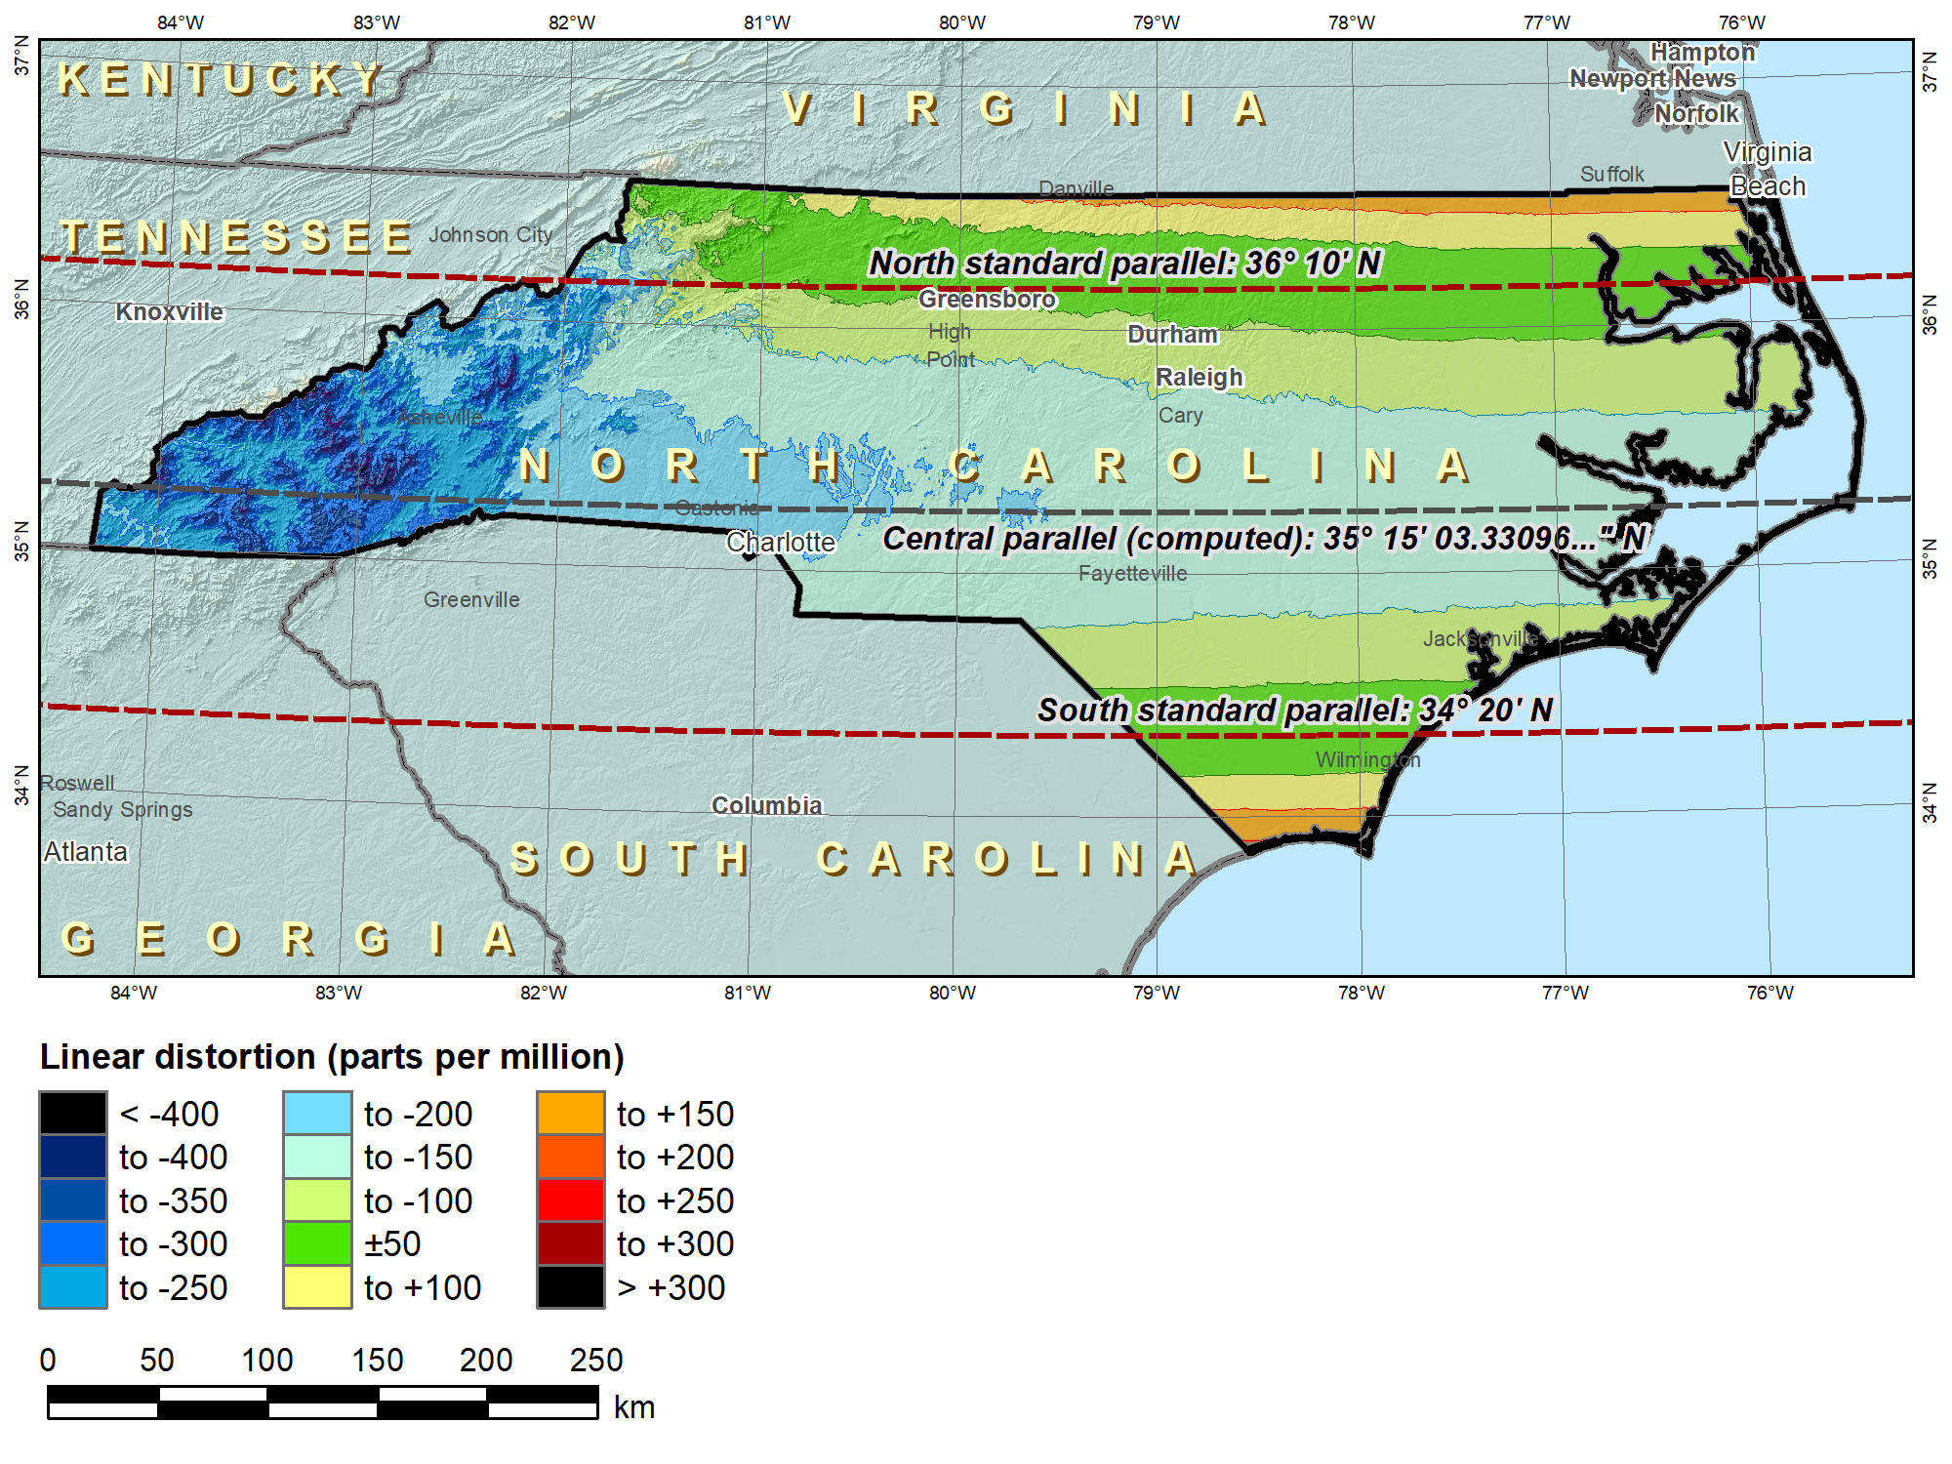
SPCS 83 North Carolina (Lambert Conformal Conic 2-parallel)
 |  | SPCS 83 NC
Central parallel |  | 35°15’06.33…”N
Cen parallel scale |  | 0.9998 7259…
 | Height (m) | Distortion (ppm)
Min | -41 | -413
Max | 1939 | +176
Mean | 197 | -93

Slide 10
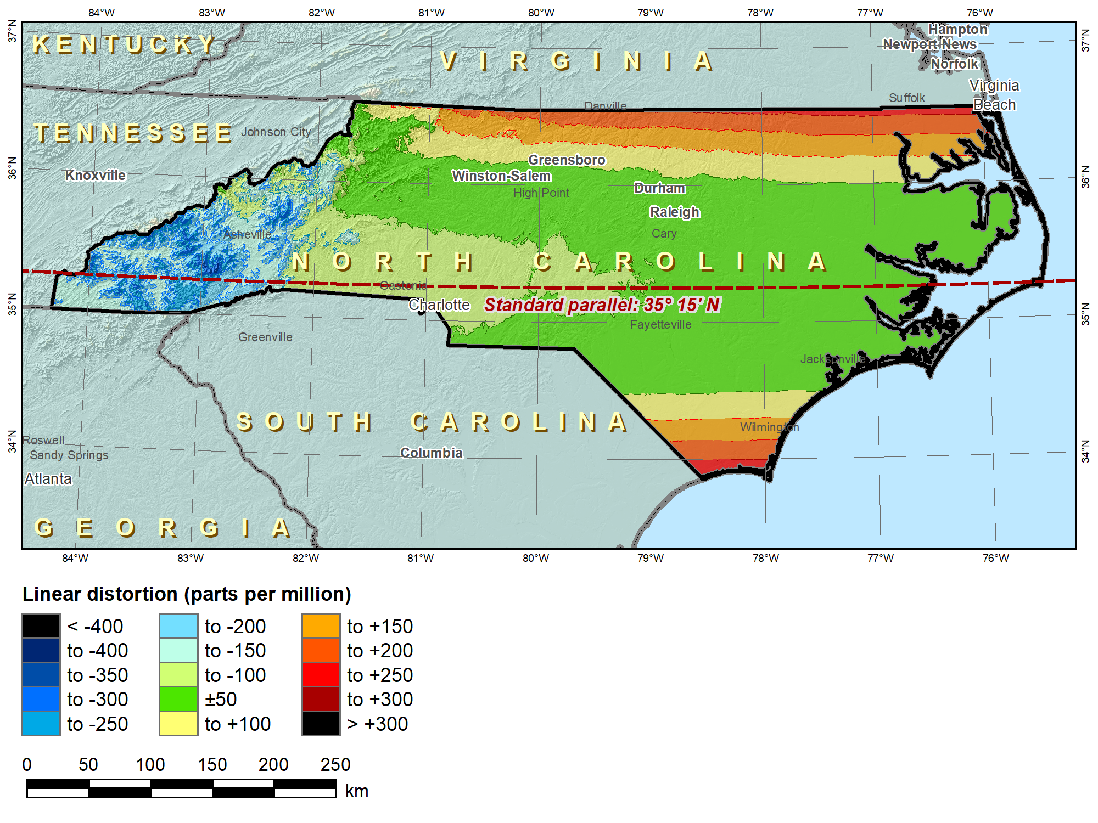
SPCS2022 “default” NC (Lambert Conformal Conic 1-parallel)
No change in projection type or zone extents
 |  | SPCS 83 NC | SPCS2022
Central parallel |  | 35°15’06.33…”N | 35°15’N
Cen parallel scale |  | 0.9998 7259… | 0.99996
 | Height (m) | Distortion (ppm)
Min | -41 | -413 | -325
Max | 1939 | +176 | +263
Mean | 197 | -93 | -5

Slide 11

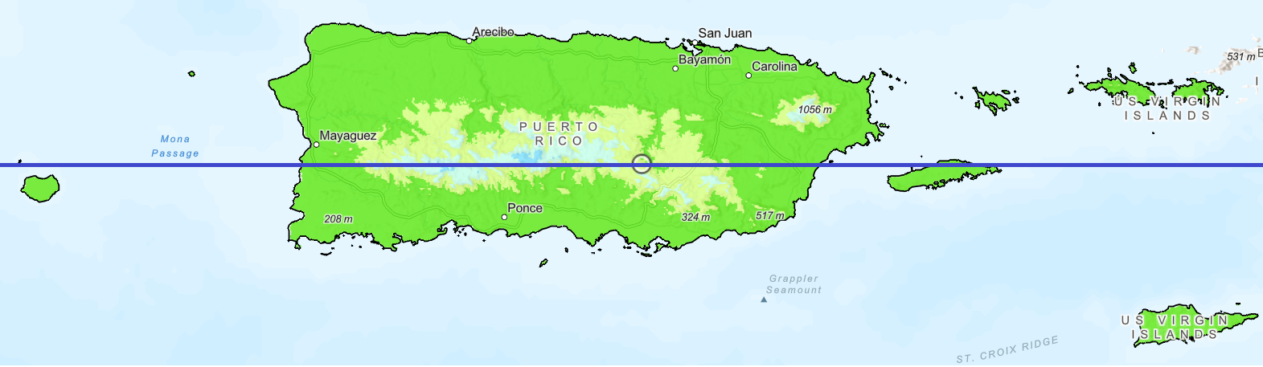

SPCS2022 “default” PR & USVI (Lambert Conformal Conic 1-parallel)
First Station : N240 CORS NAD83 ---------------- X = 2450323.4010 m LAT = 18 27 32.17035 North Y = -5533747.8920 m LON = 66 6 59.08290 West Z = 2006618.2980 m EHT = -41.3304 Meters Second Station : N240 CORS CATRF2022 ---------------- X = 2450324.1180 m LAT = 18 27 32.15593 North Y = -5533749.6730 m LON = 66 6 59.08513 West Z = 2006618.4710 m EHT = -39.4555 Meters Forward azimuth FAZ = 188 24 2.8392 From North Back azimuth BAZ = 8 24 2.8384 From North Ellipsoidal distance S = 0.4483 m Delta height dh = 1.8748 m Mark-to-mark distance D = 1.9277 m DX = 0.7170 m DN = -0.4434 m DY = -1.7810 m DE = -0.0655 m DZ = 0.1730 m DU = 1.8748 m Zenith (mk-to-mk) ZD = 13 26 46.11 Apparent zenith distance = 13 26 46.10
NGS HOME PAGE
18°09'N
18°09'N
±50 ppm = 5 cm/km = 1 : 20,000
  Minimum design criterion for SPCS2022 designs by NGS (at ground)
±400 ppm = 40 cm/km = 1 : 2,500
  Maximum design criterion for SPCS2022 zones (at ground)
  Maximum UTM value (on ellipsoid)

Slide 12
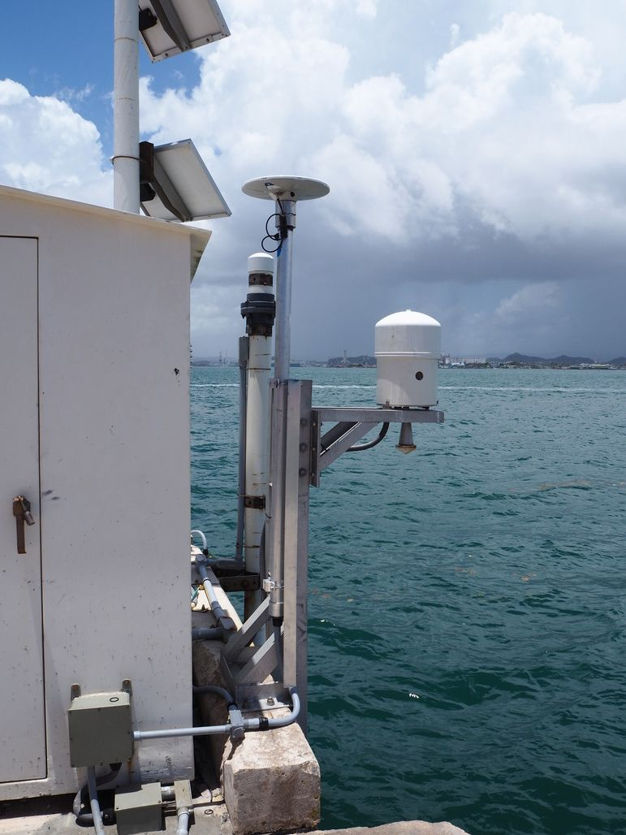
Coordinate Shift, NAD83 to CATRF2020
Ellipsoidal distance
S ≈ 0.45 m
DN ≈ -0.44 m
DE ≈ -0.07 m
NAD83 2011 (REC 2010)
Northing: 269,271.548m
Easting: 233,475.637m
CATRF2022 (REC 2020)
Northing: ~269,271.11m
Easting: ~533,475.57m
N240 SAN JUAN PR CORS ARP

Slide 13
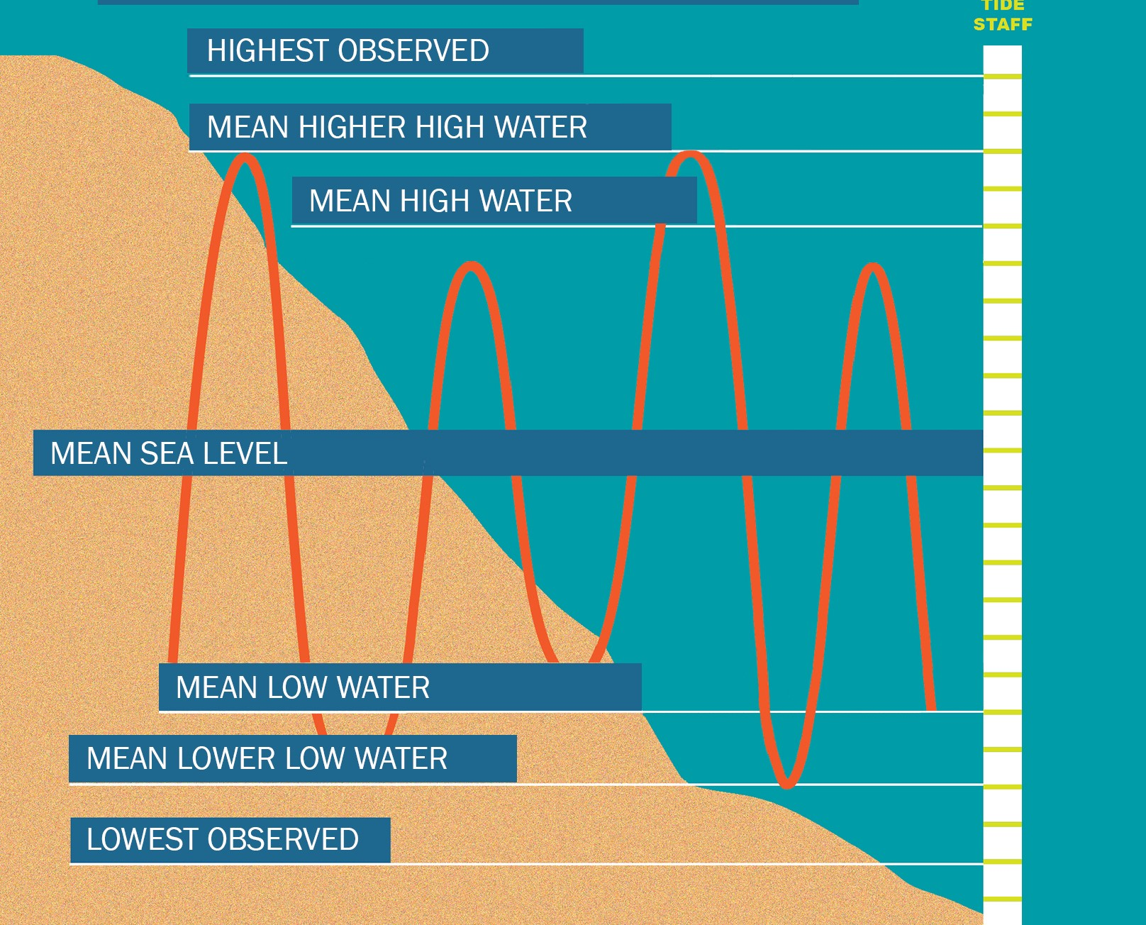
TIDAL DATUMS
The National Ocean Service ensures the nation has access to accurate tidal datums, which are the official datums depicted on nautical chart products and tide tables.
Notes:
An epoch is a 19-year tidal cycle used to calculate datums. The present National Tidal Datum Epoch (NTDE) is 1983 through 2001.
The NTDE Update: New Tidal Datums are Coming!
Measurements for the update will be based on water level data spanning the years 2002-2020. Once all data has been collected, NOAA will review, analyze, and generate revised datums. The current proposed release date for new NTDE products is after 2026.

Slide 14
How Might the NTDE Update Impact You?
Coastal boundary definition between private and publicly owned lands.
Coastal habitat restoration.
Water level regulation, forecasting, and monitoring long-term sea level trends.
Coastal zone management and planning, including flood erosion predictions and response.
Coastal engineering and design for infrastructure projects related to transportation, power generation facilities.
Economic viability and safety of commercial and recreational navigation, including charts, ports, harbors, and dredging in navigation channels.
Coastal structure design, construction and maintenance.
Notes:
All currently published tidal datums and bench mark sheets will be updated, and all water level data products that reference published tidal datums will have updated references.

Slide 15
Impact on Professional Land Surveyors
When accessing tidal datum information, ensure that the currently accepted NTDE is being used for all projects.
Historical projects may need to be updated to reflect the new datum.
  The NOAA VDatum tool will be updated in time to include the new tidal as well as geodetic datums to enable PLS to obtain tidal geodetic relationships for the coastal zone of the Contiguous US, Puerto Rico, US Virgin Islands, and Southeast Alaska.
  https://vdatum.noaa.gov/

Slide 16
Impact on Shoreline Use Planning
Oceanographic products are not significantly affected by the small vertical changes (~0.10m).
Tidal prediction products put out by CO-OPS will change.
It may be the case that downstream products relying on tidal predictions may not need to be changed as the resultant change in predictions will likely be minimal (~6-7 cm) for most locations.
Additionally, tidal datums and bench mark elevation relationships will be noticeable when re-establishing tide stations using high accuracy survey techniques.

Slide 17
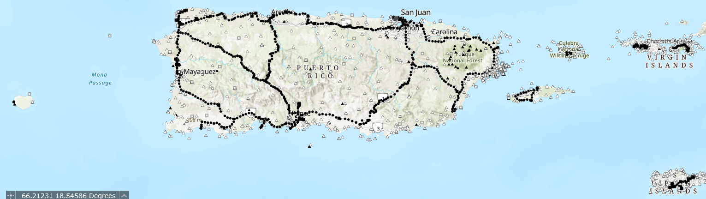
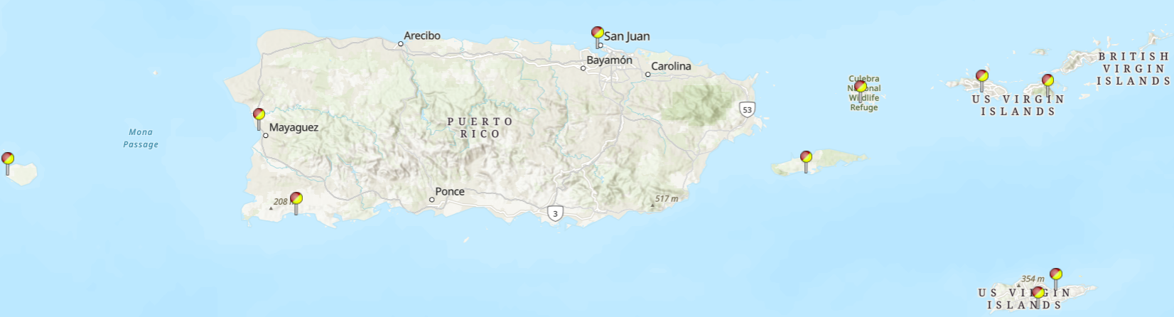
PRVD02/VIVD09 Vertical Control
PRVD02/
VIVD09
Bench Marks
NDTE 1983-2001
Tide Stations

Slide 18
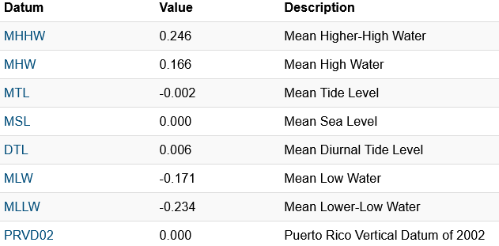
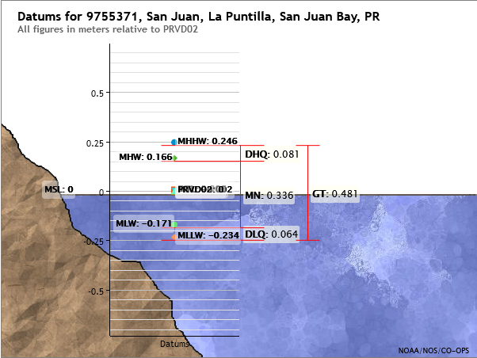
Datums for 9755371, San Juan, La Puntilla, San Juan Bay PR
Notes:
PRVD02 = MSL here only. At west end, Mayaguez tide station, MSL is 4 cm above PRVD02
From Hector: talk about actual vertical datum that is LMS [vs NAPGD2022].

Slide 19
Datums for 9755371, San Juan, La Puntilla, San Juan Bay PR
Co-located CORS Orthometric Height
N240 SAN JUAN PR CORS ARP
NAGPD2022: 3.95m*
PRVD02: 3.53m**
Approx. change: +0.38m
*Prototype using OPUS
**VDatum
Notes:
From Hector: Good afternoon, what we talk last time was in relation to the new horizontal and vertical datum, that suppose to come on 2025.
In your presentation you gong to stalk about the difference between our actual vertical datum that is LMS.

Slide 20
Datums for 9755371, San Juan, La Puntilla, San Juan Bay PR
Co-located CORS Orthometric Height
N240 SAN JUAN PR CORS ARP
NAGPD2022: 3.95m*
PRVD02: 3.53m**
Approx. change: +0.38m
*Prototype using OPUS
**VDatum
~0.38m
NAGPD2022
Notes:
From Hector: Good afternoon, what we talk last time was in relation to the new horizontal and vertical datum, that suppose to come on 2025.
In your presentation you gong to stalk about the difference between our actual vertical datum that is LMS.

Slide 21
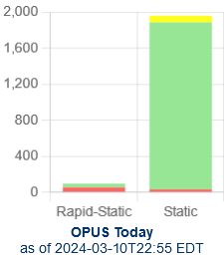
Accessing the Modernized NSRS
OPUS: NGS’s Online Positioning Users Service
  OPUS Static/Rapid-Static (https://geodesy.noaa.gov/OPUS/)
  OPUS Share (https://geodesy.noaa.gov/OPUS/)
  OPUS Projects (https://geodesy.noaa.gov/OPUS-Projects/OpusProjects.shtml)

Slide 22
Accessing the Modernized NSRS
NCAT: NGS’s Conversion And Transformation tool (https://geodesy.noaa.gov/NCAT/)
  convert between different coordinate systems and/or
  transform between different reference frames and/or datums, in a single step
  convert between lat/long/height, SPC, UTM, XYZ, and USNG systems
  After rollout, will support N,P,M,CATRF2022 and NAPGP2022

Slide 23
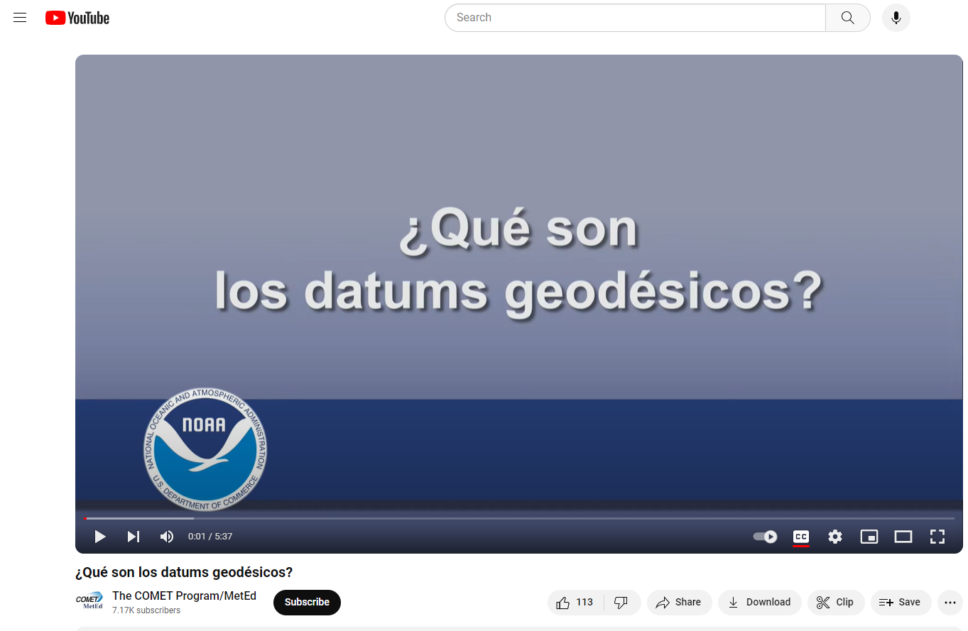

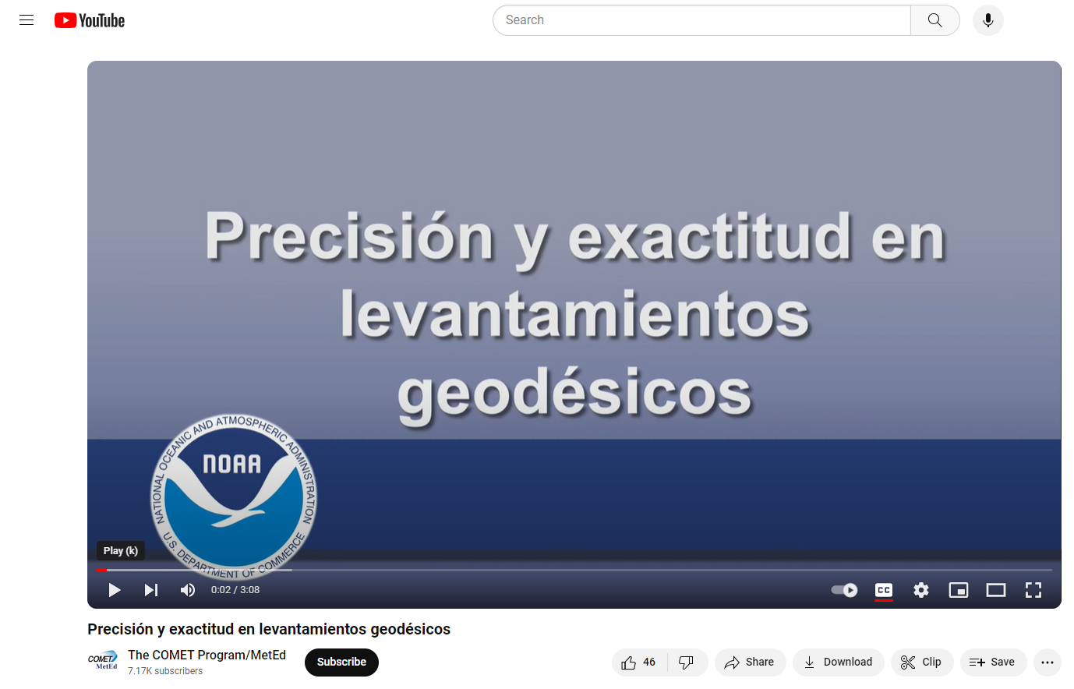
NGS online lessons in Spanish
https://geodesy.noaa.gov/web/science_edu/online_lessons/index.shtml

