Slide 1

Geodetic Control Framework Theme
6th of the CA Core Framework Themes
Marti Ikehara
Geodetic Advisor for California
NOAA’s National Geodetic Survey
Sacramento, CA
Marti.ikehara@noaa.gov

Slide 2
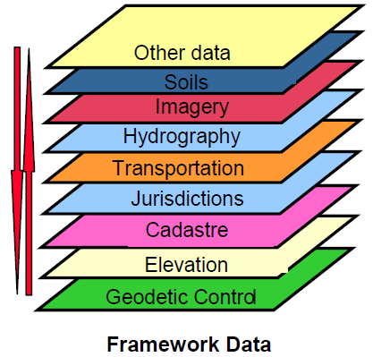
Basis for geospatial alignment
Geodetic control provides a common reference system for establishing coordinates for all geographic data.
ALL NSDI framework data and users‘ applications data require geodetic control to accurately register spatial data.
The National Spatial Reference System is the fundamental geodetic control for the United States.

Slide 3
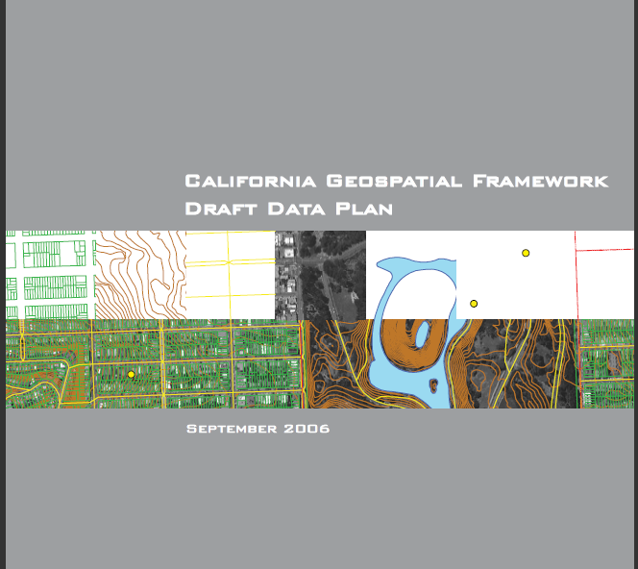
Seminal document: CA Geospatial Framework Draft Data Plan (finalized)

Slide 4
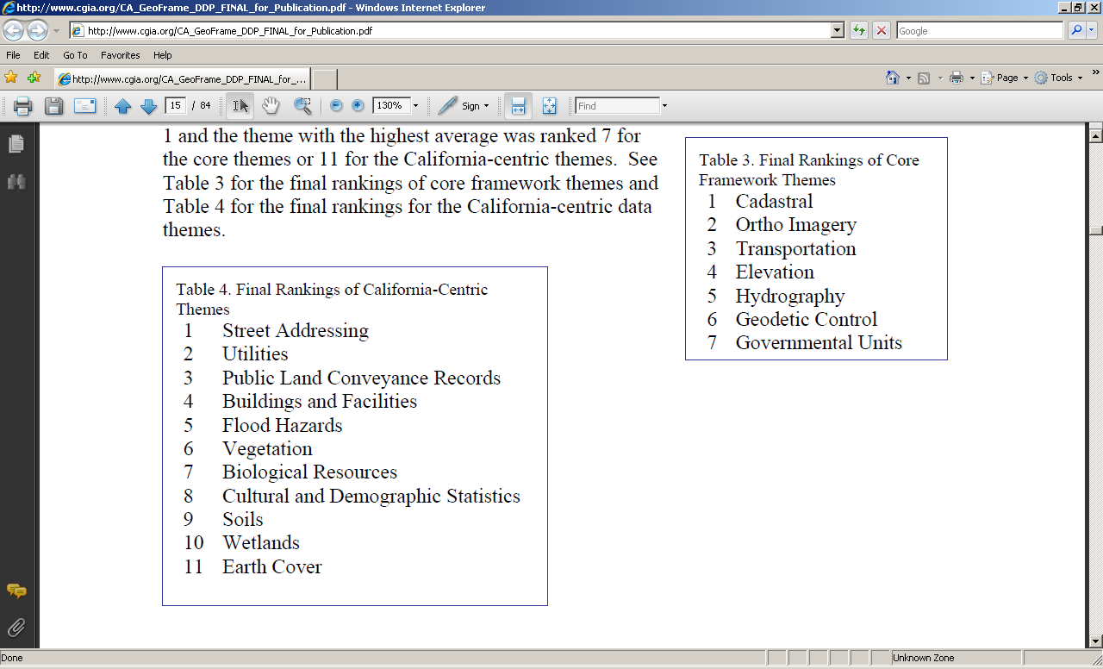

Slide 5
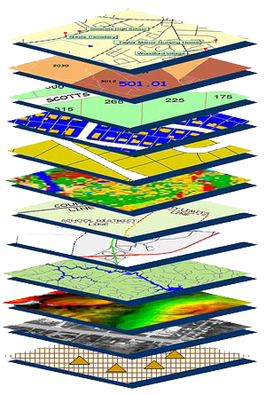
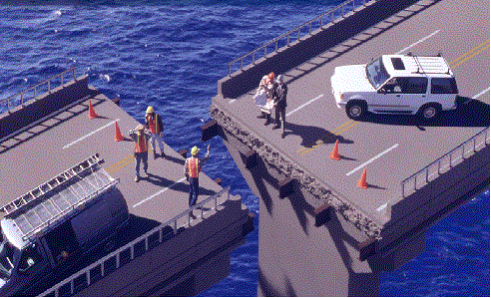
Goal: Alignment of Themes to each other using common georeferencing
Geodetic control is (or should be) the foundation for all geospatial products
Without Geodetic Control as a basemap layer, GIS themes may not ALIGN well
Source: Zurich-American Insurance Group
Notes:
All science, industry, and commercial activities that rely on precise positioning require geodetic control. Without a properly georeferenced basemap, the variety of geospatial information that is produced and used may not overlay well.
Note: The photo is a construct and for illustrative purposes ONLY.

Slide 6
CA GIS Strategy for 7 Statewide Framework Data Themes
The implementation strategy is to foster education, creation, and dissemination of core and California-centric data framework layers through partnerships, teamwork, and sustainable funding
CGC establish a working group to continue the framework data development strategy effort, including identification of primary stewards and multi-year funding approaches
Long-term goal: Regional collaboratives seek grant and operational funding to build or host framework data layers

Slide 7
Data Plan Findings, 2006
In most cases the public domain source data would only be considered by State, regional, local, and private organizations when no funds were available to obtain more current, substantial, or accurate data
The discovery of data sets is still challenged by the lack of comprehensive metadata and the lack of awareness of where to find data

Slide 8
Geodetic Control Work Group (GCWG)
Chartered by CA GIS Council (CGC)
Formed in Oct 2010
Have met 3 times, about monthly
Developed charter and work plan, presented at CGC meeting, 3/28/11
Participants: CA Geodetic Advisor, Chair; Caltrans, professional surveying/engineering associations: CLSA, LCSO (public agencies), ACEC (private), GISPs, Education

Slide 9
Goals and Work plan of Geodetic Control Work Group (GCWG)
Each theme’s WG is to address Data, Standards, Strategic Plan, Business Plan
Existing STANDARDS will be referenced
  How to collect data for horizontal and vertical:
  FGCS, NGS: Static GPS, Leveling, Height Modernization, RTK (kinematic) GPS
  Accuracy assessment:
  FGDC (linear units, eg, cm)

Slide 10
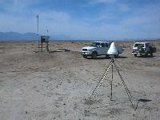
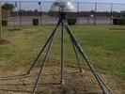
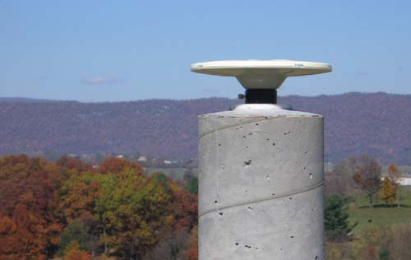
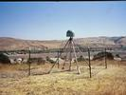
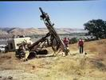
Data: What will core framework set be?
CGPS (Continuous GPS), aka Active Stations

Slide 11
Core framework dataset characteristics?
Continuous, eg, Active? Yes, ~850 CGPS in CA
  How many? Which ones?
Real-time, eg, Dynamic? Ideally
Conventional, eg, Passive? Yes, in near-time, esp for vertical—NAVD88 heights—which are not generally available at CGPS
  Phase out, akin to NGS 10-year Plan/Vision?
Role of community, commercial networks?

Slide 12
CSRC’s project CRTN:
CA Real-Time Network
CA Spatial Reference Center, at UCSD SIO
Technical/financial partner with SOPAC, UCSD
NGS partner: densification of NAVD88 control
UNAVCO PBO partner: CGPS, real-time
CRTN Proposal indicates ~160 backbone sites thruout CA w/ good telemetry possibilities
CSRC is ‘research project’ at UCSD

Slide 13
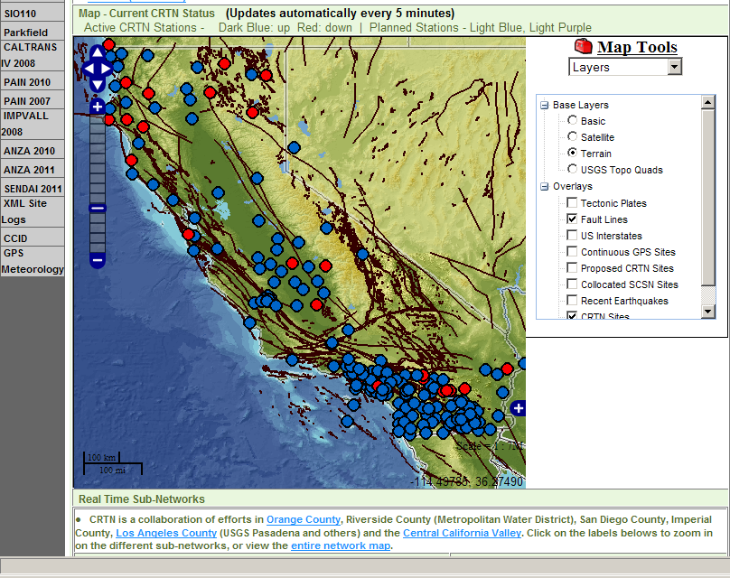
CRTN real-time status (3/22/11)

Slide 14
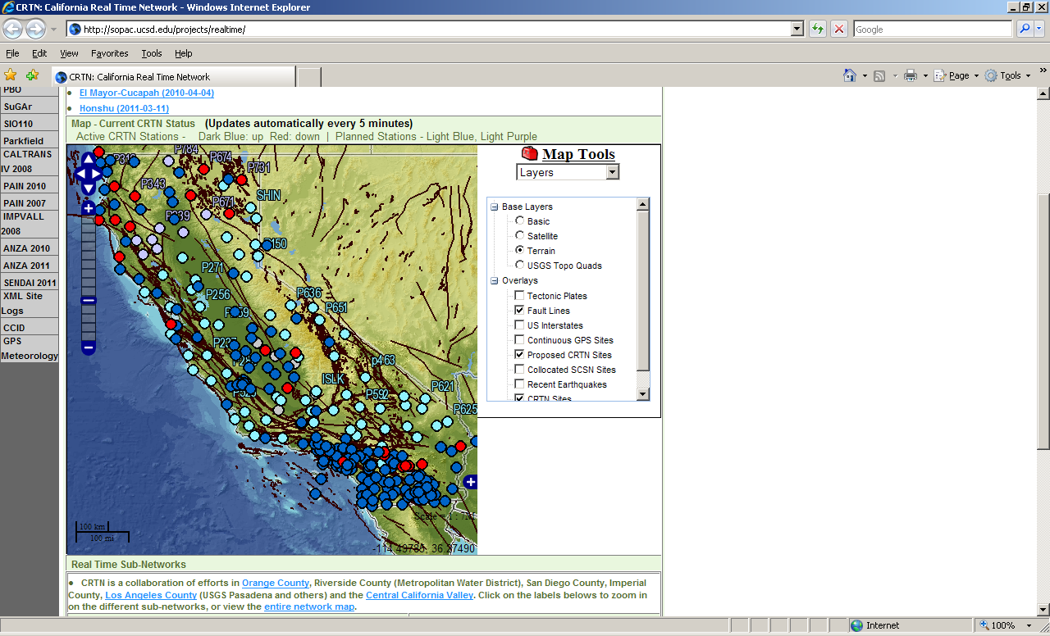
CRTN current status and proposed stations

Slide 15
Benefits of RTN
Free ‘base station’ to differential GPS/GNSS
Position of control is always known and accuracy of coordinates is immediate
Can provide fiducial reference system to denser (commercial or public) networks
Utilize for EQ early warning system
Definite Possible Downside
Need cell phone coverage by users
Funding of IT (telemetry, comms) and equipment

Slide 16
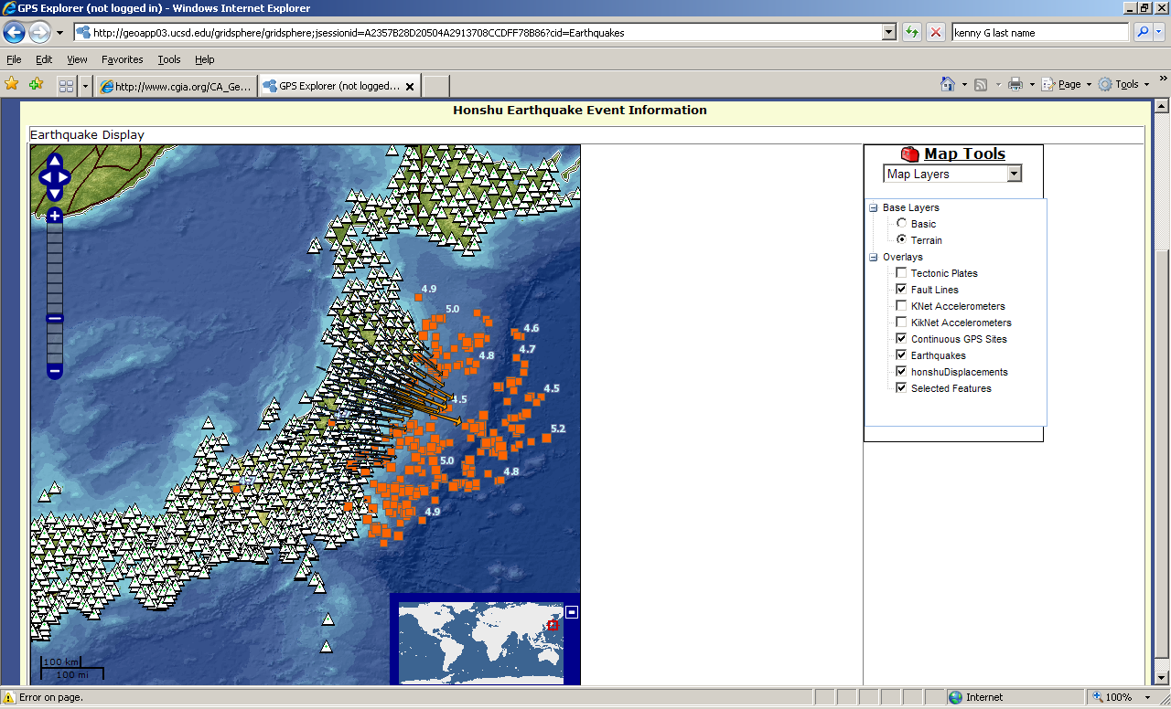

Slide 17
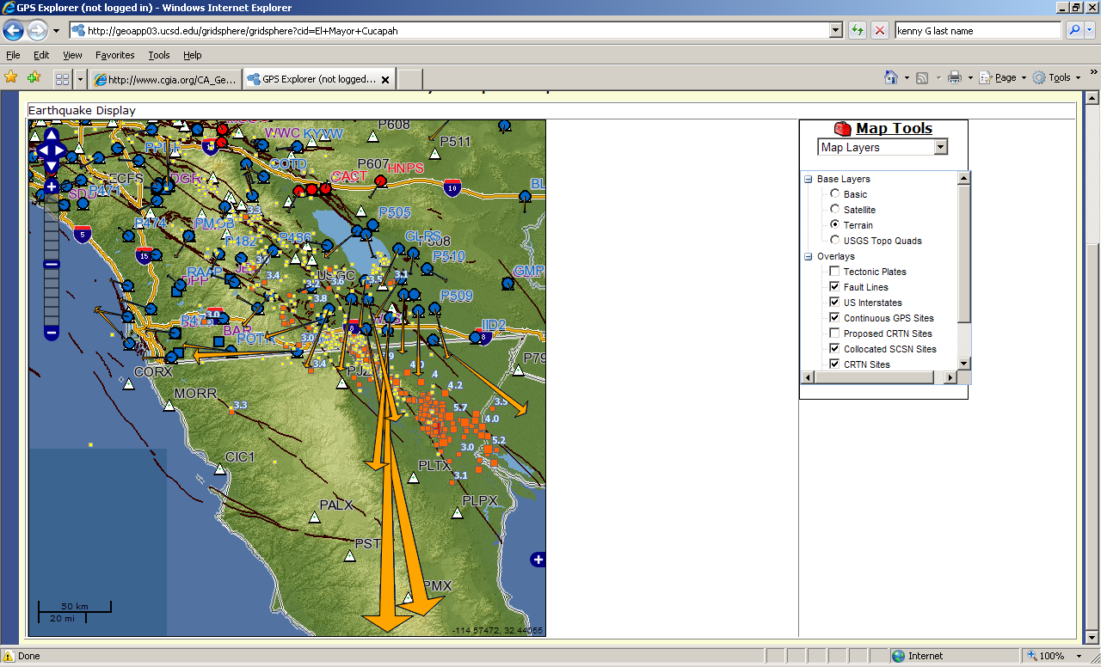

Slide 18
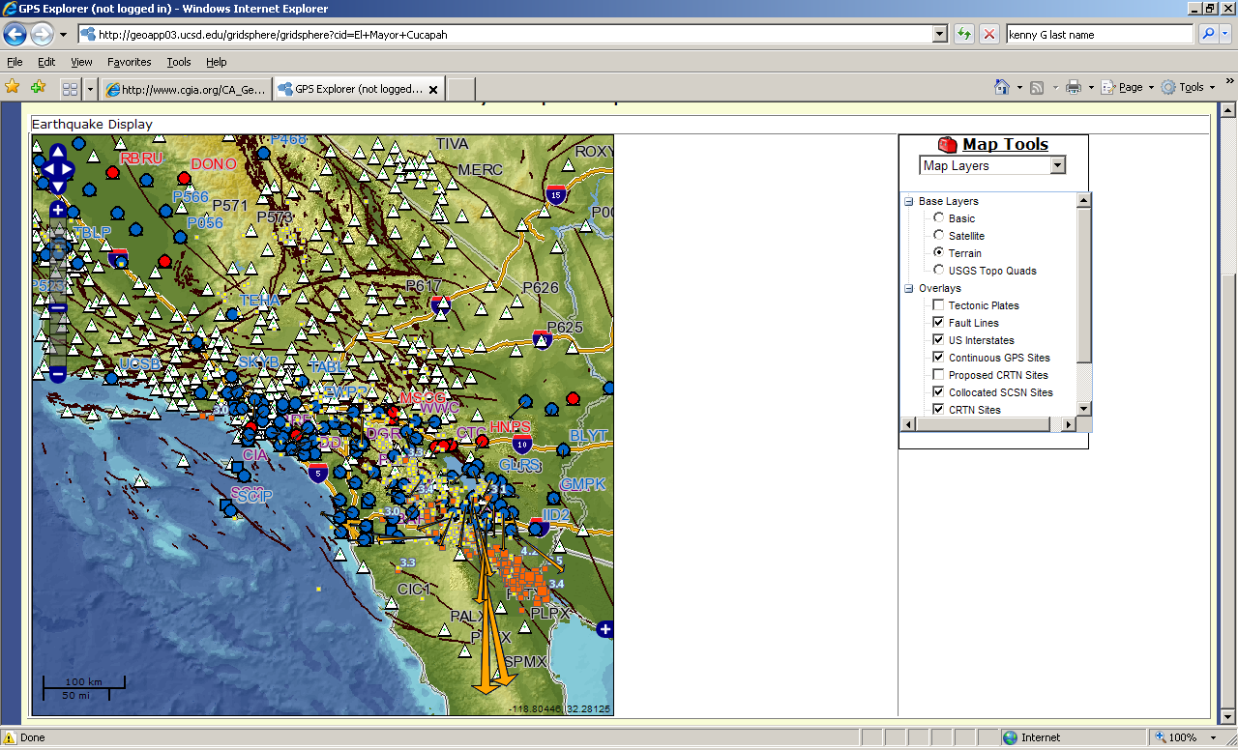

Slide 19
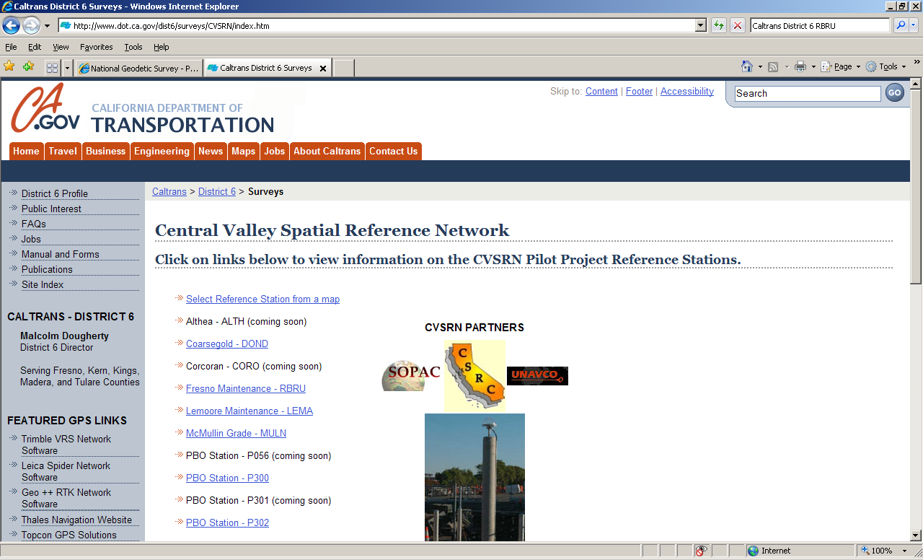
Notes:
Example of public network: what role could this have in statewide fiduciary network?

Slide 20
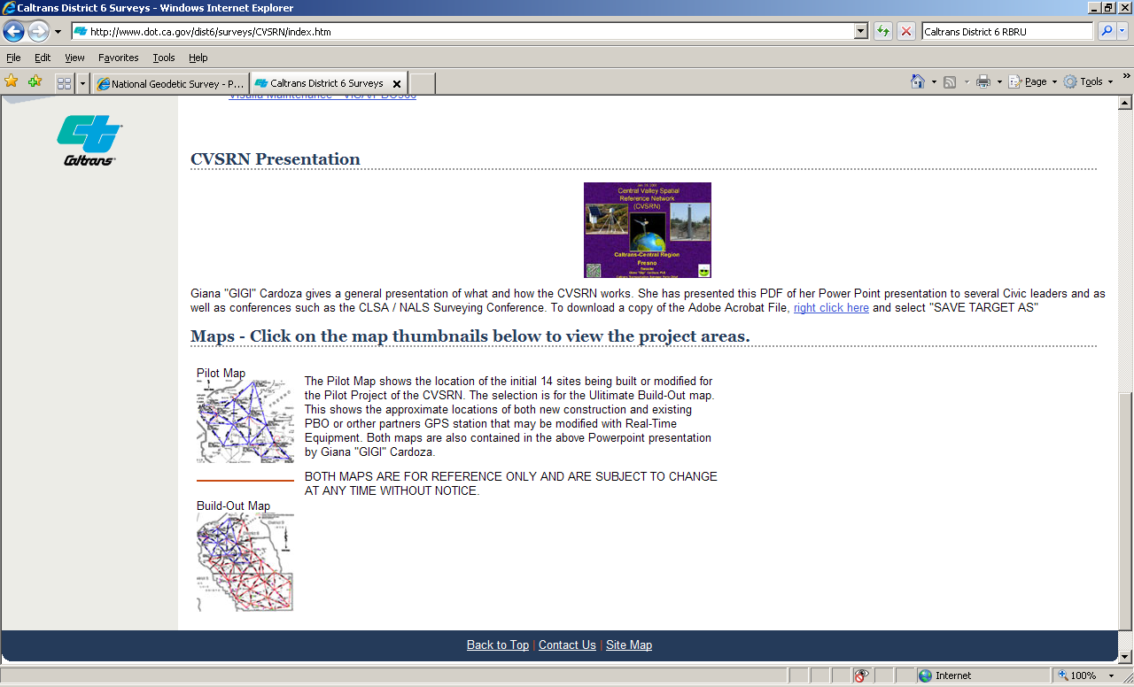

Slide 21
Stewardship and funding
CGC establish a work group to continue the framework data development strategy effort, including identification of primary stewards and multi-year funding approaches
Does steward need statutory authority?
Is cost recovery by user fees reasonable?
Portion of parcel recordation fee used to maintain accuracy of GC network if parcels required to be aligned with GCFT?

Slide 22
Accessibility of GC Framework Theme to all other GIS mapping themes
Recommendations for GC usage perhaps dependent on accuracy requirements
Are/will 6 other core themes required to be georeferenced to core GC theme?
Update frequency? CA is a dynamic state
  Annual update to coordinates?
  When exceeds X cm? Post EQ w/i X hours?
Current access for NGS data is County shapefiles

Slide 23
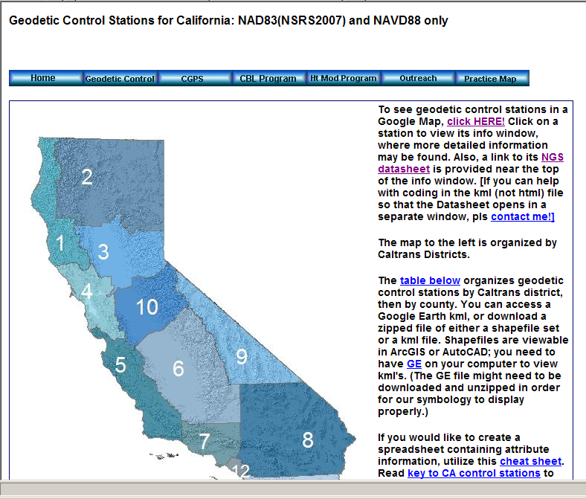
http://www.dot.ca.gov/hq/row/landsurveys/geodetic/geodetic_control.html

Slide 24
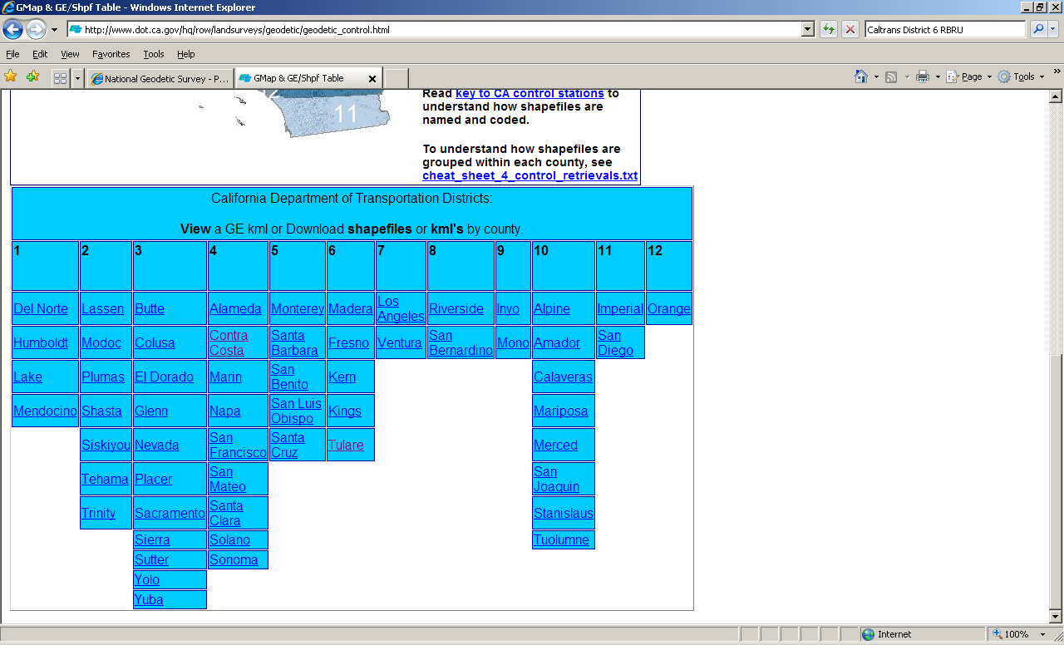

Slide 25
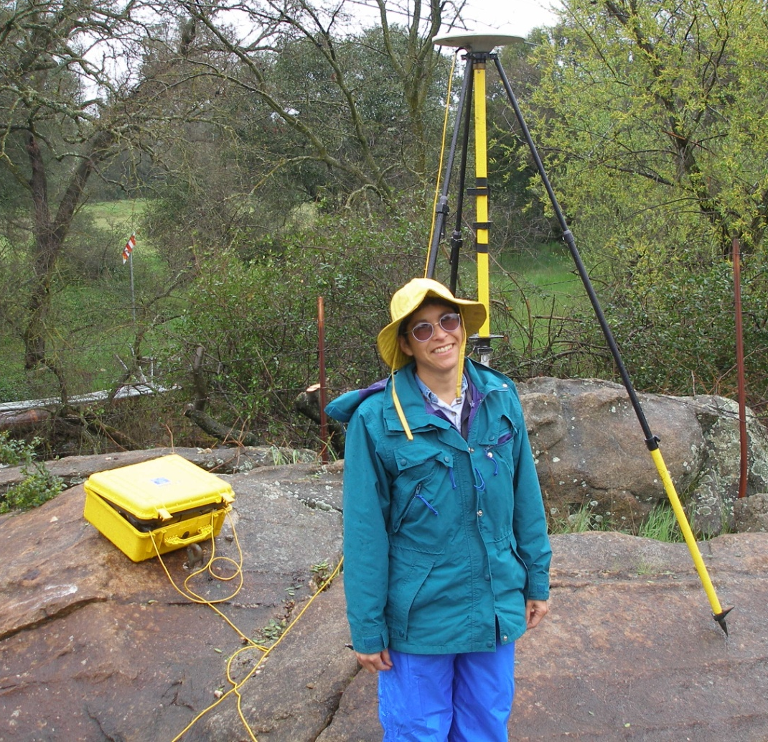
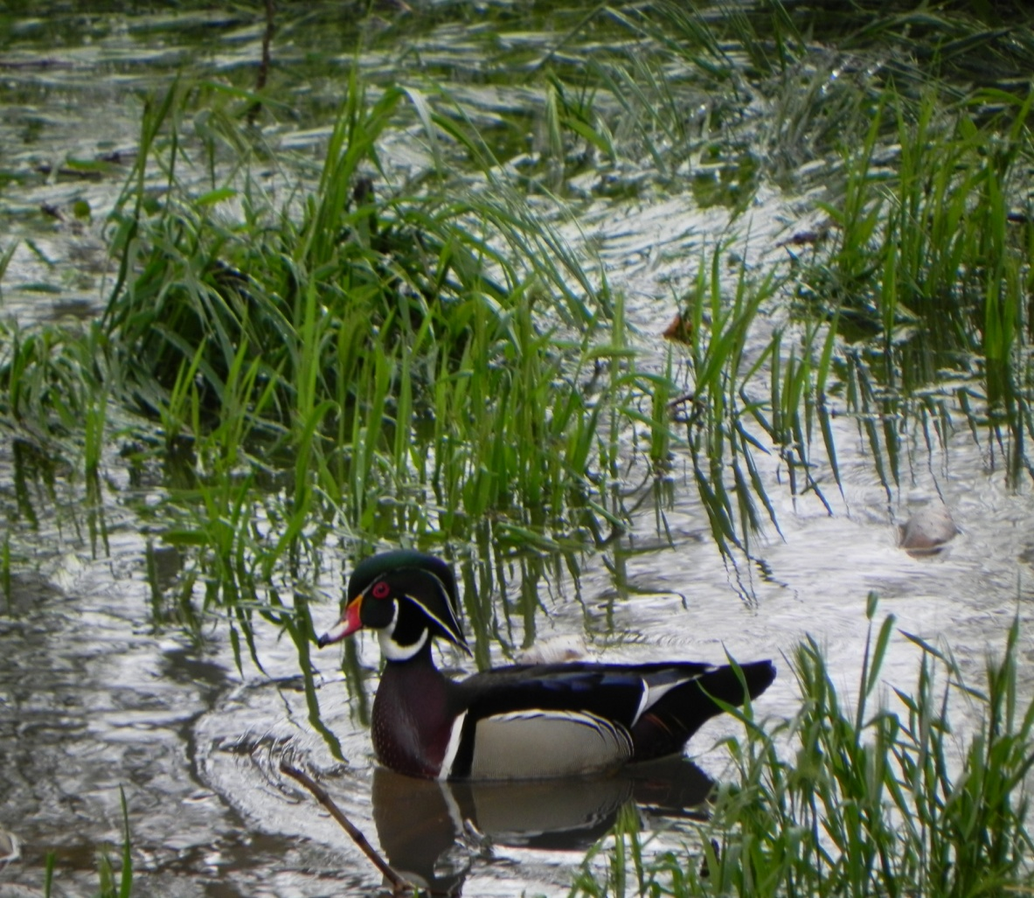
Marti.ikehara@noaa.gov http://www.ngs.noaa.gov/web/science_edu/presentations_archive/

