Slide 1

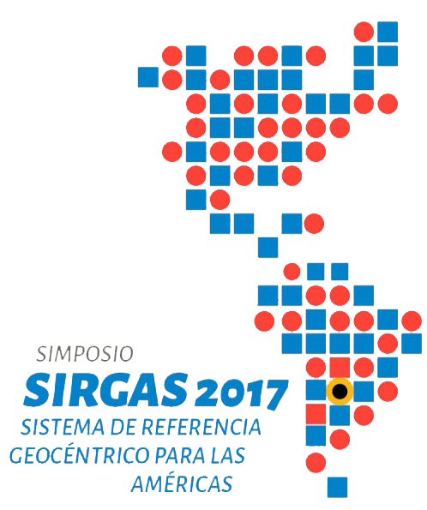
Positioning a nation for the future:
Modernizing the United States
National Spatial Reference System
Dr. Dana Caccamise
USA Representative
Pacific Southwest Region Geodetic Advisor
dana.caccamise@noaa.gov
SIRGAS Symposium Mendoza, Argentina:
November 27-30, 2017
Notes:
Intro
NGS’s role nationally
NGS’s vision for the regional advisor
How states like CA & Nevada with specific needs can interface with the NGS
How the individual surveyor would seek knowledge, information, or guidance from the regional advisor
Bio hitting the interesting news points.
My proximity to CSRC and interface with those guiding California & Nevada GeoFramework
How NGS’s vision of states stepping up to partner, etc. CSRC, DOT, Counties. Need for “current” epochs, and future datums
Q&A

Slide 2

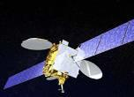
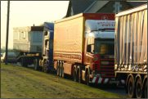
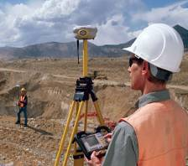
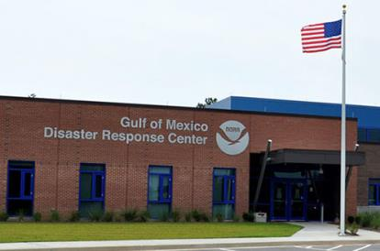
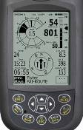

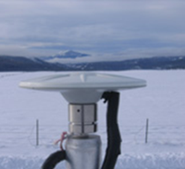



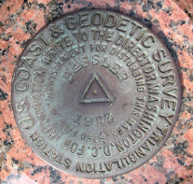
NGS Provides the Geospatial Infrastructure
Critical to Our Economy through the NSRS
Aviation
Satellite
Operations
Precision Agriculture
Trucking and Shipping
Surveying
and Mapping
Disaster Response
Personal
Navigation
CORS
Navigation
Oil Exploration
Fishing and Boating
Survey Marks

Slide 3
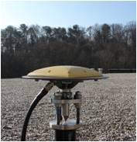
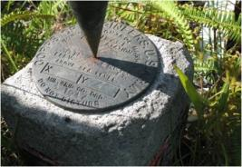
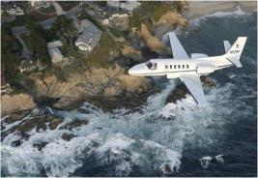
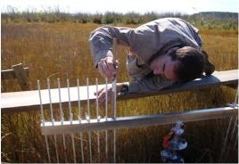
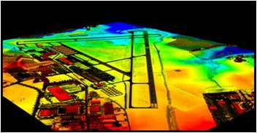
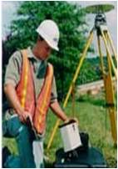
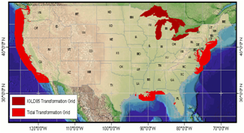
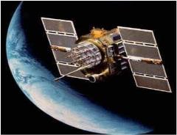
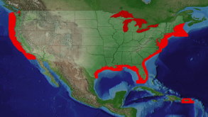
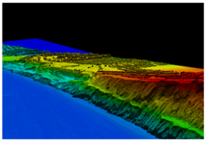
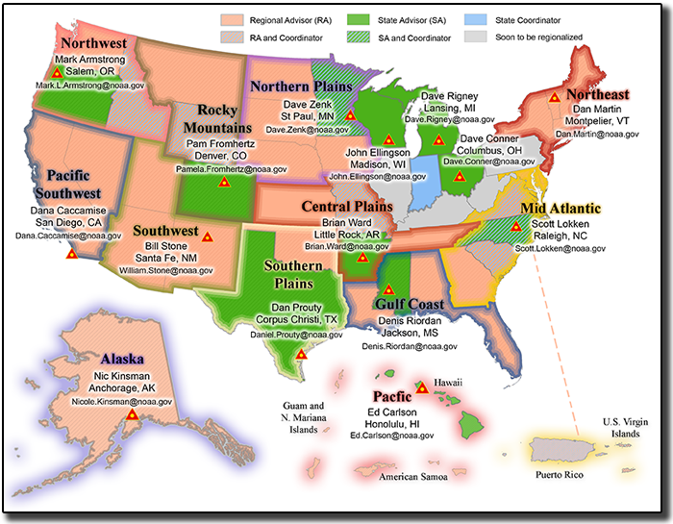
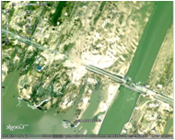

NGS Programs
Modernizing the NSRS
CORS
Height Modernization
GRAV-D
ECO
NGS Products and Services
Airport Surveys
OPUS
VDatum
GPS Satellite Orbits
Coastal Mapping
Regional
Advisor Program
Emergency Response Imagery

Slide 4
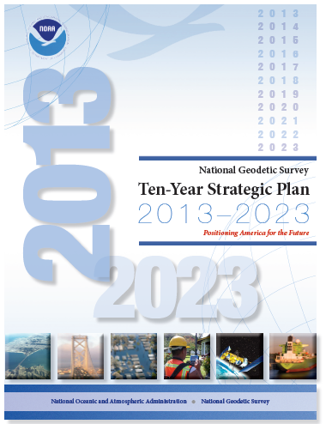
The National Geodetic Survey
Ten-Year Plan
Support the users of the National
Spatial Reference System.
Modernize and improve the National
Spatial Reference System.
Expand the National Spatial Reference
System stakeholder base through
partnerships, education, and outreach.
Develop and enable a workforce with
a supportive environment.
Improve organizational and administrative functionality.
2013, NGS Ten-Year Strategic Plan objective:
“Achieve a fully staffed regional advisor program by 2016.”
http://www.ngs.noaa.gov/web/news/Ten_Year_Plan_2013-2023.pdf
Notes:
The NGS “State Geodetic Advisor” program has engaged a long-standing cost-sharing partnership between NGS and various states. On many levels it is a success... However, the program has been a patchwork success and does not serve the nation equitably. Recognizing this imbalance… NGS determined to transition to a regional advisor program. The regional program will consist of a smaller cadre of advisors, all well-trained and dynamic educators capable of serving multi-state regions, and the new program will be run all at the cost to NGS alone.
NGS Ten-Year Strategic Plan, 2013
The NGS Ten-Year Plan was adopted at the beginning of 2013, including four major goals and an enterprise goal:
Goal 1: Support the Users of the National Spatial Reference System.
Goal 2: Modernize and Improve the National Spatial Reference System.
Goal 3: Expand the National Spatial Reference System Stakeholder Base through Partnerships, Education and Outreach.
Goal 4: Develop and Enable a Workforce with a Supportive Environment.
Enterprise Goal: Improve Organizational and Administrative Functionality.

Slide 5
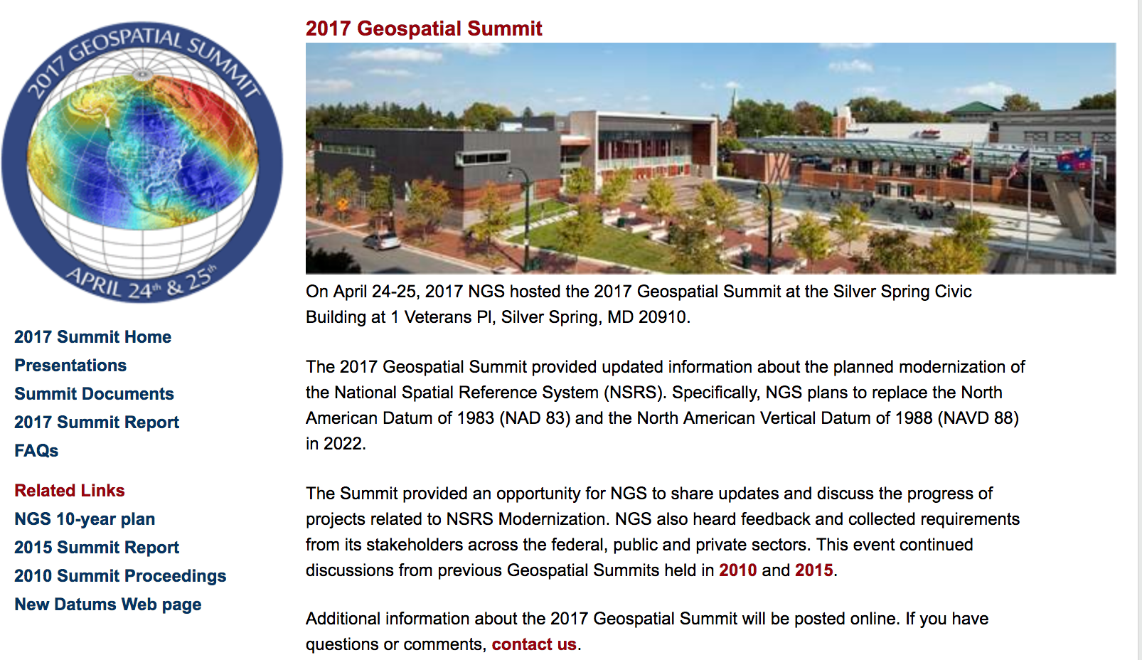
NGS Geospatial Summit 2017
Webinar videos and presentations are available
Debriefing the 2017 Geospatial Summit: NGS Webinar Series
September 14, 2017 - Webinar Information
https://geodesy.noaa.gov/geospatial-summit/
Notes:
On April 24-25, 2017, NGS hosted the 2017 Geospatial Summit to share information about the planned retirement of the North American Datum of 1983 (NAD 83) and the North American Vertical Datum of 1988 (NAVD 88). This webinar recaps the event, discusses stakeholder feedback that NGS received; and highlights resources to stay informed about National Spatial Reference System (NSRS) Modernization activities.

Slide 6

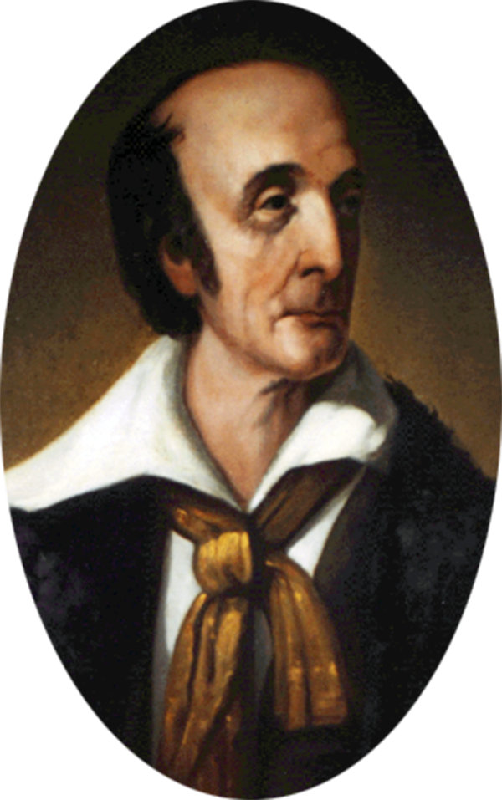


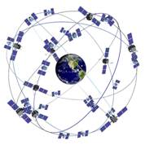
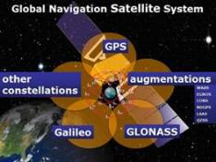
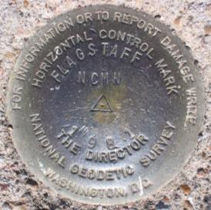
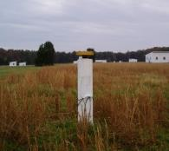
NGS and the NSRS continue to evolve!
The National Geodetic Survey (NGS) has been around a long time!
Our Nation’s first science agency (210 years)
  1807
  Thomas Jefferson
  Survey of the Coast
  1807
Ferdinand R. Hassler
First Superintendent
  1878
  U.S. Coast and
  Geodetic Survey
  1970
  NOAA is
  established
The National Spatial Reference System continues to evolve with us.
  GPS
Active
Control
(CORS)
Passive
Control
(Monuments)
  GNSS
Notes:
NGS has been around a long time. For more than 210 years (now 2017), NGS and its predecessor agencies have collaborated with public and private organizations to establish reference stations at precisely determined locations.
In Fact I would say it was conceived from a thought experiment from the American Philosophical society. Today, it is an eminent scholarly organization of international reputation, originally made up from doctors, lawyers, clergymen, and merchants interested in science, and also many learned artisans and tradesmen like Franklin. This country's first learned society, the APS has played an important role in American cultural and intellectual life for over 250 years. Washington, Jefferson and Yes, Hassler were members.
I would argue that most of the members were surveyors, and that the country was founded on the shoulders of geodesy. Anyhow one of the first “survey and mapping projects were the “Lewis and Clark Exposition”. After L&C made it back alive, The country was 30 years young and Thomas Jefferson was president. And there were a lot of problems, one such problem was shipwrecks. Shipping was the major source of commerce and transportation. Since we ran away from home so to speak our mother country “Mother”, no longer felt obliged to provide us with infrastructure items such as maps. The APS studied this issue and the mission began.
We began on a mission established by Thomas Jefferson in 1807 to conduct a “Survey of the Coast” (as the United States Coast Survey).
(Pictured are Thomas Jefferson and Ferdinand Hassler, the first Superintendent of the Coast Survey). We were renamed the U.S. Coast and Geodetic Survey in 1878. NOAA was established in 1970.
Traditionally, precise positioning locations have been identified by setting a survey mark—usually a brass, bronze, or aluminum disk. Locations might also be identified by a deeply driven rod, or a prominent object, such as a water tower or church spire.
More recently, NGS has fostered a network of continuously operating reference stations (CORS), where each CORS includes a highly accurate receiver that continuously collects radio signals broadcast by Global Navigation Satellite System (GNSS) satellites.
GPS (United States)
Compass (China)
GLONASS (Russia)
Galileo (European Union)

Slide 7
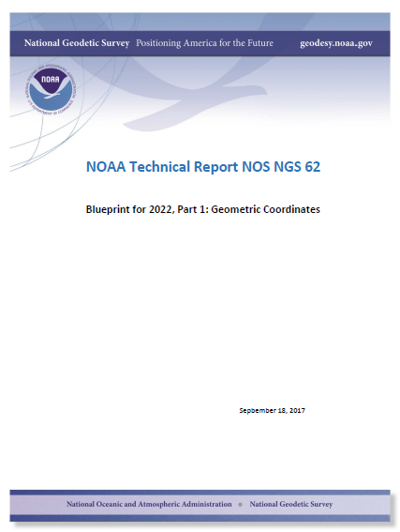
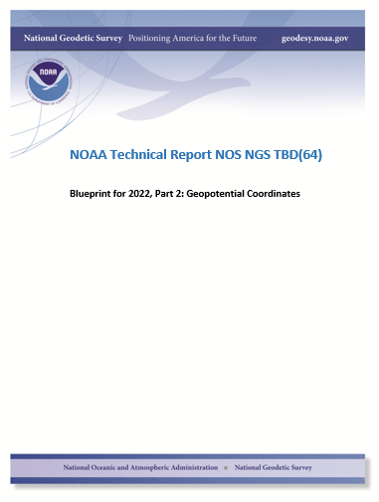
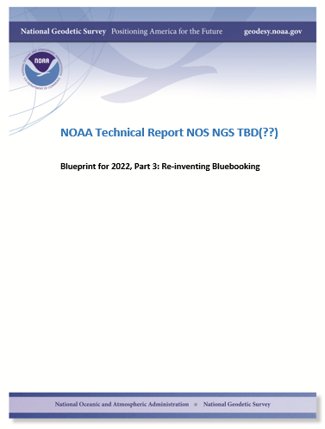
Modernizing the NSRS
The “blueprint” documents: Your best source for information
Geometric:
May 2017
(minor update Sep. 2017)
Geopotential:
Oct. 2017
Bluebooking:
Spring 2018

Slide 8
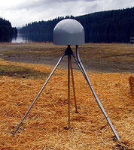
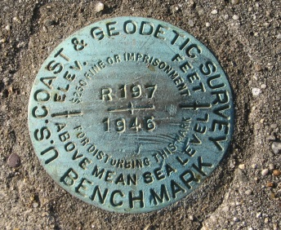
Replace NAD 83
Access and definition
Primary: CORS
  Continuous monitoring
  OPUS
  IGS coordinates
    Transformable to any national reference frame chosen for 2022
  Static Surveys
  RTK/RTN
    Validation service
Secondary: Passive
  Time-tagged coordinates
  Will reflect each occupation of the mark
  Will generally not be accepted as “fixed control” in surveys turned into NGS

Slide 9
Guiding Principals
By 2022, the National Spatial Reference System (NSRS) will be modernized with CORS becoming a more foundational component.
The International Earth Rotation and Reference Systems Service (IERS) International Terrestrial Reference System (ITRF) will continue to be the worldwide standard reference system.
NGS will continue to support the ITRF through International GNSS Service (IGS) reference sites.
The NSRS will continue to be defined in relation to the ITRF.

Slide 10
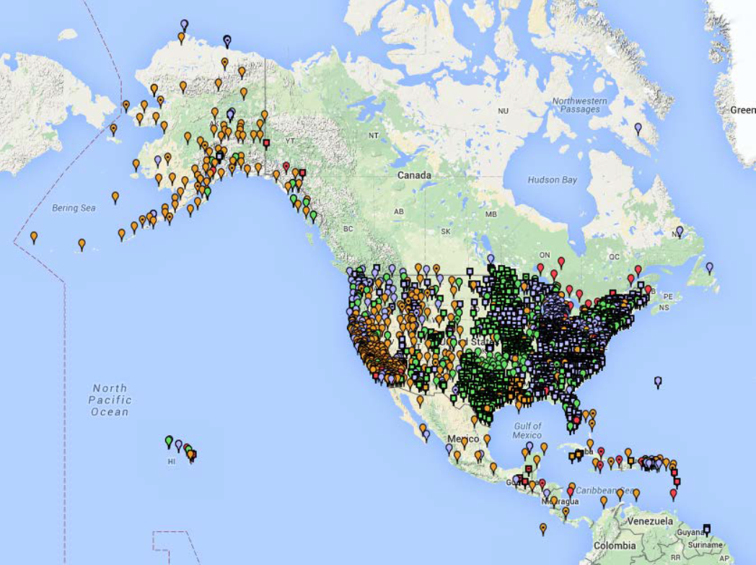
Current Continuously Operating Reference Stations (CORS)
~2000 Continuously Operating Reference Stations
Run by more than 200 organizations (various government, academic, and private organizations)
Provide access to the U.S. National Spatial Reference System

Slide 11
Foundation CORS Requirements
Baseline Foundation CORS Network:
  COLLOCATE - All Sites within the Foundation CORS target area of the United States, that have an existing space geodetic techniques (SLR, VLBI or DORIS) will have a collocated Foundation CORS
Additional Desired Foundation CORS Network Requirements:
  DENSITY – Install or adopt new stations within the Foundation CORS target area of the United States, to fulfill the spacing criteria of 800 km within the Foundation CORS target area, after the above criteria are met.
  EULER – Install or adopt new stations within the Foundation CORS target area of the United States to raise the minimum number of Foundation CORS to 3 on each of the 4 plates of interest, once the above criteria are met.
  ADDITIONAL (Gap Filling) – Install or adopt new stations, on a case-by-case basis, once the above criteria is met.

Slide 12
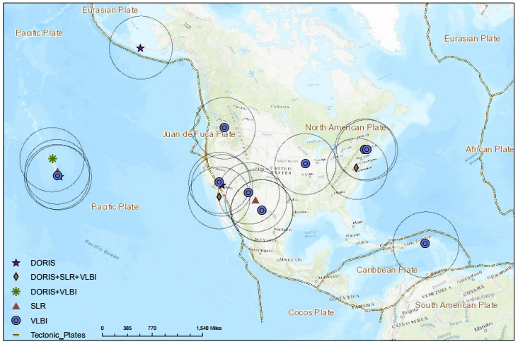
Collocated Spaced Based Technology (SBT)

Slide 13
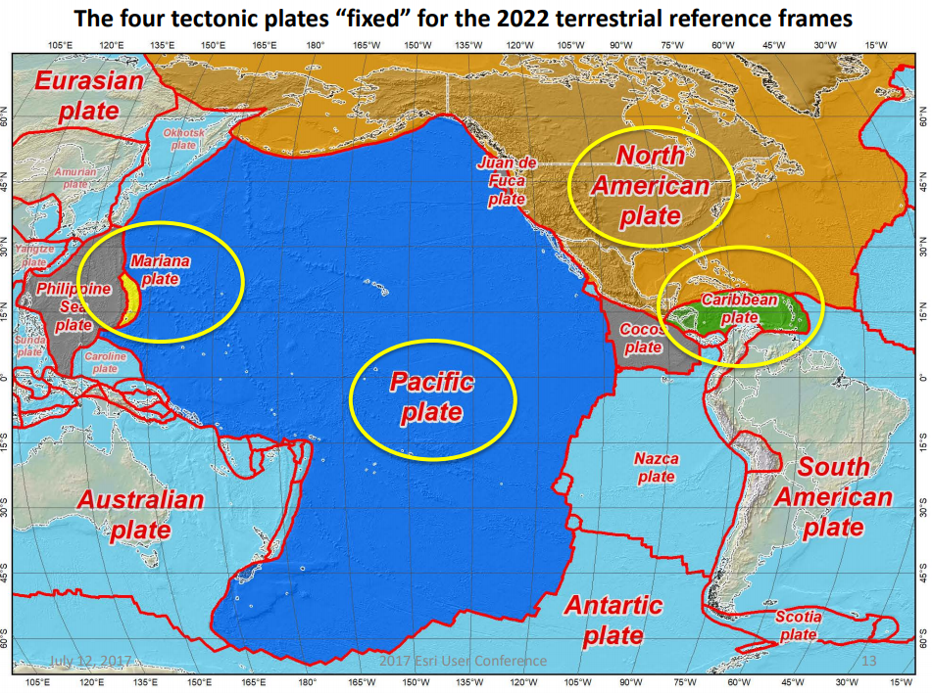
Four Tectonic Plates NGS Monitors
In 2022, the entire National Spatial Reference System (NSRS) will be modernized and will contain four new reference frames:
  North American Terrestrial Reference Frame of 2022 (NATRF2022)
  Pacific Terrestrial Reference Frame of 2022 (PATRF2022)
  Caribbean Terrestrial Reference Frame of 2022 (CATRF2022)
  Mariana Terrestrial Reference Frame of (MATRF2022)

Slide 14
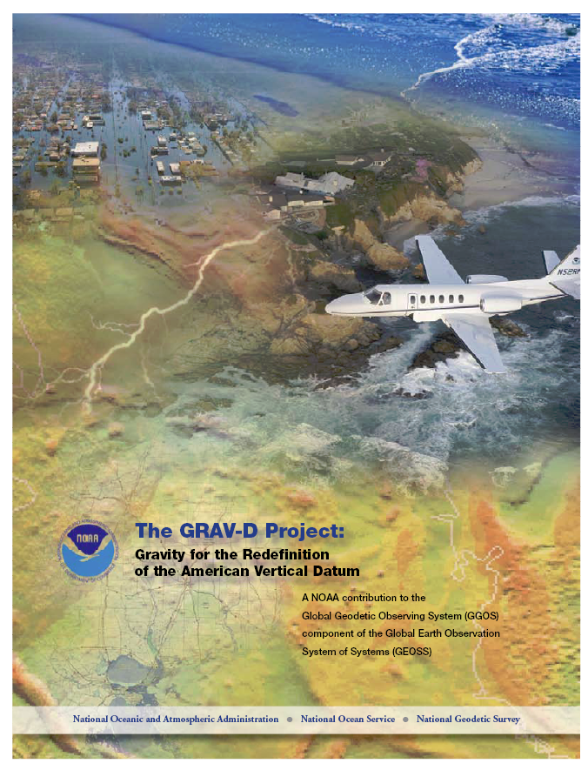
Replace NAVD 88
Changing from a leveling-based to a geoid/GNSS-based vertical datum
Biggest requirement: An updated,
accurate, nationwide gravity survey
  Airborne
  GRAV-D!
    Gravity for the Redefinition of the
    American Vertical Datum
http://www.ngs.noaa.gov/GRAV-D/pubs/GRAV-D_v2007_12_19.pdf

Slide 15
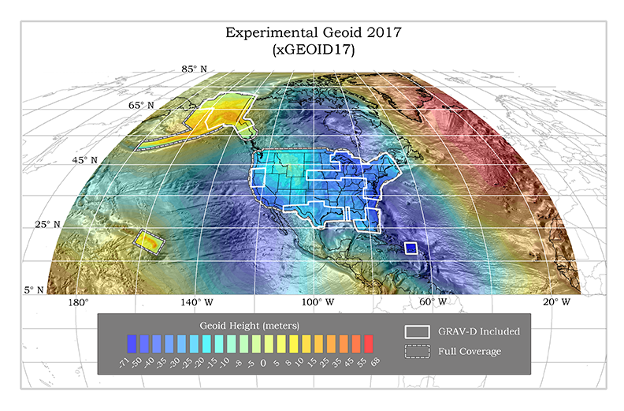
Experimental Geoids
https://beta.ngs.noaa.gov/GEOID/xGEOID17/

Slide 16
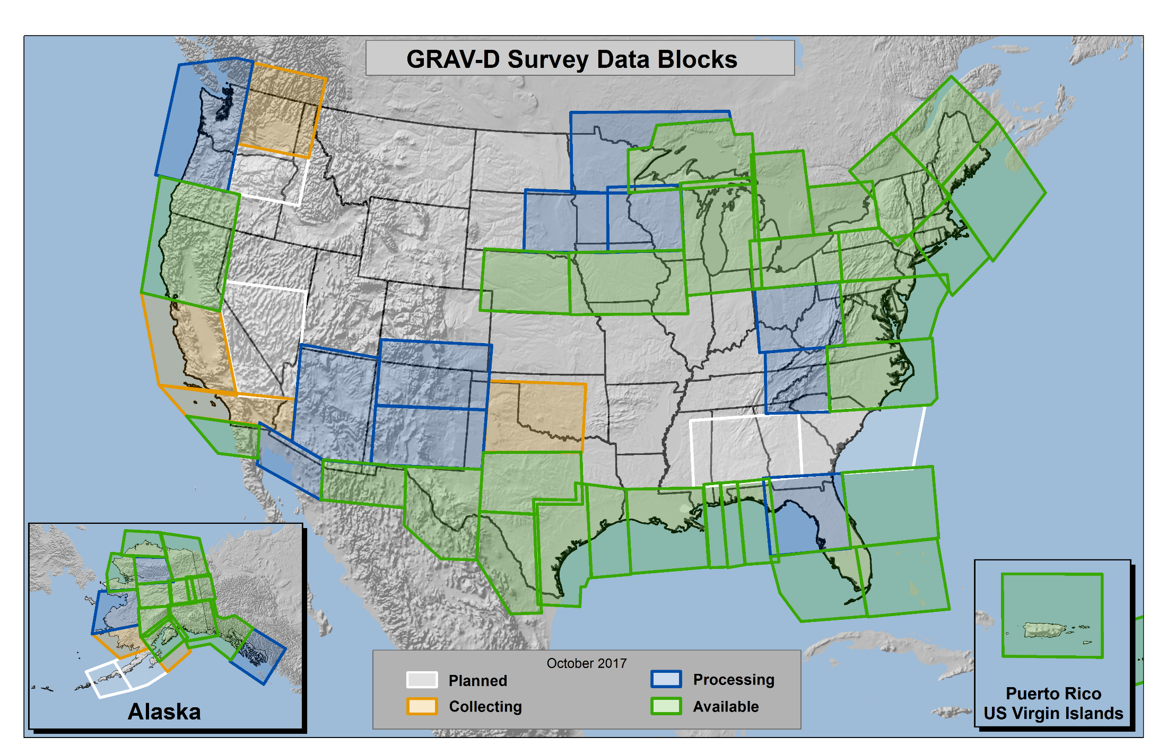
Gravity for the Redefinition of the American Vertical Datum (GRAV-D)
https://www.geodesy.noaa.gov/GRAV-D/
Notes:
Pictured: Airborne gravity survey grid and the current status of GRAV-D, with more than 64 percent of the U.S. and its territories covered and GRAV-D airborne data collected (as of the end of September 2017).
The two blue-green blocks along the border of Arizona-New Mexico-Texas should be “green” (data is available). I’m not sure what happened to the color.
In 2010, began operational collection of airborne gravity data to calculate a geoid model and ultimately a new vertical reference system for accurate height measurements up to 2 cm in the U.S. and territories.
Provides highly accurate height measurements to determine where water flows
Connects satellite and terrestrial gravity measurements for efficient and accurate gravity monitoring
Benefits include $240 Million from improved floodplain mapping alone

Slide 17
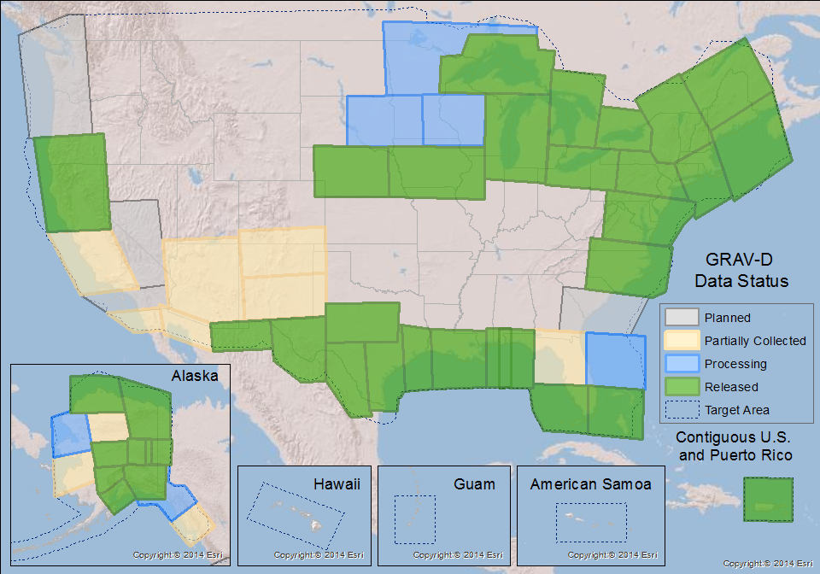
GRAV-D Status
100% by 2022
50% mark hit in FY2016
  FY2017 target: 62%
Two aircrafts at a time
  Occasionally three
Mix of Government and Private Industry Flights
Experiments with G4
  If successful, begin using G4 to collect Pacific states and territories as early as next year

Slide 18
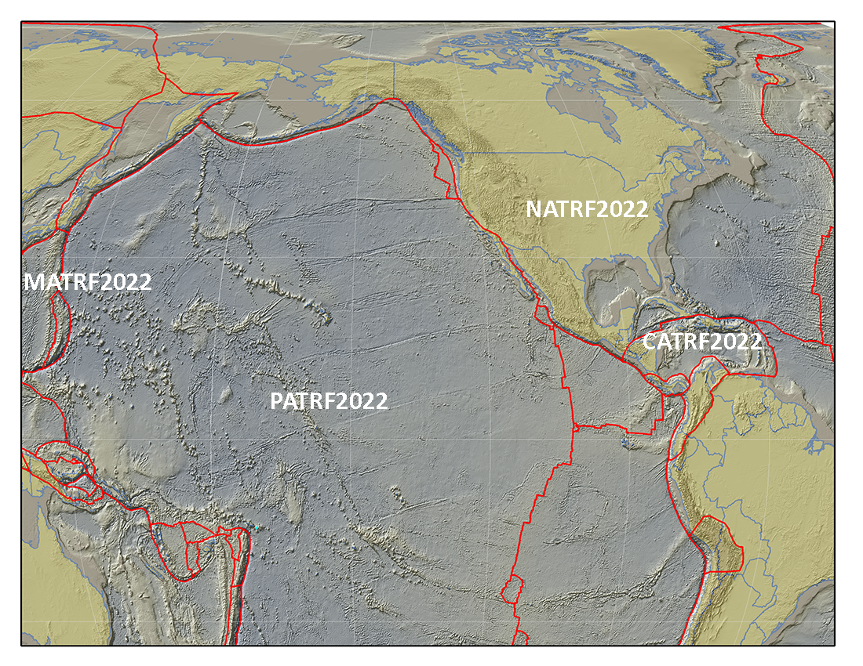
International Coordination
IAG (Comm. 1 & 2)
  ITRF/IHRF
UN-GGIM
  UN-GGRF
  UN-GGIM-Americas
  SIRGAS
FIG et al.
ISO – TC 211
GLCC – IGLD update

Slide 19
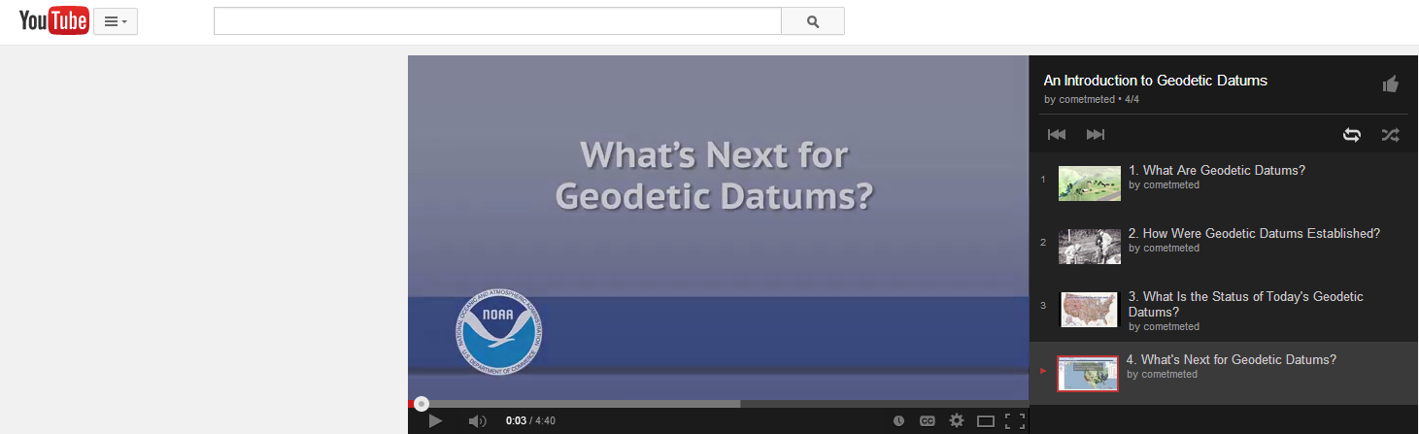

NGS Video Library
Educational Videos about New Datums and more
http://www.ngs.noaa.gov/corbin/class_description/NGS_Video_Library.shtml

Slide 20
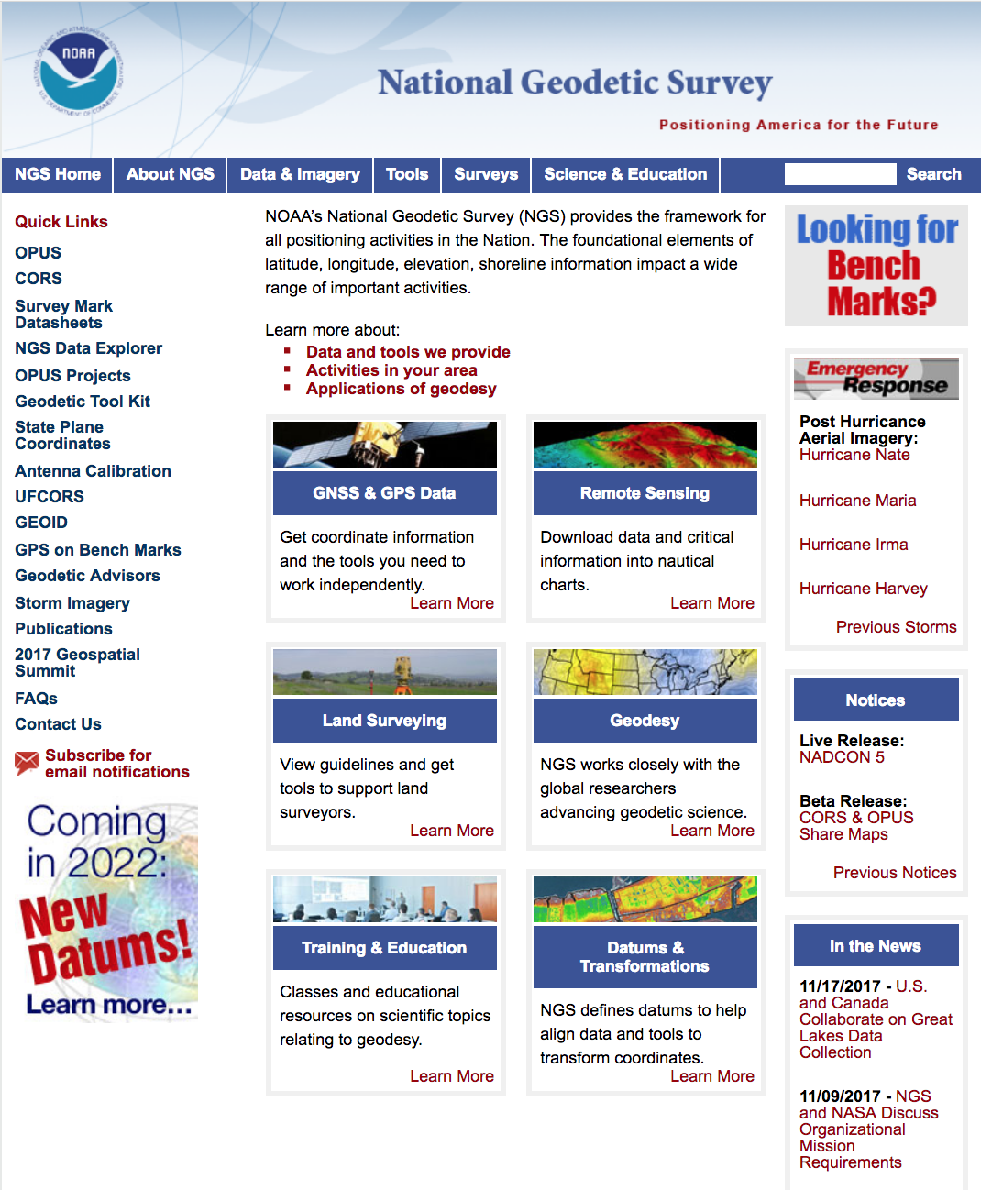

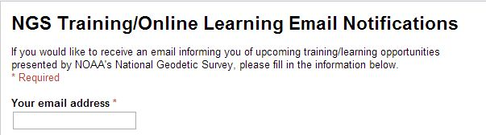
NGS Homepage:
geodesy.noaa.gov

Slide 21





Thank You !
QUESTIONS?

Slide 22
Thank You !
QUESTIONS? 2nd

Slide 23
Nomenclature
A chance to increase accuracy in naming!
  “North American”?
    Ignores Guam, Hawaii, American Samoa, Northern Mariana Islands
  Datum vs Reference Frame?
  Plate-specific?
  Vertical vs Geopotential?
6/8/2016: NGS and the Canadian Geodetic Survey negotiated a naming proposal
  Approved by NGS ESC
  Approved by the CGS leadership (with minor reservations)
  Awaiting final word from INEGI as of 10/26/2016….

Slide 24
The current naming proposal
Geometric Reference Frames (XYZ, φλh):
Geoid Models (N):
Geopotential Datum (H, Hdyn, g, Δg, ξ, η, etc)
Plate | Name | Acronym
North American | North American Terrestrial Reference Frame of 2022 | NATRF2022
Pacific | Pacific Terrestrial Reference Frame of 2022 | PATRF2022
Caribbean | Caribbean Terrestrial Reference Frame of 2022 | CATRF2022
Marianas | Marianas Terrestrial Reference Frame of 2022 | MATRF2022
Grid Area | Name
North America (pole to equator; Aleutians to Greenland) | GEOID2022-NA
American Samoa | GEOID2022-AS
Guam and CNMI | GEOID2022-GC
Area | Name | Acronym
All | North American-Pacific Geopotential Datum of 2022 | NAPGD2022

Slide 25
Replacing the NAD 83’s
The Old:
NAD 83(2011)
NAD 83(PA11)
NAD 83(MA11)
The New:
The North American Terrestrial Reference Frame of 2022
(NATRF2022)
The Caribbean Terrestrial Reference Frame of 2022
(CATRF2022)
The Pacific Terrestrial Reference Frame of 2022
(PATRF2022)
The Mariana Terrestrial Reference Frame of 2022
(MATRF2022)

Slide 26
Replace NAD 83
Simplified Concept of NAD 83 vs. “2022”
Earth’s Surface
h_{”2022”}
h_{NAD83}
φ_{NAD83} – φ_{”2022”}
λ_{NAD83} – λ_{”2022”}
h_{NAD83} – h_{”2022”}
all vary
smoothly by latitude
and longitude
“2022” origin
~2.24 m
NAD 83 origin

Slide 27
Replacing the NAD 83’s
Three plate-(pseudo)fixed frames will be replaced with four plate-fixed reference frames
  N. Amer., Pacific, Mariana, Caribbean(new!)
Remove long-standing non-geocentricity of NAD 83 frames
All four : identical to IGSxx at a TBD epoch
  2020.00?
All four : differ from IGSxx by plate rotation only
  Updated Euler Pole determination for rigid plate only

Slide 28
The TRFs
All are global frames (no “boundary”)
  This was true for the NAD 83’s also, BTW
  But each frame will rotate with one tectonic plate
    Put another way: “The frame rotates so your coordinates don’t have to”
All will have an Intra-Frame Velocity Model
  To capture any motions outside of tectonic rotation
    Residual horizontal motions
    All vertical (ellipsoid height) motions

Slide 29
What’s Being Replaced
What’s being replaced:
Horizontal Vertical
  NAD 83(2011)
  NAD 83(PA11)
  NAD 83(MA11)
  NAVD 88
  PRVD 02
  VIVD09
  ASVD02
  NMVD03
  GUVD04
  IGLD 85
Heights
Latitude
Longitude
Ellipsoid Height
State Plane Coordinates

Slide 30
The relation of five global reference
frames through time.
NATRF2022
MATRF2022
Rotations are not to scale
CATRF2022
Rotation of North American Plate
PATRF2022
Rotation of Pacific Plate
IGS frame
IGS frame through time
IGS frame
Rotation of Caribbean Plate
PATRF2022
CATRF2022
Rotation of Mariana Plate
NATRF2022
Time “t ” when
all four TRFs and the
IGS are identical.
(maybe 2020.0?)
MATRF2022
0
t=t - Δt
(“the past”)
t=t + Δt
(“the future”)
0
0

Slide 31
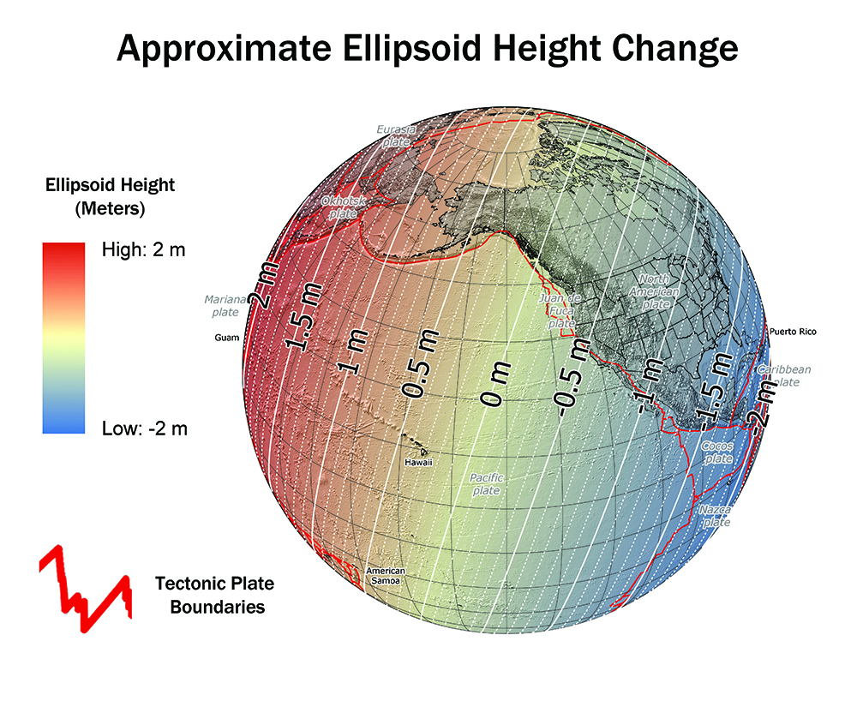

Slide 32
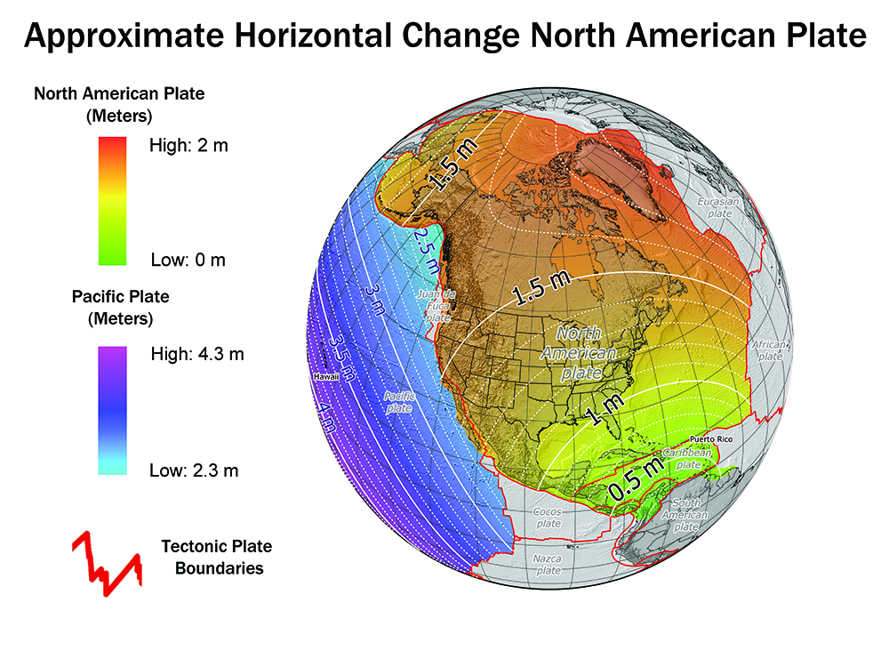

Slide 33
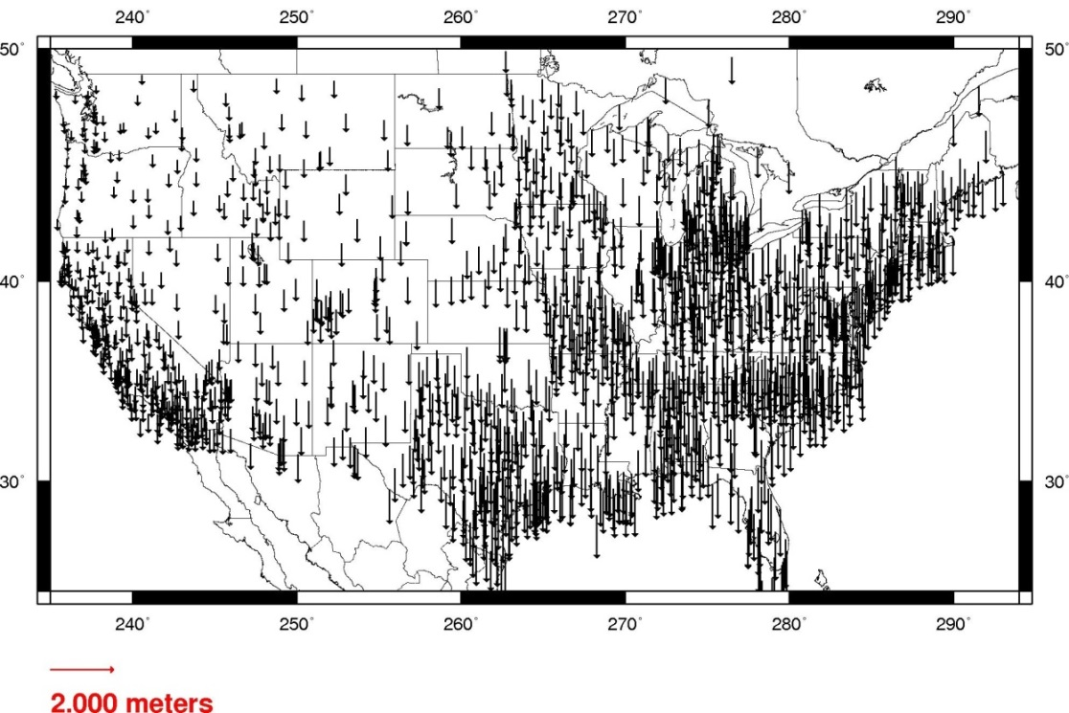
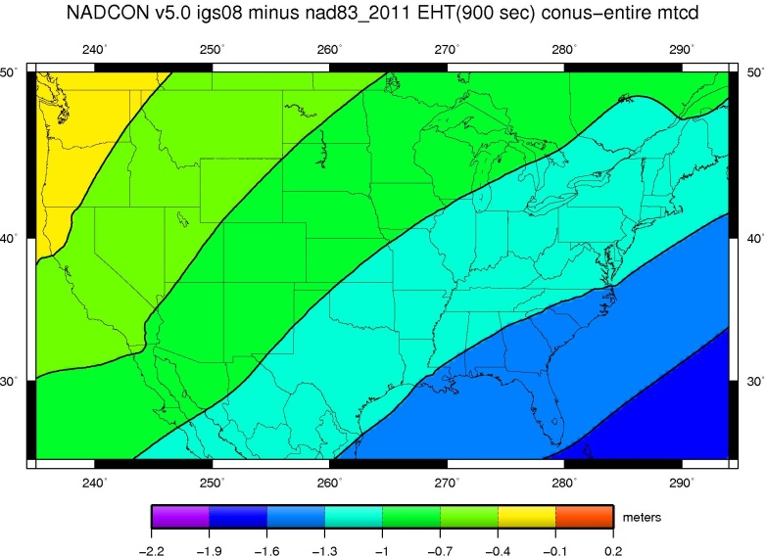
Ellipsoid Height Shifts
Approximate
  IGS08(GRS-80) minus NAD 83(2011)

Slide 34
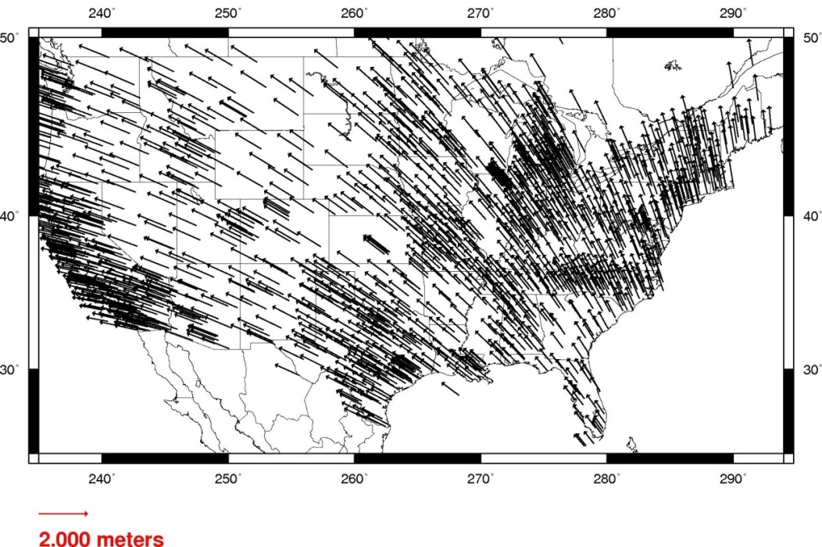
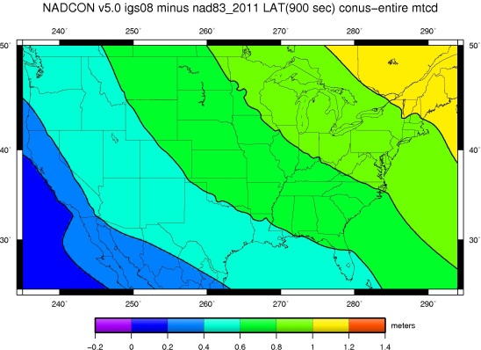
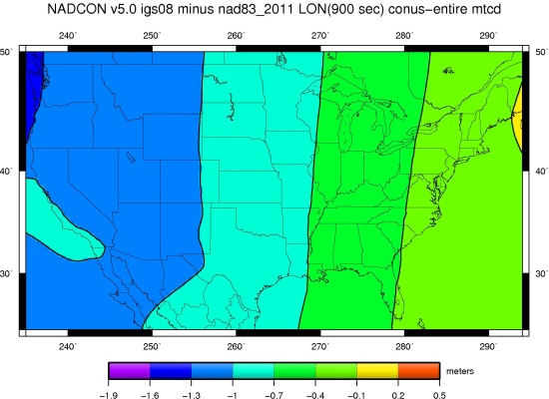
Horizontal Shifts
Approximate
  IGS08(GRS-80) minus NAD 83(2011)
Lat:
Lon:

Slide 35

GRAV-D Coverage
Alaska
“CONUS”
Guam / Northern Marianas
Hawaii
Puerto Rico / Virgin Islands
American Samoa

Slide 36
Replace NAVD 88
Earth’s
Surface
H (NAVD 88)
H
NAVD 88 reference level
The Geoid
Errors in NAVD 88 : ~50 cm average, 100 cm CONUS tilt,
1-2 meters average in Alaska, NO tracking

Slide 37

Orthometric Heights
Approximate EXPECTED SHIFTS
Approximate level of geoid mismatch known to exist in the NAVD 88 zero surface:
  Does not include local subsidence issues

Slide 38

Time Dependencies
Geoid changes cause height changes
The zero elevation surface will change with time
Heights will be time tagged to respect:
    Geoid change
    Subsidence
Possibly start a Geoid monitoring service?

Slide 39

Geoid Slope Validation Survey (GSVS17)
Colorado along Hwy 160
Durango to Walsenburg
>1250m (~4100 ft) elevation change
221 new monuments, 221 miles of hwy
Notes:
Highway 160 in Colorado.

Slide 40
X, Y, Z
NADCON 5 software
Datum
Transformations
φ, λ, h
φ, λ, h
2022
X, Y, Z
SPC
UTM
USSD
USNG
UTM
φ, λ, h
φ, λ, h
NAD 27
NAD 83 (2011)
X, Y, Z
SPC
X, Y, Z
SPC
USNG
UTM
USNG
UTM
NAD 83 (NSRS2007)
φ, λ, h
NAD 83 (1986)
φ, λ, h
NAD 83 (FBN)
NAD 83 (HARN)
φ, λ, h
X, Y, Z
SPC
X, Y, Z
SPC
φ, λ, h
USNG
UTM
USNG
UTM
X, Y, Z
SPC
X, Y, Z
SPC
USNG
UTM
USNG
UTM

Slide 41

Geometric datum transformations
b₂
b₁
a₁
ΔX, ΔY, ΔZ
a₂
3-parameter
datum transformation
p19

Slide 42
Geometric datum transformations
If datum changes with time, each component has a velocity…
rot_{Z}
b₁
a₁
b₂
ΔX, ΔY, ΔZ
rot_{X}
a₂
3-parameter
datum transformation
7-parameter
datum transformation
rot_{Y}
14-parameter
datum transformation
scale
p19

Slide 43
Emergency Response Imagery
2017 Hurricanes Harvey, Irma, Maria and Nate

Slide 44

Notes:
Wanted to do a shout out to the Emergency crews for their constant work the last three weeks …. Lieutenant commander (LCDR) Waddington sent this card in..This is the resulting before and after emergency imagery in the heart of the Florida keys (Marathon) thanks to hurricane IRMA

Slide 45
NGS Partners & Constituents
Federal
Bureau of Land Management US Army Corps of Engineers
Forest Service Int’l Boundary & Water Commission
National Park Service US Armed Forces
US Geological Survey National Guard
Bureau of Reclamation National Laboratories
Department of Energy National Geospatial-Intelligence Agency
State
Geological Surveys Departments of Transportation
Water Authorities Environment / Land Management
Geospatial Authority / Clearinghouse State Surveyor / Cartographer
Other
State GIS Councils / Committees State Surveying Organizations
Cities & Counties Regional Government Councils
Colleges, Universities Tribal Governments
Private Sector Firms / Contractors Railroads

