Slide 1

Brave New Coordinates
The Next Generation of State Plane in the United States
Blue Marble GeoTalks 2024
January 24, 2024
Michael L. Dennis, PhD, PE, PLS
SPCS2022 Project Manager

Slide 2
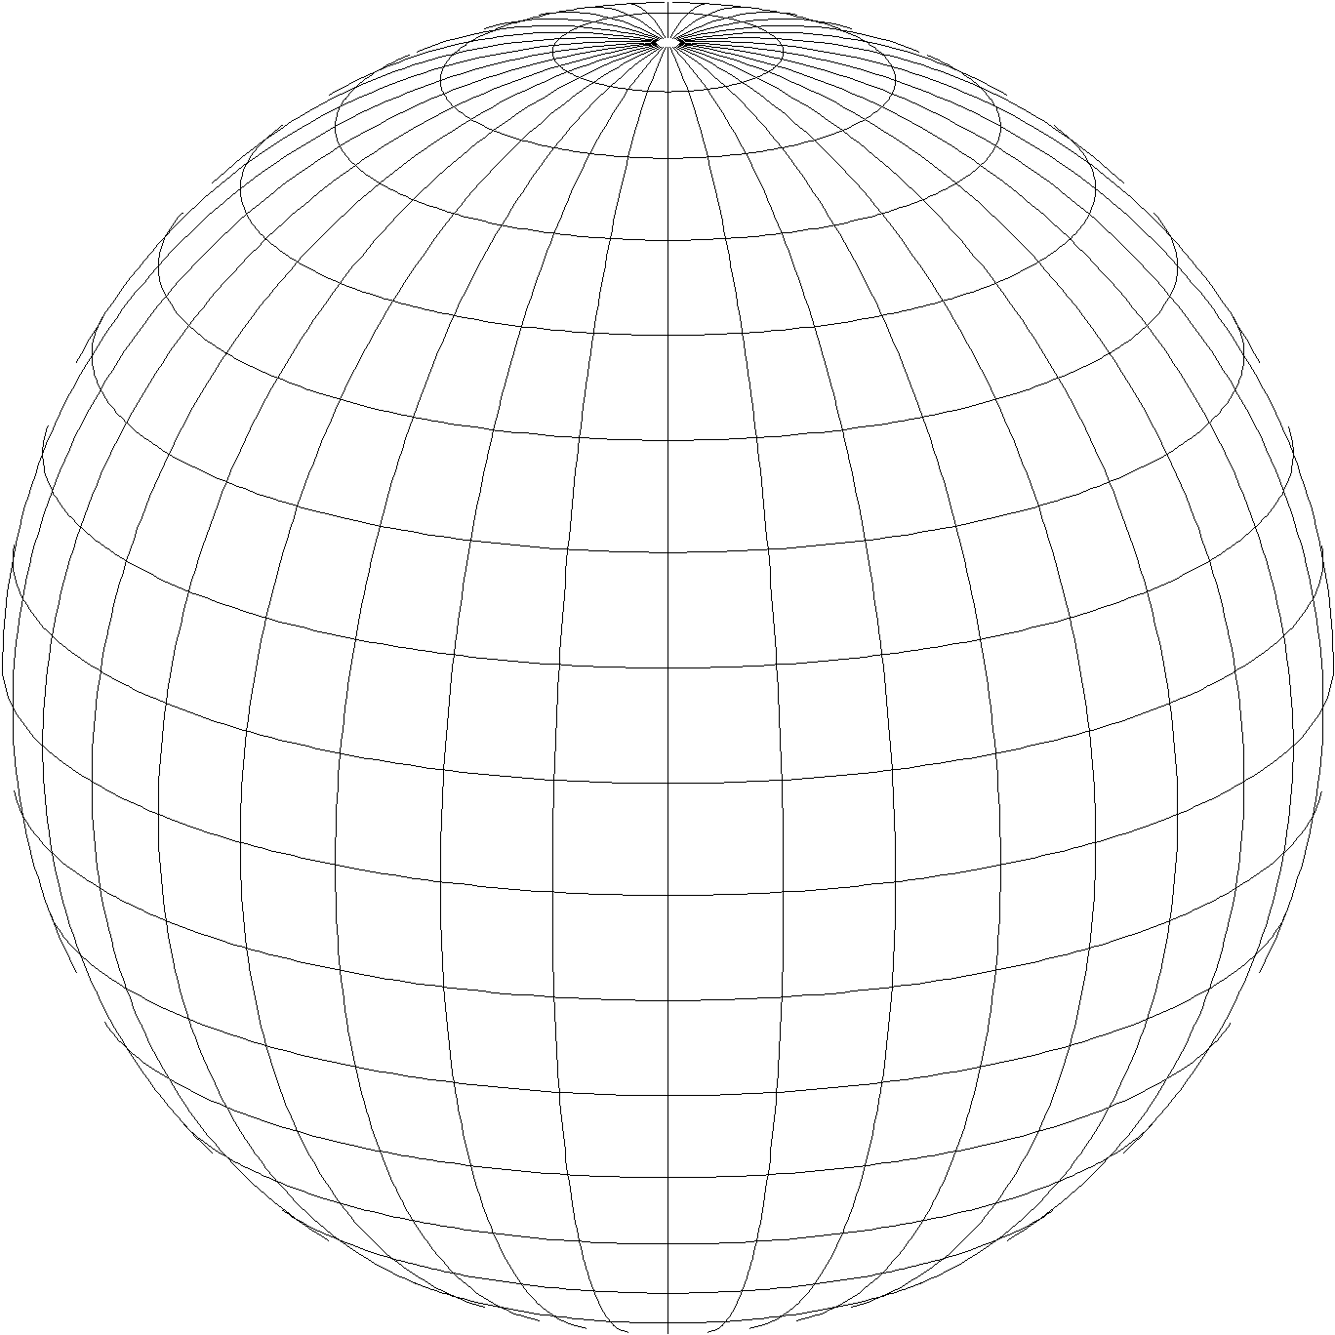
State Plane Coordinate System of 2022 (SPCS2022)
Part of modernizing the National Spatial Reference System (NSRS)
Third generation of State Plane
  First in 1930s (SPCS 27), second in 1980s (SPCS 83)
  Same 3 conformal map projection types
  Same ellipsoid as SPCS 83 (GRS 80)
Same as existing State Plane, but different…
  Based on new terrestrial reference frames instead of NAD 83
  More zones, most designed by state stakeholders
Lambert Conformal Conic
Transverse Mercator
Hotine Oblique Mercator

Slide 3
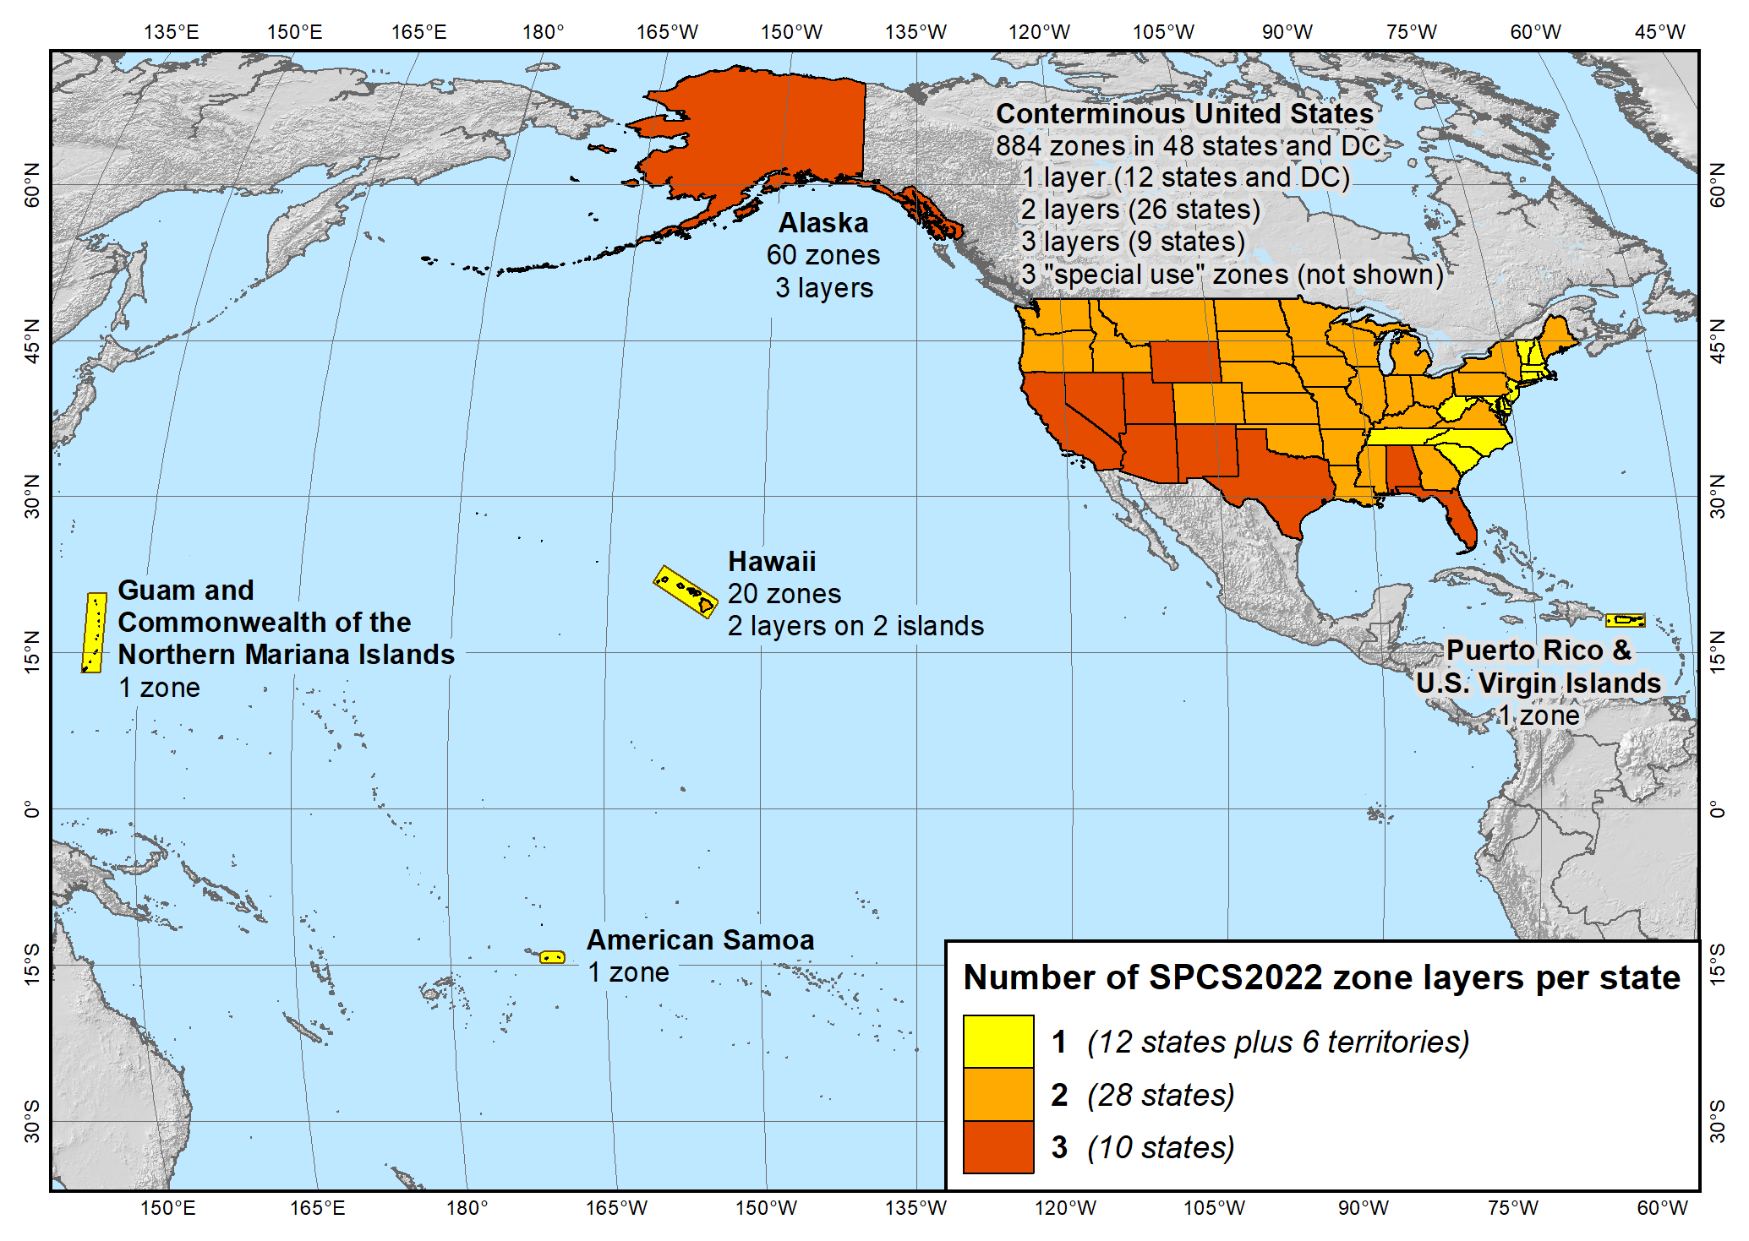
SPCS2022 zone layers
1 layer: 12 states plus 6 territories
2 layers: 28 states
3 layers: 10 states

Slide 4
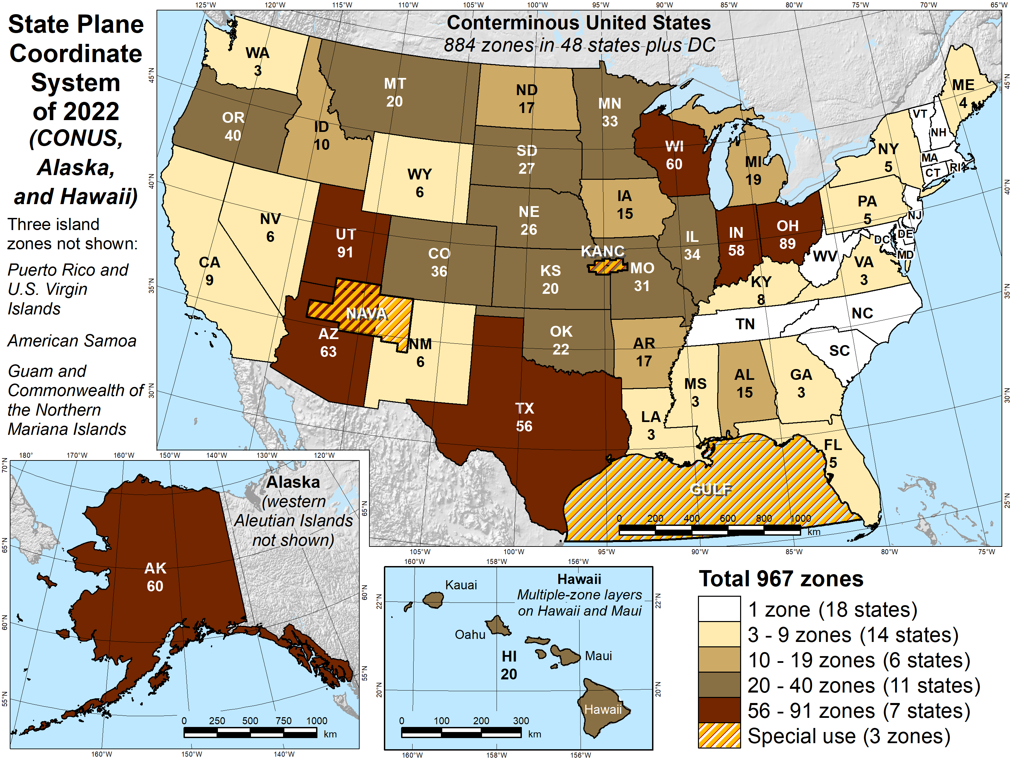
Number of SPCS2022 zones (preliminary)
Designs by NGS
  165 zones
  Includes 54 statewide zones…
  …and 3 “special use” zones
  (in more than one state)
Designs by state stakeholders
  802 zones in 28 states
Total = 967 zones
for 56 states
and territories
Compare to 125
zones in existing
State Plane

Slide 5
State Plane Coordinate System of 2022 (SPCS2022)
Part of modernizing the National Spatial Reference System (NSRS)
Third generation of State Plane
  First in 1930s (SPCS 27), second in 1980s (SPCS 83)
  Same 3 map projection types
  Same ellipsoid as SPCS 83 (GRS 80)
Same as existing State Plane, but different…
  Based on new terrestrial reference frames instead of NAD 83
  More zones, most designed by state stakeholders
  Designed to reduce linear distortion at topographic surface
  (i.e., reduce difference between “grid” and “ground” distances)
Lambert Conformal Conic
Transverse Mercator
Hotine Oblique Mercator

Slide 6
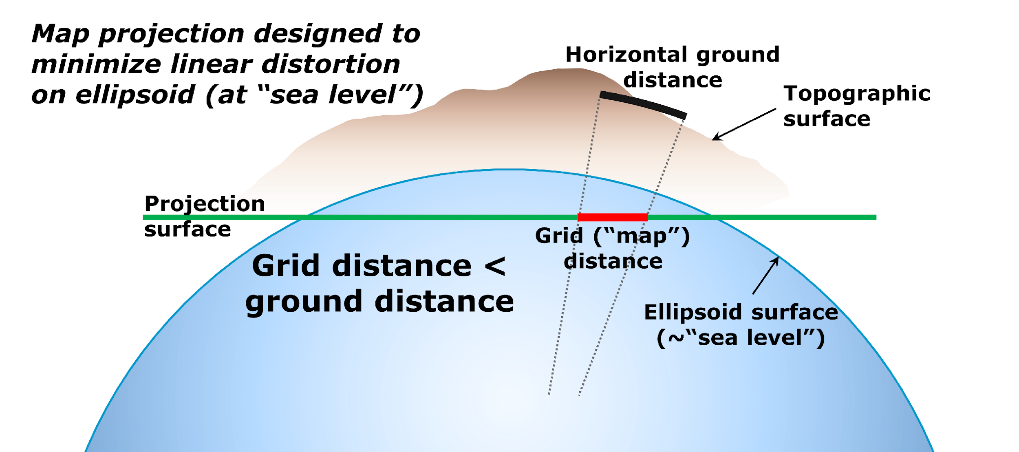
State Plane Coordinate Systems of 1983 and 1927

Slide 7
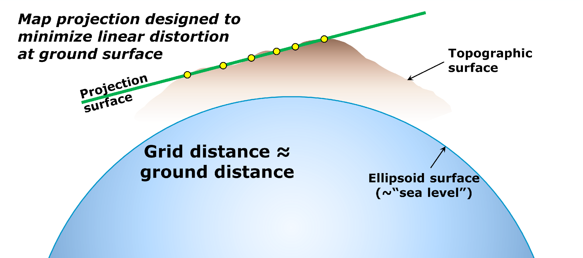
State Plane Coordinate System of 2022

Slide 8
SPCS2022 distortion design philosophy
Linear distortion minimized at topographic surface (not ellipsoid surface)
  Purpose: reduce difference between projected “grid” and actual “ground” distances
  Population distribution also taken into account in NGS designs
What is linear distortion?
  Map projection “scale error” at topographic surface
  Unique (i.e., same in every direction) only for conformal projections
  Given here in parts per million (ppm) = mm of distortion per km
Linear distortion | = | Projected minus actual distance
 |  | Actual distance

Slide 9
Linear distortion magnitudes
Parts per million | Centimeters per kilometer | Feet per mile | Dimensionless ratio | Examples
20 ppm | 2 cm/km | 0.11 ft/mile | 1:50,000 | Typical “low distortion projection” limit
50 ppm | 5 cm/km | 0.26 ft/mile | 1:20,000 | Minimum distortion for designs by NGS
100 ppm | 10 cm/km | 0.53 ft/mile | 1:10,000 | Historic State Plane distortion design limit
400 ppm | 40 cm/km | 2.11 ft/mile | 1:2,500 | UTM distortion design limit

Slide 10
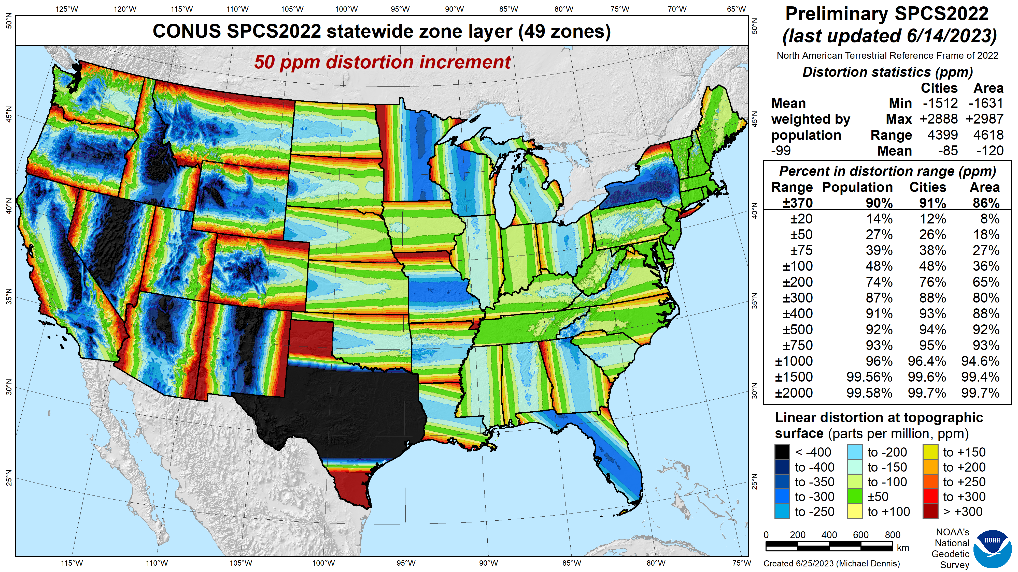
SPCS2022
linear distortion (preliminary)
Green is ±50 ppm (±0.26 ft/mile)
Distortion performance:
±370 ppm
Performance percentages:
90% population
91% cities & towns
86% total area
Mean weighted by population: -99 ppm
Grid versus ground distance
BLUE: grid SHORTER than ground
RED: grid LONGER than ground
GREEN: grid = ground (within ±50 ppm or ±0.26 ft/mile)

Slide 11
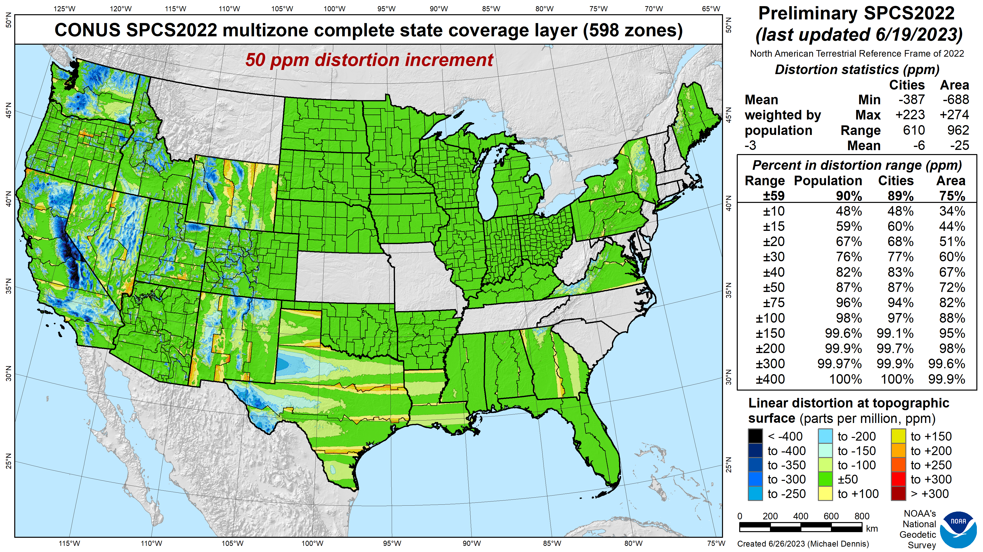
SPCS 83
linear distortion (existing)
Green is ±50 ppm (±0.26 ft/mile)

Slide 12
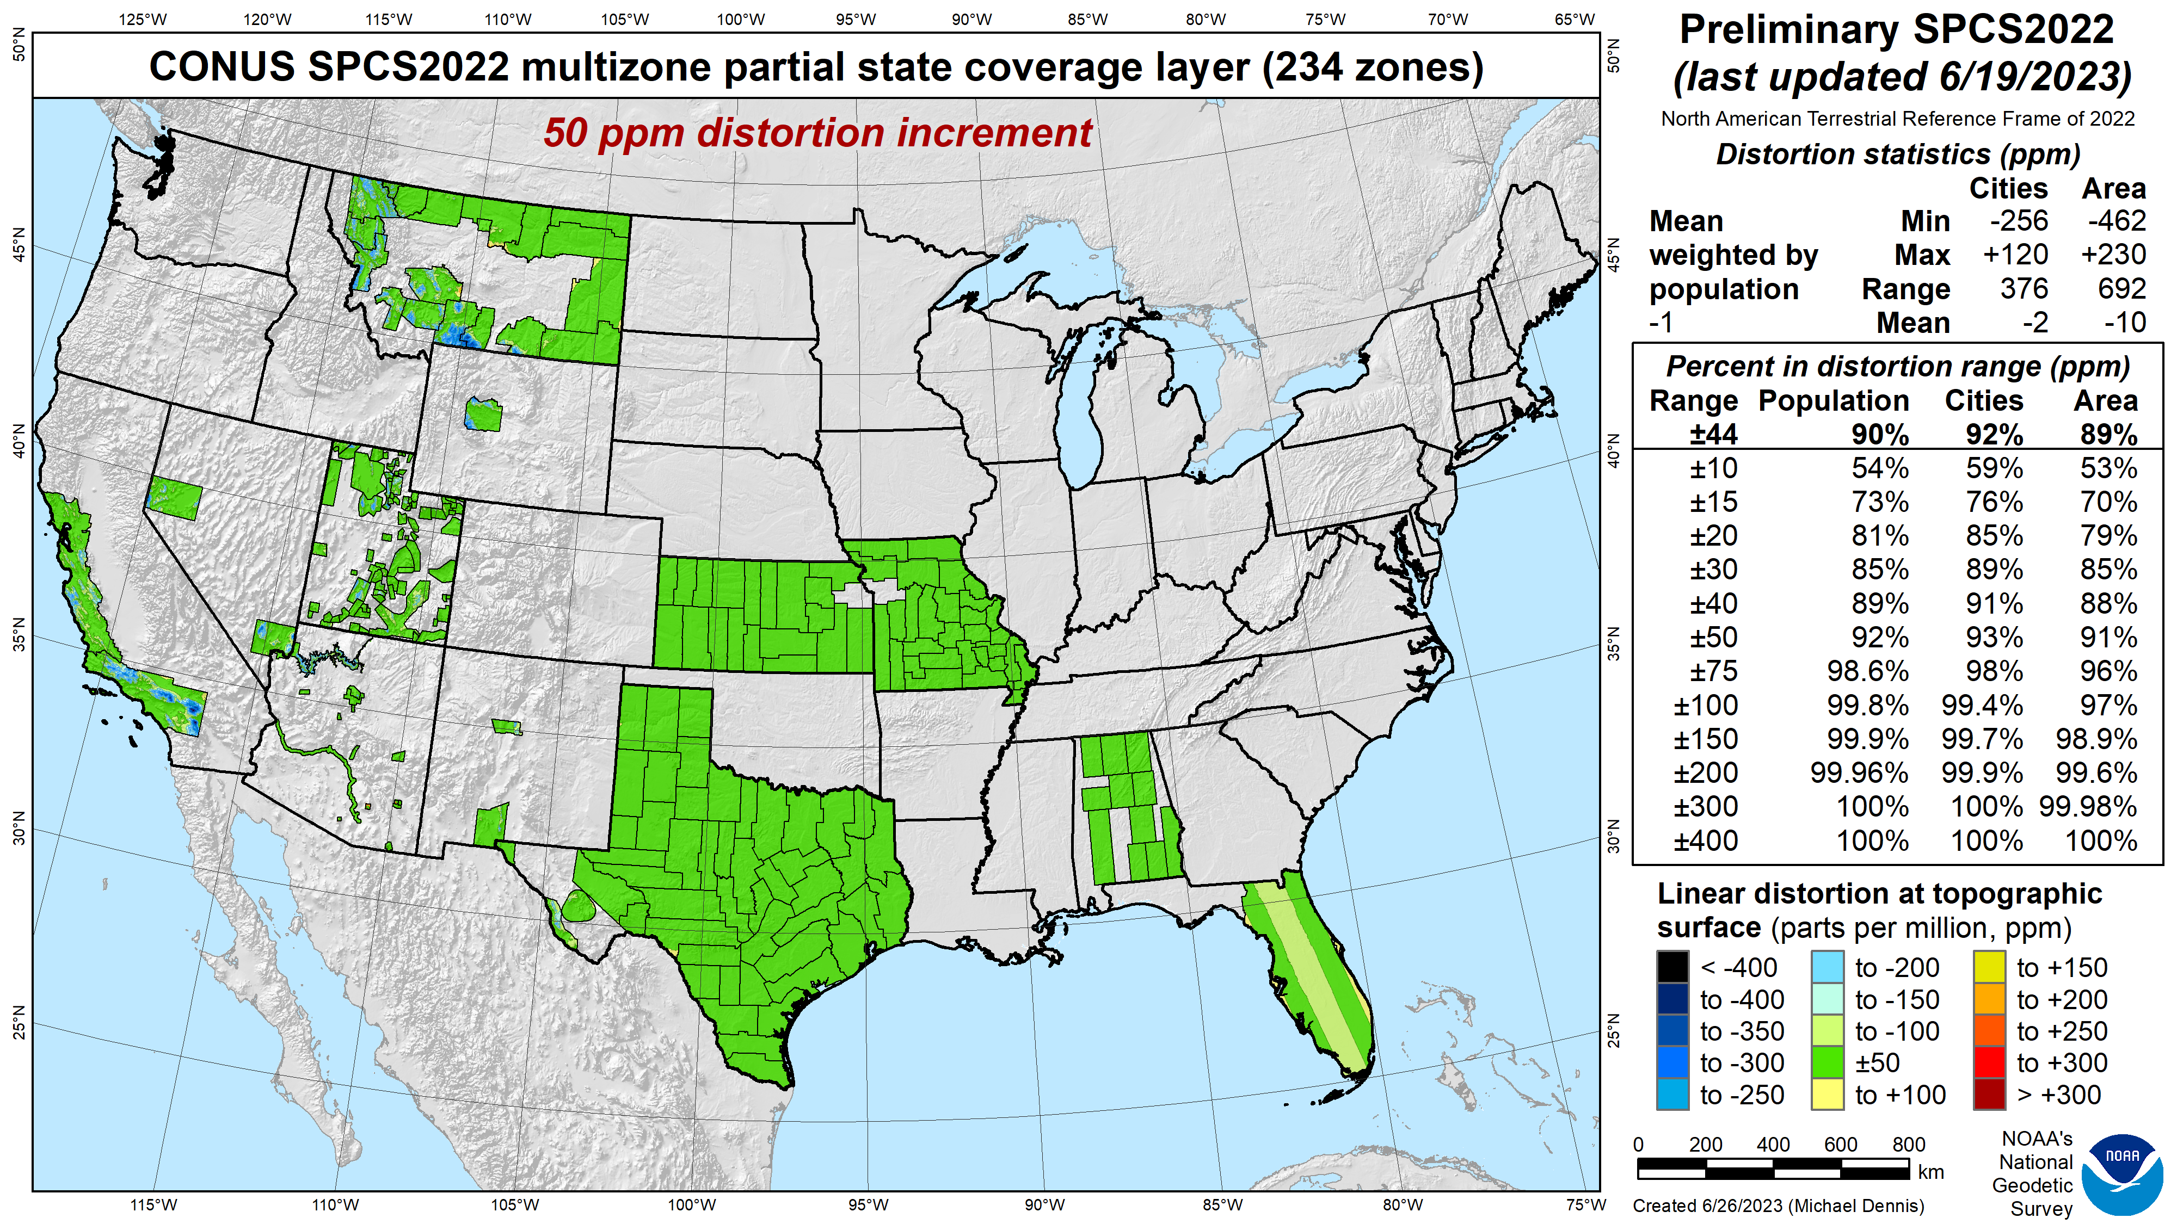
SPCS 83
linear distortion (existing)
Green is ±50 ppm (±0.26 ft/mile)
These zones will be removed

Slide 13
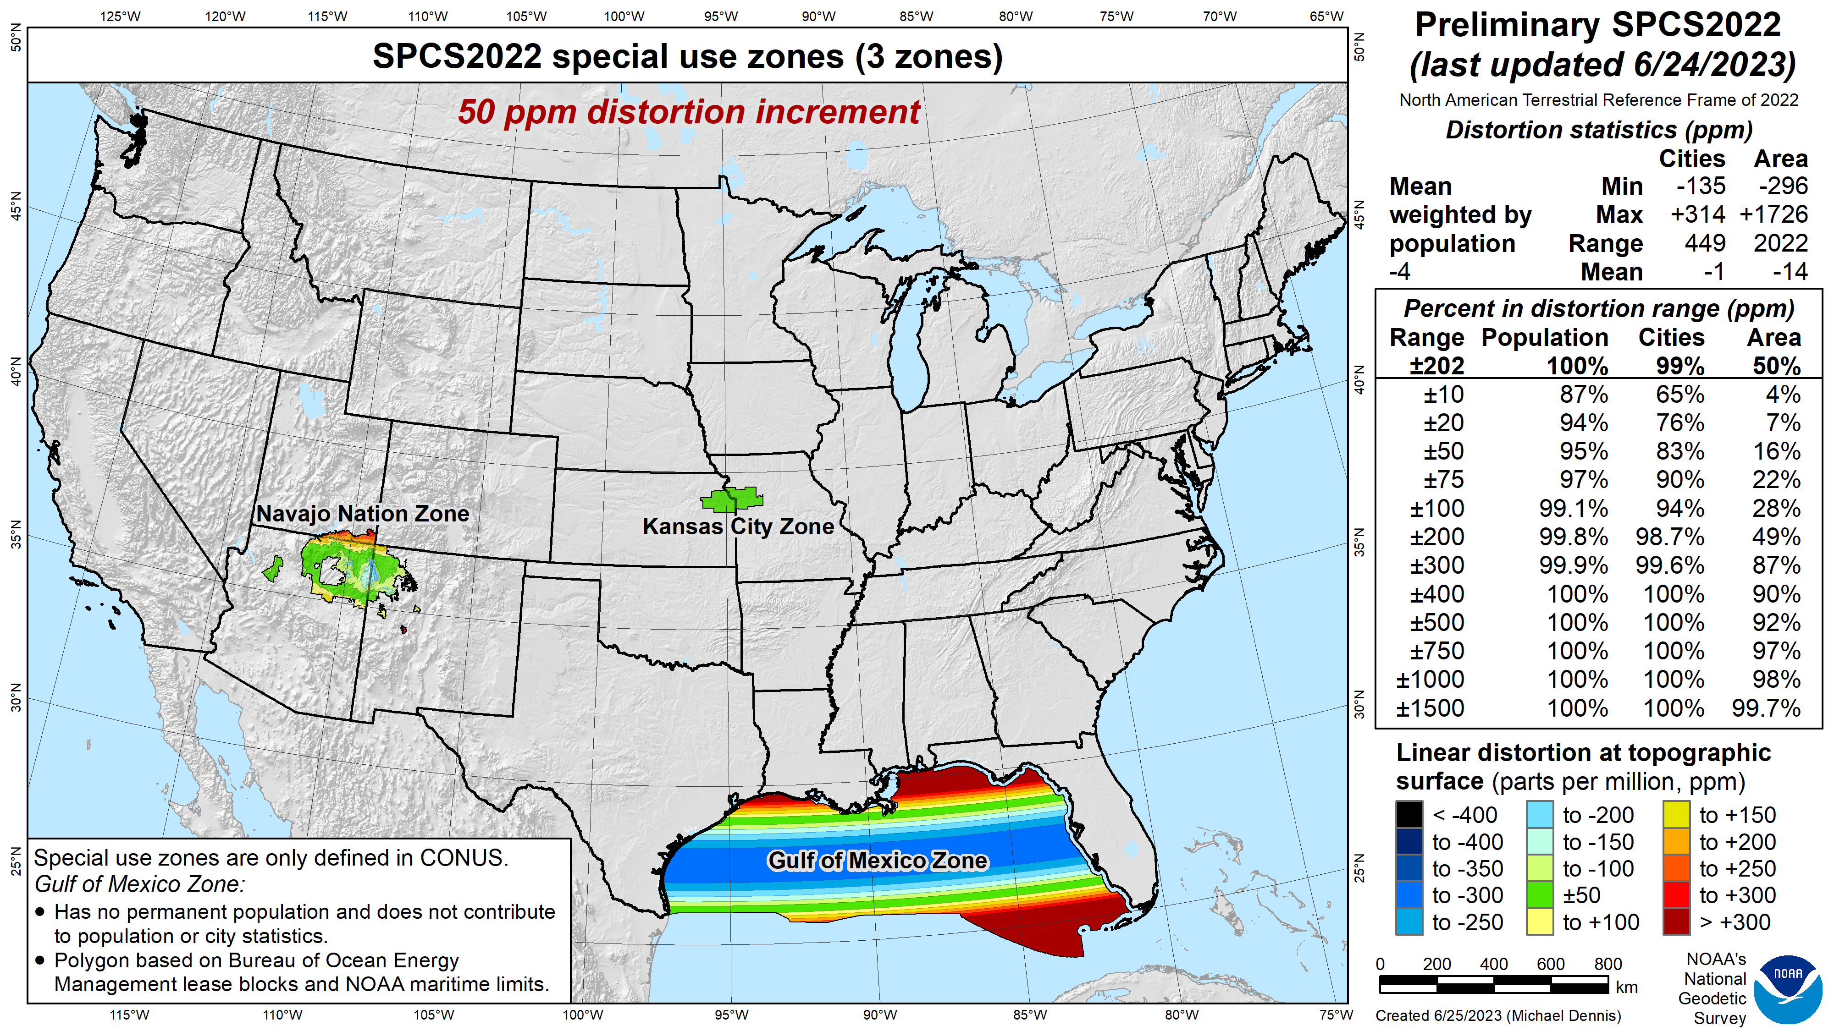
SPCS 83
linear distortion (existing)
Green is ±50 ppm (±0.26 ft/mile)
This zone will change, additional zones may be added

Slide 14
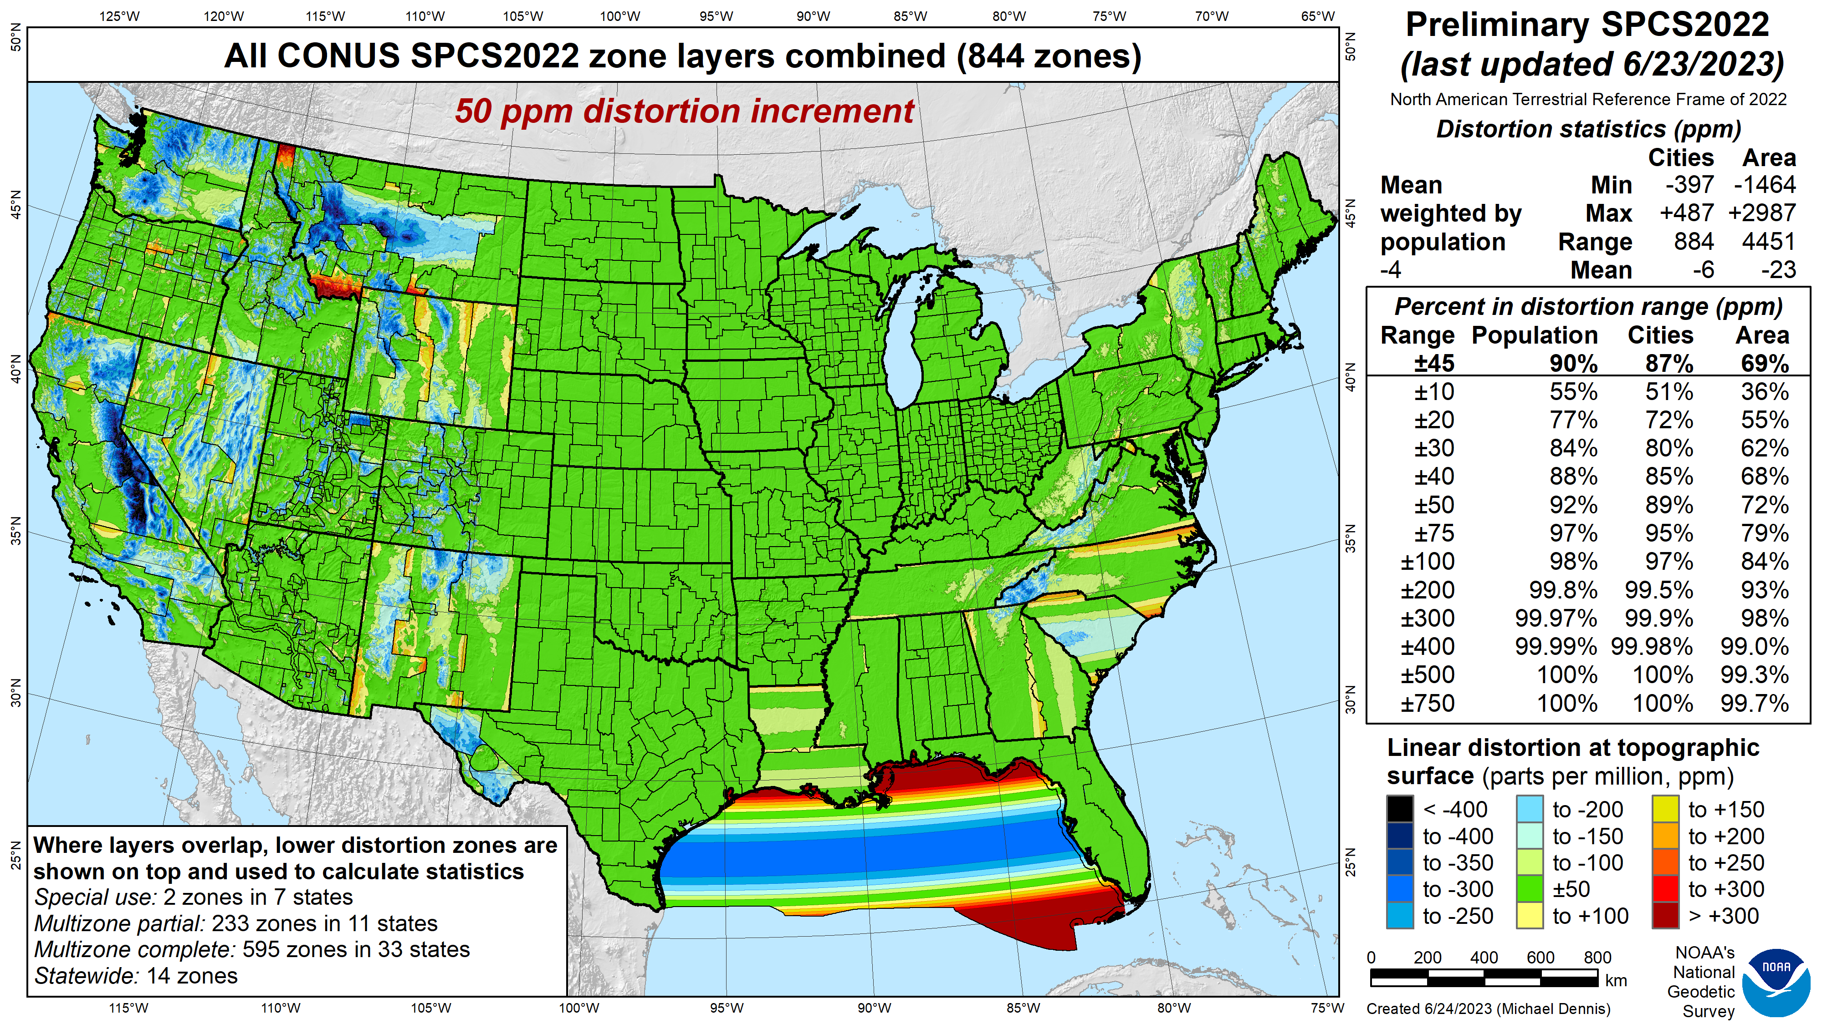
SPCS2022
linear distortion (preliminary)
Green is ±50 ppm (±0.26 ft/mile)
Distortion performance:
±45 ppm
Performance percentages:
90% population
87% cities & towns
69% total area
Mean weighted by population: -4 ppm

Slide 15
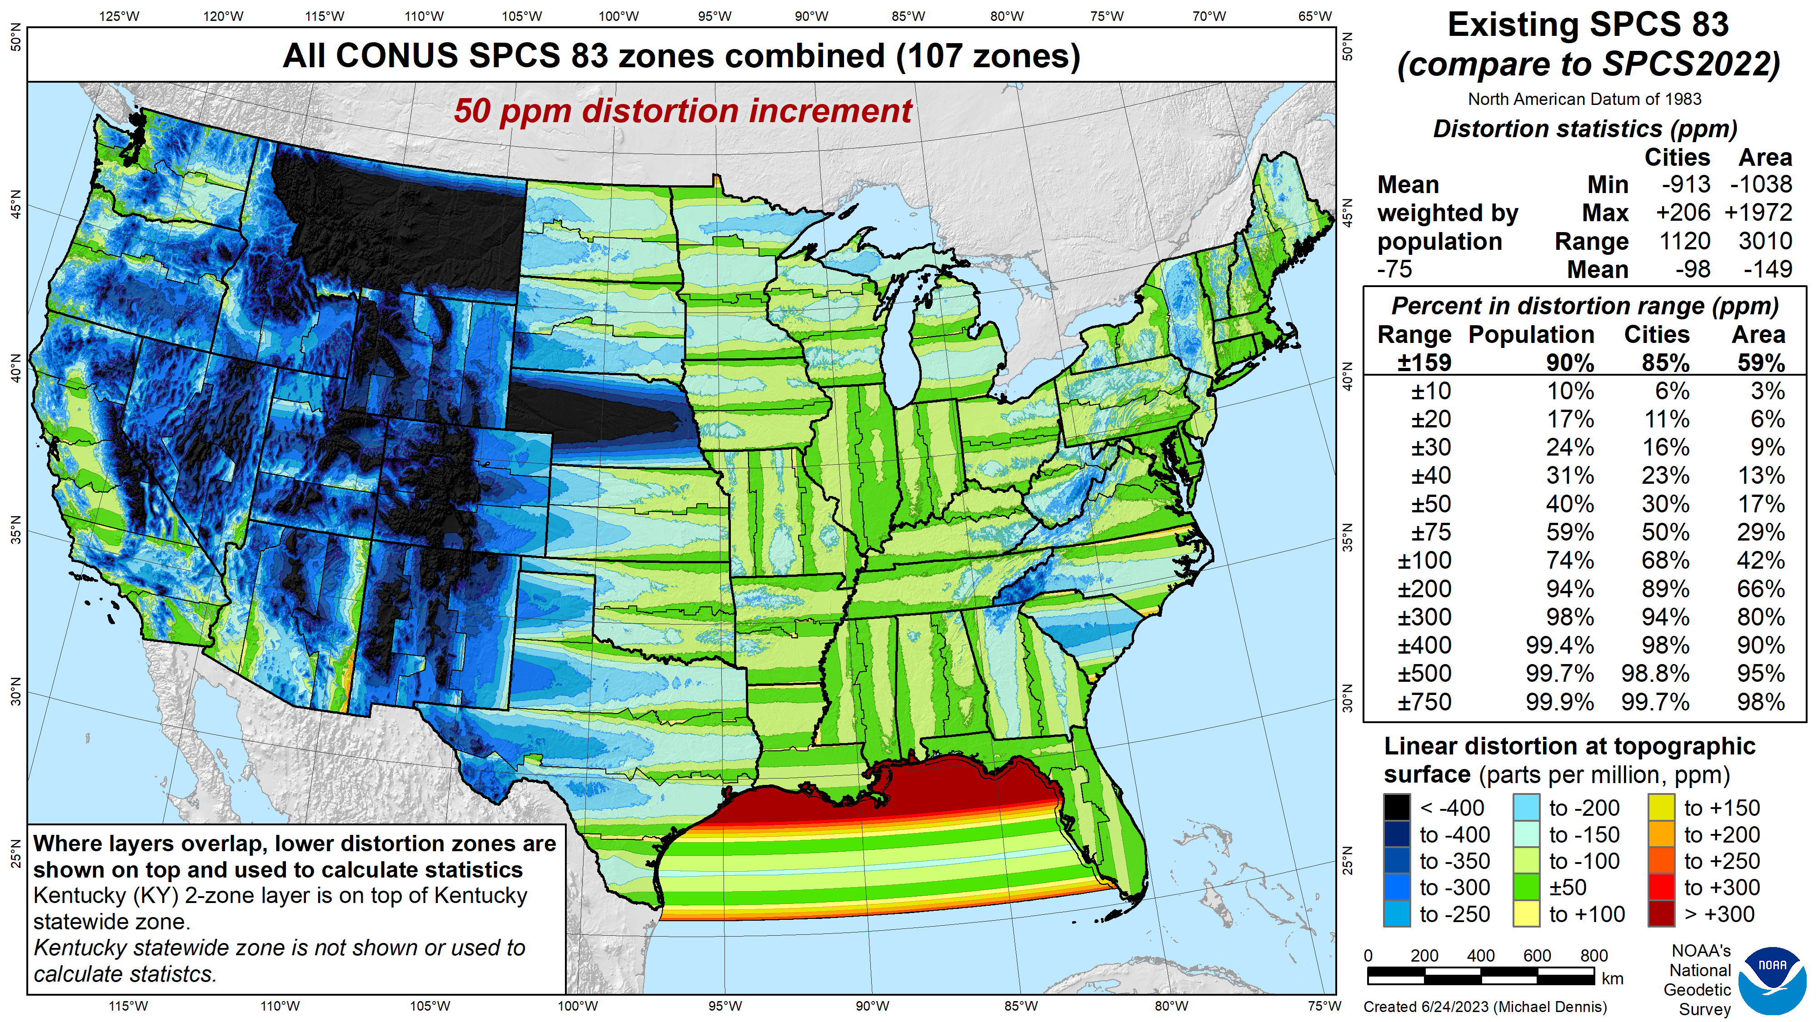
SPCS 83
linear distortion (existing)
Green is ±50 ppm (±0.26 ft/mile)
Distortion performance:
±159 ppm
Performance percentages:
90% population
85% cities & towns
59% total area
Mean weighted by population: -75 ppm

Slide 16
SPCS2022
linear distortion (preliminary)
Green is ±50 ppm (±0.26 ft/mile)
Distortion performance:
±45 ppm
Performance percentages:
90% population
87% cities & towns
69% total area
Mean weighted by population: -4 ppm

Slide 17


When will SPCS2022 be done?

Slide 18
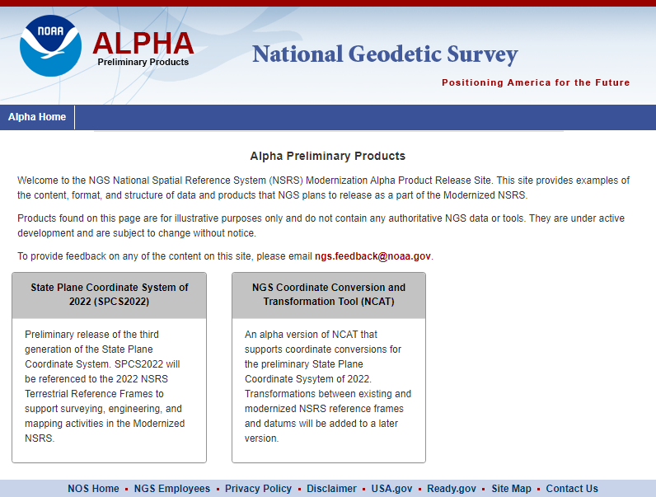


Alpha products are NOT final products!
https://alpha.ngs.noaa.gov/index.shtml
Preliminary
For illustrative
purposes only
Not authoritative
Under active development
Subject to change without notice
Feedback to: ngs.feedback@noaa.gov

Slide 19
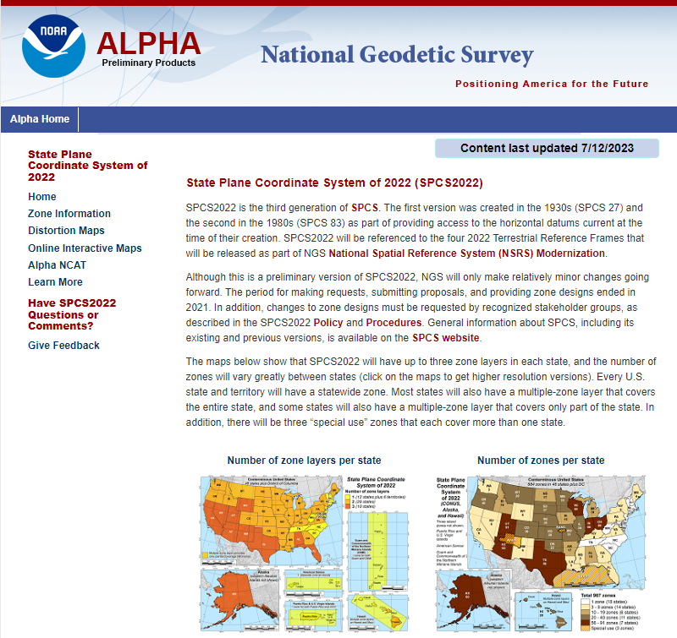

Alpha SPCS2022 Home
https://alpha.ngs.noaa.gov /SPCS/index.shtml
Gives date last updated
(on all SPCS2022 pages)
Links to other SPCS2022 pages in sidebar:
  Zone information
  Distortion maps
  Online interactive maps (SPCS2022 Experience)
  Alpha NCAT
  Additional information
  Feedback

Slide 20
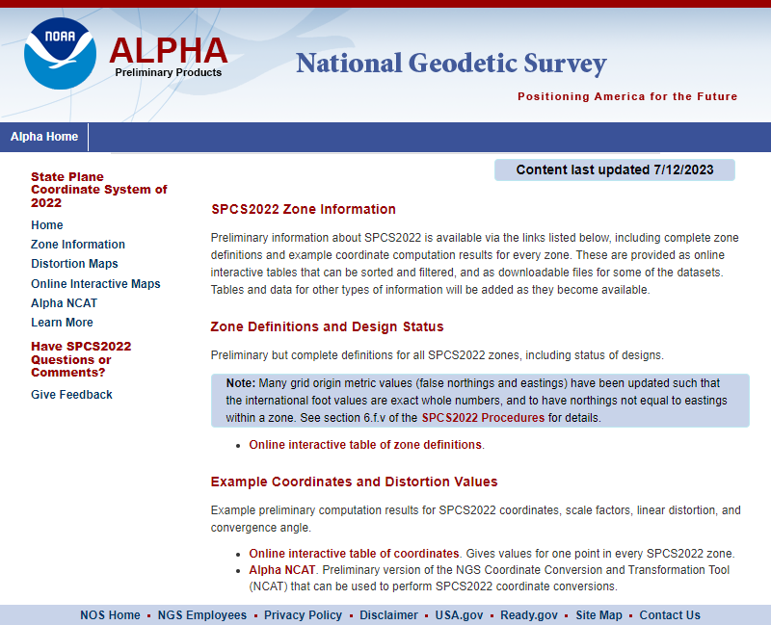
Zone Information
Interactive tables
  Zone definitions
  Example coordinates
Downloadable data and other tables will be added later
Blue Marble has already made use of this information for preliminary testing

Slide 22
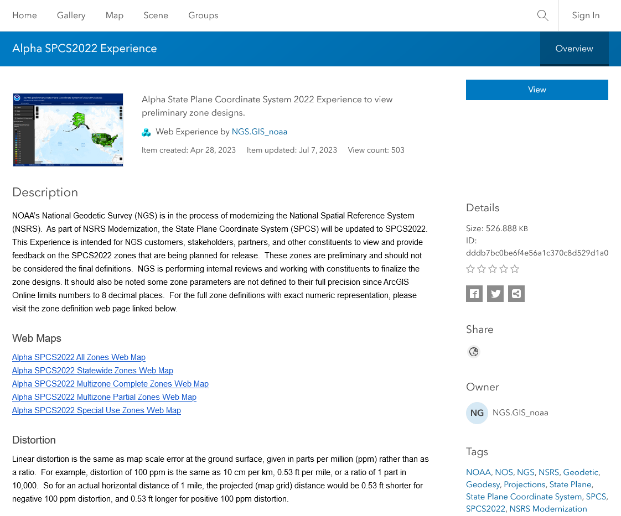
ArcGIS Online SPCS2022 Experience
Online interactive maps
Shows distortion and gives projection definitions
  Zone parameters not all given to full precision
  Cannot get distortion values from maps

Slide 23
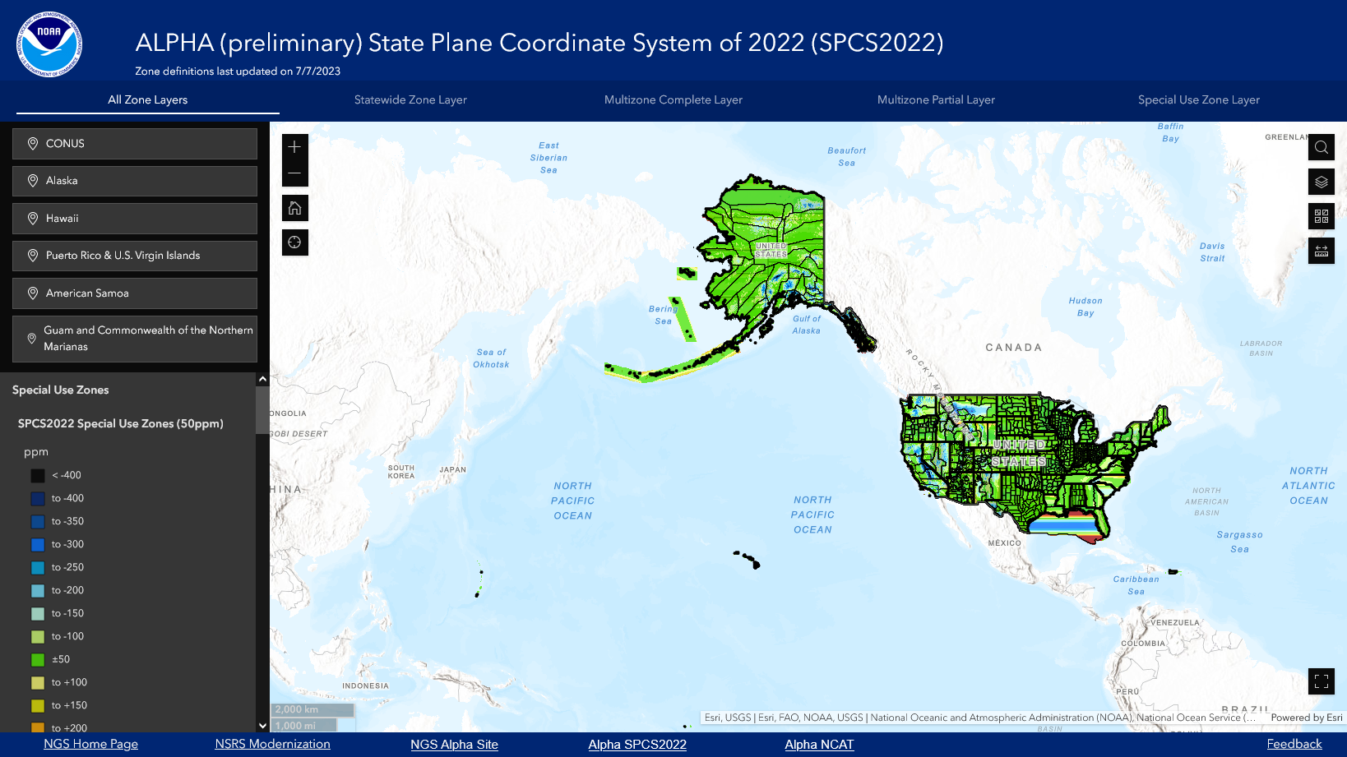
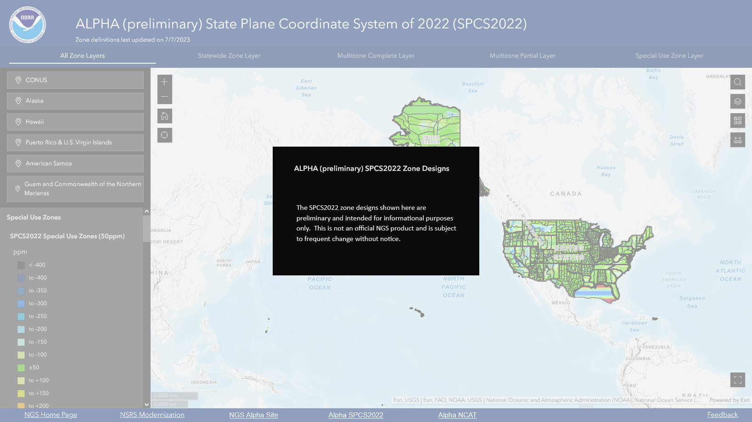

Slide 24
NSRS Modernization
Alpha site is ONLY for NSRS Modernization
Rollout 2025
More to it than just SPCS2022…
  Deprecation of U.S. survey foot
  Terrestrial reference frames
  Geopotential datum
  Time-dependence
  Reference epoch coordinates
  And more…
PRELIMINARY

Slide 25
That’s great, but when will SPCS2022 be done?
SPCS2022 included with rollout of Modernized NSRS in 2025
But SPCS2022 design will be done sooner
  Getting feedback from stakeholders and others now
  In process of updating projection algorithms
  Blue Marble has already made use of preliminary designs
  Finalize designs by mid-2024
Designs done and shared with the world in 2024!
  Will provide definitions directly usable by our commercial partners
  Includes Blue Marble, Esri, Trimble, Hexagon, Topcon, Carlson, Autodesk, etc.
  Definitions also in EPSG Geodetic Parameter Dataset and ISO Geodetic Registry

Slide 26
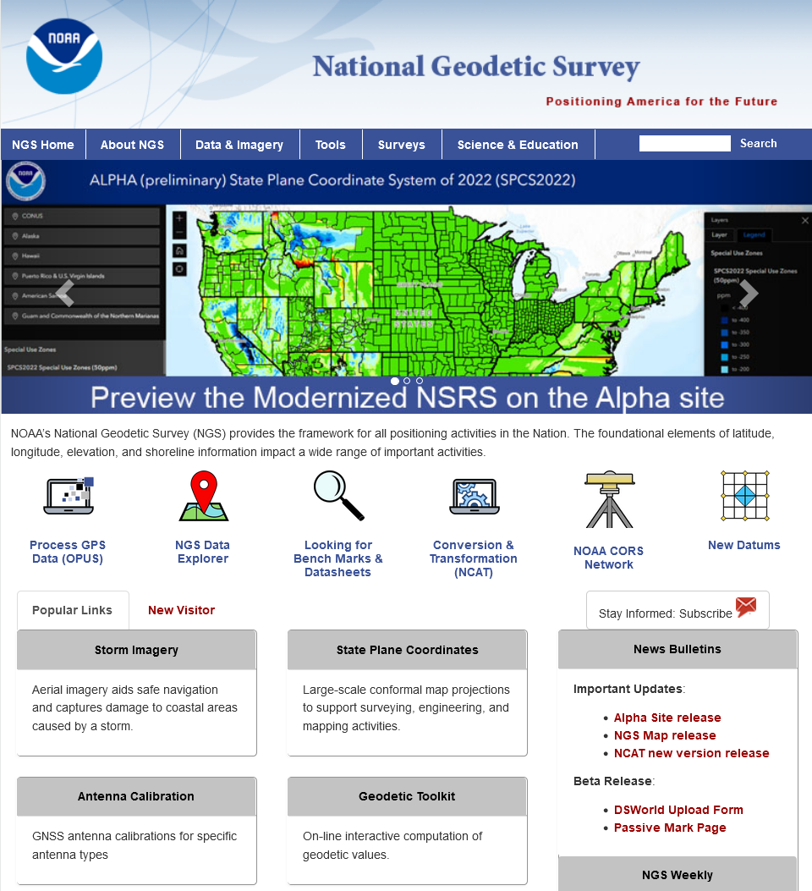

Where to learn more…
geodesy.noaa.gov
Thank you!

