Slide 1
Progress on 2013-2023 National Geodetic Survey Strategic Plan
Juliana Blackwell
Director, National Geodetic Survey
April 18, 2017

Slide 2
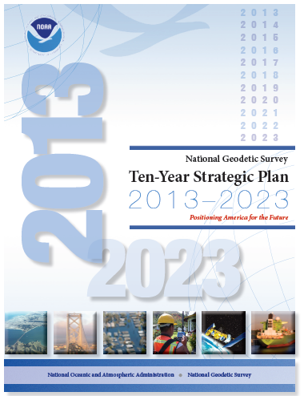
The National Geodetic Survey
Ten-Year Plan
Support the users of the National
Spatial Reference System.
Modernize and improve the National
Spatial Reference System.
Expand the National Spatial Reference
System stakeholder base through
partnerships, education, and outreach.
Develop and enable a workforce with
a supportive environment.
Improve organizational and administrative functionality.
https://www.geodesy.noaa.gov/web/news/Ten_Year_Plan_2013-2023.pdf

Slide 3
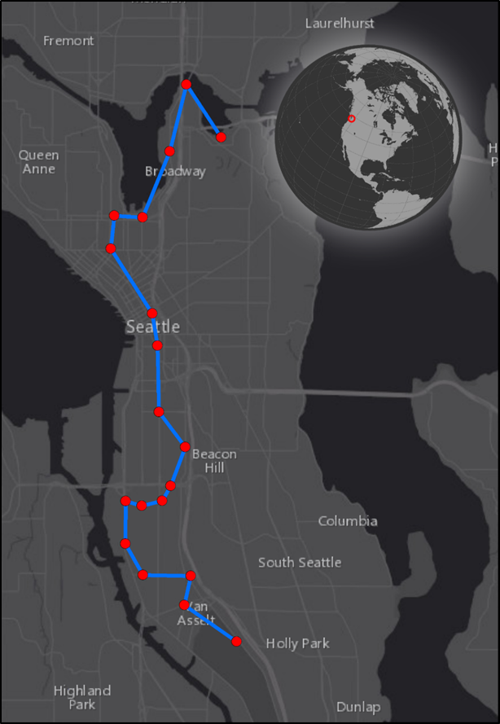
Support the Users of the NSRS
Products delivered to date in FY 2017:
1.6 million survey mark datasheets
19+ million CORS datasets
1.4 million online geoid computations

Slide 4
Support the Users of the NSRS
In FY 2016:
9,107 miles* of shoreline compiled (5.5% of US)
285+ nautical charts received updated shoreline
37 ports updated with new shoreline
35 ports analyzed for change (CSCAP)
400 sq nm of airborne lidar bathymetry data delivered
700 sq nm of airborne lidar bathymetry collected
*miles measured at 1:80,000 scale

Slide 5
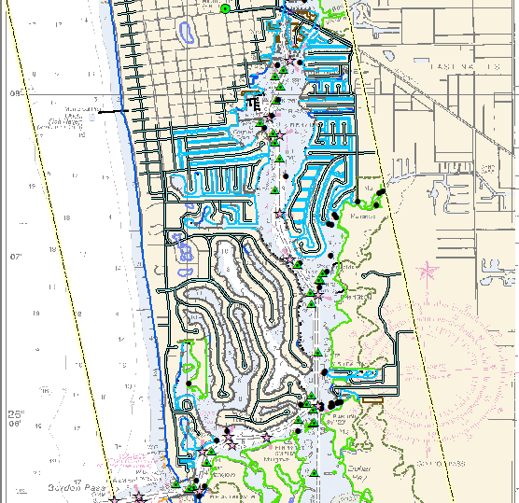
Shoreline Compilation

Slide 6
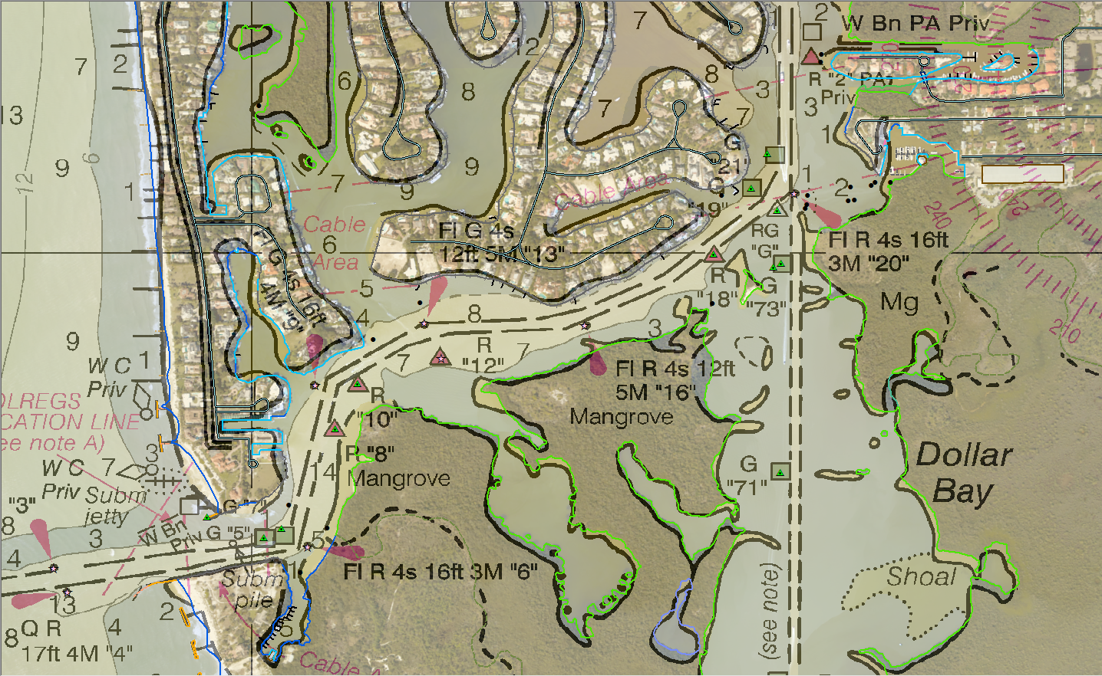

Slide 7
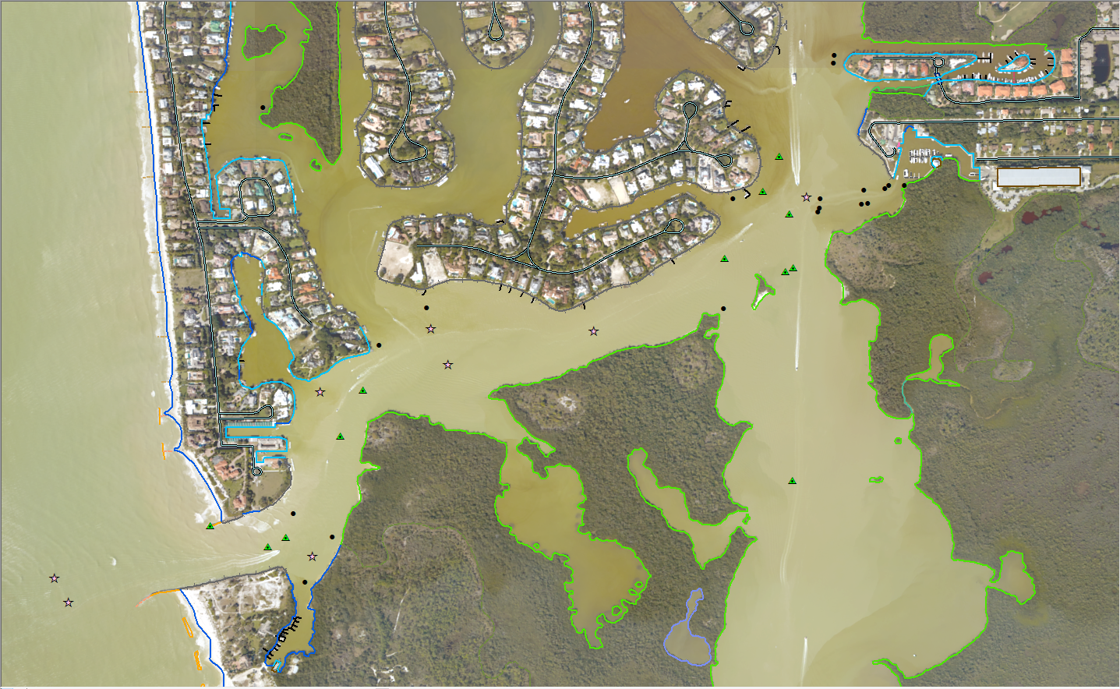

Slide 8
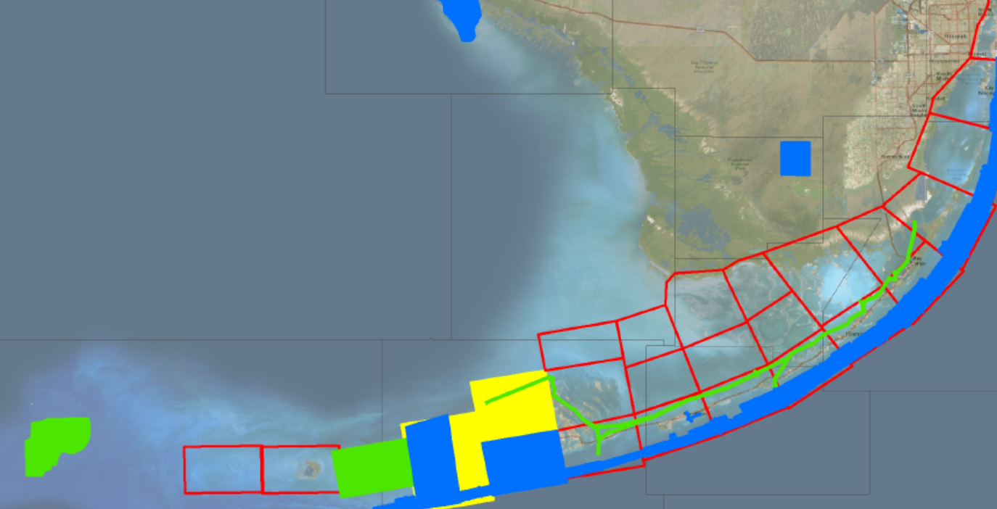
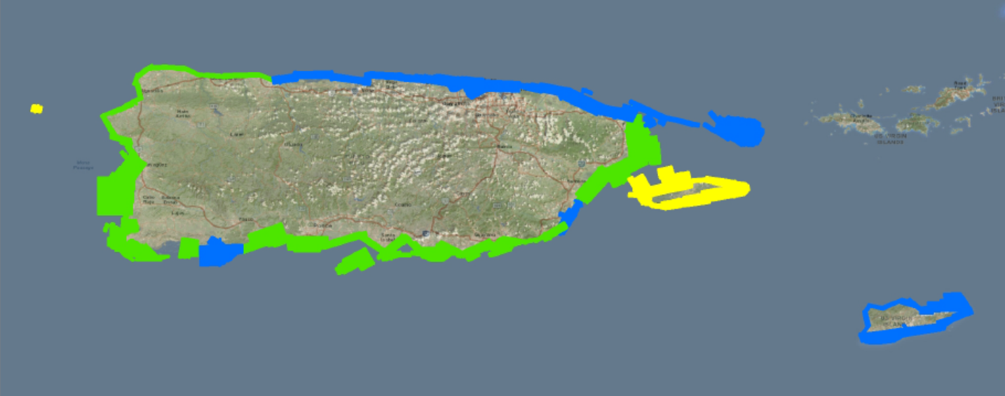
Topobathy Projects
8

Slide 9
Modernize and Improve the NSRS
Replace the geodetic datums
Improve data submission
Develop new toolkit
Update surveying methodologies

Slide 10
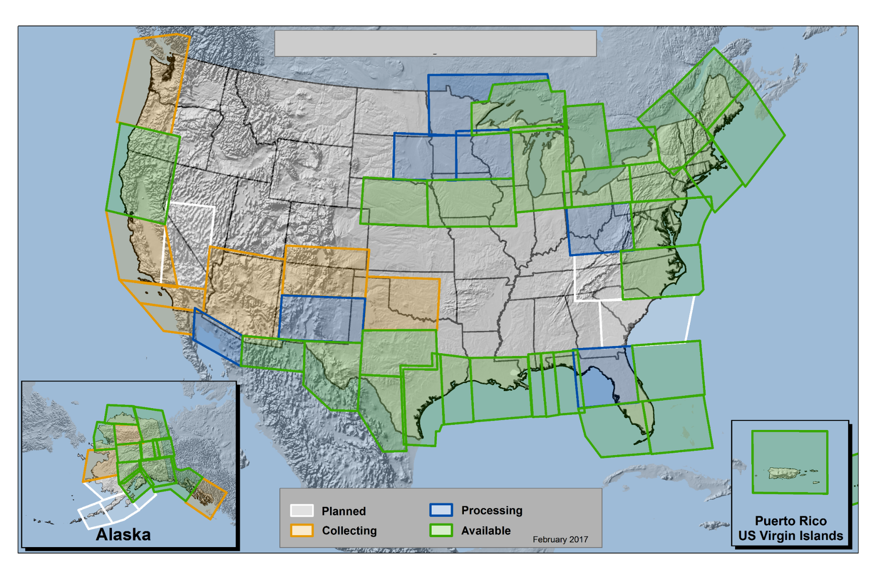
Gravity for the Redefinition of the American Vertical Datum (GRAV-D)
59.6% complete as of March 31, 2017
https://www.geodesy.noaa.gov/GRAV-D/

Slide 11
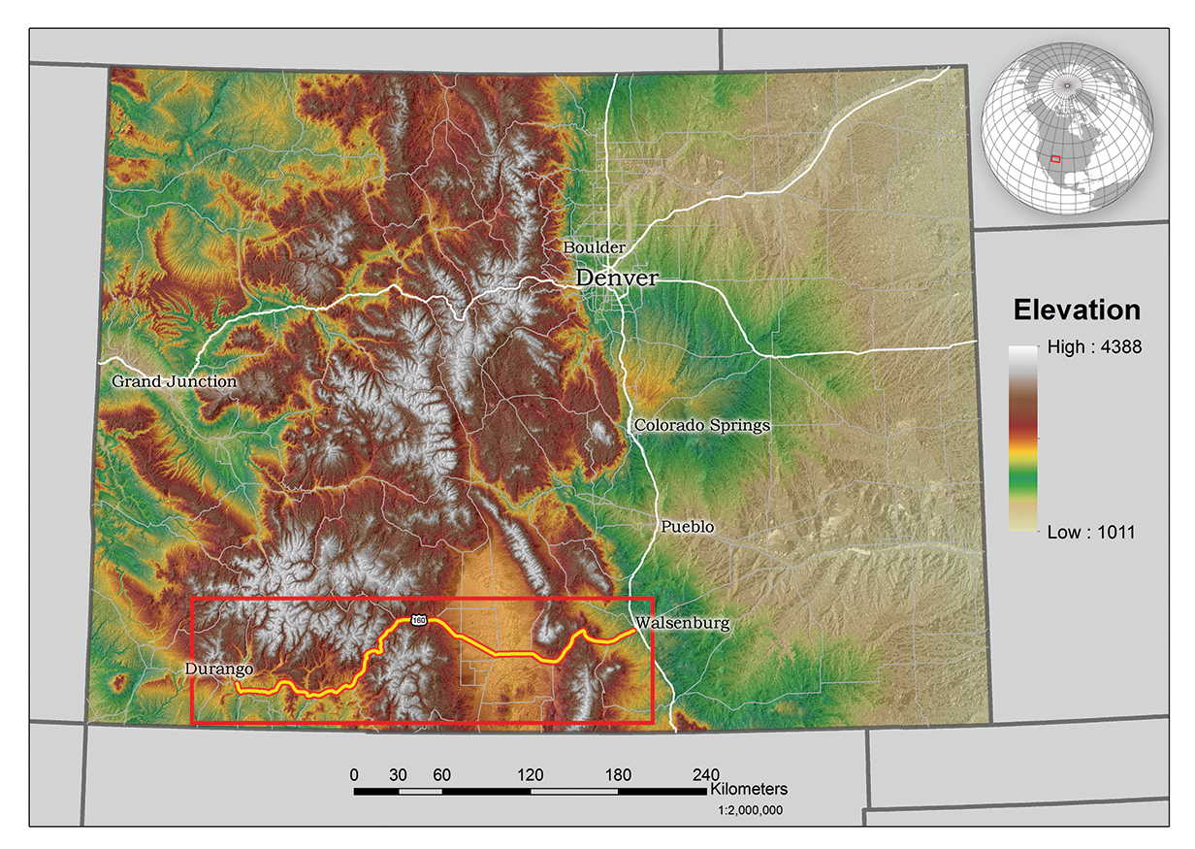
Geoid Slope Validation Survey

Slide 12
NSRS Modernization
New Geometric Reference Frames (“Horizontal”)
The Old:
NAD 83(2011)
NAD 83(PA11)
NAD 83(MA11)
The New:
The North American Terrestrial Reference Frame of 2022 (NATRF2022)
The Caribbean Terrestrial Reference Frame of 2022 (CTRF2022)
The Pacific Terrestrial Reference Frame of 2022 (PTRF2022)
The Mariana Terrestrial Reference Frame of 2022 (MTRF2022)

Slide 13
NSRS Modernization
New Geopotential Datum (“Vertical”)
  The Old:
  NAVD 88
  PRVD 02
  VIVD09
  ASVD02
  NMVD03
  GUVD04
  IGLD 85
  IGSN71
  GEOID12B
  DEFLEC12B
  The New:
  The North American-Pacific Geopotential Datum of 2022 (NAPGD2022)
  - Includes GEOID2022
Orthometric
Heights
Normal
Orthometric
Heights
Dynamic
Heights
Gravity
Geoid
Undulations
Deflections of
the Vertical

Slide 14
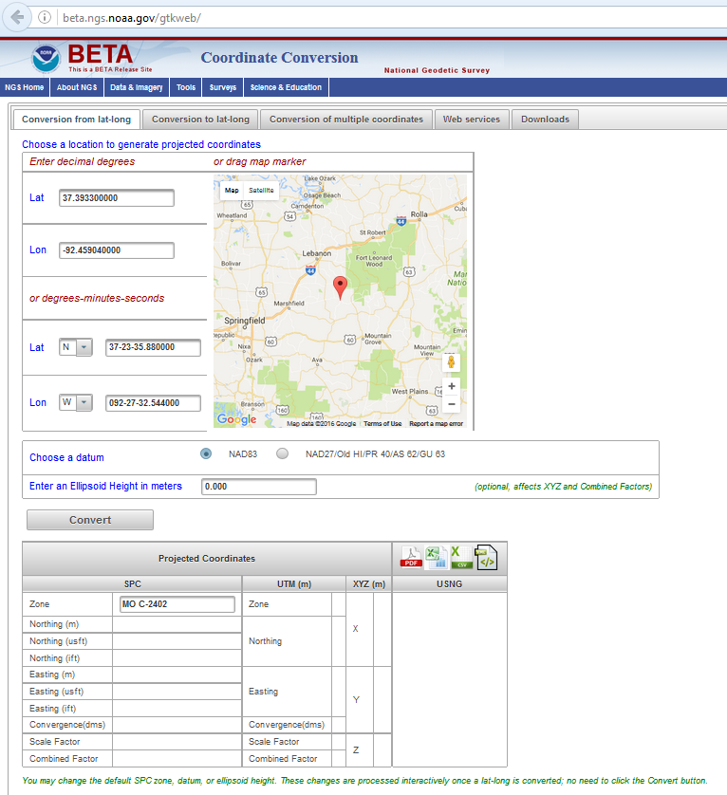
Beta Geodetic Toolkit
Web service
Coordinate conversions between latitude and longitude and
    - State Plane Coordinates
    - Universal Transverse Mercator
    - XYZ
    - US National Grid
Will soon include NADCON5 with many improved transformations from the US Standard Datum to NAD83(2011)
https://beta.ngs.noaa.gov/gtkweb/

Slide 15
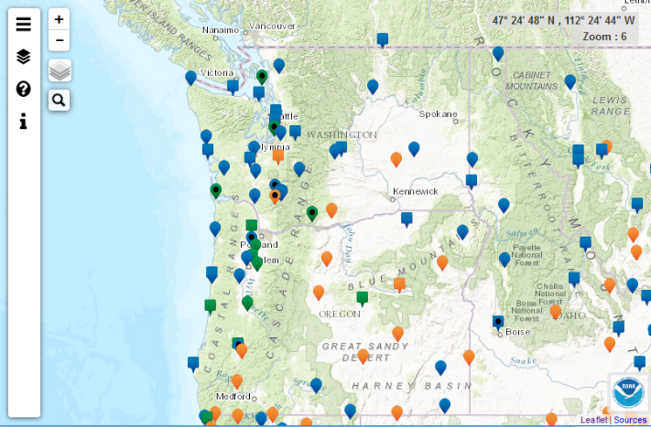
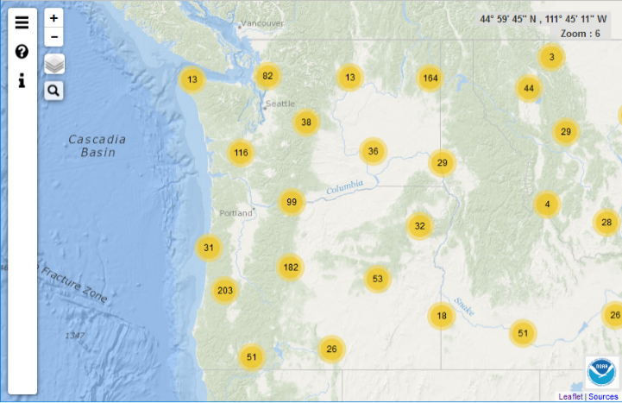
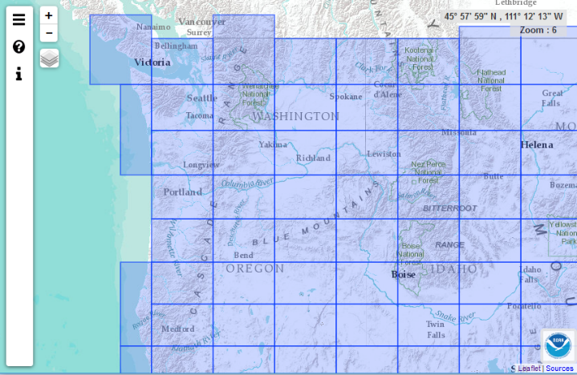
Beta Mapping Applications
Responsive design, mobile friendly
CORS Map
https://beta.ngs.noaa.gov/corsmap/
OPUS Share Map
https://beta.ngs.noaa.gov/opusmap/
Geodetic Control Diagrams
https://beta.ngs.noaa.gov/gcd/

Slide 16
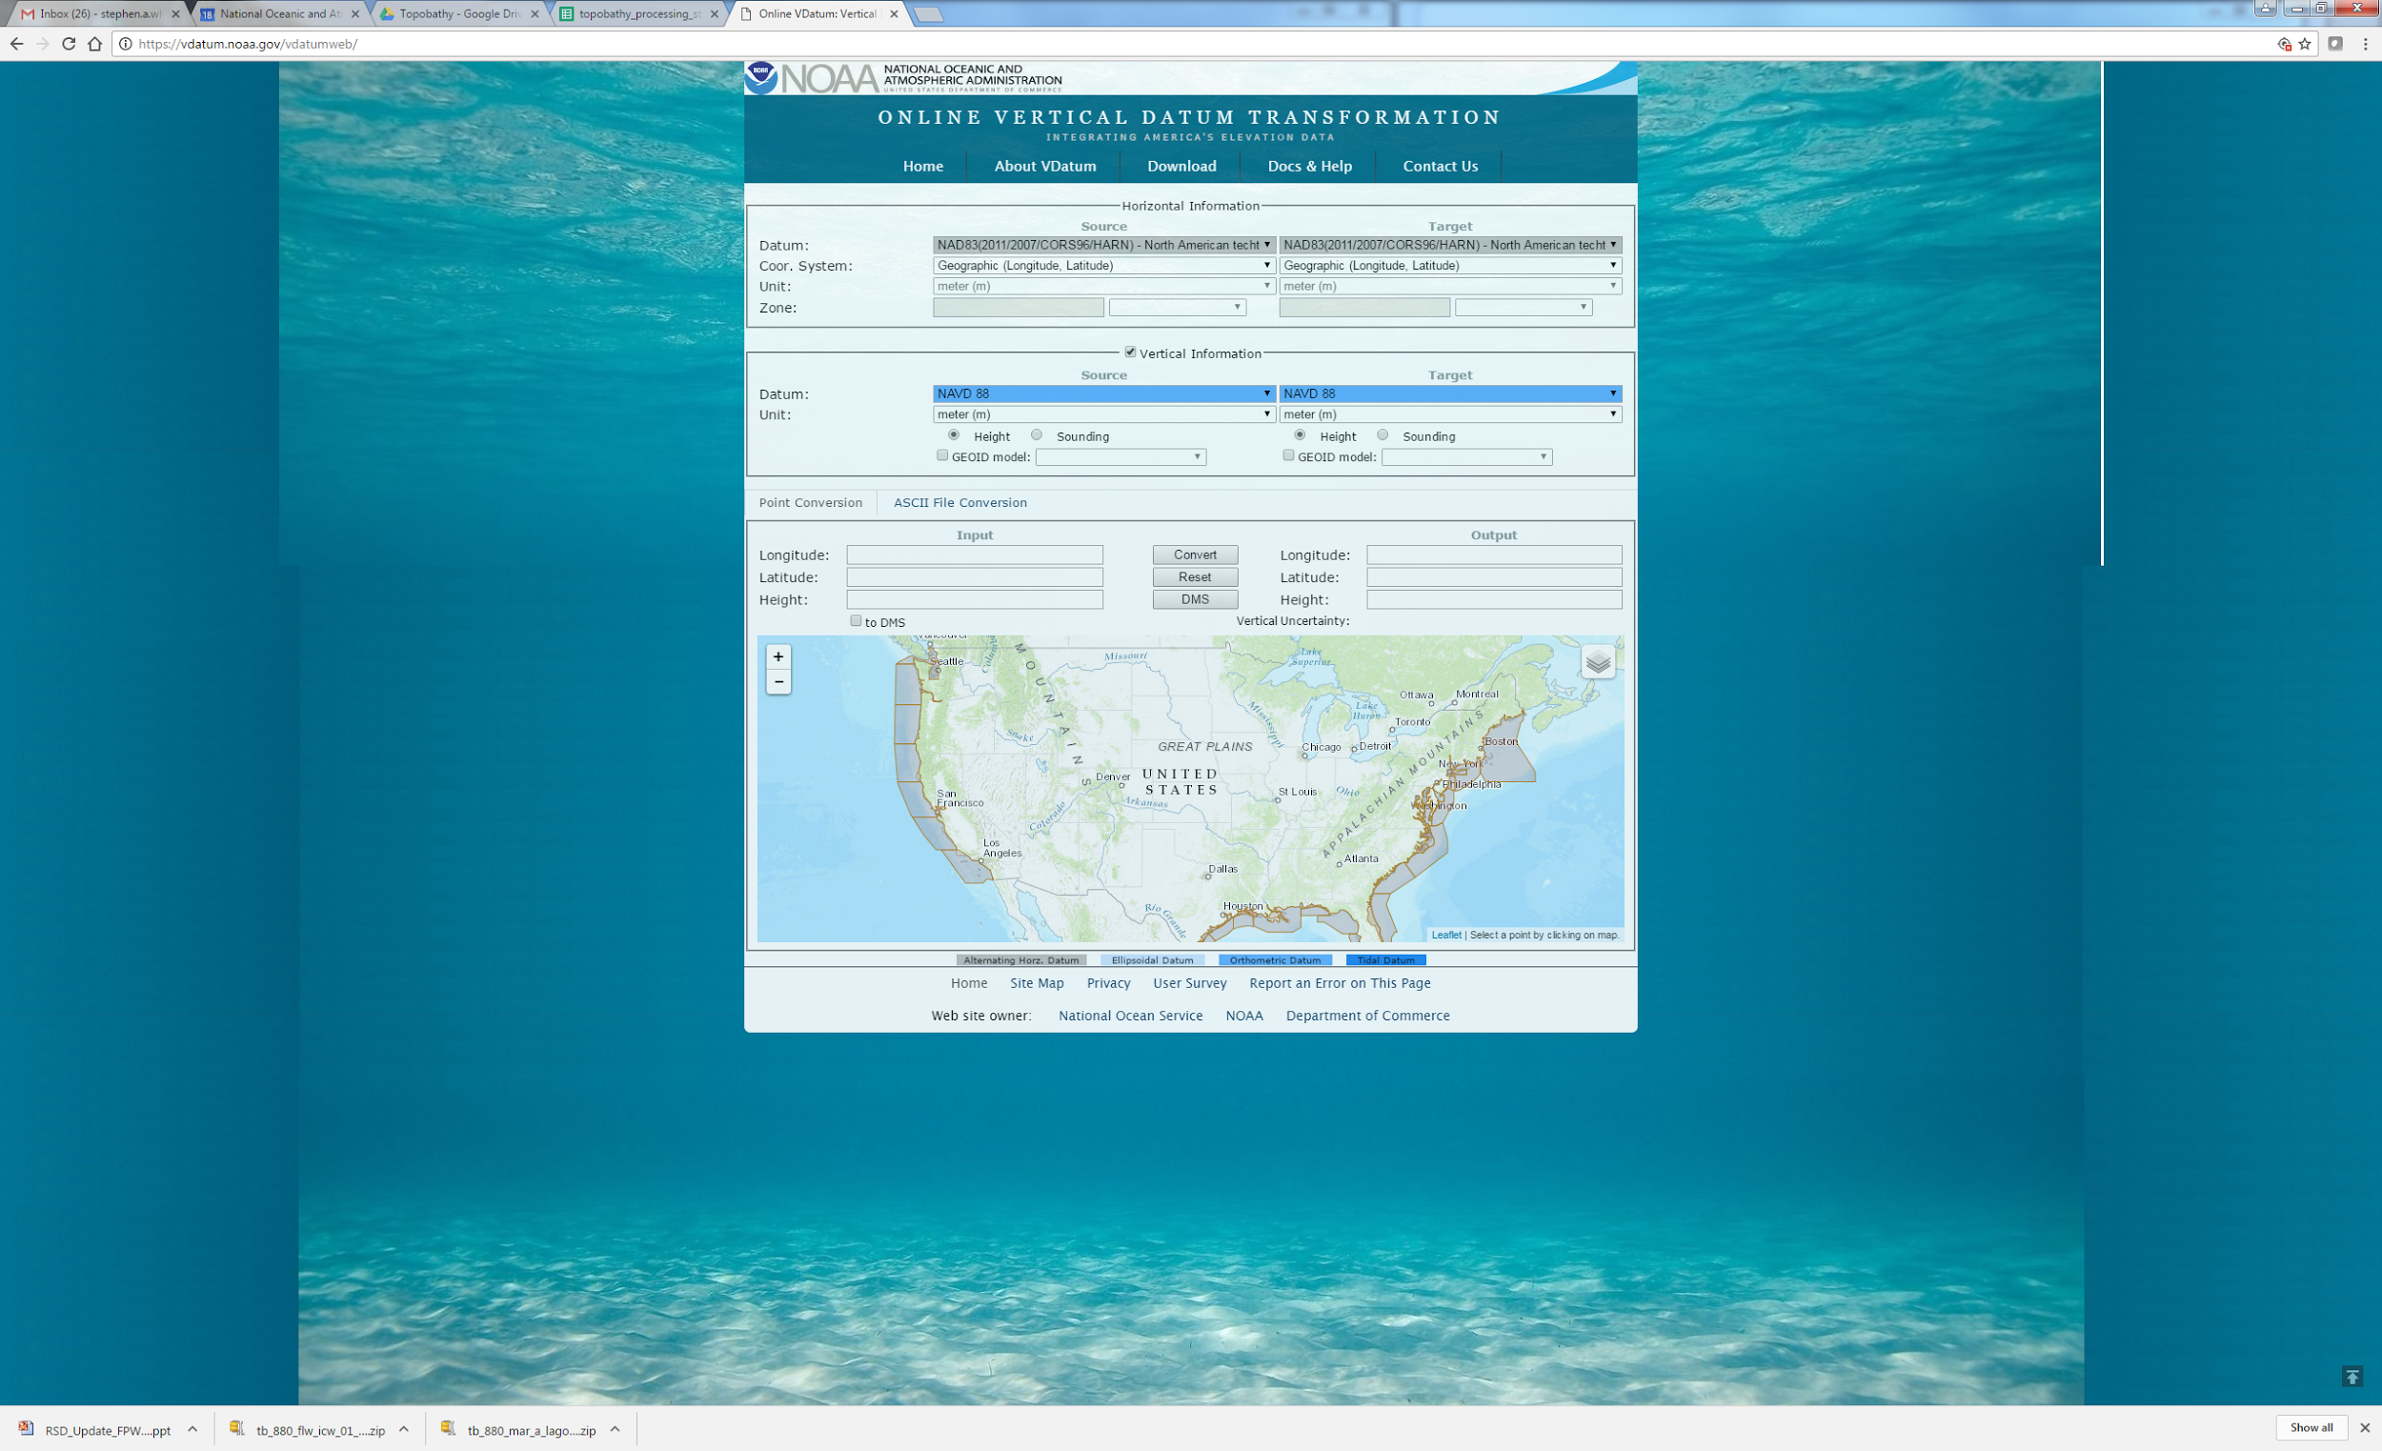
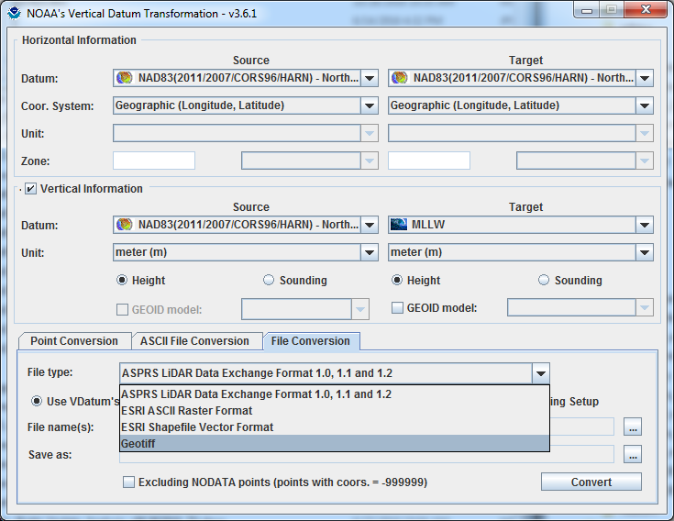
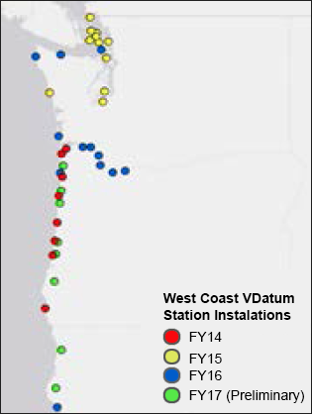
VDatum Tool
Integrating America’s Elevation Data
https://vdatum.noaa.gov/

Slide 17
Expand the NSRS Stakeholder Base
Outreach and education
University engagement
Integrated Ocean and Coastal Mapping (IOCM)

Slide 18
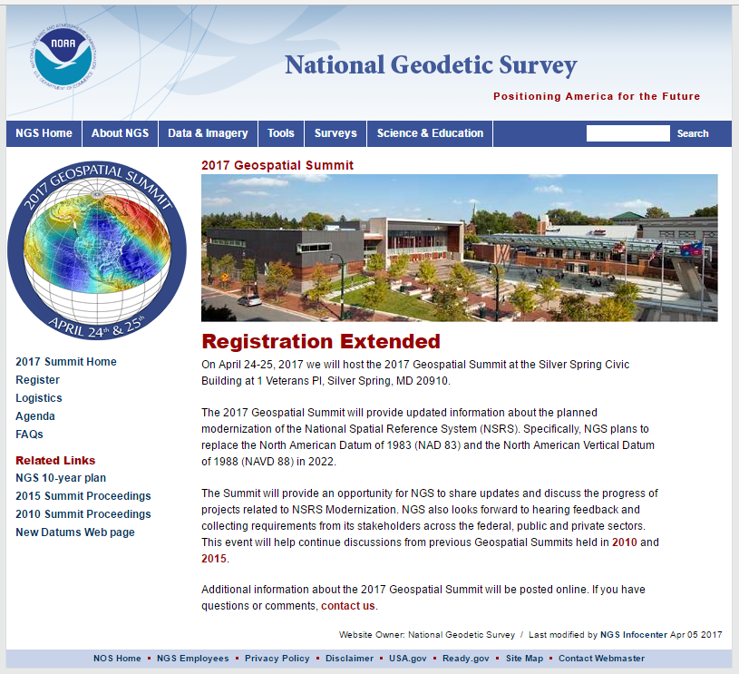
Geospatial Summit
April 24-25, 2017
Attend in person or by
webinar!

Slide 19
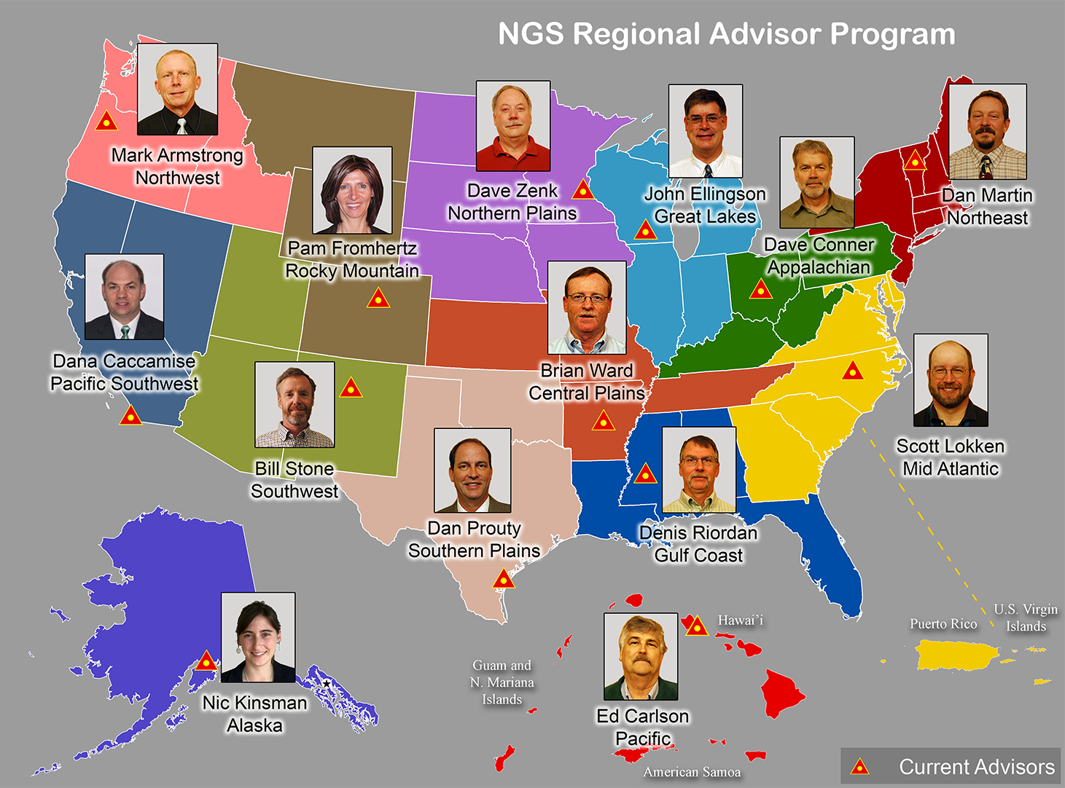
NGS Regional Advisor Program

Slide 20
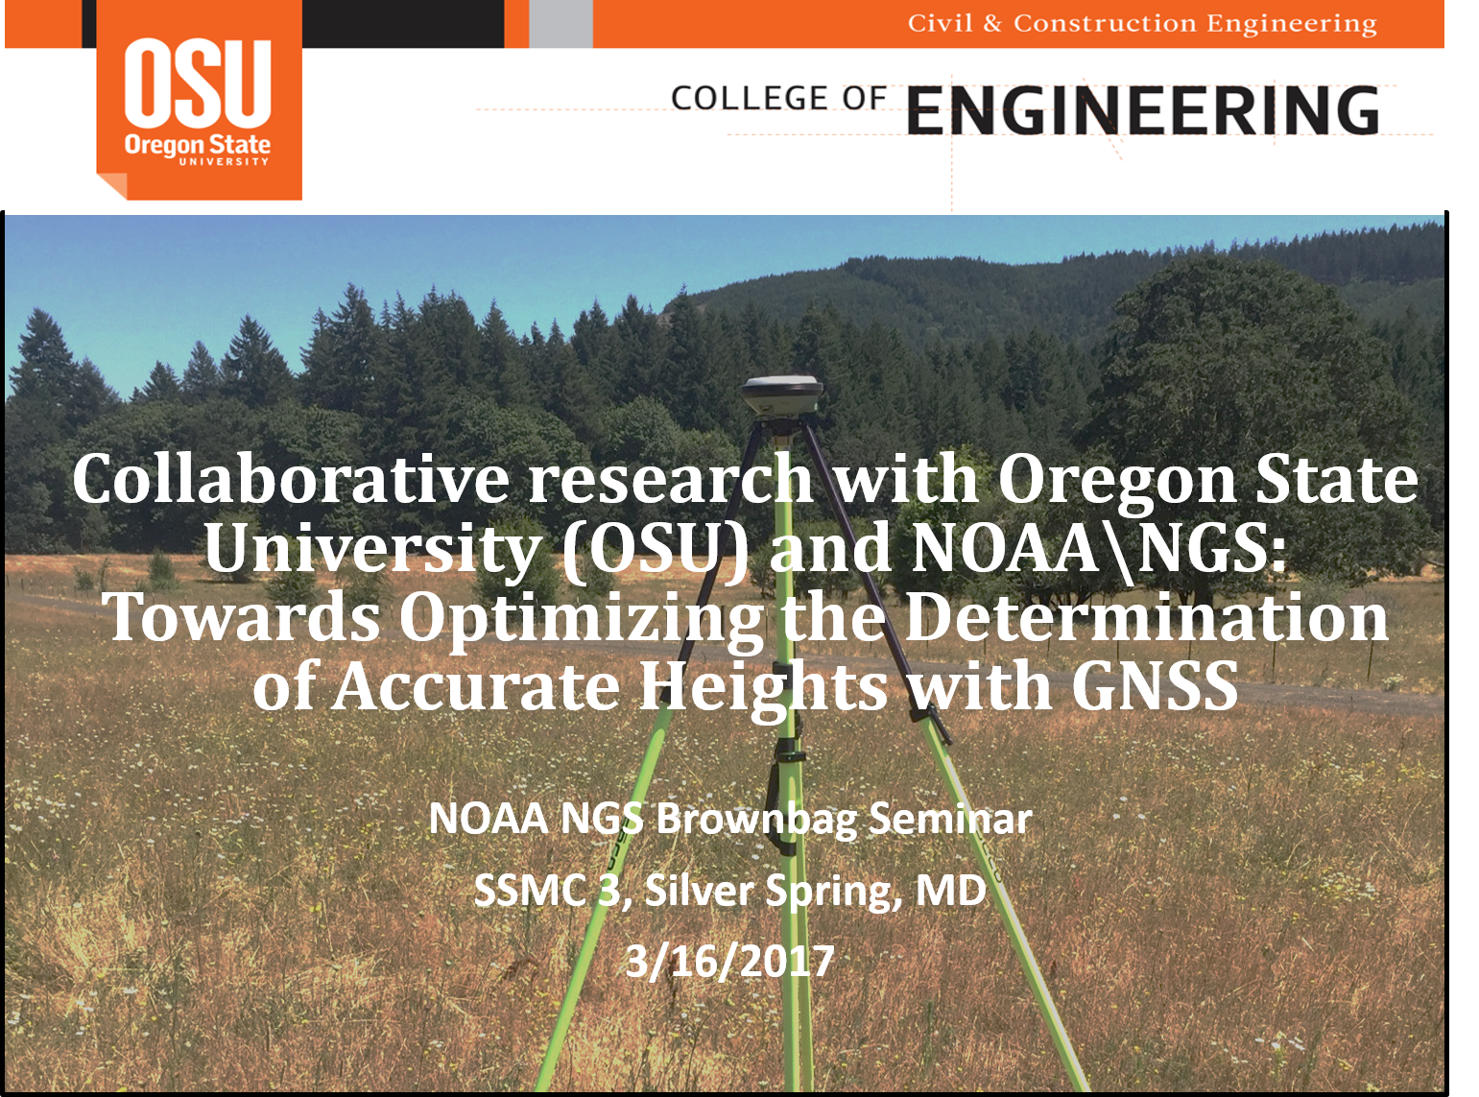
University Engagement

Slide 21
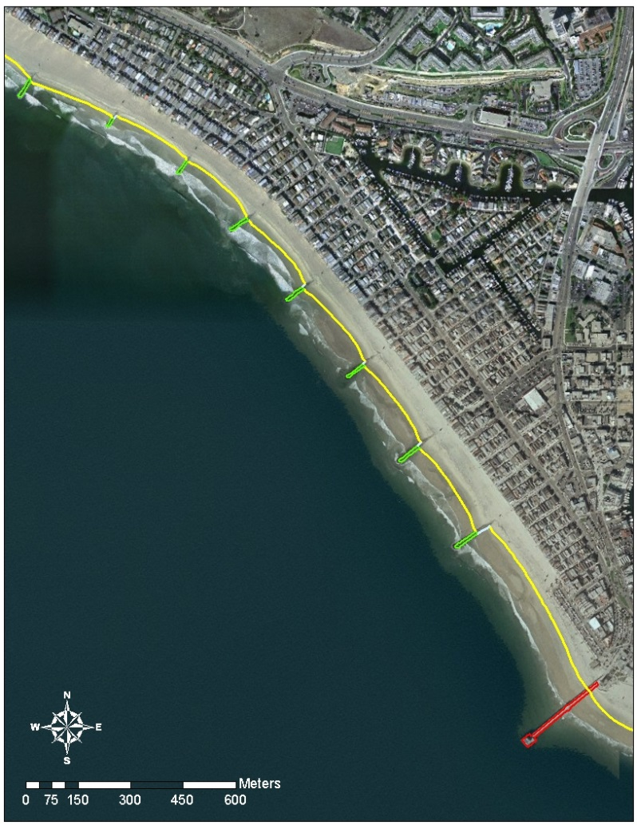
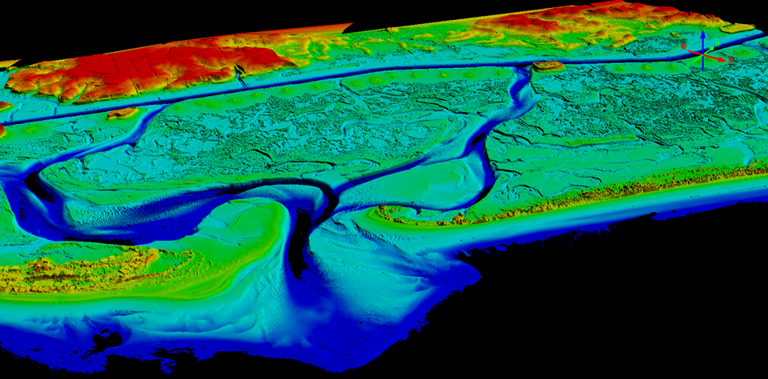
NGS Coastal Mapping Program
Defines the National Shoreline and provides nearshore elevation data
NOAA nautical charts updates
Other important applications:
    Used in defining U.S. territorial limits
    Coastal resource management
    Storm surge and coastal flooding modeling
    GIS analysis
    Benthic habitat mapping

Slide 22
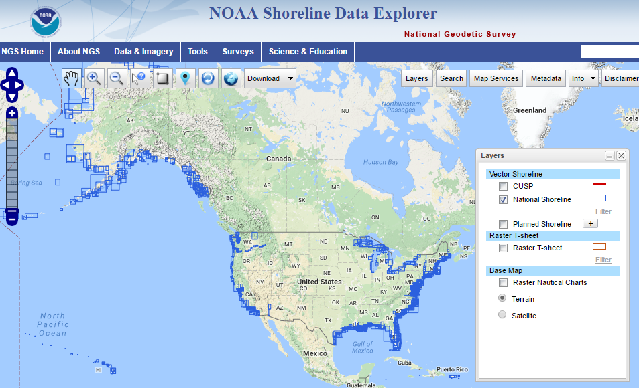
https://www.ngs.noaa.gov/NSDE/

Slide 23
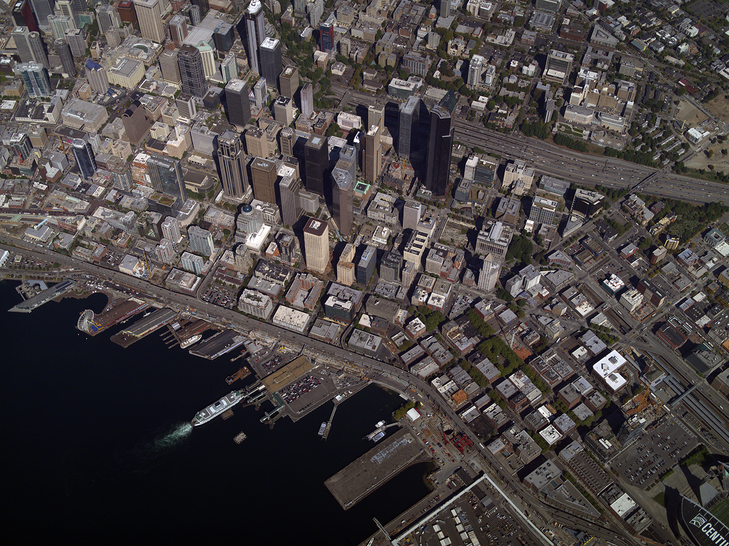
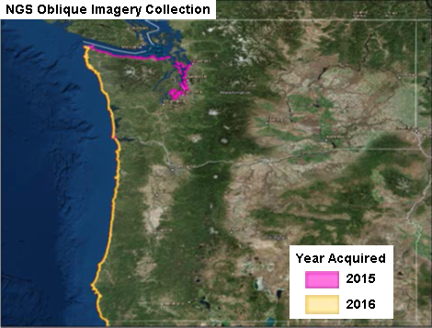
Northwest Oblique Imagery
https://geodesy.noaa.gov/storm_archive/coastal/viewer/

Slide 24
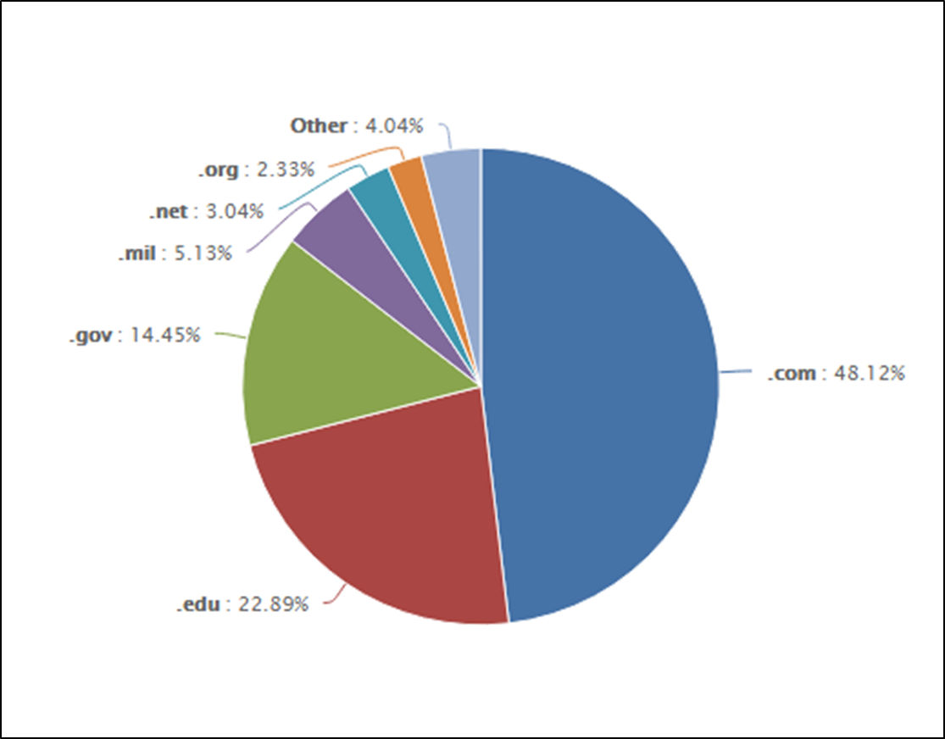
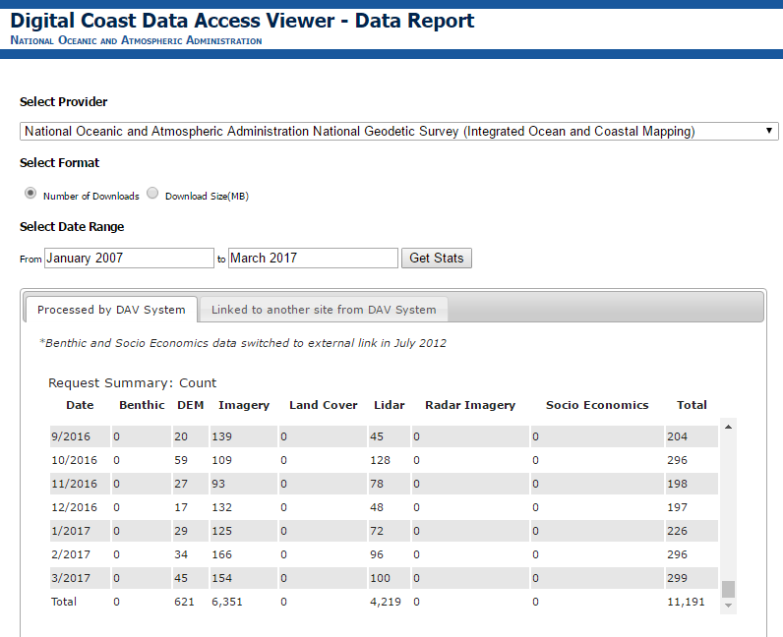
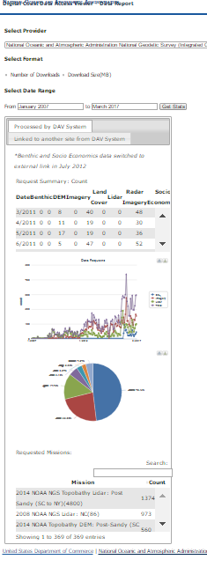
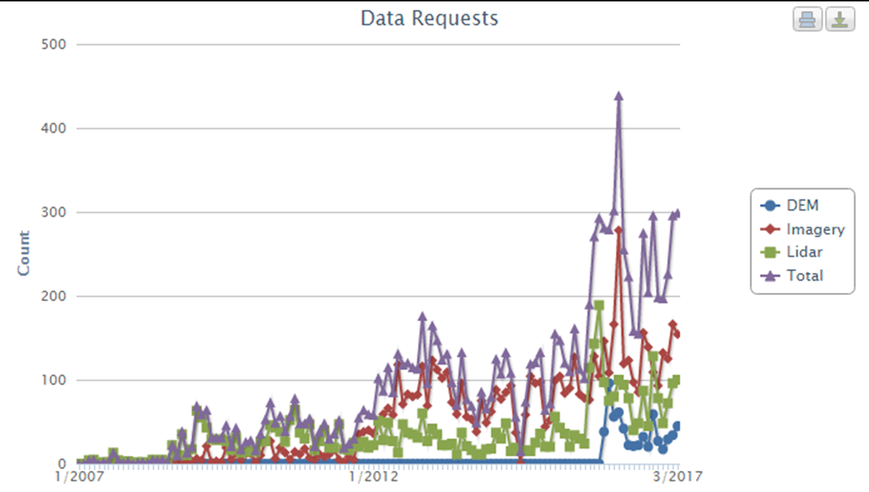
Stakeholder Growth
NOAA’s Digital Coast report detailing 10 years of NGS lidar and imagery served from the site
Provides insight to users (general) but also areas of collection and event driven interests
Highlights the value of the NGS public/private partnership in contract services but also users – map once use many times! IOCM!

Slide 25
NGS Partnerships
Research
Modeling, Survey Methodologies, Sensor Development, Cloud Processing by Contractors, Cooperative Institutes, Grantees, Visiting Scientists
Data Collection
Shoreline, Topobathy Lidar, CORS, GRAV-D, Geodetic Control by Contractors, CORS Partners, Academia, Surveyors, Federal and State Agencies, Private Citizens
Product Development
Data Processing, Compilation, Data Management by Contractors, Third Party Vendors
Product Distribution
Data Ingestion by Federal, State and Local Agencies, GIS Community, Academia, Third Party Vendors

Slide 26
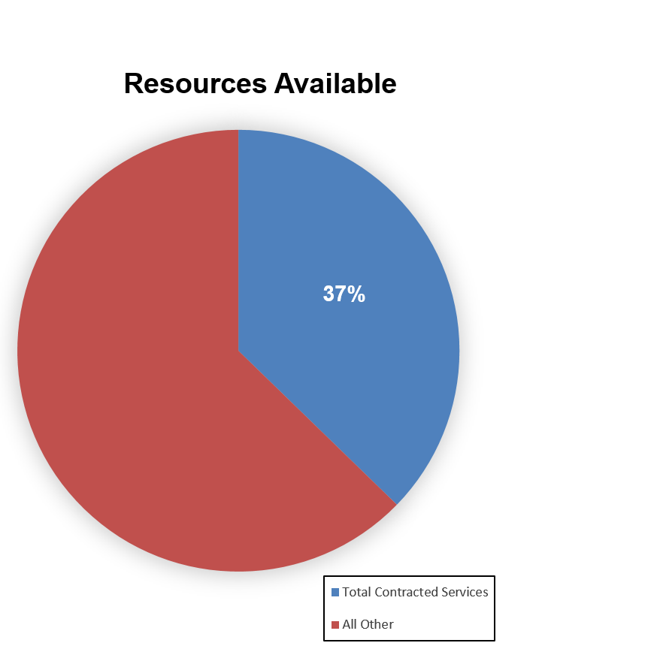
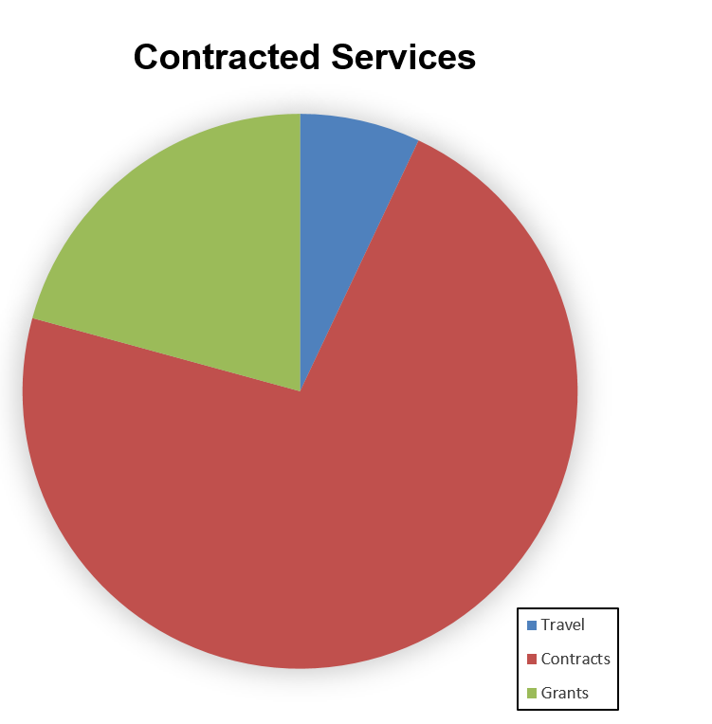
Resource Allocation
7%
21%
63%
72%

