Slide 1
Height Modernization
Activities at the HARRIS GALVESTON SUBSIDENCE DISTRICT
DRAFT - DO NOT DISTRIBUTE

Slide 2
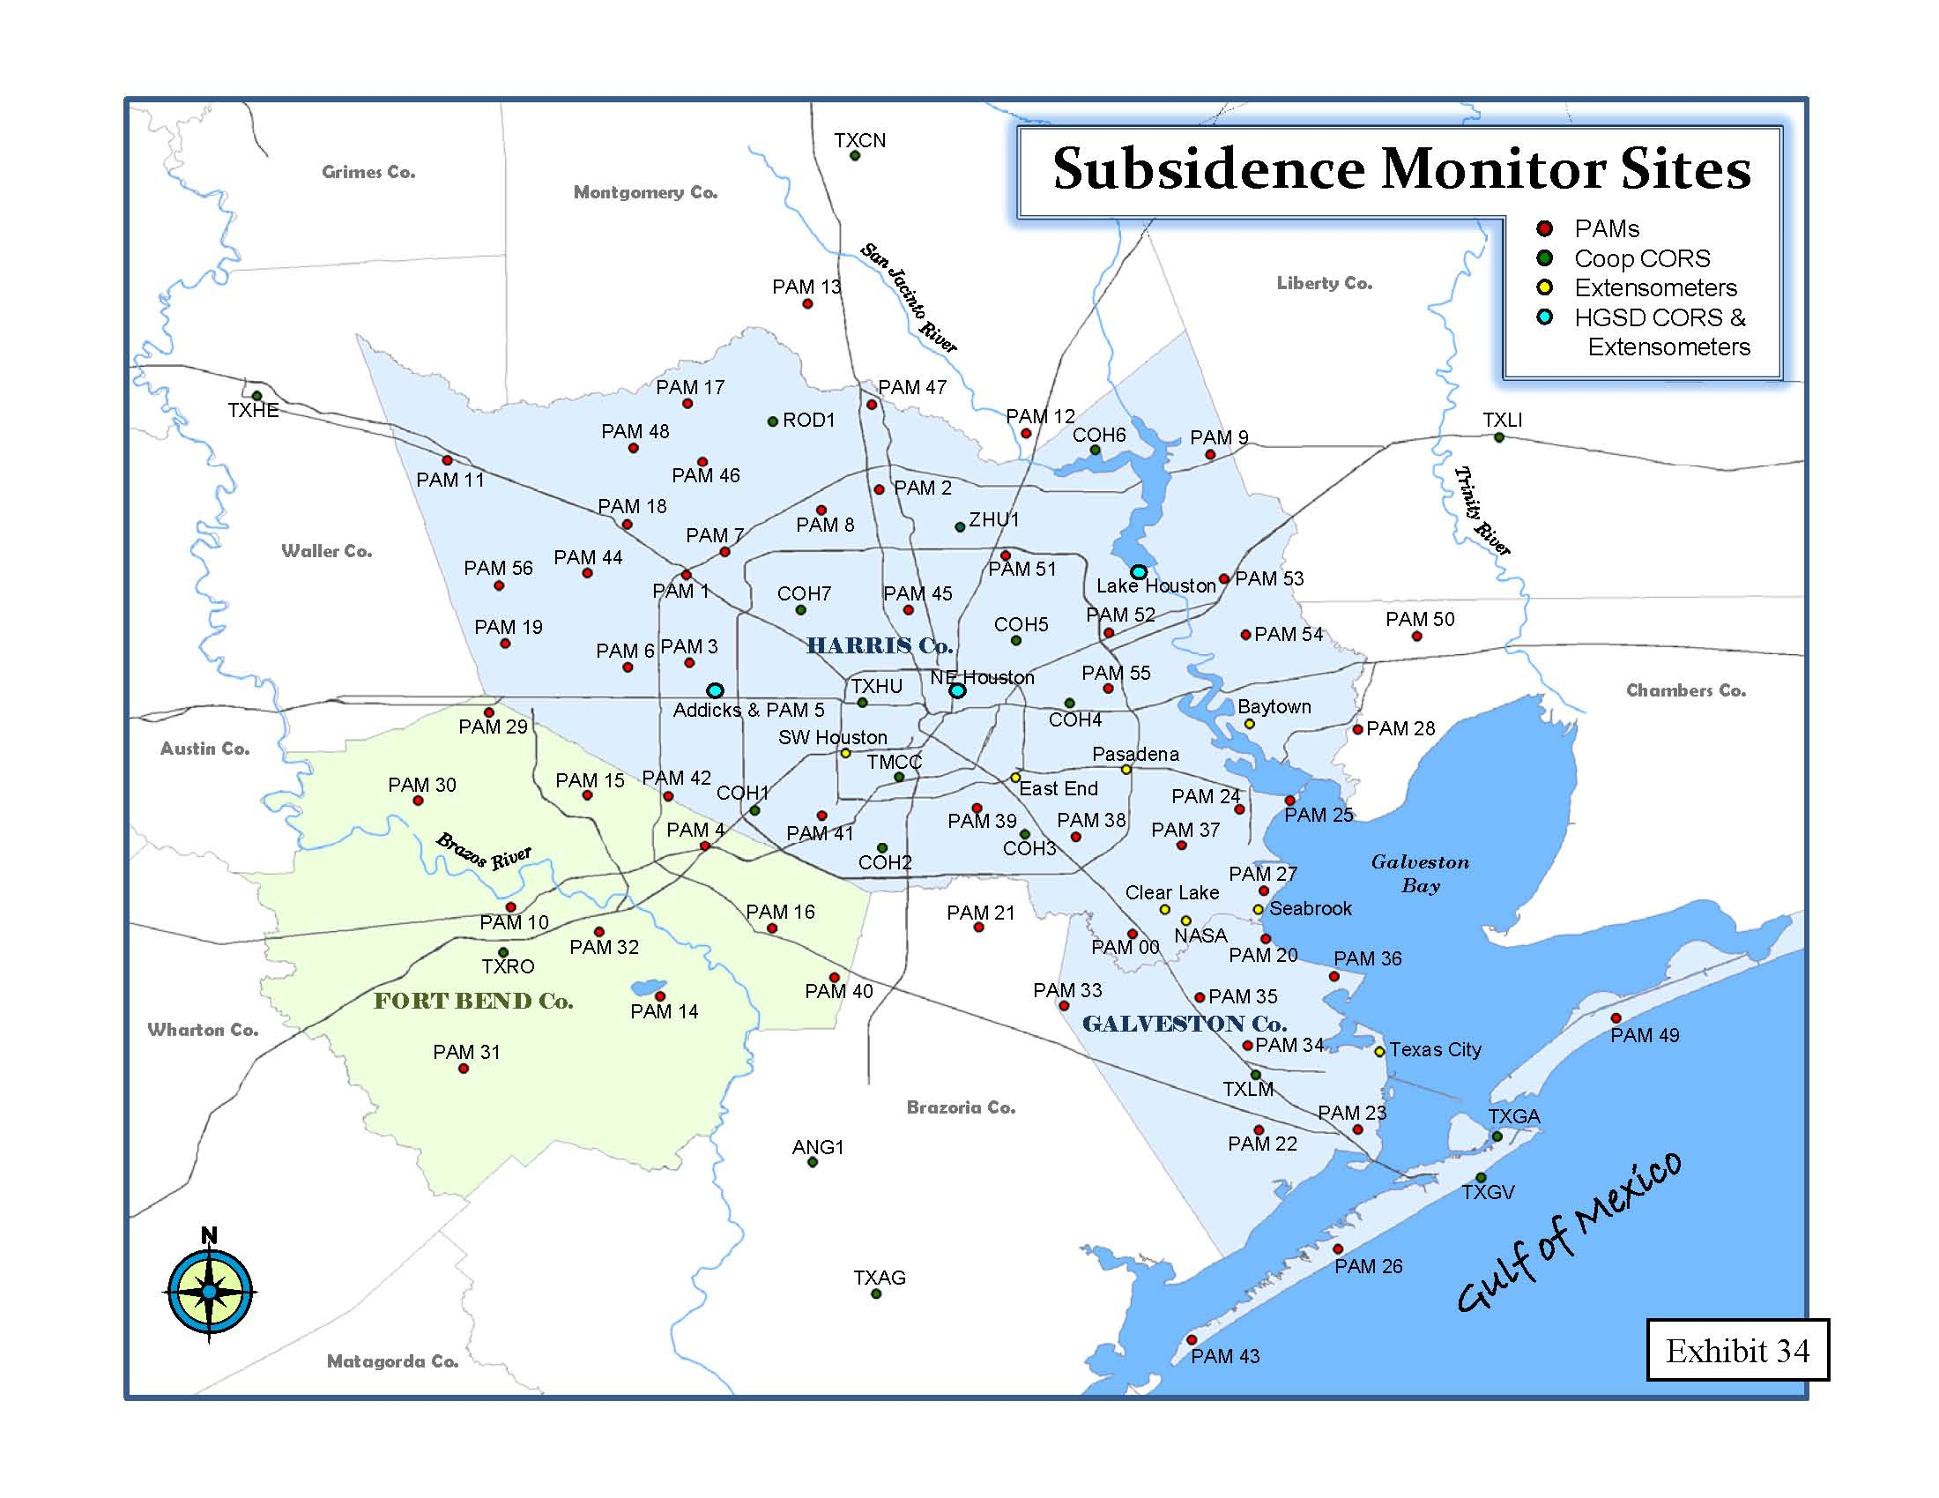
DRAFT - DO NOT DISTRIBUTE

Slide 3
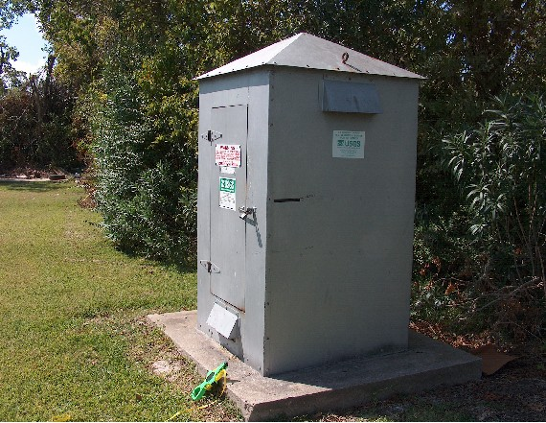
SEABROOK EXTENSOMETER HOUSING

Slide 4
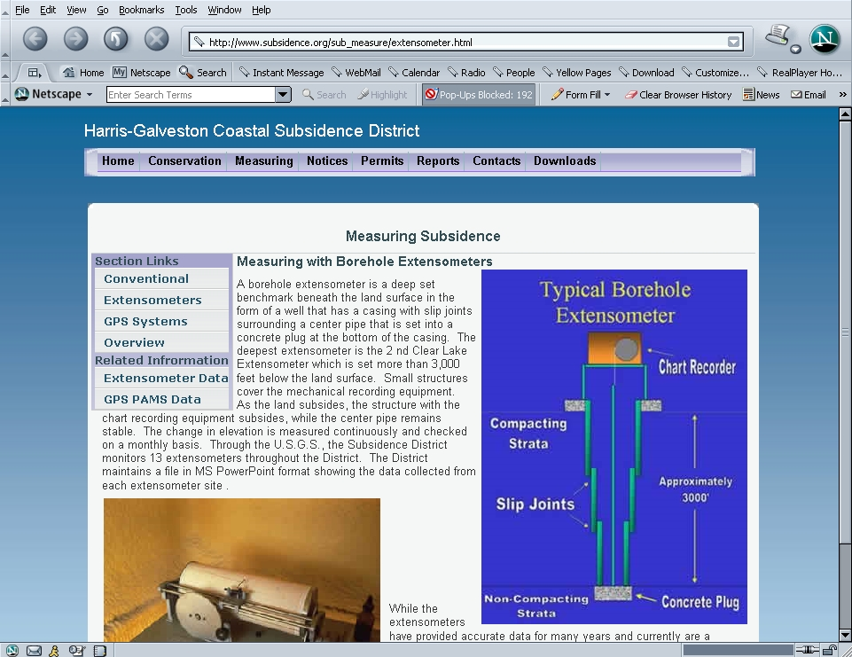

Slide 5
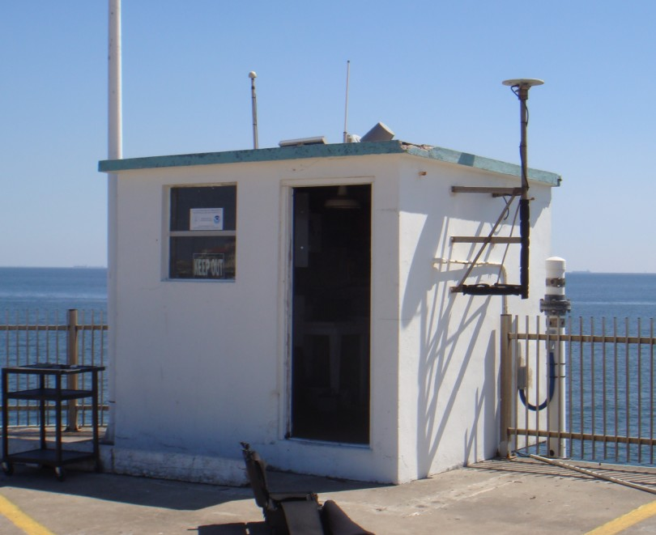

Slide 6
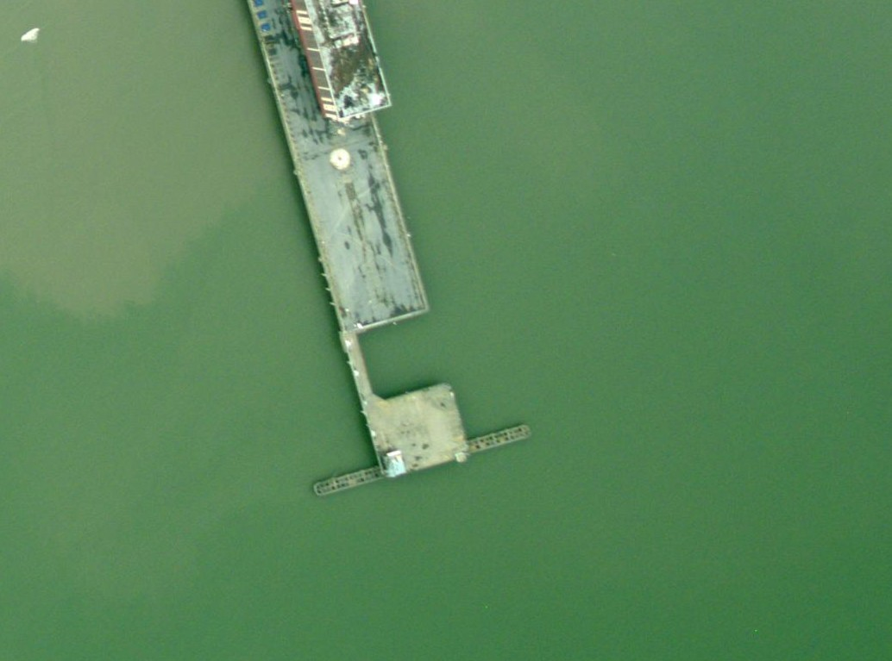
877-1510

Slide 7
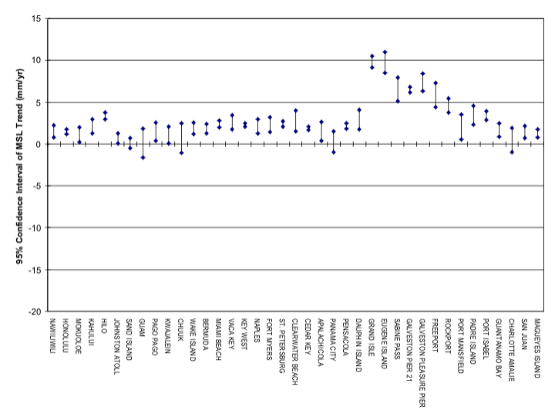

Slide 8
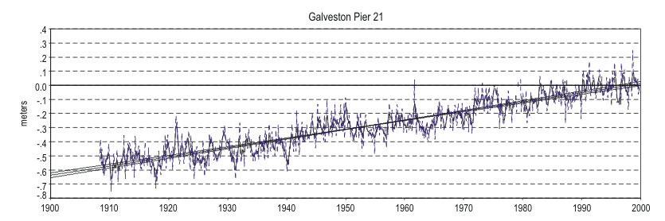

Slide 9
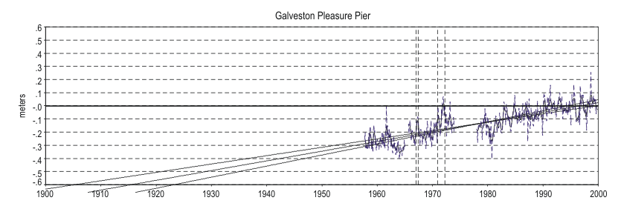

Slide 10
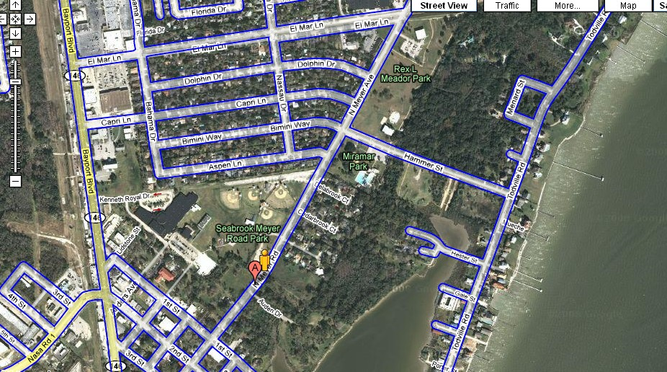
SEABROOK EXTENSOMETER

Slide 11
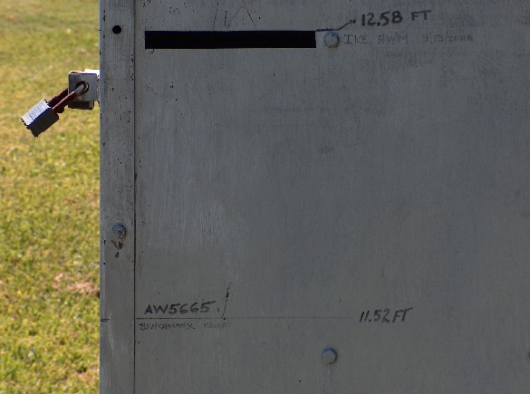
IKE High Water Mark relative to AW5665

Slide 12
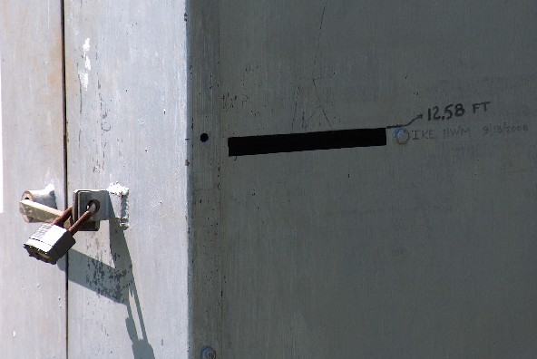

Slide 13
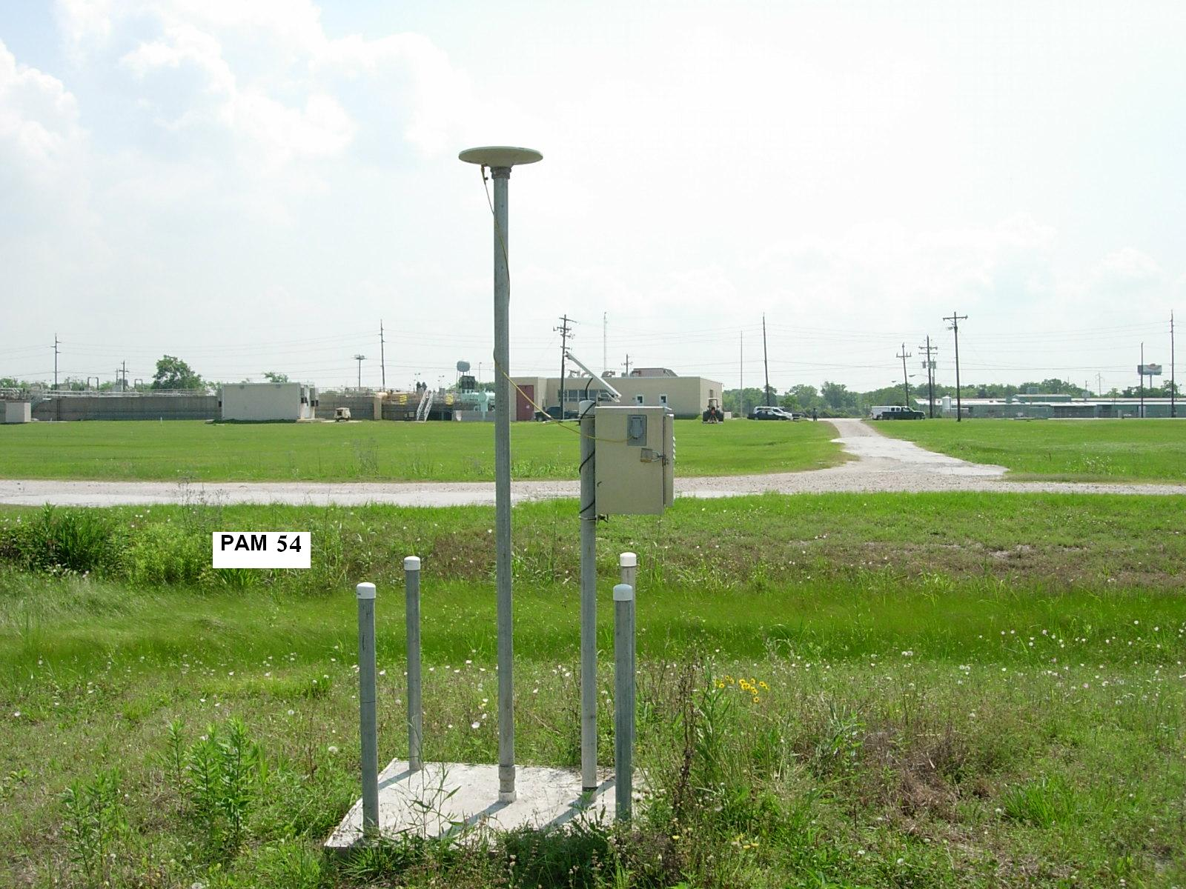

Slide 14
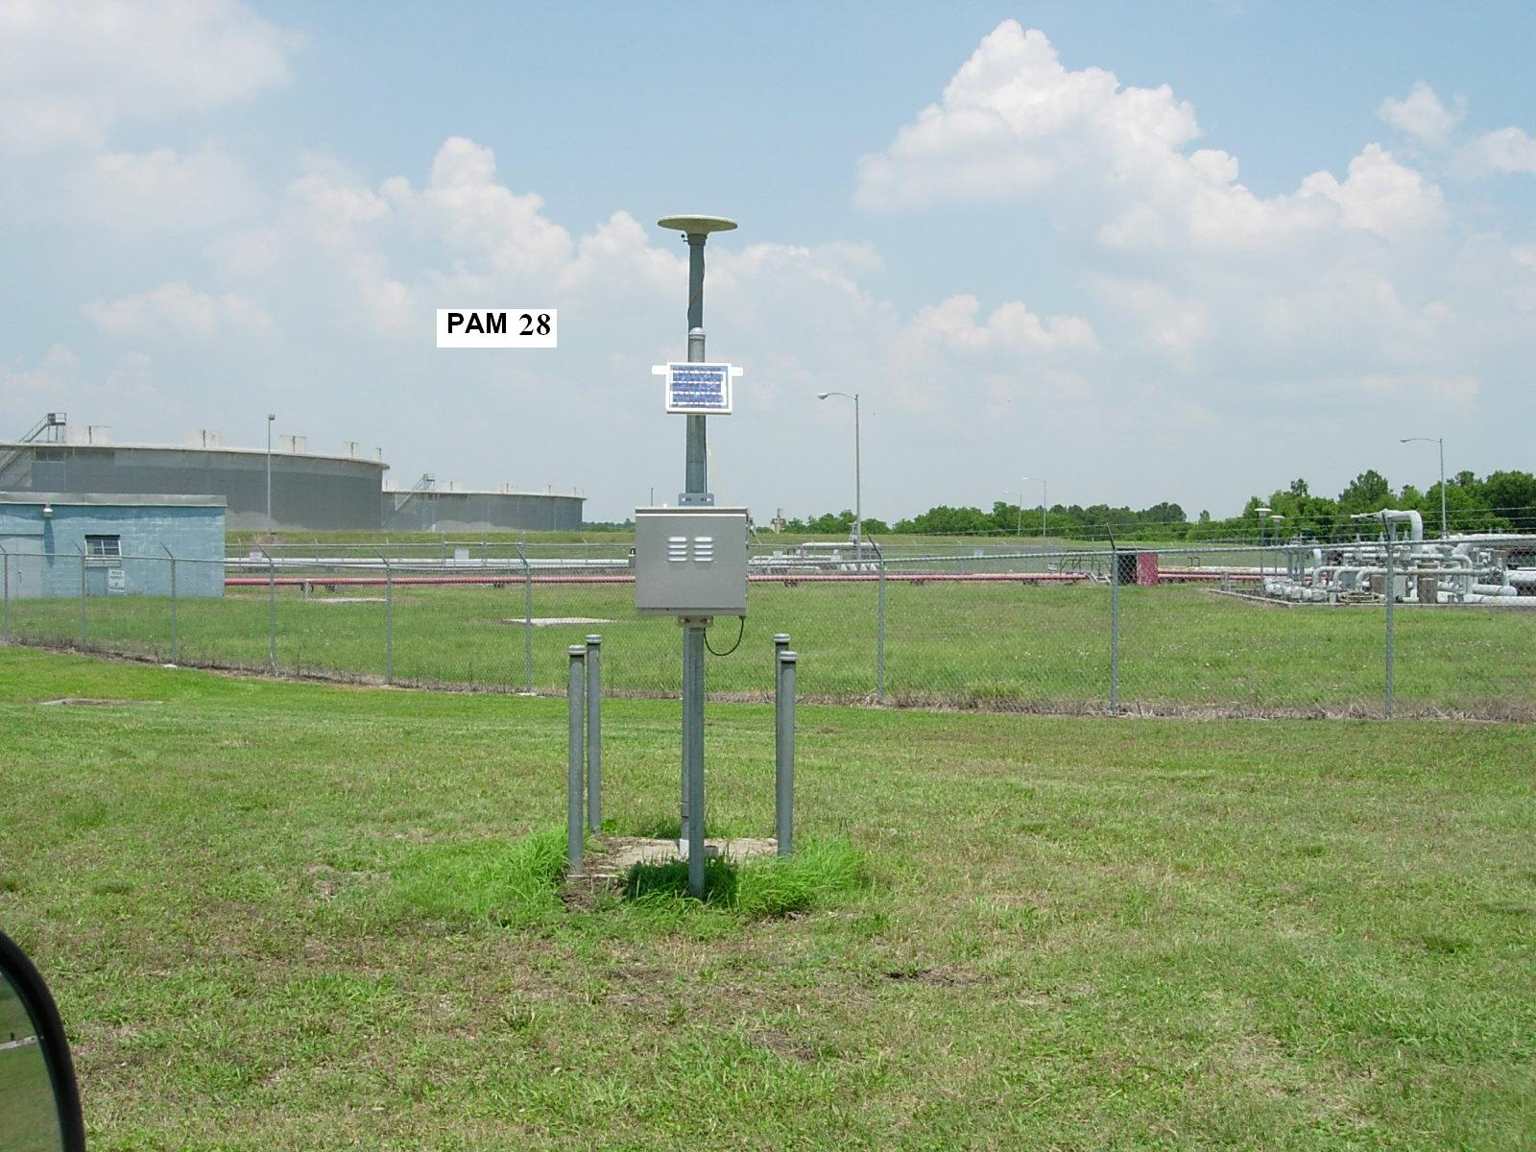

Slide 15
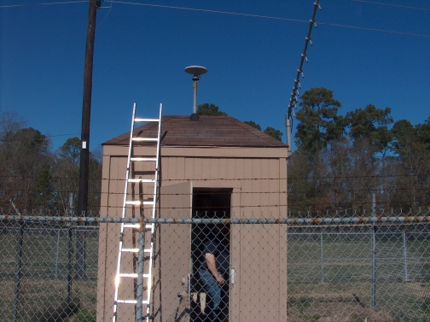
LKHU CORS

Slide 16
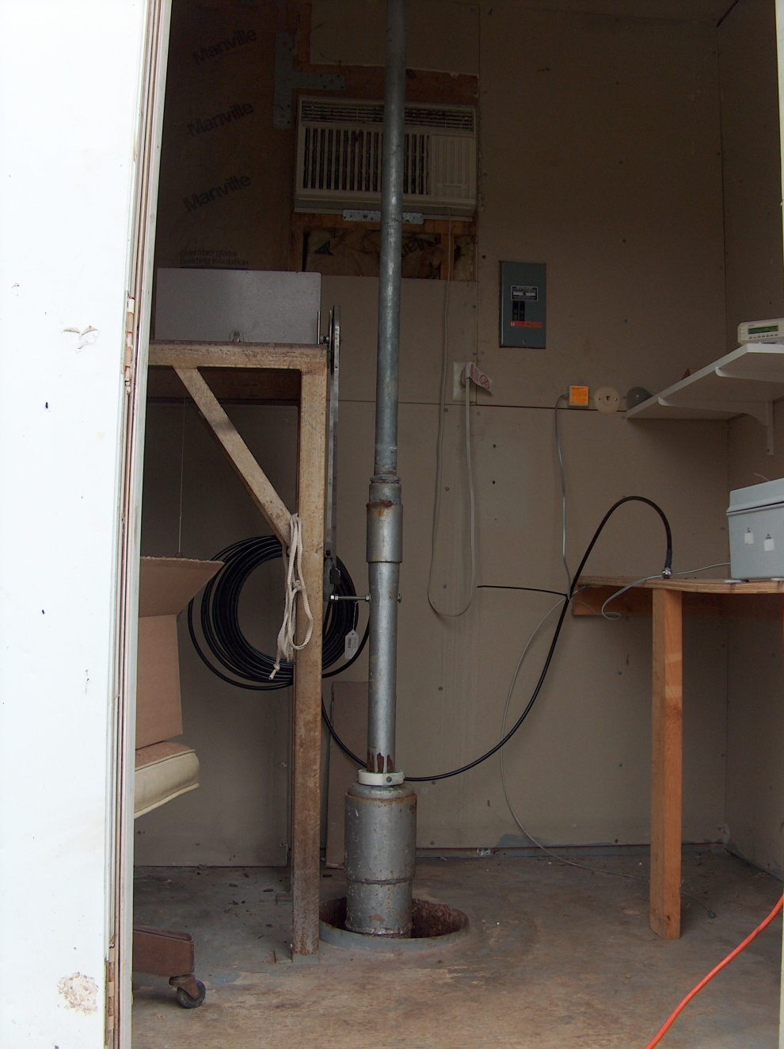

Slide 17
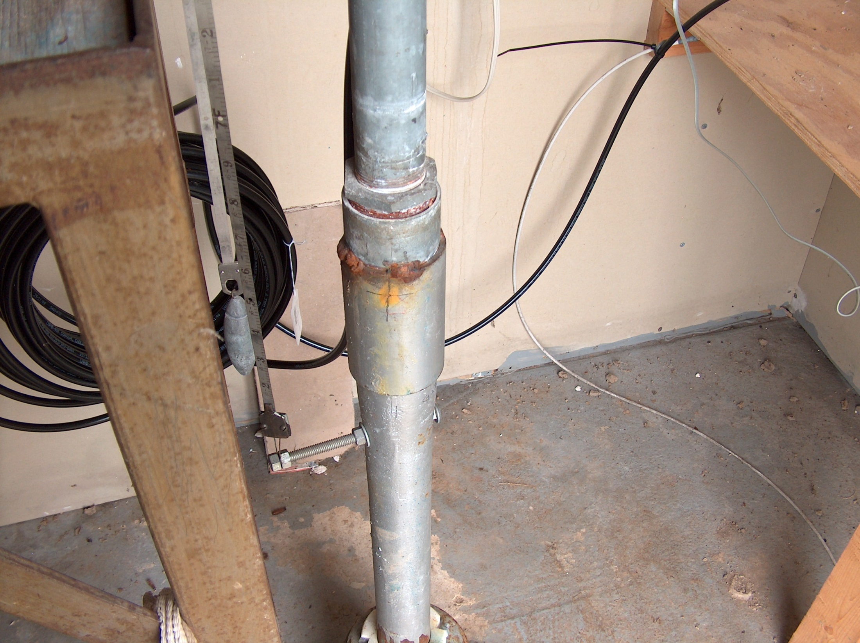

Slide 18
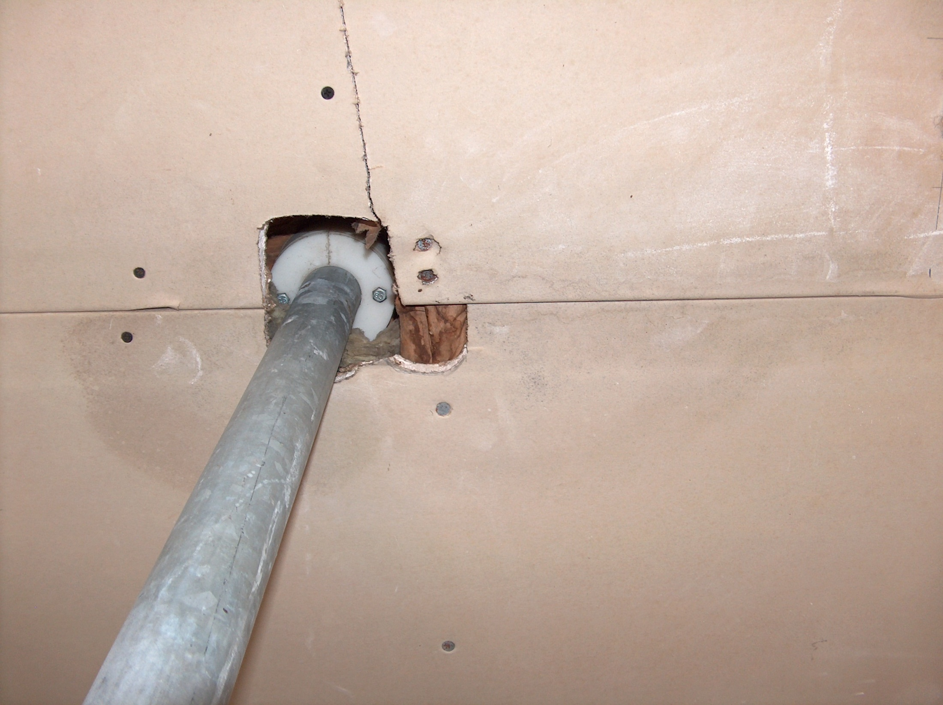

Slide 19
HGSD GPS Data Processing
HGSD data
NGS CORS
COOP CORS
Other
HGSD SUNNY PAGES
NGS magic
PLOTS & Vectors
Notes:
In contrast, OPUS-DB is very streamlined; all the work takes place on the NGS-side of the internet
Of course, that puts the burden of effort on NGS, but most of the data handling routines were already in place to support the CORS network; adding the functions to support the passive network were relatively simple.

Slide 21
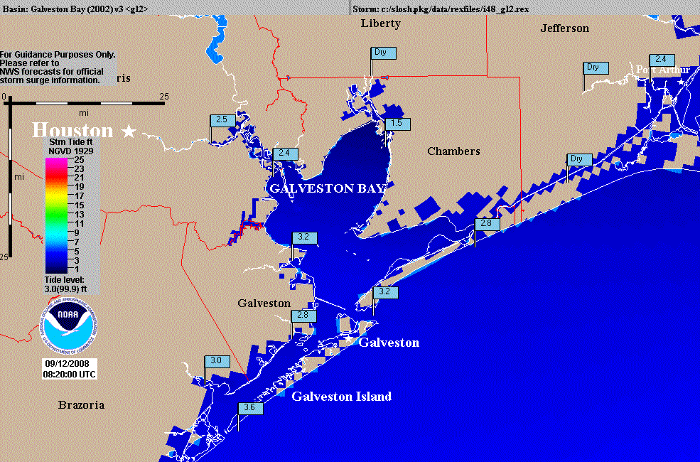

Slide 22
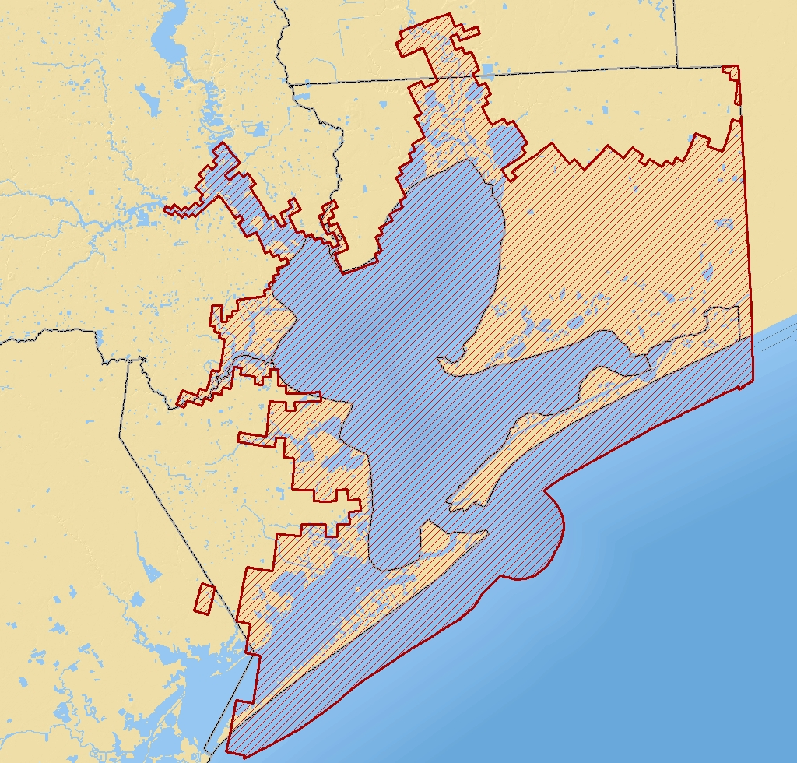
IKE
10 Ft Surge

Slide 23
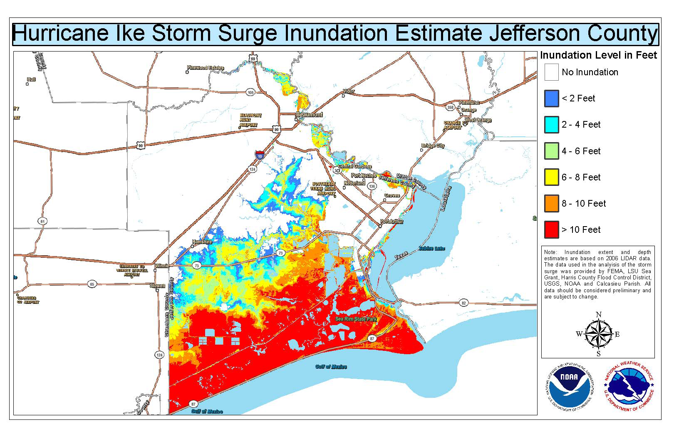

Slide 24
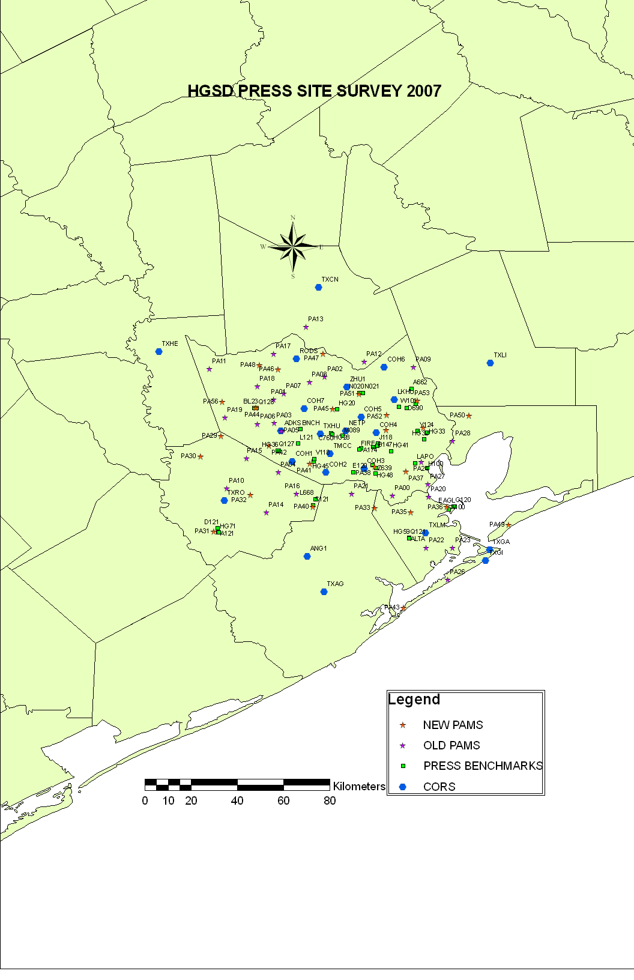

Slide 25
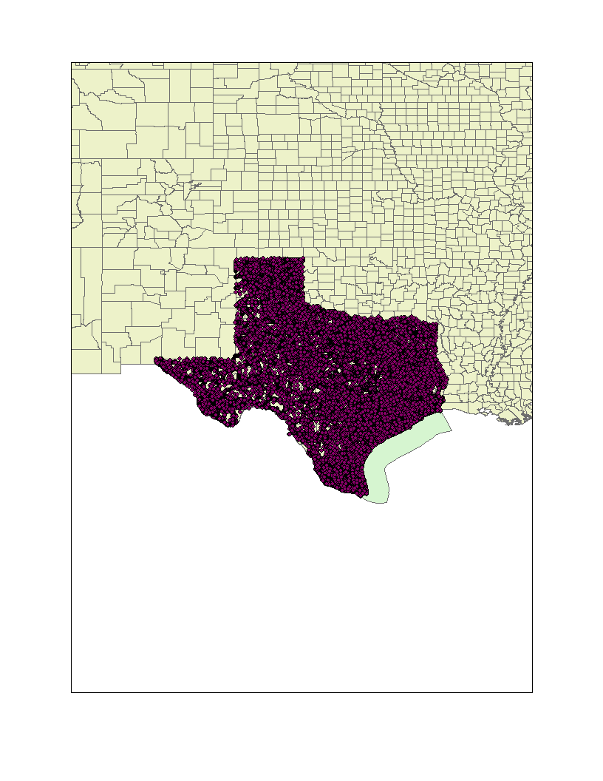

Slide 26
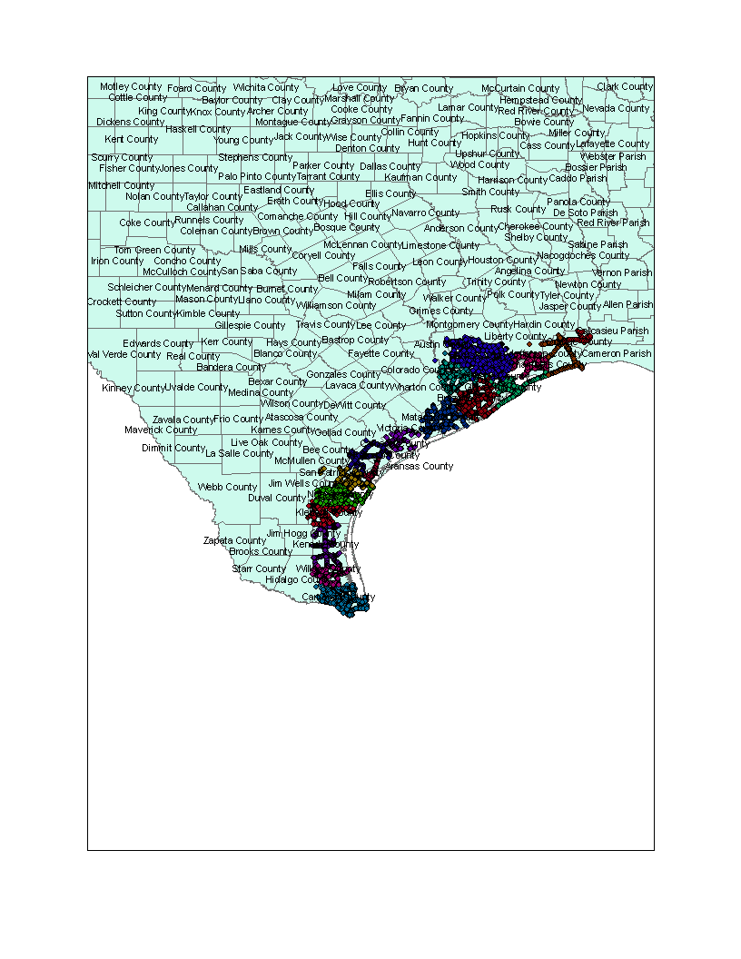

Slide 27
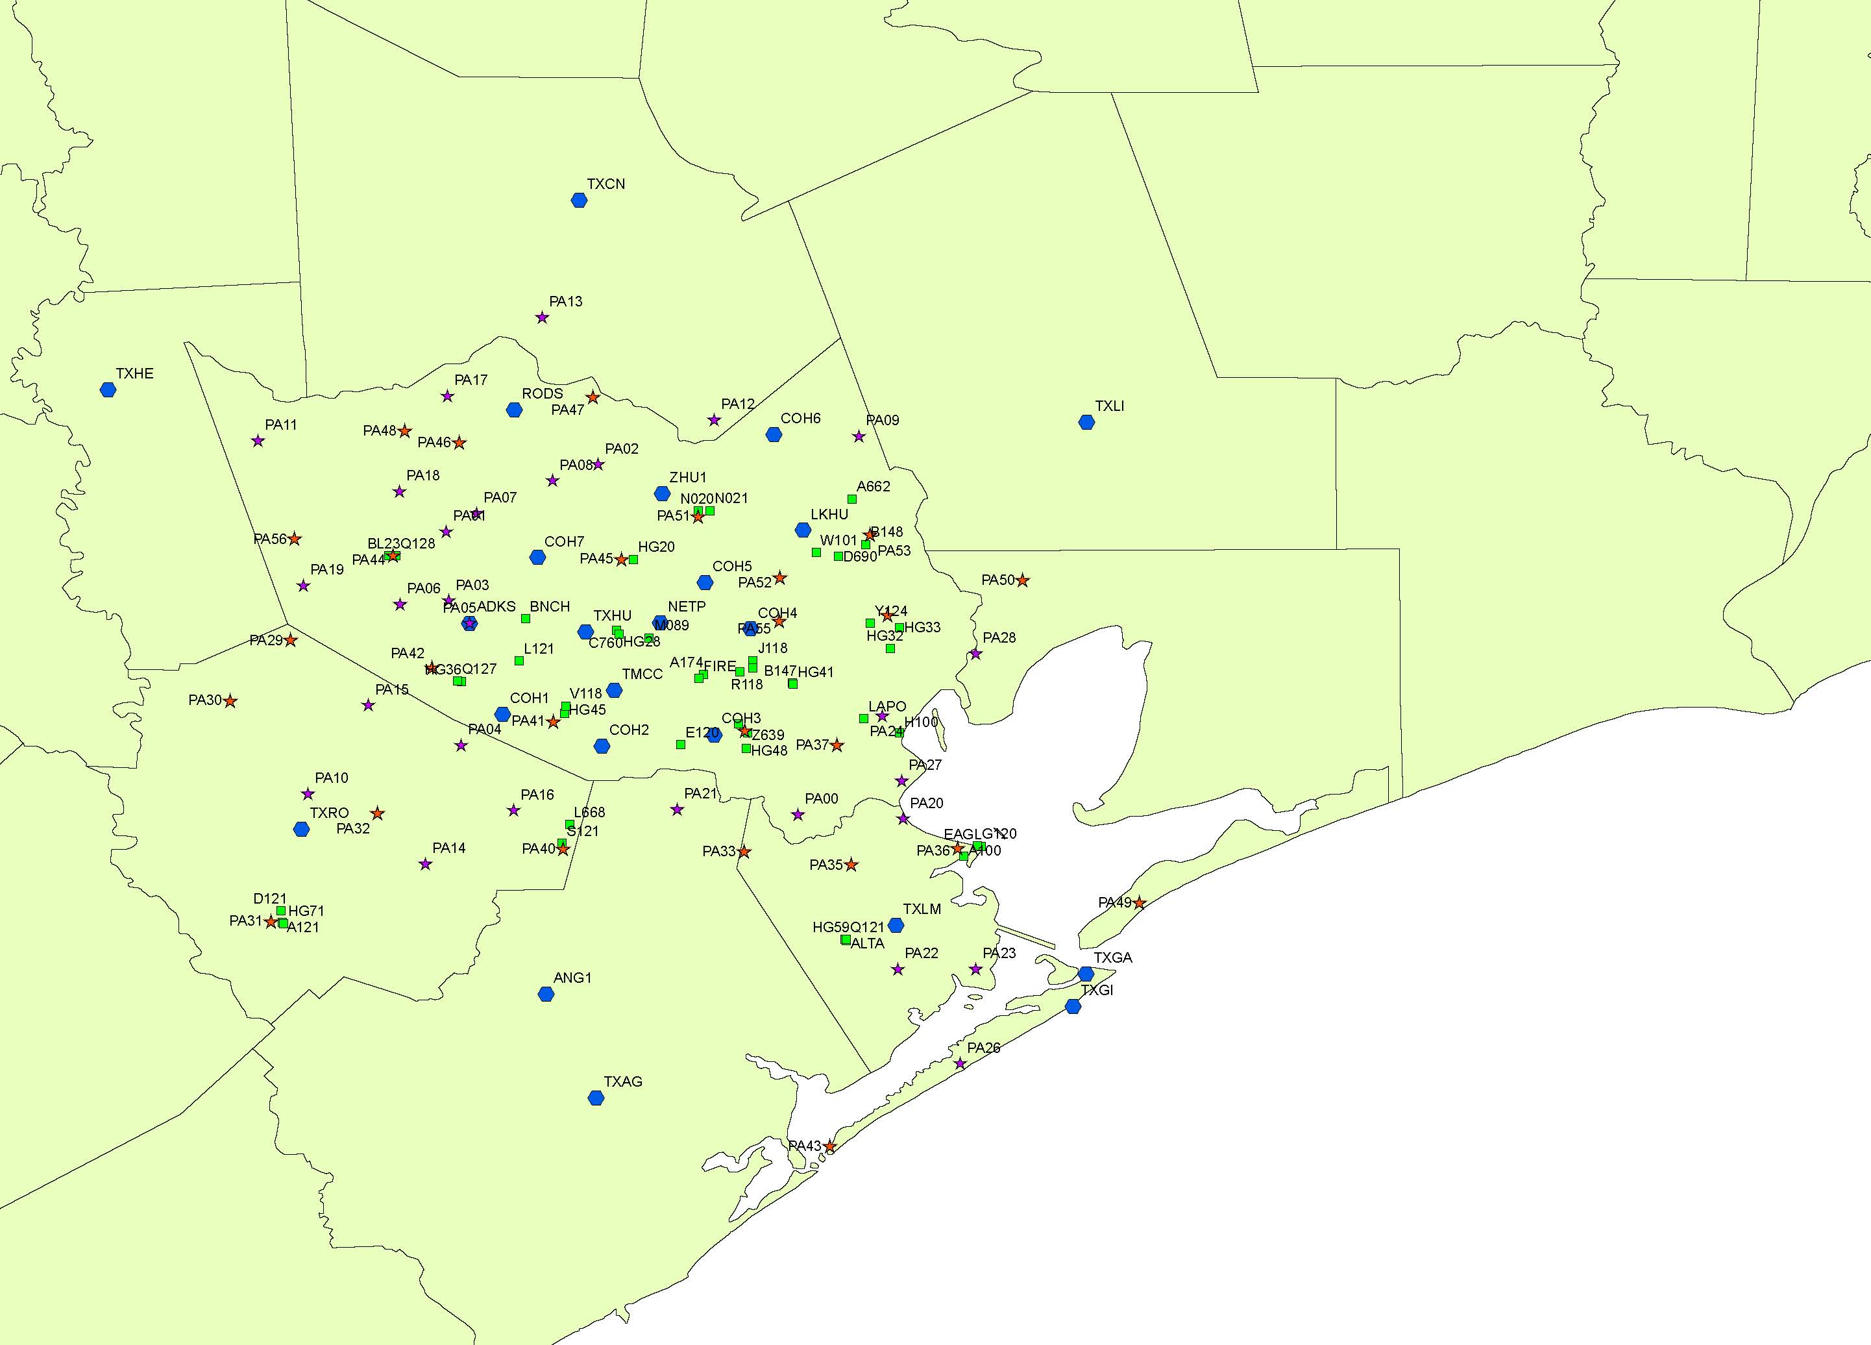

Slide 28


Slide 29

QUESTIONS ?

