Slide 1
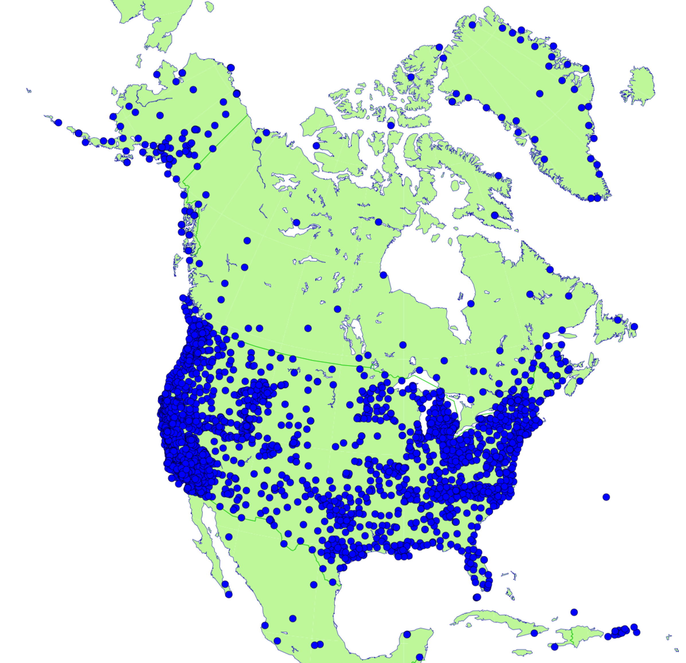
Regional Reference Frames for North America Current Status & Future Plans of Regional Sub-Commission SC1.3c
Dan Roman U.S. National Geodetic Survey
Michael Craymer
Canadian Geodetic Survey
Reference Frames for Applications in Geosciences (REFAG) COSPAR 2018 Scientific Assembly
Pasadena USA, July 14-22, 2018

Slide 2
Outline
Regional Subcommission objectives
WG1 – North American Reference Frame
WG2 – New Plate-Fixed North American Reference Frame
WG3 – Reference Frame Transformations
Other activities

Slide 3
Objectives
Provide international focus and cooperation for issues involving the horizontal, vertical and three dimensional geodetic networks of North America, including Greenland, Mexico and the Caribbean
Co-Chairs
Mike Craymer, Canada
Dan Roman, USA (replaced Neil Weston in 2015)
Working Groups
SC1.3cWG1 – North American Reference Frame (NAREF)
SC1.3cWG2 – New Plate-Fixed North American Reference Frame
SC1.3cWG3 – Reference Frame Transformations

Slide 4
WG1 – NAREF
Objective
Densify the ITRF/IGS global reference frame in North America
Compute weekly coordinate solutions
Combine weekly solutions into multi-year cumulative solutions
Integrate into ITRF via the IGS global network
Include all public continuous GPS sites in N.A. (4500+ stations)
Follow IGS processing guidelines
Current IGS reference frame
IGS orbits and EOPs
Current absolute antenna phase center models
Products
Weekly coordinate solutions (combinations of regional solutions)
Periodic multi-year cumulative (velocity) solutions

Slide 5
Regional Solutions – Canada
Network of all public GNSS stations in northern half of N.A.
~900 active stations & ~230 passive stations (high campaign)
Many new stations added to densify the ITRF – see map next slide
Mainly in targeted areas for monitoring GIA and tectonic motion
Considering adding ~1000 commercial RTK networks in Canada
Producing weekly coordinate solutions since 2000
Bernese GNSS Software 5.2
IGS final orbits (current & repro2) and antenna calibrations
Aligned to IGS14 with global IGS core stations
Producing cumulative solutions from weekly solutions
Multi-year solutions for coordinates & velocities updated monthly with new data and stations
Able to simultaneously estimate seasonal & post-seismic terms

Slide 6
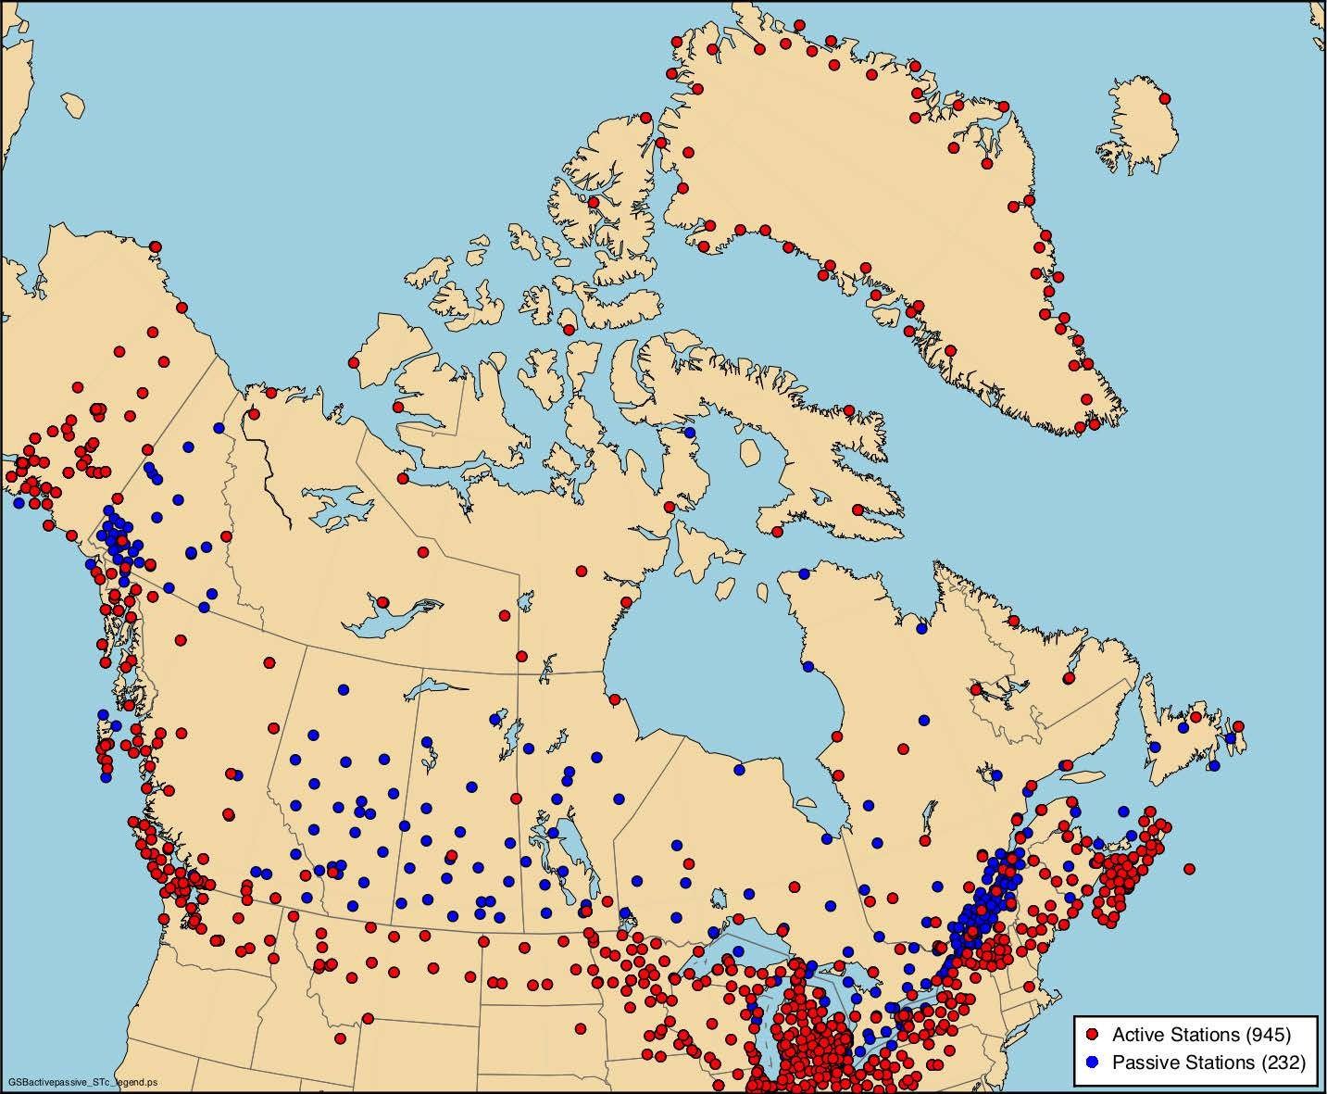
Active & Passive Networks

Slide 7
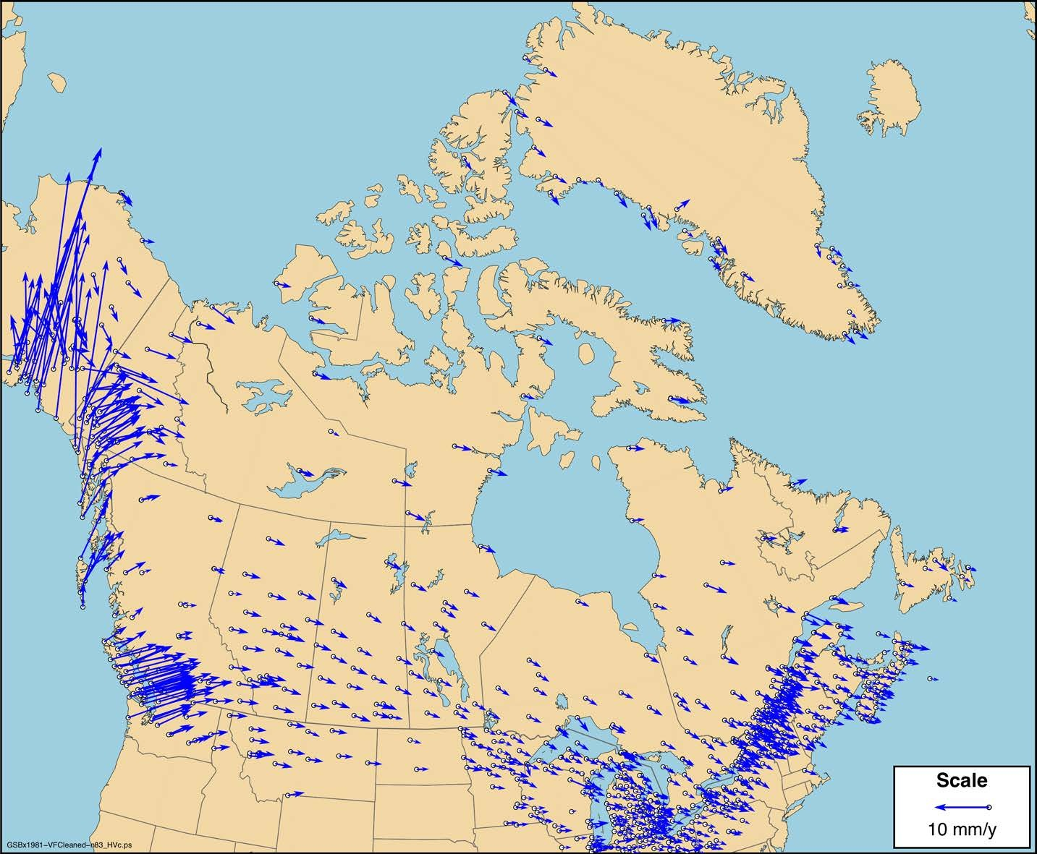
Canadian NAD83
Horizontal Velocity Field

Slide 8
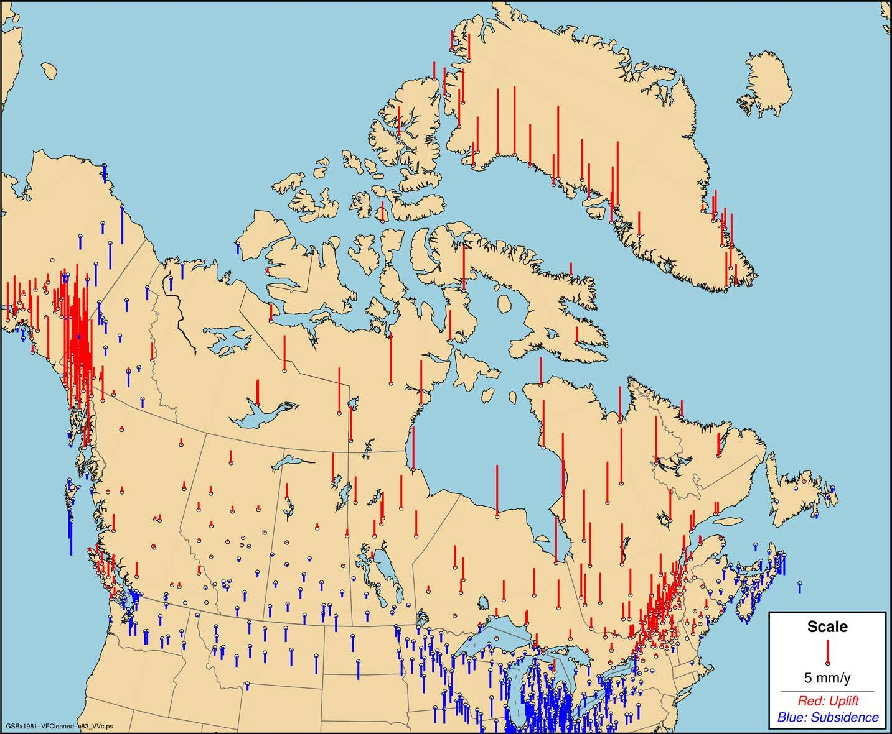
Canadian NAD83
Vertical Velocity Field

Slide 9
Regional Solutions – United States
Network of all public GNSS stations (CORS)
~2500 CORS stations
Covers continental US, Mexico, Hawaii and US territories in Caribbean, American Samoa, Guam & Marianas – see map
Weekly coordinate solutions
Reprocessing all data with PAGES software
IGS final orbits (current & repro2) and latest antenna calibrations
Aligning to IGS14 with global IGS core stations
Multi-year solution
Last solution from 2011
New solution from reprocessing results by end of year
Using recent version of CATREF

Slide 10
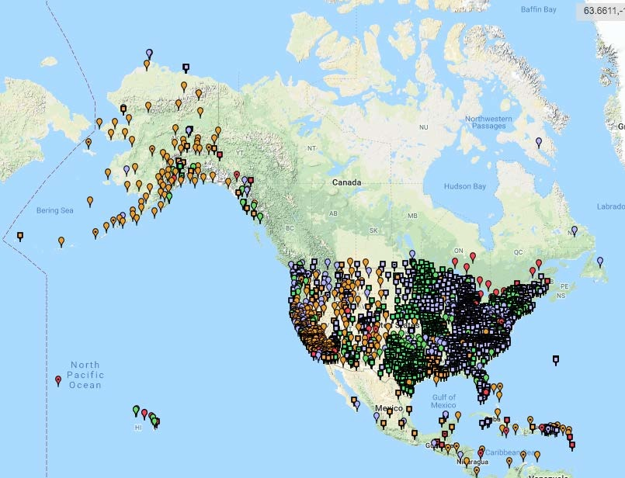
CORS Network
CORS Network

Slide 11
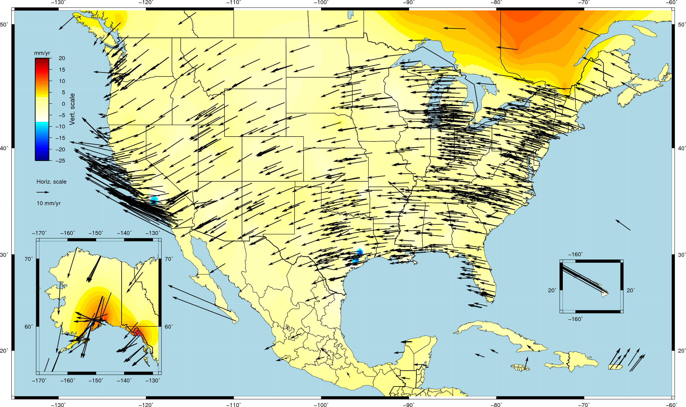
NGS Multi-Year IGS08 Solution from 2011

Slide 12
Future Plans
US repro2 processing
Currently in internal testing; public release planned for September
Position & velocity discontinuities
Determine a common set of position & velocity discontinuities for US & Canadian multi-year solutions
Commercial RTK networks in Canada
Densify sparse active network with commercial RTK stations
Already processing commercial RTK data for RTK compliance agreements
Currently investigating stability of sites
Foundation CORS
US National Assets to densify IGS network to meet operational needs

Slide 13
Foundation CORS Requirements
Baseline Foundation CORS Network
Collocation:
All sites within the Foundation CORS target area of the United States, with existing space geodetic techniques (SLR, VLBI or DORIS), will have a collocated Foundation CORS.
Additional Desired Foundation CORS Network Requirements
Density: Install or adopt new stations within the Foundation CORS target area of the United States. (Fulfill the spacing criteria of 800 kilometers within the Foundation CORS target area.)
Plate Rotation (Euler Pole): Install or adopt new stations within the U.S. Foundation CORS target area to raise the minimum number of Foundation CORS to three on each of the four plates of interest, once the above criteria are met.
Additional (Gap Filling): Install or adopt new stations, on a case-by-case basis, once the above criteria is met (*).

Slide 14
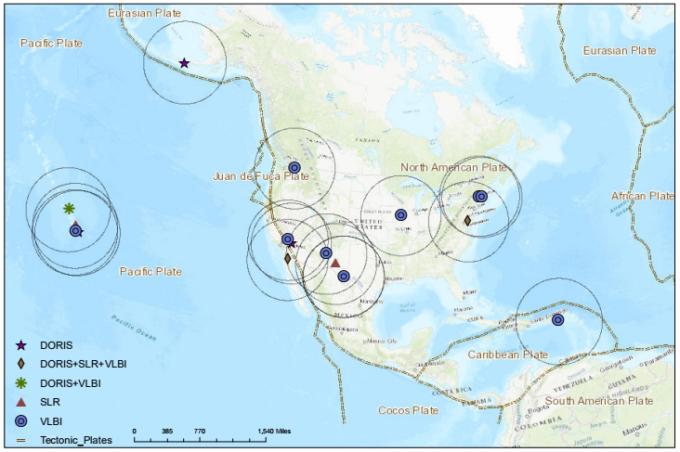
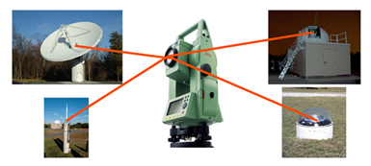
Collocated w/ NASA Spaced-Based Technology
DORIS = Doppler Orbitography and Radiopositioning Integrated by Satellite
SLR = Satellite Laser Ranging
VLBI = Very Long Baseline Interferometry

Slide 15
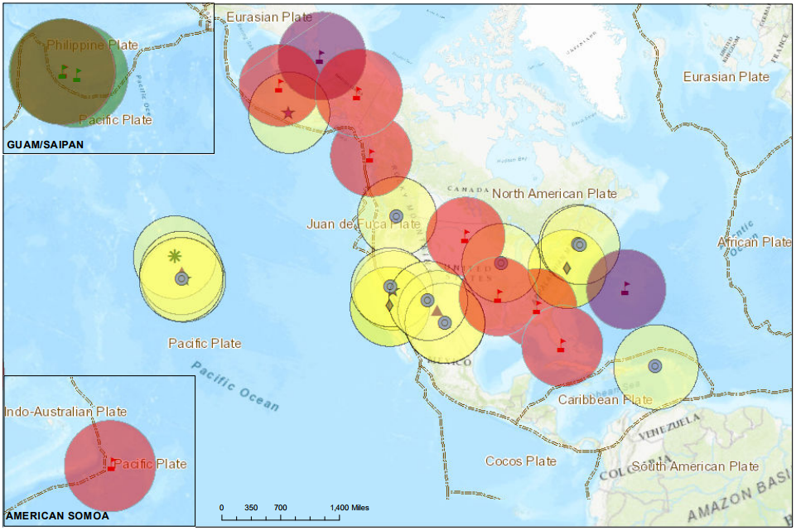
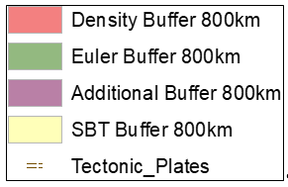
Collocated + Density + Plate Rotation + Additional

Slide 16
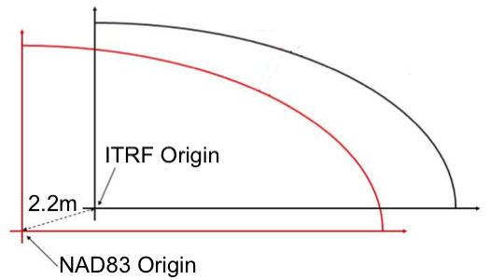
WG2 – Plate-Fixed N.A. Reference Frame
Problems with NAD83
Offset ~2 m from geocentre (ITRF)
Defined by transformation from ITRF but biased by 2 mm/yr
Objective
Establish a new high-accuracy, geocentric reference frame, including velocity models, procedures and transformations, tied to the North American tectonic plate
Establish similar frames for US territories in Caribbean & Pacific
Determine intra-frame velocity models (grids) for each frame to enable propagating coordinates to different reference epochs
Replace NAD83 & US vertical datum by 2022

Slide 17
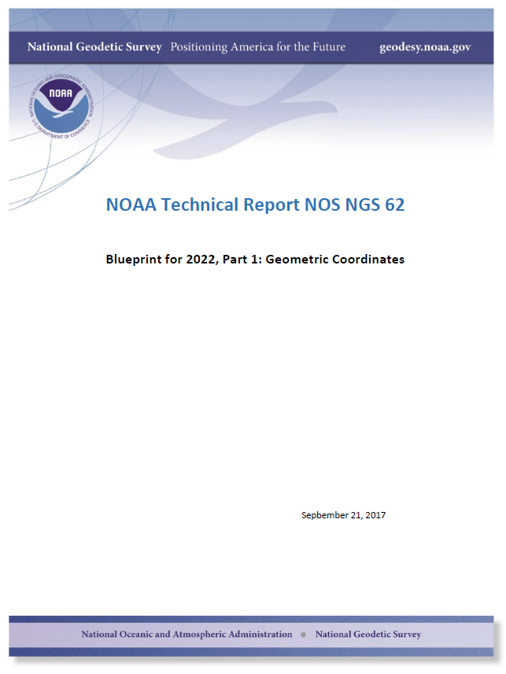
Current Progress
Published “blueprint” documents
Defines implementation of new reference systems
Part 1 on geometric and Part 2 on vertical
Reference frame definition
Will use latest ITRF in 2022 at some adopted reference epoch
Will estimate plate motion via Euler pole rotation to keep frames aligned to plates
Defined names of new reference frames for North America & other US territories
NATRF2022 – North American Terrestrial Reference Frame
CATRF2022 – Caribbean Terrestrial Reference Frame
PATRF2022 – Pacific Terrestrial Reference Frame
MATRF2022 – Marianas Terrestrial Reference Frame

Slide 18
Current Progress – cont’d
US Foundation CORS
Creating a network of ~36 highly stable CORS sites
Densifies IGS network and provides a more stable network to define the new frames in US territories
NGS either owns/operates or has MOAs with other US Agencies
First site installed in Miami
Outreach efforts
Public US Federal Geospatial Summits held in 2010, 2015 & 2017
AGU 2016 Fall Meeting session on new reference frames
WG2 workshop held at CGU 2018 Annual meeting in June
Discussed different methods of determining Euler pole rotation
AGU 2018 Fall Meeting session on new reference frames planned

Slide 19
WG3 – Reference Frame Transformations
Objectives
To determine consistent relationships between international, regional and national reference frames/datums in North America
Maintain and update these relationships
Provide tools for implementing the transformations
Primarily involves maintaining the adopted relationship between ITRF and NAD83
NAD83 – ITRF Transformation
NAD83 is now defined by a transformation from ITRF96
Transformation is incrementally updated to new ITRF’s using adopted IERS transformations between ITRF realizations
NNR-NUVEL-1A is used to keep the frame fixed to N.A.
Updated transformation to ITRF2014

Slide 20
WG3 – Reference Frame Transformations
Transforming NAD83 coordinates between epochs in Canada
Required to propagate coordinates to a common reference epoch
Different provinces in Canada use different reference epochs
Using model (grid) of 3D crustal velocities interpolated from GPS velocity field in NAD83
Using a “hybrid” vertical grid derived from GIA models constrained to the GPS velocity field (remove, compute, restore method)
Estimates of uncertainties of velocity model also provided and used to target weak areas for new GNSS stations
Intra-frame velocity/deformation models will be determined for new reference frames in 2022
These deformation models will replace HTDP in US
Investigating different methods of determining deformation models

Slide 21
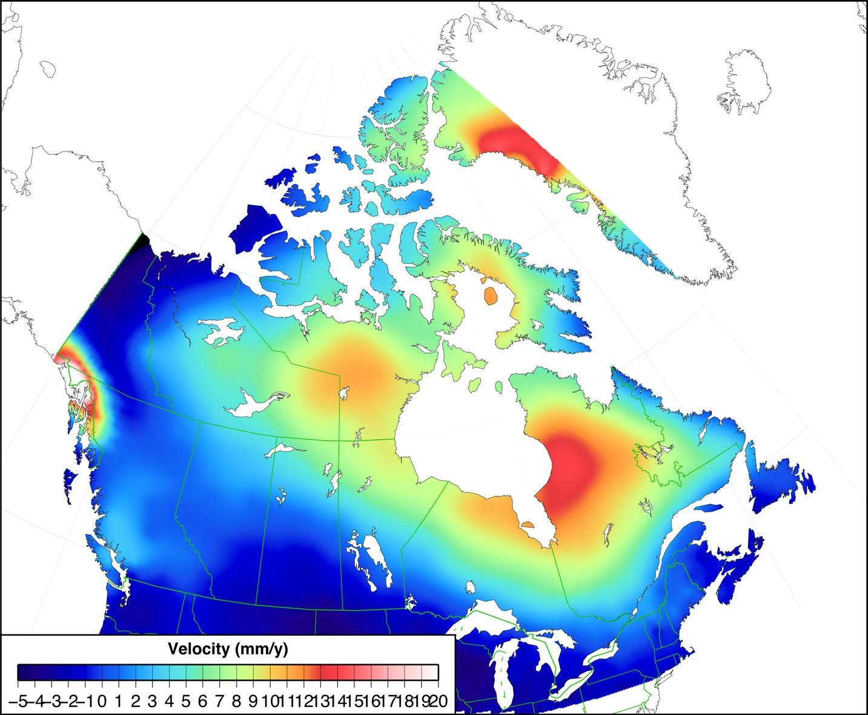
NAD83 Vertical Velocity Model for Canada

Slide 22
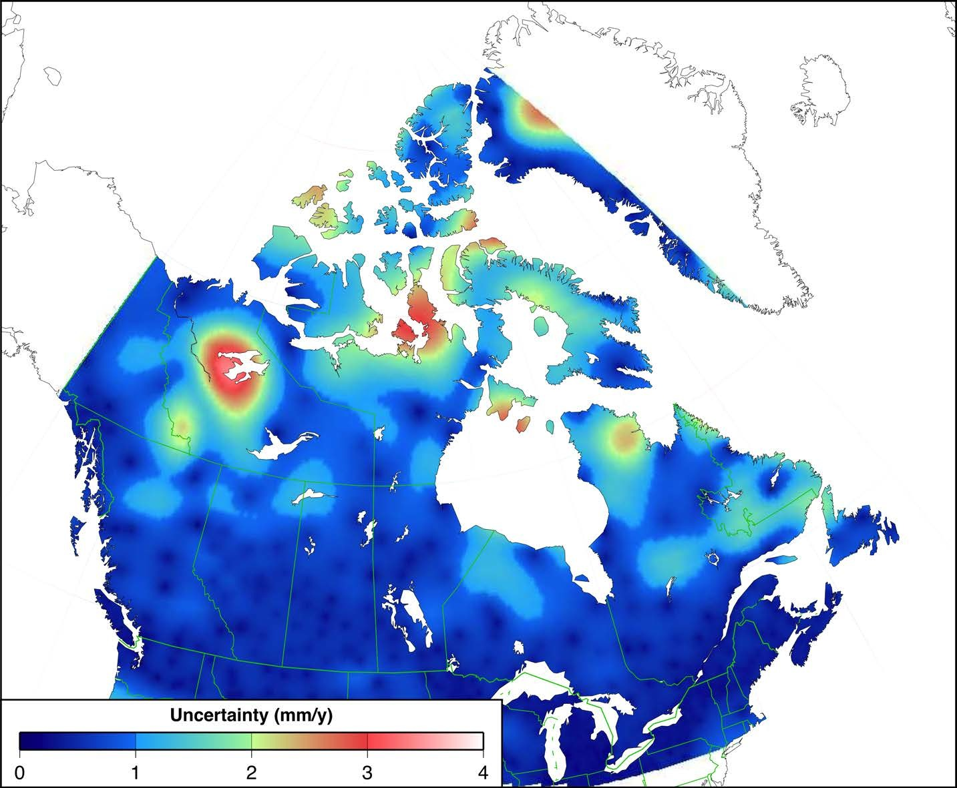
NAD83 Vertical Velocity Model Uncertainty Estimates
Uncertainties largest in areas with little or no GPS stations
New station installed in 2017
New stations planned in 2018 & 2019

Slide 23
Other N.A. Activities
Commercial RTK network certification in Canada
Commercial RTK networks (RTNs) effectively acting as access points to NAD83 for many users
Problem – RTNs integrated into different realizations of NAD83 and in inconsistent ways
Canada (CGS) has implemented “compliance” agreements with 4 largest RTN service providers
Providing official NAD83 coordinates for all RTN stations (~1000 stations)
Monitoring stations using weekly coordinate solutions – time series publicly available online
Classifying stations as non-compliant when weekly coordinates differ from official values by defined tolerance (2 cm horz, 3 cm vert)

Slide 24
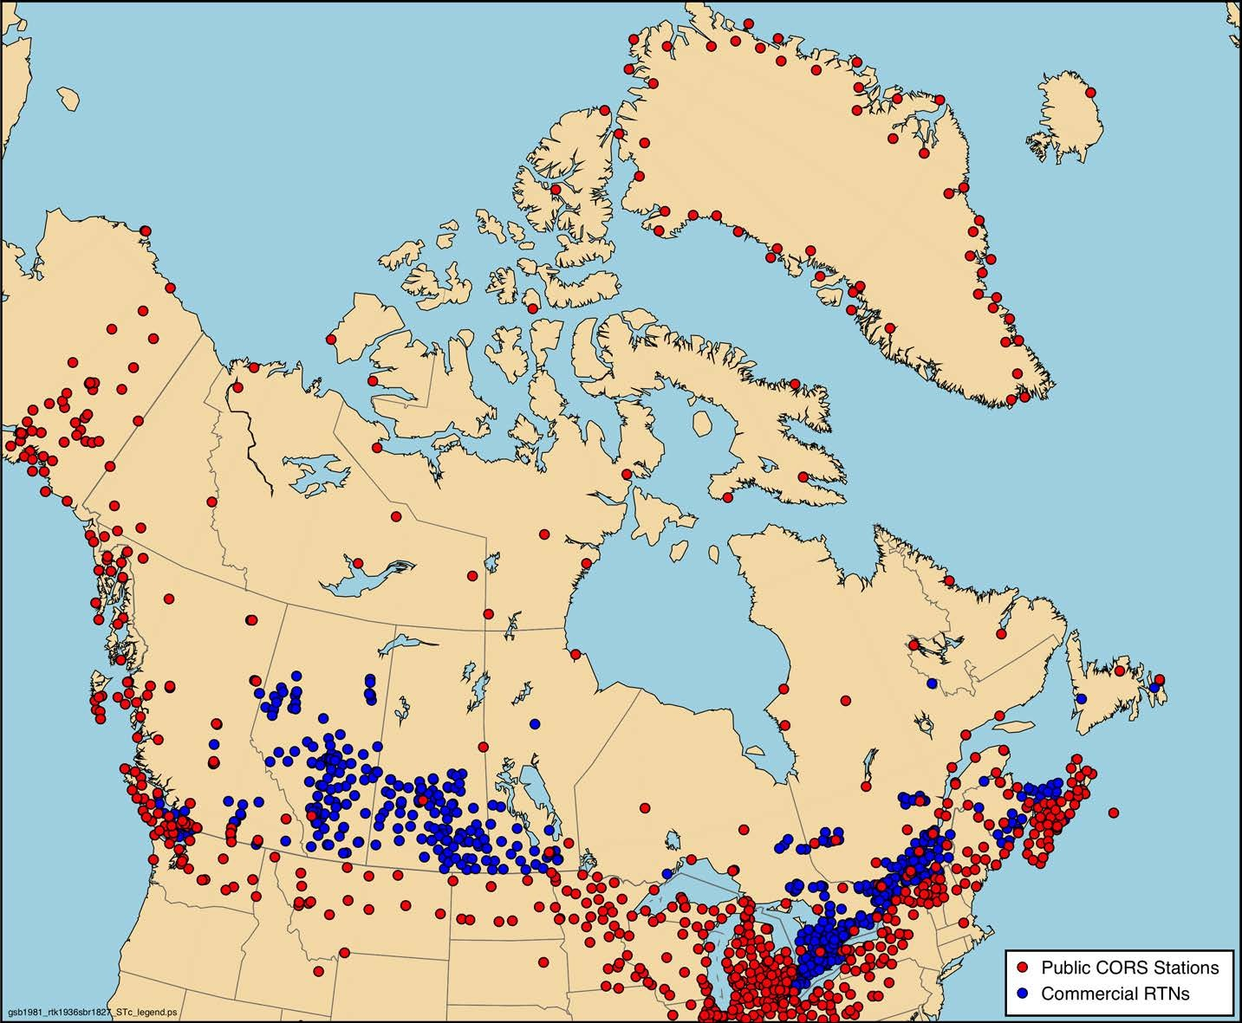
Commercial RTK Networks in Canada
Commercial RTNs significantly densify public network in the Prairies

Slide 25
Other N.A. Activities – cont’d
Commercial RTK networks in United States
US (NGS) has no plans to certify RTNs in United States
RTN users validate RTN services by comparing RTN positions of known geodetic markers to published positions or OPUS-Share solutions
Developing alignment/tracking tool for RTNs and other private CORS networks

Slide 26
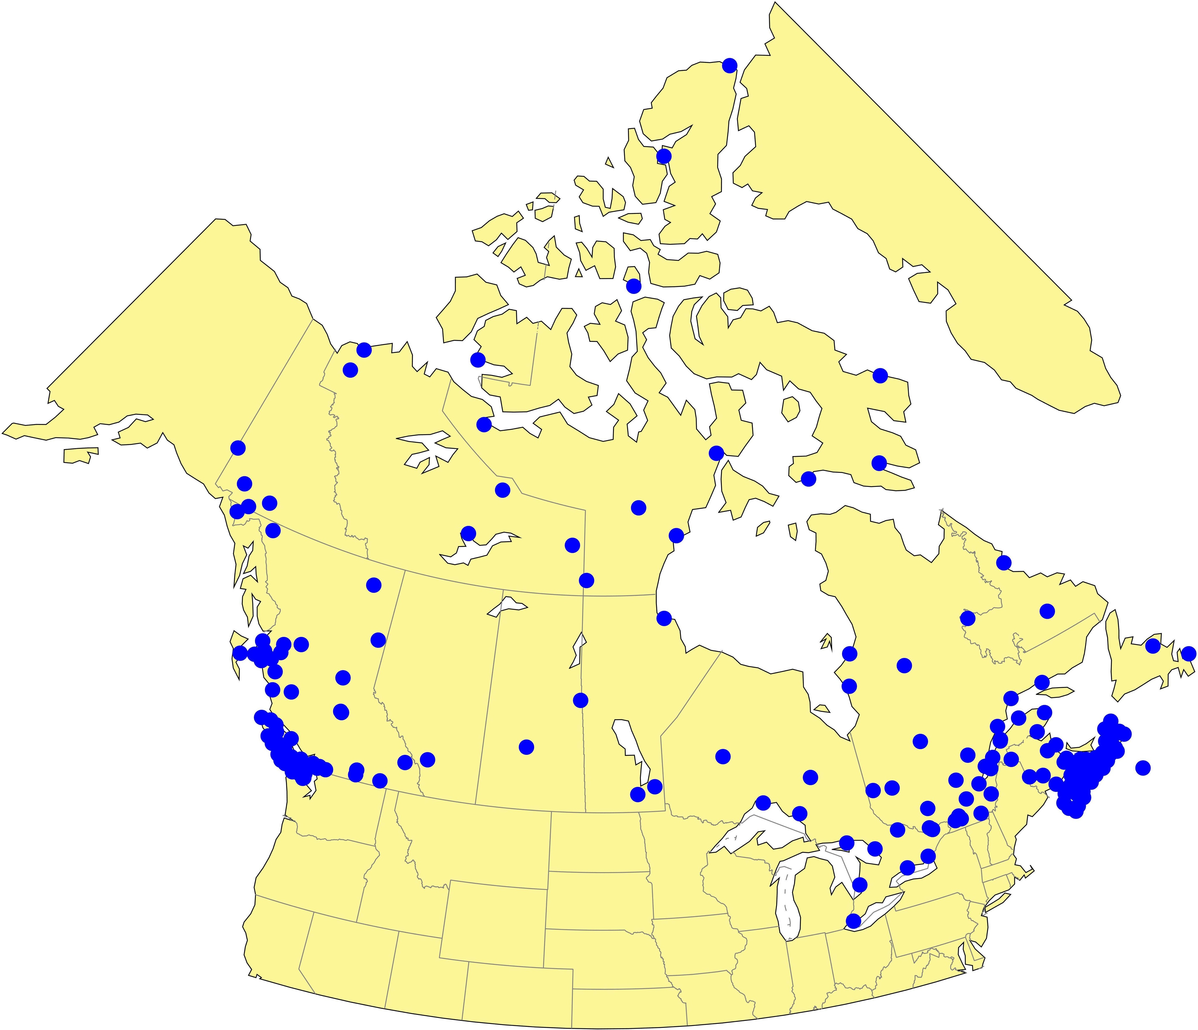
Other N.A. Activities – cont’d
Initiative to enhance geodetic infrastructure in Canada
General areas of discussion for PNT initiative:
Densification of CORS, more real-time, perhaps in partnership with industry/provincial governments
Greater GGOS contribution
Improved real-time PPP availability
Resilience through integrity monitoring
Consideration of non-geodetic uses of GNSS data (e.g., meteorology)
Existing CORS

Slide 27
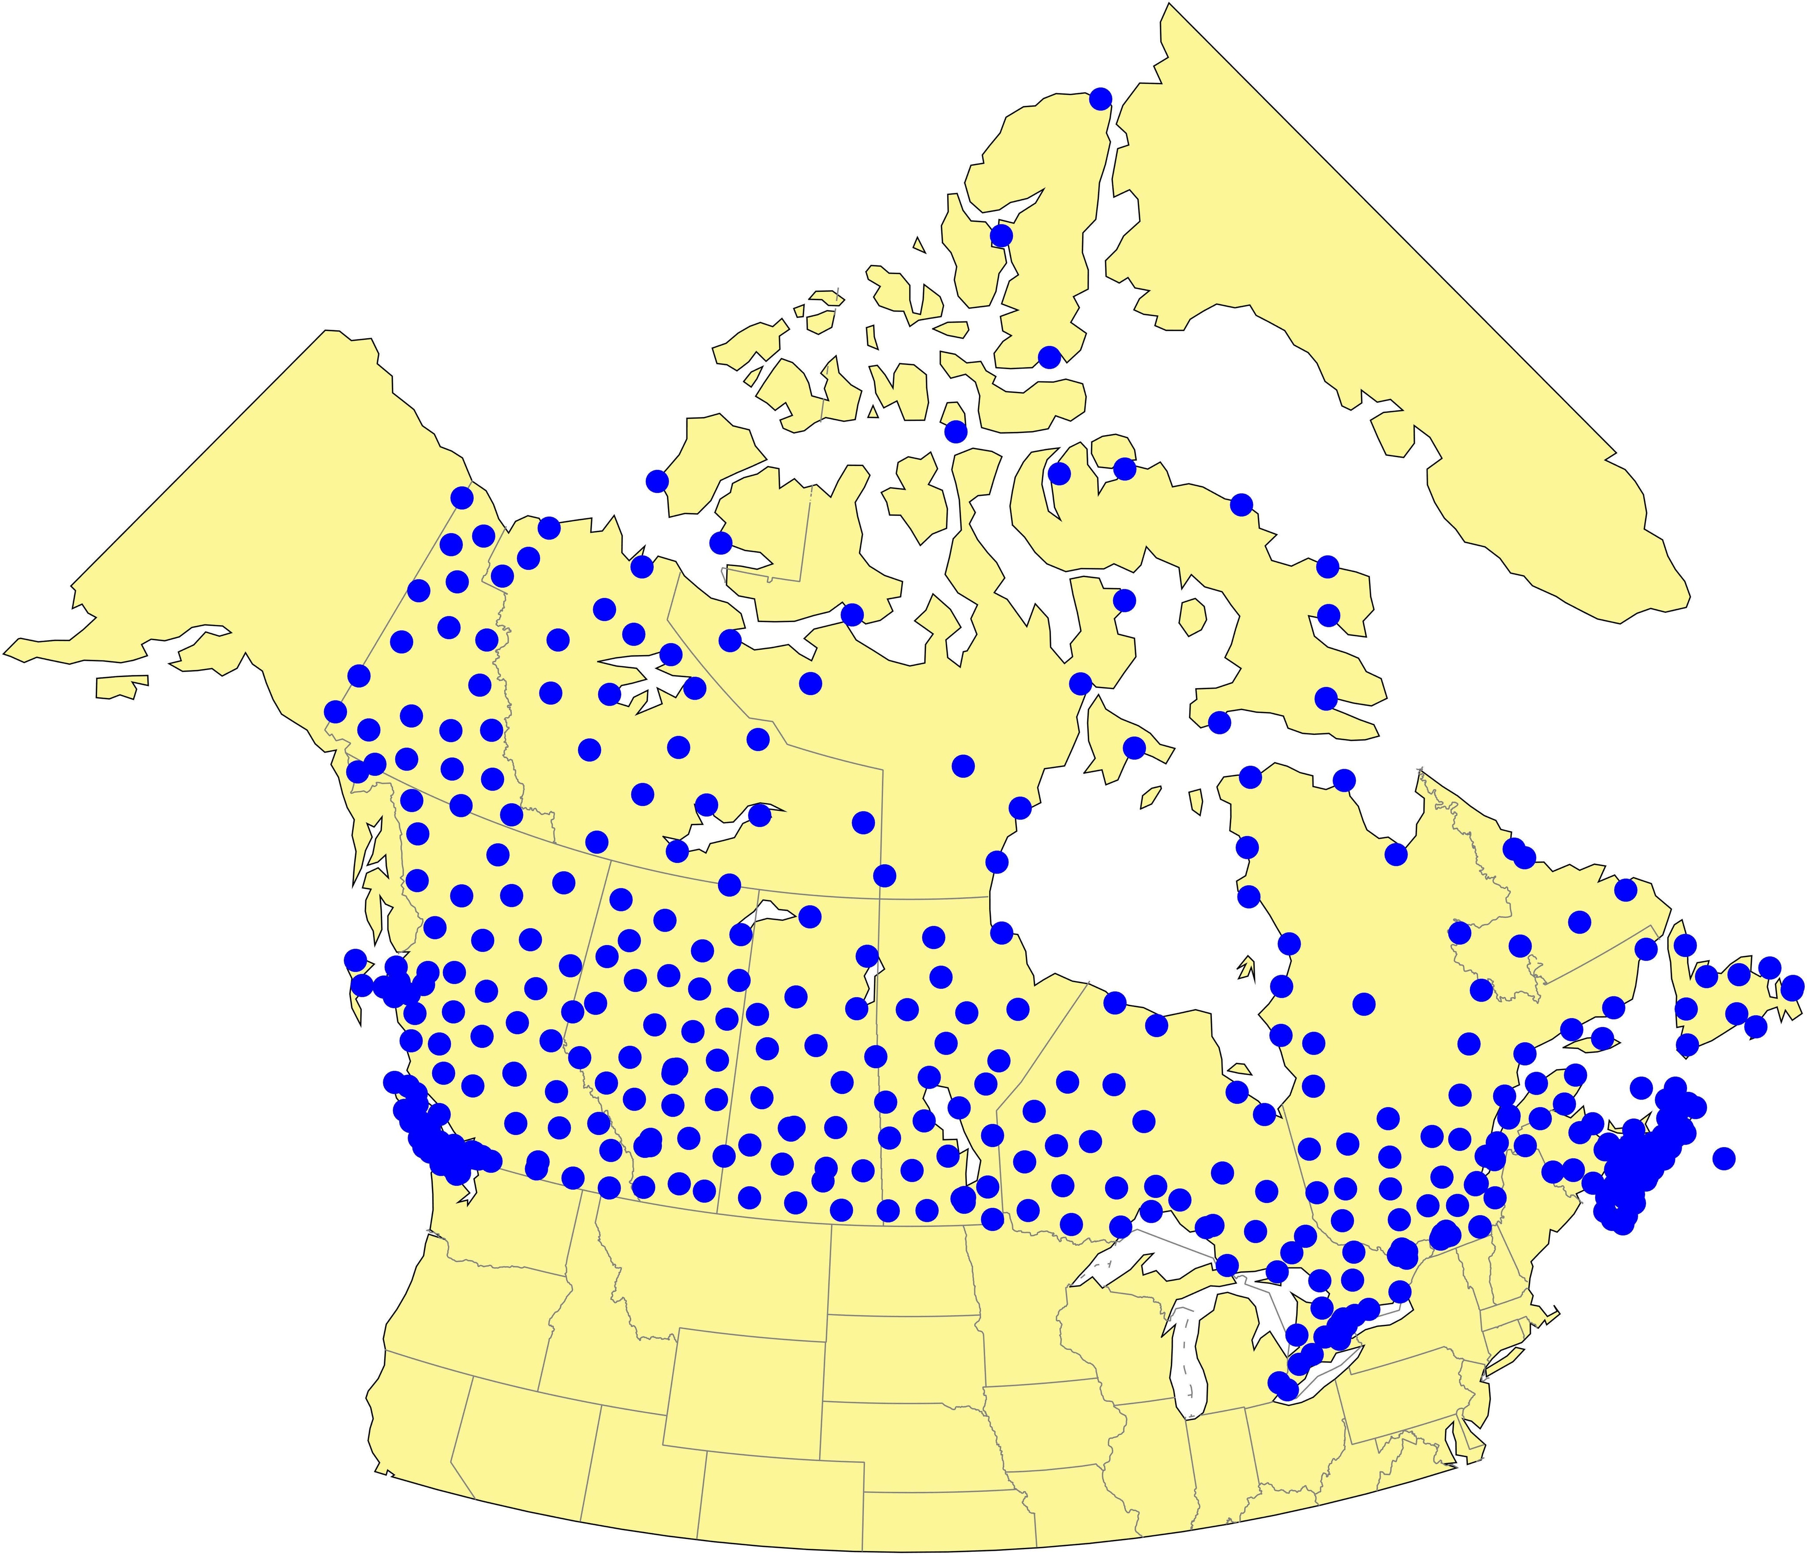
Other N.A. Activities – cont’d
Initiative to enhance geodetic infrastructure in Canada
General areas of discussion for PNT initiative:
Densification of CORS, more real-time, perhaps in partnership with industry/provincial governments
Greater GGOS contribution
Improved real-time PPP availability
Resilience through integrity monitoring
Consideration of non-geodetic uses of GNSS data (e.g., meteorology)
Proposed densification

Slide 28
Other N.A. Activities – cont’d
International Coordination
SIRGAS
Focus is by definition on all of the Americas
US is now member of SIRGAS
Coordination between IAG 1.3b and 1.3c
UN-GGIM-Americas
WG 3 on Geospatial Data Infrastructure
Oversight of SIRGAS activities proposed
Consistent with EUREF and UN-GGIM-Europe
UN-GGIM-Asia/Pacific
WG 1 on Reference Frames
Aligned with APREF
US joining in support of PATRF and MATRF development

Slide 29
Questions?

Slide 30
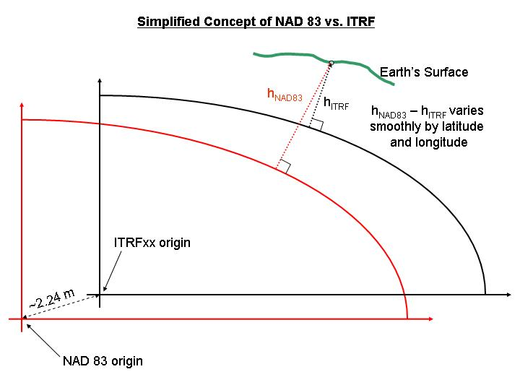
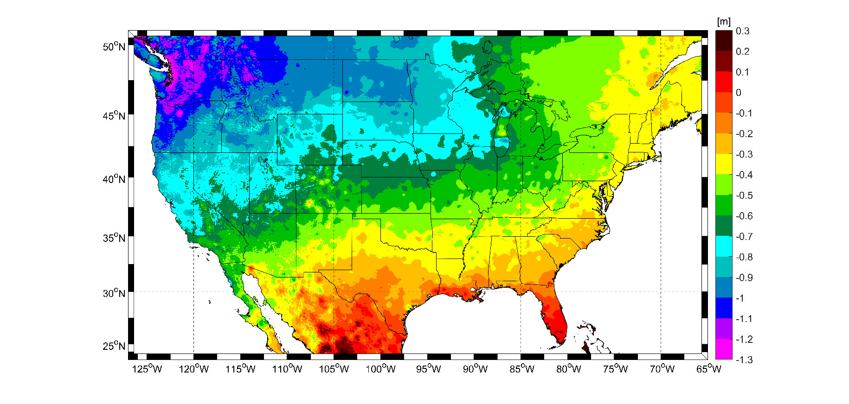
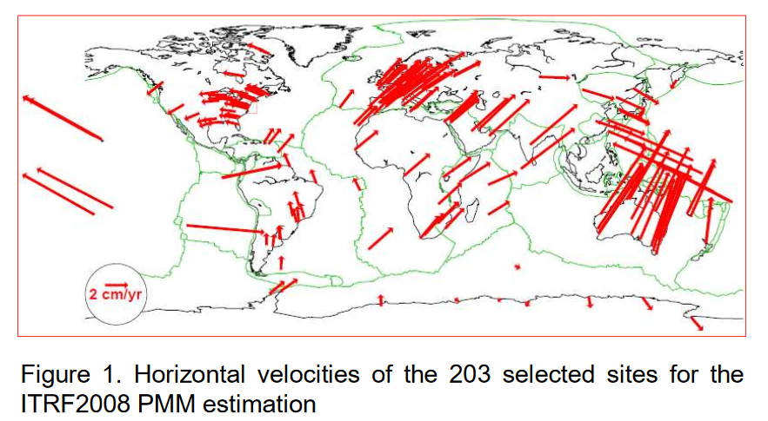
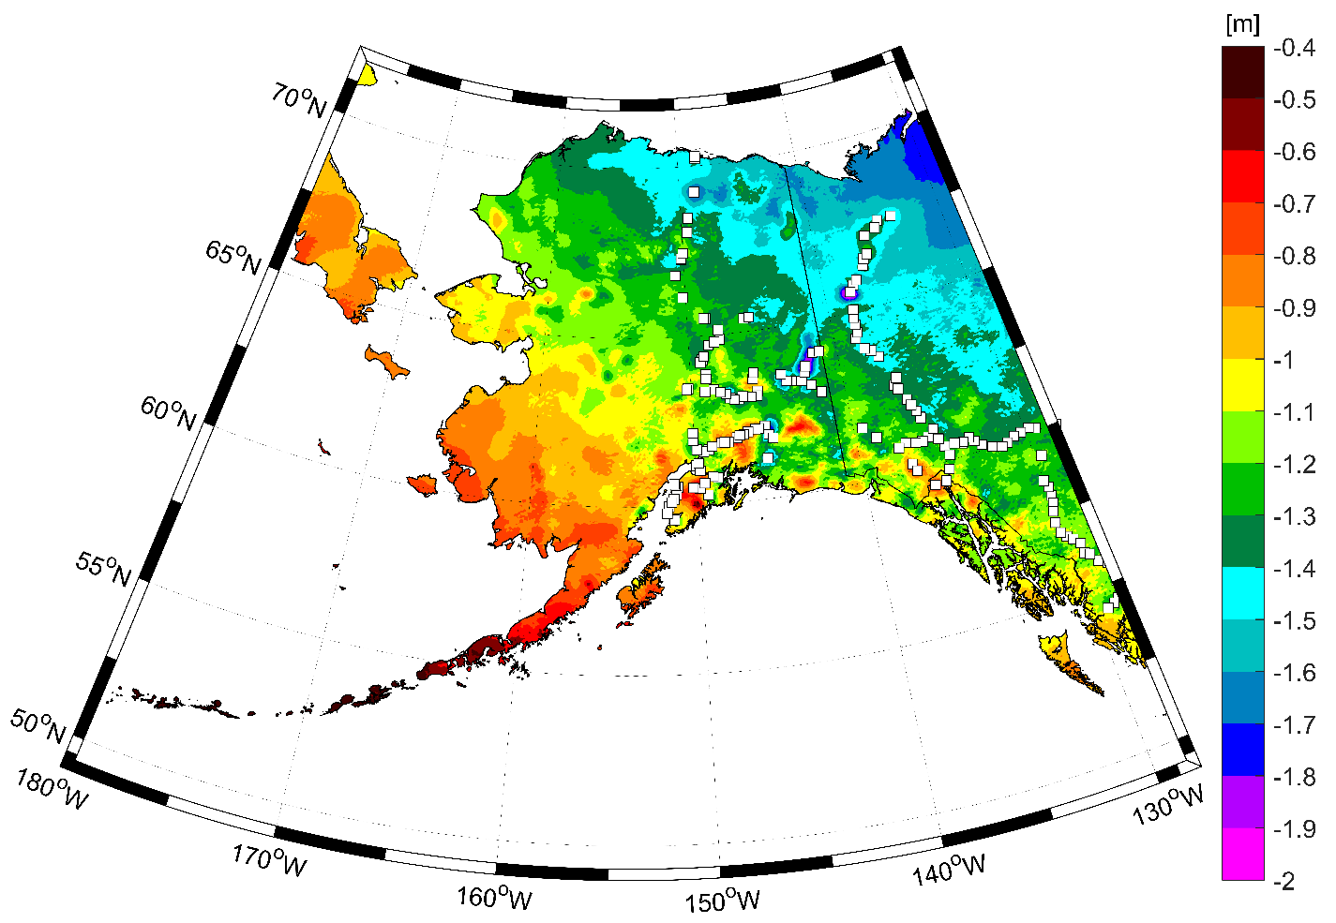
Why Update the US NSRS?
NAD83 issues
NAVD 88 issues

Slide 31
NAPGD2022
Mutual consistency of heights, gravity, etc.
Time dependent coordinates
Geoid definition decoupled from GMSL
Orthometric heights defined by GNSS & geoid heights

Slide 32
Definitional Relationship
H_{NAPGD2022}(t) = h_{ITRF2022}(t) – N_{GEOID2022}(t)
Time-dependencies of ellipsoid heights
come from OPUS, where time-dependent
CORS coordinates serve as control for
your time-dependent GNSS survey.
Time-dependencies of geoid undulations
are captured in the dynamic component
of GEOID2022 (“DGEOID2022”), which
will come from the geoid monitoring
service, or GeMS.

Slide 33
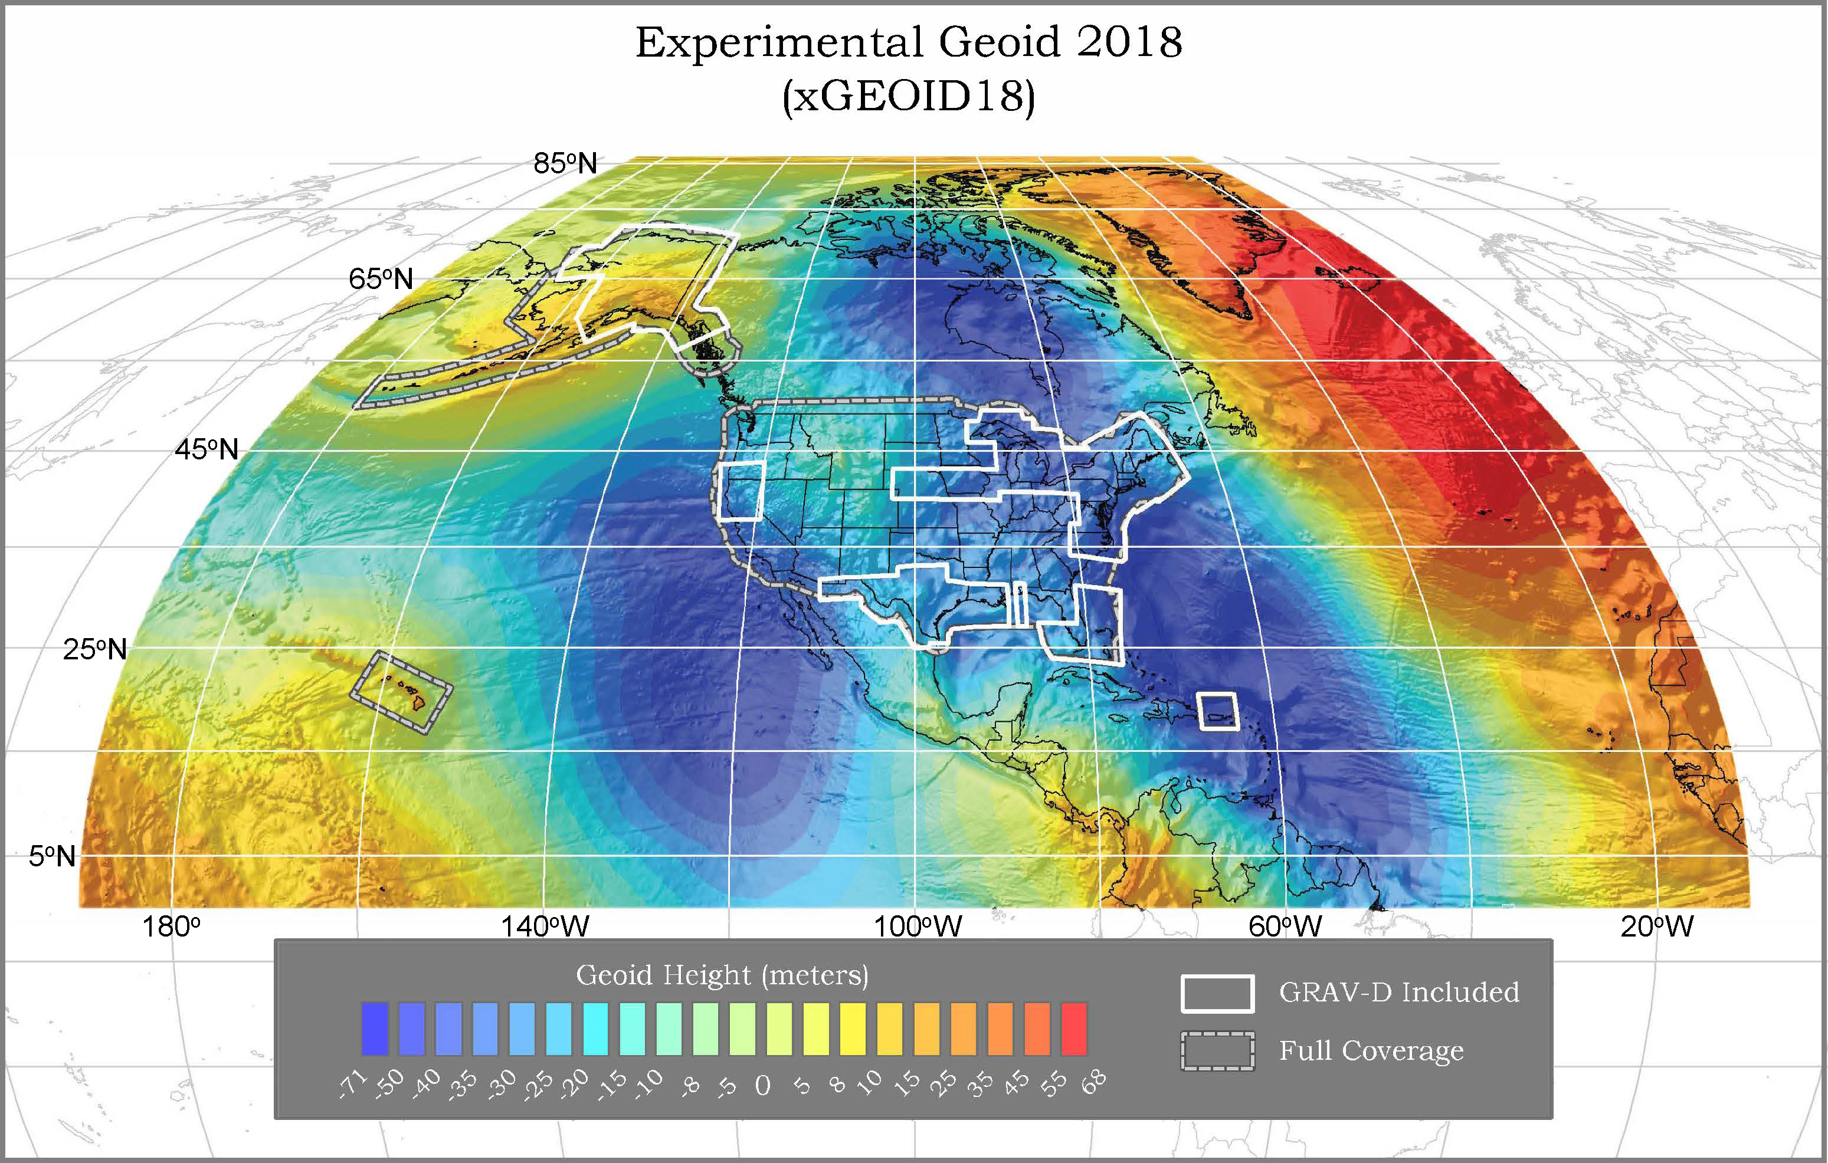
Experimental Geoids
Combining most recent satellite, airborne, and terrestrial gravity data to test methods for 2022
Published annually
Updated with airborne gravity data
Available on the website
Testing methods
Blending techniques
Density
Terrestrial data improvements
https://beta.ngs.noaa.gov/GEOID/xGEOID18/

Slide 34
High resolution products
All will be 1 x 1 arcminute grids
All will cover three finite regions of the globe
All will have a static and dynamic component
Dynamic surface gravity not expected to be ready by 2022
GEOID2022
Official converter of *TRF2022 ellipsoid heights into NAPGD2022 orthometric heights
DEFLEC2022
Surface deflections of the vertical in N/S and E/W
GRAV2022
Surface acceleration of gravity

Slide 35
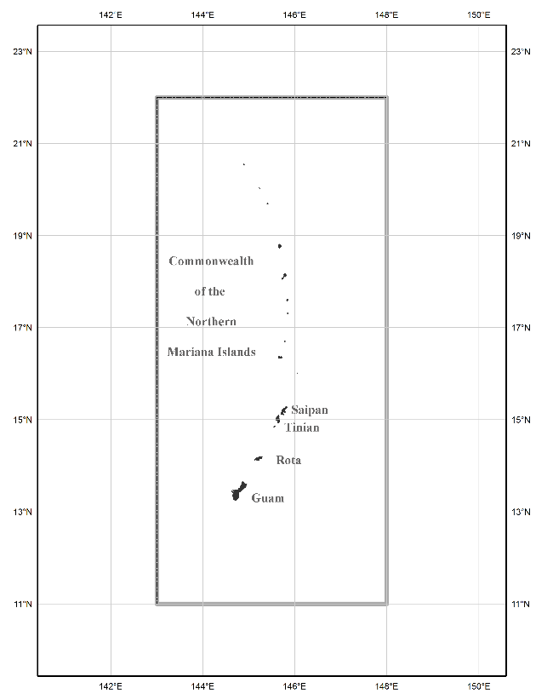
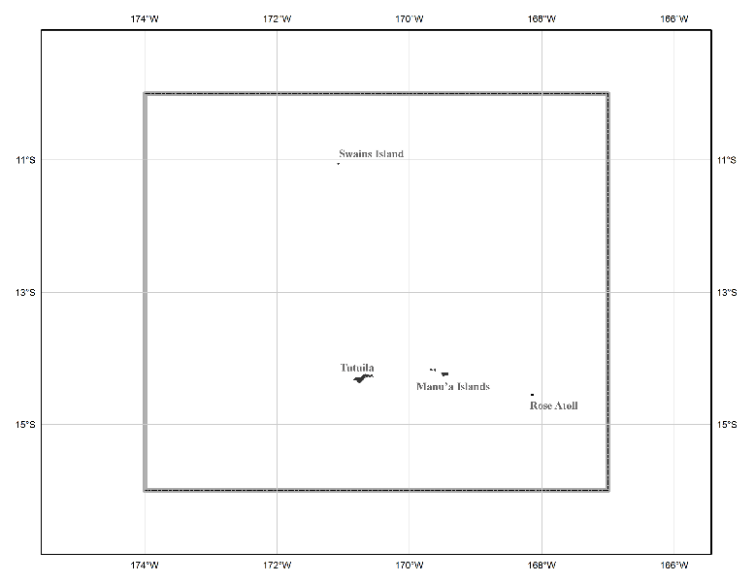
The three gridded regions
North American region
¼ of the Earth
American Samoa region
Guam/CNMI region

