Slide 1



NGS Control Mark Datasheets
Alabama Society of Prof. Land Surveyors
2017 Annual Conference
Pelham, Alabama
October 18, 2017
Denis Riordan, PSM
NOAA, National Geodetic Survey
denis.riordan@noaa.gov

Slide 2
Goal today: To improve understanding of NGS datasheets
Learn alternate ways to obtain datasheets while in the office, or in the field.
Learn about the different sections of datasheets
Learn about important differences in the information that is found in certain sections of the datasheet.

Slide 3
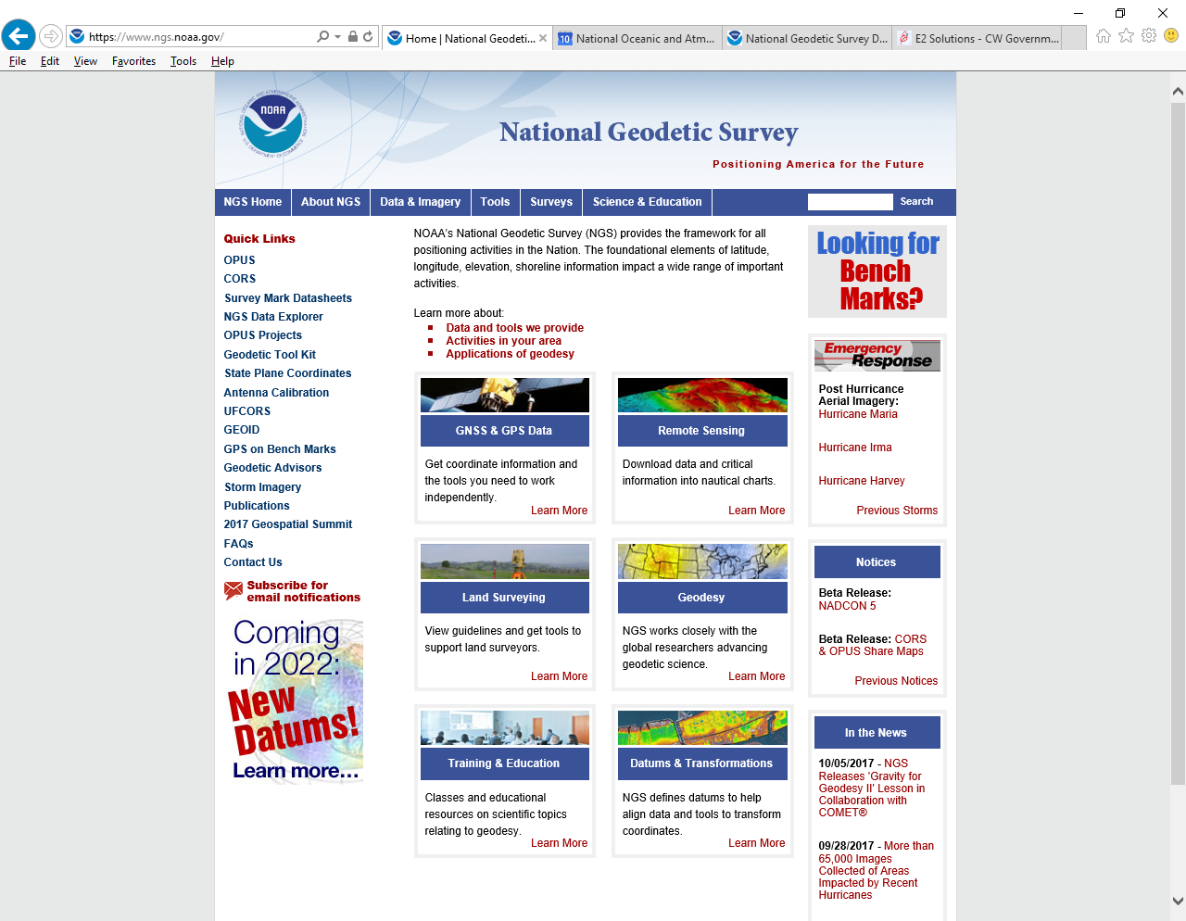
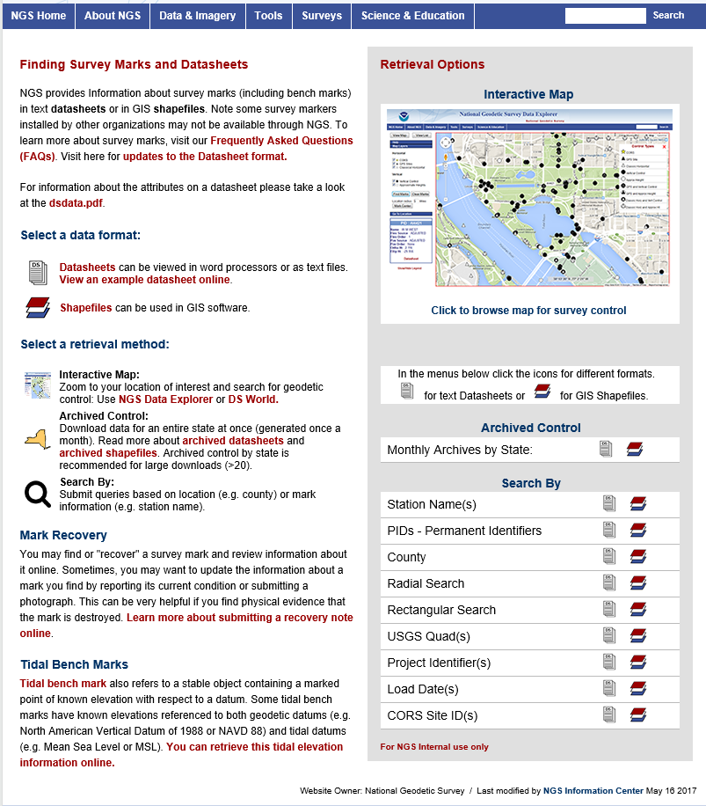
Where to Find NGS datasheets

Slide 4
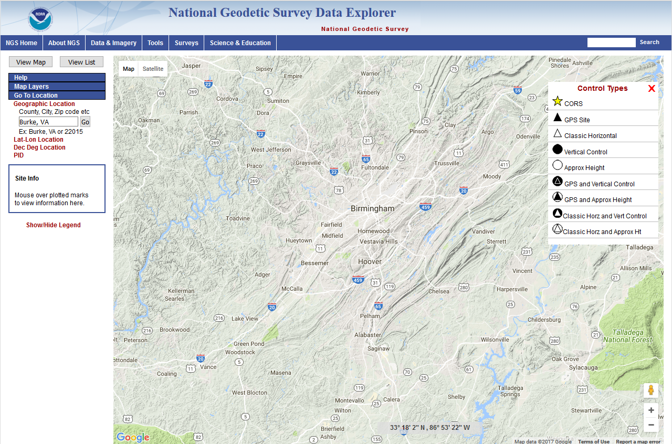
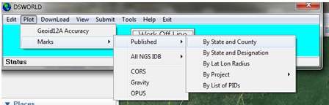
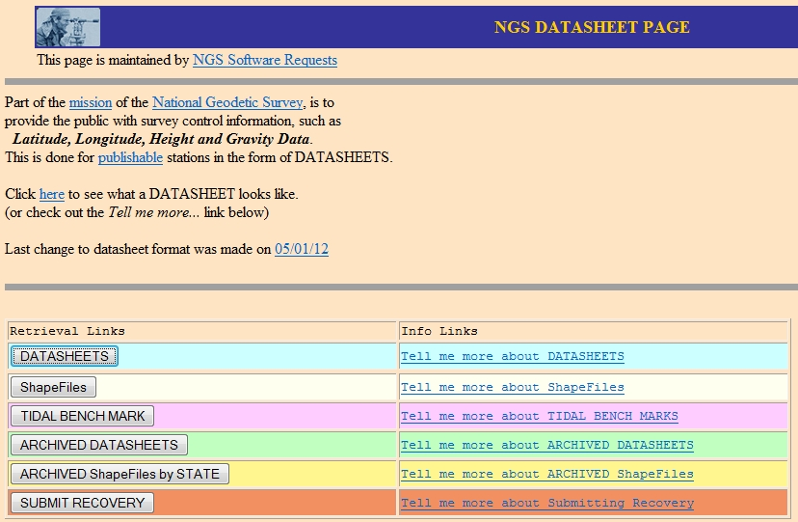
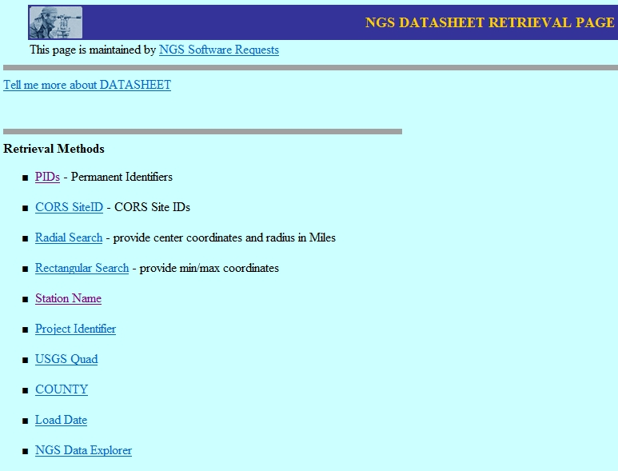
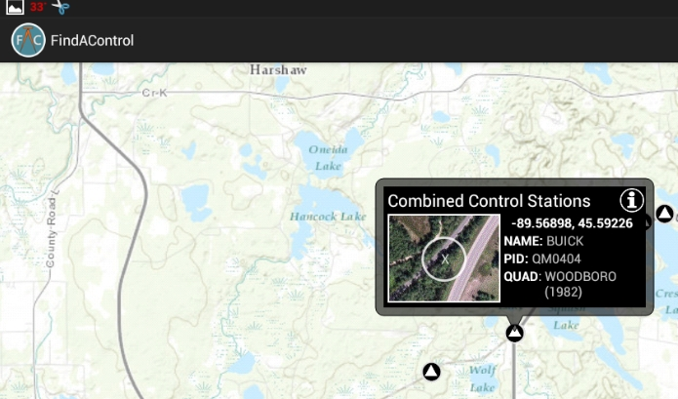
METHODS TO OBTAIN DATASHEETS
“Classical” NGS website retrieval
NGS Data Explorer retrieval
DSWorld software with Google Earth
Smart Phone App - “FindAControl” *
NGS DATA EXPLORER
DSWorld
Find-A-Control
(not an NGS product)
CLASSICAL METHOD

Slide 5
CLASSICAL Retrieval
Useful information
You can also find a Project ID using a PID
Interactive Map Option

Slide 6
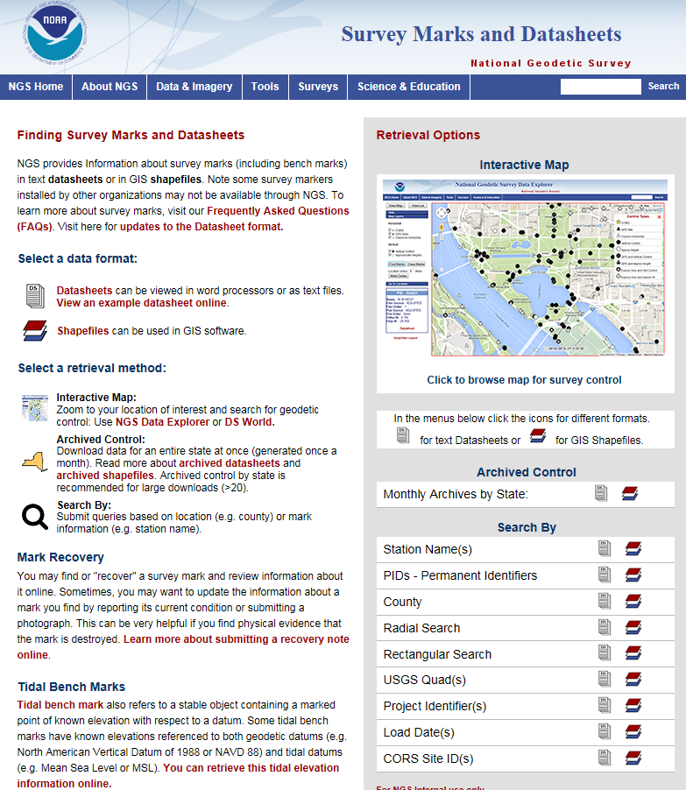
Interactive map method
Statewide datasheet extractions- latest month is available here
Go To “classical method”
“Text format” datasheet retrievals, or…
“Shapefile format” for GIS functionality

Slide 7

NGS Data Explorer

Slide 8
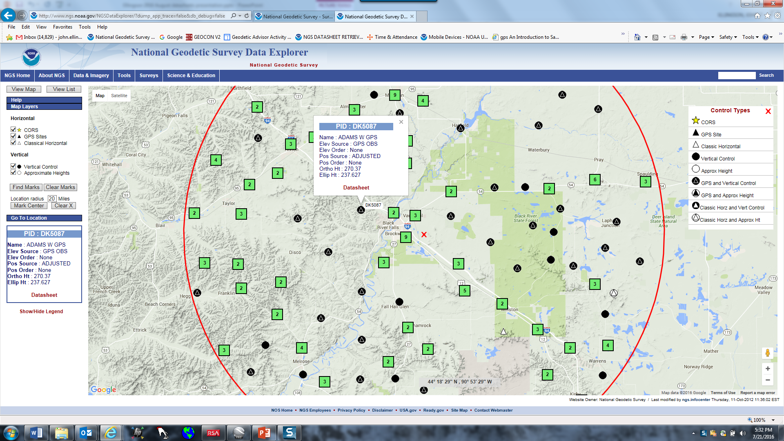
Sample search using NGS “Data Explorer” tool

Slide 9
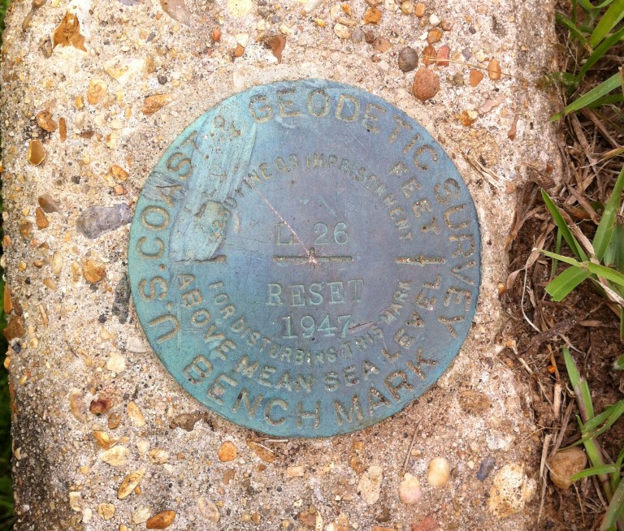
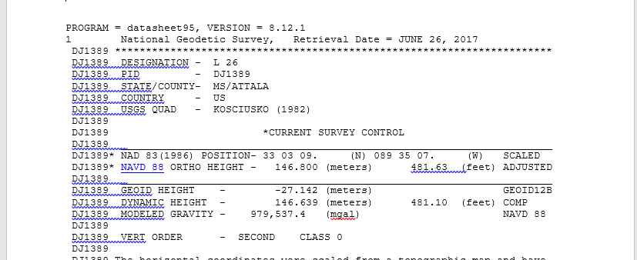
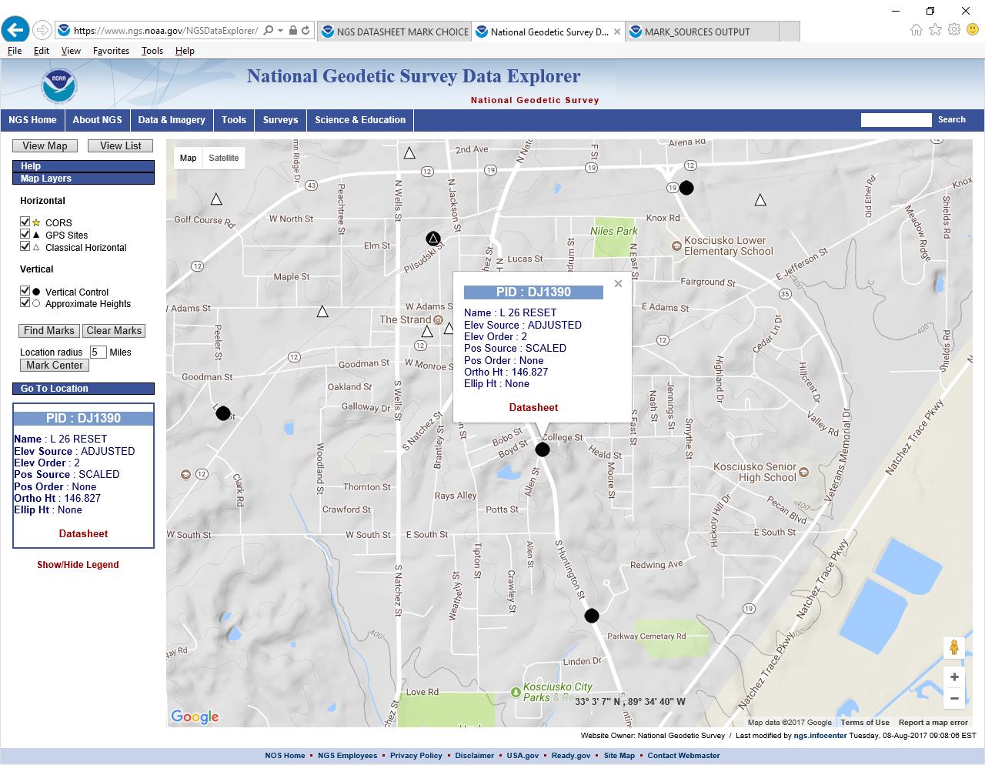
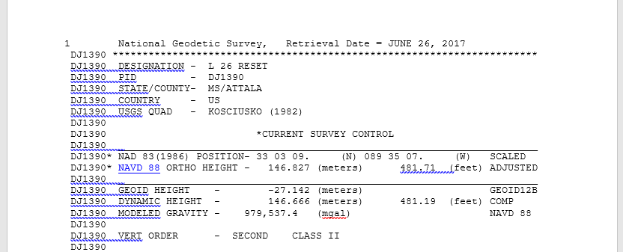
Data Explorer Example of Interest

Slide 10
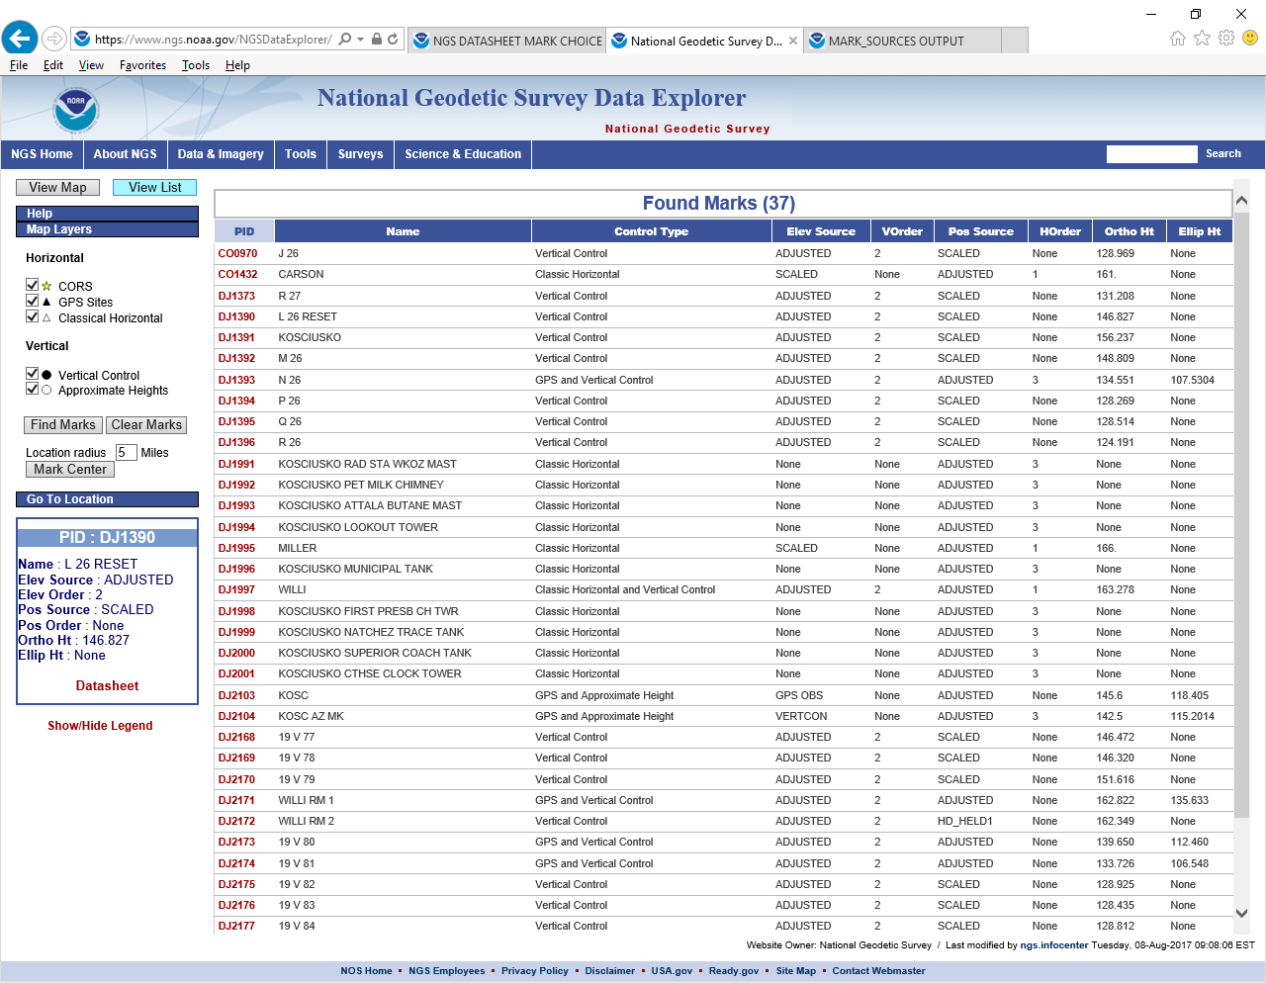
“CAUTION EXAMPLE”
DJ1389

Slide 11
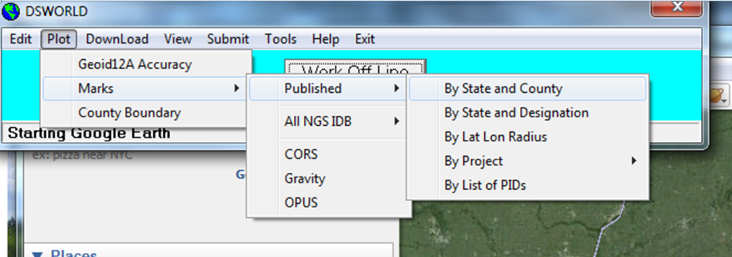
DSWorld Retrievals - software developed by Malcolm Archer-Shee
Download this free program from the NGS website at – http://www.ngs.noaa.gov/PC_PROD/PARTNERS/index.shtml
* Search for DSWorld

Slide 12
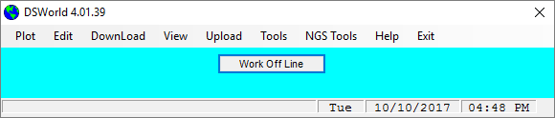
DSWorld - Retrievals
Short Demo of DSWorld program (live).

Slide 13
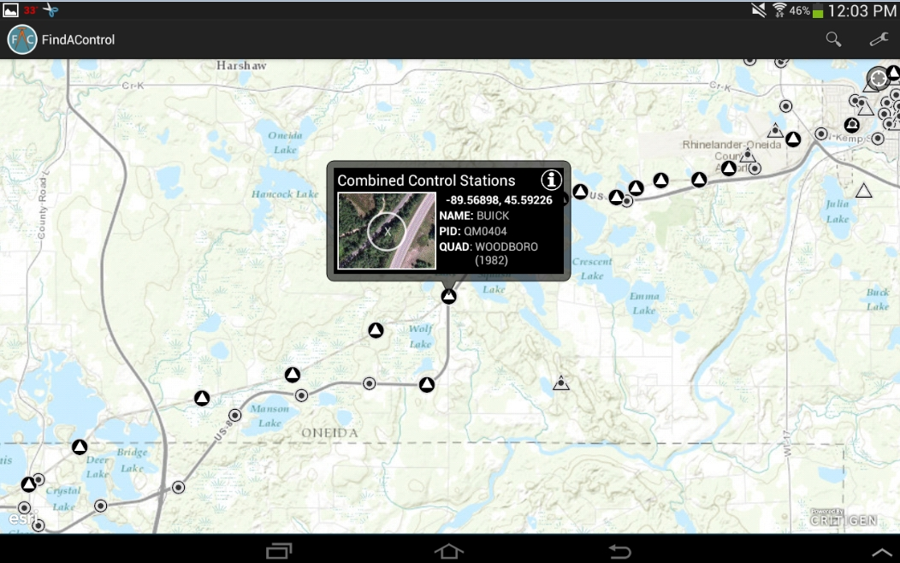
SMART PHONE or TABLET APP --- Find-A-Control
Android and iOS Application - NOT an NGS product

Slide 14
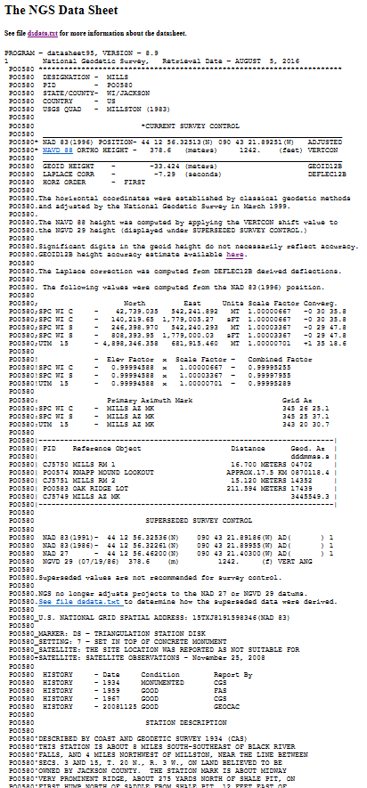
DATASHEET SECTIONS:
Basic Metadata
Current Survey Control
Accuracy
Data Determination Methodology
Projections
Azimuth Marks (old hz marks only)
Superseded Survey Control
U.S. National Grid
Monument Information
History
Description and Recoveries
* Information is pulled from tables and
assembled upon retrieval request.

Slide 15
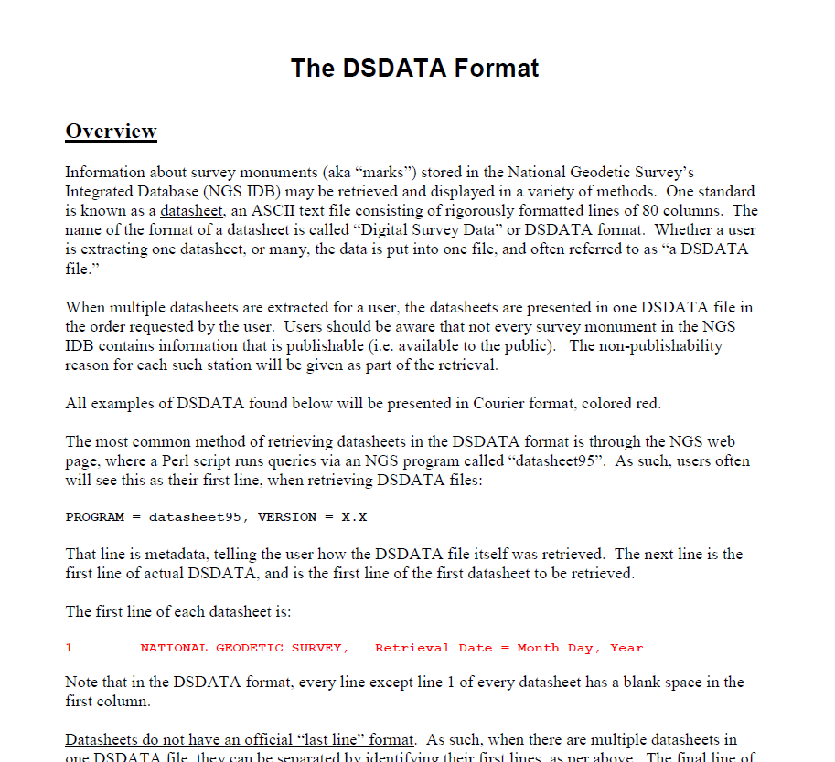
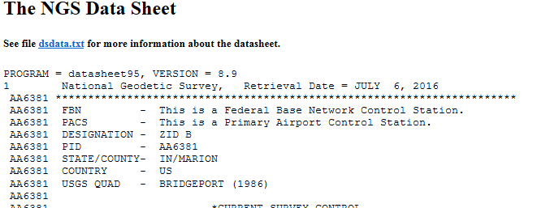
BASIC METADATA SECTION OF EACH DATA SHEET
dsdata.txt is a guide to understanding datasheet info
VERSION # matters to some vendor software programs
THE “PID”….. IT IS IMPORTANT

Slide 16
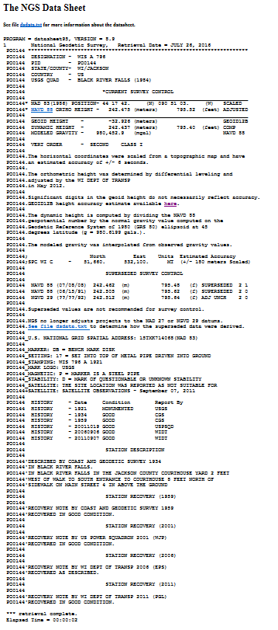
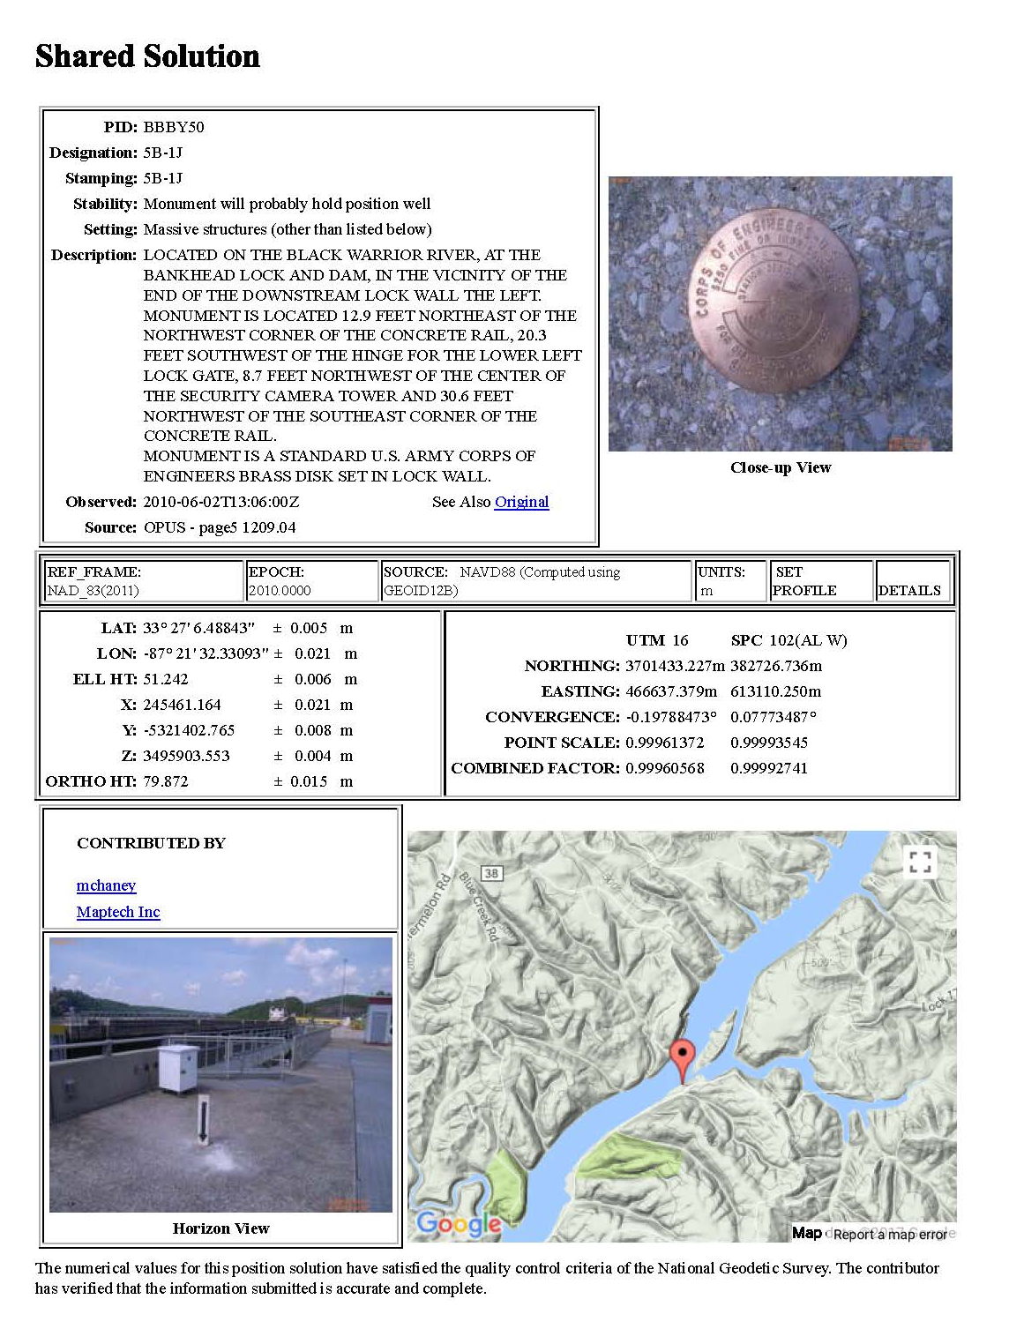
OPUS “SHARE” DATASHEET
CLASSICAL DATASHEET FROM NGS “INTEGRATED DATABASE” (IDB).

Slide 17
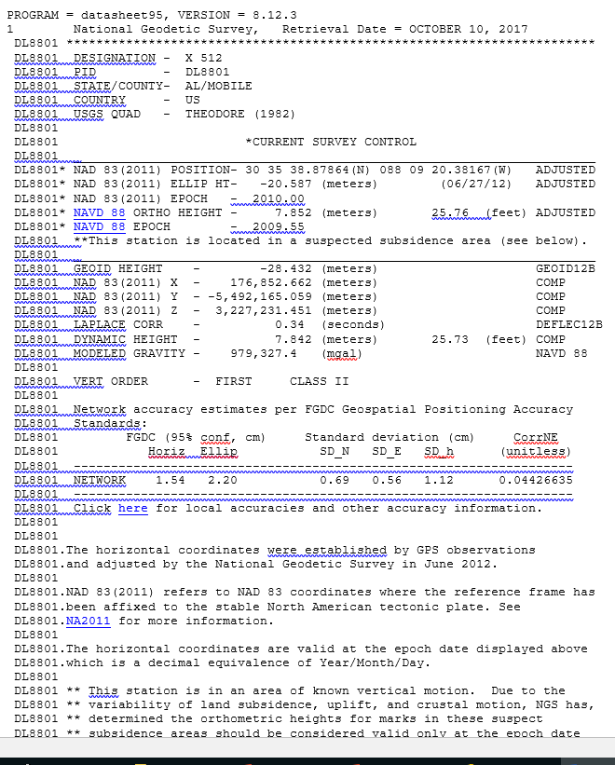
PIDs – IDB vs OPUS Database
DL8801 - PID from NGS IDB
BBBY50 - PID from OPUS Database

Slide 18
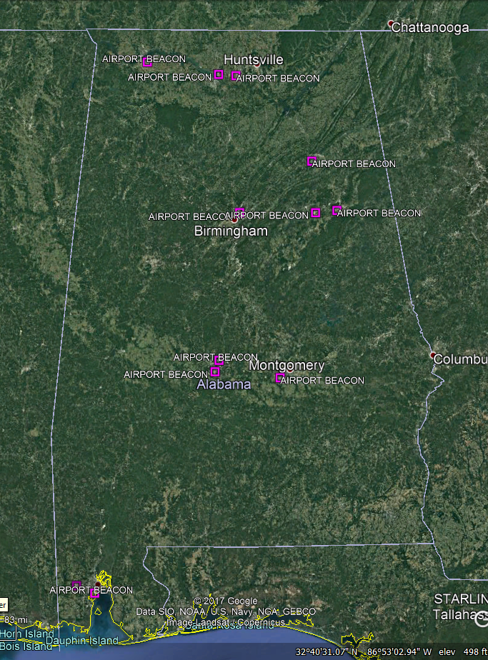
Why is the “PID” important?
The PID is the key to the NGS database which contains more than 1.5 million marks
Twelve stations are named “AIRPORT BEACON” in Alabama
Each one has a unique PERMANENT IDENTIFIER (six character PID)

Slide 19
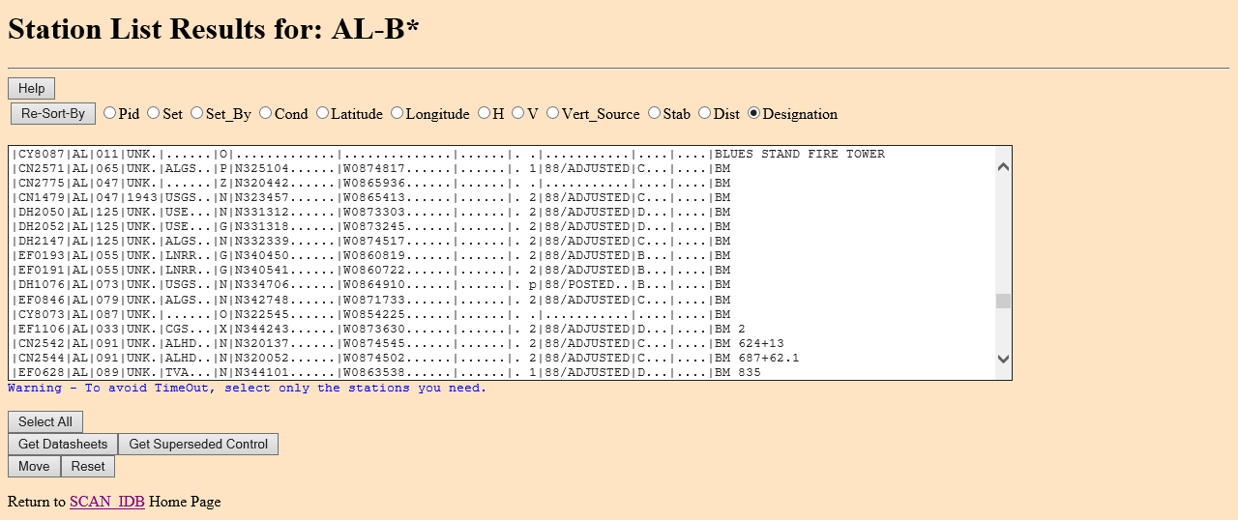
Name Search for AL Found
3 - A
3 - ADAMS
12 - AIRPORT BEACON
2 - ALLISON
3 - AP STA A
- ARP
- BM

Slide 20
BASIC METADATA SECTION OF EACH DATA SHEET
dsdata.txt is a guide to understanding datasheet info
VERSION # matters to some vendor software programs
THE “PID”….. IT IS IMPORTANT

Slide 21
Three Primary Types of “MODERN” Geodetic Marks:
Leveled only
GPS-Observed only
Leveled and GPS-Observed on same mark
NOTE: there are many old triangulation stations that still exist in the NGS database…. CAUTION: avoid mixing old triangulation data with modern GPS-surveyed marks, unless updated by GNSS observations

Slide 22
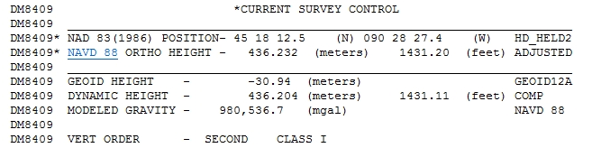

Published “CURRENT SURVEY CONTROL” for a LEVELED-ONLY mark. (NOT GPS observed)
Note Handheld GPS Pos.
Note Position
SCALED from Topo map
Another Vertical Mark Example

Slide 23
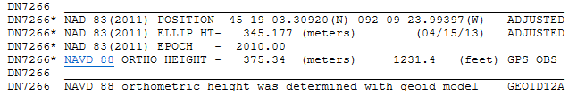
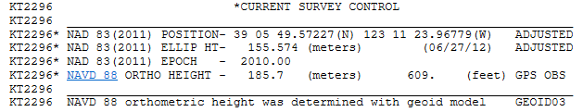
This mark was observed only with GPS (it WAS NOT leveled) -
published height was GPS derived using Geoid model
This mark is also…. GPS-Only

Slide 24
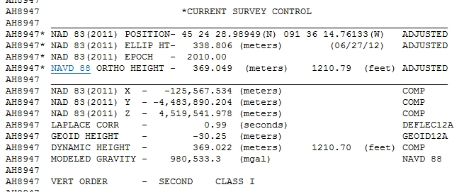
This mark WAS observed with GPS, and it WAS separately leveled
15 vertical
source options
Sources: ADJUSTED, ADJ_UNCH, POSTED, READJUST, N_HEIGHT, RESET, COMPUTED, GPSCONLV, LEVELING, H_LEVEL, GPS_OBS, VERT_ANG, SCALED, U_HEIGHT, VERTCON
Each type is explained in the “dsdata.txt” document

Slide 25
“…CONTROL” Section continued
Cartesian
Coordinates
Laplace Correction - combined with astronomic azimuth, yields the geodetic azimuth
Geoid Height -separation between Geoid and the reference ellipsoid (negative in CONUS)
Dynamic Height -geopotential value at the mark (NOT an orthometric height).
Modeled Gravity – interpolated from observed gravity values
Vertical Order Will be 2nd order (or better). NGS does not accept 3rd order, except on “Resets”
* HEIGHTS ARE SEPARATELY DETERMINED, NOT COMPUTED.

Slide 26
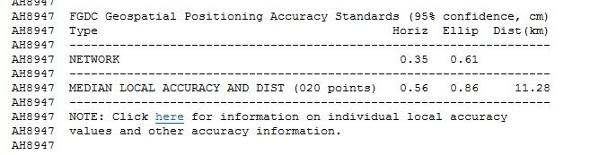
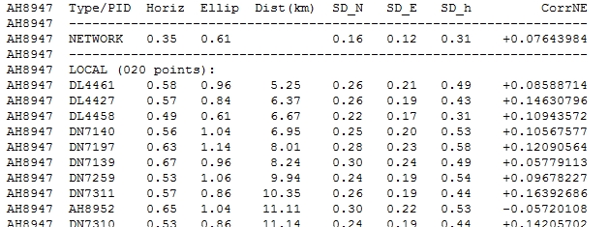
ACCURACY STANDARDS SECTION
(replaces Hz Order & Class for marks)
Clicking on the “here” link generates the following table
Local Accuracies

Slide 27
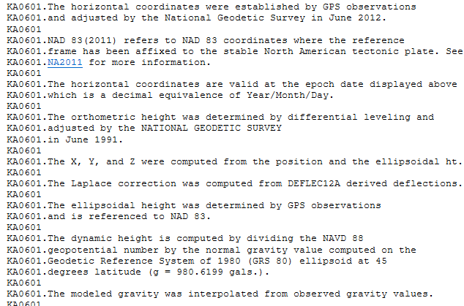
THE NEXT SECTION EXPLAINS HOW THE PUBLISHED VALUES WERE DETERMINED

Slide 28
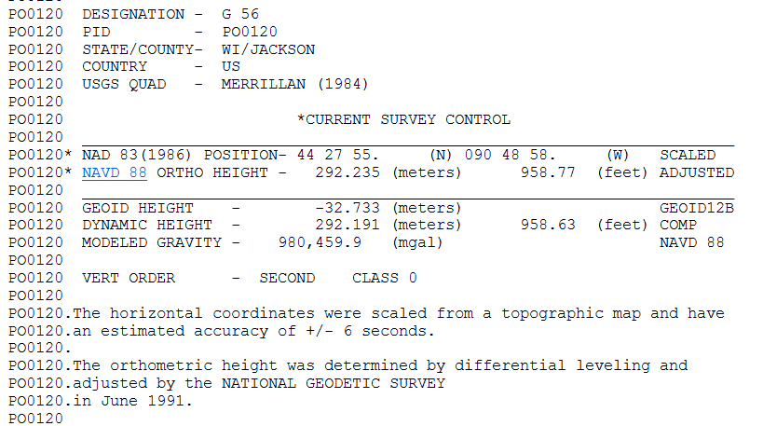
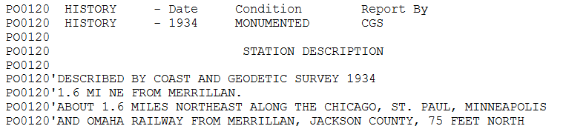
Caution: don’t overlook the age of the observations
Adjusted
in 1991
(re-adjusted)
Leveled
in ~1934

Slide 29
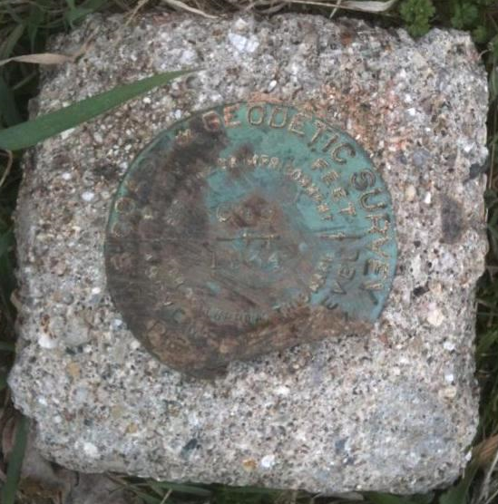

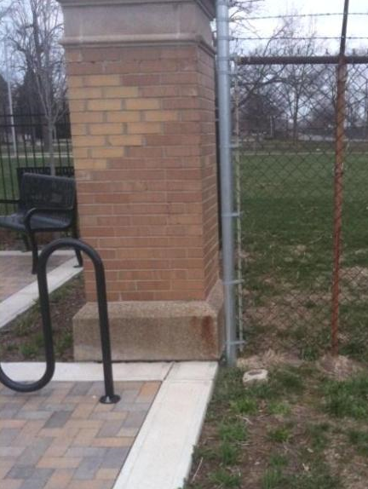
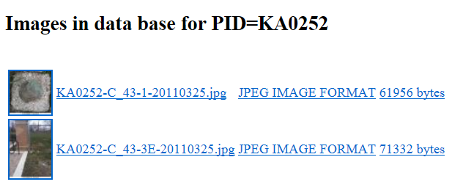
PHOTOGRAPH SECTION

Slide 30
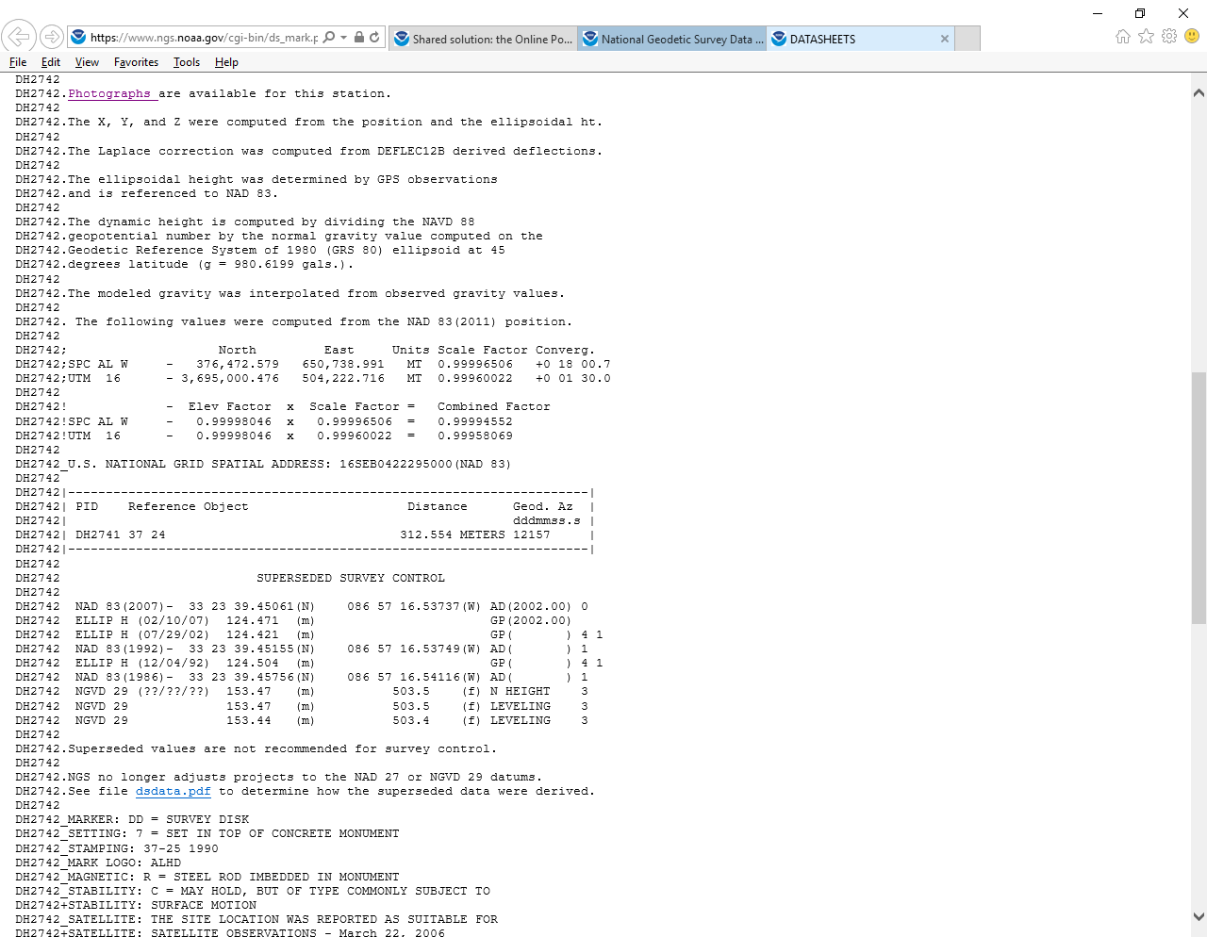
SECTION PROVIDING STATE PLANE and
UTM COORDINATES

Slide 31
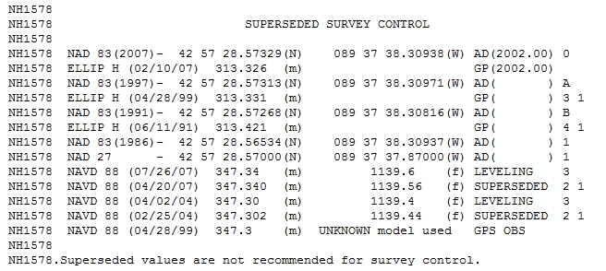
SECTION SHOWING SUPERSEDED VALUES
*
*
*
*

Slide 32
SECTION PROVIDING THE MARK’S
NATIONAL GRID ADDRESS
U. S. National Grid (USNG) system is a FGDC standard, developed to improve public safety and commerce.
http://www.fgdc.gov/usng

Slide 33
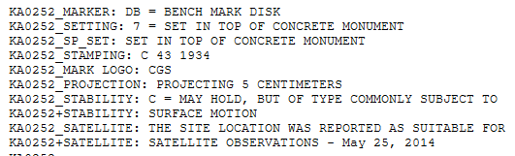
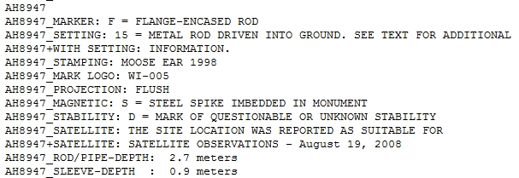
Mark Description Section - Two examples
(Coast and Geodetic Survey disk)
(set by Barron Co. WI )

Slide 34
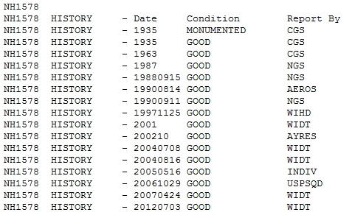
SECTION SHOWING THE MARK’S
“SETTING AND RECOVERY HISTORY”

Slide 35
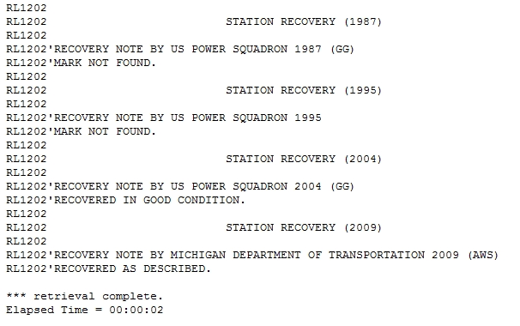
STATION RECOVERY NOTES - BE AWARE THAT RECOVERY NOTES CAN SOMETIMES BE MISLEADING!
Mark originally set by NGS (CGS) in 1948
17 YEARS LATER

Slide 36
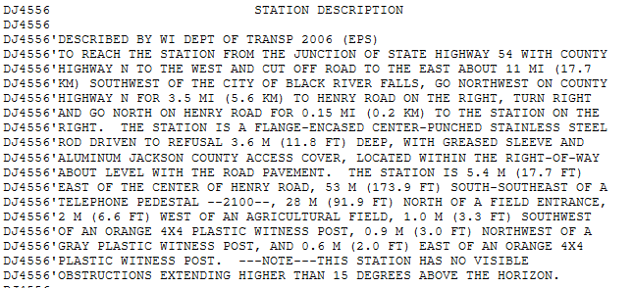
SECTION OF THE DATASHEET SHOWING THE STATION DESCRIPTION … (TO-REACH and TIES)
To-Reach Info
Ties

Slide 37

FINALLY,
WATCH FOR NOTIFICATION THAT YOUR DATASHEET(S) EXTRACTION IS COMPLETE
If you do not see this message at the end, you did not get all of the datasheets that you requested.

Slide 38
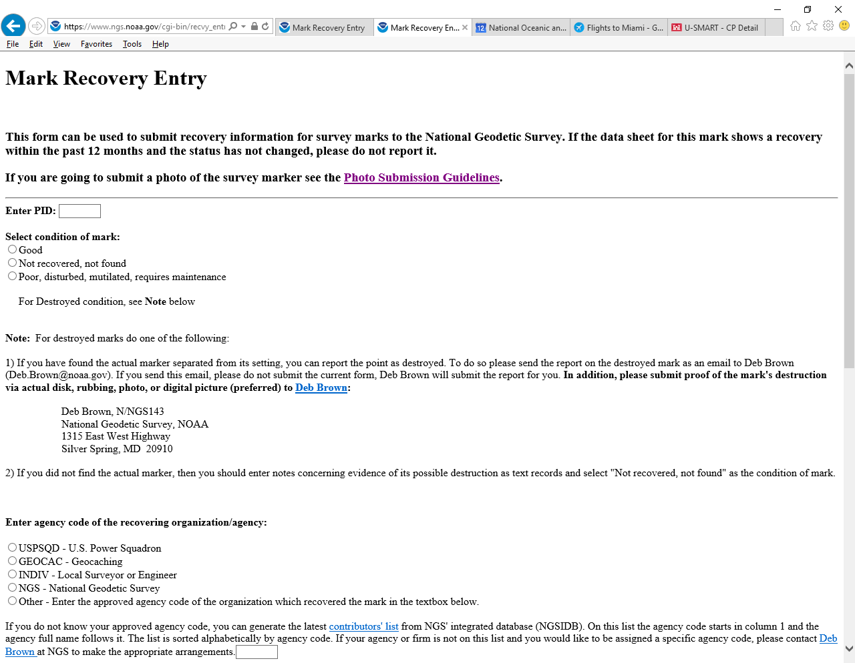
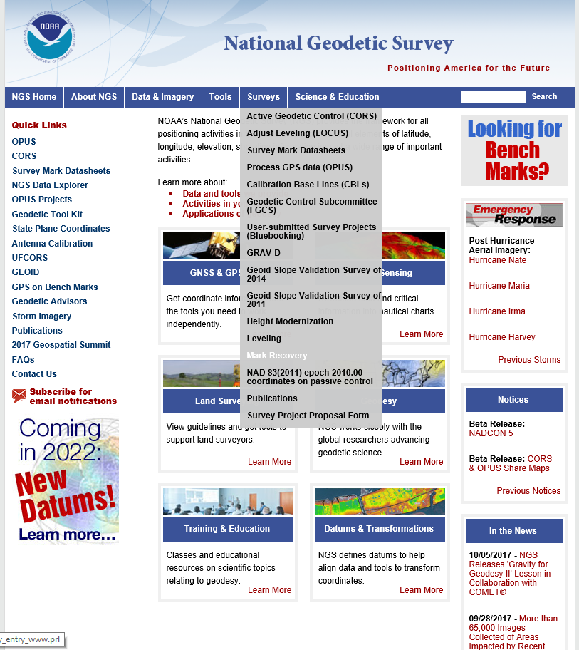
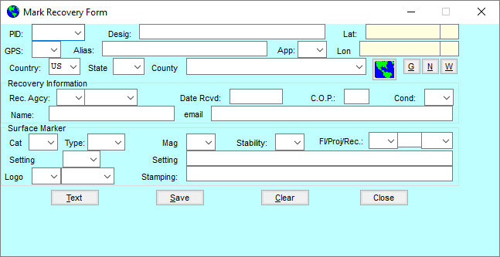
Ever searched for a mark that wasn’t there?
STATION RECOVERY NOTES.

Slide 39
STATION RECOVERY NOTES
Recovery Note Terms
Good - Mark is in good shape and has no issues to note.
Poor - Mark has issues. Can be disk has scars (mutilated),
overall monument leaning, guardrail place above
mark, etc.
Destroyed - Mark will only be listed as “destroyed” when
evidence is submitted to validate mark is
gone.
- Take pictures as evidence

Slide 40

? ? QUESTIONS ? ?

