Slide 1


National Geodetic Survey
Highlights
William Stone
NGS Southwest Region (UT, NV, AZ, NM) Geodetic Advisor
NOAA’s National Geodetic Survey
geodesy.noaa.gov
william.stone@noaa.gov
505-277-3622 x252
APLS Conference
April 28, 2012
Tempe, AZ

Slide 2
Today’s Topics
Continuously Operating Reference Stations (CORS)
Multi-Year CORS Solution (new CORS network coords)
NAD83 (2011) epoch 2010.00 (new passive network coords)
Online Positioning User Service (OPUS)
NGS Ten-Year Plan (new datums)
Geoid Slope Validation Study 2011
DSWorld, Datasheet changes, Real-time Networks, etc.
Notes:
This is a listing of the parts of subject matters to be covered. Cut out entire chapters if they are unimportant to your audience.

Slide 3
U.S. Department of Commerce National Oceanic & Atmospheric Administration National Geodetic Survey
Mission: To define, maintain & provide access to the
National Spatial Reference System (NSRS)
to meet our Nation’s economic, social & environmental needs
National Spatial Reference System
& their time variations
Latitude
Longitude
Height
Scale
Gravity
Orientation
Notes:
- NSRS benefit to the nation = $2.5B/year
est. 300K precision GPS users worldwide (2008); ¼ in US
- Very exciting to us at NGS to see how it has evolved over the years – now cm-accuracy capability / tracking with time

Slide 4
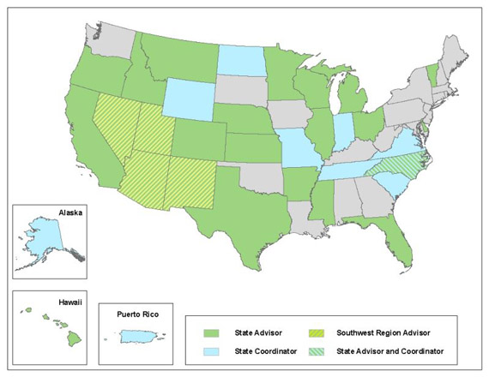
NGS Geodetic Advisors
SW Region
(AZ,NV,NM,UT)
Bill Stone
Colorado
Pam Fromhertz
Idaho/Montana
Curt Smith
California
Marti Ikehara
Geodetic Advisor Contact Info: http://geodesy.noaa.gov/ADVISORS/AdvisorsIndex.shtml

Slide 5
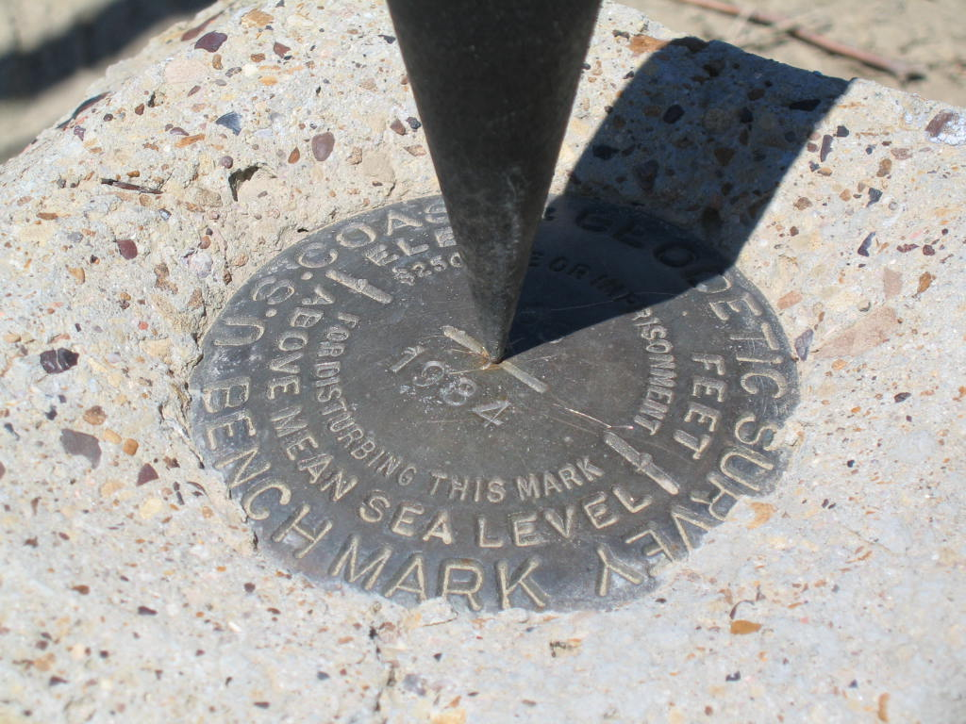
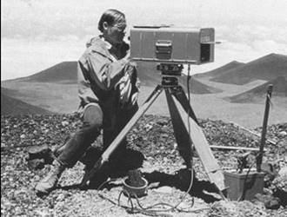
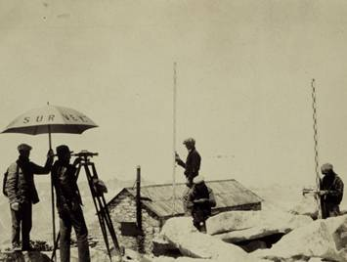
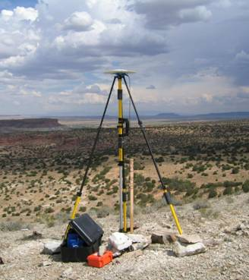
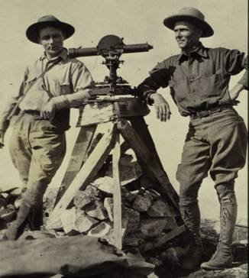
36 33 42.15986 N / 105 12 15.67754 W
1855.973 m
NAD83(2007) / NAVD88

Slide 6
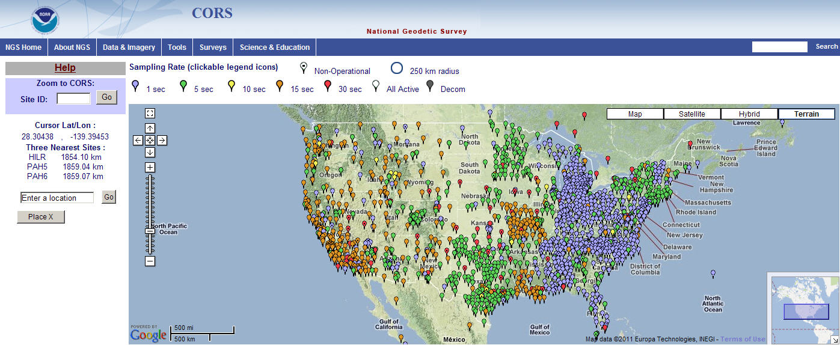
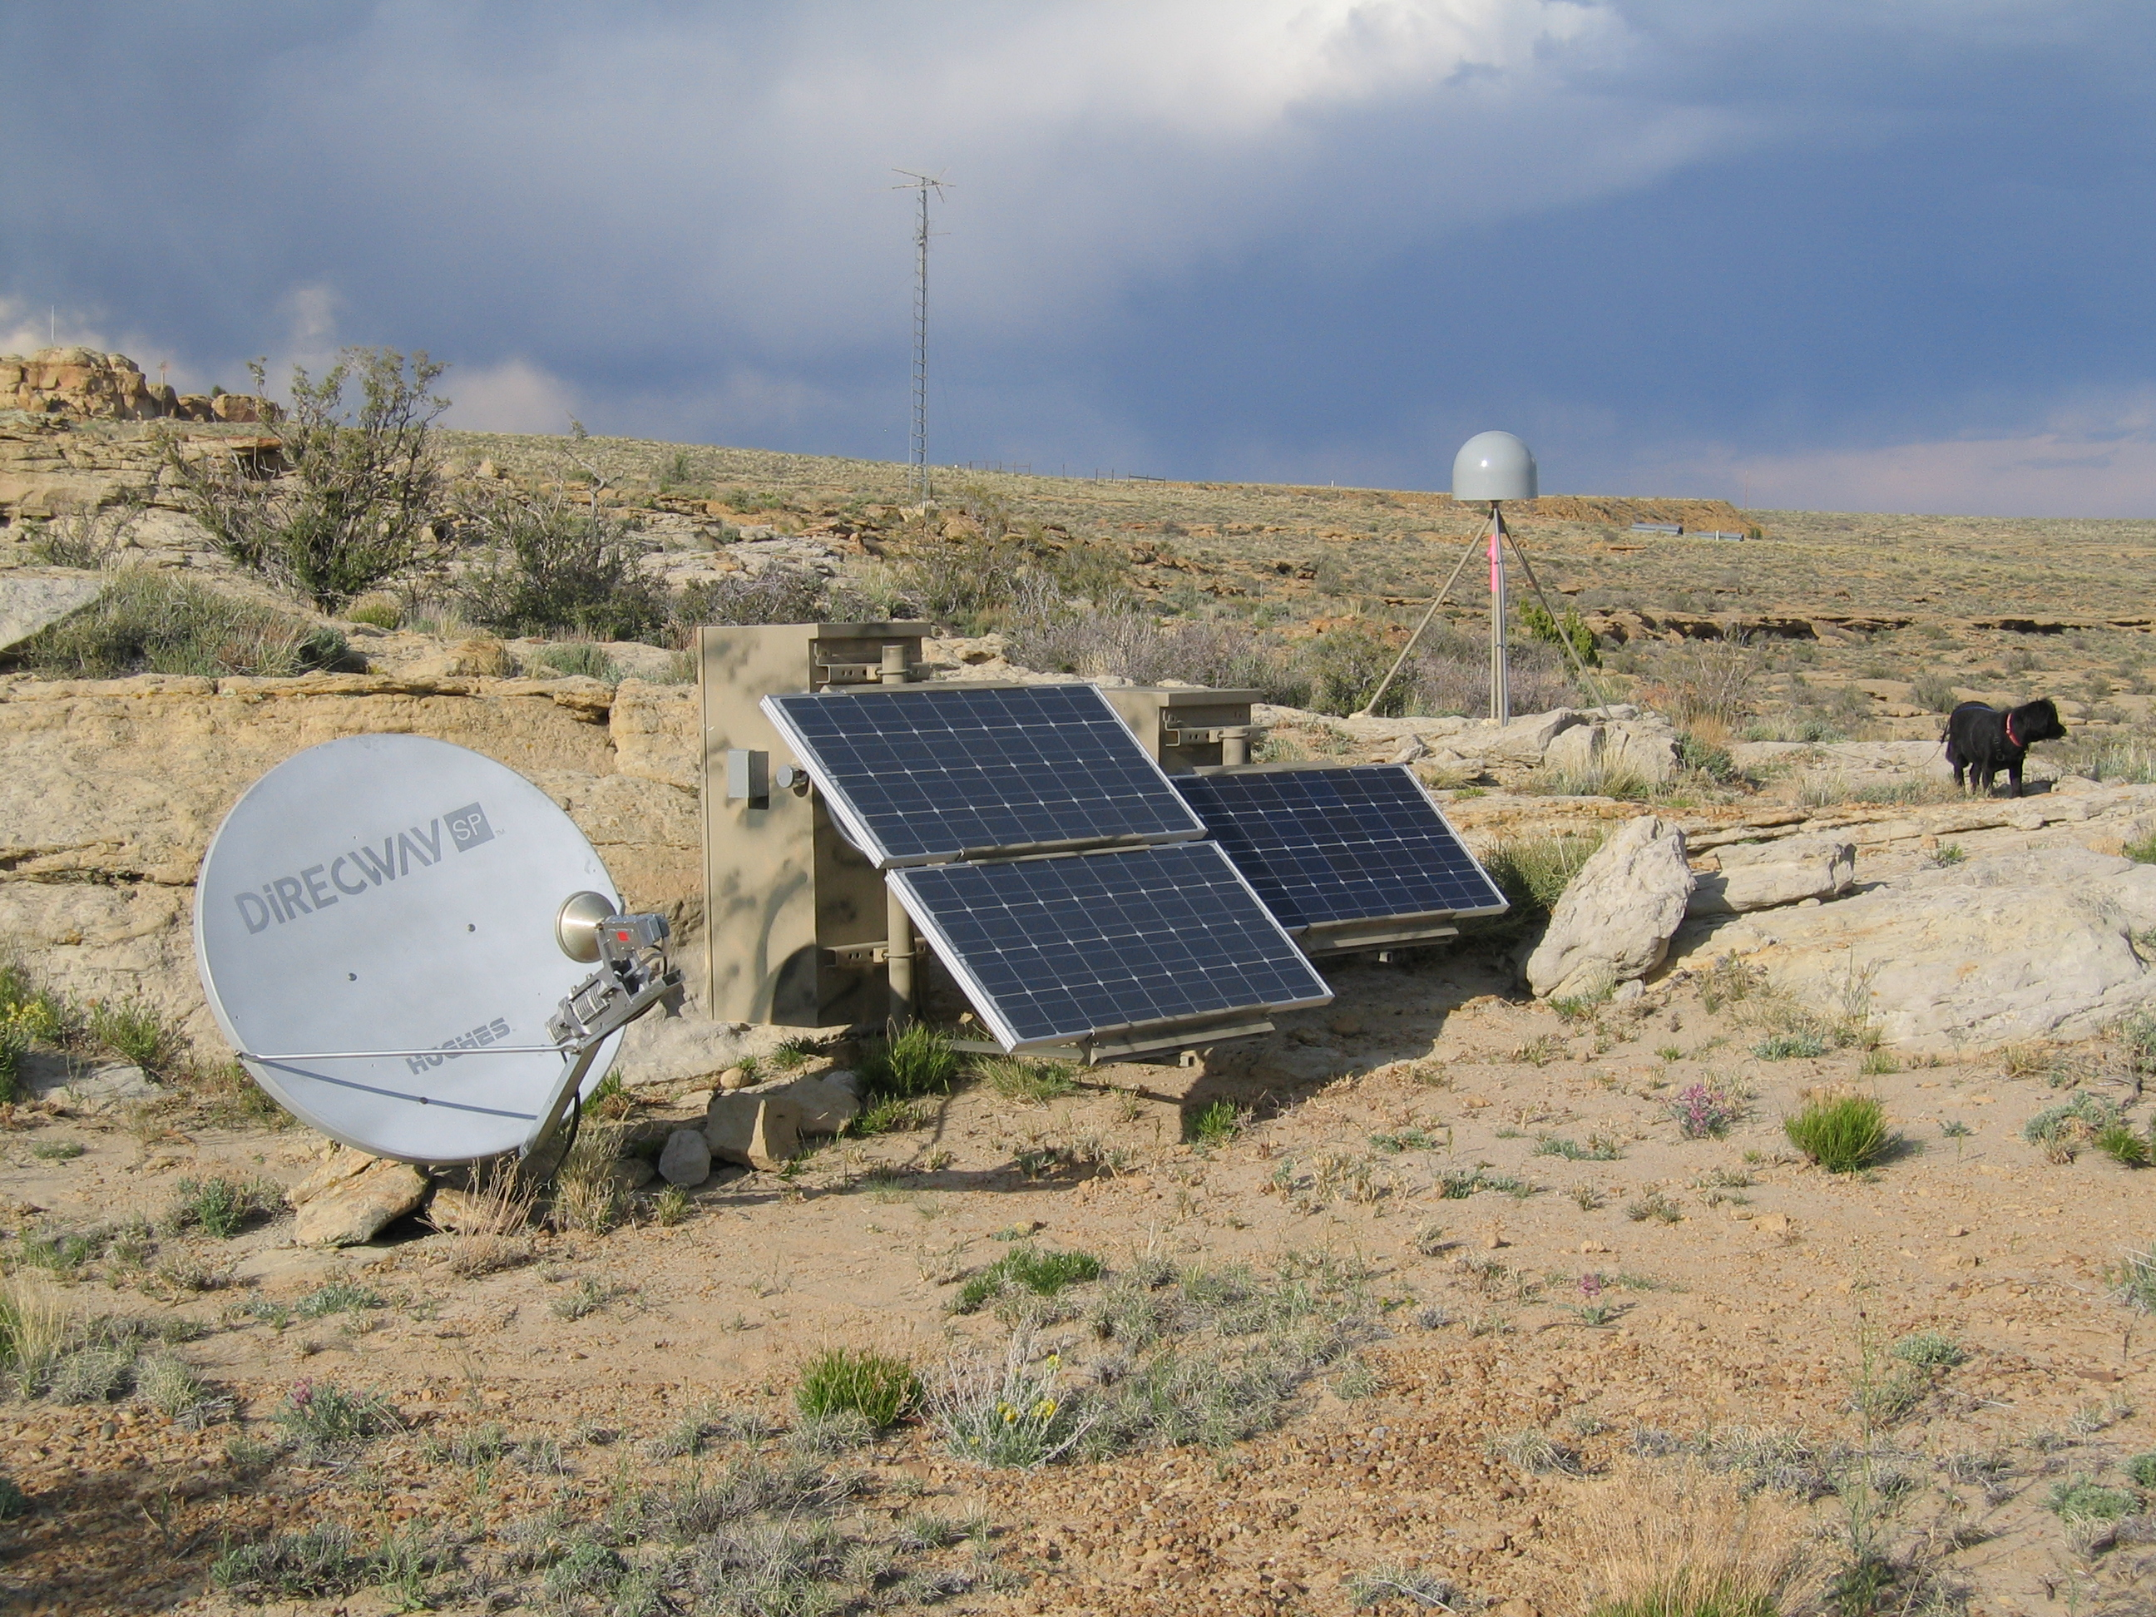
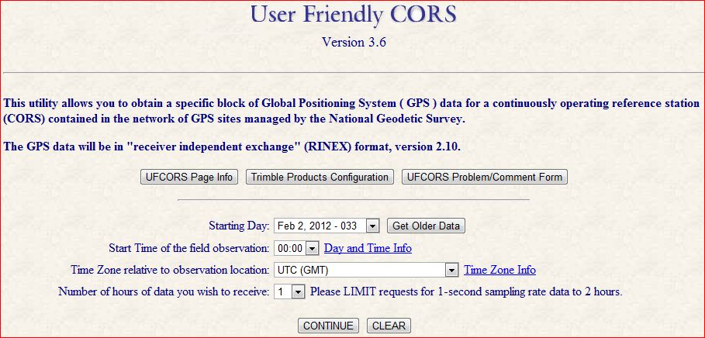
Continuously Operating Reference Stations (CORS)
1750+ GPS/GNSS Stations
200 organizations

Slide 7
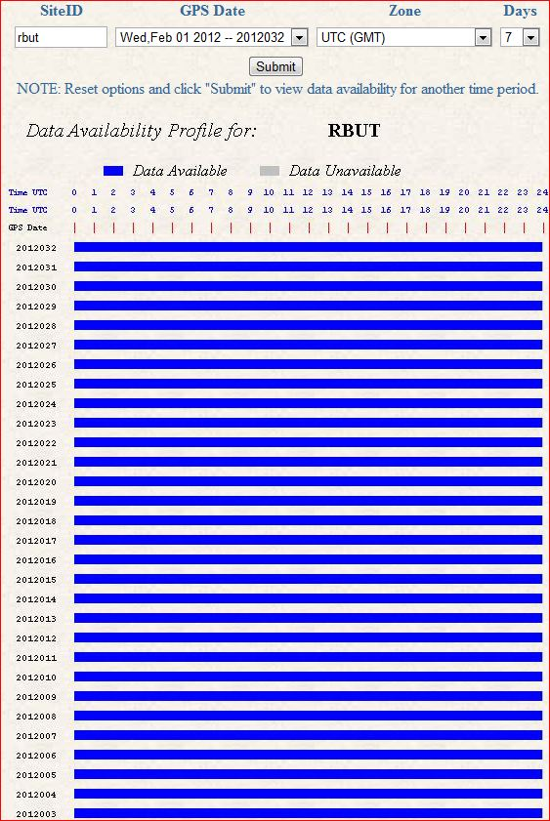
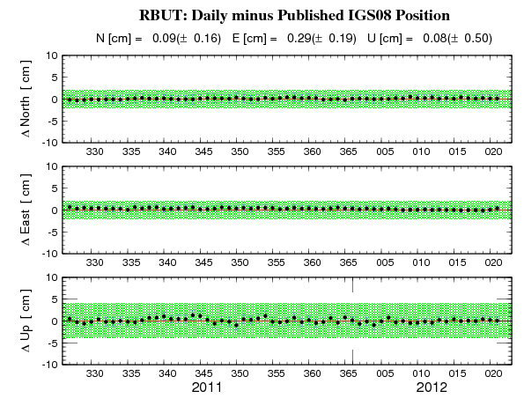
Red Butte, UT (RBUT) CORS Plots
Data Availability
60-day Time Series

Slide 8

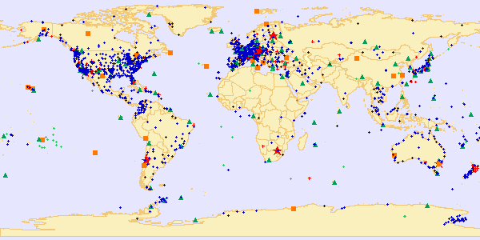
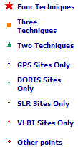
International Terrestrial Reference Frame (ITRF)
space-based techniques: VLBI, DORIS, SLR, GNSS
Current version: ITRF2008 (epoch 2005.0)
International Earth Rotation and Reference System Service(IERS) (http://www.iers.org)

Slide 9
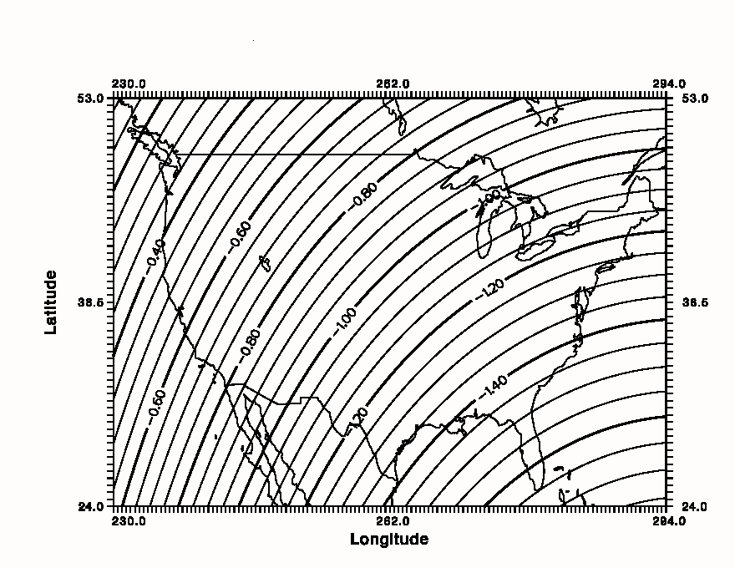
Simplified Concept of NAD 83 vs. ITRF
In Southwest US - NAD83 & ITRF
differ by
ABOUT 1 meter H & V
h_{NAD83}
h_{ITRF}
Earth’s
Surface
ITRF 00
Origin
2.2 meters
Ellipsoid for both NAD83 and ITRF:
Geodetic Reference System 1980 (GRS80)
a = 6,378,137.000 meters (semi-major axis)
1/f = 298.25722210088 (flattening)
NAD 83
Origin
WGS84 (G1150) ~ ITRF2000
Notes:
ITRF (International Terrestrial Reference Frame) just has an origin; take NAD83 shaped ellipsoid centered at the ITRF origin to derive ITRF97 ellipsoid heights.
Ellipsoid heights NAD83 vs. ITRF97 - Defined origins are best estimate of the center of mass; NAD83 is not geocentric. Move origin; move ellipsoid surface as illustrated.
Ellipsoid height differences reflect the non-geocentricity of NAD83.

Slide 10
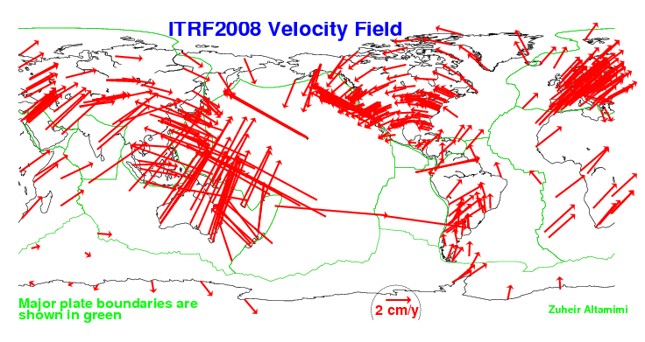
Global Velocity Field - ITRF2008

Slide 11
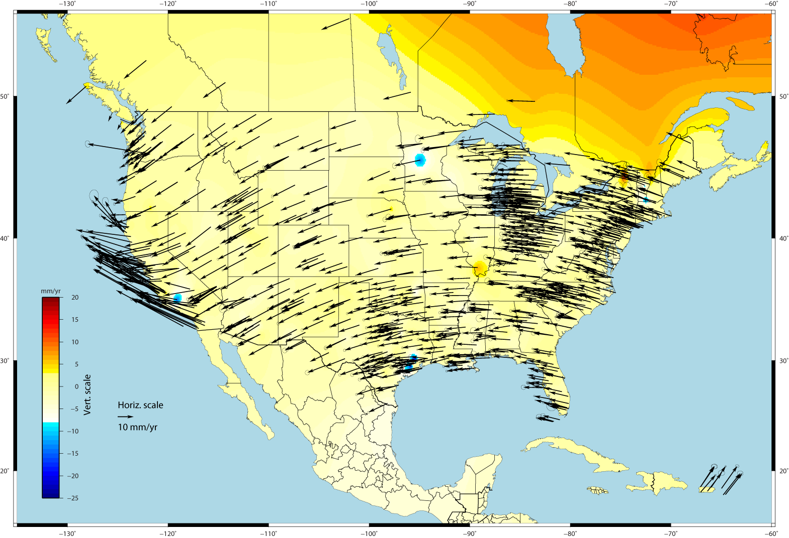
U.S. CORS Velocity Field – ITRF2008 (IGS08 epoch 2005.0)

Slide 12
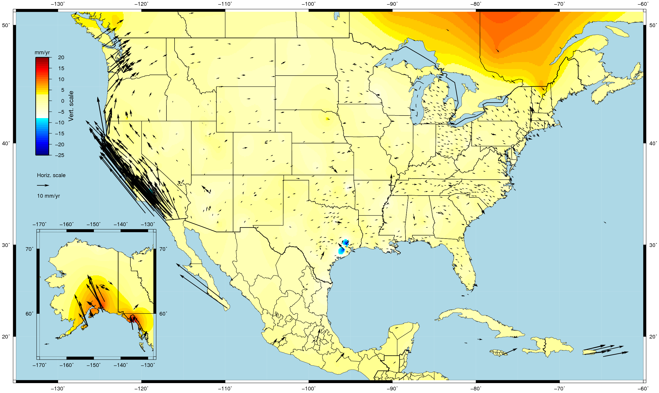
U.S. CORS Velocity Field - NAD83(2011) epoch 2010.0

Slide 13
Why a Multi-Year CORS Solution?
Consistent coordinates and velocities from combined solution
Previous a mix of station and velocity sources, few ties to global frame
Previous vertical velocities of zero for most CORS
Aligned with most recent realization of global frame (IGS08)
IGS08 epoch 2005.0 (previously ITRF00 at epoch 1997.0)
NAD 83 epoch 2010.0 (previously NAD83 (CORS96) at epoch 2002.0)
Major processing algorithm, modeling, metadata improvements
Conformance with current international conventions (IERS)
Absolute phase center antenna calibrations
Both ground (receiving) and satellite (transmitting) antennas
Previous (CORS96) used relative calibrations (significant change)
Highly accurate and consistent CORS coordinates and velocities determined using Best Available Methods
Needed because CORS network is foundation of NSRS

Slide 14
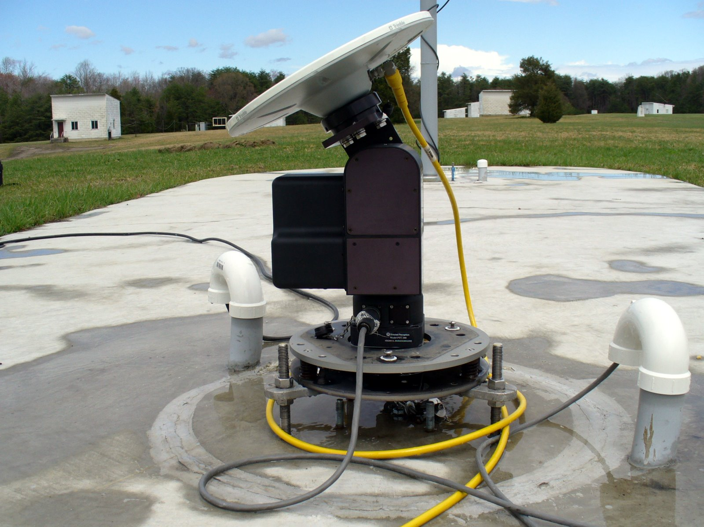
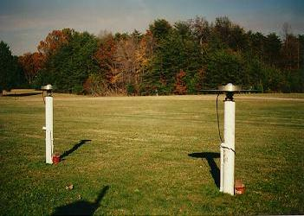
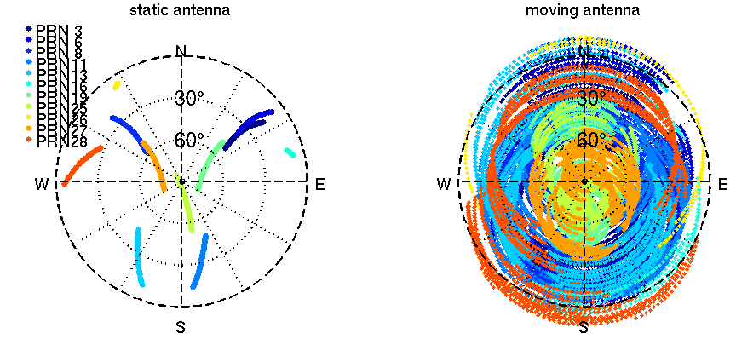
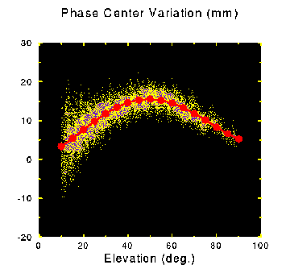
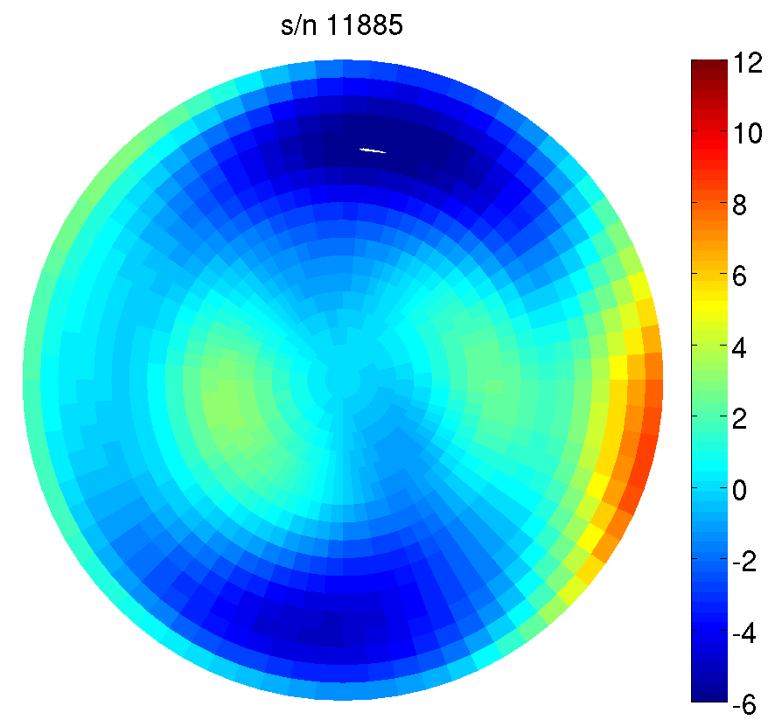
NGS Antenna Calibration – Relative vs. Absolute GNSS Antenna Calibration
relative
absolute
2 hours
GPS tracking

Slide 15
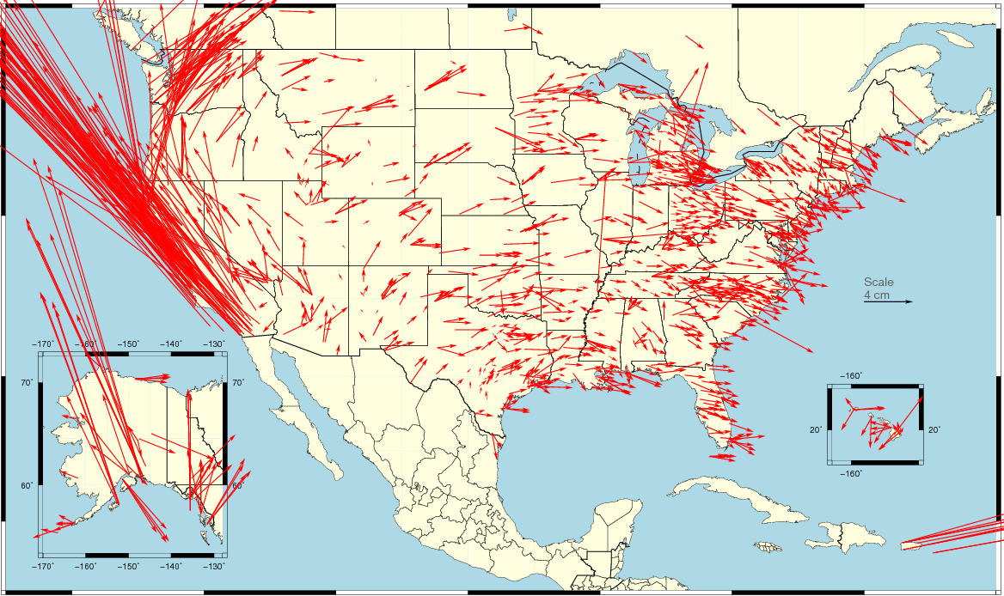
Changes in Horizontal NAD 83 Positions NAD 83(2011) epoch 2010.0 – NAD 83(CORS96) epoch 2002.0
Avg. shifts: ΔE = 0.05cm ± 5.25cm ΔN = 2.12cm ±6.08cm
combination of position and velocity differences
due mostly to updated velocities (including up to 8 more years of data)
ID+MT+ND+SD+WY
1.7E / 0.5N cm
WA+OR
4.4E / 5N cm
East
1.4E / -0.2N cm
CA+NV
-10.8E / 14.4N cm
UT+CO+NM+AZ
0.5E /1.0N cm

Slide 16
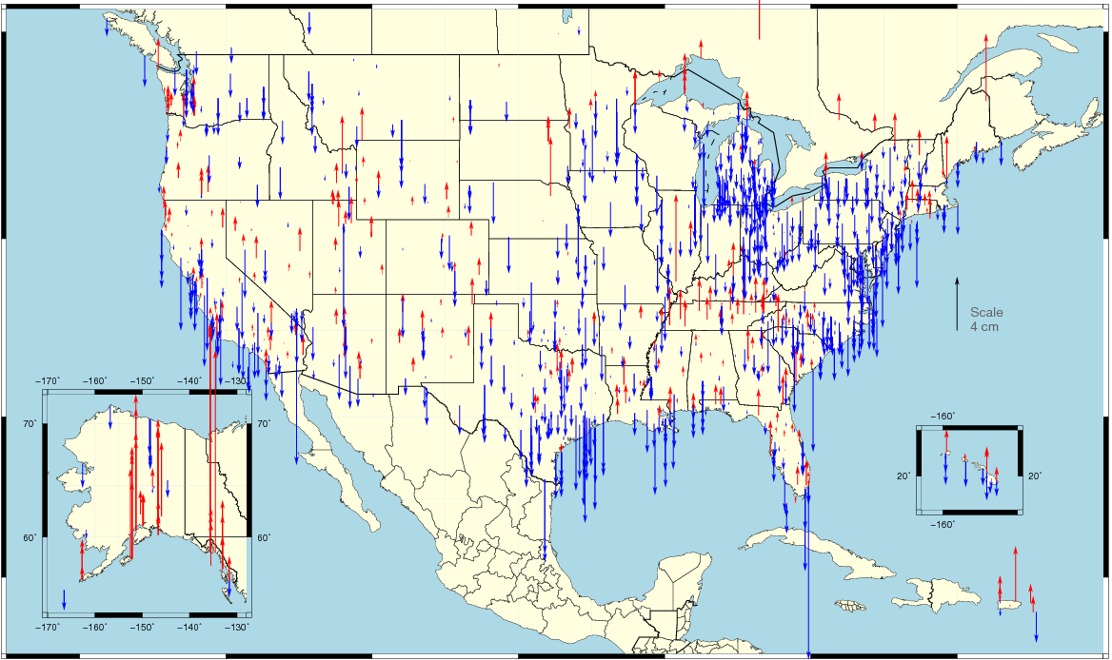
Changes in Vertical NAD 83 Positions NAD 83(2011) epoch 2010.0 – NAD 83(CORS96) epoch 2002.0
Avg. shifts: ΔU = -0.66cm ±2.24cm
combination of position and velocity differences from additional data, tectonics
assuming vertical velocity ≈ 0.00 in NAD 83(CORS96)

Slide 17
What’s different about the CORS coordinates?
Change to absolute antenna calibrations
Use absolute cal. in your processing: DON’T MIX!
Better because 8 more years of:
International CGPS sites
CORS data: about 1600 total, ~1000 w/ >2.5 yrs history
Orbit determination sophistication
CORS velocity data
Better Horizontal Time-Dependent Positioning (HTDP) software modeling for CORS w/ <2.5 yrs history
Better processing algorithms

Slide 18
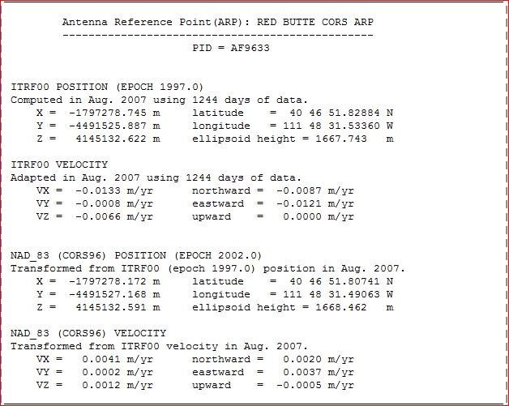
CORS Reference Frame Changes Due to MYCS –
available now
> IGS08 epoch 2005.0
IGS08 = International GNSS Service 2008
(GPS-only realization of ITRF2008)
> NAD83 (2011) epoch 2010.0
NAD83 (2011) = North American Datum 1983
(2011 Realization)

Slide 19
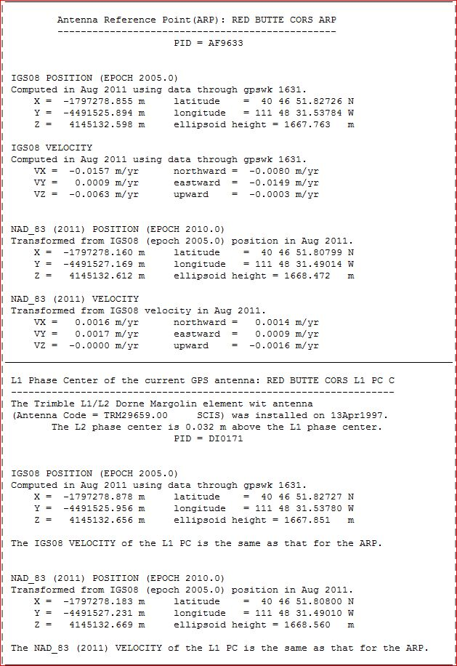
CORS Coordinates – New Reference Frames
IGS08 = International GNSS Service 2008
(GPS-only realization of ITRF2008)
NAD83 (2011) = North American Datum 1983
(2011 Realization)

Slide 20
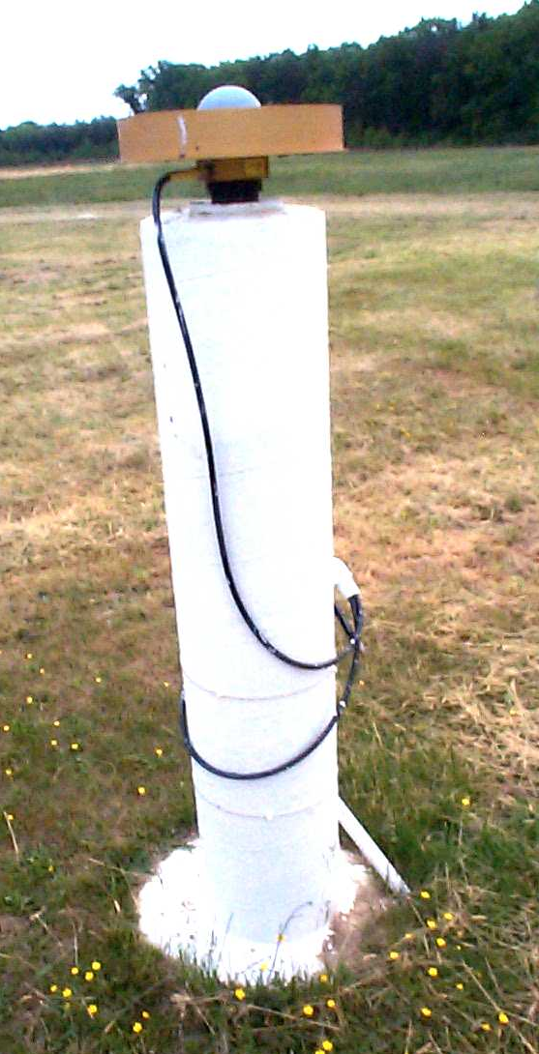
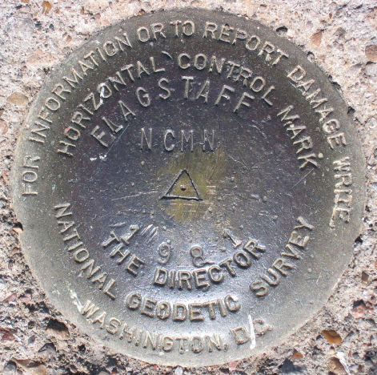
Introducing… NAD 83(2011) epoch 2010.00
Multi-Year CORS Solution (MYCS)
Reprocessed all CORS GPS data Jan 1994-Apr 2011
2264 CORS & global stations
NAD 83 computed by transformation from ITRF08(IGS08)
National Adjustment of 2011 (NA2011)
New adjustment of GNSS passive control
GNSS vectors tied (and constrained) to CORS NAD 83(2011) epoch 2010.00
Approximately 80,000 stations and more than 400,000 GNSS vectors
SAME Datum Realization for CORS and passive marks
This is NOT a new datum! (still NAD 83)
The name: NAD 83(2011) epoch 2010.00
“2011” is datum tag → year adjustment complete
“2010.00” is “epoch date” (January 1, 2010)
Date associated with coordinates of control station
Frame fixed to North American tectonic plate
Includes CA, AK, Puerto Rico, US Virgin Islands

Slide 21
Why a new national adjustment of the passive network?
Optimally align passive control with new CORS
Add >1000 projects submitted since 2007 adjustment
Also observations for Hawaii, other Pacific islands
Network and local accuracies on all stations
Including future submitted projects
More consistent results in tectonically active areas
More current data, better tectonic modeling
Better computations and analysis techniques
e.g., improved outlier detection
Incorporation of lessons learned from previous national adjustment

Slide 22
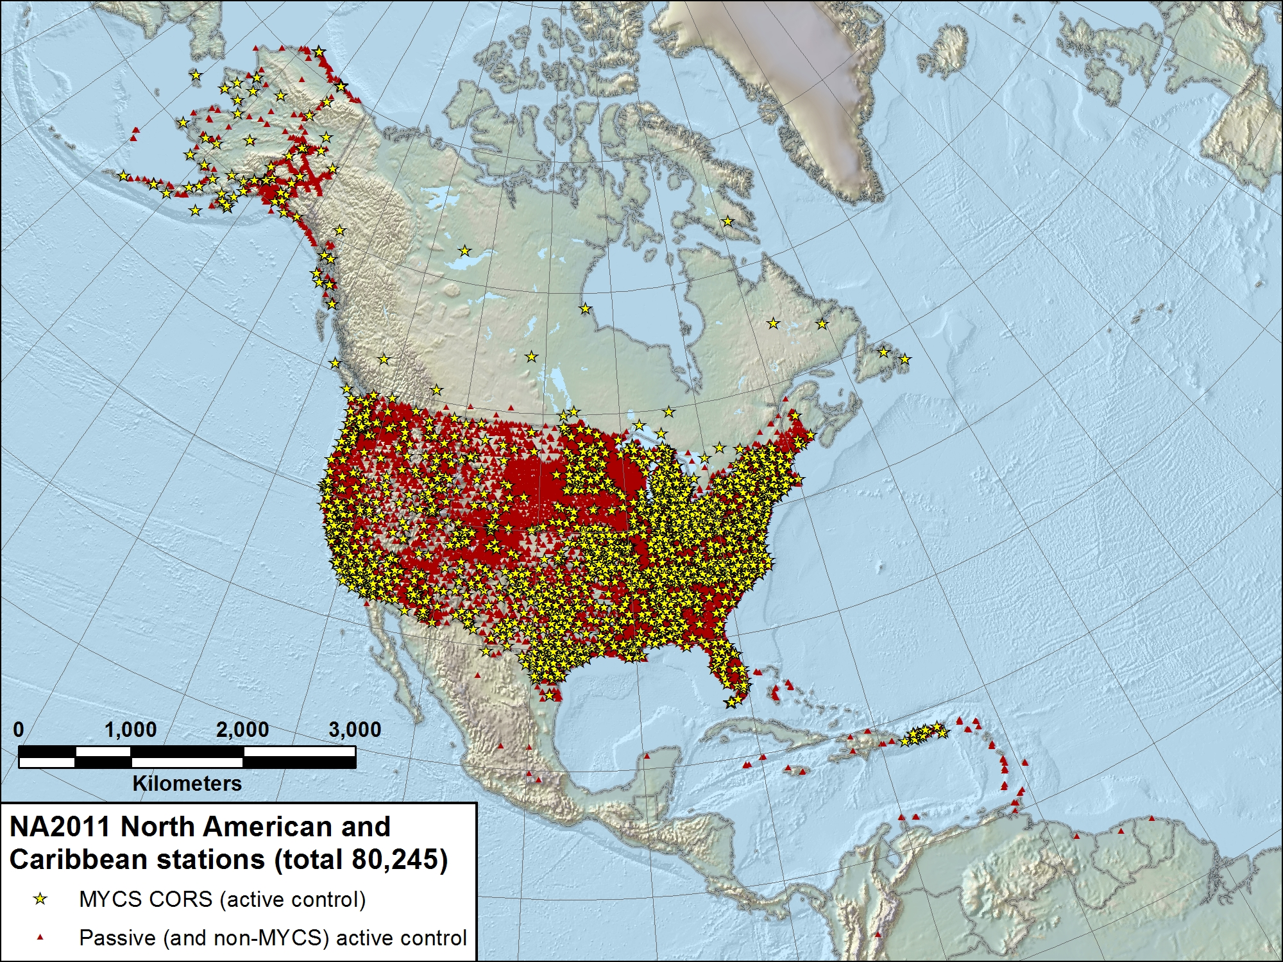

Slide 23
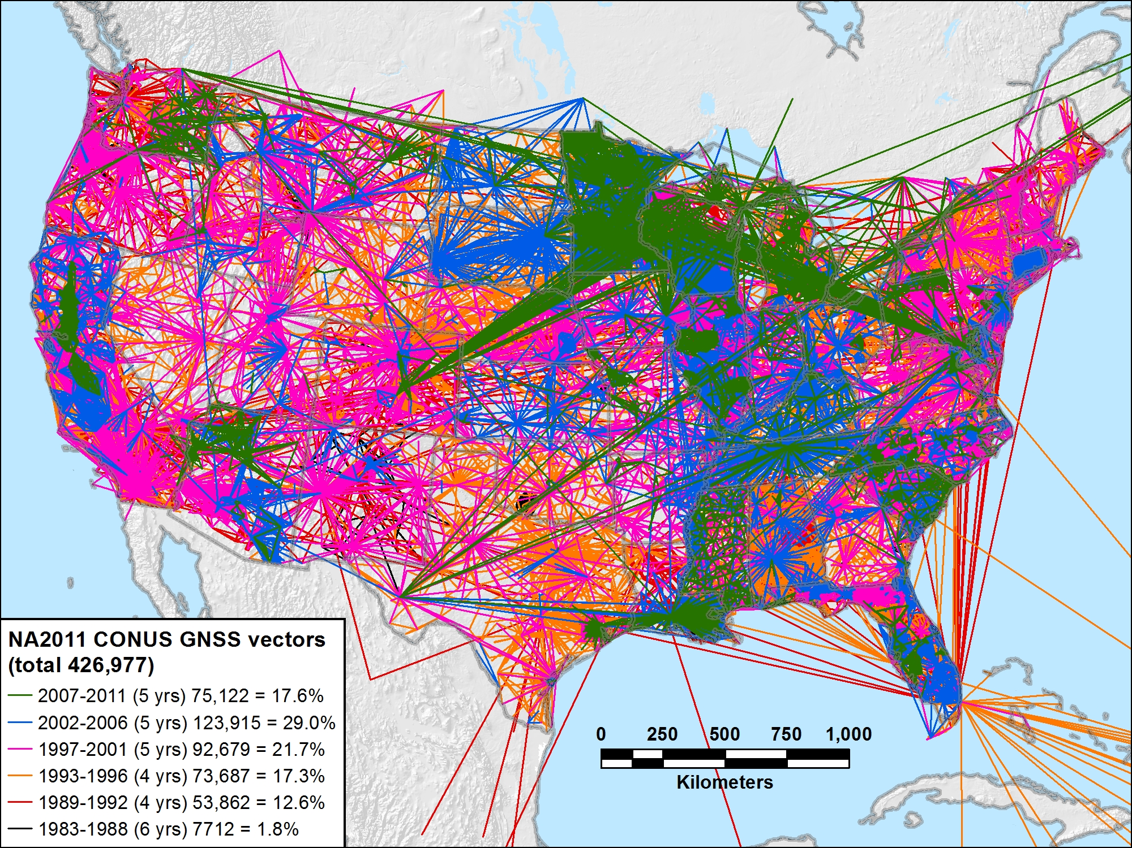
NA2011 CONUS 1983-2011 (29 yrs) 426,977 vectors (100.0%)

Slide 24
NA2011 Project Status
Expect overall coordinate change approx same as MYCS
Horizontal: Mean ~2 cm (±8 cm), median ~0 cm
Vertical: Mean ~ -1 cm (±2 cm), median ~ -1 cm
This is for change in realization and reference epoch
NAD 83(CORS96) epoch 2002.00 → NAD 83(2011) epoch 2010.00
New NAD 83 coordinate transformation tools
NAD 83(HARN) ←→ (NAD83(2007)/CORS96) ←→ NAD83(2011)
Both horizontal coordinates and ellipsoid heights
Currently under study and development by NGS
Prelim high res (1 arc-minute) grids completed for HARN / NSRS2007
Includes error grid to give users estimate of accuracy

Slide 25
When will it all be done?
Multi-Year CORS Solution
Officially released coordinates September 2011
Will publish in NGS database simultaneously with NA2011
National Adjustment of 2011
Goal: Complete May 18, 2012; publish June 30, 2012
Final data added to NA2011 network mid-Dec 2011
OPUS (Online Positioning User Service)
Dual solutions (CORS96 and MYC) are available until NA2011 release
NAD 83(HARN)←→(NSRS2007/CORS96) coordinate transformation tool
Expect completion soon
Will create (NSRS2007/CORS96) ←→(2011) tool after NA2011 complete
New hybrid geoid model (GEOID12)
Use NAD 83(2011) ellipsoid heights on leveled NAVD 88 benchmarks
Plan release same time as NA2011

Slide 26
Near-future (possible) plans
Might perform national vertical adjustment
Constrain vertically to NAVD 88 benchmarks
Perform as simultaneous nationwide adjustment
GNSS-derived orthometric heights
NAD 83(2011) ellipsoid heights with GEOID12
NOT a readjustment of NAVD 88 leveling

Slide 27

More information…
geodesy.noaa.gov

Slide 28

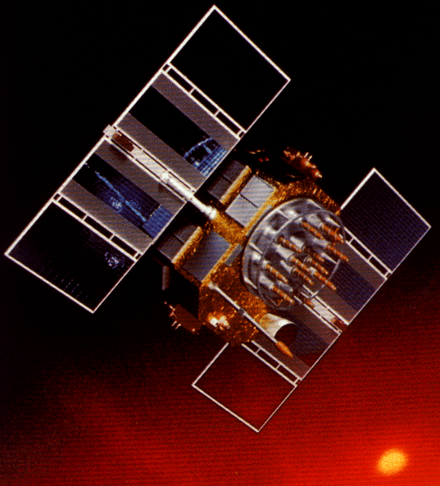
National Adjustment of 2011 &
Multi-Year CORS Solution
Some questions for you:
What accuracy meets your positioning needs?
How well aligned should passive control be with CORS?
Should a “threshold” position change value be used to determine when new coordinates are published?
How frequently should control coordinates be updated?

Slide 29
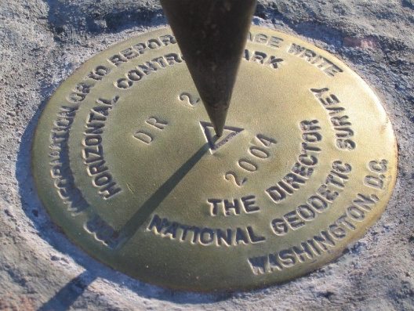
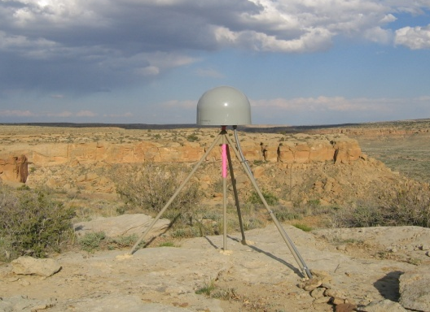
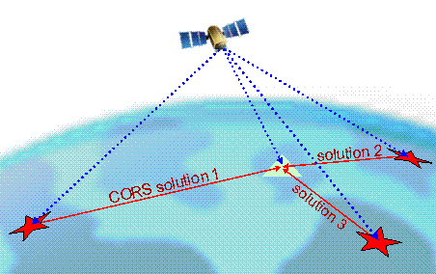
Online Positioning User Service (OPUS)
>15 min of L1/L2 GPS data >>> www.ngs.noaa.gov/OPUS
Processed automatically on NGS computers
Solution via email - in minutes
Fast, easy, consistent access to NSRS

Slide 30
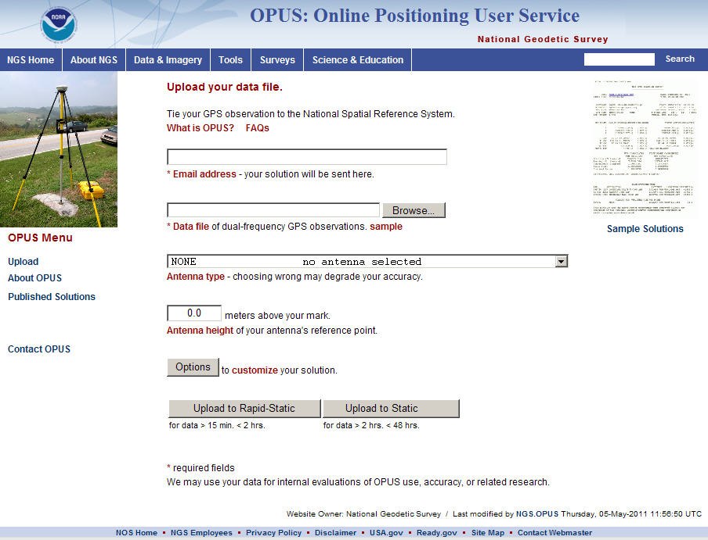
e-mail
GPS file
antenna
antenna height
(OPTIONS)
OPUS-RS or OPUS-Static
(15 min-2 hr) (2-48 hr)

Slide 31
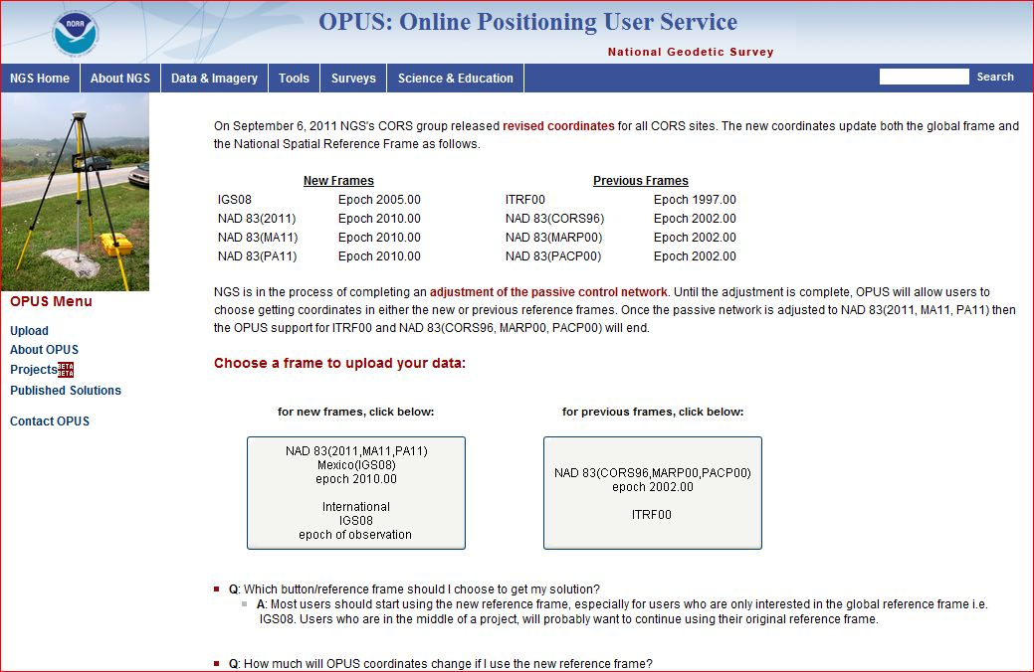
OPUS – choose your flavor (reference frame)

Slide 32
How Does OPUS-RS Work?
OPUS-RS selects three to nine “best” CORS based upon:
Having common satellite visibility with the user data.
Having distances from the user’s site <250 km.
This is shown here graphically. The star represents the user’s site. The triangles are CORS.
No CORS farther than 250 km from the user’s site will be included.
The three CORS minimum is shown. No more than nine are used.
s
>250km
250km
Choi, 2010, personal communication.

Slide 33
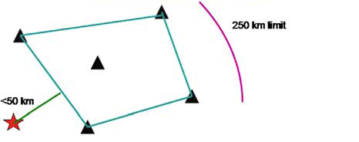
How Does OPUS-RS Work?
In addition, user’s site must be no more than 50 km from the (convex) polygon created by the selected CORS.
Again in this figure, the star represents the user’s site; the
triangles are CORS. Five CORS and their resulting polygon are shown in this example.
If the user’s site, the star, is more than 50 km outside this polygon, alternate CORS will be considered.
If none can be found, the processing will abort.
Schwarz et al., “Accuracy assessment of the National Geodetic Survey's OPUS-RS utility”, 2009, GPS Solutions, 13(2), 119-132.

Slide 34
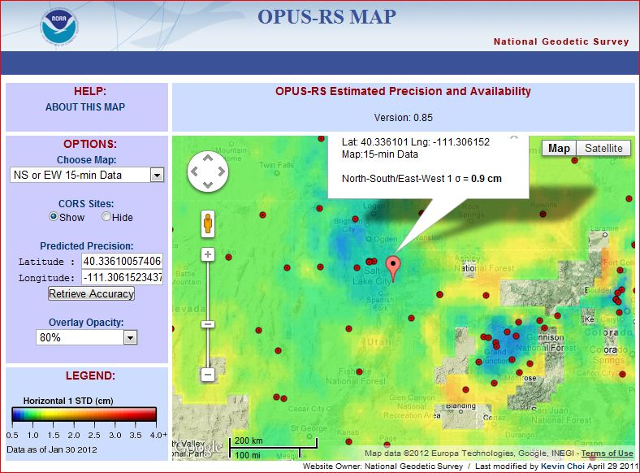

Slide 35
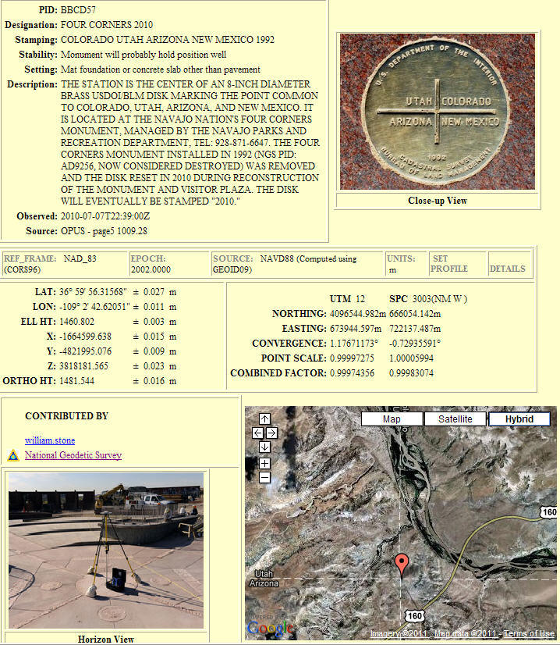
OPUS –
Datasheet Publishing
Publishing Criteria:
NGS-calibrated GPS antenna
> 4 hour data span
> 70% observations used
> 70% fixed ambiguities
< 0.04m H peak-to-peak
< 0.08m V peak-to-peak
Uses:
GPS on BMs
PLSS / GCDB
Data archive
Data sharing

Slide 36
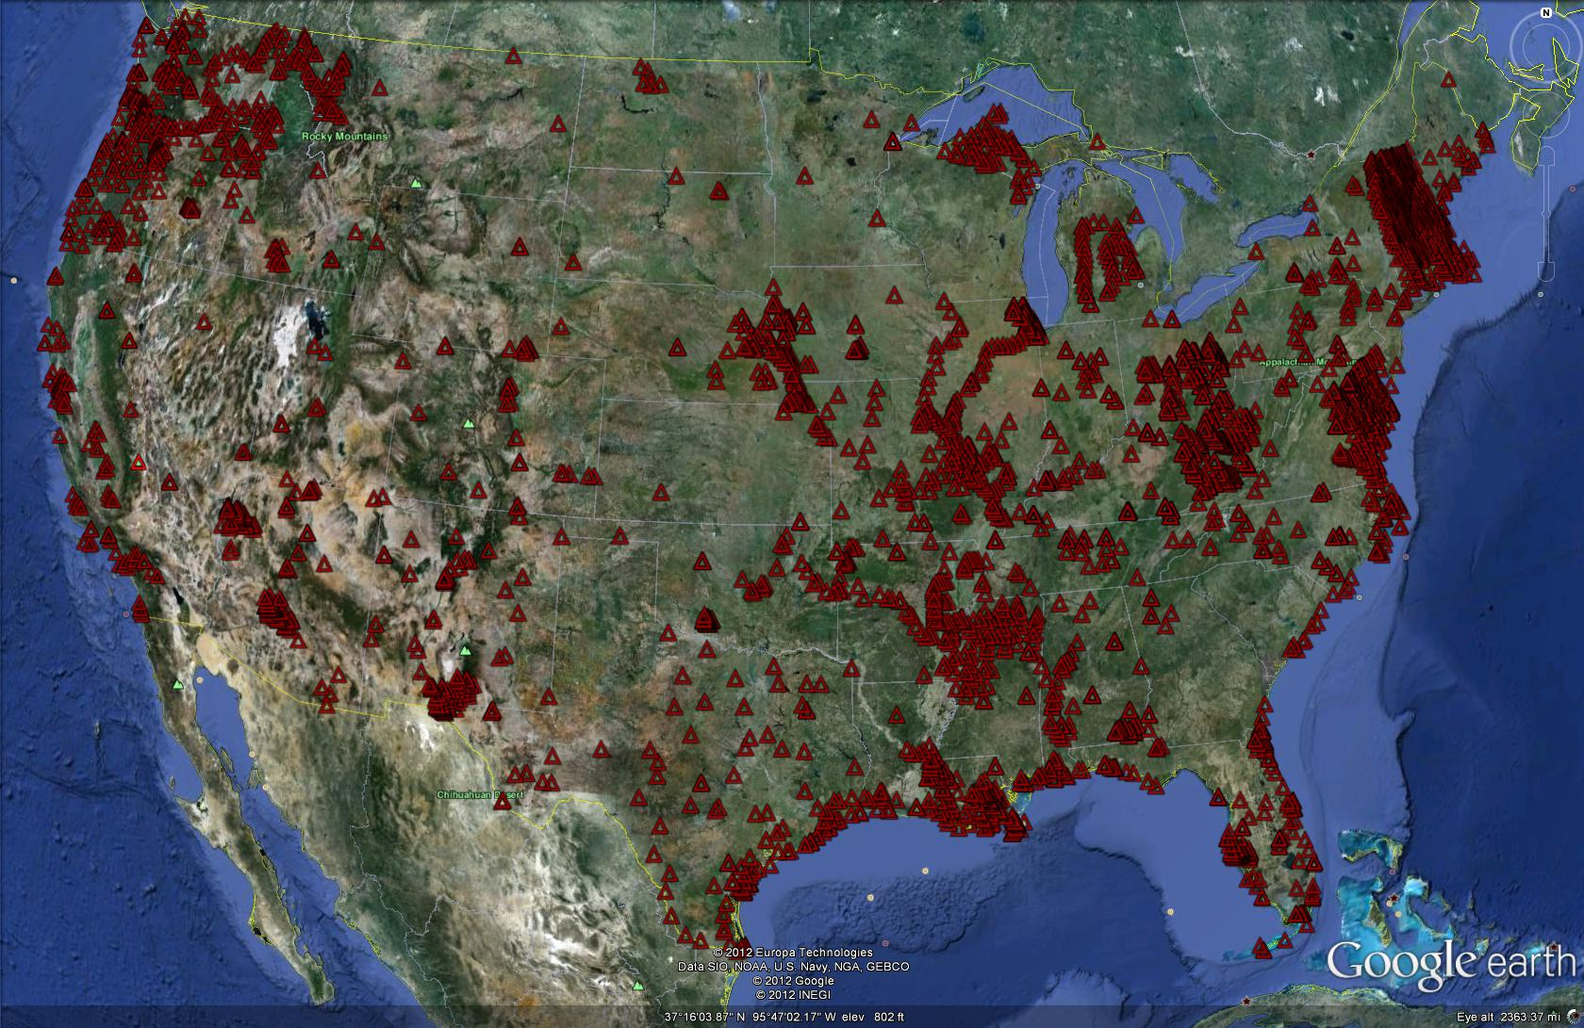
OPUS-Published Stations

Slide 37
OPUS – Projects

Slide 38
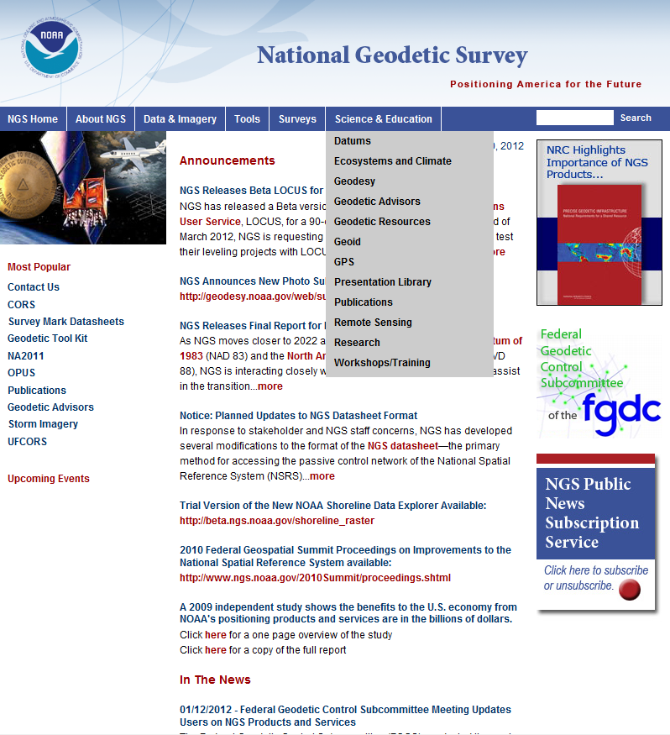
OPUS-Projects WORKSHOP/TRAINING
Check here for upcoming OPUS-Projects Workshops

Slide 39
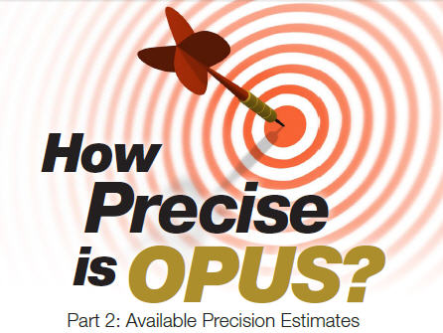
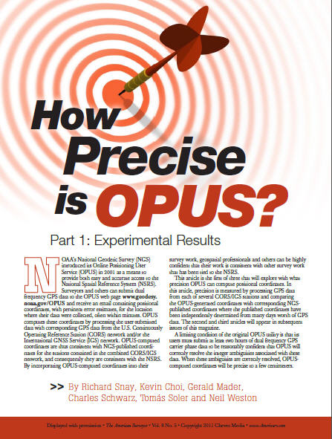
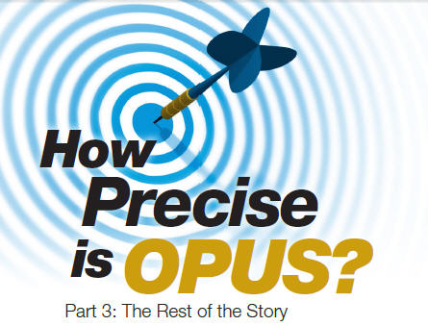
see The American Surveyor vol 8 (no. 5,6,7)

Slide 40

National Geodetic Survey Ten-Year Plan
Approved January, 2008
Refines mission, vision, & strategy for the future of NGS actions
Emphasis on outside capacity
Modernize the Geometric (“Horizontal”) Datum
Modernize the Geopotential (“Vertical”) Datum
Migrate the Coastal Mapping Program >>> Integrated Ocean & Coastal Mapping
Evolve Core Capabilities
Increase Agency Visibility
Available at: geodesy.noaa.gov

Slide 41
Why New Datums?
NAD 83
non-geocentric, i.e. inconsistent with GNSS positioning
NAD 83 coordinates of the CORS network are inconsistent with passive marks
Lack of velocities, i.e. NAD 83 does not report station motion for passive marks
NAVD 88
cross-country build up of errors (“tilt” or “slope”) from geodetic leveling
Passive marks inconveniently located and vulnerable to disturbance and destruction
A 0.5 m bias in the NAVD 88 reference surface from the geoid surface best approximating global mean sea level
Subsidence, uplift, freeze/thaw, and other crustal motions invalidate heights of passive marks, and can make it difficult to detect such motions.
Passive marks without adequate geophysical models make it difficult to reliably detect sea level change
Changes to Earth’s gravity field cause changes in orthometric heights, but NAVD 88 does not account for those changes (because it is based on a static gravity model)
The gravity model and modeling techniques used to determine NAVD 88 are not consistent with those currently used for geoid modeling

Slide 42
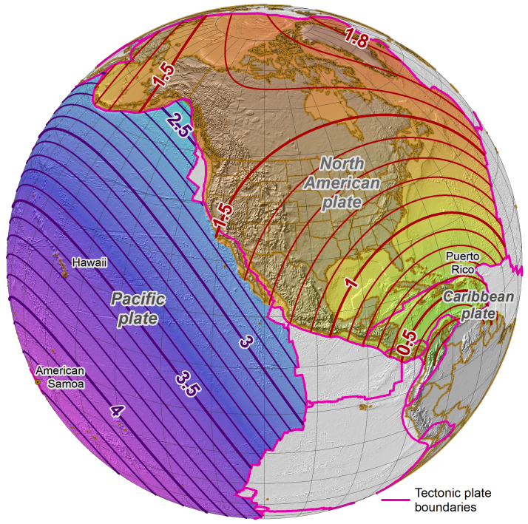
Horizontal position differences (in meters) between NAD 83 and ITRF 08 at time 2022.00 (January 1, 2022).
Positional differences are shown for the North American and Pacific tectonic plates. The difference for Guam and the Commonwealth of the Northern Mariana Islands (CNMI) on the Mariana tectonic plate (not shown) is about 1.3 m. Note that stations located on the Caribbean tectonic plate are reference to the North American plate.

Slide 43
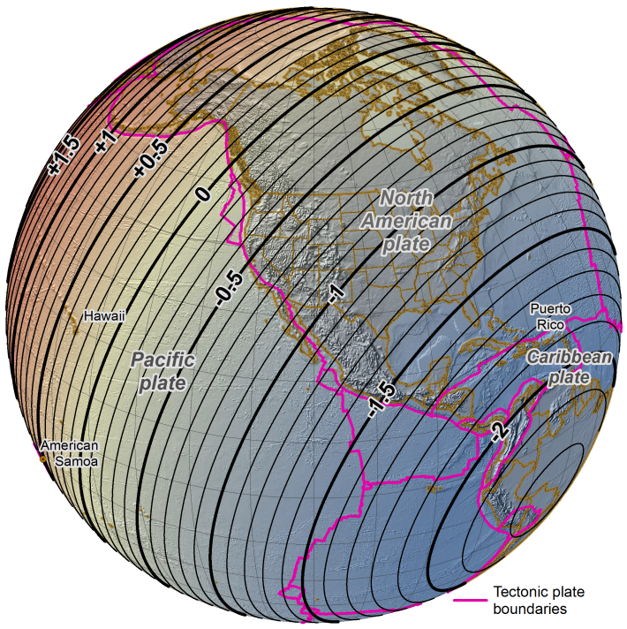
Difference in ellipsoid heights (in meters) between NAD 83 and ITRF 08 at time 2022.00 (January 1, 2022), as ITRF 08 minus NAD 83.
The height differences are with respect to the North American tectonic plate. However, large-scale tectonic plate motion is nearly entirely horizontal, so the change in ellipsoid height is essentially independent of plate motion, as indicated in the figure.
The difference for Guam and CNMI on the Mariana tectonic plate (not shown) is about +2.0 meters.

Slide 44
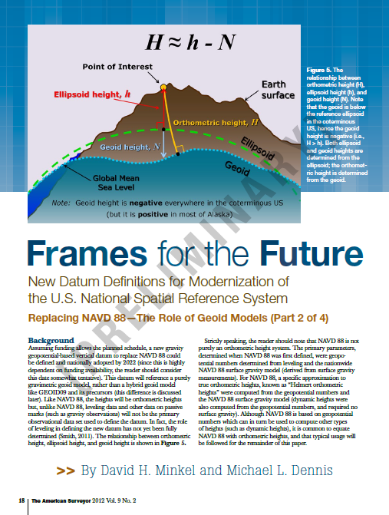





Find the article(s) in the Archives at:
http://www.amerisurv.com
?

Slide 45
And now….. the rest of the story.
Orthometric Heights
(a.k.a. NAVD 88 elevations)
“By 2018, a new geopotential datum (for orthometric and dynamic heights) is defined and realized through the combination of GNSS technology and gravity field modeling.”
In other words, orthometric heights will NOT be based on leveling data and they too will change.
2022

Slide 46
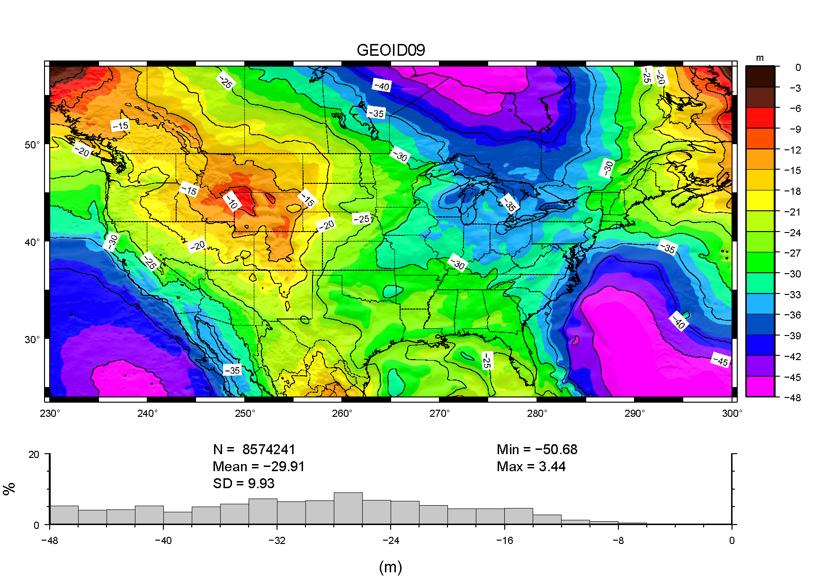
GEOID09:
relates NAD83 (ellipsoid heights) to NAVD88 (orthometric heights)
GEOID09:
+/- 2.8cm @ 95%

Slide 47
GPS Bench Marks (GPSBMs)
H
H
(NAVD 88)
h
H
(EGM2008)
h
h
GRS80 Ellipsoid
h
H
GEOID09 (NAVD 88)
Errors in NAVD 88 :
~50 cm average, 100 cm CONUS tilt,
1-2 meters average in Alaska
Geoid (EGM2008)

Slide 49

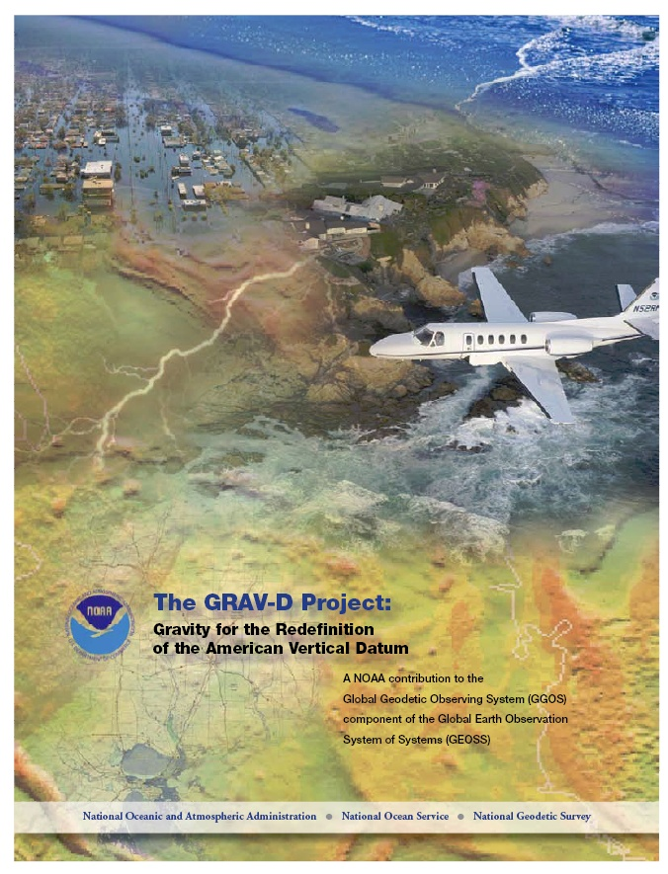
Gravity for the Redefinition of the American Vertical Datum (GRAV-D)
Replace the Vertical Datum of the USA by 2022 (at today’s funding) with a gravimetric geoid accurate to 1 cm
Orthometric heights accessed via GNSS accurate to 2 cm
Three thrusts of project:
Airborne gravity survey of entire country and its holdings
Long-term monitoring of geoid change
Partnership surveys
Working to launch a collaborative effort with the USGS for simultaneous magnetic measurement
Gravity and Heights are
inseparably connected
Notes:
GRAV-D is the NGS project designed to replace NAVD88 with a vertical datum based upon a gravimetric geoid accurate to 1 cm. Heights above this datum will be accessed via GNSS measurements. Three thrusts of project. Launch USGS collaboration for simultaneous mag measurement.

Slide 50
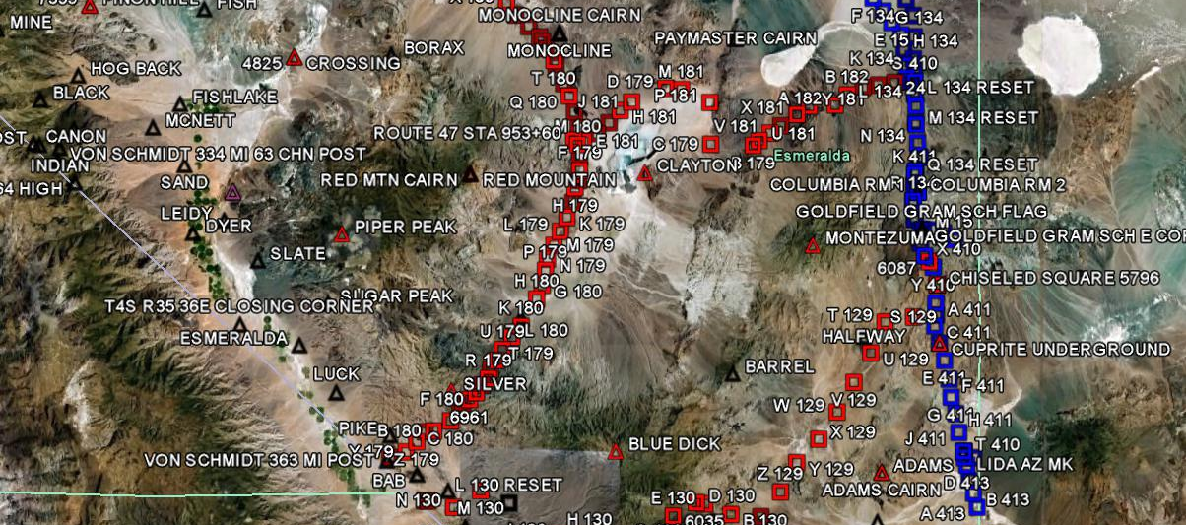
GRAV-D Goals
2 cm accuracy orthometric heights -
from GNSS (1 cm) + geoid model (1 cm)
fast, accurate, consistent orthometric heights -
everywhere in the USA

Slide 51


Slide 52
How to Plan for the Future
Move to newest realization, i.e. NAD 83(2011) epoch 2010.00
NAD 83(HARN) <-> NAD 83(NSRS2007) &
NAD 83(NSRS2007) <-> NAD 83(2011) tools under development
Obtain precise ellipsoid heights on NAVD 88 bench marks (OPUS-DB, contact NGS Geodetic Advisor)
Improves hybrid geoid models and provides “hard points” in new vertical datum
Move off of NGVD 29 to NAVD 88
Understand the accuracy of VERTCON in your area
Move away from passive marks to GNSS
Especially move off of classical passive control
Require/provide complete metadata for all mapping contracts
How did they get the positions/heights? Document it!!

Slide 53

Geoid Slope Validation Survey
Austin
Observe geoid shape (slope) using multiple independent terrestrial survey methods
GPS + Leveling
Deflections of the Vertical
Compare observed slopes (from terrestrial surveys) to modeled slopes (from gravimetry or satellites)
With / Without new GRAV-D airborne gravity
325 km
218 points
1.5 km apart
Rockport
Notes:
But will this method produce a sufficiently accurate geoid?
This summer, we conducted an experiment to determine the accuracy of our geoid. We selected a line that extended 325 km from downtown Austin, Texas (North end) to Rockport, Texas (South end). There were 218 official survey points along the line, with an average spacing of 1.5 km between them. We compared the slope of the geoid along the line determined with GPS + leveling with deflections of the vertical as measured by the ETH Zurich DIADEM zenith camera. We also compared the observed geoid slope with slopes calculated from various geoid models to evaluate the their quality. As for NGS models, we tested geoids that both included and didn’t include new GRAV-D airborne gravity.

Slide 54
Surveys Performed
GPS: 20 identical units, 10/day leapfrog, 40 hrs ea.
Leveling: 1st order, class II, digital barcode leveling
Gravity: FG-5 and A-10 anchors, 4 L/R in 2 teams
DoV: ETH Zurich DIADEM GPS & camera system
LIDAR: Riegl Q680i-D, 2 pt/m² spacing, 0.5 km width
Imagery: Applanix 439 RGB DualCam, 5000’ AGL
Other: RTN, short-session GPS, extra gravity marks around Austin, gravity gradients

Slide 55





GPS
LIDAR/
Imagery
DoV
Gravity
Leveling
Notes:
These are just a small sampling of the field crews in action. Not shown are the RTN, FG-5, short-session GPS, relative gravity and mark setting crews.

Slide 56
The “1 cm geoid”
Notes:
This slide is a companion to the previous one, but the h-H errors have been removed, in an RMS sense, from the total h-H-N errors, leaving, ostensibly, gravimetric geoid errors only. As seen previously, the airborne geoid is the best performer, by far. In fact, as a general statement, it could be said that USGG2012x02, an airborne gravity data enhanced geoid model, is effectively at the 1 cm differential geoid undulation accuracy level across all distances, in the region of GSVS11.

Slide 57
Geoid Slope Survey Conclusions
Including airborne gravity data improves geoid slope accuracy at nearly all distances <325 km
The NGS geoid in the TX survey meets the 1 cm accuracy objective only if airborne data are included
No other model achieved 1 cm accuracy
Gravimetric geoid models and GPS are a viable alternative to long-line leveling
Notes:
The Survey verified that the inclusion of the GRAV-D airborne survey improved the geoid slope accuracies at all distances measured by the survey.

Slide 58
Future Milestones of the NSRS
Multi-Year CORS Solution (MYCS) –
Completed and available, but not yet fully implemented
National Adjustment (geometric) of passive control
Underway, expected completion by April 2012
Hybrid Geoid Model (GEOID12) using new ellipsoid heights
Underway, expected completion by April, 2012
Simultaneous release of MYCS, NAD 83(2011) epoch 2010.00, and GEOID12
National Adjustment (vertical) of GPS passive marks
Under consideration
This is not adjusting the leveling network
Adoption of new datums
Vertical, requires completion of GRAV-D
Geometric, could happen at any time but will be delayed until definition of new vertical datum is complete
Crystal ball says completion in 2022 (Good luck to you all!)

Slide 59


NGS Real-time Guidelines: Single-base and Network

Slide 60


OPERATIONAL PROTOTYPE SCORS – 19 STATIONS STREAMING GNSS OBSERVABLES IN RTCM 3.0 FORMAT

Slide 61

NGS Datasheet
Geodetic values
Accuracy estimates
Source information
Grid coordinates
Superseded control
Monumentation
Photographs
Description/Recovery

Slide 62

DSWORLD Software-
available at geodesy.noaa.gov
SEARCH STATIONS
State / County
State / Designation
Lat /Long / Radius
Project ID
Control Type
(H, V, Order)
VIEW PUBLISHED OPUS
SOLUTIONS
SUBMIT TO NGS
Photos
HandHeld GPS
Recovery Reports
GOOGLE EARTH DISPLAY

Slide 63


Slide 64


Slide 66

Datasheet Format Changes
Move ell ht and epoch info into top box, add datum tags
Note when GPS Ortho Ht computed with previous geoid model, and provide that model ht
Better way to quantify accuracies

Slide 67
Announcing… A New NGS Datasheet Format

Slide 68
Announcing… A New NGS Datasheet Format

Slide 69
Announcing… A New NGS Datasheet Format

Slide 70


NGS Geodetic Tool Kit & Geodetic Software Download
datum/coordinate conversion
time-dependent positioning
datasheet utilities
geodetic utilities
geoid modeling
gravity prediction
network adjustment
GPS project analysis
project submission

Slide 71




NGS Training Center

Slide 72


Slide 73


