Slide 1
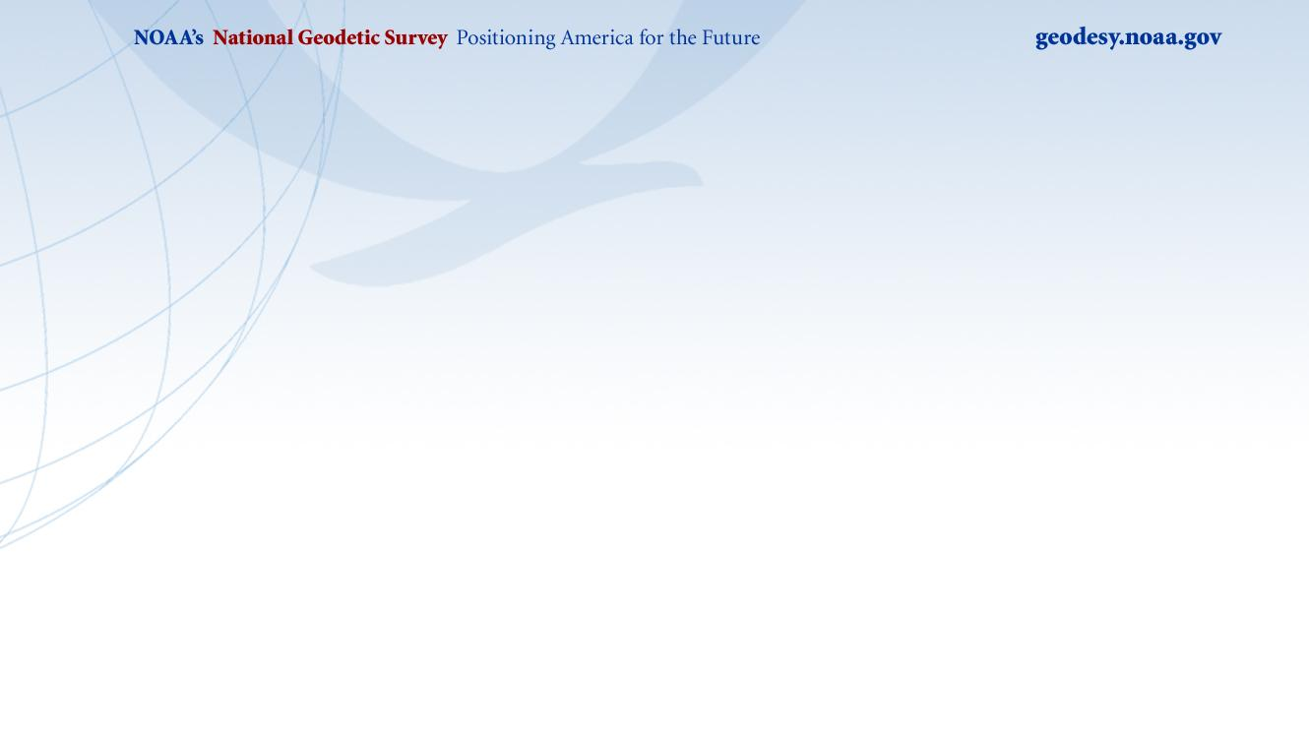
API
Krishna Tadepalli

Slide 2
API vs Download
API | Download
Platform independent | Platform independent (?)
Internet access required | No internet access required
Updates are automatic | Updates are manual(?)
Command line access | Command line access
Access is through API calls | Access is through an executable
Backward compatibility | Backward compatibility may not be guaranteed

Slide 3
API
Delivered in JSON format
{
"geoidModel": "GEOID18",
"station": "UserStation",
"lat": 40.0,
"latDms": "N400000.00000",
"lon": -80.0,
"lonDms": "W0800000.00000",
"geoidHeight": -33.203,
"error": 0.034
}
GeoJSON option under consideration
Easy to consume and parse

Slide 4
API
Standardized URL patterns
https://geodesy.noaa.gov/api/<product>/<request>
Metadata available for keys used in JSON
https://geodesy.noaa.gov/api/<product>/meta
{
"error": "Error, in meters, associated with Geoid Height computation",
"geoidHeight": "Geoid Height in meters",
"geoidModel": "An alphanumeric ID of the model used to compute Geoid Height",
"lat": "Latitude, in decimal degrees, positive north of the equator",
"latDms": "Latitude in Degrees-Minutes-Seconds with a 'N'orth or 'S'outh hemisphere prefix",
"lon": "Longitude in decimal degrees; negative west of the prime meridian",
"lonDms": "Longitude in Degrees-Minutes-Seconds with an 'E'ast or 'W'est hemisphere prefix",
"station": "An alphanumeric name associated with a given lat-long"
}
Rate limits apply

Slide 5
What’s available as an API?
API discovery link
  https://geodesy.noaa.gov/web_services/
  or
  Navigate to Tools->Web Services
The link provides:
Available APIs
Sample URL patterns
Description of request parameters
APIs for alpha products (under development)

Slide 6
Other Services
WMS/WMTS
WFS
Vector Tiles

