Slide 1
Antenna Calibration at the National Geodetic Survey
Andria Bilich
Andria.Bilich@noaa.gov
Geosciences Research Division
January 14, 2021

Slide 2


Coming to you live from my dining room
When I went to my NOAA office every day
“Work from home” hearing protection

Slide 3
Antcal Team ngs.antcal@noaa.gov
Antenna Calibrations
Engineering / Software
Operations / Analysis
Infrastructure
Applications/Program Support
Andria Bilich
Bryan Stressler
Charles Geoghegan
Benjamin Erickson
Bruce Tran
Giovanni Sella
Kendall Fancher
Steven Breidenbach
Jacob Heck
Clement Ogaja
Phillip MacFarland
Steve Hilla

Slide 4
Talk Outline
The Past / Background
What is antenna calibration?
Terminology
Why are calibrations important?
Brief history
NGS’s relative calibration
Today
Robotic calibration
NGS’s multi-GNSS absolute calibration results
Near Future
IGS approval
Production calibration service
Cool research

Slide 5



Antenna Calibration is not Certification
No coordination with or approval by standards organizations
International GNSS Service (IGS)
  Antenna Working Group: ground and GNSS satellite antenna data
  Coordination of calibration institutions
  Aggregate data and metadata
Notes:
I’ll actually start answering the question “what is antenna calibration” by talking about what it is not.
Calibration is not an endorsement of a product’s quality.
NGS coordinates our calibration efforts with other institutions by working with the IGS. The AWG aggregates calibration data and metadata for both ground and satellite antennas, and AWG members work together to make sure their results are complementary. However, this is not equivalent to certification.

Slide 6
This talk: receiver antennas
Notes:
GNSS signals are broadcast by an antenna array on a satellite, and received by an antenna on the ground.
Calibrations are computed for the antenna arrays on the GNSS satellites themselves, and these calibrations are publically available and commonly used by processing software. However, for the remainder of this talk, I’m going to concentrate on receiving antennas, also known as ground antennas.

Slide 7
What is Antenna Calibration?
Antennas introduce additional “length” to the ranging signal
Determine point of reception for carrier phase signals
Calibration composed of:
  Average phase center
  Corrections to the phase center
Notes:
I love cartoons in presentations, so here’s my cartoon geodetic-grade chokering antenna attached to geodetic monument. Precise positioning with GNSS relies upon accurately knowing the range between the point of signal reception and the satellite itself. But this cartoon antenna, like all antennas, has hardware that introduces additional length to the ranging signal being broadcast by GNSS satellites. That additional length results in positioning error, as I’ll demonstrate later.
Antenna calibration is the act of determining the point of reception for carrier phase signals. I’ve highlighted “carrier phase” because antenna calibrations are only necessary for phase data. Thus we won’t be talking about pseudorange data during this presentation.
In an ideal world, the signals would be received at a physical point on the antenna that is easily related to a monument or mark. For example, in an ideal world we would use antennas where the signals were received at the bottom of the antenna, and it wouldn’t matter what direction the signals are coming from – all signals would experience the same phase advance or delay due to hardware.
In the real world, we need antenna calibrations to relate the point of reception to the physical antenna structure. Antenna calibration is usually decomposed into two components, the average phase center and corrections to that phase center.

Slide 8
Terminology

Slide 9
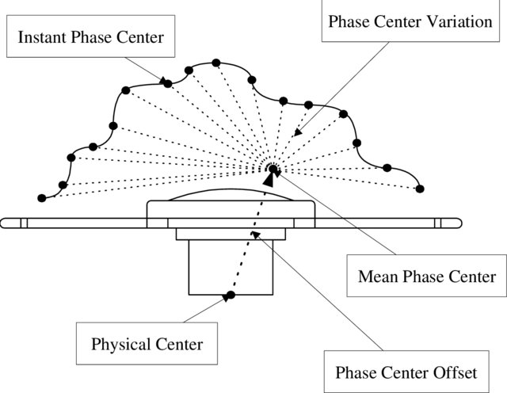
Phase Center
Antenna “phase center, i.e., the mathematically best fitted non-physical point that relates the incoming electromagnetic signals’ time of arrival to the tangible structure.” Bergstrand et. al, 2020, Jour. of Geodesy
Figure from Chen et al (2000), The impact of GPS antenna phase center offset and variation on the positioning accuracy, Bollettino di Geodesia et Scienze Affini 9(1):1-22
Notes:
Here’s a great definition of the antenna phase center from a 2020 paper in Journal of Geodesy. The paper is available as an open access article.
Let’s start out with the part about the tangible structure.

Slide 10
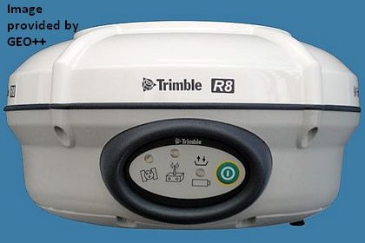
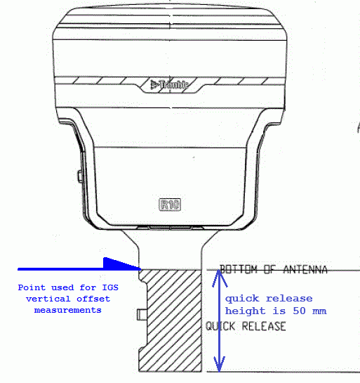
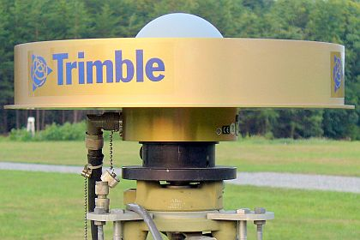
Antenna’s “tangible structure”
North reference point (NRP)
Antenna reference point (ARP)
MMI (man-machine interface)
RXC (receiver connector)
Notes:
The “tangible structure” of an antenna is directly related to application and interpretation of antenna calibrations. For a person doing fieldwork to collect GNSS data, this might be the most important slide of the entire talk.
Antenna calibrations are referenced to a location on the outside of the antenna called the Antenna Reference Point or ARP. The ARP is preferably an easily accessible point on the lowest non-removable horizontal surface of the antenna. Typically, the ARP coincides with the antenna’s axis of attachment to a monument or surveying instrument. It is important to identify the ARP of your particular antenna. Most processing software, OPUS included, will apply antenna calibration data to bring the calculated position down to the ARP.
Paying attention to ARP is important for getting correct heights out of processing. For example, TRMR10 has a 5-cm tall quick-release which allows attachment to a fixed-height pole. However, ARP is the top of the quick release. If you are using a 2-m fixed-height pole for your data collection, you need to tell your processing software that there is a 2.05 m difference between the bottom of the pole and the ARP, or you will have an approximately 5cm height error in your results.
The north reference point (NRP) is a physical antenna feature which must be oriented toward the true north direction. Some antennas have a north mark on the bottom, but other common features are MMI and RXC.
These physical features of the antenna, the ARP and the NRP, are important for orienting your antenna in the field so that antenna calibrations will be correctly applied when you go to process data.

Slide 11
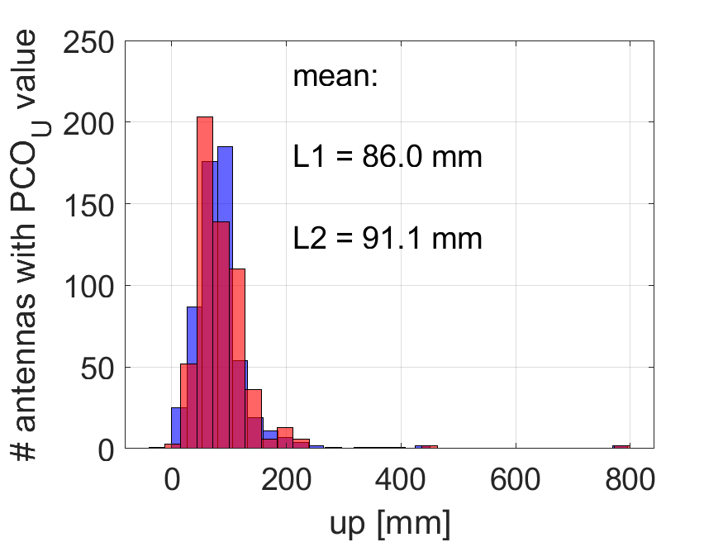
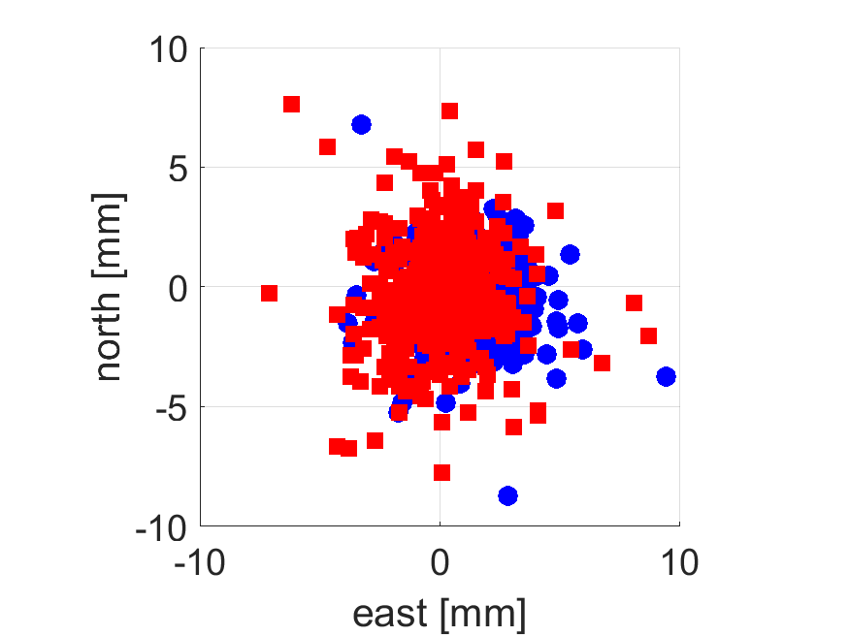
Calibration Terminology
NGS14.atx
NONE radome
577 antennas
PCO = phase center offset
Mean point at which carrier phase is received
3-component vector
Relative to ARP
GPS L1
GPS L2
U
PCO
N
E
ARP is important
Notes:
Calibrations are typically decomposed into two components. The first component is the phase center offset, abbreviated as PCO. This is the mean point at which the carrier phase signals are received. It is expressed as a 3-component NEU vector relative to the antenna frame.
To show the magnitude and variation of the PCO components for geodetic antennas, let’s look at PCO values for a subset of the NGS calibration catalog; all antennas that do not have an additional protective cover or radome on top of them.
In general, the east and north components are small, on the order of a few mm.
However, the up component of the PCO is the largest magnitude of all the calibration terms, usually at the CM level.
Typically GNSS processing software solves for the position at the mean phase center, then applies the PCO to move that position down to the ARP. Hopefully you can now see that knowing the ARP of your antenna is important so that you can then relate the ARP position to your monument or mark.

Slide 12
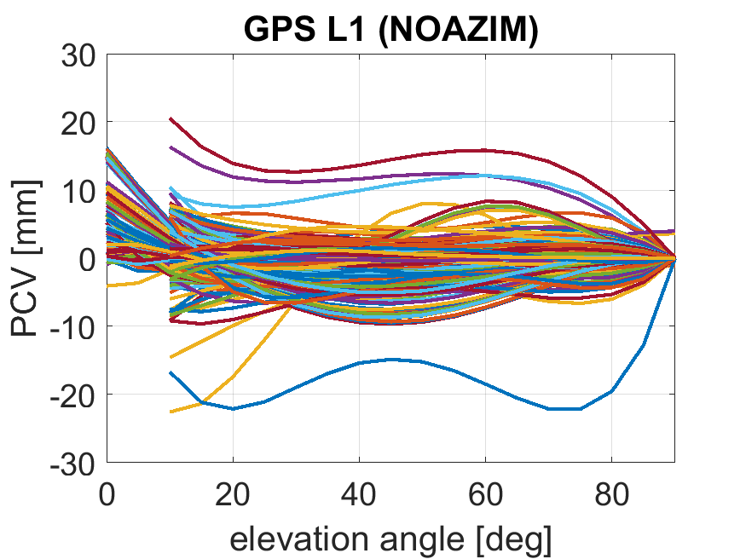
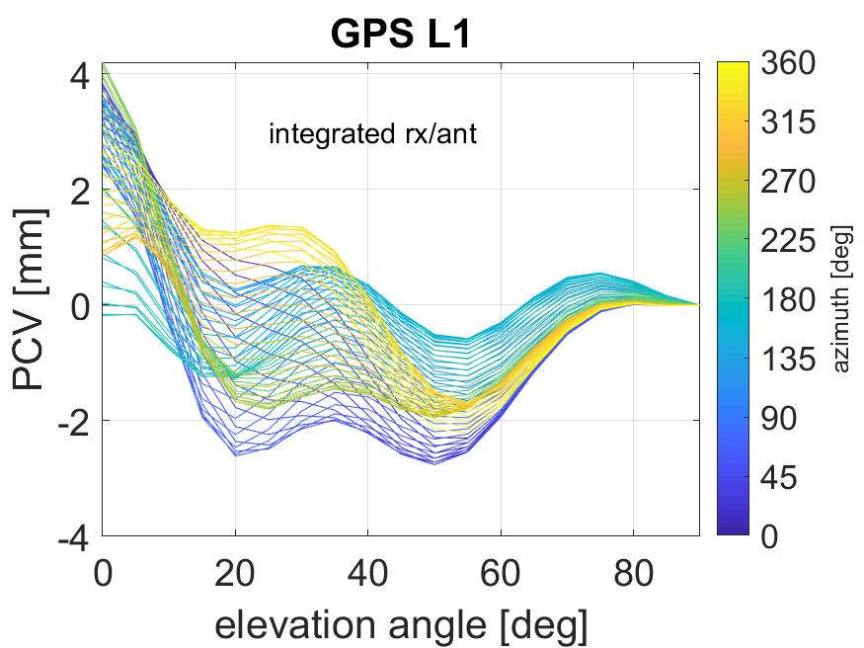
Calibration Terminology
NGS14.atx
NONE radome
577 antennas
PCV = phase center variations
Variations around PCO
mm-cm level correction
PCV
NRP is important
Notes:
Phase center variations or PCV are the second component of an antenna calibration.
These are variations around the PCO, as I show here with my cartoon antenna.
Continuing with the same 577 antennas from the previous slide, let’s take a look at the magnitude and distribution of PCVs in the NGS calibration catalog.
This colorful pot of spaghetti shows that, for the most part, PCV magnitudes are plus or minus 10 mm. PCV is not a bias term – we see that PCV varies as a function of elevation angle.
Although some geodetic antennas such as chokerings have PCV trends that are the same regardless of the azimuth of the incoming signal, many common geodetic antennas (such as integrated receiver/antenna units) have PCV with a strong azimuthal dependence. For this particular antenna, we see that some elevation angles have a 4-5 mm spread in PCV. This azimuthal variation is why NRP is important – if you do not align your antenna with North in the field, it will result in misapplication of the PCV, which creates a range error and therefore less accurate positions.

Slide 13
Calibration Terminology
PCO = phase center offset
Mean point at which carrier phase is received
cm level correction, mostly up
PCV = phase center variations
Variations around PCO
mm-cm level correction
PCO
PCV

Slide 14
Calibration Types and Data Format

Slide 15
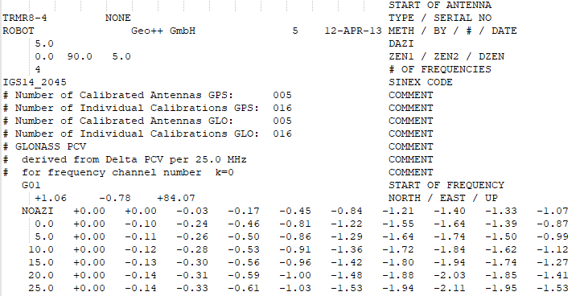
ANTEX (ANTenna EXchange format)
Software Developers: email
ngs.antcal@noaa.gov
Large ASCII data tables
Used as model in processing software
Distributed by IGS and calibration facilities
PCO
PCV
Notes:
Calibrations are typically distributed in the ANTEX format.
If you Google “ANTEX format”, you’ll quickly find the format specification
For each antenna in an ANTEX file, there’s a header section that details the who, what, when, where, how of calibration
The header is followed by the corrections used as model in software.
Are you a software developer who uses antenna calibration products? We’d like to hear from you, as we’re curious where NGS products are being used and where they are NOT being used.

Slide 16
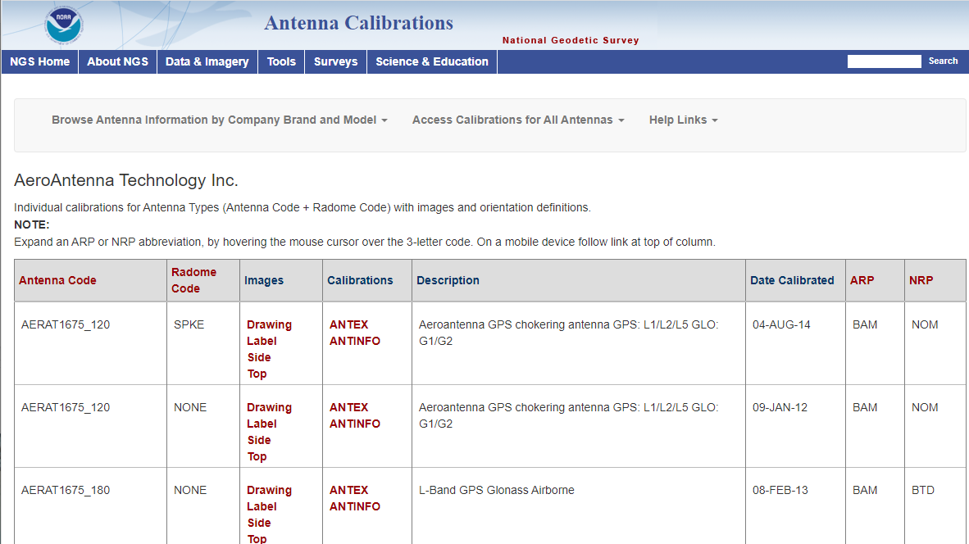
https://geodesy.noaa.gov/ANTCAL/
One big ANTEX file for all receiver antennas in NGS database
Individual calibrations, in ANTEX and ANTNFO formats

Slide 17
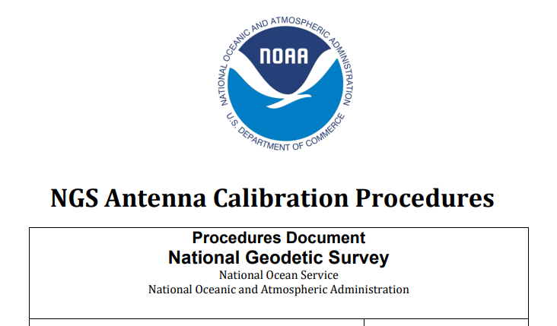
How do antennas appear on ANTCAL?
Sourced from
  IGS ANTEX
  NGS calibrations database
Antenna not listed = has not been calibrated.
User or manufacturer can request calibration
  Send 3+ samples
  Pay all shipping costs
  See Procedures
Calibrations are by default added to public database and products.
Notes:
Either an end user or an antenna manufacturer can request a calibration, as long as they can send in 3 or more samples of a market-ready antenna and pay all shipping costs.
Once an antenna is calibrated by NGS or made available in the IGS ANTEX product, we add it to the NGS public database and products for general use.

Slide 18
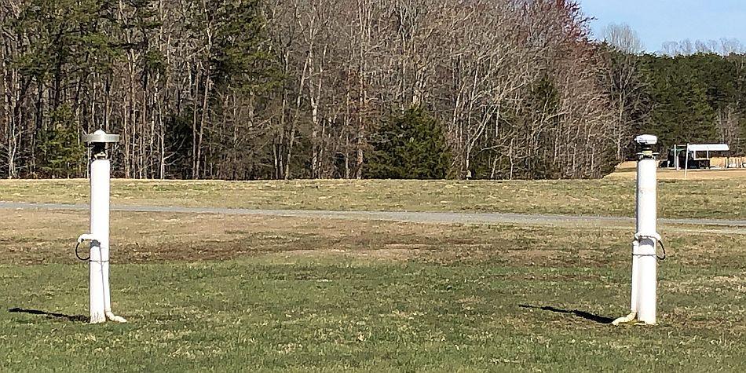
NGS: Relative Calibrations
NGS started in 1994
Adopted by IGS in 1996
Use GNSS receivers and signals from space
ANTEX method (METH):
RELATIVE (CONVERTED)
Notes:
There are three main types of antenna calibrations that you’ll see in ANTEX files.
The earliest calibration technique used for geodetic ground antennas were relative calibrations. Pioneered by NGS in 1994, these corrections were adopted by the IGS for routine network processing in the late 90’s. Relative calibration is an outdoor, field-based method using GNSS receivers and actual signals from GNSS satellites.
In early ANTEX products, when relative calibrations were the only type around, the method type was denoted in ANTEX as RELATIVE. Later, when a different technique came along, NGS relative calibrations had to be CONVERTED to the new standard.

Slide 19
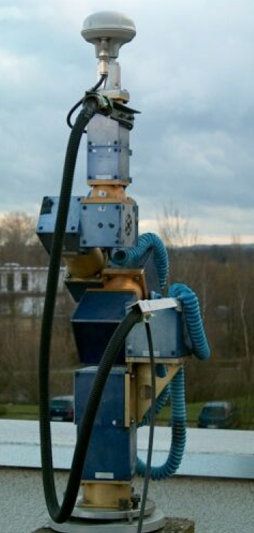
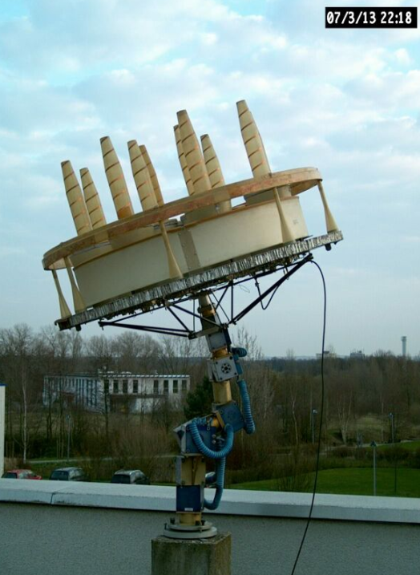
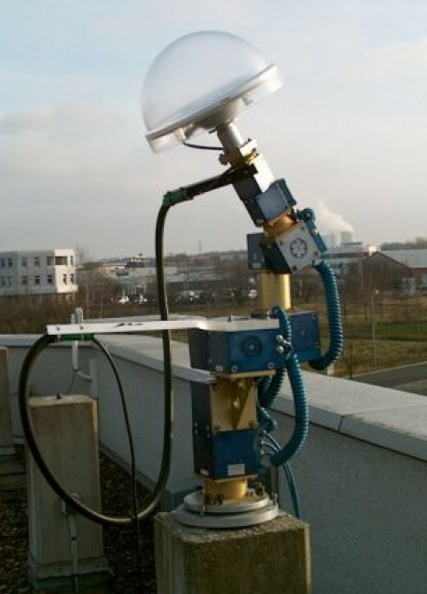
Geo++: the original ‘absolute’
Developed ~ 2000
Adopted by IGS in 2006
Robot + software used at many IGS calibration institutions
GNSS receivers and signals from space
ANTEX method (METH): ROBOT
Notes:
That new technique was called absolute calibration. Like relative calibrations, absolute calibrations are computed with signals from space recorded by GNSS receivers. Instead of mounting the antenna under test on a static monument, absolute calibrations use a robot to manipulate the antenna being tested.
Pioneered by a company called Geo++ in Germany, absolute calibrations became the IGS standard in 2006. Geo++ has sold its complete robot and software system to other institutions, all of which contribute to the IGS calibration files.
In the IGS calibration files, to this date the label ROBOT is synonymous with the Geo++ robot and technique.

Slide 20
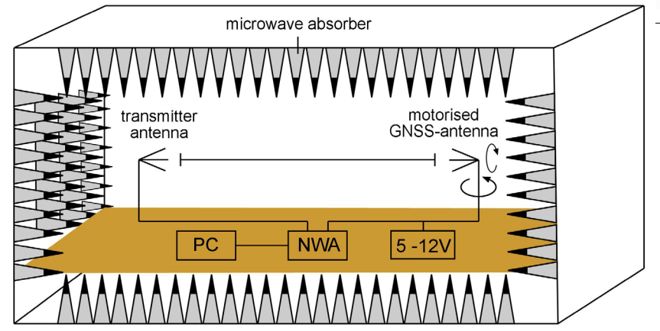
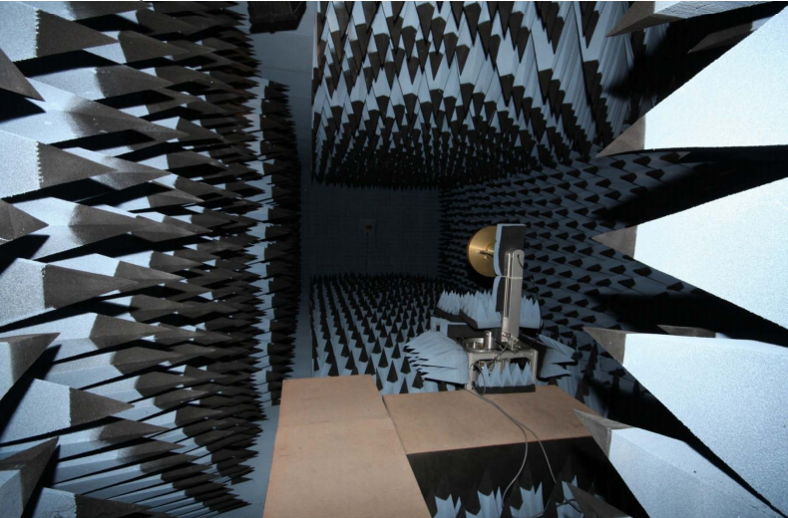
Chamber calibrations
Anechoic chamber
Network analyzer (not a receiver)
No signals in space
ANTEX method (METH): CHAMBER
Notes:
The third calibration method seen in ANTEX is the CHAMBER calibration. These calibrations are done indoors in reflection-free environment using artificial GNSS signals.

Slide 21
Utility of Antenna Calibrations
… viewed through NGS’s OPUS service
Notes:
Now that you know a lot about calibration data and techniques, let’s look at the effect of these calibrations on positioning results.

Slide 22
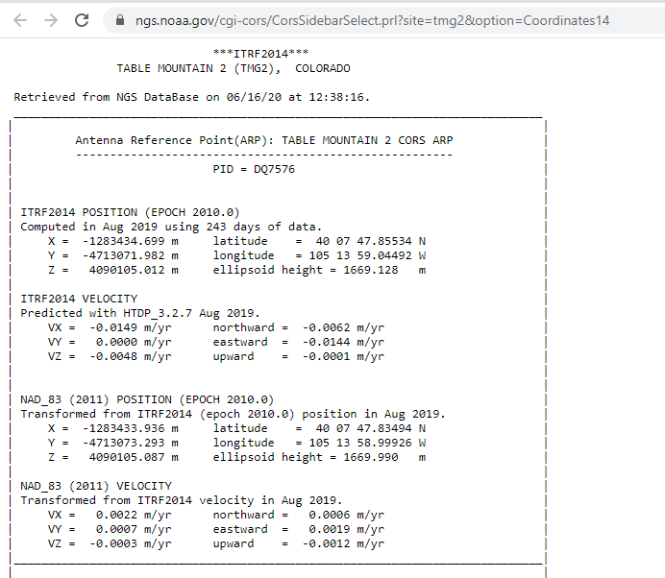
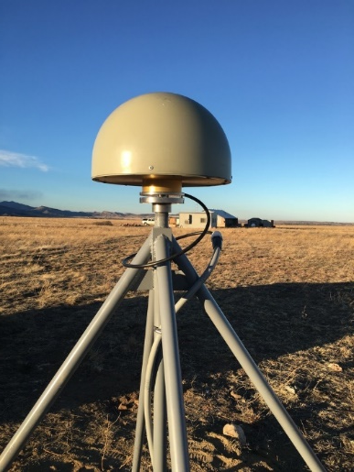
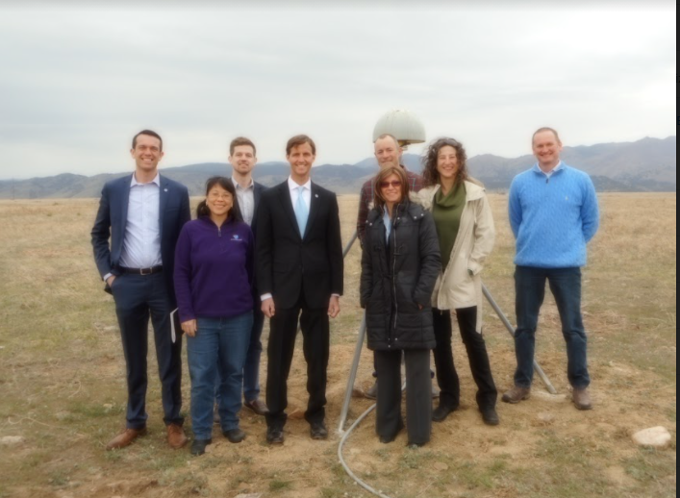
TMG2 near Boulder, CO
Notes:
I will use a Foundation CORS as a test case for the effects of antenna calibration on position results.
Here’s a number of NGS staff members, including myself, with the Admiral when we were honored to have him out to the Table Mountain Geophysical Observatory for a site visit. We’re standing in front of station TMG2, a Foundation CORS station. From NGS’s website, we can pull down position information for this station which has been computed using ¾ of a year of data and reported at epoch 2010.0. I’ll use these NAD83 (2011) coordinates, at epoch 2010, as a reference in the next slide.

Slide 23
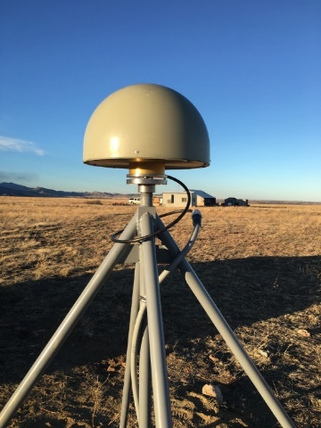
OPUS Results – TMG2
NAD83_2011 (epoch 2010.00), relative to MCYS2 coordinates; 2021 Jan 01 data
Units of cm on all quantities
TMG2 actual antenna model
* peak-to-peak error
Antenna | Radome |  | ΔN | E | Ellip Ht | Ht err* |  | Δ PCO up (L1/L2)
JAVRINGANT_DM | SCIS |  | -0.34 | 0.42 | -1.40 | 1.3
TRMR8_GNSS | NONE |  | 0.12 | 0.67 | 7.80 | 0.8 |  | -0.2 / -4.3
LEIAT504 | SCIS |  | -0.34 | 0.59 | -1.20 | 1.3 |  | 0.0 / 0.0
JAVGRANT_G5T+GP | NONE |  | -0.43 | -0.17 | -0.20 | 1.2 |  | -4.5 / -6.9
EML_REACH_RS2 | NONE |  | -0.34 | 0.26 | 11.30 | 1.1 |  | 5.0 / 2.2
Notes:
Let’s take a look at what happens if we process TMG2 GPS data with OPUS for a single day, using different antennas. I randomly selected the first day of this year, when final orbit products are not yet available but the rapid orbits should be pretty solid. When selecting a antenna model, OPUS returns the position at the ARP. In this table, I remove the single-day GPS position solution of the ARP from the published coordinates of the ARP, so we can look at the effect of antenna choice on the position solution.
TMG2 operates with a Javad chokering antenna with SCIGN short dome installed on the antenna. In this first line of the table, we see that the single-day OPUS result recovers the published coordinates; note that the 1.4 cm height difference is within the expected error bounds.
For the remaining lines of the table, I ran the same data through OPUS but with different antennas. A couple features are interesting to note:
An incorrect choice of antenna may result in a significant height error.
People are often tempted to think of PCO as a physical height offset. To debunk this framing, in the last column, I provide the difference in the PCO up component for the calibration relative to the as-installed antenna. There is no one-to-one correspondence between the PCO up differences and the ellipsoid height difference. So PCO cannot be mapped directly to a height error.

Slide 24
Why Does NGS Do Antenna Calibration?
Antenna calibration is necessary to obtain the most precise and accurate GNSS positions possible.
Antenna calibration supports NGS’s mission to define, maintain, and provide access to the National Spatial Reference System (NSRS).

Slide 25
Antenna Calibration Services at NGS

Slide 26
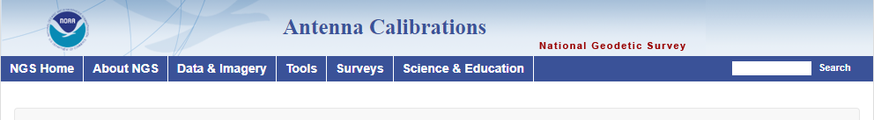
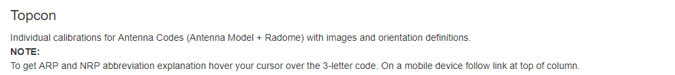
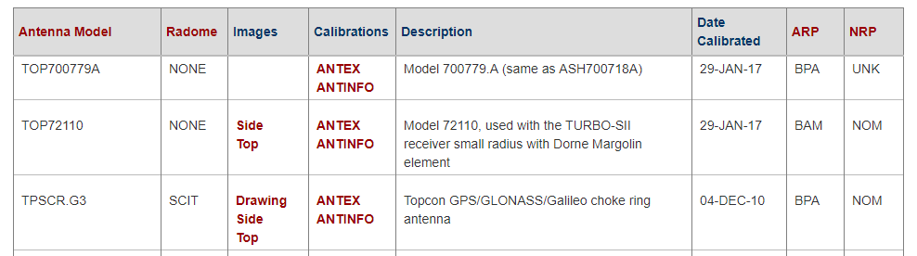
NGS Calibration Products
Consistently combines IGS and NGS data
Antenna metadata
  Descriptions
  Photos & drawings
  ARP and NRP
geodesy.noaa.gov/ANTCAL/

Slide 27
NGS Relative Calibrations
Calibration of test antenna determined relative to the reference antenna
Calibrated > 500 antenna types and configurations to date

Slide 28
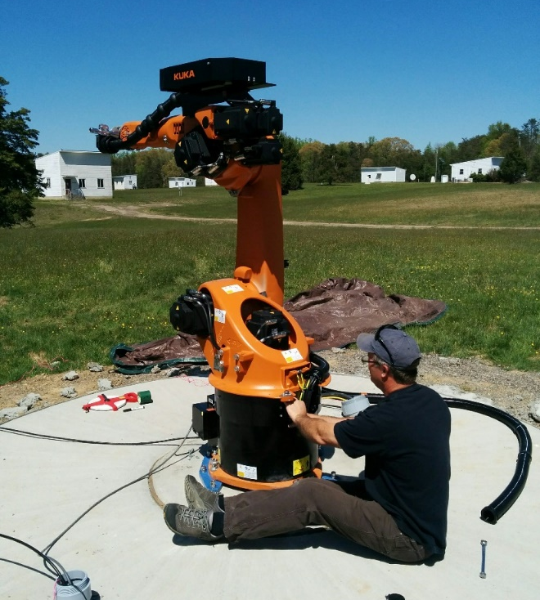
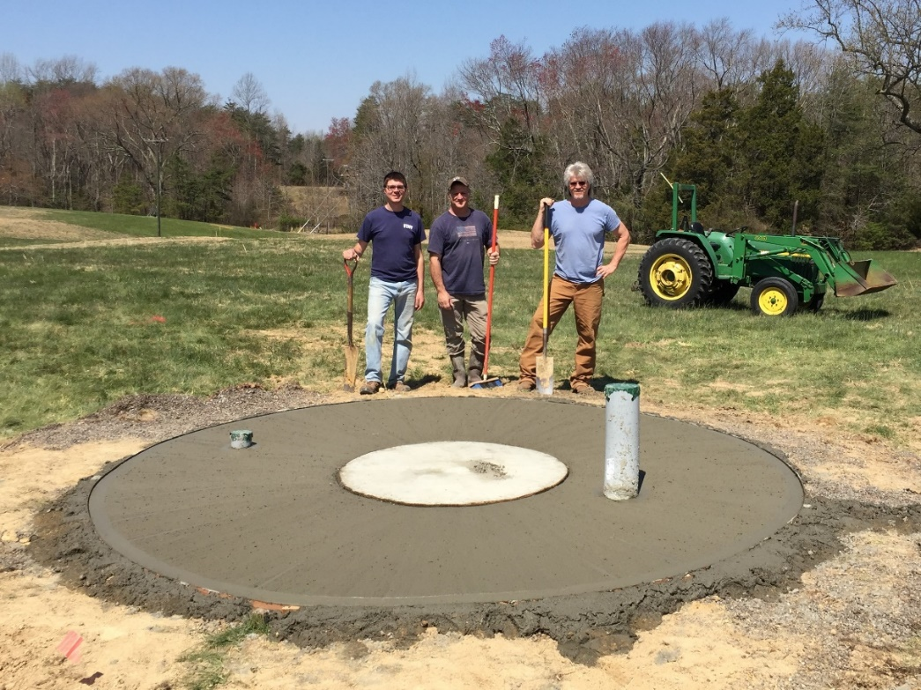
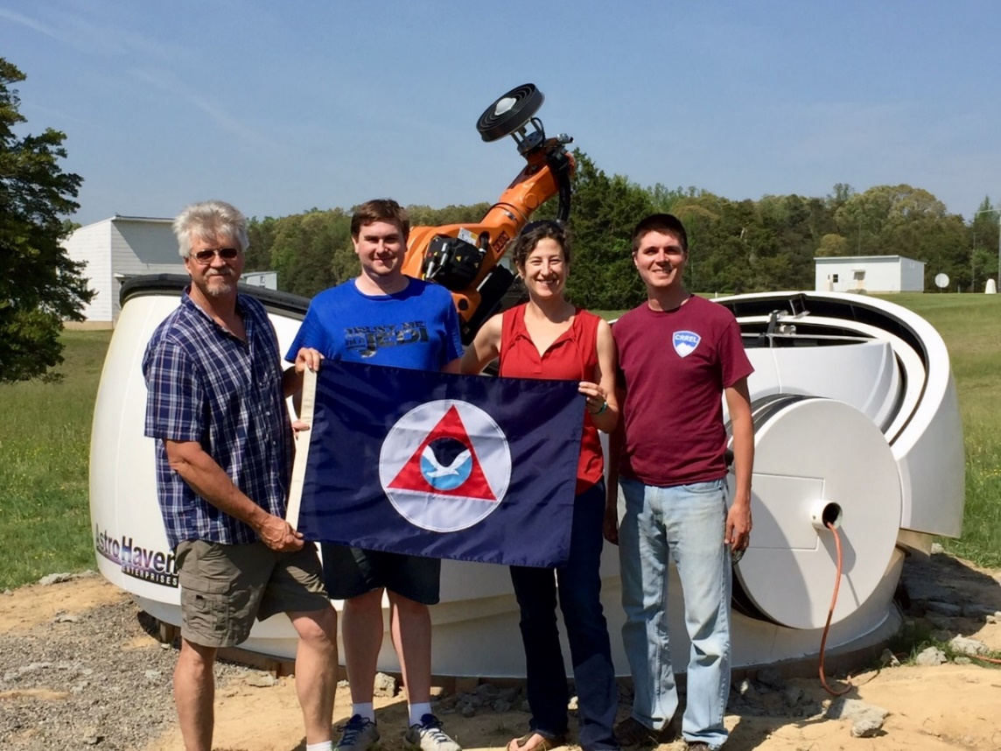
NGS Absolute Calibrations
NGS’s Testing and Training Center near Fredericksburg, VA

Slide 29
Field Methods: Relative vs. Absolute
 | Relative | Absolute
Calibration values | Relative to a reference antenna (AOA D/M_T) | Independent of reference antenna
Method | Stationary antennas | Test antenna moves
Advantages | Straightforward math | Sample full hemisphere and low elevation angles; fast testing
Limitations | Cannot sample full pattern (azimuthal dependence); slow testing | Requires robot and rigorous accounting of angles & rotations
Notes:
In a relative calibration, all PCOs and PCVs are computed with respect to a reference antenna. This has a few significant disadvantages.
In an absolute calibration, all antenna offsets and phase center variations are independent of the reference antenna. This independence from a reference antenna is why absolute calibration is now considered the standard technique.

Slide 30
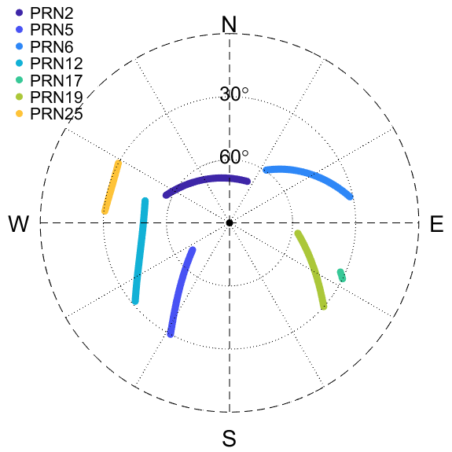
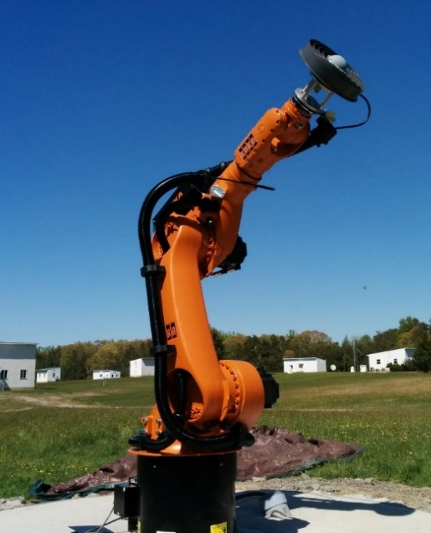
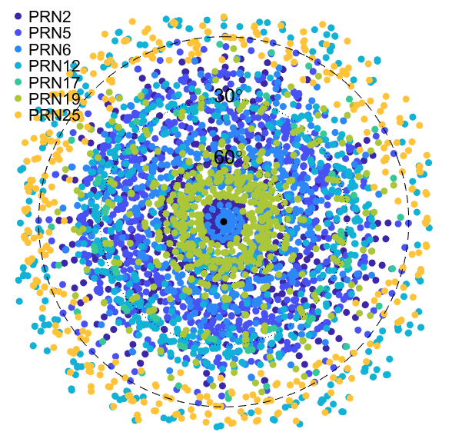
What’s the robot for?
Receive signals at all possible angles
Move antenna precisely (0.2 mm or better)
Keep antenna fixed in space
Cancel out factors affecting the signal…
Notes:
To compute a calibration over the full range of possible satellite reception angles, it is necessary to move the antenna around.
NOTES TO ME: C:\antcal\work\skyplot_staticVSdynamic.m

Slide 31
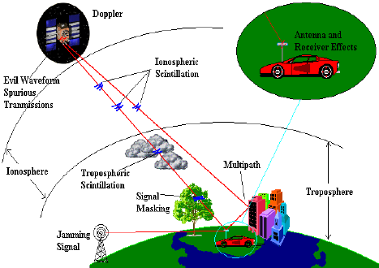
GNSS signals are affected by a lot of stuff
Antenna calibration requires removing all the factors to isolate “antenna effects”
All these factors influence the GNSS phase observation

Slide 32
Moving antenna + math = everything but `antenna effects` cancel out
1) Station differences
satellite clocks
ionosphere
troposphere
2) Satellite differences
receiver clocks
3) Time differences
multipath
reference ant. calib.
Time₂
Time₁
Test
(end of robot)
Reference
(nearby pier)
GRP
PCO
Time₂ minus Time₁ = 1-3 seconds
GRP: Geometric Reference Point (see Blueprint Part 3)
Notes:
By moving the antenna under test with a robotic arm, and doing some creative math, we can get everything but the antenna effects to cancel out.
Absolute calibration at NGS is accomplished through a series of three differencing operations, where data points are subtracted from each other to eliminate any factor that is not an antenna effect. I’m going to walk you through these operations using more cartoon antennas.
The NGS calibration technique starts with two monuments on a very short baseline, with known coordinates at their geometric reference points (GRP). One GRP is the tool end of the robot, and the other GRP is on a concrete pier a few meters away.
The we add two antennas. The antenna being calibrated is mounted onto the robot. The second antenna serves as a reference. Then we hook them up to GNSS receivers and start collecting data. Phase data are collected at a very high rate, typically 10 samples per second, to enable some creative math.
Calibrations require subtracting phase observations from each other to cancel out undesired effects. In the first differencing operation, we difference data from one satellite that is observed at both stations. This eliminates the satellite clock. Also, due to the short baseline, we can assume that atmospheric effects such as ionosphere and tropospheric delay are identical at the two stations, so those drop out as well.
In the second differencing operation, we then subtract data from two satellites, again observed at both stations. This eliminates the receiver clock.
After collecting a couple seconds of data, we move the test antenna while holding the robot GRP fixed in space.
Note that with both of step1 and step2 differences, we are using data from the same exact moment in time. In the third step, called a “time difference”, we subtract data taken only a few seconds apart. In that brief period of time, the test antenna must be quickly and accurately moved to a totally different orientation in space. During that time interval nothing has changed at the reference antenna – signals are still coming in at exactly the same angles, so site multipath plus calibration effects of the reference antenna are the same. However, the satellite signal is being observed by the test antenna in a totally different location, and that signal is therefore experiencing a different ‘antenna effect’.
The third differencing operation is one additional reason we need a robot – to move the antenna quickly, so that multipath and reference antenna calibration do not change, and will drop out in the data differencing.

Slide 33
NGS
Absolute Antenna Calibration
Examples

Slide 34
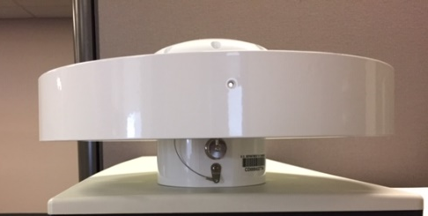
Terminology
Individual
Type Mean
PCV_{ant1}
PCV_{ant2}
PCV_{ant3}
PCV_{ant1}
PCV_{type_mean}
Notes:
One more piece of terminology needs to be introduced before we look at actual data. There are two ways that calibrations are presented, known as individual and type mean.
An individual calibration is what it sounds like – one sample of antenna is calibrated, and it’s PCO and PCV should only be applied to that particular serial number.
With a type mean calibration, 3 or more samples of an antenna type are individually calibrated, often multiple times each, then their data are combined to yield an average calibration. A type mean calibration should average through any manufacturing differences within a model run, and therefore should be generally applicable to any individual antenna with that model code.
Type means are the calibrations presented on the NGS ANTCAL website and in the IGS ANTEX product.

Slide 35
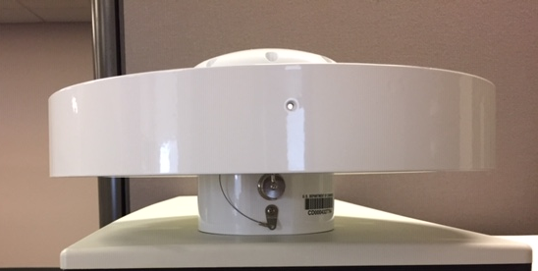
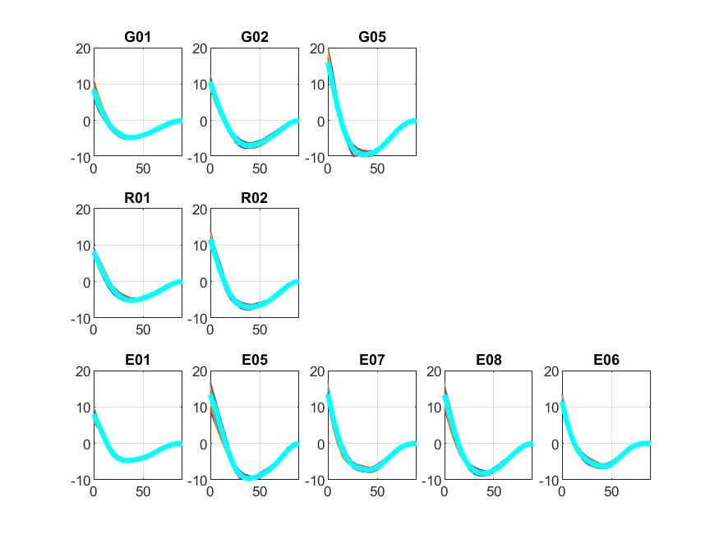
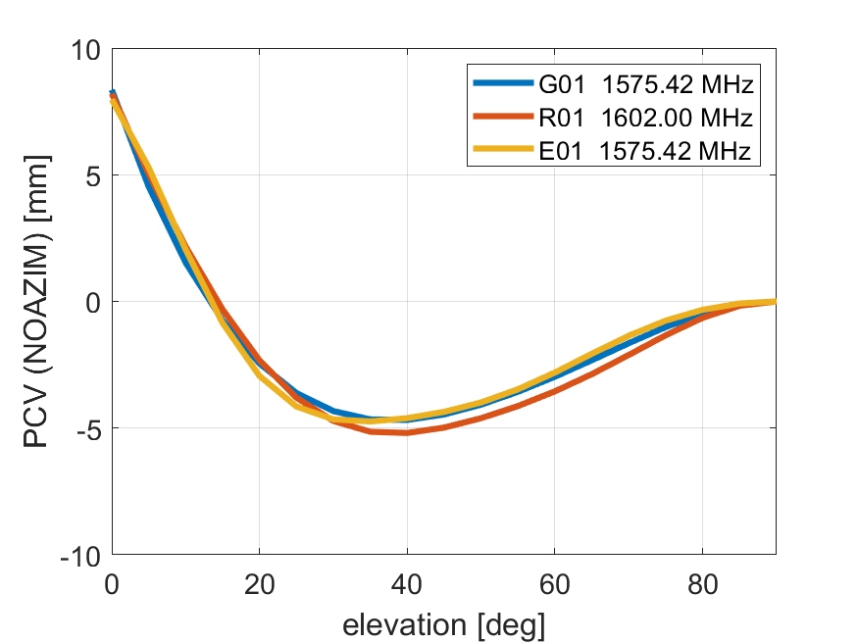
GPS+GLO+GAL
PCO
freq N E U [mm]
-------------------------------
G01 0.10 0.44 124.39
G02 -0.48 -0.08 137.36
G05 -0.17 -0.15 139.69
freq N E U [mm]
-------------------------------
R01 -0.57 1.27 123.12
R02 -0.65 -0.04 135.25
freq N E U [mm]
-------------------------------
E01 0.19 0.24 125.42
E05 -0.48 -0.17 136.10
E07 -0.77 -0.19 140.28
E08 -0.62 -0.23 138.60
E06 -0.80 -0.29 139.26
Serial 5404
Single test: 20jan10a
SEPCHOKE_B3E6 NONE
Notes:
C:\antcal\work\SEPCHOKE_B3E6_NONE_5404_20jan10a
plotAll('GRE','STA2Data')

Slide 36
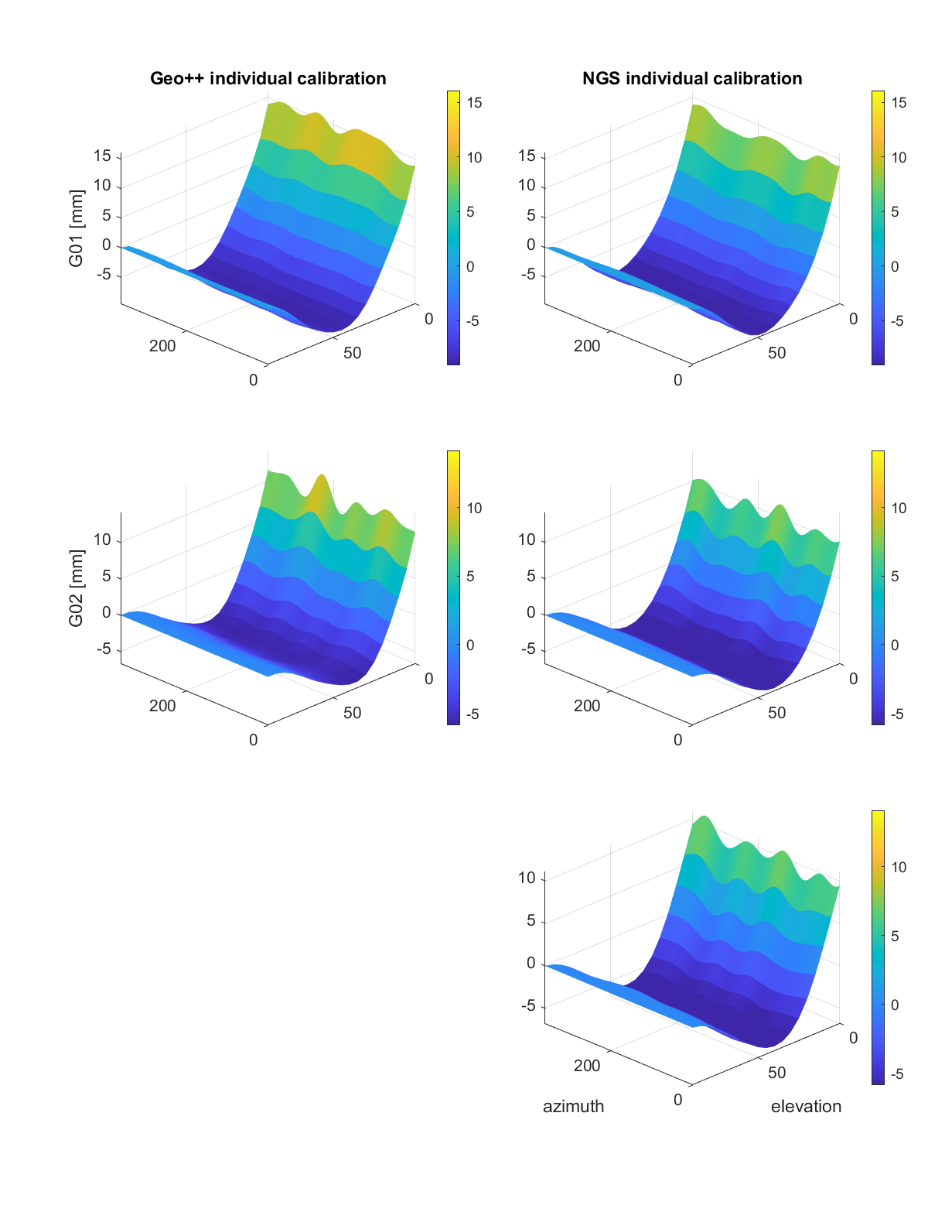
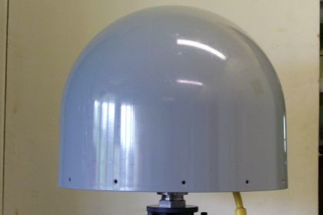
Individual Calibration Comparison
TRM59800.00 SCIT provided by UNAVCO
Geo++ GPS L1+L2 calibration (2 tests) versus NGS (4 tests)
Geo++ N E U [mm]
-------------------------------
G01 1.39 1.09 85.06
G02 1.09 -0.86 117.61
NGS N E U [mm]
-------------------------------
G01 -1.64 0.70 87.02
G02 0.11 0.29 117.02
Notes:
C:\antcal\work\TypeMeans\TRM59800.00_SCIT_4846A60358
load typeMeanCV.mat
calib = TM('G')
calib.sys = 'G'
compareTMeanNGS('TRM59800.00 SCIT', calib, atx)

Slide 37
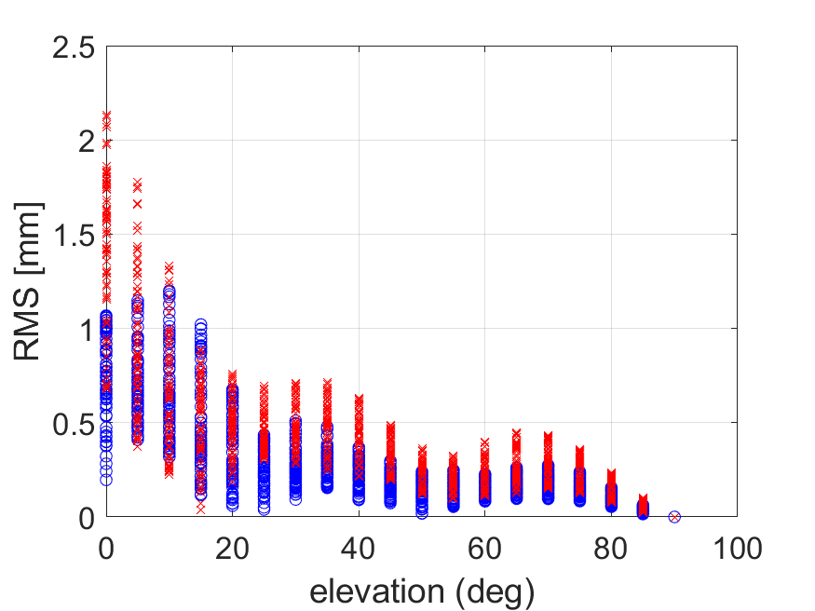
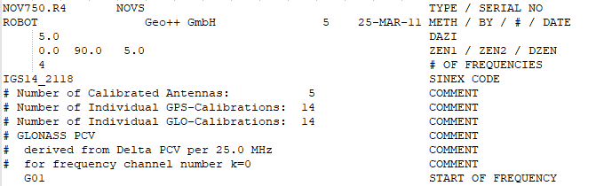
Type Mean
Combined solution of 3+ samples
  Natural variation in individual results
  Published in IGS and NGS ANTEX
NGS will include combination statistics with published calibrations
Notes:
I mentioned that type mean calibrations combine 3 or more sets of results, to average through the natural variation in individual results. The ANTEX header for each antenna typically contains information on the number of antennas which contribute to the type mean – the more, the better!
To help users understand the natural variability within a model run, NGS commits to providing error estimates and combination statistics with our published absolute calibrations. Here’s an example of root-mean-squared error from a recent type mean computation, showing that this antenna type had 1-2 mm of variation in PCVs within the tested antenna group.

Slide 38
But when?
NGS will email every attendee of this webinar
NGS will also notify stakeholders through website, newsletter, etc.
Soon – hopefully spring to summer 2021
NGS cannot calibrate every antenna,
so NGS results must be combined with others
Therefore, accurate positioning with any antenna requires NGS results to be consistent with results from other calibration institutions
Work with IGS Antenna Working Group
to verify results

Slide 39

Near Future

Slide 40
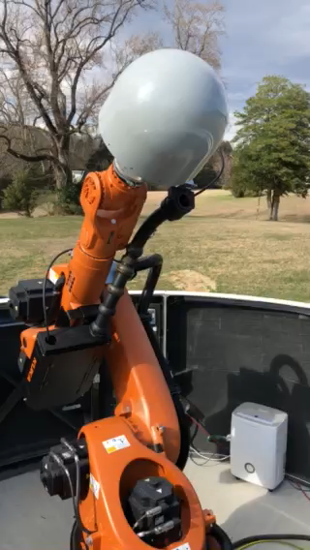
NGS Robotic Calibrations
Absolute calibrations
GPS+GLO+GAL; add other GNSS later
Prioritize type mean, but individual possible for research purposes
Calibrations are publically available
  On ANTCAL website
  Direct to OPUS “pick list”
Public service provided at no charge*
* provider covers shipping

Slide 41

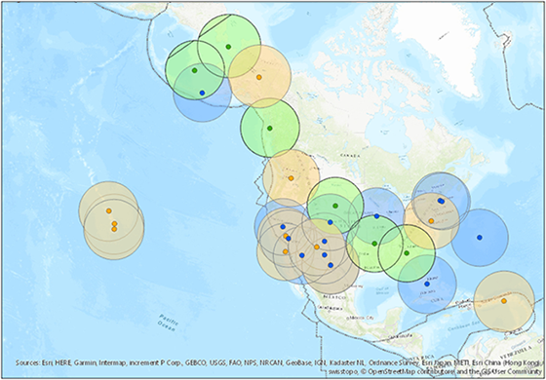
Calibrate important geodetic antennas
NOAA Foundation CORS Network (NFCN)
NOAA CORS Network (NCN)
  Joining network
  Equipment changes
Reference frame stations
OPUS “pick list”
New equipment marketed to NGS stakeholders

Slide 42
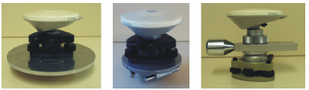
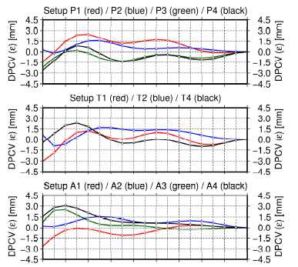
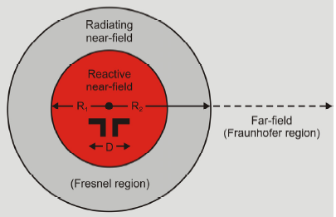
Research: antenna near-field
Antenna nearfield affects calibration
P2
T2
A2
Graphics from Dilssner et al (2008), Impact of Near-Field Effects on the GNSS Position Solution

Slide 43
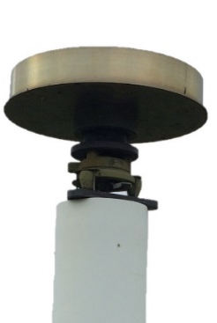
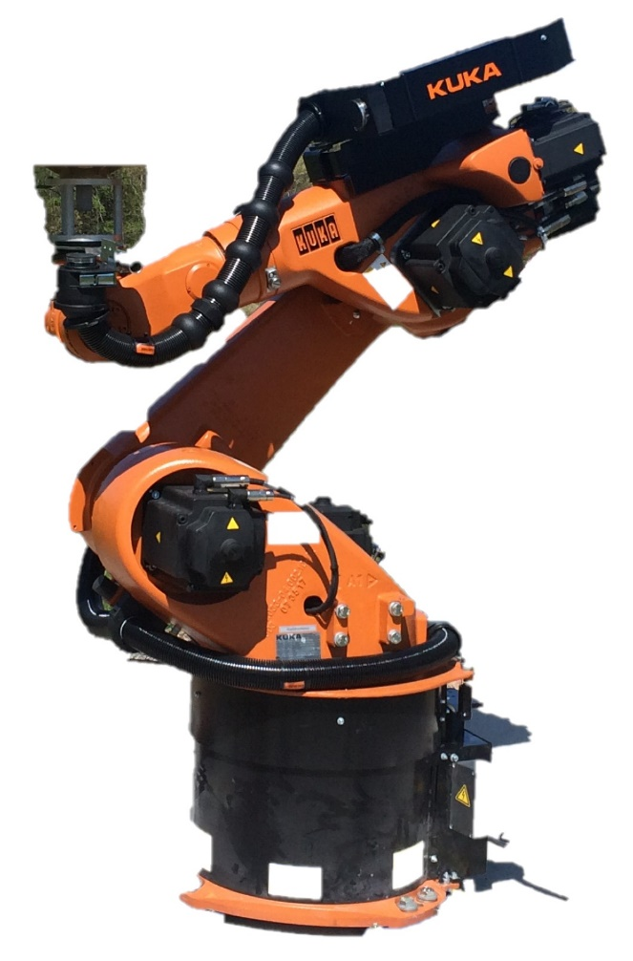

Research: “Mini Monuments”
Antenna nearfield should be part of the calibration
  Mount
  Monument
NGS creating monument “tops” for testing
60 kg
[132 lbs]

Slide 44
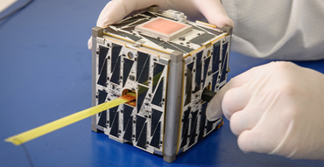
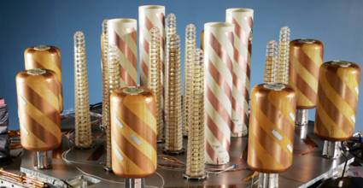

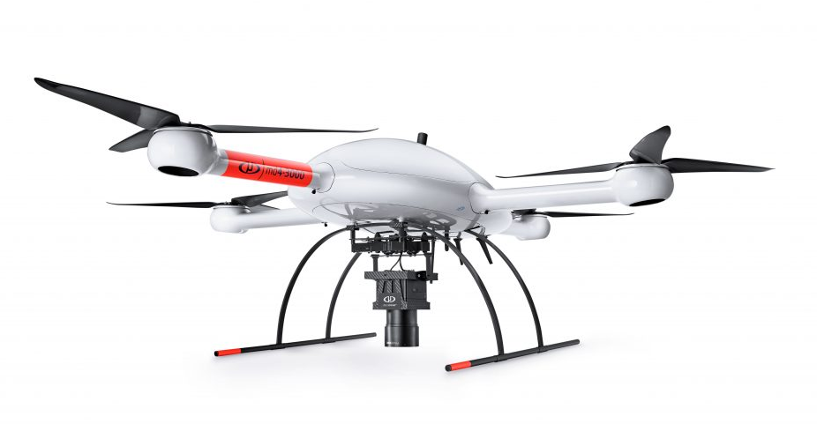
Research: other platforms
Calibrate other antennas that NGS uses
  Satellite arrays
  Mini satellites / LEOs
  Aircraft antennas w/ fuselage
  UAVs

Slide 45
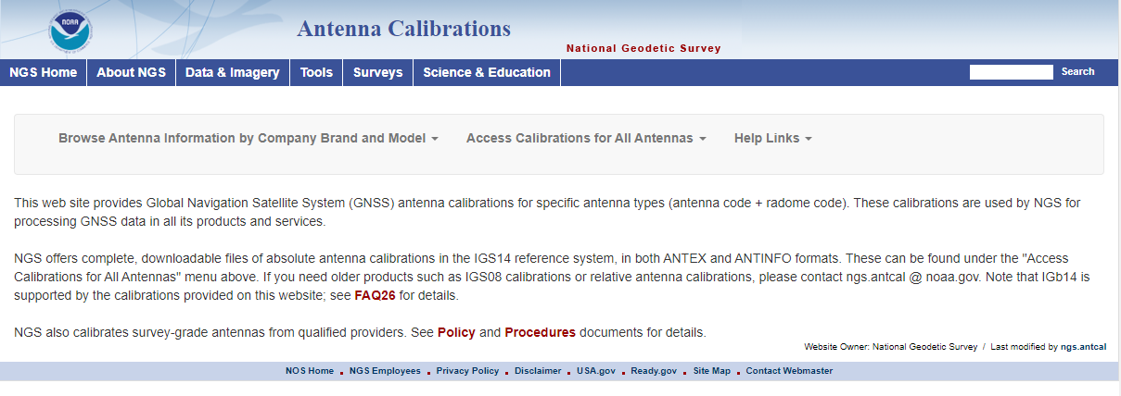
Thank You!
For more information
https://geodesy.noaa.gov/ANTCAL/
  Policy
  Procedures
  FAQ
Email ngs.antcal@noaa.gov

Slide 47
END OF PRESENTATION reserve slides follow

Slide 48




New Kids on the Block
ETH Zurich [Switzerland]
(Willi and Rothacher, IGS Workshop 2018)
NGS [Virginia USA]
Geoscience Australia [Canberra]
University of Wuhan
(Hu and Zhao, IGS Workshop 2018)
Notes:
A number of groups, mine included, have developed their own calibration techniques using other types of multi-axis robots. These industrial robots are
relatively inexpensive
straightforward to program for the movements necessary for antcal
Fairly precise (0.2 mm accuracy with position and orientation)
This is an exciting time for antenna calibrations, as we hope having multiple absolute techniques, robots, and environments will allow us to do great research and verify Geo++ results.

Slide 49

IGS Approval
All calibrations must “play well together” in igs14.atx
Show close agreement of NGS technique with other IGS-contributing institutions
NGS has two “gold standard
samples” for check calibrations
and comparisions

Slide 50
History of IGS Antenna Calibrations
Antenna calibration file | Reference frame | Calibrations
IGS01 | IGS00?? | Relative
IGS05 | IGS05 / ITRF2005 | Absolute (some robot, mostly converted relatives)
IGS08 | IGS08/IGb08 / ITRF2008 | Absolute (more robot calibs)
IGS14 | IGS14 / ITRF2014 | Absolute (almost all robot/chamber)
Calibrations are “to be used with IGSxx terrestrial reference frame which is closely related to, but not identical with, ITRFxx because the latter is based on the [previous] antenna phase center corrections”
Notes:
Over the history of the IGS, there have been 4 releases of antenna calibrations, each of which matches up to the release of a corresponding IGS terrestrial reference frame.
I’ll note that some of this history has been driven by the evolution of antenna calibrations themselves, where over time the IGS has shifted the calibration method from the original “relative” type to the more robust “absolute” type, which is a nice segue into …

Slide 51

All Models Change Together
Antenna calibrations are tied to
  GNSS orbits
  Station coordinates in a reference frame (ITRF / IGS)
Update/change calibrations of existing antennas only with IGS/ITRF update
http://www.igs.org/network
Notes:
It is the practice of the IGS and the AWG to only change calibration values for existing antennas when there is a frame change, so that all models change together. This is b/c calib inherently tied to orbits and station coordinates. When processing GNSS data, all three of these products need to be tied to the same reference frame.

