Slide 1
Error analysis of the airborne gravity data collected over Alabama in 2008
YM Wang¹, C Huang², J Saleh³, S Holmes⁴, XP Li³,
DR Roman¹, S Preaux ¹, T Dieh¹ , V Childers¹
¹National Geodetic Survey
²National Chiao Tung University, Taiwan
³ERT Inc.
⁴SGT Inc.

Slide 2
Outline
Description of test airborne gravity flights over Alabama at three altitudes in 2008
Airborne gravity modeling and methods of downward continuation
Inter-comparisons between airborne gravity at three altitudes
Comparison with NGS2008 surface gravity survey
Conclusions

Slide 3
Alabama test flights
Flights at altitude of 1700m, 6300m and 11000m over the same area in 2008
Data collected at 10km track spacing at altitude of 1700m and 6300m; 5km track spacing at 11000m
Data processed by applying filters in the frequency domain (cut off frequency 1/40 Hz ~ 4km) , then smoothed by Gaussian filter in the space domain (75 seconds window ~ 6km)
RMS values of the crossovers ranges from 1.6 - 2.1 mGals at the three altitudes

Slide 4
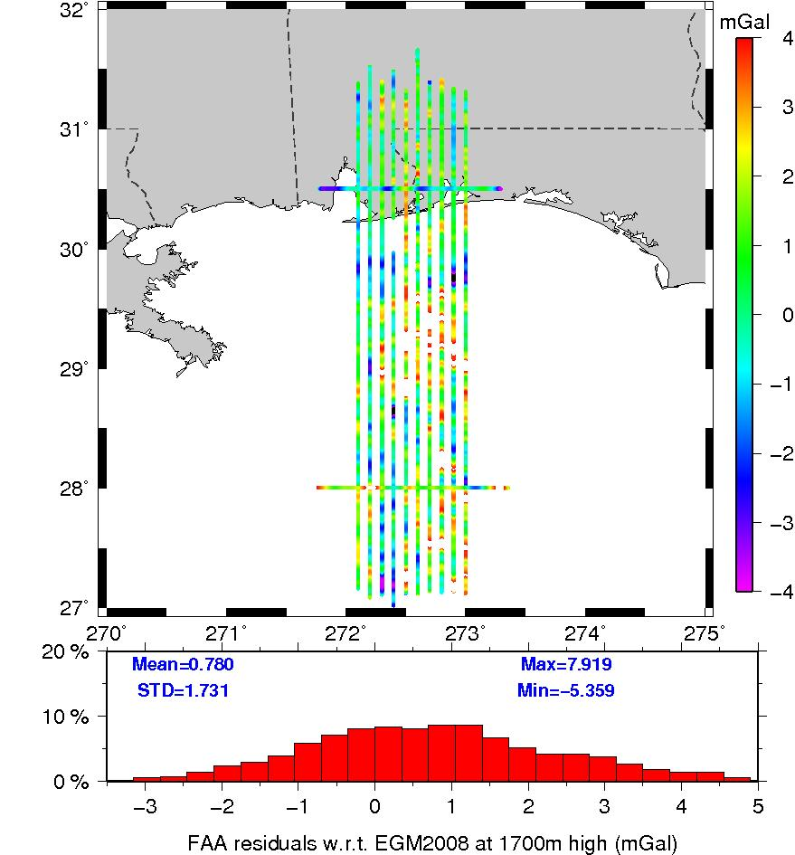

Slide 5
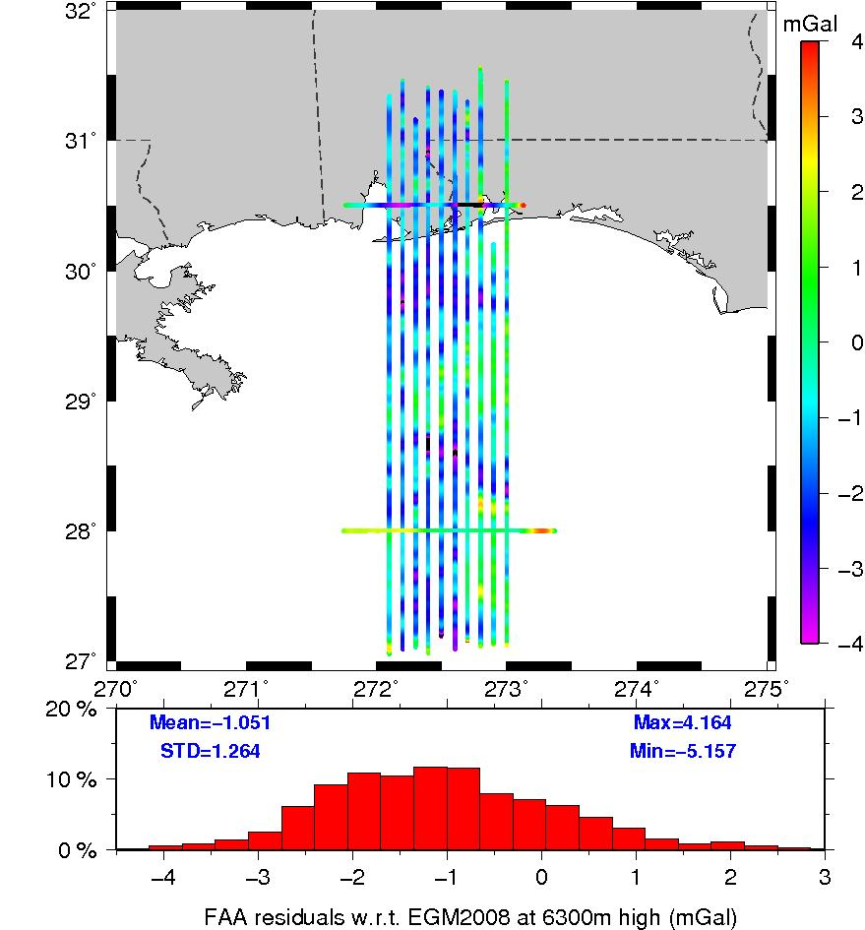

Slide 6
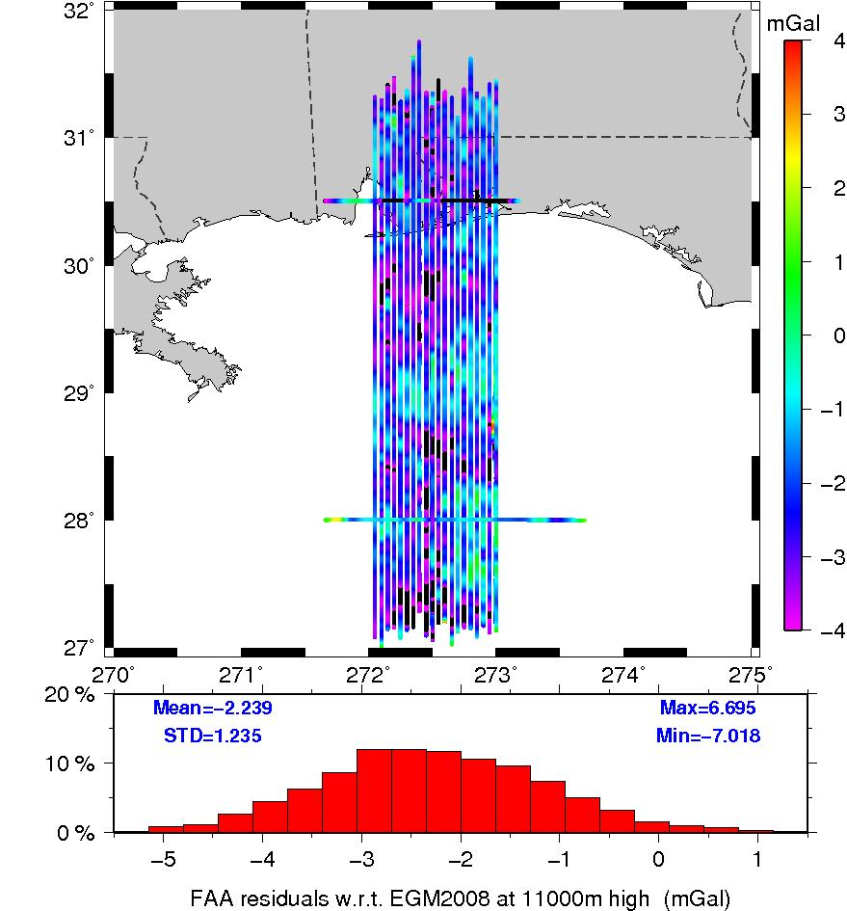

Slide 7
Comparison with EGM08 (Units mGal)
Units in mGal
 | 1700m | 6300m | 11000m
No. | 48869 | 38702 | 78436
Mean | 0.78 | -1.05 | -2.24
RMS | 1.90 | 1.64 | 2.56
STD | 1.73 | 1.26 | 1.24
Min. | -5.36 | -5.16 | -7.02
Max. | 7.92 | 4.16 | 6.70

Slide 8
Modeling airborne gravity and downward continuation
3D Fourier series (3DF) under Isometric Latitude map projection (5’ resolution assumed)
- Coefficients are estimated by the least squares adjustment
- degree variance used for conditioning the normal matrix
- Gravity values are computed from the Fourier series at given locations (e.g., h=0 for downward continuation )
- Spherical harmonic expansion (Nmax=2190, resolution ~ 5’) used for verification

Slide 9
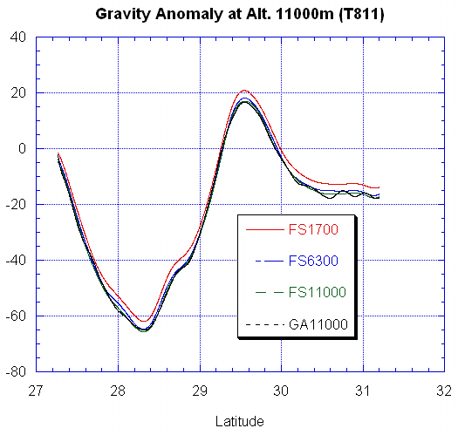
Consistency check

Slide 10
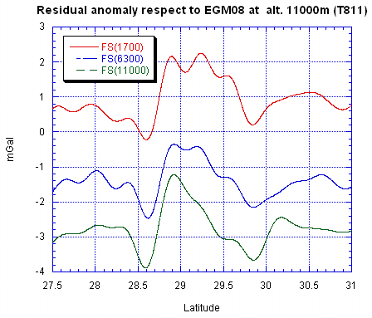
.

Slide 11
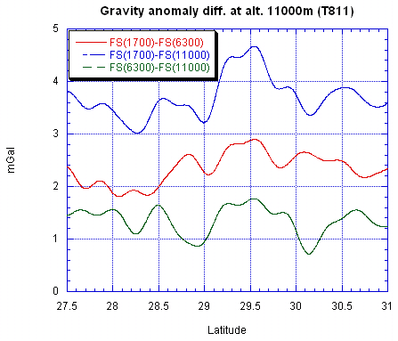
.

Slide 12
Statistics of modeled gravity anom. diff. at alt. 11000m (Units mGal)
 | 1700m- -6300m | 1700m – 11000m | 6300m- 11000m
No. | 78436 | 78436 | 78436
Mean | 1.88 | 3.18 | 1.30
STD | 0.56 | 0.72 | 0.42
RMS | 1.96 | 3.26 | 1.37
Min. | -0.06 | -0.06 | -0.93
Max. | 3.51 | 5.37 | 2.72

Slide 13
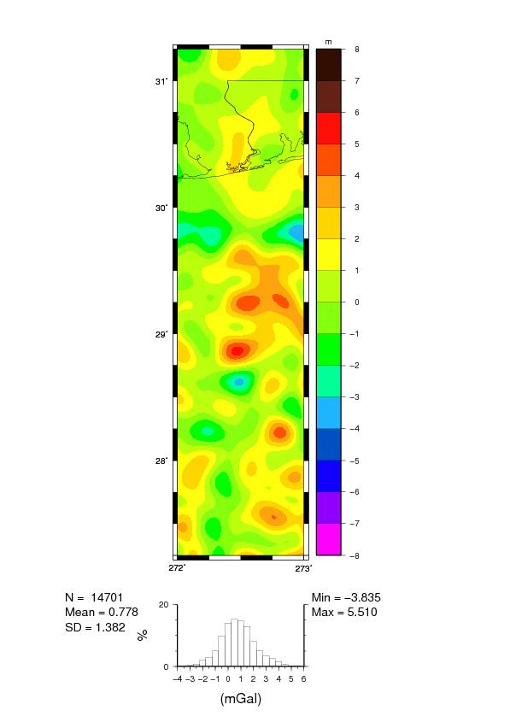
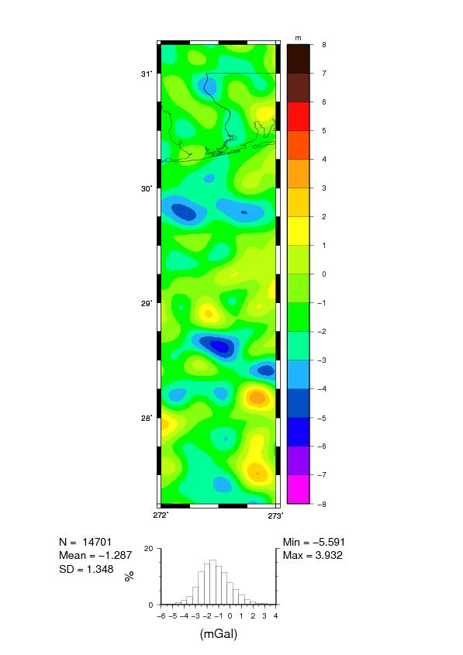
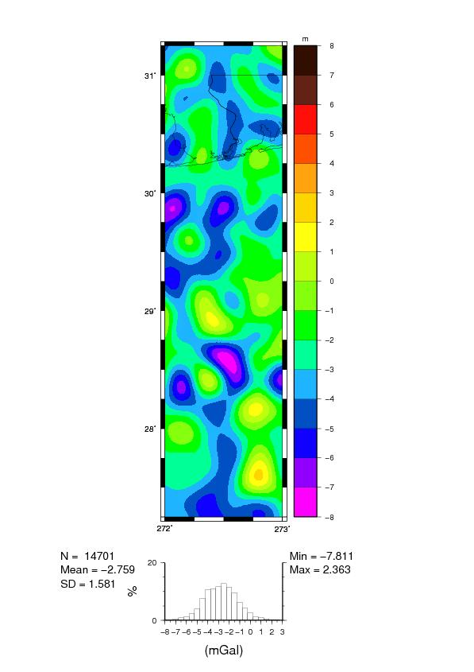
Residual anom. Wrt EGM08 at the ground

Slide 14
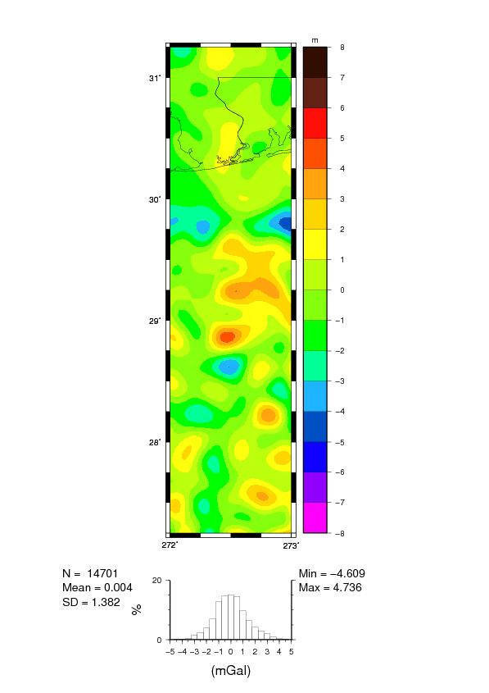
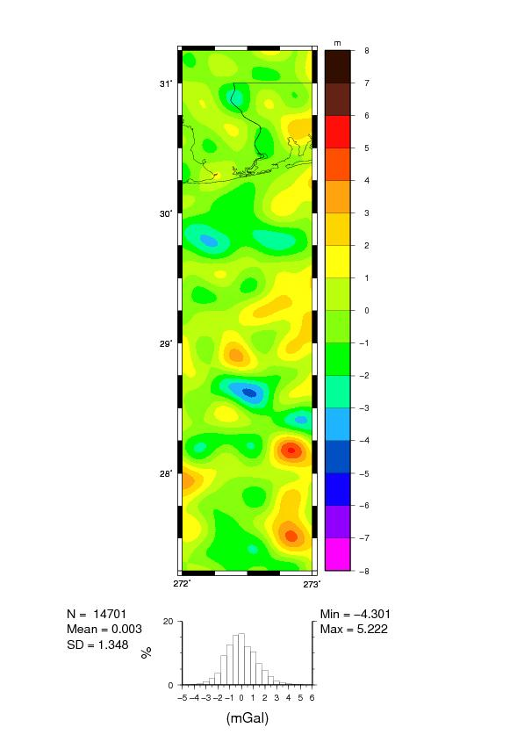
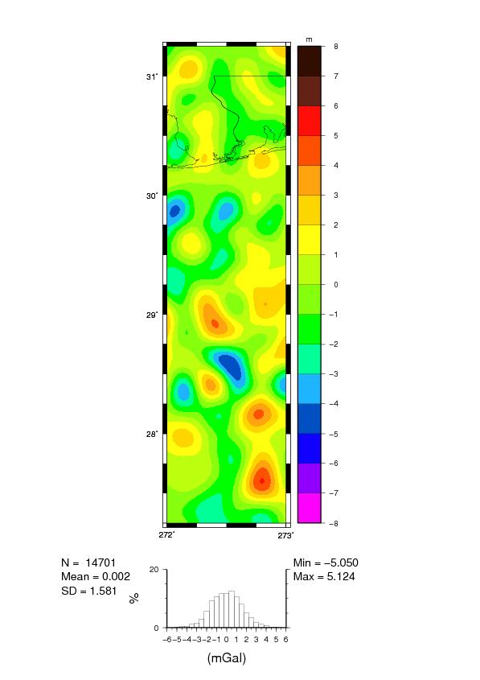
Residual anom. Wrt EGM08 at the ground (bias removed)

Slide 15
Statistics of the modeled gravity anom. diff. at the ground (Units in mGal)
 | 11000m- -6300m | 11000m – 1700m | 6300m- 1700m
No. | 14701 | 14701 | 14701
Mean | -1.47 | -3.54 | -2.06
STD | 1.12 | 1.50 | 1.15
RMS | 1.85 | 3.84 | 2.37
Min. | -5.87 | -7.96 | -5.37
Max. | 1.71 | 1.09 | 1.97

Slide 16
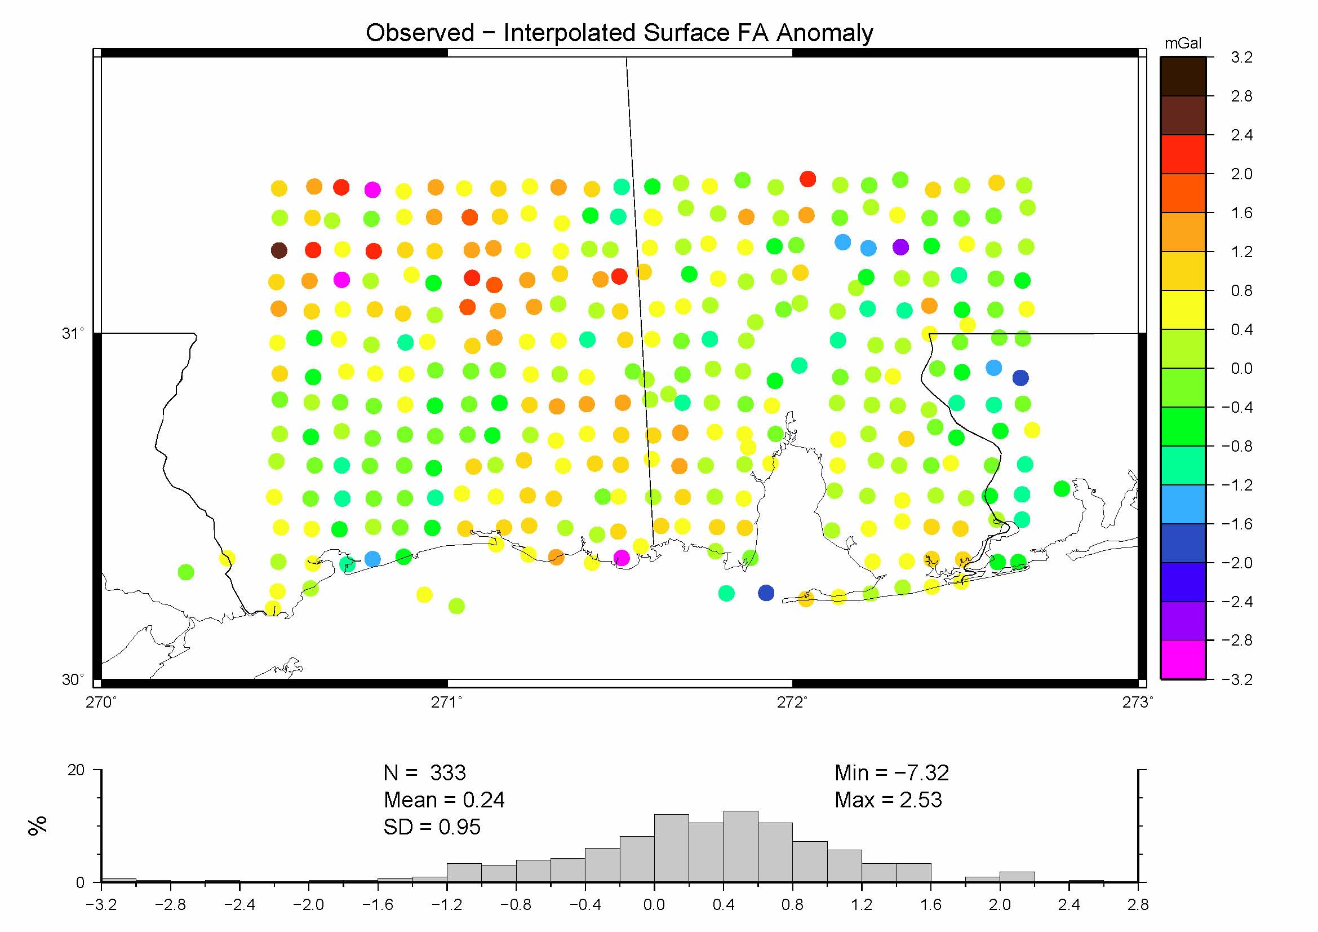
Surface gravity survey 2008
Units in mGal

Slide 17
Statistics of the gravity difference wrt gravity survey 2008 (Units in mGal)
 | 1700m | 6300m | 11000m
No. of Pts. | 84 | 84 | 84
Mean | -0.87 | 1.45 | 2.75
STD | 1.34 | 1.32 | 1.74
RMS | 1.60 | 1.95 | 3.26
Min. | -3.99 | -2.35 | -2.56
Max. | -1.95 | 4.35 | 6.73

Slide 18
Summery
At altitude 11000m, the RMS values of differences between the gravity collected at the three altitudes are between 1.4 to 3.3 mGal. Excluding the mean, the agreement is better than 1 mGal (STD).
At the ground, the RMS values of the downward continued gravity anomalies from the three altitudes are between 1.9 to 3.8 mGal . Excluding the mean, the differences (STD) are smaller than1.5 mGal.
The airborne gravity anomalies agree with NGS2008 surface gravity from 1.6 to 3.3 mGal (RMS) . If the mean is removed, the agreement is reduced to 1.3 to 1.7 mGal.
Res. geoid contributions (EGM08) are within ±2 cm.

Slide 19
Conclusions
The gravity collected at the three altitudes seem to have accuracy of 2-3 mGal at the ground (flat area)
The data collected at 11000m performs the worst in comparisons (smaller signal/noise ratio, D. C. effect).
The data collected at 1700m does not perform significantly better than at altitude 6300m, because of the track spacing (10km) and the smoothing applied.
Reasons for bias problem are not known. However, it can be solved through using satellite models.

