Slide 1
Geoid model development at NOAA’s National Geodetic Survey
Kevin Ahlgren, PhD
NOAA/National Geodetic Survey
kevin.ahlgren@noaa.gov

Slide 2
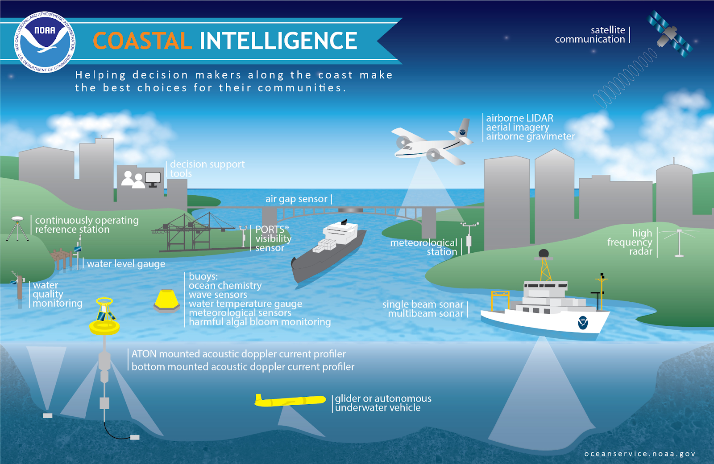
oceanservice.noaa.gov
Notes:
What’s the big deal with a geoid model? On the slide, we see just a few examples of the various science applications that are performed at the National Ocean Service in support of coastal mapping, intelligence, and resilience. All of these elements have a clear need to know exactly where they are! A CONSISTENT latitude, longitude, and ESPECIALLY height. These geospatial coordinates are the underpinning, and hidden infrastructure that is necessary for all sorts of science and geospatial applications. NOAA’s National Geodetic Survey provides the nation with the National Spatial Reference System (NSRS), which defines and provides access to the latitude, longitude, height, and gravity across the country.

Slide 3
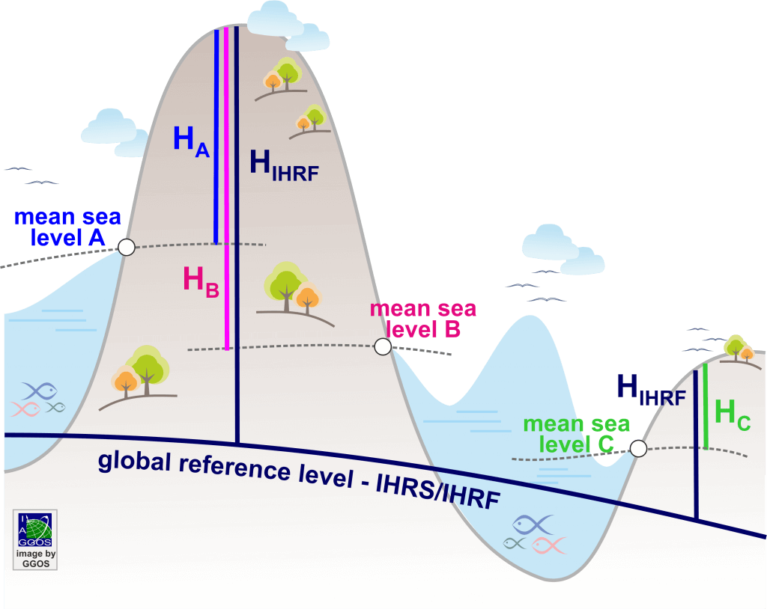
Real-world needs for an accurate Reference Frame / Vertical Datum
Bridge in Laufenburg connecting Germany and Switzerland
oceanservice.noaa.gov
Notes:
27 cm difference between Swiss datum and German datum – Switzerland using values from the Mediterranean Sea and Germany using values from the North Sea.
This was known at the time and it was accounted for in the plans - But an error occurred in implementation where on the Swiss side, they were supposed to add the 27 cm BUT instead they subtracted the 27 cm. Thus a 54 cm problem.
This illustrates the real-world need for a consistent, defined reference frame and vertical datum, which is what NOAA and NGS provide the nation for the past 200 years.

Slide 4
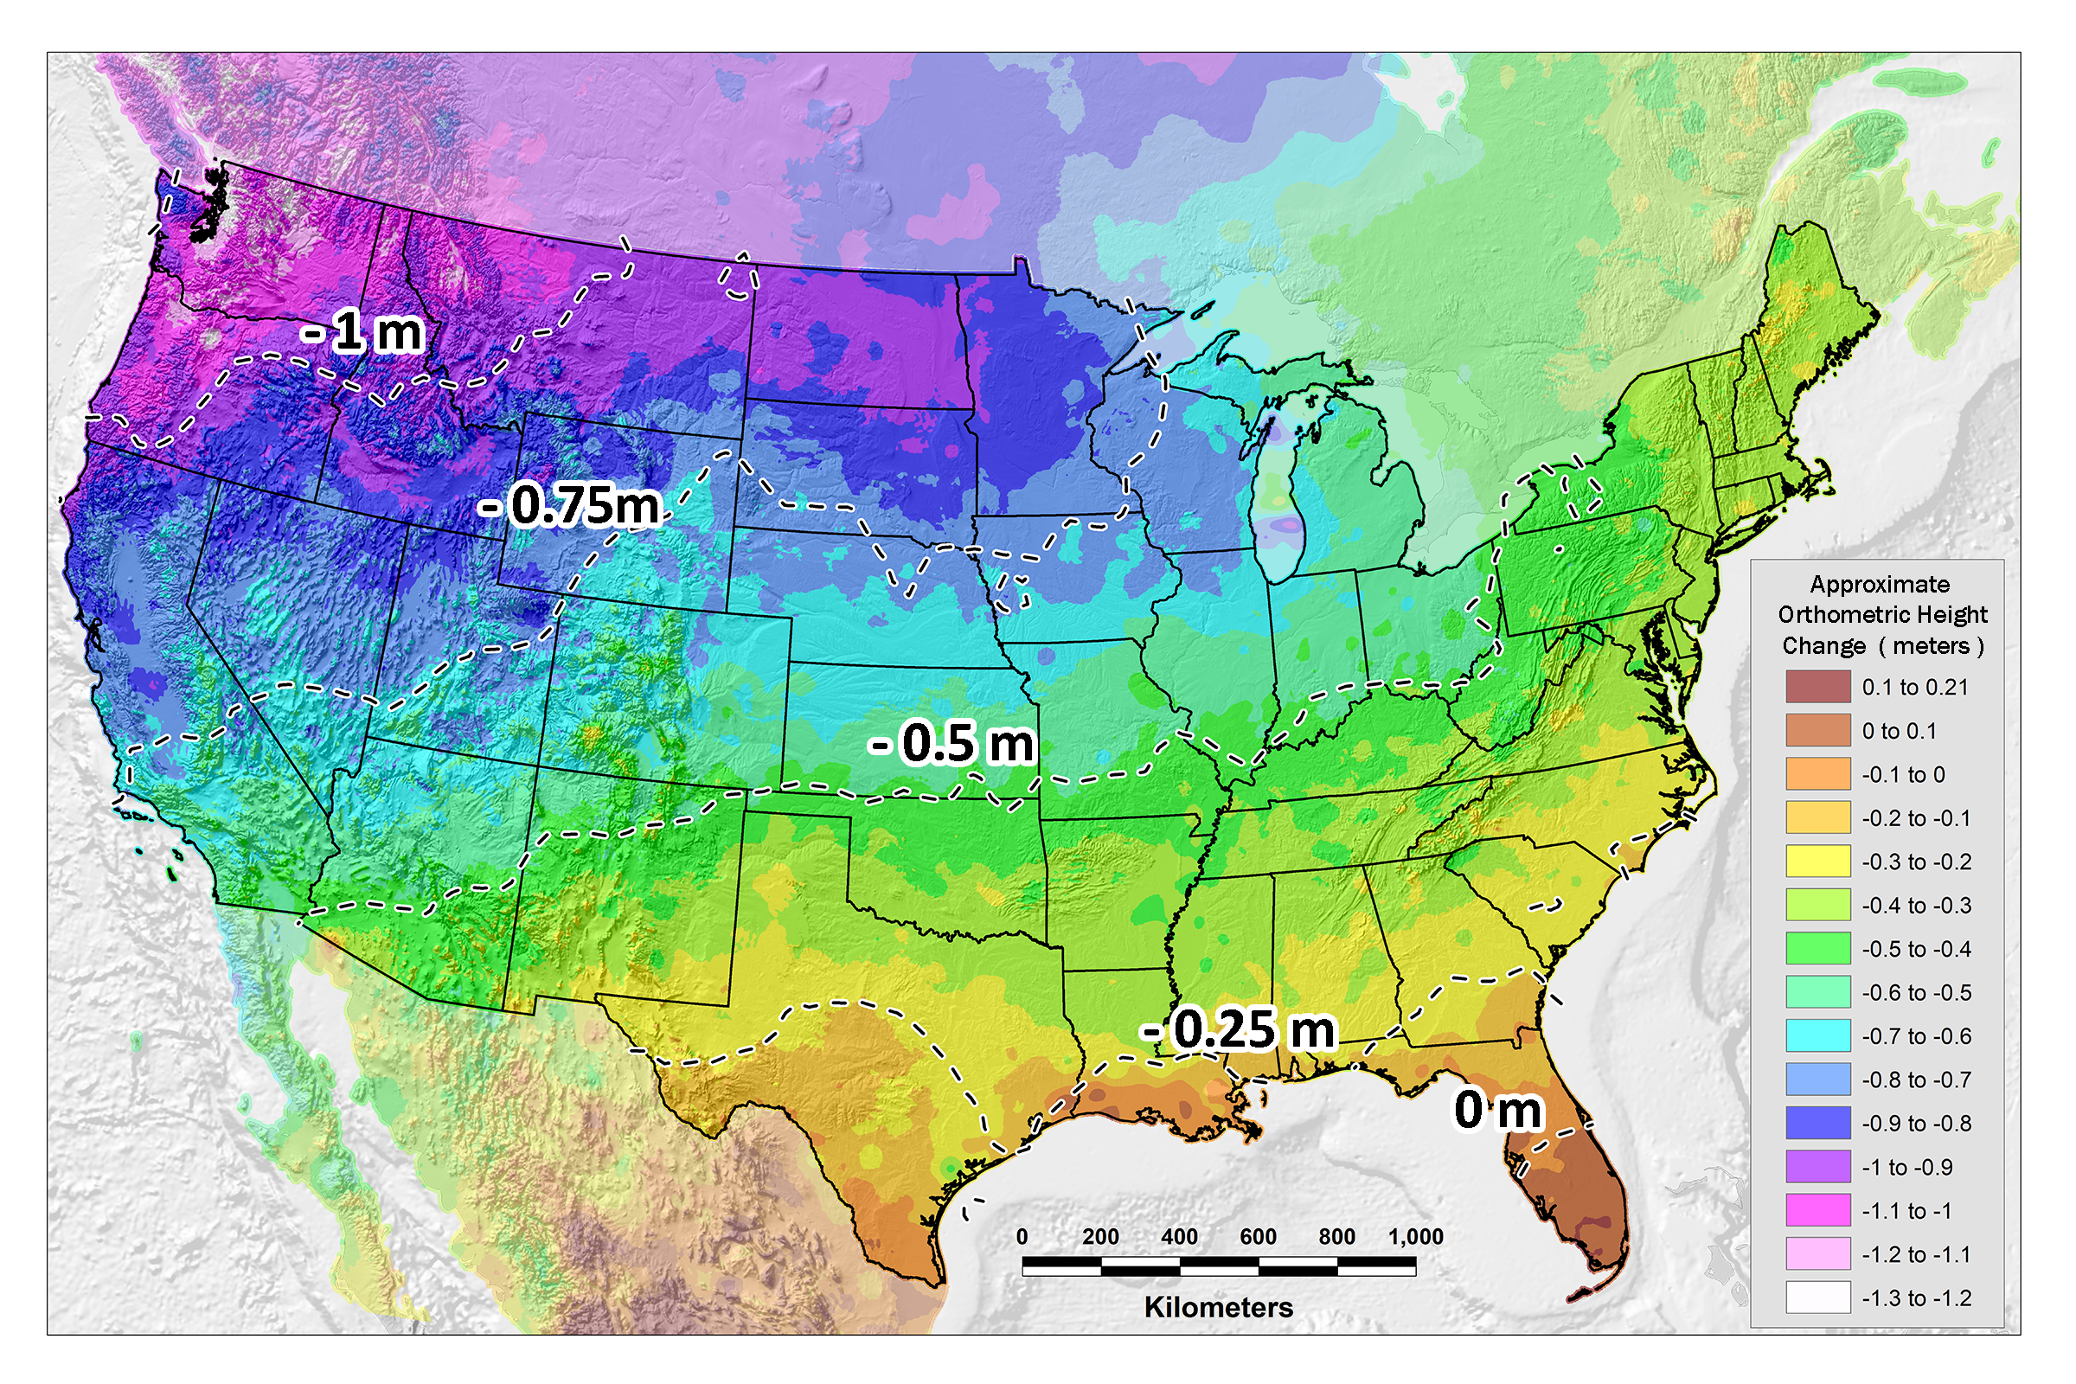
Issues with NAVD 88
PID: EZ0840
Systematic artifact in current datum, NAVD 88 (tilt of $\sim$1.5 m)
Notes:
Obtain hear about ‘bias’ and ‘tilt’ from different NGS people.
Sometimes the bias is concerning; sometimes its not. For gravity, a bias is problematic. If used in geoid modeling, this will lead to a step in the geoid if unaccounted for.
In this case, we know there is a bias and it is not worrisome. NAVD 88 is based on a single tide gauge – other geoids and/or datums are likely to be based on a different W0

Slide 5
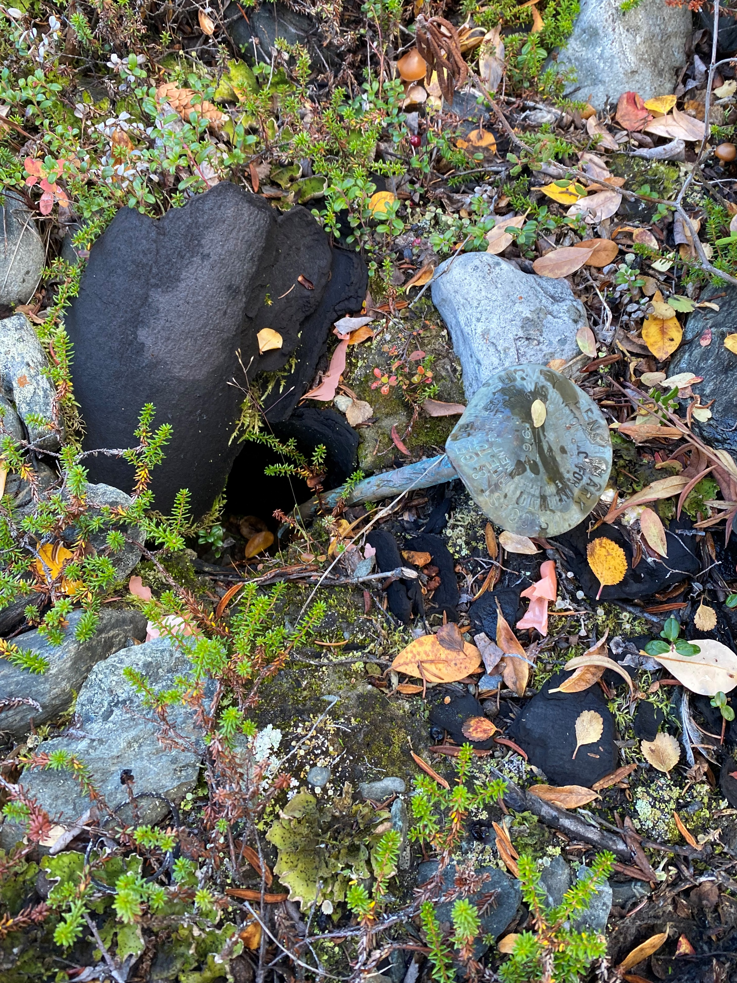
Issues with passive geodetic control
PID: EZ0840
Destroyed
Mutilated
Uplifted/Subsided
Notes:
Passive marks have been used to define heights for centuries. However, they are subject to manmade and natural elements that can cause them to be unusable. We have all seen examples like this – and even when the mark is stable, the entire ground surface and mark within it can be uplifting or subsiding and unknown rates like the figure on the right, where the mark is subsiding at roughly 1 cm per year.

Slide 6
Geoid and Heights
h
= H
+ N
h: ellipsoidal height (from GPS)
H: orthometric height
N: geoid undulation
Topography
h
H
A chosen geoid
N
A chosen ellipsoid
Notes:
But how? …..

Slide 7
Properties of Earth’s Gravity Field, W
Each line around the Earth is where W is equal to some constant.
It’s a surface of constant geopotential: Units: m²/s²
Water doesn’t flow along a surface – they’re level.
There are infinitely many level surfaces. They are not necessarily parallel to each other, but never intersect.
Up close they’re lumpy blobs, but farther out they become more and more ellipsoidal.
Plumb lines are always perpendicular to every surface they intersect.
There is one level surface that, on average, best matches sea level – the Geoid.
Incidentally, here’s the Ellipsoid.
Notes:
Mention that the geoid is not an ellipsoid shape, but lumpier. Only 170m_pp though!

Slide 8
Define W₀: the ‘zero’ level for the geoid & heights
IHRF (W₀ = 62,636,853.4 m² s⁻²)
26.5 cm
Mean coastal sea level for NA (W₀ = 62,636,856.0 m² s⁻²)
GEOID2022 W₀
31 cm
Rimouski / NAVD 88 (W₀ = 62,636,859.0 m² s⁻²)
43 cm
36 cm
Kingston (W₀ = 62,636,860.2 m² s⁻²)
67 cm
Thunder Bay (W₀ = 62,636,862.6 m² s⁻²)
Existing geoid models and reference potential
GEOID2022 (XGEOID series): 62,636,856.00 m² s⁻²
EGM2008, USGG2009 and CGG2010: 62,636,855.69 m² s⁻² (3 cm higher than coastal MSL for NA)
EGM96, USGG2003 and CGG2005: 62,636,856.88 m² s⁻² (8 cm lower than coastal MSL for NA)
IERS and IAU conventions: 62,636,856.00 m² s⁻² (0 cm, same as coastal MSL for NA)
Notes:
First, need to define W0. This is based on the local mean sea level across North America. Examples of different W0 values used in North America. Rimouski or NAVD 88 value is also shown in bold.
The new 0 level is 31 cm above NAVD 88 which translates to the value of heights to be lower.
If you have a geoid model or vertical datum that has a different W0 than the IHRF value, how do you convert your height so that it reflects the IHRF value?

Slide 9
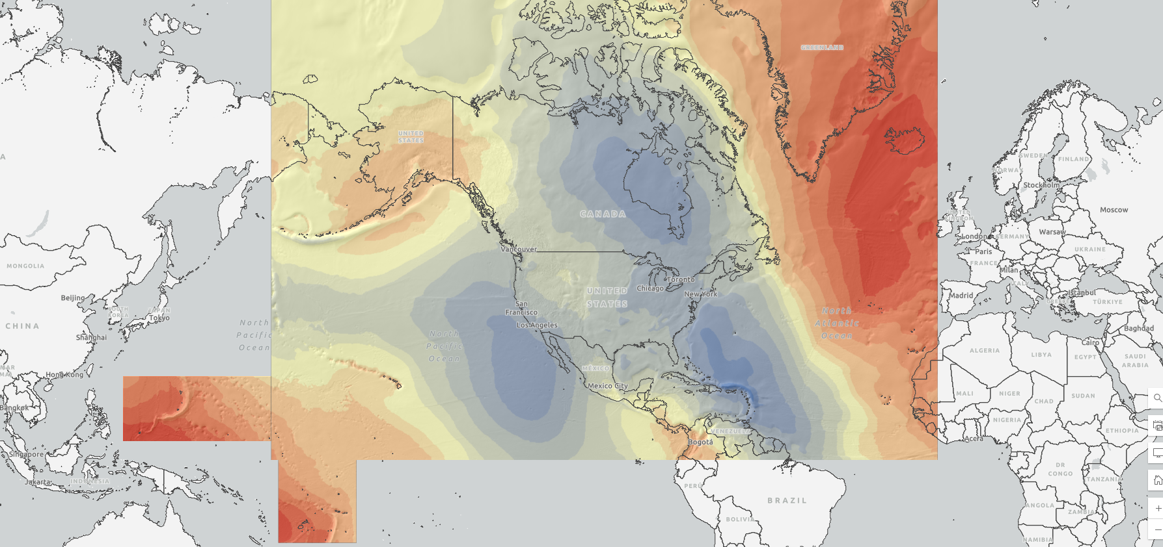
North American-Pacific Geopotential Datum of 2022
Definitions: | Value and realization:
W₀ | 62,636,856 m²s⁻²
GM | 3.986004415x10¹⁴ m³s⁻²
Realization | GEOID2022
Geometric RF | ITRF2020
Height (type) | Orthometric: H(t) = h(t) – N(t)
Tide system | Tide Free
Velocity of geoid height | Linear: $\dot{N}$
Reference epoch | 2020.0
Notes:
The static geoid model (SGEOID2022) has been agreed upon with geoid teams. This combined model is a simple average of 1 CGS model, 1 NGS model, and 1 INEGI model. Since INEGI computes their model over a more limited area, the INEGI contribution is limited to the Mexico land mass. So, outside of Mexico, the model is a 50/50 split of CGS and NGS models.
This update is going to be released on the NGS ALPHA website as a Major Alpha Update, after evaluation by the NGS Product and Services Committee. This update will also incorporate the deflection and gravity models that have not previously been released on ALPHA.
We plan to release all the grids in the GGXF format for this release.
There are a number of components that still need to be resolved for a BETA release, which NGS will be working towards in the next quarter.
For outreach, NGS and CGS each have an oral presentation at AGU in December; and NGS will be giving a webinar in our Webinar Series in January.

Slide 10
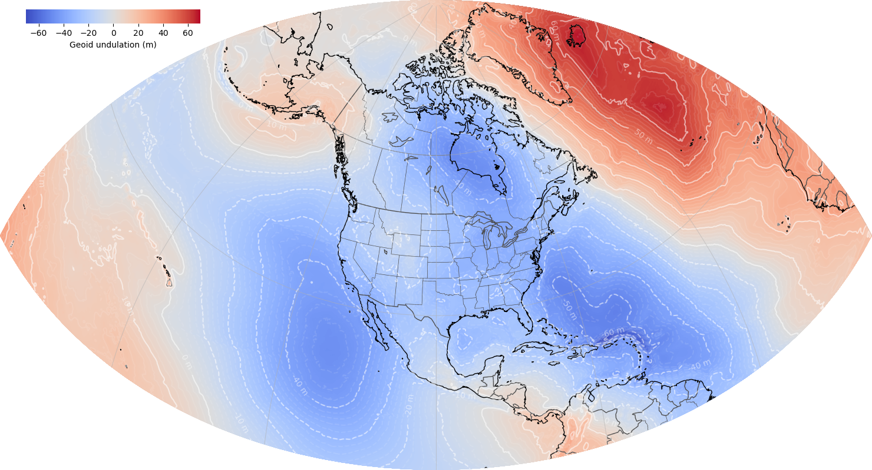
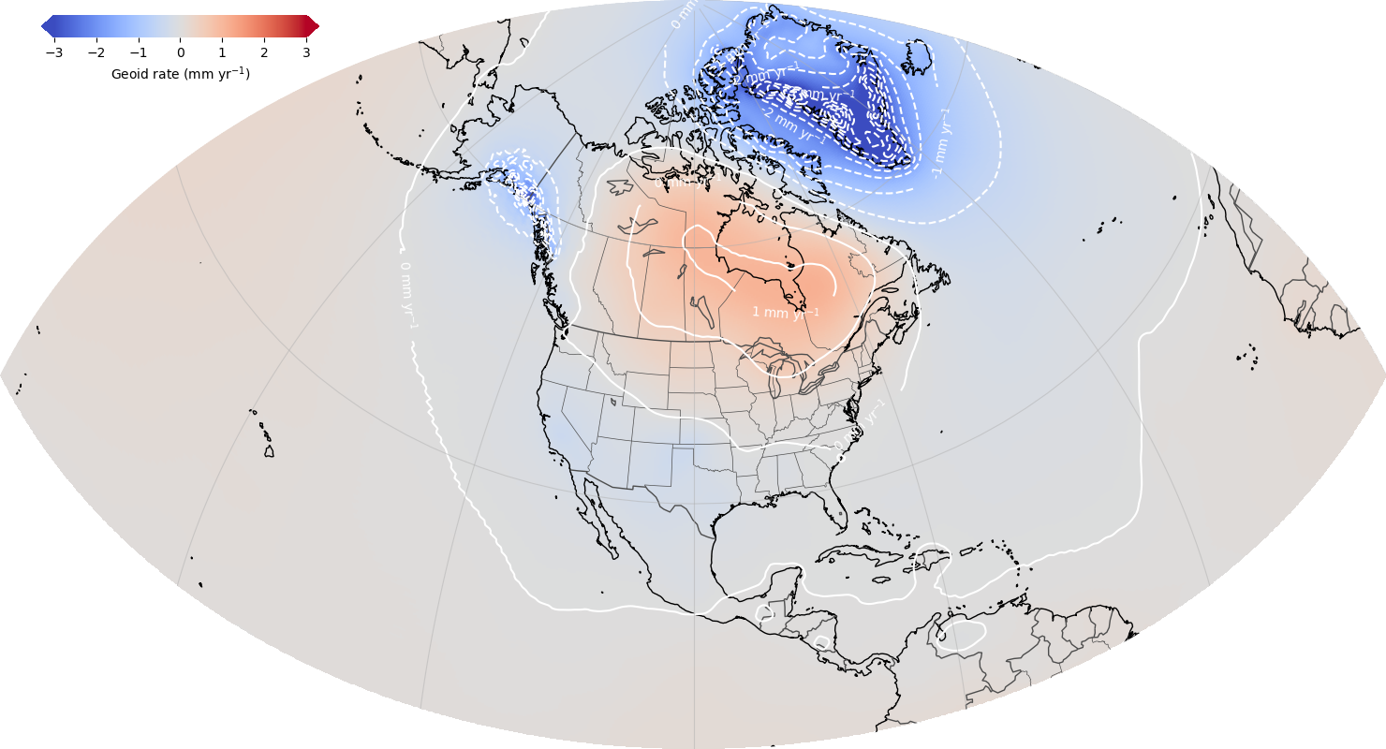
North American-Pacific Geopotential Datum of 2022
https://alpha.ngs.noaa.gov/GEOID2022/
ALPHA Release: GEOID2022 / DEFLEC2022 / GRAV2022 / GM2022
GEOID2022: Combined model (CGS+NGS+INEGI)
¼ Earth’s Surface
GEOID2022: Static Component Dynamic Component
Notes:
The static geoid model (SGEOID2022) has been agreed upon with geoid teams. This combined model is a simple average of 1 CGS model, 1 NGS model, and 1 INEGI model. Since INEGI computes their model over a more limited area, the INEGI contribution is limited to the Mexico land mass. So, outside of Mexico, the model is a 50/50 split of CGS and NGS models.
This update is going to be released on the NGS ALPHA website as a Major Alpha Update, after evaluation by the NGS Product and Services Committee. This update will also incorporate the deflection and gravity models that have not previously been released on ALPHA.
We plan to release all the grids in the GGXF format for this release.
There are a number of components that still need to be resolved for a BETA release, which NGS will be working towards in the next quarter.
For outreach, NGS and CGS each have an oral presentation at AGU in December; and NGS will be giving a webinar in our Webinar Series in January.

Slide 11
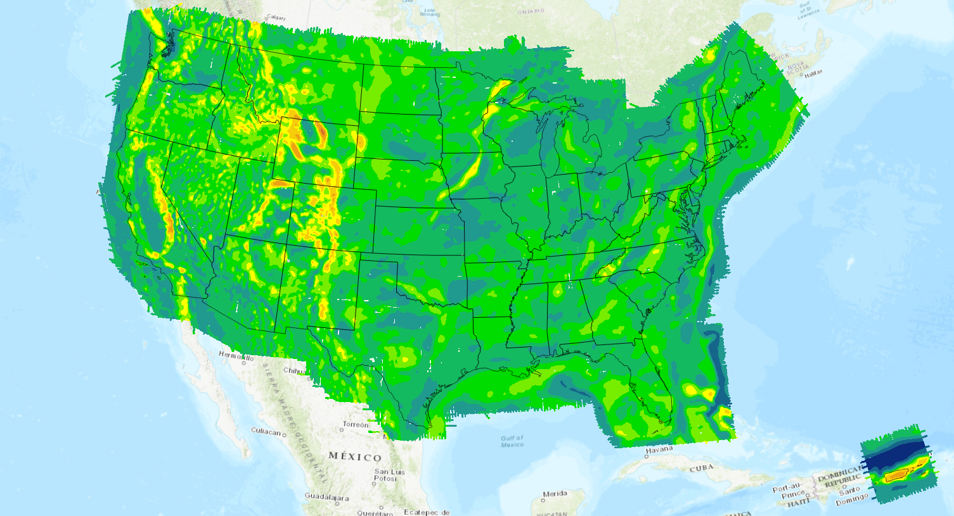
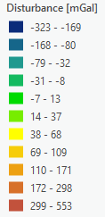
CONUS and PR/VI
GRAV-D
Notes:
Free air disturbance gravity field collected from the GRAV-D airborne project.

Slide 12
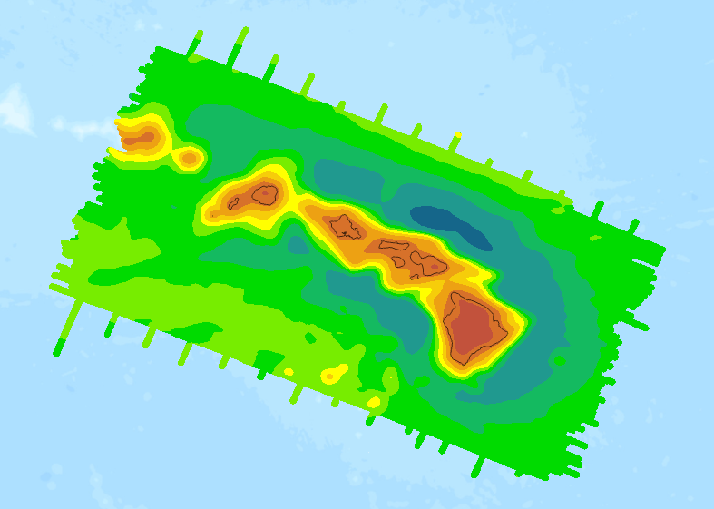
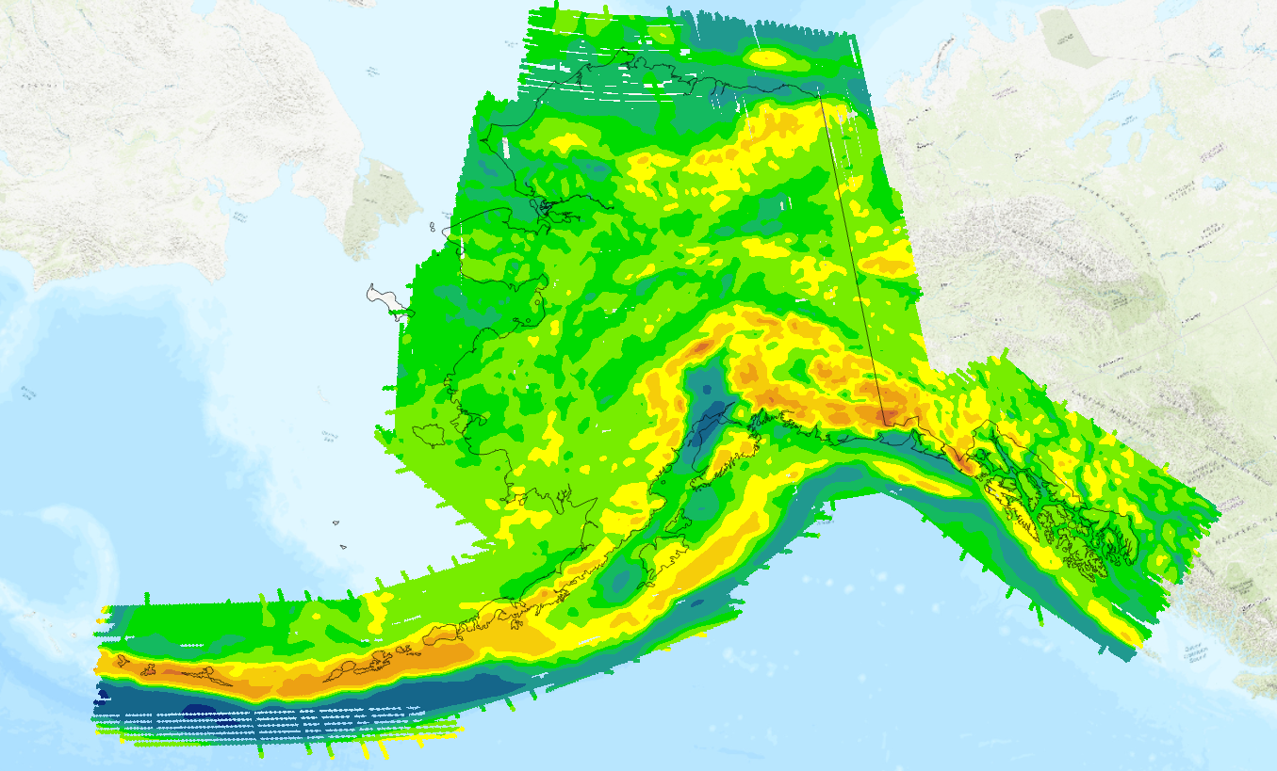
Hawaii
GRAV-D
Alaska

Slide 13
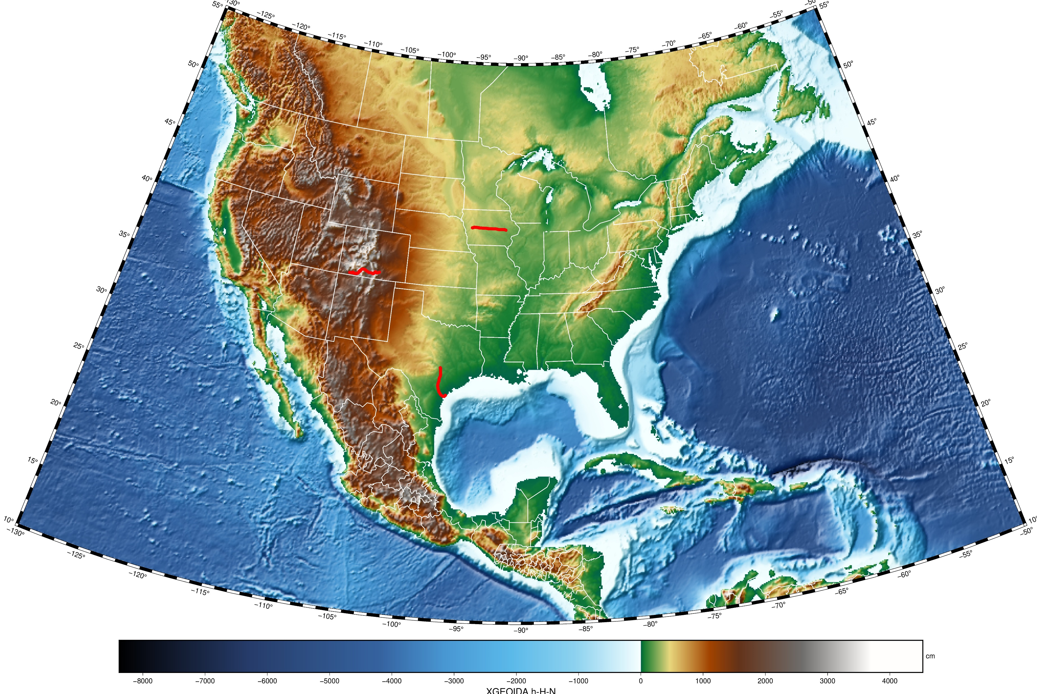
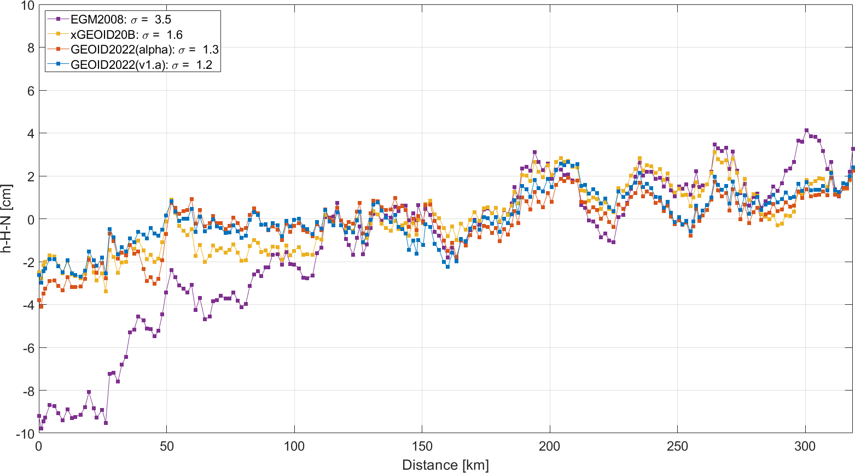
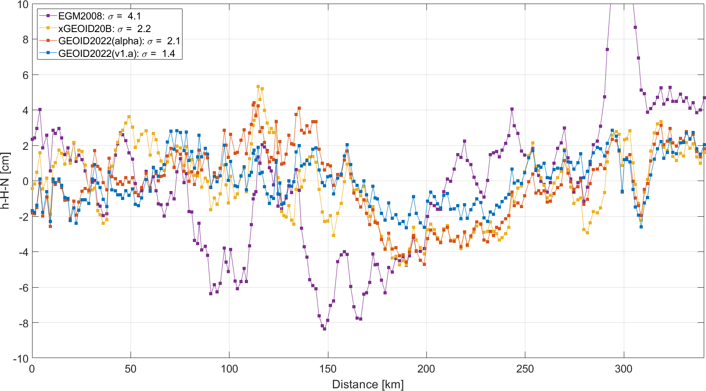
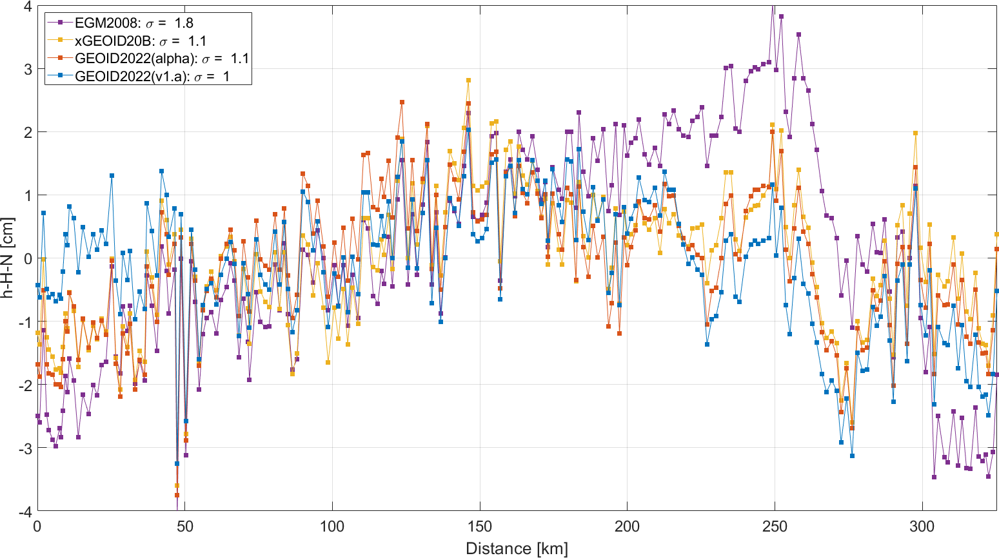
Geoid Slope Validation Surveys (GSVS)
Residual geoid along three GSVS lines
Wang et al, 2014
van Westrum et al, 2021
oceanservice.noaa.gov
Smith et al, 2012
13

Slide 14
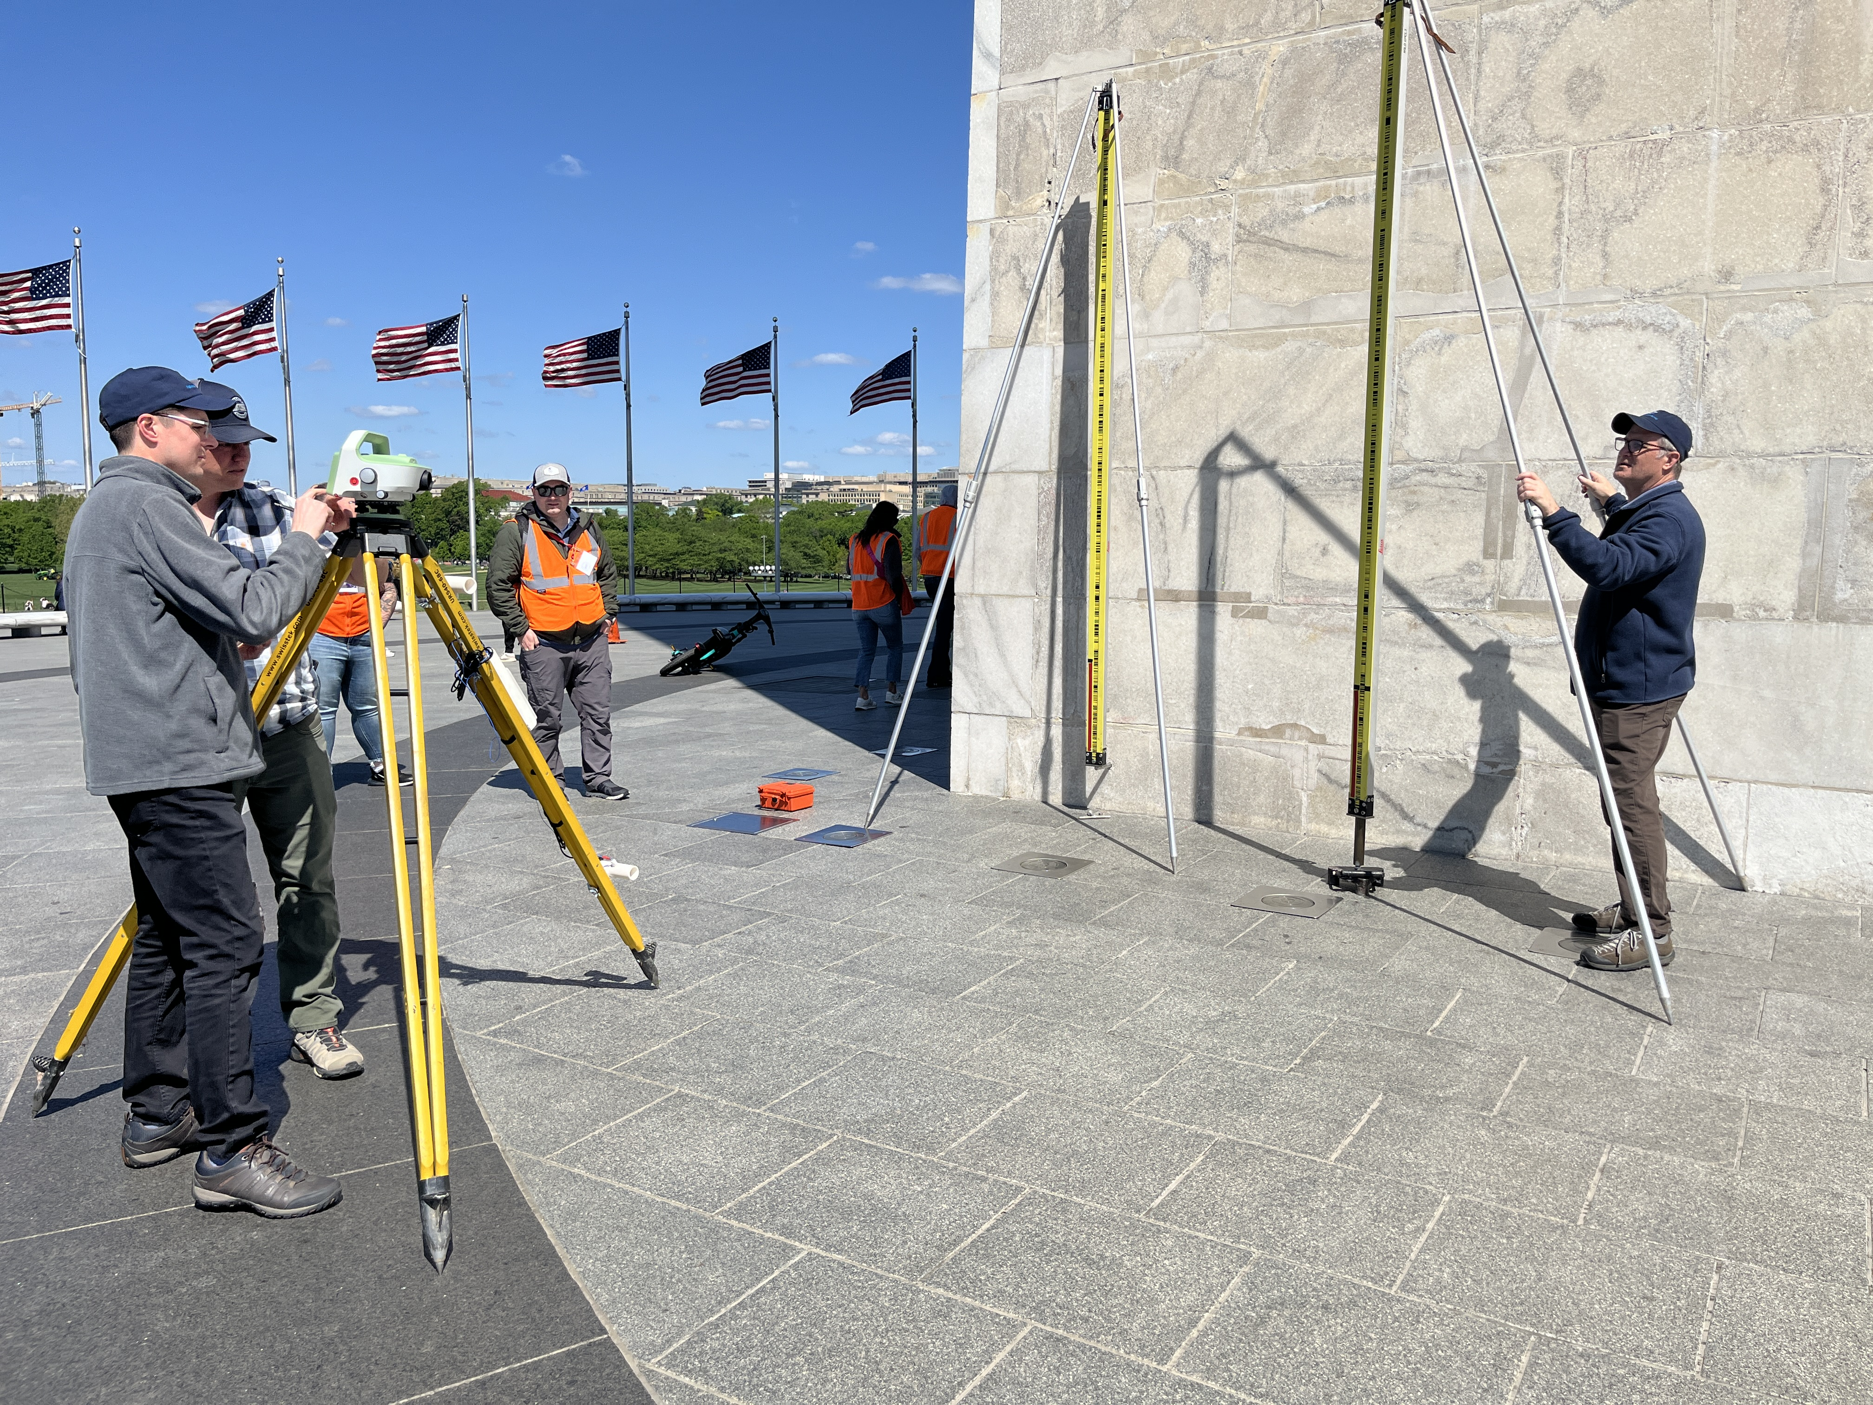
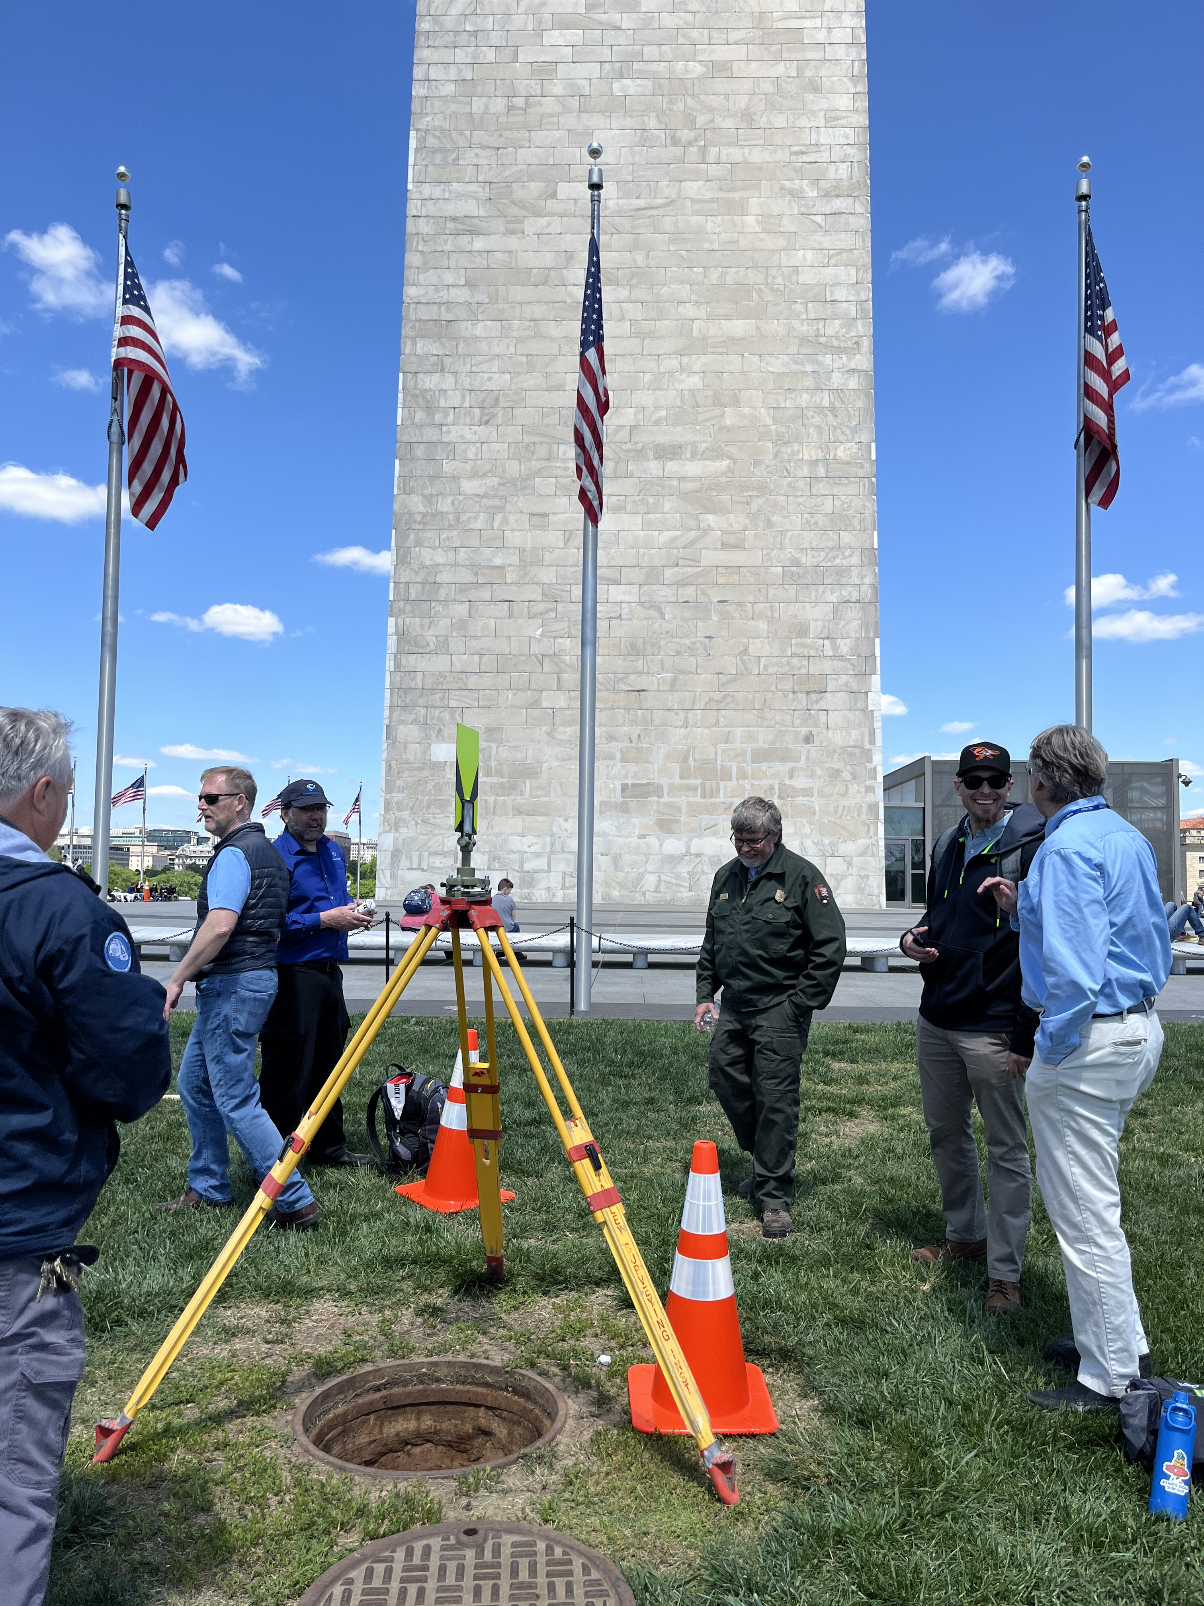
NGS Washington Monument 2024 leveling survey
Kevin Ahlgren
kevin.ahlgren@noaa.gov
Mini-monument –BM A
Notes:
Set in 1877

