Slide 1
G31A-08 Current Status of GEOID2022 – a new basis for heights throughout North America
Ahlgren K¹, YM Wang¹, X Li¹, R Hardy¹, J Huang², I Foroughi², M Véronneau², D Avalos-Naranjo³
¹National Geodetic Survey – National Oceanic and Atmospheric Administration
²Canadian Geodetic Survey – Natural Resources Canada
³National Institute of Statistics and Geography, Mexico (INEGI)
kevin.ahlgren@noaa.gov
 | AGU 2024 Fall Meeting | 12/11/24

Slide 2
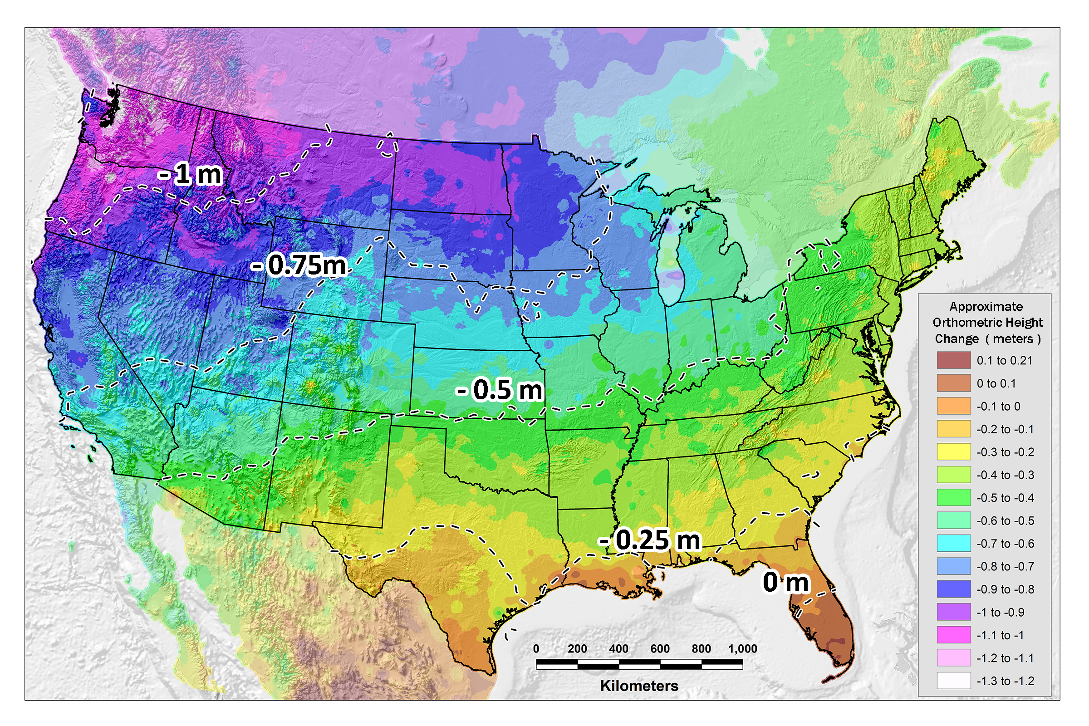
Issues with NAVD 88
PID: EZ0840
Systematic artifact in current datum, NAVD 88 (tilt of $\sim$1.5 m)
Notes:
Obtain hear about ‘bias’ and ‘tilt’ from different NGS people.
Sometimes the bias is concerning; sometimes its not. For gravity, a bias is problematic. If used in geoid modeling, this will lead to a step in the geoid if unaccounted for.
In this case, we know there is a bias and it is not worrisome. NAVD 88 is based on a single tide gauge – other geoids and/or datums are likely to be based on a different W0

Slide 3
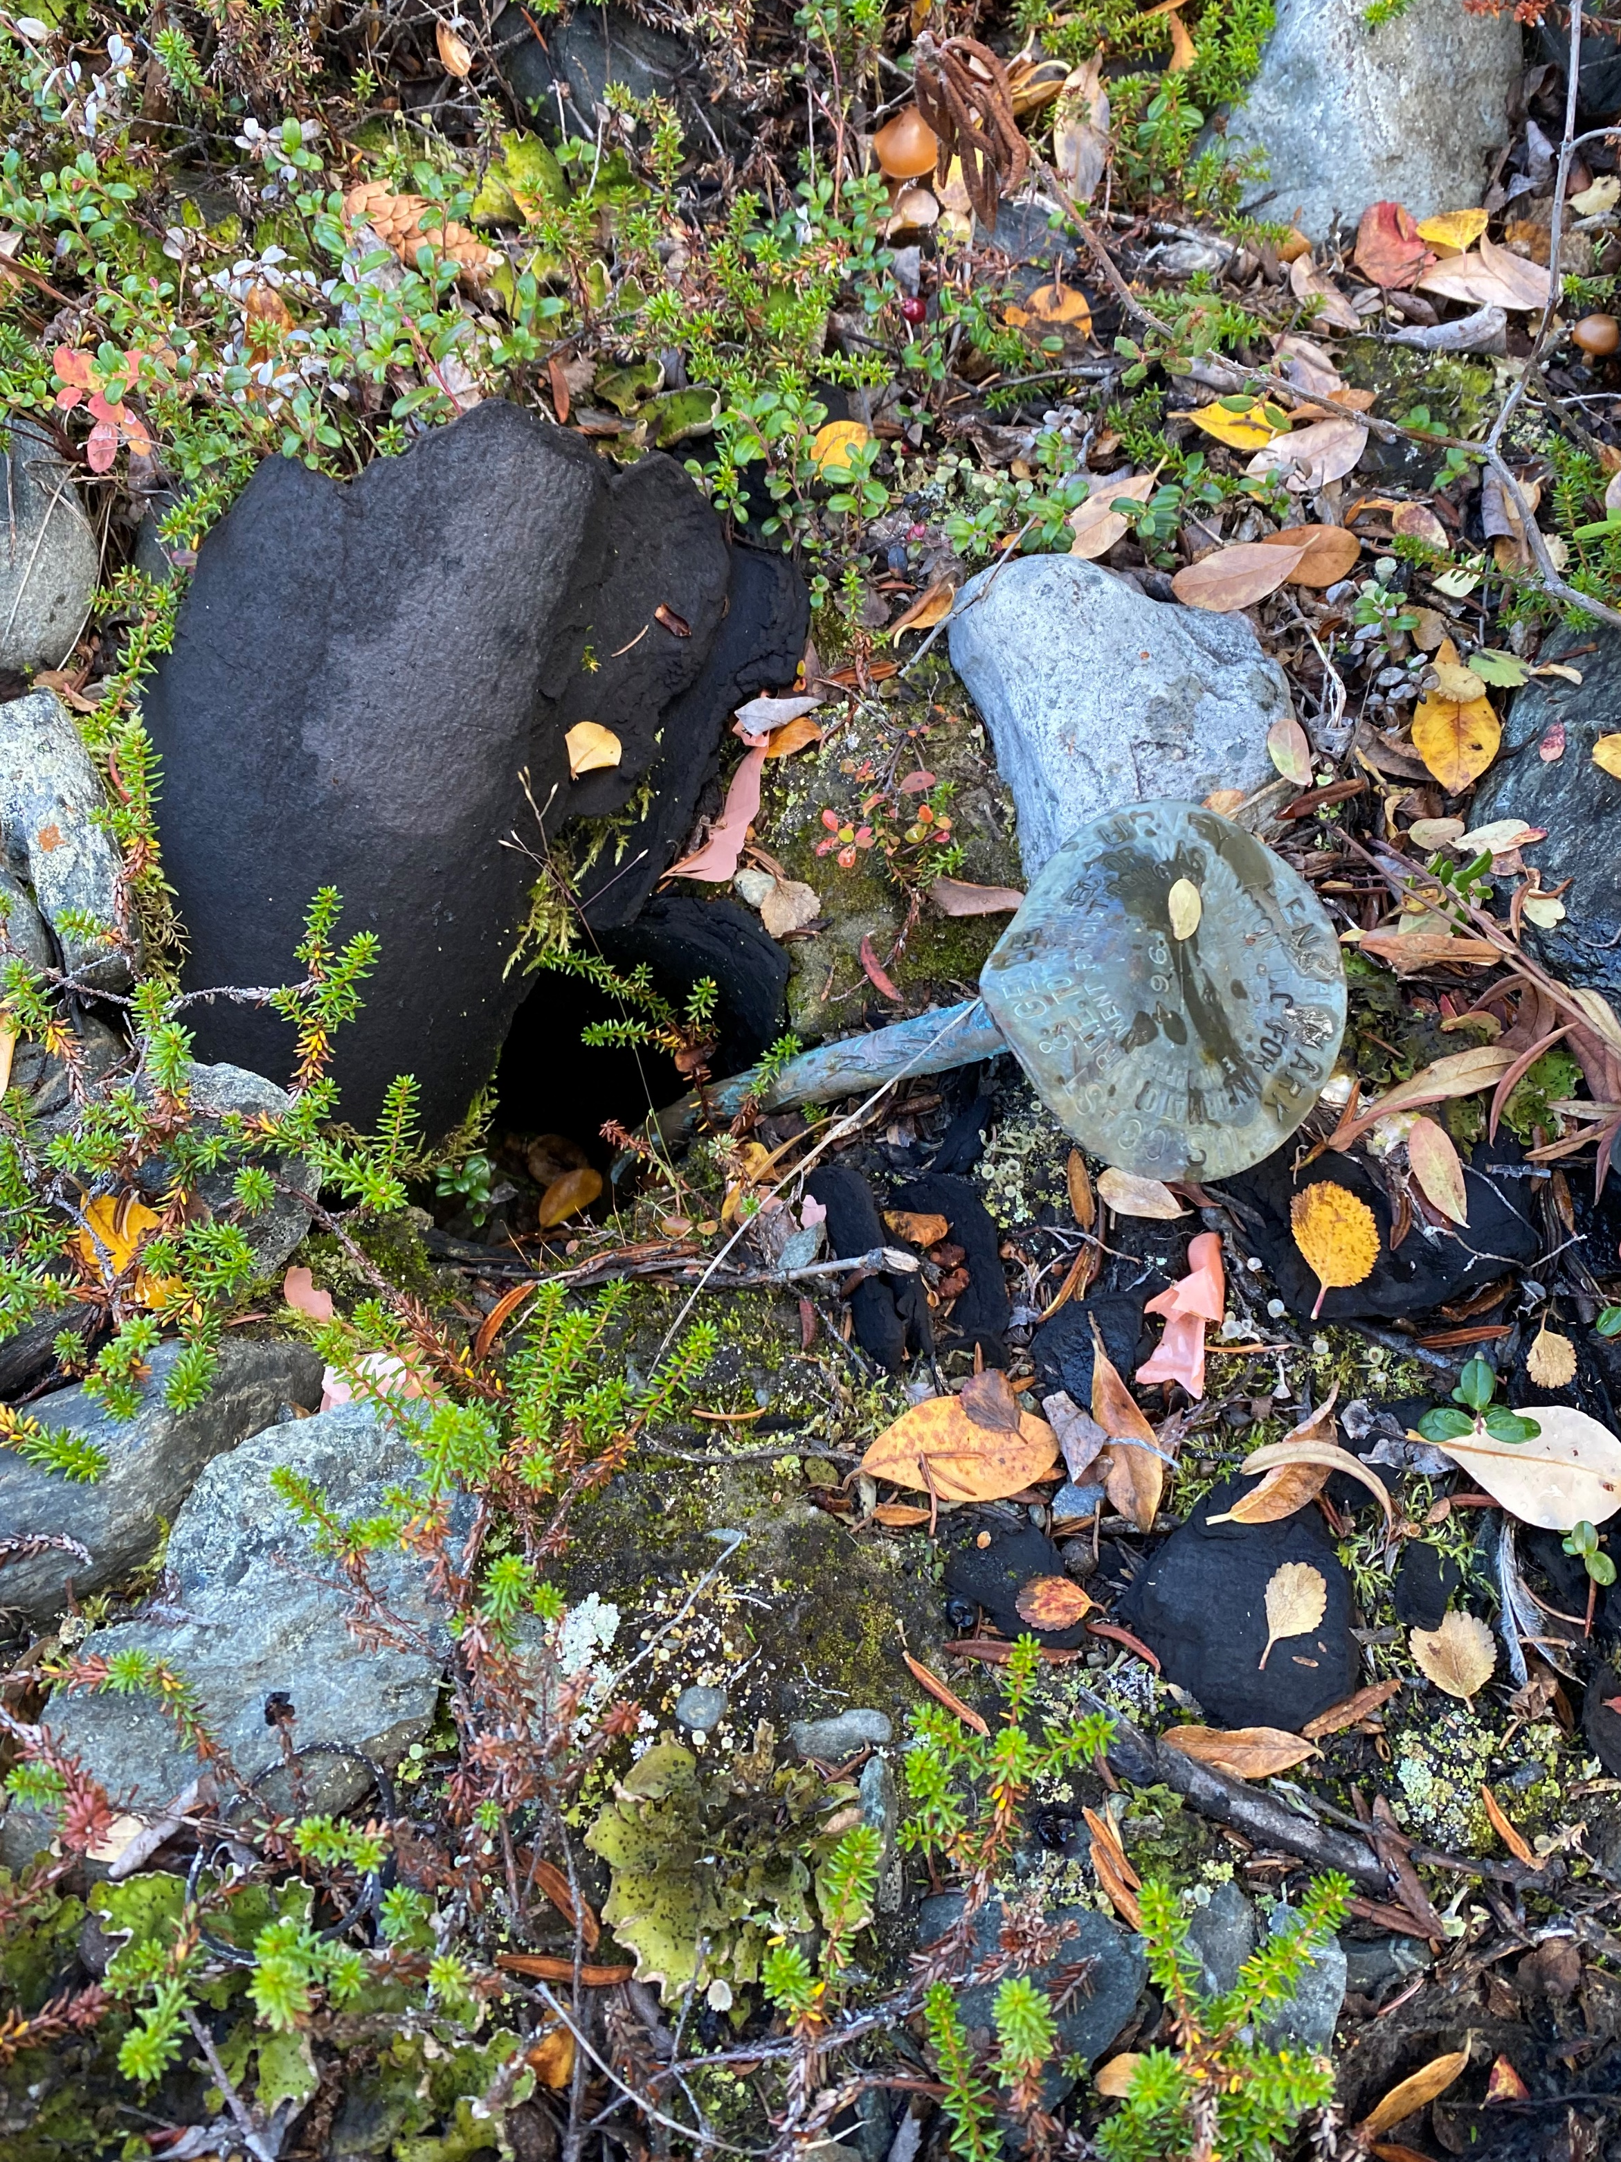
Issues with passive geodetic control
PID: EZ0840
Destroyed
Mutilated
Uplifted/Subsided
Notes:
Passive marks have been used to define heights for centuries. However, they are subject to manmade and natural elements that can cause them to be unusable. We have all seen examples like this – and even when the mark is stable, the entire ground surface and mark within it can be uplifting or subsiding and unknown rates like the figure on the right, where the mark is subsiding at roughly 1 cm per year.

Slide 4
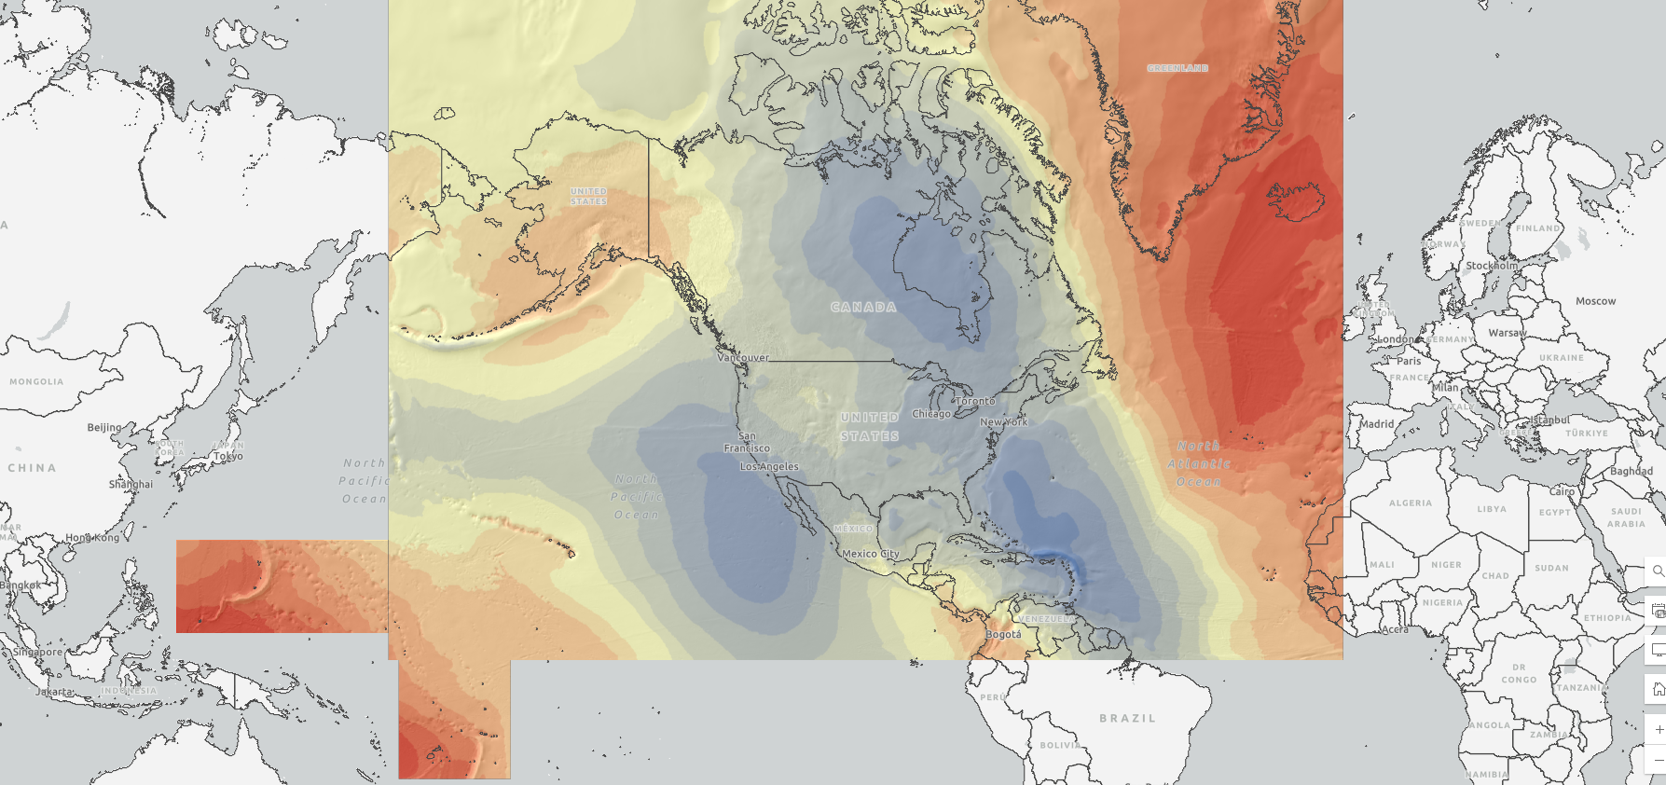
North American-Pacific Geopotential Datum of 2022
Definitions: | Value and realization:
W₀ | 62,636,856 m²s⁻²
GM | 3.986004415x10¹⁴ m³s⁻²
Realization | GEOID2022
Geometric RF | ITRF2020
Height (type) | Orthometric: H(t) = h(t) – N(t)
Tide system | Tide Free
Velocity of geoid height | Linear: $\dot{N}$
Reference epoch | 2020.0
Notes:
The static geoid model (SGEOID2022) has been agreed upon with geoid teams. This combined model is a simple average of 1 CGS model, 1 NGS model, and 1 INEGI model. Since INEGI computes their model over a more limited area, the INEGI contribution is limited to the Mexico land mass. So, outside of Mexico, the model is a 50/50 split of CGS and NGS models.
This update is going to be released on the NGS ALPHA website as a Major Alpha Update, after evaluation by the NGS Product and Services Committee. This update will also incorporate the deflection and gravity models that have not previously been released on ALPHA.
We plan to release all the grids in the GGXF format for this release.
There are a number of components that still need to be resolved for a BETA release, which NGS will be working towards in the next quarter.
For outreach, NGS and CGS each have an oral presentation at AGU in December; and NGS will be giving a webinar in our Webinar Series in January.

Slide 5
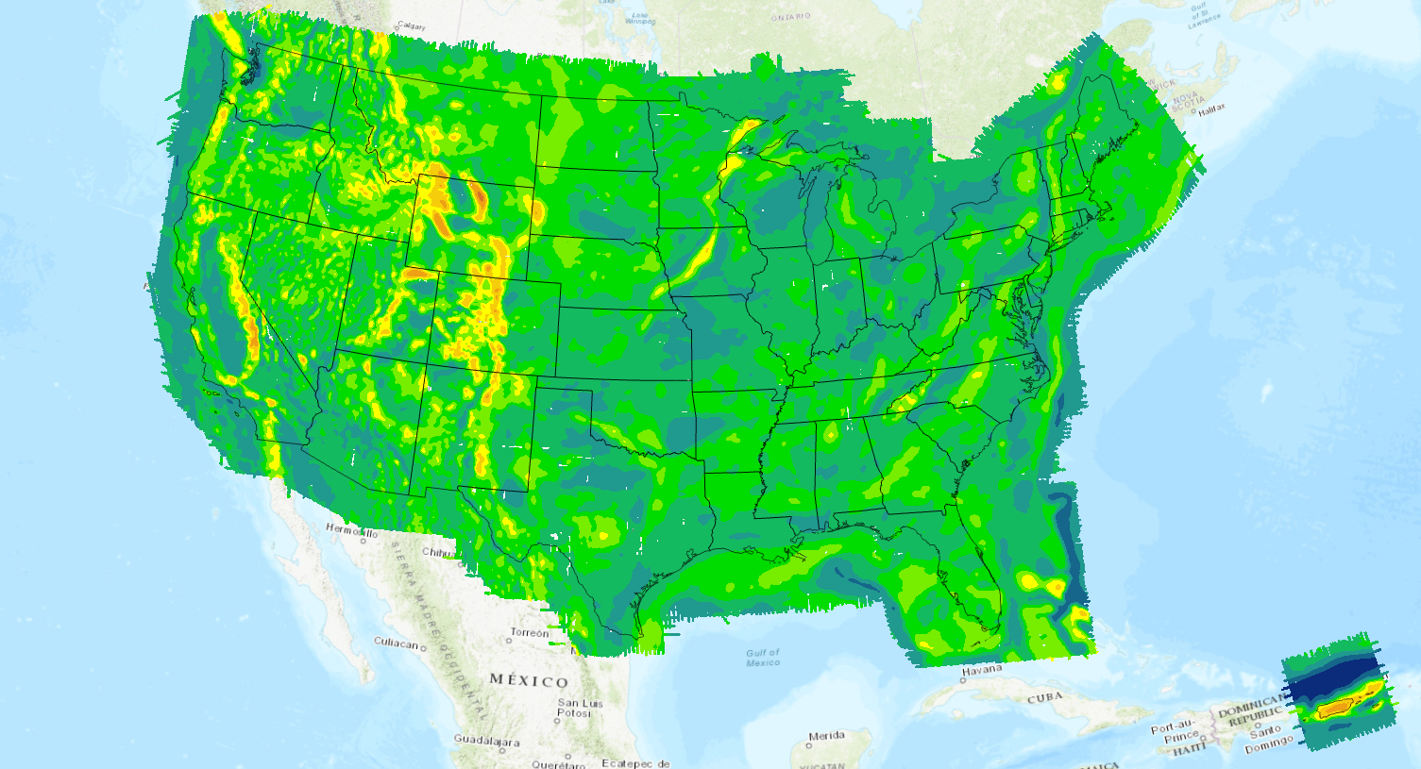
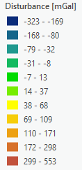
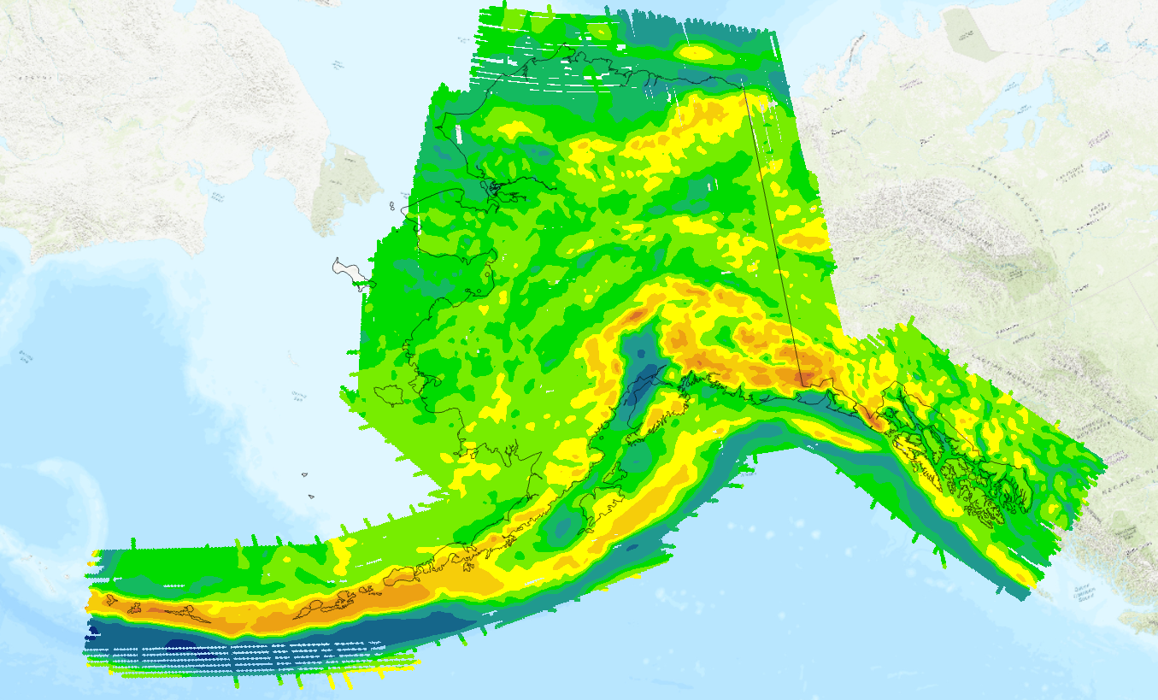
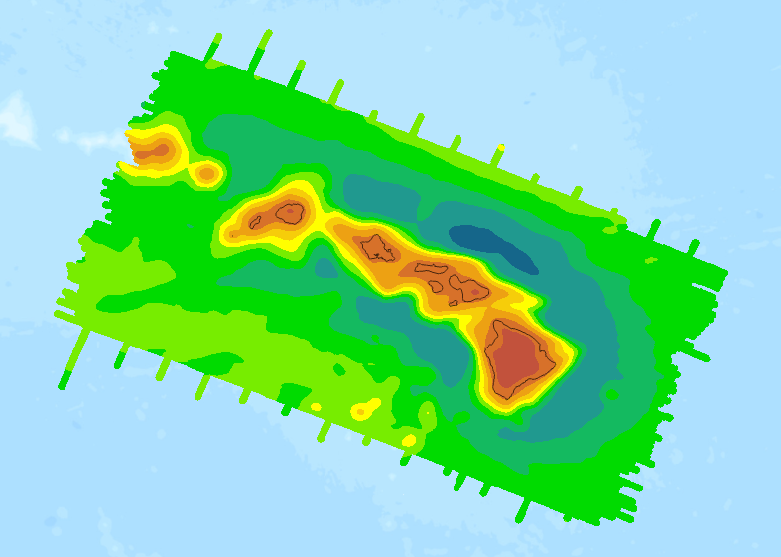
Data used in GEOID2022
Terrestrial gravity data
Altimetric gravity (DTU21) in 1’x1’ grid
DEM2022 (3′′, a combination of TanDEM-X, NED, and MERIT)
ArcGPv2020 in 3’x3’ grids from NGA
Ice thickness data sets over Greenland
Airborne gravity data (GRAV-D) (shown)
GRAV-D data coverage
Alaska
Hawaii

Slide 6
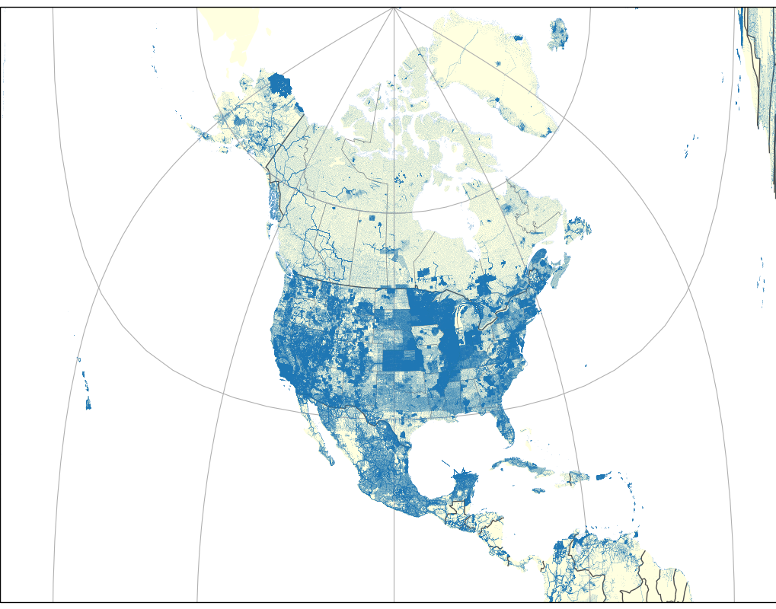
Density of terrestrial gravity data
2.1 million gravity observations throughout North America
Data included from Canada, Mexico, and USA
Various other regions
Quality is variable – most data were from many decades ago
Spacing is variable
Density of terrestrial gravity

Slide 7
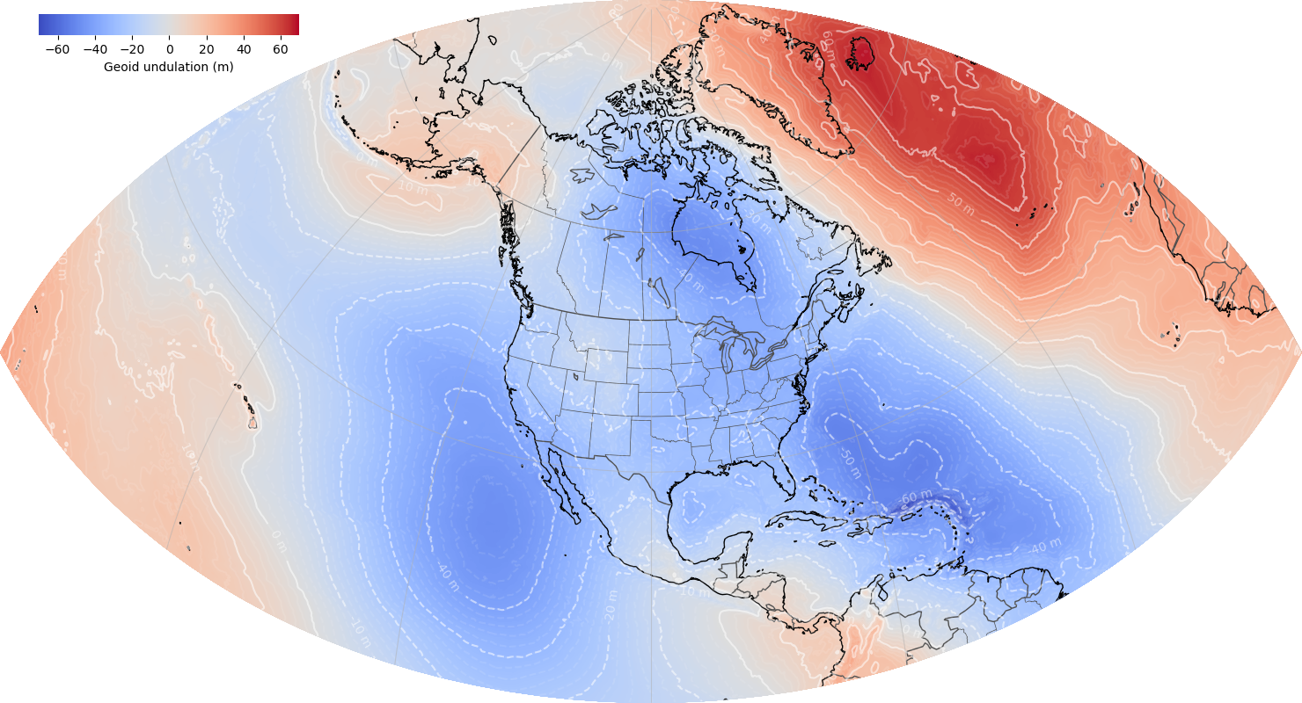
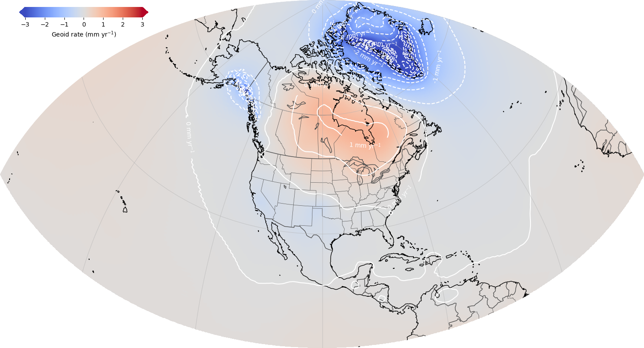
North American-Pacific Geopotential Datum of 2022
ALPHA Release: GEOID2022 / DEFLEC2022 / GRAV2022 / GM2022
GEOID2022: Combined model (CGS+NGS+INEGI)
¼ Earth’s Surface
GEOID2022: Static Component Dynamic Component
Notes:
The static geoid model (SGEOID2022) has been agreed upon with geoid teams. This combined model is a simple average of 1 CGS model, 1 NGS model, and 1 INEGI model. Since INEGI computes their model over a more limited area, the INEGI contribution is limited to the Mexico land mass. So, outside of Mexico, the model is a 50/50 split of CGS and NGS models.
This update is going to be released on the NGS ALPHA website as a Major Alpha Update, after evaluation by the NGS Product and Services Committee. This update will also incorporate the deflection and gravity models that have not previously been released on ALPHA.
We plan to release all the grids in the GGXF format for this release.
There are a number of components that still need to be resolved for a BETA release, which NGS will be working towards in the next quarter.
For outreach, NGS and CGS each have an oral presentation at AGU in December; and NGS will be giving a webinar in our Webinar Series in January.

Slide 8
GEOID2022 Validation

Slide 9
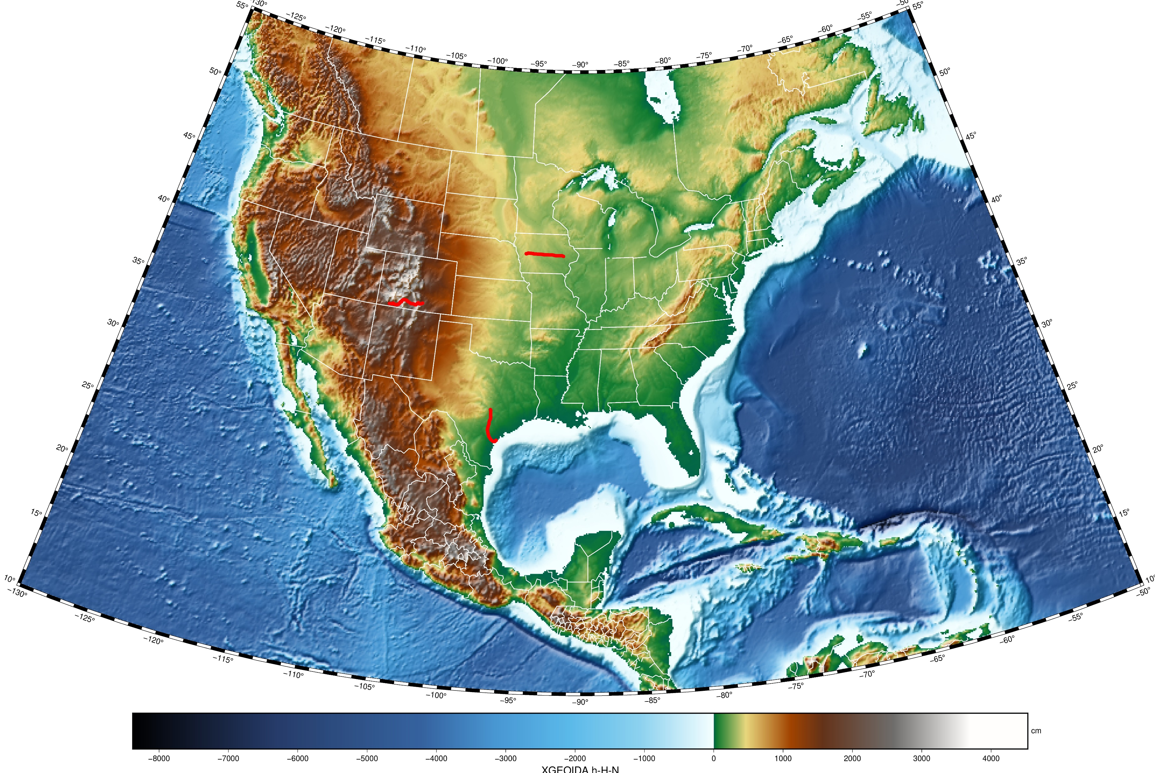
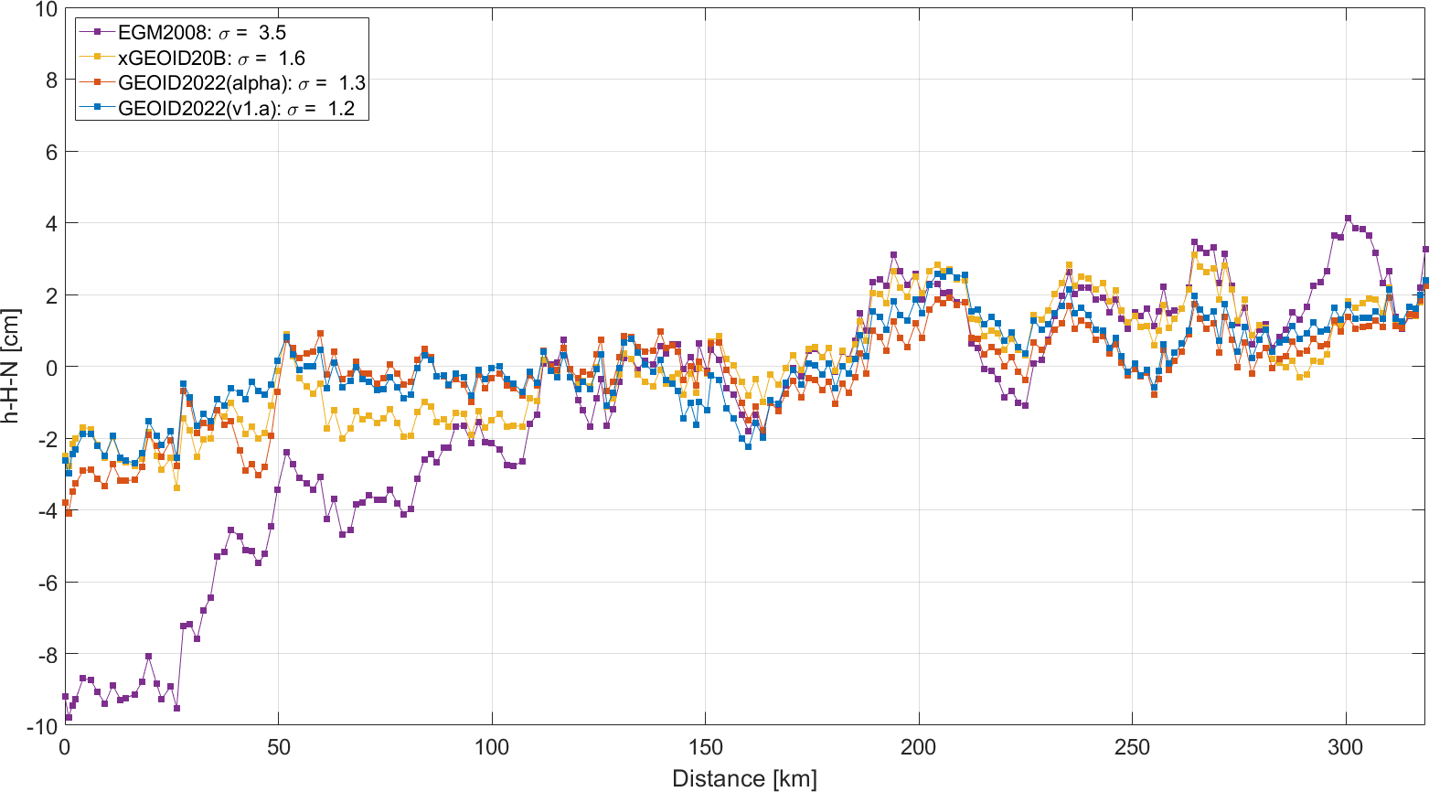
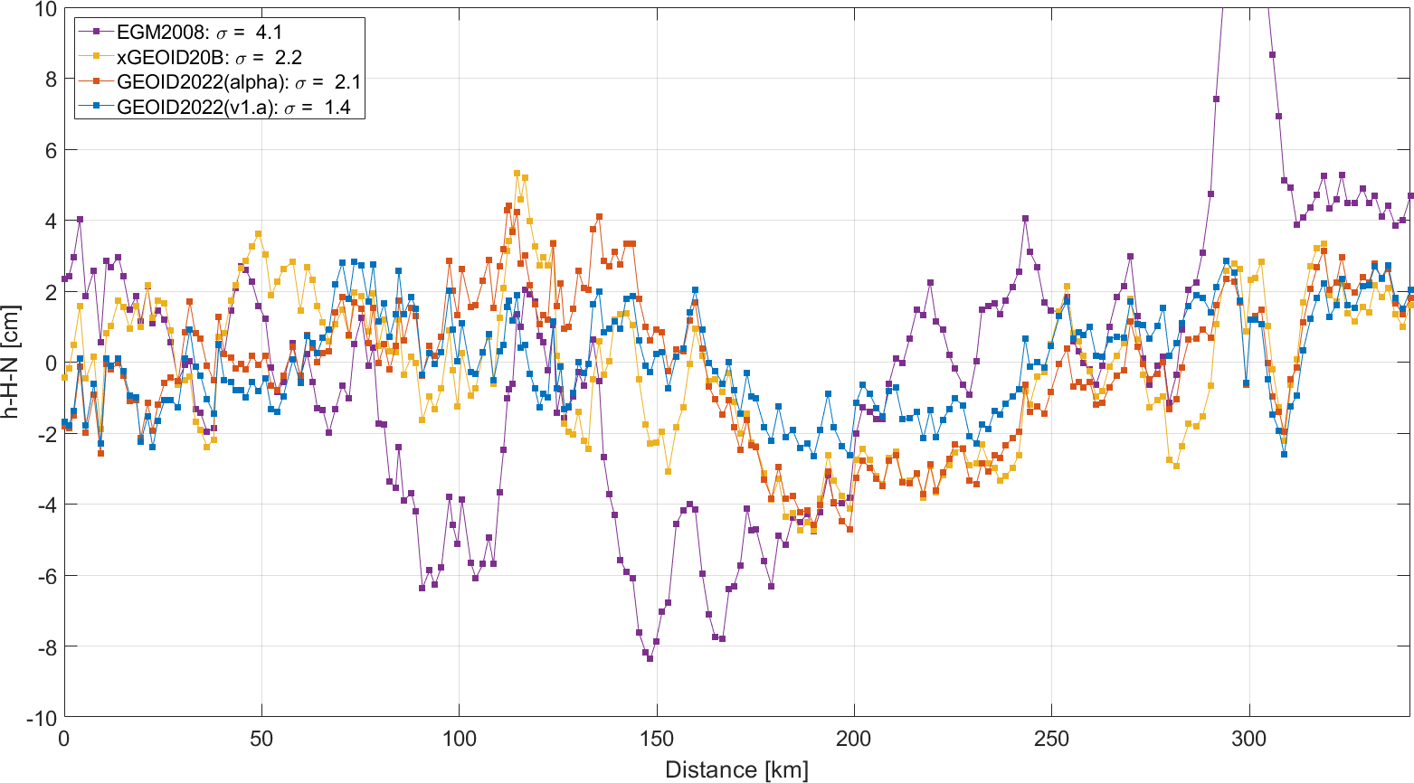
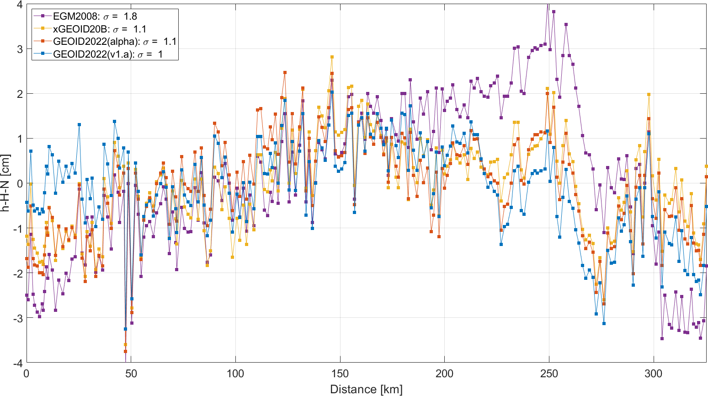
Residual geoid along three GSVS lines
Geoid Slope Validation Surveys (GSVS)

Slide 10
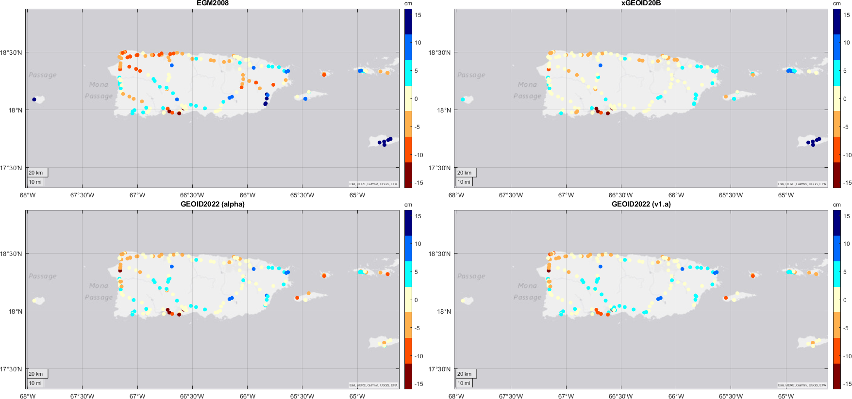
Puerto Rico / US Virgin Islands
Highlights the regional variability of GEOID2022
Not tailored to this region, specifically
Still showing improvement with respect to GPS\leveling but slightly higher than other regions:
Likely due to combination of geoid and GNSS\leveling
σ = 6.8 cm
σ = 4.6 cm
σ = 3.7 cm
σ = 3.6 cm

Slide 11
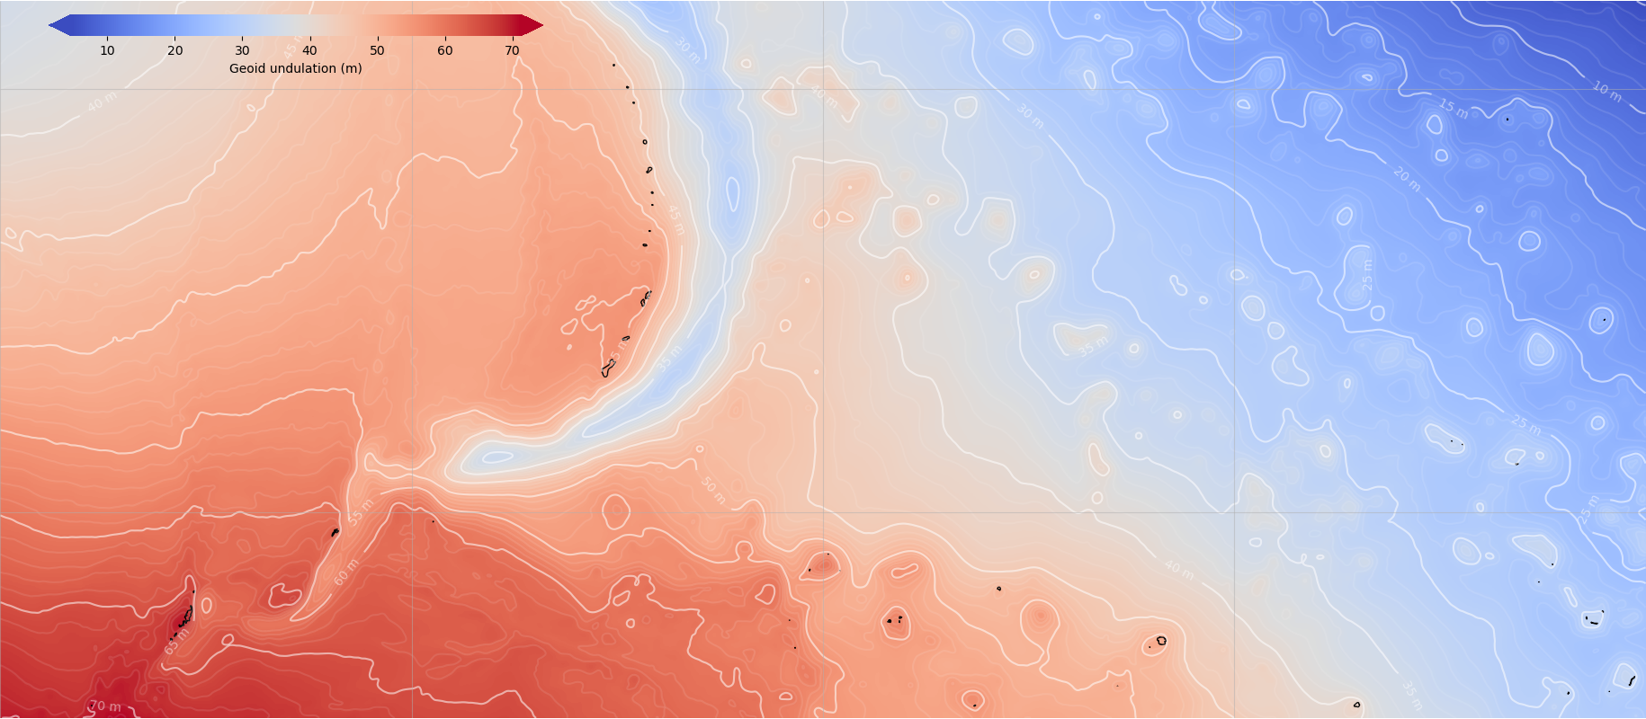
Guam and Commonwealth of Northern Mariana Islands
20º
Regional model tailored to the local region based on GPS \ leveling data
Very similar to the main, North American-Pacific geoid model
Coverage includes: Palau, Micronesia Wake Island, Marshall Islands
10º
140º
150º
160º
Notes:
Regional model tailored to the local region; very similar to the main, North American-Pacific geoid model. Coverage includes Palau, Micronesia, Wake Island, Marshall Islands

Slide 12
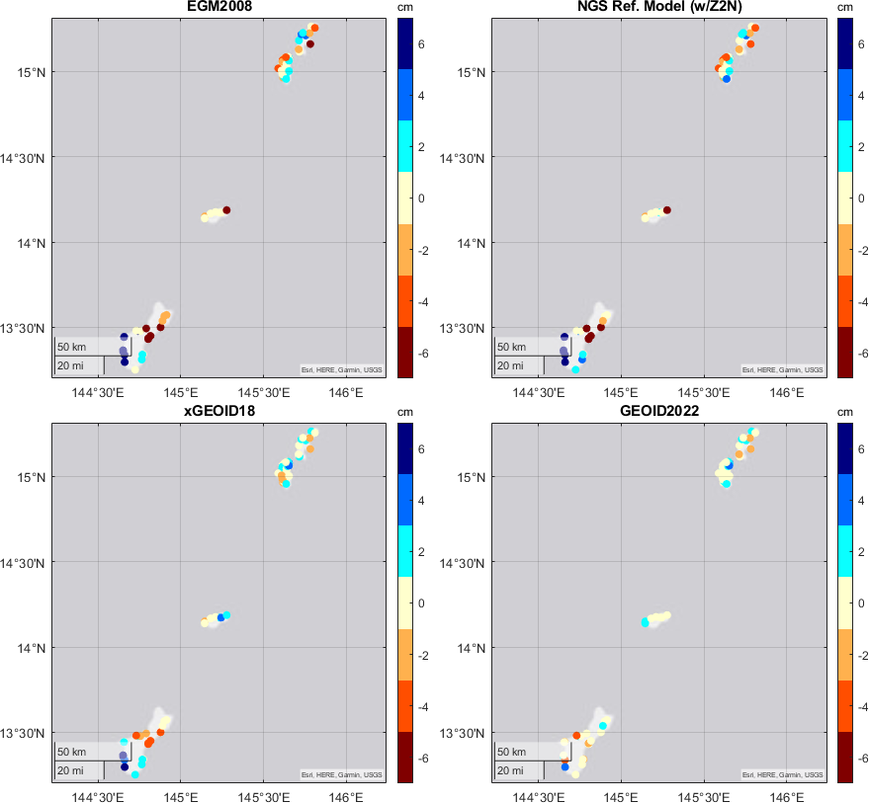
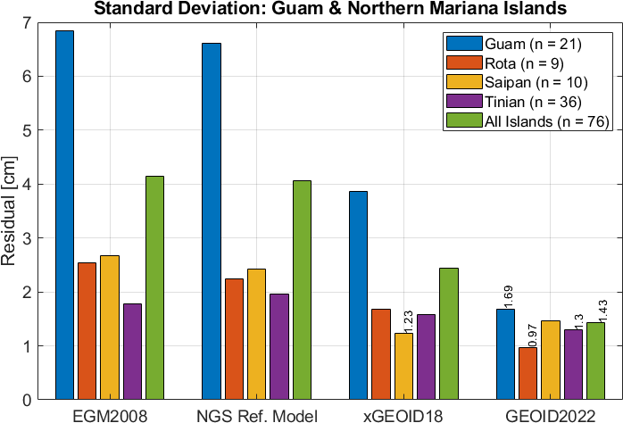
Guam and Commonwealth of Northern Mariana Islands
Saipan
Regional model tailored to the local region; very similar to the main, North American-Pacific geoid model
Coverage includes Palau, Micronesia, Wake Island, Marshall Islands
Comparisons with local GNSS\leveling show GEOID2022 has 65% improvement over EGM2008 and 40% improvement over most recent NGS model, xGEOID18
Tinian
Rota
Guam

Slide 13
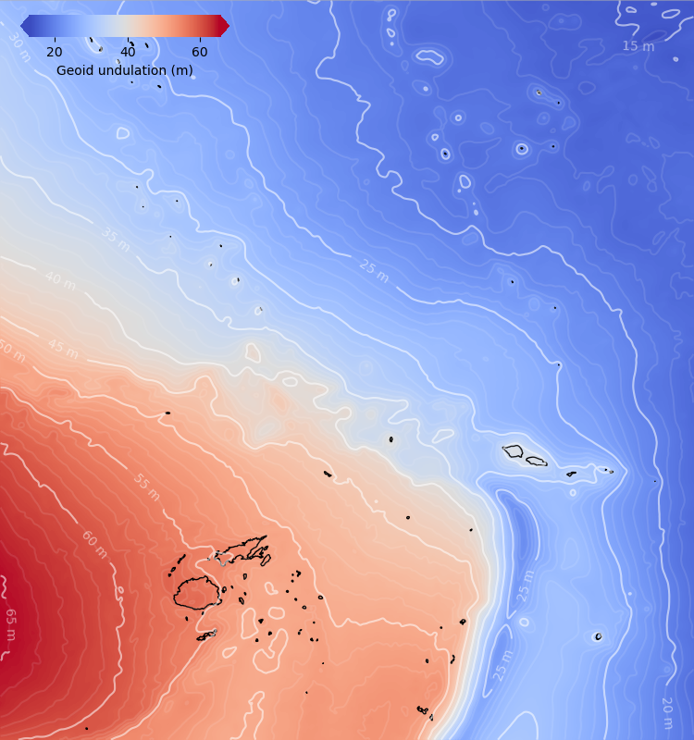
American Samoa
0º
Regional model tailored to the local region; very similar to the main, North American-Pacific geoid model
Coverage includes Fiji, Samoa, Tuvalu, Tokelau, Wallis and Futuna, Niue, Tonga
GNSS\Leveling and GEOID2022: 1.9 cm std. dev. | 11.4 cm for EGM2008 | 6.2 cm for xGEOID18 (83% | 69%)
-22º
172º
193º

Slide 14
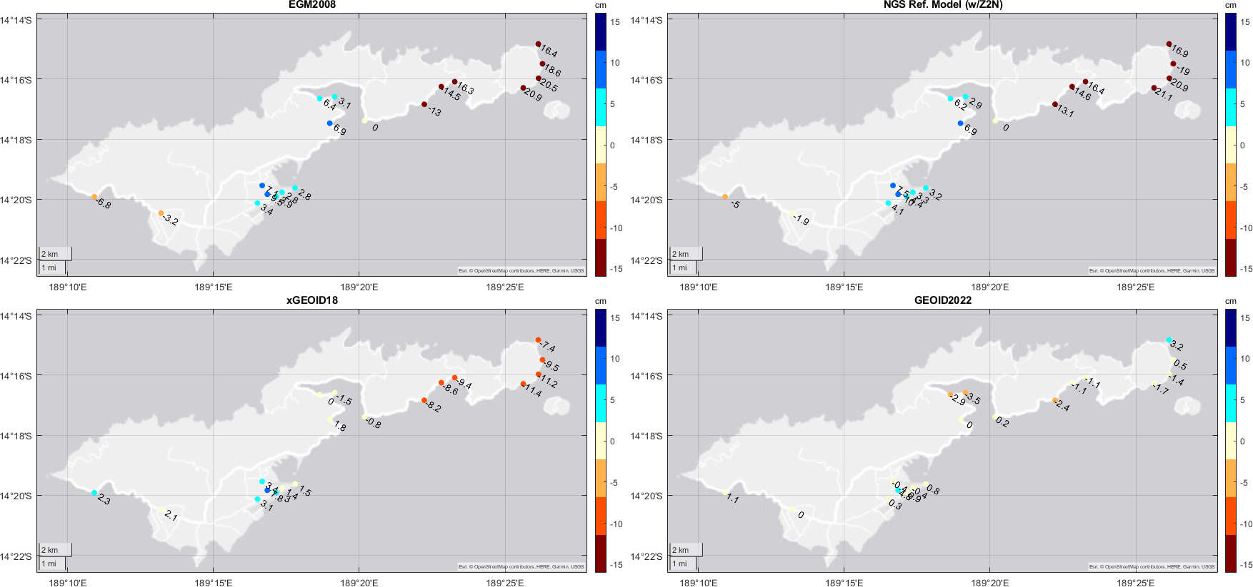
American Samoa: GNSS\leveling comparisons
σ = 11.4 cm
σ = 6.2 cm
σ = 6.2 cm
σ = 1.9 cm

Slide 15
Conclusions:
Updated GEOID2022:
Contributions from NGS/CGS/INEGI
Additional models within NAPGD2022
DEFLEC2022, GRAV2022, GM2022
Model performance continues to improve:
GSVS: σ = 1 cm, 1.1 cm, 1.4 cm (30% improvement)
Puerto Rico/US VI: σ = 3.6 cm
Pacific regional models
Guam: σ = 1.4 cm
American Samoa: σ = 1.9 cm
Kevin Ahlgren
kevin.ahlgren@noaa.gov
NOAA’s National Geodetic Survey
https://alpha.ngs.noaa.gov/GEOID2022/index.shtml

