Slide 1
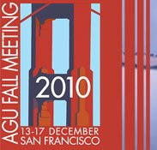
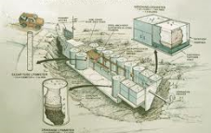
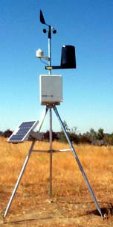


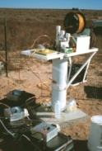
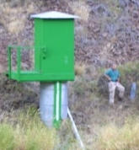

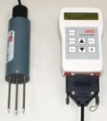

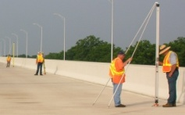

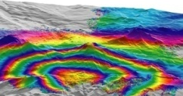
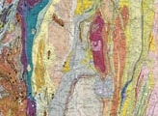


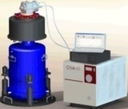
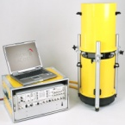
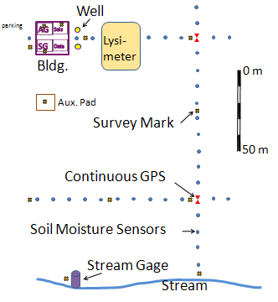
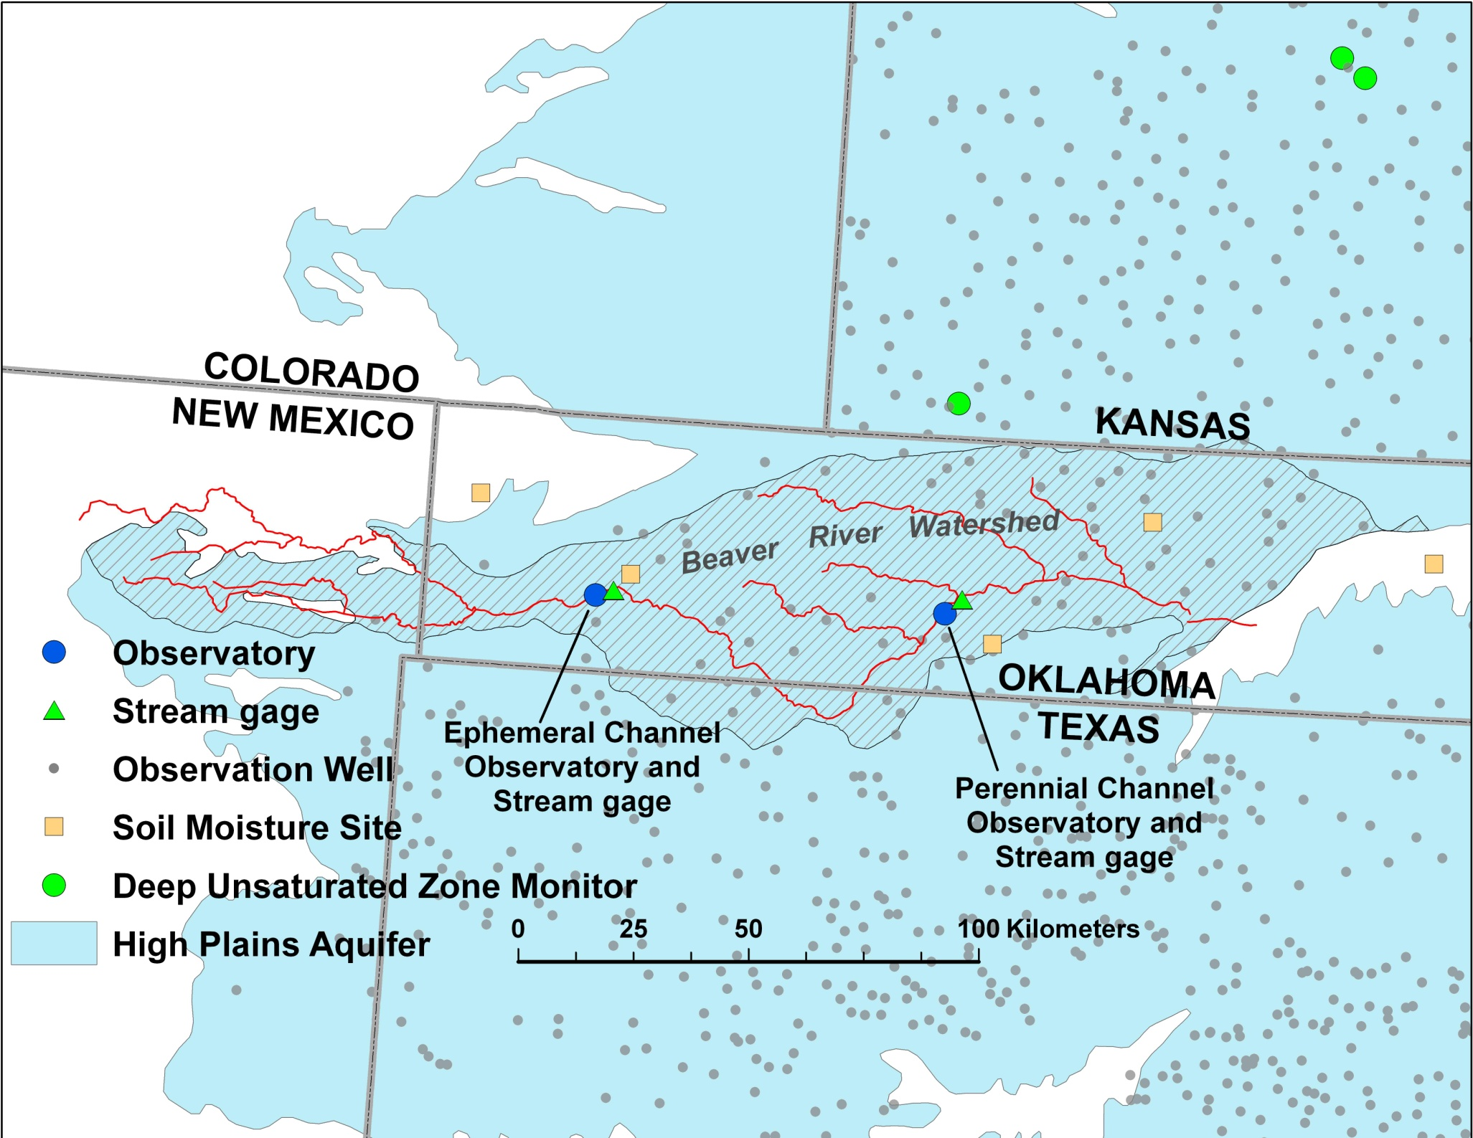
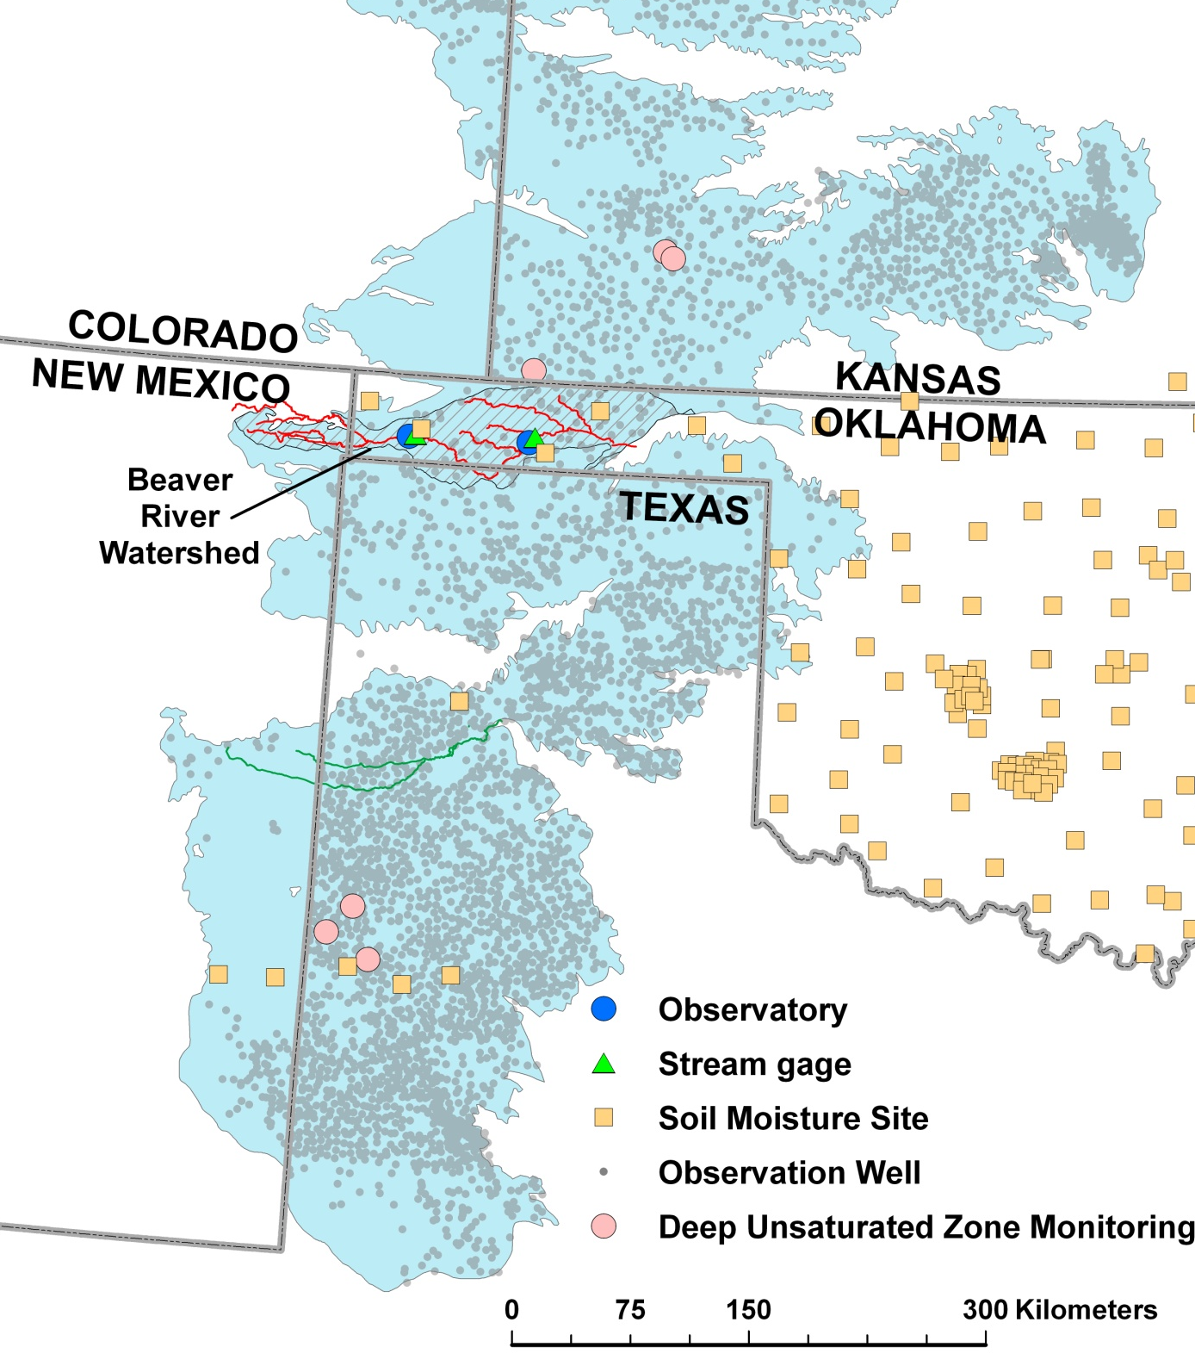
A regional-scale network for geoid monitoring and satellite gravimetry validation
Daniel Winester, NOAA-National Geodetic Survey daniel.winester@noaa.gov
Donald R. Pool & Jeffrey R. Kennedy, USGS-Arizona Water Science Center
Background:
In the past two decades, improved measurements of acceleration due to gravity have allowed for accurate detection of temporal gravity change. Terrestrial gravimeters can sense changes of gravity induced by elevation or mass changes, including local effects that may bias regional studies. Satellite instrumentation can detect large scale mass changes on a regular basis. The minimum resolution of the GRACE satellite is about 400 km, which is too large for the size of most, direct regional studies. Also, satellites are limited by their life of deployment. Both techniques can be scaled to (in)validate change models generated from other geophysical observations including water storage (underground and glacial), geoid definition, isostatic adjustments and tectonic activity.
Problem:
There is a gap between the spatial resolution of terrest-rial and satellite gravity observations and temporally between satellite missions when investigating regional effects (e.g., a hydrologic basin).
Approach:
This gap could be bridged by developing a terrestrial network of observatories that define the hydrologic and geodetic change within a representative sample of a region. This information could then be extrapolated to the extent of the region on the basis of statistics or models. Our example region uses a network of two observatories. The number of observatories would need to be calculated for other regions depending on local conditions and availability of models. Each observatory would have extensive instrumentation for monitoring, including at a minimum,
Hydrology: Soil moisture and characteristics, depth of water in wells, streamflow, glacial extent.
Geodetic: Continuous GPS, InSAR, campaign GPS at other sensors, possible level surveys.
Gravity: Continuous with tidal gravimeter, periodic calibration with absolute gravimeter, possible areal grid of observations.
Weather: Precipitation, humidity, air pressure, anemometer, evapotranspiration.
Some of these measurements exceed what satellites can measure, but they are needed to model mass change from the surface. Where possible, the observatory would build upon existing data collection infrastruc-ture. Preferably, the region would also have seismic tomography or crustal seismic reflection observations to characterize Moho-depth mass changes and have regional Bouguer anomaly & elevation mapping. In addition to providing information on local hydrology and geology, data collection would allow for character-ization of local seasonal corrections, earth tides, atmospheric loading and episodic slip. Observatories could be made available for other atmospheric and geophysical measurements, assuming there are no conflicts. Previous studies suggest that more than a decade of observations will be needed to characterize and separate geoid/tectonic versus hydrologic signals.
G41A-0795
Weather Observations; on-site and regional (e.g. MADIS, LAPS, COCORAHS, HPRCC)
Climatology Models (e.g. RUC, NAM, GFS)
Lysimeter
Hydrology Models (e.g. MODFLOW, PRMS, GSFLOW, LaD)
Weather station
Hydrology Observations (e.g. lysimeter, soil moisture, wells, stream gages)
Geoid Change Models (e.g. ICE6G, mass changes
Monitoring well
Stream gage
Soil moisture probe
Geodetic Observations (e.g. continuous & campaign GPS, InSAR, levels)
Continuous GPS
Leveling
Tectonic Changes (e.g. fault displacements, subduction, subsidence
Geologic Mapping
InSAR map
Geologic map
Gravity Monitoring (continuous observations, campaign regional grid)
Costs:
No test network has yet been funded, but cost of equipment, installation, maintenance, travel and human resources can be estimated. Cost would be minimized by building on existing infrastructure and cooperation with federal, state, local and university groups.
Tidal gravimeter
Absolute gravimeter
Potential Paired Observatory Sites:
The Southern High Plains Aquifer (example region) is a good candidate for the observatories because of its large aquifer extent, uniform geology and minimal topographic relief. Groundwater levels, soil moisture, and streamflow are also monitored extensively in this region. The upper part of the Beaver River drainage in the Panhandle of Oklahoma is one of many potential locations for paired observatories, with one in the upland area of the aquifer that includes large depths to water and ephemeral streams and the other in the lowland area where depths to water are shallow and groundwater discharges to perennial streams.
Single Observatory Estimates in $1K
Item: Start up Annual
Absolute gravimeter(borrowed) 15 15
Building, utilities 100 5
Continuous GPS 40 0.5
Geologic & soils mapping 10 0
InSAR 15 15
Land 50 50
Leveling (assume 20 km) 50 10
Lysimeter 40 1
Operators and scientists 10 20
Soil moisture probes 8 0.5
Stream gage 30 15
Tidal gravimeter 100-300 3
Weather station 10 0.5
Wells (2) 40 0.5
TOTALS: 518-718 136
Model Observatory
Beaver River Watershed
Southern High Plains Aquifer

