Slide 1
Accepting Real-time Kinematic GNSS Data
geodesy.noaa.gov
Dan Gillins, Ph.D., P.L.S.
May 7, 2018
NGS Industry Workshop

Slide 2


Accuracy vs. Cost
Accuracy
Cost
Set a continuous GNSS reference station (i.e., CORS)
  Permanent or semi-permanent base station
Campaign-style static GNSS survey with multiple receivers
  Develop survey network for adjustment
  OPUS-Projects
Static GNSS survey session with one receiver (i.e., OPUS-S)
Rapid-static GNSS survey session with one receiver (i.e., OPUS-RS)
Real-time kinematic (RTK) observation

Slide 3
Campaign-style GNSS Surveys at NGS
“Height Modernization Surveys” – NOS NGS 58/59
  Establish geodetic coordinates on passive marks
  Constrain survey networks to orthometric heights on bench marks to derive orthometric heights on passive marks
“FAA Control Surveys” – AC 150/5300-16A
  Establish geodetic coordinates on passive marks near runways
  Control for airport obstruction surveys

Slide 4
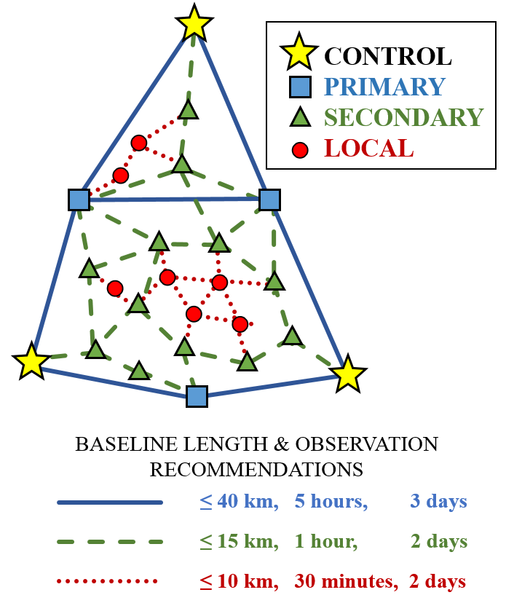
NOS NGS-58
Published in 1997
Network hierarchy
Repeat observations
Survey traceability
Adjustments of GNSS network holding control
Local accuracy ≤ 2 cm (95% conf.)
Network accuracy ≤ 5 cm (95% conf.)

Slide 5
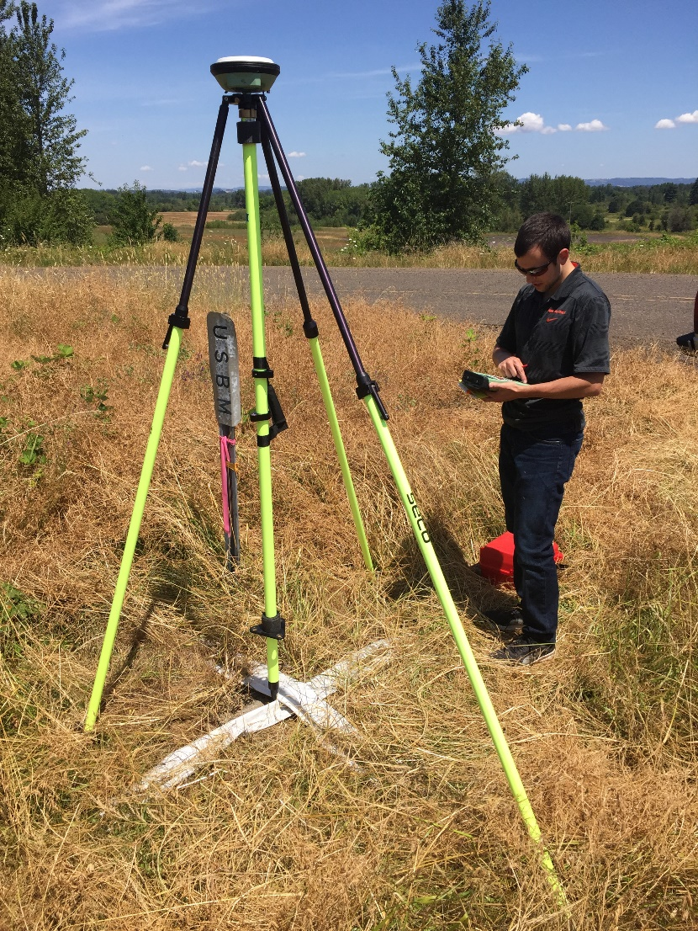
Real-time Networks (RTNs)
Network of continuously operating GNSS stations
  ~ 70 km interstation spacing
Atmospheric and orbital corrections are transmitted to rover via mobile data link
Baselines processed in real-time
Coordinates to cm-level accuracies derived in seconds to minutes

Slide 6
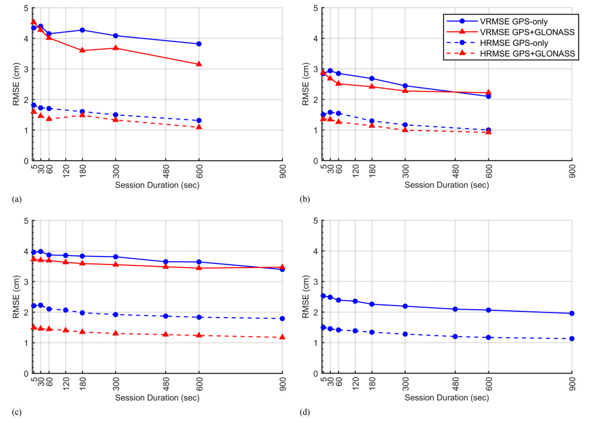
Empirical Evaluation of the Accuracy of RTNs
[Allahyari et al. 2018]

Slide 7
RTN Surveys Compared to Static Surveys
Benefits | Concerns
FAST. Could reduce field observations from several hours to just a few minutes | RTN may not be aligned with the National Spatial Reference System
Can evaluate data quality in real time | Ideally, survey should be tied to CORS Network
Easy to obtain additional observations | More prone to multipathing errors
Only a single receiver (i.e., rover) is needed during a session | Baselines must be kept short (i.e., < 40 km)

Slide 8
Methods for Receiving Corrections from an RTN
Virtual Reference Station (VRS)
Master-Auxiliary Concept (MAC)
Vector “tails” referenced to virtual base station—can be moved to physical ref. station (PRS)
Vector “tails” connected to physical base station
Base station position is fixed
RTN Base
RTN Base
VRS
Control
Center
(Landau et al. 2002)
RTN Base
(Leica 2005)
Notes:
VRS
1.) Rover sends approx. position to RTN control center
2.) Control center assigns this position as the location of an imaginary base station and interpolates corrections at this virtual location
3.) These interpolated corrections are used to generate corrected pseudo-observables that are “transmitted” from the virtual base to the rover to be processed using conventional single-base RTK algorithms to solve for precise geodetic coordinates at the rover (Wang et al. 2010)
MAC
1.) The rover transmits an uncorrected point position to the central server, and then the server searches and selects a “cell” of reference stations for generating corrections
2.) The phase ranges from all selected stations are reduced to a common ambiguity level, and dispersive and nondispersive errors for each frequency and satellite-receiver pair are computed relative to the master station
3.) The residual corrections between the auxiliary stations and the master station, as well as the full corrections and published coordinates at the master station are transmitted to the rover. The rover then interpolates the received corrections and network information to derive its precise position (Janssen 2009).

Slide 9
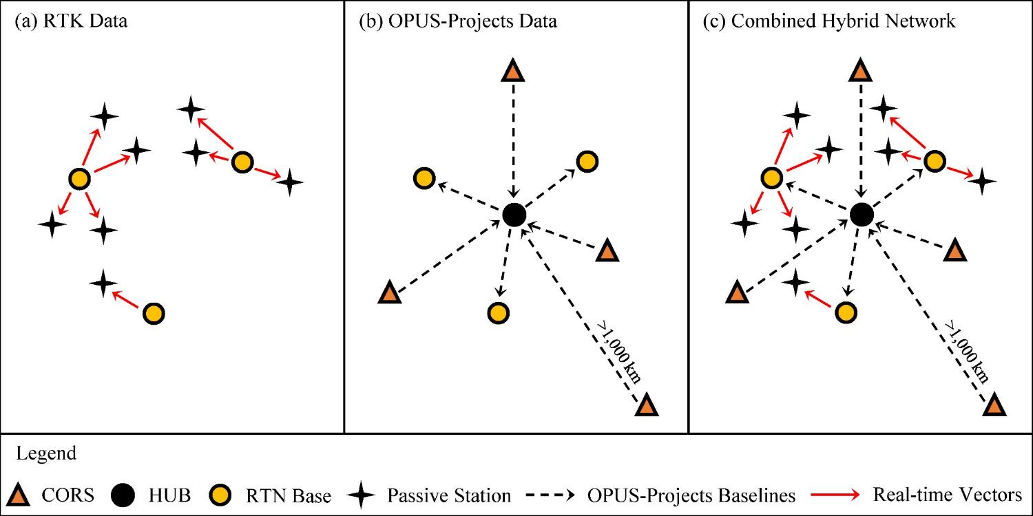
Hybrid Static + RTN Survey Networks
[Weaver et al. 2018]

Slide 10
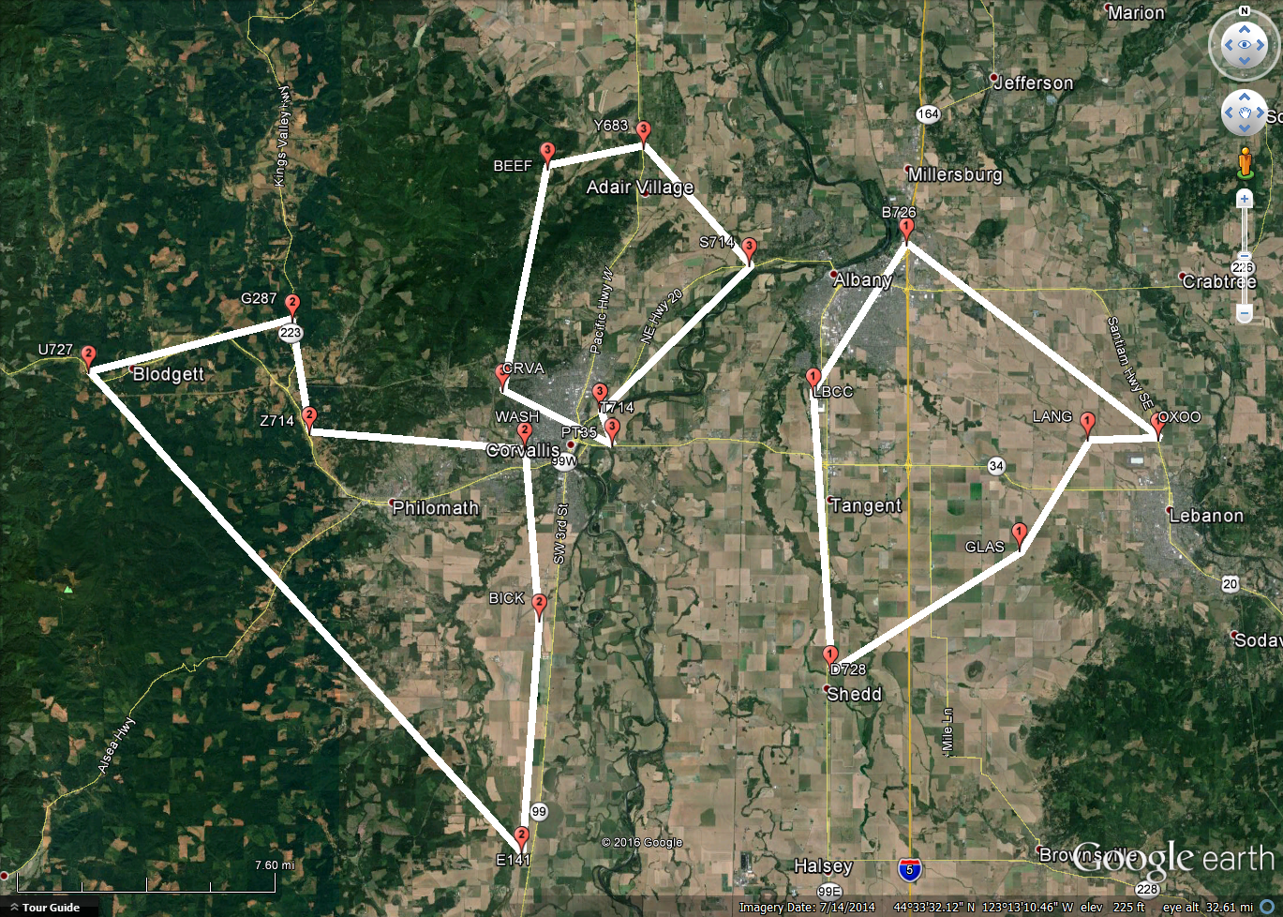
Example: Conduct RTN Survey

Slide 11
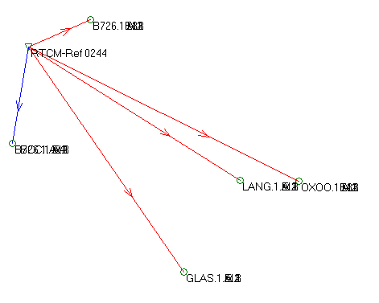
Example: Download RTN Data
BASE
(LCS1)
Notes:
Download RTN data from a data collector to software. Then, identify which base stations were chosen by the RTN as references during the survey. Go to an FTP or website to download the static data logged at the base stations on the day(s) of the RTN survey. Upload this static data (preferably as 24-h files) to OPUS-Projects.

Slide 12
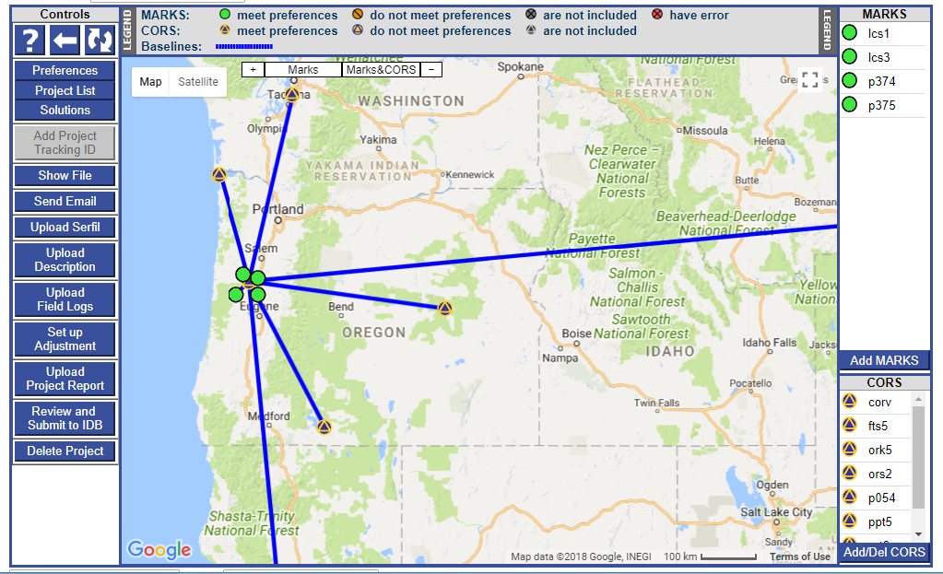
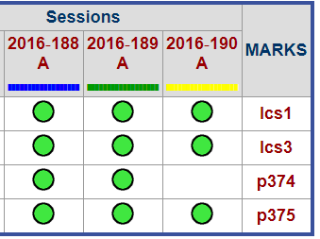
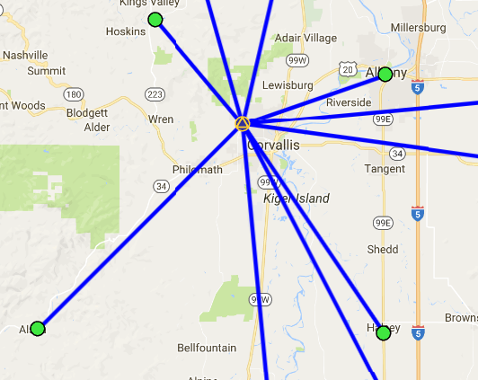
Example: Process Static Data in OPUS-Projects
Upload Vectors

Slide 13
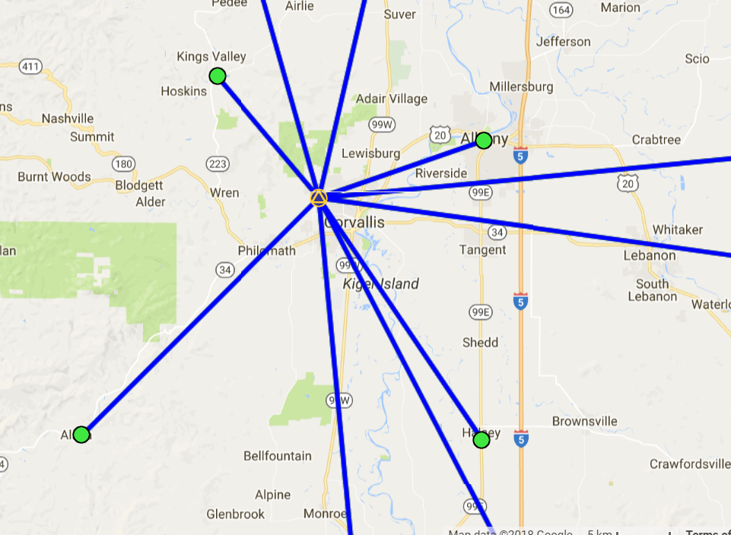
Example: Upload RTN Vectors to OPUS-Projects
LEGEND
CORS
User Mark
Processed Vector (OPUS-Projects)
Uploaded Vector
Upload Vectors

Slide 14
Example: Adjust Static + RTN Network
Run least squares adjustment(s) of the combined static data and RTN vectors in the survey network
Hold CORS (and possibly other published coordinates on passive marks) as control in network adjustments
Check quality of results
Submit survey project to NGS for review and publication in national database

Slide 15
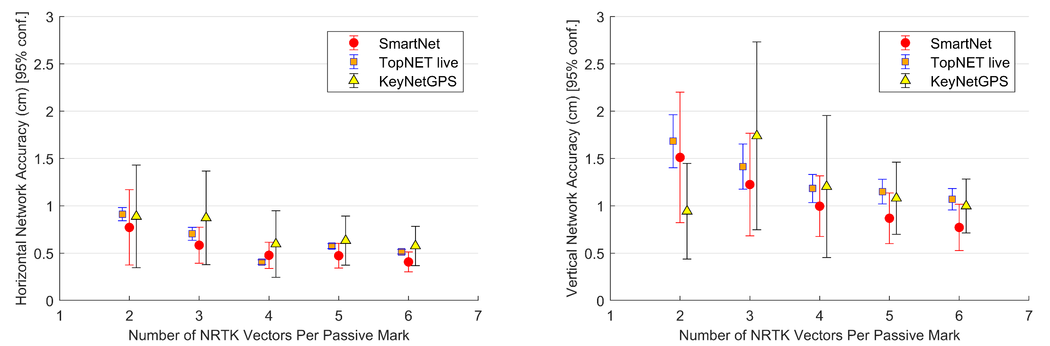
Network Accuracy at Marks in Hybrid Network vs. Number of Independent RTN Observations
(Each real-time vector based on a 5-minute (300-epoch), fixed observation; GPS+GLONASS)

Slide 16
“Standardized GNSS Vector Exchange Format”
Must Have:
Mark-to-mark ECEF vector components (dX, dY, dZ)
Standard deviations of vector components
Correlations or covariances
Reference frame
Start and stop time of observation
A-priori coordinates of the “from” station

Slide 17
“Standardized GNSS Vector Exchange Format”
Should Have:
Equipment information (at both “from” and “to” station)
Number of satellites used (GPS vs. GLONASS vs. Galileo vs. Beidou)
DOP
Solution type (fixed vs. float)
Orbit source
Observer name or ID
RTN metadata
  Name of RTN; network type
  inside/outside network
  Mount point; data format; IP address; IP port
  RTCM age

Slide 18
Summary
Real-time kinematic GNSS data are sufficiently accurate for many geodetic surveying applications
  Must balance accuracy versus efficiency
Developing tools in OPUS-Projects so surveyors can upload, include, and adjust vectors from real-time GNSS surveys
  Need a standardized GNSS vector exchange format for industry
Developing new surveying guidelines and/or specifications for including real-time data in a GNSS geodetic control survey

Slide 19
References
Allahyari, M., Olsen, M.J., Gillins, D.T., and Dennis, M.L. (2018). “Tale of Two RTNs: Rigorous Evaluation of Real-Time Network GNSS Observations,” J. Surv. Engr., 144(2): 05018001.
Weaver, B., Gillins, D.T., and Dennis, M.L. (2018). “Hybrid Survey Networks: Combining Real-Time and Static GNSS Observations for Optimizing Height Modernization,” J. Surv. Eng., 144(1): 05017006.

Slide 20
Why 5-minute Observations?
SRTK, South Carolina NRTK, South Carolina
SRTK, Oregon NRTK, Oregon
[Allahyari et al. 2018]

Slide 21
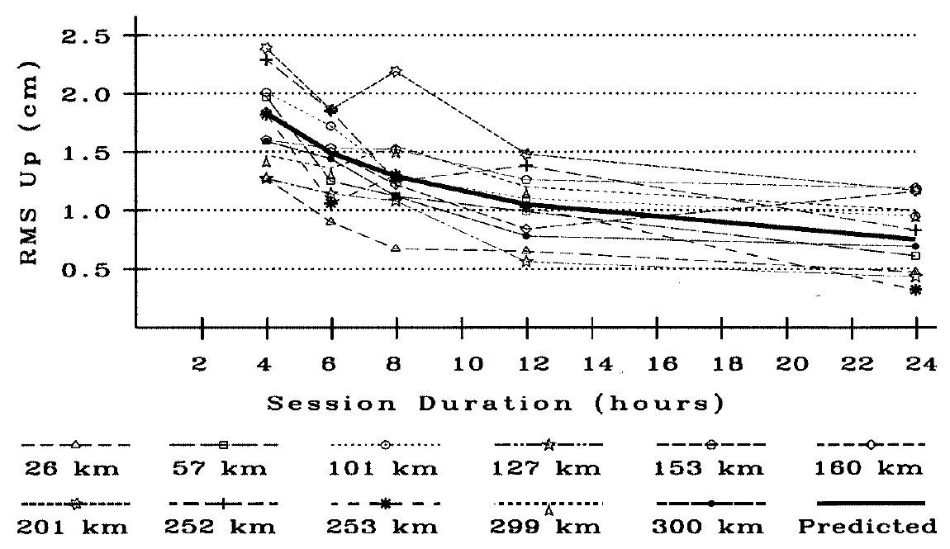
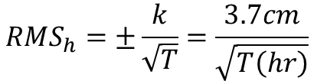
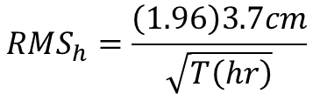
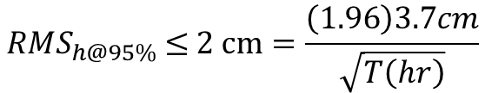

Accuracy of PAGES
  Dependent on observation duration
  Capable of processing long baselines
Scale to 95% confidence
Eckl et al. 2001

Slide 22
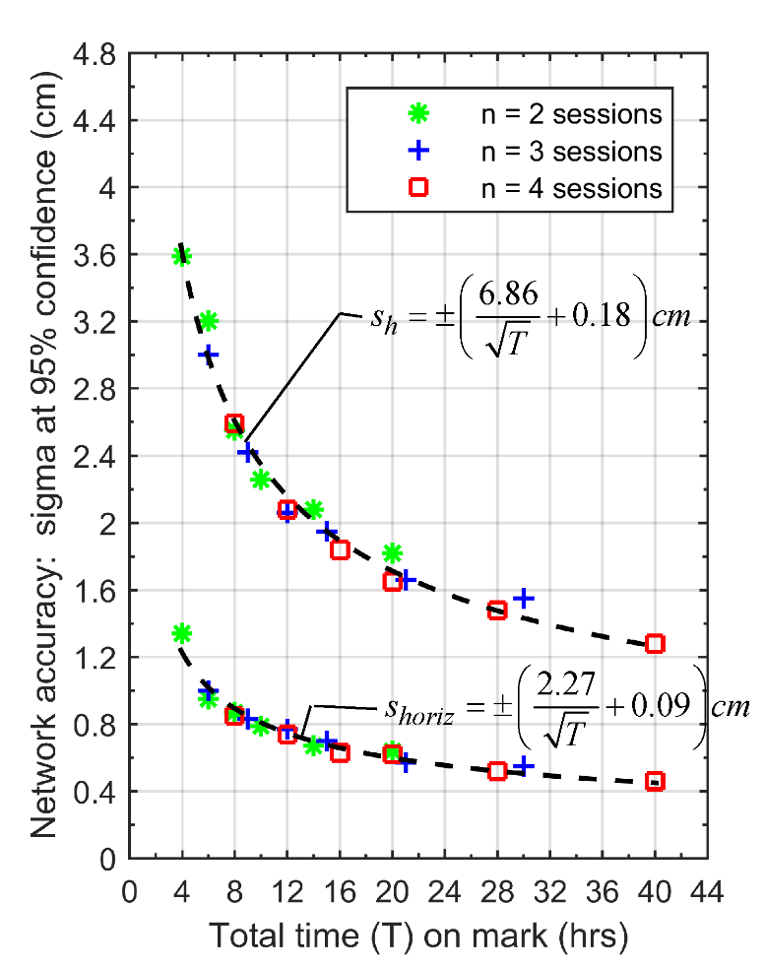
Empirical Evaluation of OPUS-Projects
s_{h} = ± 2.0 cm at 95% confidence when T = 14.2 hours
(2) 7.5 hour sessions
(3) 5 hour sessions
  (morning, midday, afternoon)
(4) 4 hour sessions
  (2 morning, 2 afternoon)

