Slide 1
GNSS Absolute Antenna Calibration at the
National Geodetic Survey
Andria Bilich & Gerald Mader
Geosciences Research Division
National Geodetic Survey
With contributions from:
Steven Breidenbach, Hong Chen, Kendall Fancher, Charles Geoghegan, David Gietka, Heeyul Han, Dennis Lokken, Frank Marion, Jaya Neti, Jarir Saleh

Slide 2
Outline
Motivation
NGS methods and observation models
Example results
NGS Calibration Services

Slide 3
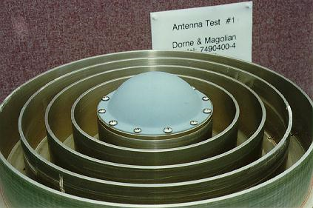
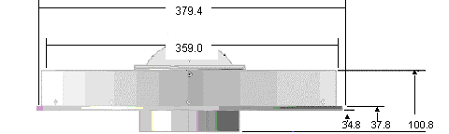
Where do I receive the signal?
Antenna element
Nonphysical and inconstant point floating in space?
Antenna reference point (ARP)
Notes:
Antenna calibration attempts to answer very important question – where do I receive the signal?

Slide 4
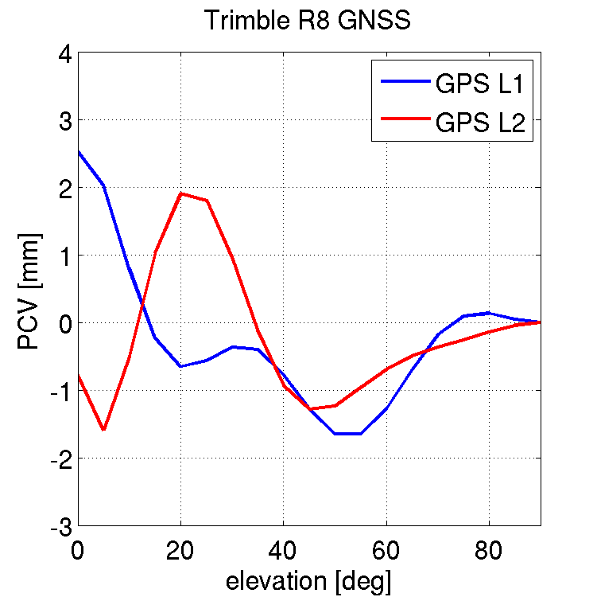
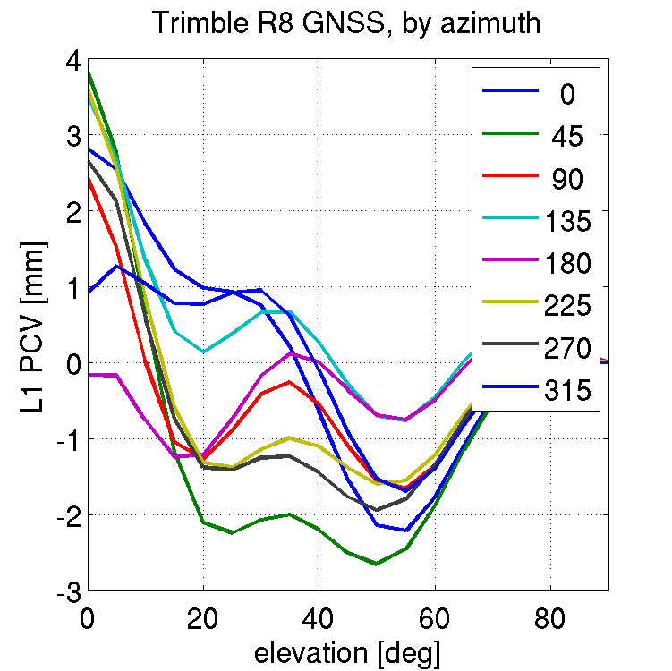
What is GNSS Antenna Calibration?
PCV
(el)
PCV
(az,el)
Create a “map” of antenna characteristics
Mean point being positioned (PC0)
Spatial variations (PCV)
PC0 [ENU]
Notes:
Determination of receiving antenna characteristics required for accurate geodetic positions.
What is the location of the point being positioned?
How does that point vary in space?
How to neutralize antenna contributions (flatten out spatial variation)?

Slide 5
What Is The Effect of PC0/PCV?
Antenna element introduces elevation- (and azimuth-) dependent advance/delay to the carrier phase observation = PC0 + PCV
  Effect on heights (with respect to elevation cutoff)
  Alias into troposphere estimate
  <= 10cm height errors on mixed-antenna baselines
  Mixed-antenna and longer baselines demand good antenna calibrations
  Published values are idealized (environment-free)
Notes:
Applies an elevation (and azimuth) dependent phase variation to the observed phase data
Makes height sensitive to elevation cutoff
Looks like troposphere variation - leads to incorrect tropo scale factors and heights
Especially pronounced for mixed-antenna baselines - 10cm height errors are not unusual
Mixed-antennas and longer baselines demand good antenna calibrations

Slide 6
NGS Motivations and Goals
Serve high precision needs of U.S. surveying and geodesy communities
Simultaneous multi-freq, multi-GNSS calibrations
2-D (elevation, azimuth) phase center patterns
Free calibration service w/ quick turn-around
Calibration values publicly distributed via Internet
Compatibility with IGS ANTEX values
Notes:
Although there are other absolute antenna calibration facilities in operation, the National Geodetic Survey felt that a domestic, free calibration service is consistent with our misson. Our overall goal is to serve high precision needs of US surveying/geodesy communities. To do this, we have developed a facility that… (read other bullets)

Slide 7
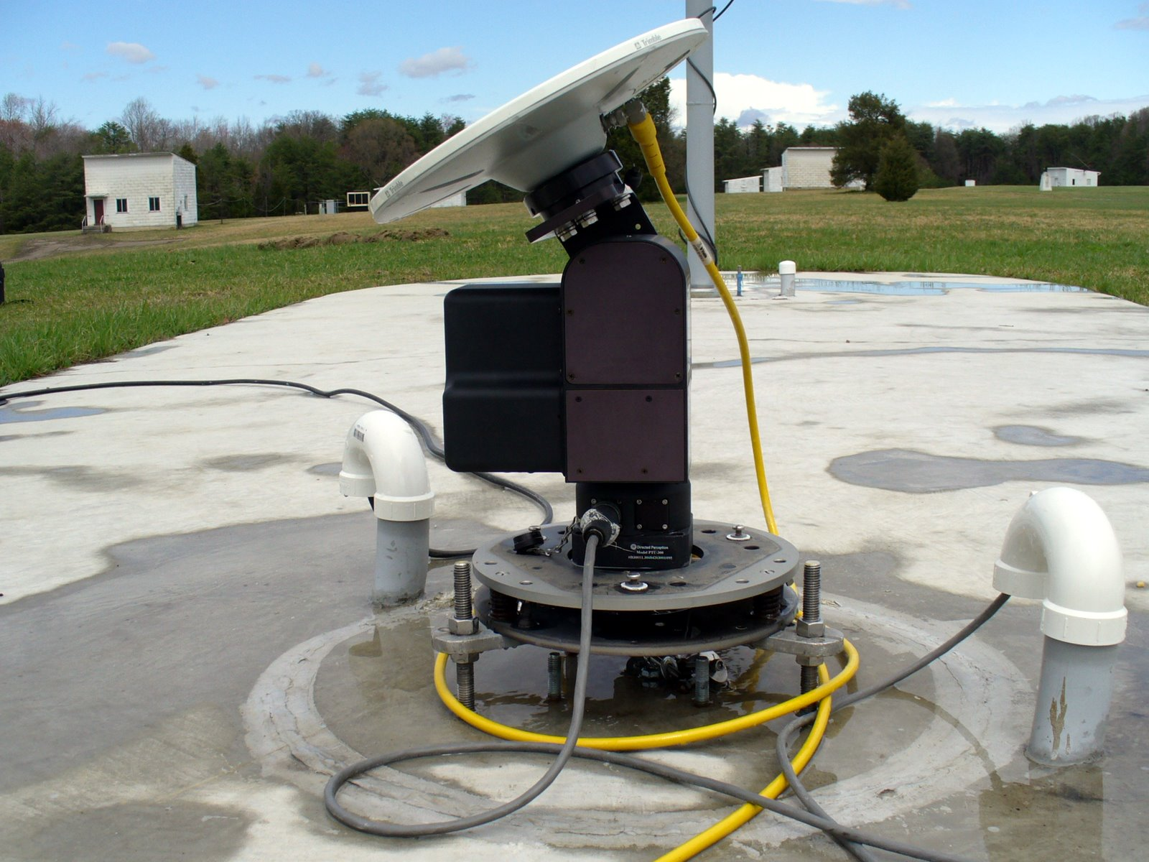
NGS Calibration Facility and Methods

Slide 8
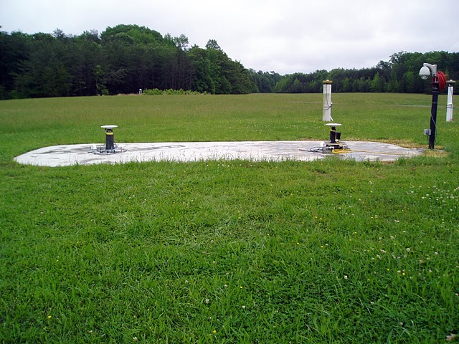
Calibration Setup
Single differences
Short baseline (5 m)
Simplified multipath environment
Common clock (heading receiver)
Remaining factors = phase centers (ref, test), differential multipath, hardware bias
Notes:
Experimental setup removes many common phase delay factors via single difference

Slide 9
Time Difference of Single Differences
Closely spaced time pairs + robot motion =
PC0/PCV at reference antenna removed
slowly varying biases (differential MP, hardware bias) minimized
Fixed reference antenna
Test antenna
Notes:
When time pairs are closely spaced (< 10 seconds), satellite motion is negligible.
Between time 1 and time 2, I move antenna under test by a large pan or tilt angle
Results in large change in reception angles for test antenna, but no net change at reference antenna
** Removes phase center effects of reference antenna, and minimizes the slowly varying biases

Slide 10
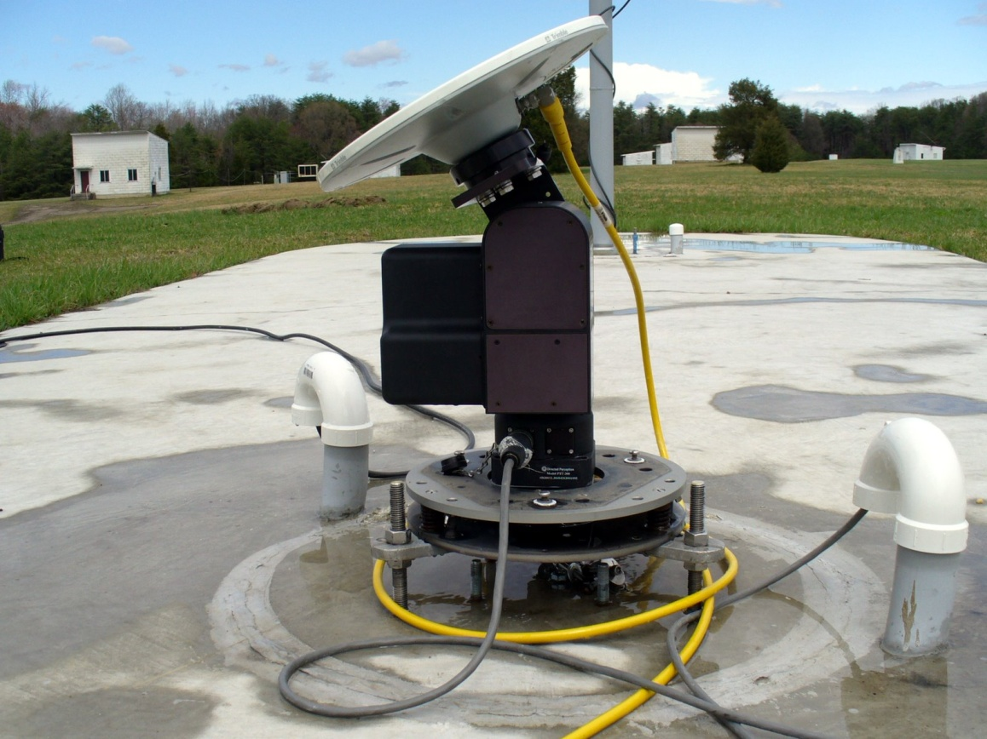
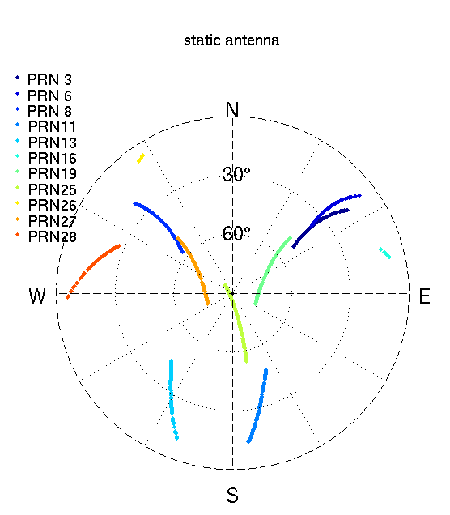
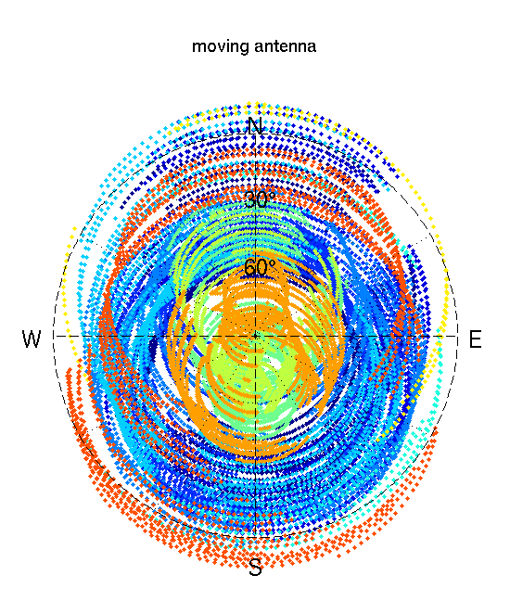
Why Robot?
Introduce angle changes for TDSD
Better spatial coverage

Slide 11
Modelled Factors
PCV (az,el)
A priori position
Frame rotation(s) between robot and local frame
Rotation arm length
Phase windup (antenna motion)
PC0 [ENU]
V
N
E

Slide 12
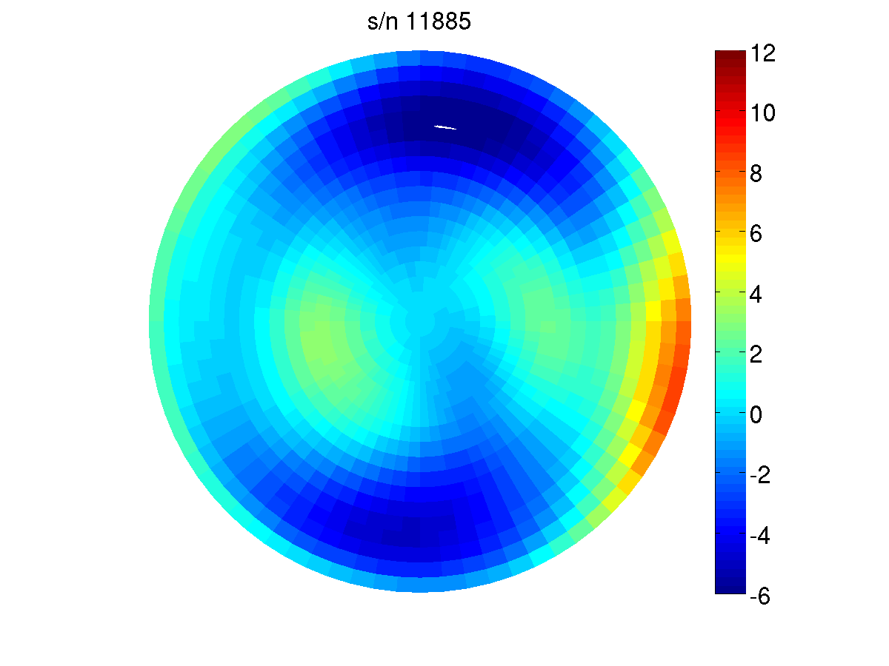
NGS Calibration Results
mm

Slide 13
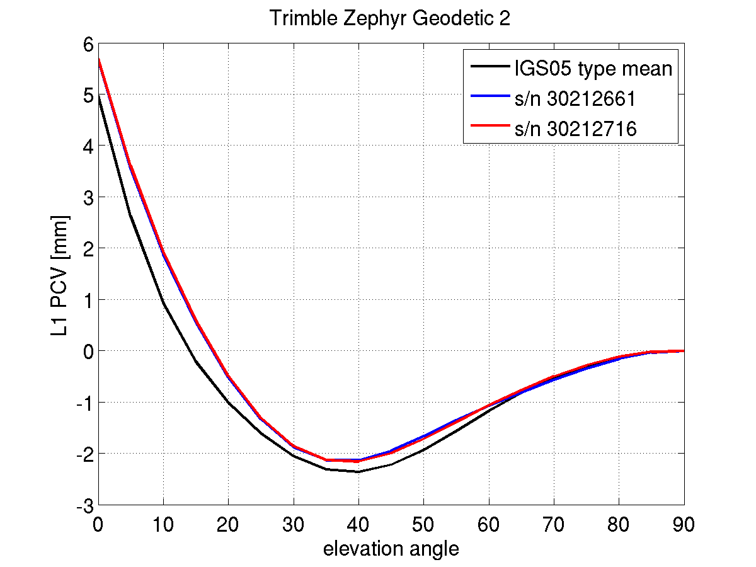
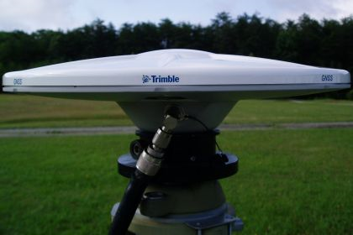
Trimble Zephyr Geodetic 2
(TRM55971.00)
(mm) | North | East | Up
IGS | 1.07 | -0.19 | 67.17
30212661 | 1.38 | -0.45 | 69.84
30212716 | 0.92 | -0.47 | 69.84
Notes:
~/conferences/IONGNSS2010/plotTrmZeph1.m
Patterns have been adjusted so that all use same PC0 (from IGS).

Slide 14
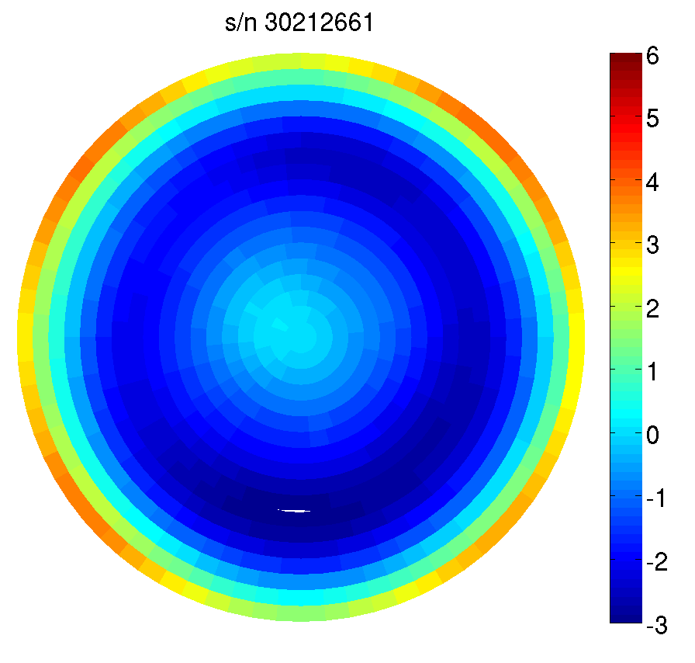
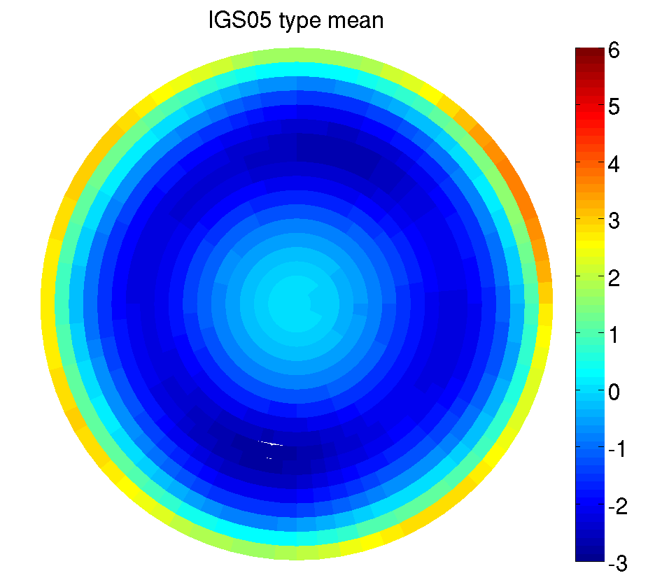
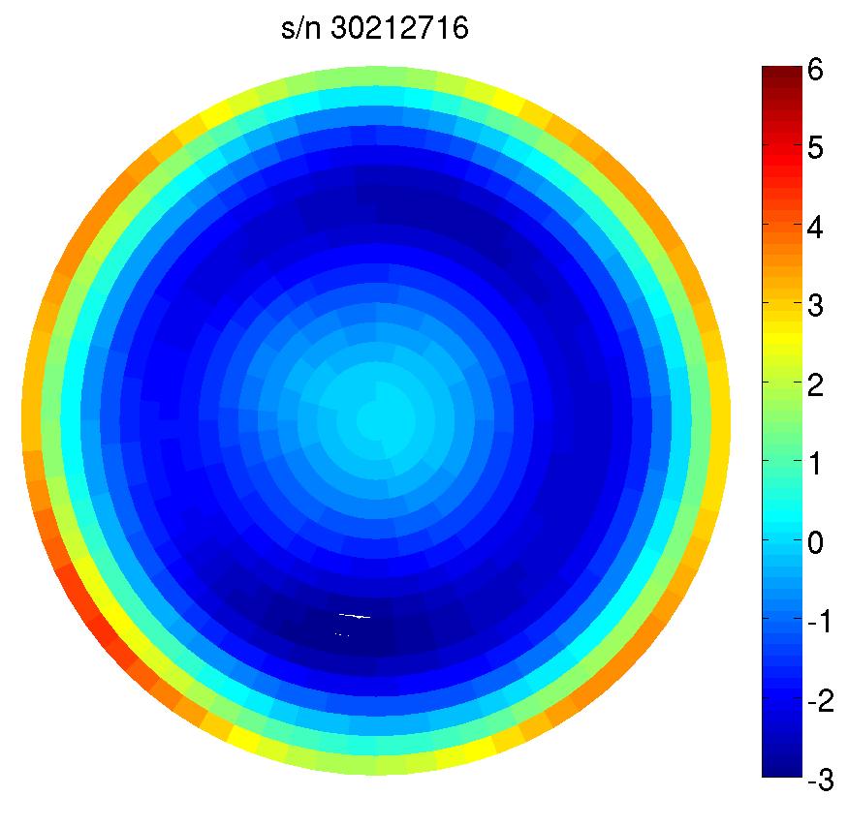
TRM55971.00 phase center pattern
mm
mm

Slide 15
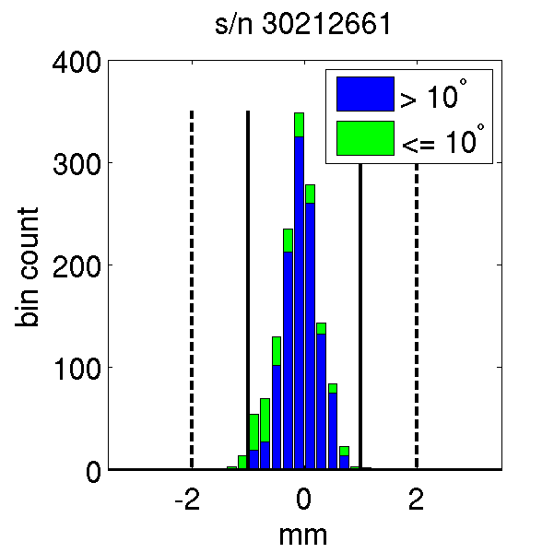
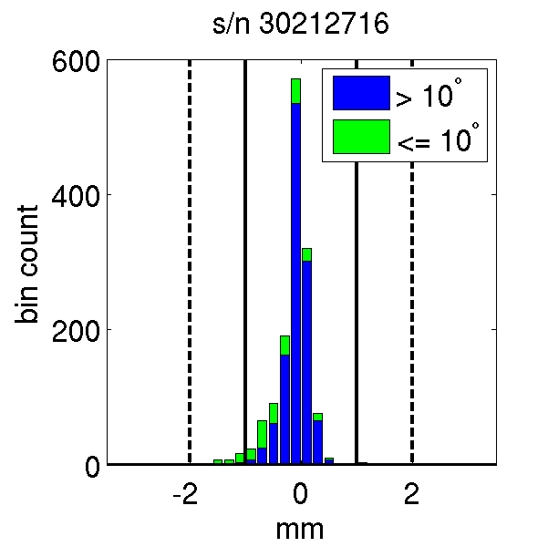
Deviation from IGS type mean
mm

Slide 16
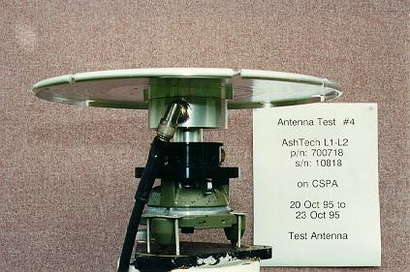
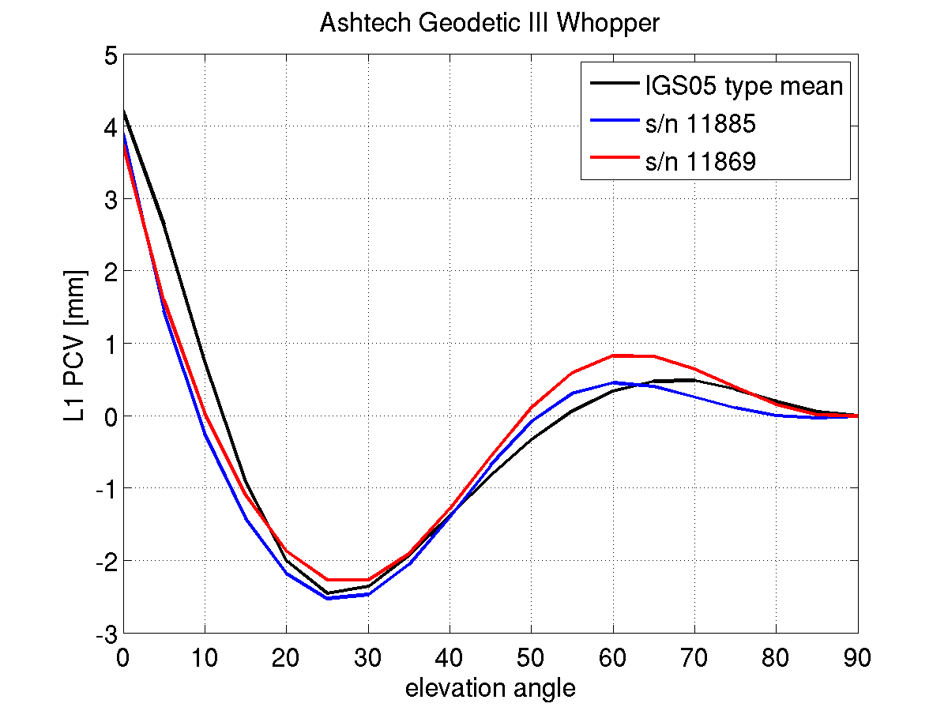
Ashtech Geodetic III ‘Whopper’
(ASH700718B)
(mm) | North | East | Up
IGS | -1.67 | -0.47 | 69.48
11885 | -1.22 | 0.22 | 69.13
11869 | -1.40 | 0.23 | 69.17
Notes:
~/conferences/IONGNSS2010/plotAshWhop2.m

Slide 17
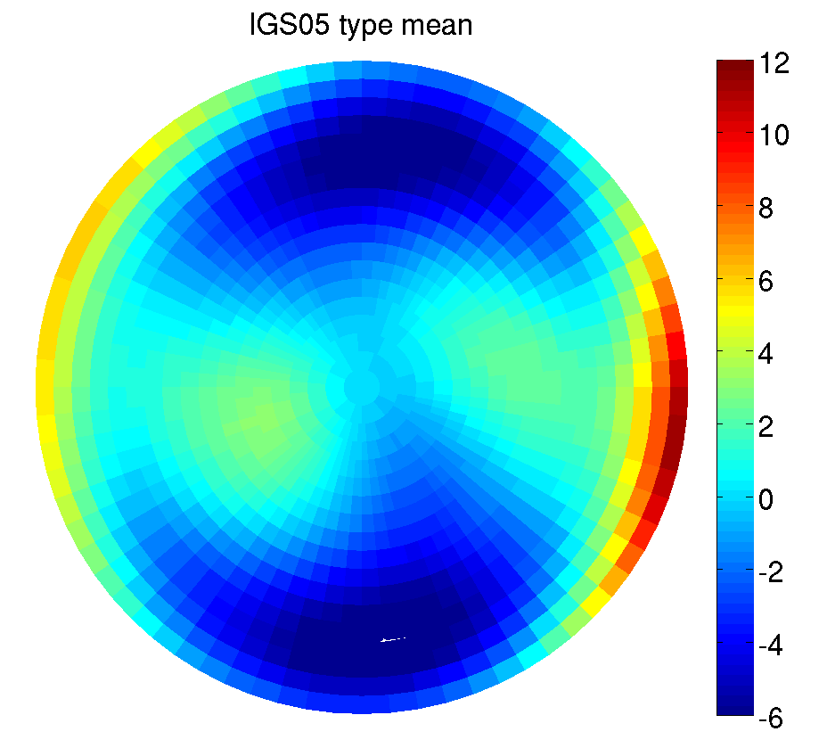
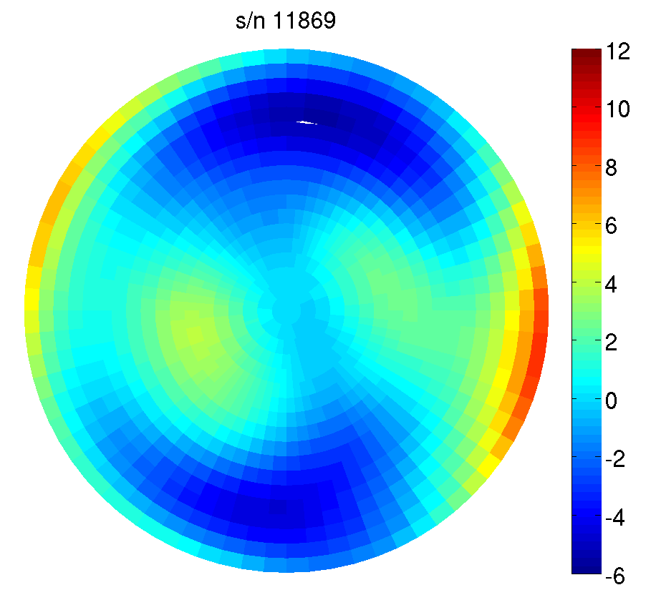
ASH700718B phase center pattern
mm
mm

Slide 18
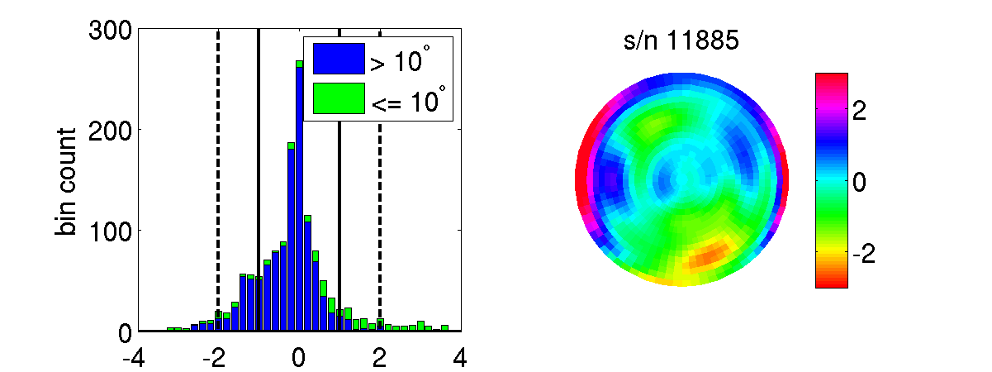
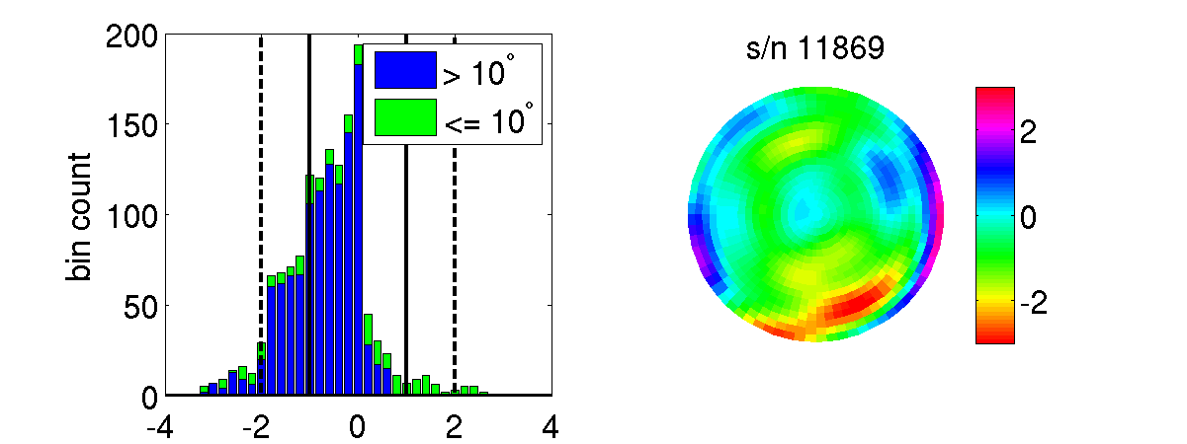
Deviation from IGS type mean
mm
mm
mm

Slide 19
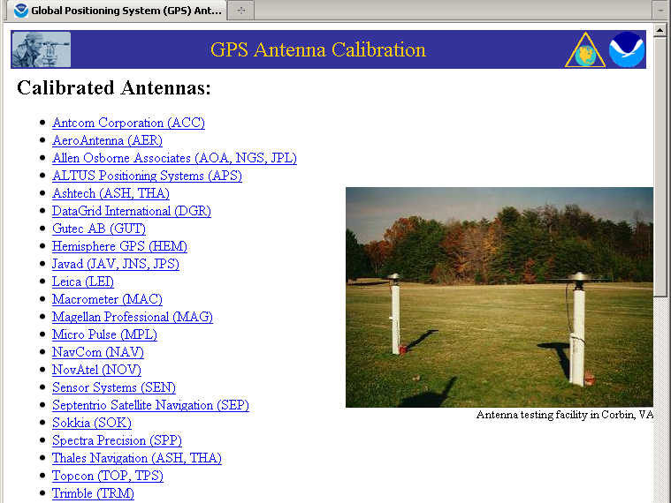
NGS Calibration Services

Slide 20
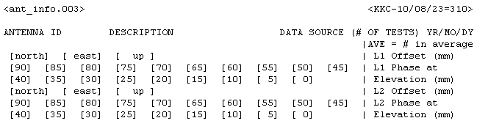
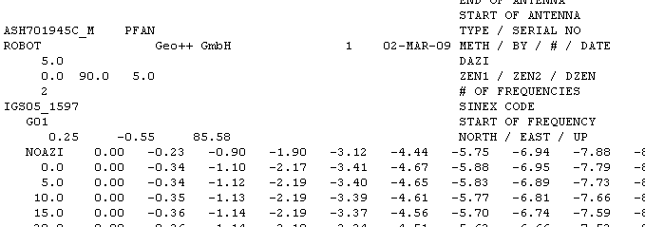
PC0/PCV Distribution
Freely available
Distribution via website: http://www.ngs.noaa.gov/ANTCAL
Data formats for different software:
  NGS format (relative and absolute)
  ANTEX (absolute)

Slide 21
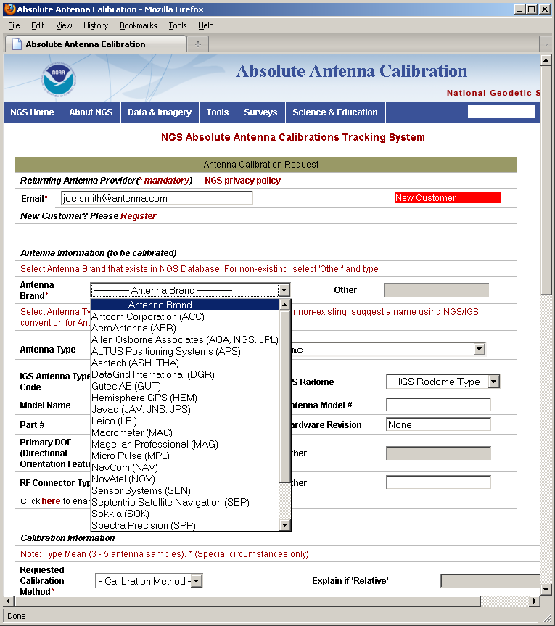
NGS Calibration Services
Formal policy document
  Calibration process and stages
  Eligibility for calibration
  Rights and responsibilities
Request calibration via web form
Tracking system with automated customer notification emails

Slide 22
Conclusions and Outlook
Good agreement with IGS type means
Pending approval from International GNSS Service (IGS)
Soon to be “open for business”
For more information
  http://www.ngs.noaa.gov/ANTCAL
  Email andria.bilich@noaa.gov or NGS.AbsAntCal@noaa.gov

