Slide 1
Geoid18
GPS on Bench Marks
Tools and Resources
John Hunter
CO State Geomatics Coordinator
John.Hunter@denverwater.org
303.634.3519
Pam Fromhertz
Rocky Mountain Regional Advisor
Pamela.Fromhertz@noaa.gov
240-988-6363
CoCoordinator@plsc.net
PLSC Western Chapter Seminar
May 3, 2019
geodesy.noaa.gov

Slide 2
GPS on Bench Marks
Phase I
Geoid 18
You helped with the final hybrid Geoid Model
All About heights
How important will heights/elevation be in the future?
Phase II
Transformation Tools
Help needed with the transformation tools to the new systems over the next couple of years
Thank you

Slide 3
Winners
CO Submitters | August Observations | Aug 16-19 Observation
keith.luttrell@denvergov.org | 6 | 2
george.preiser@state.co.us | 6 | 0
zachary.padilla@state.co.us | 6 | 1
mark.wagner@state.co.us | 3 | 1
james.walsh@state.co.us | 3 | 0
daniel.kuxhausen@woolpert.com | 2 | 0
hlassner@f-w.com | 2 | 1
perrybassett@gallowayus.com | 2 | 0
arthur.lacombe@state.co.us | 1 | 0

Slide 4
Ellipsoid, Geoid, and Orthometric Heights
Heights – why so important?
H = Orthometric Height (leveling)
H = h - N
h = Ellipsoidal Height (GPS)
N = Geoid Height (model)
h (NAD83)
TOPOGRAPHIC
SURFACE
(NAVD88) H
N
Geoid Height
(GEOID12B)
Geoid
Ellipsoid

Slide 5
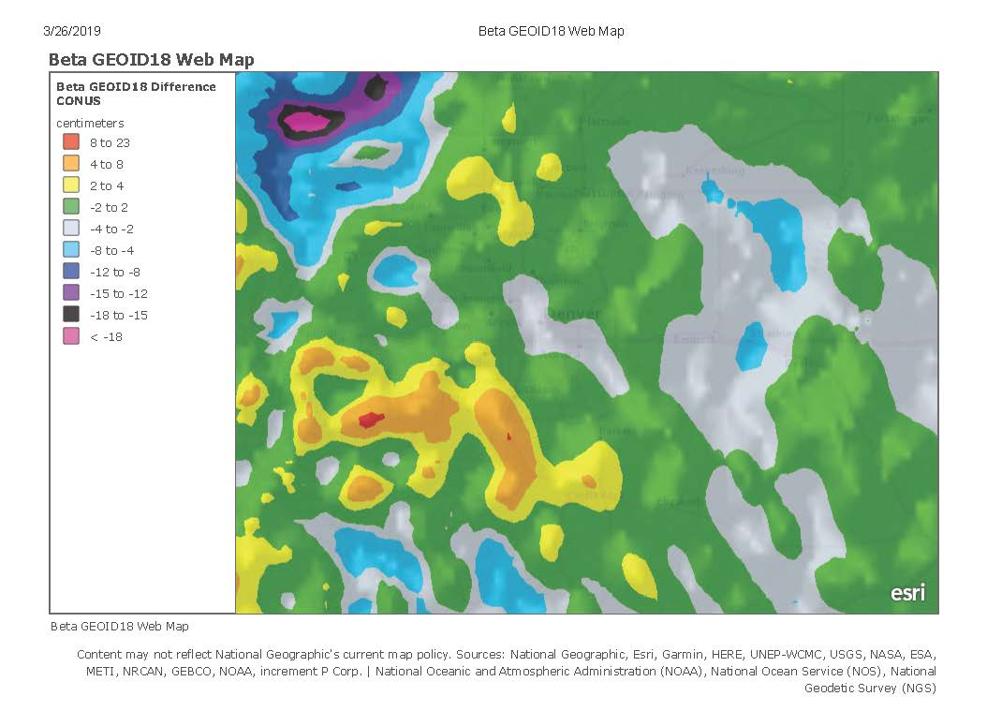

Slide 6
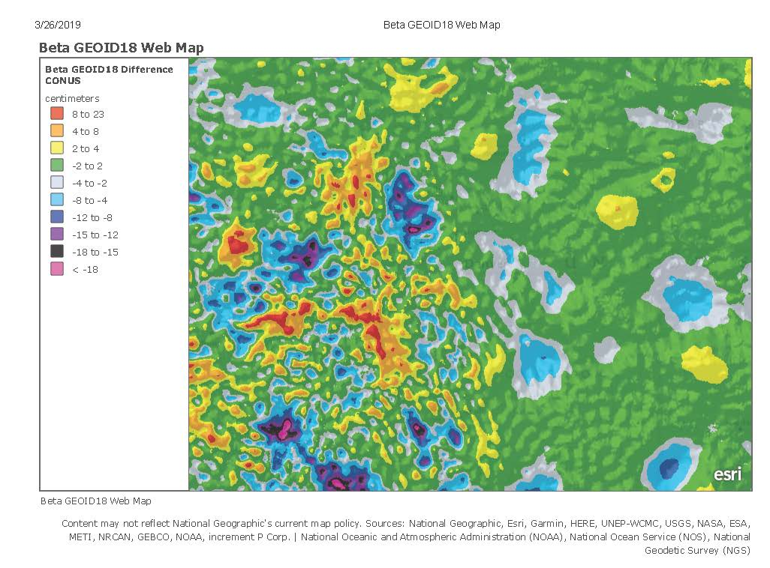

Slide 7
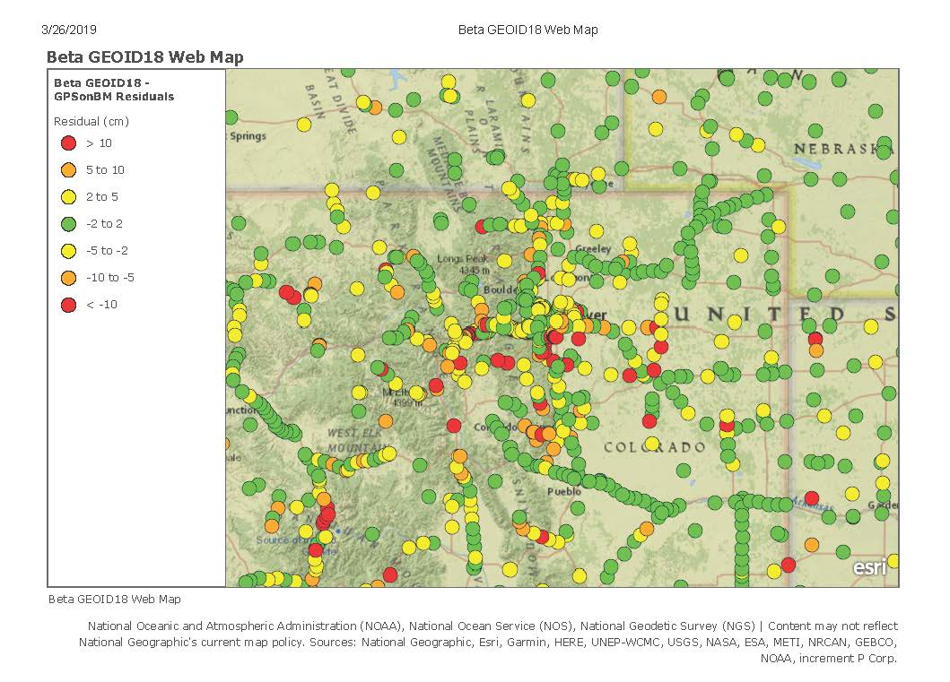

Slide 8
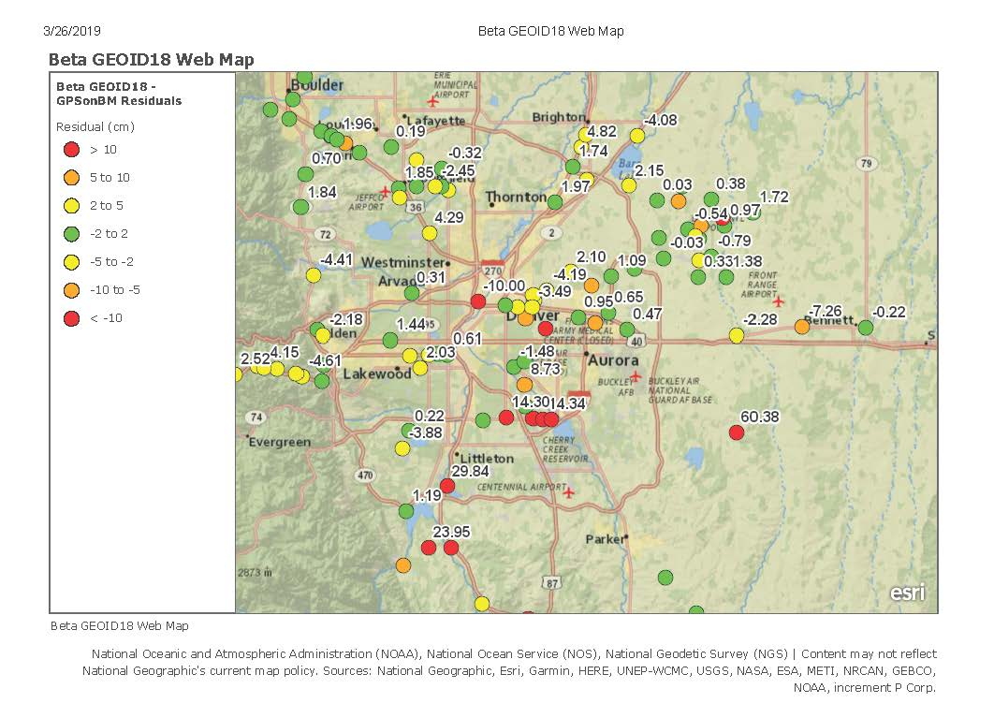

Slide 9
Next Steps
Phase II
New priority stations for Transformation tool
Many more stations (from 30 km to 10 km spacing)
Design a more localized approach
Provide incentive
Utilize interns (request positions)
NGS is exploring use of RTK

Slide 10
Crowdsourcing GPS on Bench Marks
Find Bench Marks (priority and others)
Use our priority BM/tracking map
Use NGS Data Explorer
Use DS-World
Provide a recovery note
Use DS-World (or new NGS beta app)
Provide updated descriptions,
Coordinates, photos (use DS-World)
Collect GPS data
Share through OPUS
Create OPUS Data Sheet
GIS Community
can assist here
Requires Survey Grade
GPS data and
min. of 4 hrs of data

Slide 11
OPUS Share Data Sheet

Slide 12
Mark Recovery Form
Partial Sample

Slide 13
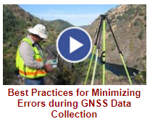
NGS GPS on BM Training Material
GPS on Bench Marks Webpages
NGS Video Library
NGS Online Lessons

Slide 14
Rocky Mountain Region Map and Volunteer Sign up
Signup sheet:
https://survey123.arcgis.com/share/130be382350e4a38a71de3b2e4d92a98 (Must cut and paste)
Status Map:
https://www.arcgis.com/apps/webappviewer/index.html?id=0829616b6ec740b7a0bfbf057188e865
NGS Map:
https://geodesy.noaa.gov/GPSonBM/index.shtml

Slide 15
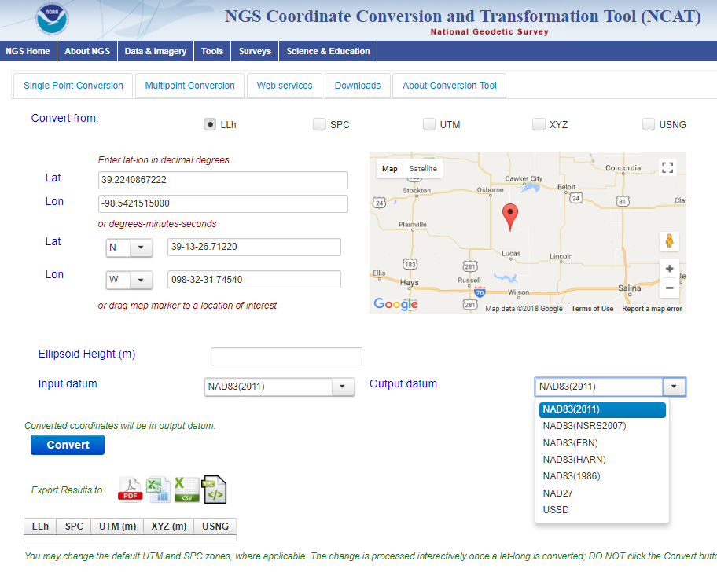
NCAT NGS Coordinate Conversion and Transformation Tool
Notes:
We also have a new tool available to convert between various coordinate systems using various projects.

Slide 16
Resources geodesy.noaa.gov
Webinars
SPCS2022, GPS on BM, …
Subscriptions Services
NGS news, webinars, training, GPS on BMs
Geospatial Summit
Register now – in person, webinars, recordings
May 6-7, outside DC
Training, Presentations (library)

Slide 17
geodesy.noaa.gov

Slide 18
NOAA’s National Geodetic Survey
Thank you
Pam Fromhertz
Rocky Mountain Regional Advisor
Pamela.Fromhertz@noaa.gov
240-988-6363
Geodesy.noaa.gov
John Hunter
CO State Geomatics Coordinator
CoCoordinator@plsc.net
John.Hunter@denverwater.org
303.634.3519

