Slide 1
NOAA’s National Geodetic Survey
Webinar Series: Geospatial Resources
Brian Shaw
brian.shaw@noaa.gov
October 14, 2021

Slide 2
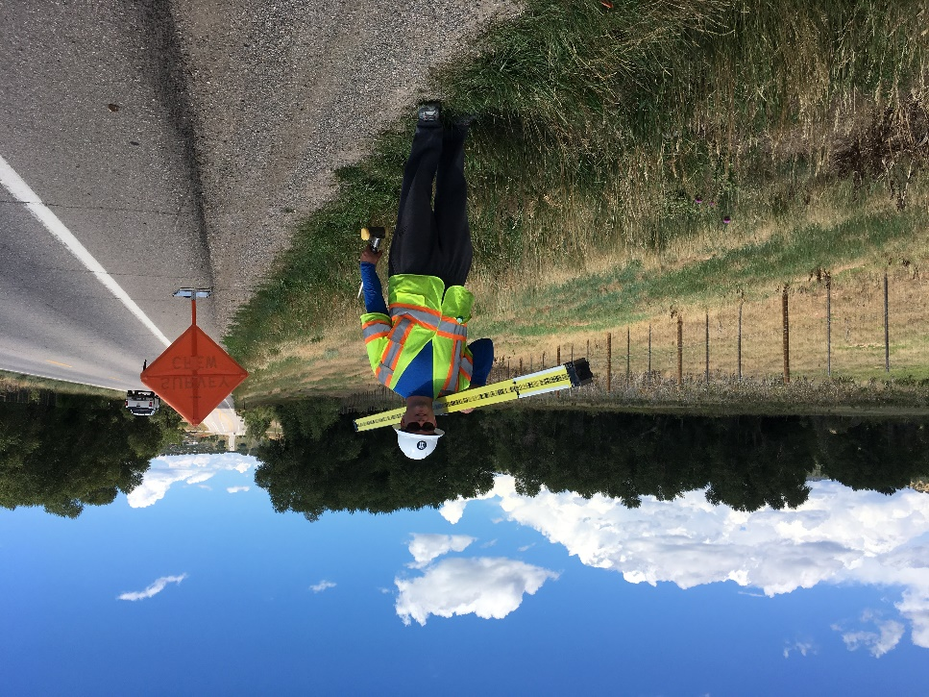
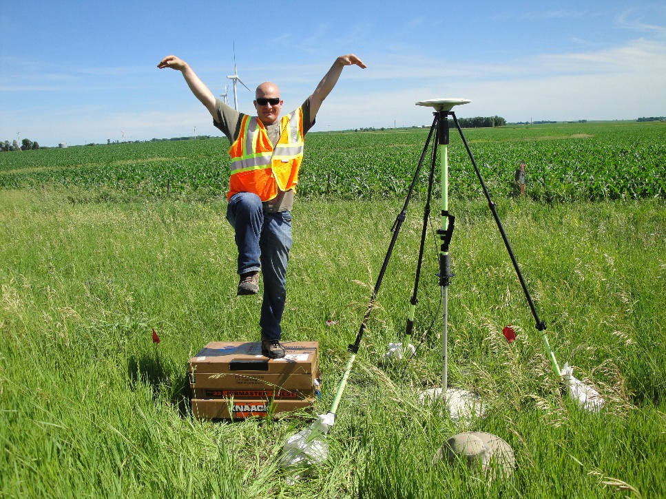
Brian Shaw
Rocky Mountain Advisor
brian.shaw@noaa.gov

Slide 3
Presentation Outline
Geospatial Datasets
Web Maps
NGS Specialty Web Maps/Applications
Web Services
Web Map Services
ArcGIS Online Feature Services
ArcGIS Online Vector Tile Layers
ArcGIS Online Raster Tile Layers
Demo if time allows

Slide 4
Geospatial Datasets
NGS Datasheet Shapefiles (Production, Beta)
CORS Stations (KML, GeoJSON, Text)
GPS on Bench Marks Priority List (Shape, Excel)
xGEOID20 (GeoTIFF)
OPUS Share (GeoJSON)
Federal Shoreline Data
Aerial Photo Orders (KMZ)
Aeronautical Survey Program Universal Data Delivery Format (UDDF)

Slide 5
Web Maps
NGS Data Explorer
CORS Map
OPUS Share Map
OPUS Projects
Emergency Response Imagery
Shoreline Data Explorer
GPS on Bench Marks Web Map
GEOID18 Web Map
Geodetic Control Diagram Map
Beta Calibration Baseline Map
Office for Coastal Management Application
Digital Coast: Data Access Viewer (Topobathy Lidar)

Slide 6
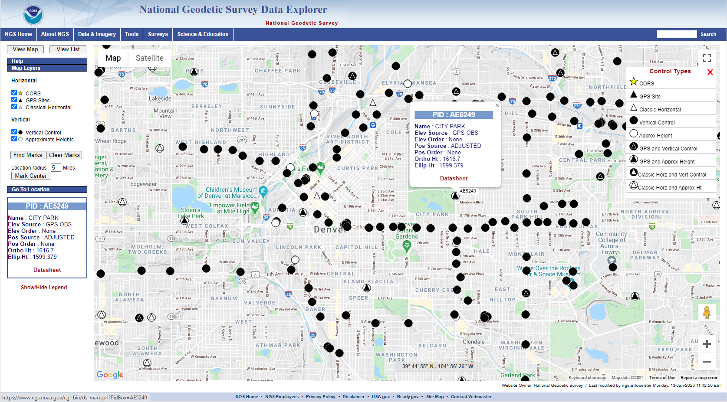
NGS Data Explorer

Slide 7
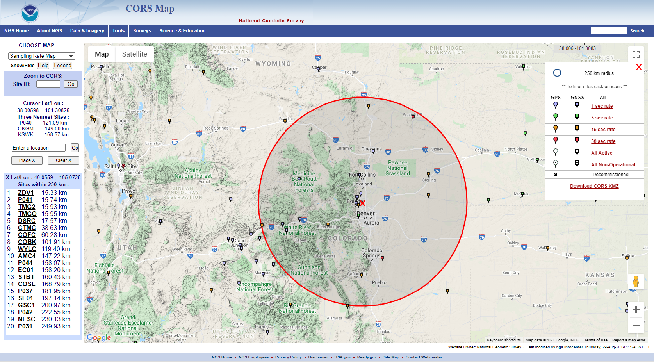
CORS Map

Slide 8
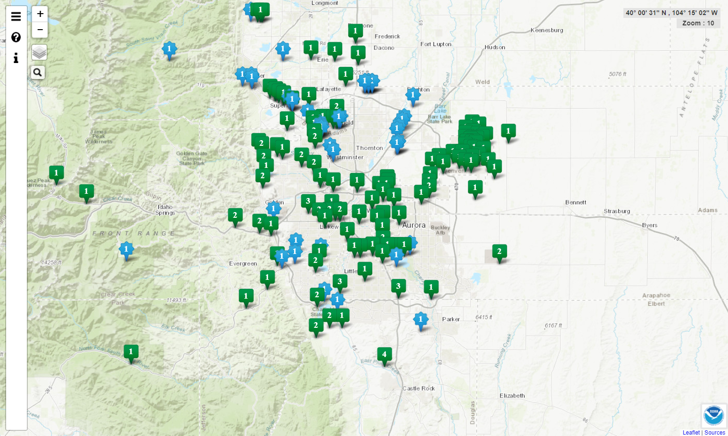
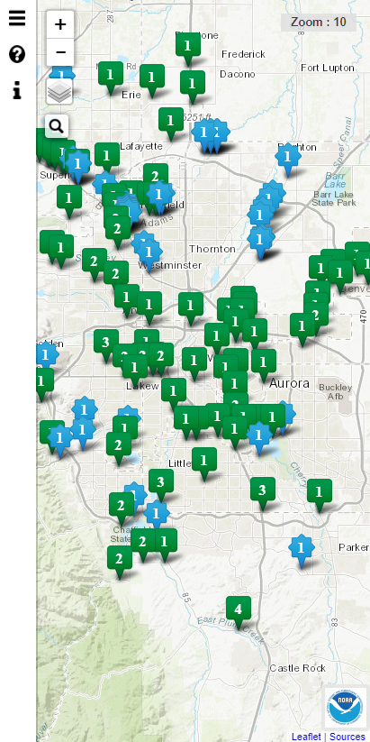
OPUS Share Map
Responsive Web Maps
https://geodesy.noaa.gov/opusmap/

Slide 9
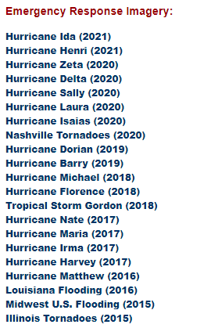
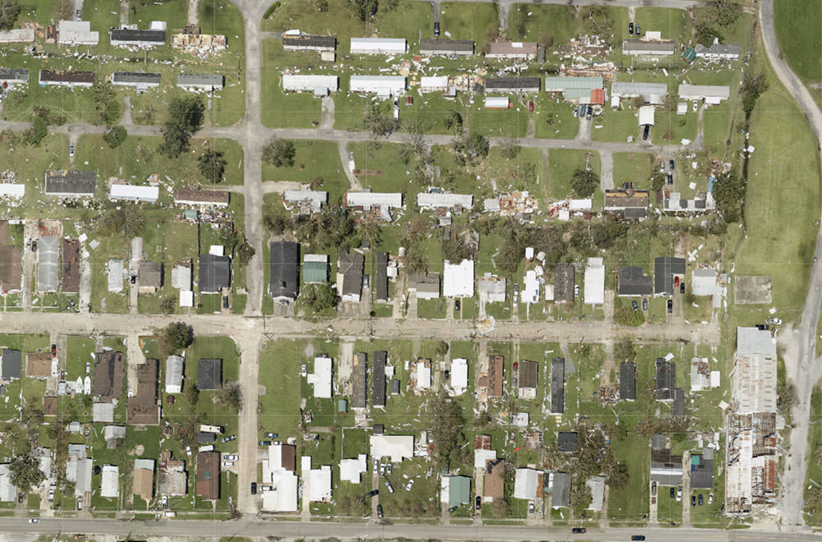
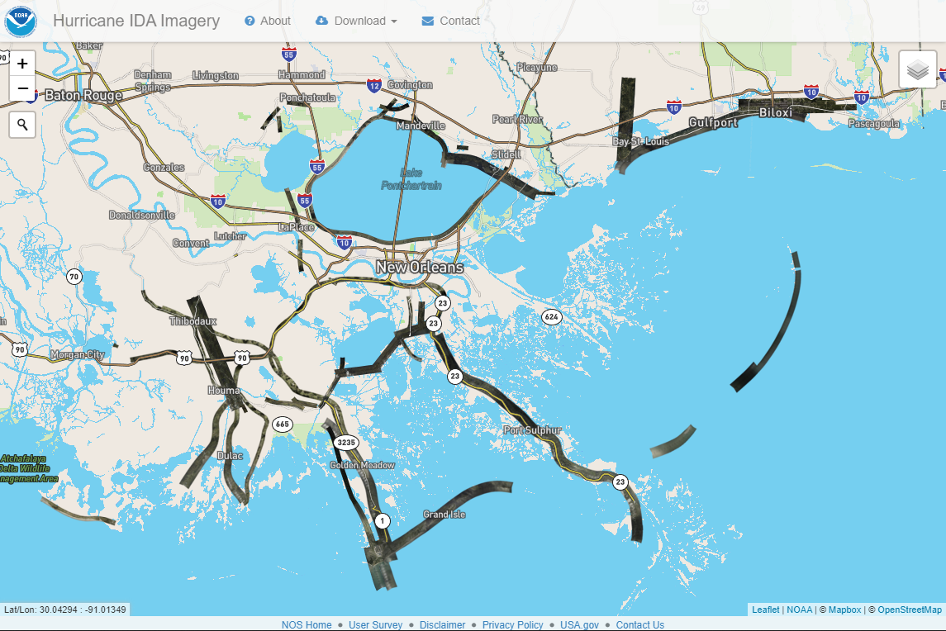
Emergency Response Imagery

Slide 10
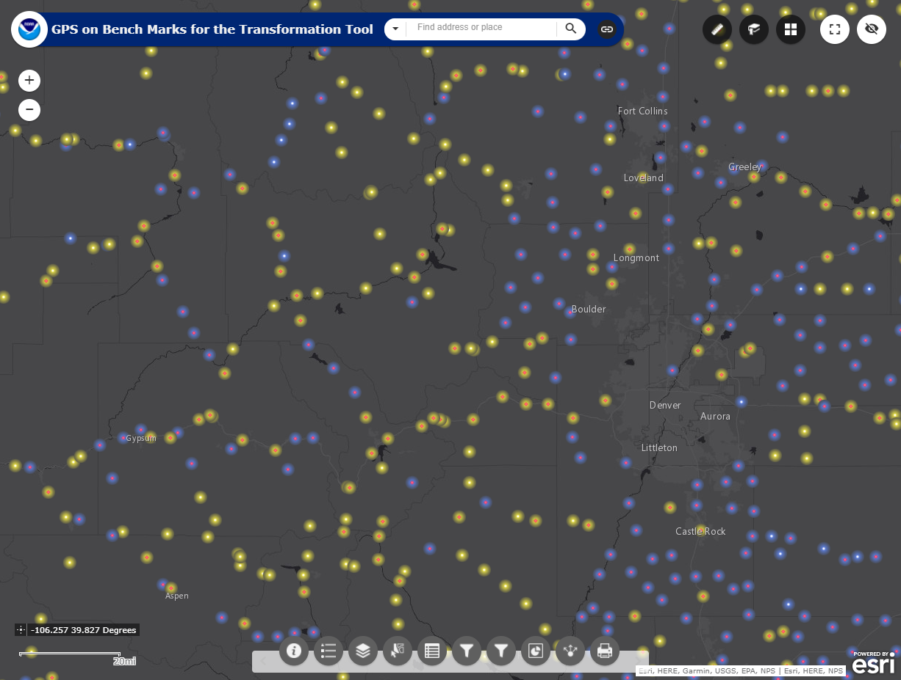
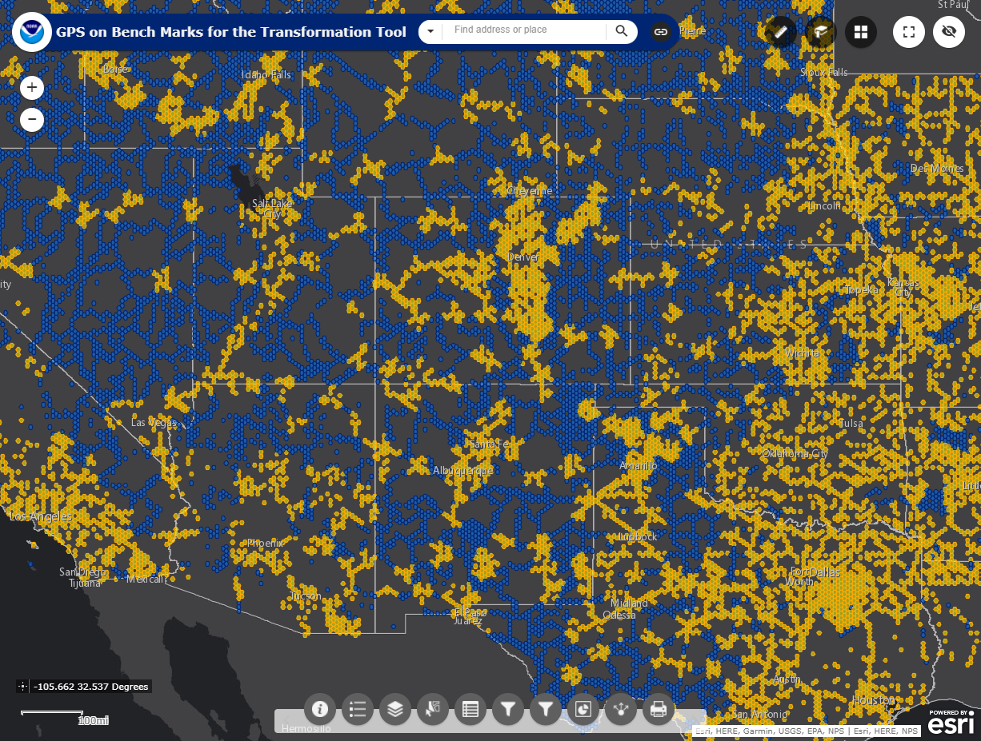
GPS on Bench Marks
Mark Priority List
New Population Priority

Slide 11
NGS Specialty Maps/Applications
OPUS Projects
OPUS-RS Estimated Precision and Availability
Mark Recovery Page
Beta Passive Marks Page
Beta Leveling Projects Page
GPS on Benchmarks Dashboard
OPUS Share Dashboard
Mark Recovery Dashboard
DS World (User Contributed Software)

Slide 12
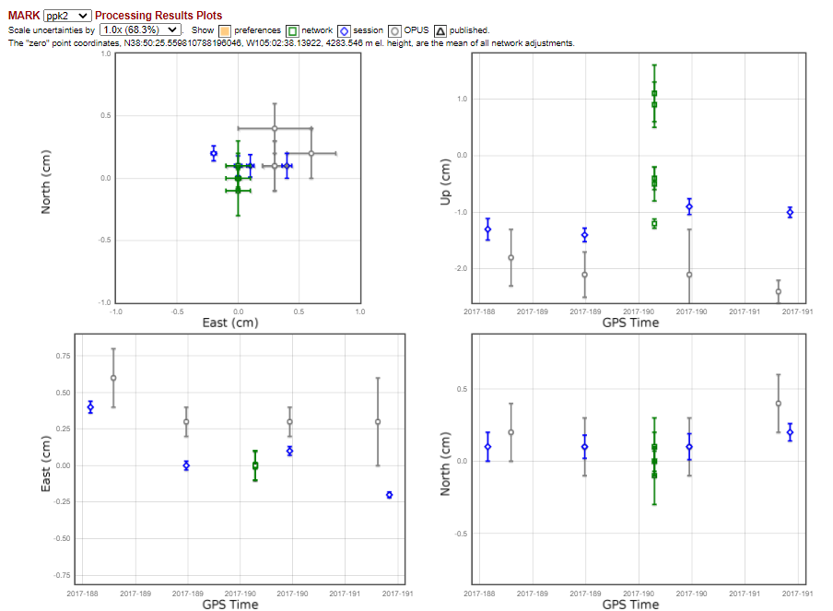
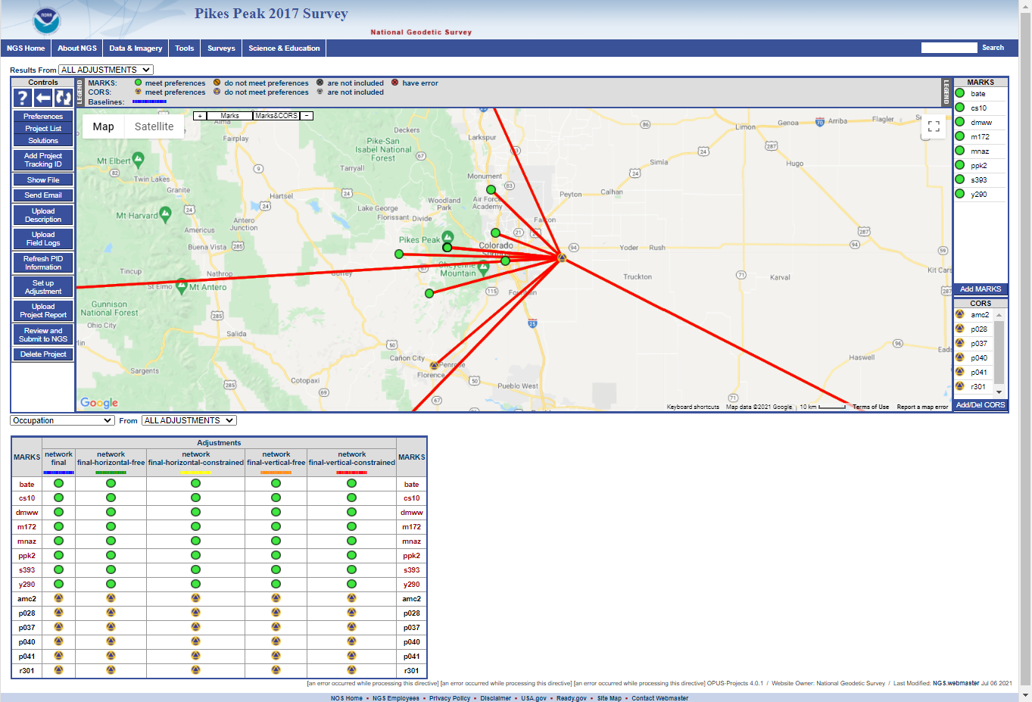
OPUS Projects

Slide 13
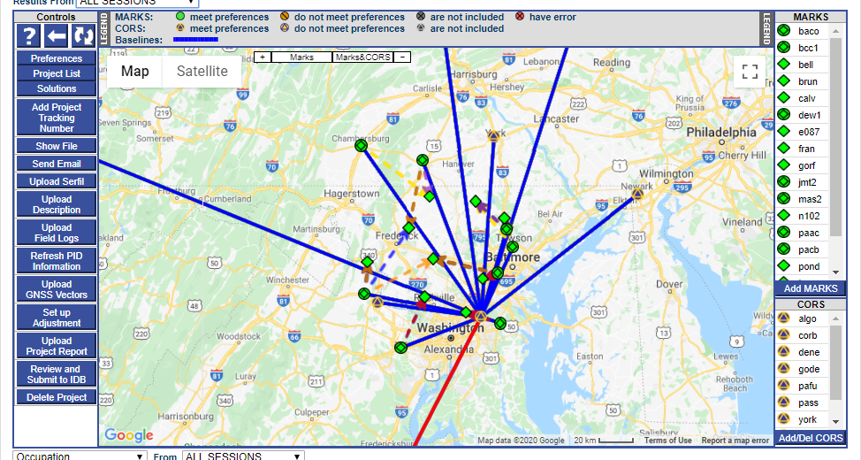
OPUS-Projects 5.0: (RTK/RTN Vectors) Beta Testing
Notes:
Links on the slide.

Slide 14
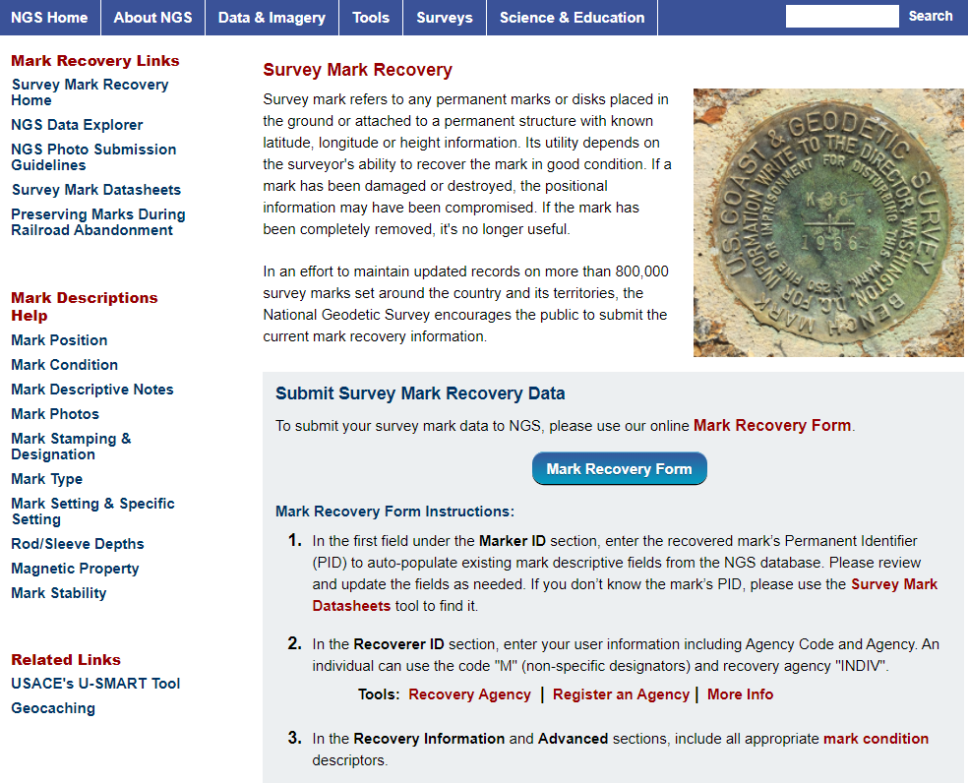
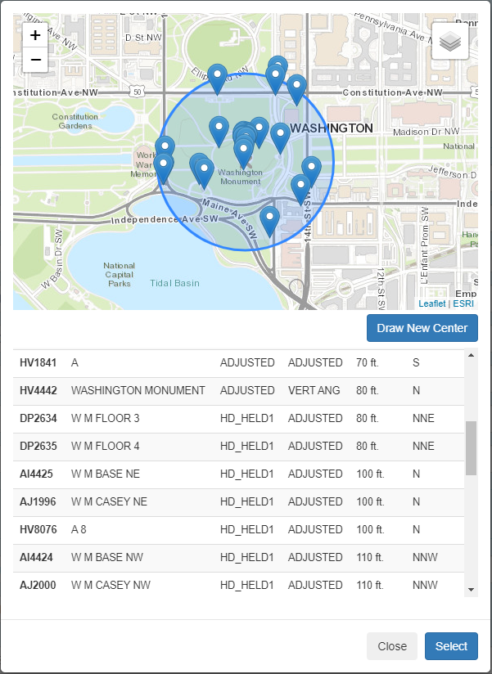
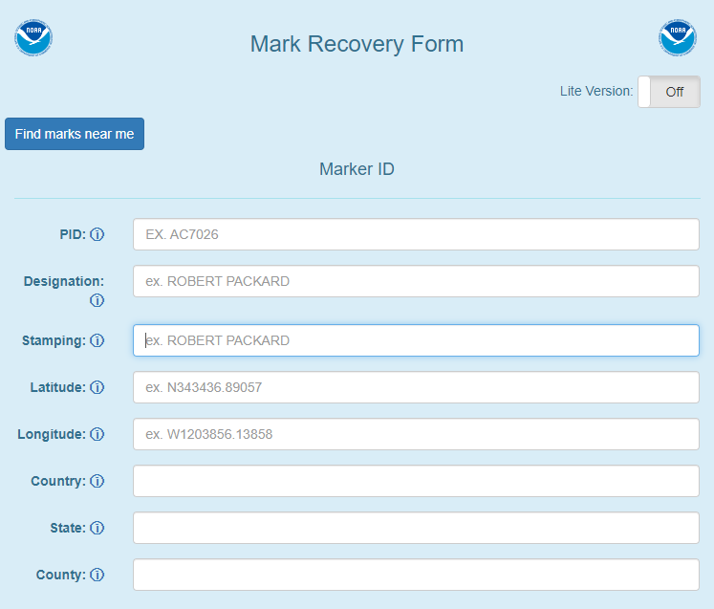
NGS Mark Recovery Webpage
Crowd sourced mark recoveries help update the NGS Database, let NGS and others know if the mark is still usable, and adding photos makes it easier to find.
www.ngs.noaa.gov/surveys/mark-recovery
Now with Find Marks Near Me!

Slide 15
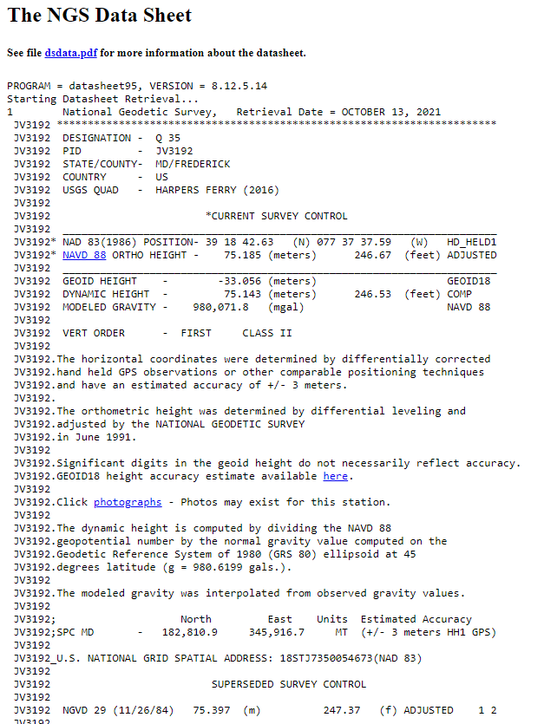
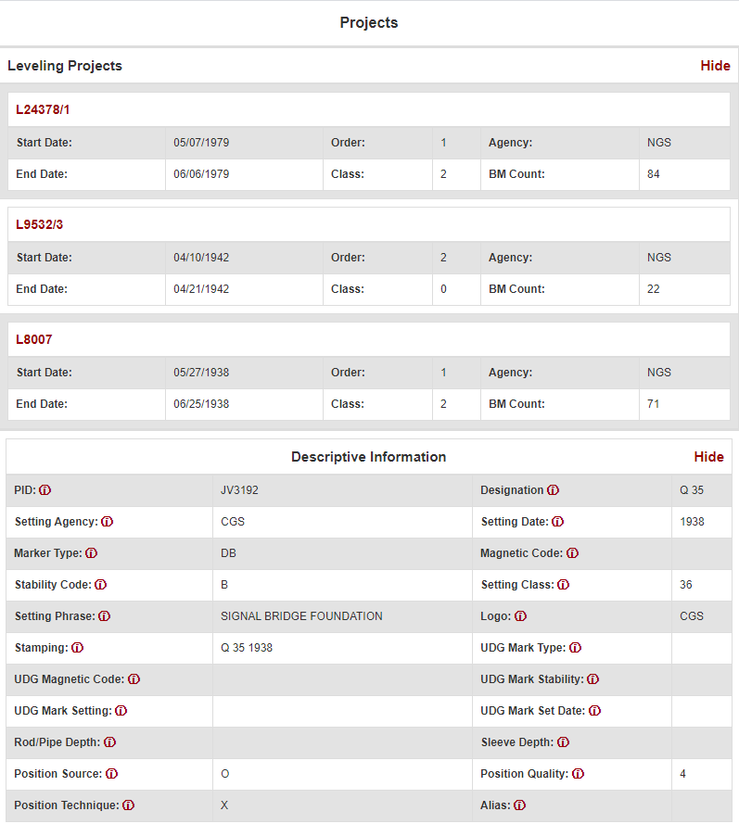
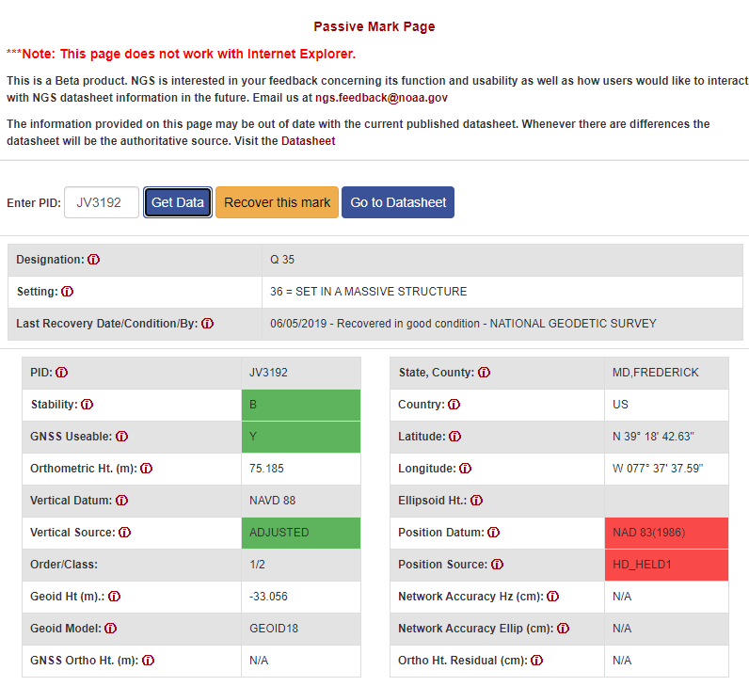
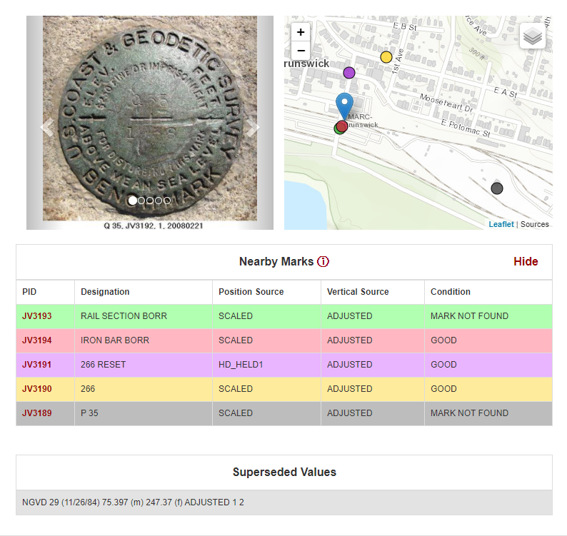
Beta Passive Marks Page
https://beta.ngs.noaa.gov/datasheets/passive-marks/index.html

Slide 16
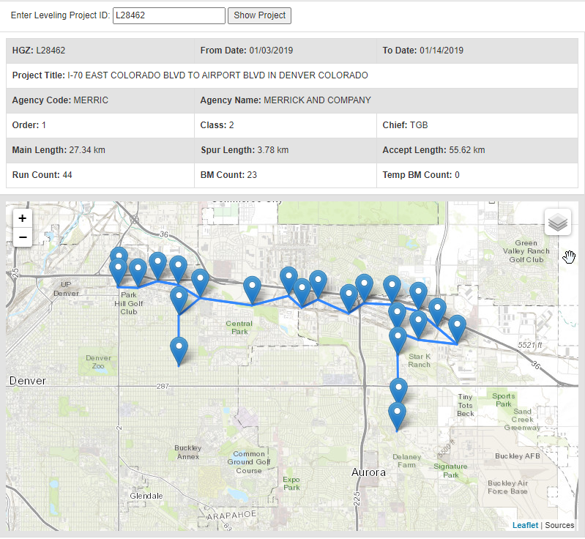
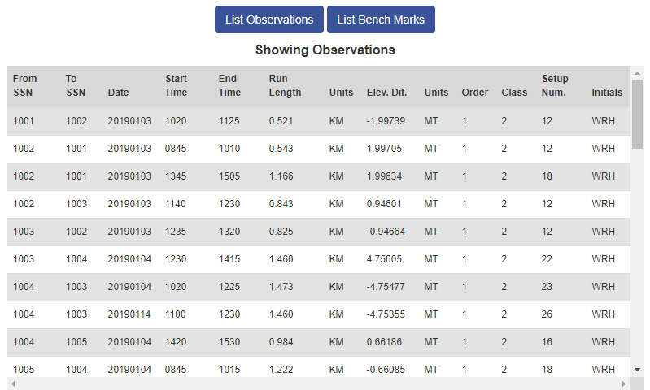
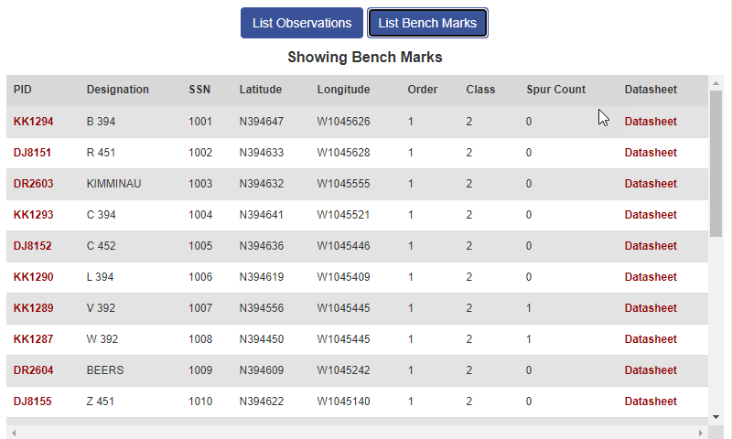
Beta Leveling Projects Page

Slide 17
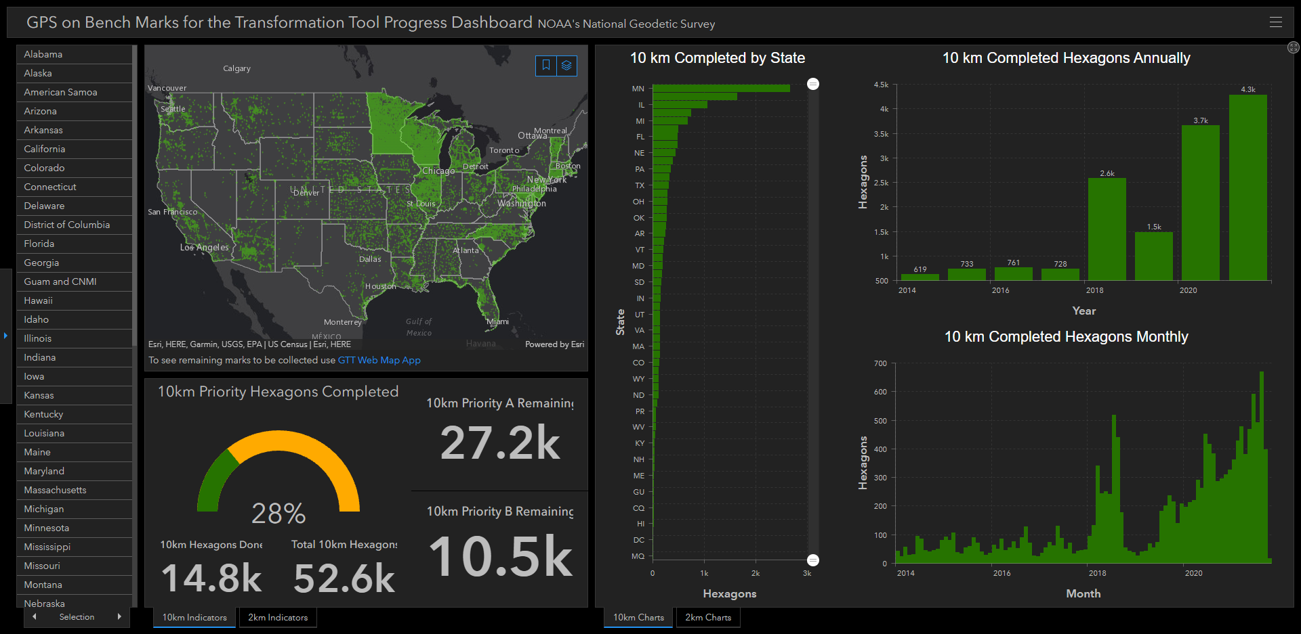
GPS on Benchmarks Dashboard
~3,800 Completed in 2020
~4,300 Completed in 2021 (to date)
Notes:
https://noaa.maps.arcgis.com/apps/dashboards/449e3051fbf44202ba6606e2dbcb0e29

Slide 18
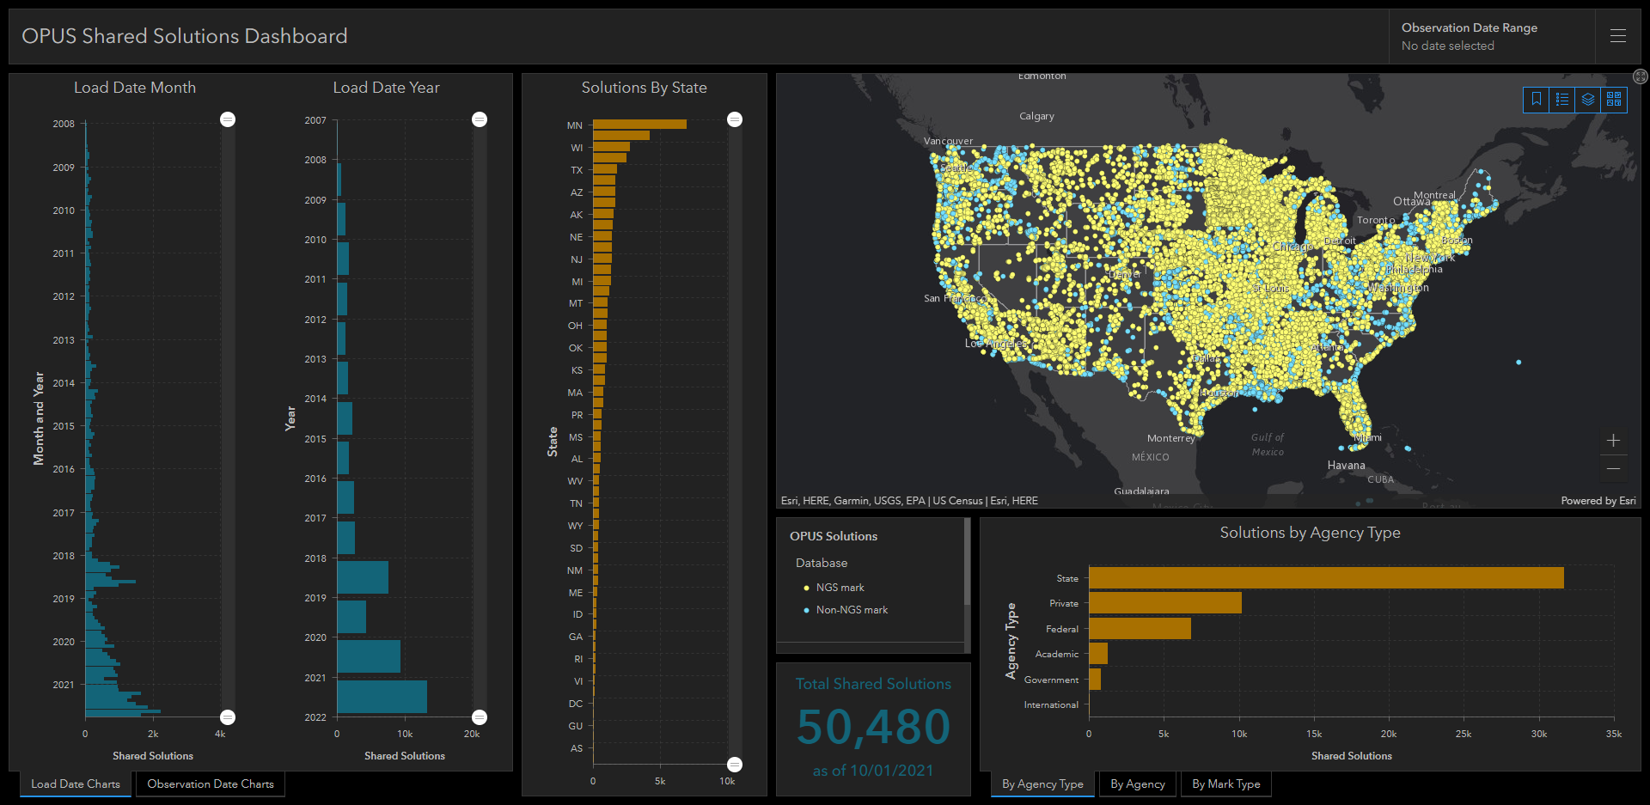
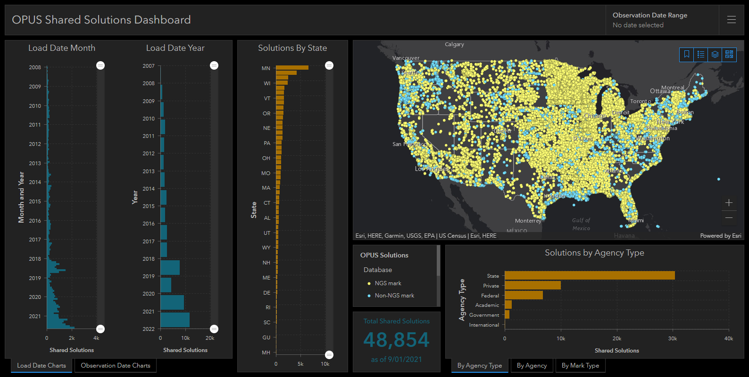
OPUS Shared Solutions Dashboard
Dashboard enables sorting and visualization of Shared Solutions by
Month & Year, State, Agency Type, and submitting agency
Agency type | # Shared Solutions on NGS marks
State | ~27,400
Private Sector | ~5,000
Federal | ~3,200
Academic | ~1000
2018
Note the impact of GPSonBM Campaigns
Note the impact of GPSonBM Campaigns
Note the impact of GPSonBM Campaigns
2020
2021
18
Notes:
https://noaa.maps.arcgis.com/apps/dashboards/b3f9dcfde4c249bc9cd5817489c5d53c

Slide 19
NGS Web Services
NGS Data Explorer API
NGS Coordinate Conversion and Transformation Tool (NCAT) API
OPUS API
VDatum API
Gravity Predictor API
Geoid API

Slide 20
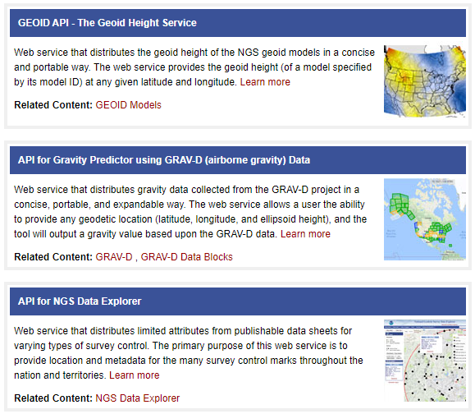
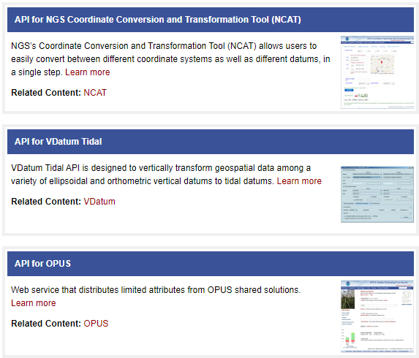
Application Programming Interfaces (APIs)
https://geodesy.noaa.gov/web_services/

Slide 21
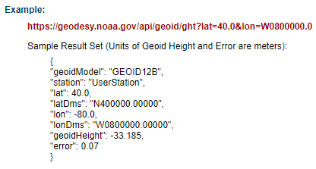
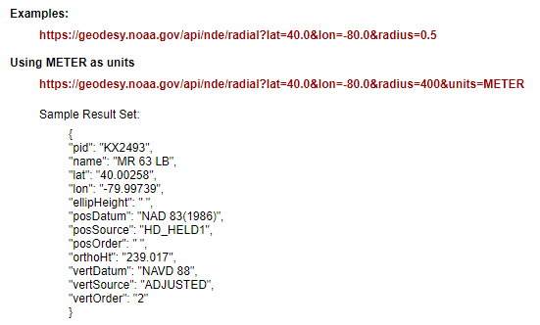
JSON Web Services
GEOID
Data Explorer

Slide 22
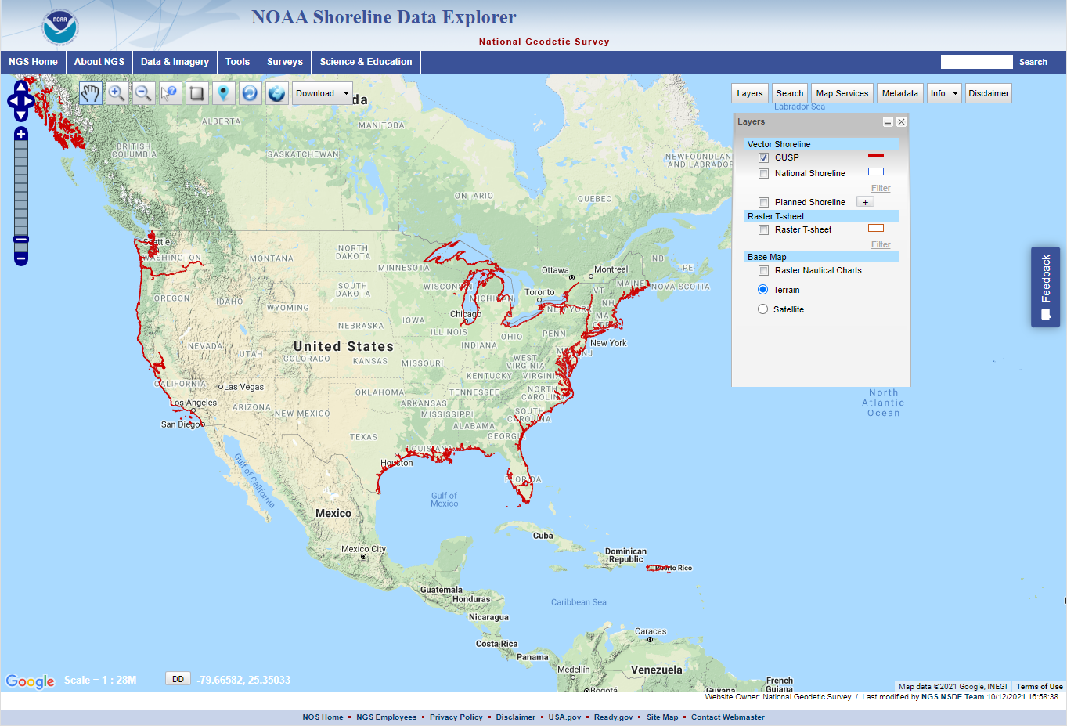
NGS Web Map Services (WMS)
Continually Updated Shoreline Product (CUSP)
CUSP Web Map Service

Slide 23
NGS ArcGIS Online Feature Services
NGS Datasheets
NOAA CORS Network
GPS on Benchmarks Priority List (4 layers - marks, hexagons)
GEOID18 GPS on Benchmarks
GEOID12B GPS on Benchmarks
OPUS Shared Solutions
Mark Recoveries Submitted to NGS

Slide 24
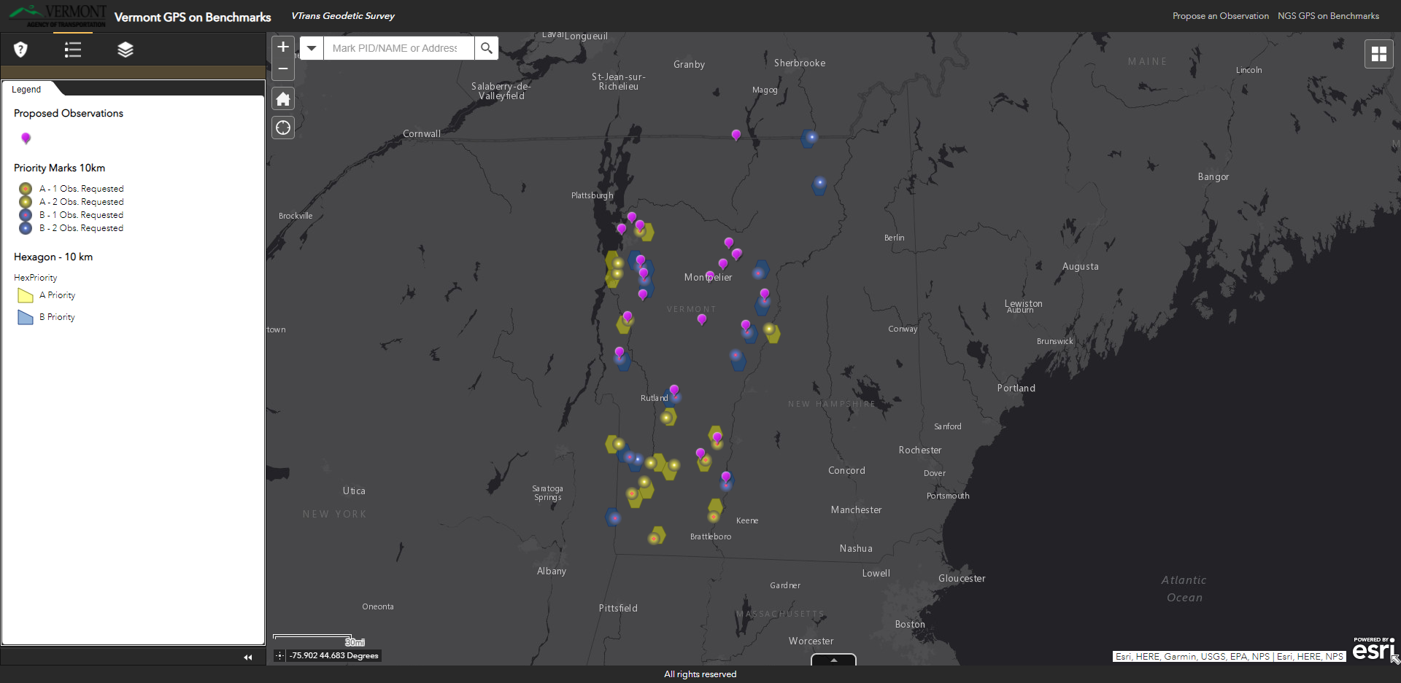
GPS on Bench Marks (Vermont)

Slide 25
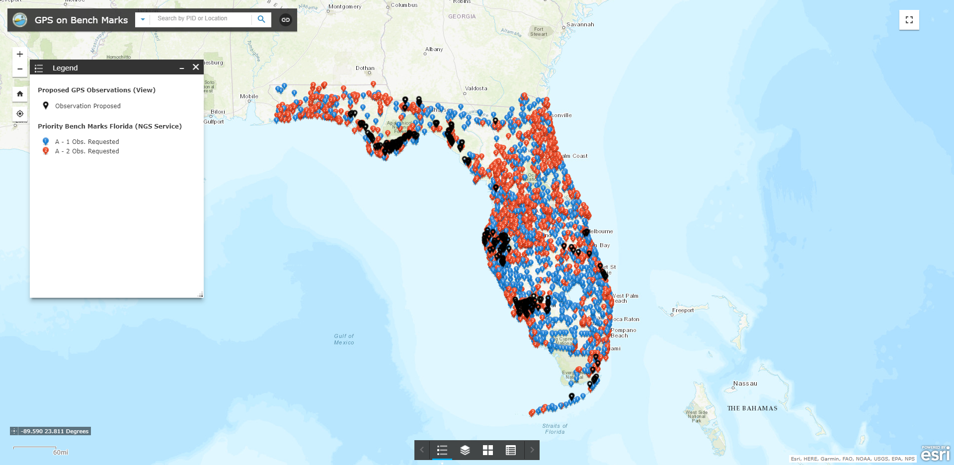
GPS on Bench Marks (Florida)

Slide 26
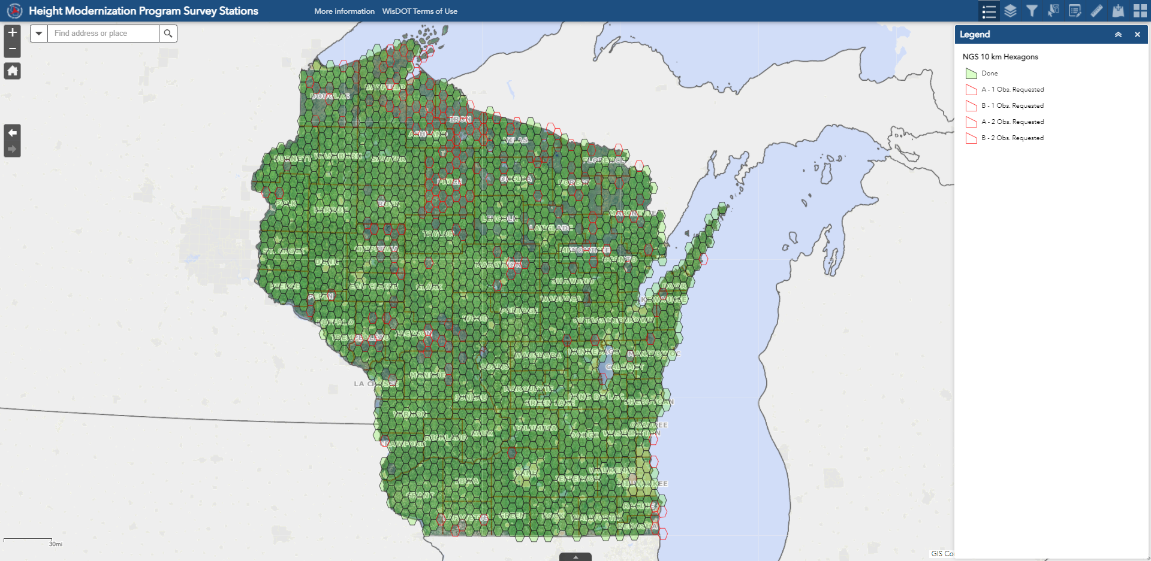
GPS on Bench Marks (Wisconsin)

Slide 27
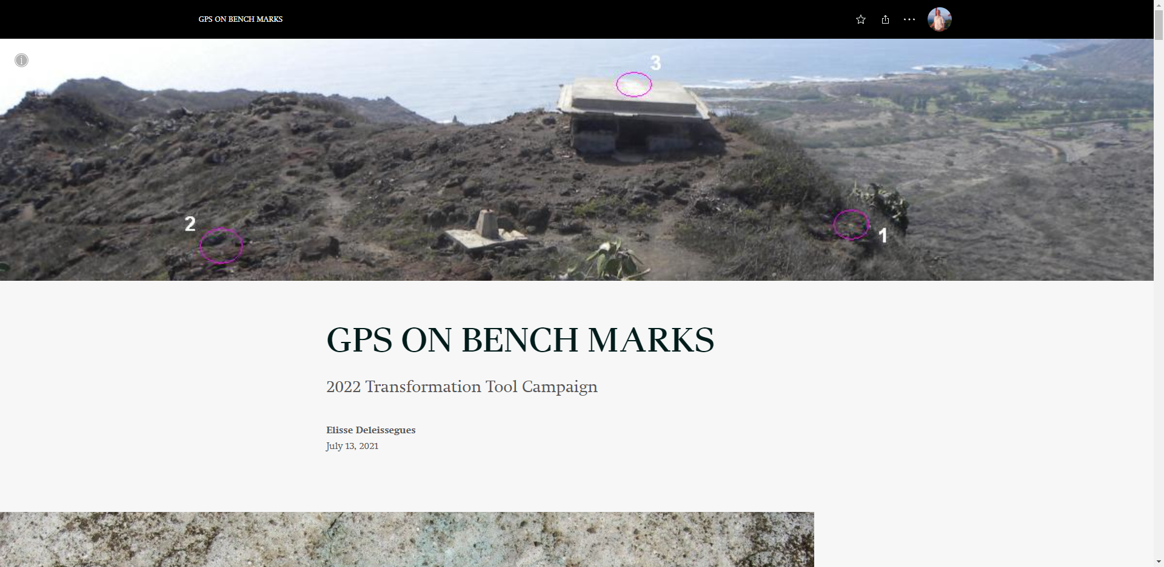
GPS on Bench Marks (Hawaii)

Slide 28
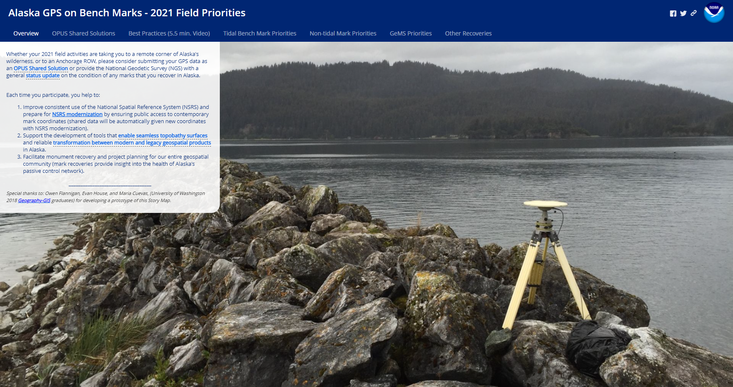
GPS on Bench Marks (Alaska)

Slide 29
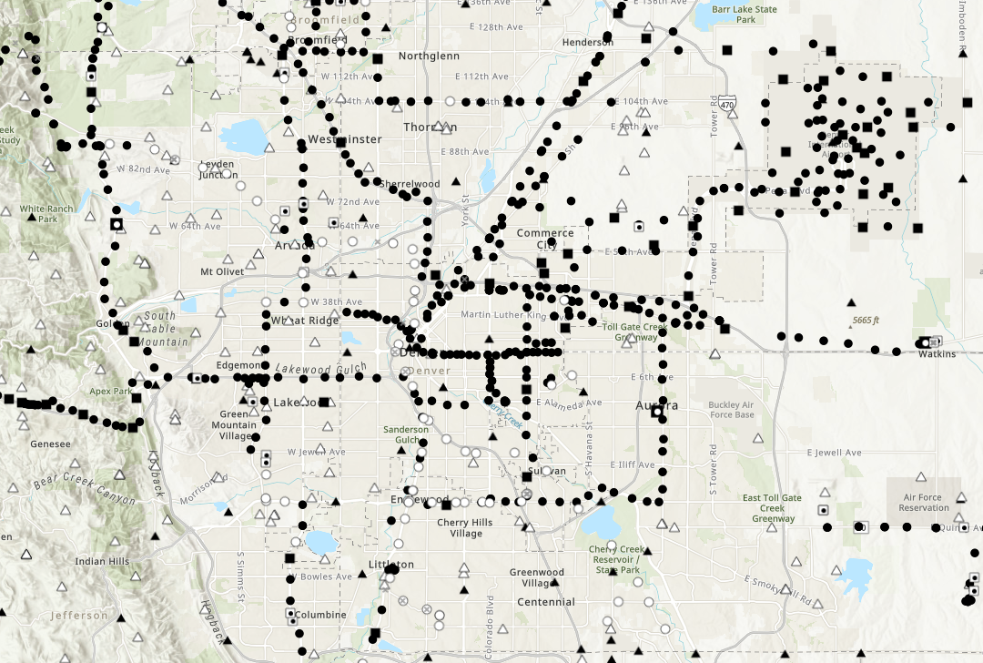
NGS ArcGIS Online Vector Tile Layers
NGS Datasheets

Slide 30
NGS ArcGIS Online Raster Tile Layers
GEOID18 Height (CONUS, PRVI)
GEOID18 Difference (CONUS, PRVI)
GEOID18 Uncertainty (CONUS, PRVI)
GEOID18 Improvements (CONUS, PRVI)

Slide 31
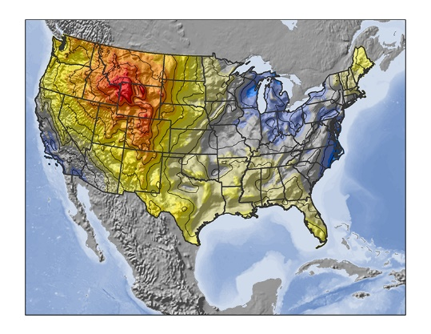
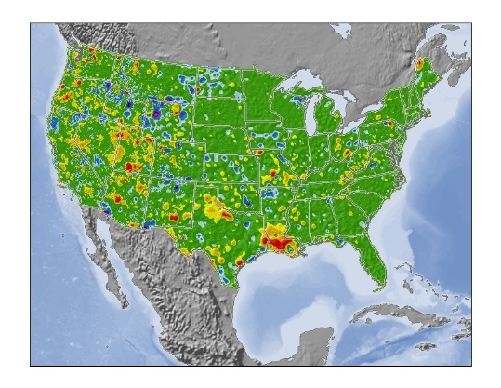
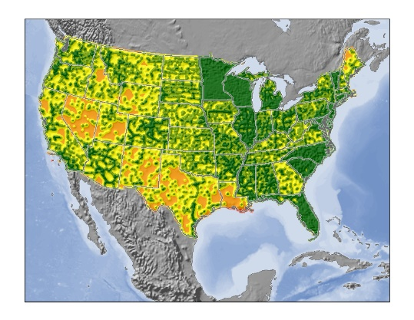
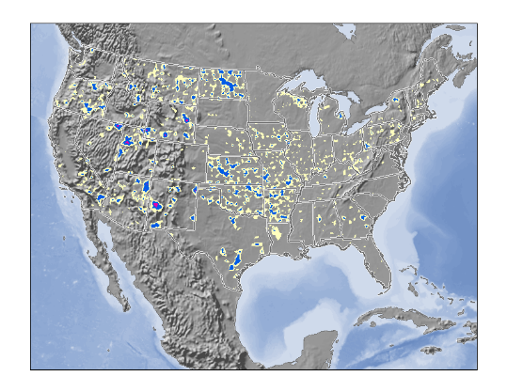
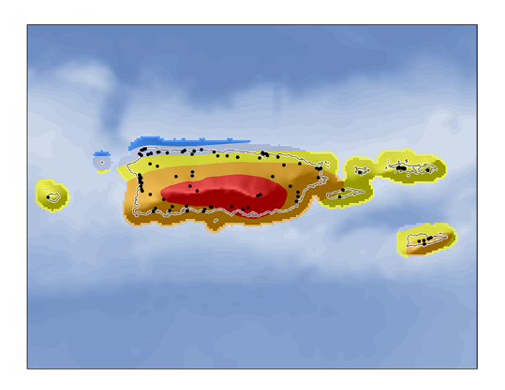
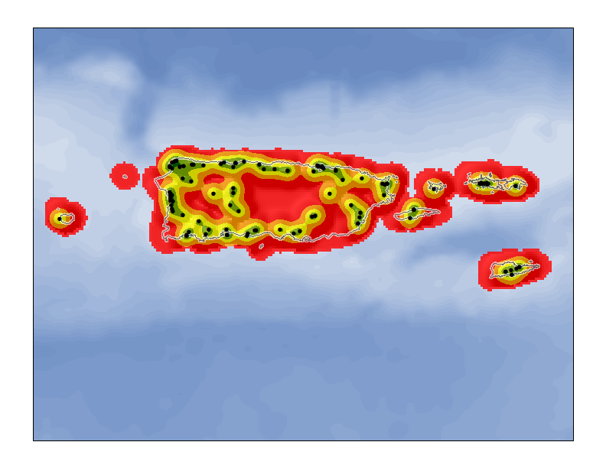
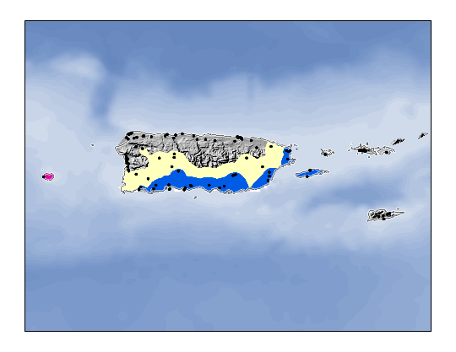
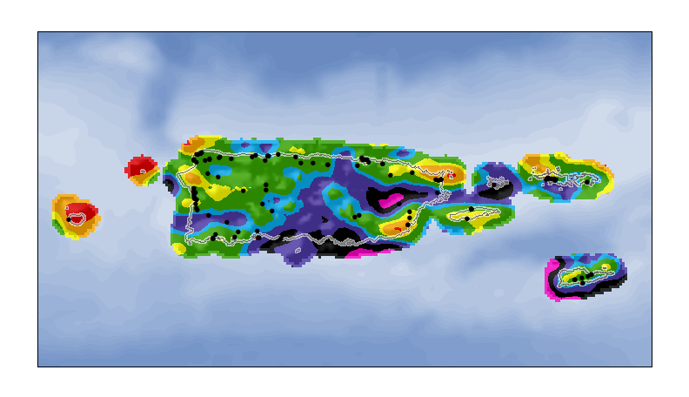
NGS GEOID18 Rasters
height
difference
uncertainty
improvements

Slide 32
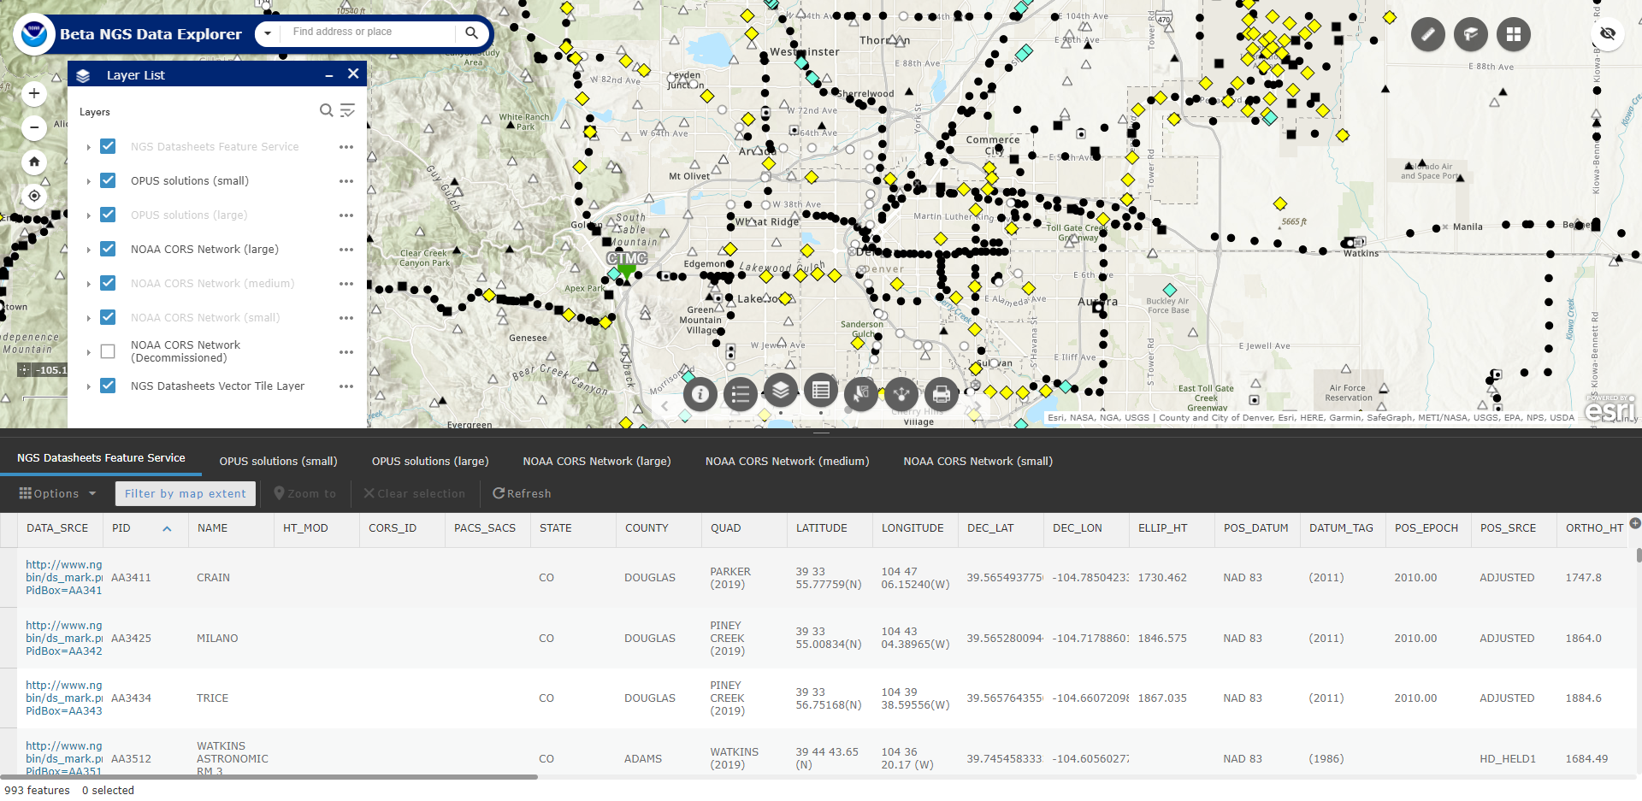
Beta NGS Data Explorer (ArcGIS Online soon)
Notes:
Links on the slide.

Slide 33
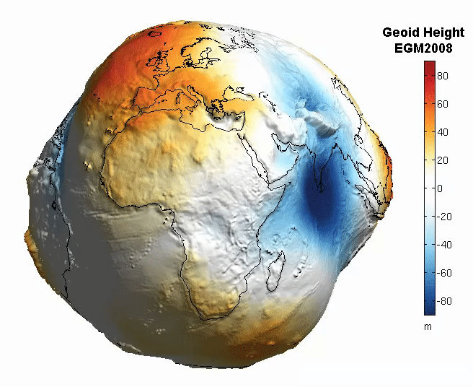
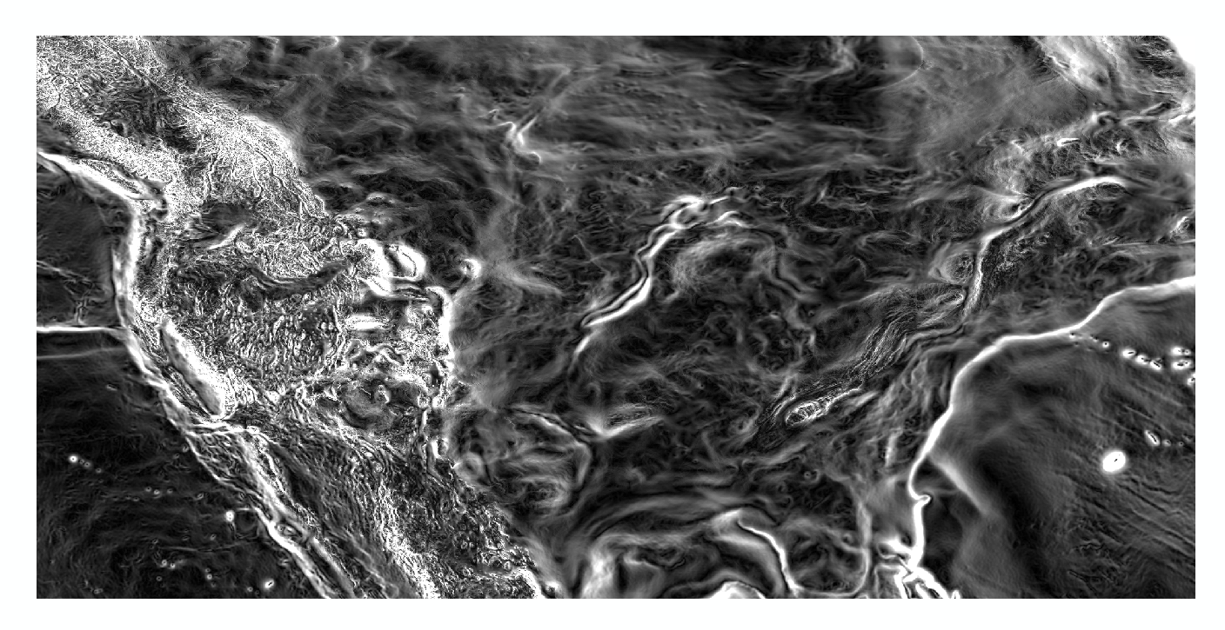
Magnitude of the Deflection of the Vertical
Questions?
Brian Shaw
brian.shaw@noaa.gov

