Slide 1
Datums: The Foundation of Geospatial Data
Jacob Heck, Ph.D., P.S.
NGS Great Lakes Regional Advisor
2023 WSLS Institute
Notes:
100 minutes
When it comes to geospatial data, it is important to use a common reference so data collected at different times by different people can be compared. Think about it as the zero line on a graph. Changing that zero line changes the values. A set of coordinates does not tell much without including what those coordinates are referenced to. A datum or reference frame enables data to be compared. I'll cover the basics of datums and reference frames, including how they are determined and how they connect at the national and global levels.

Slide 2
Deprecation of the US Survey Foot
U.S. survey foot was deprecated on December 31, 2022
But use can continue for SPCS 83 (and SPCS 27)
The 40 states that “officially” use U.S. foot for SPCS 83
All SPCS 27 zones
NGS will support such “legacy” use forever
But NOT supported for ANY zones in SPCS2022
NGS will always support U.S. survey foot for SPCS 83 and 27

Slide 3
NSRS Modernization: Delay
Will names change?
No, “GEOID2022”, “NATRF2022”, etc. will remain the same
NGS anticipates the release of all data, and limited tools, by the middle of 2025.
Some of this may depend on things outside of NGS control (we have already delayed beyond 2022!)
Work on additional tools will continue in the out-years

Slide 4
Overview
Background on coordinate systems
International geodetic efforts
Datum access
Horizontal datums
Geometric reference frames
Vertical datums
Notes:
Datum determination
How datums connect

Slide 5
Background on coordinate systems

Slide 6
Datum Fundamentals
Find the coordinate of point A
A

Slide 7
Datum Fundamentals
Find the coordinate of point A
4
A
3
2
1
Datum = 0

Slide 8
Datum Fundamentals
4
Find the coordinate of point A
3
A
2
1
Datum = 0

Slide 9
Geodetic Control Primer
Find the coordinates of point A
Somewhere on Earth…
You are presented with this problem…
Without any other information, the problem is unsolvable.
A

Slide 10
Geodetic Control Primer
Find the coordinates of point A
Wouldn’t it be fantastic if someone just provided you with a coordinate system?
Unfortunately, the Earth doesn’t come with lines of latitude and longitude just drawn all over it…
“The Earth is not a globe”
4
3
A
(x=1.8,y=2.6)
2
1
1
2
3
4

Slide 11
Geodetic Control Primer
Find the coordinates of point A
But what if someone gave you enough other points with pre-determined coordinates?
With a little measuring and trigonometry, you could certainly determine the coordinates of point A!
These “other points with pre-determined coordinates” are “geodetic control”
C (x=2.7,y=3.9)
A
B (x=3.1,y=1.4)
D (x=0.8,y=0.9)

Slide 12
Geodetic Control Primer
Find the coordinates of point A
Although the coordinate axes are not visible, their location and scale are implied by the given coordinates of the points B, C, and D.
It is often the job of surveyors, mappers and other geospatial professionals to determine the coordinates of many points on Earth.
It is the job of NGS to provide the geodetic control to the nation to make those jobs possible.
4
C (x=2.7,y=3.9)
3
2
B (x=3.1,y=1.4)
1
D (x=0.8,y=0.9)
1
2
3
4

Slide 13
Article 1, Section 8:
“The Congress shall have Power To lay and collect Taxes, Duties, Imposts and Excises, to pay the Debts and provide for the common Defence and general Welfare of the United States; but all Duties, Imposts and Excises shall be uniform throughout the United States;
…
To coin Money, regulate the Value thereof, and of foreign Coin, and fix the Standard of Weights and Measures; ...”
Notes:
OMB Circular A-16: provides direction for federal agencies that produce, maintain, or use spatial data either directly or indirectly in the fulfillment of their mission and provides for improvements in the coordination and use of spatial data.
EO 12906: National spatial data infrastructure
From NGS Strategic plan:
NGS draws its mission and work from numerous executive orders, laws, and mandates, and the goals and objectives in this plan directly relate to these public requirements. NGS’ goals also serve to further the science, service, and stewardship of NOAA as a whole. Indeed, the capabilities and the geodetic framework NGS provides through the NSRS play a crucial role in the success of almost all the goals and objectives held within NOAA’s Strategic Plan. Direct mission-related objectives are drawn from language in Office of Management and Budget (OMB) circular “A-16,” as well as from Executive Order 12906, or from the original legislation used to create NGS’ predecessor agencies, the U.S. Coast and Geodetic Survey Act. NGS complies with additional OMB, Department of Commerce (DOC), and Congressional mandates, including the Air Commerce Act of 1926. OMB A-16 mandated the formation of the Federal Geographic Data Committee (FGDC) as a means to coordinate all U.S. governmental activities related to geospatial information. Numerous subcommittees exist within the FGDC, and NGS leads the Federal Geodetic Control Subcommittee (FGCS). Geodetic Control is fundamental to all of NGS’ work, and it also underpins all geospatial activities of the organizations comprising the FGDC. The United States is a leading member of the UN-GGIM. The UN-GGIM has stipulated that all countries adopt a Global Geodetic Reference Frame (GGRF) to ensure standardized positioning of geospatial information. The effort to implement the GGRF is led by the United Nations Subcommittee on geodesy (UN-GGIM SCoG)

Slide 14
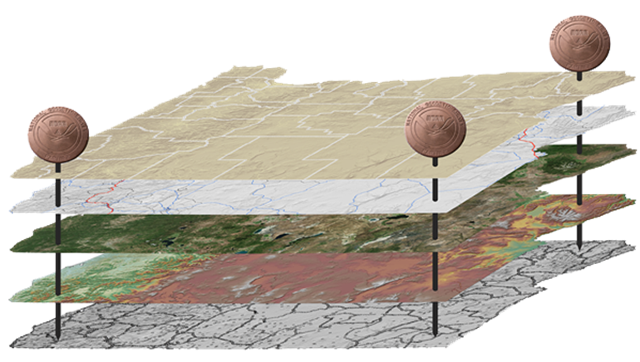
The National Spatial Reference System
NGS defines, maintains and provides access to the NSRS to meet our Nation’s economic, social & environmental needs
North American Datum of 1983 (NAD 83)
North American Vertical Datum of 1988 (NAVD 88)
Latitude • Longitude • Elevation • Gravity • Shoreline Position
+ changes over time
Today’s NSRS

Slide 15
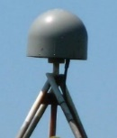
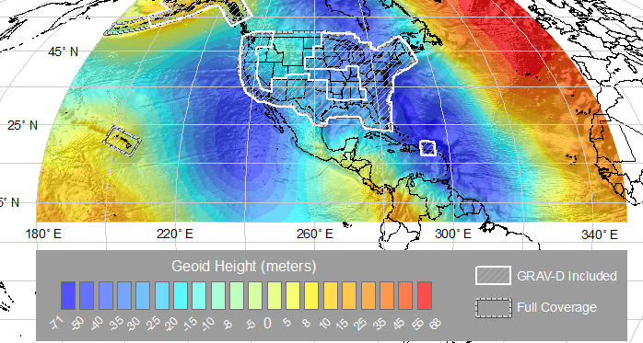
The National Spatial Reference System
NGS defines, maintains and provides access to the NSRS to meet our Nation’s economic, social & environmental needs
Latitude • Longitude • Elevation • Gravity • Shoreline Position
+ changes over time
North American Terrestrial Reference Frame (NATRF2022)
Caribbean Terrestrial Reference Frame (CATRF2022)
Pacific Terrestrial Reference Frame (PATRF2022)
Marianas Terrestrial Reference Frame (MATRF2022)
North America and Pacific Geopotential Datum (NAPGD2022)
Tomorrow’s NSRS

Slide 16
National Spatial Reference System (NSRS)
Geometric Geodesy
Physical Geodesy
Horizontal Datums/Geometric Reference Frames
Latitude
Longitude
Ellipsoid Height
State Plane Coordinates
Geopotential Datums
Orthometric Height
Dynamic Height
Surface Gravity
Leveling
Main Components: latitude, longitude, height, origin, scale, gravity, and orientation

Slide 17
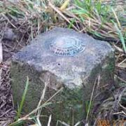
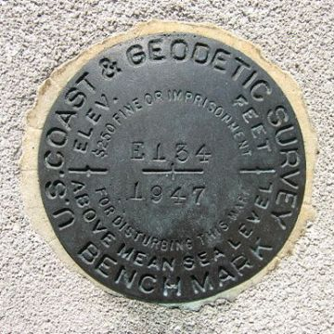
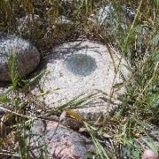
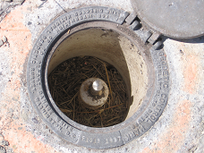
Passive Control
Any geodetic control point that is infrequently or intermittently observed.
Common examples include a metal disk set in concrete or stone, or a stainless steel rod driven into the ground.
Notes:
All marks are passive—in that they sit there doing nothing in and of themselves besides holding a point

Slide 18
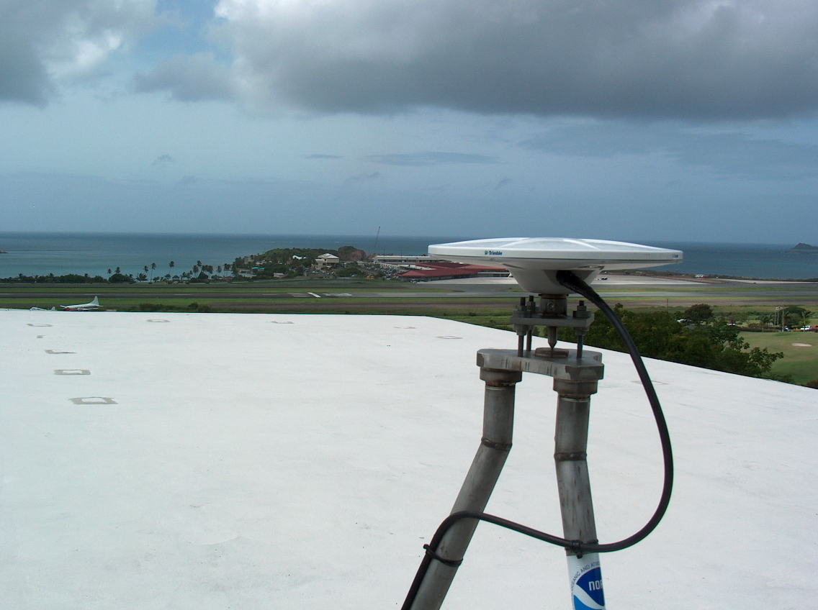
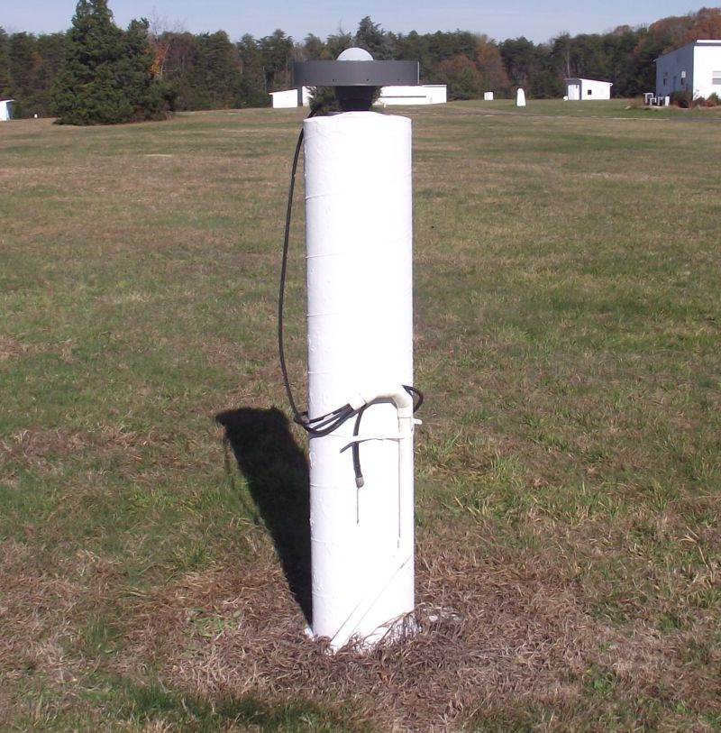
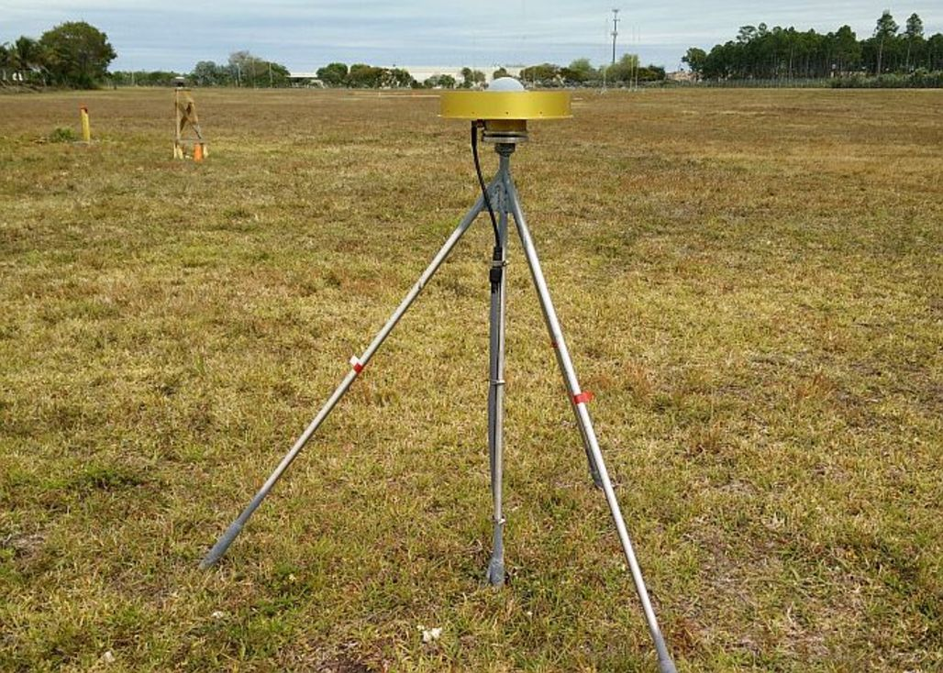
Active Control
A geodetic control point at a station occupied by equipment intended for and capable of continuously collecting geodetic quality data for multiple years.
CORS

Slide 19
Geodetic Stations
Common geodetic stations:
Continuously Operating GNSS Reference Station (CORS)
Satellite Laser Ranging (SLR) Station
Very Long Baseline Interferometry (VLBI) Station
Doppler Orbitography and Radiopositioning Integrated by Satellite (DORIS) Station
Continuously Operating Relative Gravimeter Station
Notes:
Note that only CORS and CORGS are continuous stations, though DORIS might also be. SLR and VLBI are actually just “frequently observed”.

Slide 20
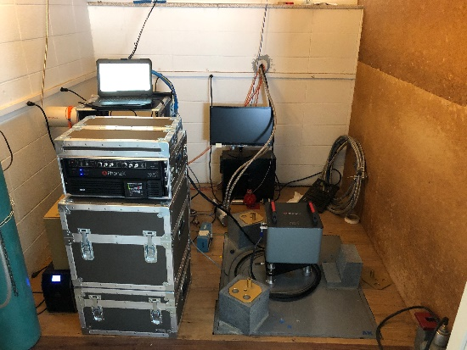
Geodetic Stations
SLR
DORIS
VLBI
Gravity
CORS

Slide 21
Global Geodetic Control
Geodetic control is inherently global.
NGS works with international groups to improve the global geodetic framework.
The UN Global Geodetic Reference Frame (UN-GGRF) was adopted by the UN Committee of Experts on Global Geospatial Information Management (UN-GGIM). The NSRS ties to the UN-GGRF.
Notes:
Geodesy comes from the Greek word meaning Earth Division, latitude and longitude are global.

Slide 22
UN-GGIM
United Nations
SubCommittee on Geodesy (UN SCoG)
EG on Land Administration and Management
EG on the Integration of Statistical and Geospatial Information
WG on Development of a Statement of Shared Principles for the Management of Geospatial Information
WG on Trends in National Institutional Arrangements in Geospatial Information Management
WG on Geospatial Information and Services for Disasters
WG on Global Fundamental Geospatial Data Themes
WG on Legal and Policy Frameworks for Geospatial Information Management
WG on Marine Geospatial Information
UN-GGIM adopted the GGRF – that is, all Nations (including USA) have agreed to use a common reference frame based on the ITRS
The UN-SCoG is tasked with implementing the GGRF globally
That agreement and the obligation to adopt the GGRF was also passed through to the Regional Committees (RCs).
Department of Economic and Social Affairs (ECOSOC)
Statistics Division
United Nations Global Geospatial Information Management (UN-GGIM)
UN-GGIM Asia-Pacific | UN-GGIM Americas | UN-GGIM Arab States | UN-GGIM Europe | UN-GGIM Africa
Notes:
Two NGS staff participated in the ninth session meeting of the United Nations initiative on Global Geospatial Information Management (UN-GGIM)-Americas and two side events in Santiago, Chile. UN-GGIM-Americas is the regional committee that implements and coordinates geospatial management for the Americas including the Geodetic Reference Frame for the Americas (SIRGAS). The side events focused on building the regional spatial data infrastructure and capacity development. An NGS regional geodetic advisor represented the United States in the meetings and the NGS Chief Geodesist presented an update on global activities of the U.N. Subcommittee on Geodesy to the Regional Committee. This demonstrated NGS leadership within NOAA and the U.S. government and aided in regional coordination of Geospatial activities.

Slide 23
UN Global Geodetic Reference Frame
GGRF encompasses all aspects of a modernized reference frame including:
Geodetic infrastructure (GI)
Education Training and Capacity Building (ETCB)
Governance (GOV)
Outreach and Communication (OC)
Policies Standards and Conventions (PSC)
Includes both International Terrestrial Reference System (ITRS) and the International Height Reference System (IHRS)
Determined and maintained by the International Association of Geodesy (IAG)
Notes:
A system is how you do things, whereas a frame is a specific realization within the system. ITRF is a scientific construct.
Except in this case the GGRF is actually more of political construct.
While the ITRS is very mature, the infrastructure behind is very mature – to the point of degradation and potential loss of functionality.
ISO – International Standards Organization
OGC – Open Geospatial Consortium
This has been one of the primary motivations for elevating the concerns of the GGRF to the UN. Scientific groups cannot continue sustain this on their own.
The IHRS is still evolving and growing.

Slide 24
Structure of the International Association of Geodesy
International Council for Science (ICSU): 142 Countries, 31 Unions
IAU
IGU
ISPRS
IUGG
IUGS
ICA
other Unions
International Union of Geodesy and Geophysics (IUGG)
IACS
IAG
IAHS
IAGA
IAMAS
IAPSO
IASPEI
IAVCEI
International Association of Geodesy (IAG)
Commissions
1 Reference Frames
2 Gravity Field
3 Earth Rotation
and Geodynamics
4 Positioning and
Applications
Inter-Commission Committee on Theory
Scientific Services
ITRF models
IHRF models (eventually)
Geometry:
IERS
IDS
Gravity:
IGFS
BGI
Combining:
BIPM
IGS
ILRS
IVS
ICGEM
IDEMS
ISG
IGETS
PSMSL
Global Geodetic Observing System (GGOS)
Notes:
IGS: International GNSS Service
IERS: International Earth Rotatoion and reference System Service
ILRS: International Laser ranging Service
IDS: International DORIS Service
DORIS: Doppler Orbitography and Radiopositioning Intergated by Satellite
IVS: International VLBI Service
VLBI: Very Long Baseline Interferometry
ITRS: International Terrestrial Reference System
ITRF: International Terrestrial Reference Frame
IHRS: International Height Reference System
IHRF: International Height Reference Frame
SIstema de Referencia Geocéntrico para las AméricaS (SIRGAS)
Geocentric Reference System for the Americas

Slide 25
Accessing Datums

Slide 26
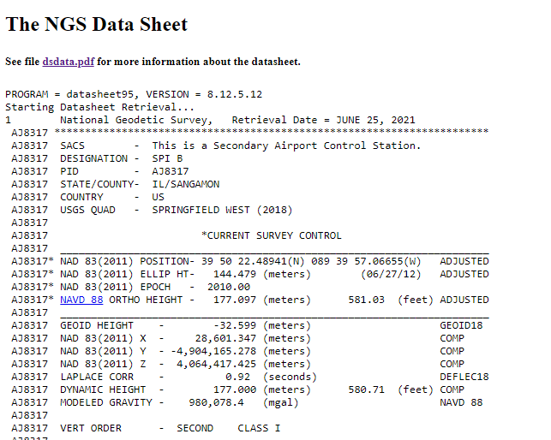
Traditional Access: Passive Control
Horizontal
Vertical

Slide 27
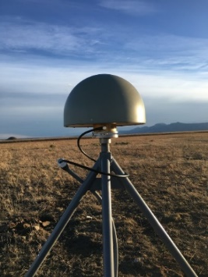
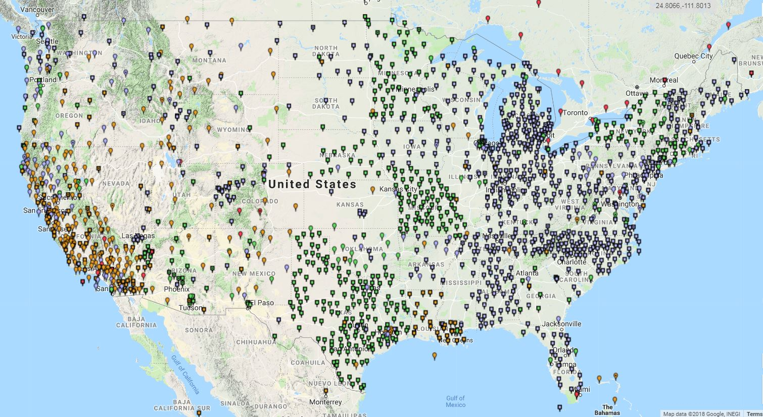
Modernized Access: Through the CORS and OPUS
NGS provides data and coordinate functions with NOAA CORS Network
And one definitive coordinate function for each one
And the software (M-PAGES / OPUS / OPUS Projects) to differentially position your GPS receiver to each station
Notes:
Very similar philosophically:
The NSRS remains “geodetic control” for you to “access”
Geospatial information and metadata about various points
Passive control will exist…we aren’t getting out bulldozers and shovels
But gone are the days of getting “the coordinate” on a point from a “datasheet”

Slide 28
Data Delivery System
The Data Delivery System (DDS) is a system for querying the new NSRS database
The most common query will be for a new version of datasheets
But other queries will be part of the DDS
Mark recovery and mark reporting
Active control (CORSs)
Projects, observations, data, etc.

Slide 29
The Data in the Datasheet
Starting Datasheet Retrieval...
1 National Geodetic Survey, Retrieval Date = JULY 1, 2022
AC6803 ***********************************************************************
AC6803 HT_MOD - This is a Height Modernization Survey Station.
AC6803 PACS - This is a Primary Airport Control Station.
AC6803 DESIGNATION - AZC A
AC6803 PID - AC6803
AC6803 STATE/COUNTY- AZ/MOHAVE
AC6803 COUNTRY - US
AC6803 USGS QUAD - LOST SPRING MOUNTAIN EAST (2018)
AC6803
…
In ASCII format
{"datasheet":
{
"datasheetHeading":"National Geodetic Survey",
"datasheetRetrievalDate":"JULY 1, 2022",
"htMod":"This is a Height Modernization Survey Station.",
"pacs":"This is a Primary Airport Control Station.",
"determinedProjects":[
{"project":"GPS1154"},{"project":"GPS2300"},{"project":"GPS2507"},{"project":"GPS280"},
{"project":"GPS2846"}
],
"observedProjects":[{"project":"GPS1154"},{"project":"GPS1195/11"},{"project":"GPS2507"}],
"occupiedProjects":[{"project":"GPS1154"},{"project":"GPS1195/11"}],
"designation":"AZC A",
"pid":"AC6803",
"state":"AZ",
"county":"MOHAVE",
"country":"US",
"quad":"LOST SPRING MOUNTAIN EAST (2018)",
…
}
}
In JSON format

Slide 30
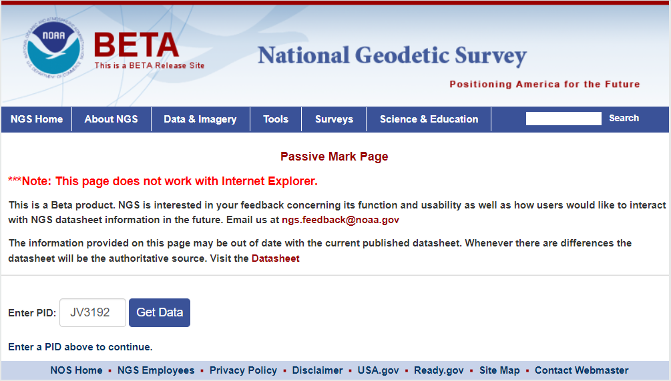
Beta Passive Marks page
Easier to read
Includes geospatial information
A preview of the future data delivery system
https://beta.ngs.noaa.gov/datasheets/passive-marks/index.html
Notes:
Show DE9524, a mark near Springfield

Slide 31
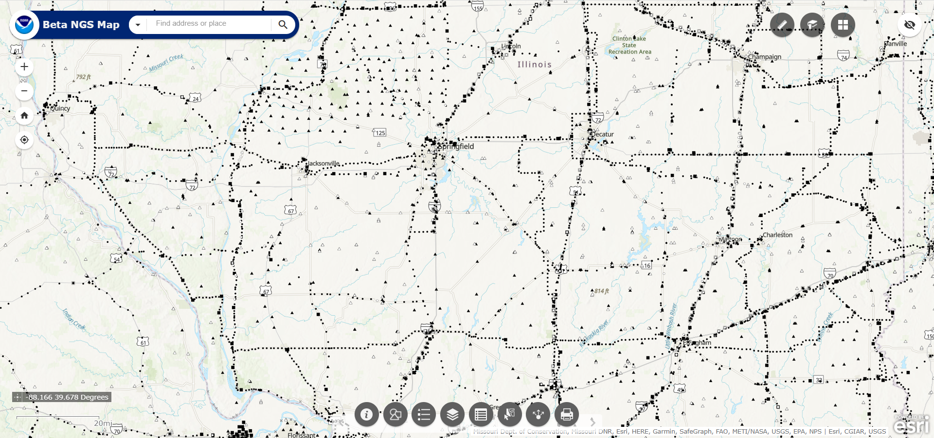
NGS Map
https://geodesy.noaa.gov/datasheets/ngs_map/

Slide 32
NGS Coordinate Conversion and Transformation Tool (NCAT)
Converts between types of coordinates
Transforms between datums
Works with vertical and horizontal datums in the NSRS

Slide 33
Horizontal Datums

Slide 34
Developing previous horizontal datums

Slide 35
Marks in the NSRS 1816–2006
Watch for: 1849 CA Gold Rush 1895 Systematic Mapping of Seward’s Folly 1896 Transcontinental Arc of Triangulation (39th Parallel) 1901 Transcontinental Arc of Triangulation (98th Meridian) 1933 Public Works Administration 1950–1980 NAD 83
Project 1990s Statewide HARN and FBN Projects

Slide 36
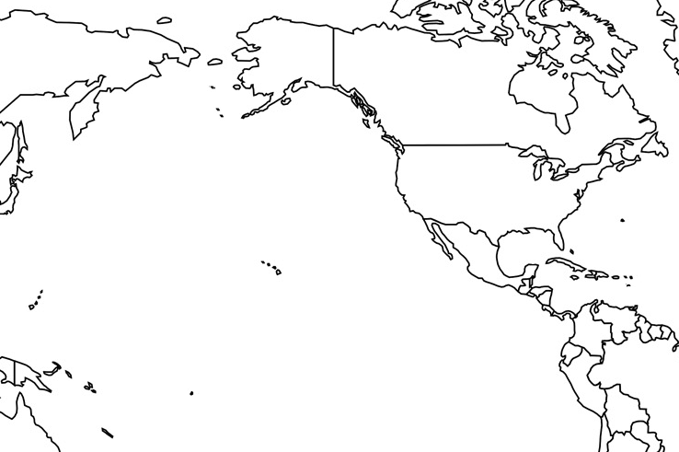
Horizontal Datums of the NSRS
St. Paul I.
St. Paul 1897
St. Paul 1952
NAD 83(1986)
NAD 83(2002:AK)
NAD 83(NSRS2007)
NAD 83(2011) epoch 2010.00
St. Lawrence I.
St. Lawrence 1952
NAD 83(1986)
NAD 83(2002:AK)
NAD 83(NSRS2007)
NAD 83(2011) epoch 2010.00
St. Matthew I.
St. Matthew 1952
Alaska
NAD 27
NAD 83(1986)
NAD 83(2002:AK)
NAD 83(NSRS2007)
NAD 83(2011) epoch 2010.00
St. George I.
St. George 1897
St. George 1952
NAD 83(1986)
NAD 83(2002:AK)
NAD 83(NSRS2007)
NAD 83(2011) epoch 2010.00
CONUS
U.S. Standard Datum
NAD 27
NAD 83(1986)
NAD 83(“HARN”)
NAD 83(“FBN”)
NAD 83(NSRS2007)
NAD 83(2011) epoch 2010.00
Hawaii
Old Hawaiian Datum
NAD 83(1986)
NAD 83(1993:HI)
NAD 83(PA11) epoch 2010.00
CNMI
Guam 1963
NAD 83(1993:GU)
NAD 83(2002:GU)
NAD 83(MA11) epoch 2010.00
Puerto Rico
Puerto Rico 1940
NAD 83(1986)
NAD 83(1993:PR)
NAD 83(1997:PR)
NAD 83(2002:PR)
NAD 83(NSRS2007)
NAD 83(2011) epoch 2010.00
U.S. Virgin Islands
Puerto Rico 1940
NAD 83(1986)
NAD 83(1993:PR)
NAD 83(1997:PR)
NAD 83(2002:PR)
NAD 83(NSRS2007)
NAD 83(2011) epoch 2010.00
Guam
Guam 1963
NAD 83(1993:GU)
NAD 83(2002:GU)
NAD 83(MA11) epoch 2010.00
American Samoa
American Samoa 1962
NAD 83(1993:AS)
NAD 83(2002:AS)
NAD 83(PA11) epoch 2010.00

Slide 37
Replacing the NAD 83s
The Old | The New
NAD 83 (2011) | NATRF2022 - The North American Terrestrial Reference Frame of 2022
NAD 83 (2011) | CATRF2022 - The Caribbean Terrestrial Reference Frame of 2022
NAD 83 (PA11) | PATRF2022 - The Pacific Terrestrial Reference Frame of 2022
NAD 83 (MA11) | MATRF2022 - The Mariana Terrestrial Reference Frame of 2022

Slide 38
Traditional horizontal geodetic datums
Positions of points on Earth’s surface are reduced to the surface of a reference ellipsoid
The reference ellipsoid roughly matches the shape of the Earth
A reference point is selected as the origin, all other positions are given with respect to that point

Slide 39
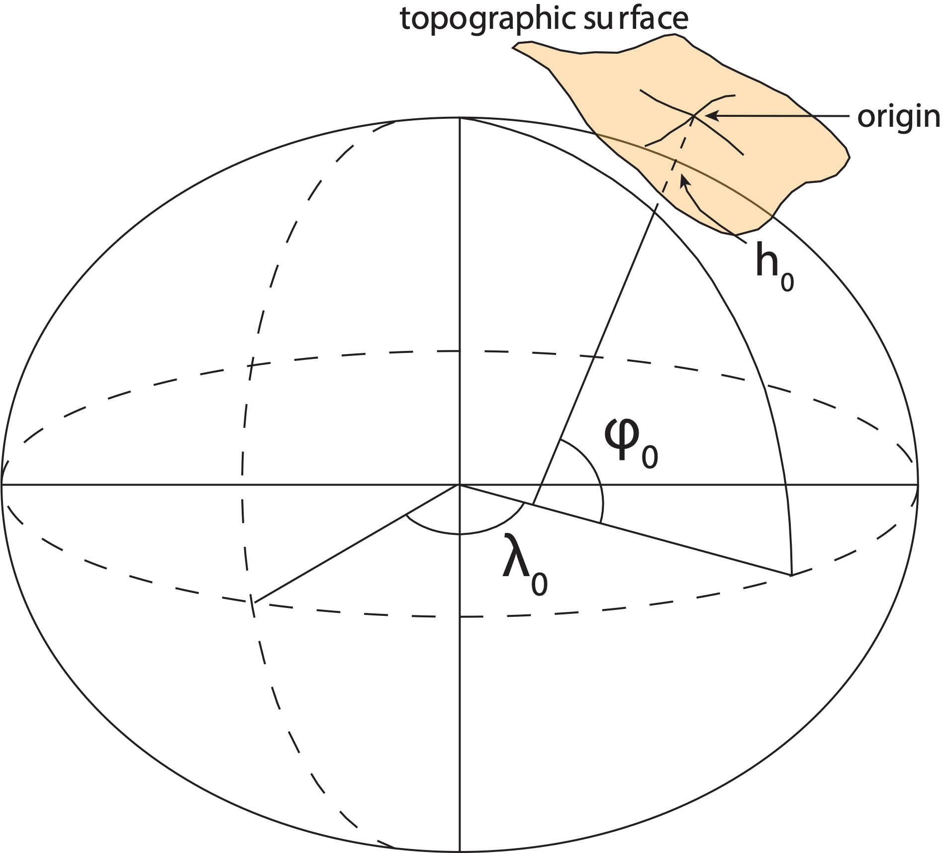
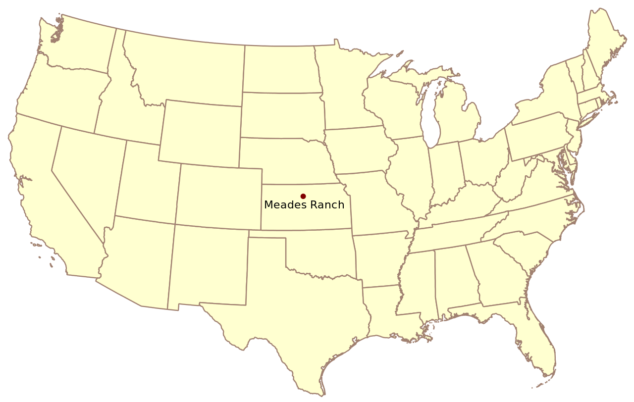
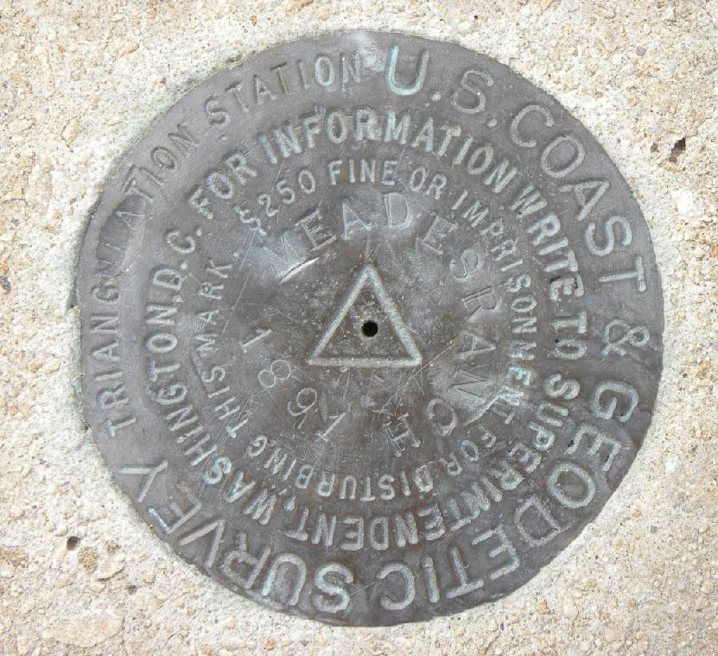
Traditional horizontal geodetic datums
(NAD 27)

Slide 40
Traditional horizontal geodetic datums
Drawbacks of using this approach:
The reference ellipsoid is optimized for the region; it is not suitable for global positioning
The center of the reference ellipsoid does not coincide with the location of the center of mass of the Earth
Neighboring countries may use different datums which can cause unnecessary complications when dealing with points of interest in border regions
https://www.e-education.psu.edu/geog862/node/1797
Notes:
NAD 83 is non-geocentric

Slide 41
Drawbacks of Passive Control
Traditional horizontal and vertical datums were built onand accessed through passive control
PID: EZ0840
PID: EZ0840
Notes:
Old datums were built on passive control and accesses through passive control

Slide 42
Geometric Reference Frames

Slide 43
Definitions
Reference System
Reference Frame
A set of prescriptions and conventions together with the modeling required to define at any time a triad of coordinate axes
ITRS: International Terrestrial Reference System
Realizes the system by means of coordinates of definite points that are accessible directly by occupation or observation
ITRF: International Terrestrial Reference Frame
From Springer Handbook of Global Navigation Satellite Systems, Ch. 2, p. 34
Notes:
Reference frames give us a means to assign self-consistent coordinates to physical locations and to describe how those coordinates change over time
Realization is defined as the practical implementation of a concept
Coordinates assigned to points in a way that best represents the mathematically abstract definition
Coordinates come from geodetic surveys of the highest accuracy
Coordinates could stand unchanged for decades (NAD 27, NGVD 29 being the best known examples)
Piecemeal updates from re-surveys

Slide 44
International Terrestrial Reference System (ITRS)
Defined and maintained by the International Earth Rotation and Reference System Service (IERS)
Defines conventions for:
Origin (Where is the zero point?)
Scale (What is the measure of length?)
Orientation (How are the axes oriented in space?)

Slide 45
Ideal Geometric Frames
ITRF
Combination of four frames (SLR, VLBI, GNSS, DORIS)
IGS
Post-ITRF frame
Most accurate GNSS orbits are in this frame
Currently the NSRS is mathematically defined:
Three NAD 83 frames: North America, Pacific, Mariana plates
All 3 defined with respect to ITRF94 (same as ITRF96)
All other ITRFs defined with transformations between ITRFs

Slide 46
The IGS Reference Frame
The ITRF is defined by reference epoch coordinates AND velocities at stations
The ITRF velocity field very closely resembles absolute plate motion
The ITRF and IGS frames are both no-net-rotation frames – the sum of the angular velocities is constrained to be zero
The Modernized (2022) NSRS Reference Frames will tie to ITRF2020
Altamimi et al., 2016, JGR

Slide 47
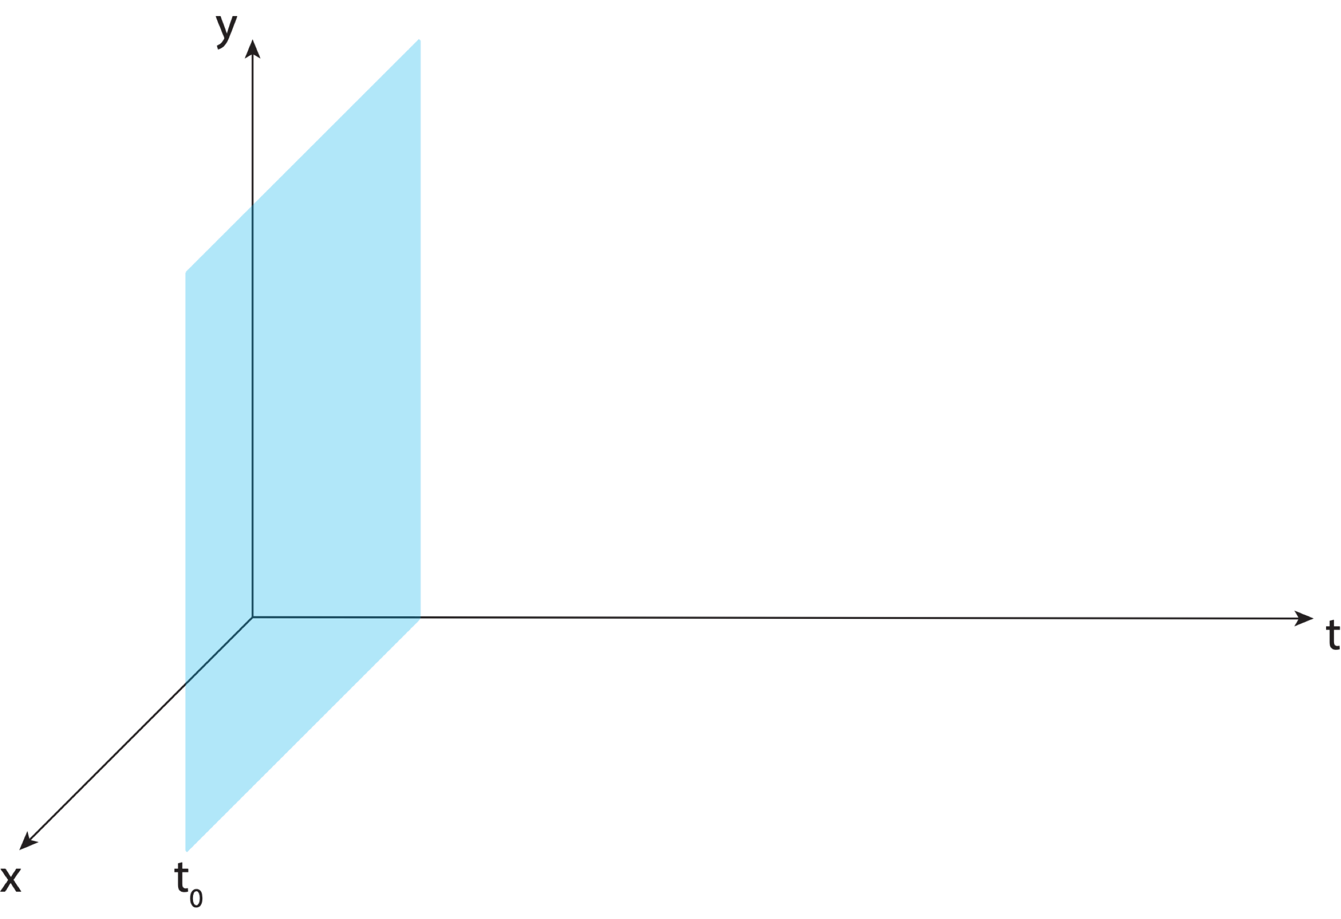
Aligning the NSRS to the IGS reference frame

Slide 48
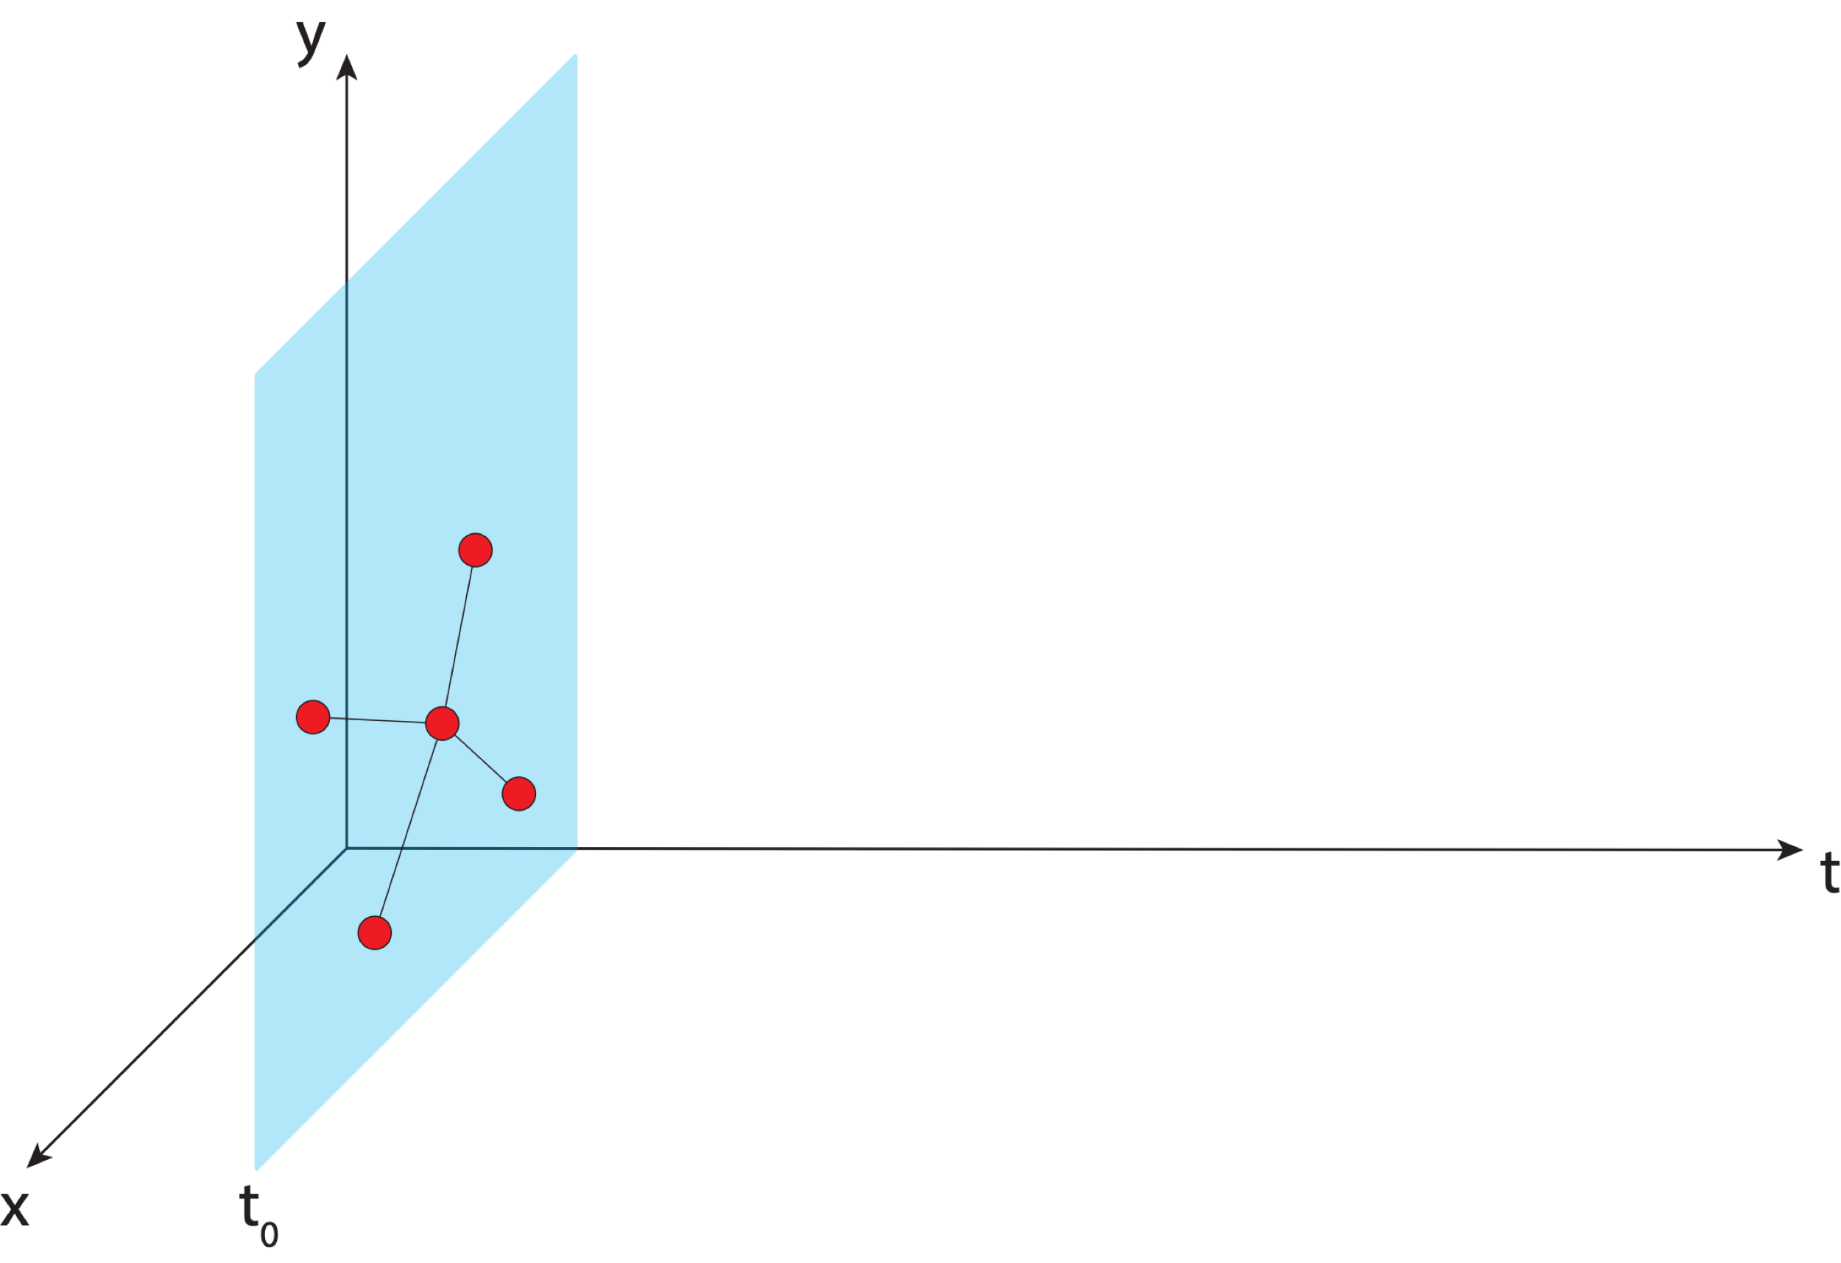
Aligning the NSRS to the IGS reference frame
IGS GNSS station
station trajectory

Slide 49
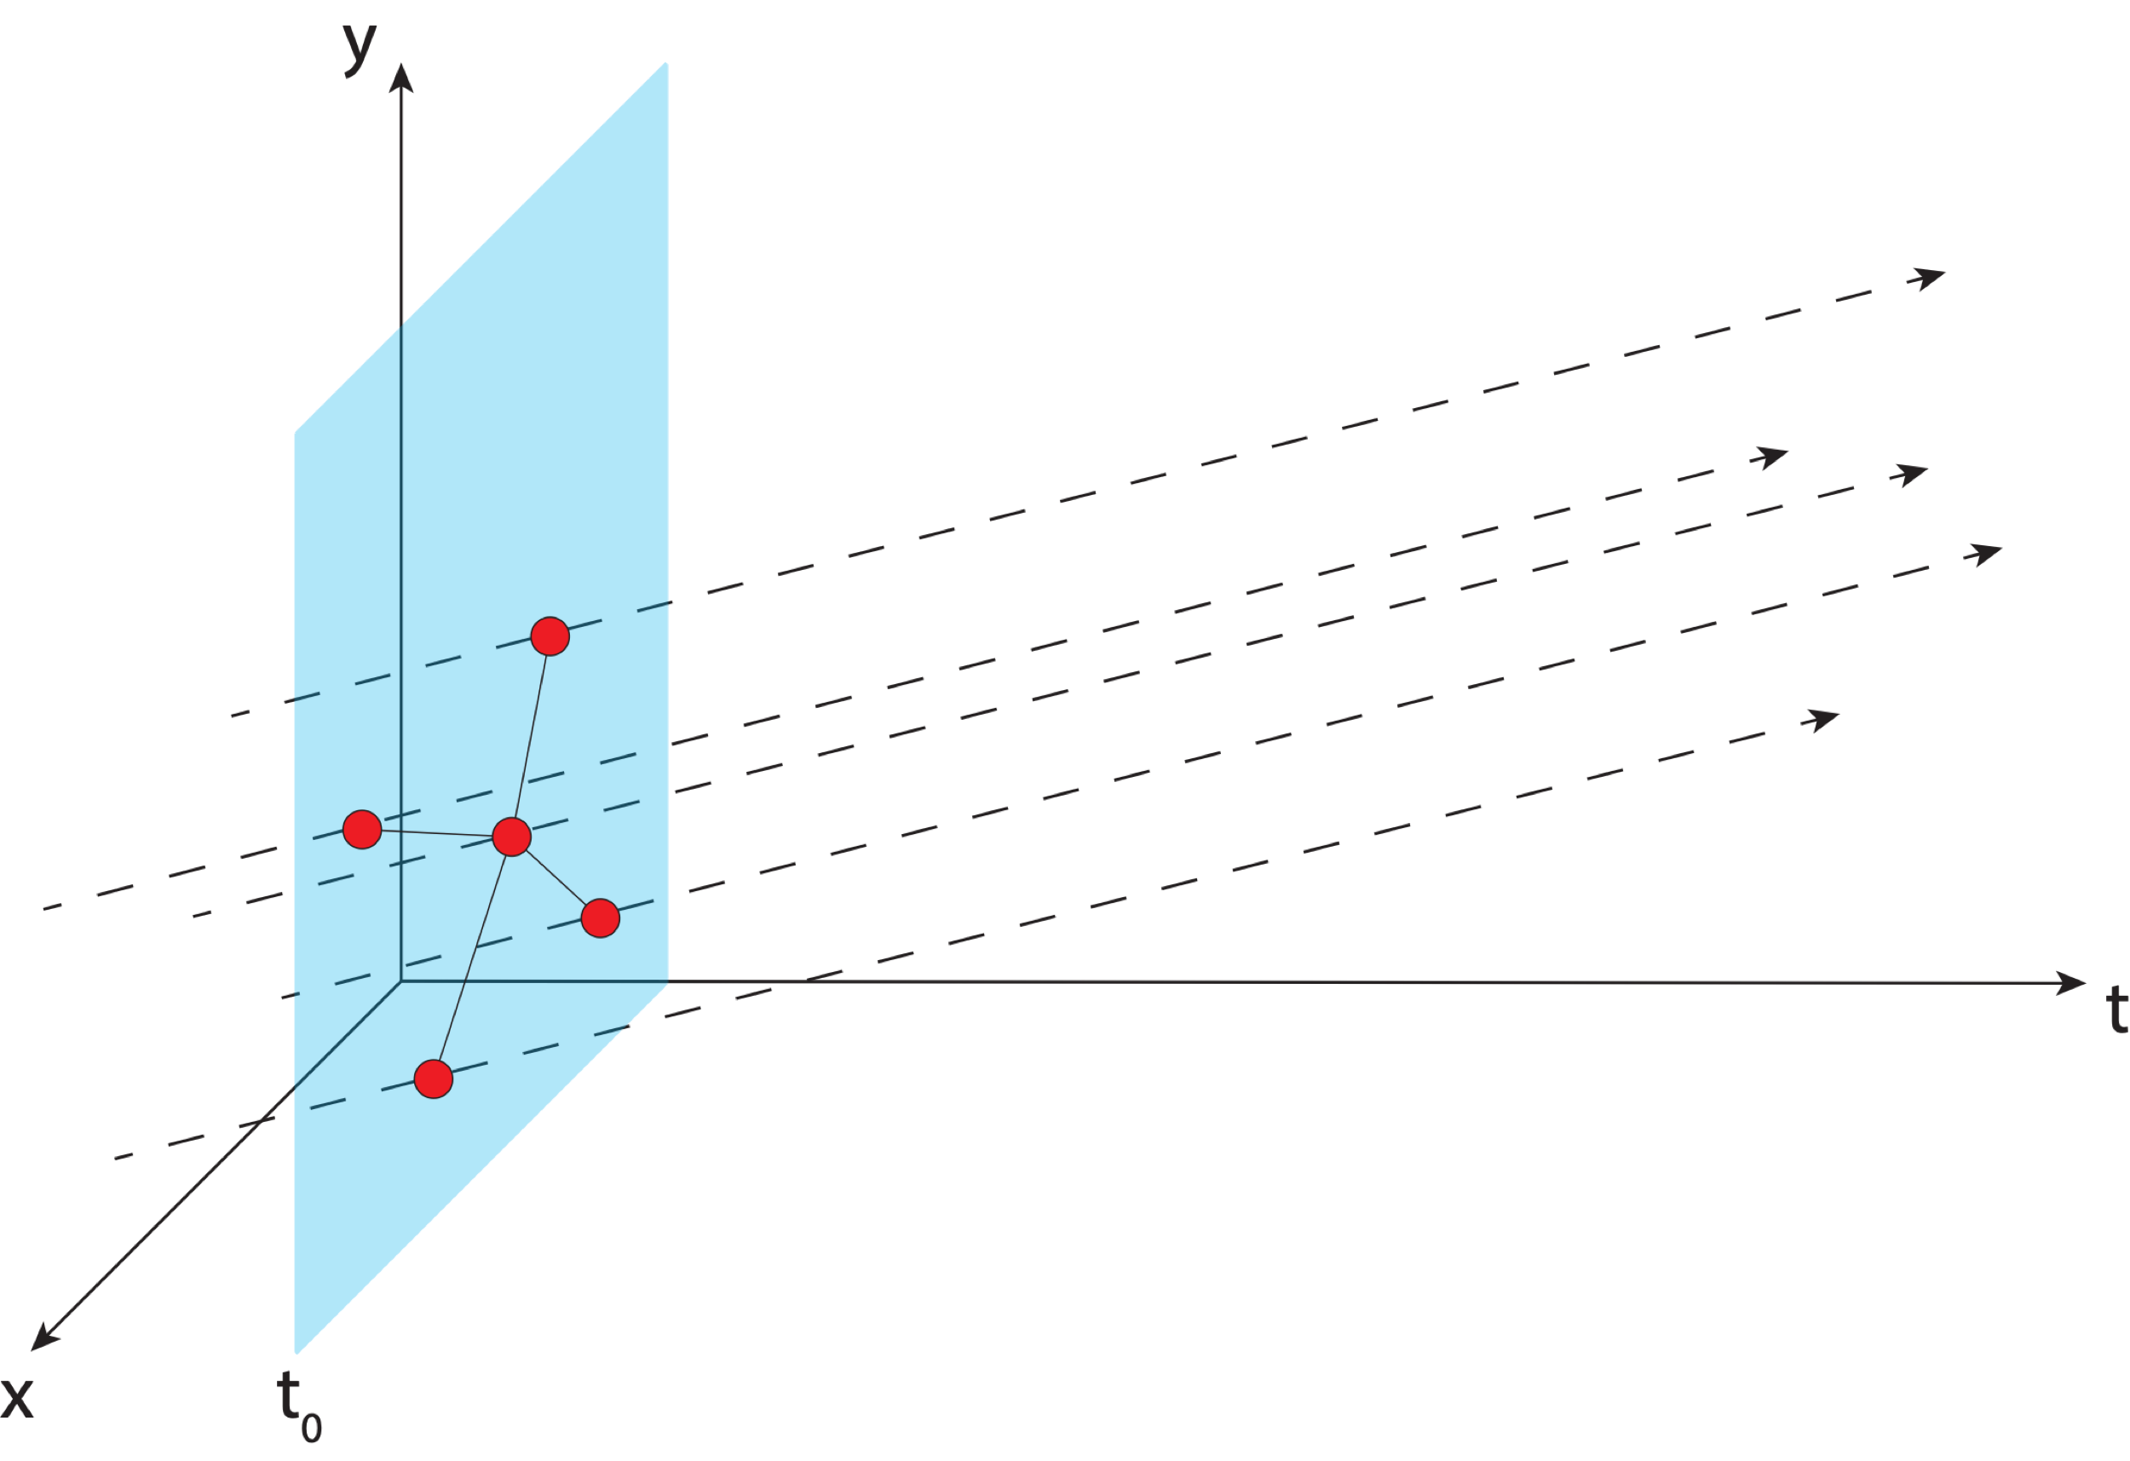
Aligning the NSRS to the IGS reference frame
IGS GNSS station
station trajectory

Slide 50
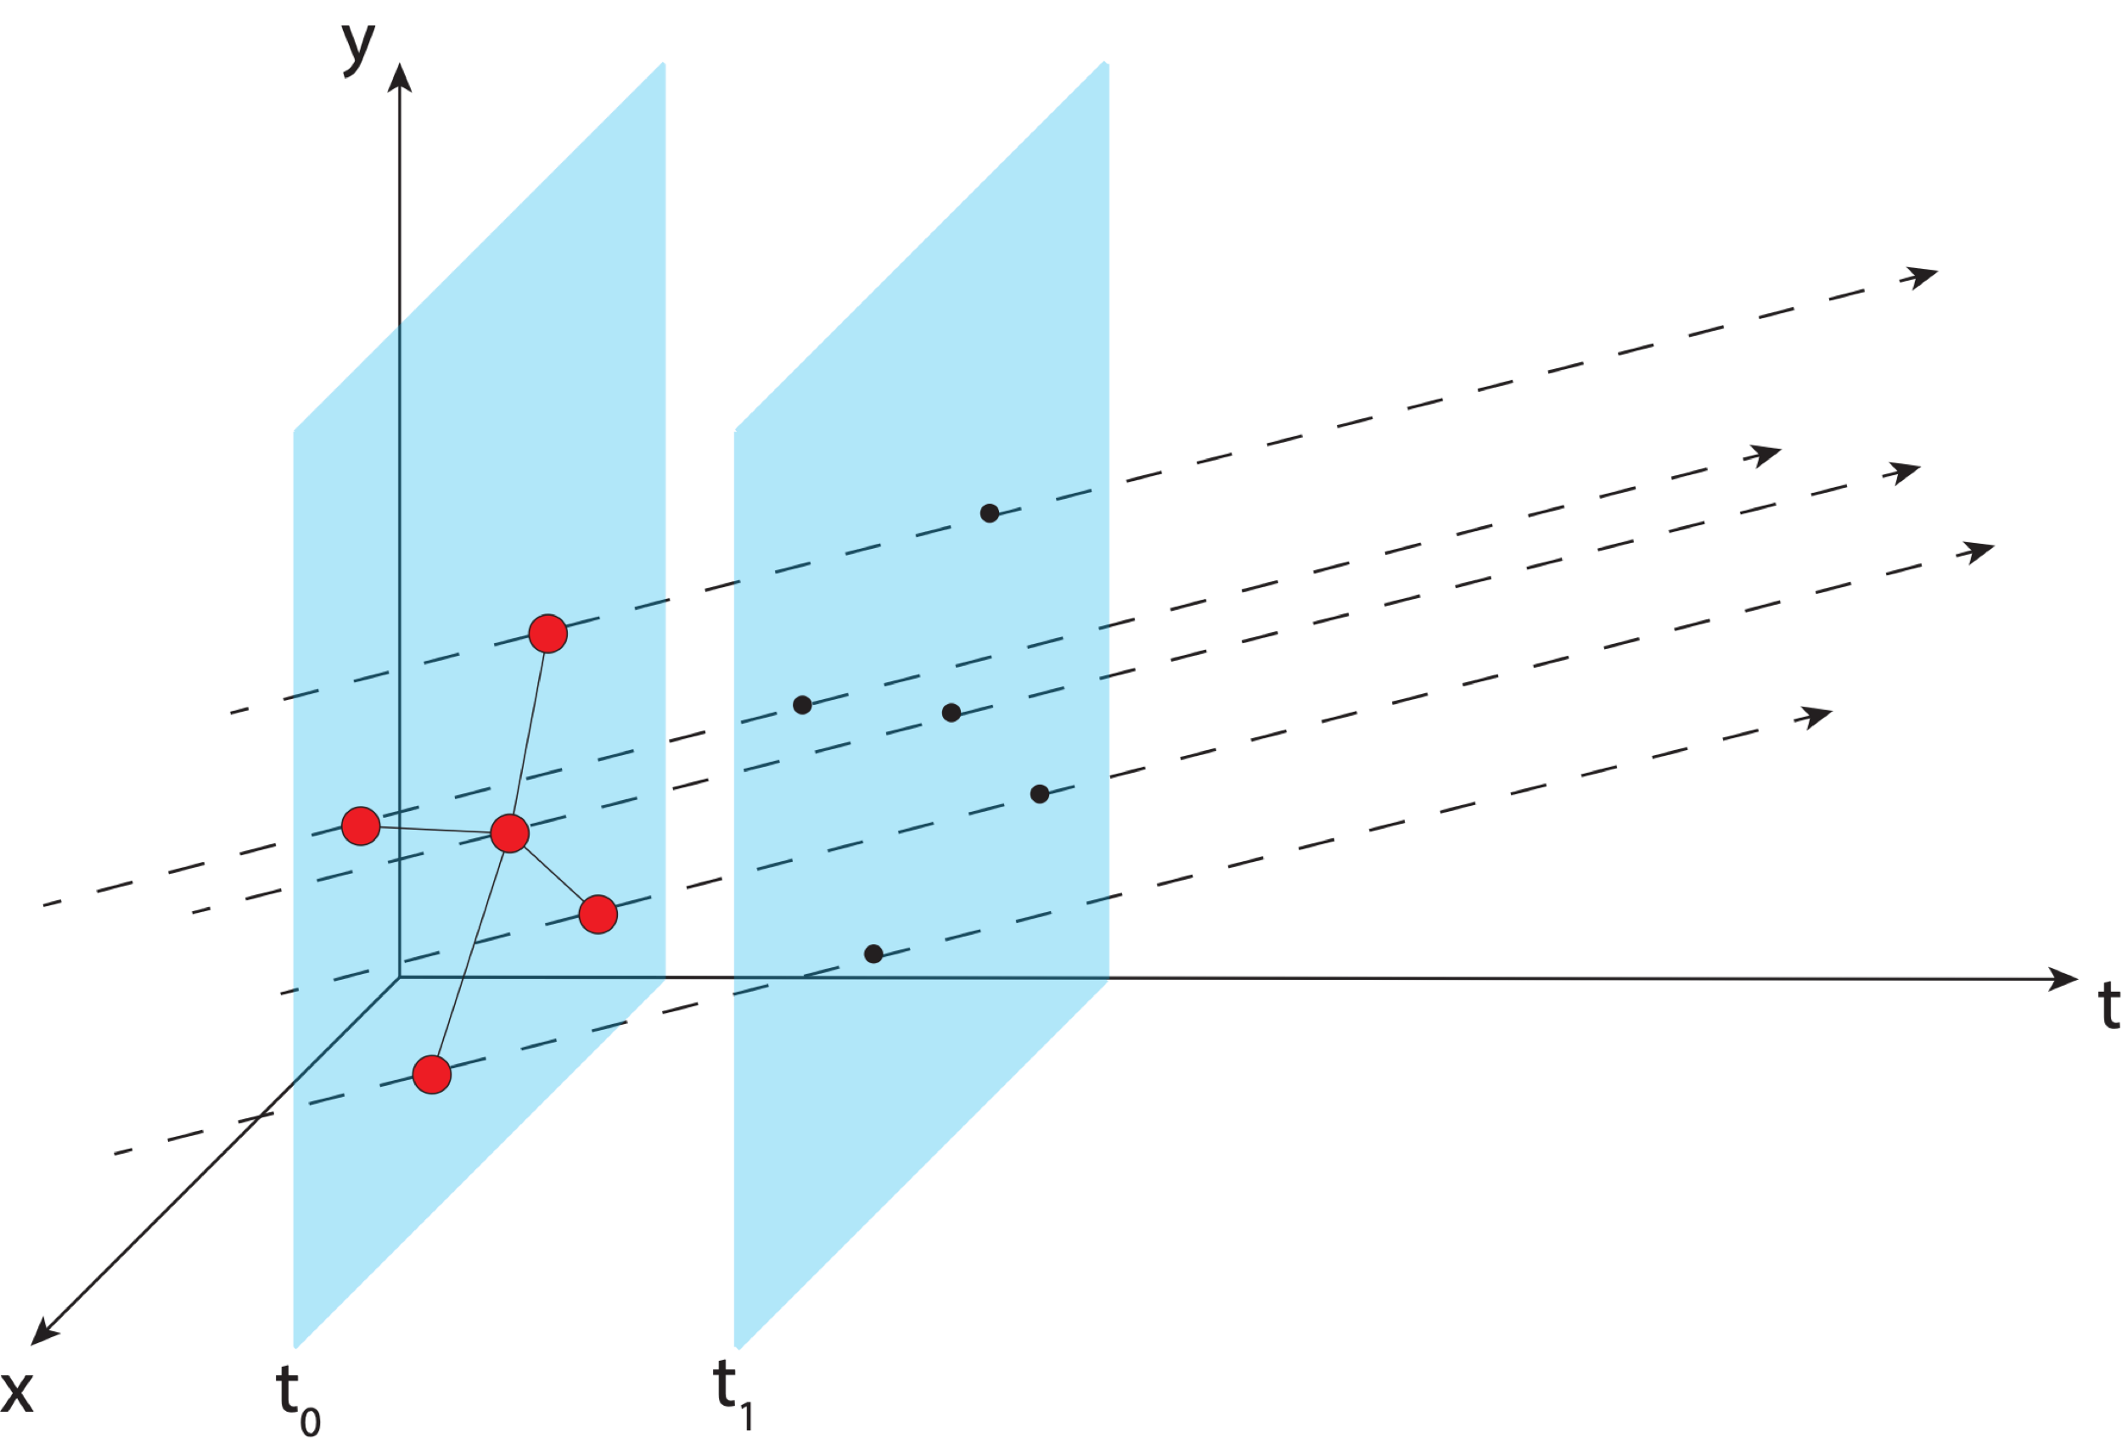
Aligning the NSRS to the IGS reference frame
IGS GNSS station
station trajectory
projected IGS station position
Notes:
Trajectory of IGS stations through time

Slide 51
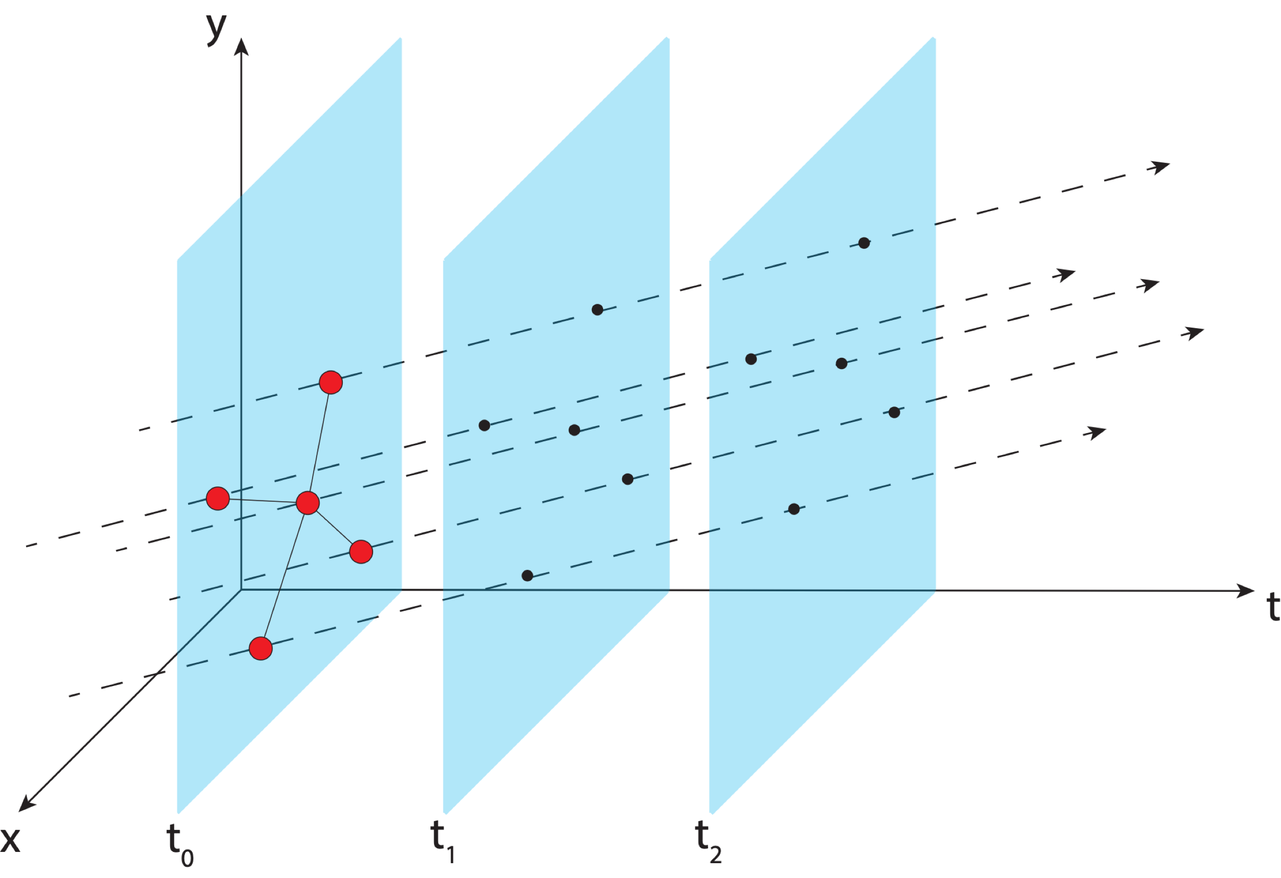
Aligning the NSRS to the IGS reference frame
IGS GNSS station
station trajectory
projected IGS station position

Slide 52
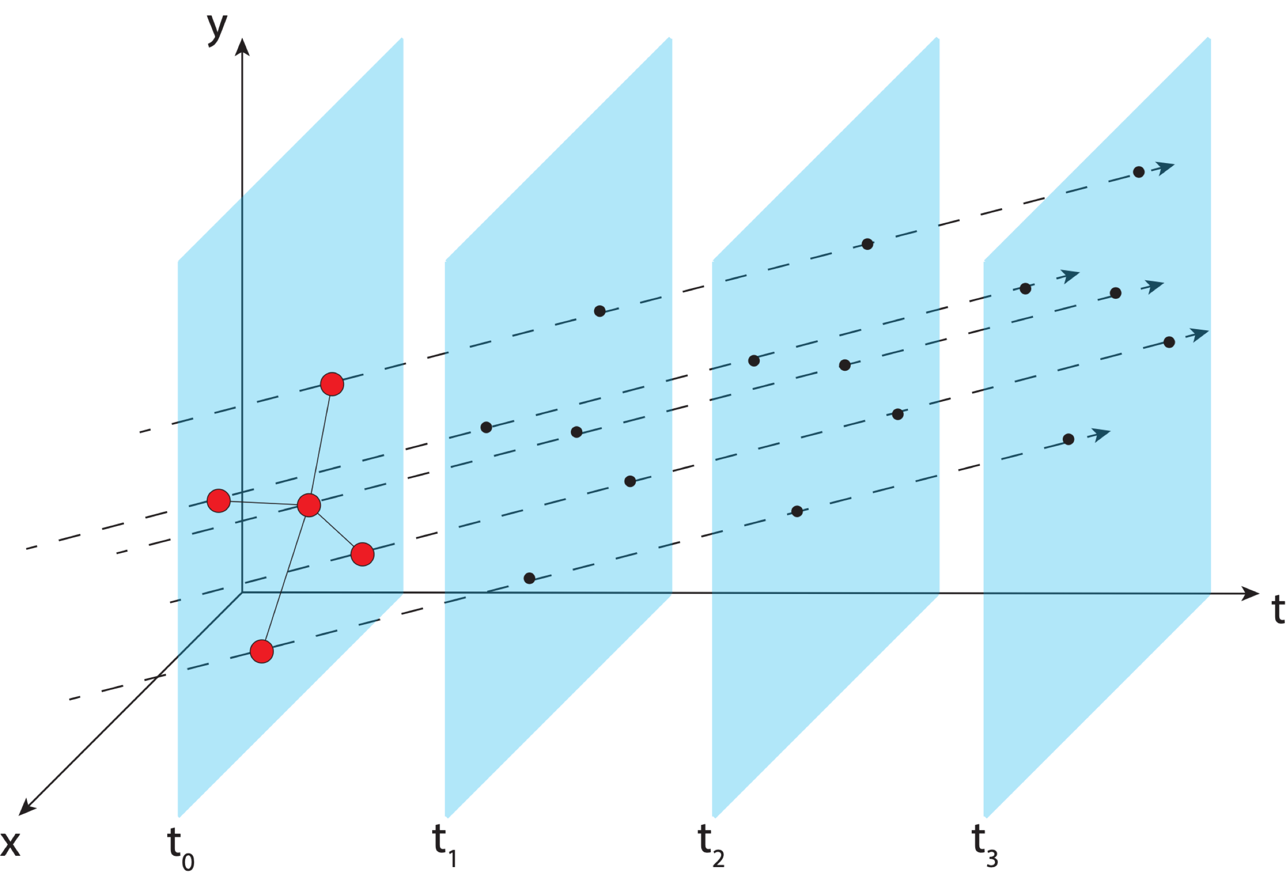
Aligning the NSRS to the IGS reference frame
IGS GNSS station
station trajectory
projected IGS station position

Slide 53
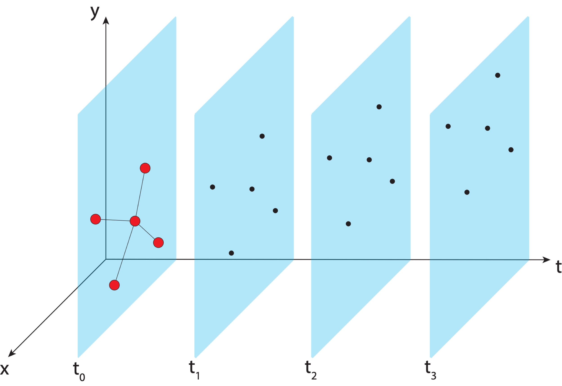
Aligning the NSRS to the IGS reference frame
IGS GNSS station
station trajectory
projected IGS station position

Slide 54
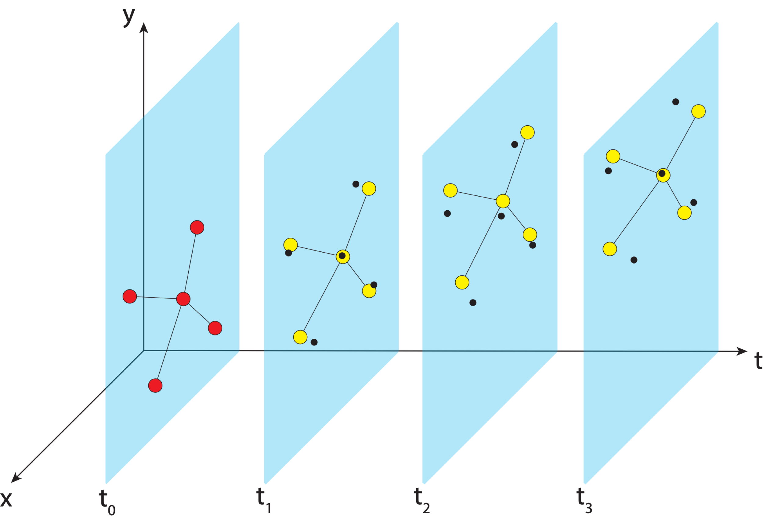
Aligning the NSRS to the IGS reference frame
IGS GNSS station
station trajectory
projected IGS station position
NGS estimate of IGS station position
Notes:
NGS estimates positions of IGS stations and compute transformation parameters to get them to align

Slide 55
Aligning the NSRS to the IGS reference frame
IGS GNSS station
station trajectory
projected IGS station position
NGS estimate of IGS station position

Slide 56
Aligning the NSRS to the IGS reference frame
IGS GNSS station
station trajectory
projected IGS station position
NGS estimate of IGS station position

Slide 57
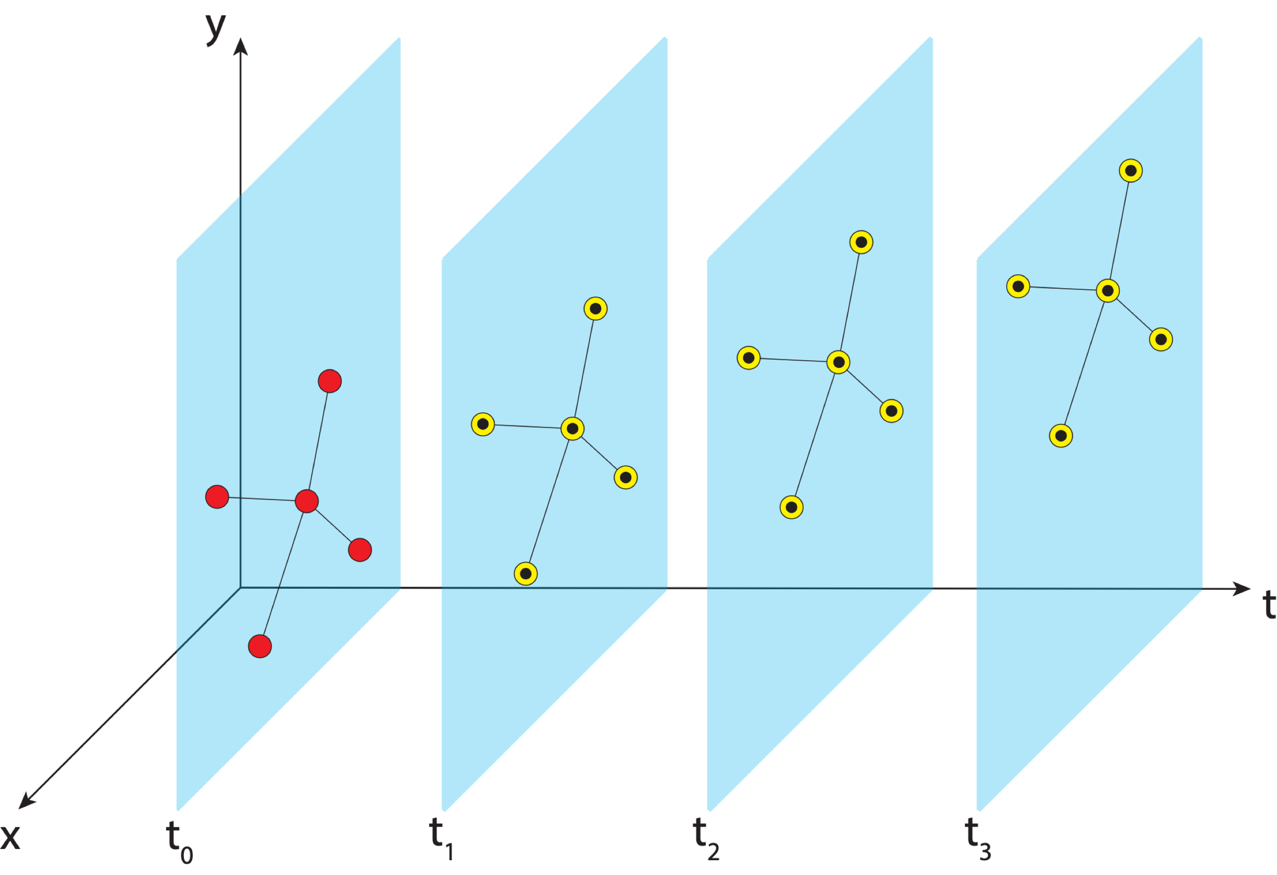
Aligning the NSRS to the IGS reference frame
IGS GNSS station
station trajectory
projected IGS station position
NGS estimate of IGS station position

Slide 58
Aligning the NSRS to the IGS reference frame
IGS GNSS station
station trajectory
projected IGS station position
NGS estimate of IGS station position
NCN GNSS station

Slide 59
Aligning the NSRS to the IGS reference frame
IGS GNSS station
station trajectory
projected IGS station position
NGS estimate of IGS station position
NCN GNSS station

Slide 60
Aligning the NSRS to the IGS reference frame
IGS GNSS station
station trajectory
projected IGS station position
NGS estimate of IGS station position
NCN GNSS station

Slide 61
Aligning the NSRS to the IGS reference frame
IGS GNSS station
station trajectory
projected IGS station position
NGS estimate of IGS station position
NCN GNSS station

Slide 62
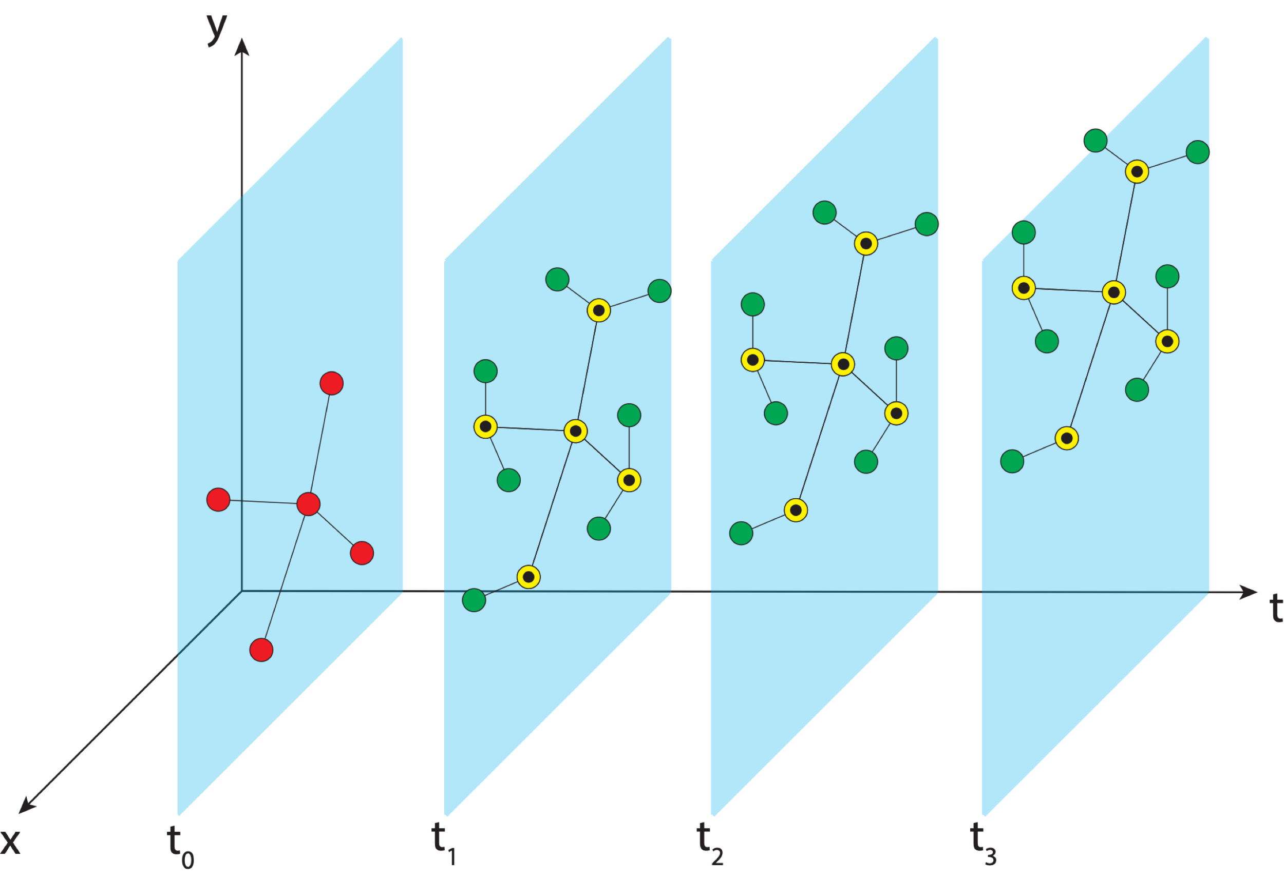
Aligning the NSRS to the IGS reference frame
IGS GNSS station
station trajectory
projected IGS station position
NGS estimate of IGS station position
NCN GNSS station
Notes:
We realize the ITRF by using the IGS realization and bringing the NOAA CORS network along with it to snap everything into a self-consistent frame

Slide 63
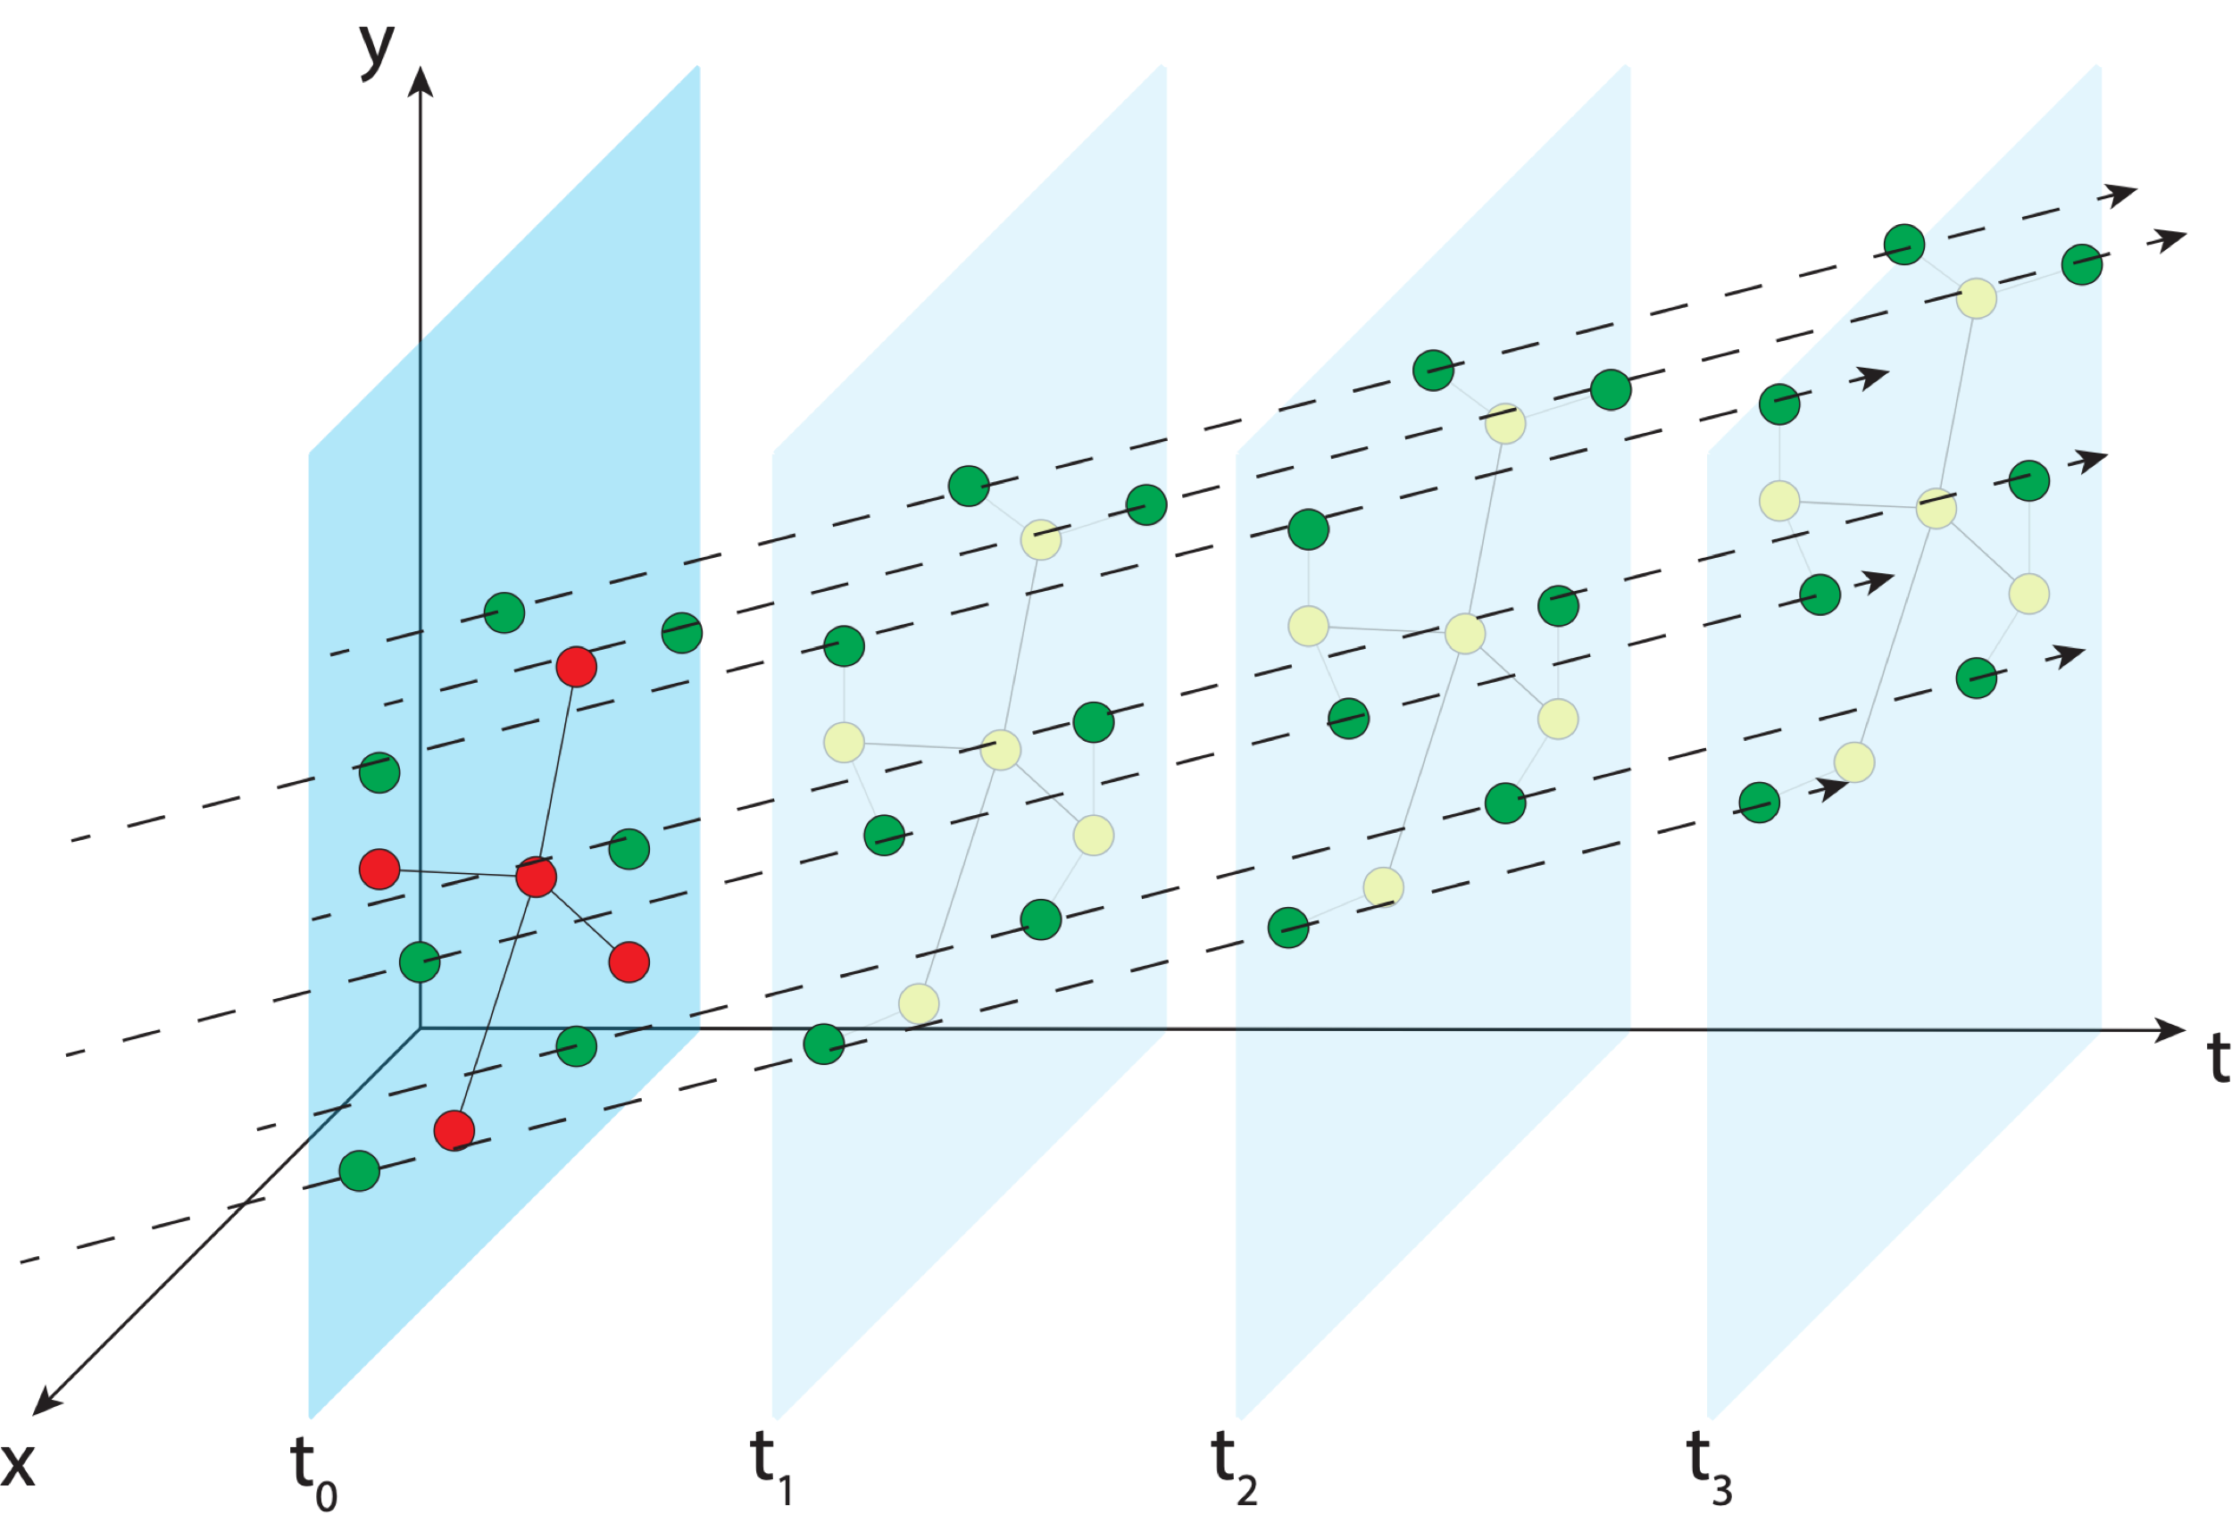
Aligning the NSRS to the IGS reference frame
IGS GNSS station
station trajectory
projected IGS station position
NGS estimate of IGS station position
NCN GNSS station
Notes:
In MYCS, we take those positions at those times and estimate the velocity (trajectory) of the stations through time

Slide 64
Aligning the NSRS to the IGS reference frame
IGS GNSS station
station trajectory
projected IGS station position
NGS estimate of IGS station position
NCN GNSS station

Slide 65
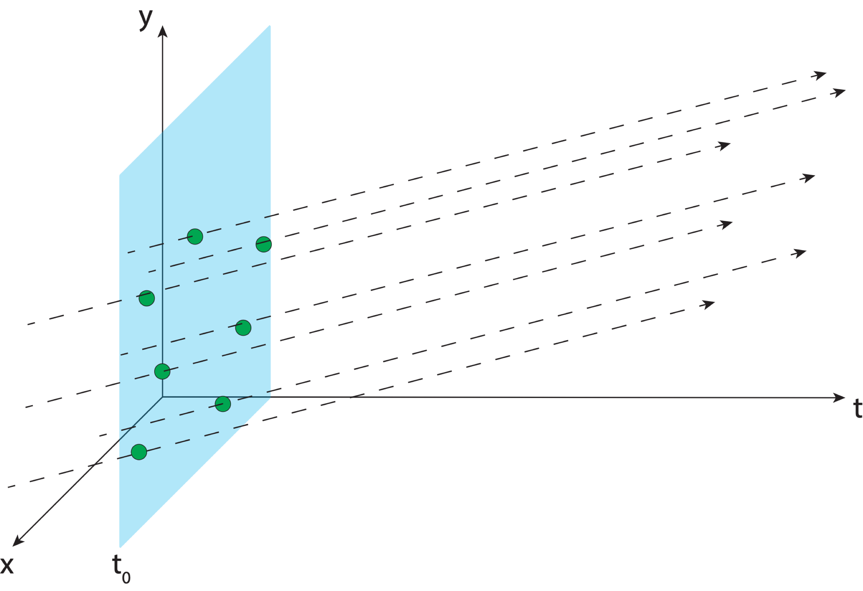
Aligning the NSRS to the IGS reference frame
IGS GNSS station
station trajectory
projected IGS station position
NGS estimate of IGS station position
NCN GNSS station
Notes:
We provide reference epoch coordinates and velocities for users to align to the NSRS

Slide 66
Aligning the NSRS to the IGS reference frame
IGS GNSS station
station trajectory
projected IGS station position
NGS provides access to the NSRS through reference epoch positions and velocities for NCN stations
When users access the NSRS through OPUS, a very similar process is performed using NCN stations as the reference
NGS estimate of IGS station position
NCN GNSS station

Slide 67
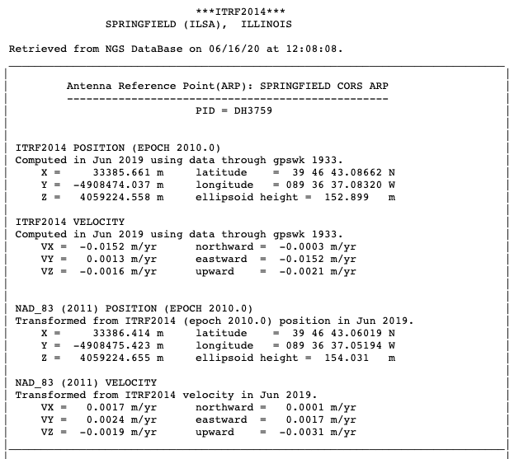
Aligning the NSRS to the IGS reference frame
IGS GNSS station
station trajectory
projected IGS station position
NGS estimate of IGS station position
NCN GNSS station

Slide 68
Aligning the NSRS to the IGS reference frame
IGS GNSS station
station trajectory
projected IGS station position
NGS estimate of IGS station position
NCN GNSS station
Notes:
And that’s what we give you. Coordinates at an epoch and a velocity

Slide 69
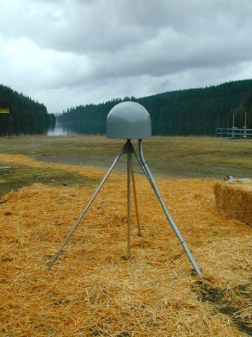
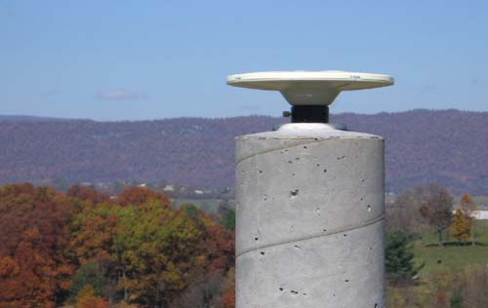
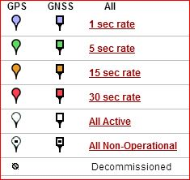
Continuously Operating Reference Station (CORS) Network
2000 sites
225 organizations

Slide 70
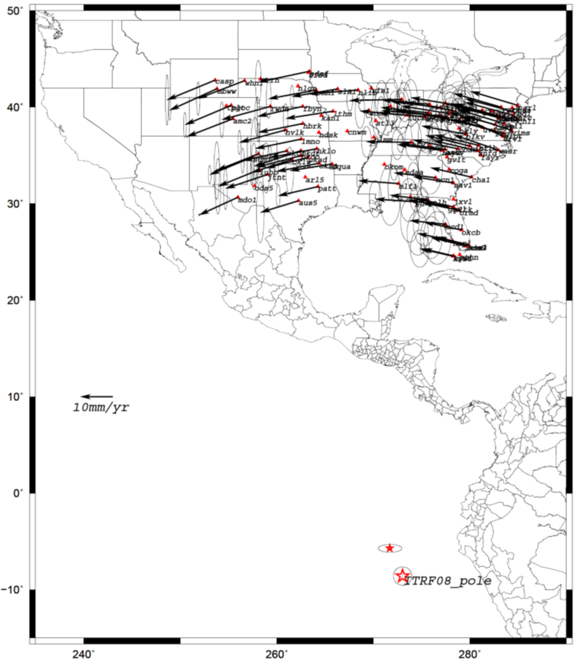
Euler Poles and “Plate-Fixed”
In the ITRF, many tectonic plates have a dominant motion: rotation
Euler Pole - point about which a plate rotates (yellow star)
Euler Pole Parameters (EPP) define this rotation
Residual motion is characterized in an Intra-Frame Deformation Model (IFDM)
NATRF2022 Euler Pole
Notes:
We say “NATRF2022” is “fixed” to the N.A. Plate, making it a “plate fixed” frame
-the frame is constant to itself, but rotating within ITRF, and moving in a different direction than the other 3 frames

Slide 71
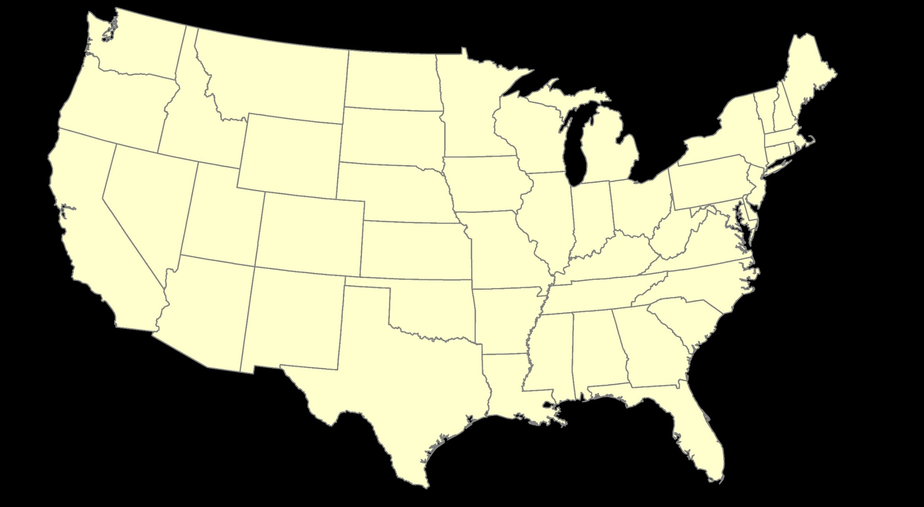
ITRF2020: Constant Frame, Rotating Plate

Slide 72
NATRF2022: Constant Frame, Rotating Plate “Plate-Fixed”

Slide 73
ITRF2020 or NATRF2022

Slide 74
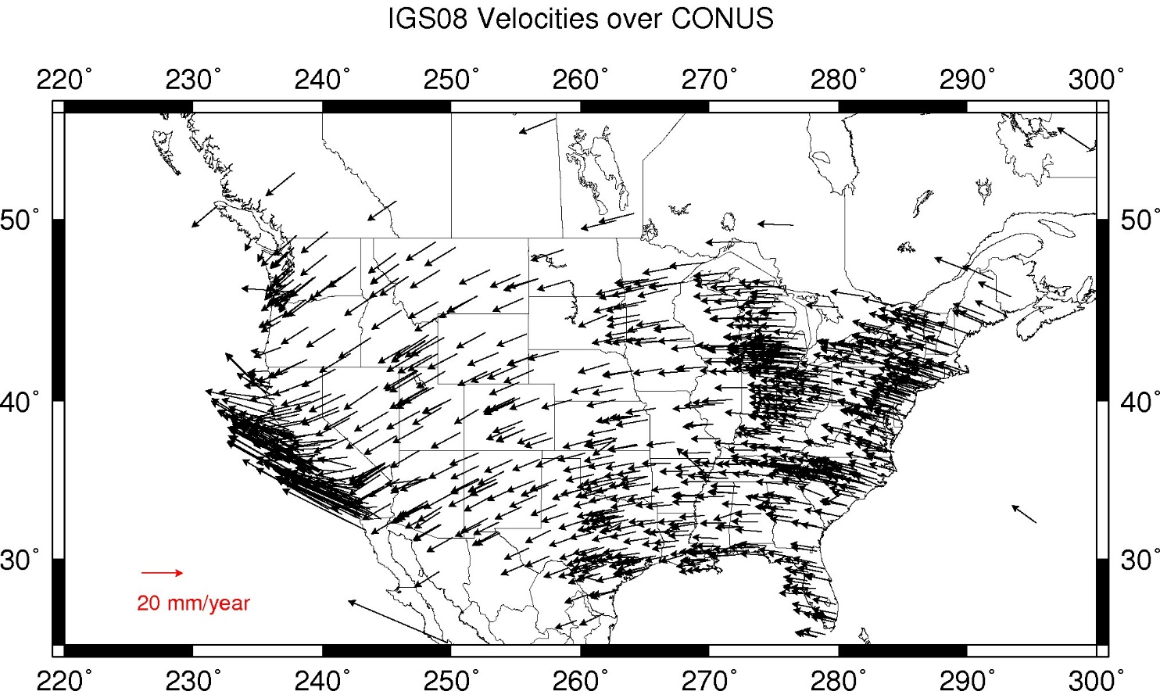
Residual Velocities – ITRF2020/CONUS
Notes:
This diagram of CONUS shows the IFVM2022 velocities expressed in the ITRF2020 Frame.
Note the arrows are about 20 mm/yr
It can generally be interpreted as “at what velocity are points in CONUS moving relative to the ITRF Frame?”

Slide 75
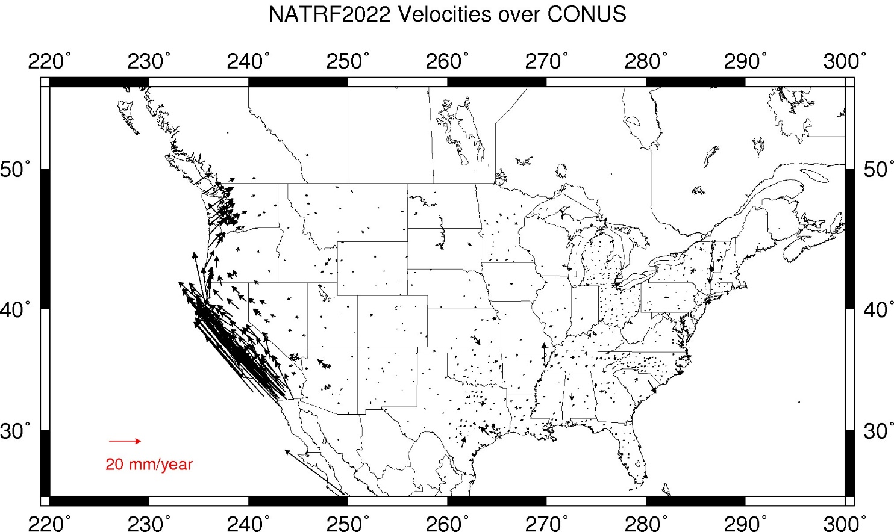
Residual Velocities – NATRF2022/CONUS
Notes:
This diagram of CONUS shows the IFVM2022 velocities expressed in the NATRF2022 Frame.
Note that even in “stable North America”, these velocities are not absolutely zero!
The IFVM2022 model will contain these tiny deviations from simple plate rotation!
It can generally be interpreted as “at what velocity are points in CONUS moving relative to the North American plate?”

Slide 76
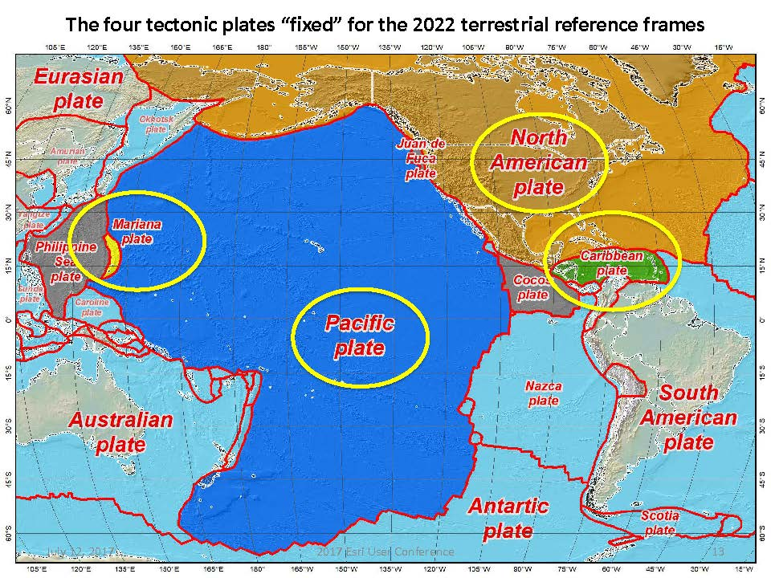
Four Tectonic Plates

Slide 77
The Relation of 5 Global Reference Frames through Time
MATRF2022
NATRF2022
Rotation of North American Plate
Rotations are not to scale
PATRF2022
CATRF2022
Rotation of Pacific Plate
ITRF2020 frame
ITRF2020 frame through time
ITRF2020 frame
Rotation of Caribbean Plate
PATRF2022
Rotation of Mariana Plate
CATRF2022
NATRF2022
2020.00 : The time when
all four TRFs and
ITRF2020 are identical by definition.
MATRF2022
t = 2020.00 - Dt
(“the past”)
t = 2020.00 + Dt
(“the future”)

Slide 78
Vertical Datums

Slide 79
Notes:
What’s up with that? We’re going to have some fun today. Maybe not that much fun though.

Slide 80
Vertical Datums of the NSRS
St. Paul I.
- None -
St. Lawrence I.
- None -
St. Matthew I.
- None -
Alaska
NGVD 29
NAVD 88
St. George I.
- None -
CONUS
NGVD 29
NAVD 88
Hawaii
- None -
CNMI
NMVD 03
Puerto Rico
PRVD 02
U.S. Virgin Islands
VIVD 09
American Samoa
ASVD 02
Guam
GVD 63
GUVD 04

Slide 81
Developing the previous vertical datums
Notes:
NGVD 29: 26 Tide gauges in North America
NAVD 88: Father Point in Rimouski, Canada

Slide 82
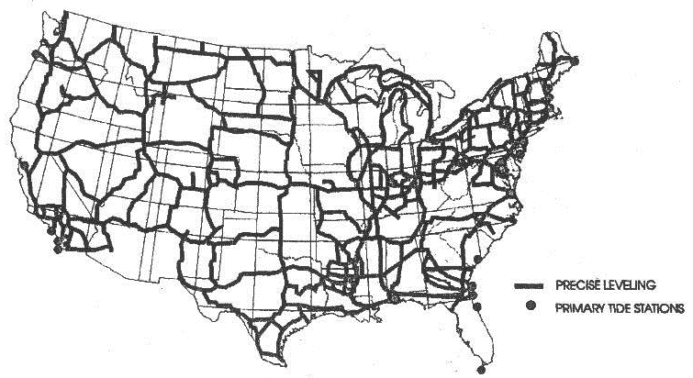
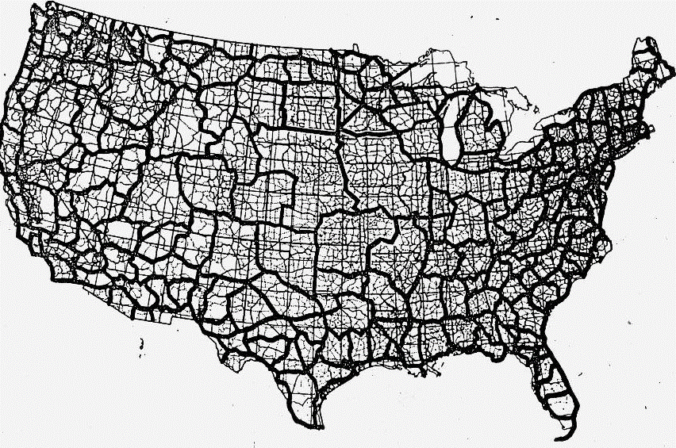
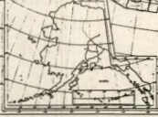
Developing the previous vertical datums
NGVD 29
NAVD 88

Slide 83
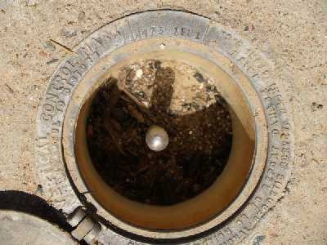
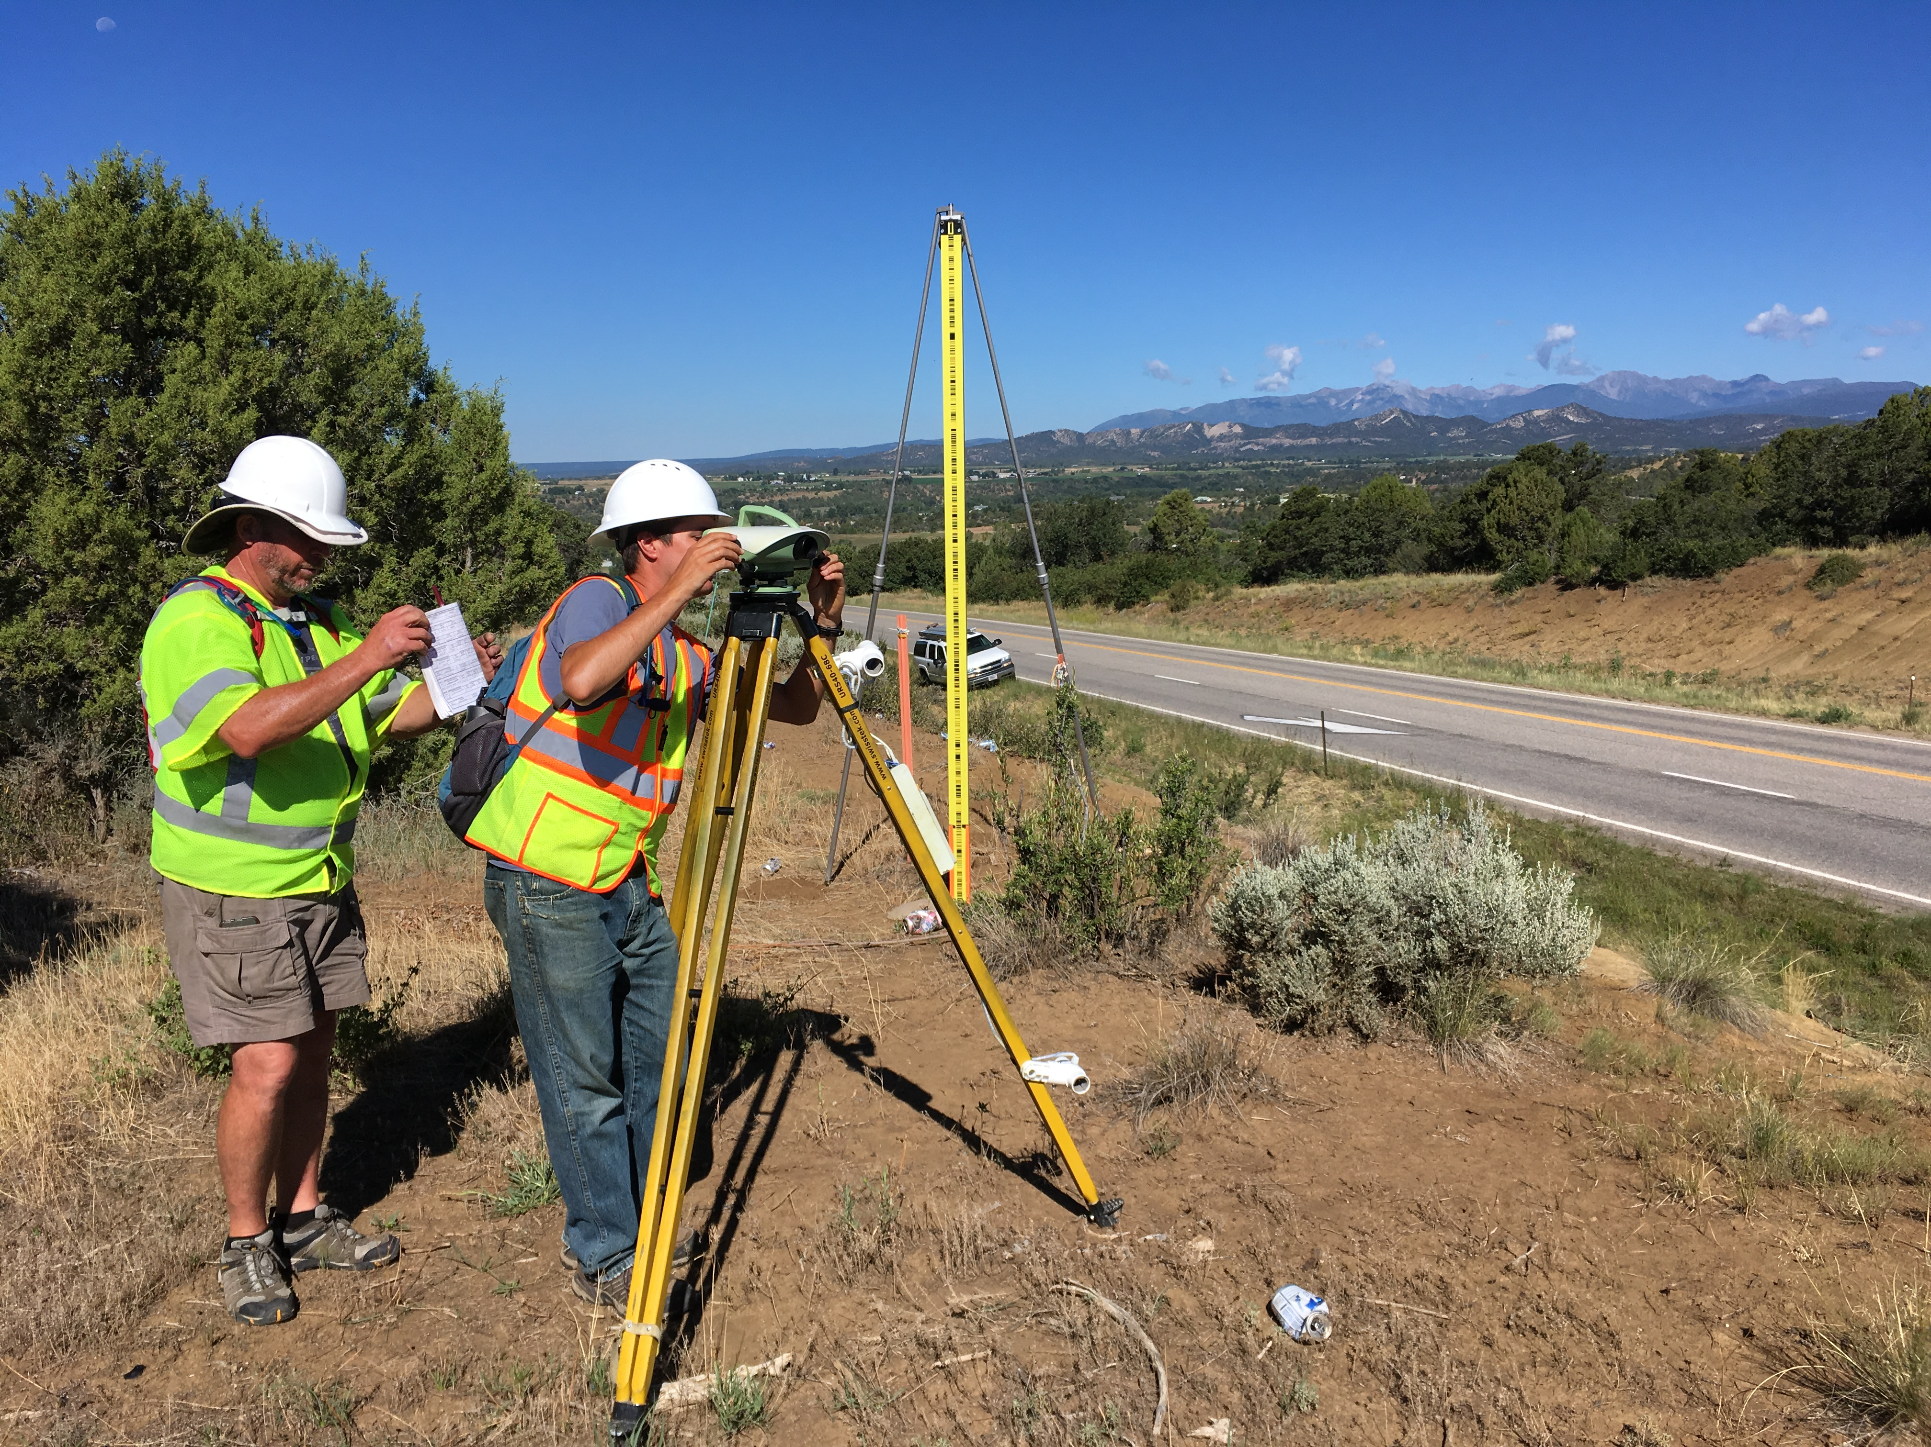
Leveling
Notes:
NAVD 88 is accessed through leveling off of marks with NAVD 88 heights on them.
Those heights were determined by leveling crews.

Slide 84
Other vertical datums
International Great Lakes Datum (more on that later)
Pre-1929 General Adjustments (1900, 1903, 1907, 1912)
River datums (Mean Gulf Level, Memphis, others)
Tidal Datums (NTDE)
Notes:
See Pearson and Mick: Legacy height datums on the Mississippi and Illinois river systems https://www.ngs.noaa.gov/PUBS_LIB/Miss_ht%20datums_ACSM_v3.pdf

Slide 85
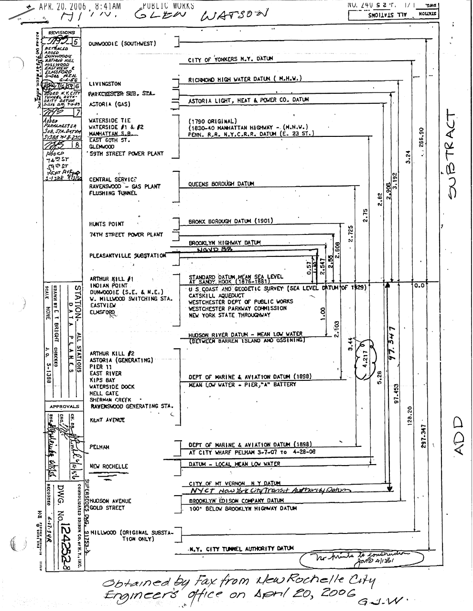
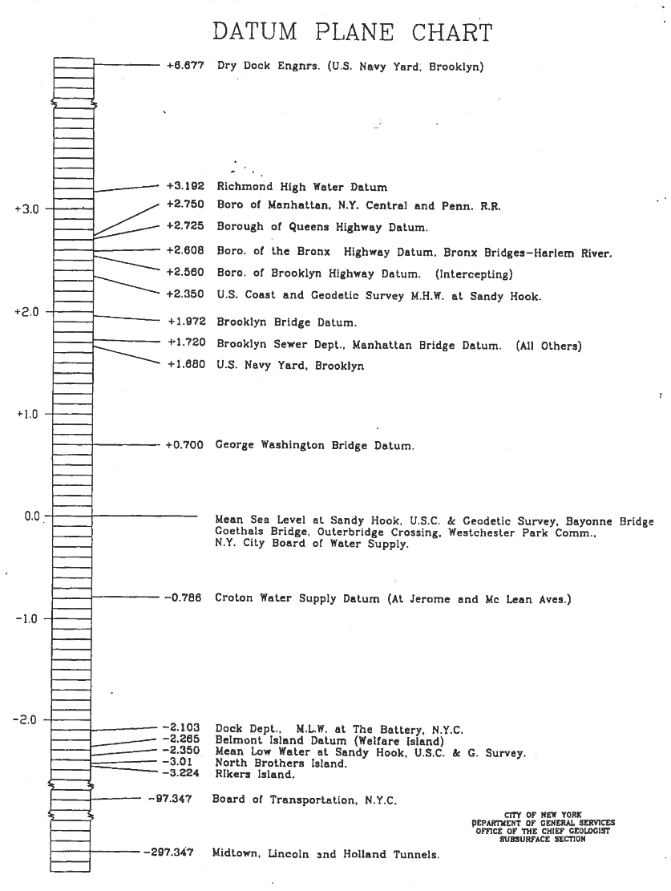

Slide 86
Draw a DATUM PROFILE
St. Paul, MN
(PBM 67)
Dresbach, MN
(PBM 182)
Elevation above datum = Depth to datum
NGVD29
NAVD88
0.046 m
0.013 m
NAVD88
NGVD29
0.098 m
0.071 m
Mean Gulf
Mean Gulf
1912
0.003 m
0.078 m
2.222 m
2.148 m
1912
Memphis
Memphis
February 9, 2018
Professional Surveyors Association of Nebraska
86
Notes:
We note that the Datums are not parallel
They do not converge/diverge uniformly
underlying undetected errors in the leveling
underlying undetected errors in the adjustment
by the choice of constraints used in the adjustments.
There is NO single “Correct” conversion between datums!

Slide 87
Types of heights summary
Height | Symbol | Equation | Example of datum
Ellipsoidal | h |  | NAD 83
Orthometric | H | H = h - N | NAPGD2022
Helmert | H | $$H=\frac{C}{\overline{g}}$$ | NAVD 88
Dynamic | $$H^{D}$$ | $$H^{D}=\frac{C}{γ_{45}}$$ | IGLD (1985)
Normal | H* | $$H^{∗}=\frac{C}{\overline{γ}}$$ | NGVD 29

Slide 88
Replacing NAVD 88
The Old:
NAVD 88
PRVD 02
VIVD09
ASVD02
NMVD03
GUVD04
IGLD 85
IGSN71
GEOID18
DEFLEC18
The New:
The North American-Pacific Geopotential Datum of 2022 (NAPGD2022)
Will include:
GEOID2022
DEFLEC2022
GRAV2022
DEM2022
More
Orthometric
Heights
Normal
Orthometric
Heights
A HUGE component of this
effort is GRAV-D:
Gravity for the Redefinition of
the American Vertical Datum
Dynamic
Heights
Gravity
Geoid
Undulations
Deflections of
the Vertical

Slide 89
Understanding “Geo-Potential”
h
The resting water has “potential” energy just by being high up on this cliff.
Energy = mgh
That potential energy can turn into real (kinetic) energy by falling.
Energy = ½ mv² (= mgh)
Think of the Earth as creating a “gravity field” that masses experience. I’ve drawn potential “field lines”
Potential = gh
Gravity x Height is “Geopotential”. This is what water “feels”.

Slide 90
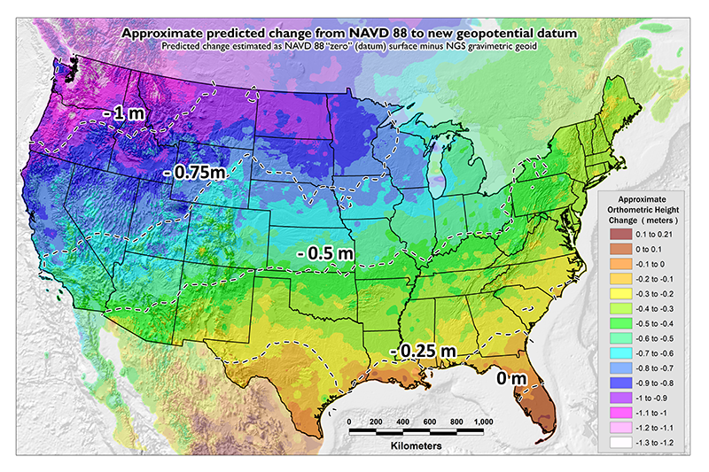
NAVD 88 (epoch ?) to NAPGD2022 Epoch 2020.00 (estimate)

Slide 91
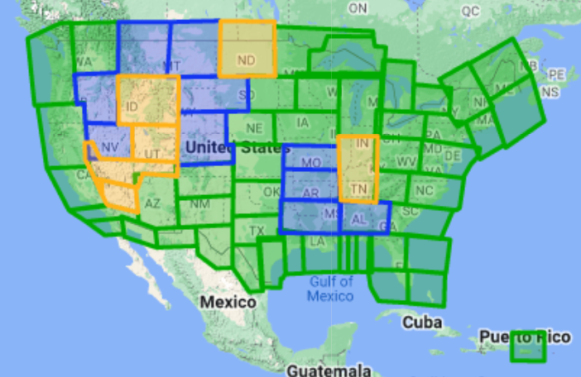
Gravity for the Redefinition of the American Vertical Datum (GRAV-D)
10 km data lines
70 km cross lines
20,000 ft altitude
230 kt flight speed
Over 96% complete
Alaska
Hawaii
American Samoa
Guam & CNMI
Notes:
96.78% complete as of 1/11/2023

Slide 92
Notes:
The geoid model looks something like this.

Slide 93
The Geoid, and Heights
h
= H
+ N
h: ellipsoidal height
H: orthometric height
N: geoid undulation
Topography
h
H
The geoid
N
A chosen
ellipsoid
Notes:
Fundamental changes to how we access the vertical datum

Slide 94
International Great Lakes Datum

Slide 95
What is IGLD?
International Great Lakes Datum (IGLD) is a common height reference system by which water levels can be measured and meaningfully related to each other
Joint effort between the United States and Canada
Maintained by the Coordinating Committee on Great Lakes Basic Hydraulic and Hydrologic Data
Due primarily to Glacial Isostatic Adjustment, IGLD is updated every 25-35 years
The next update will be IGLD (2020)

Slide 96
Current IGLD
IGLD (1985) replaced IGLD (1955) in 1992
Same reference zero as NAVD 88 (at Pointe au Père, Québec)
Surface determined by leveling
Dynamic heights
Hydraulic correctors

Slide 97
IGLD (1985) Reference Surface
Reference surface is each lake (equipotential surface) to which heights are referenced
IGLD 1955 & 1985 used 1000’s miles of geodetic leveling to indirectly define the reference surface
Very time consuming & cost prohibitive
Datum accessible only where leveling exists (benchmarks)
Susceptible to accumulation of systematic errors
Extends the reference zero inland

Slide 98
Why a new IGLD?: Glacial Isostatic Adjustment – (GIA)
Process of Glacial Isostatic Adjustment (left) and the resulting tilting of the entire Great Lakes region (right) as determined by high accuracy GPS measurements in units of mm/year. M. Craymer and C. Wisotzkey, 2021.
Entire basin is:
Uplifting in north
Subsiding in south
Overall tilting ~7 mm/year
(21cm or 0.7’ over 30 year)
Need to update IGLD
every 25-30 years

Slide 99
Dynamic height
$H^{D}=\frac{C}{γ_{45}}$
Normal gravity value, $γ$, is a constant

Slide 100
Dynamic vs. Orthometric Heights
South
Dynamic Height
North
Orthometric Height

Slide 101
Definition of IGLD (2020)
Reference Zero
$W_{0}$ = 62,636,856.00 m²/s² that the U.S. and Canada have adopted for the new geoid-based North American-Pacific Geopotential Datum of 2022 (NAPGD2022) & Canada has already adopted for the Canadian Geodetic Vertical Datum of 2013 (CGVD2013)
Realization of the Reference Surface
NAPGD2022 geoid model representing the reference zero everywhere over the Great Lakes – St. Lawrence River system, not only where leveling and bench marks exist
Reference Epoch
2020.0, the central epoch of the 7-year water level observation period of 2017–2023
Dynamic Height
IGLD (2020) will use dynamic heights derived from GNSS occupations
The dynamic height represents the difference in potential above the reference surface and is the same at all points on a level surface
Notes:
IGLD (2020) will be completely compatible with dynamic heights in CGVD2013

Slide 102
Status of IGLD Update
GNSS field campaign took place in 2022 – data processing continues
Seasonal gauging continues
Hydraulic corrector working group is investigating the need for HCs in IGLD (2020)
IGLD (2020) is planned for release about one year after the release of the NAPGD2022 vertical datum (around 2026)

Slide 103
2022 IGLD GNSS Campaign

Slide 104
Save the Date! Water Level Datum Workshop
NOAA, the Canadian Hydrographic Service (CHS), and the Coordinating Committee on Great Lakes Basic Hydraulic and Hydrologic Data would like to invite you to a virtual workshop on Tidal and Water Level Datums. Participants will have the opportunity to learn more about the datums and impacts on the coastal, navigation and shipping communities and industries.
April 5: National Tidal Datum Epoch (NTDE)
April 6: International Great Lakes Datum (IGLD) and the Low Water Datum (LWD)
The workshop will feature presentations and discussions from NOAA’s Center for Operational Oceanographic Products and Services, the National Geodetic Survey, and the Office of Coast Survey, as well as U.S. Army Corps of Engineers, CHS, Natural Resources Canada, Environment and Climate Change Canada, and others.

Slide 105
Consistent nationwide reference frame The Modernized NSRS
Revolutionize professional surveying
No more need for installing and locating bench marks
Absolute, consistent positioning autonomously, anywhere
Vastly improved flood plain mapping
Water flows due to differences in gravity
Critically important in low-lying, flat communities
Fundamental support for new technologies
“Smart Highways” for autonomous vehicles
Consistent nationwide reference frame
Support precision agriculture
Absolute, consistent positioning autonomously, anywhere for efficiency
Impacts on infrastructure
Any application requiring precise positioning -- bridges, tunnels, railways, navigation -- will be easier and more accurate

Slide 106
Deprecation of the US Survey Foot
U.S. survey foot was deprecated on December 31, 2022
But use can continue for SPCS 83 (and SPCS 27)
The 40 states that “officially” use U.S. foot for SPCS 83
All SPCS 27 zones
NGS will support such “legacy” use forever
But NOT supported for ANY zones in SPCS2022
NGS will always support U.S. survey foot for SPCS 83 and 27

Slide 107
NSRS Modernization: Delay
Will names change?
No, “GEOID2022”, “NATRF2022”, etc. will remain the same
NGS anticipates the release of all data, and limited tools, by the middle of 2025.
Some of this may depend on things outside of NGS control (we have already delayed beyond 2022!)
Work on additional tools will continue in the out-years

Slide 108
Save the Date! NGS day at FIG 2023
NGS will present a full day’s worth of content at the 2023 FIG Working Week in Orlando, FL on May 31, 2023
https://geodesy.noaa.gov/datums/newdatums/fig-2023.shtml
https://fig.net/fig2023/

Slide 109
Thank You!
Jacob M. Heck, Ph.D., P.S.
Great Lakes Regional Geodetic Advisor (WI, MI, IN, IL)
U.S. National Geodetic Survey, NOAA
jacob.heck@noaa.gov
c/o NOAA Great Lakes Environmental Research Laboratory
4840 S. State Road
Ann Arbor, MI 48108
For more information, visit https://geodesy.noaa.gov

