Slide 1

Changes are coming
NGS 2022 - NSRS Modernization
Pam Fromhertz
Rocky Mountain Regional Advisor
Pamela.Fromhertz@noaa.gov
240-988-6363
Geodesy.noaa.gov
Mark Corbridge
WY NGS Geodetic Coordinator
WYNGScoordinator@gmail.com
(307) 777-4123
WES
February 6, 2019
geodesy.noaa.gov

Slide 2
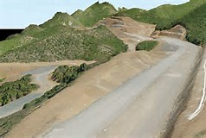
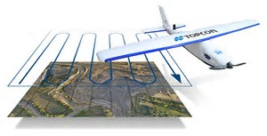
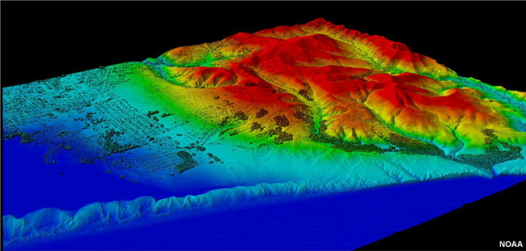
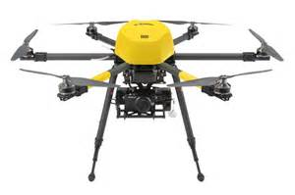

LiDAR, UAV, GPS Data

Slide 3
Agenda
WY Geodetic Coordinator and Working Group
NSRS Modernization
SPCS2022
  Changes are coming – what do you want for WY
Geoid18
GPS on BM
  Phase II
Geospatial Summit

Slide 4
Wyoming Coordinator Working Group
* Mark Corbridge, Geodetic Coordinator, WYDOT/PLSW
Karen Rogers, WGFD/WyGEO
Chad Kopplin, DEQ/TAG
Rich Greenwood, Greenwood Mapping/WyGEO
Wally Gladstone, Tribal
Paddington Hodza, WYGISC
Local Government
Technical Advisors – Mike Londe, Herb Stoughton, Mary Wilson
Pam Fromhertz, National Geodetic Survey (NGS)
WYngsCoordinator@gmail.com
wygeo.org

Slide 5
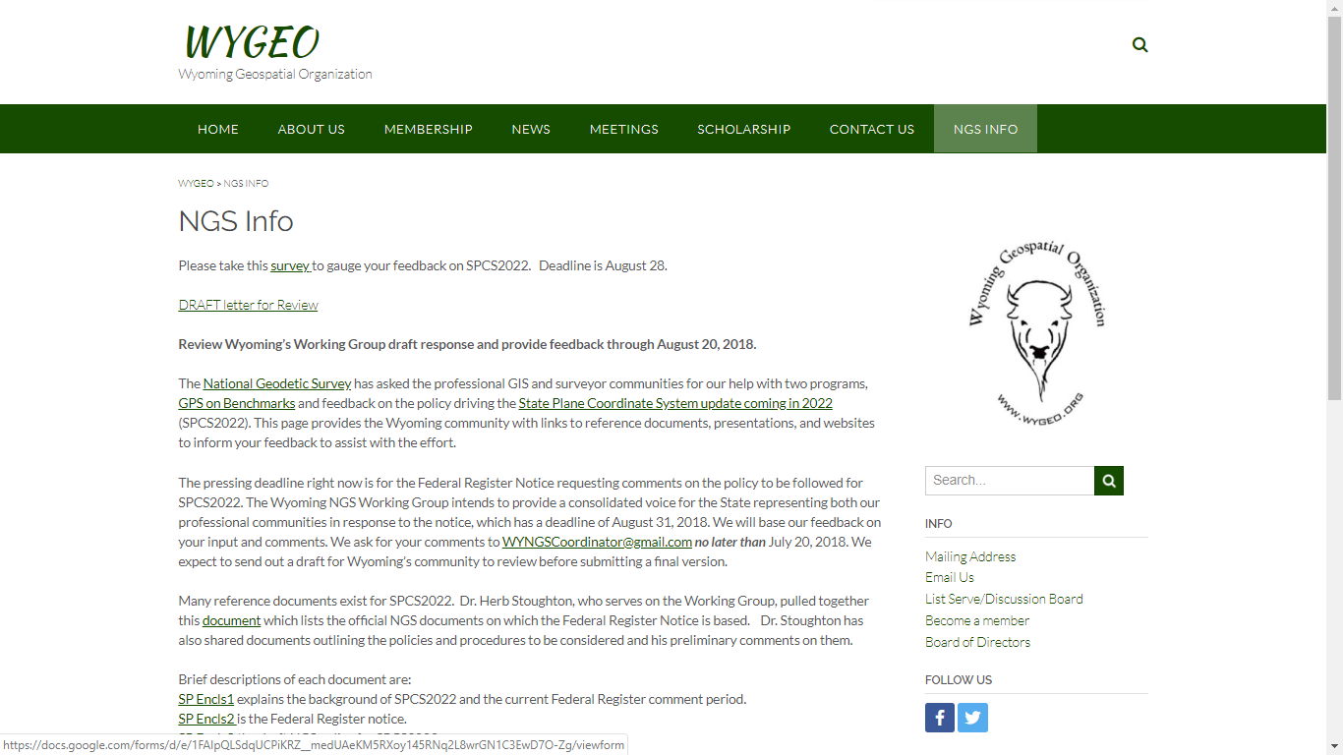

Slide 6
NSRS Modernization
Who and What
The National Geodetic Survey, the federal agency responsible for establishing and maintain the positioning framework to support all federal civilian mapping and charting in the United States, is modernizing the National Spatial Reference System (NSRS).
What does this mean?
  All horizontal and vertical datums in the NSRS (NAD 83, NAVD 88, etc.) will be updated with:
    Four (4) new Terrestrial Reference Frames of 2022
    North American-Pacific Geopotential Datum of 2022
  New tools, products, services, and methodologies will be developed jointly to support the transition and access to an improved, modernized NSRS.

Slide 7
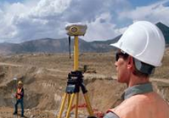



What life will be like in the future
Revolutionize professional surveying
No more need for installing and locating bench marks
Absolute, consistent positioning autonomously, anywhere
Impacts on infrastructure
Any application requiring precise positioning -- bridges, tunnels, railways, agriculture, navigation -- will be easier and more accurate
Vastly improved flood plain mapping
Water flows due to differences in gravity
Critically important in low-lying, flat communities
Fundamental support for new technologies
“Smart Highways” for autonomous vehicles

Slide 8
All coordinates and heights
will change!
In Wyoming by
4 feet horizontally and
-2 to 3 feet vertically

Slide 9
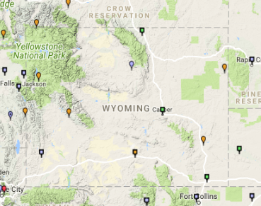
WY Continuously Operating Reference Stations (CORS)

Slide 10
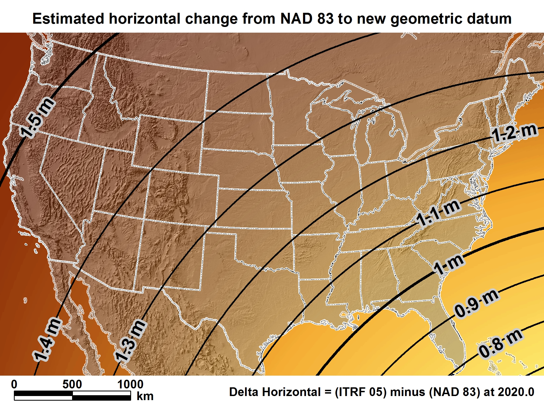
New geometric datum minus NAD 83 (horizontal)

Slide 11
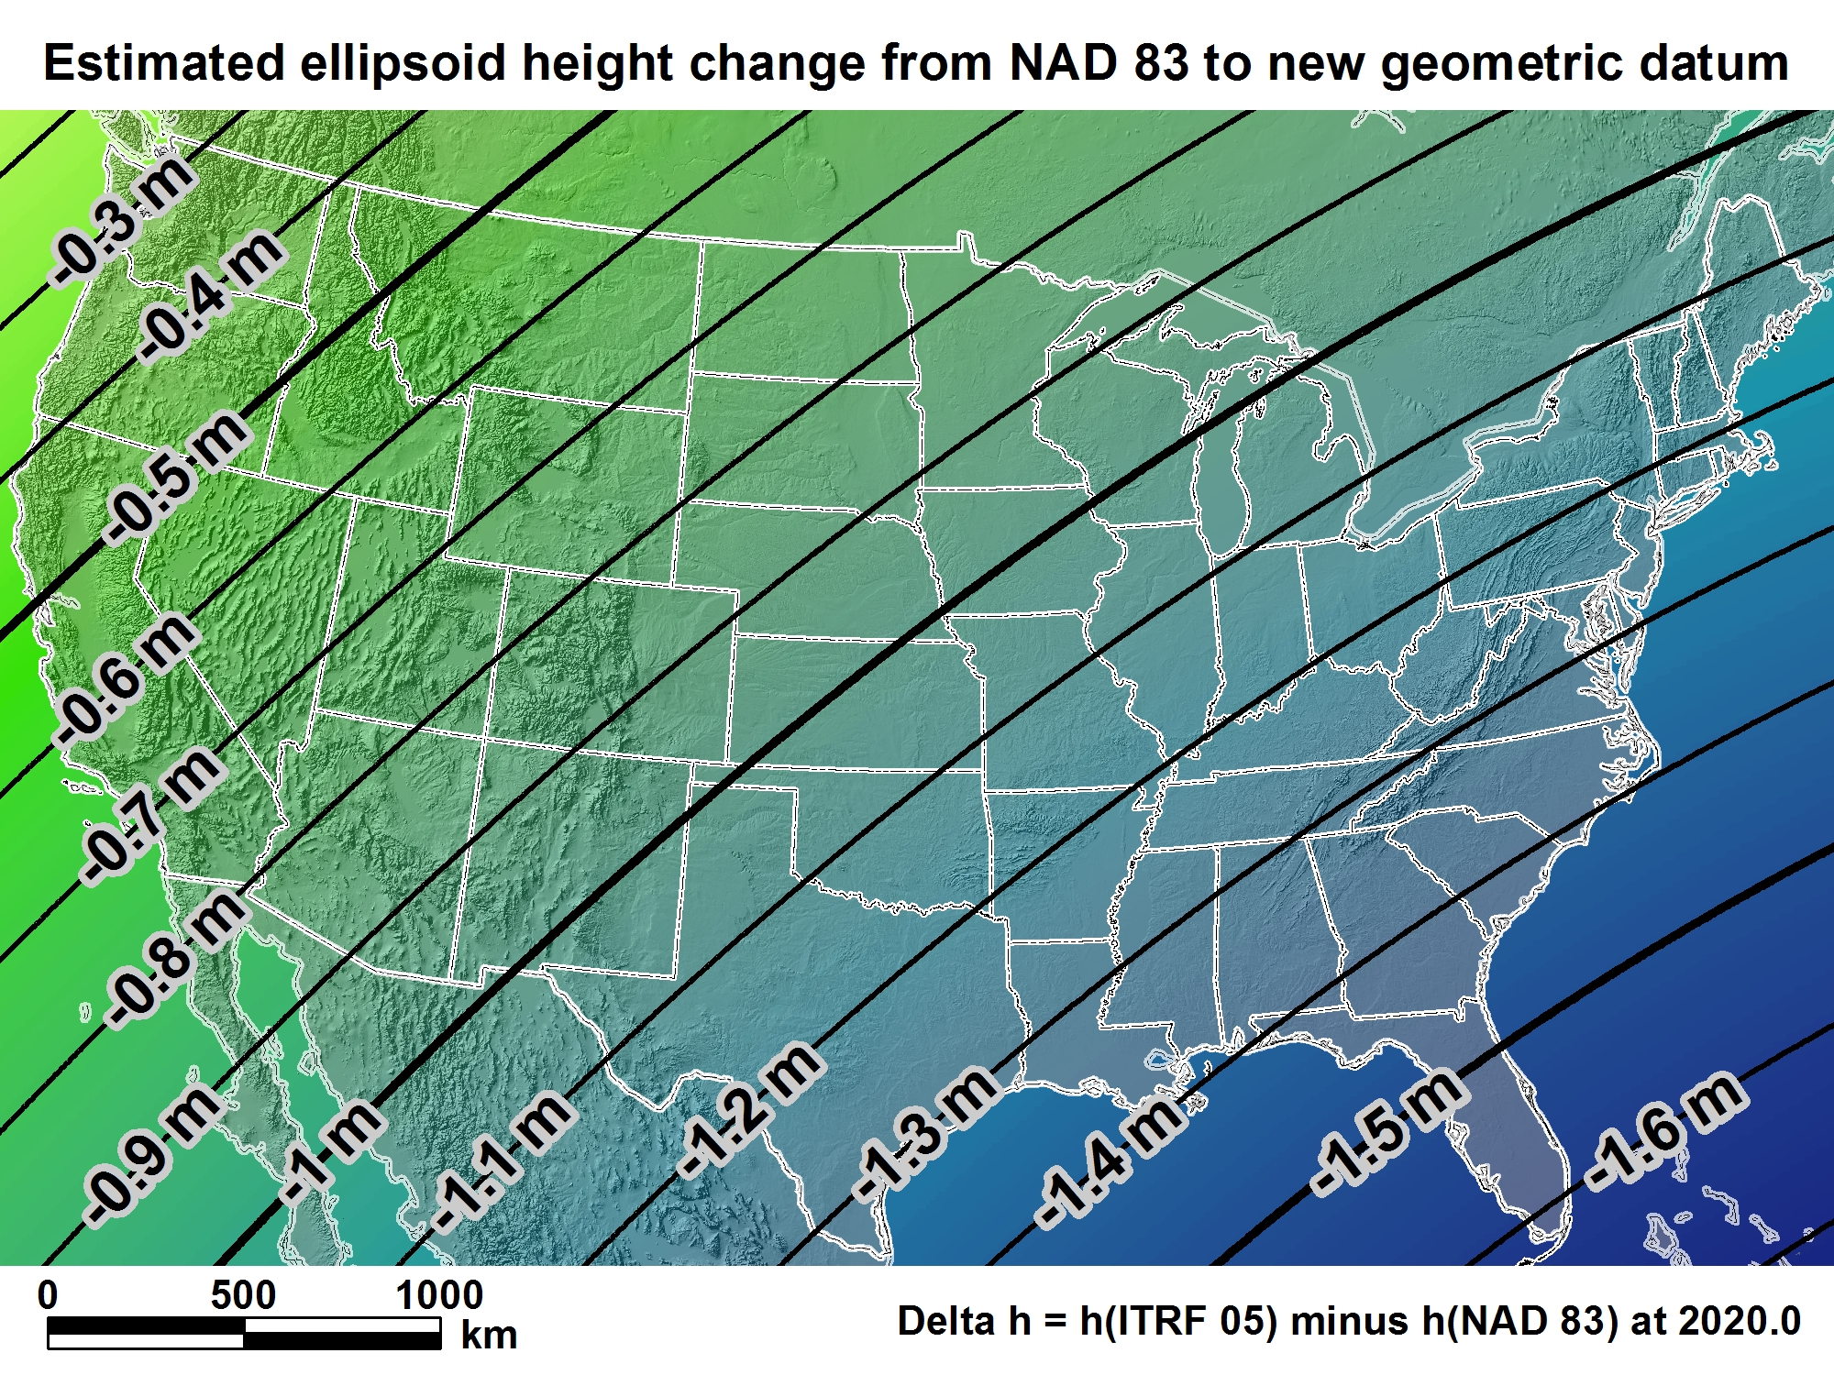
New geometric datum minus NAD 83
(ellipsoid height)

Slide 12
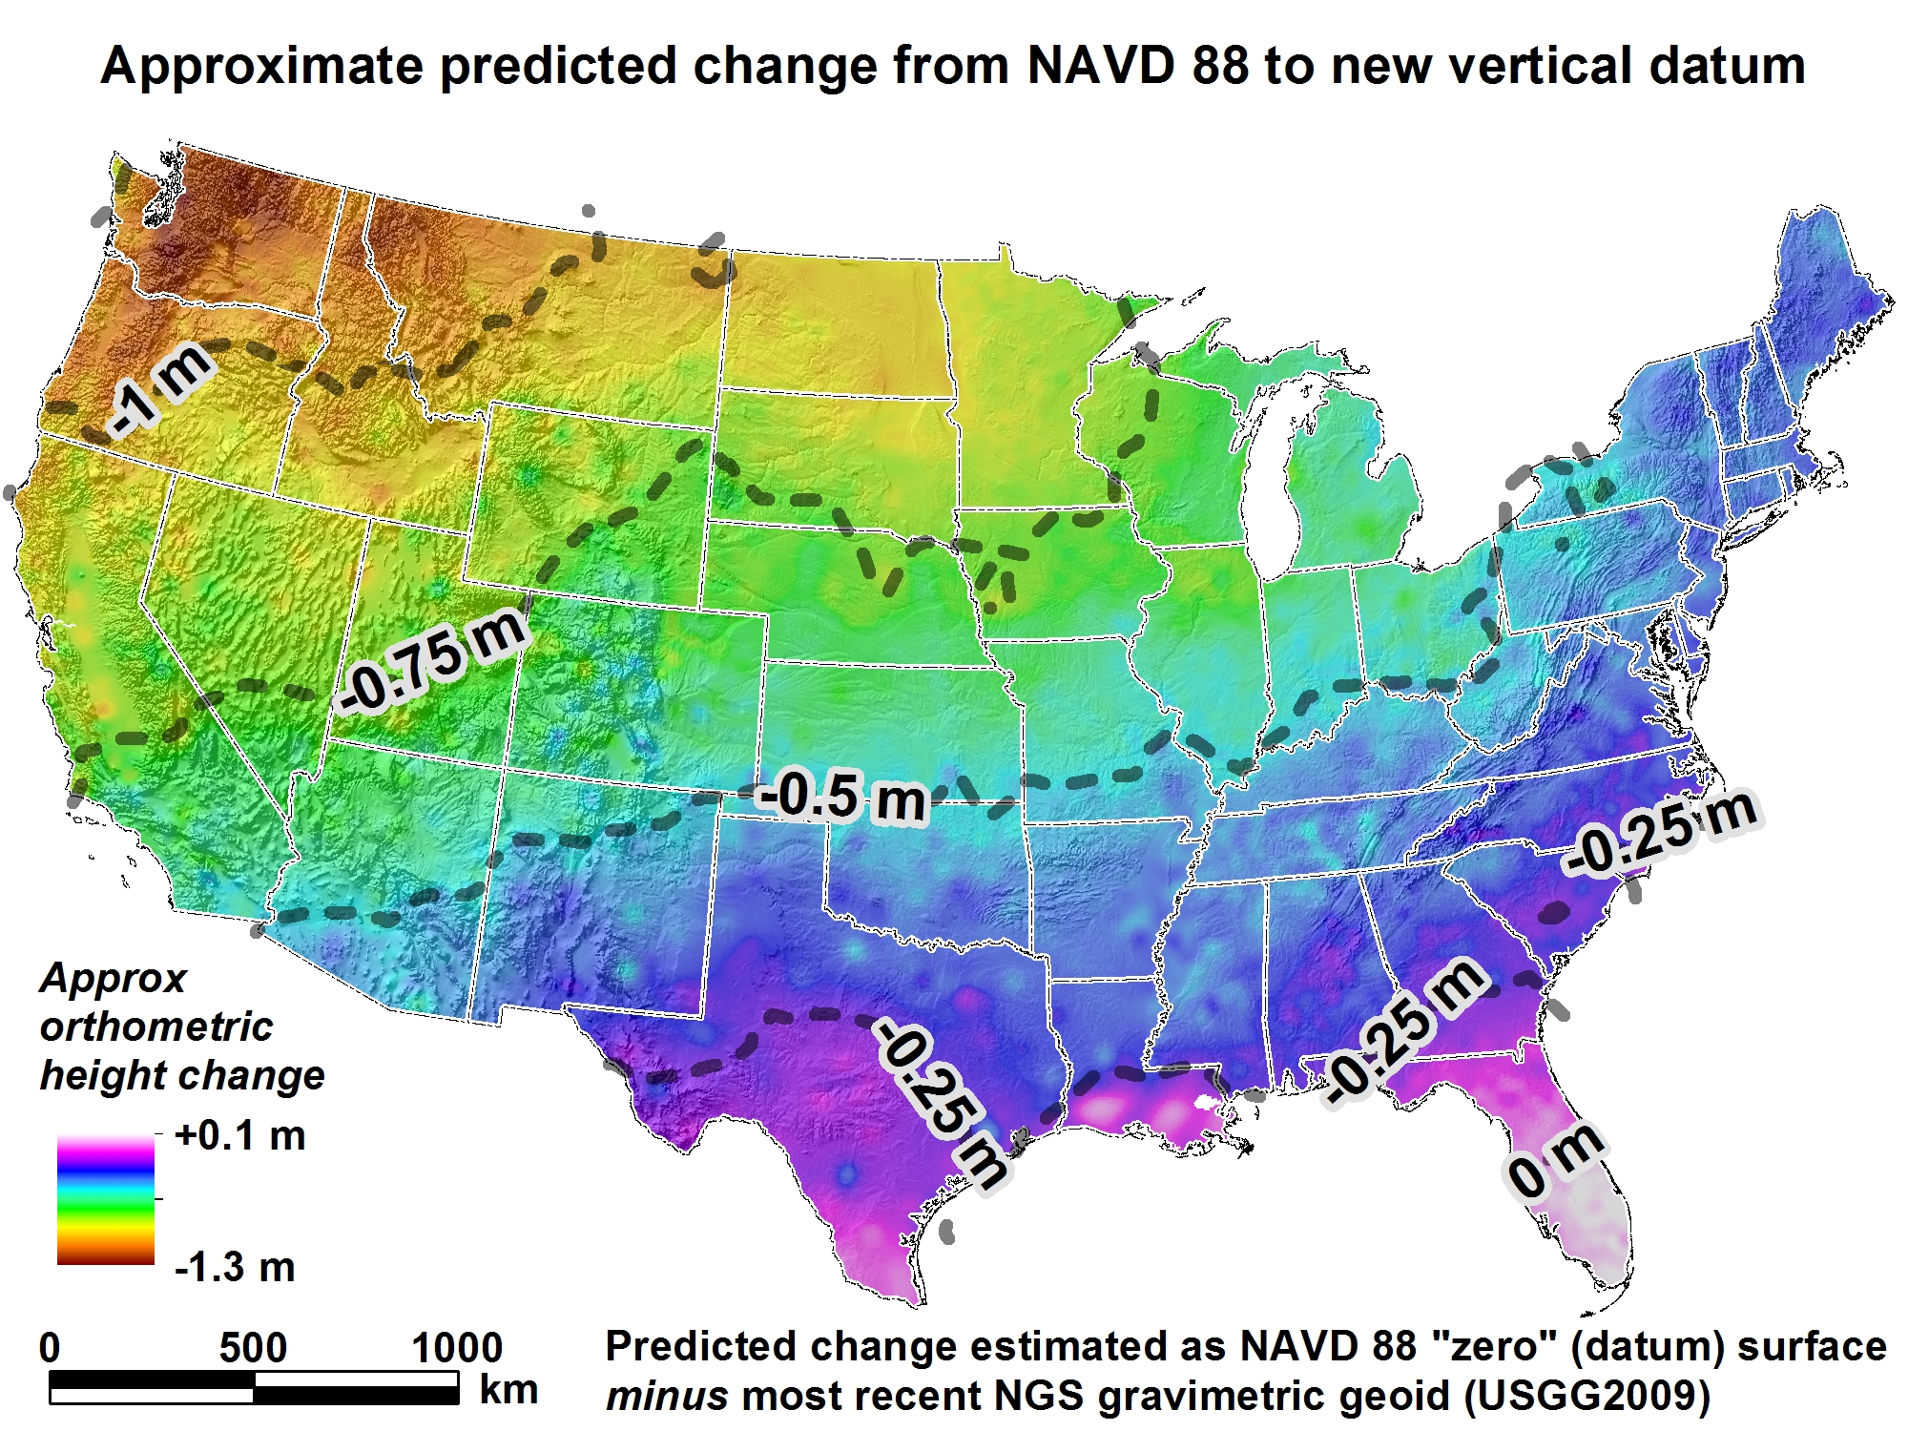
New Vertical Datum
(Outcome)

Slide 13
Predicted Positional Changes in 2022
Computed for Q 32(NR0035) near Casper, WY
HORIZONTAL = 1.2401 m (4.07 ft)
ELLIPSOID HEIGHT = - 0.77 m (-2.53 ft)
Computed with HTDP and Inverse
ORTHOMETRIC HEIGHT = - 0.706 m (-2.32 ft)
Computed with xGEOID16B
Notes:
NAD 83(2011) POSITION- 42 55 33.76190(N) 106 19 58.11320(W) ADJUSTED
NAD 83(2011) ELLIP HT- 1615.234 (meters) (06/27/12) ADJUSTED
NAD 83(2011) EPOCH - 2010.00
NAVD 88 ORTHO HEIGHT - 1628.602 (meters) 5343.17 (feet) ADJUSTED
NR0035

Slide 14
New Reference (Datums) Frames
Horizontal
Vertical
Geometric
  Latitude
  Longitude
  Ellipsoidal Height
  Euler Rotation and angle
  Intra-frame Velocity Models
Geopotential
  Geoid Model
Time Dependent Coordinates on a fixed Plate

Slide 15
NSRS Modernization News
Four Terrestrial Reference Frames
North American Terrestrial Reference Frame of 2022 (NATRF2022)
Pacific Terrestrial Reference Frame of 2022 (PATRF2022)
Mariana Terrestrial Reference Frame of 2022 (MATRF2022)
Caribbean Terrestrial Reference Frame of 2022 (CATRF2022)
Geopotential Datum for Heights and other Physical Coordinates
North American-Pacific Geopotential Datum of 2022 (NAPGD2022)
Geoid Model (time-dependent, provided in three regions)
GEOID2022
Notes:
Four Terrestrial Reference Frames
Replacing the three existing NAD 83 reference frames will be four plate-fixed terrestrial reference frames. The tectonic plate for each frame may be inferred from their names.
Geopotential datum
A geopotential datum will be created which will contain all of the information necessary to provide mutually consistent orthometric heights, geoid undulations, gravity anomalies, deflections of the vertical and all other geodetic coordinates related to the gravity field.
Geoid model
Within NAPGD2022, a variety of products will exist. The most prominent will be a time dependent model of the geoid, provided in three regions (the first covering the entirety of North and Central America, Hawaii, Alaska, Greenland and the Caribbean, the second covering American Samoa and the third covering Guam and the Commonwealth of the Mariana Islands).

Slide 16

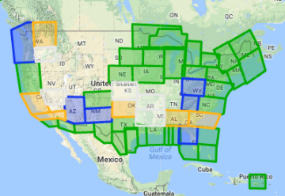
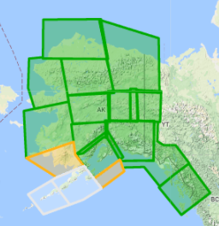
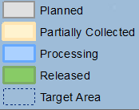
Gravity for the Redefinition of the
American Vertical Datum (GRAV-D)
https://www.geodesy.noaa.gov/GRAV-D/
Notes:
Pictured: Airborne gravity survey grid and the current status of GRAV-D, with more than 45 percent of the U.S. and its territories covered and GRAV-D airborne data collected.
In 2010, began operational collection of airborne gravity data to calculate a geoid model and ultimately a new vertical reference system for accurate height measurements up to 2 cm in the U.S. and territories.
Provides highly accurate height measurements to determine where water flows
Connects satellite and terrestrial gravity measurements for efficient and accurate gravity monitoring
Benefits include $240 Million from improved floodplain mapping alone

Slide 17
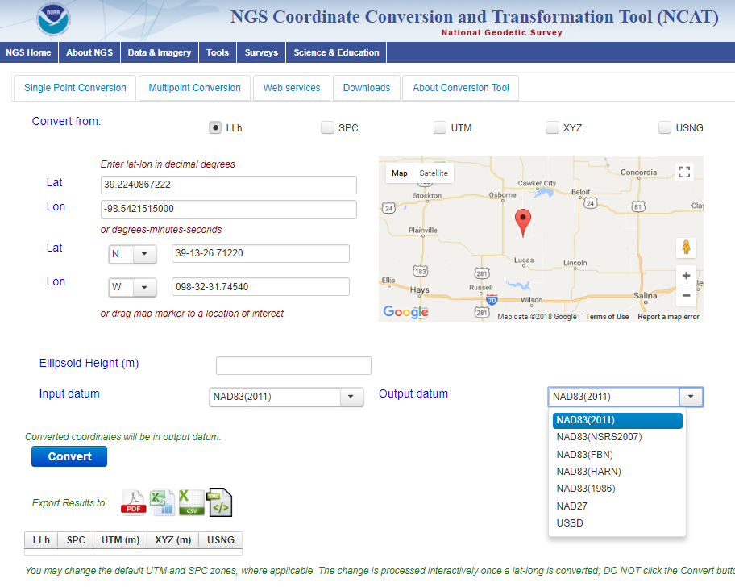
NCAT
NGS Coordinate Conversion and Transformation Tool
Notes:
We also have a new tool available to convert between various coordinate systems using various projects.

Slide 18
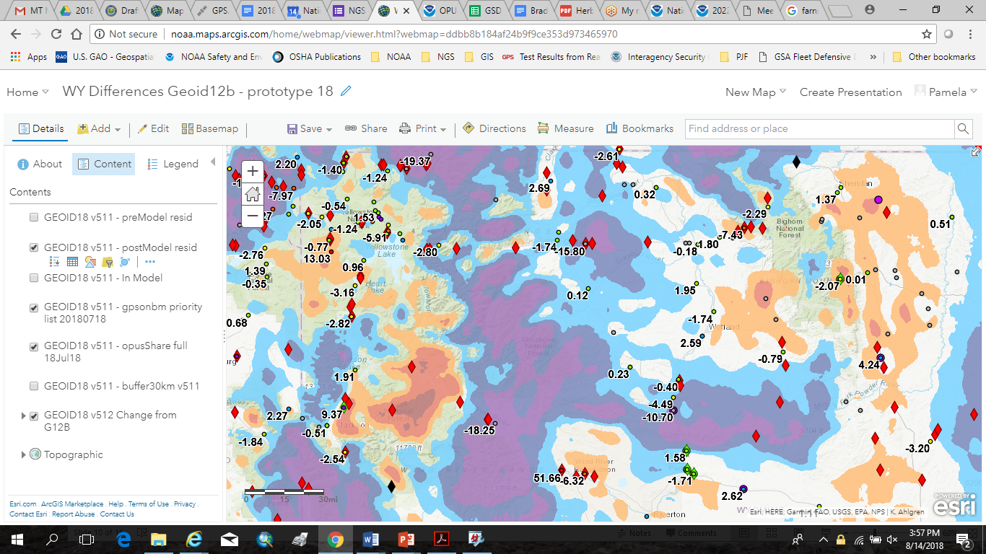
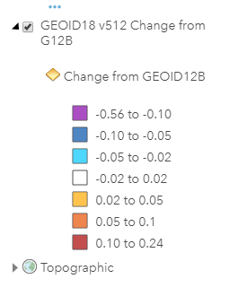

Slide 19
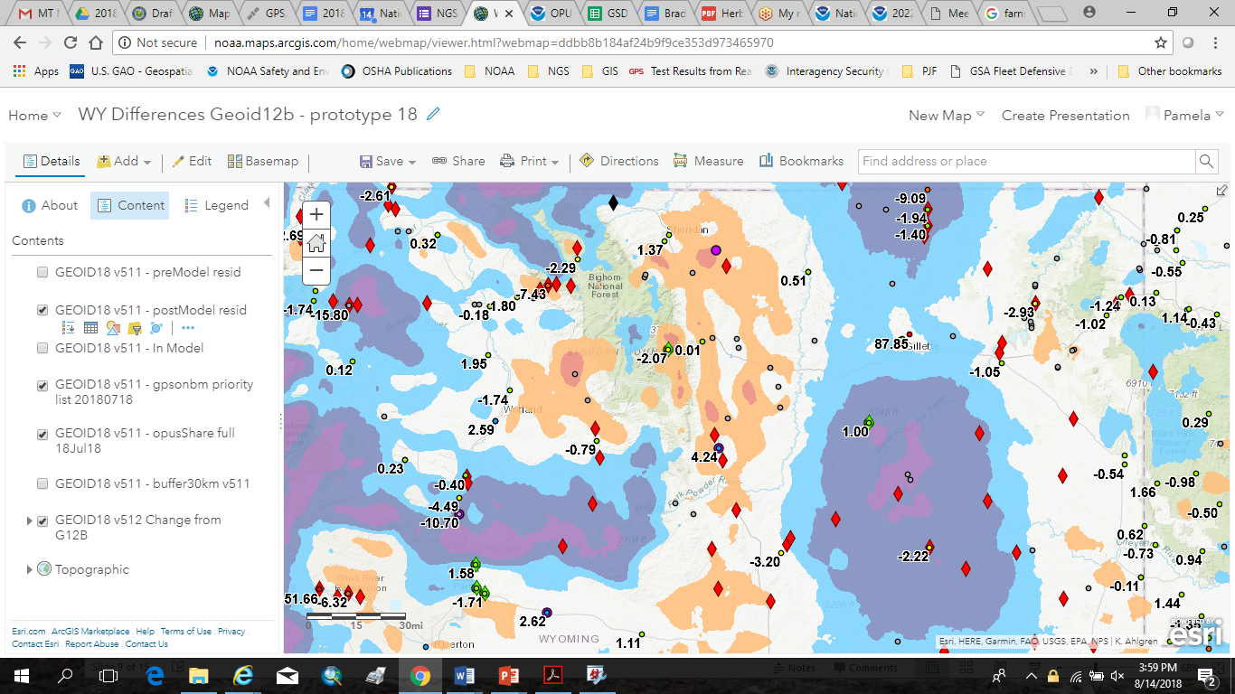

Slide 20
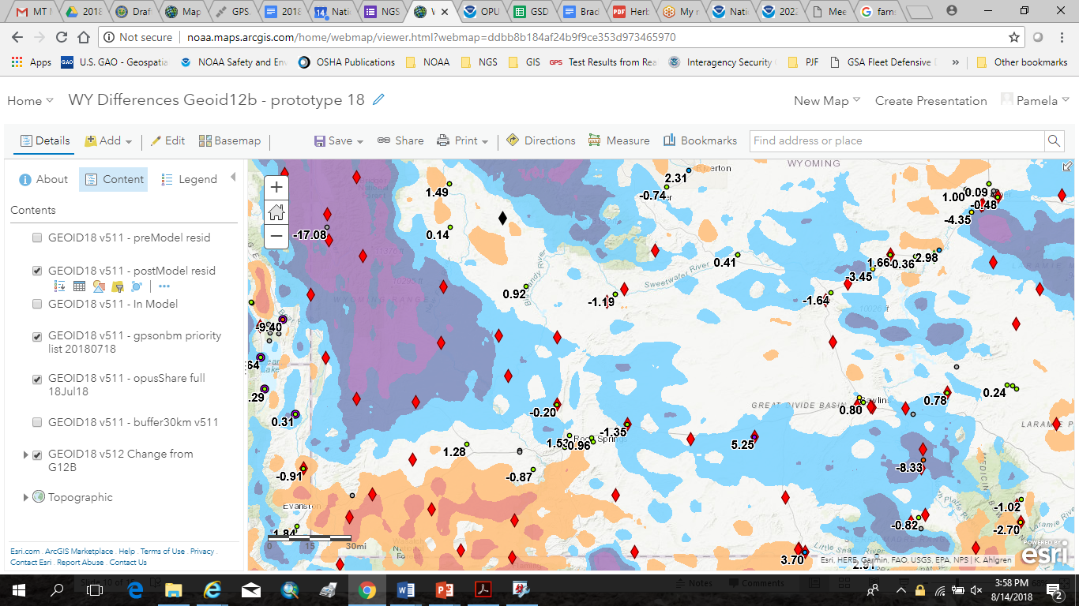

Slide 21
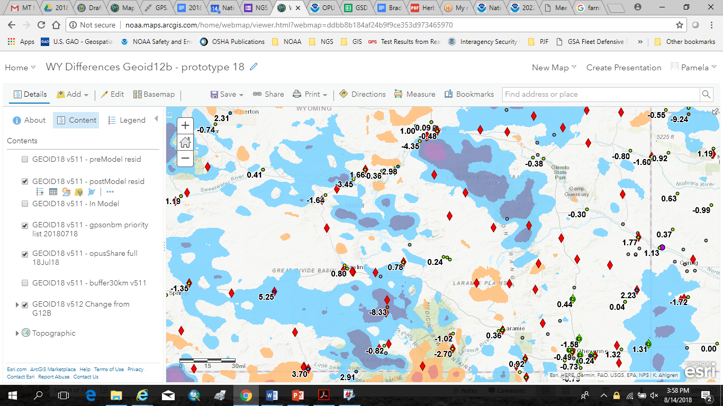

Slide 22
State Plane Coordinates 2022
Assist NGS in developing a new State Plane Coordinate System for the future.
Input received on draft SPCS2022 policy and procedure
Documents
  Draft SPCS2022 Policy
  DRAFT SPCS2022 Procedures
  NOAA Special Publication NOS NGS13
Webinar – March 8, April 12, 2018, Jan 10, 2019, March 7, 2019

Slide 23
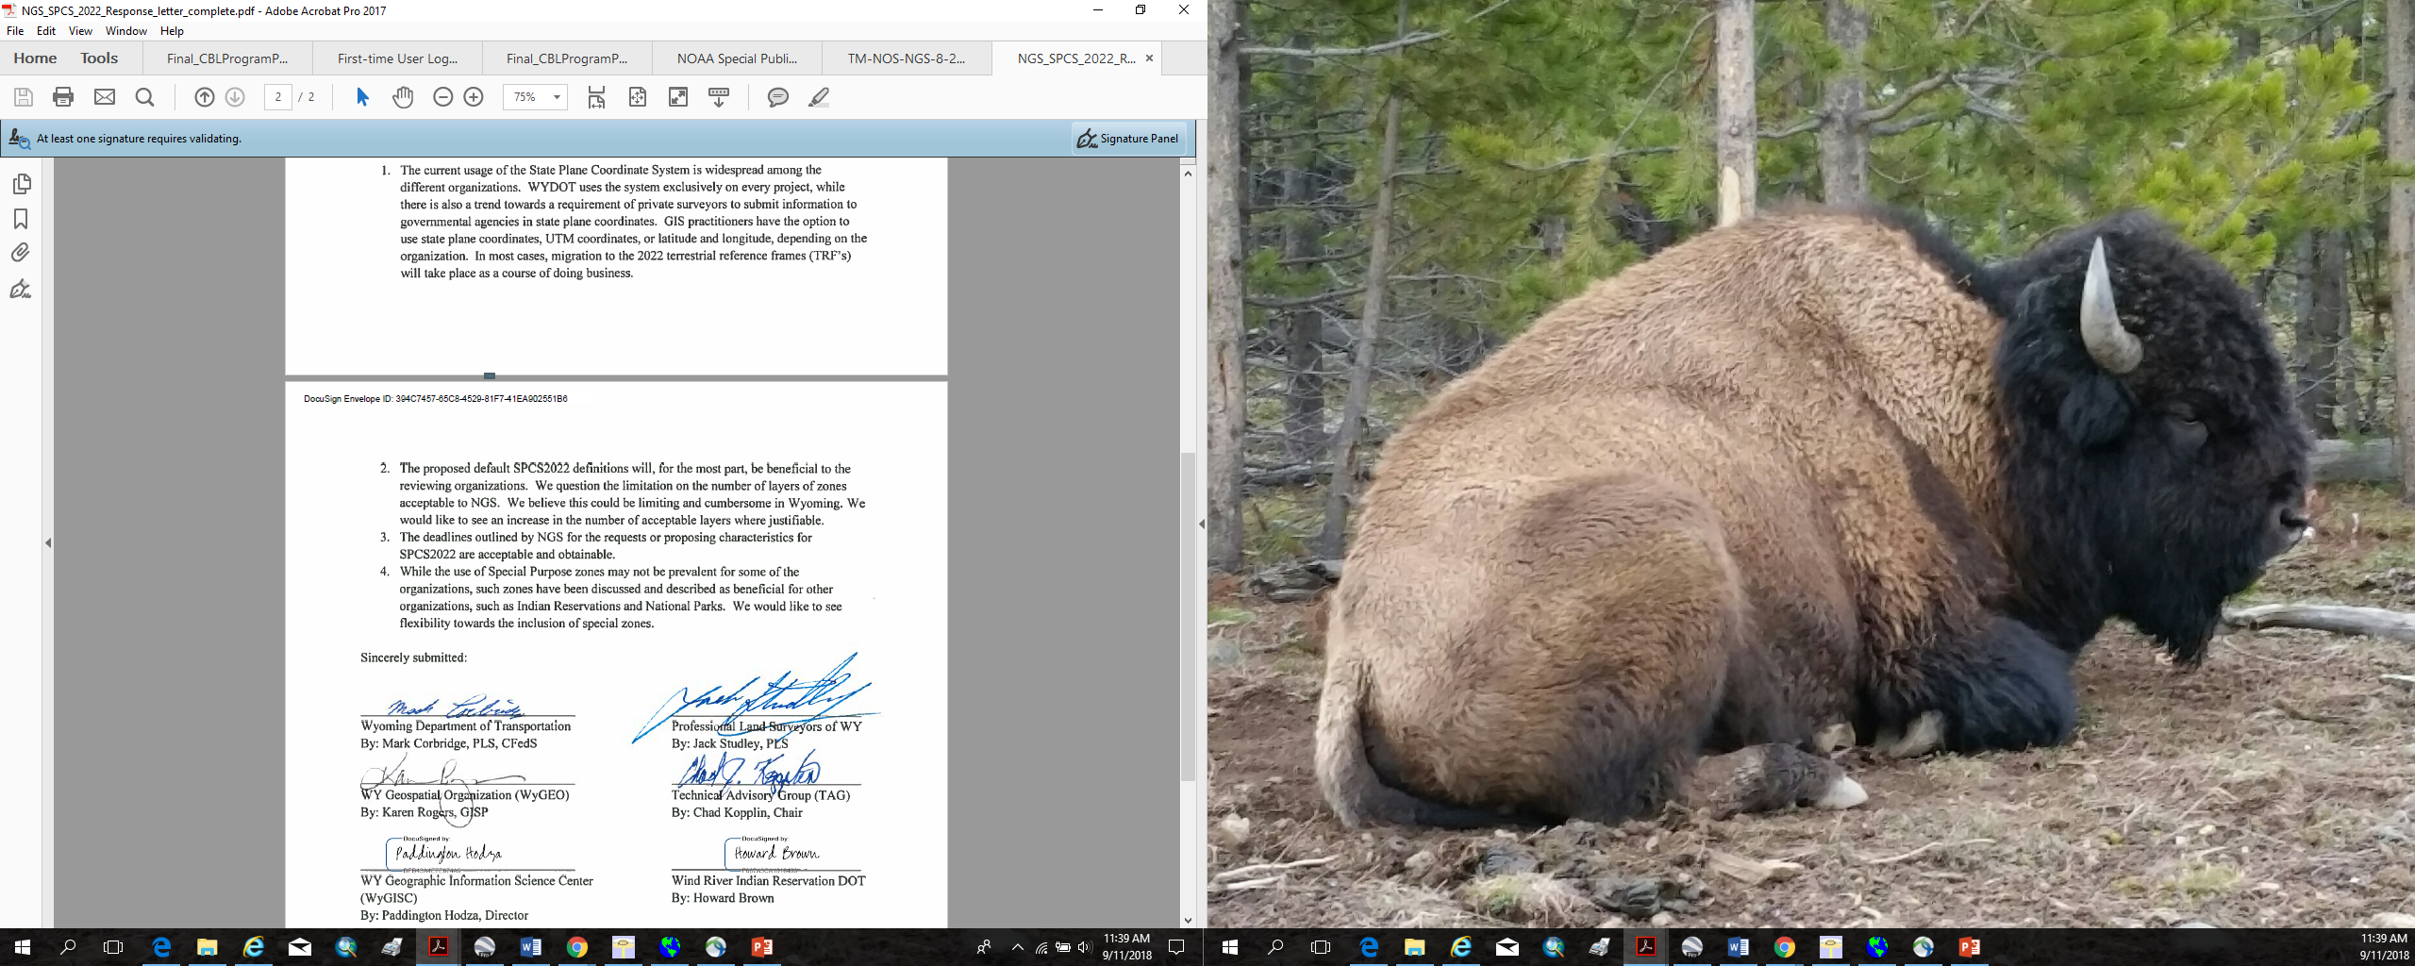
Letter submitted to NGS under Federal Register Notice
Many thanks to Dr. Stoughton for his thorough analysis

Slide 24
Letter submitted to NGS under Federal Register Notice

Slide 25
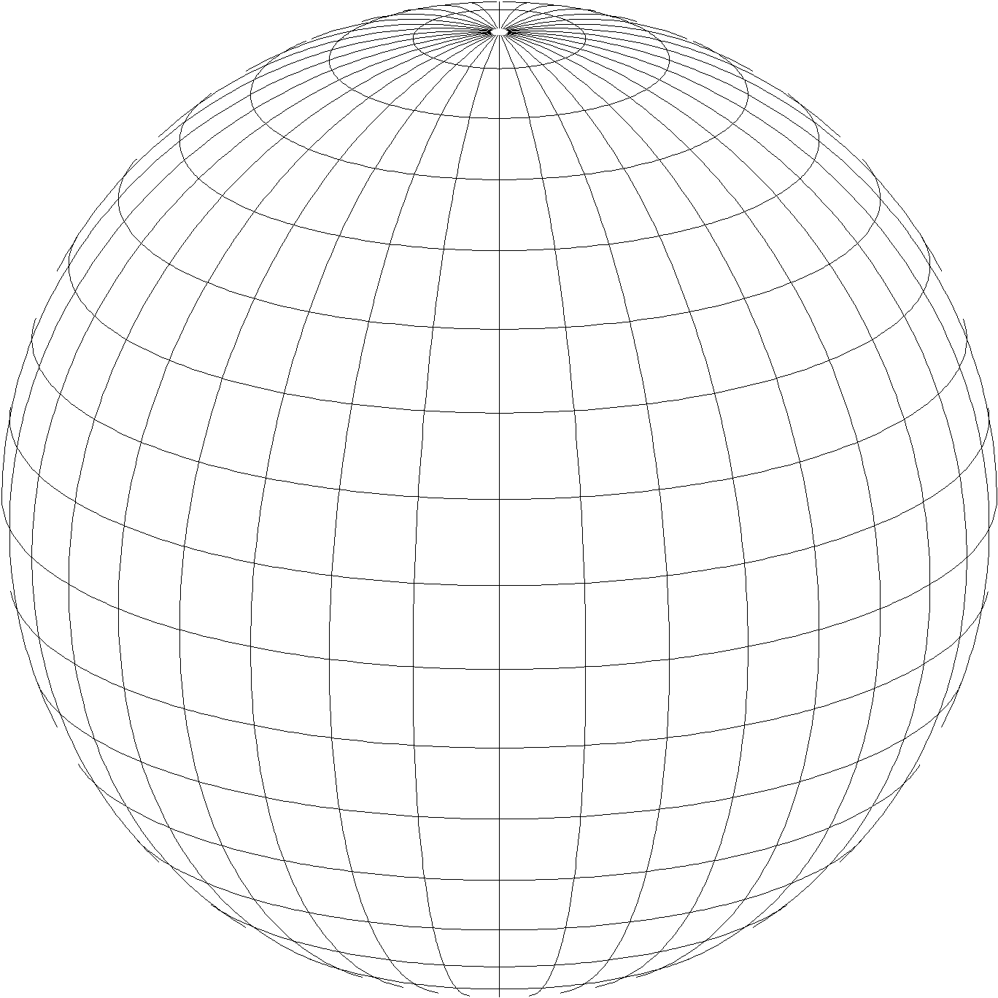
A New State Plane Coordinate System
State Plane Coordinate System of 2022 (SPCS202)
  Referenced to new 2022 Terrestrial Reference Frames (TRFs)
  Based on same reference ellipsoid (GRS 80)
  Same 3 conformal projection types:
Lambert conformal conic
Transverse Mercator
Oblique Mercator

Slide 26
SPCS2022 project moving forward!
Main differences with existing State Plane:
  Design to minimize distortion at topographic surface
  Switch to one-parallel Lambert
  Use of default SPCS2022 definitions
  “Layered” and “special purpose” zones
  Allowance for low distortion projections
Need for effective communication, outreach, and response
Goal: Work with customers to define practical SPCS2022 that best meets their needs for the NSRS of the future

Slide 27
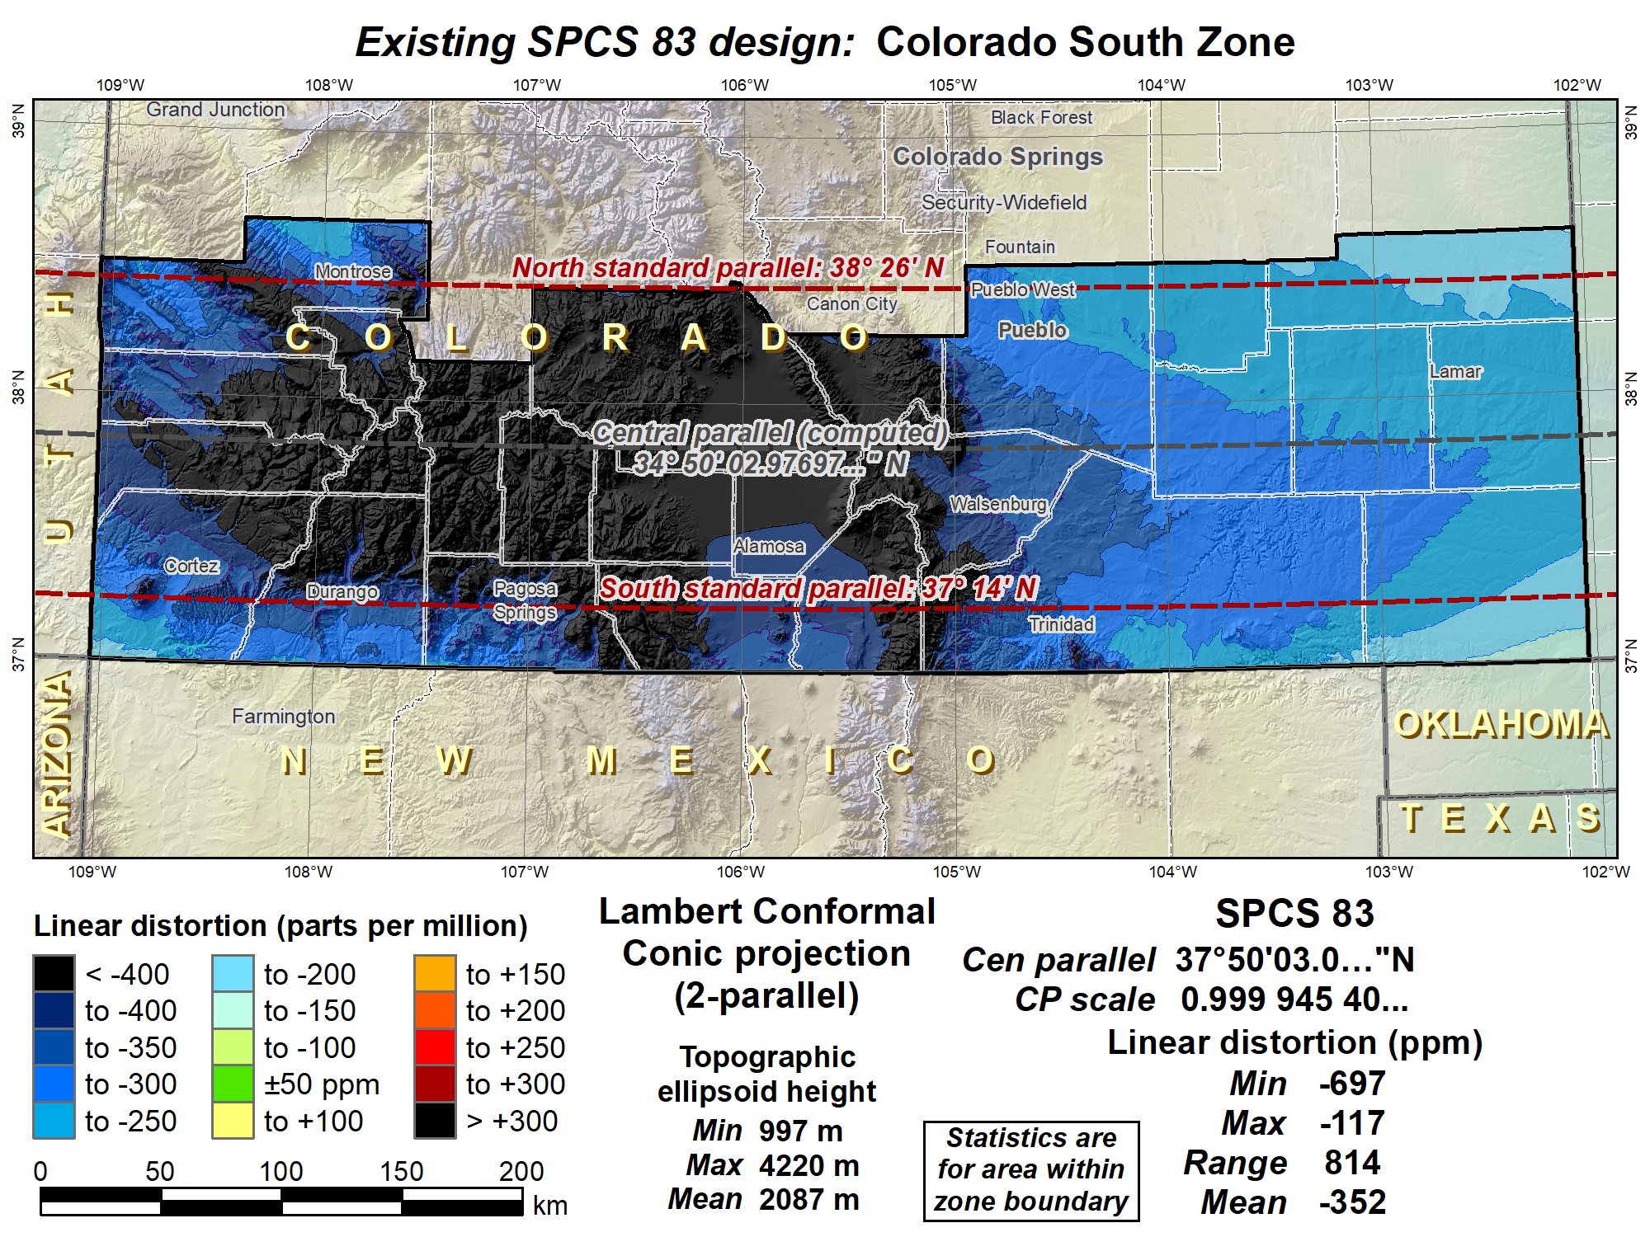

Slide 28
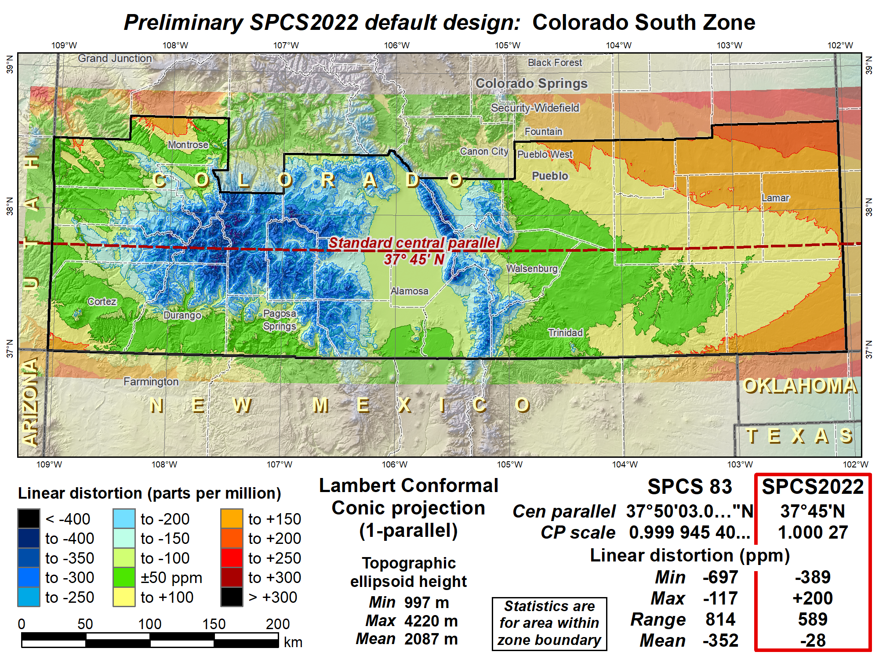
Shifted central parallel south to reduce distortion range, decreased scale to reduce distortion in cities.

Slide 29
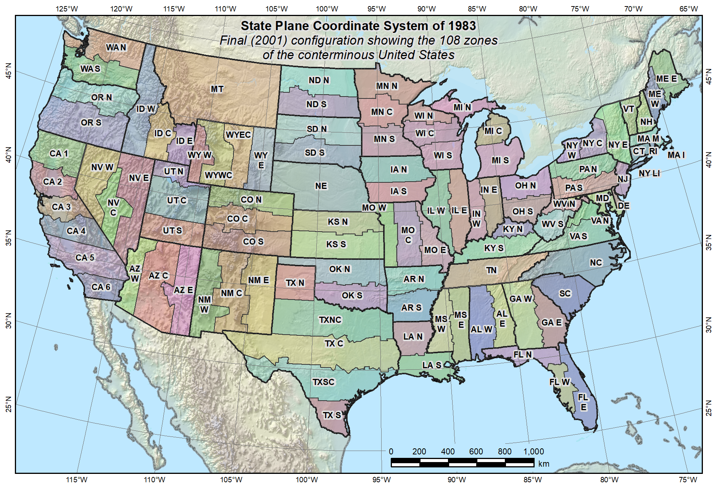
Default SPCS2022 would look a lot like SPCS 83…

Slide 30
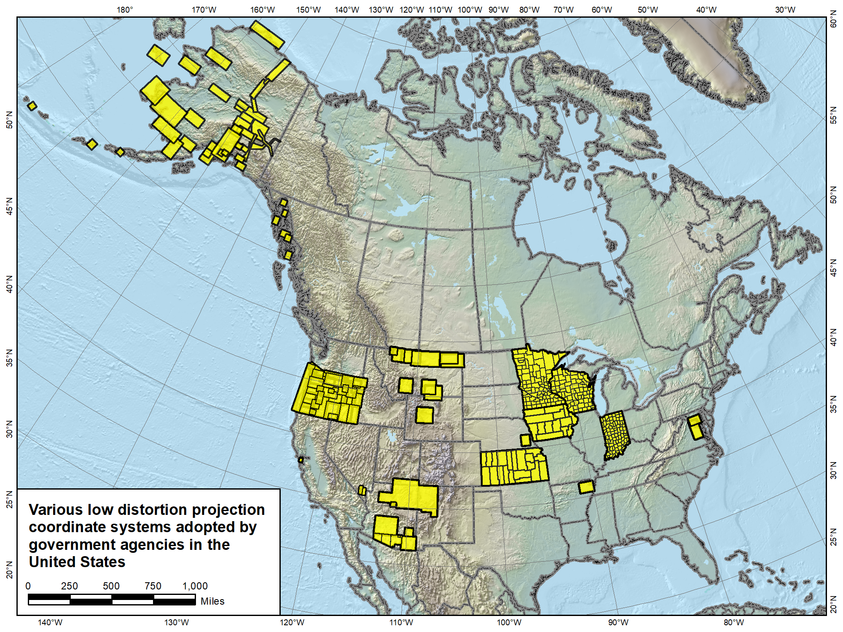

Slide 31
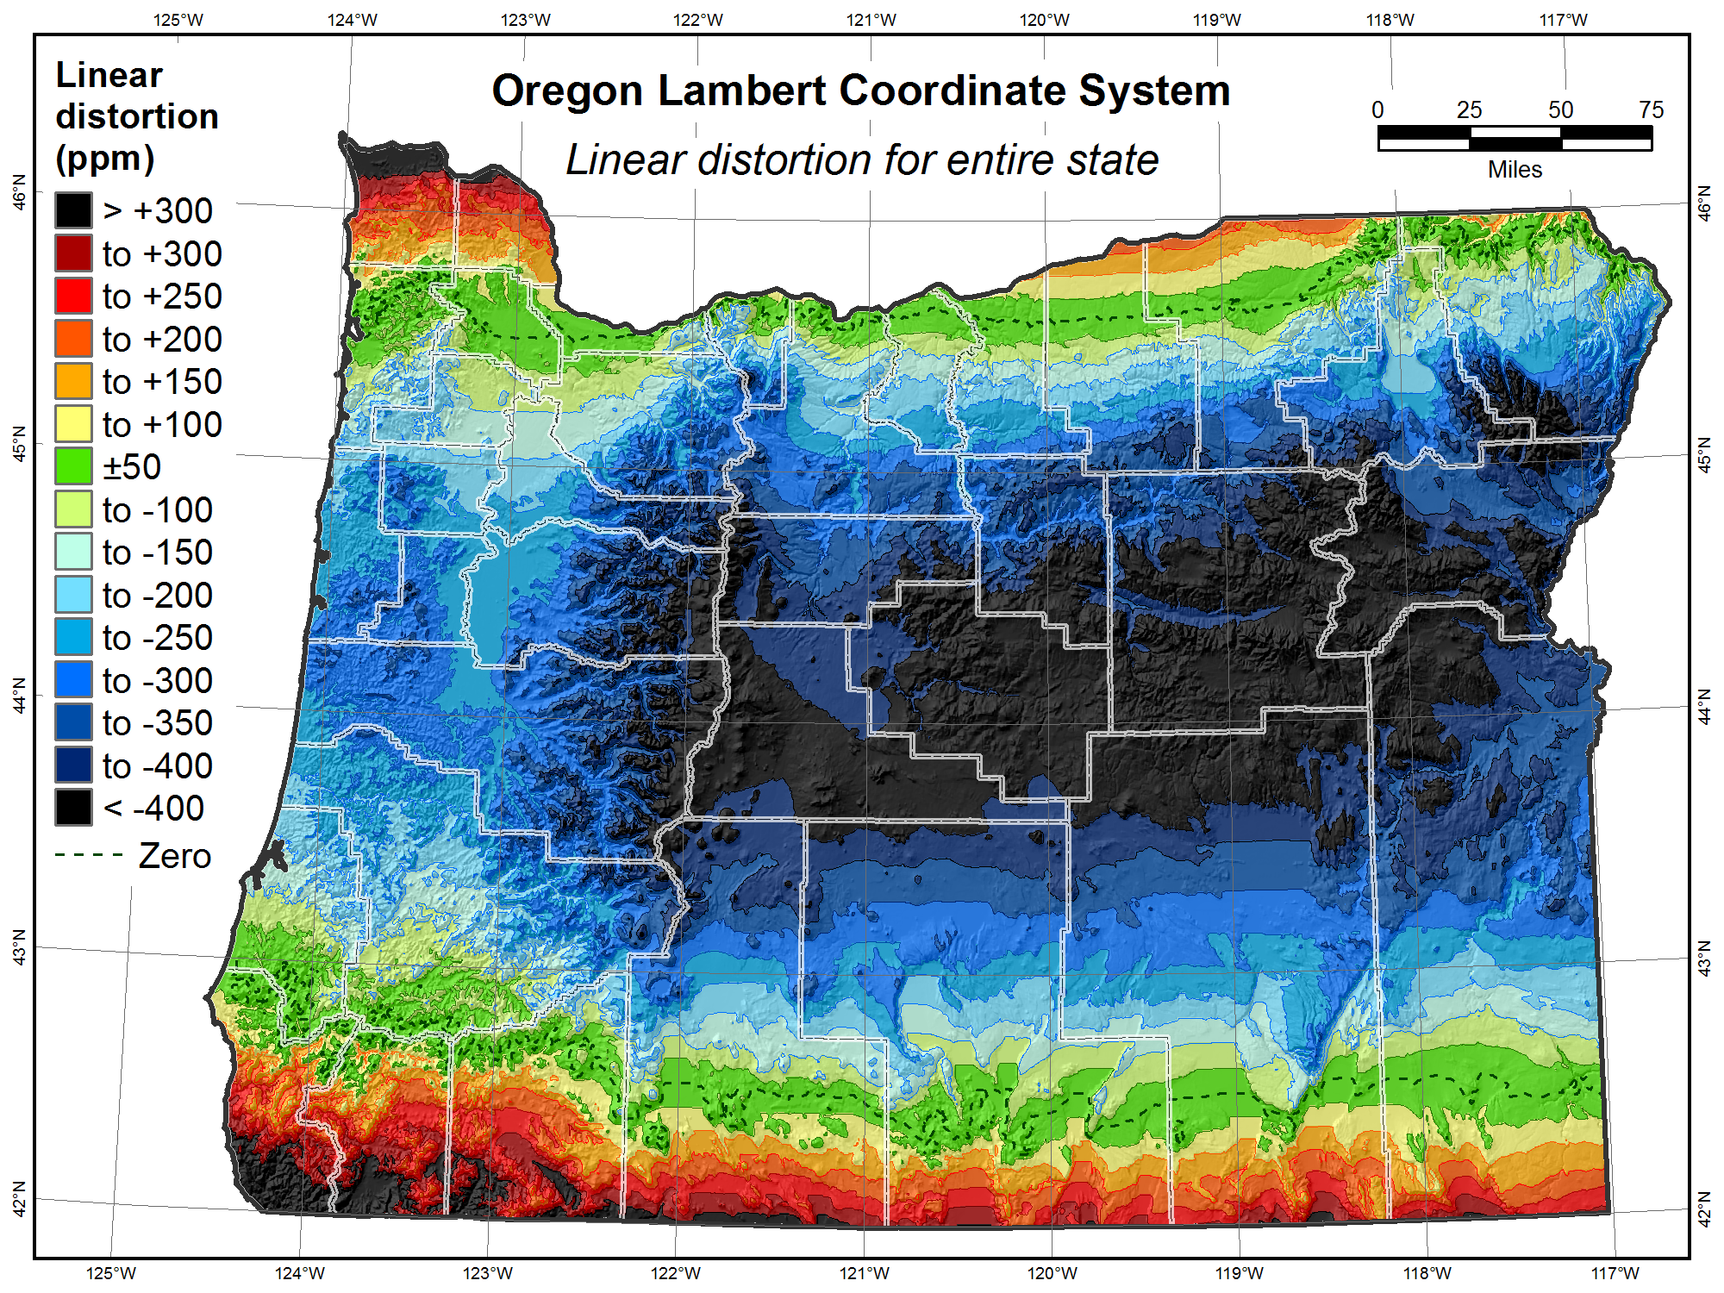

Slide 32
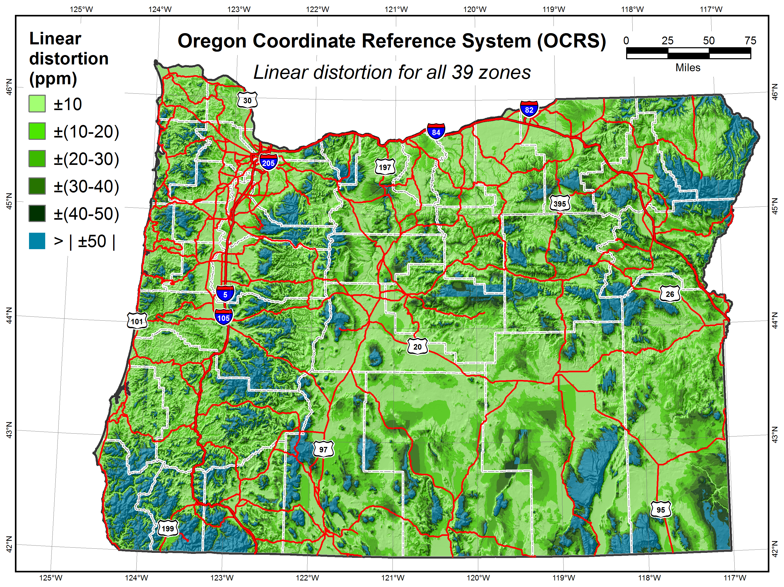

Slide 33
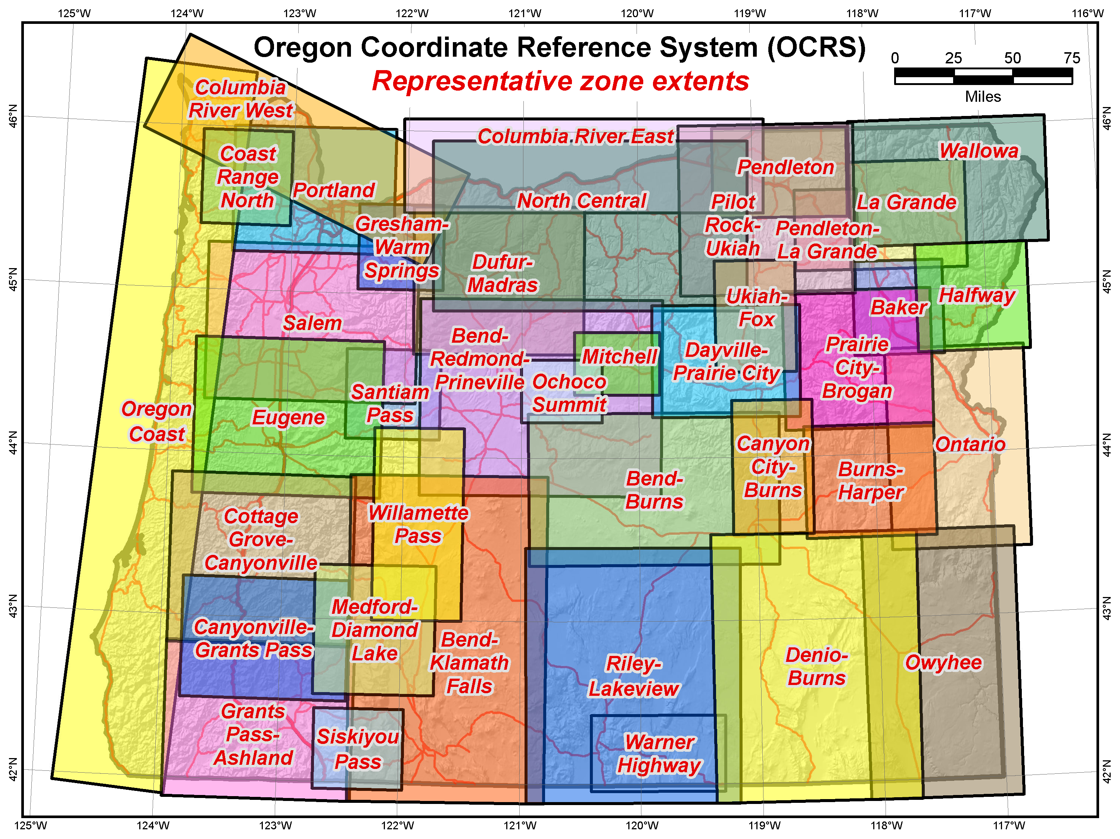

Slide 34
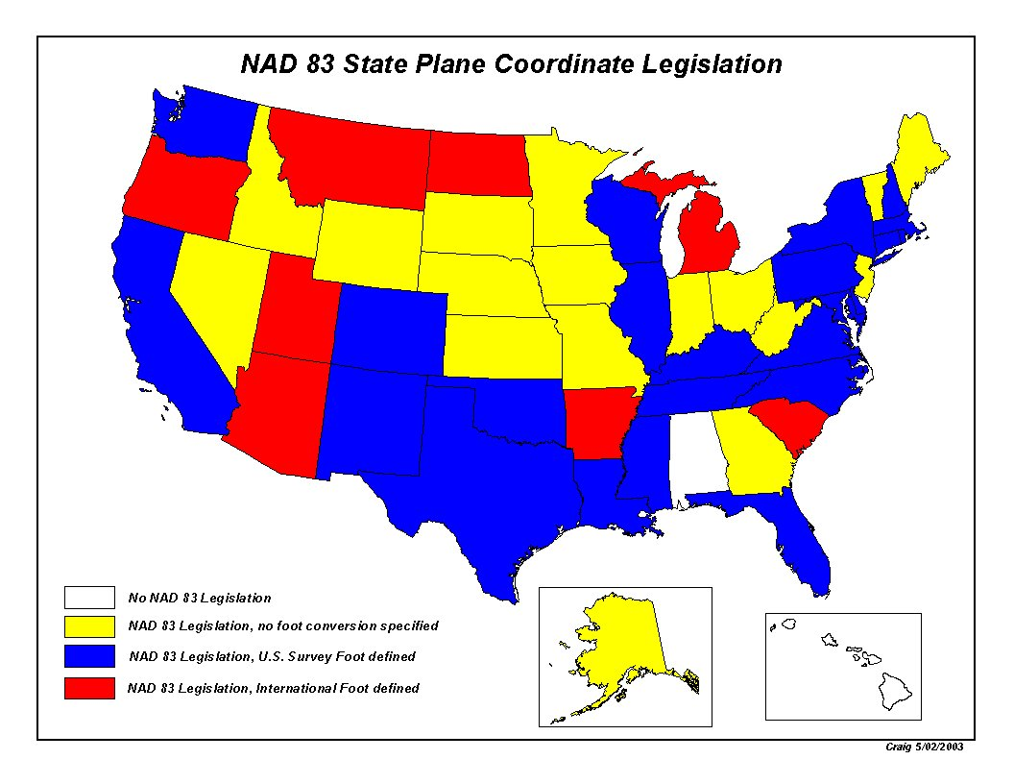

Slide 35
SPCS2022
Deadlines (could change)
August 31, 2018 for Federal Register Notice comments
On policy and procedures
Includes “special purpose” zones
Deadlines for consensus input (Procedures 1.d.i.)
Dec 31, 2019 for requests and proposals
  Requests are for designs by NGS
  Proposals are for designs by contributing partners
Dec 31, 2020 for submittal of approved designs
  Proposal must first be approved by NGS
  Designs submitted by contributing partners
  Designs must be complete before NGS review
Dec 31, 2021 for NGS to confirm zone computations
After deadlines, will be a change request for SPCS2022
NGS.Feedback@noaa.gov
Recommend input by
August 31, 2019
NGS.SPCS@noaa.gov
Jan. 10, 2019

Slide 36
What matters to WY
Do you want to retain 4 zones as is?
All States will get 1 zone
Do you want LDPs (in addition to 4 zones)?
Do you want Special Zones – in Yellowstone? Any place else? Could it merely be an LDP?
Your opinions and feedback critical to the outcome
How do you want WY to make final decisions?

Slide 37
What do you need to do?
6 months critical decision making
Outreach to associations (GIS, survey, parks,FS, tribal)
Chapters – local input
List options and get consensus (perhaps by votes at board mtgs)
Recommend target for decision August 2019

Slide 38

GPS on Bench Marks
Phase I
  Geoid 18
  You helped with the final hybrid Geoid Model
  All About heights
  How important will heights/elevation be in the future?
Phase II
  Transformation Tools
  Help needed with the transformation tools to the new systems over the next couple of years
Thank you

Slide 39
GPS on BM Efforts in WY
WY Submitters | August Observations | Aug 16-19 Observations
Alan Cormier | 22 | 6
Richard Kusaba | 10 | 8
Aaron Gow | 4 | 0
Stan Abell | 4 | 0
Michael Flaim | 1 | 0

Slide 40
GPS on BM
Phase I - Geoid18 Model Nearing Completion
Over 45% complete (2469 observations)
WY 22%
  A Priority 163 provided, 36 observed 22%
  B Priority 19 provided, 4 observed 21%
CO 54%
  A Priority 40 provided, 15 observed 37%
  B Priority 30 provided, 22 observed 76%
MT 53%
  A Priority 233 provided, 137 observed 58%
  B Priority 43 provided, 24 observed 56%
Numbers as of Oct 31, 2018

Slide 41
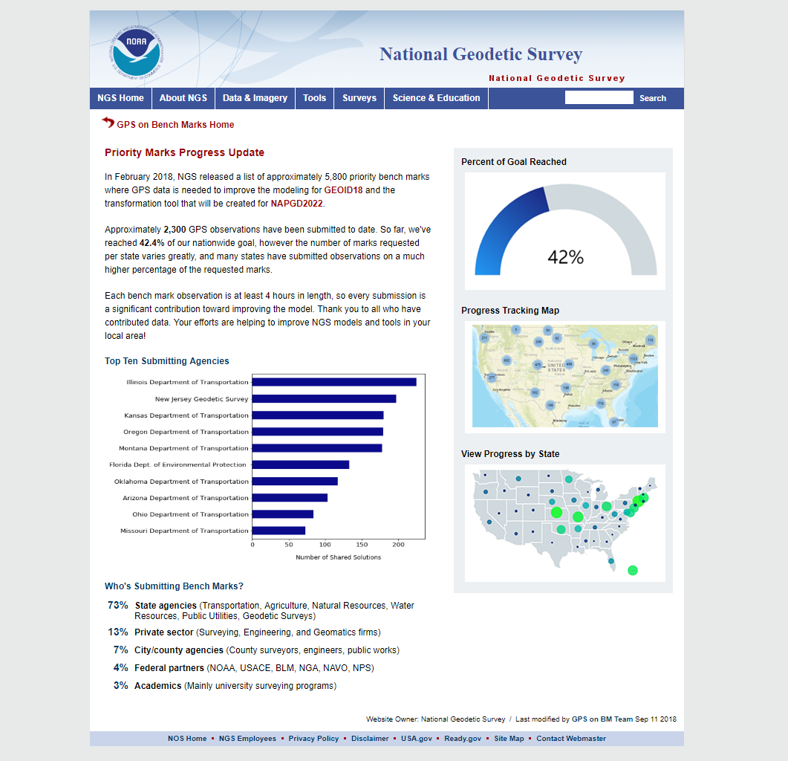
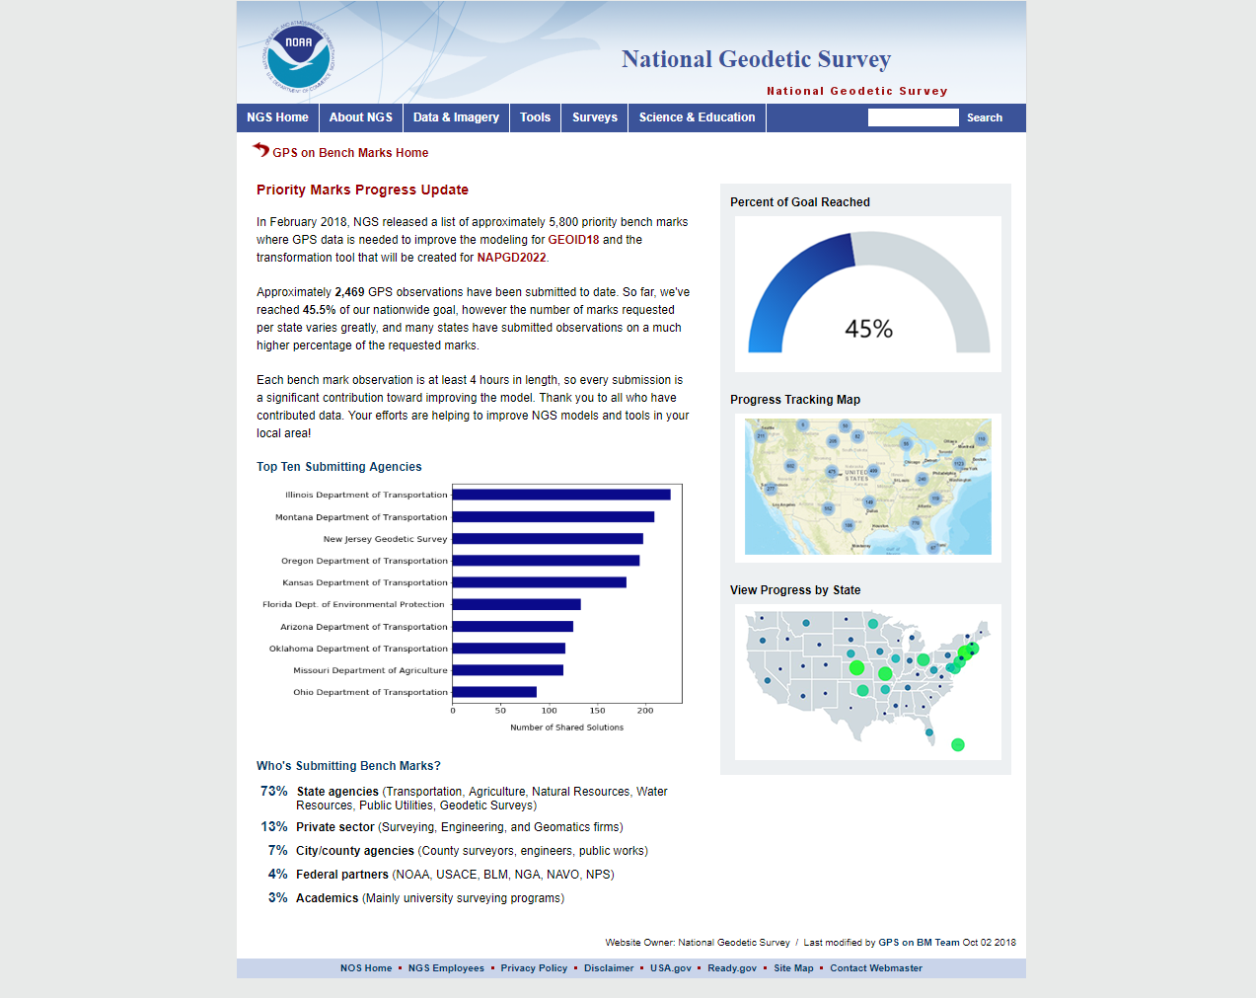

Slide 42
Ellipsoid, Geoid, and Orthometric Heights
Heights – why so important?
H = Orthometric Height (leveling)
H = h - N
h = Ellipsoidal Height (GPS)
N = Geoid Height (model)
h (NAD83)
TOPOGRAPHIC
SURFACE
(NAVD88) H
N
Geoid Height
(GEOID12B)
Geoid
Ellipsoid

Slide 43
Crowdsourcing
GPS on Bench Marks
Find Bench Marks (priority and others)
  Use our priority BM/tracking map
  Use NGS Data Explorer
  Use DS-World
Provide a recovery note
  Use DS-World (or new NGS beta app)
  Provide updated descriptions,
  Coordinates, photos (use DS-World)
Collect GPS data
  Share through OPUS
  Create OPUS Data Sheet
GIS Community
can assist here
Requires Survey Grade
GPS data and
min. of 4 hrs of data

Slide 44
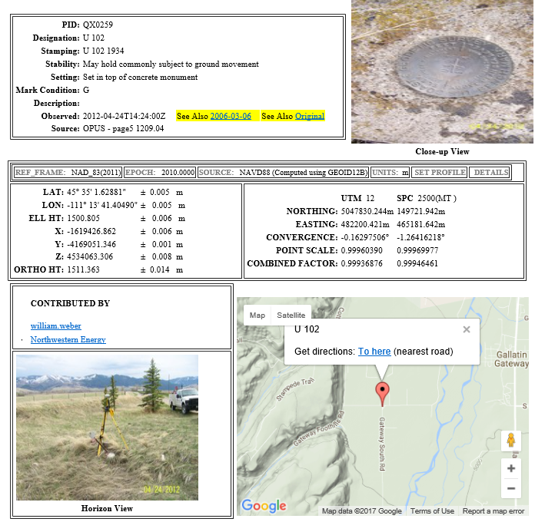
OPUS Share Data Sheet

Slide 45
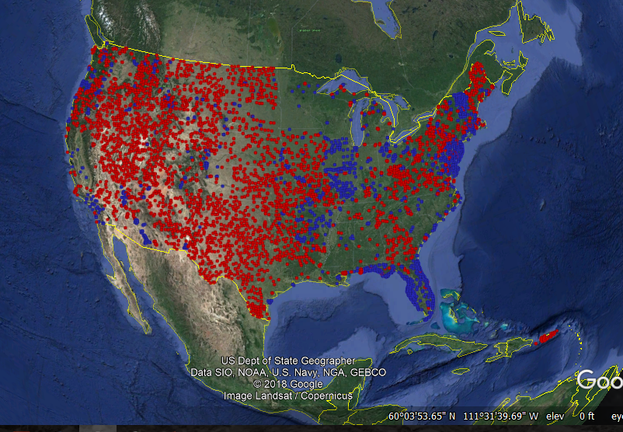
Priority BMs Identified
A Priority
B Priority

Slide 46
Rocky Mountain Region Map and Volunteer Sign up
Signup sheet:
https://survey123.arcgis.com/share/130be382350e4a38a71de3b2e4d92a98 (Must cut and paste)
Status Map:
https://www.arcgis.com/apps/webappviewer/index.html?id=0829616b6ec740b7a0bfbf057188e865
NGS Map:
https://geodesy.noaa.gov/GPSonBM/index.shtml

Slide 47
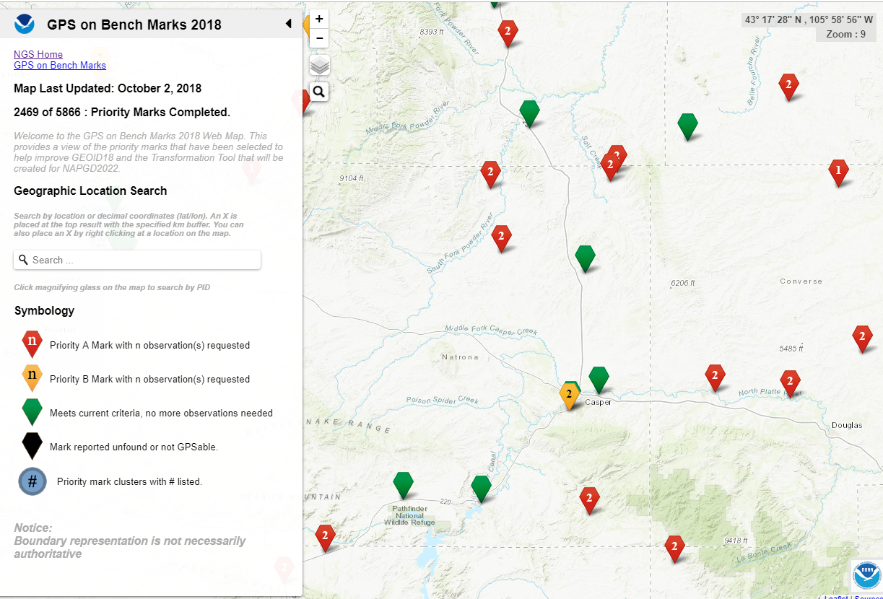
Priority Stations near Casper, WY

Slide 48

Priority Stations near Casper, WY

Slide 49
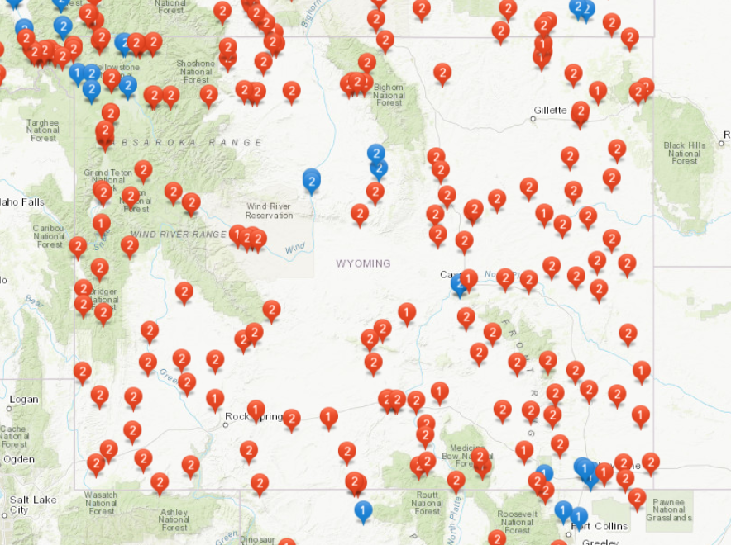
Rocky Mountain Regional Map

Slide 50
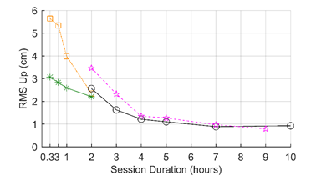

Why do we need 4 hours of data?
NGS is working on OPUS for RTK that will accept 3 minute observations, however the accuracy will NOT be as good as 4 hour observations.
1 sigma
Graph Courtesy of Dr. Daniel Gillins
Notes:
Better solutions with lower RMS are important for creating the hybrid geoid model. The Transformation Tools will need a higher density of data, so we are willing to trade a decrease in accuracy for the ability to get data on many more marks.

Slide 51
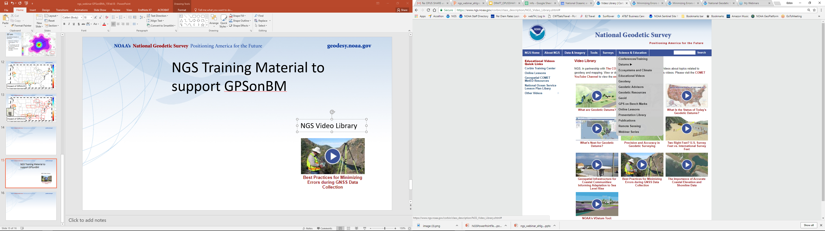
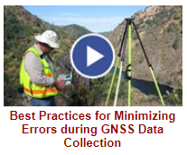

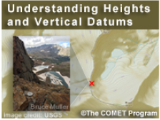
NGS GPS on BM Training Material
GPS on Bench Marks Webpages
NGS Video Library
NGS Online Lessons

Slide 52
Rocky Mountain Region Webinars
GPS on BM
May 21, 2018 2:00 Basics, why, how, when
June 7, 2018 2:00 Mark Recovery (DS-World)
June 14, 2018 2:00 Collecting GPS data and Sharing through OPUS (Survey Grade, min. of 4 hrs) https://attendee.gotowebinar.com/recording/3222375402987297281
https://attendee.gotowebinar.com/recording/4100208993309956616
https://attendee.gotowebinar.com/recording/8767732610551898883

Slide 53
Next Steps
Phase II
New priority stations for Transformation tool
  Many more stations
  Design a more localized approach
  Provide incentive
  Utilize interns (request positions)
  NGS is exploring use of RTK

Slide 54
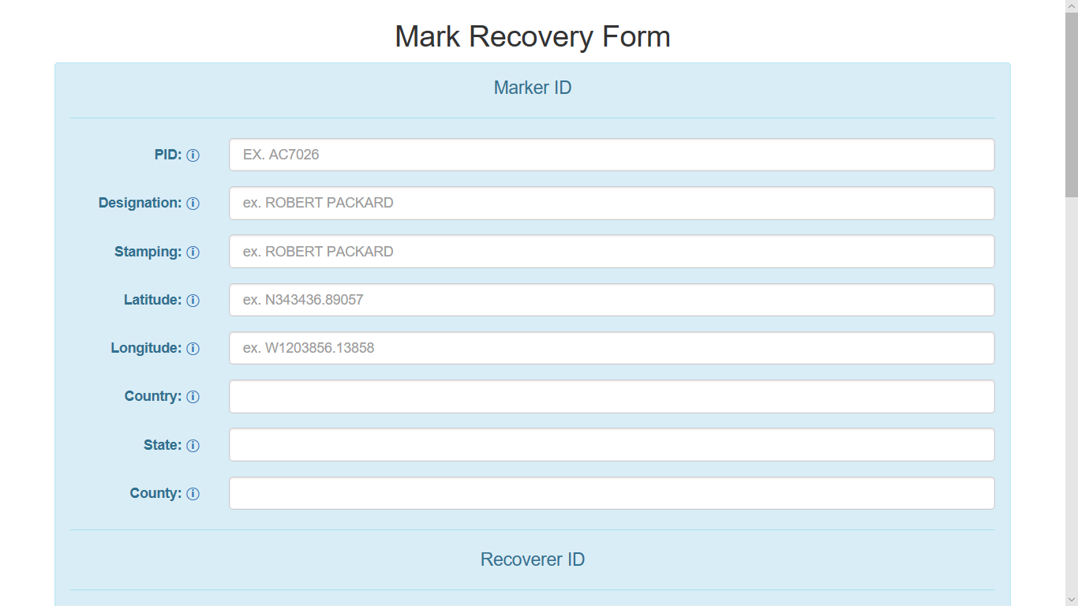

Slide 55
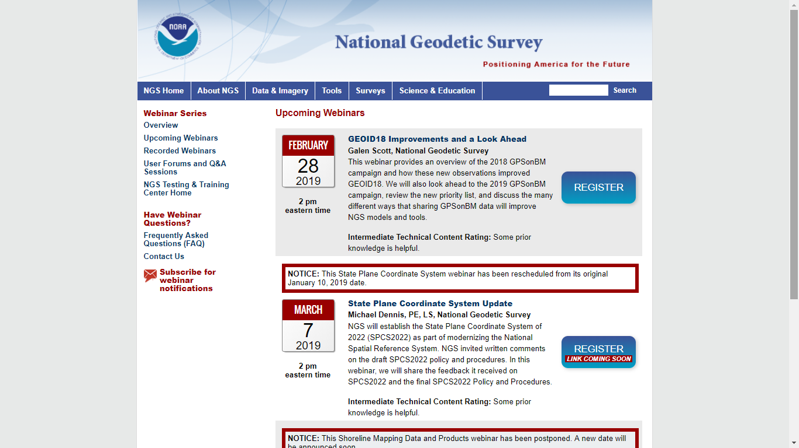

Slide 56
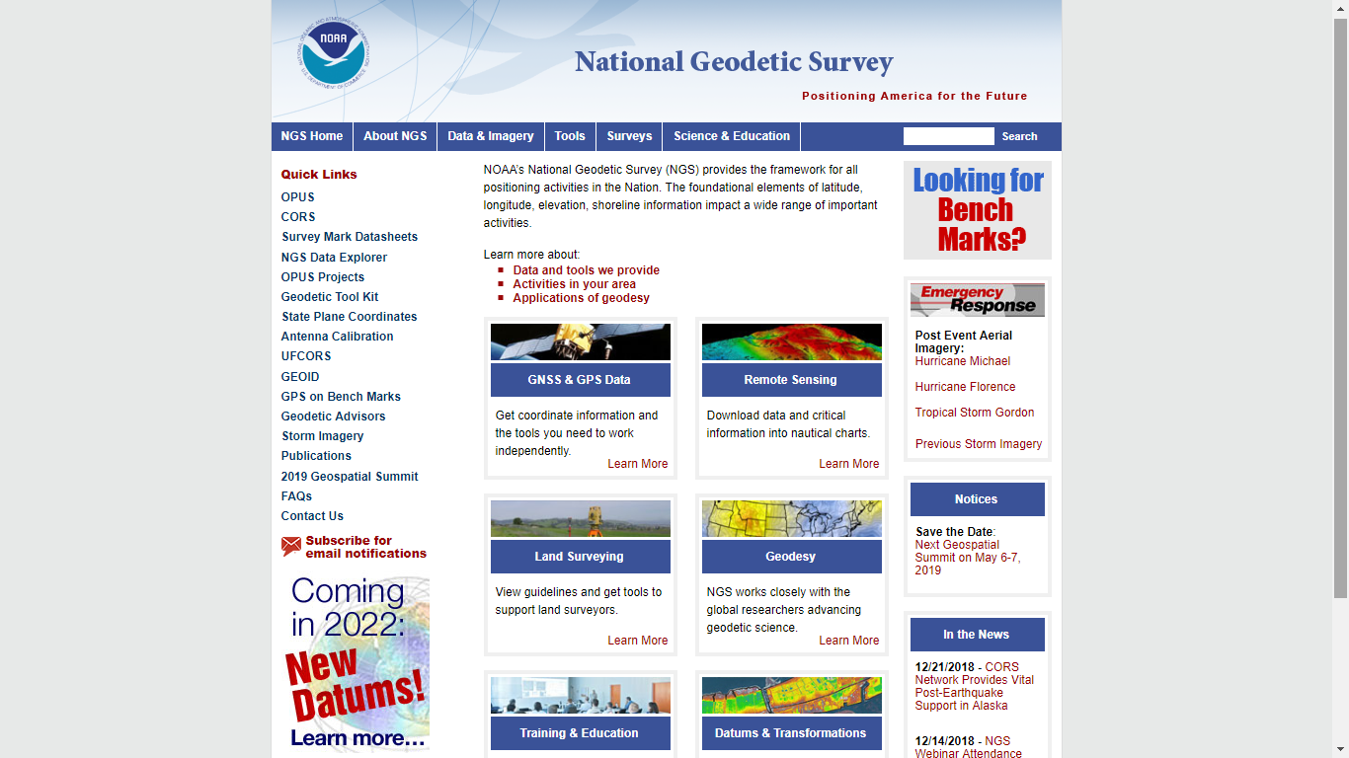
geodesy.noaa.gov

Slide 57
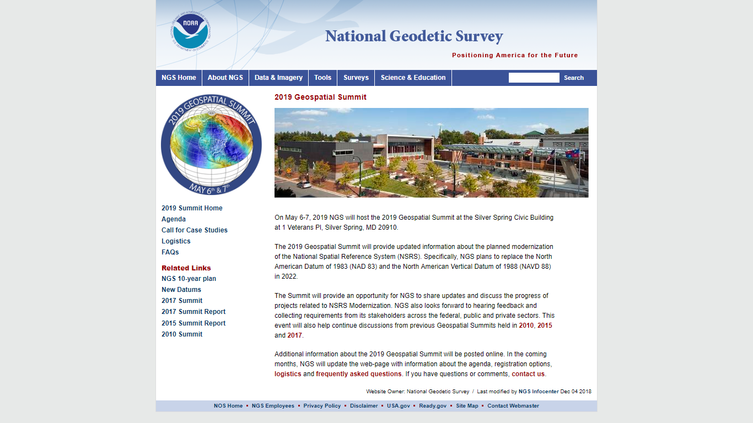

Slide 58
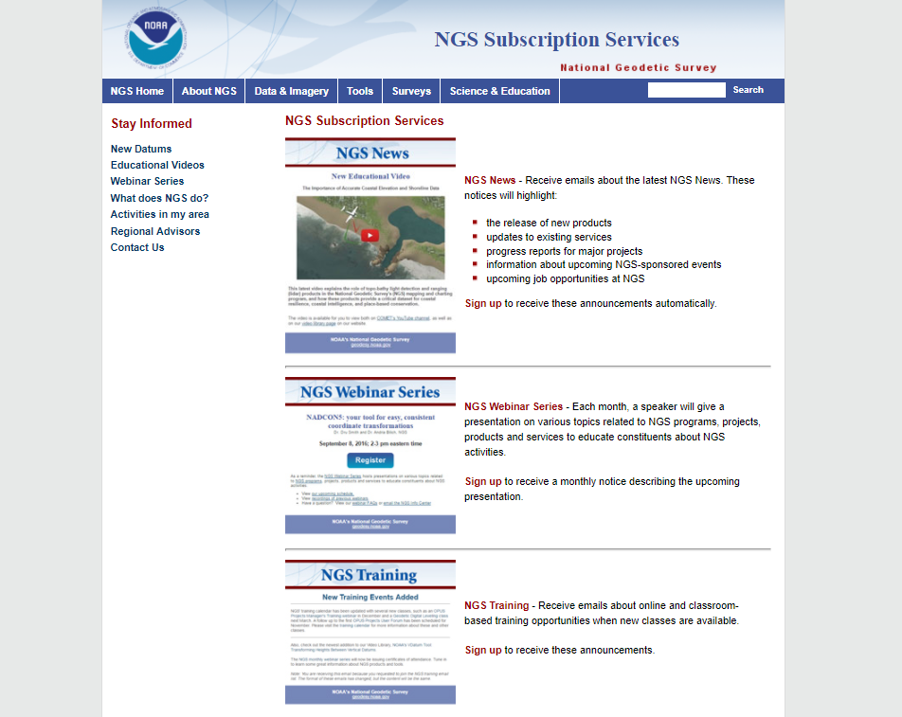

Slide 59
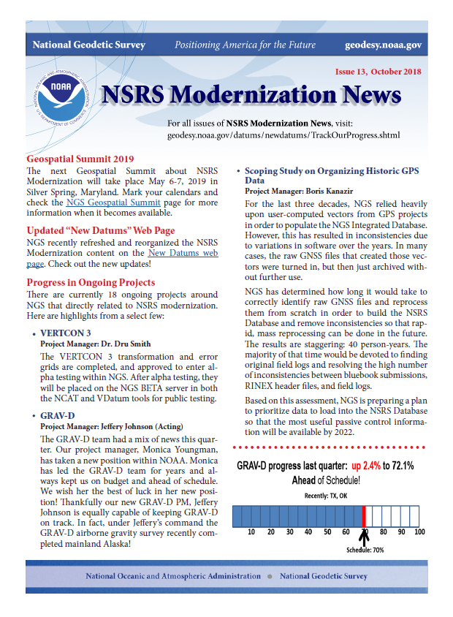
Geospatial Summit
May 6-7, 2019
Vertcon 3
GRAV-D
NOAA Technical Report NOS NGS 62, “Blueprint for 2022, Part 1: Geometric Coordinates
NOAA Technical Report NOS NGS 64, “Blueprint for 2022, Part 2: Geopotential Coordinates
Geodesy.noaa.gov

Slide 60

2019 Geospatial Summit
SAVE THE DATE!
Geospatial Summit
Dates: May 6 - May 7, 2019
Location: Silver Spring Civic Center
Invitees: NSRS users plus NGS Subject Matter Experts

Slide 61
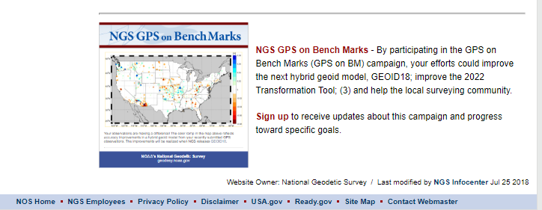
New Subscription Service
GPS on Bench Marks

Slide 62
Next steps and Future
SPCS 2022
  Consensus needed across the State
  4 existing zones, 1 zone, LDPs, Special Zones?
GPS on BM for transformation tools
  Need GIS communities assistance in identifying whether marks are in place and good for GPS
  Interns
  RTK
???

Slide 63
NOAA’s National Geodetic Survey
Thank you
Pam Fromhertz
Rocky Mountain Regional Advisor
Pamela.Fromhertz@noaa.gov
240-988-6363
Geodesy.noaa.gov
Mark Corbridge
WY NGS Geodetic Coordinator
WYNGScoordinator@gmail.com
(307) 777-4123

