Slide 1
State Plane Coordinate System Update
Michael L. Dennis, PhD, RLS, PE
SPCS2022 Project Manager
March 7, 2019

Slide 2
Overall webinar statistics
Total of 1013 attendees
939 attendees for at least 30 minutes
All 50 states represented
Plus DC, Puerto Rico, and U.S. Virgin Islands
Also had federal and outside U.S. attendees
Total of 334 attendees not associated with any state or U.S. territory
70% to 80% of attendees responded to poll questions

Slide 3
The Plan
Recent NGS activity on SPCS2022
Summary of customer feedback
Overview of SPCS2022 Policy & Procedures
Zone design approach and linear distortion
Preliminary statewide and default zone designs
Zone layers and uniqueness
Making requests/proposals and submitting designs
Low distortion projection (LDP) zones
Poll questions!
Note that many questions will be state-specific

Slide 4
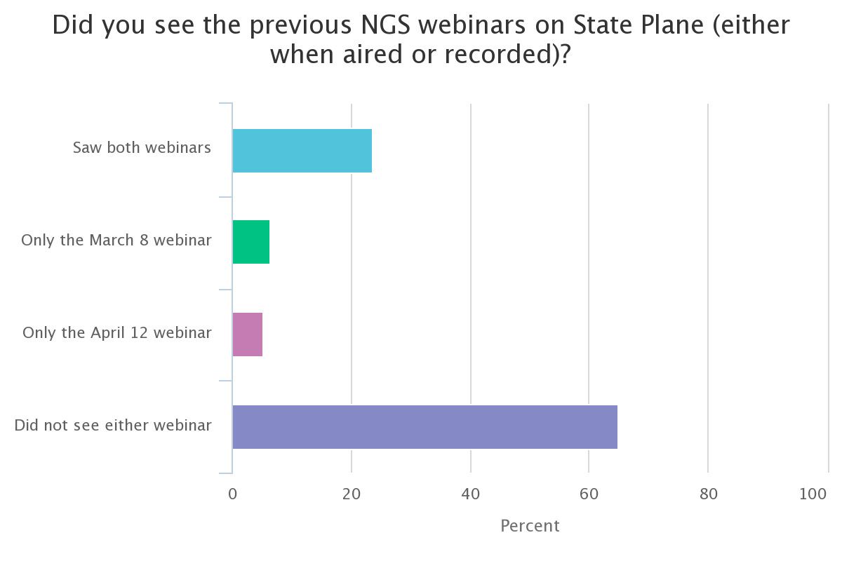
Poll question 1
Did you see the March 8 and April 12, 2018, NGS webinars on State Plane (either when aired or recorded)?
Saw both webinars
Only the March 8 webinar
Only the April 12 webinar
Did not see either webinar
664 responses

Slide 5
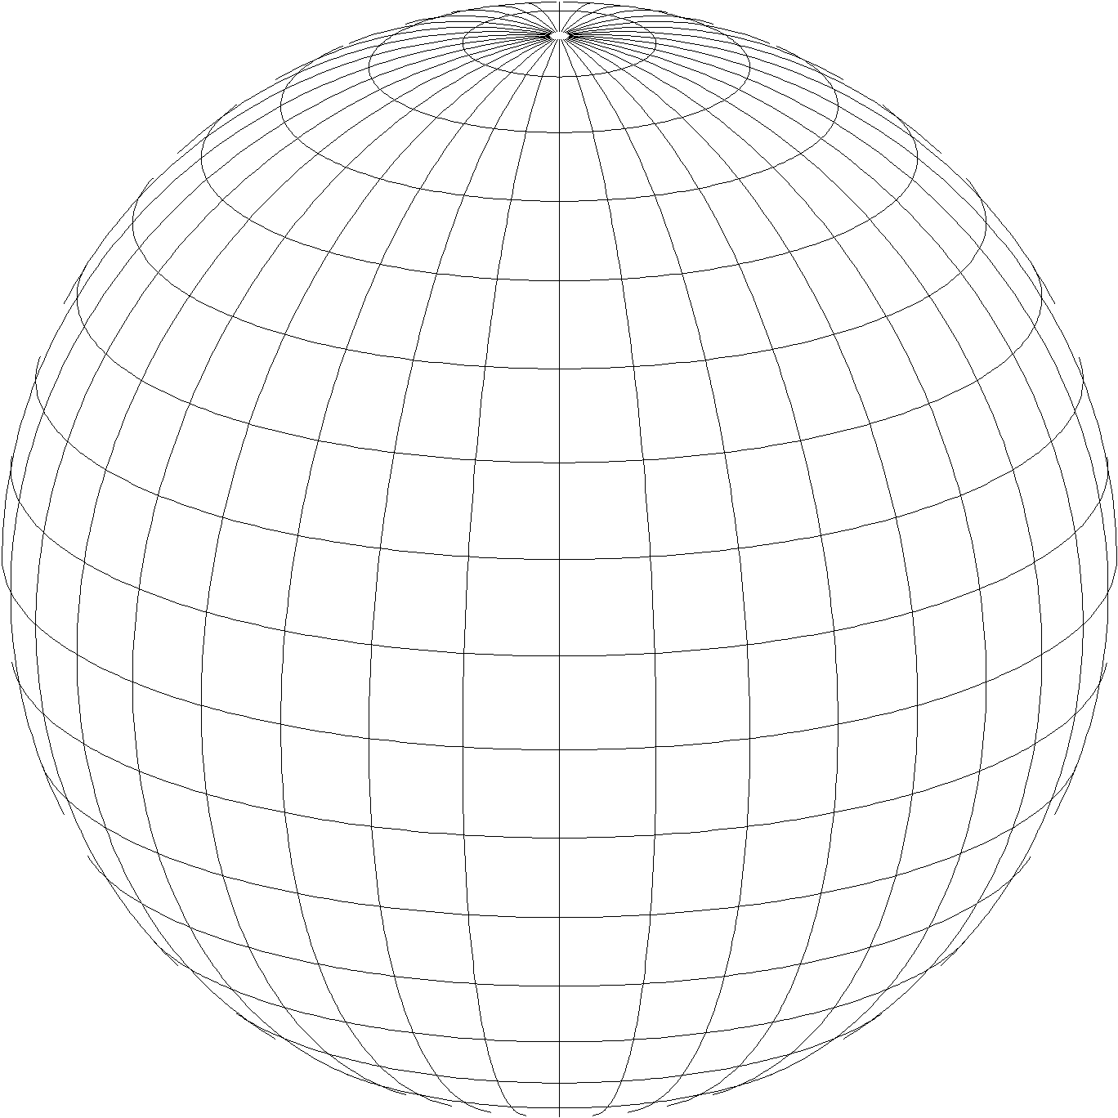
A New State Plane Coordinate System
State Plane Coordinate System of 2022 (SPCS2022)
Referenced to 2022 Terrestrial Reference Frames (TRFs)
Based on same reference ellipsoid as SPCS 83 (GRS 80)
Same 3 conformal projection types as SPCS 83 and 27:
Lambert Conformal Conic (LCC)
Transverse Mercator (TM)
Oblique Mercator (OM)
Notes:
State Plane Coordinate System of 2022 (SPCS2022) is also part of modernizing the NSRS
Referenced to the new 2022 TRFs (not to NAD 83)
But still uses same reference ellipsoid (GRS 80) and same 3 conformal projections

Slide 6
SPCS2022 activity over the last year
Publish State Plane history report: March 6
Webinars on March 8 and April 12
Launch new SPCS web pages: March 19
Publish Federal Register Notice (FRN) and draft SPCS2022 Policy & Procedures: April 18
FRN response deadline: August 31
Provide first preliminary design maps: October 11
Finalizing policy & procedures: Right now!
Goal is completion in March 2019
Notes:
A list of the things that have occurred in the SPCS2022 Project
Currently in process of finalizing the SPCS2022 Policy & Procedures, with goal of publishing them in March 2019

Slide 7
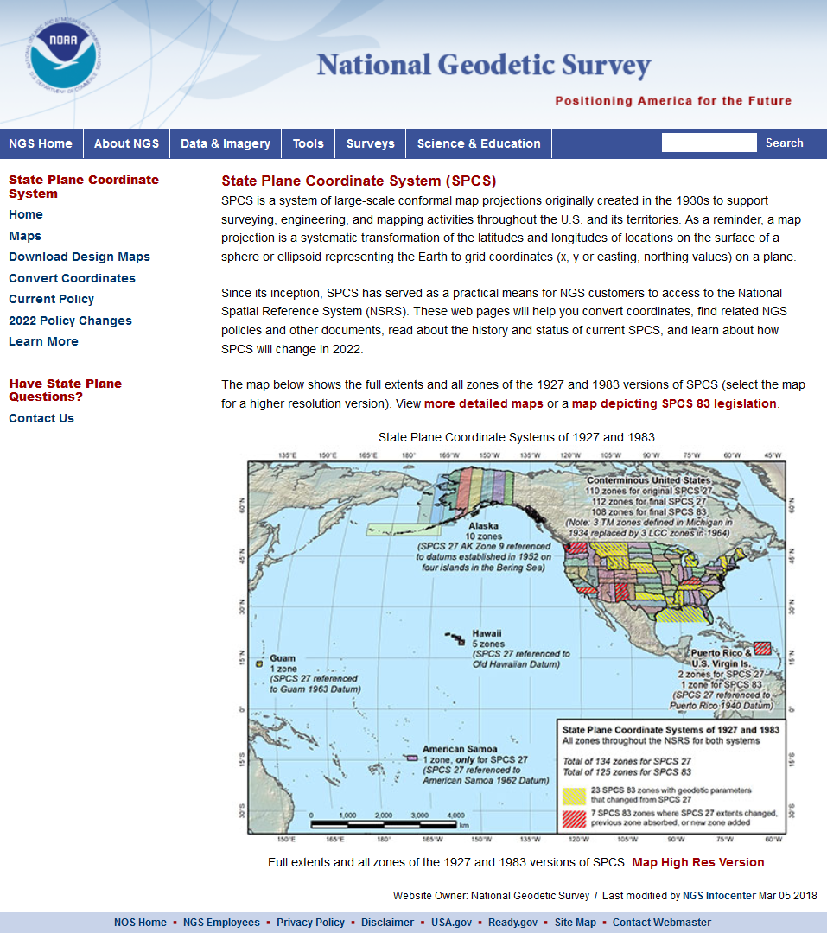
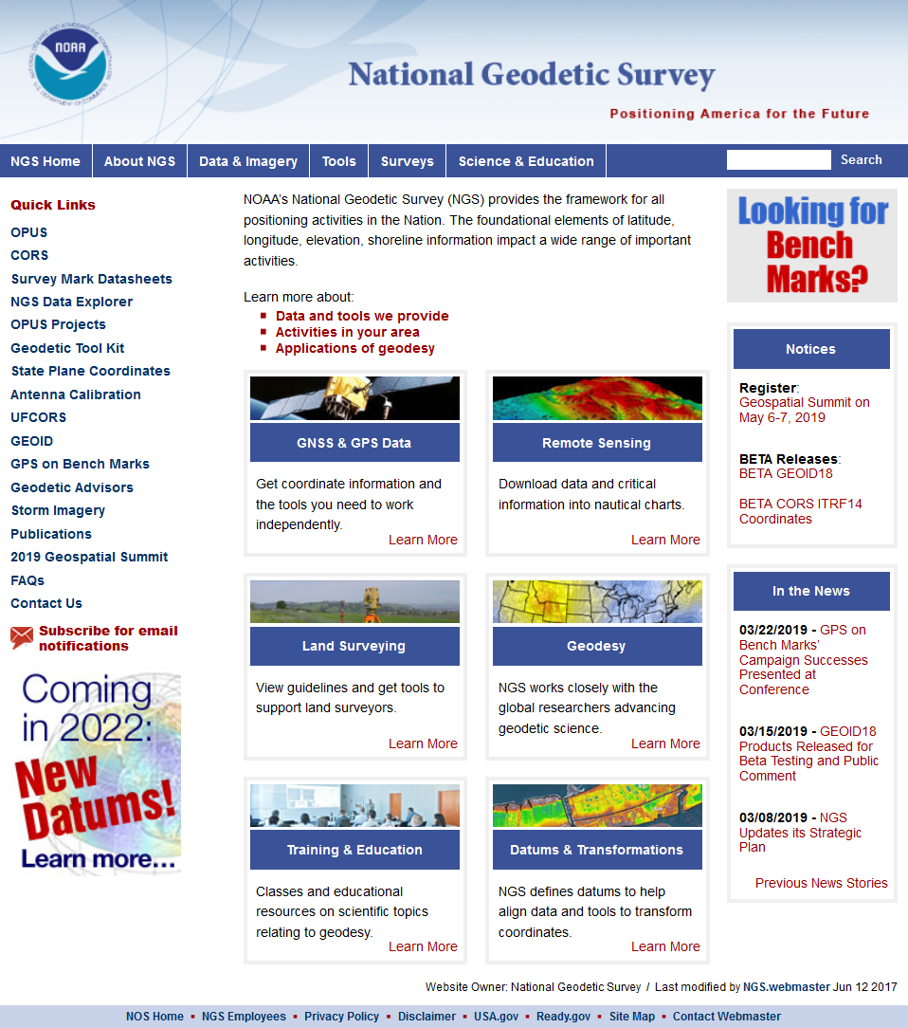
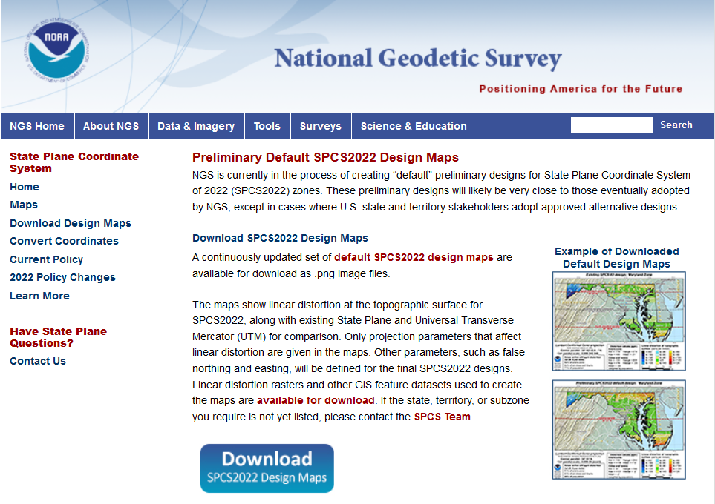
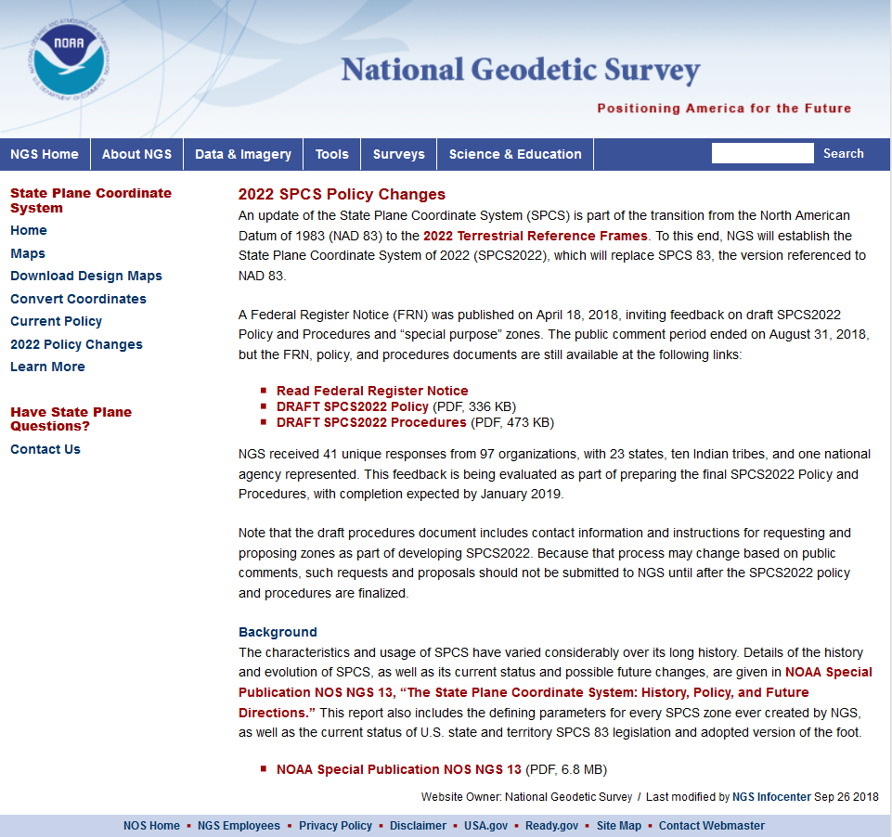
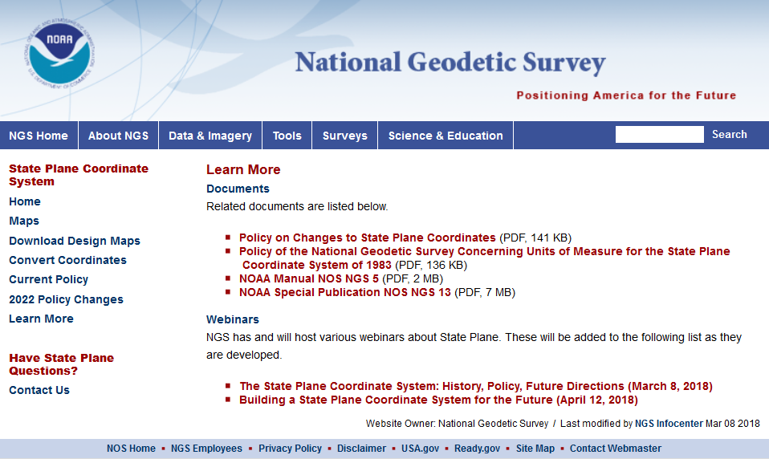
geodesy.noaa.gov
Notes:
A lot of information is available on the NGS website, including:
2022 policy changes
Supporting information (old policy and manuals, new report on SPCS history)
Maps of preliminary SPCS2022 designs available for download
Not all states yet available, but designs are in progress
Includes maps of existing SPCS 83 for comparison

Slide 8
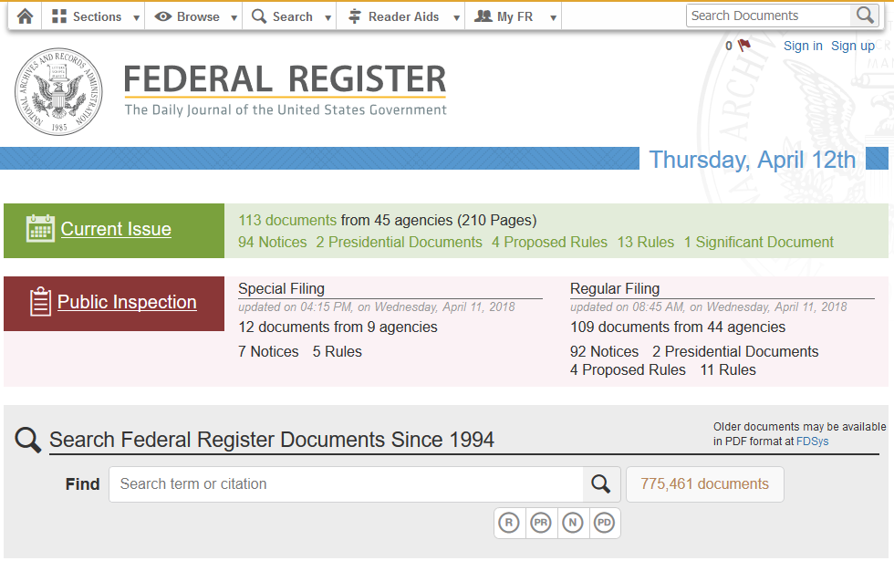
Federal Register Notice
https://www.federalregister.gov/
Announced draft SPCS2022 Policy and Procedures
Also asked for input on “special use” zones
Published on April 18, 2018
Public comment period ended Aug 31, 2018
Notes:
A Federal Register Notice (FRN) was published on April 18, 2018
Announced publication of DRAFT SPCS2022 Policy & Procedures for public comment
Also asked for input on “special purpose” zones (will describe these later); may change name to “special use” zones.
Public comment period ended on August 31, 2018
Will review responses later, but first need some background information

Slide 9
Overview of FRN feedback
FRN public comment period April 18-Aug 31
For draft SPCS2022 policy & procedures
Wide variety of formats and content
Individuals, organizations, and groups of organizations
Received 41 unique responses:
1 federal agency (USGS)
10 Native American tribes
23 states (includes state and private organizations)
105 people represented by name
97 organizations represented

Slide 10
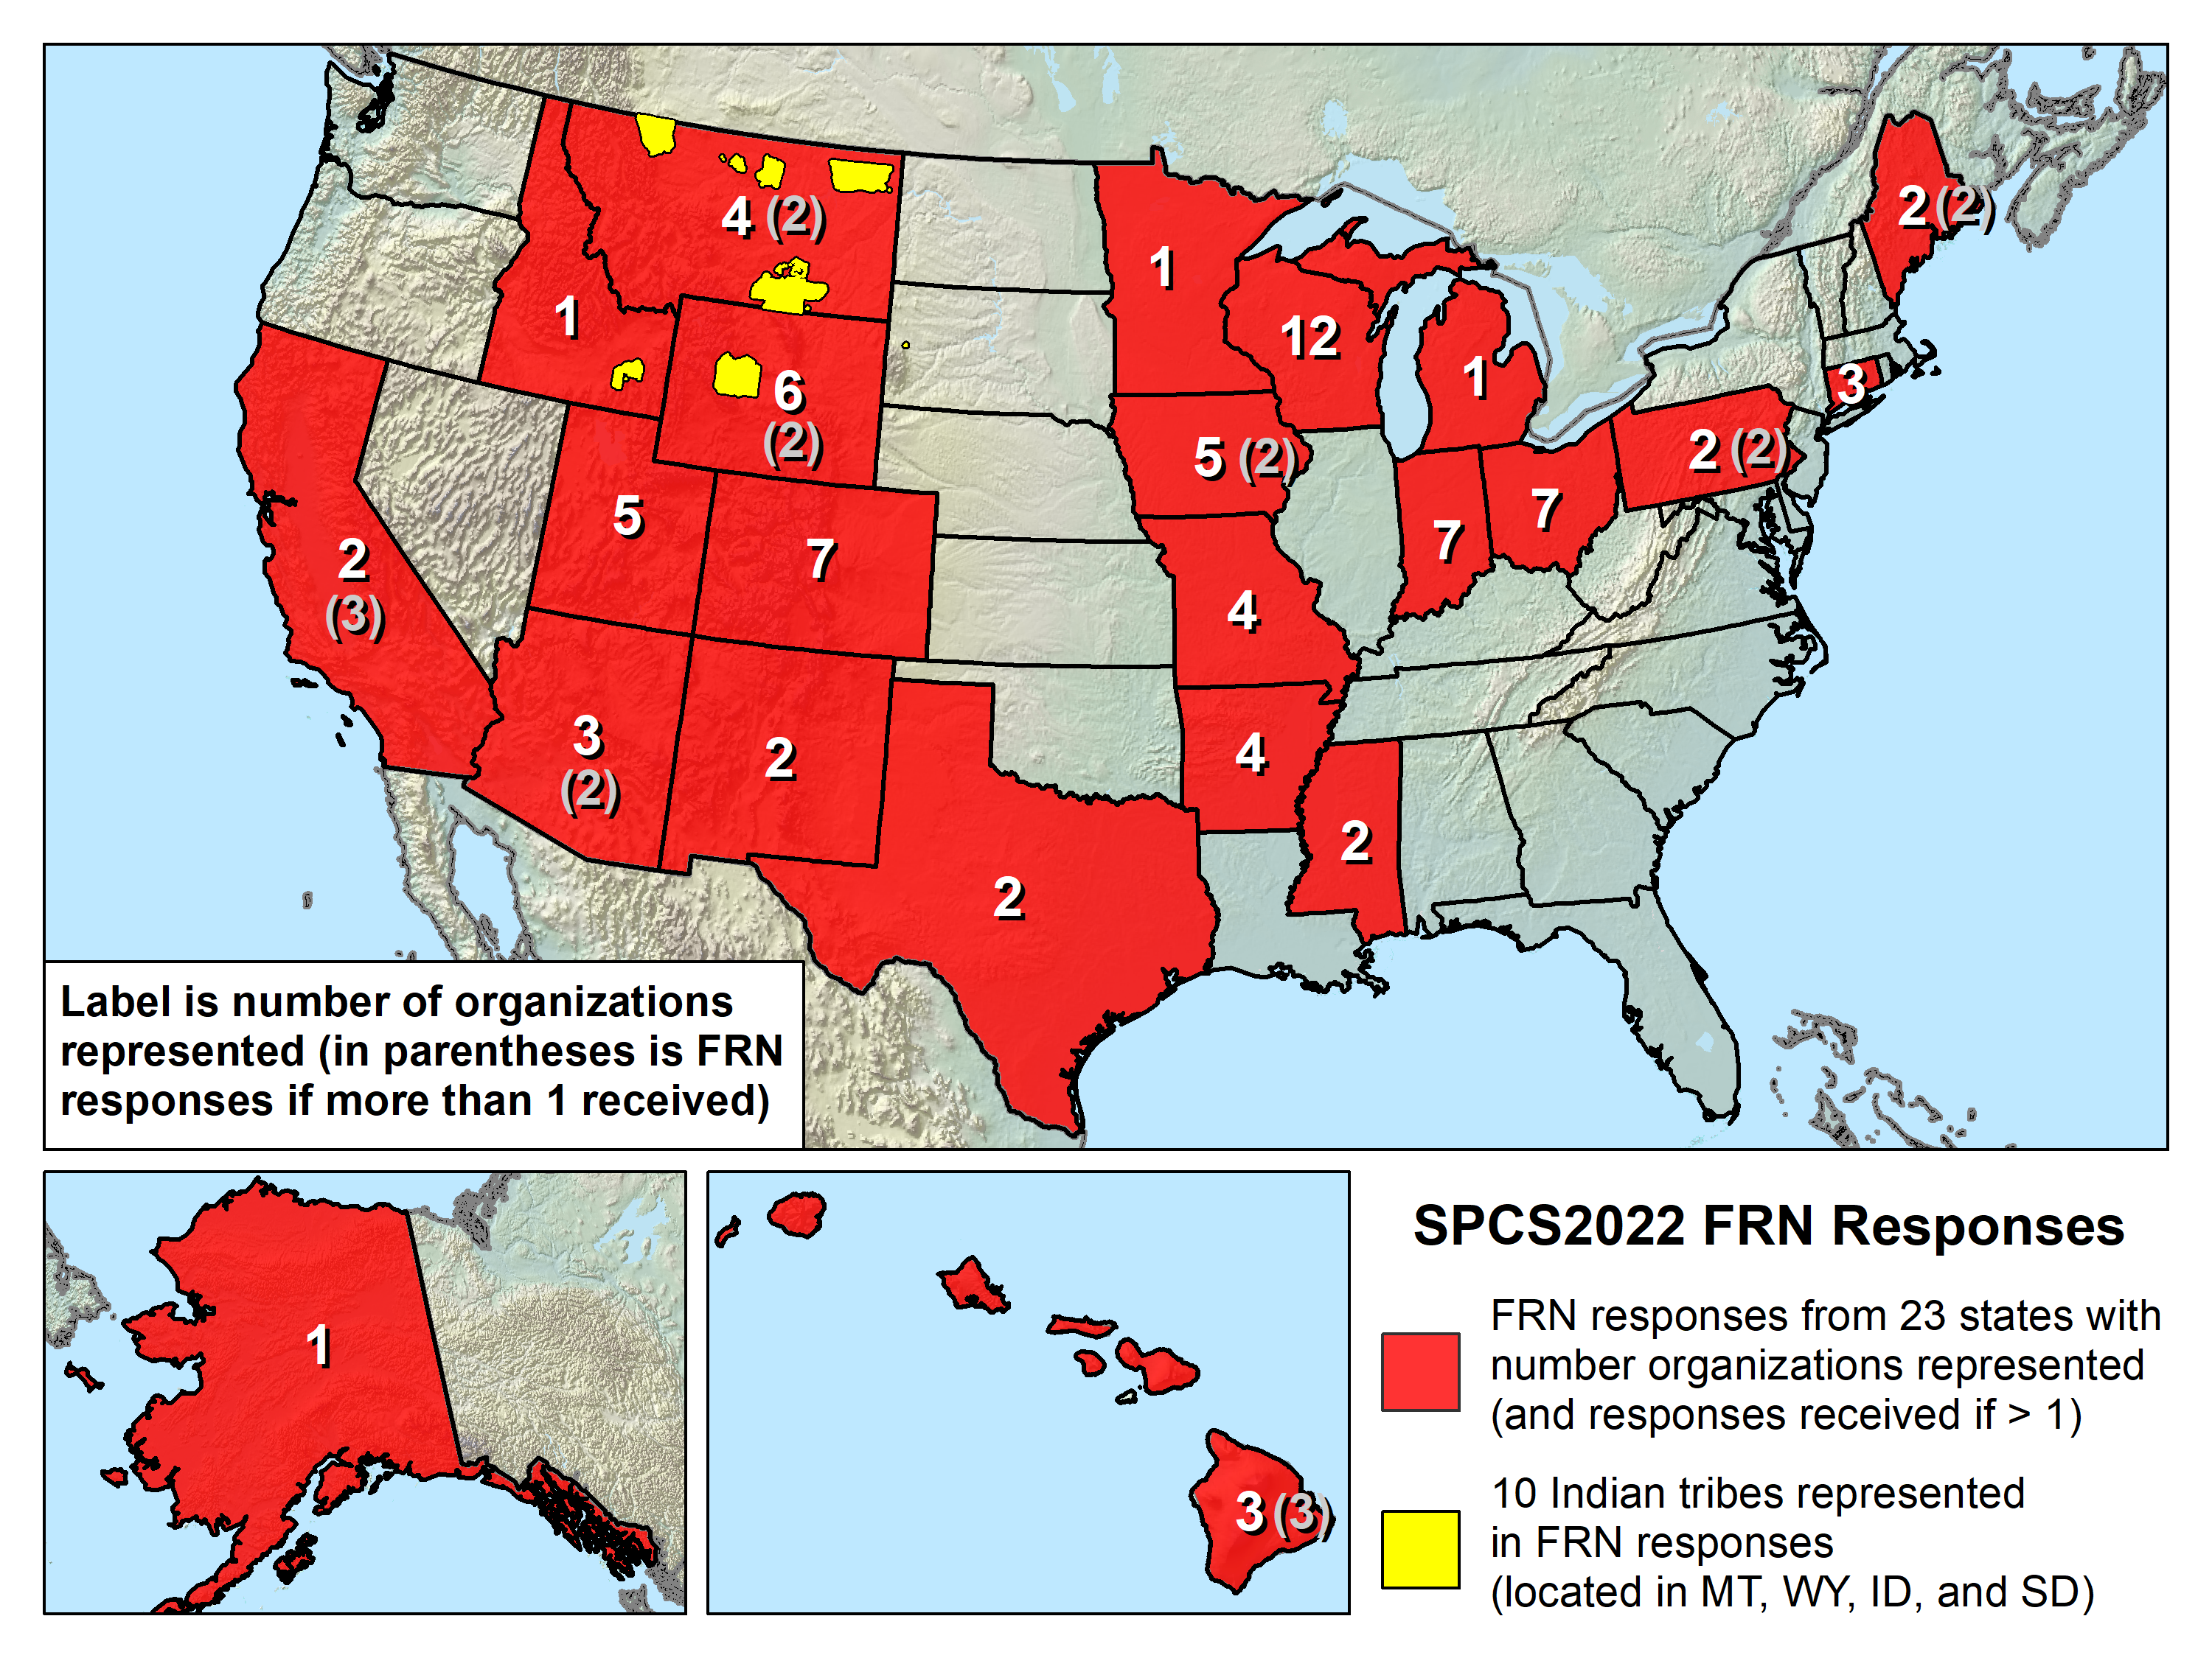
Expected responses from more states…

Slide 11
Reminders about SPCS2022 stuff
Default zone designs
Created by NGS if get no input; similar to SPCS 83
Special purpose zones
For regions that span multiple states/zones
e.g., Navajo Nation (3 states, 5 SPCS 83 zones)
Layered zones: Max 2 layers (e.g., Kentucky)
A statewide zone plus 1 layer of multiple subzones
Low distortion projections (LDPs)
Can be part of SPCS2022, but with min size limits
Must be designed by others (not by NGS)

Slide 12
The 5 FRN questions
Usage of current SPCS in your organization.
Whether default SPCS2022 definitions impose hardship or are beneficial.
Whether there is sufficient flexibility in SPCS2022 characteristics.
Whether the SPCS2022 deadlines are acceptable.
Whether “special purpose” zones in SPCS2022 would be beneficial, problematic, or irrelevant.

Slide 13
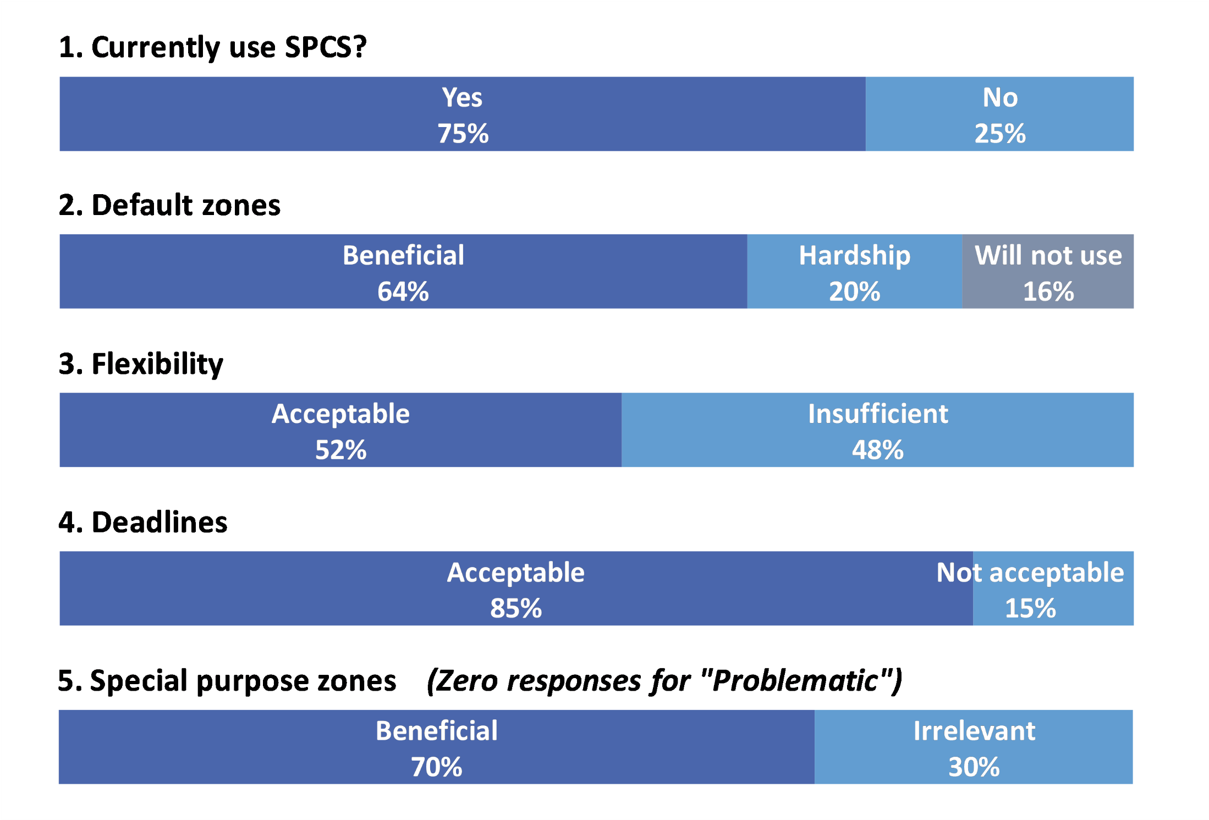
Responses to the 5 FRN questions

Slide 14
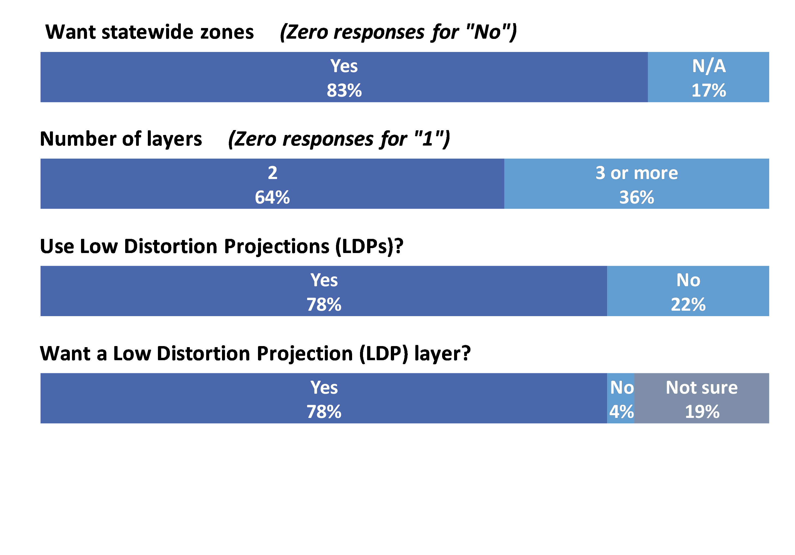
Summary of other FRN input

Slide 15
SPCS2022 Policy & Procedures
Summary of main things that did NOT change
Policy
Limited to LCC, TM, and OM projections
Zones designed to reduce distortion at ground
Default zones designed by NGS if no consensus input
Parameters in meters, but feet allowed for output
Procedures
Stakeholders must submit requests/proposals
1-parallel LCC and local OM projection definitions
Specified a linear distortion design criterion
Limit NGS designs to minimum of ±50 ppm
50 km min zone size for height range of 250 m or less
Notes:
A major component of SPCS2022 are stakeholders
Stakeholders have a role in helping define (and maintain) SPCS2022
A major stakeholder group is state DOTs, along with other geospatial groups as listed here
There is a formal process for stakeholders to submit REQUESTS and PROPOSALS for SPCS2022
Stakeholders must consist of one of the STATE groups listed, and
Input must be unanimous for NGS to act
NGS cannot act on input from individuals; they should work through a stakeholder group

Slide 16
Changes to SPCS2022 Policies
Summary of main changes
Allow “special use” zones
But only for zone areas in more than 1 state
NGS will design statewide zone for every state
Also will design default zones if no consensus stakeholder request for something different
Allow max of 3 “layers” (1 statewide + 2 multi-zone)
But most states will have 1 or 2 layers
Added requirement that all zones be unique
Zones within a layer cannot overlap
Require positive east longitudes
Notes:
A major component of SPCS2022 are stakeholders
Stakeholders have a role in helping define (and maintain) SPCS2022
A major stakeholder group is state DOTs, along with other geospatial groups as listed here
There is a formal process for stakeholders to submit REQUESTS and PROPOSALS for SPCS2022
Stakeholders must consist of one of the STATE groups listed, and
Input must be unanimous for NGS to act
NGS cannot act on input from individuals; they should work through a stakeholder group

Slide 17
Changes to SPCS2022 Procedures
Summary of main changes
Delayed deadlines by 3 months
Removed “contributing partner” category
Moved submittal details to fillable forms
Added section on zones numbers and names
Added details on linear distortion design criterion
Removed minimum distortion limit
Added 10 km min zone size for height range > 250 m
Notes:
A major component of SPCS2022 are stakeholders
Stakeholders have a role in helping define (and maintain) SPCS2022
A major stakeholder group is state DOTs, along with other geospatial groups as listed here
There is a formal process for stakeholders to submit REQUESTS and PROPOSALS for SPCS2022
Stakeholders must consist of one of the STATE groups listed, and
Input must be unanimous for NGS to act
NGS cannot act on input from individuals; they should work through a stakeholder group

Slide 18
SPCS2022 stakeholders
State groups that formally interface with NGS
Departments of transportation
Cartographer/GIS office
Professional surveying, engineering, GIS societies
Colleges/universities with geospatial curriculum
Can submit requests and proposals for designs
Requests are for designs by NGS
Proposals are designs by stakeholders
Stakeholder input must be unanimous
Notes:
A major component of SPCS2022 are stakeholders
Stakeholders have a role in helping define (and maintain) SPCS2022
A major stakeholder group is state DOTs, along with other geospatial groups as listed here
There is a formal process for stakeholders to submit REQUESTS and PROPOSALS for SPCS2022
Stakeholders must consist of one of the STATE groups listed, and
Input must be unanimous for NGS to act
NGS cannot act on input from individuals; they should work through a stakeholder group

Slide 19
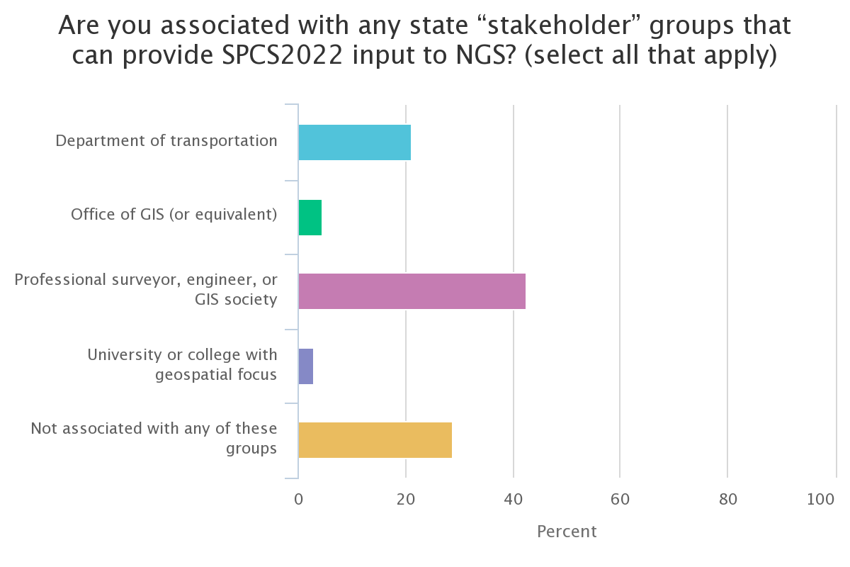
Poll question 2
Are you associated with any state “stakeholder” groups that can provide SPCS2022 input to NGS? (select all that apply)
Department of transportation
Office of GIS (or equivalent)
Professional surveyor, engineer, or GIS society
University or college with geospatial focus
Not associated with any of these groups
738 responses

Slide 20
General SPCS2022 characteristics
Distortion design requirements
Linear distortion minimized at topographic surface (not at ellipsoid surface)
Purpose: to reduce difference between and projected “grid” and actual “ground” distances
Other characteristics
Default designs (if no consensus stakeholder input)
Statewide and “layered” zones
Positive east longitudes
Low-distortion projections (LDPs)
“Special use” zones
Notes:
Will go over main general characteristics of SPCS2022 (not enough time to go into detail)
This is based on final SPCS2022 Policy & Procedures (not yet published but most decisions have been made on content)
Final policy & procedures created based in part on public response to the FRN
A key element of SPCS2022 is linear distortion (“scale error”) design requirements
Linear distortion is the difference between a “grid” distance (between the projected coordinates of a pair of points) and the true horizontal “ground” distance (at the topographic surface of the Earth)
SPC2022 zones are designed to minimize linear distortion at the topographic surface, NOT at the ellipsoid surface (as was done for SPCS 83 and 27)
Other relevant characteristics are listed; each will be discussed in this presentation

Slide 21
Linear distortion with respect to ellipsoid
Projection axis
Projection surface (secant)
Ellipsoid distance
Grid distance > ellipsoid distance
Ellipsoid distance
Ellipsoid surface
This design approach used for SPCS 27 and 83 (minimizes distortion with respect to ellipsoid)
Grid distance < ellipsoid distance

Slide 22
“Non-intersecting” conformal map projection
Topographic surface
Grid distance = ground distance at a point
Projection axis
Grid distance = ground distance at a point
Non-intersecting
Grid distance ≈ ground distance over finite distance
Purpose is to reduce linear distortion at “ground” (topographic surface).
But distortion can vary considerably across area of interest.
Ellipsoid surface

Slide 23
“Non-intersecting” conformal map projection
Topographic surface
Projection axis
Non-intersecting
Ellipsoid surface

Slide 24
Changing projection axis to reduce distortion variation
Topographic surface
Grid distance = ground distance at many points
Projection axis
Non-intersecting
Ellipsoid surface
This design approach is being used for SPCS2022 (minimizes distortion with respect to topography)

Slide 25
Linear distortion magnitudes
Linear distortion (ppm = parts per million) | Corresponding zone dimension and height limits
 | Zone width perpendicular to projection axis (no variation in topo height) | Topographic height range (independent of zone width)
±5 ppm (1:200,000) | 57 km (35 miles) | 64 m (209 ft)
±10 ppm (1:100,000) | 81 km (50 miles) | 127 m (418 ft)
±20 ppm (1:50,000) | 114 km (71 miles) | 255 m (836 ft)
±50 ppm (1:20,000) | 180 km (112 miles) | 637 m (2,090 ft)
±100 ppm (1:10,000) | 255 km (158 miles) | 1,274 m (4,180 ft)
±400 ppm (1:2,500) | 508 km (316 miles) | 5,097 m (16,722 ft)

Slide 26
Linear distortion and zone width
If zone width in km known, can estimate linear distortion design (in ±ppm) criterion as:
$$±0.00154 ppm × {\left(km\right)}^{2}$$
e.g., for zone 180 km wide→ ±50 ppm distortion
If linear distortion design criterion known, can estimate zone width (in km) as:
$$25.5 km×\sqrt{ppm}$$
e.g., for ±20 ppm distortion→ zone 114 km wide

Slide 27
Zone widths for distortion due to curvature
Nominal SPCS 83 and 27 zone width
±100 ppm (±0.5 ft/mile)
255 km (158 miles)
Projection surface
Projection surface
Ellipsoid surface
Max SPCS2022 distortion; also UTM zone width
±400 ppm (±2.1 ft/mile)
508 km (316 miles)

Slide 28
Zone widths for distortion due to curvature
NOTE: Change in height of 255 m (836 ft) causes 20 ppm change in distortion
Distortion due to height changes at rates of:
15.7 ppm per 100 m
4.8 ppm per 100 ft
Common distortion criterion for LDP designs
±20 ppm (±0.1 ft/mile)
114 km (71 miles)
Projection
surface
Ellipsoid surface
Minimum distortion criterion for NGS designs
±50 ppm (±0.3 ft/mile)
180 km (112 miles)

Slide 29
Default SPCS2022 zones
To ensure all states and U.S. territories covered
For complete system if no consensus stakeholder input
Nearly same as SPCS 83 but with some changes
Almost all zone projection types and extents the same
Modify existing zones to meet SPCS2022 policy
Scale redefined with respect to topographic surface
Use 1-parallel Lambert and local Oblique Mercator
Will also create a statewide zone for ALL states
Notes:
Default SPCS2022 zones are zones that will be created by NGS in the absence of consensus stakeholder input.
Most will be same zone extents and same projection type as SPCS 83
A few will use a different projection type and slightly different zone extents
Default designs will modify existing SPCS 83 zones so that they are consistent with new SPCS2022 Policy & Procedures. The most relevant of these modifications are:
Modify the projection axis scale, location, and orientation to minimize linear distortion at topographic surface (rather than at ellipsoid surface)
Use 1-parallel definition for all LCC zones, and use local (“center”) definition of OM projection (rather than “true” or “natural” origin)
NGS will also create a statewide zone for every state (and U.S. territory)
Note that some default zones are already for an entire state. States with more than one zone will also get a statewide zone

Slide 30
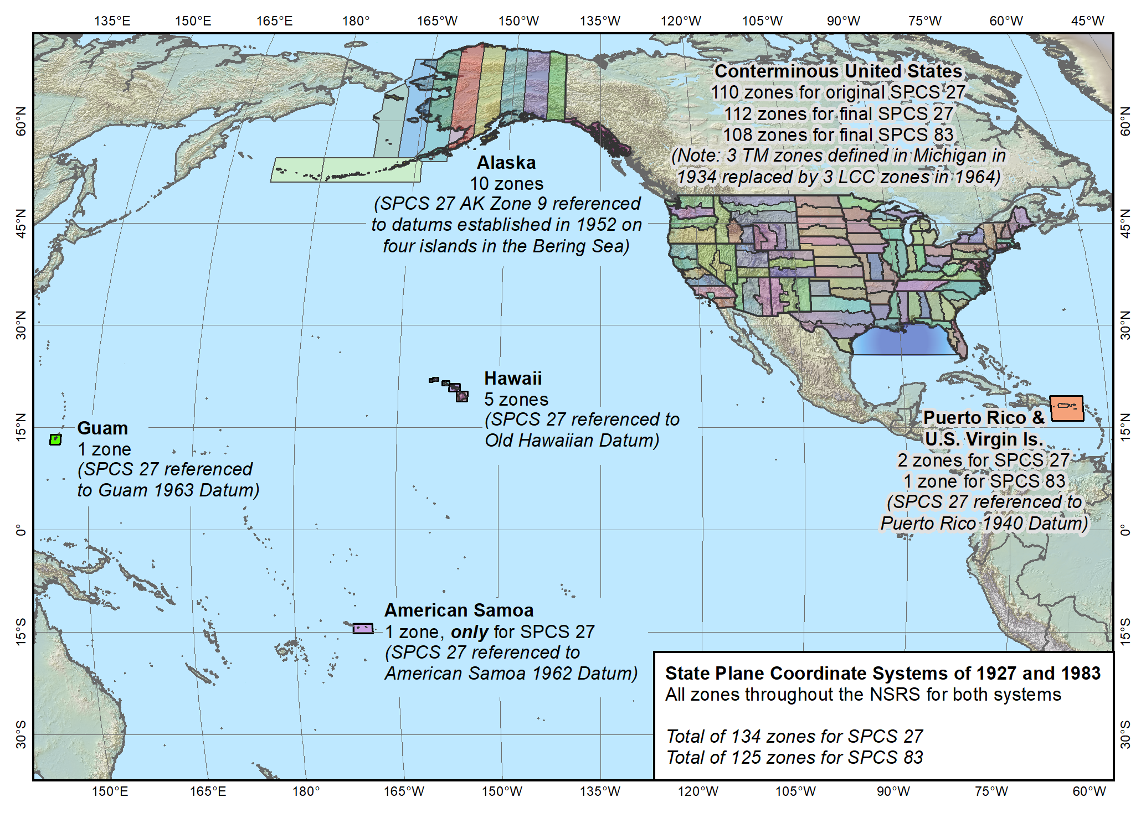
Entire SPCS
State Plane Coordinate Systems of 1927 (134 zones) and 1983 (125 zones)
Notes:
Map of the overall existing and previous versions of SPCS (1983 and 1927)
Shows the full large extent of the system.
Include CONUS, Alaska, and Hawaii
Also includes territories of Puerto Rico, U.S. Virgin Islands, American Samoa, and Guam (American Samoa included in SPCS 27 but not in 83)
Does NOT include Washington DC or islands of CNMI (but those will be included in SPCS2022)

Slide 31
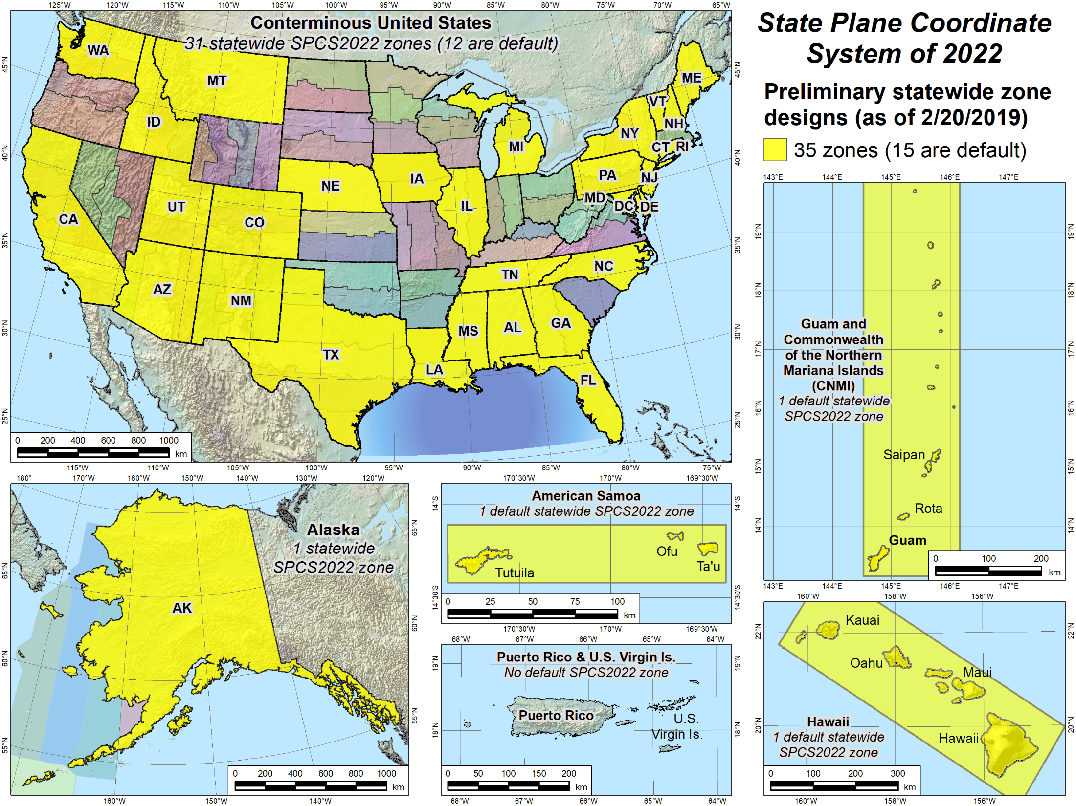
Statewide zones
Notes:
Similar to previous slide, but showing statewide SPCS2022 zones that have preliminary designs and maps available for download.
Note that some of the statewide zones are the same as the default zones in the previous slide
Note also that some states have a preliminary statewide zone design but no default zone design (e.g., Iowa).
States with no default design are ones that will design their own LDP system that provides statewide coverage and will not use the NGS default designs (that correspond to the existing SPCS 83 zones)
Reminder: All sates will get a statewide zone

Slide 32
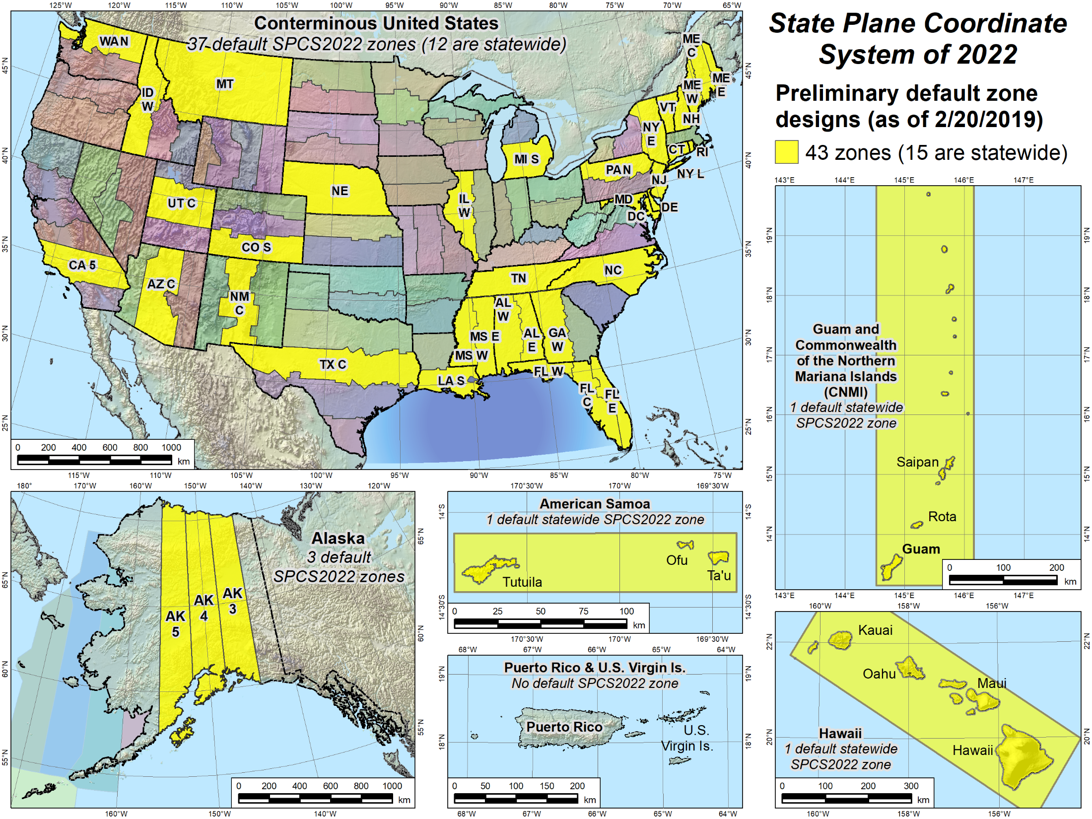
Default zones
Notes:
Larger scale maps of the areas included in the NSRS where SPCS2022 zones will be established
Yellow zones are preliminary designs of SPCS2022 default zones that have been completed.
Some of the default zones are statewide (or territory-wide, as the case may be)
Maps for (most of) these designs are currently available for download, along with maps of the corresponding SPCS 83 zones for comparison (will show examples).

Slide 33
Zone “layers” and uniqueness
Allow maximum of THREE layers
One must be statewide layer (designed by NGS)
0, 1, or 2 multiple-zone layers can exist. However:
Only ONE layer can have complete state coverage
Only ONE layer can have partial state coverage
Result: ONE multi-zone layer in most states
Partial coverage layer intended for mountainous states
All zones must be geodetically unique
Three values: origin latitude, origin longitude, and scale
Combined set of three values unique for ALL zones
Notes:
Layered zones are allowed for SPCS2022 (for a max of 3 layers)
One state in SPCS 83 has 2 layers, Kentucky (statewide plus a pre-existing 2-zone layer)
States can have 1, 2, or 3 layers
One layer MUST be a statewide zone (so a state with 1 layer has only a statewide zone)
The other 1 or 2 layers will almost always have multiple zones (unless a state has, say, a single LDP in SPCS2022 that covers only part of the state)
Only 1 layer can be “discontinuous”, that is, consist of layers that do not collectively cover the entire state (will show an example of this)
Decision to go with 3 layers based on FRN responses, especially those from mountainous western states
The multi-zone layer(s) can consist of LDPs
Almost always means distortion criterion < ±50 ppm, so must be designed by others (i.e., “contributing partners”), not by NGS

Slide 34
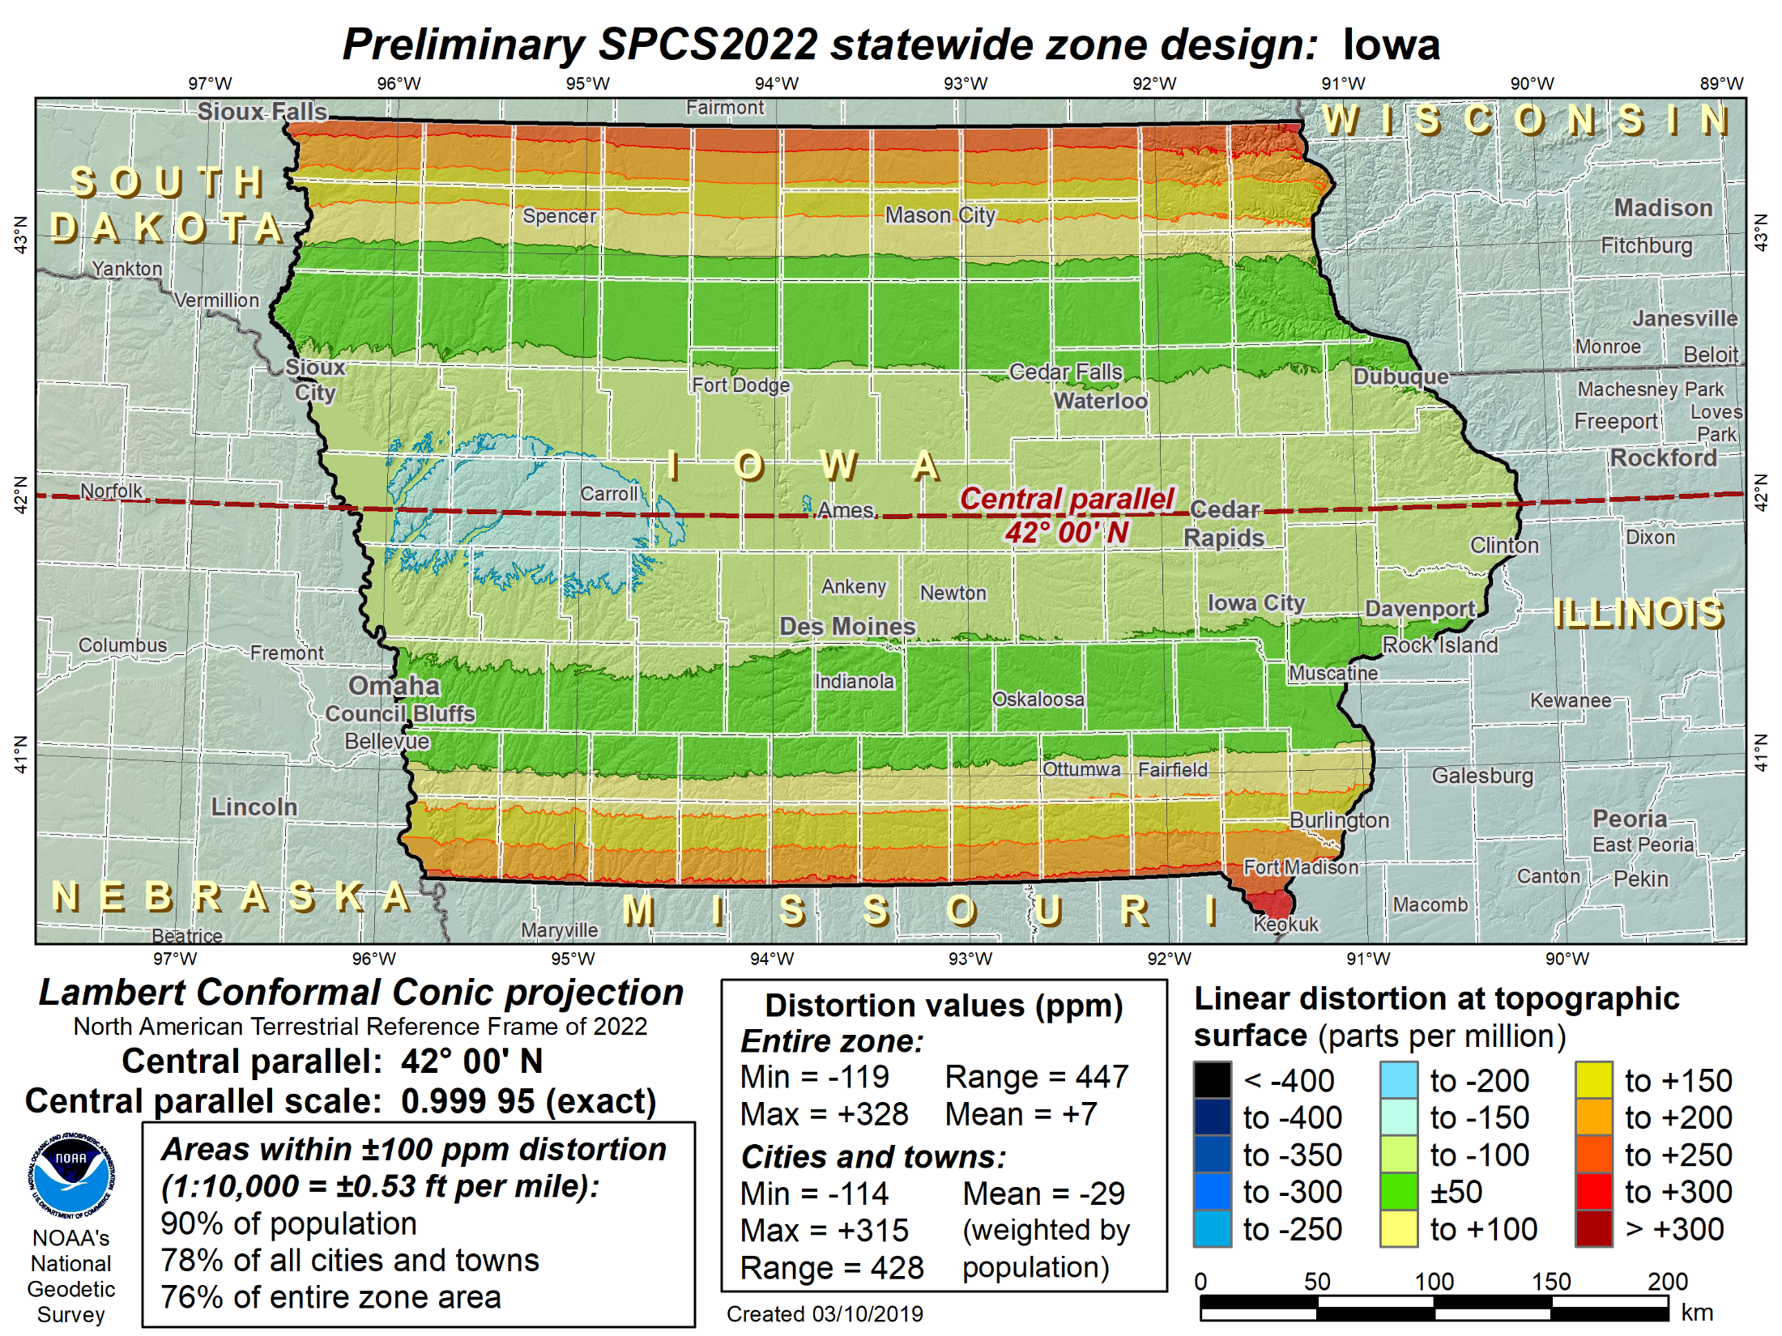
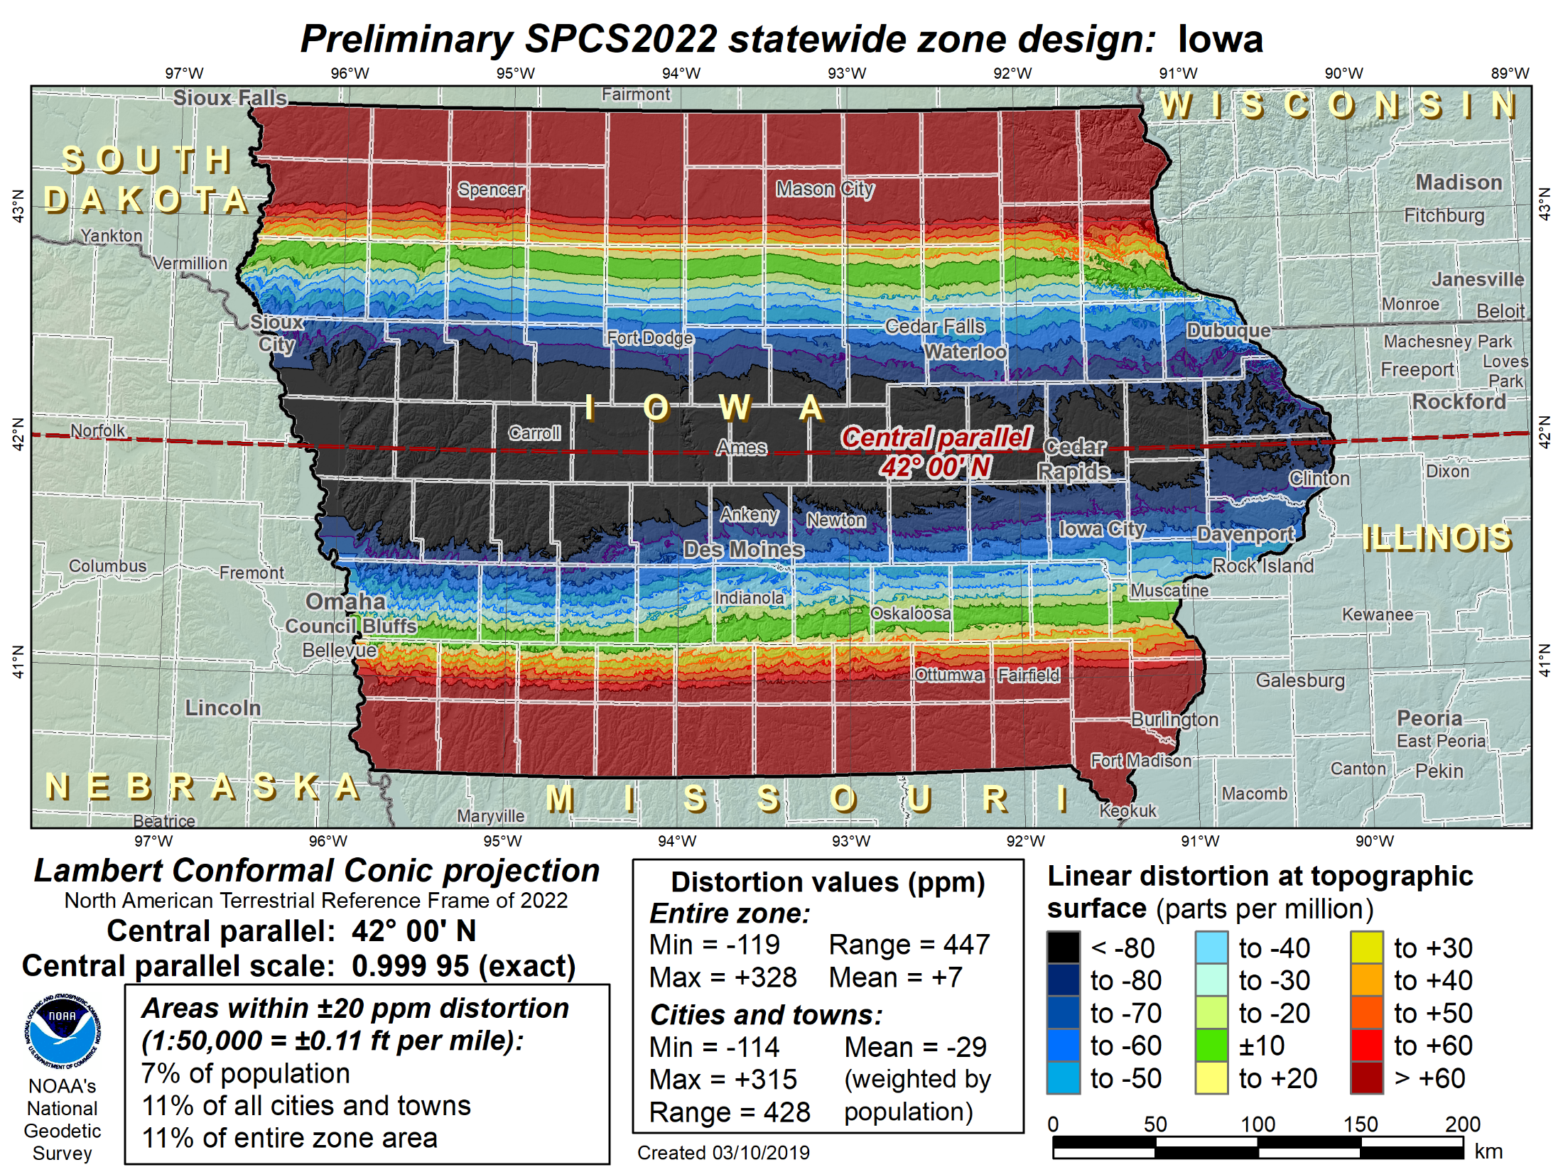
Iowa statewide “base” layer
99 counties in 1 zone: Lambert Conformal Conic projection
Area of state within: Distortion statistics
±20 ppm = 11% Min = -119 ppm
±50 ppm = 29% Max = +328 ppm
±100 ppm = 76% Mean = +7 ppm

Slide 35
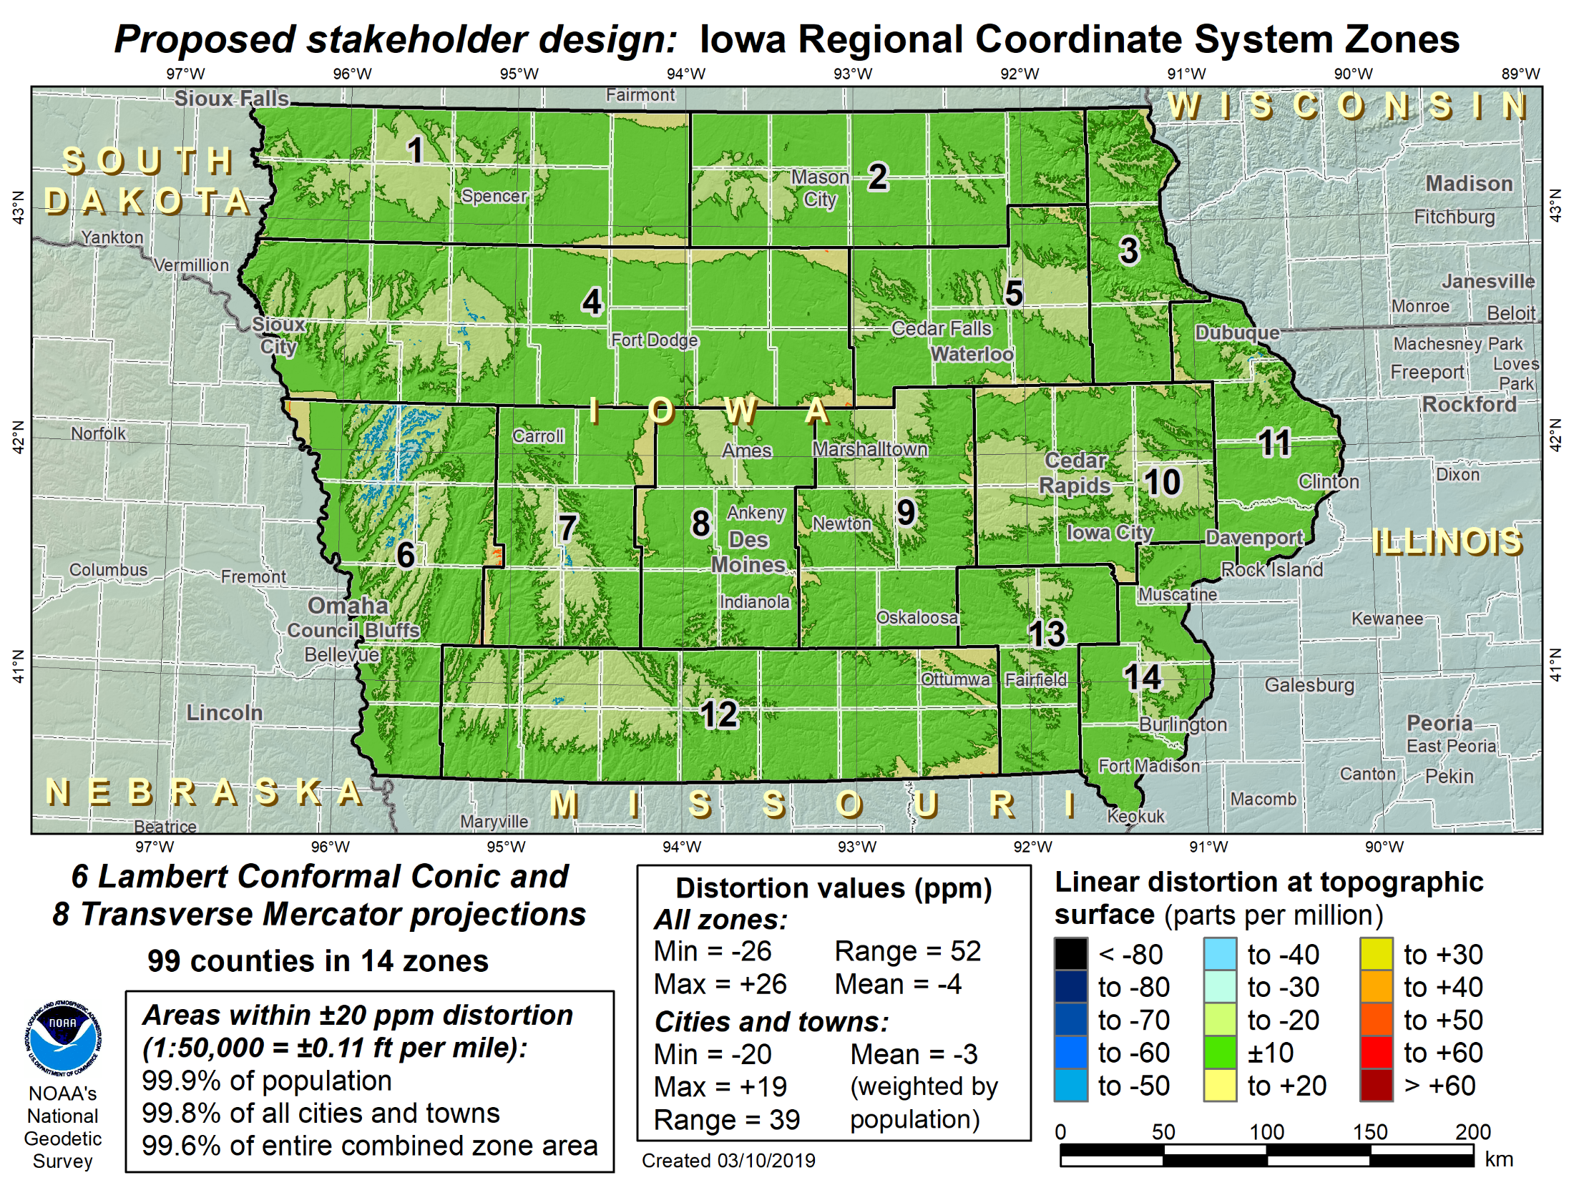
Iowa LDP layer
99 counties in 14 zones: 6 Lambert Conformal Conic and 8 Transverse Mercator projections
Area of state within: Distortion statistics
±10 ppm = 73.628% Min = -26 ppm
±20 ppm = 99.605% Max = +26 ppm
±25 ppm = 99.999% Mean = -4 ppm

Slide 36
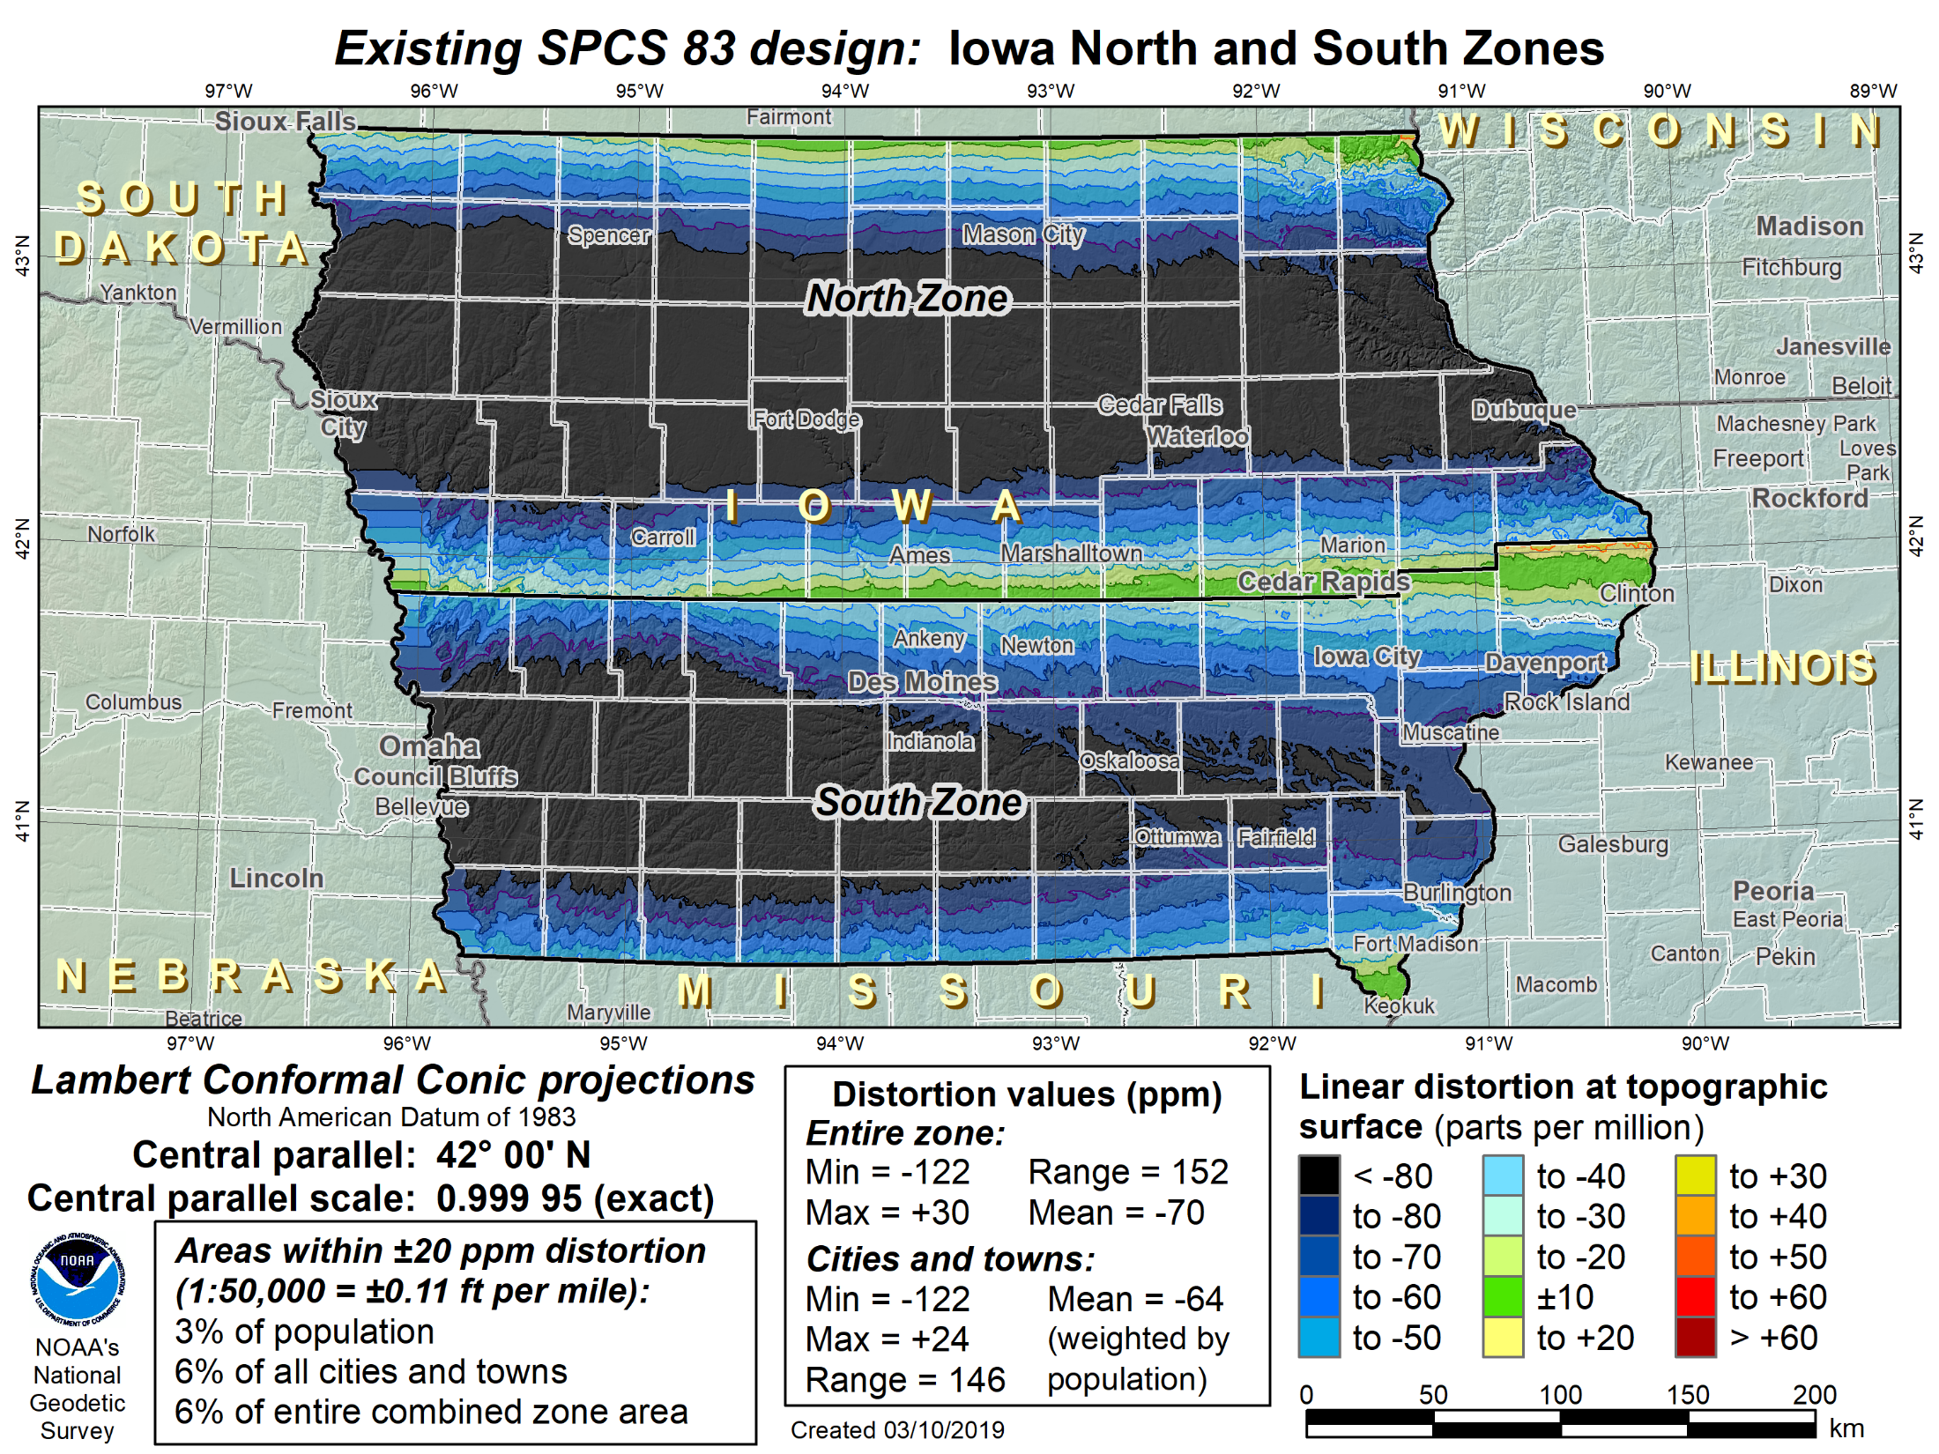
Iowa SPCS 83-like layer
99 counties in 2 zones: 2 Lambert Conformal Conic projections
Area of state within: Distortion statistics
±20 ppm = 6% Min = -122 ppm
±50 ppm = 24% Max = +30 ppm
±100 ppm = 84% Mean = -70 ppm

Slide 37
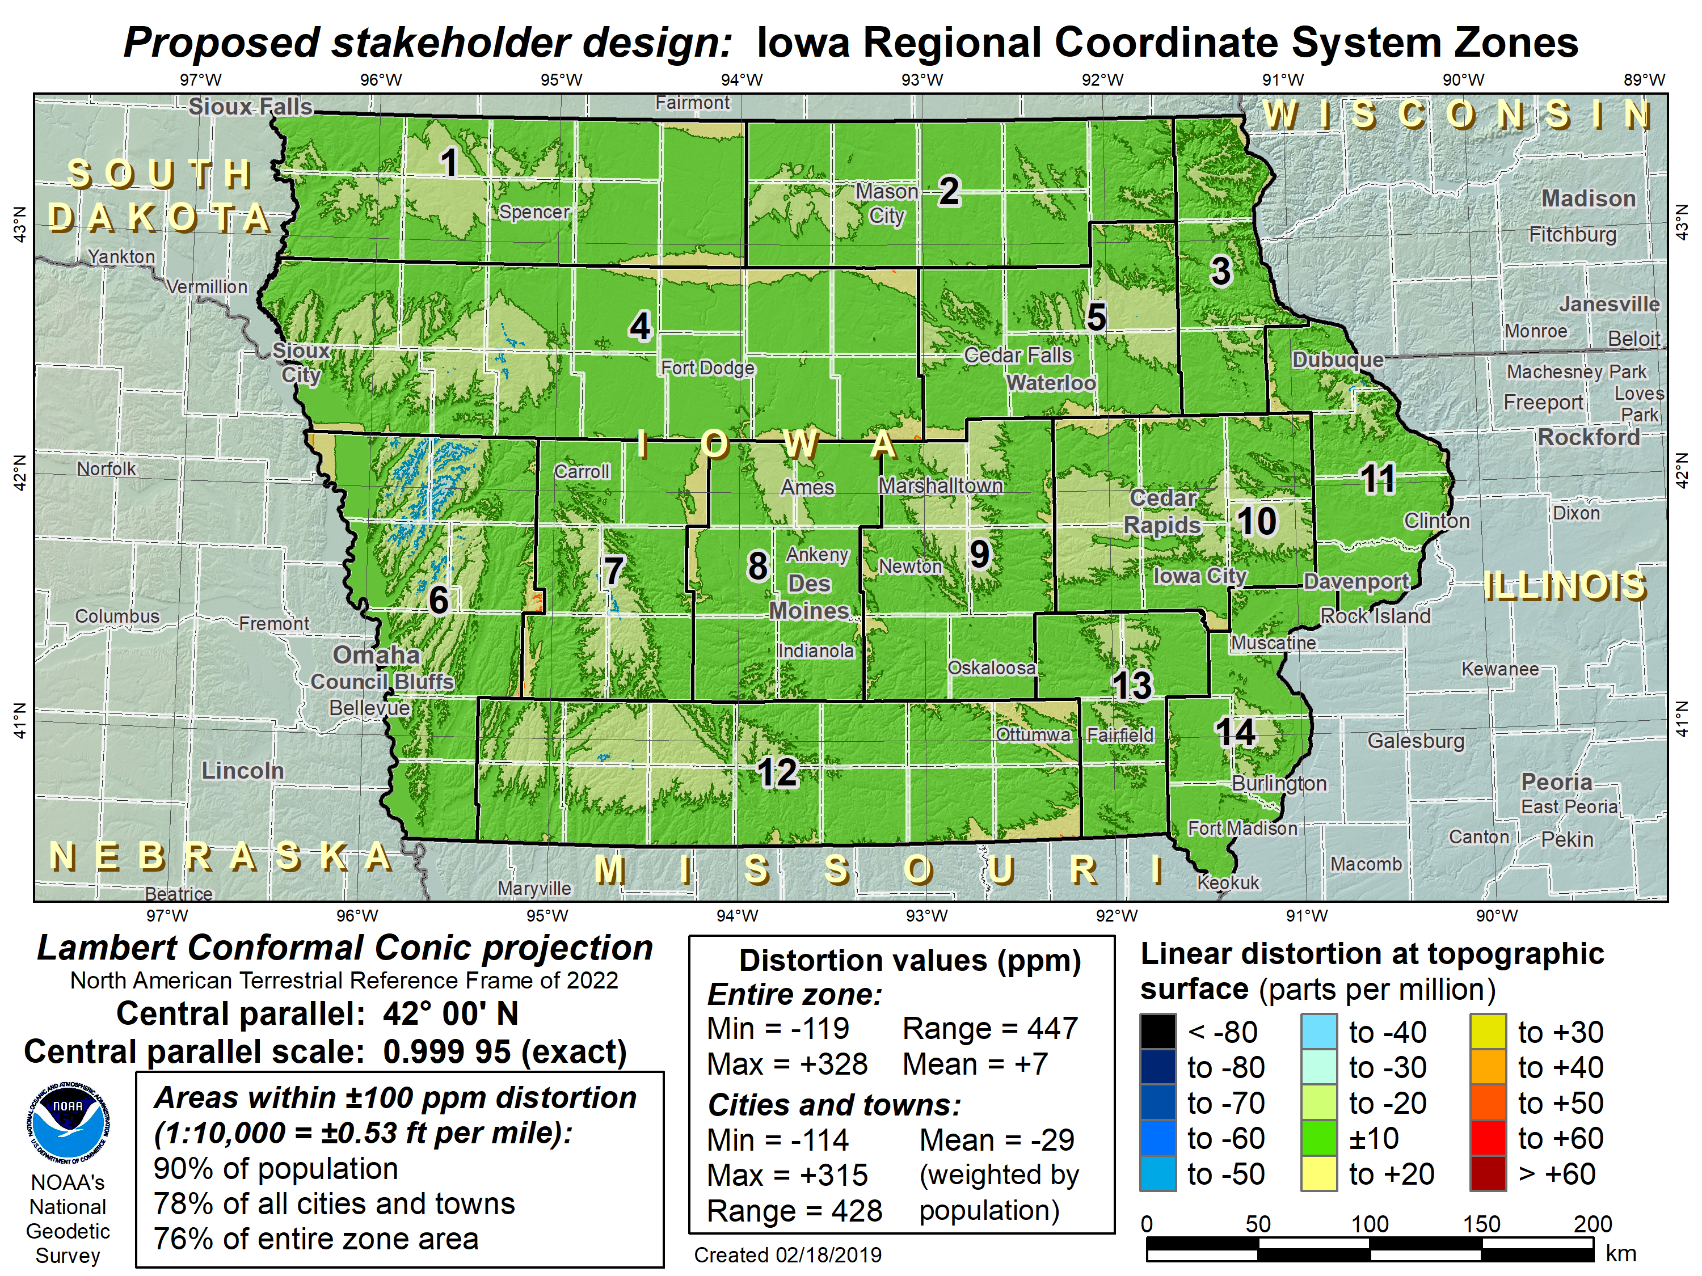
Iowa with TWO SPCS2022 layers
LDP multiple-zone layer (complete state coverage)
SPCS 83-like multiple-zone layer (complete state coverage)
OR
Statewide layer for EVERY state

Slide 38
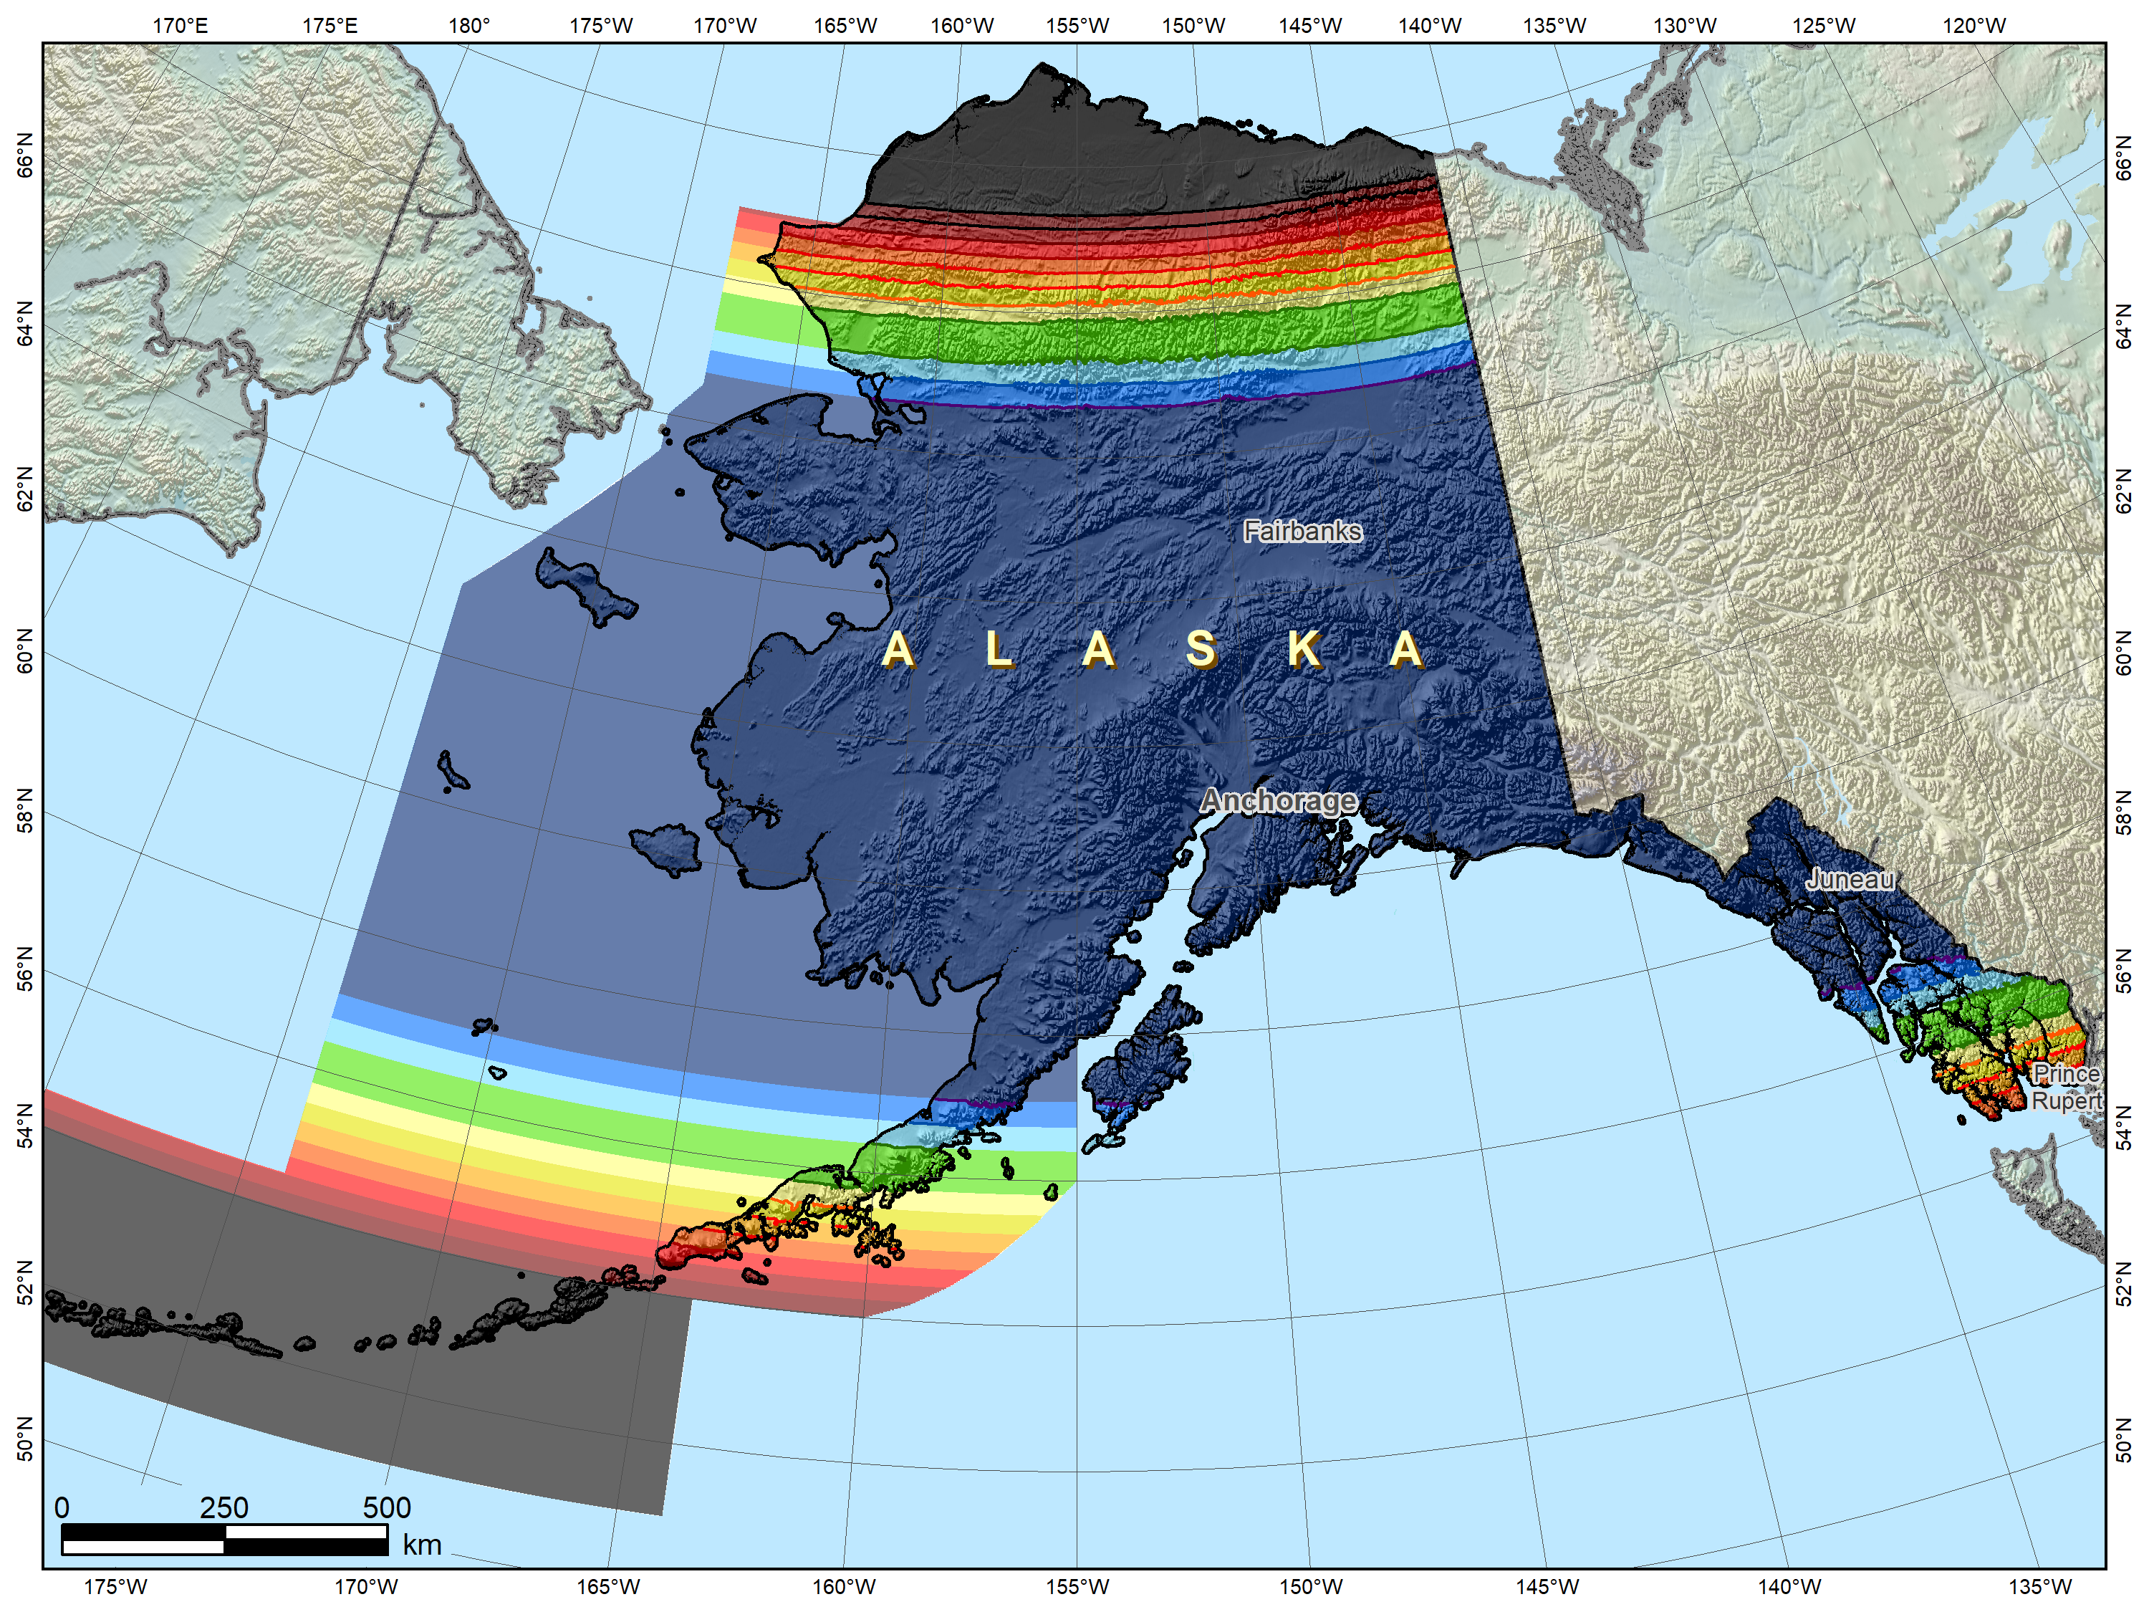
Alaska statewide “base” layer
Possible Alaska zone layer configuration
1. Statewide layer

Slide 39
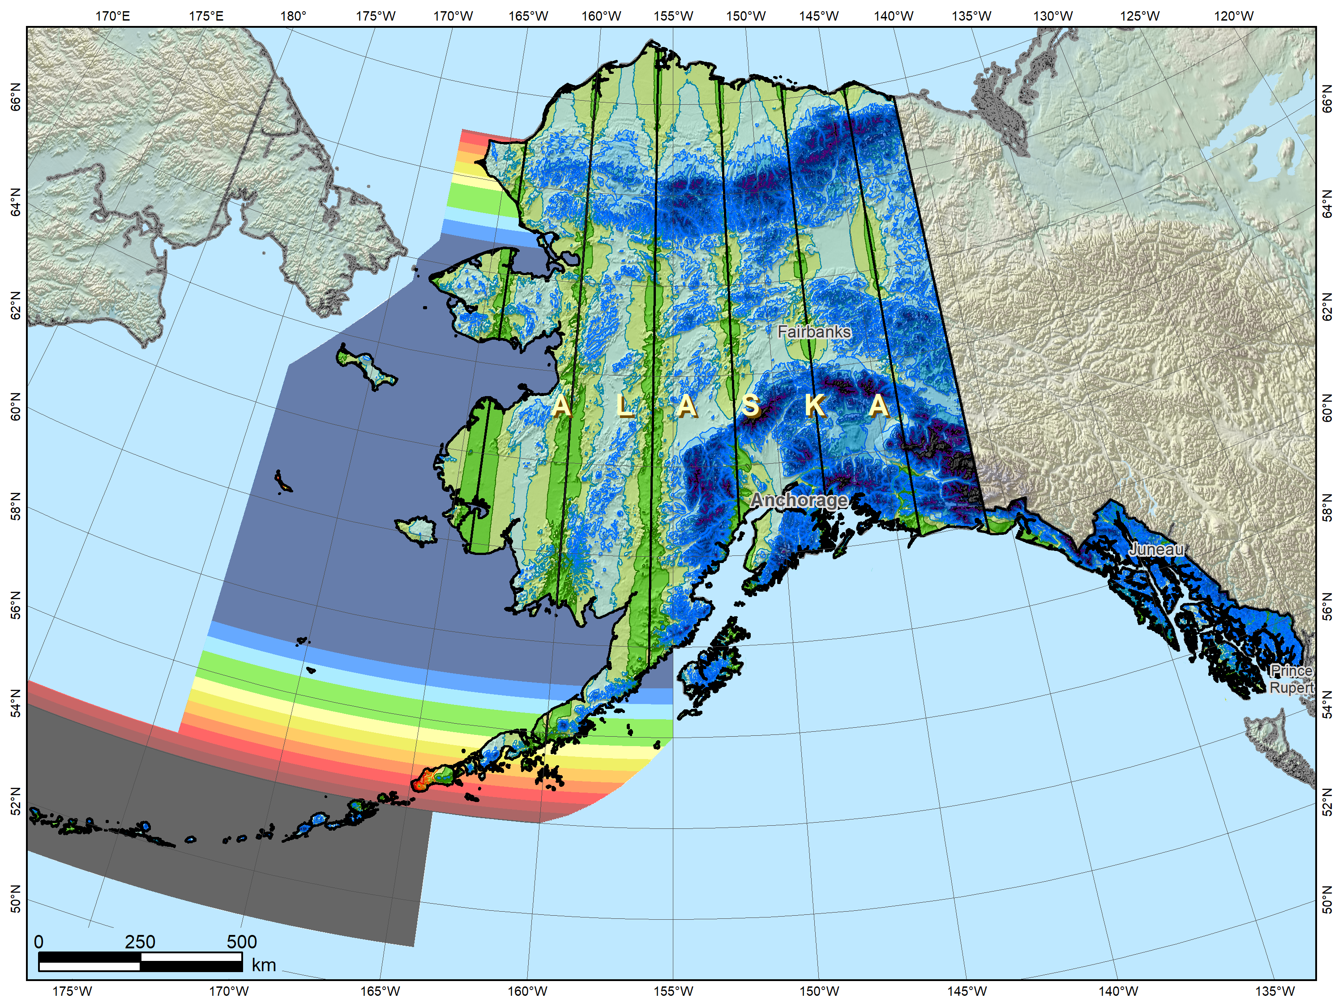
Alaska complete “intermediate” layer
Possible Alaska zone layer configuration
1. Statewide layer
2. “Intermediate” layer (complete state coverage)
39

Slide 40
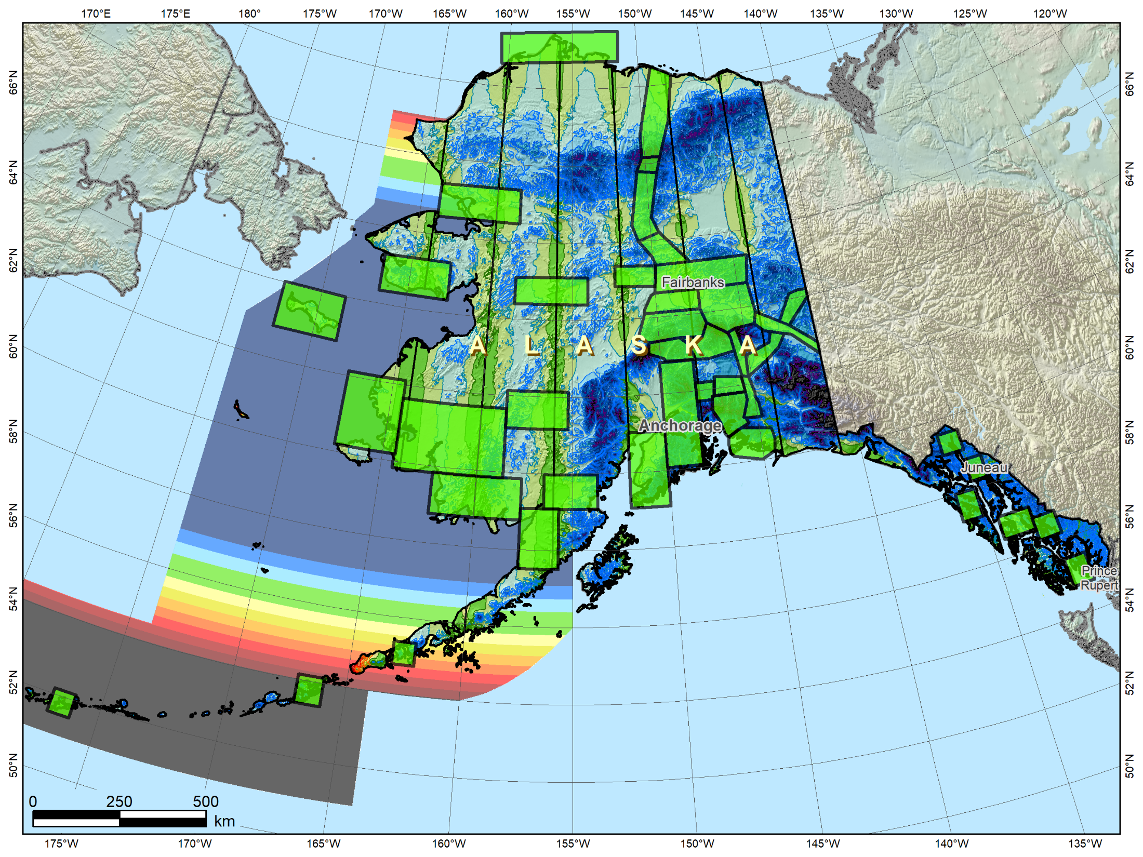
Alaska with THREE SPCS2022 layers
Possible Alaska zone layer configuration
1. Statewide layer
2. “Intermediate” layer (complete state coverage)
3. LDP layer (partial state coverage)
40

Slide 41
SPCS2022 zones designed by NGS
Linear distortion design criterion
Parts per million (ppm), e.g., ±20 , ±50 , ±100 ppm, etc.
Criterion must satisfy all of following:
90% of population
75% of all cities and towns (by location only)
50% of entire zone area
Limitations for designs by NGS
Minimum design criterion ±50 ppm (1:20,000)
Maximum design criterion ±400 ppm (1:2,500)
May be less for default zones if existing zone small
Low distortion projections (LDPs)
Must be designed by others for distortion < ±50 ppm
Notes:
This is a quick description of the design method used by NGS for SPCS2022 zones
Designs are based on a “linear distortion design criterion”
Criterion can initially be estimated by width of zone perpendicular to the projection axis (central meridian for TM, central parallel for LCC, and skew axis for OM).
The value in parts per million (ppm) for the criterion are ranges of ±5, ±10, ±20, ±30, ±40, ±50, ±75, ±100, ±150, ±200, ±300, or ±400 ppm.
Standard values are used to facilitate design comparison and evaluation
Gives indication of performance at topographic surface, where it is actually used
Design criterion is the smallest standard range (listed above) that satisfies all three of the following minimum percentages:
90% of population (based on actual population distribution)
75% of cities and towns, based only on location, irrespective of population. Done to prevent excessive dominance of very large cities at expense of small communities. Concept here is similar to Congress being represented by the same number of senators for every state, in contrast to population-based matric being analogous to House of Representatives.
50% of entire zone area. This value is set to accommodate mountainous zones; zones with minor topographic relief will usually get much here percent coverage by area.
Zones design by NGS will use a minimum criterion of ±50 ppm (which is half the nominal ±100 ppm used for SPCS 83 and 27, with respect to the ellipsoid).
However, there are many states and existing zones within states that are small enough that a lower criterion will be used by NGS for default designs.
For new zones requested by stakeholders in multi-zone states, NGS will typically not design for less than ±50 ppm.
Low distortion projections (LDPs) must be designed by stakeholder “contributing partners” if the criterion is less than ±50 ppm.

Slide 42
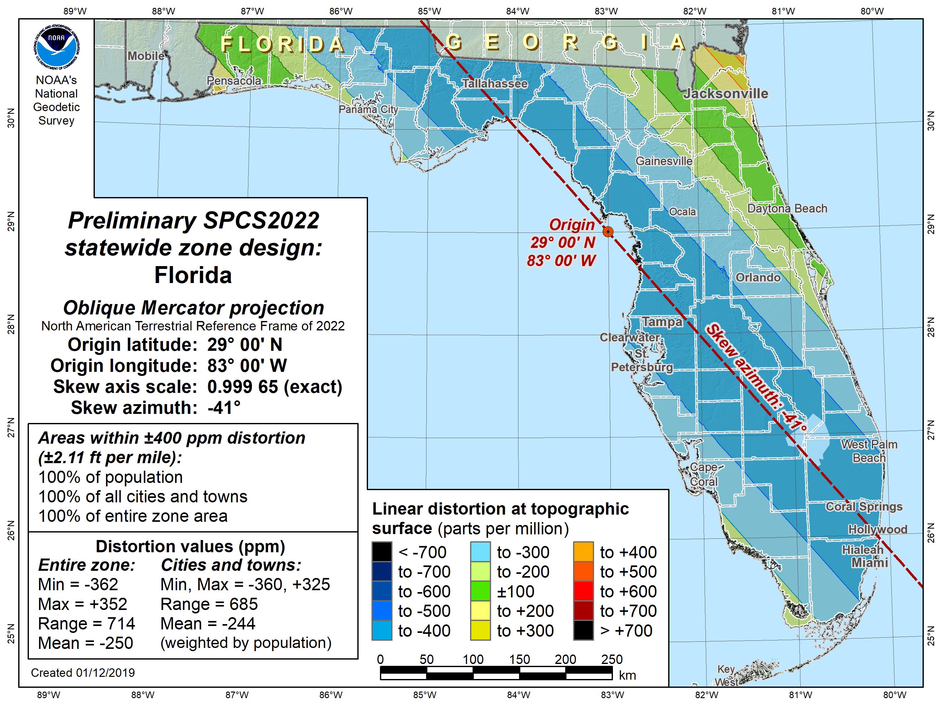
Florida statewide
±400 ppm distortion design criterion:
100% of population
100% of cities
100% of area
Notes:
Preliminary statewide design for Florida, also using an OM projection
Design criterion of ±400 ppm has all percentages of 100%
Next lower criterion of ±300 ppm did not meet all three (90%, 75%, 50%) minimum requirements, so ±400 ppm is smallest available criterion value
±400 ppm corresponds to the distortion limits of a UTM zone (with respect to the ellipsoid)

Slide 43
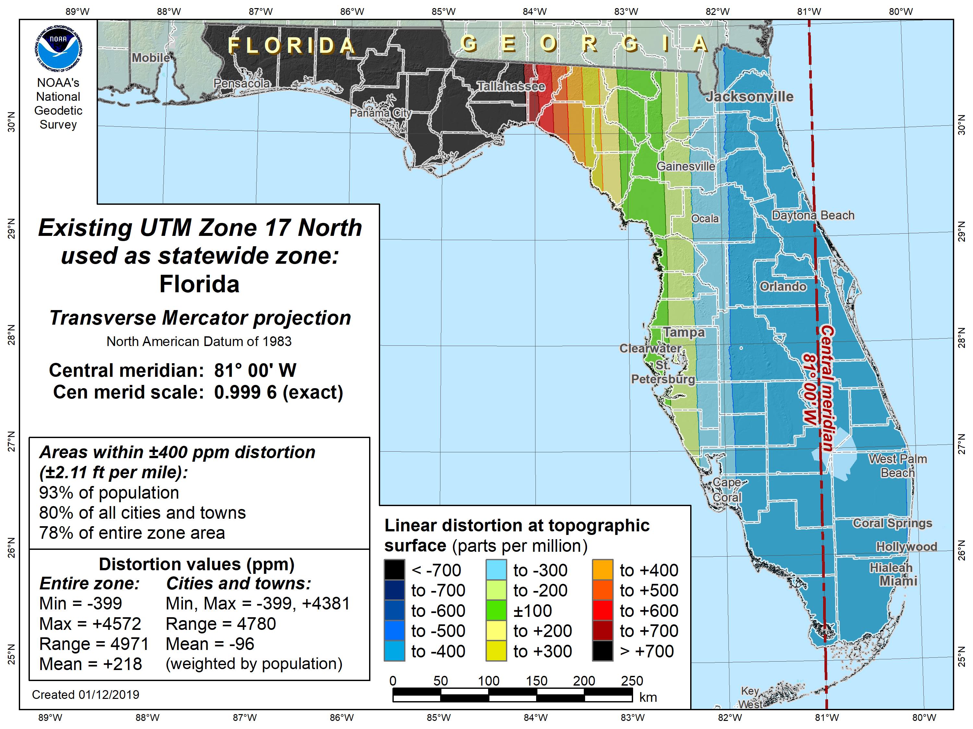
Florida statewide using UTM
±400 ppm distortion design criterion:
93% of population
80% of cities
78% of area
Notes:
Map showing distortion of the nearest UTM zone used as a statewide zone for Florida (this is used by some Florida agencies)
Performance is significantly inferior to preliminary SPCS2022 zone design (greater distortion, highly imbalanced)
UTM does not work well for Florida as a statewide system because:
Central meridian of nearest zone is biased east (at 81°W longitude)
Even for a centered TM zone, Florida is too wide east-west (~7.5°), which is wider than 6° zone width of UTM
UTM generally does NOT work well for statewide zones because:
UTM central meridian usually is not close to the east-west midpoint of a state
Many states are too wide east-west even if the central
UTM is designed to minimize distortion at ellipsoid surface, not topographic surface

Slide 44
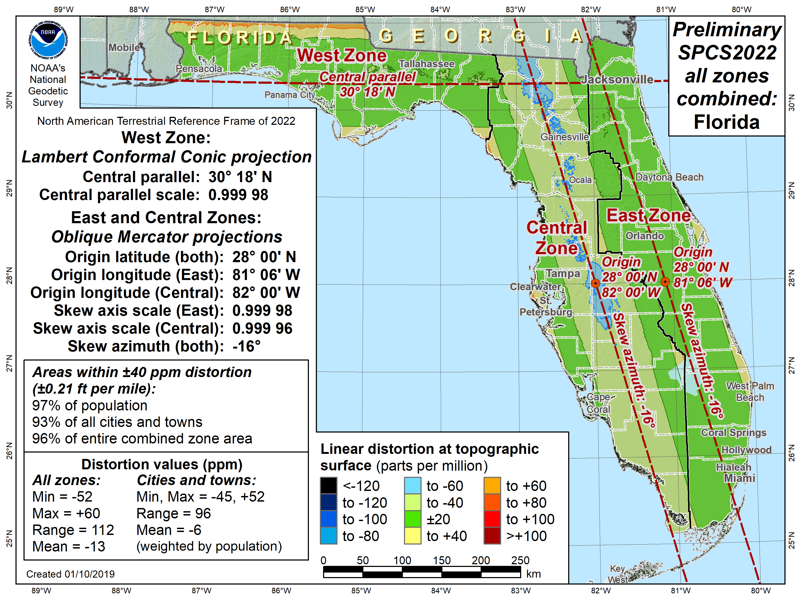
Florida SPCS2022 (preliminary)
±40 ppm distortion design criterion:
97% of population
93% of cities
96% of area
Notes:
Example of 3 preliminary default SPCS2022 zones designed by NGS for Florida
Replaces the existing 3 SPCS 83 zones (shown on the next slide)
Note that following characteristics:
Uses 2 OM projections to replace existing 2 TM projections for the peninsula
Uses 1-parallel LCC to replace existing 2-parallel LCC for panhandle
Uses ±40 ppm design criterion (less than minimum of ±50 ppm) because existing areas are too narrow for a ±50 ppm criterion

Slide 45
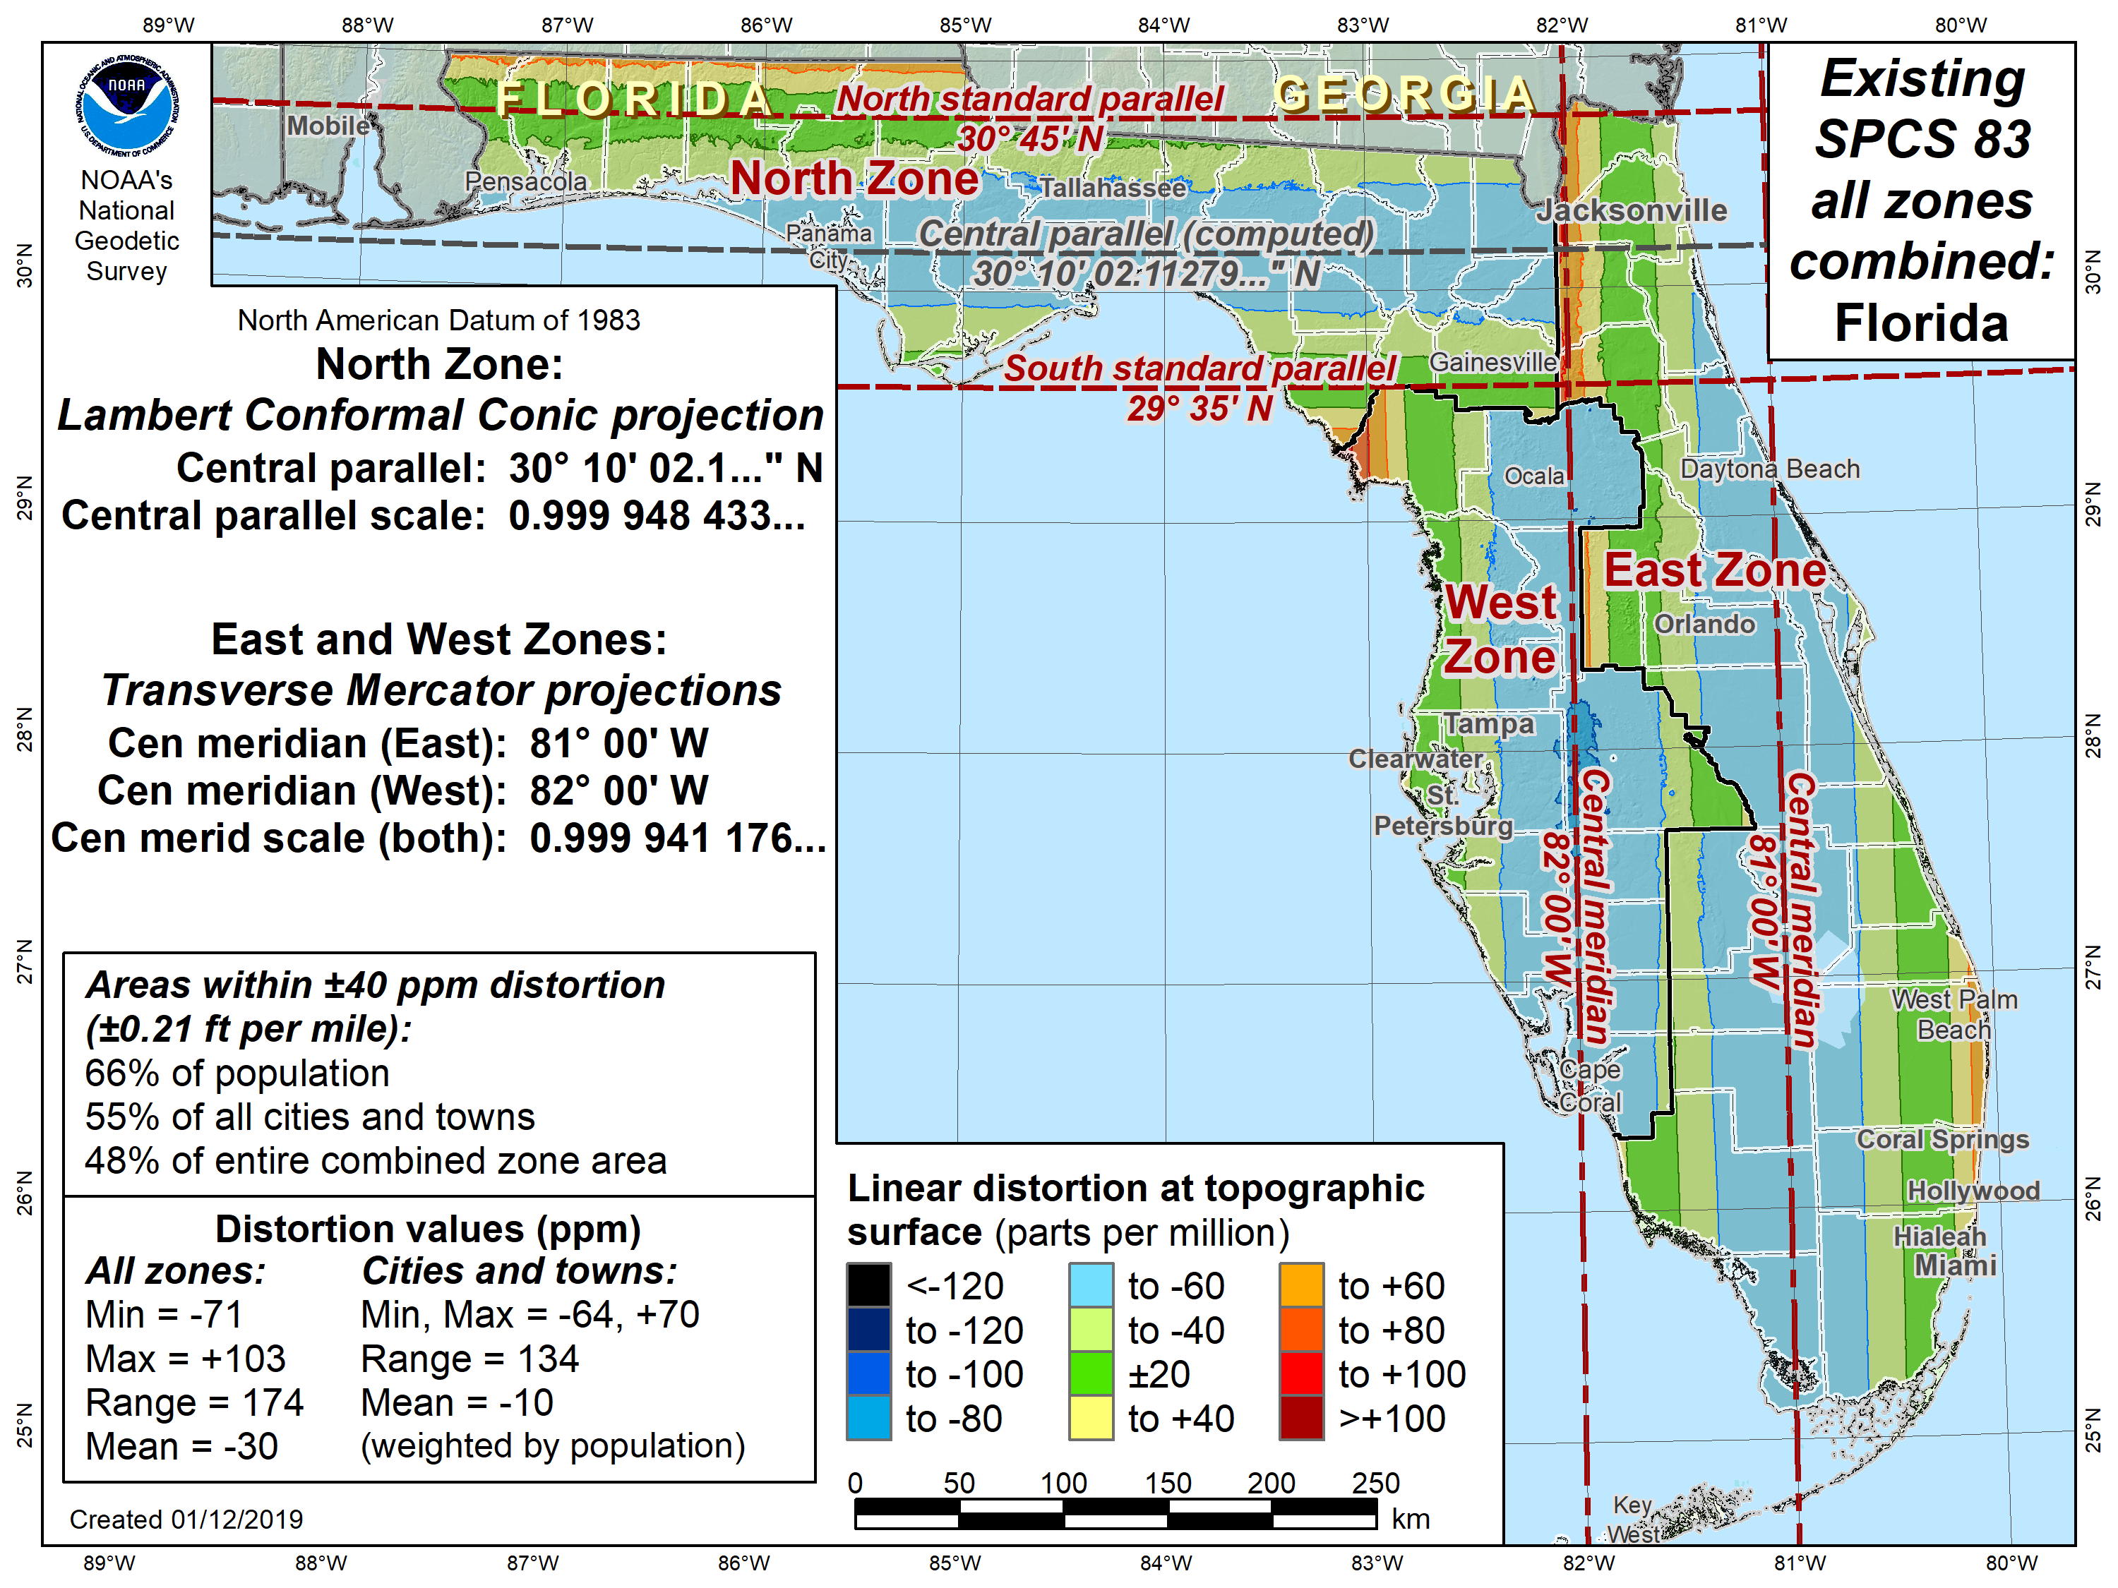
Florida SPCS 83
±40 ppm distortion design criterion:
66% of population
55% of cities
48% of area
Notes:
Distortion map of existing 3 Florida SPCS 83 zones, for comparison with preliminary default SPCS2022 designs
Distortion significantly greater than SPCS2022 design
Performance percentages do not meet design requirements, because this is an “as is” map (not a design), and it uses the same criterion as the design for comparison.

Slide 46
NGS design request in practice
Minimum distortion criterion of ±50 ppm
Corresponds to nominal width of 180 km
Example: Request zones different from default
State has 3 SPCS 83 zones designed for ±100 ppm
State about 600 km wide
Wants new set of zones at ±50 ppm
Estimated number of new zones:
State width / 180 km, rounded up to next whole number
600 km / 180 km = 3.333 → 4 zones
New SPCS2022 configuration will likely consist of 4 zones

Slide 47
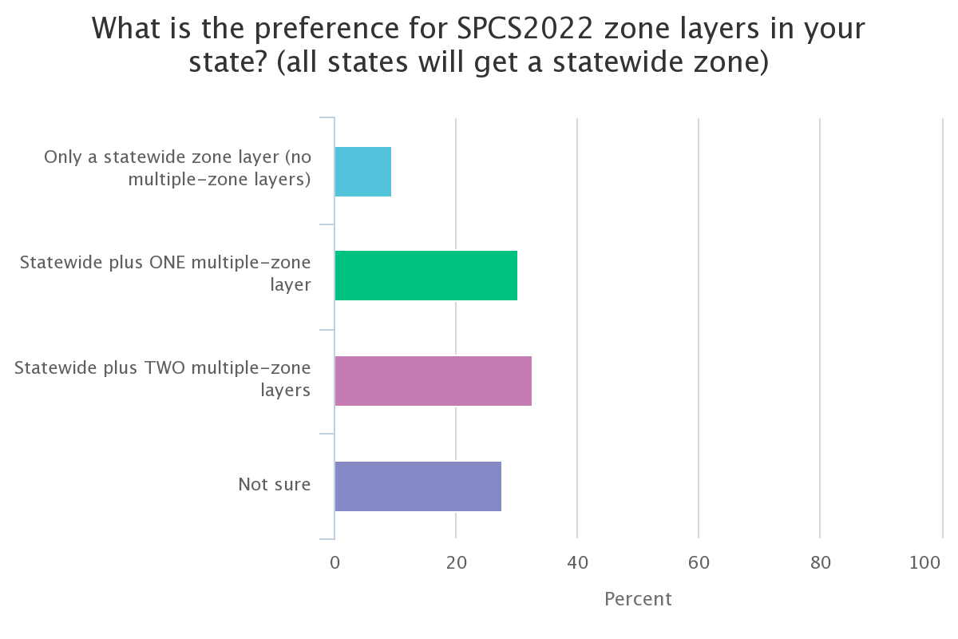
Poll question 3
What is the preference for SPCS2022 zone layers in your state? (all states will get a statewide zone)
Only a statewide zone layer (no multi-zone layers)
Statewide plus ONE multiple-zone layer
Statewide plus TWO multiple-zone layers
Not sure
711 responses

Slide 48
Fillable PDF stakeholder forms
SPCS2022 Zone Request and Proposal Form
To request zones designed by NGS
To propose zones that stakeholders will design
SPCS2022 Zone Design Submittal Form
For stakeholders to submit designs
Based in NGS-approved previously submitted proposal
For default designs, no request form needed
But submitting a request will expedite final design

Slide 49
Request/proposals Design submittals

Slide 50
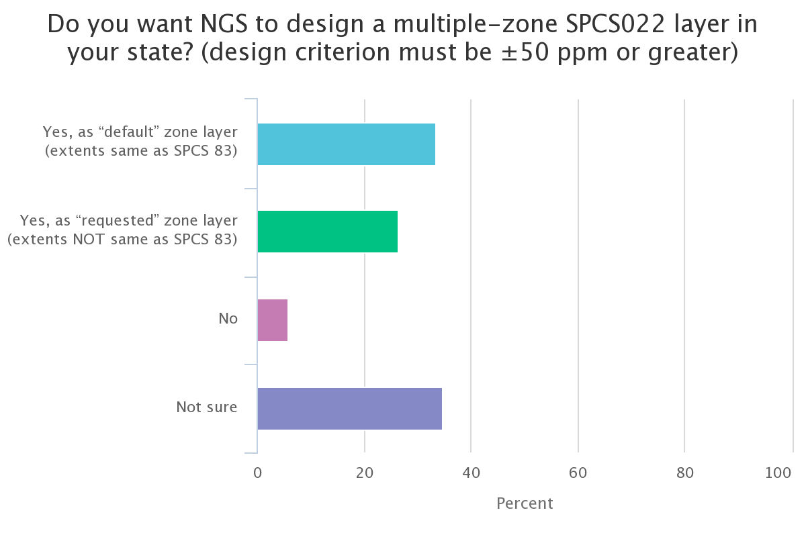
Poll question 4
Do you want NGS to design a multiple-zone SPCS022 layer in your state? (design criterion must be ±50 ppm or greater)
Yes, as “default” zone layer (extents same as SPCS 83)
Yes, as “requested” zone layer (NOT same as SPCS 83)
No
Not sure
708 responses

Slide 51
Low distortion projections (LDPs)
Multi-zone layer can consist of LDPs
Designed by stakeholders
Coverage can be complete or partial (discontinuous)
Minimum zone width
50 km (31 miles) if height range <= 250 m
10 km (6 miles) if height range > 250 m
What is zone “width” anyway?
Width of rectangle that completely encloses zone
“Minimum bounding rectangle by width”
Rectangle in same projection as zone, any orientation
Notes:
Layered zones are allowed for SPCS2022 (for a max of 3 layers)
One state in SPCS 83 has 2 layers, Kentucky (statewide plus a pre-existing 2-zone layer)
States can have 1, 2, or 3 layers
One layer MUST be a statewide zone (so a state with 1 layer has only a statewide zone)
The other 1 or 2 layers will almost always have multiple zones (unless a state has, say, a single LDP in SPCS2022 that covers only part of the state)
Only 1 layer can be “discontinuous”, that is, consist of layers that do not collectively cover the entire state (will show an example of this)
Decision to go with 3 layers based on FRN responses, especially those from mountainous western states
The multi-zone layer(s) can consist of LDPs
Almost always means distortion criterion < ±50 ppm, so must be designed by others (i.e., “contributing partners”), not by NGS

Slide 52
Iowa LDP layer
Lambert Conformal Conic and Transverse Mercator projections
99 counties in 14 zones
Area of state within: Distortion statistics
±10 ppm = 73.628% Min = -25.9 ppm
±20 ppm = 99.605% Max = +25.9 ppm
±25 ppm = 99.999% Mean = -3.9 ppm

Slide 53
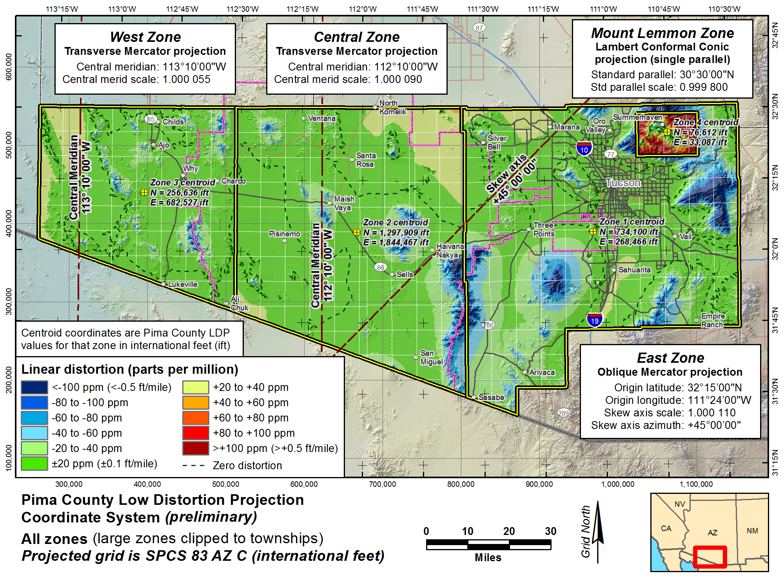

Slide 54
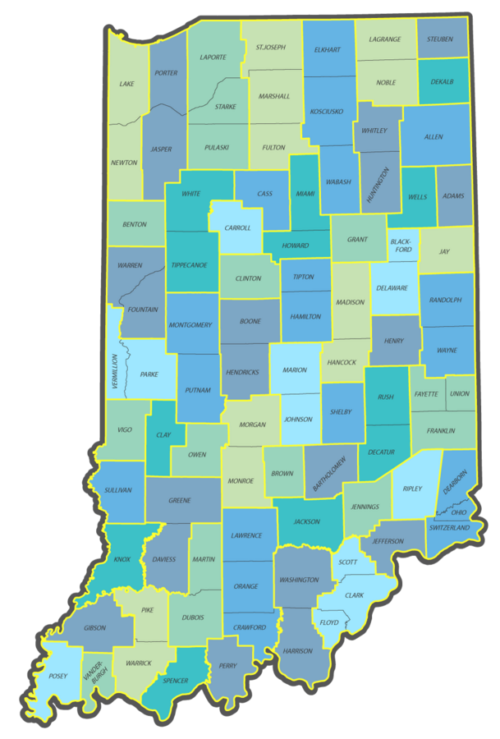
Indiana Geospatial Coordinate System
92 zones (by county)
57 unique definitions (some counties share projections)
Transverse Mercator used for all zones
www.in.gov/indot/InGCS.htm
Does NOT meet revised draft SPCS2022 policy
Zones too small
Zones not unique
Will require exceptions to become part of SPCS2022

Slide 55
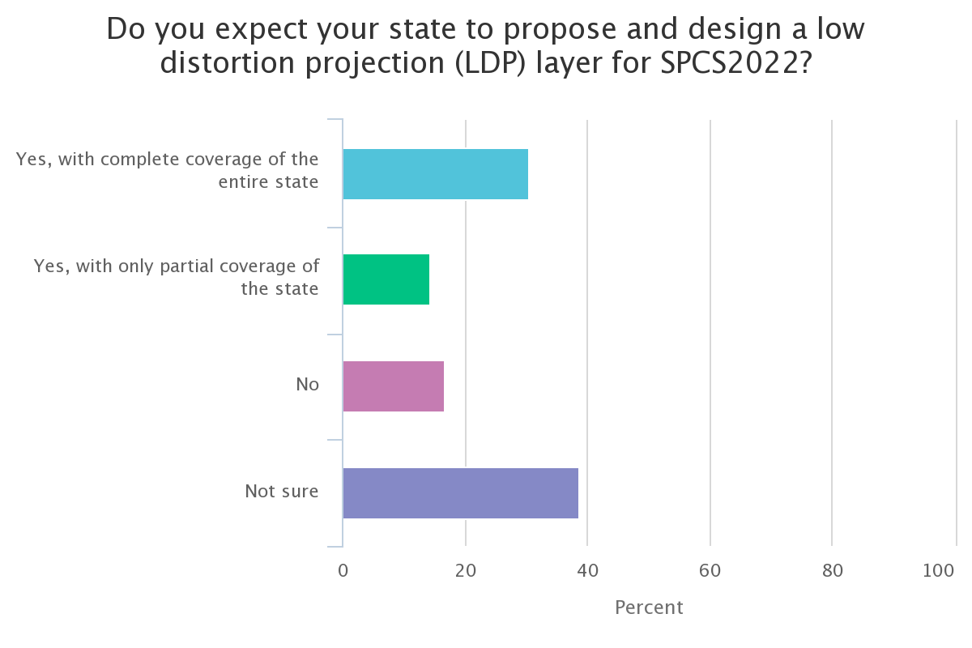
Poll question 5
Do you expect your state to propose and design a low distortion projection (LDP) layer for SPCS2022?
Yes, with complete coverage of the entire state
Yes, with only partial coverage of the state
No
Not sure
739 responses

Slide 56
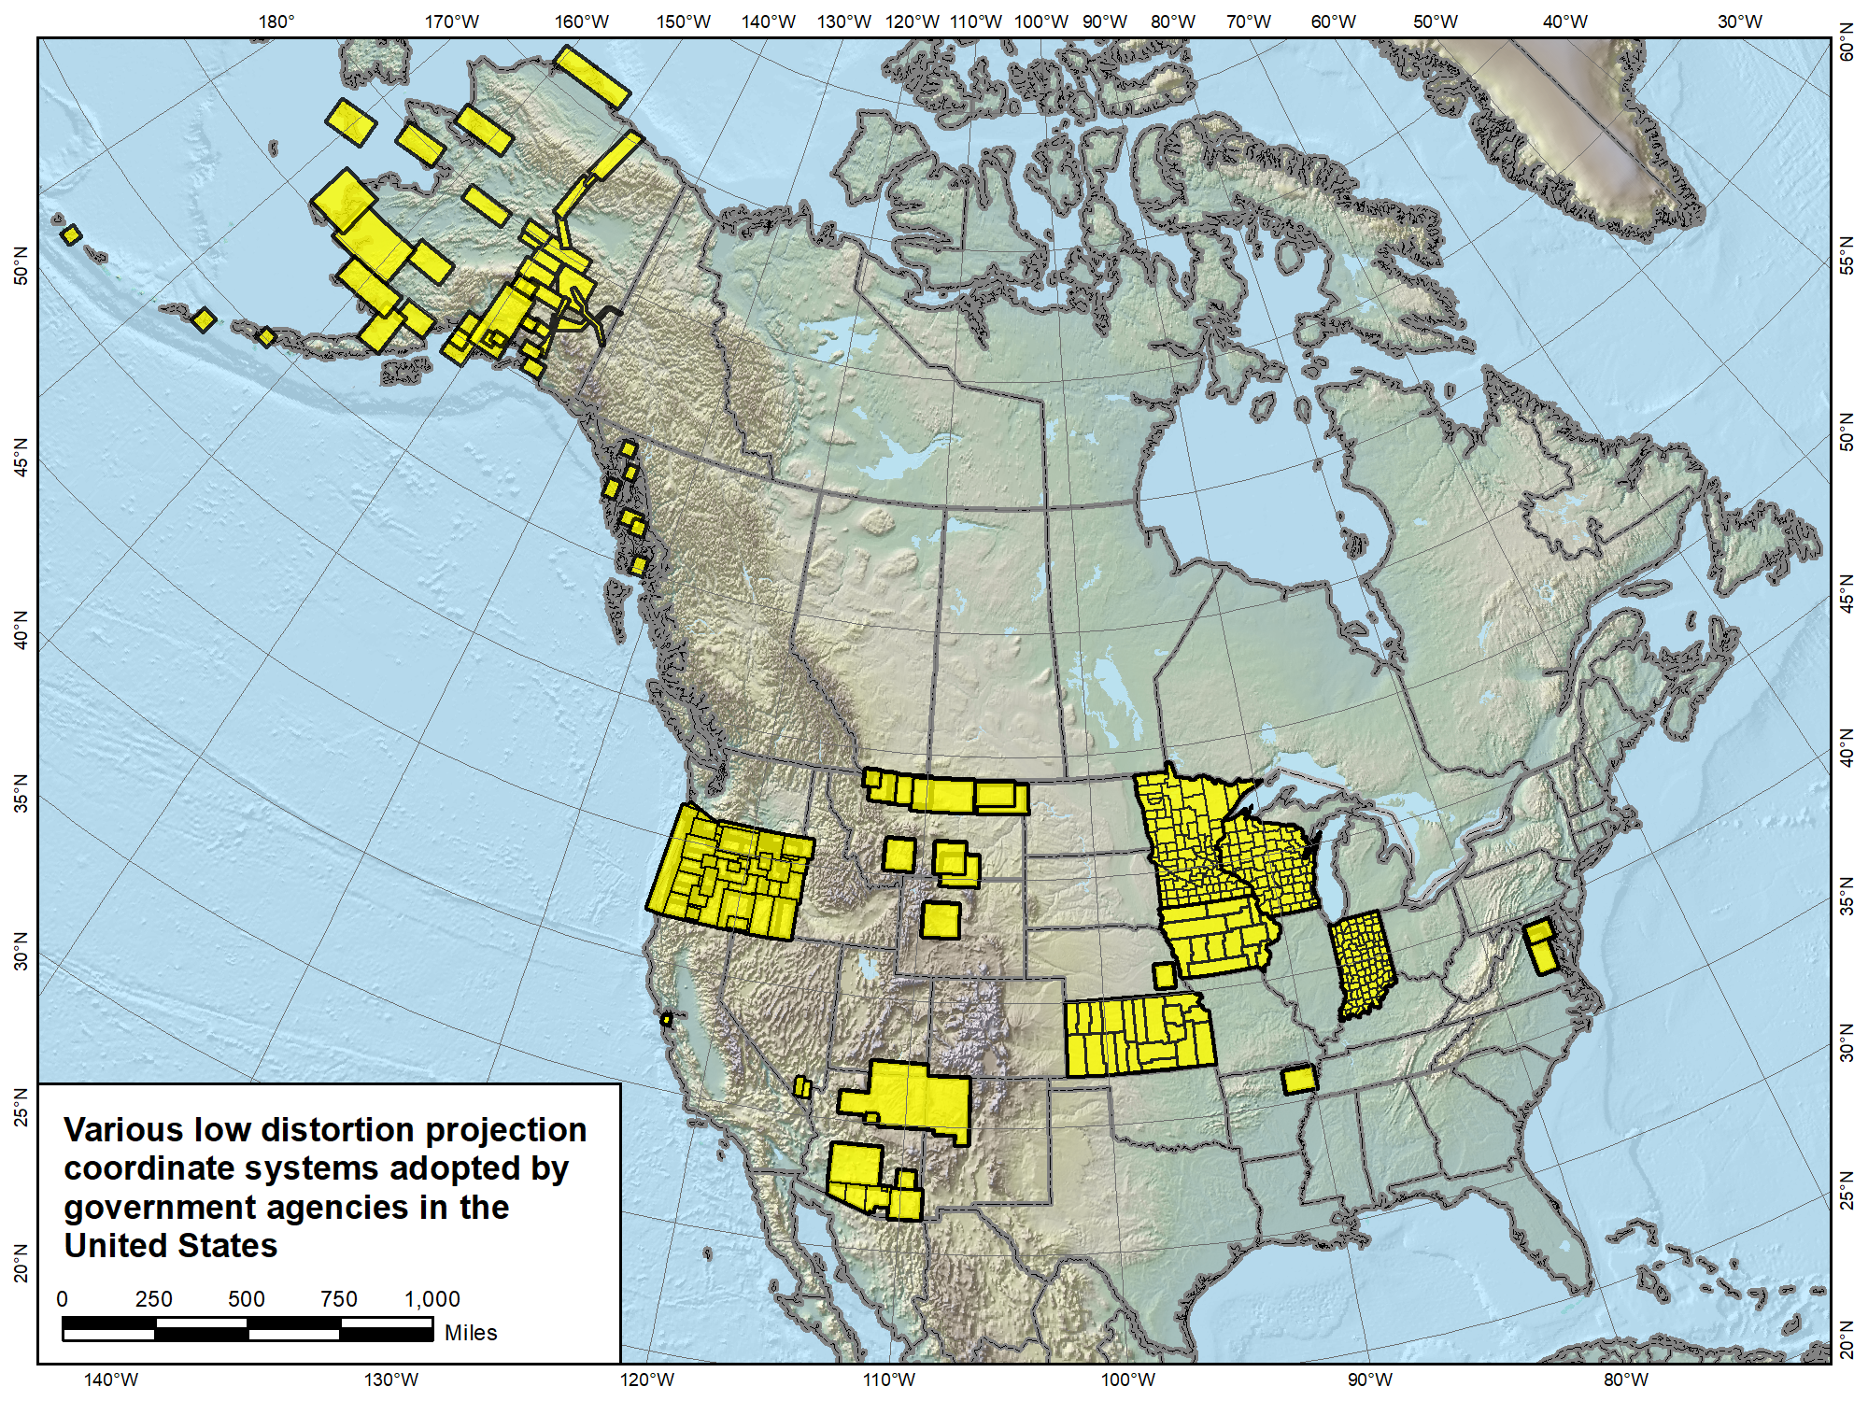
Versions of most of the LDP systems shown (as well as others) will likely become part of SPCS2022, both with complete and partial state coverage.
Navajo Nation Coordinate System not actually an LDP, and it falls in 3 states. It is something “special”…
Notes:
Map showing LDP systems adopted by government agencies and currently in use throughout the U.S. (there are likely quite a few others).
Note that discontinuous systems like that in Montana exist in other states, most notably Alaska
States with compete LDP zone coverage also exist, and it is expected that all shown will propose an LDP SPCS2022 layer, with no default layer corresponding to their existing SPCS 83 zones (i.e., they will have only 2 layers, statewide and LDP)
One zone shown is for the Navajo Nation
Too large (with too much distortion) to realistically be considered an LDP zone
Falls in 3 states (Arizona, New Mexico, and Utah)
Because it is in more than 1 state, it is a candidate for a “special purpose” zone, which is the topic of the next slide…

Slide 57
“Special use” SPCS2022 zones
Formerly “special use” zones
Zones for regions in more than one state
Categories:
Major urban areas (e.g., New York, Chicago, St. Louis)
Large American Indian reservations (e.g., Navajo Nation)
Large federal jurisdictions or applications (e.g., Yellowstone National Park, mapping of Atlantic Coast)
Requires NGS Director approval (case-by-case basis)
Notes:
Special use zones were not included in the draft SPCS2022 policy & procedures, but were asked about in the FRN
Most FRN responses indicated this zone type was desirable. Some had no preference, but none were opposed
Specification restricted to areas in more than 1 state (since 3 zone layers allowed in new policy & procedures)
Allowed for large urban areas in more than one zone under initial (1977) SPCS 83 policy (but never used)
Requires approval of NGS Director on case-by-case basis
Mainly because if more than 1 state, difficult to deal with under state stakeholder structure of all other SPCS2022 zones

Slide 58
Positive east longitudes (0° to 360°)
Historically used west longitudes at NGS
Both negative and positive west longitudes
Sometimes ±180° at anti-prime meridian (Guam 145°E)
Sometimes keep increasing west (Guam 215°W)
Advantages of positive east longitudes
NSRS spans anti-prime but NOT prime meridian
From +140° → +300° (vs. +140° → −60°)
No ±180° “switch” at anti-prime meridian
GEOID2022 grid from +170° → +350° (vs. +10° → − 10°)
Longitude increases east (just like SPCS eastings)
It just makes sense
Default positive east (but west longitude still available)

Slide 59
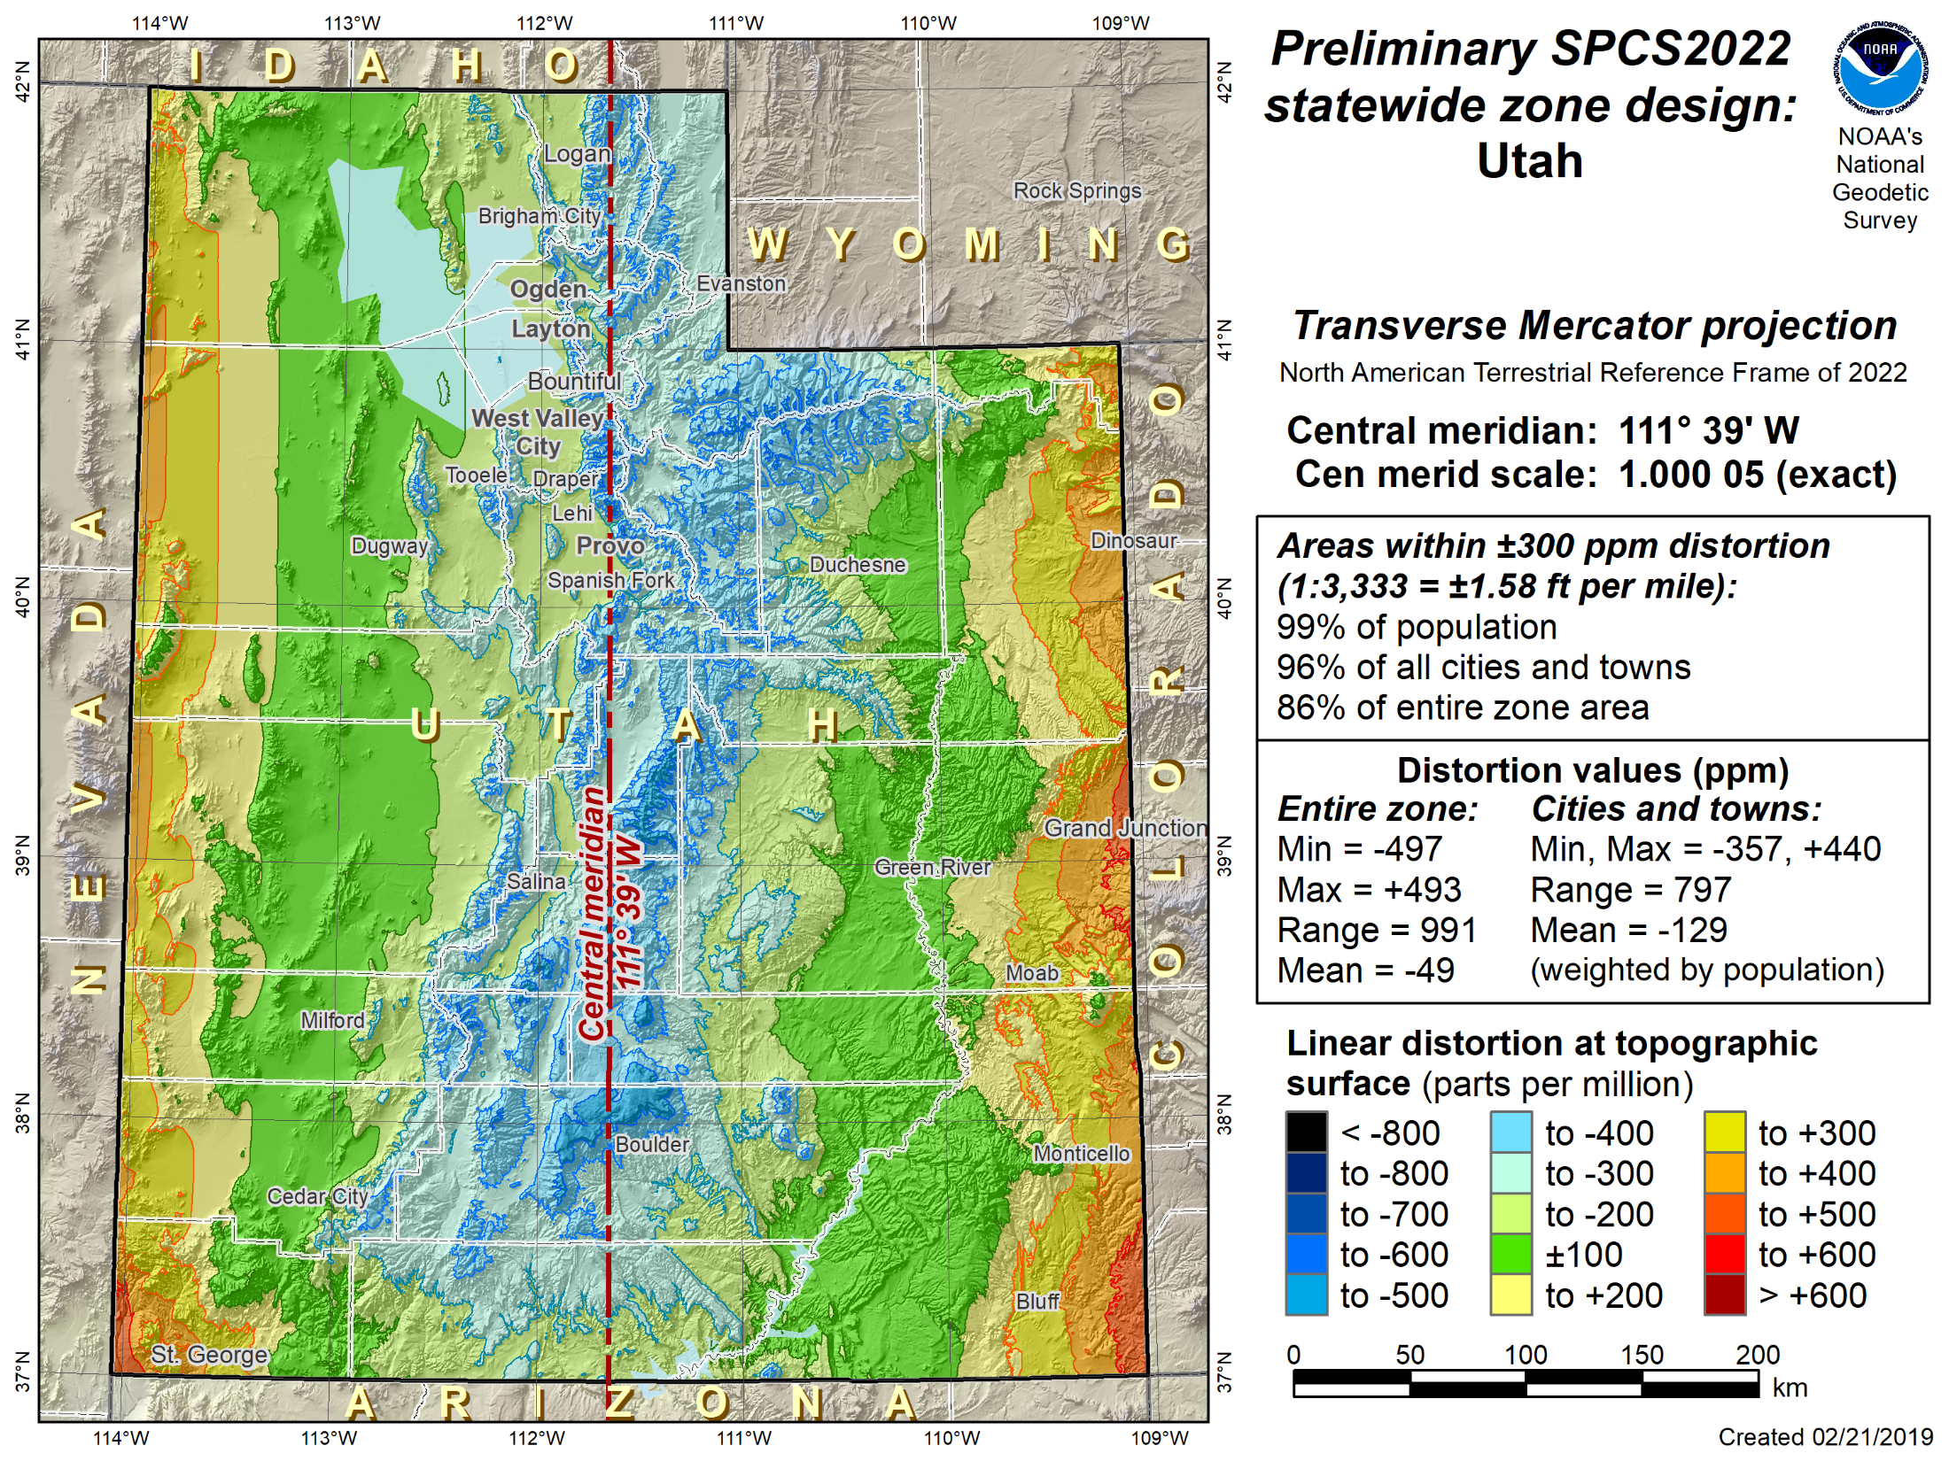
Positive East Longitudes
West Longitudes

Slide 60
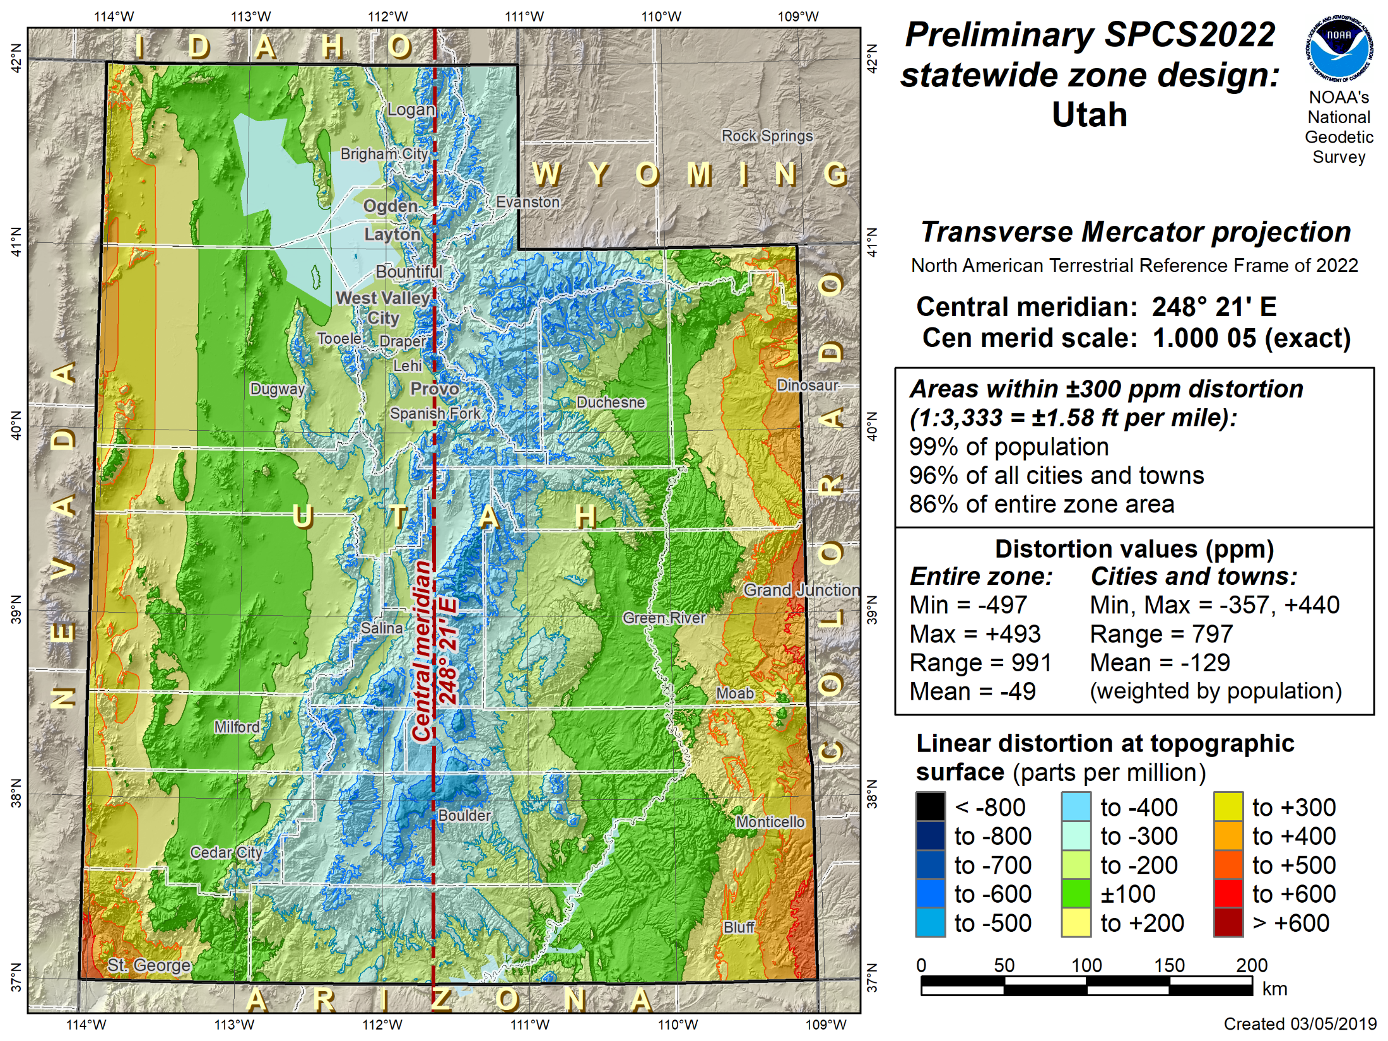
Positive East Longitudes
Positive East Longitudes

Slide 61
SPCS2022 deadlines
Consensus input per SPCS2022 procedures
Requests for designs done by NGS
Proposals for designs by contributing partners
Submittal of approved designs
Proposal must first be approved by NGS
Designs must be complete for NGS to review
Later requests will be for changes to SPCS2022
NGS.SPCS@noaa.gov
by March 31, 2020 for requests and proposals
by March 31, 2021 for submittal of approved designs
Notes:
Deadlines for requests, proposals, and submittal of approved designs
Designs by “contributing partners” must first be approved as proposals by NGS
Contributing partners can be the stakeholders, or an individuals or organizations designing the zones for the stakeholders
It is expected that most (all?) proposed designs will be for LDP systems (with design criterion < ±50 ppm), since NGS will not design those
Any requests, proposals, or submittals that are not received by the deadlines will not be included in the initial release of SPCS2022 (in 2022)
However, these could still become part of SPCS2022 at a later time
Policy & procedures provide mechanism for changing SPCS2022, so there will still be an opportunity to change/add SPCS2022 layers even after 2022

Slide 62
SPCS2022 summary
SPCS2022 characteristics different from SPCS 83:
Minimize distortion at topo surface, not ellipsoid
NGS will design statewide and default zones
Up to 3 zone “layers” allowed (including an LDP layer)
Allow “special use” zones (if in multiple states)
Coordinate changes of at least 10,000 m everywhere
Longitudes defined as positive east (0°-360°)
Stakeholders can request and propose preferences
Consensus state stakeholder input required for SPCS2022 zone requests, proposals, and designs
Can still change/add/remove zones after 2022

Slide 63
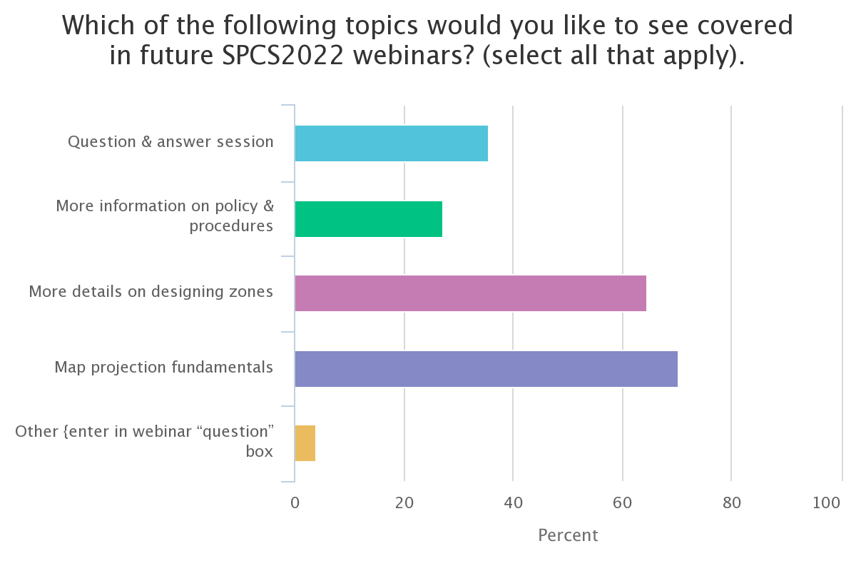
Poll question 6
Which of the following topics would you like to see covered in future SPCS2022 webinars? (select all that apply).
Question & answer session
More information on policy & procedures
More details on designing zones
Map projection fundamentals
Other [enter in the webinar question box]
694 responses

Slide 64
Questions?

