Slide 1

Building a State Plane
Coordinate System
for the Future
Michael L. Dennis
SPCS2022 Project Manager
April 12, 2018

Slide 2
A Tale of Two Webinars on the State Plane Coordinate System (SPCS)
Second webinar today (April 12)
  Greater detail on SPCS2022 policy and procedures
  Additional technical information
  More SPCS2022 zone design examples
First webinar was on March 8
  History and status of SPCS 27 and SPCS 83
  Map projection concepts
  Introduction to SPCS2022
Your questions from March 8 helped with the webinar today!

Slide 3
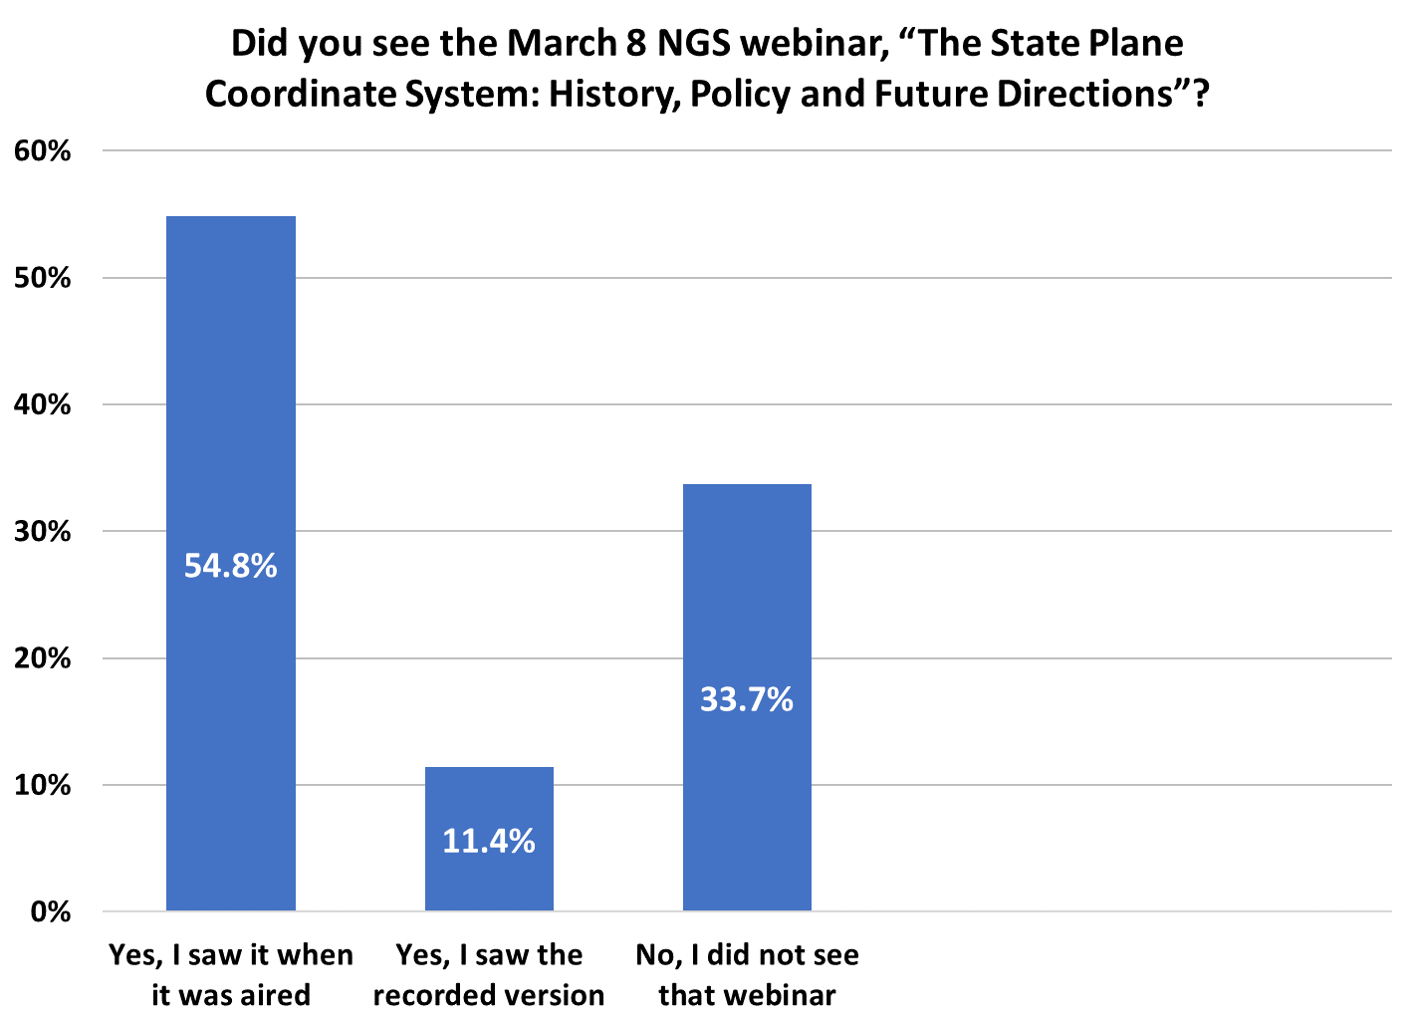
Poll question
221
Total responses = 403
136
46

Slide 4
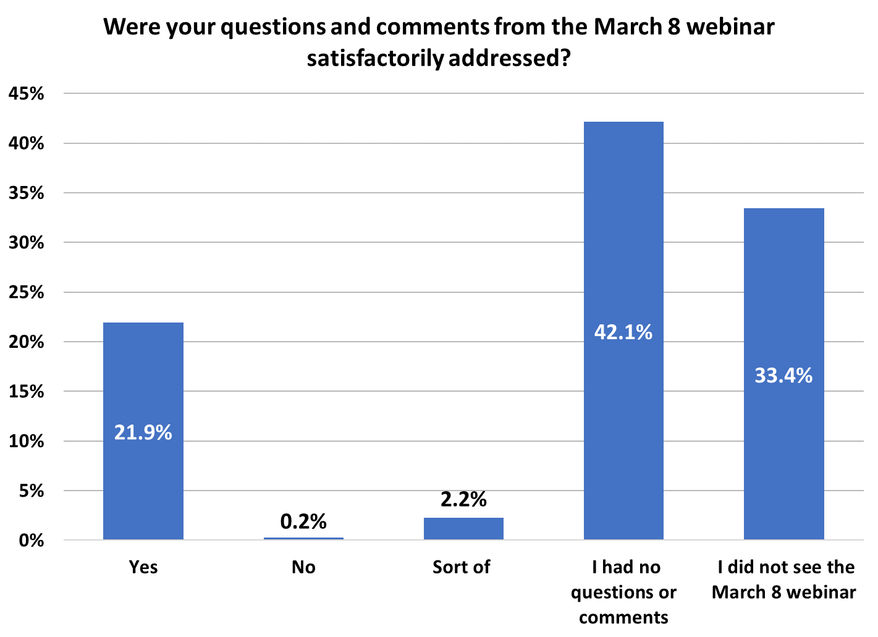
Poll question
Total responses = 401
169
134
88
9
1

Slide 5
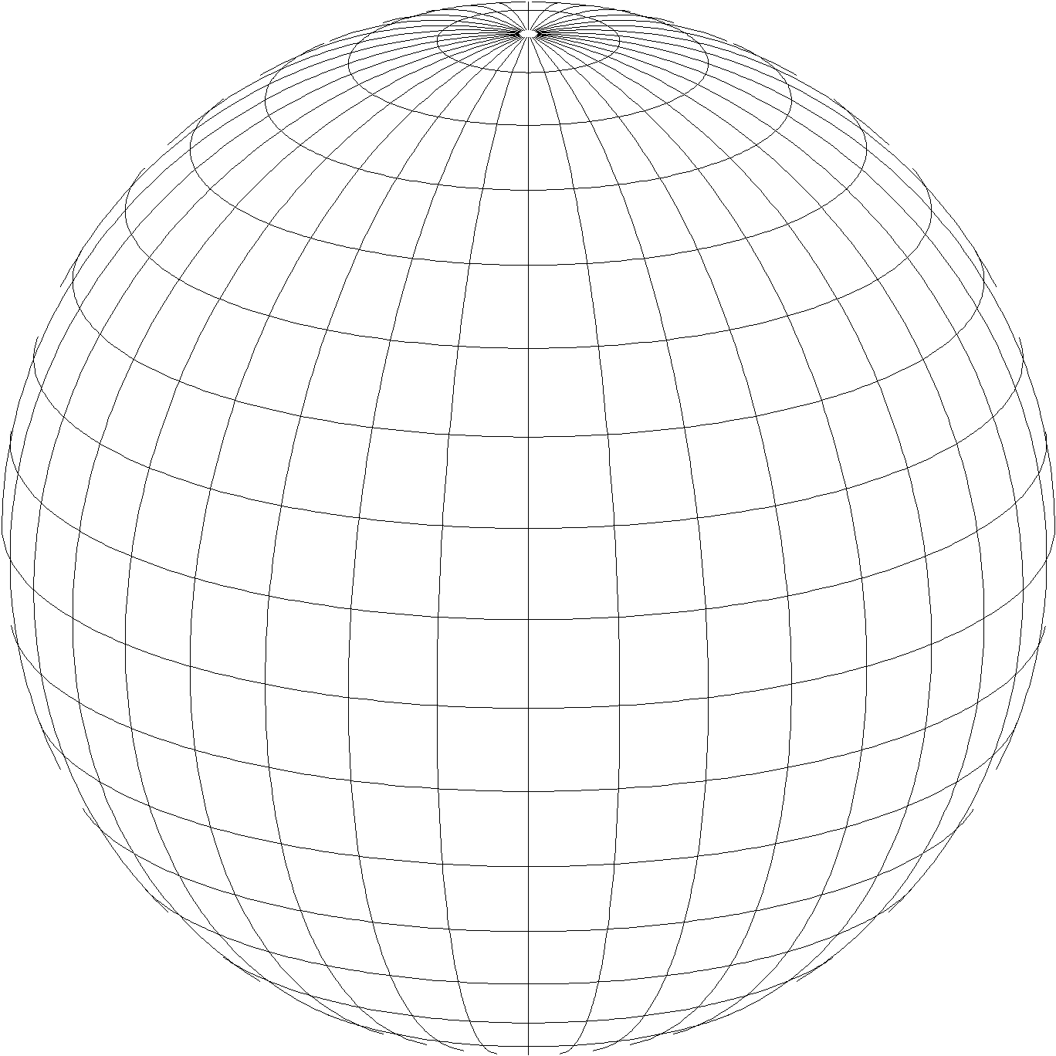
A New State Plane Coordinate System
State Plane Coordinate System of 2022 (SPCS202)
  Referenced to new 2022 Terrestrial Reference Frames (TRFs)
  Based on same reference ellipsoid (GRS 80)
  Same 3 conformal projection types:
Lambert conformal conic
Transverse Mercator
Oblique Mercator

Slide 6
Recent activity at NGS on State Plane
New report on State Plane history, policy, and future
  NOAA Special Publication NOS NGS 13
Federal Register Notice (FRN) will soon be published
  Requests public comment on policy and procedures
  Includes “special purpose” zones
Draft SPCS2022 policy and procedures
  Policy: defines characteristics and requirements
  Procedures: instructions for zone requests and proposals
  Released when FRN published
NOTE: SPCS2022 policy and procedures are DRAFT documents
  Final version may differ after FRN public comment period ends (August 31, 2018)

Slide 7
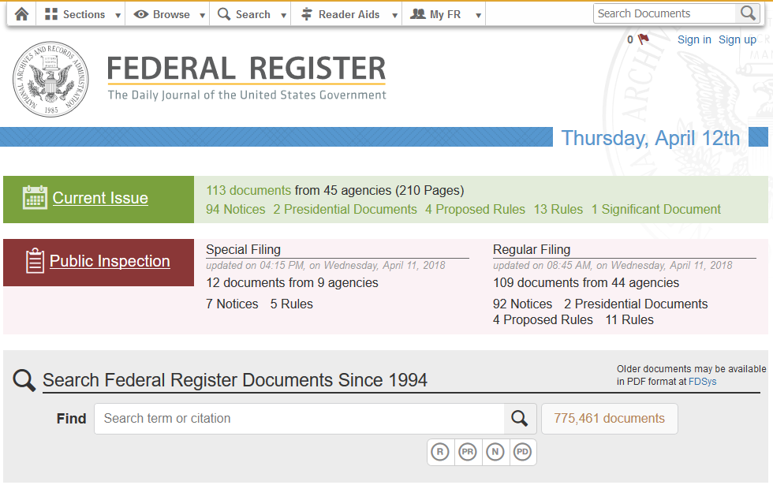
Federal Register Notice
Announces SPCS2022 Policy and Procedures
Public comment period through Aug 31, 2018 at NGS.Feedback@noaa.gov
Also asks for input on “special purpose” zones
Will be published on April 18, 2018
https://www.federalregister.gov/

Slide 8
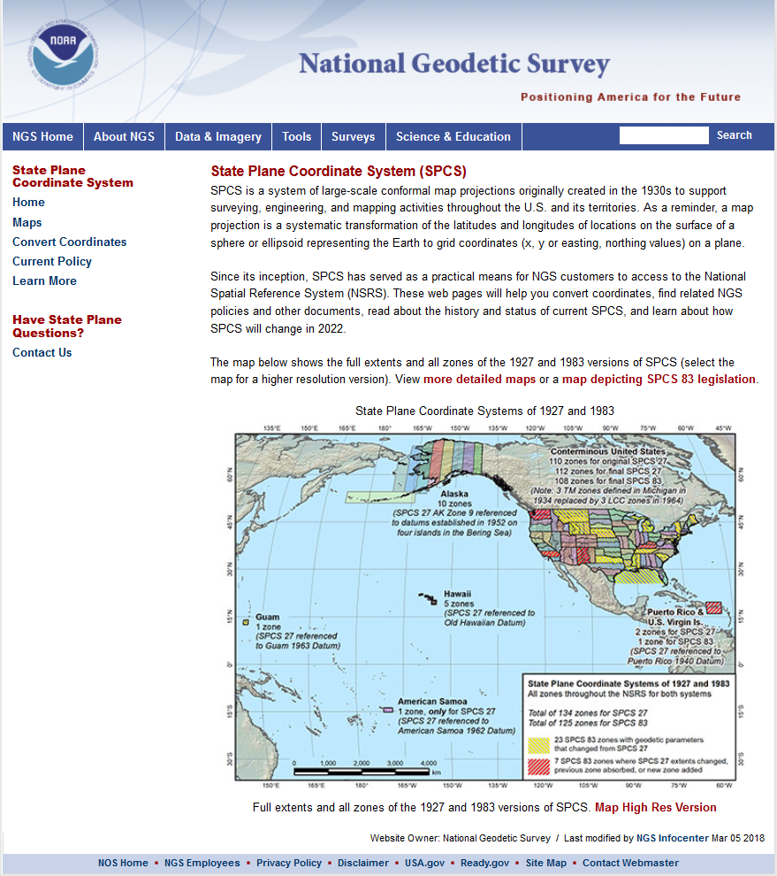
geodesy.noaa.gov/SPCS/
Look here for link
2022 SPCS Policy Changes

Slide 9
Draft SPCS2022 Policy & Procedures
Policy (7 pages): 4 main sections
  General policy
  Technical characteristics and requirements
  Zones and consistency with statute
  Default SPCS2022 definitions
Procedures (15 pages): 5 main sections
  NGS contact information, criteria for stakeholder input, deadlines
  Requirements for stakeholder requests and proposals of designs
  Requirements for submittal of designs by contributing partners
  NGS role and responsibilities for SPCS2022 reviews and designs
  Technical specifications for SPCS2022 design and implementation
Both:
  Background and definitions
  Embedded “remarks” (blue italicized text) to aid in review

Slide 10
Why are the documents so long?
SPCS2022 is fairly complex and requires detail
  Tried to keep draft versions as short as possible
  Later versions will be shorter
After public comment period (ends August 31, 2018):
  “Remarks” removed from approved version
  Stakeholder requirement lists moved to online forms
  Technical specifications moved to design manual
By official release of SPCS2022 (sometime in 2022):
  Deadlines for requests, proposals, submittals removed
  Default SPCS2022 design approach removed
Final versions will be < half current length

Slide 11
Definitions in Policy & Procedures
Stakeholders. State organizations that can give input on SPCS2022: DOTs, GIS offices, surveying & engineering societies, professional geospatial organizations, and universities that perform geospatial education or research.
Contributing partners. Organizations or individuals that design SPCS2022 zones for stakeholders and in cooperation with NGS.
Zone. The region where a projected coordinate system is used.
Linear distortion. Amount a map projection distance differs from “true” horizontal distance at the ground surface.
Conformal map projection. Linear distortion is unique (same in every direction) at a point.
Projection axis. The line along which linear distortion is minimum and constant with respect to the reference ellipsoid.

Slide 12
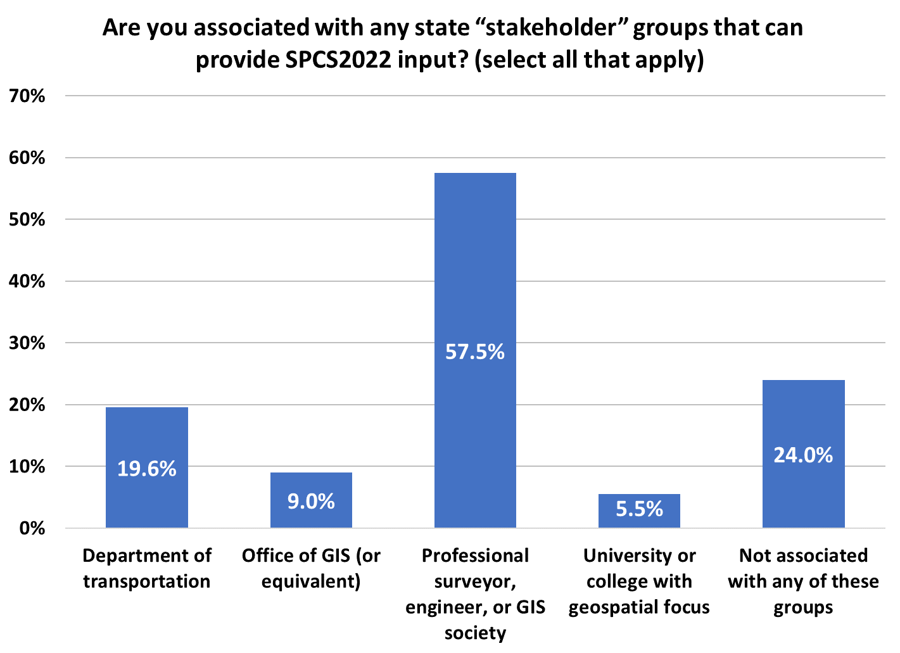
Poll question
Total responses = 454
261
Total number of stakeholder groups selected = 525
109
89
41
25

Slide 13
Explore Policy, Procedures, and FRN
Linear distortion at topographic surface
One-parallel Lambert Conformal Conic projections
Default SPCS2022 zone designs
Statewide and “layered” zones
Linear distortion design criteria
  Maximum and minimum zone size and distortion
  Low distortion projections (LDPs)
“Special purpose” zones (in FRN only)
Linear units
Submittal process and deadlines
  For Federal Register Notice comments
  For requests, proposals, and submittal of designs

Slide 14
Linear distortion at topo surface
Policy§II.C and Procedures§5.c.
Distortion for design evaluated at topo surface
  Minimize range and mean distortion in zone
  Account for cities with distortion weighted by population
Design not evaluated at the ellipsoid surface
  Nobody lives or works on the ellipsoid
  Likely used in past because it is easier
Projection scaled to topo surface (“ground”)
  Reduces difference between “grid” and “ground”
  Topographic ellipsoid height not part of definition

Slide 15

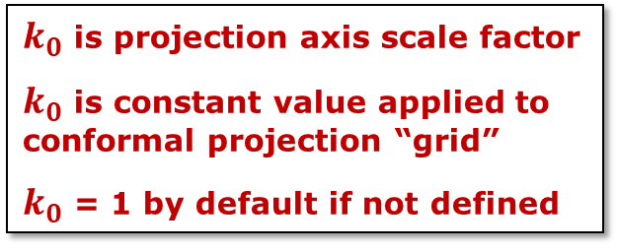

A map projection is a mathematical function
$$\left(northing, easting\right)=f\left(latitude, longitude\right)$$
$$×k_{0}$$
$k_{0}$ is projection axis scale factor
$k_{0}$ is constant value applied to conformal projection “grid”
$k_{0}$ = 1 by default if not defined
Projection
axis
Grid distance = ellipsoid distance
Grid distance > ellipsoid distance
Tangent ($k_{0}$ = 1)
Ellipsoid distance
Ellipsoid surface

Slide 16

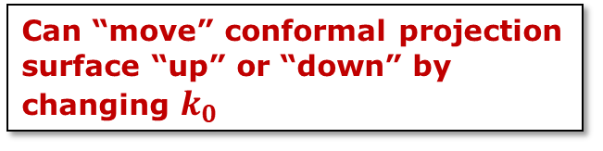


A map projection is a mathematical function
$$\left(northing, easting\right)=f\left(latitude, longitude\right)$$
$$×k_{0}$$
Can “move” conformal projection surface “up” or “down” by changing $k_{0}$
Projection
axis
Grid distance > ellipsoid distance everywhere
Non-intersecting ($k_{0}$ > 1)
Grid distance = ellipsoid distance
Grid distance > ellipsoid distance
Tangent ($k_{0}$ = 1)
Ellipsoid distance
Grid distance > ellipsoid distance
Secant ($k_{0}$ < 1)
Grid distance = ellipsoid distance
Grid distance < ellipsoid distance
Ellipsoid distance
Ellipsoid surface
Grid distance = ellipsoid distance

Slide 17
“Secant” conformal map projection
Projection
axis
Ellipsoid distance
Grid distance > ellipsoid distance
Secant ($k_{0}$ < 1)
Grid distance = ellipsoid distance
Grid distance < ellipsoid distance
Ellipsoid distance
Ellipsoid surface
Grid distance = ellipsoid distance
14.5%
71%
14.5%
Zone width to balance positive and negative distortion (scale error) with respect to ellipsoid

Slide 18
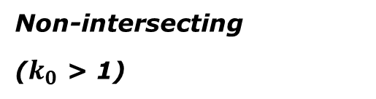
“Non-intersecting” conformal map projection
Topographic surface
Grid distance = ground distance at a point
Projection
axis
Grid distance = ground distance at a point
Non-intersecting
($k_{0}$ > 1)
Grid distance ≈ ground distance over finite distance
Purpose is to reduce linear distortion at “ground” (topographic surface).
But distortion can vary considerably across area of interest.
Ellipsoid surface

Slide 19
“Non-intersecting” conformal map projection
Topographic surface
Projection
axis
Non-intersecting
($k_{0}$ > 1)
Ellipsoid surface

Slide 20
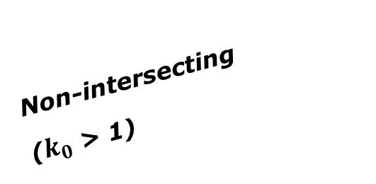
Changing projection axis to reduce distortion variation
Topographic surface
Grid distance = ground distance at many points
Projection
axis
Ellipsoid height of surface not constant:
h₁ ≠ h₂
h₂
Non-intersecting
($k_{0}$ > 1)
h₁
Only way to reduce variation in distortion is to change projection axis location.
IMPORANT: For large areas, there is no single defining ellipsoid height, h, for scaling the projection.
Ellipsoid surface

Slide 21
Explore Policy, Procedures, and FRN
Linear distortion at topographic surface
One-parallel Lambert Conformal Conic projections
Default SPCS2022 zone designs
Statewide and “layered” zones
Linear distortion design criteria
  Maximum and minimum zone size and distortion
  Low distortion projections (LDPs)
“Special purpose” zones (in FRN only)
Linear units
Submittal process and deadlines
  For Federal Register Notice comments
  For requests, proposals, and submittal of designs

Slide 22
Why only a 1-parallel LCC?
Policy§II.A.1-2 and Procedures§5.a.i.
Consistency
  Explicitly define projection scale (same as TM and OM)
  Can use same number of parameters as TM
  Applicable to both “secant” and “non-intersecting” cases
Simplicity
  Easier to design with respect to topography
  Scale due to separation of 2 standard parallels not obvious
  Can more readily use “clean” values for parallels
Mathematically identical to 2-parallel
  Any 2-parallel LCC can be recast as 1-parallel that behaves exactly the same

Slide 23
Explore Policy, Procedures, and FRN
Linear distortion at topographic surface
One-parallel Lambert Conformal Conic projections
Default SPCS2022 zone designs
Statewide and “layered” zones
Linear distortion design criteria
  Maximum and minimum zone size and distortion
  Low distortion projections (LDPs)
“Special purpose” zones (in FRN only)
Linear units
Submittal process and deadlines
  For Federal Register Notice comments
  For requests, proposals, and submittal of designs

Slide 24
Default SPCS2022 designs
Policy§IV and Procedures§5.g.
For complete system even with no stakeholder input
  To ensure coverage of all states and U.S. territories
Nearly same as SPCS 83 but with some modifications
  Almost all zone projection types and extents the same
  Modified to align with SPCS2022 policy and procedures
  Small number of zones may change projection type, extents
Modifications to align with SPCS2022 policy:
  Scale redefined with respect to topographic surface
  One-parallel Lambert and local Oblique Mercator

Slide 25
What changes for default designs?
Most zones will keep same extents and projection type
Possible changes in projection types and zone extents
  Single OM zone for FL peninsula (replaces 2 TM zones)
  Single OM zone for Hawaii (replaces 5 TM zones)
  Group RI, CT, MA into one zone (reduces number zones by 3)
  Include Guam and CNMI in a single TM zone
  Define LCC zone for American Samoa
  Redefine AK zones to better correspond to land use
  Add zone for Washington D.C.

Slide 26
Examples of combined characteristics
Characteristics for default design examples:
  Designs are “SPCS 83-like”
  Minimize linear distortion at “ground”
    Minimize distortion range and mean for entire zone
    Also mean distortion of cities (weighted by population)
  Define LCC projections with 1 standard parallel
Example default zones:
  Colorado South Zone
  California Zone 5

Slide 27
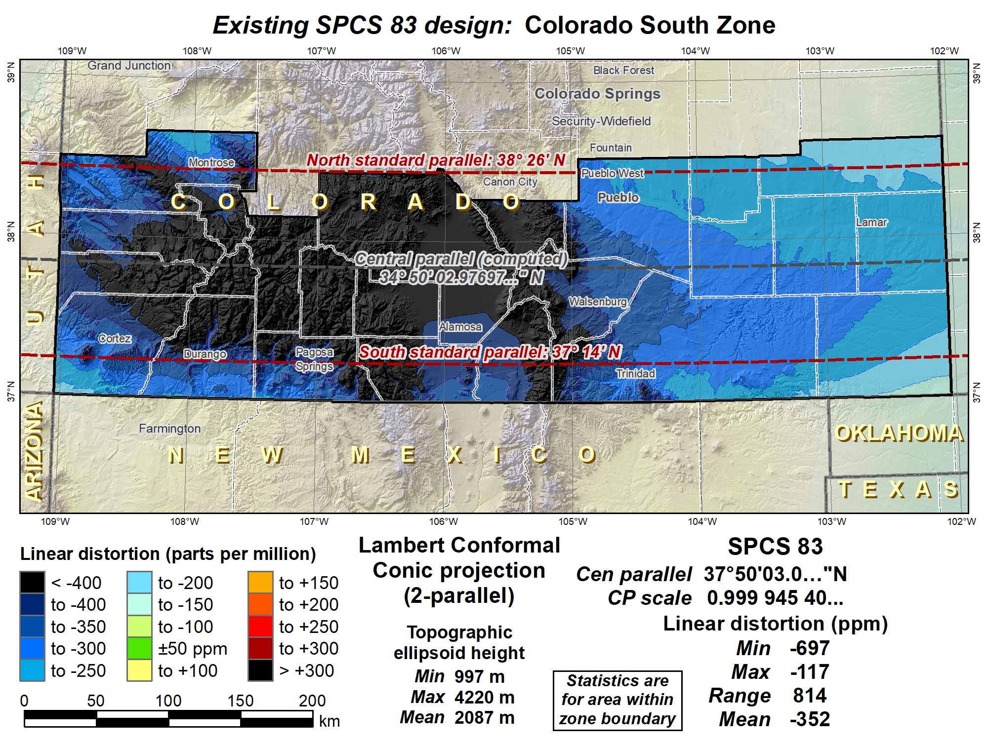

Slide 28
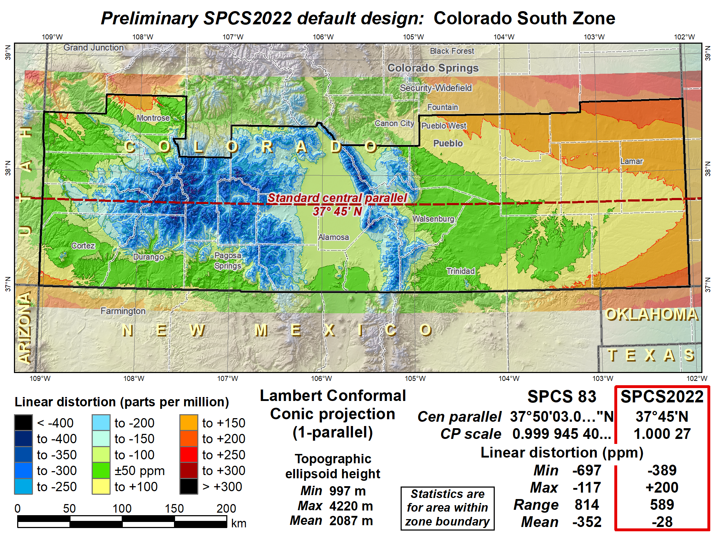
Shifted central parallel south to reduce distortion range, decreased scale to reduce distortion in cities.

Slide 29
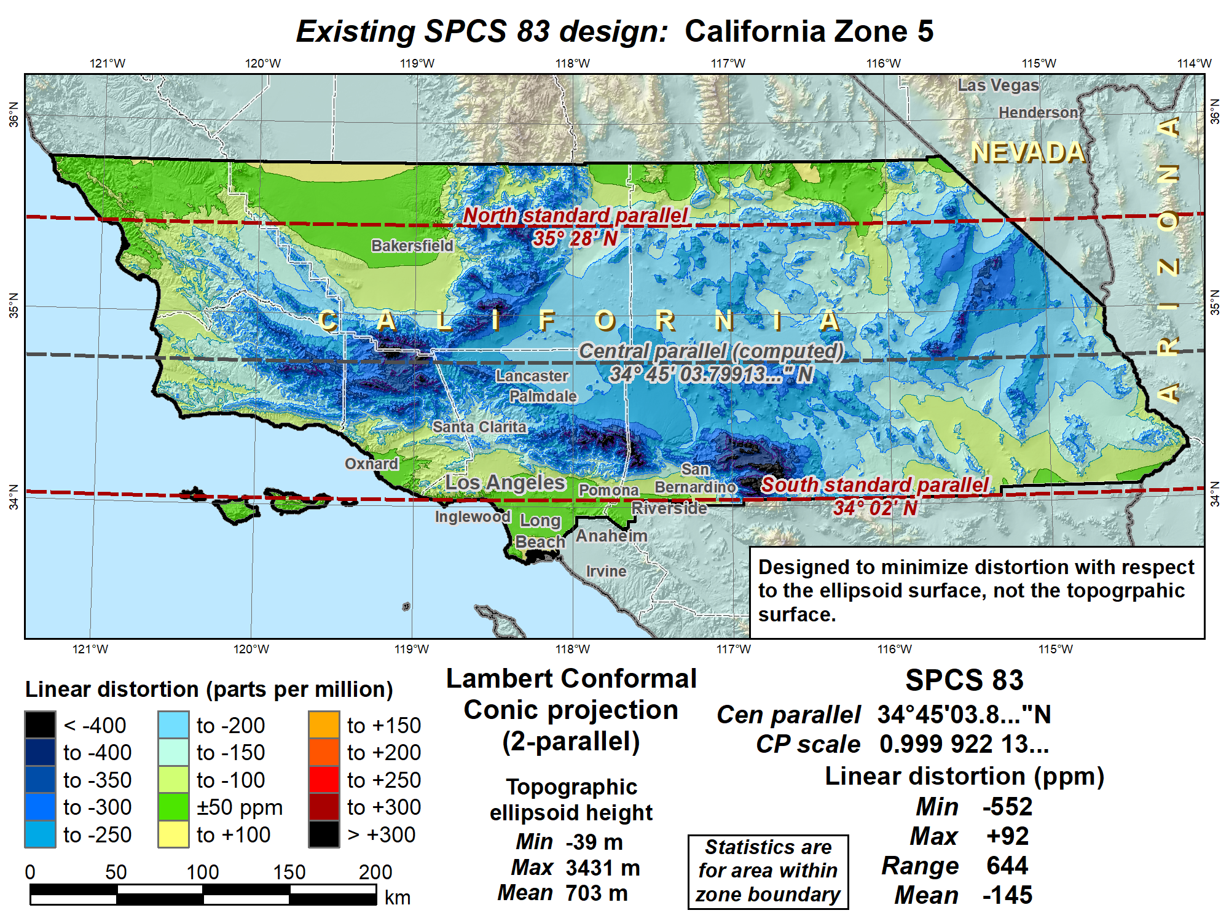

Slide 30
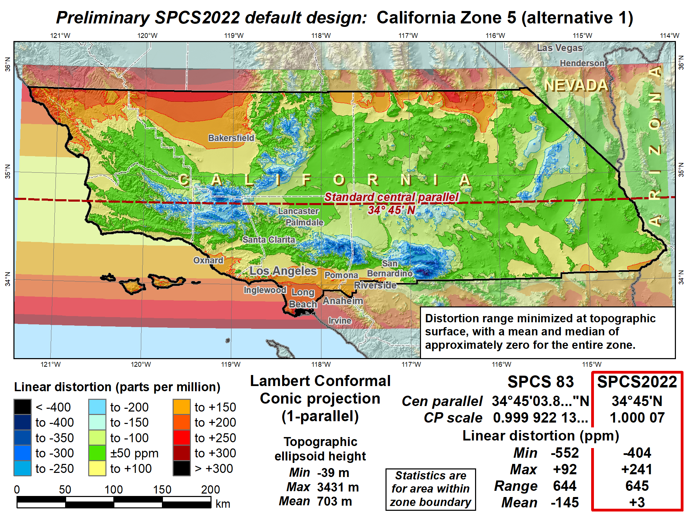
Mean distortion near zero, but excessive distortion in highly populated areas

Slide 31
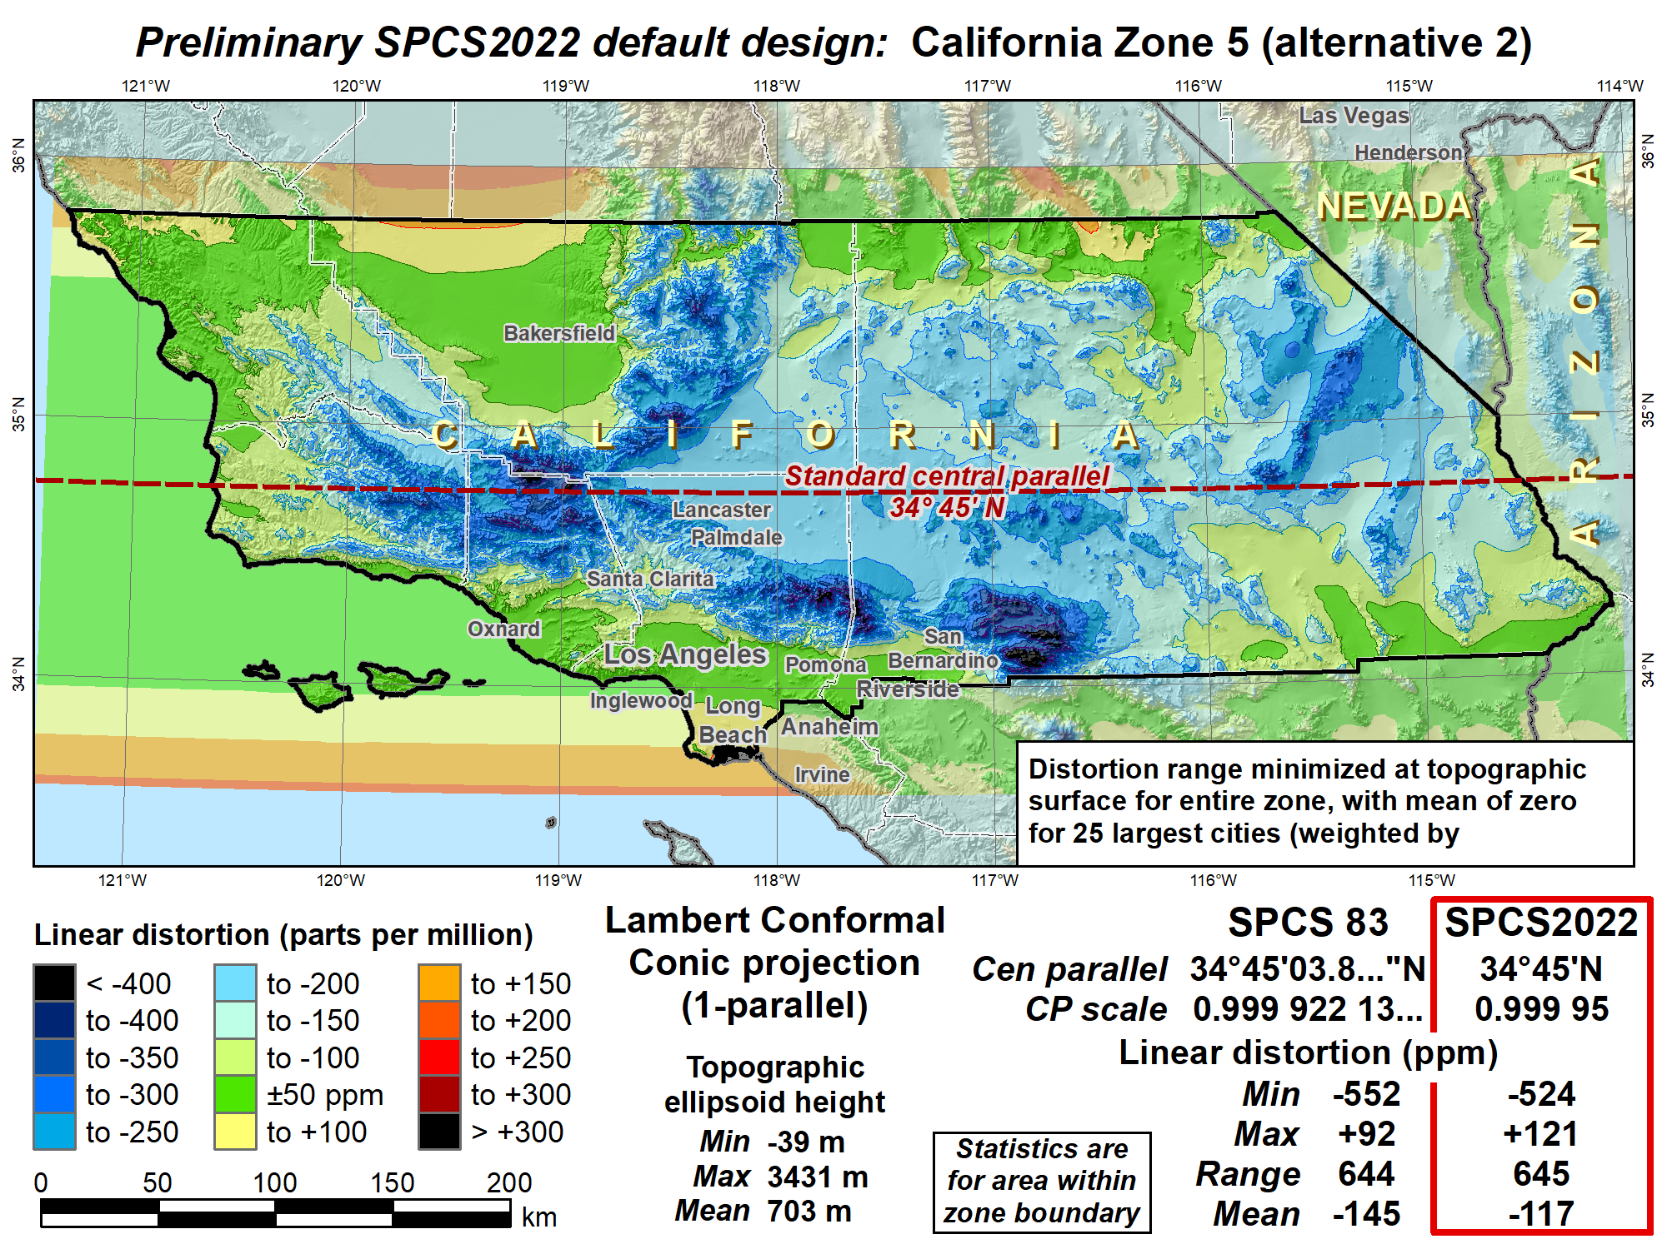
Weighted mean distortion of 25 largest cities is zero; likely a better design

Slide 33
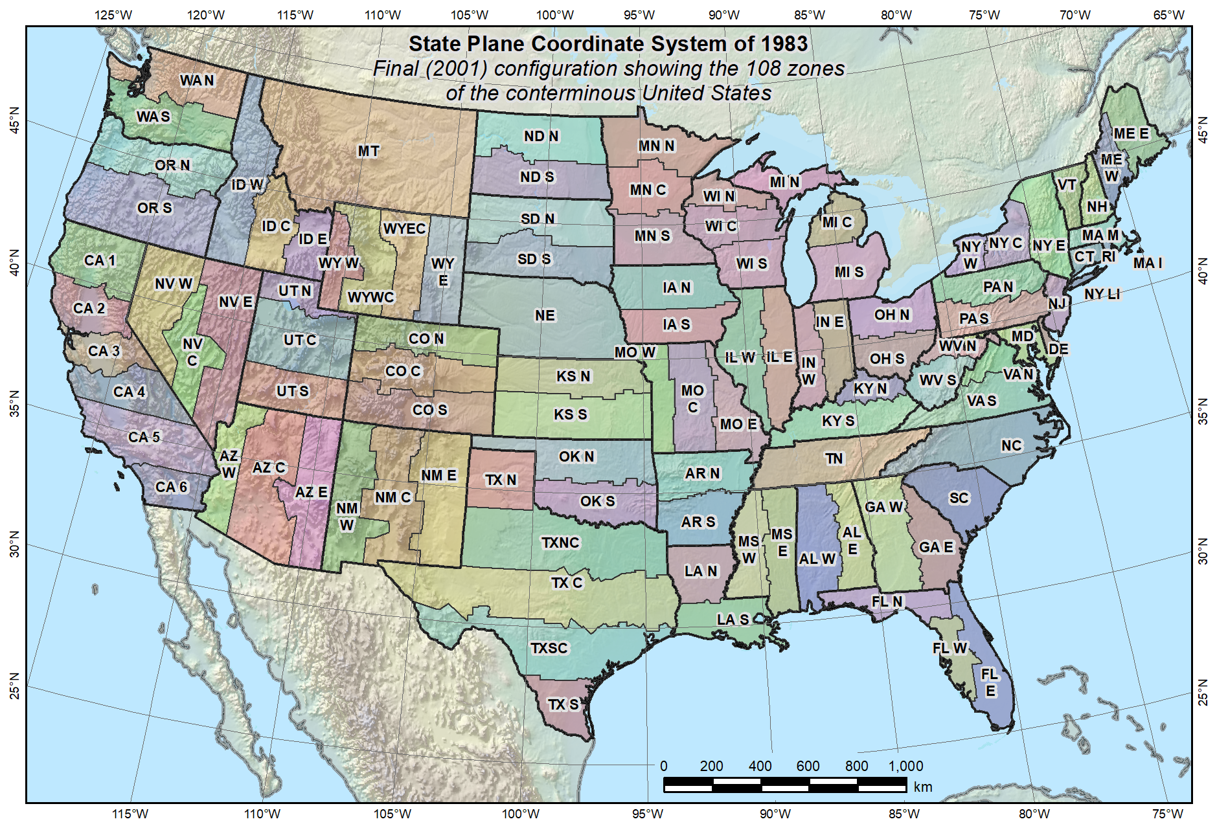
Default SPCS2022 would look a lot like SPCS 83…

Slide 34
What changes for default designs?
Most zones will keep same extents and projection type
Possible changes in projection types and zone extents
  Single OM zone for FL peninsula (replaces 2 TM zones)
  Single OM zone for Hawaii (replaces 5 TM zones)
  Group RI, CT, MA into one zone (reduces number zones by 3)
  Include Guam and CNMI in a single TM zone
  Define LCC zone for American Samoa
  Redefine AK zones to better correspond to land use
  Add zone for Washington D.C.
Examples follow of zones where the projection type or extents change. Remember, these are PROPOSED only…

Slide 35
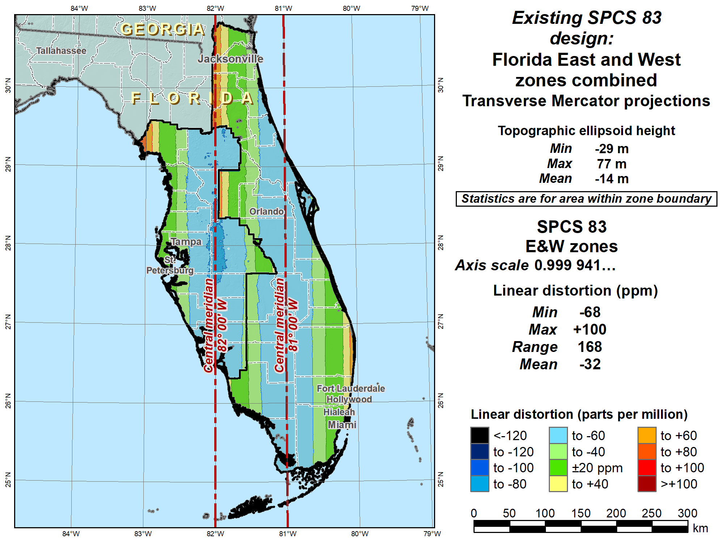

Slide 36
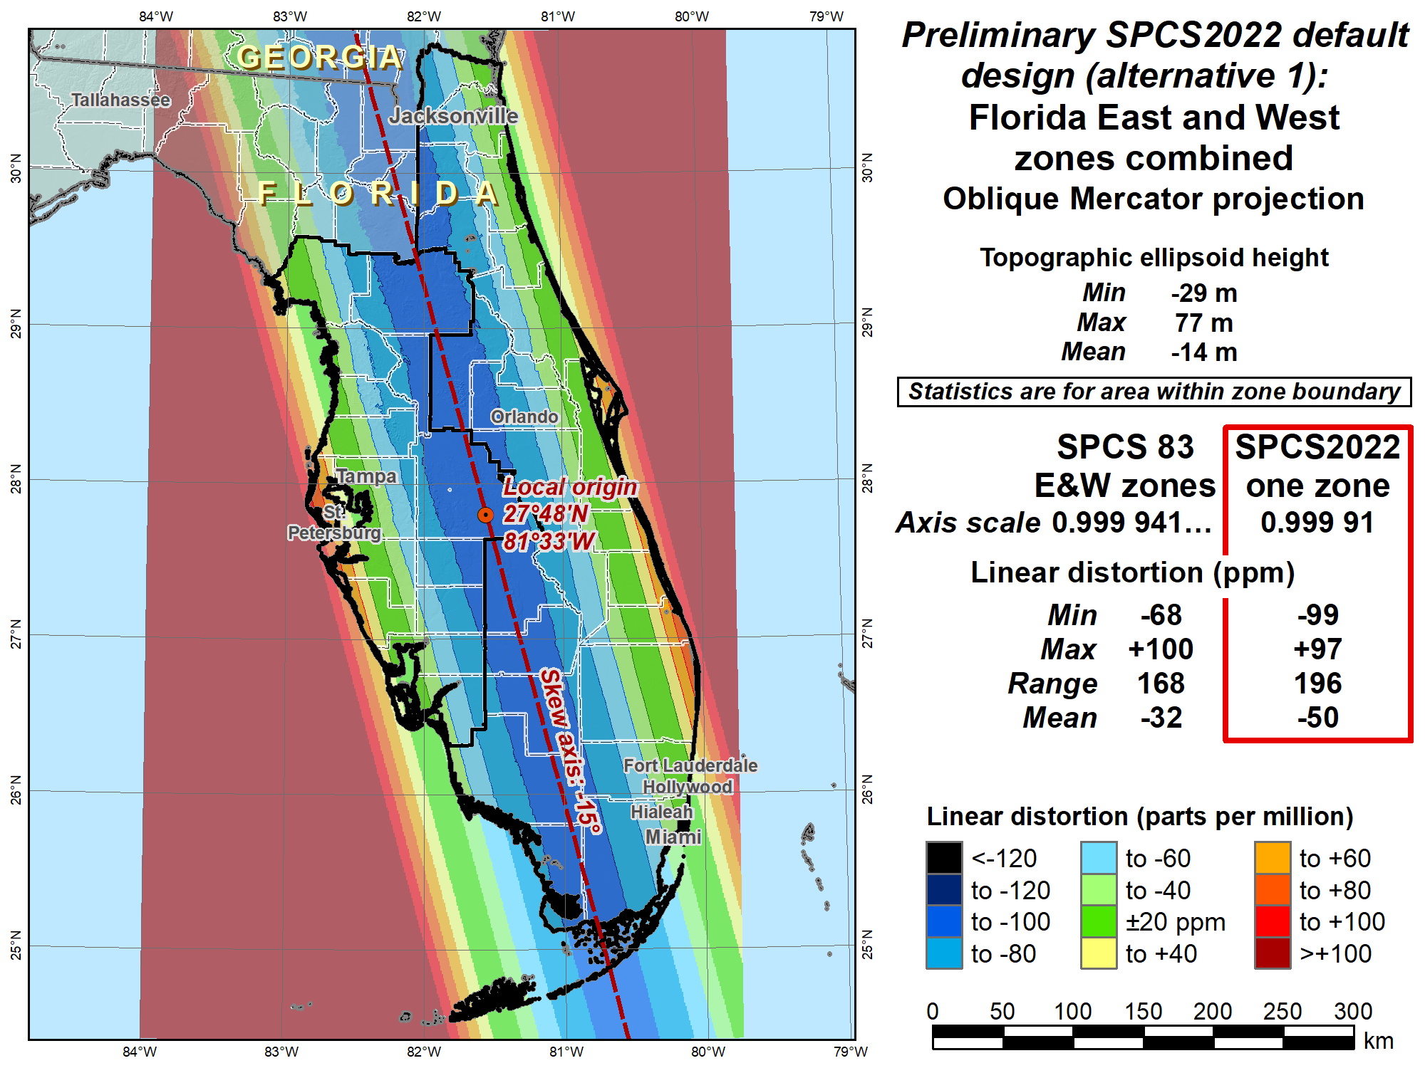
Change projection type and replace two zones with one

Slide 37
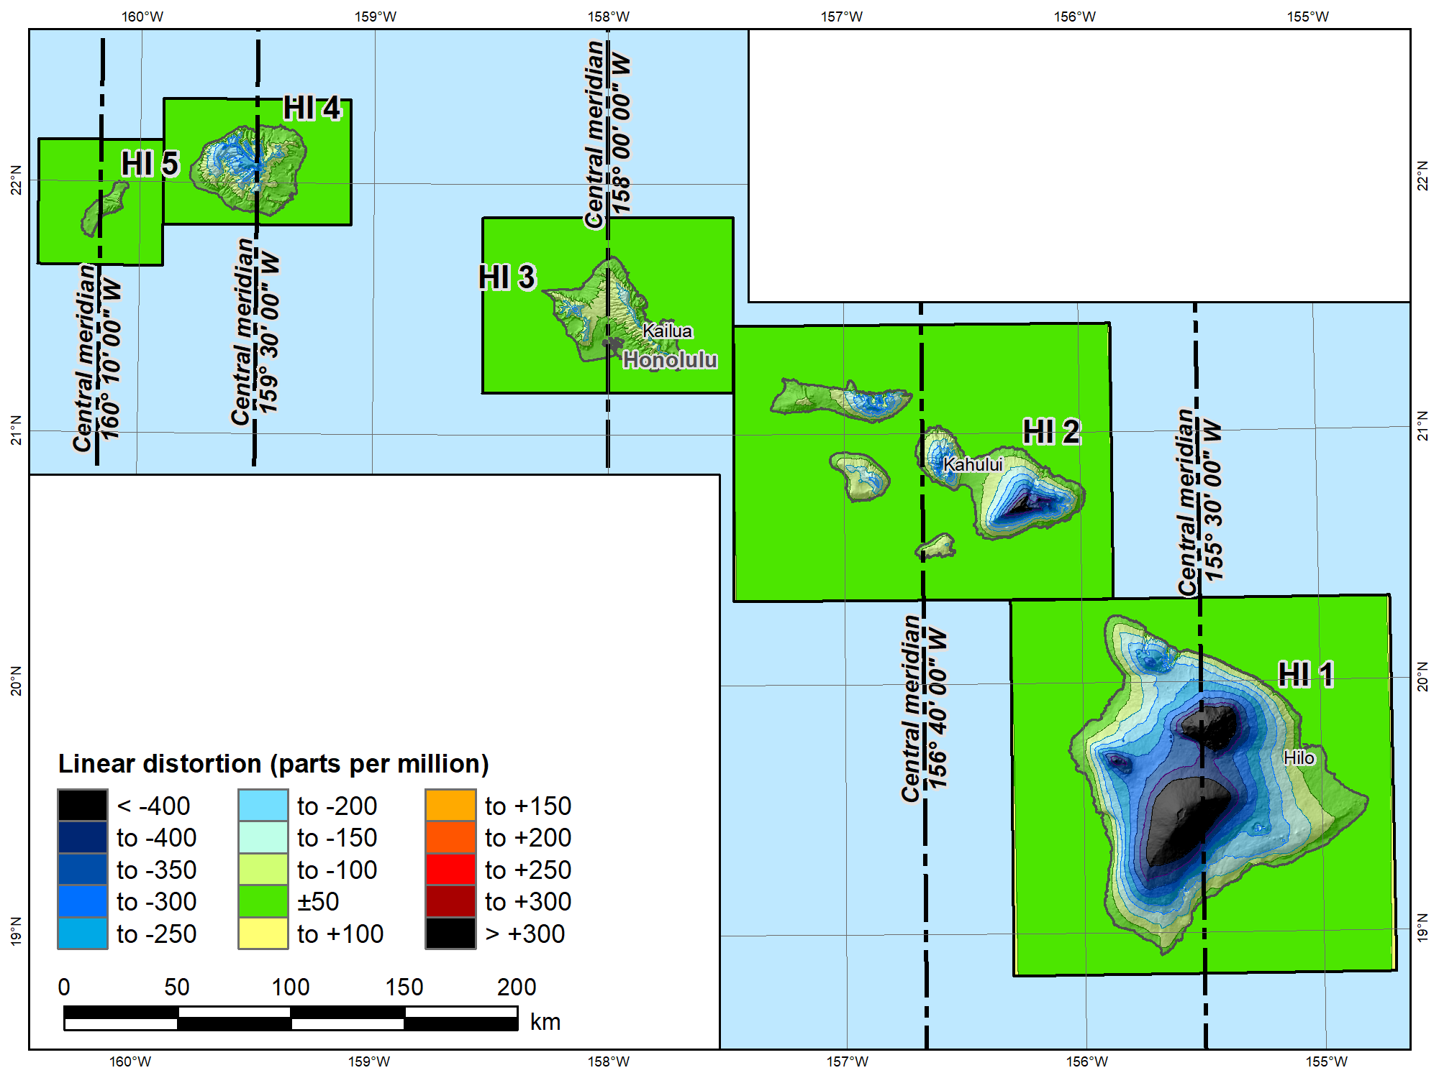
SPCS 83 Hawaii Zones 1 – 5
(all Transverse Mercator)
Topographic
ellipsoid height
(meters)
Min | 12
Max | 4188
Mean | 918
 |  | SPCS 83 HI
Scale |  | 1 to 0.99996667
 |  | Distortion (ppm)
Min |  | -690
Max |  | +29
Mean |  | -163

Slide 38
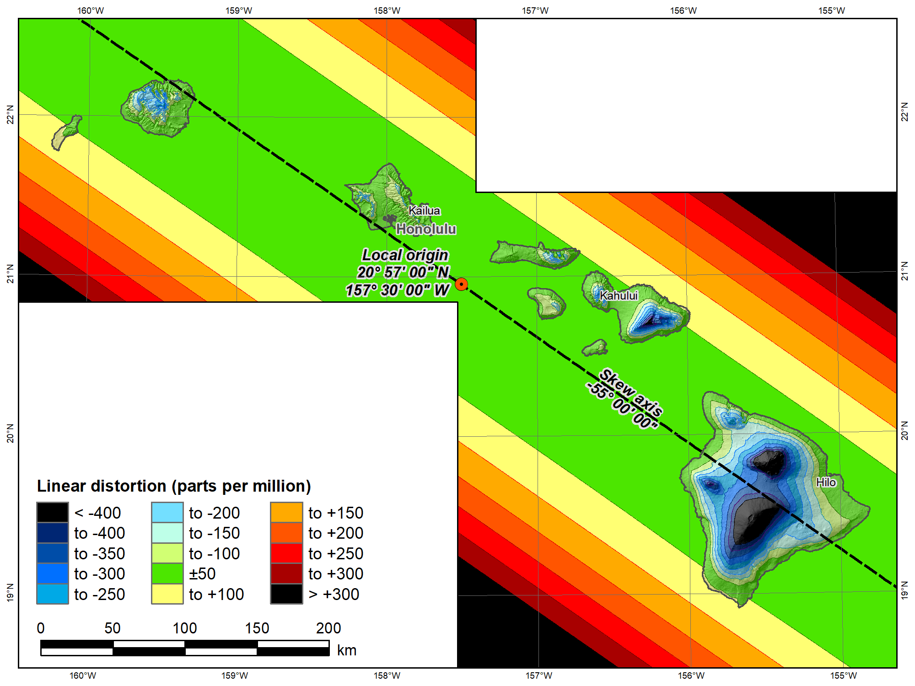
Single SPCS2022 Hawaii “default”
(Oblique Mercator)
Topographic
ellipsoid height
(meters)
Min | 12
Max | 4188
Mean | 918
 |  | SPCS 83 HI | SPCS2022
Scale |  | 1 to 0.99996667 | 1
 |  | Distortion (ppm)
Min |  | -690 | -652
Max |  | +29 | +160
Mean |  | -163 | -129
Change projection type and replace five zones with one

Slide 39
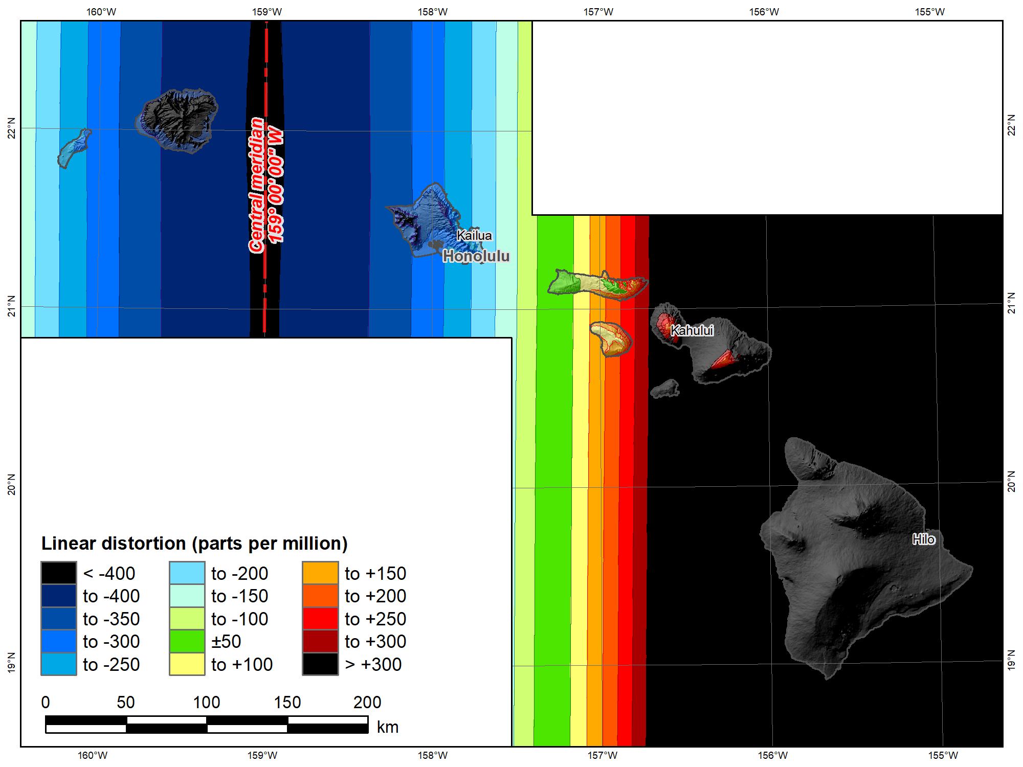
UTM 83
Zone 4 North
(Transverse Mercator)
Topographic
ellipsoid height
(meters)
Min | 12
Max | 4188
Mean | 918
 |  | UTM 83 4N | SPCS2022
Scale |  | 0.9996 | 1
 |  | Distortion (ppm)
Min |  | -613 | -652
Max |  | +1995 | +160
Mean |  | +659 | -129

Slide 40
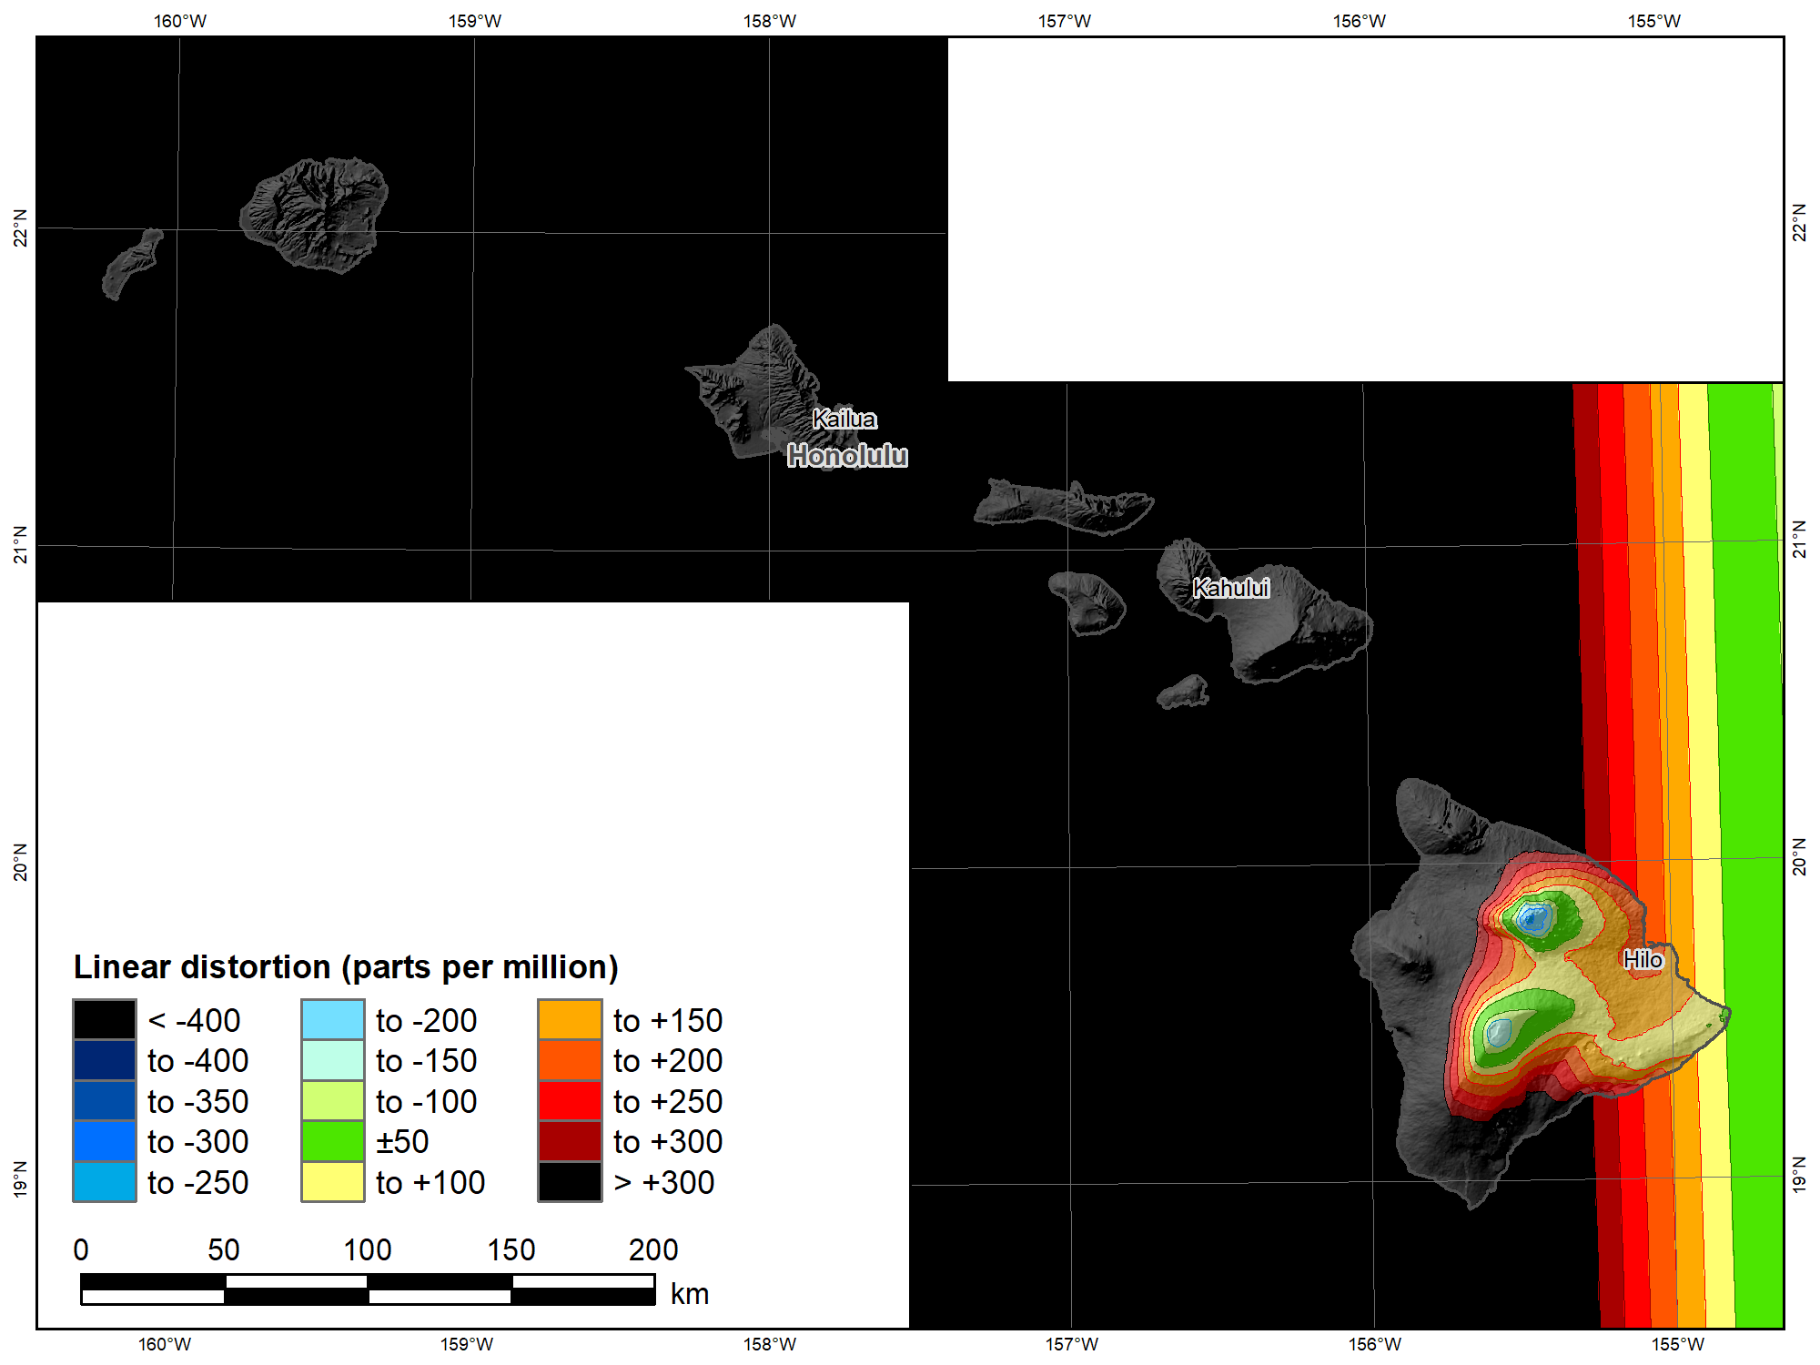
UTM 83
Zone 5 North
(Transverse Mercator)
Topographic
ellipsoid height
(meters)
Min | 12
Max | 4188
Mean | 918
 |  | UTM 83 5N | SPCS2022
Scale |  | 0.9996 | 1
 |  | Distortion (ppm)
Min |  | -234 | -652
Max |  | +6558 | +160
Mean |  | +1192 | -129

Slide 41
Explore Policy, Procedures, and FRN
Linear distortion at topographic surface
One-parallel Lambert Conformal Conic projections
Default SPCS2022 zone designs
Statewide and “layered” zones
Linear distortion design criteria
  Maximum and minimum zone size and distortion
  Low distortion projections (LDPs)
“Special purpose” zones (in FRN only)
Linear units
Submittal process and deadlines
  For Federal Register Notice comments
  For requests, proposals, and submittal of designs

Slide 42
Statewide and “layered” zones
Policy§III.A.2.
Limitations
  Max of TWO layers: Statewide and sub-zones
  If two layers, one MUST be statewide
  Minimum subzone dimension > 50 km
States often want statewide and small zones
  Statewide: Single geometry required for state GIS
  Sub-zones: Lower distortion for surveying/engineering
Accommodates state needs, but with restrictions
  Prevent poor design choices for statewide zones

Slide 43
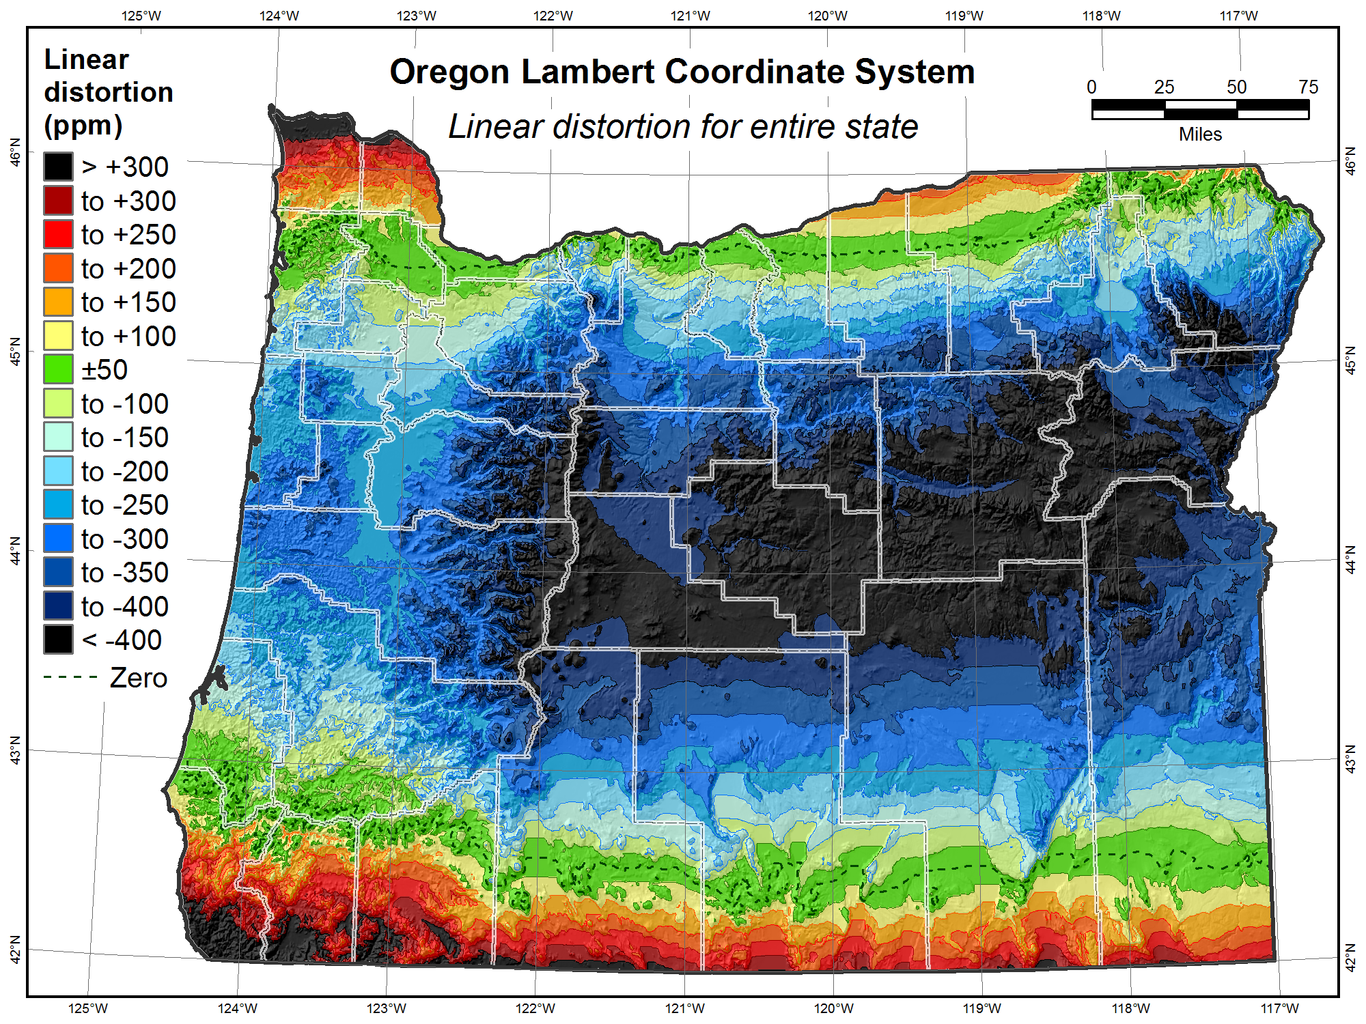

Slide 44
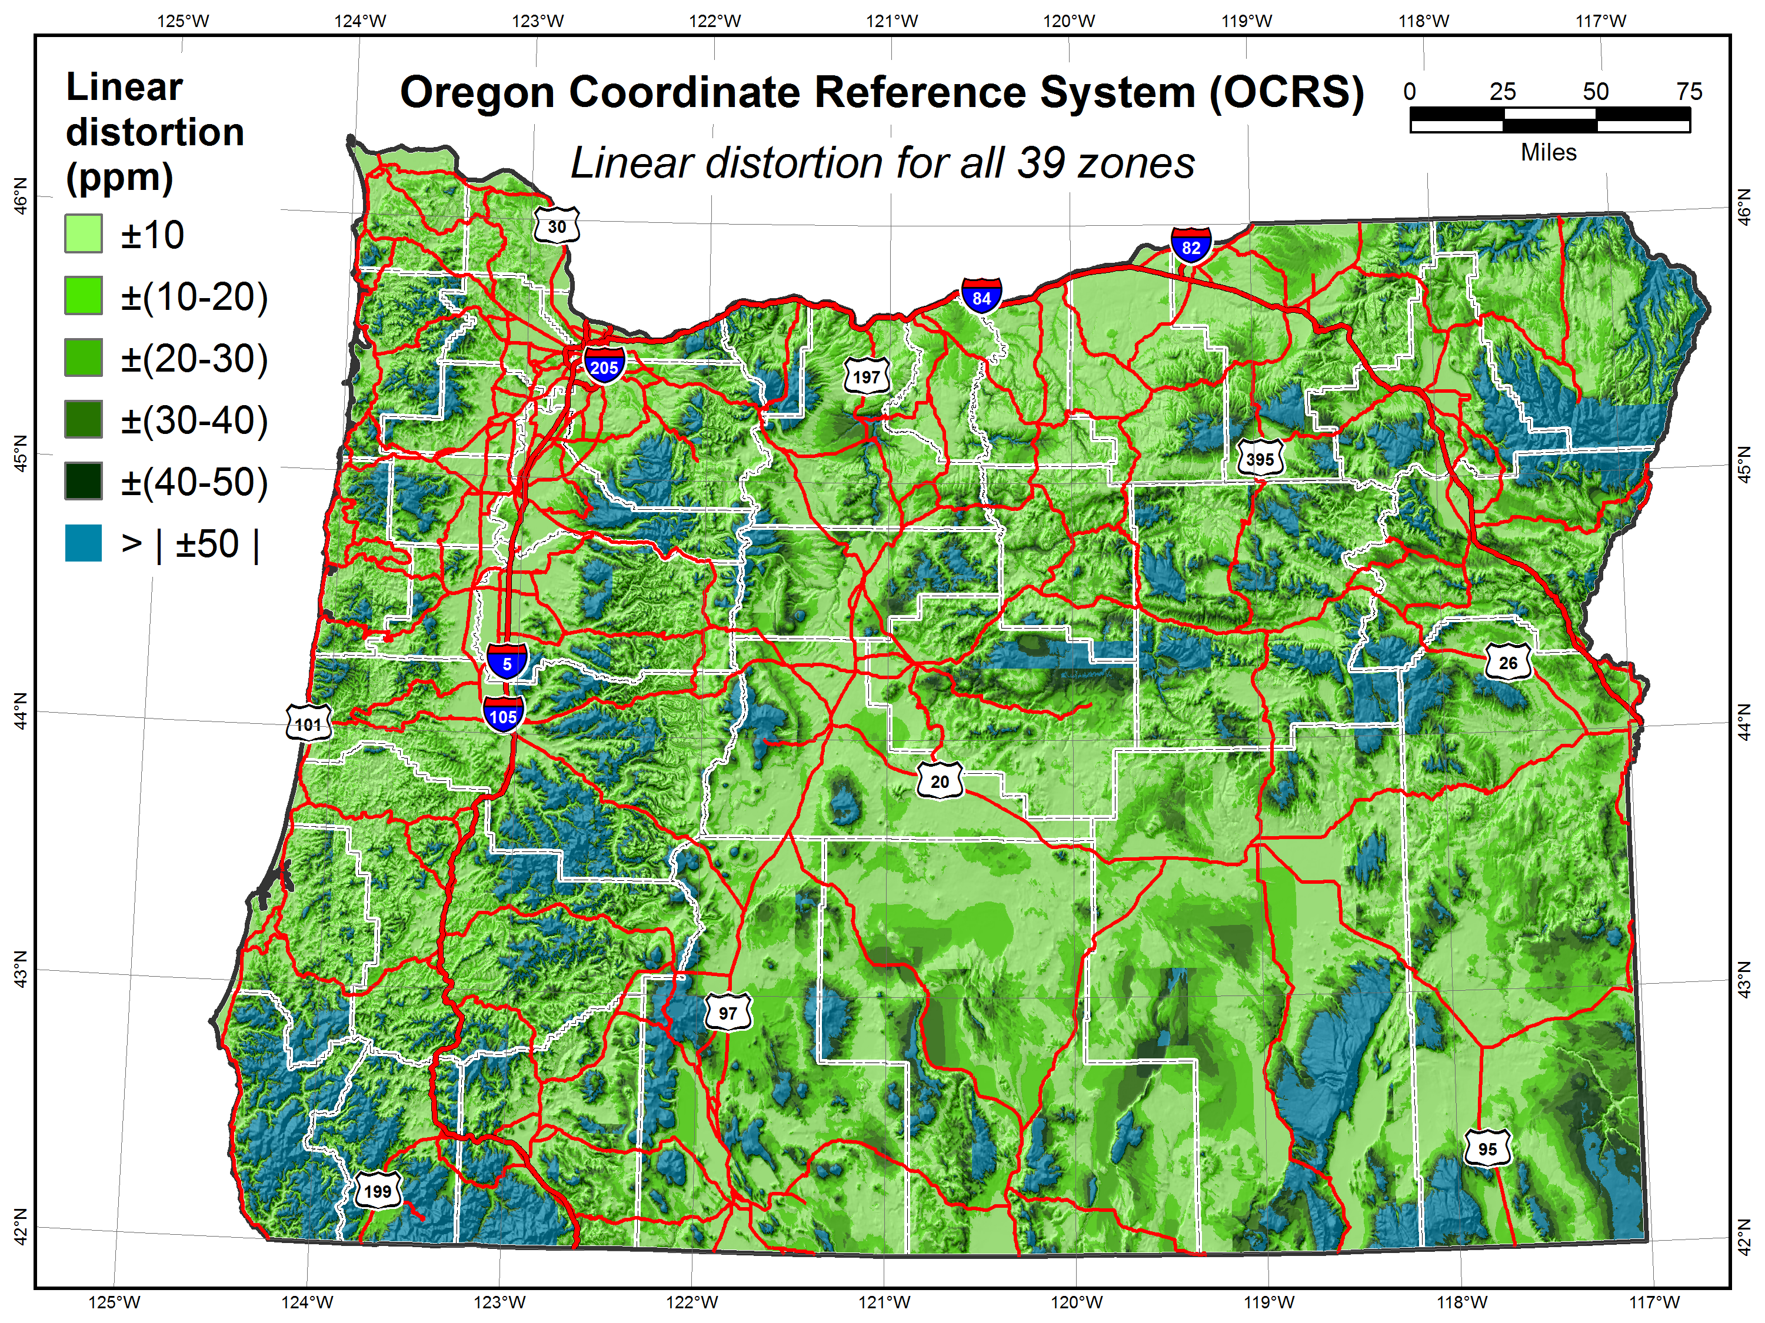

Slide 45
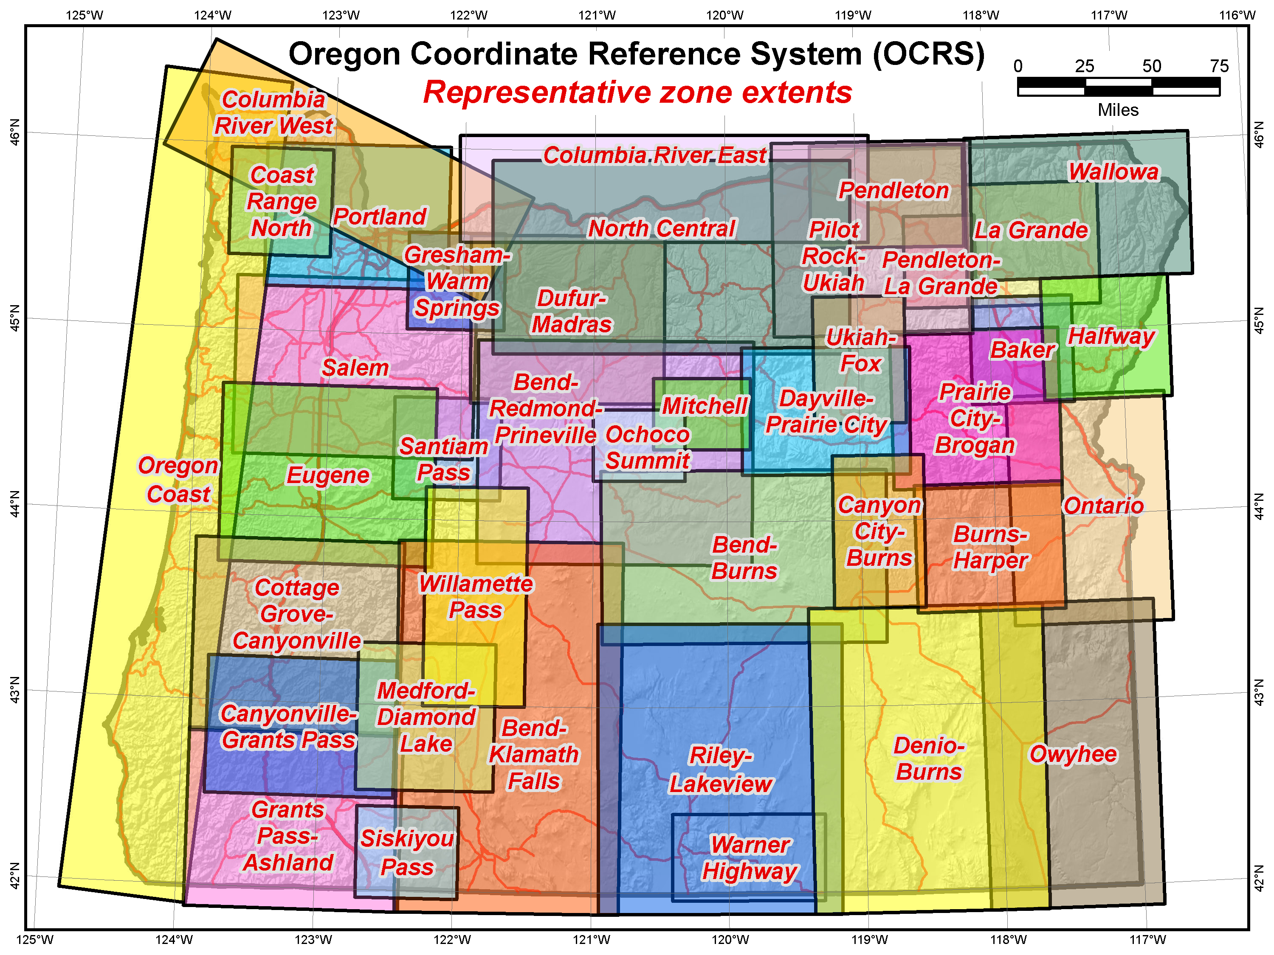

Slide 46
Explore Policy, Procedures, and FRN
Linear distortion at topographic surface
One-parallel Lambert Conformal Conic projections
Default SPCS2022 zone designs
Statewide and “layered” zones
Linear distortion design criteria
  Maximum and minimum zone size and distortion
  Low distortion projections (LDPs)
“Special purpose” zones (in FRN only)
Linear units
Submittal process and deadlines
  For Federal Register Notice comments
  For requests, proposals, and submittal of designs

Slide 47
Linear distortion design criteria
Procedures §4.b.i-ii and§5.c.i.
NGS design of zones requested by stakeholders
  Limited to zones with 50-400 ppm distortion criterion
    50 ppm = 5 cm/km = 0.3 ft/mi = 1:20,000
    400 ppm = 40 cm/km = 2.1 ft/mi = 1:2,500
Design criterion < 50 ppm (“low distortion”)
  Low distortion projections (LDPs)
  Must be designed by others (not by NGS)
  Proposed and final design reviewed by NGS

Slide 48
Linear distortion magnitudes
Procedures§5.c.ii
Linear distortion (ppm = parts per million) | Corresponding zone dimension and height limits
 | Zone width perpendicular to projection axis (no variation in topo height) | Topographic height range (independent of zone width)
±5 ppm (1:200,000) | 57 km (35 miles) | 64 m (209 ft)
±10 ppm (1:100,000) | 81 km (50 miles) | 127 m (418 ft)
±20 ppm (1:50,000) | 114 km (71 miles) | 255 m (836 ft)
±50 ppm (1:20,000) | 180 km (112 miles) | 637 m (2,090 ft)
±100 ppm (1:10,000) | 255 km (158 miles) | 1,274 m (4,180 ft)
±400 ppm (1:2,500) | 508 km (316 miles) | 5,097 m (16,722 ft)

Slide 49
Linear distortion magnitudes
Parts per million | Centimeters per kilometer | Feet per mile | Dimensionless ratio
20 ppm | 2 cm/km | 0.1 ft/mile | 1:50,000
50 ppm | 5 cm/km | 0.3 ft/mile | 1:20,000
100 ppm | 10 cm/km | 0.5 ft/mile | 1:10,000
400 ppm | 40 cm/km | 2.1 ft/mile | 1:2,500

Slide 50
Minimum LDP distortion & zone size
Procedures§5.c.ii
Create largest zone that meets distortion criterion
  To avoid creating excessive number very small zones
Minimum distortion design criterion
  20 ppm = 2 cm/km = 0.1 ft/mi = 1:50,000
  Nominal zone width of 114 km (71 miles)
  Nominal height change of 255 m (836 ft)
Minimum allowable zone width 50 km (31 miles)
  Unless height change in zone > 250 m (820 ft)
  Note: 50 km corresponds to approx ±5 ppm distortion

Slide 51
Zone widths for distortion due to curvature
Nominal SPCS 83 and 27 zone width
±100 ppm (±0.5 ft/mile)
255 km (158 miles)
Projection surface
Projection surface
Ellipsoid surface
Max SPCS2022 distortion; also UTM zone width
±400 ppm (±2.1 ft/mile)
508 km (316 miles)

Slide 52
Zone widths for distortion due to curvature
NOTE: Change in height of 255 m (836 ft) causes 20 ppm change in distortion
Distortion due to height changes at rates of:
  15.7 ppm per 100 m
  4.8 ppm per 100 ft
Minimum distortion criterion for LDP designs
±20 ppm (±0.1 ft/mile)
114 km (71 miles)
Projection
surface
Ellipsoid surface
Minimum distortion criterion for NGS designs
±50 ppm (±0.3 ft/mile)
180 km (112 miles)

Slide 53
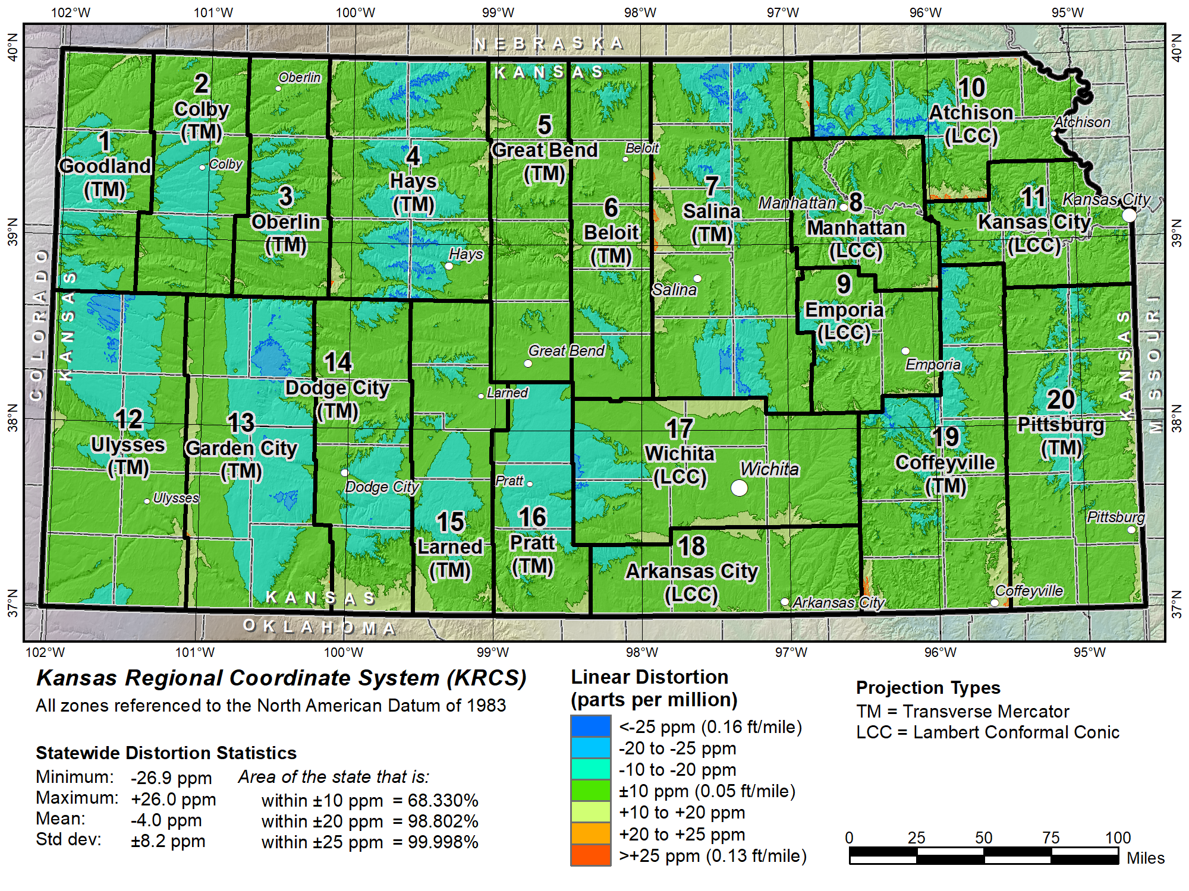

Slide 54
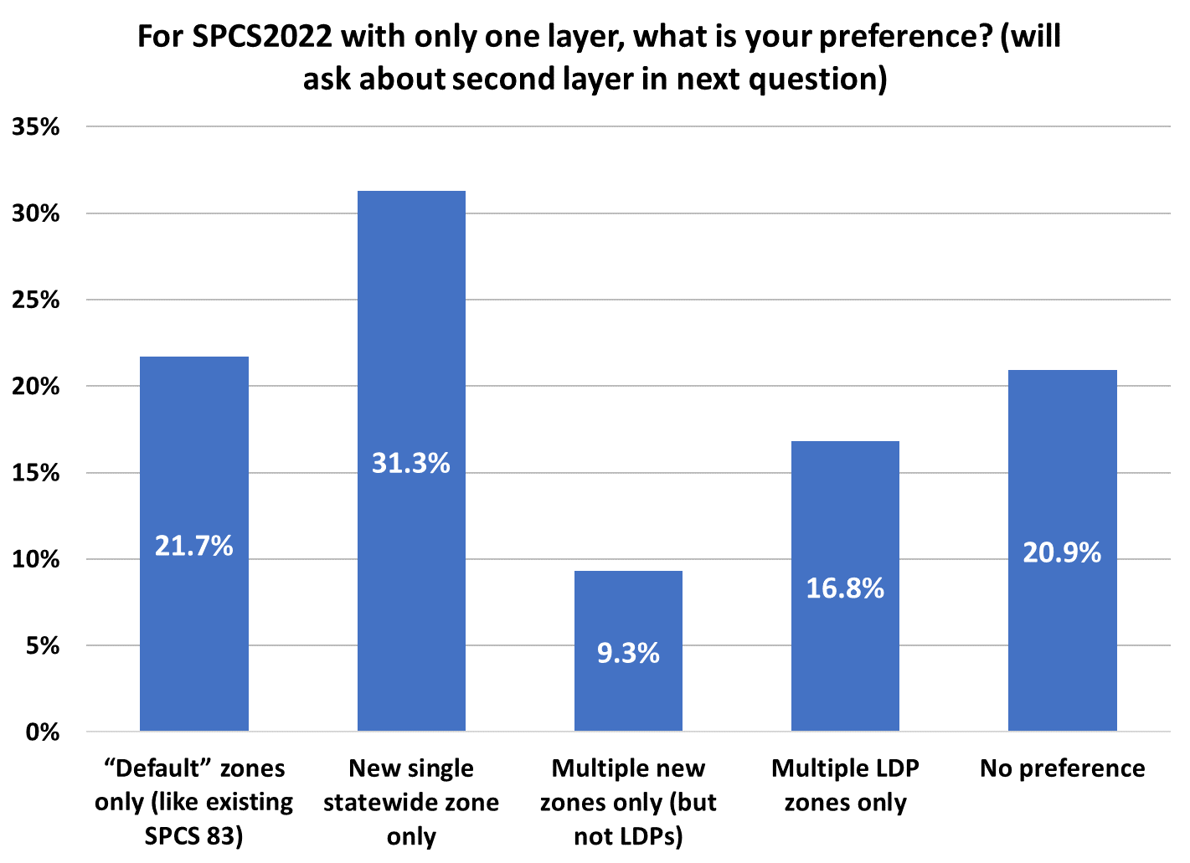
Poll question
121
Total responses = 387
84
81
65
36

Slide 55
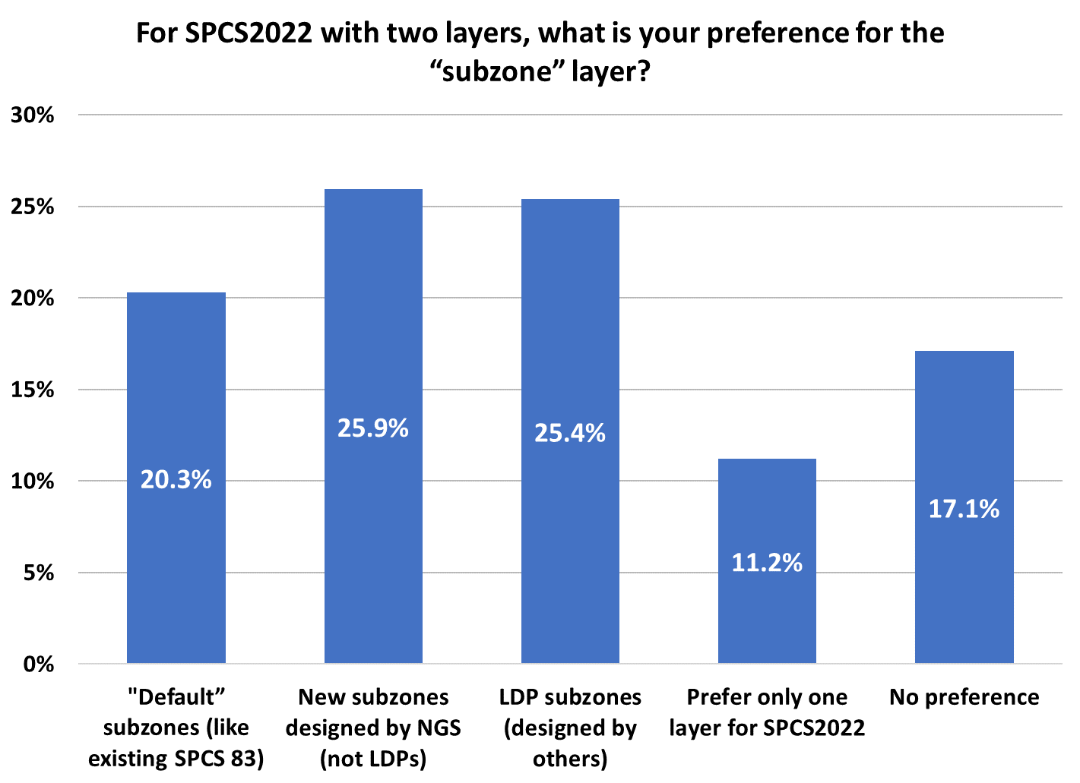
Poll question
Total responses = 374
97
95
76
64
42

Slide 56
Explore Policy, Procedures, and FRN
Linear distortion at topographic surface
One-parallel Lambert Conformal Conic projections
Default SPCS2022 zone designs
Statewide and “layered” zones
Linear distortion design criteria
  Maximum and minimum zone size and distortion
  Low distortion projections (LDPs)
“Special purpose” zones (in FRN only)
Linear units
Submittal process and deadlines
  For Federal Register Notice comments
  For requests, proposals, and submittal of designs

Slide 57
“Special purpose” zones
In Federal Register Notice (not in policy & procedures)
For areas with inadequate SPCS zone coverage
  Usually areas that are in more than one zone
Categories:
  Major urban areas (e.g., New York, Chicago, St. Louis, Denver)
  Large Indian reservations (e.g., Navajo Nation)
  Federal applications covering large areas (e.g., coastal mapping of Atlantic Coast; Grand Canyon National Park)
Permitted for metro areas in 1977 policy (but never used)
Only in FRN, not in draft policy & procedures
  Intent is to get input on concept first
  If used in SPCS2022, will NOT count as a subzone layer

Slide 58
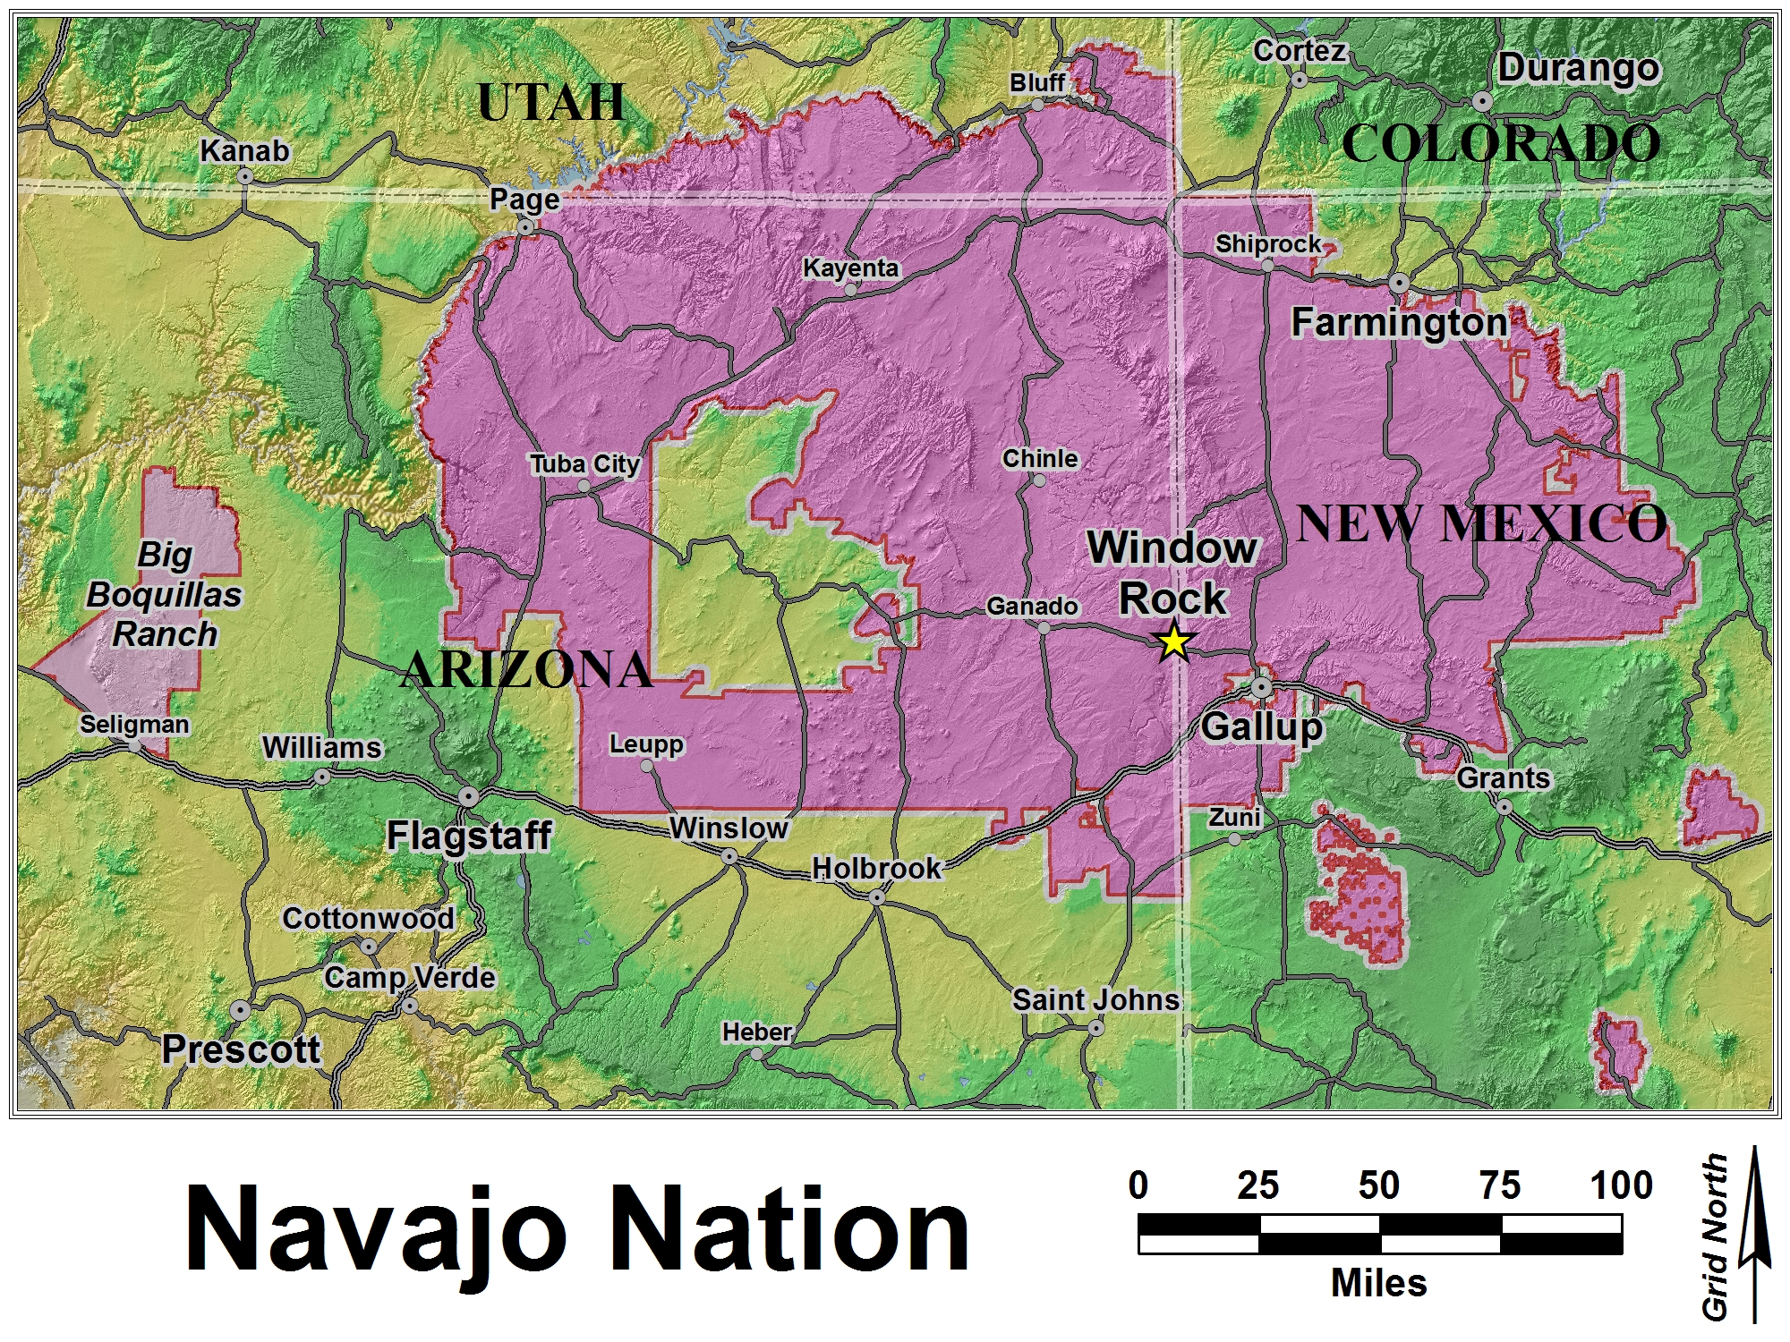
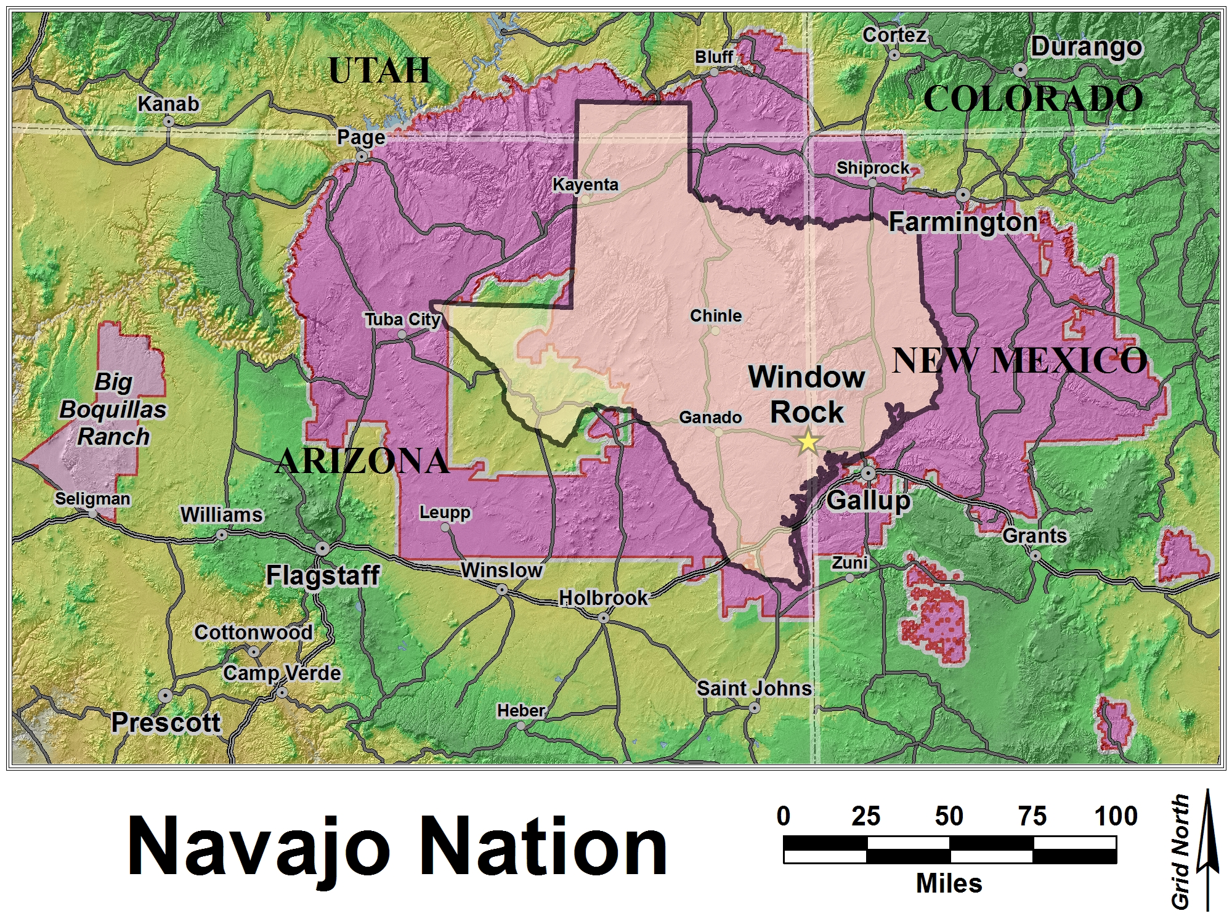
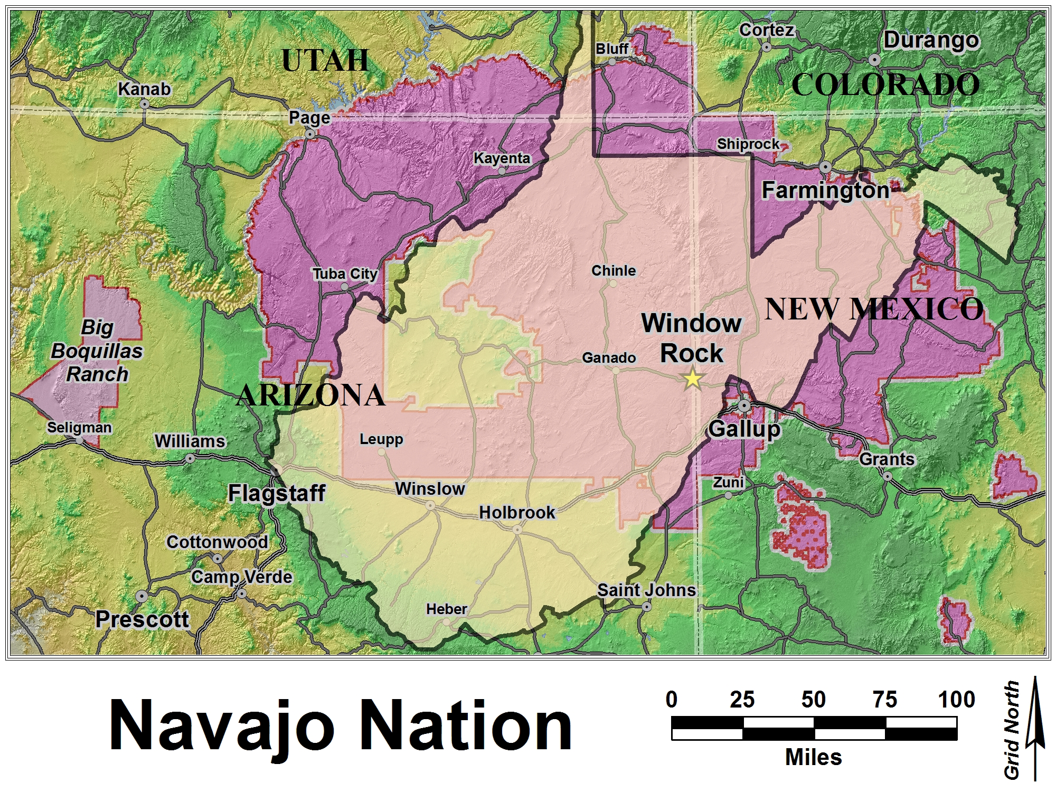
Navajo Nation

Slide 59
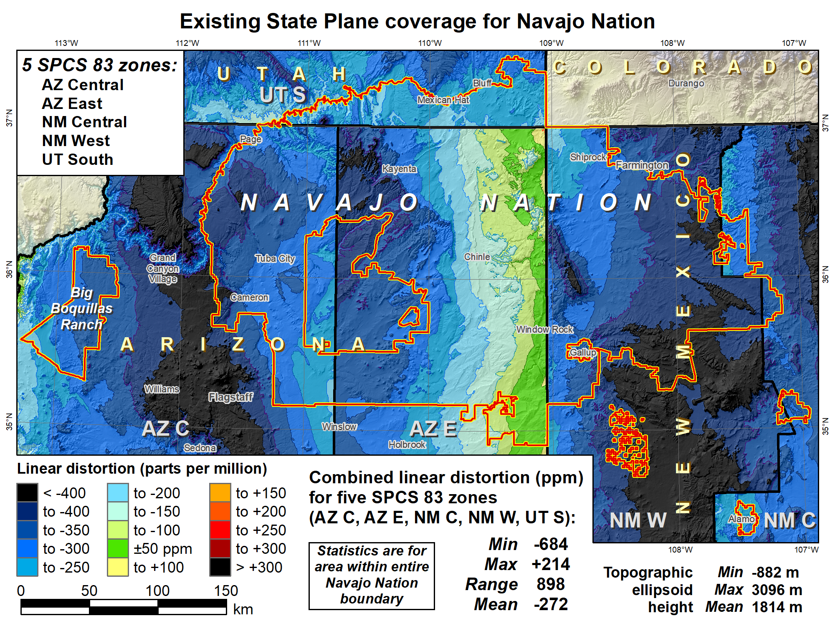

Slide 60
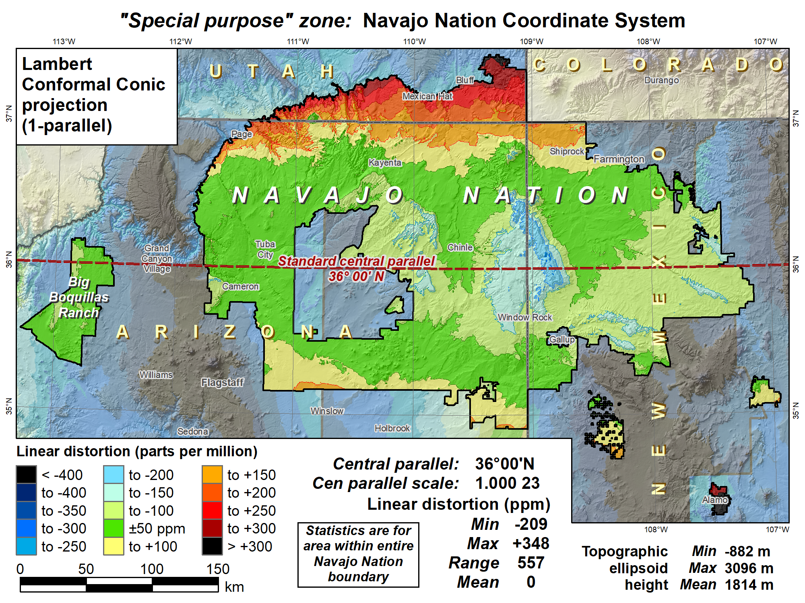

Slide 61
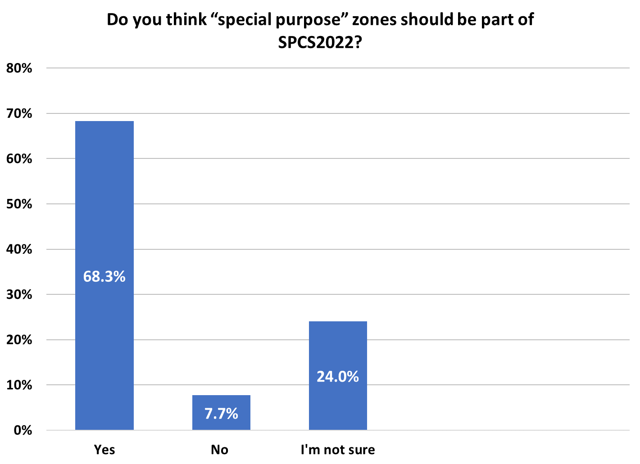
Poll question
Total responses = 416
284
100
32

Slide 62
Explore Policy, Procedures, and FRN
Linear distortion at topographic surface
One-parallel Lambert Conformal Conic projections
Default SPCS2022 zone designs
Statewide and “layered” zones
Linear distortion design criteria
  Maximum and minimum zone size and distortion
  Low distortion projections (LDPs)
“Special purpose” zones (in FRN only)
Linear units
Submittal process and deadlines
  For Federal Register Notice comments
  For requests, proposals, and submittal of designs

Slide 63
Linear units
Policy§II.D and E
All linear parameters defined in meters
Will also give output in feet version if specified by state
Policy§IV.C (for default zones only)
Will use foot as defined in current statute for SPCS 83
In Appendix C of NOAA Special Publication NOS NGS 13

Slide 64
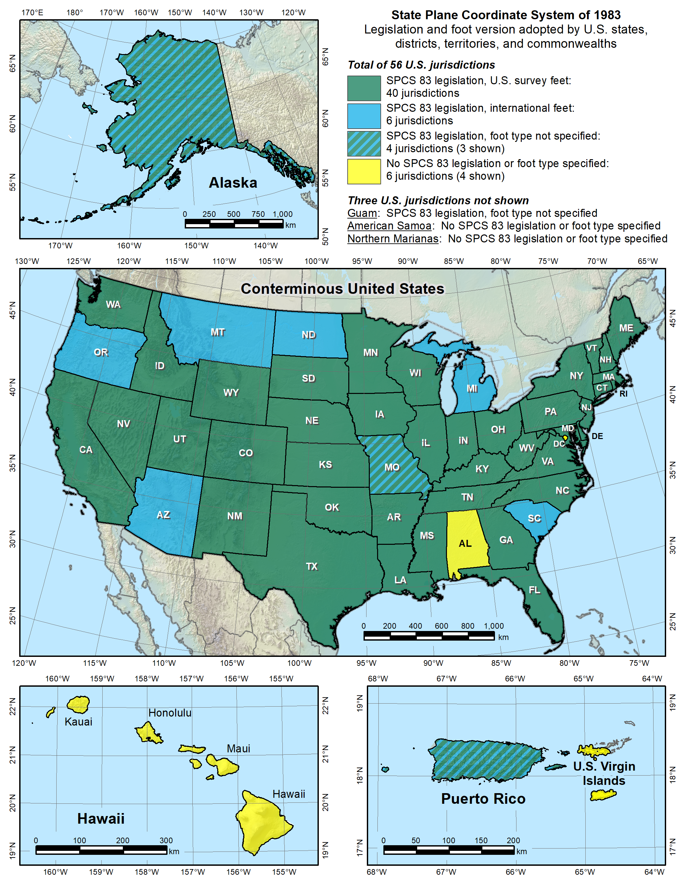

Slide 65
Explore Policy, Procedures, and FRN
Linear distortion at topographic surface
One-parallel Lambert Conformal Conic projections
Default SPCS2022 zone designs
Statewide and “layered” zones
Linear distortion design criteria
  Maximum and minimum zone size and distortion
  Low distortion projections (LDPs)
“Special purpose” zones (in FRN only)
Linear units
Submittal process and deadlines
  For Federal Register Notice comments
  For requests, proposals, and submittal of designs

Slide 66
Procedures for SPCS2022 input
Procedures§1
NGS contact information
CONSENSUS stakeholder input is REQUIRED
Stakeholders should first agree, then collectively provide input
Procedures§2
Stakeholder requests for designs by NGS
Stakeholder proposals of designs by contributing partners
Procedures§3
Submittal of approved designs by contributing partners
Procedures§4
NGS role and responsibilities for SPCS2022 reviews
Limitations for zones designed by NGS
If no input is received from a state, or if input is not unanimous, DEFAULT design will be used for state zones

Slide 67
Deadlines for SPCS2022 input
NGS.Feedback@noaa.gov by August 31, 2018
Federal Register Notice (FRN)
Announcement and public comments
  On draft SPCS2022 policy & procedures
  On “special purpose” zones
Procedures§1
Consensus input per SPCS2022 procedures
  Requests for designs done by NGS
  Proposals for designs by contributing partners
Submittal of approved designs
  Proposal must first be approved by NGS
  Designs must be complete for NGS to review
After deadlines, requests will be for changes to SPCS2022
NGS.SPCS@noaa.gov
by December 31, 2019 for requests and proposals
by December 31, 2020 for submittal of approved designs
Submit after policy and procedures finalized (after August 31, 2018)

Slide 68
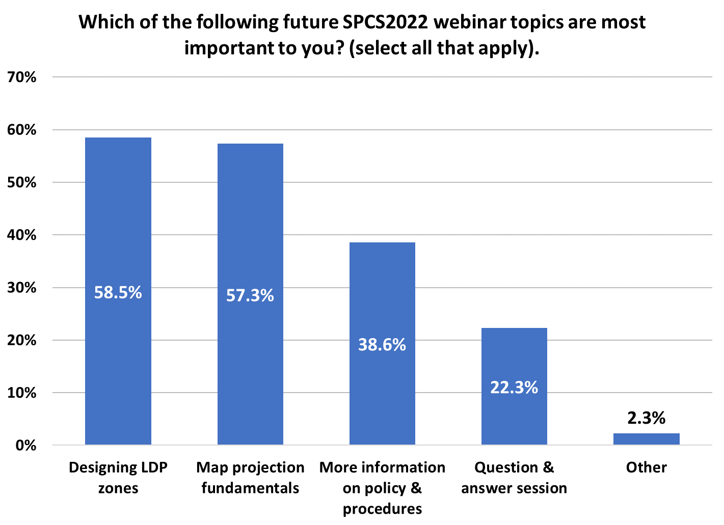
Poll question
Total responses = 443
259
254
Total number of webinar topics selected = 793
171
99
10

Slide 69
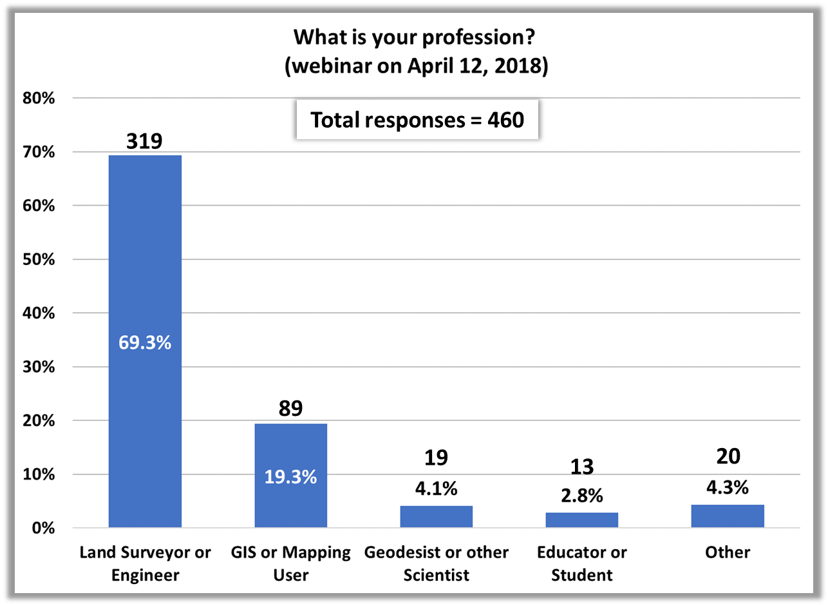
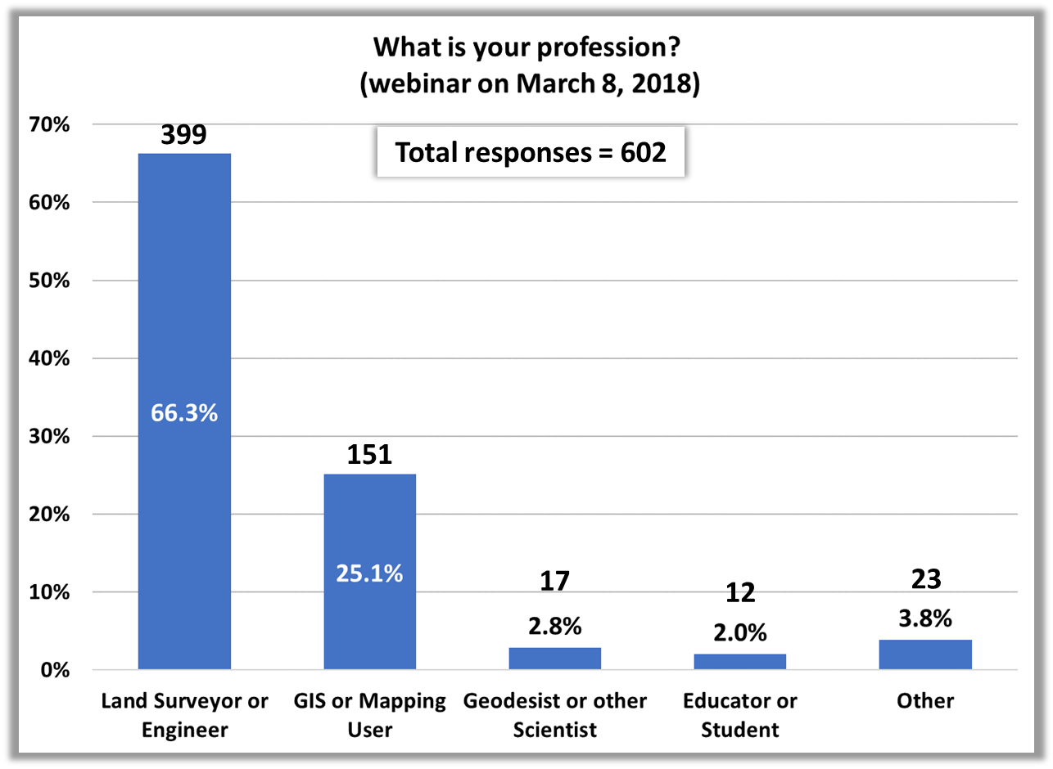
Poll questions
Questions are from this April 12 webinar and from previous March 8 webinar
Total webinar attendance:
Mar 8. 802 (757 with location)
Apr 12. 628 (611 with location)
(location not available for all attendees)

Slide 70
What locations were represented in the webinars?
Location | Mar 8 | Apr 12 | Location | Mar 8 | Apr 12 | Location | Mar 8 | Apr 12
Alabama | 7 | 8 | Maryland | 25 | 20 | Rhode Island | 0 | 1
Alaska | 26 | 20 | Massachusetts | 1 | 1 | South Carolina | 7 | 6
Arizona | 48 | 42 | Michigan | 34 | 57 | South Dakota | 7 | 4
Arkansas | 1 | 1 | Minnesota | 124 | 34 | Tennessee | 1 | 1
California | 35 | 30 | Mississippi | 8 | 6 | Texas | 20 | 16
Colorado | 17 | 25 | Missouri | 7 | 11 | Utah | 2 | 9
Connecticut | 4 | 11 | Montana | 16 | 13 | Vermont | 0 | 3
Delaware | 1 | 2 | Nebraska | 16 | 11 | Virginia | 8 | 5
Florida | 52 | 44 | Nevada | 5 | 1 | Washington | 12 | 16
Georgia | 8 | 3 | New Hampshire | 1 | 1 | West Virginia | 1 | 0
Hawaii | 5 | 6 | New Jersey | 4 | 1 | Wisconsin | 9 | 27
Idaho | 12 | 11 | New Mexico | 12 | 7 | Wyoming | 3 | 2
Illinois | 15 | 12 | New York | 4 | 5 | American Samoa | 0 | 0
Indiana | 4 | 7 | North Carolina | 10 | 8 | District of Columbia | 2 | 1
Iowa | 6 | 7 | North Dakota | 33 | 13 | Guam | 0 | 0
Kansas | 5 | 3 | Ohio | 31 | 24 | Mariana Islands | 0 | 0
Kentucky | 5 | 5 | Oklahoma | 3 | 1 | Puerto Rico | 2 | 3
Louisiana | 13 | 10 | Oregon | 53 | 23 | US Virgin Islands | 0 | 1
Maine | 1 | 1 | Pennsylvania | 23 | 18 | International | 8 | 13

Slide 71
Summary
Main characteristics of SPCS2022
  Designed with respect to “ground”
  Use 1-parallel definitions for LCCs
  Default designs similar to existing SPCS 83
  Can include a statewide zone plus a subzone layer
  LDPs can be used but must be designed by other than NGS
Federal Register Notice (FRN)
  Public comment on policy & procedures
  Input on “special purpose” zones
Consensus state stakeholder input required for SPCS2022 zone requests, proposals, and designs
To respond to the FRN: NGS.Feedback@noaa.gov
General questions about State Plane and submittal of SPCS2022 requests, proposals, and designs: NGS.SPCS@noaa.gov
Remember, SPCS2022 policy & procedures are DRAFT until after August 31, 2018

