Slide 1
Be a Part of the Change A Guide to Customizing State Plane for 2022
Michael L. Dennis, PhD, RLS, PE
SPCS2022 Project Manager
October 10, 2019

Slide 2
Previous State Plane webinars
The State Plane Coordinate System: History, Policy, Future Directions (March 8, 2018)
Building a State Plane Coordinate System for the Future (April 12, 2018)
State Plane Coordinate System Update (March 7, 2019)
The State Plane Coordinate System of 2022: Making It Your Way (May 6, 2019, at Geospatial Summit)

Slide 3
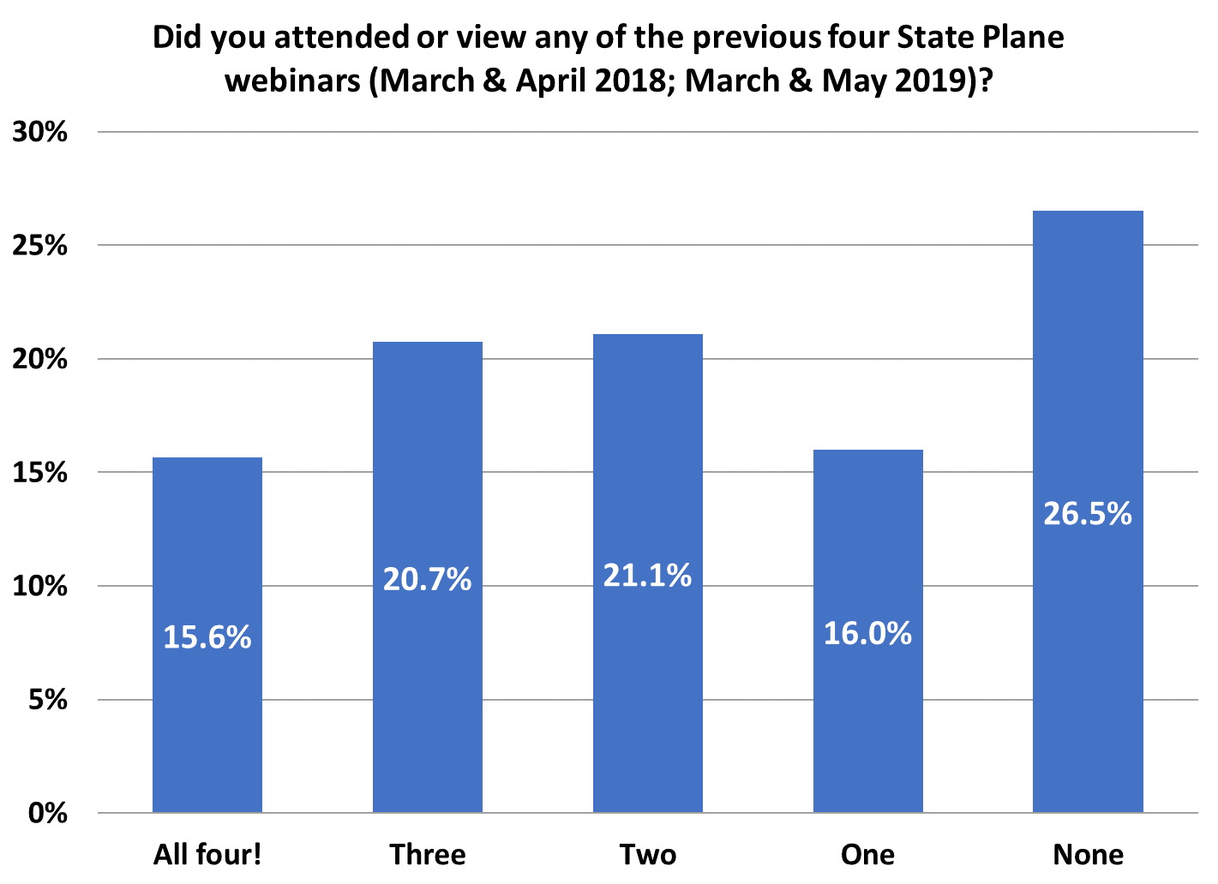
Poll Question
Total responses = 294
78
61
62
46
47

Slide 4
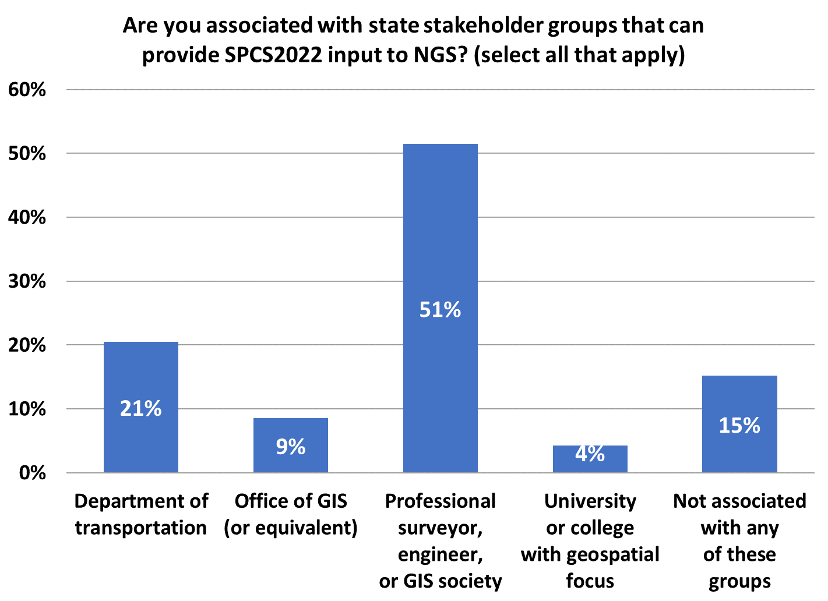
Poll Question
Total responses = 375
193
Not all stakeholders must be represented
But all represented MUST agree
77
57
32
16

Slide 5
Poll Question
Which state is your primary focus for SPCS2022?
Total of 417 attendees for 30 or more minutes.
From 49 states, plus Puerto Rico and Canada

Slide 6
Why another State Plane webinar?
First deadline fast approaching!
Getting lots of questions
Reinforce concepts
Give examples
Explain the “rules”
Provide a resource for stakeholders
Opportunity for attendees to ask questions!

Slide 7
SPCS2022 Deadlines
Consensus input per SPCS2022 procedures
Requests for designs done by NGS
Proposals for designs by stakeholders
Submittal of approved designs
Proposal must first be approved by NGS
Designs must be complete for NGS to review
Forms are easy → hard part may be getting agreement
After deadlines→ changes to SPCS2022 (after 2022)
NGS.SPCS@noaa.gov
by March 31, 2020 for requests and proposals
by March 31, 2021 for submittal of approved designs
Form for requests and proposals
Form for submitting stakeholder designs

Slide 8
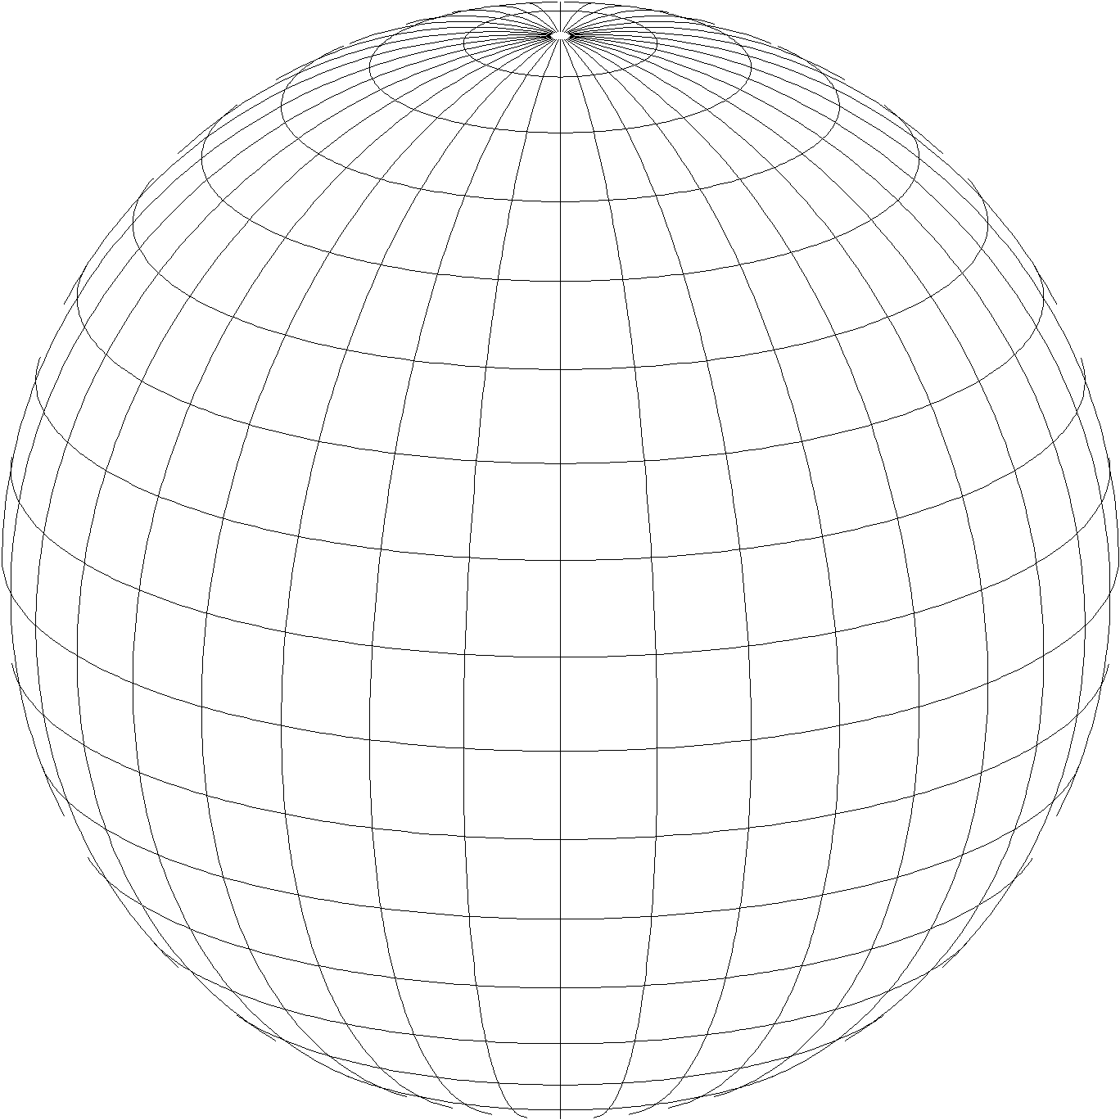
A New State Plane for 2022
State Plane Coordinate System of 2022 (SPCS2022)
Referenced to 2022 Terrestrial Reference Frames (TRFs)
Based on same reference ellipsoid as SPCS 83 (GRS 80)
Same 3 conformal projection types as SPCS 83 and 27:
Lambert Conformal Conic (LCC)
Transverse Mercator (TM)
Oblique Mercator (OM)

Slide 9
Creating SPCS2022 for You
Like existing State Plane, but different
Zones designed “at ground”
Can have zone “layers”
Statewide zone for every state
Allow “low distortion projections” (LDPs)
You are the users of State Plane
Make SPCS2022 useful as possible
Design zones based on stakeholder input

Slide 10
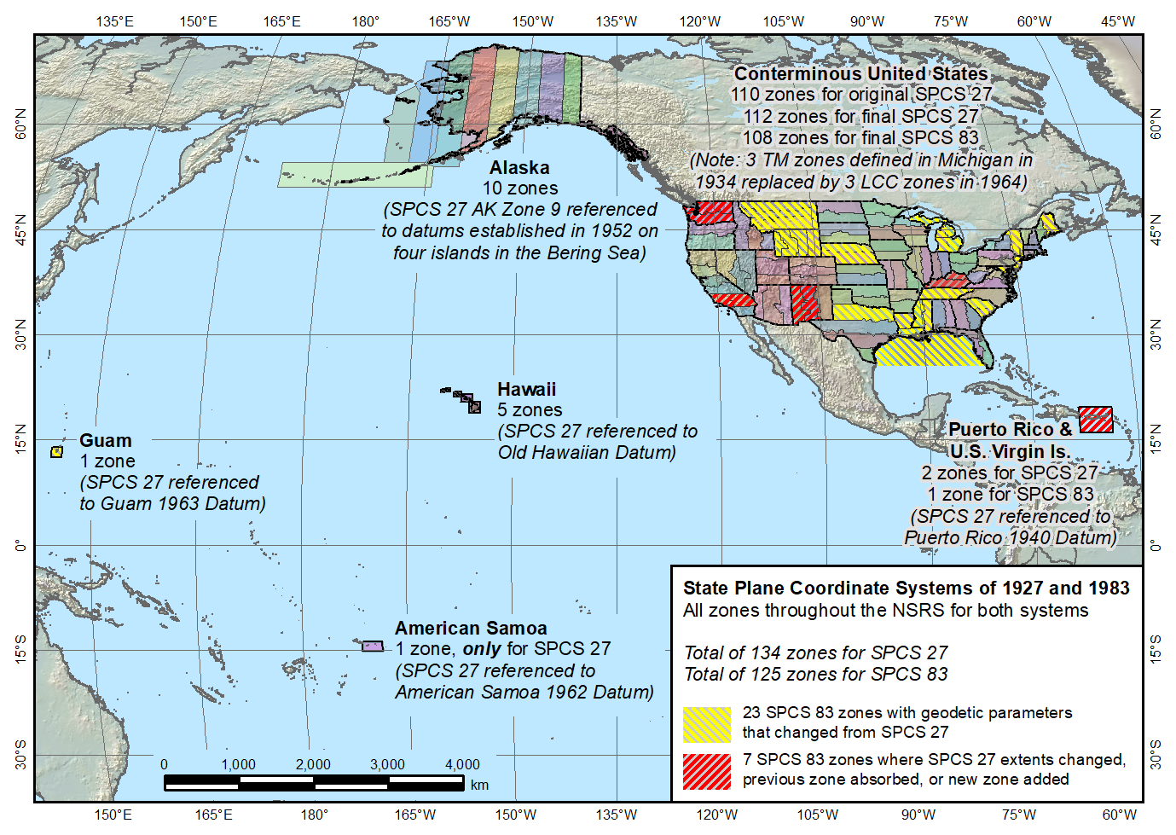
SPCS 83 and 27
State Plane Coordinate Systems of 1927 (134 zones) and 1983 (125 zones)

Slide 11
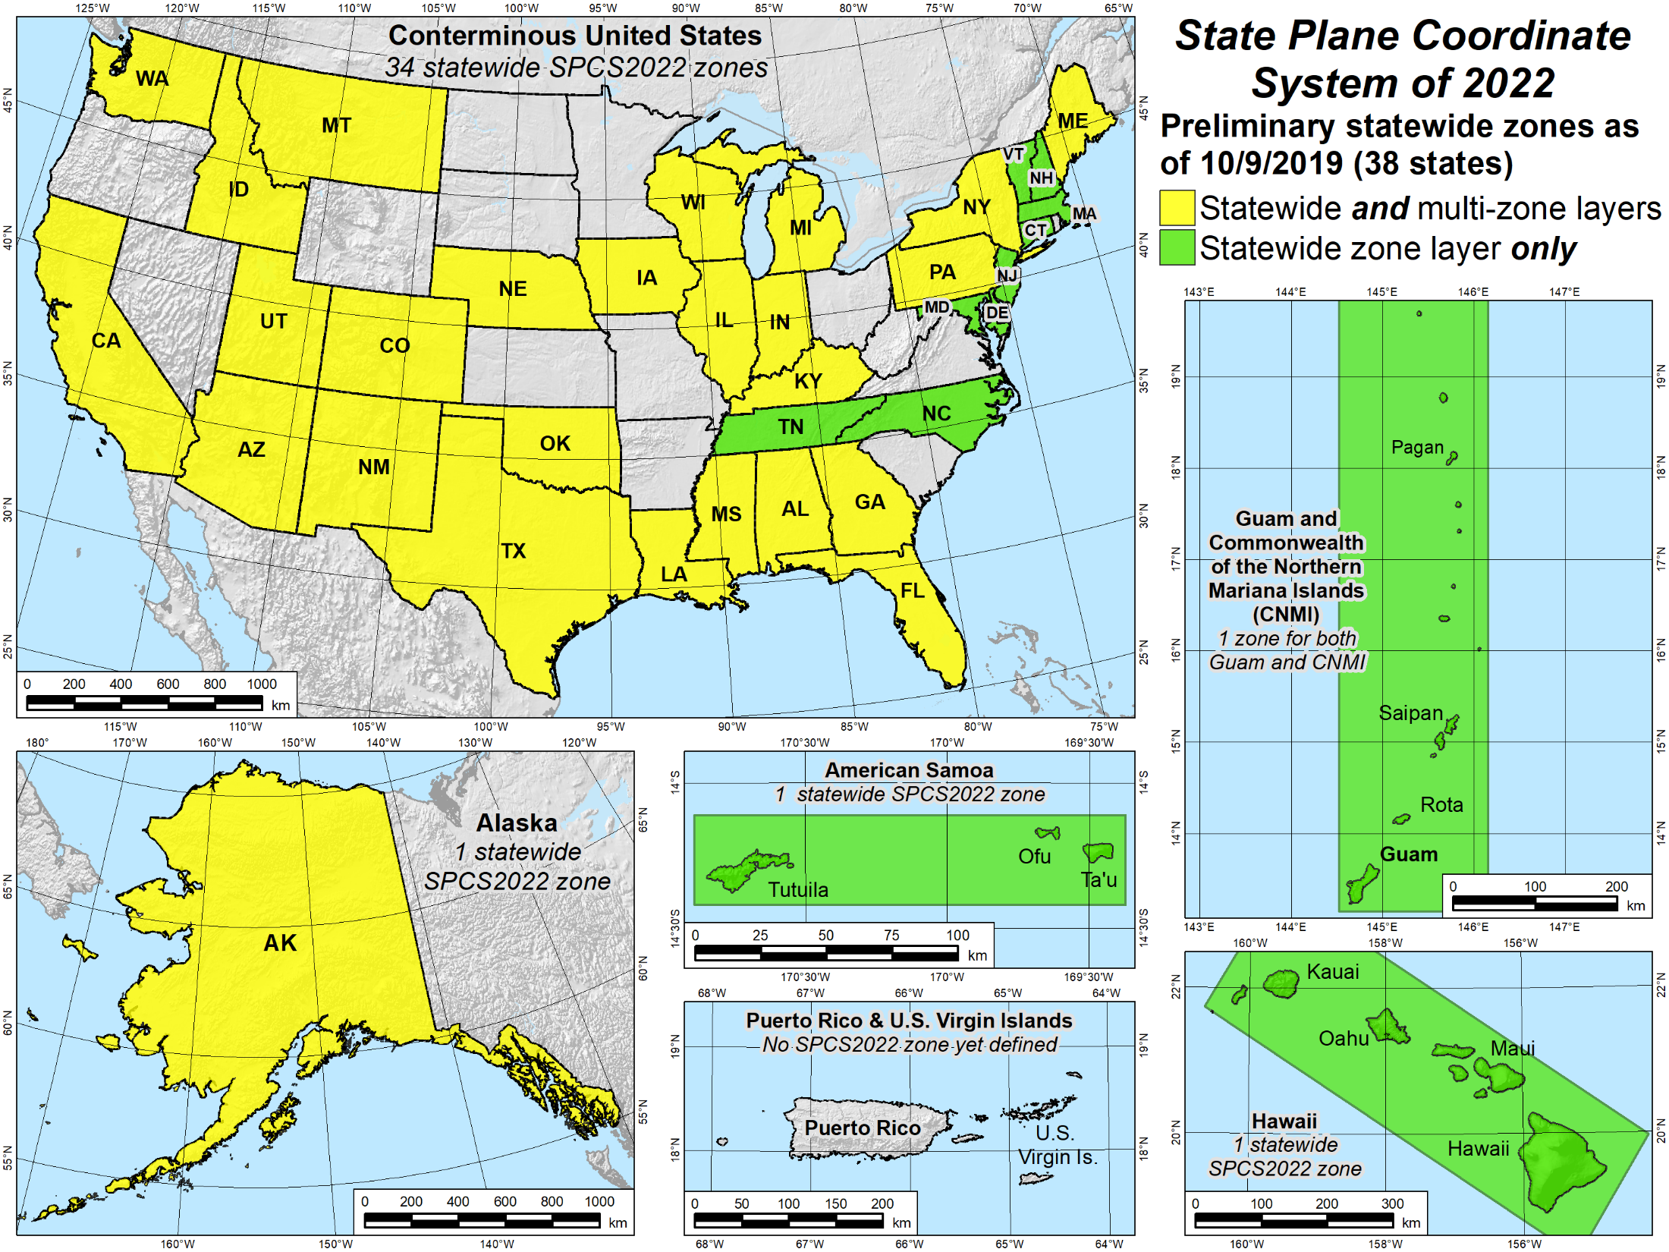
Status of Statewide Designs

Slide 12
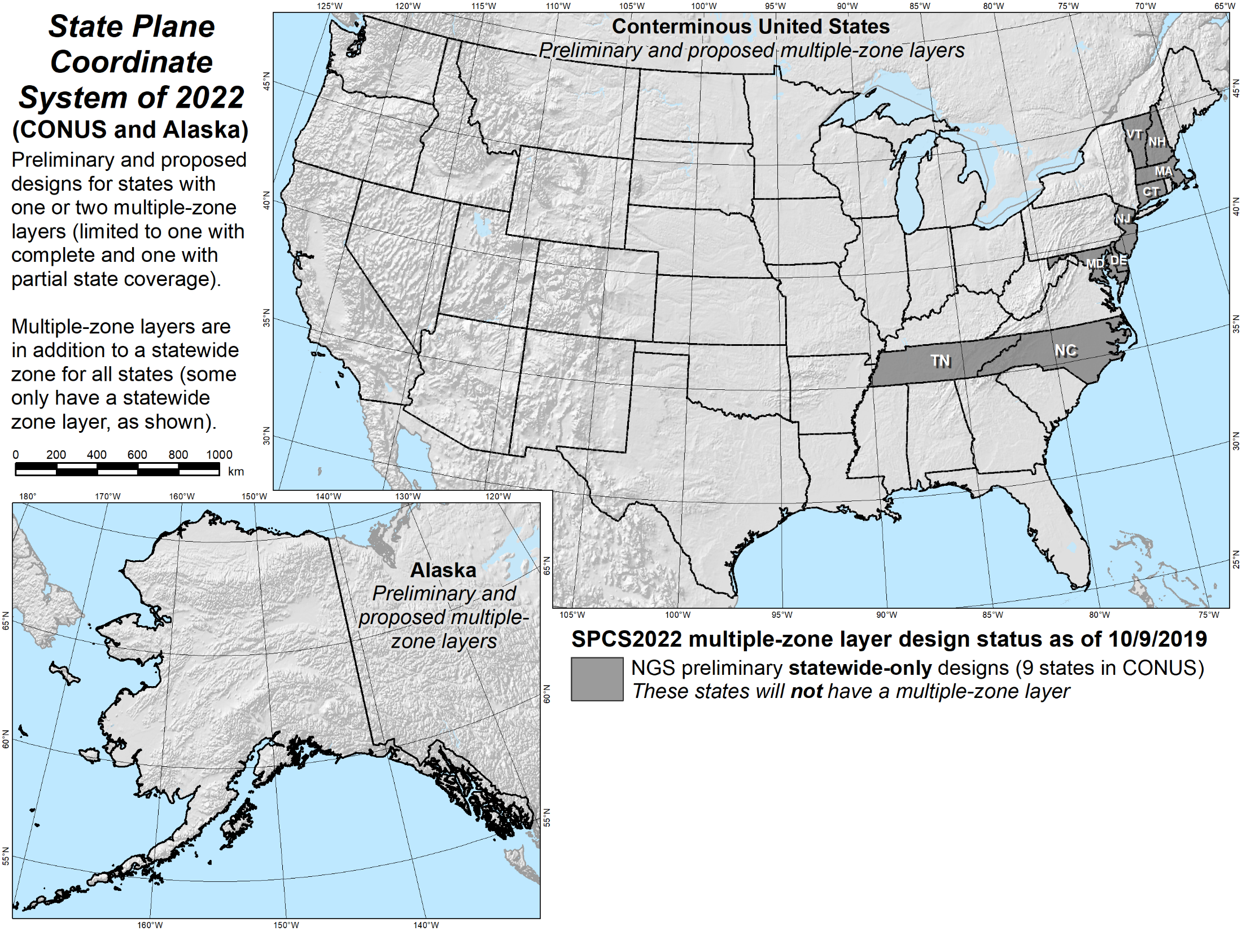
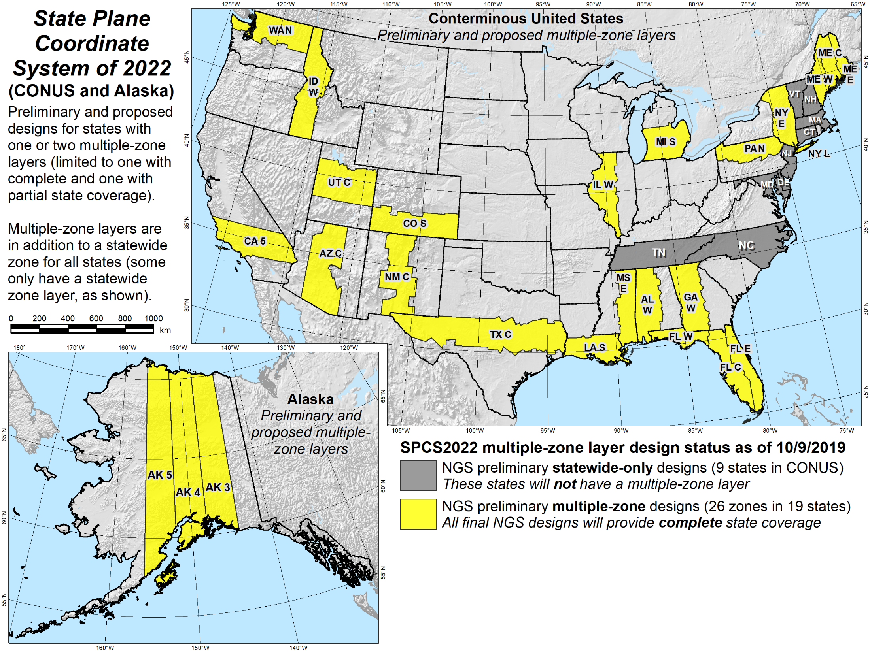
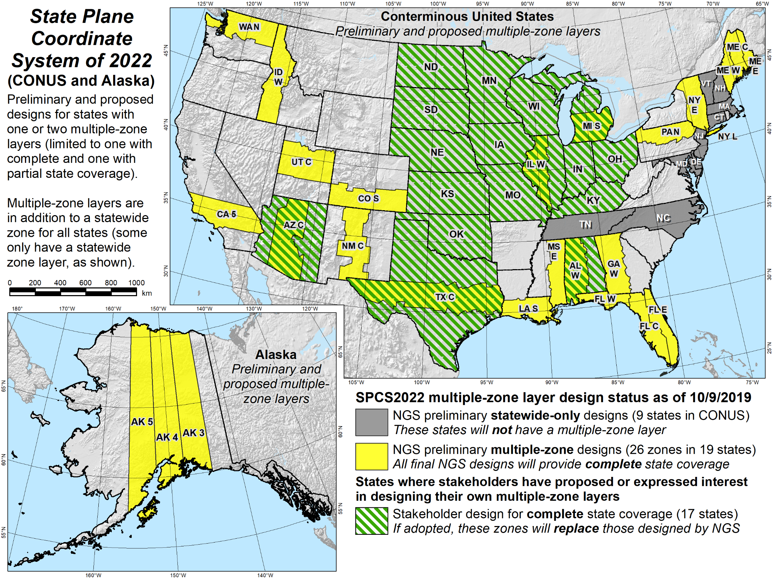
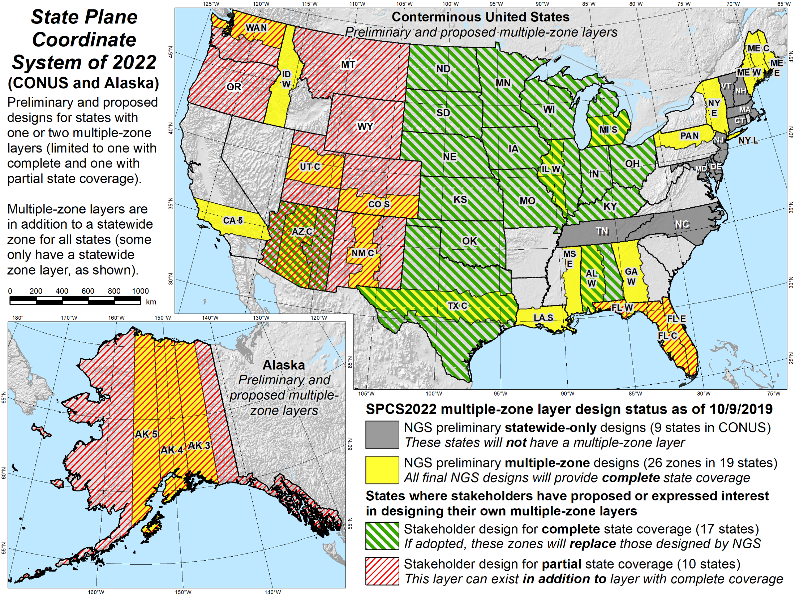
Status of Multiple-Zone Designs

Slide 13
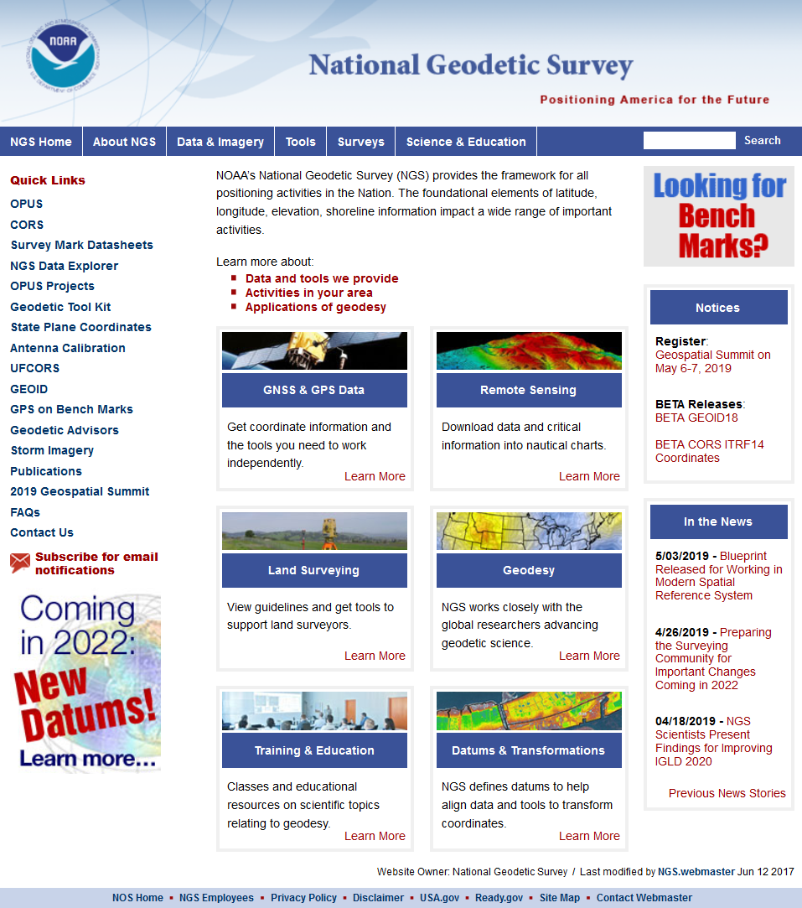
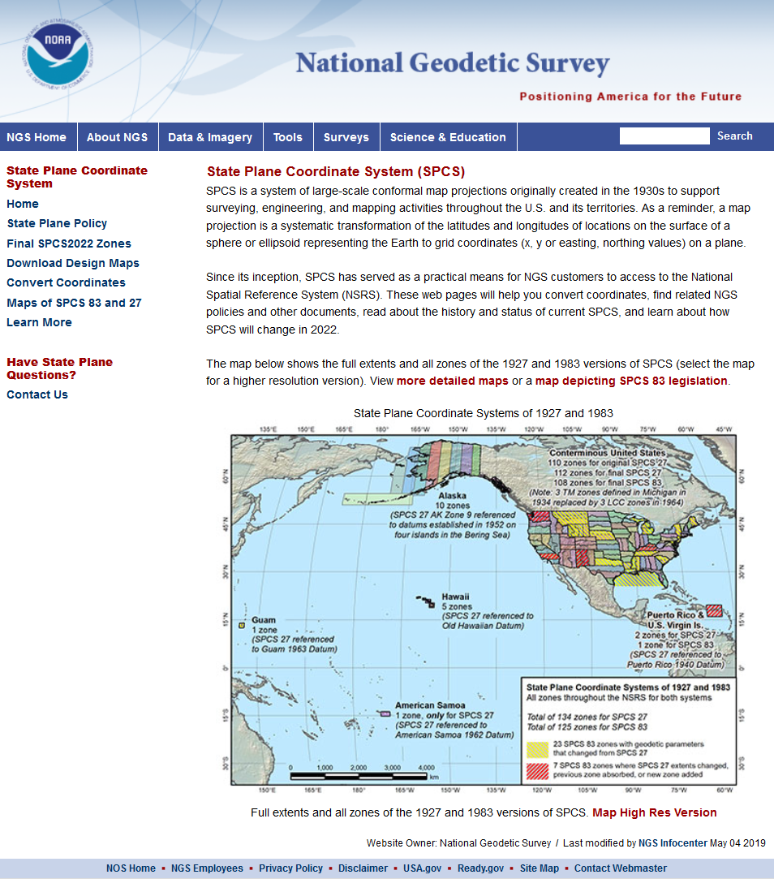
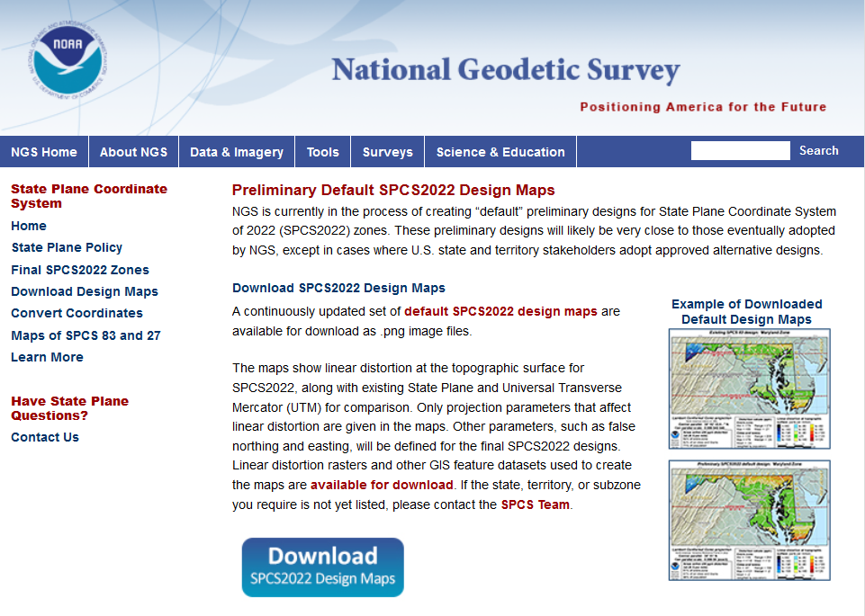
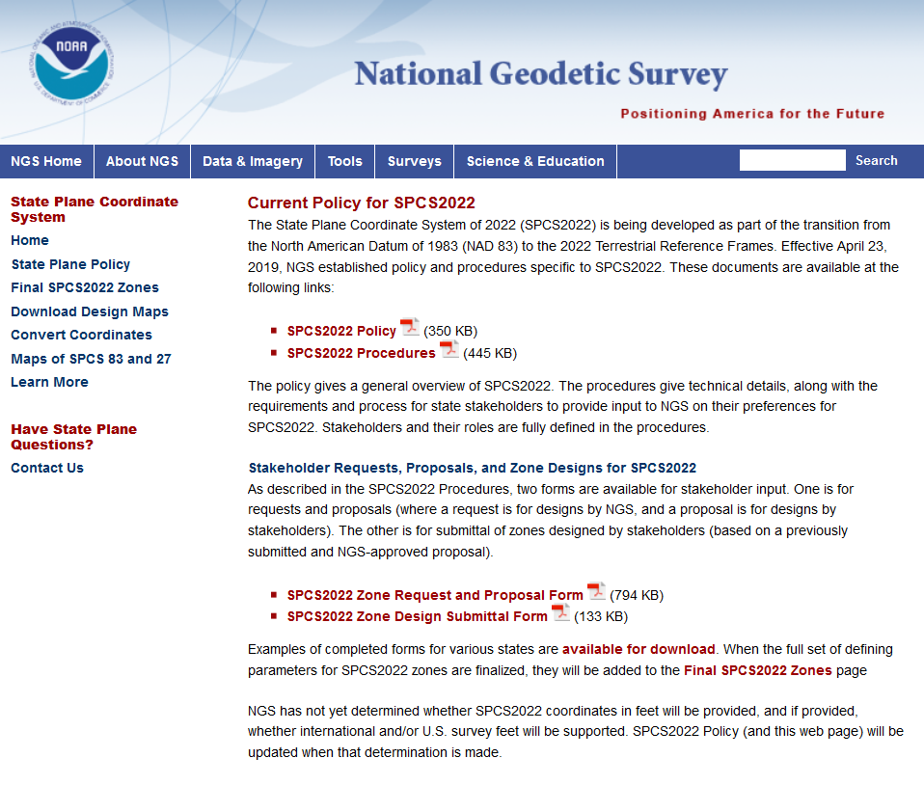
geodesy.noaa.gov

Slide 14
SPCS2022 Policy and Procedures
SPCS2022 Policy (released 4/23/2019)
Overall characteristics
Will update soon (mainly for foot definition)
Procedures (updated 10/9/2019)
Technical details
Requirements for requests, proposals, submitting designs
Forms for requests/proposals and submitting designs
Resources available for download
Preliminary design maps
Map and design data
Example completed forms
Example state legislation

Slide 15
The Forms
Two forms (updated 10/7/2019)
Request/Proposal
Design Submittal
Not required for default designs
But can use to expedite design
Can also use to request certain characteristics
Contact info only required for POC
Can include supporting information (files)
No letter is required!
Just email completed forms to NGS.SPCS@noaa.gov
Intent is to make process as simple as possible

Slide 16
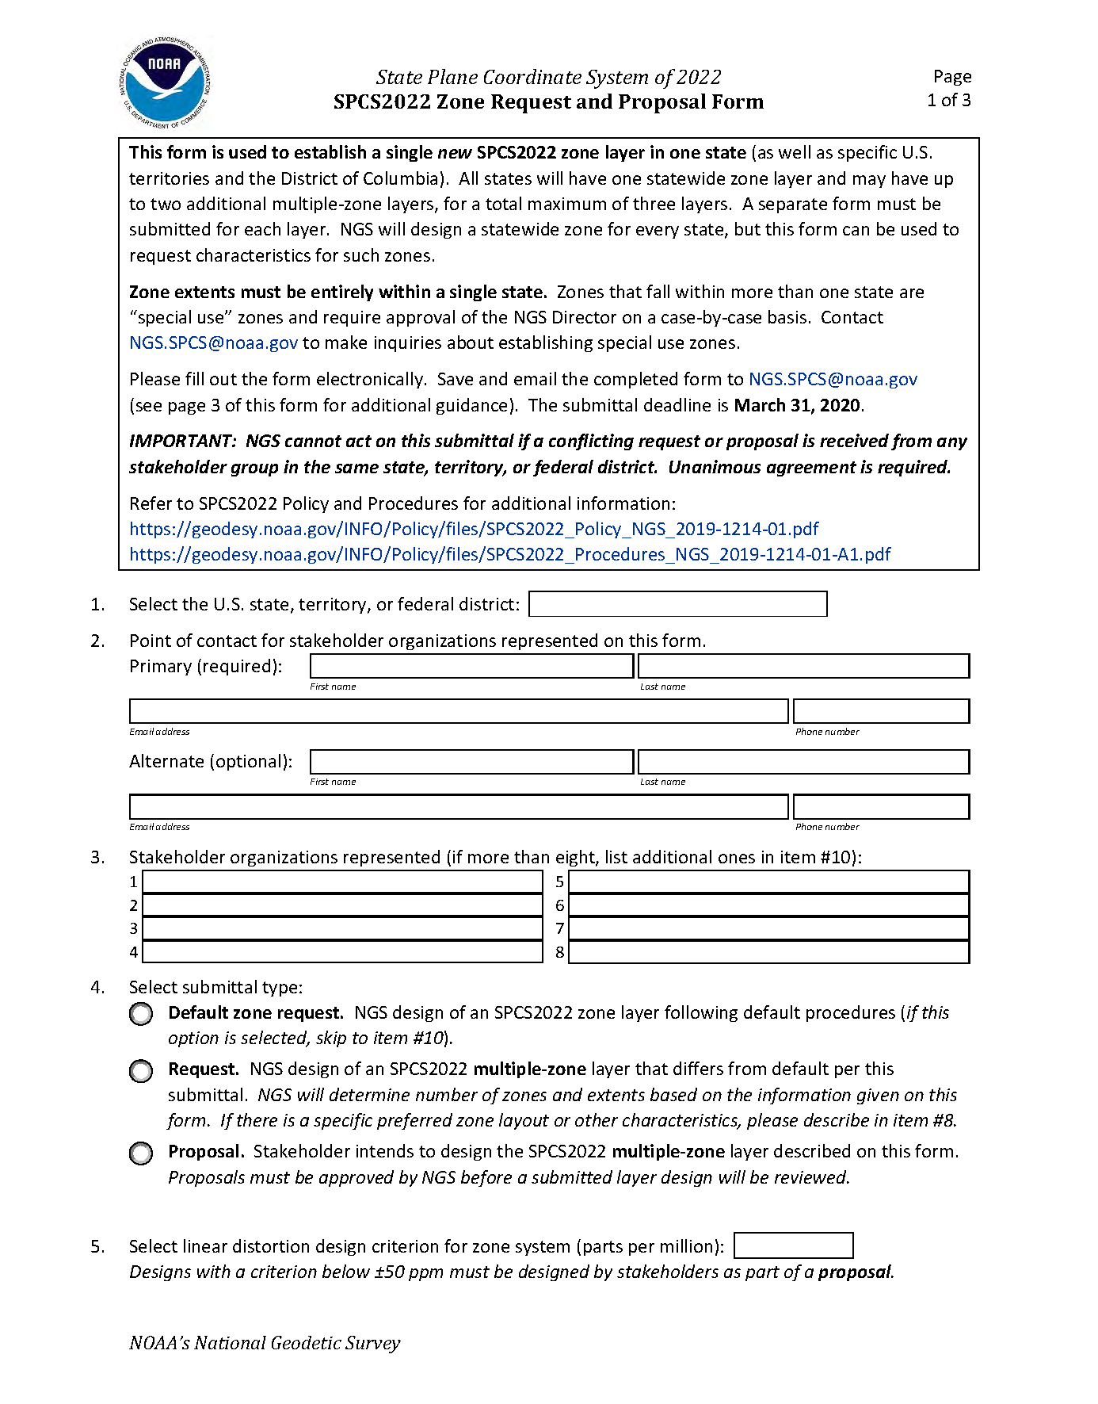
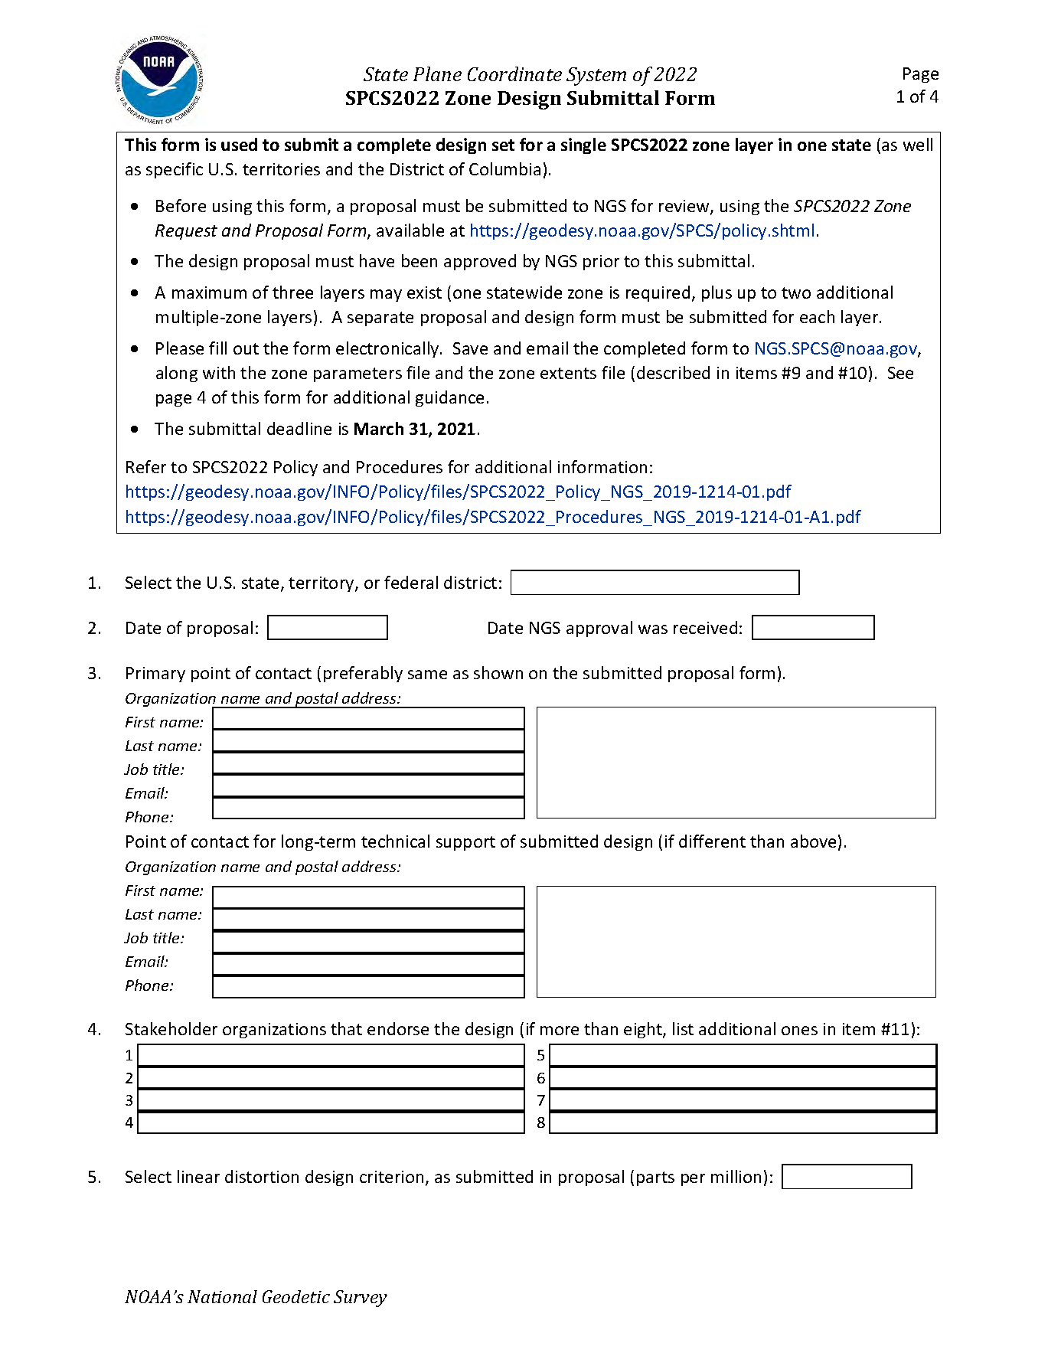
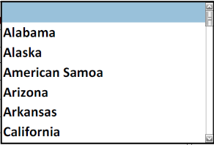
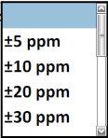
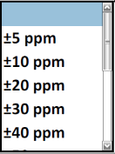
Request/Proposal Form
Design Submittal Form
Deadline: March 31, 2020
Deadline: March 31, 2021
NGS-approved proposal required

Slide 17
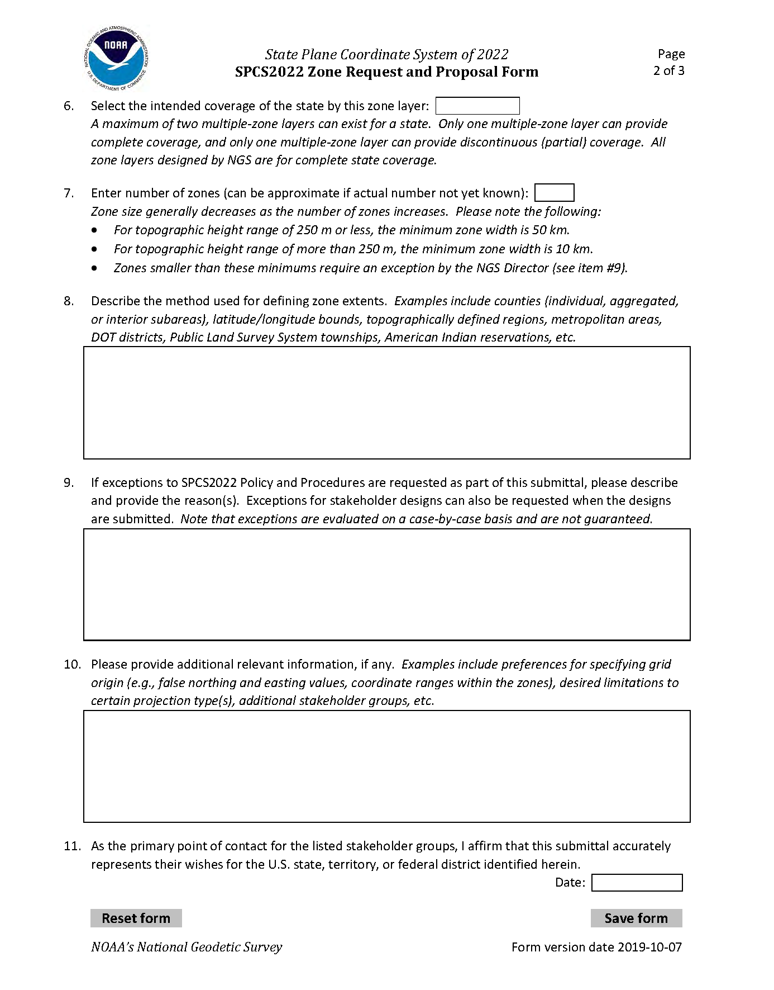
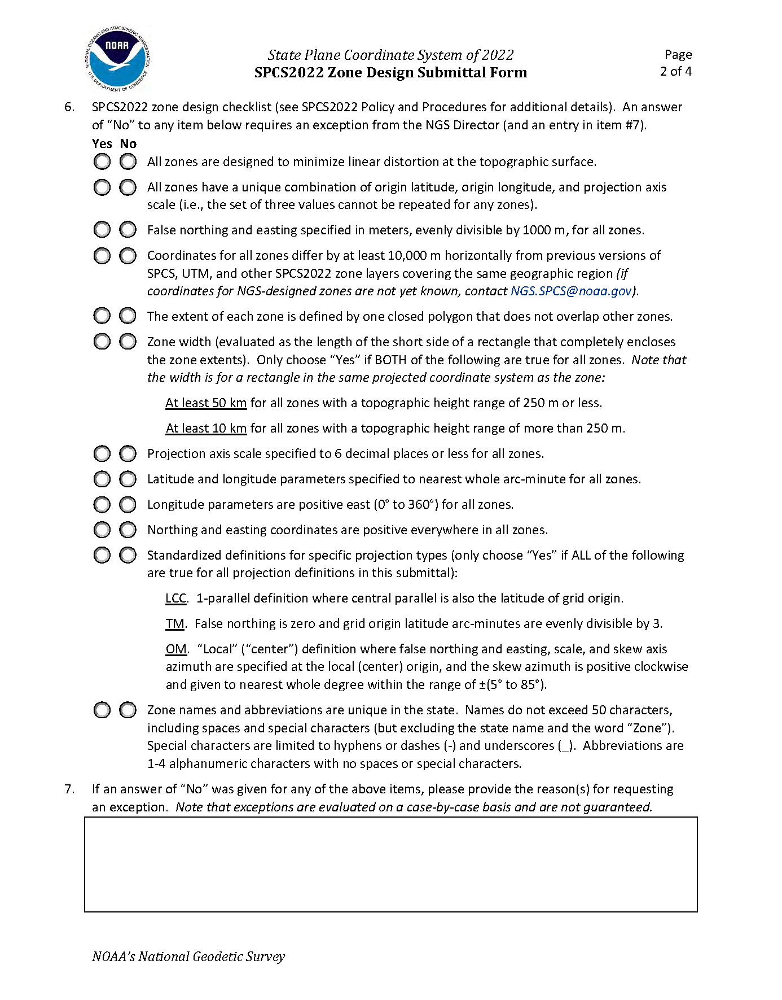
Request/Proposal page 2
Design Submittal page 2

Slide 18
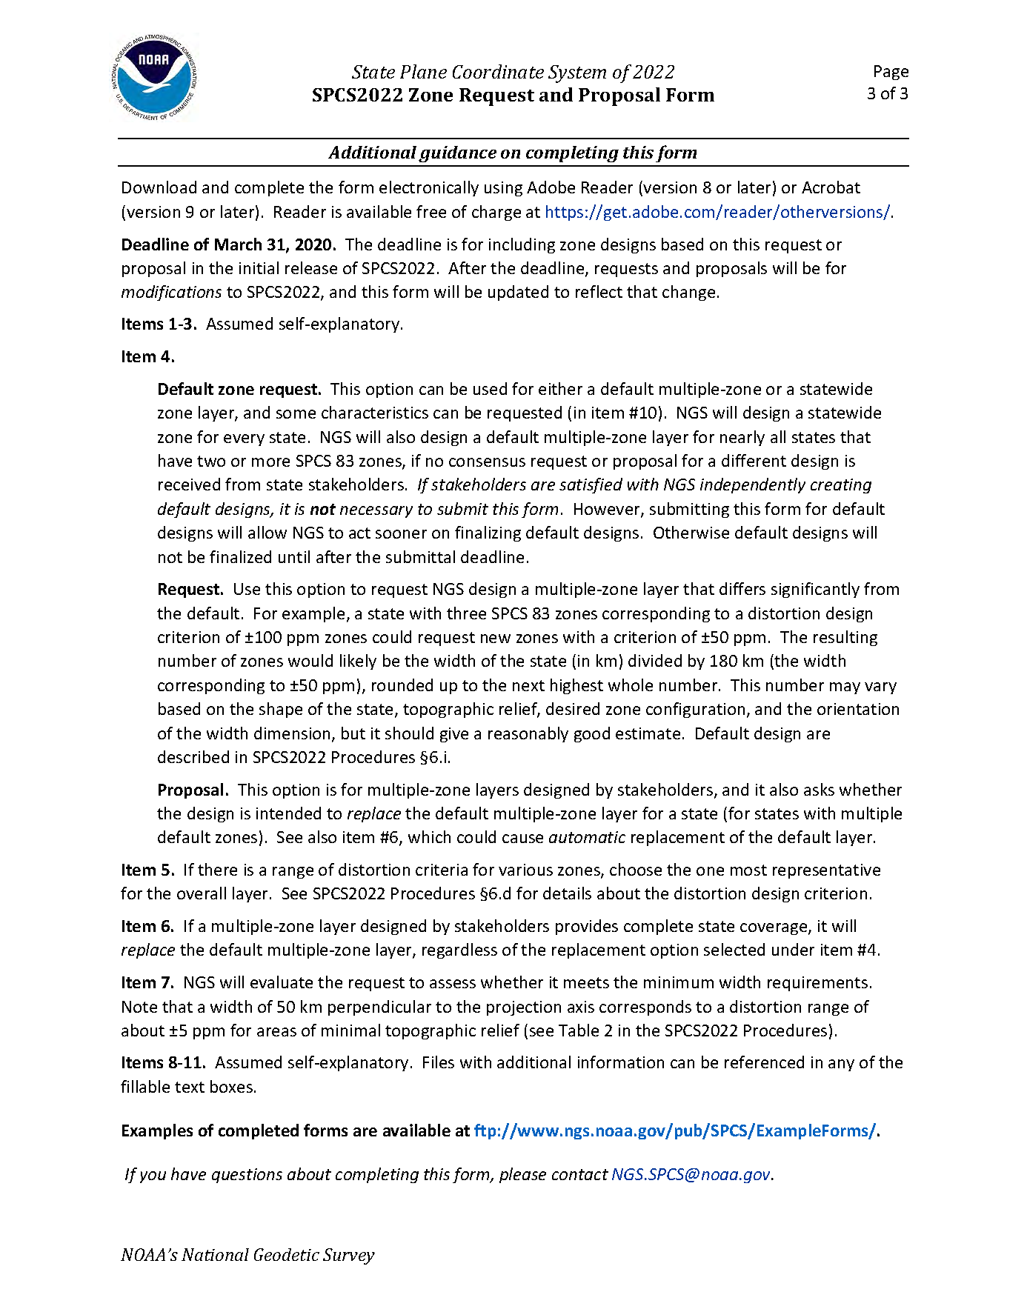
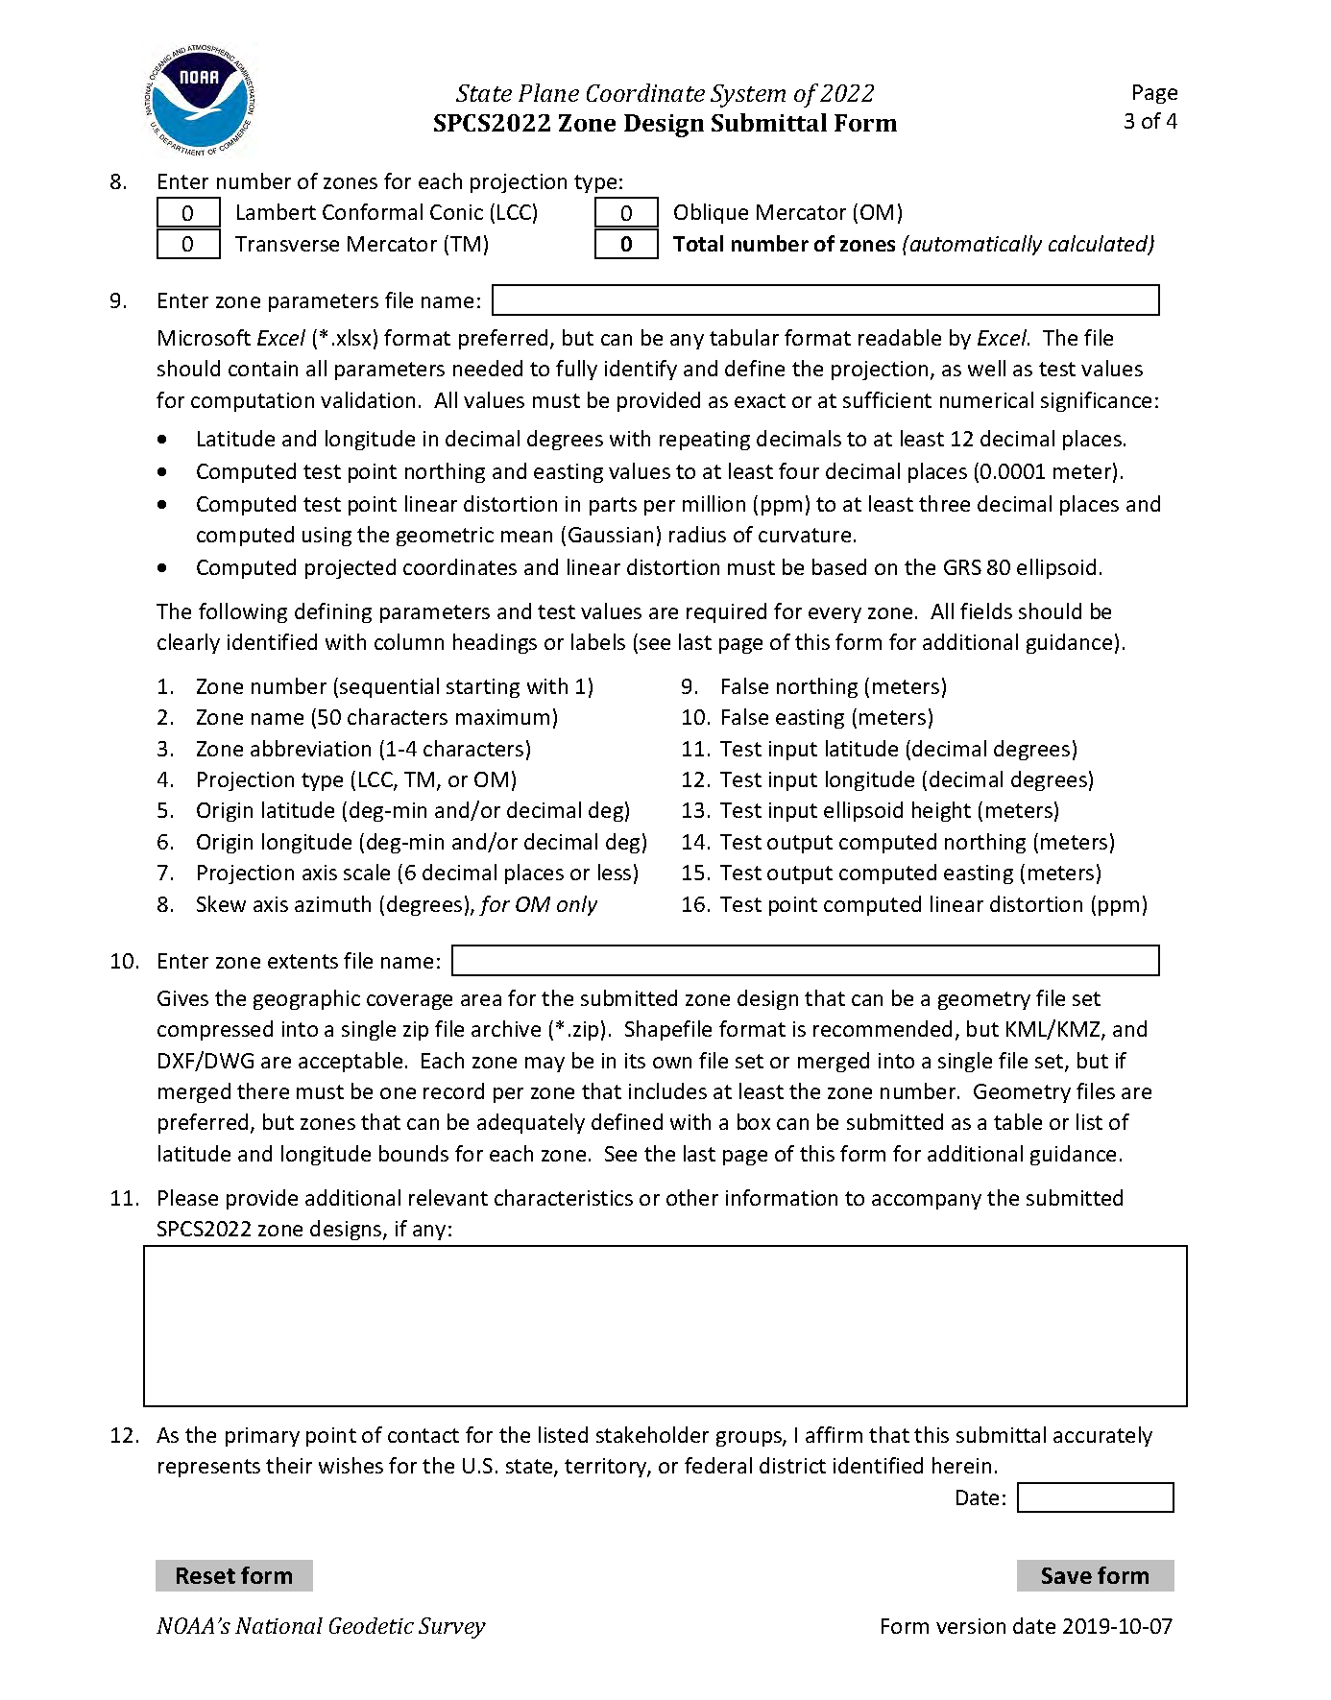
Request/Proposal page 3
Design Submittal page 3

Slide 19
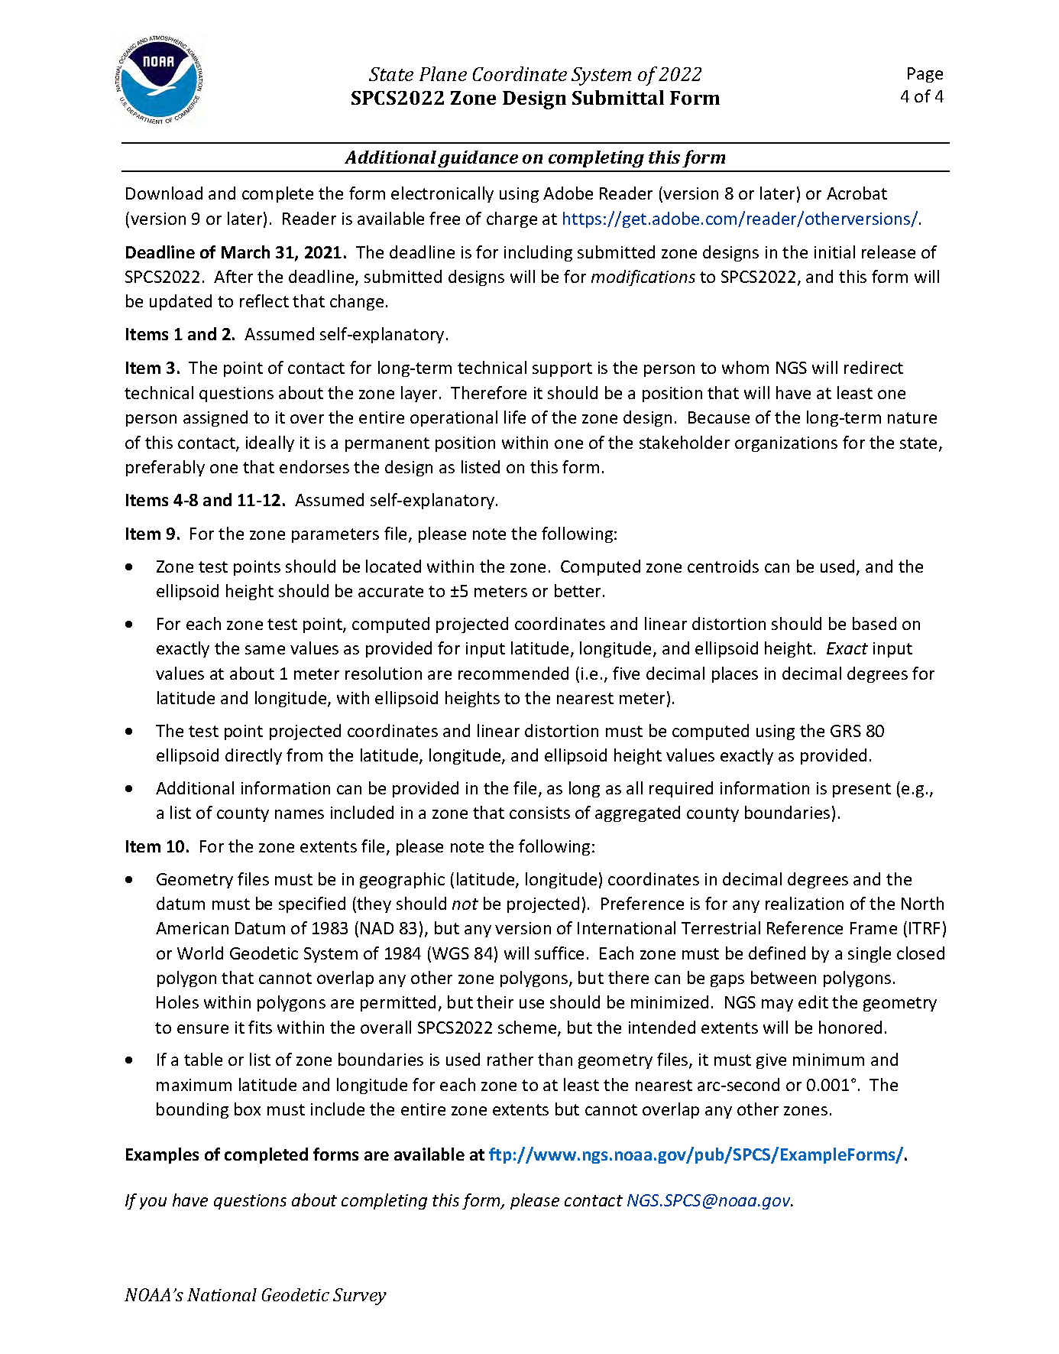
Request/Proposal last page
Design Submittal last page

Slide 20
Use as policy & procedures checklist

Slide 21
The Right Answer is “Yes”
Yes | No | Requirement
○ | ○ | Minimize distortion at topographic surface
○ | ○ | Unique combination of geodetic origin and scale
○ | ○ | False northing and easting evenly divisible by 1000
○ | ○ | Coordinates differ by > 10,000 m from other SPCS
○ | ○ | Zones do not overlap other zones in same layer
○ | ○ | Zone width must satisfy both following criteria:
 |  | Zone width > 50 km if height range <= 250 m
 |  | Zone width > 10 km if height range > 250 m
○ | ○ | Projection axis scale to 6 decimal places or less

Slide 22
The Right Answer is “Yes”
Yes | No | Requirement
○ | ○ | Latitude and longitude origins to nearest arc-minute
○ | ○ | Longitudes positive east (0° to 360°E)
○ | ○ | Coordinates positive everywhere in the zone
○ | ○ | Standardized projection definitions:
 |  | LCC: Use 1-parallel definition for all zones
 |  | TM: False northing zero at origin latitude
 |  | OM: Local (“center”) definition; skew within ±(5° to 85°)
○ | ○ | Unique zone names and abbreviations in state
Any answers of “No” → must request exceptions

Slide 23
Example Completed Forms
Request/Proposal form (deadline 3/31/2020)
North Carolina default zone selection
Idaho default statewide zone selection
Maine request: NGS-designed multiple-zone layer
Kentucky proposal: LDP multiple-zone layer
Design submittal form (deadline 3/31/2021)
Kentucky low-distortion projection layer
Requires an NGS-approved proposal
Must include complete parameters and geometry

Slide 24
Request/Proposal Form
First 3 items: State, POCs, and stakeholders

Slide 25
North Carolina default selection
Form NOT required, but:
Can use to expedite NGS design
Request characteristics (e.g., coordinate values)

Slide 26
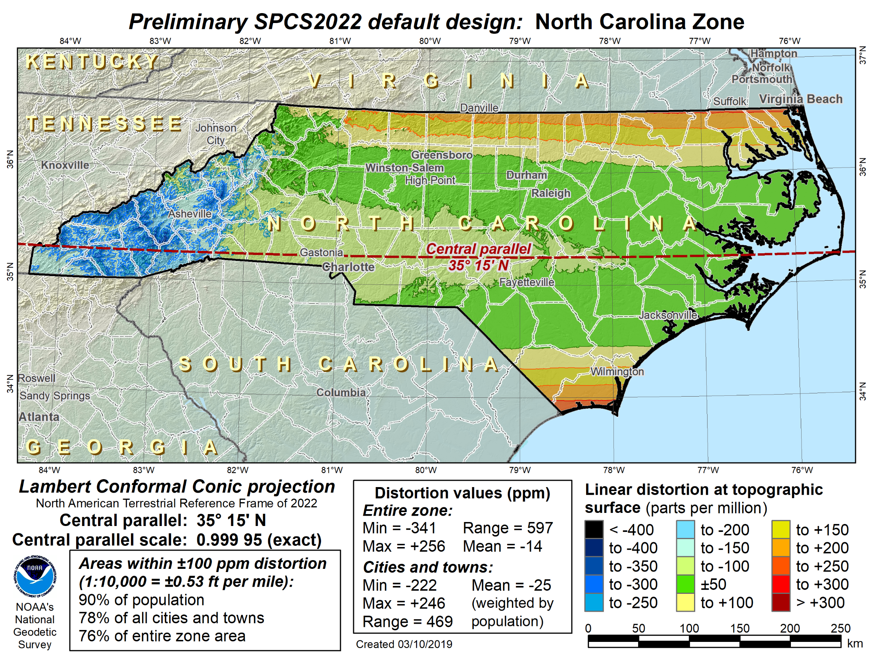
Example Statewide Default: NC
x
Note 1-parallel definition, even though projection is secant (i.e., “cuts” through ellipsoid)

Slide 27
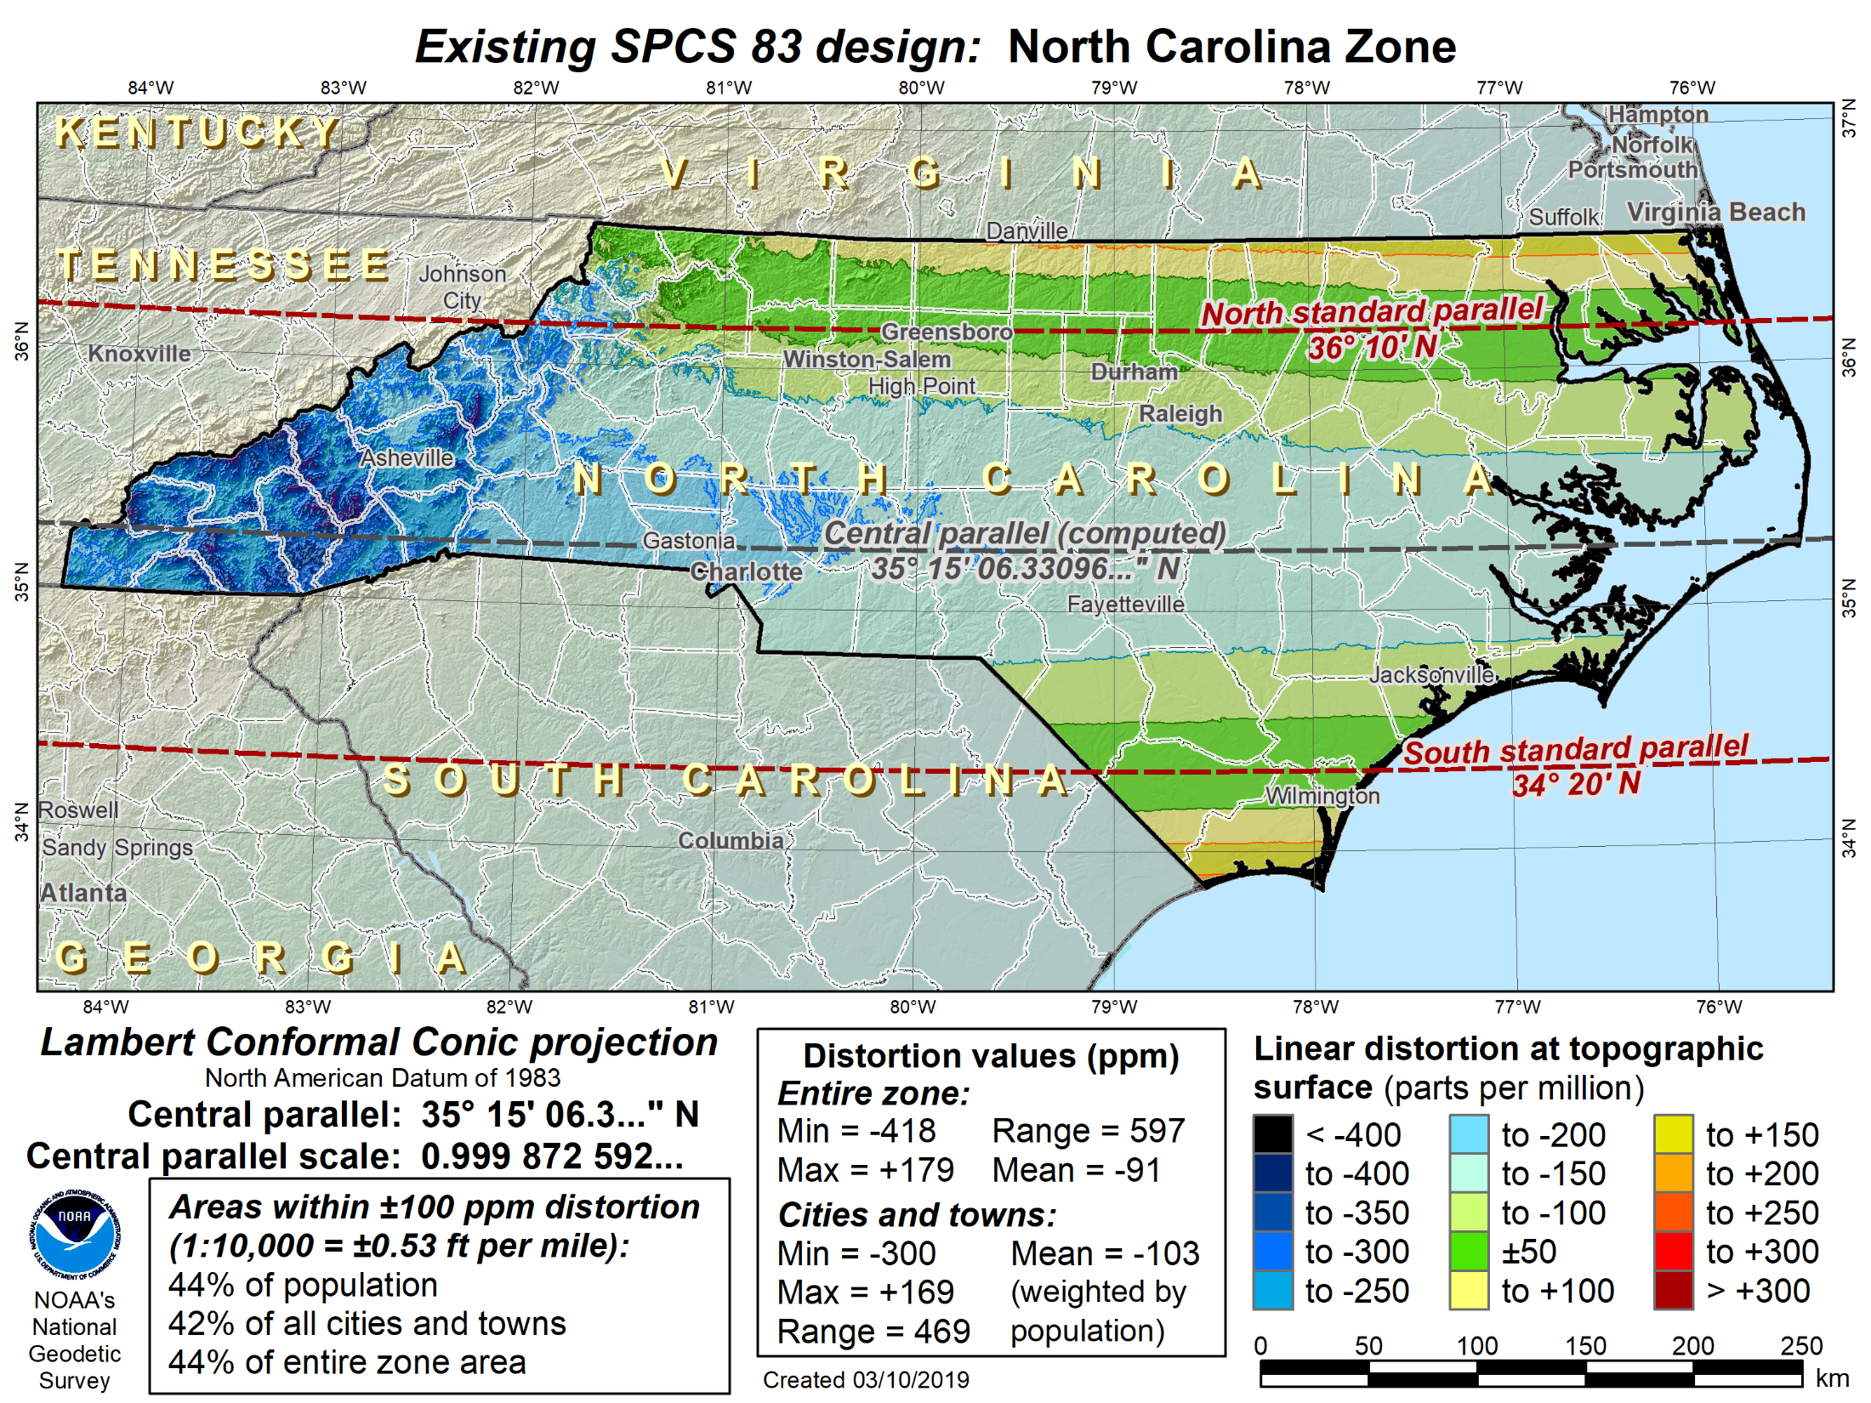

Slide 28
Idaho default statewide

Slide 29
Idaho default statewide
Item #10: Preferences for zone parameters

Slide 30
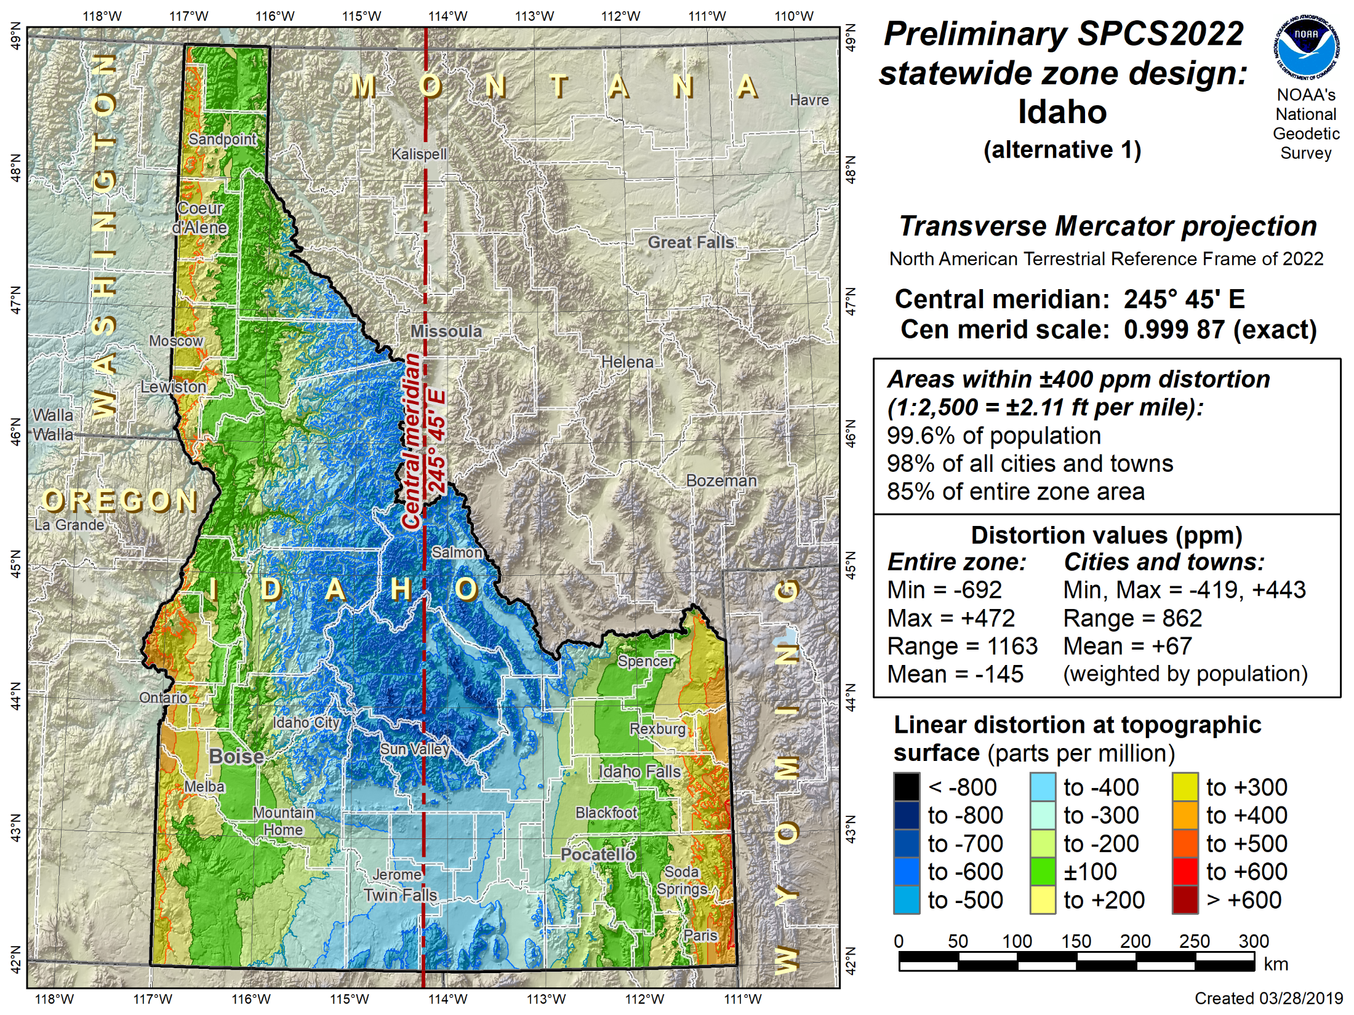
Idaho statewide zone request
Origin latitude: 33° 00’ N
False northing: 0 m
False easting: 4,000,000 m

Slide 31
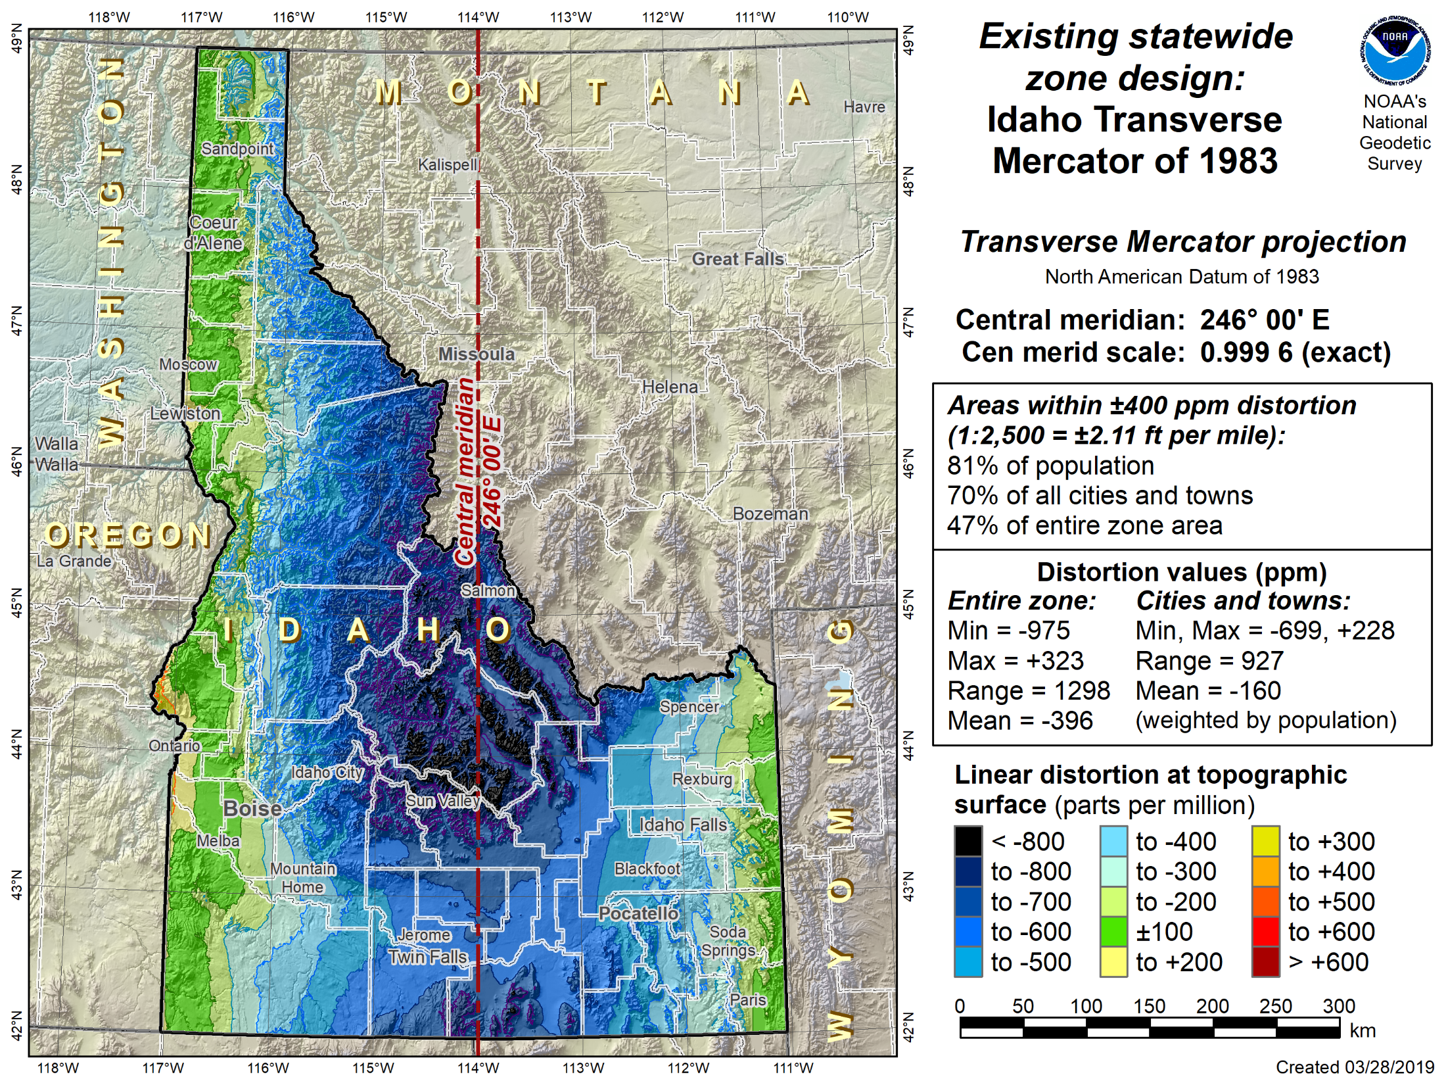
Origin latitude: 42° 00’ N
False northing: 1,200,000 m
False easting: 2,500,000 m

Slide 32
Example Multi-Zone Request: Maine

Slide 35
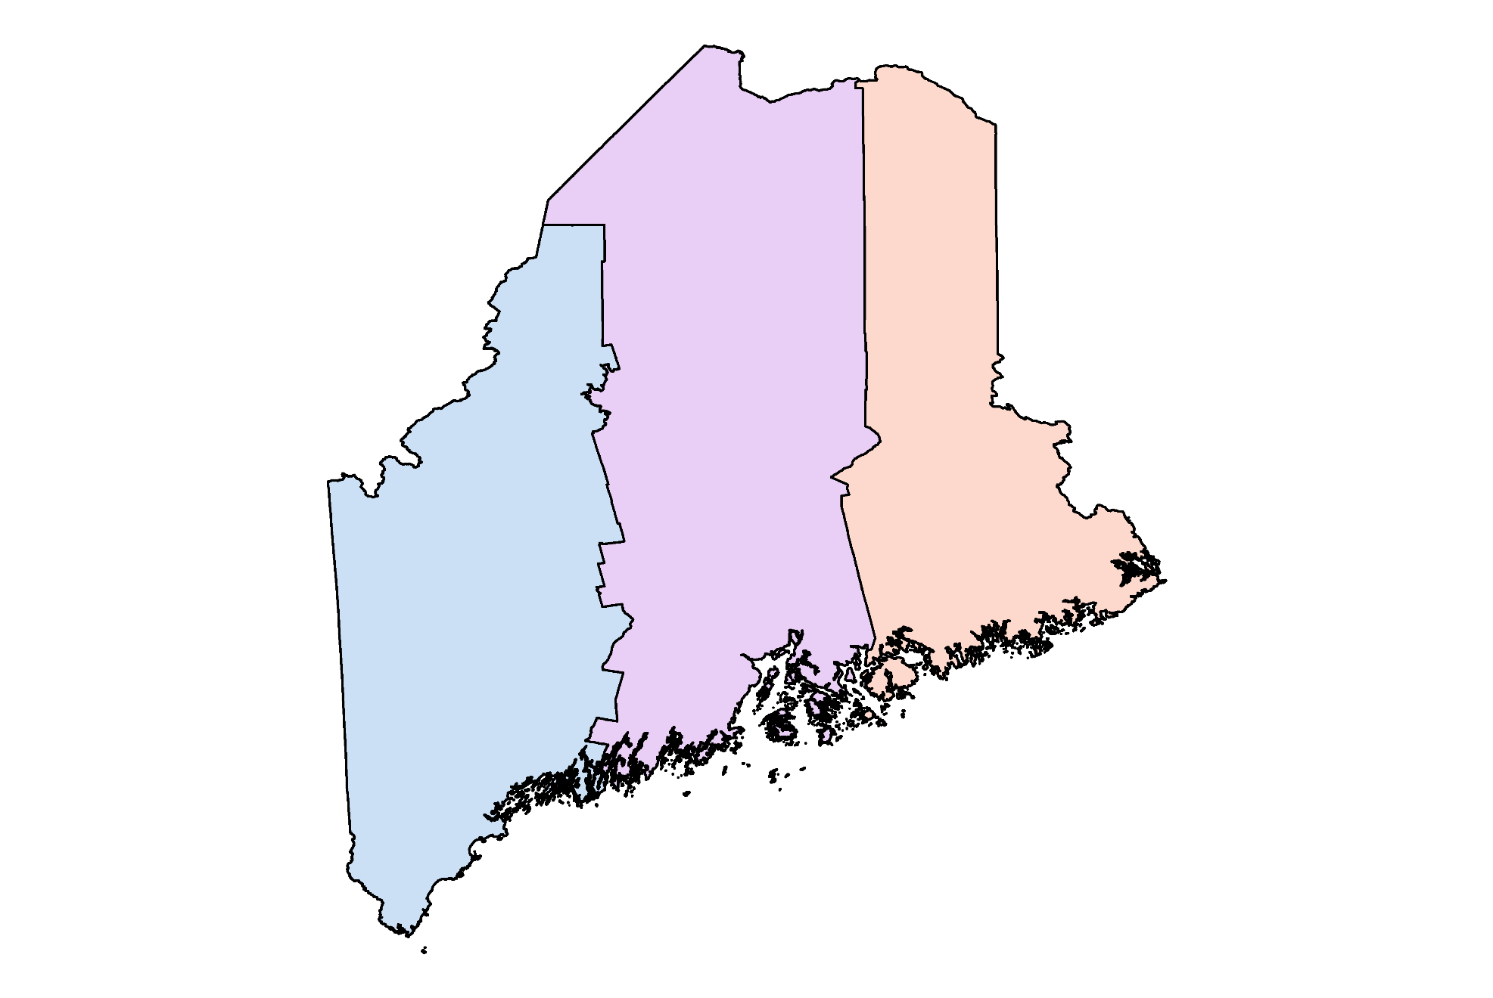
Maine shapefile of zone extents

Slide 36
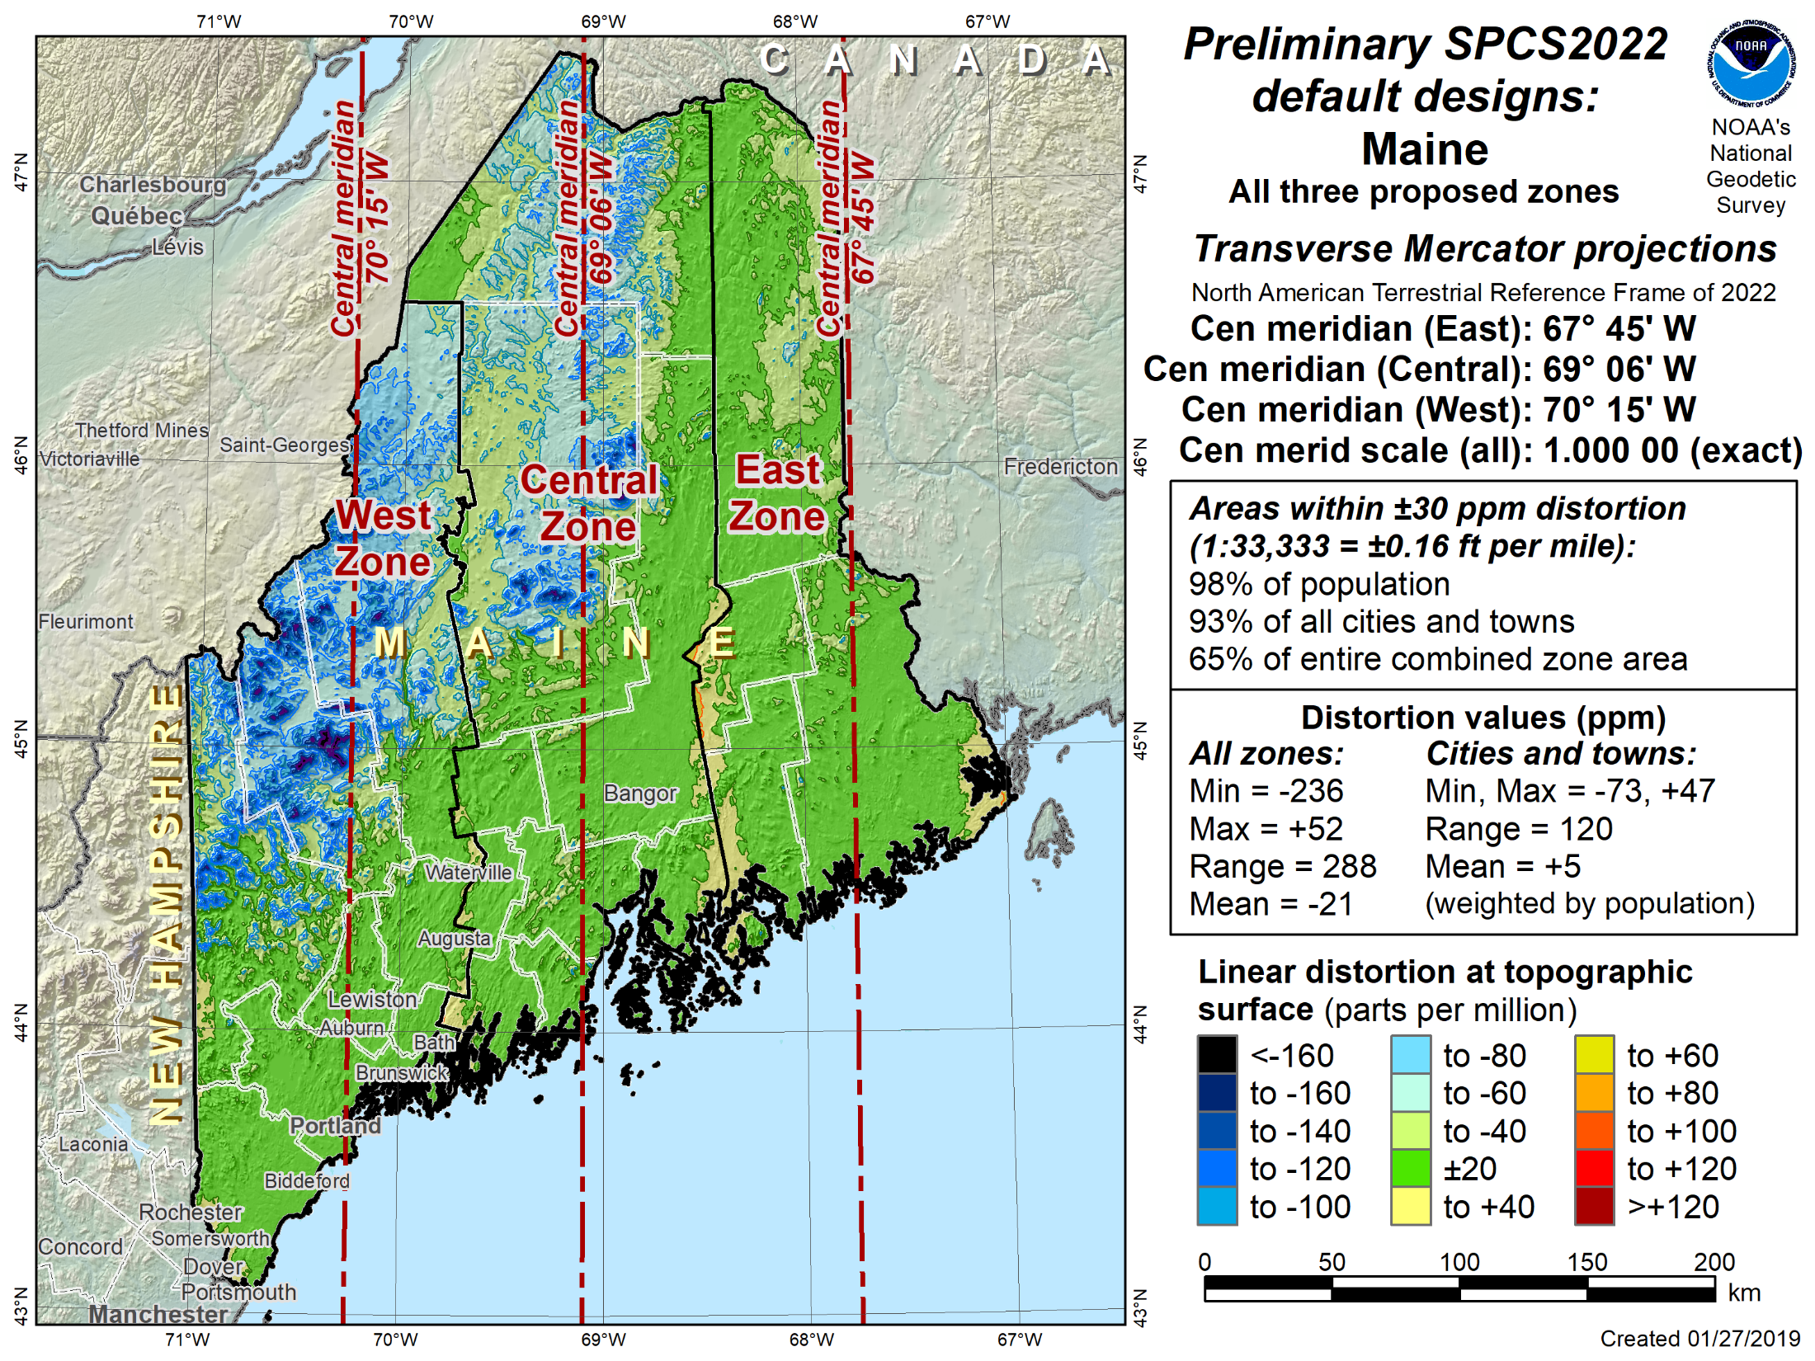

Slide 37
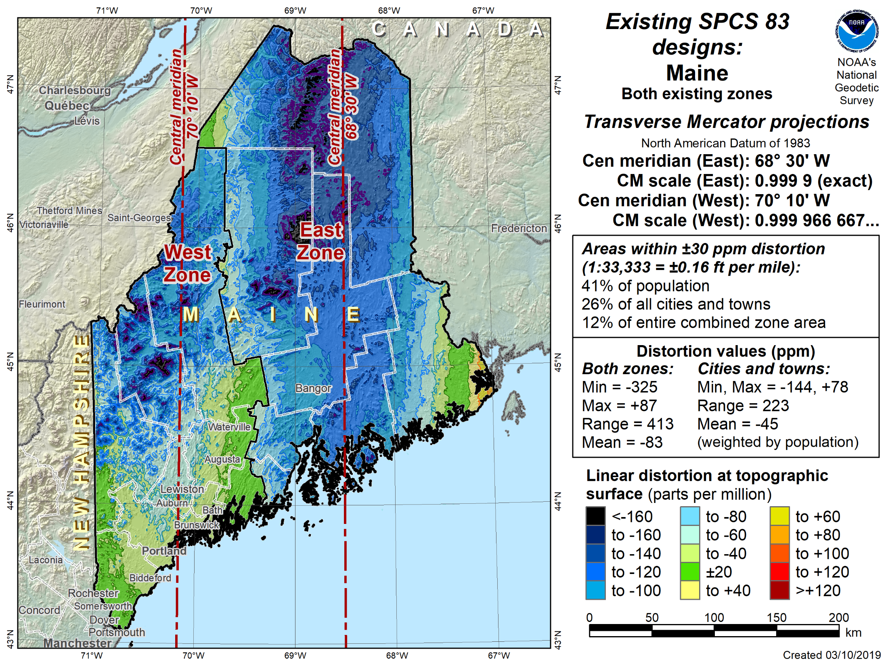

Slide 38
Multi-Zone (LDP) Proposal: Kentucky

Slide 39
Multi-Zone (LDP) Proposal: Kentucky

Slide 40
Multi-Zone (LDP) Proposal: Kentucky

Slide 41
Submitting approved designs
Page 1. Basic information
State
Date of NGS approval of proposal
Contact information
List of stakeholder organizations
Distortion design criterion
Page 2. The Rules (answer “Yes” to everything!)
Page 3. Supporting information
Spreadsheet of parameters
Geometry of zones
Deadline March 31, 2021

Slide 42
Kentucky LDP design submittal (p. 1)
List of stakeholders
Distortion design criterion (±30 parts per million)

Slide 43
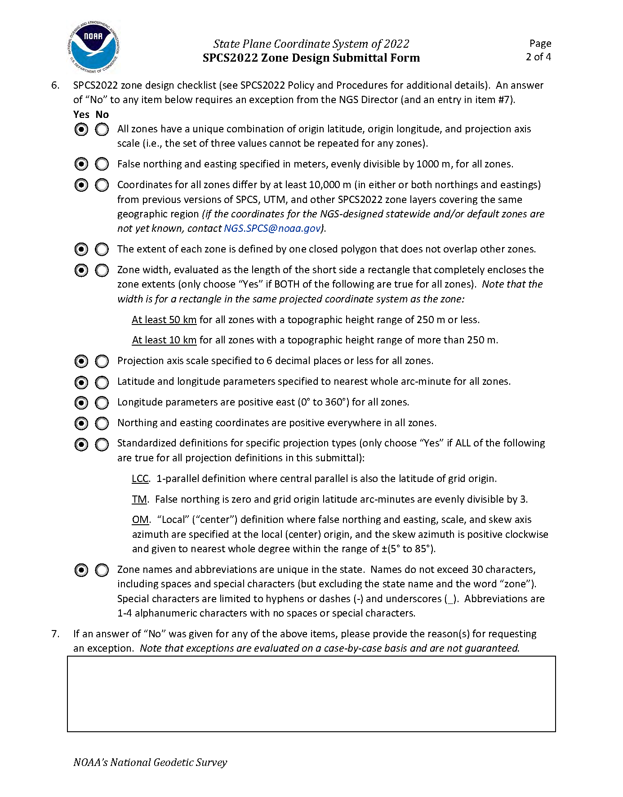
Kentucky LDP design submittal (p. 2)
“Yes” to everything!
No exceptions requested!

Slide 44
Kentucky LDP design submittal (p. 3)
Number zones and projection types
Complete set of zone parameters
Zone extents definition (geometry)

Slide 45
Kentucky LDP design submittal (p. 3)
Number zones and projection types
Complete set of zone parameters
Zone extents definition (geometry)

Slide 46
Kentucky LDP Zone Parameters

Slide 47
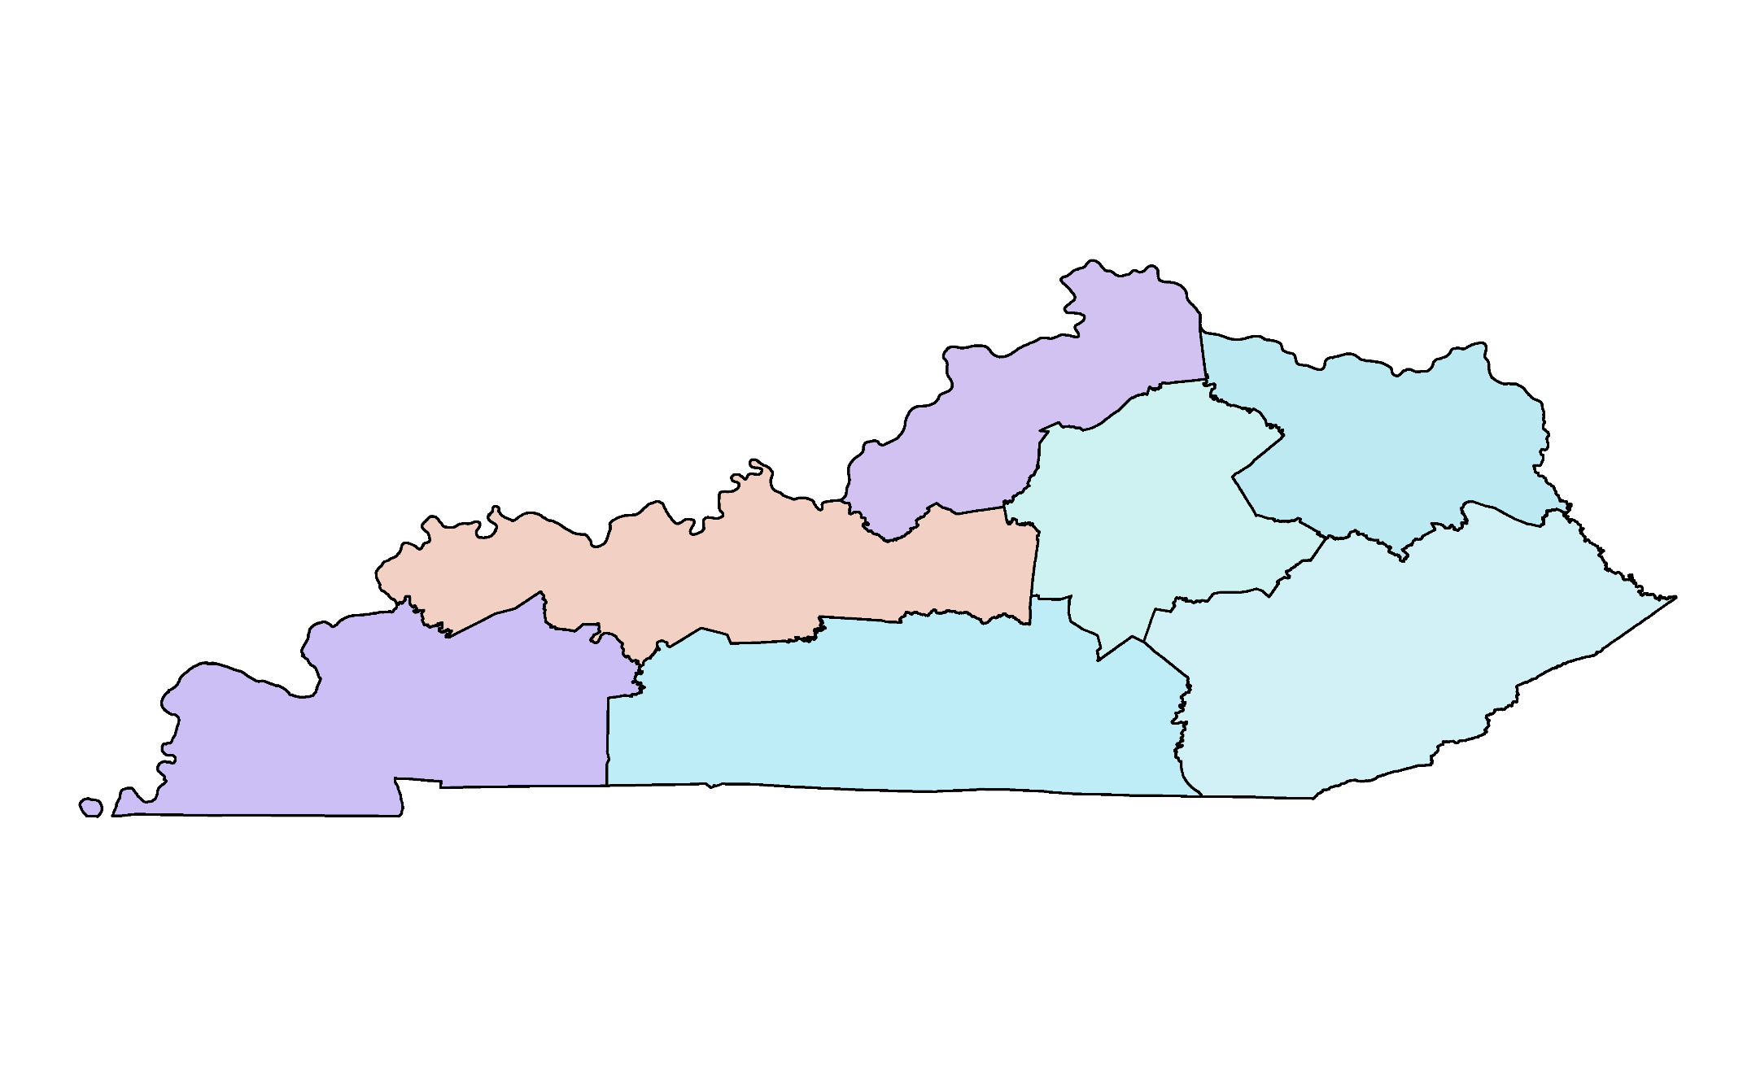
Kentucky LDP Zone Shapefiles

Slide 48
Multiple-Zone LDP Design: Kentucky

Slide 49
The Rules
Minimum zone size
50 km if height range 250 m or less
10 km if height range more than 250 m
Purpose: to prevent large number tiny zones
NOTE: 50 km → ±5 ppm linear distortion!
Multiple-zone coverage
Only one multi-zone layer with complete coverage
Only one multi-zone layer with partial coverage
Purpose: to create layers with clear use cases
Purpose: to avoid excessive number of layers

Slide 50
Minimum zone size
Defined as “minimum bounding geometry” of rectangle completely enclosing zone
Based on rectangle with minimum width
Can be in any orientation
In same projected coordinate system as proposed for SPCS2022
Easier to understand with an example…

Slide 51
Minimum bounding geometry
Minimum bounding rectangle by width based on projected geometry is also used for initial design of Oblique Mercator (OM) zones. It shows that an OM is not a good choice for Idaho, since its skew axis is close to a cardinal direction (north).

Slide 52
Exceptions
Can request exceptions to policy & procedures
MAY be granted by NGS Director
No guarantee that exceptions will be granted!
Recommend avoiding exception requests
Must have compelling reason
“Keeping things the same” is not compelling
NGS wants to follow policy and procedures as much as possible
For consistency
Good design practice

Slide 53
Keeping things the same
The desire for no change
Azimuths
Central meridians
Converge angles
Scale
Coordinates
Keep in mind that everything is changing
Latitudes, longitudes, ellipsoid height
Grid coordinates > 10,000 meters
May be better to allow all things to change rather than trying to keep some things the same

Slide 54
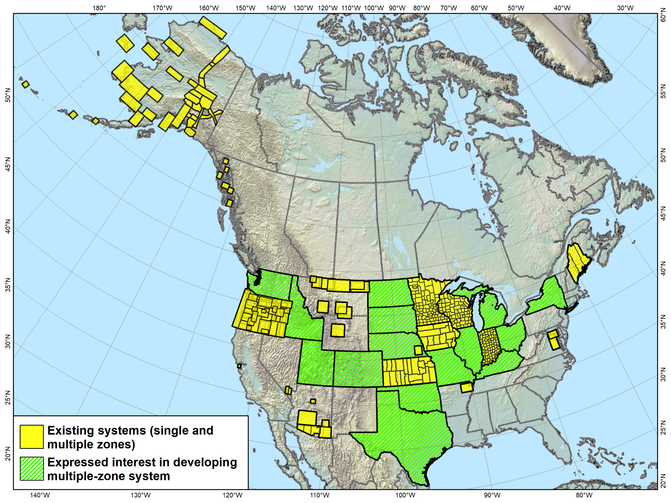
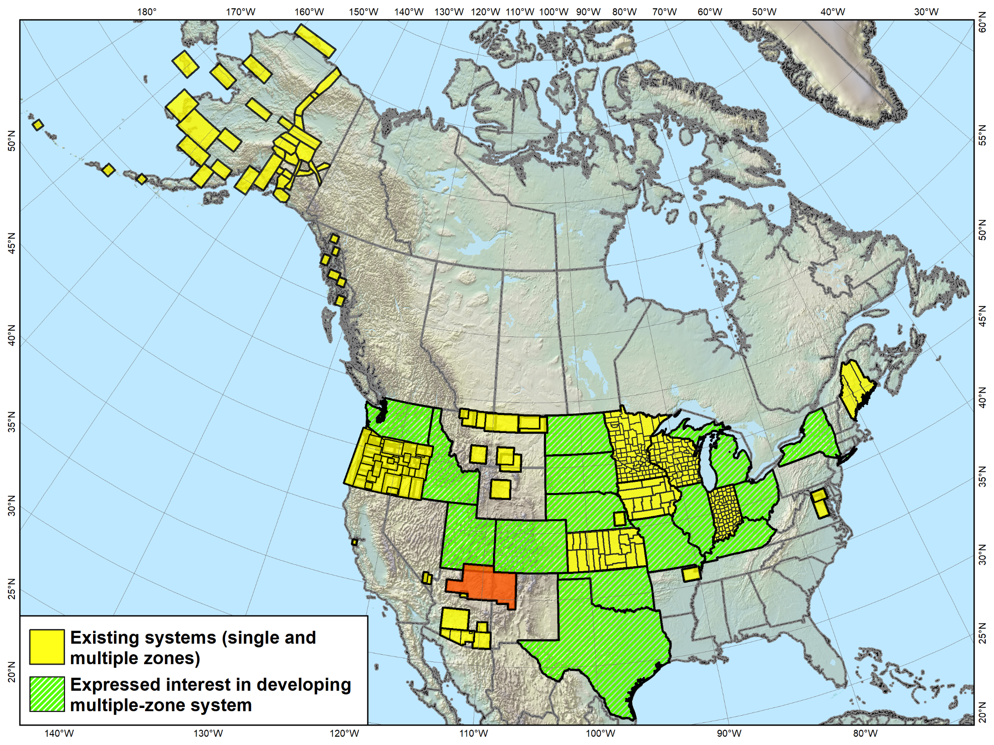
Low Distortion Projections
Versions of most of the LDP systems shown (as well as others) will likely become part of SPCS2022 (some with complete, others with partial state coverage).
Navajo Nation Coordinate System not actually an LDP, and it falls in 3 states. It is something “special”…

Slide 55
“Special Use” SPCS2022 Zones
Zones for regions in more than one state
Categories:
Major urban areas (e.g., New York, Chicago, St. Louis)
Large American Indian reservations (e.g., Navajo Nation)
Large federal jurisdictions or applications (e.g., shoreline mapping of Atlantic Coast)
Does NOT count against 2- or 3-layer limit
Requires NGS Director approval
On a case-by-case basis
Contact NGS.SPCS@noaa.gov

Slide 56
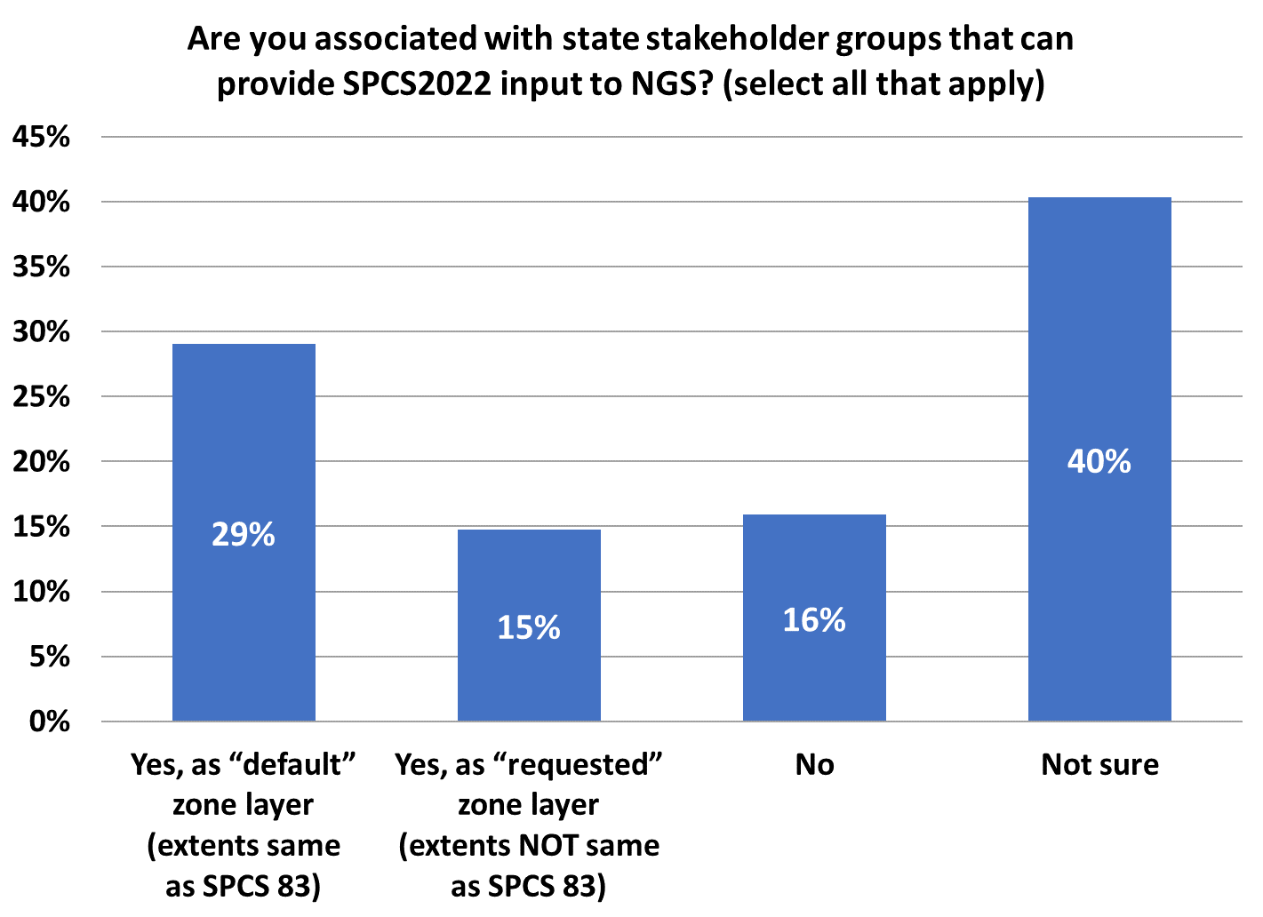
Poll Question
Total responses = 258
104
75
38
41

Slide 57
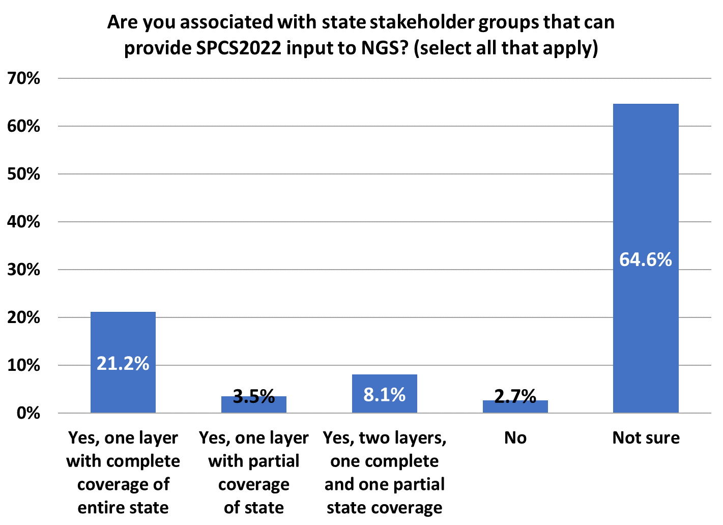
Poll Question
168
Total responses = 260
55
9
21
7

Slide 58
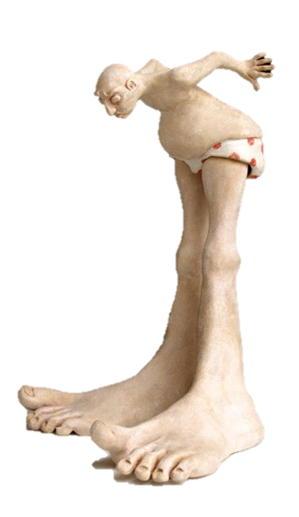
Putting the best “foot” forward
U.S. survey foot is going away
Not supported for SPCS2022 (or any part of NSRS after 2022)
Effective December 31, 2022
Federal Register Notice
Will be published soon
45 day comment period
NGS webinars
Previous one April 25, 2019
New one on December 12, 2019

Slide 59
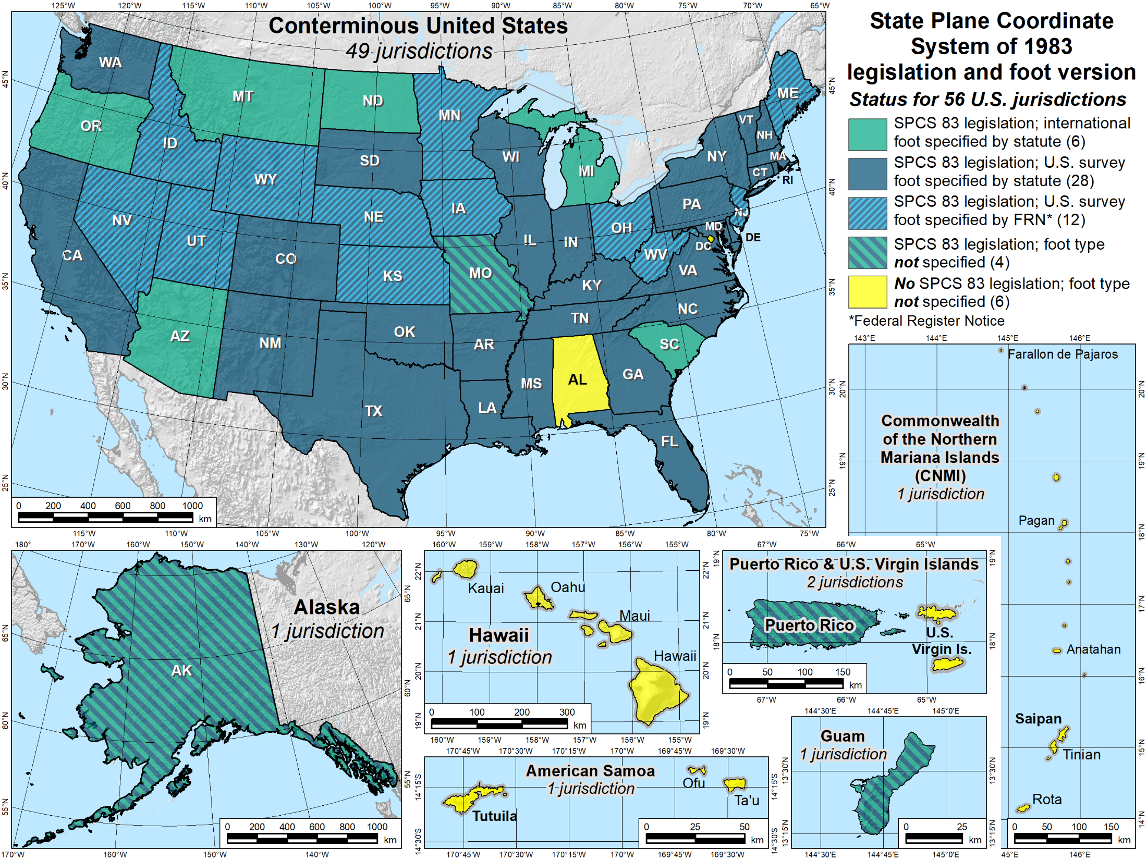
The end of the U.S. survey foot
x

Slide 60
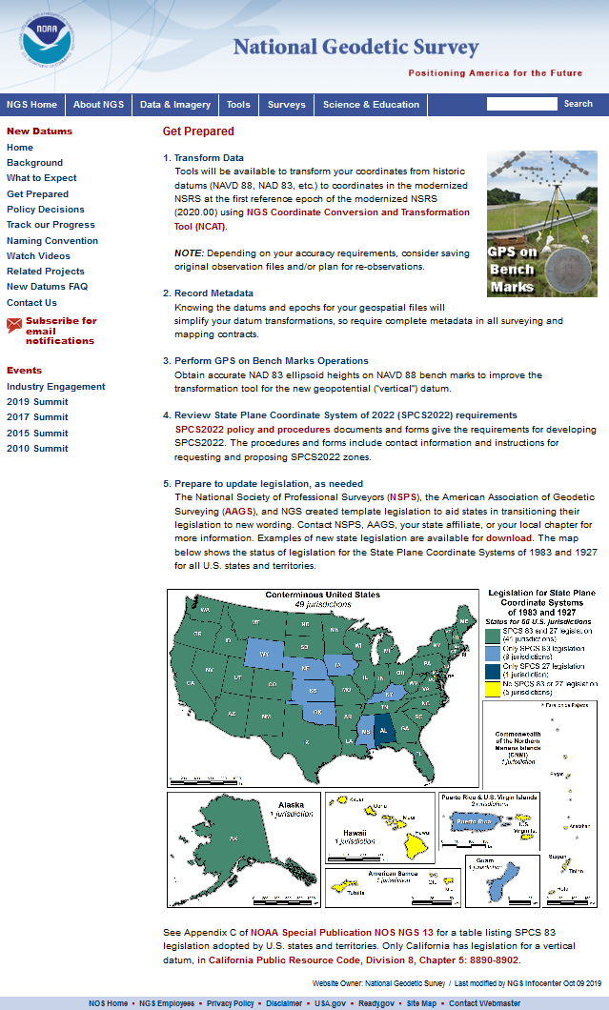
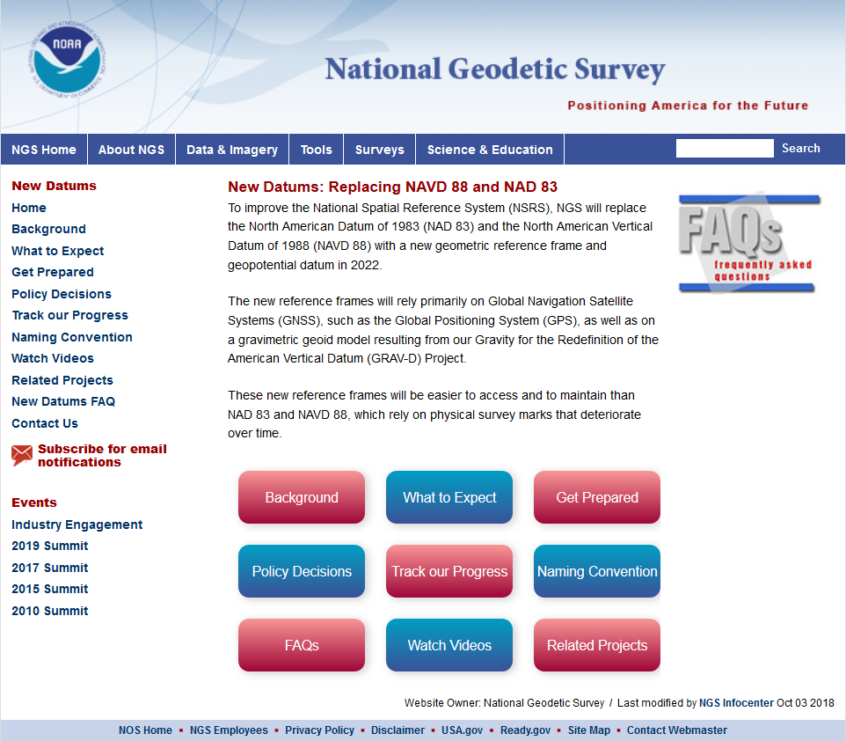
NSRS State Legislation
geodesy.noaa.gov

Slide 61
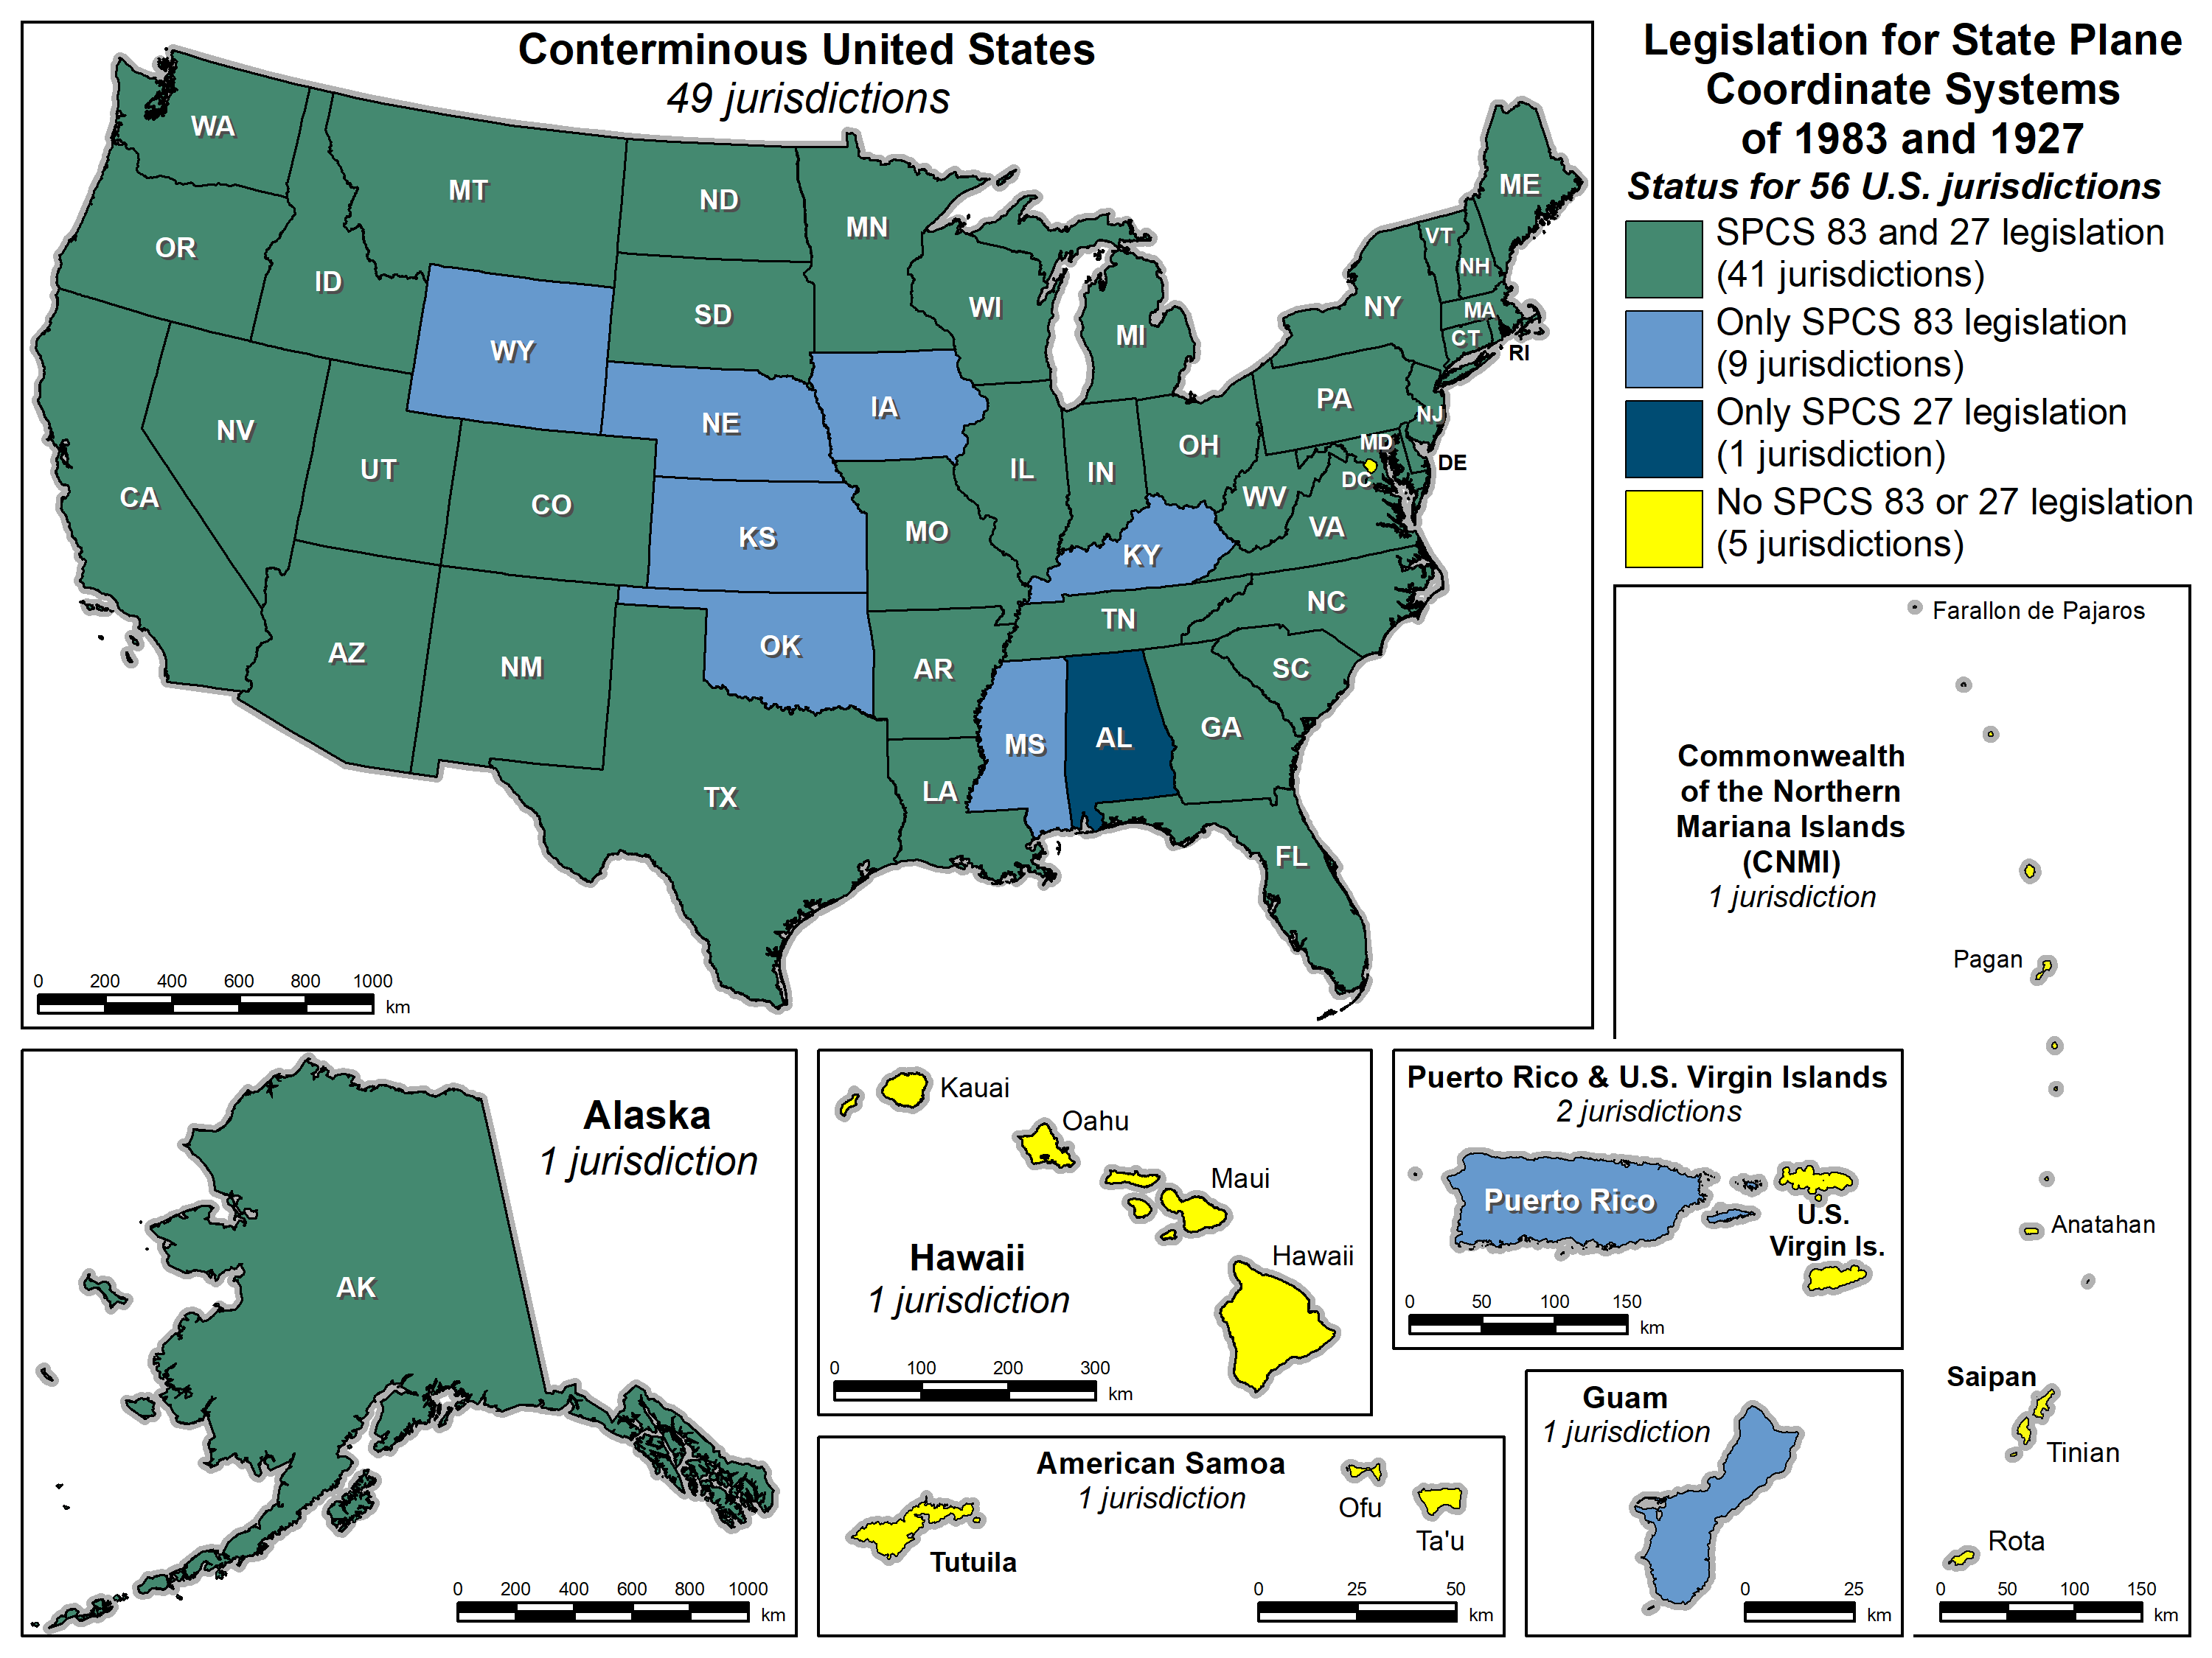
SPCS legislation

Slide 62
Questions?

