Slide 1
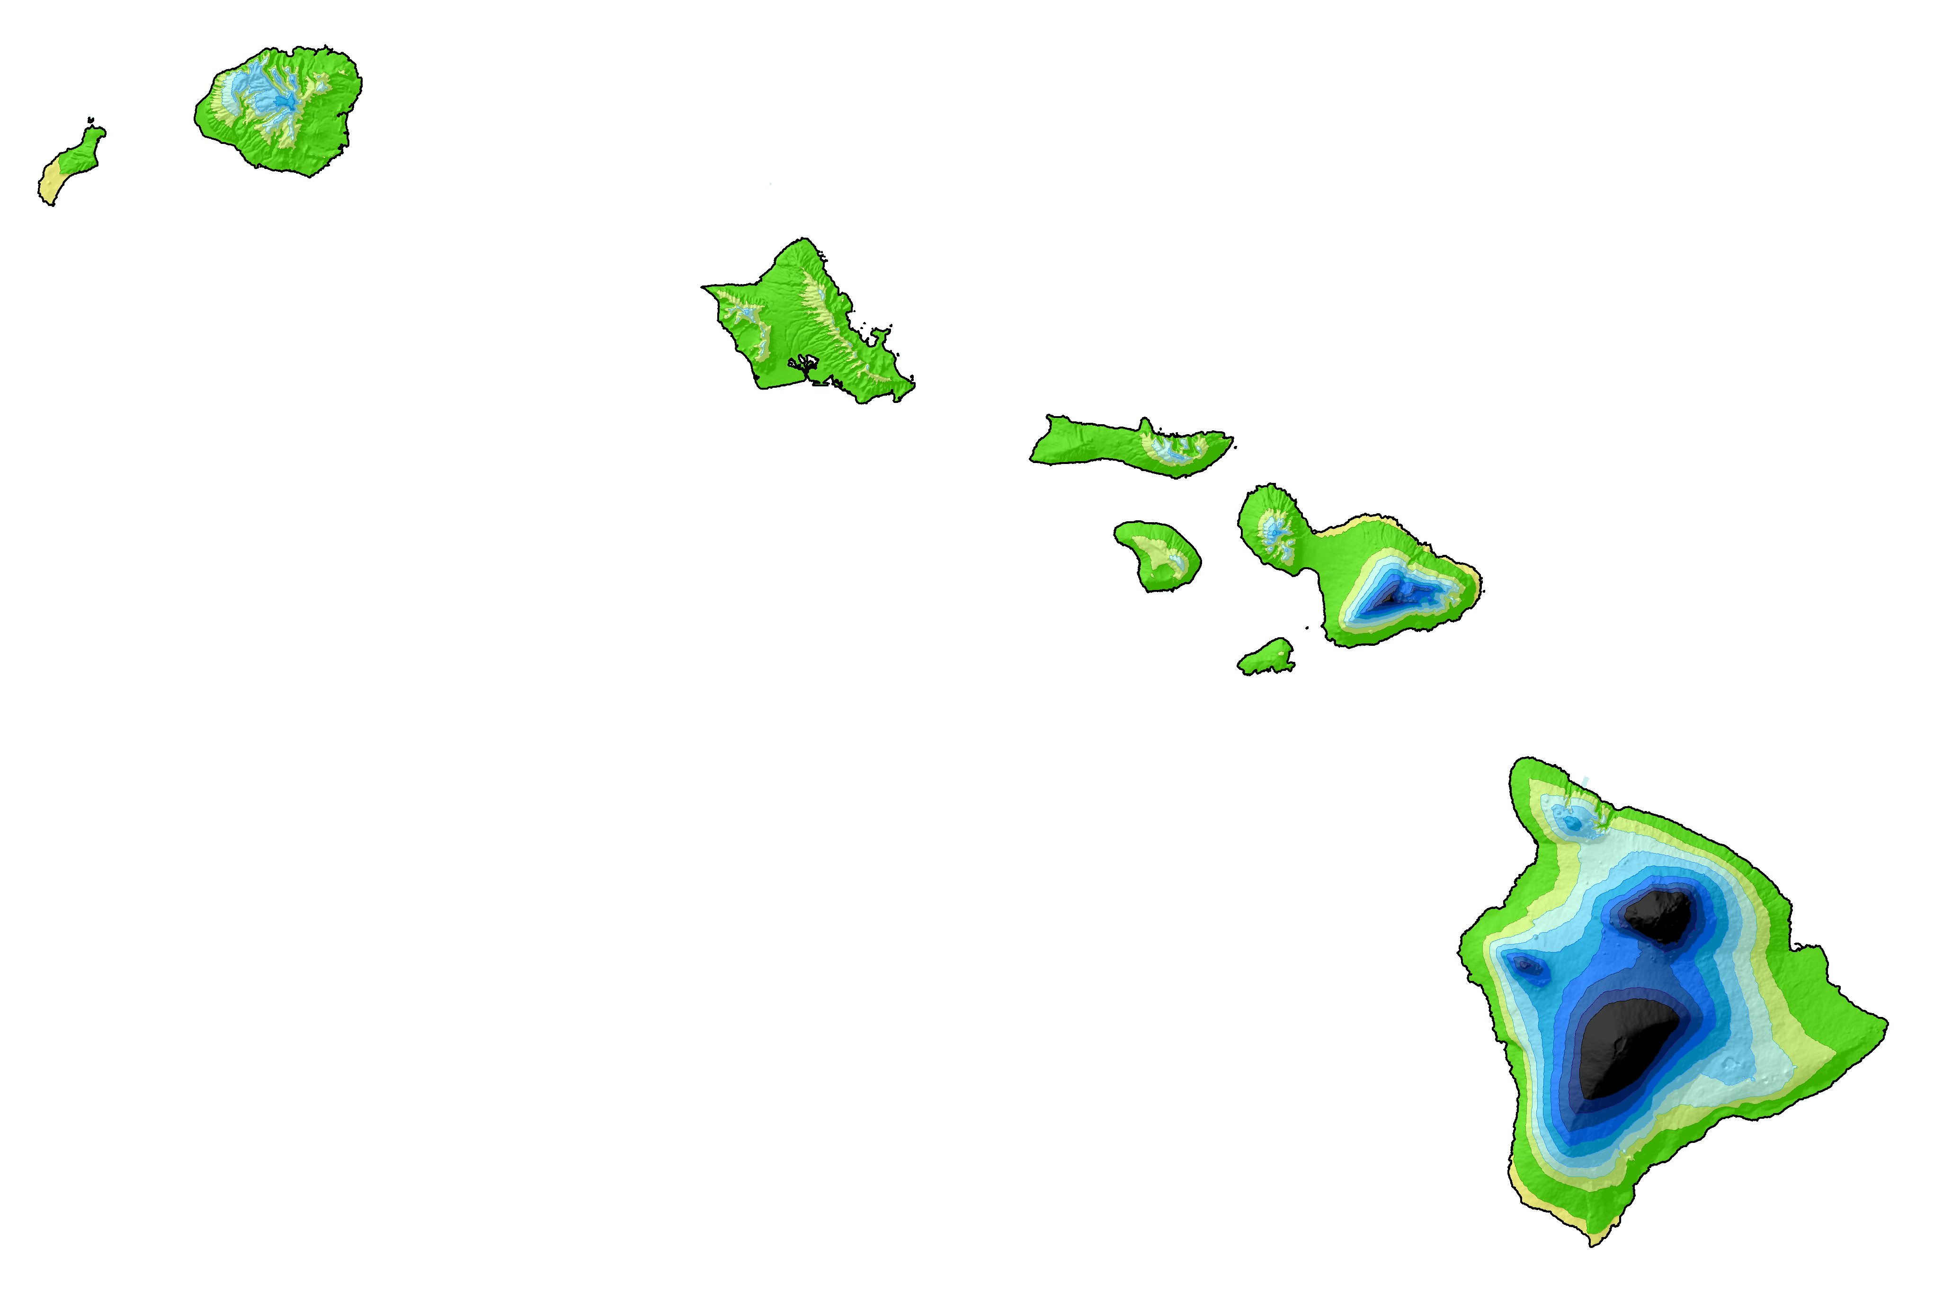
State Plane 2022
Where Things Stand in Hawai’i
and the Road Ahead
Michael L. Dennis, PhD, PE, PLS
SPCS2022 Project Manager
2023 Pacific Rim Geospatial Conference
March 17, 2023

Slide 2
Surveyors (and engineers) the State Plane Coordinate System
STATE PLANE
Making the Earth flat
…one zone at a time

Slide 3
How surveyors and engineers see the Earth…

Slide 4
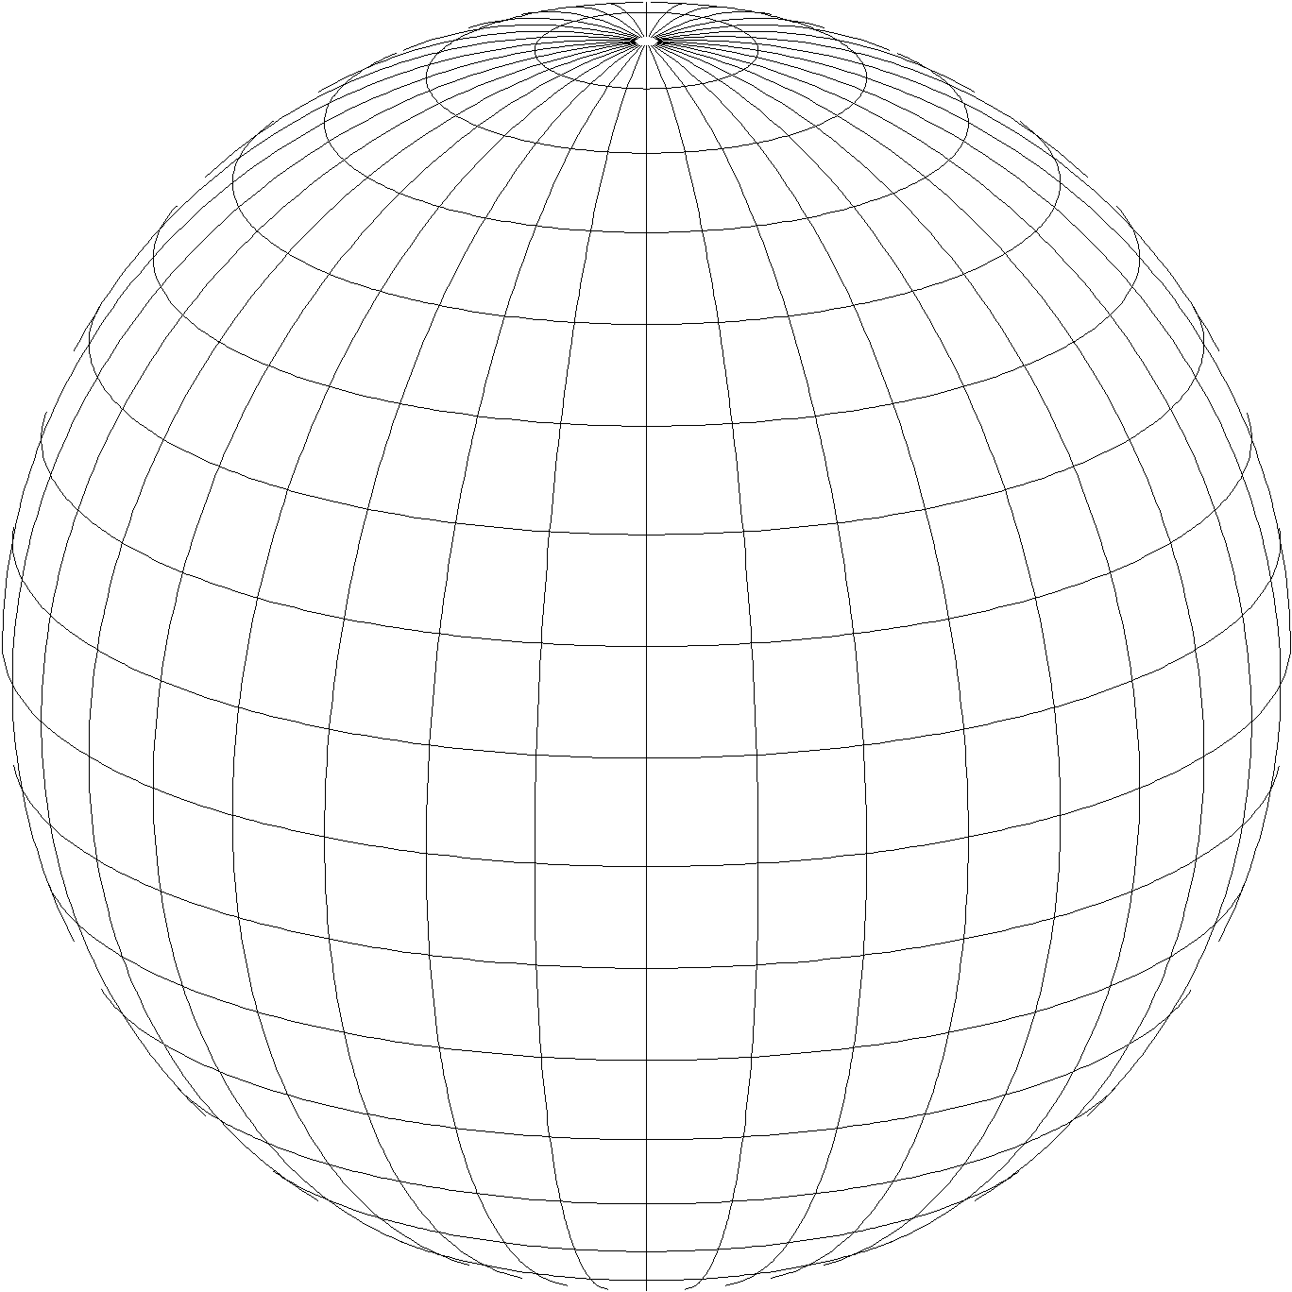
A “flat” Earth for the future
State Plane Coordinate System of 2022 (SPCS2022)
Third generation of State Plane
First in 1930s, second in 1980s
Same 3 map projection types
Same ellipsoid as SPCS 83 (GRS 80)
The same, but different…
Based on new terrestrial reference frames instead of NAD 83
Designed to reduce difference between “grid” and “ground” distances
Zone “layers” will exist in most states
More zones, most designed by state stakeholders
Lambert Conformal Conic (LCC)
Transverse Mercator (TM)
Oblique Mercator (OM)

Slide 5
Getting acquainted with SPCS2022
Overall distortion design philosophy
Linear distortion minimized (or “optimized”) at topographic surface (not at ellipsoid surface)
Purpose: reduce difference between projected “grid” and actual “ground” distances
What is linear distortion?
Defined at a point (infinitesimal distances)
Unique (i.e., same in every direction) only for conformal projections
Given here in parts per million (ppm) = mm per km
Linear distortion | = | Projected minus actual distance
 |  | Actual distance

Slide 6
Linear distortion with respect to ellipsoid surface
Projection axis (k₀ < 1)
Topographic surface
Horizontal ground distance
> ellipsoid distance and > grid distance
k₀ = scale on projection axis
LCC: central parallel
TM: central meridian
OM: skew axis
h
Ellipsoid distance
Grid distance > ellipsoid distance < ground distance (k > 1 and δ < 0)
Projection surface (secant)
Ellipsoid distance
Ellipsoid surface
This design approach used for SPCS 27 and 83 (minimizes distortion with respect to ellipsoid)
Grid distance < ellipsoid distance < ground distance (k < 1 and δ < 0)
6

Slide 7
Linear distortion with respect to topographic surface
Projection axis (k₀ > 1)
Horizontal ground distance
> ellipsoid distance and > grid distance
Topographic surface
Projection surface (non-intersecting)
h
Ellipsoid distance
Grid distance > ellipsoid distance ≈ ground distance (k > 1 and δ ≈ 0)
Ellipsoid surface
7

Slide 8
“Non-intersecting” conformal map projection
Topographic surface
Grid distance = ground distance at a point
Projection axis
Grid distance = ground distance at a point
Non-intersecting
($k_{0}$ > 1)
Grid distance ≈ ground distance over finite distance
Purpose is to reduce linear distortion at “ground” (topographic surface).
But distortion can vary considerably across area of interest.
Ellipsoid surface
8

Slide 9
“Non-intersecting” conformal map projection
Topographic surface
Projection axis
Non-intersecting
($k_{0}$ > 1)
Ellipsoid surface
9

Slide 10
Changing projection axis to reduce distortion variation
This design approach used for SPCS2022 (minimizes distortion with respect to topography)
Topographic surface
Grid distance = ground distance at many points
Projection axis
Ellipsoid height of surface not constant:
h₁ ≠ h₂
h₂
Non-intersecting
($k_{0}$ > 1)
h₁
ONLY way to reduce variation in distortion is to change projection axis location (or change projection).
Ellipsoid surface
Projection axis scale can be less than 1 for steeply sloping areas even if heights are large.
10

Slide 11
Linear distortion magnitudes
Parts per million | Centimeters per kilometer | Feet per mile | Dimensionless ratio
20 ppm | 2 cm/km | 0.1 ft/mile | 1:50,000
50 ppm | 5 cm/km | 0.3 ft/mile | 1:20,000
100 ppm | 10 cm/km | 0.5 ft/mile | 1:10,000
400 ppm | 40 cm/km | 2.1 ft/mile | 1:2,500

Slide 12
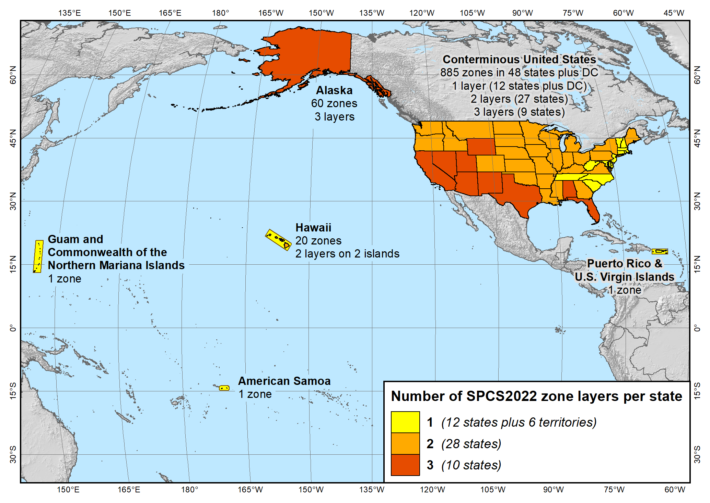
SPCS2022 zone layers
1 layer: 12 states plus 6 territories
2 layers: 28 states
3 layers: 10 states

Slide 13
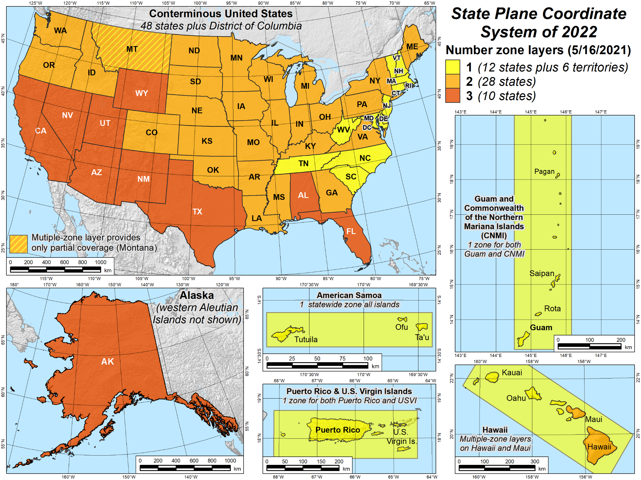
SPCS2022 zone layers
1 layer: 12 states plus 6 territories
2 layers: 28 states
3 layers: 10 states

Slide 14
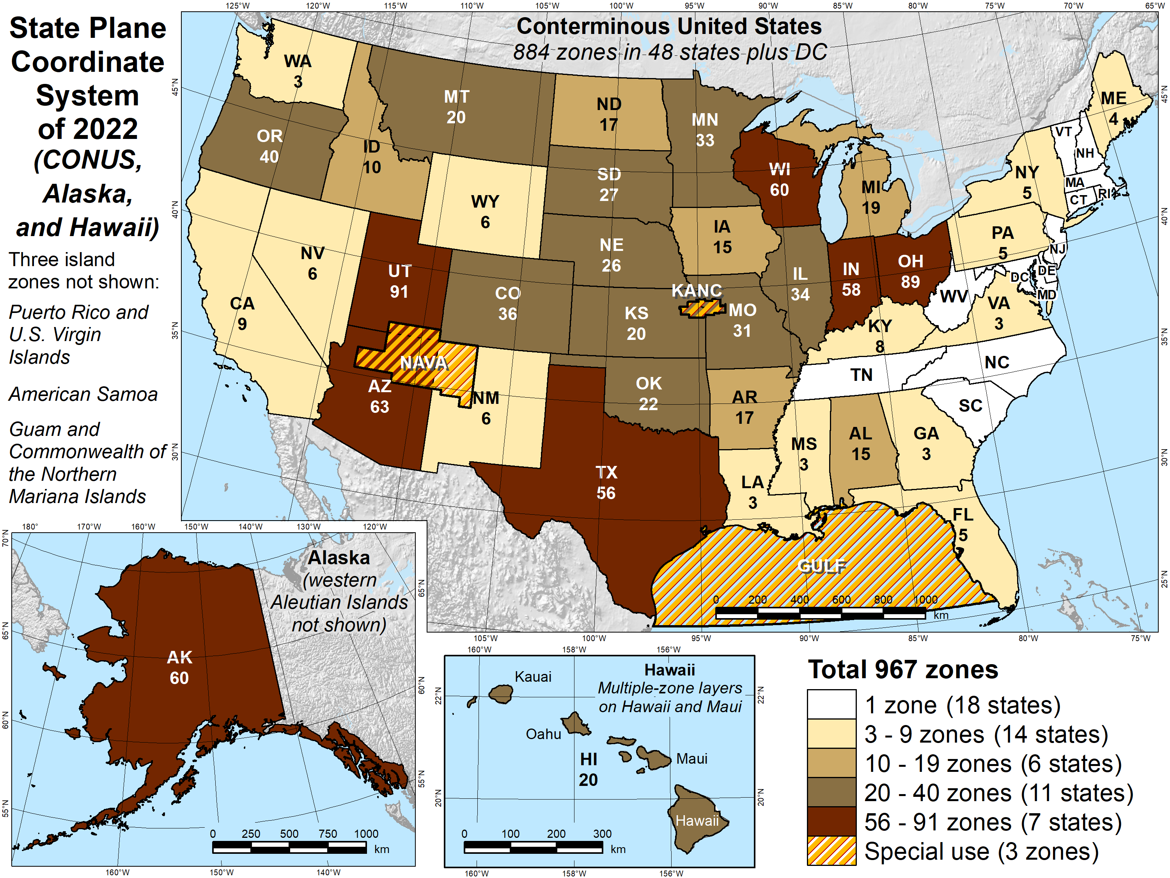
Number of SPCS2022 zones (preliminary)
Designs by NGS
165 zones
Includes 54 statewide zones and 3 “special use” zones (in more than one state)
Designs by state stakeholders
802 zones in 28 states
Total = 967 zones for 56 states and territories
Compare to 125 zones in existing State Plane

Slide 15
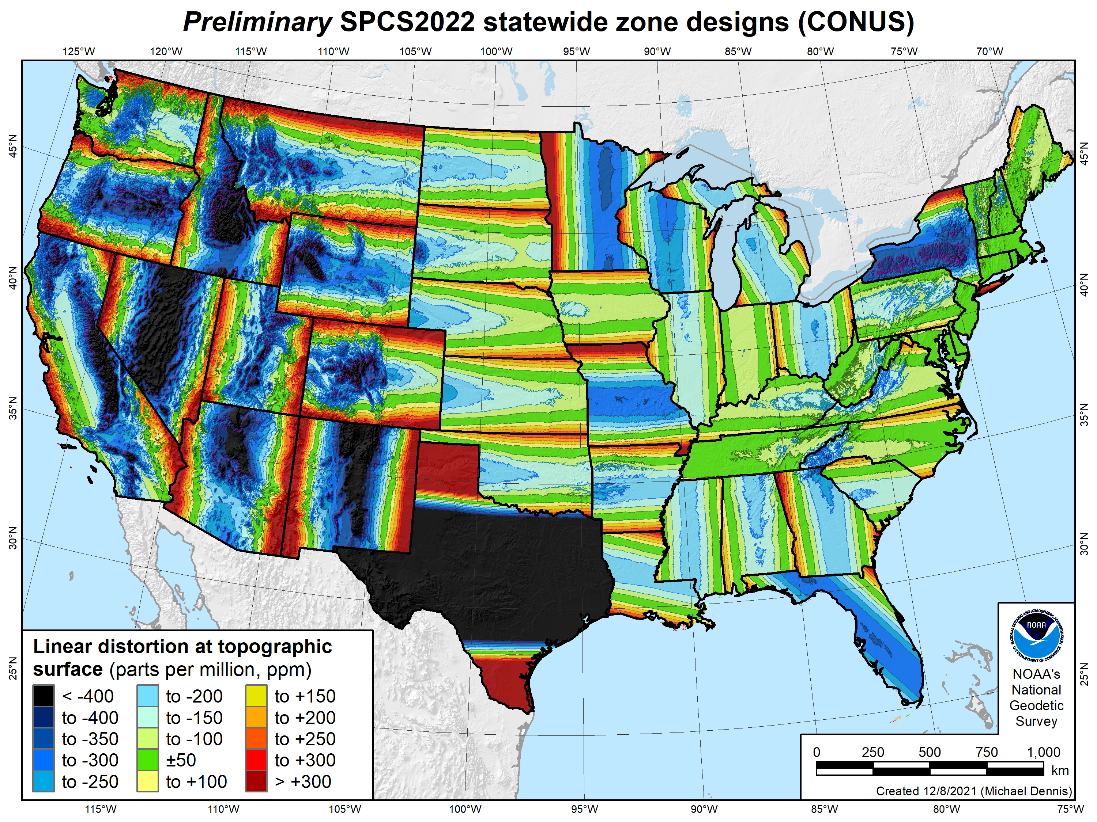
SPCS2022 linear distortion (prelim)
49 zones (CONUS)
Percent within distortion (ppm):
Distor | Pop | Cities | Area
±20 | 14% | 12% | 7%
±50 | 27% | 26% | 18%
±100 | 48% | 48% | 36%
±400 | 91% | 93% | 88%
City and area statistics (ppm):
 | Min | -1512 | -1627
 | Max | +2888 | +2987
 | Range | 4400 | 4614
 | Mean | -86 | -120
Mean weighted by pop = -100
15

Slide 16
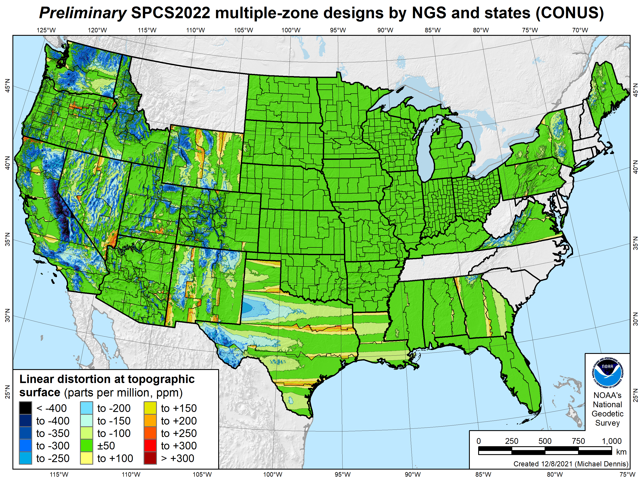
SPCS2022 linear distortion (prelim)
646 zones (35 states)
Percent within distortion (ppm):
Distor | Pop | Cities | Area
±20 | 76% | 70% | 54%
±50 | 92% | 88% | 73%
±100 | 98% | 97% | 89%
±400 | 100% | 100% | 99.9%
City and area statistics (ppm):
 | Min | -400 | -684
 | Max | +245 | +295
 | Range | 644 | 979
 | Mean | -5 | -23
Mean weighted by pop = -4
16

Slide 17
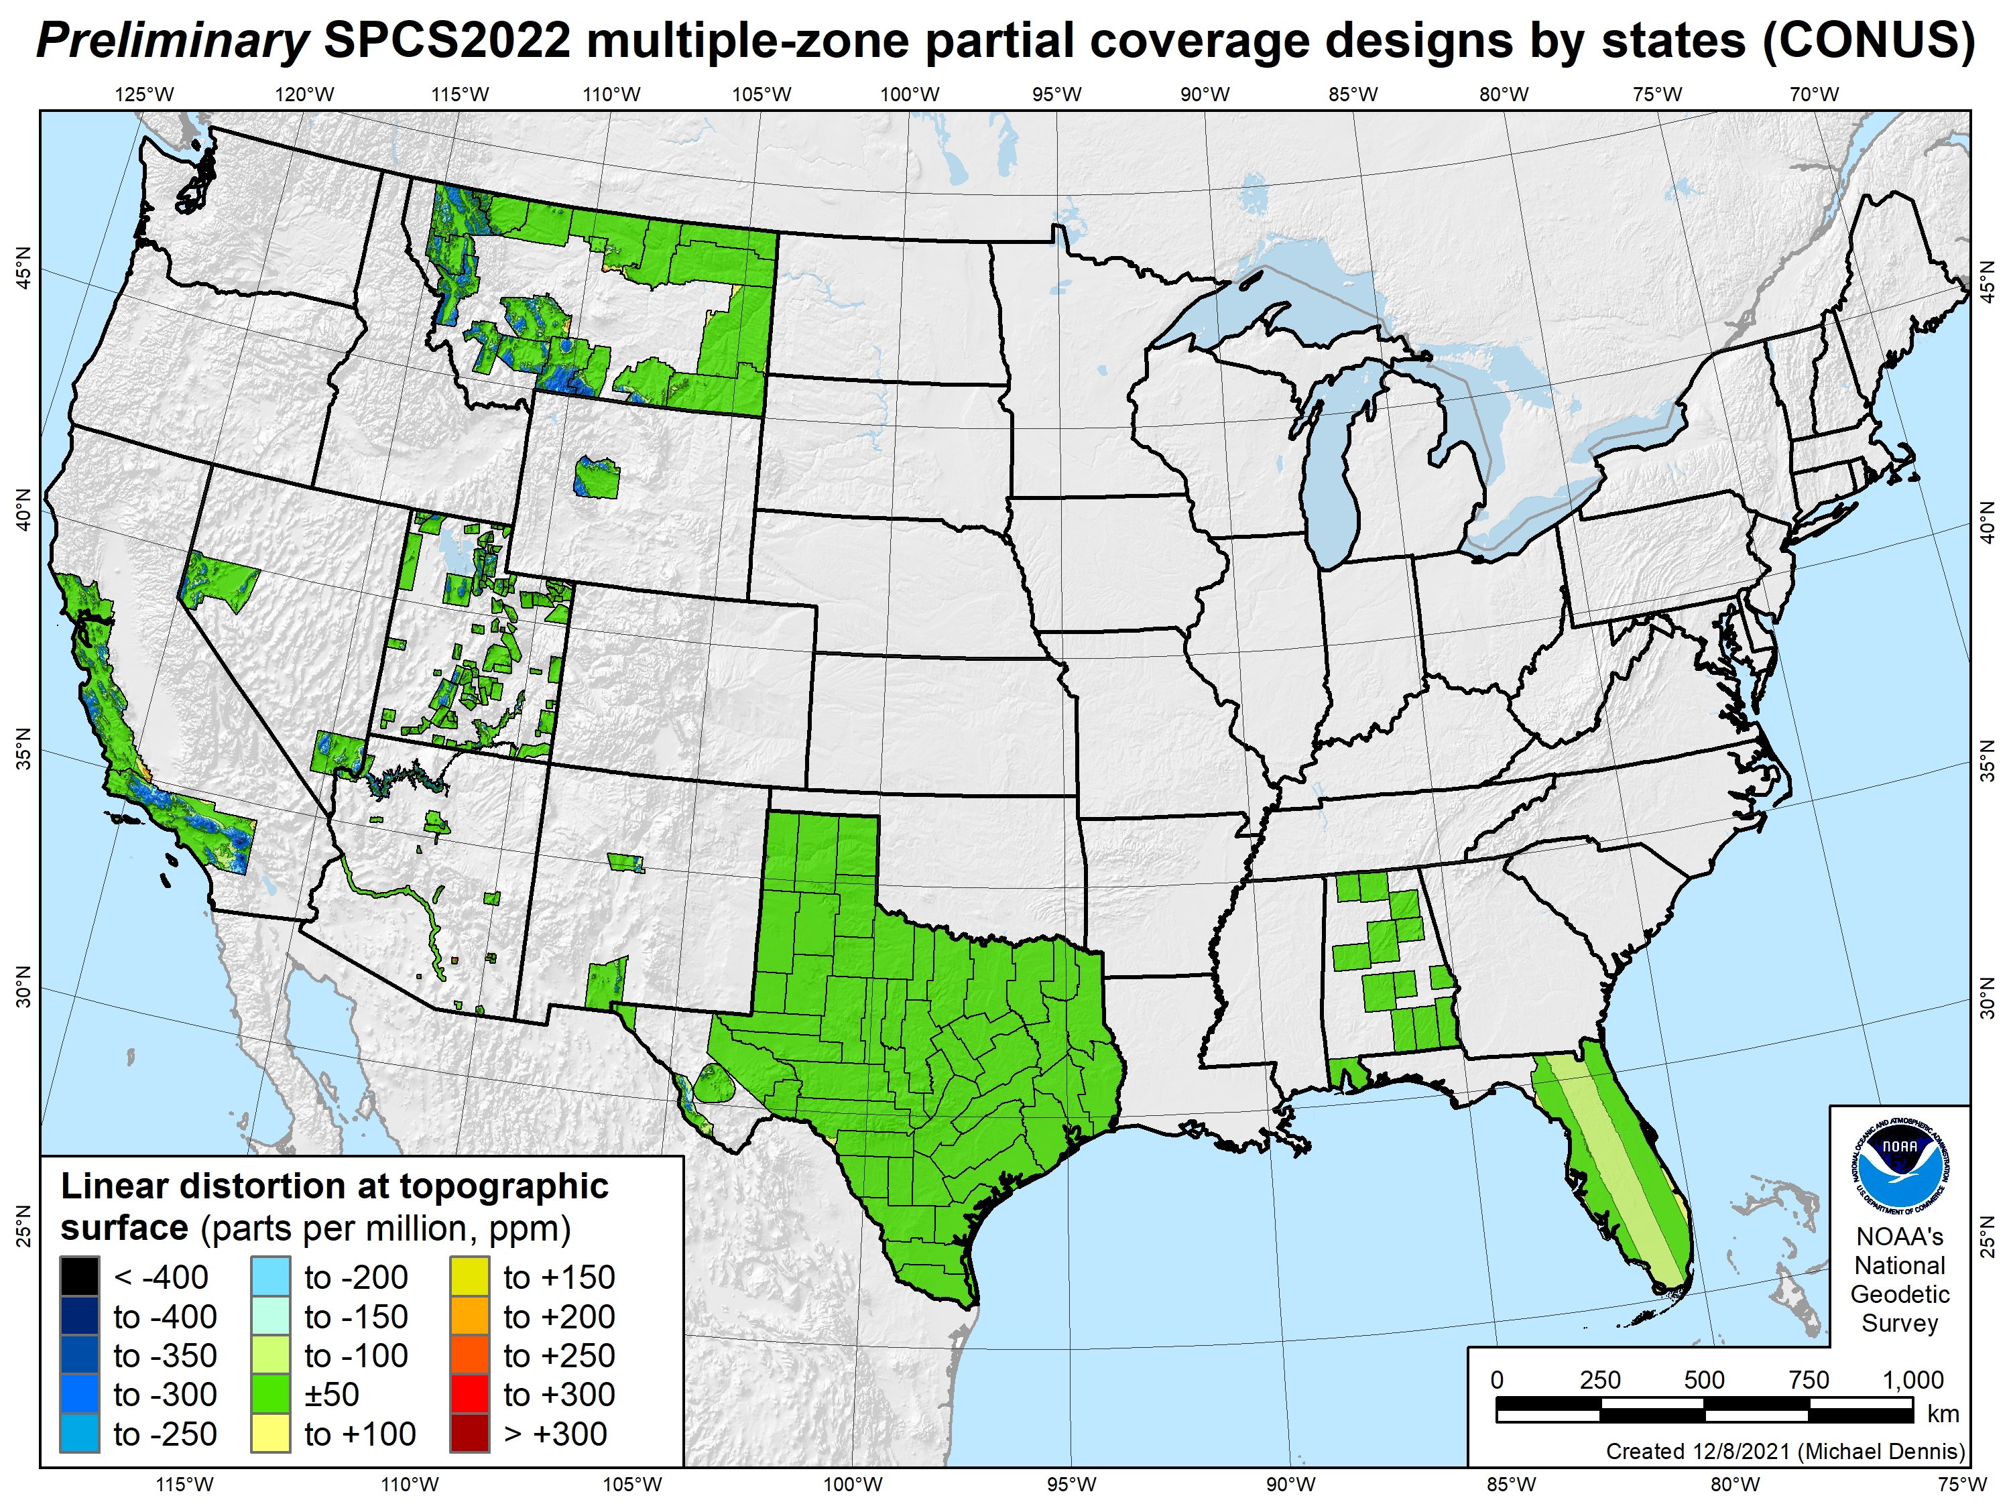
SPCS2022 linear distortion (prelim)
187 zones (10 states)
Percent within distortion (ppm):
Distor | Pop | Cities | Area
±20 | 78% | 78% | 73%
±50 | 91% | 90% | 88%
±100 | 99.8% | 99% | 97%
±400 | 100% | 100% | 100%
City and area statistics (ppm):
 | Min | -261 | -465
 | Max | +120 | +240
 | Range | 381 | 705
 | Mean | -3 | -12
Mean weighted by pop = -1
17

Slide 18
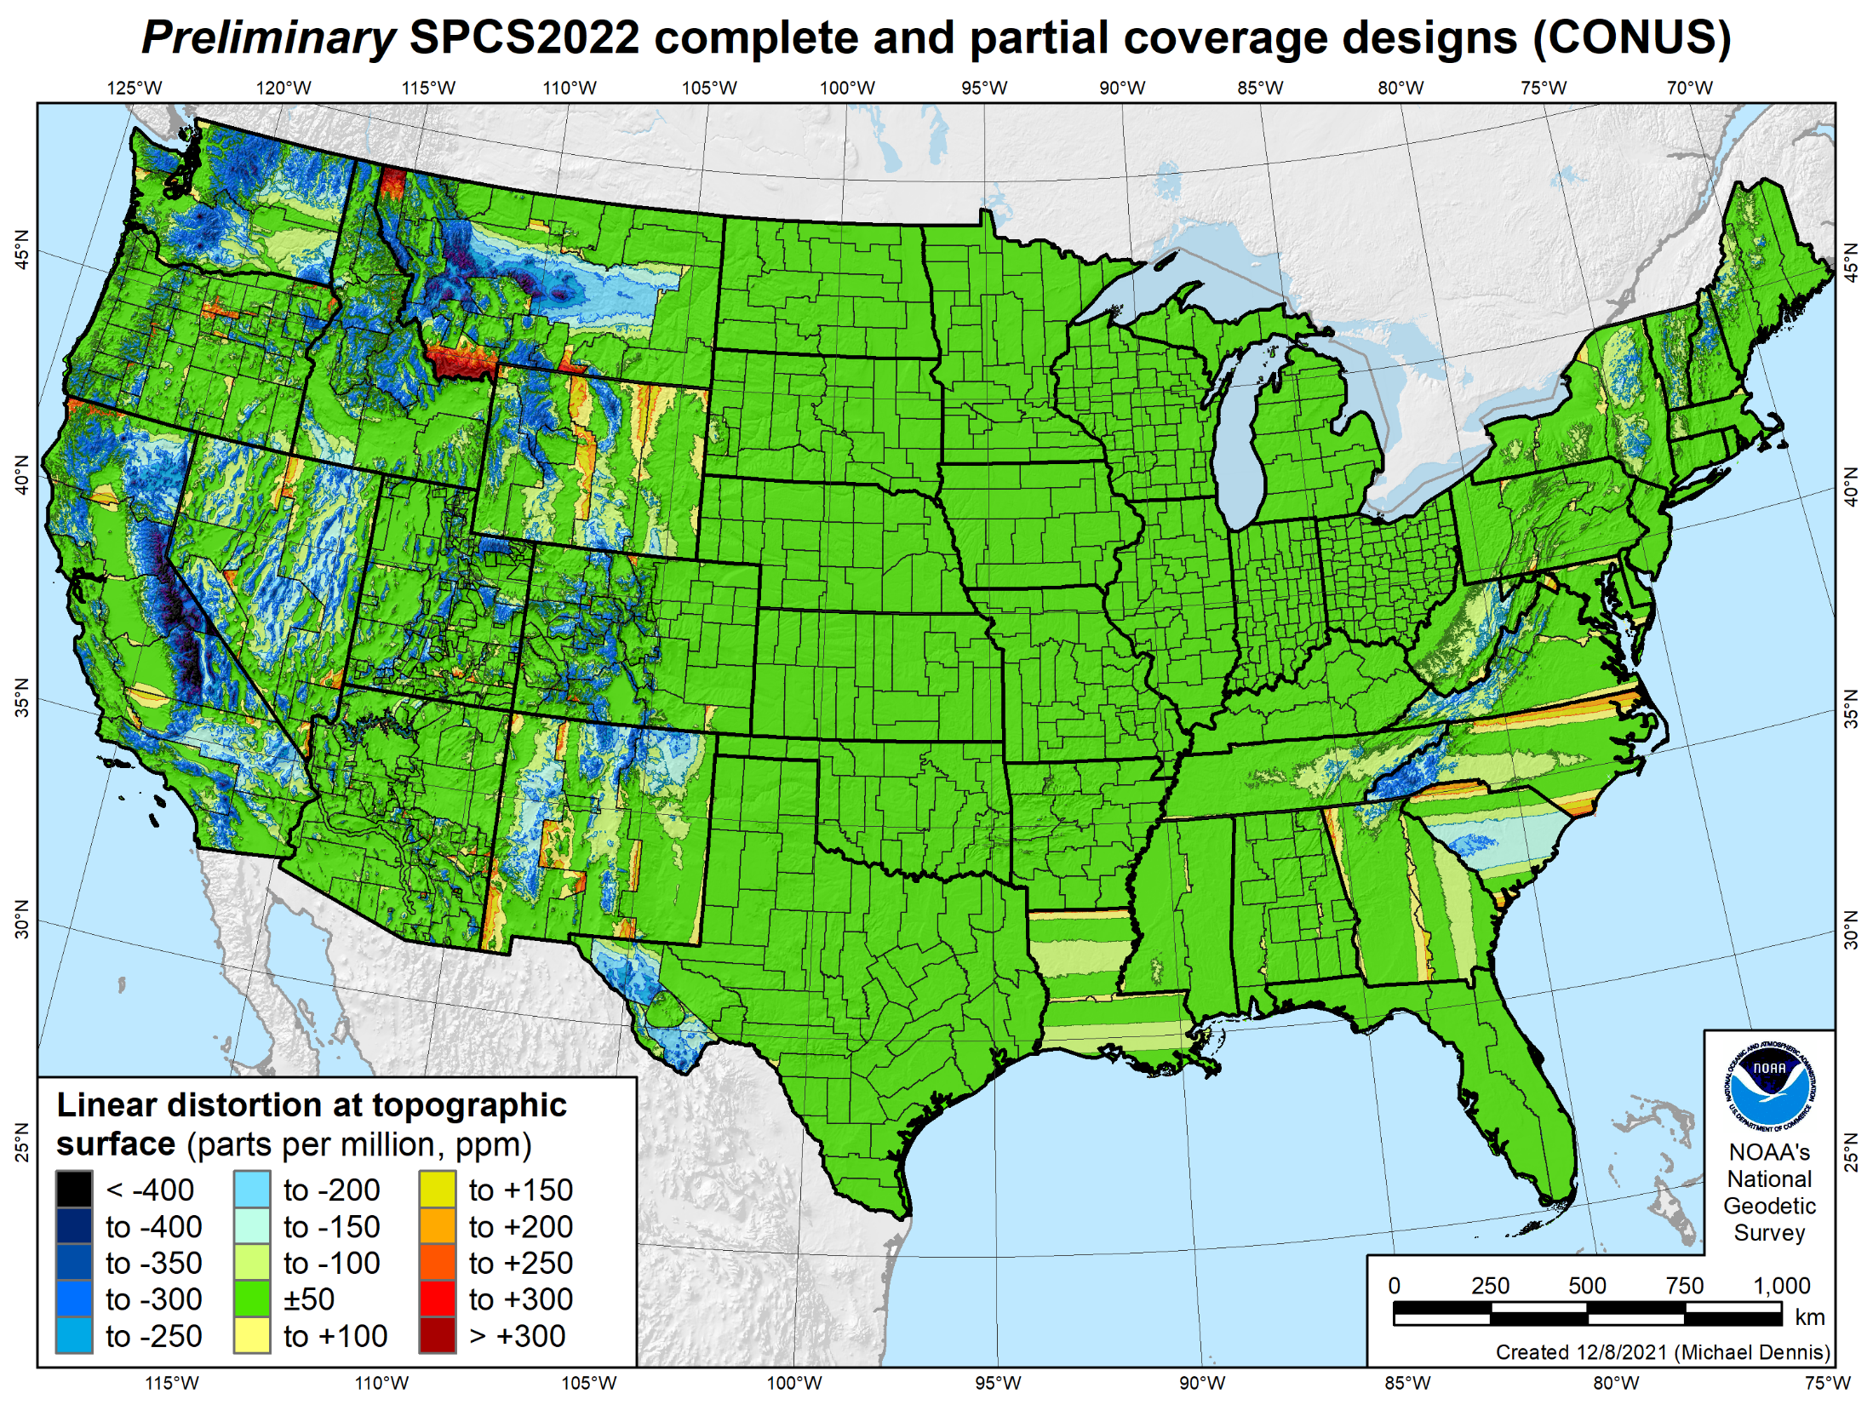
SPCS2022 linear distortion (prelim)
846 zones (CONUS)
Percent within distortion (ppm):
Distor | Pop | Cities | Area
±20 | 76% | 71% | 58%
±50 | 92% | 89% | 76%
±100 | 98% | 97% | 89%
±400 | 100% | 100% | 99.9%
City and area statistics (ppm):
 | Min | -407 | -1438
 | Max | +486 | +2624
 | Range | 893 | 4062
 | Mean | -6 | -23
Mean weighted by pop = -4

Slide 19
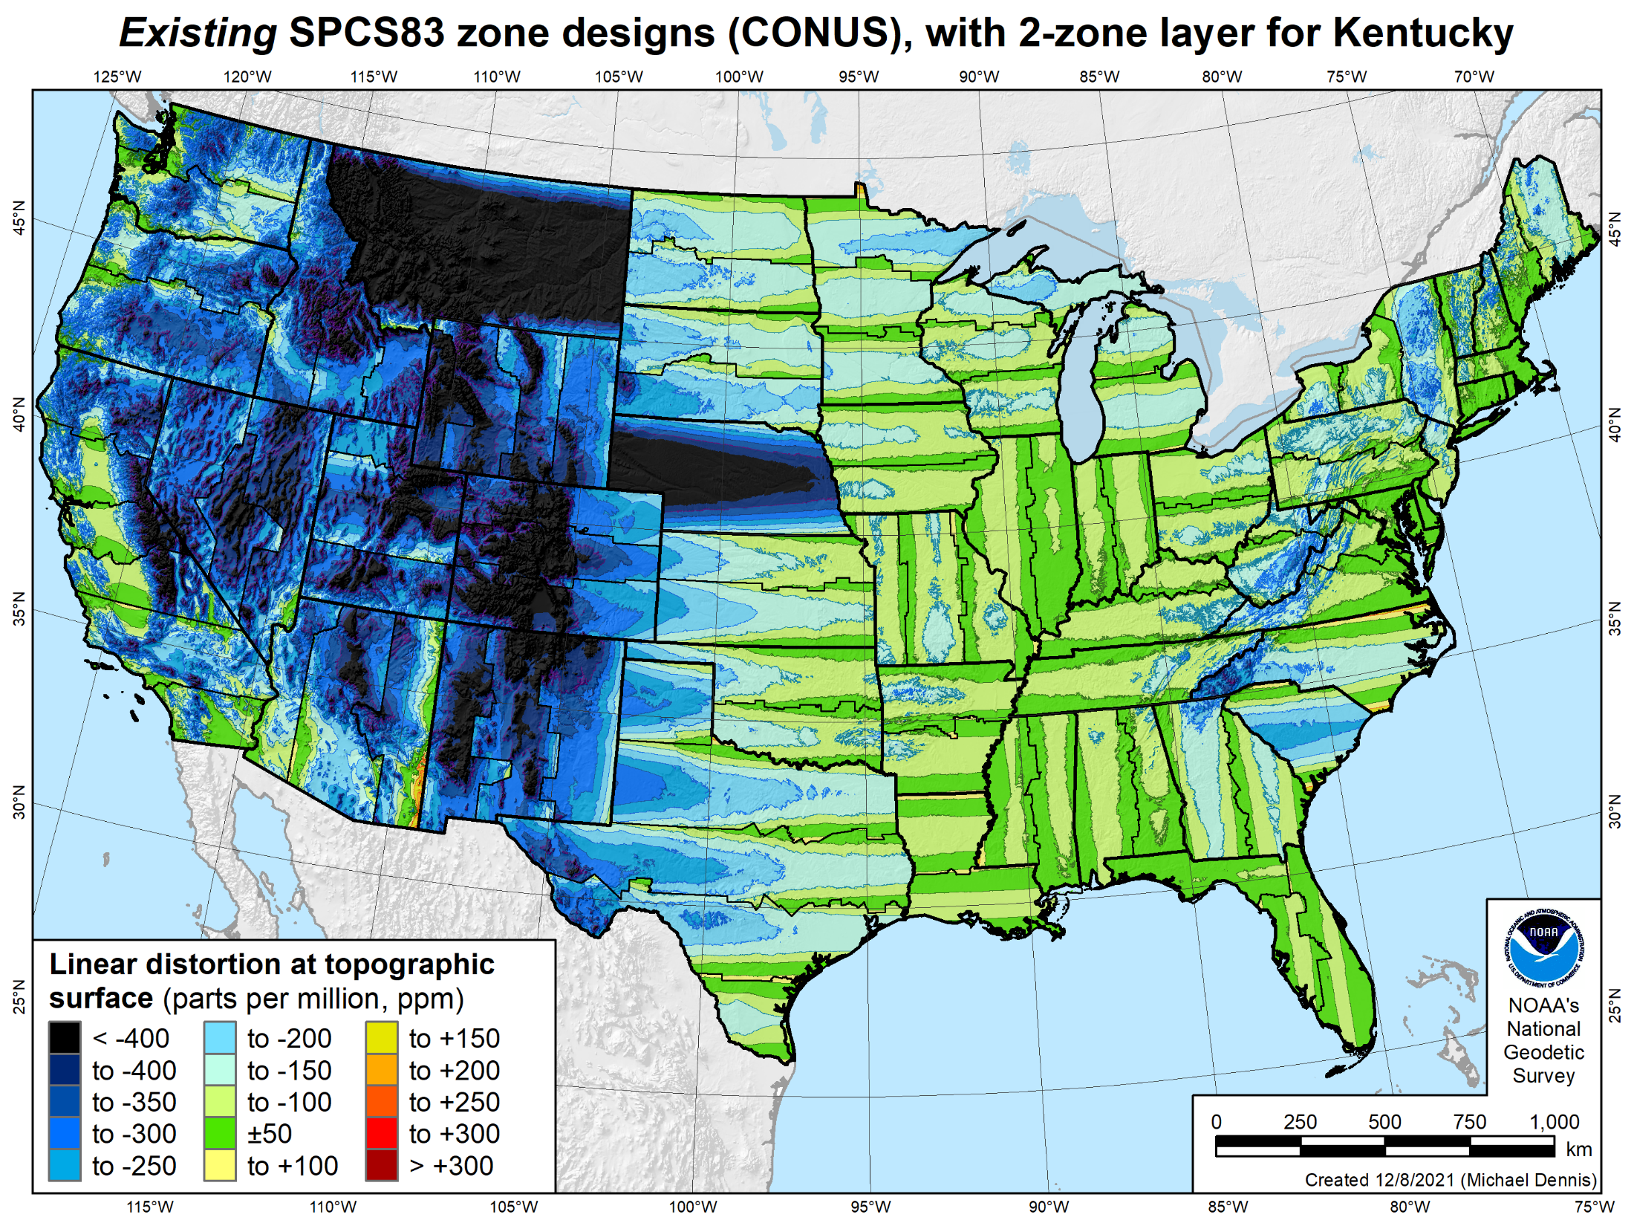
Existing SPCS 83 linear distortion
106 zones (CONUS)
Percent within distortion (ppm):
Distor | Pop | Cities | Area
±20 | 17% | 11% | 6%
±50 | 40% | 30% | 17%
±100 | 74% | 68% | 41%
±400 | 99% | 98% | 91%
City and area statistics (ppm):
 | Min | -913 | -1038
 | Max | +206 | +223
 | Range | 1120 | 1261
 | Mean | -98 | -178
Mean weighted by pop = -75
19

Slide 20
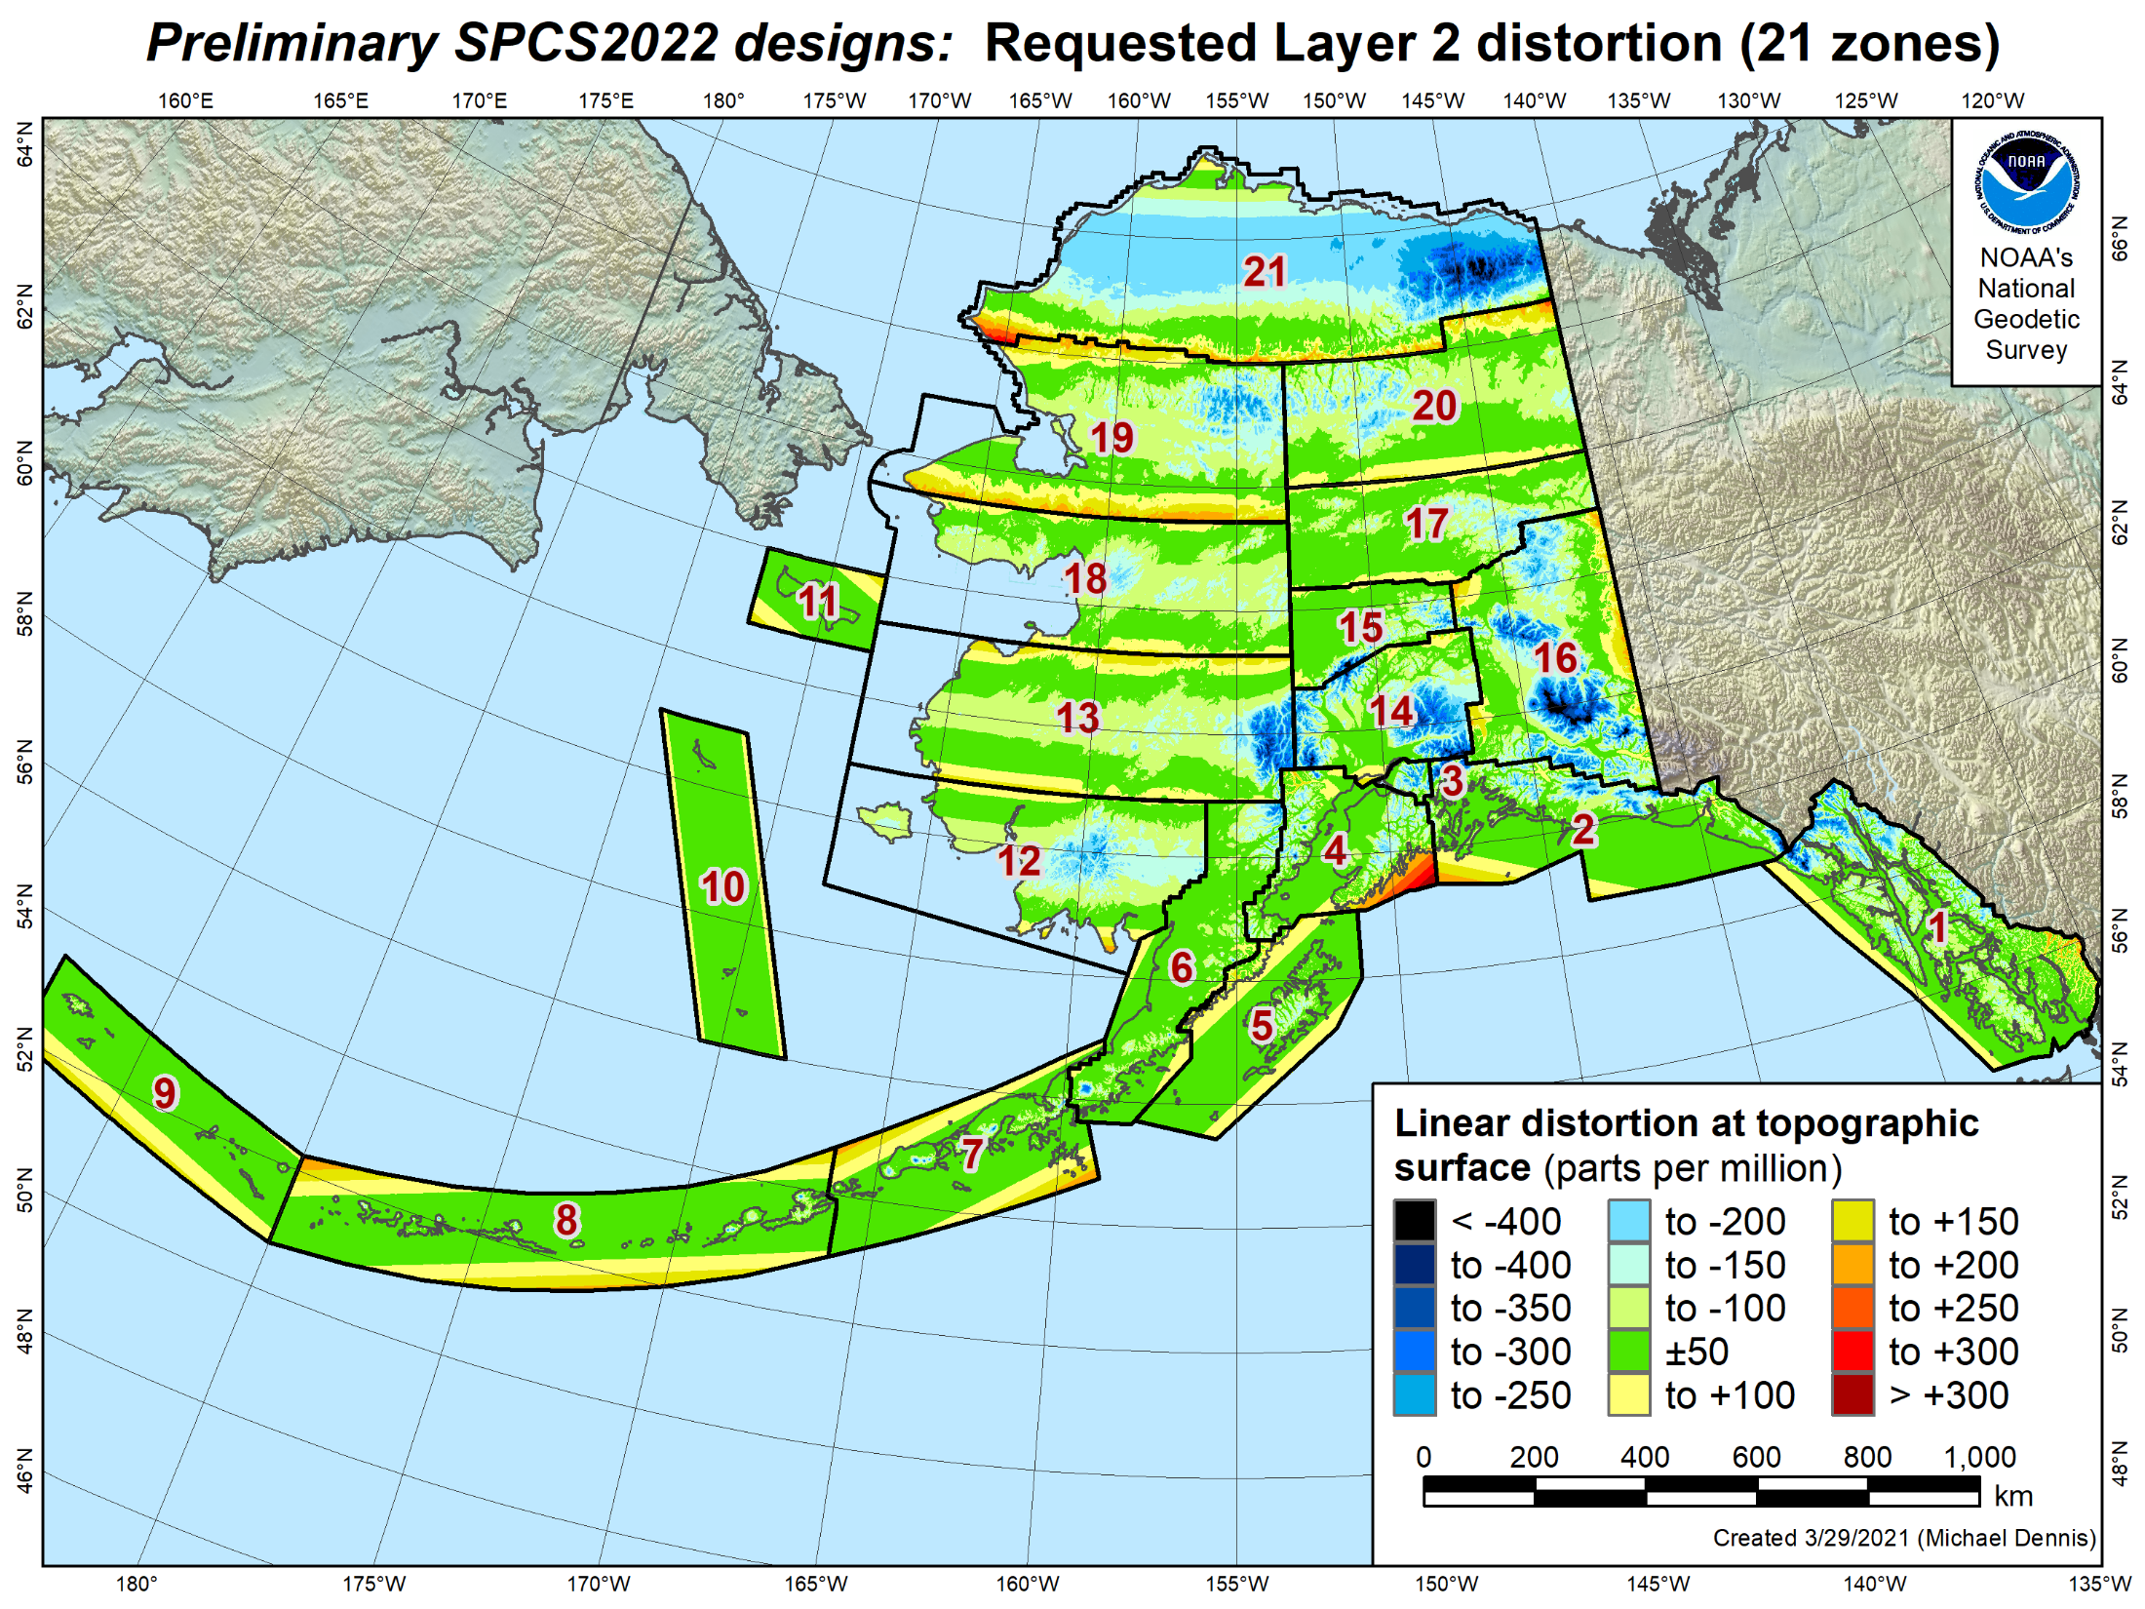
SPCS2022 linear distortion (prelim)
21 zones (Alaska)
Percent within distortion (ppm):
Distor | Pop | Cities | Area
±20 | 77% | 38% | 17%
±50 | 90% | 67% | 38%
±100 | 98% | 93% | 68%
±400 | 100% | 100% | 99.8%
City and area statistics (ppm):
 | Min | -177 | -794
 | Max | +321 | +331
 | Range | 498 | 1125
 | Mean | -7 | -53
Mean weighted by pop = -4
Statistics are for land areas only

Slide 21
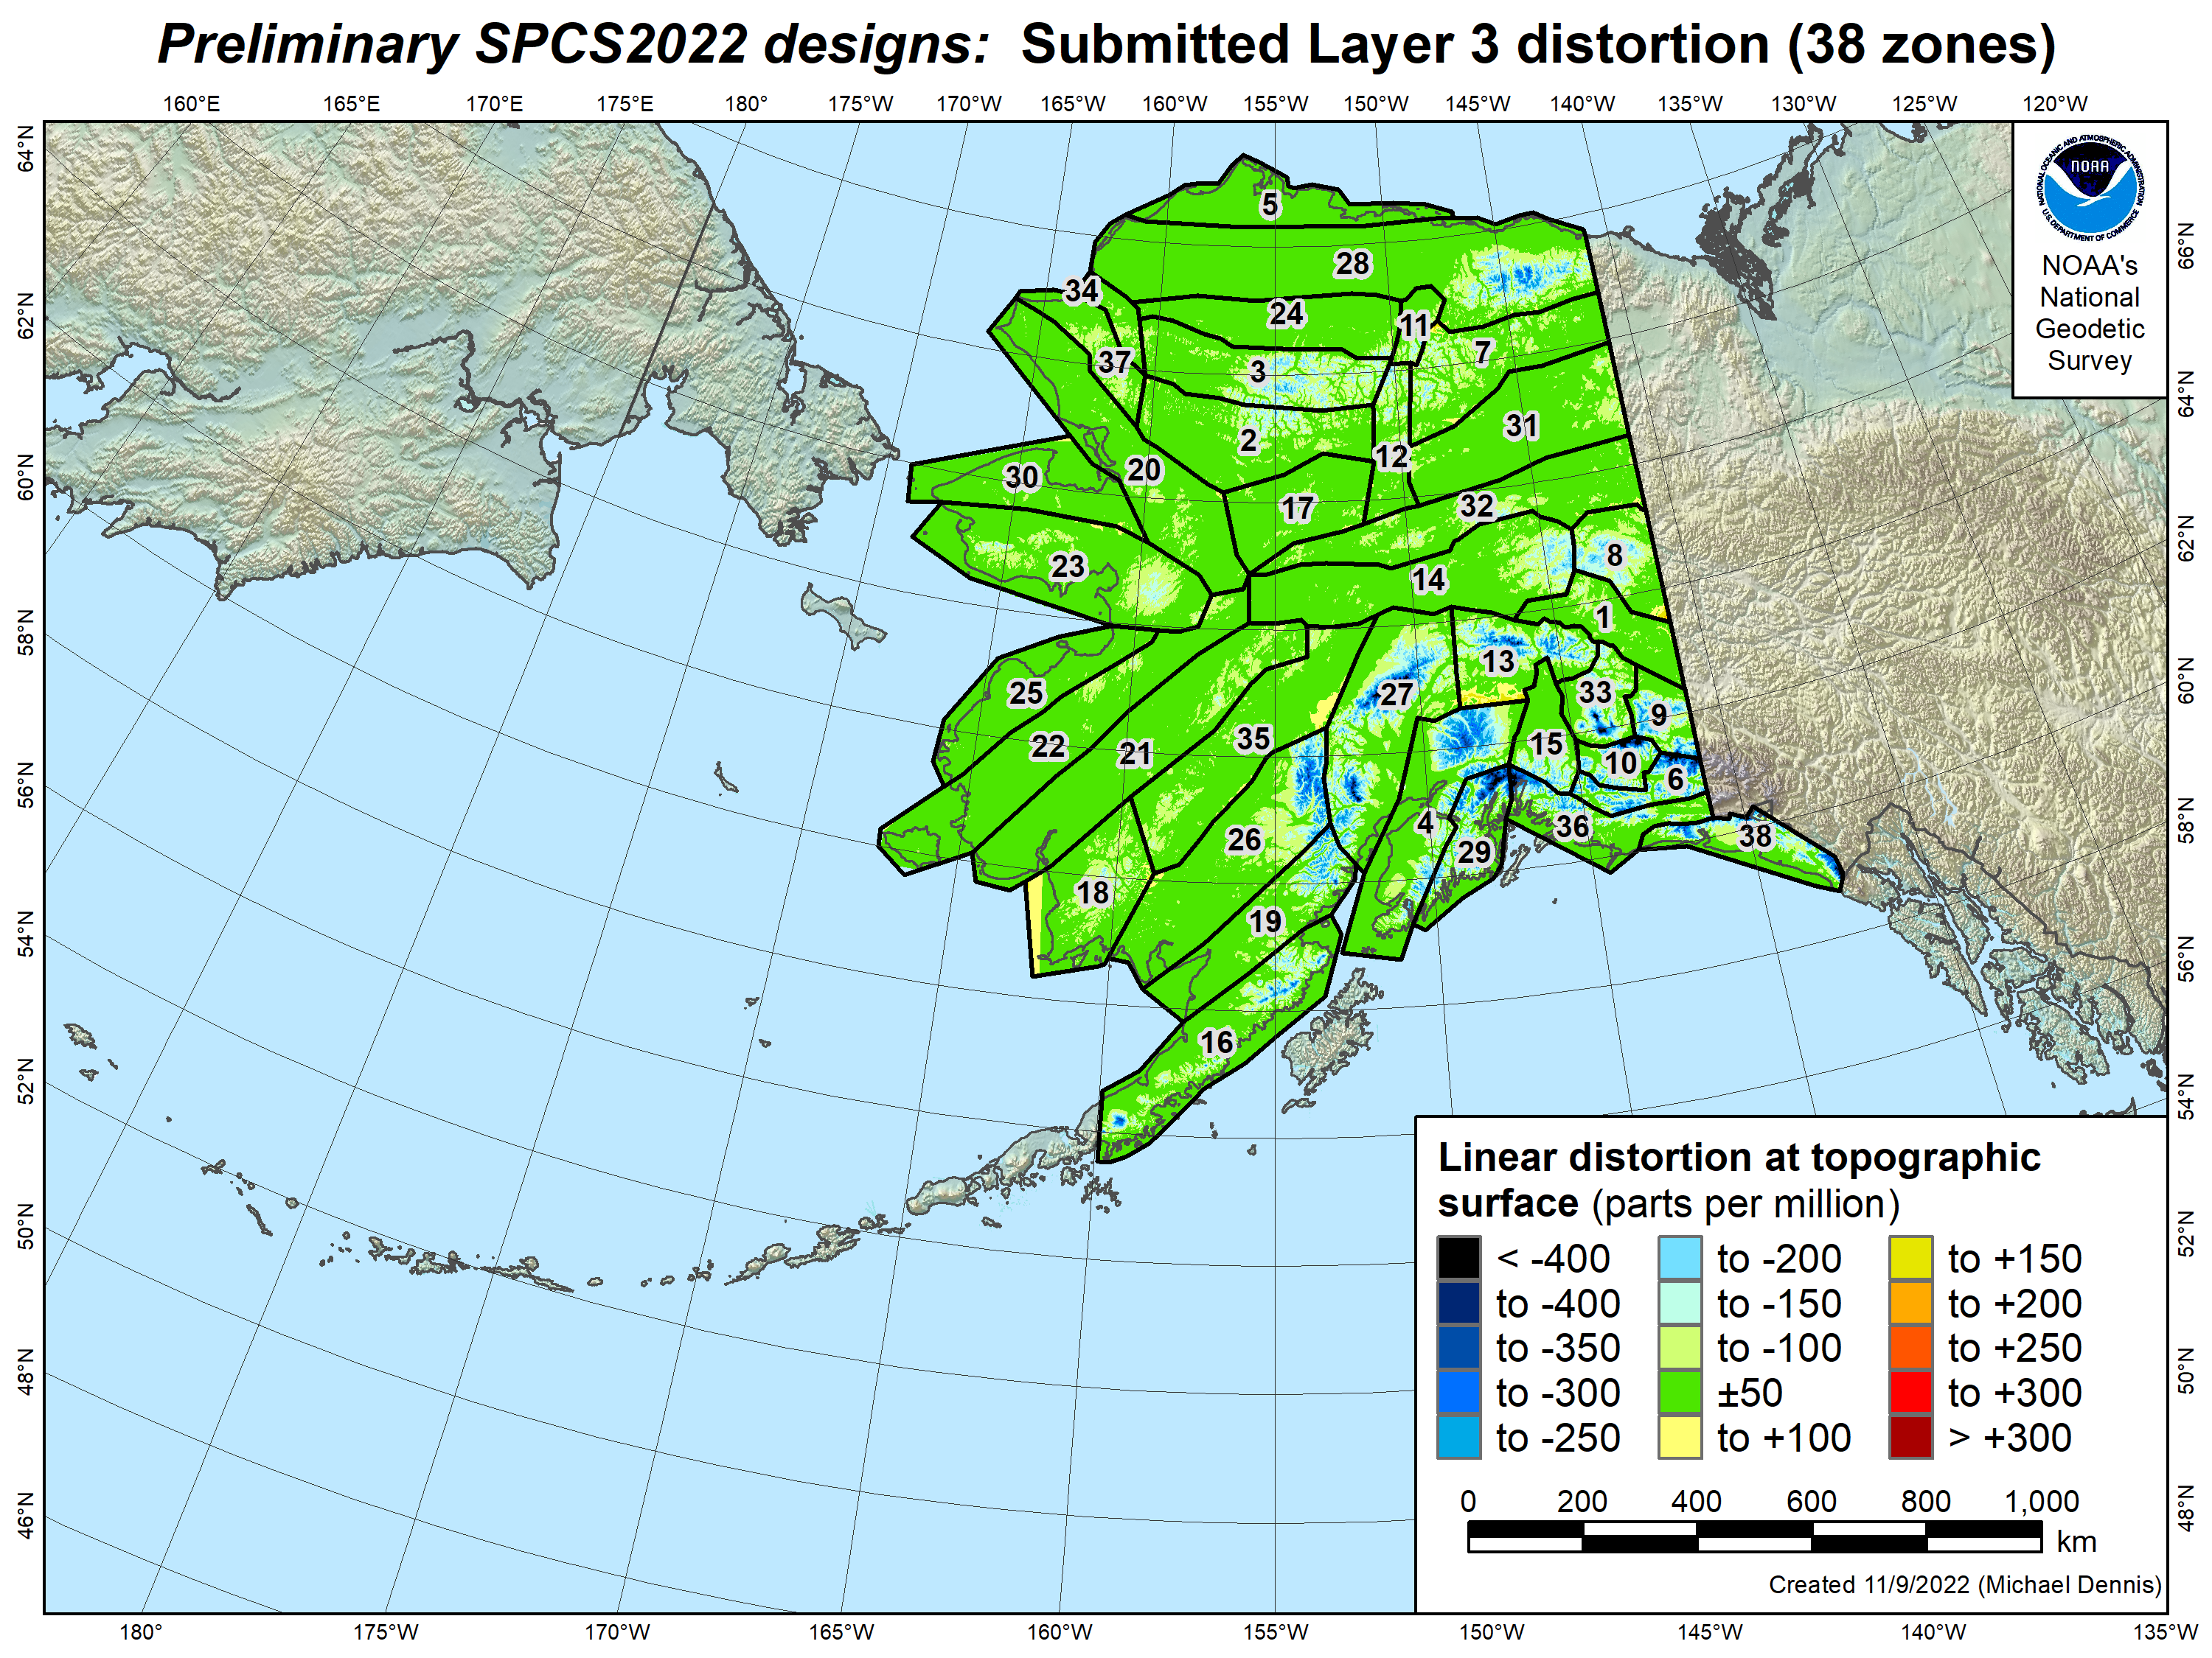
SPCS2022 linear distortion (prelim)
38 zones (Alaska)
Percent within distortion (ppm):
Distor | Pop | Cities | Area
±20 | 89% | 93% | 49%
±50 | 98% | 99.7% | 74%
±100 | 99.7% | 100% | 88%
±400 | 100% | 100% | 99.9%
City and area statistics (ppm):
 | Min | -59 | -937
 | Max | +49 | +190
 | Range | 108 | 1127
 | Mean | +0.4 | -34
Mean weighted by pop = -8
Statistics are for land areas only

Slide 22
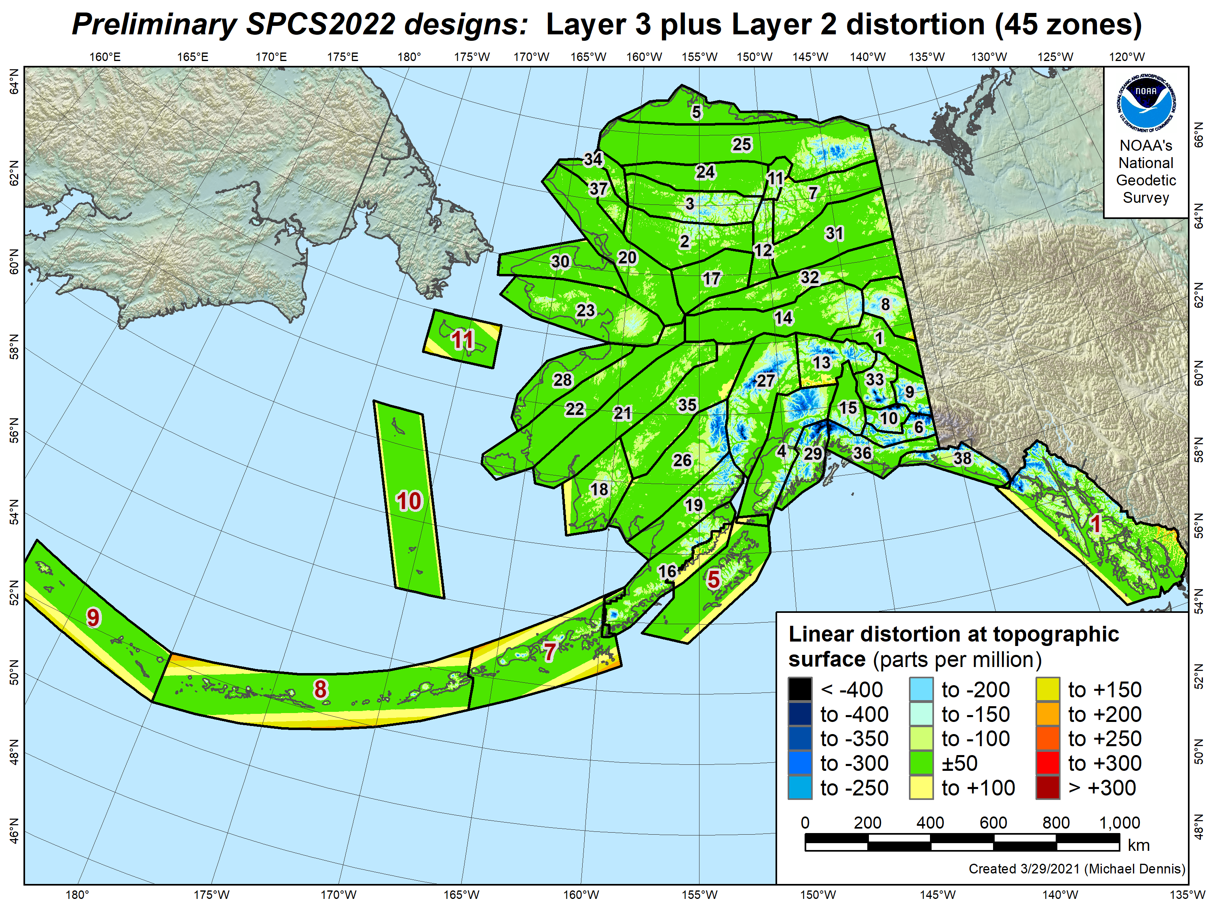
SPCS2022 linear distortion (prelim)
45 zones (Alaska)
Percent within distortion (ppm):
Distor | Pop | Cities | Area
±20 | 86% | 85% | 47%
±50 | 97% | 98% | 73%
±100 | 99.5% | 99.7% | 88%
±400 | 100% | 100% | 99.9%
City and area statistics (ppm):
 | Min | -60 | -937
 | Max | +321 | +335
 | Range | 380 | 1272
 | Mean | -3 | -35
Mean weighted by pop = -10
Statistics are for land areas only

Slide 23
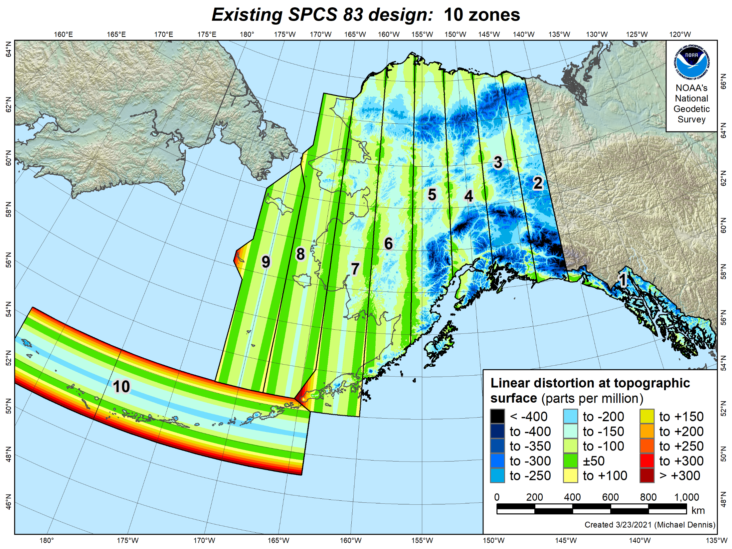
Existing SPCS 83 linear distortion
10 zones (Alaska)
Percent within distortion (ppm):
Distor | Pop | Cities | Area
±20 | 4% | 10% | 4%
±50 | 16% | 23% | 11%
±100 | 40% | 62% | 36%
±400 | 100% | 100% | 99.1%
City and area statistics (ppm):
 | Min | -263 | -967
 | Max | +86 | +342
 | Range | 349 | 1308
 | Mean | -83 | -135
Mean weighted by pop = -92
Statistics are for land areas only
23

Slide 24
The situation for Hawai’i
Two zone layers
1 statewide zone (designed by NGS)
19 zones on partial coverage layer (proposed by stakeholders)
12 zones for the Big Island
7 zones for Maui
Total 20 zones
Designs in progress, preliminary ones done soon!
Based on refined design process for steep topography
Remaining zone designs currently underway
Final zone number and extents may change
Will work with Hawai’i stakeholders to finalize designs

Slide 25
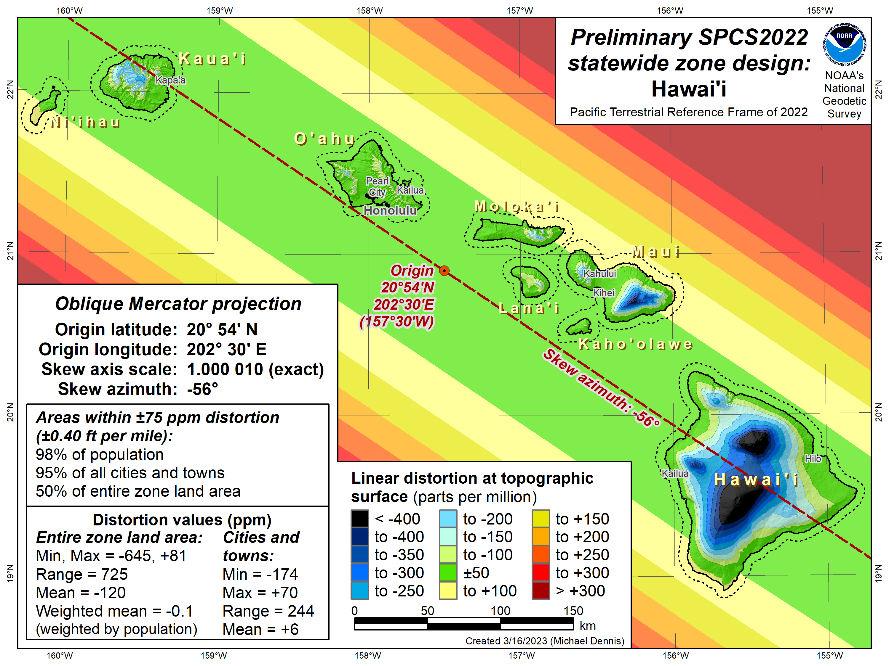
SPCS2022 linear distortion (prelim)
Hawai’i (statewide)
Percent within distortion (ppm):
Distor | Pop | Cities | Area
±20 | 73% | 58% | 23%
±50 | 95% | 87% | 40%
±100 | 98% | 97% | 56%
±400 | 100% | 100% | 95%
City and area statistics (ppm):
 | Min | -174 | -645
 | Max | +70 | +81
 | Range | 244 | 725
 | Mean | +6 | -120
Mean weighted by pop = -0.1
Statistics are for land areas only
25

Slide 26
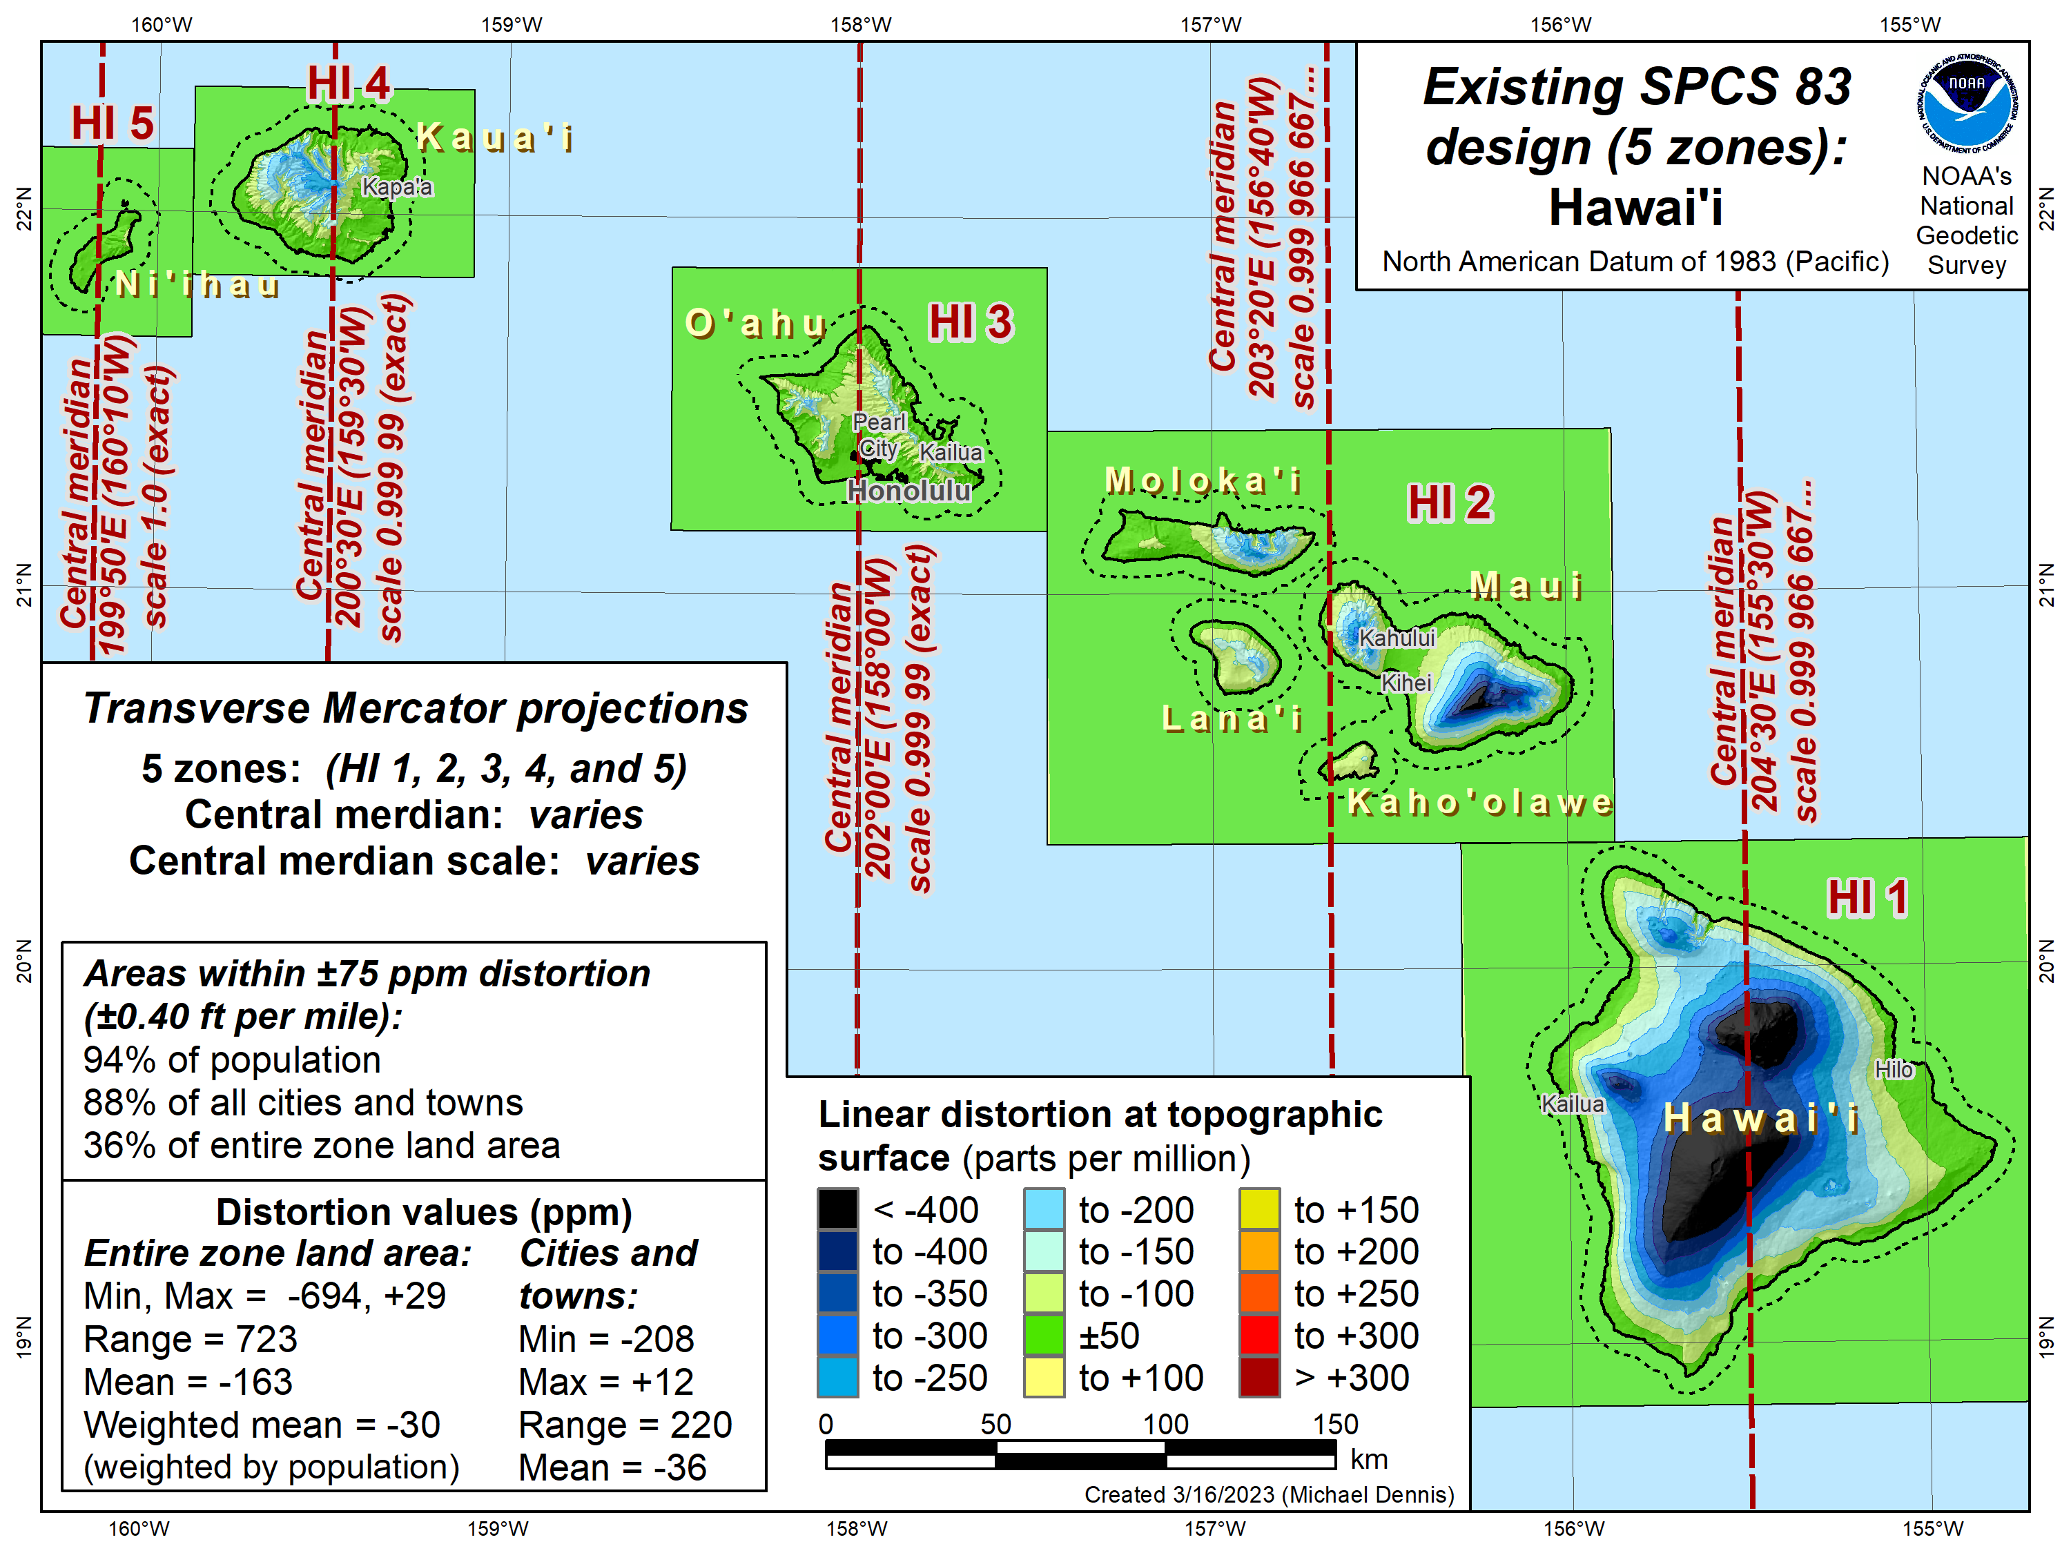
Existing SPCS 83 linear distortion
Hawai’i (5 zones)
Percent within distortion (ppm):
Distor | Pop | Cities | Area
±20 | 54% | 40% | 10%
±50 | 85% | 81% | 26%
±100 | 97% | 94% | 45%
±400 | 100% | 100% | 92%
City and area statistics (ppm):
 | Min | -208 | -694
 | Max | +12 | +29
 | Range | 220 | 723
 | Mean | -36 | -163
Mean weighted by pop = -30
Statistics are for land areas only
26

Slide 27
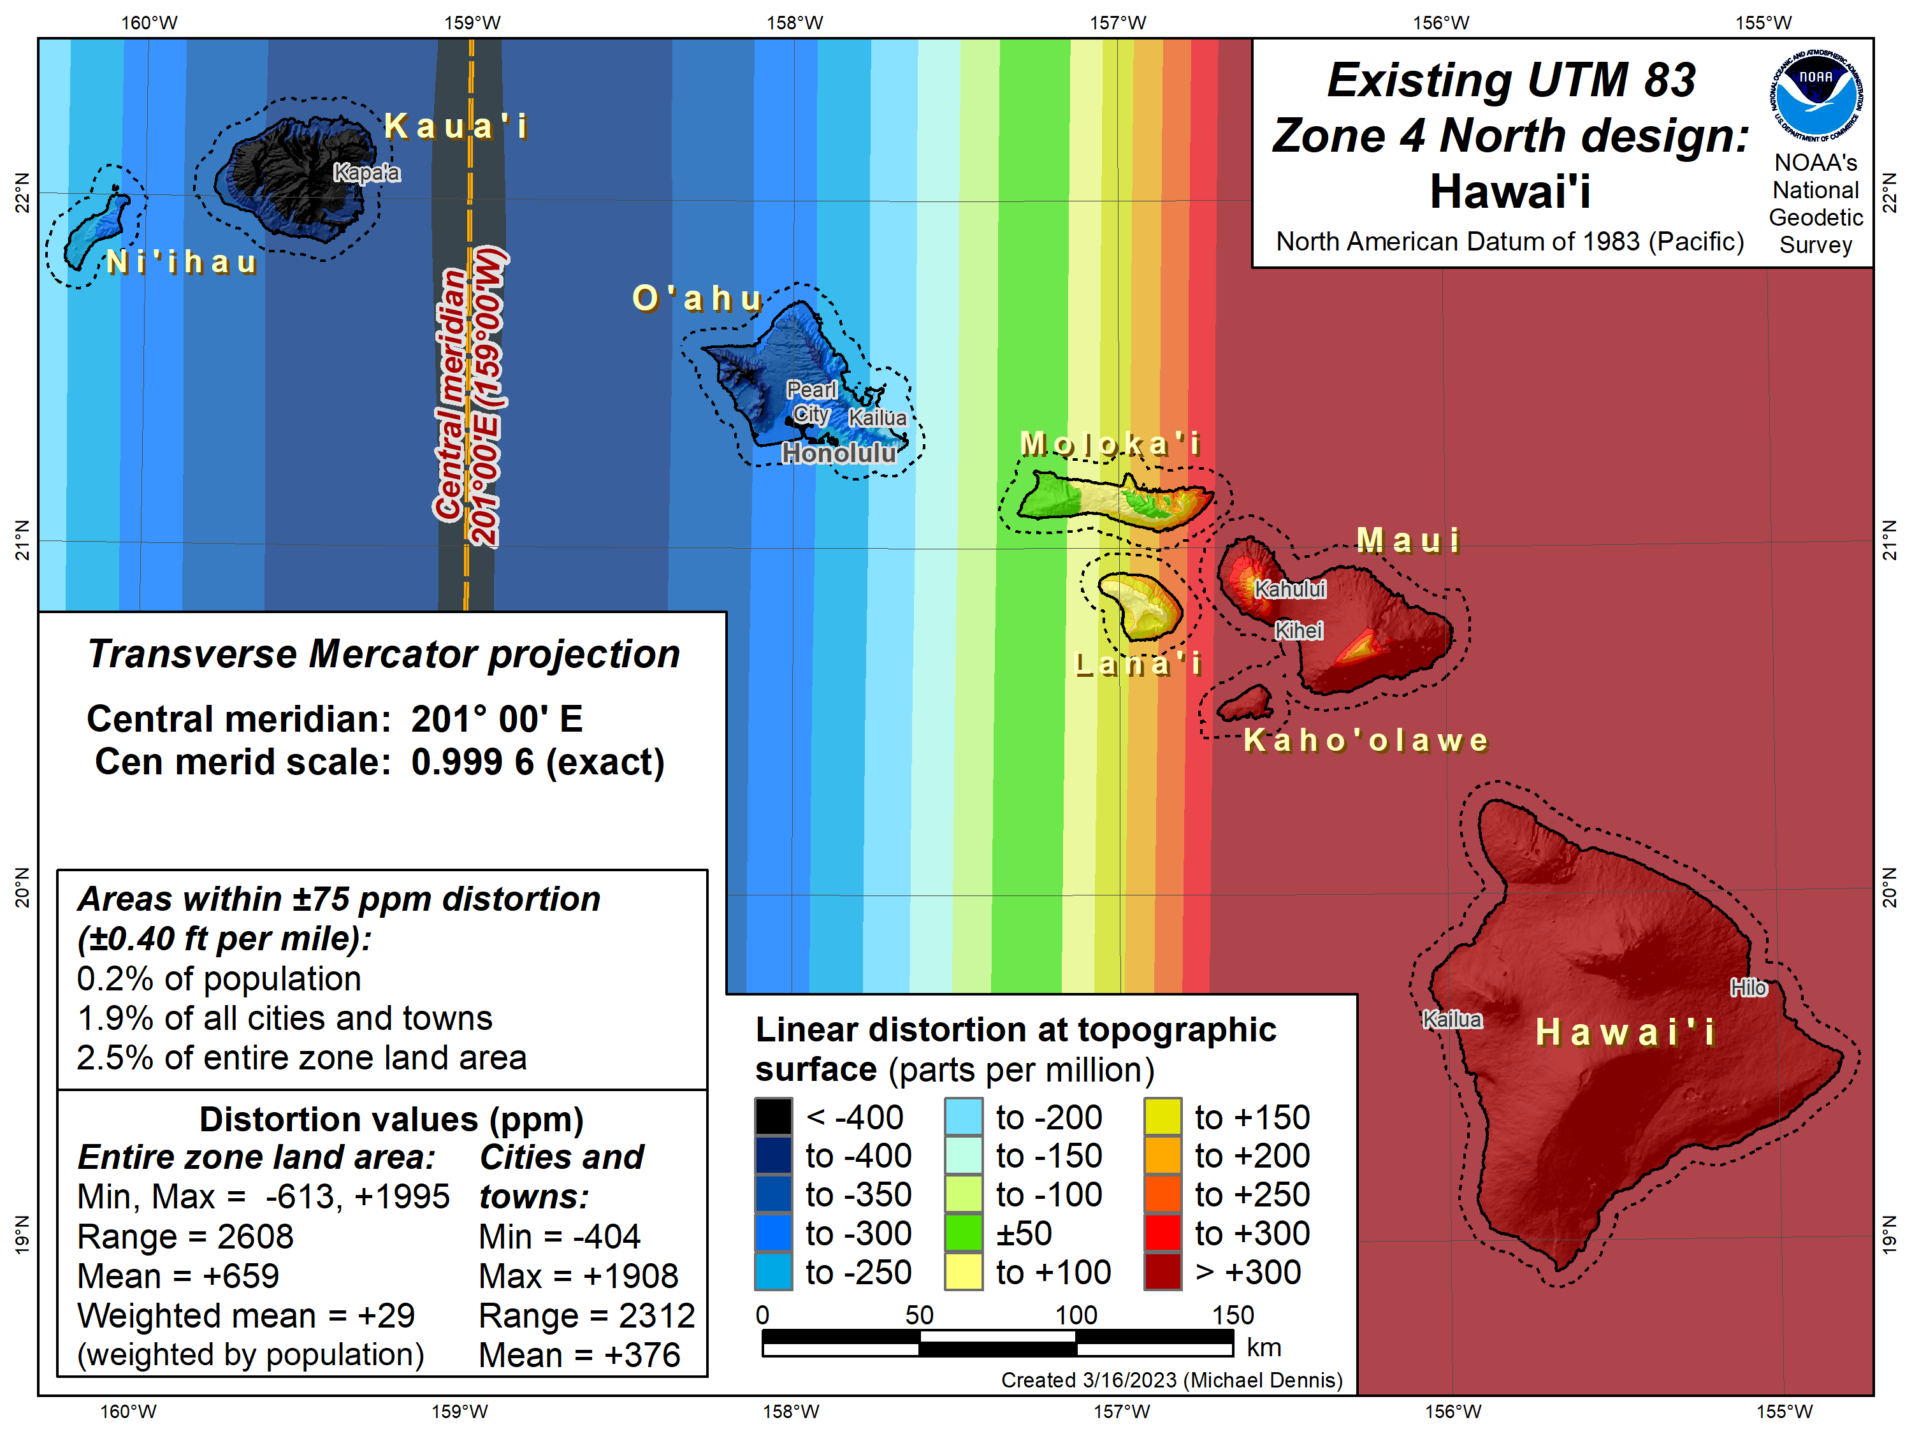
Existing UTM 83 linear distortion
Hawai’i (UTM 4 North)
Percent within distortion (ppm):
Distor | Pop | Cities | Area
±20 | 0.02% | 0% | 1.0%
±50 | 0.1% | 0.9% | 1.6%
±100 | 0.4% | 2.8% | 3.6%
±400 | 77% | 54% | 25%
City and area statistics (ppm):
 | Min | -404 | -613
 | Max | +1908 | +1995
 | Range | 2312 | 2608
 | Mean | +376 | +659
Mean weighted by pop = +29
Statistics are for land areas only
27

Slide 28
SPCS2022 linear distortion (prelim)
Hawai’i (statewide)
Percent within distortion (ppm):
Distor | Pop | Cities | Area
±20 | 73% | 58% | 23%
±50 | 95% | 87% | 40%
±100 | 98% | 97% | 56%
±400 | 100% | 100% | 95%
City and area statistics (ppm):
 | Min | -174 | -645
 | Max | +70 | +81
 | Range | 244 | 725
 | Mean | +6 | -120
Mean weighted by pop = -0.1
Statistics are for land areas only
28

Slide 29
Statewide zone performance for O’ahu
Following 2 maps show statewide and SPCS 83 design performance
Distortion increment of 20 ppm used to show more detail
Both maps give statistics for O’ahu only
Existing SPCS 83 Hawai’i Zone 3 is a single projection for Oahu only
Both maps give distortion design performance value in ppm, where:
The distortion value includes at least 90% of population…
…AND at least 75% of cities and towns (irrespective of population)
…AND at least 50% of total land area
SPCS2022 statewide zone performance better than SPCS 83 HI Zone 3

Slide 30
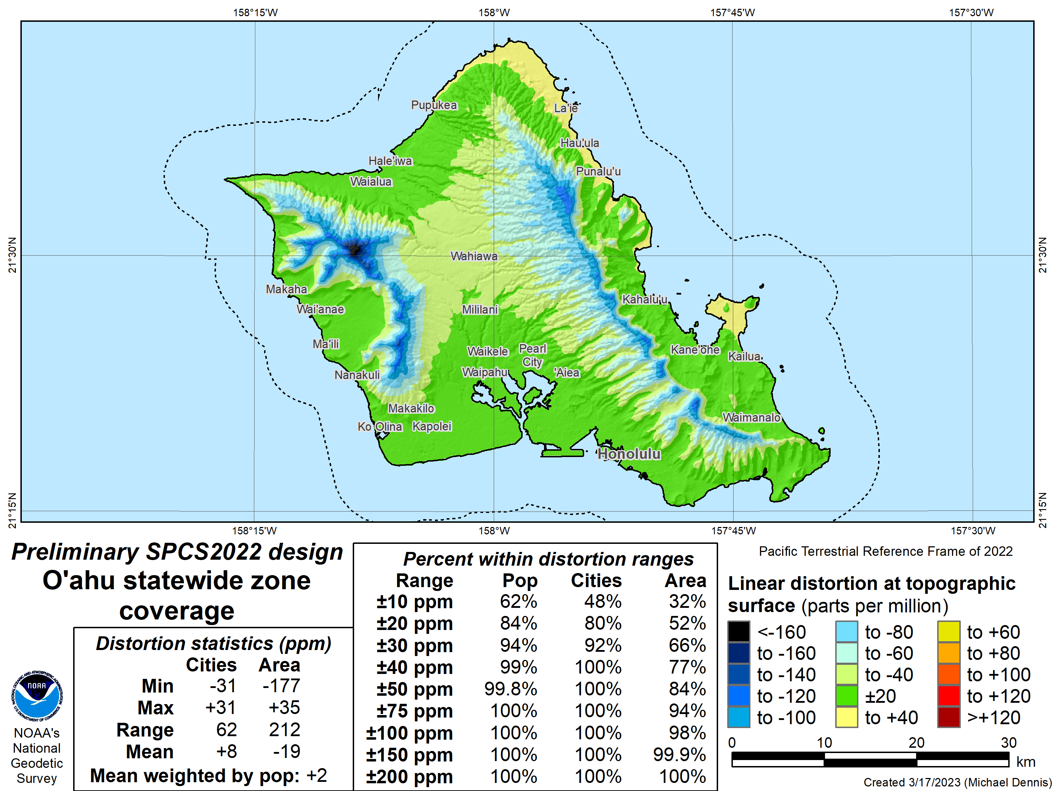
SPCS2022 linear distortion (prelim)
Distortion increment 20 ppm
O’ahu (statewide)
Percent within distortion (ppm):
Distor | Pop | Cities | Area
±20 | 84% | 80% | 52%
±50 | 99.8% | 100% | 84%
±100 | 100% | 100% | 98%
±400 | 100% | 100% | 100%
City and area statistics (ppm):
 | Min | -31 | -177
 | Max | +31 | +35
 | Range | 62 | 212
 | Mean | +8 | -19
Mean weighted by pop = +2
Distortion design
performance ±30 ppm
Statistics are for land areas only
30

Slide 31
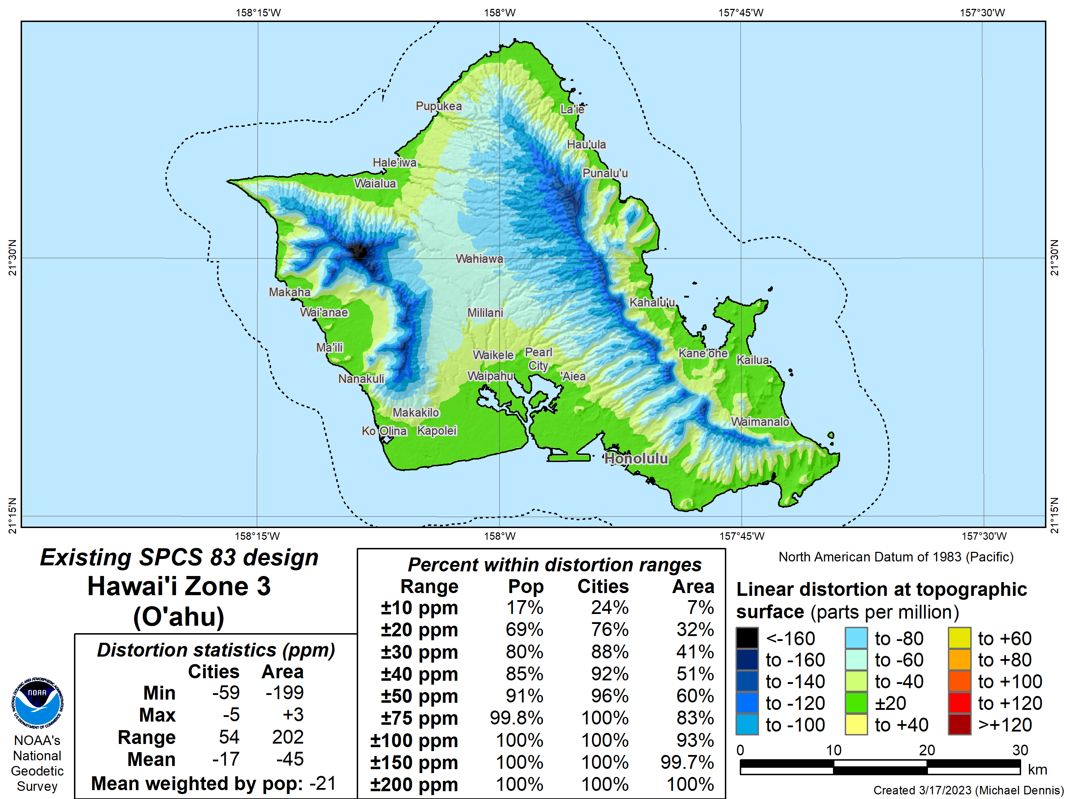
Existing SPCS 83 linear distortion
Distortion increment 20 ppm
O’ahu (HI Zone 3)
Percent within distortion (ppm):
Distor | Pop | Cities | Area
±20 | 69% | 76% | 32%
±50 | 91% | 96% | 60%
±100 | 100% | 100% | 93%
±400 | 100% | 100% | 100%
City and area statistics (ppm):
 | Min | -59 | -199
 | Max | -5 | +3
 | Range | 54 | 202
 | Mean | -17 | -45
Mean weighted by pop = -21
Distortion design
performance ±50 ppm
Statistics are for land areas only
31

Slide 32
Preliminary zone designs for Maui
Based on 7 zones as proposed by stakeholders
Following 4 maps show statewide and preliminary design performance
First 2 maps with distortion increment of 50 ppm
Second 2 maps with distortion increment of 20 ppm to show more detail
All maps give distortion design performance value in ppm, where:
The distortion value includes at least 90% of population…
…AND at least 75% of cities and towns (irrespective of population)
…AND at least 50% of total land area
The multi-zone designs are PRELIMINARY and WILL change!
Will seek input from stakeholders before finalizing

Slide 33
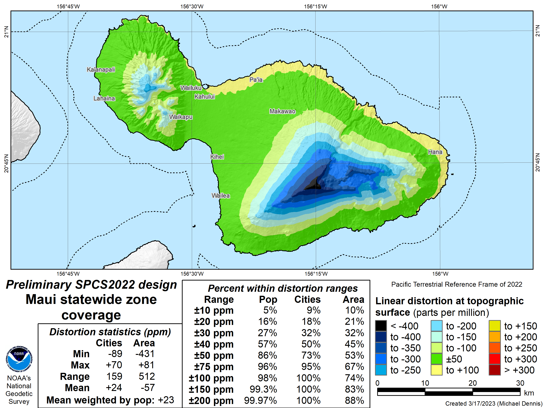
SPCS2022 linear distortion (prelim)
Distortion increment 50 ppm
Maui (statewide)
Percent within distortion (ppm):
Distor | Pop | Cities | Area
±20 | 16% | 18% | 21%
±50 | 86% | 73% | 53%
±100 | 98% | 100% | 74%
±400 | 100% | 100% | 99.7%
City and area statistics (ppm):
 | Min | -89 | -431
 | Max | +70 | +81
 | Range | 159 | 512
 | Mean | +24 | -57
Mean weighted by pop = +23
Distortion design
performance ±75 ppm
Statistics are for land areas only
33

Slide 34
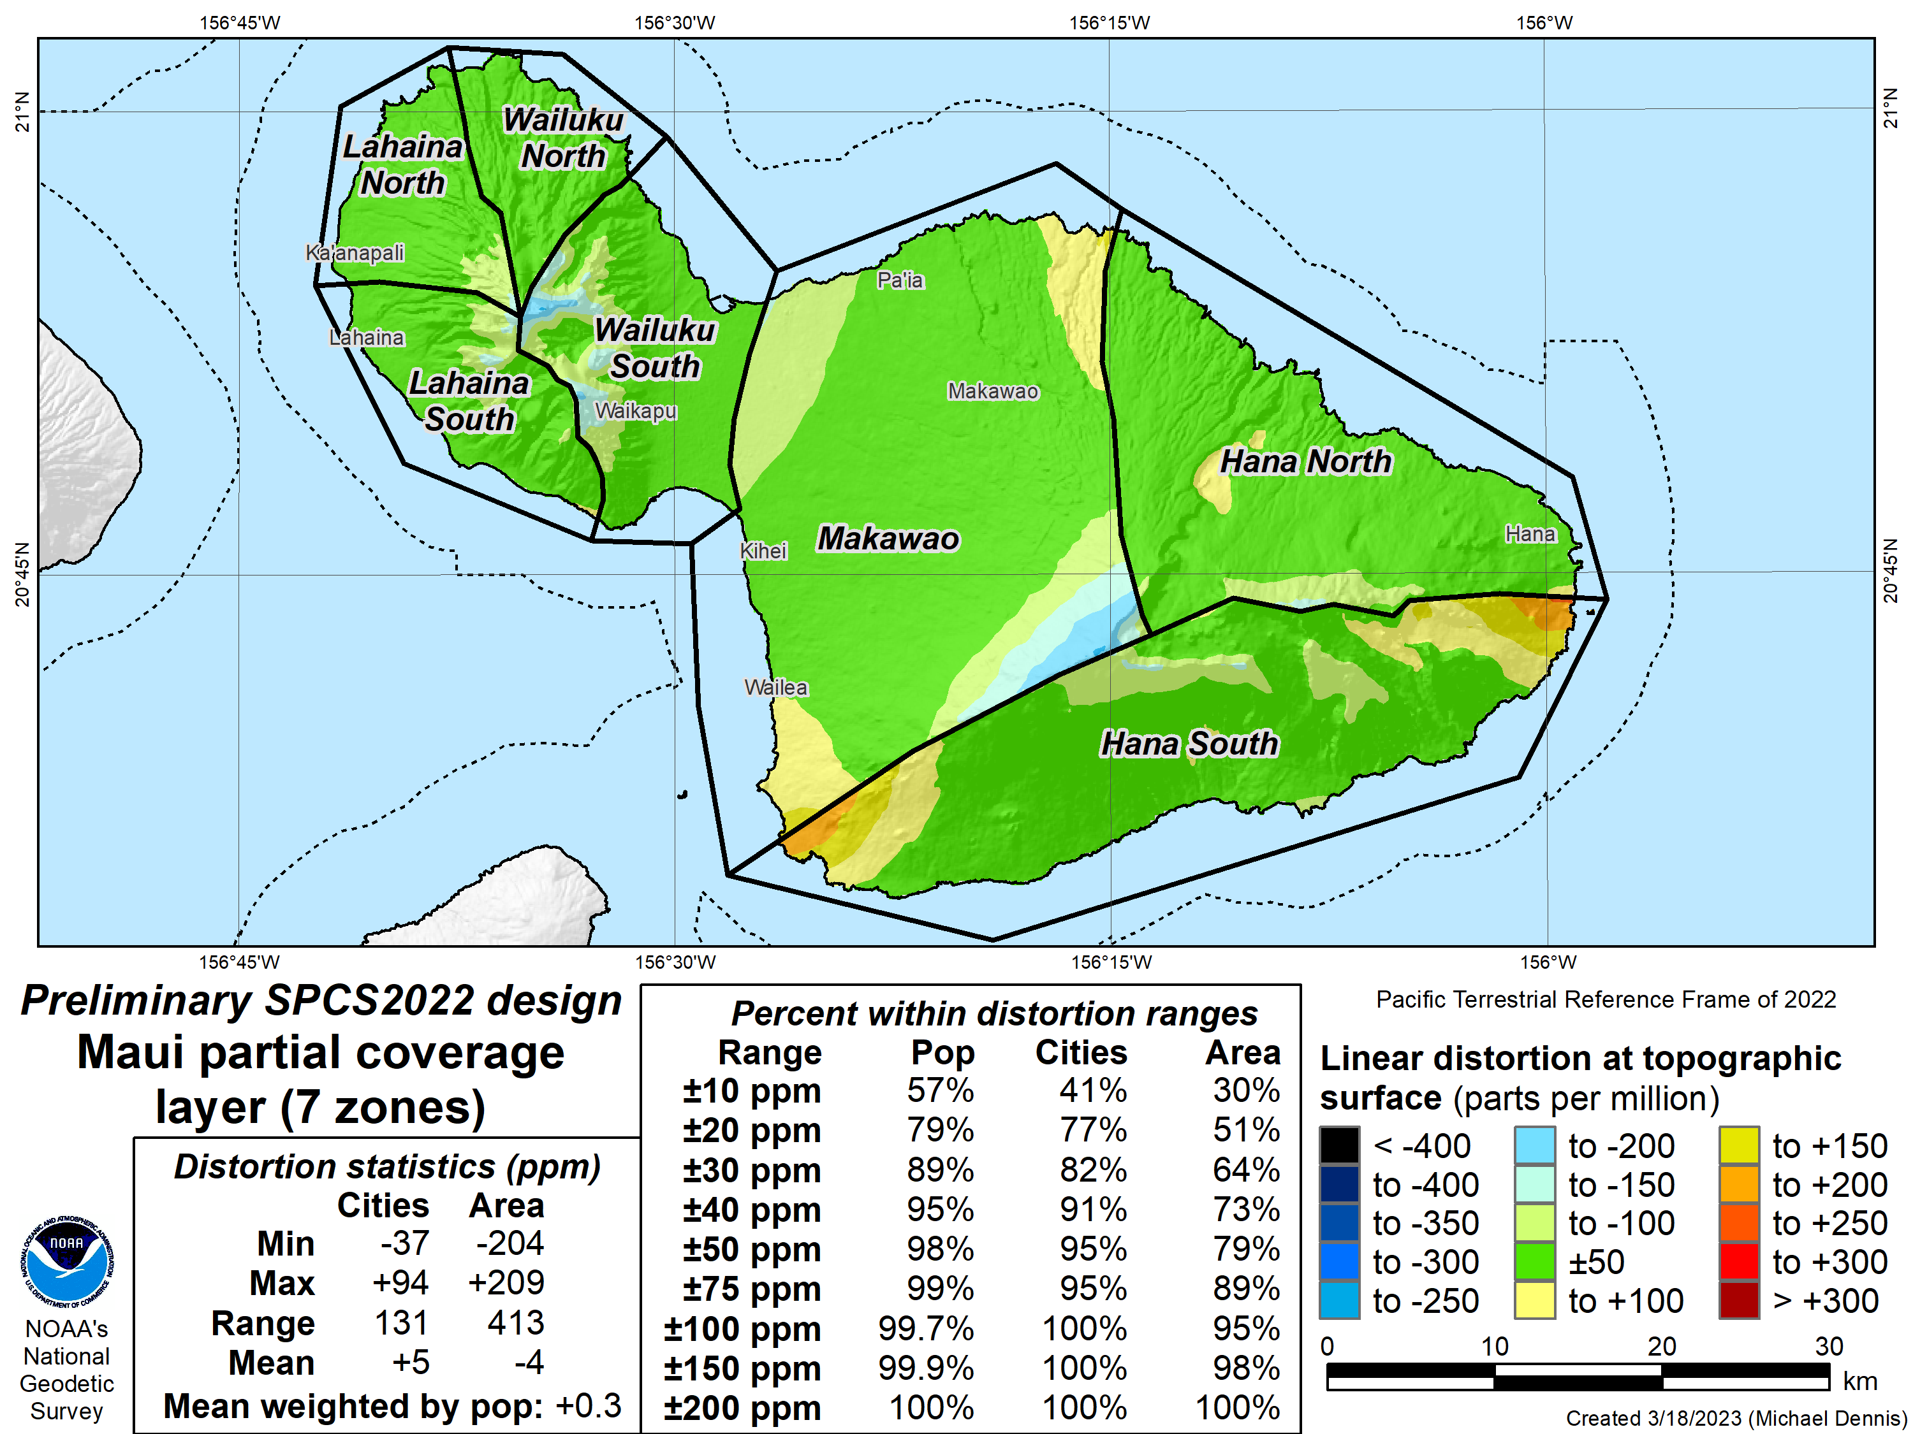
SPCS2022 linear distortion (prelim)
Distortion increment 50 ppm
Maui (7 zones)
Percent within distortion (ppm):
Distor | Pop | Cities | Area
±20 | 79% | 77% | 51%
±50 | 98% | 95% | 79%
±100 | 99.7% | 100% | 95%
±400 | 100% | 100% | 100%
City and area statistics (ppm):
 | Min | -37 | -204
 | Max | +94 | +209
 | Range | 131 | 413
 | Mean | +5 | -4
Mean weighted by pop = +0.3
Distortion design
performance ±40 ppm
Statistics are for land areas only
34

Slide 35
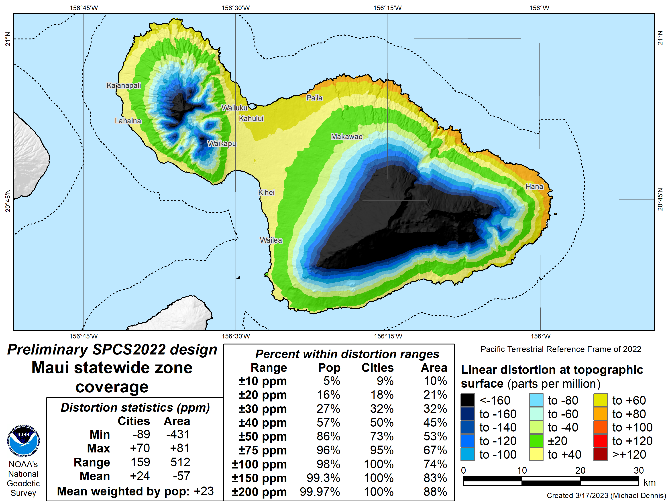
SPCS2022 linear distortion (prelim)
Distortion increment 20 ppm
Maui (statewide)
Percent within distortion (ppm):
Distor | Pop | Cities | Area
±20 | 16% | 18% | 21%
±50 | 86% | 73% | 53%
±100 | 98% | 100% | 74%
±400 | 100% | 100% | 99.7%
City and area statistics (ppm):
 | Min | -89 | -431
 | Max | +70 | +81
 | Range | 159 | 512
 | Mean | +24 | -57
Mean weighted by pop = +23
Distortion design
performance ±75 ppm
Statistics are for land areas only
35

Slide 36
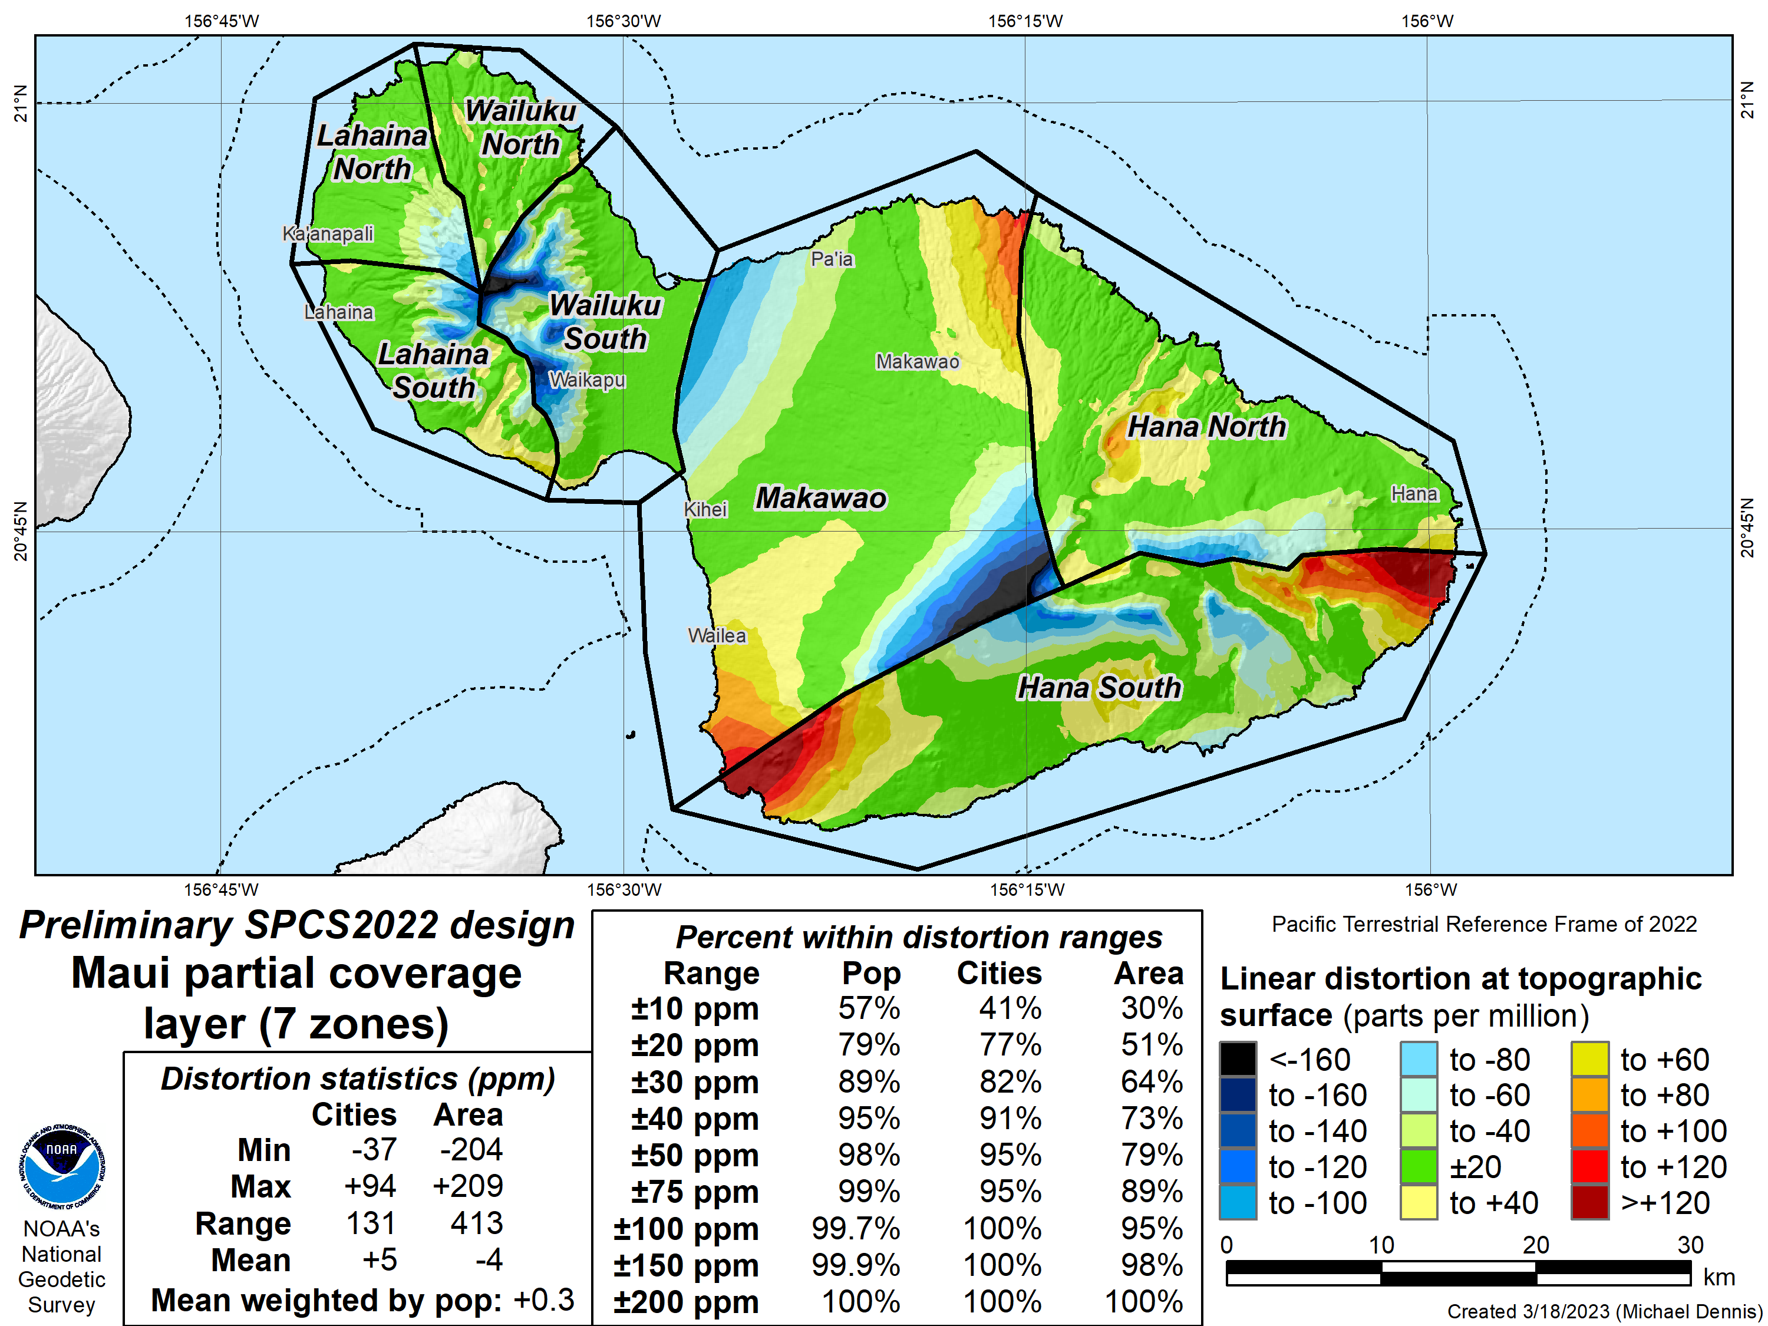
SPCS2022 linear distortion (prelim)
Distortion increment 20 ppm
Maui (7 zones)
Percent within distortion (ppm):
Distor | Pop | Cities | Area
±20 | 79% | 77% | 51%
±50 | 98% | 95% | 79%
±100 | 99.7% | 100% | 95%
±400 | 100% | 100% | 100%
City and area statistics (ppm):
 | Min | -37 | -204
 | Max | +94 | +209
 | Range | 131 | 413
 | Mean | +5 | -4
Mean weighted by pop = +0.3
Distortion design
performance ±40 ppm
Statistics are for land areas only
36

Slide 37
Preliminary zone designs for Big Island
Based on 12 zones as proposed by stakeholders
Following 4 maps show statewide and preliminary design performance
First 2 maps with distortion increment of 50 ppm
Second 2 maps with distortion increment of 20 ppm to show more detail
All maps give distortion design performance value in ppm, where:
The distortion value includes at least 90% of population…
…AND at least 75% of cities and towns (irrespective of population)
…AND at least 50% of total land area
The multi-zone designs are PRELIMINARY and WILL change!
Will seek input from stakeholders before finalizing

Slide 38
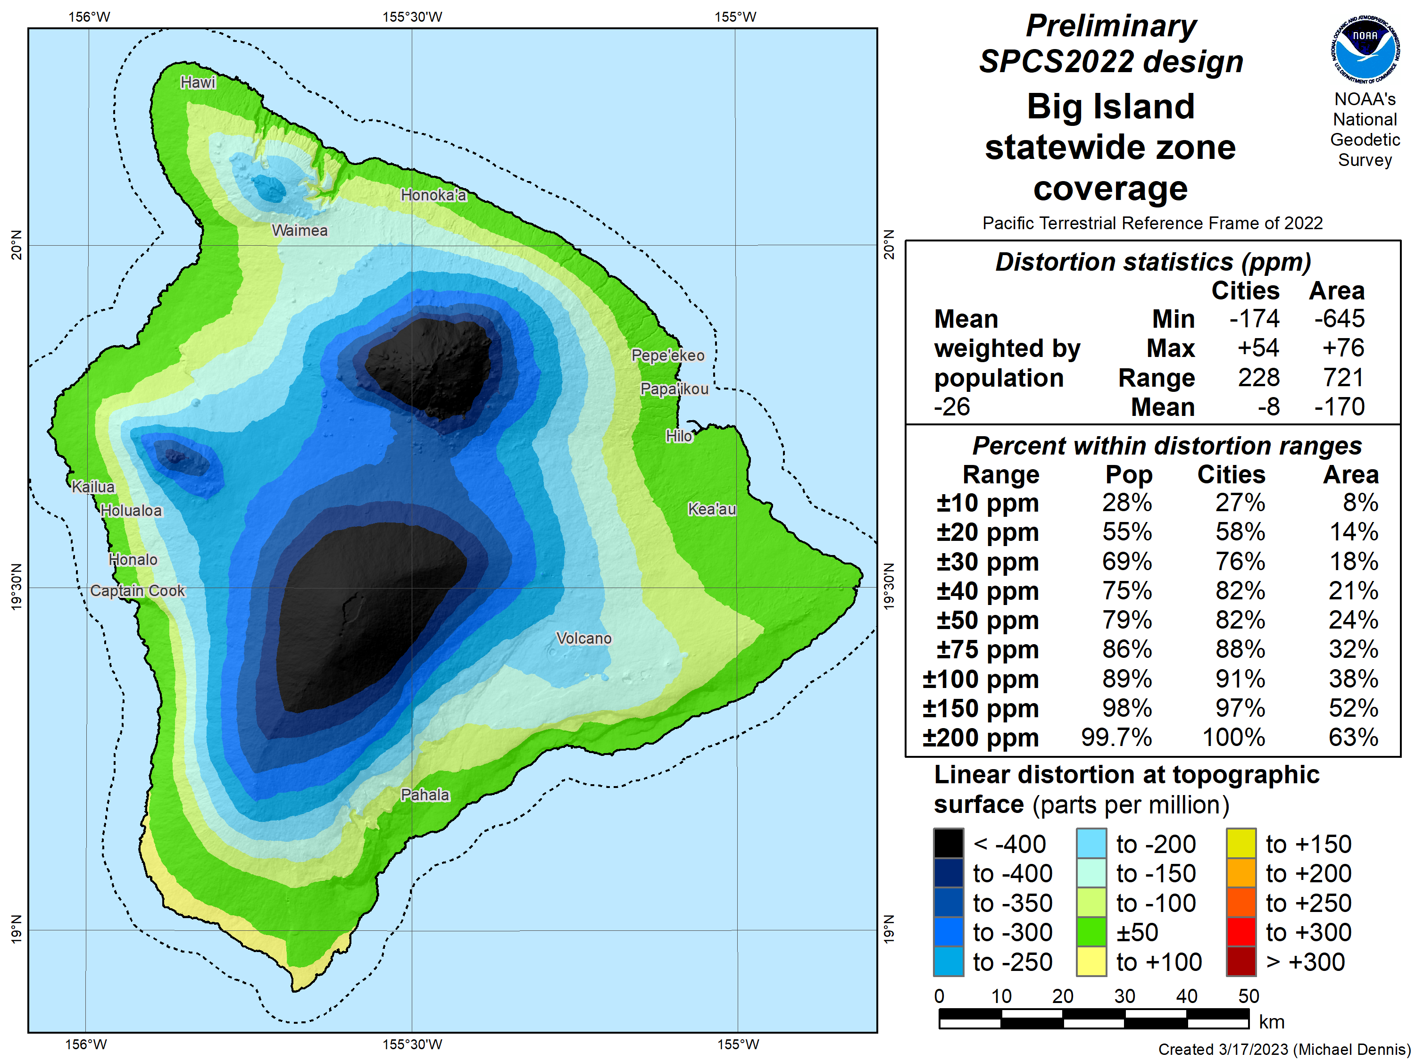
SPCS2022 linear distortion (prelim)
Distortion increment 50 ppm
Big Island (statewide)
Percent within distortion (ppm):
Distor | Pop | Cities | Area
±20 | 55% | 58% | 14%
±50 | 79% | 82% | 24%
±100 | 89% | 91% | 38%
±400 | 100% | 100% | 92%
City and area statistics (ppm):
 | Min | -174 | -645
 | Max | +54 | +76
 | Range | 228 | 721
 | Mean | -8 | -170
Mean weighted by pop = -26
Distortion design
performance ±150 ppm
Statistics are for land areas only
38

Slide 39
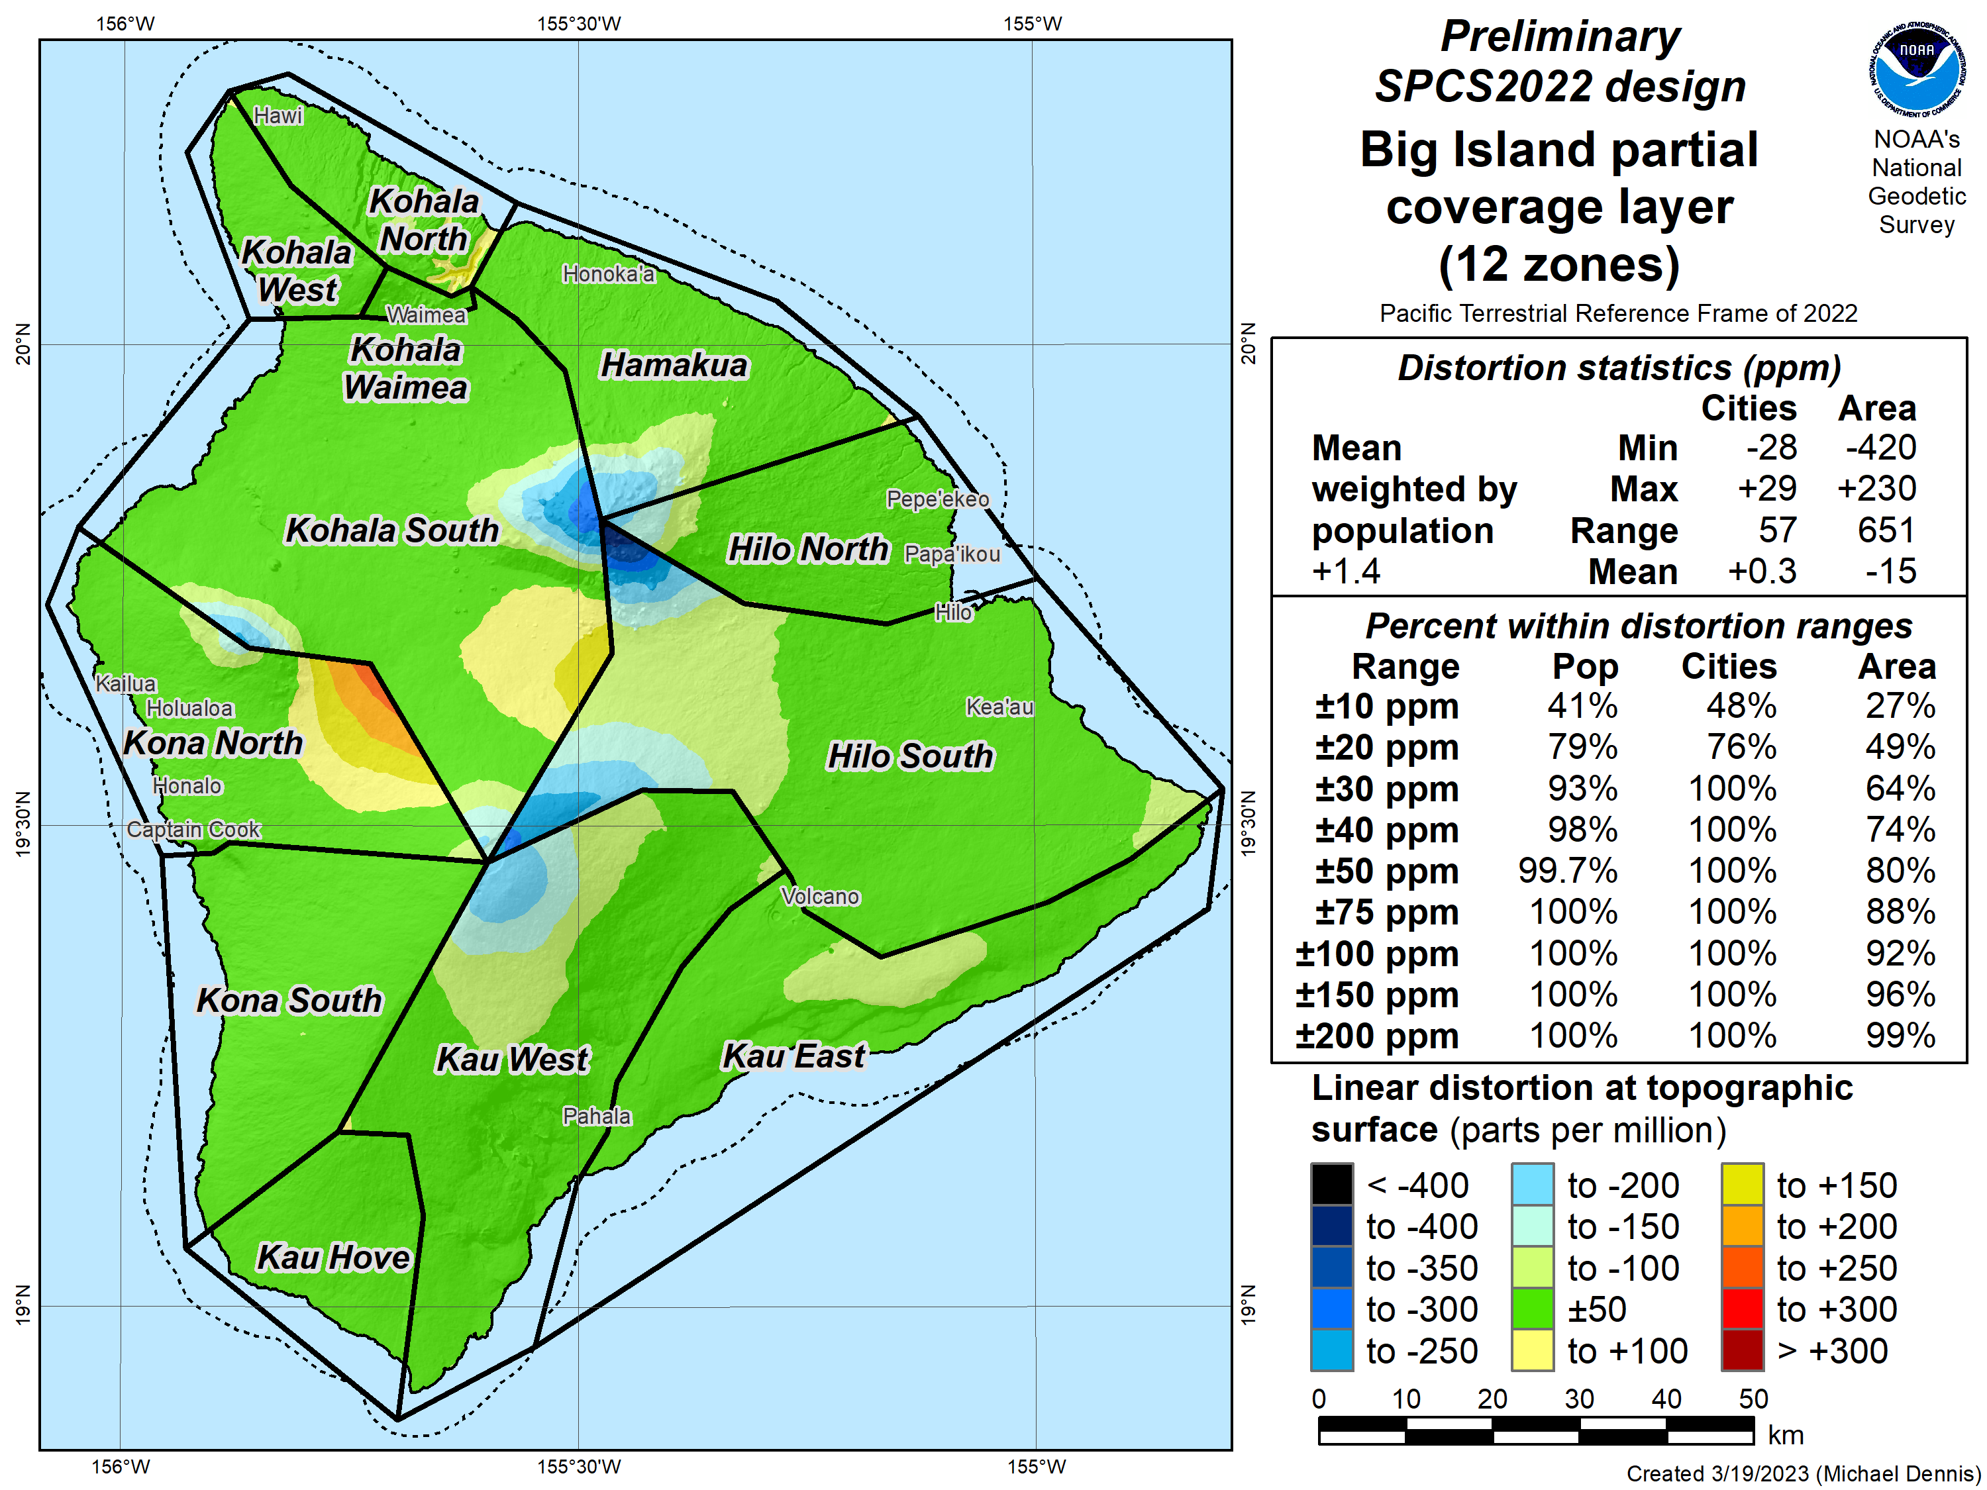
SPCS2022 linear distortion (prelim)
Distortion increment 50 ppm
Big Island (12 zones)
Percent within distortion (ppm):
Distor | Pop | Cities | Area
±20 | 79% | 76% | 49%
±50 | 99.7% | 100% | 80%
±100 | 100% | 100% | 92%
±400 | 100% | 100% | 100%
City and area statistics (ppm):
 | Min | -28 | -420
 | Max | +29 | +230
 | Range | 57 | 651
 | Mean | +0.3 | -15
Mean weighted by pop = +1.4
Distortion design
performance ±30 ppm
Statistics are for land areas only
39

Slide 40
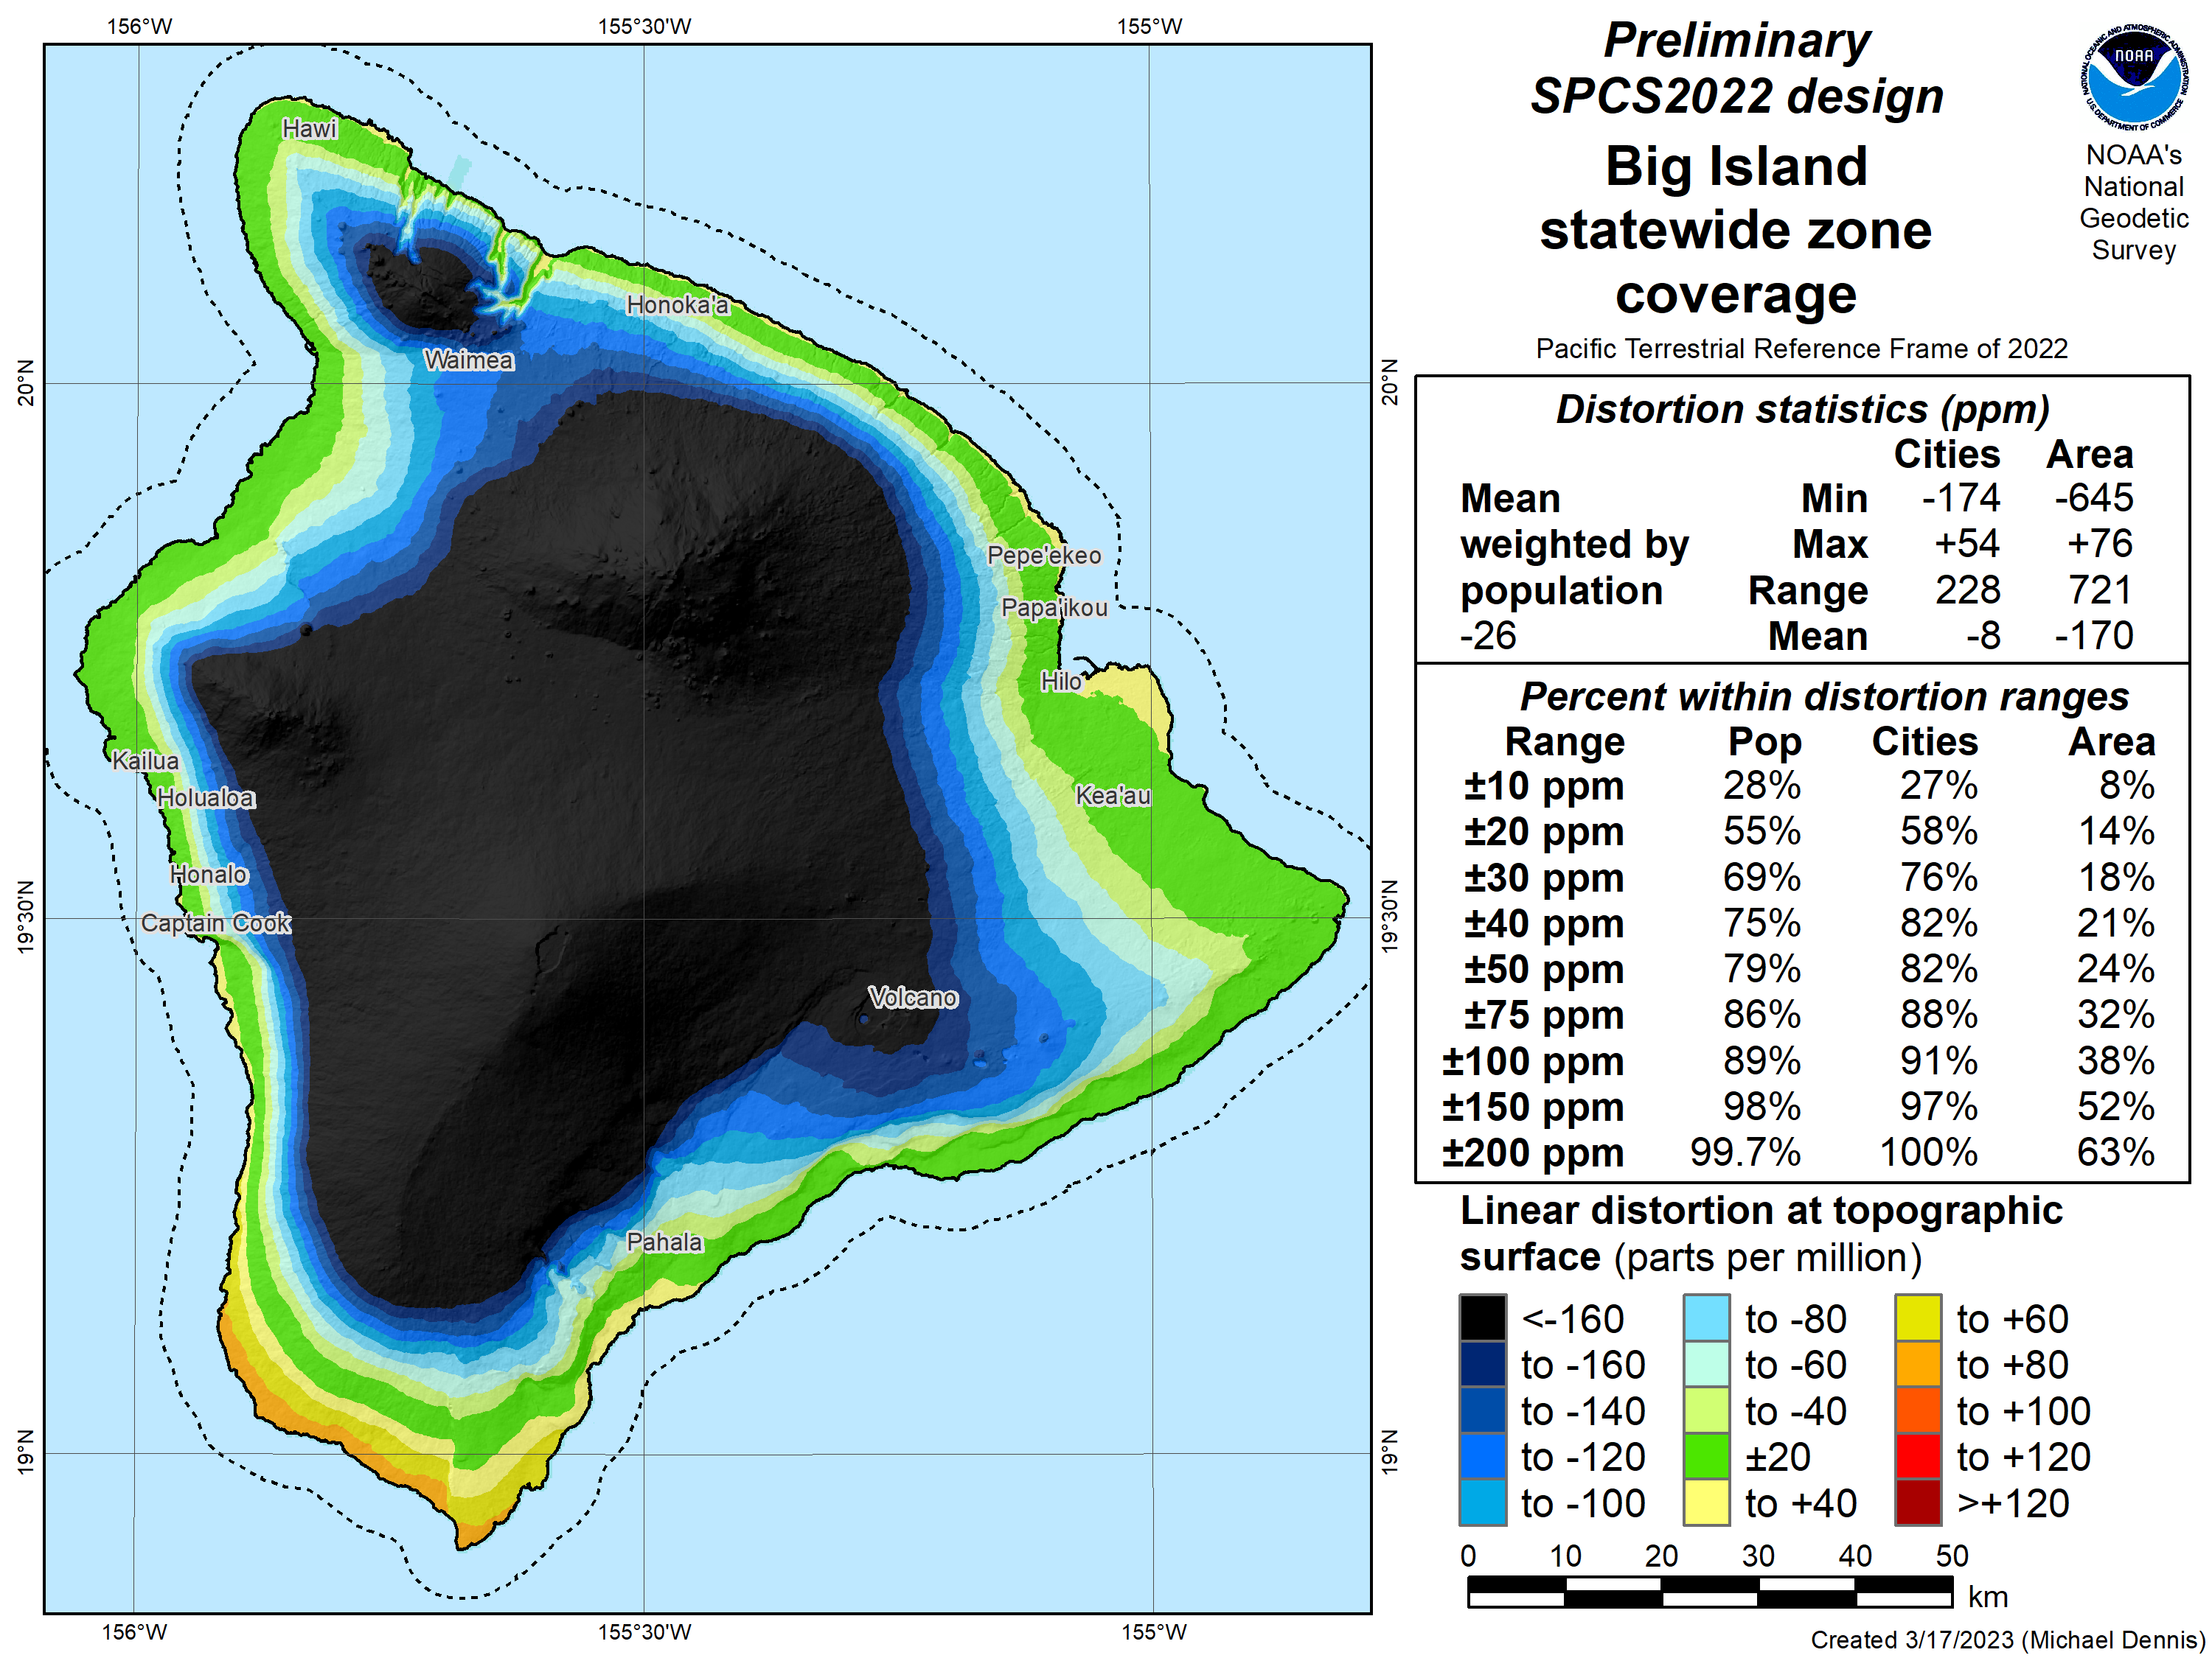
SPCS2022 linear distortion (prelim)
Distortion increment 20 ppm
Big Island (statewide)
Percent within distortion (ppm):
Distor | Pop | Cities | Area
±20 | 55% | 58% | 14%
±50 | 79% | 82% | 24%
±100 | 89% | 91% | 38%
±400 | 100% | 100% | 92%
City and area statistics (ppm):
 | Min | -174 | -645
 | Max | +54 | +76
 | Range | 228 | 721
 | Mean | -8 | -170
Mean weighted by pop = -26
Distortion design
performance ±150 ppm
Statistics are for land areas only
40

Slide 41
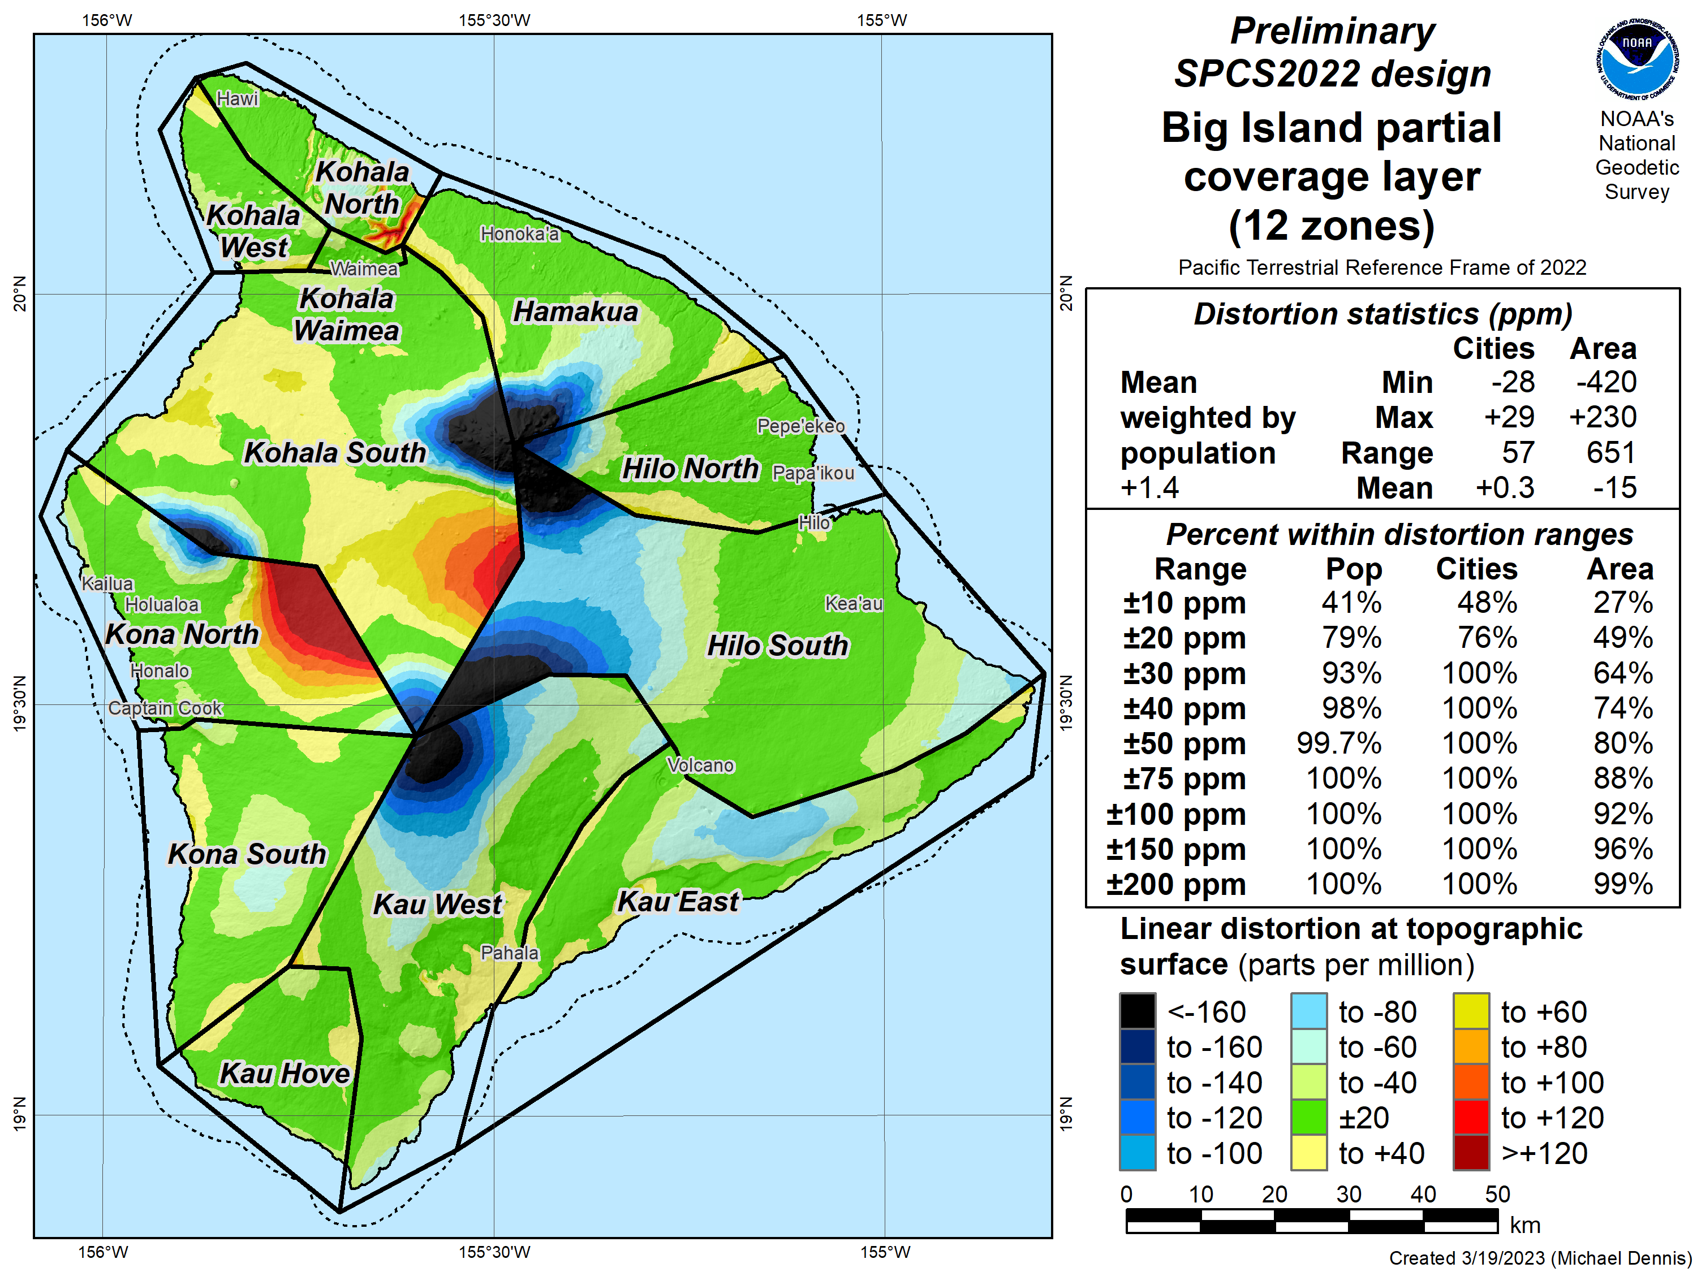
SPCS2022 linear distortion (prelim)
Distortion increment 20 ppm
Big Island (12 zones)
Percent within distortion (ppm):
Distor | Pop | Cities | Area
±20 | 79% | 76% | 49%
±50 | 99.7% | 100% | 80%
±100 | 100% | 100% | 92%
±400 | 100% | 100% | 100%
City and area statistics (ppm):
 | Min | -28 | -420
 | Max | +29 | +230
 | Range | 57 | 651
 | Mean | +0.3 | -15
Mean weighted by pop = +1.4
Distortion design
performance ±30 ppm
Statistics are for land areas only
41

Slide 42
About the timing of it all…
Timeline
Complete review of stakeholder submittals (DONE)
Early-mid 2023: Preliminary designs for stakeholder review
Mid-late 2023: Finalize all zone designs
Other things in 2023
Provide machine-readable definitions
Modify NGS algorithms (e.g., 1-parallel Lambert)
Document new projection algorithms
Release with rollout of modernized NSRS
Final definitions available by late 2023
Release with new “datums” in 2025
Rollout in
2025

Slide 43
A tale of two feet
Two versions of “foot” in current use:
“Old” U.S. survey foot (adopted 1893)
“New” international foot (adopted 1959)
‭1 ft = 1200/3937 m (0.3048006096…‬ m)
1 ft = 0.3048 m exactly
Differ by
2 parts per million (ppm) or ~0.01 ft (~1/8 inch) per mile
A real problem with real costs

Slide 44
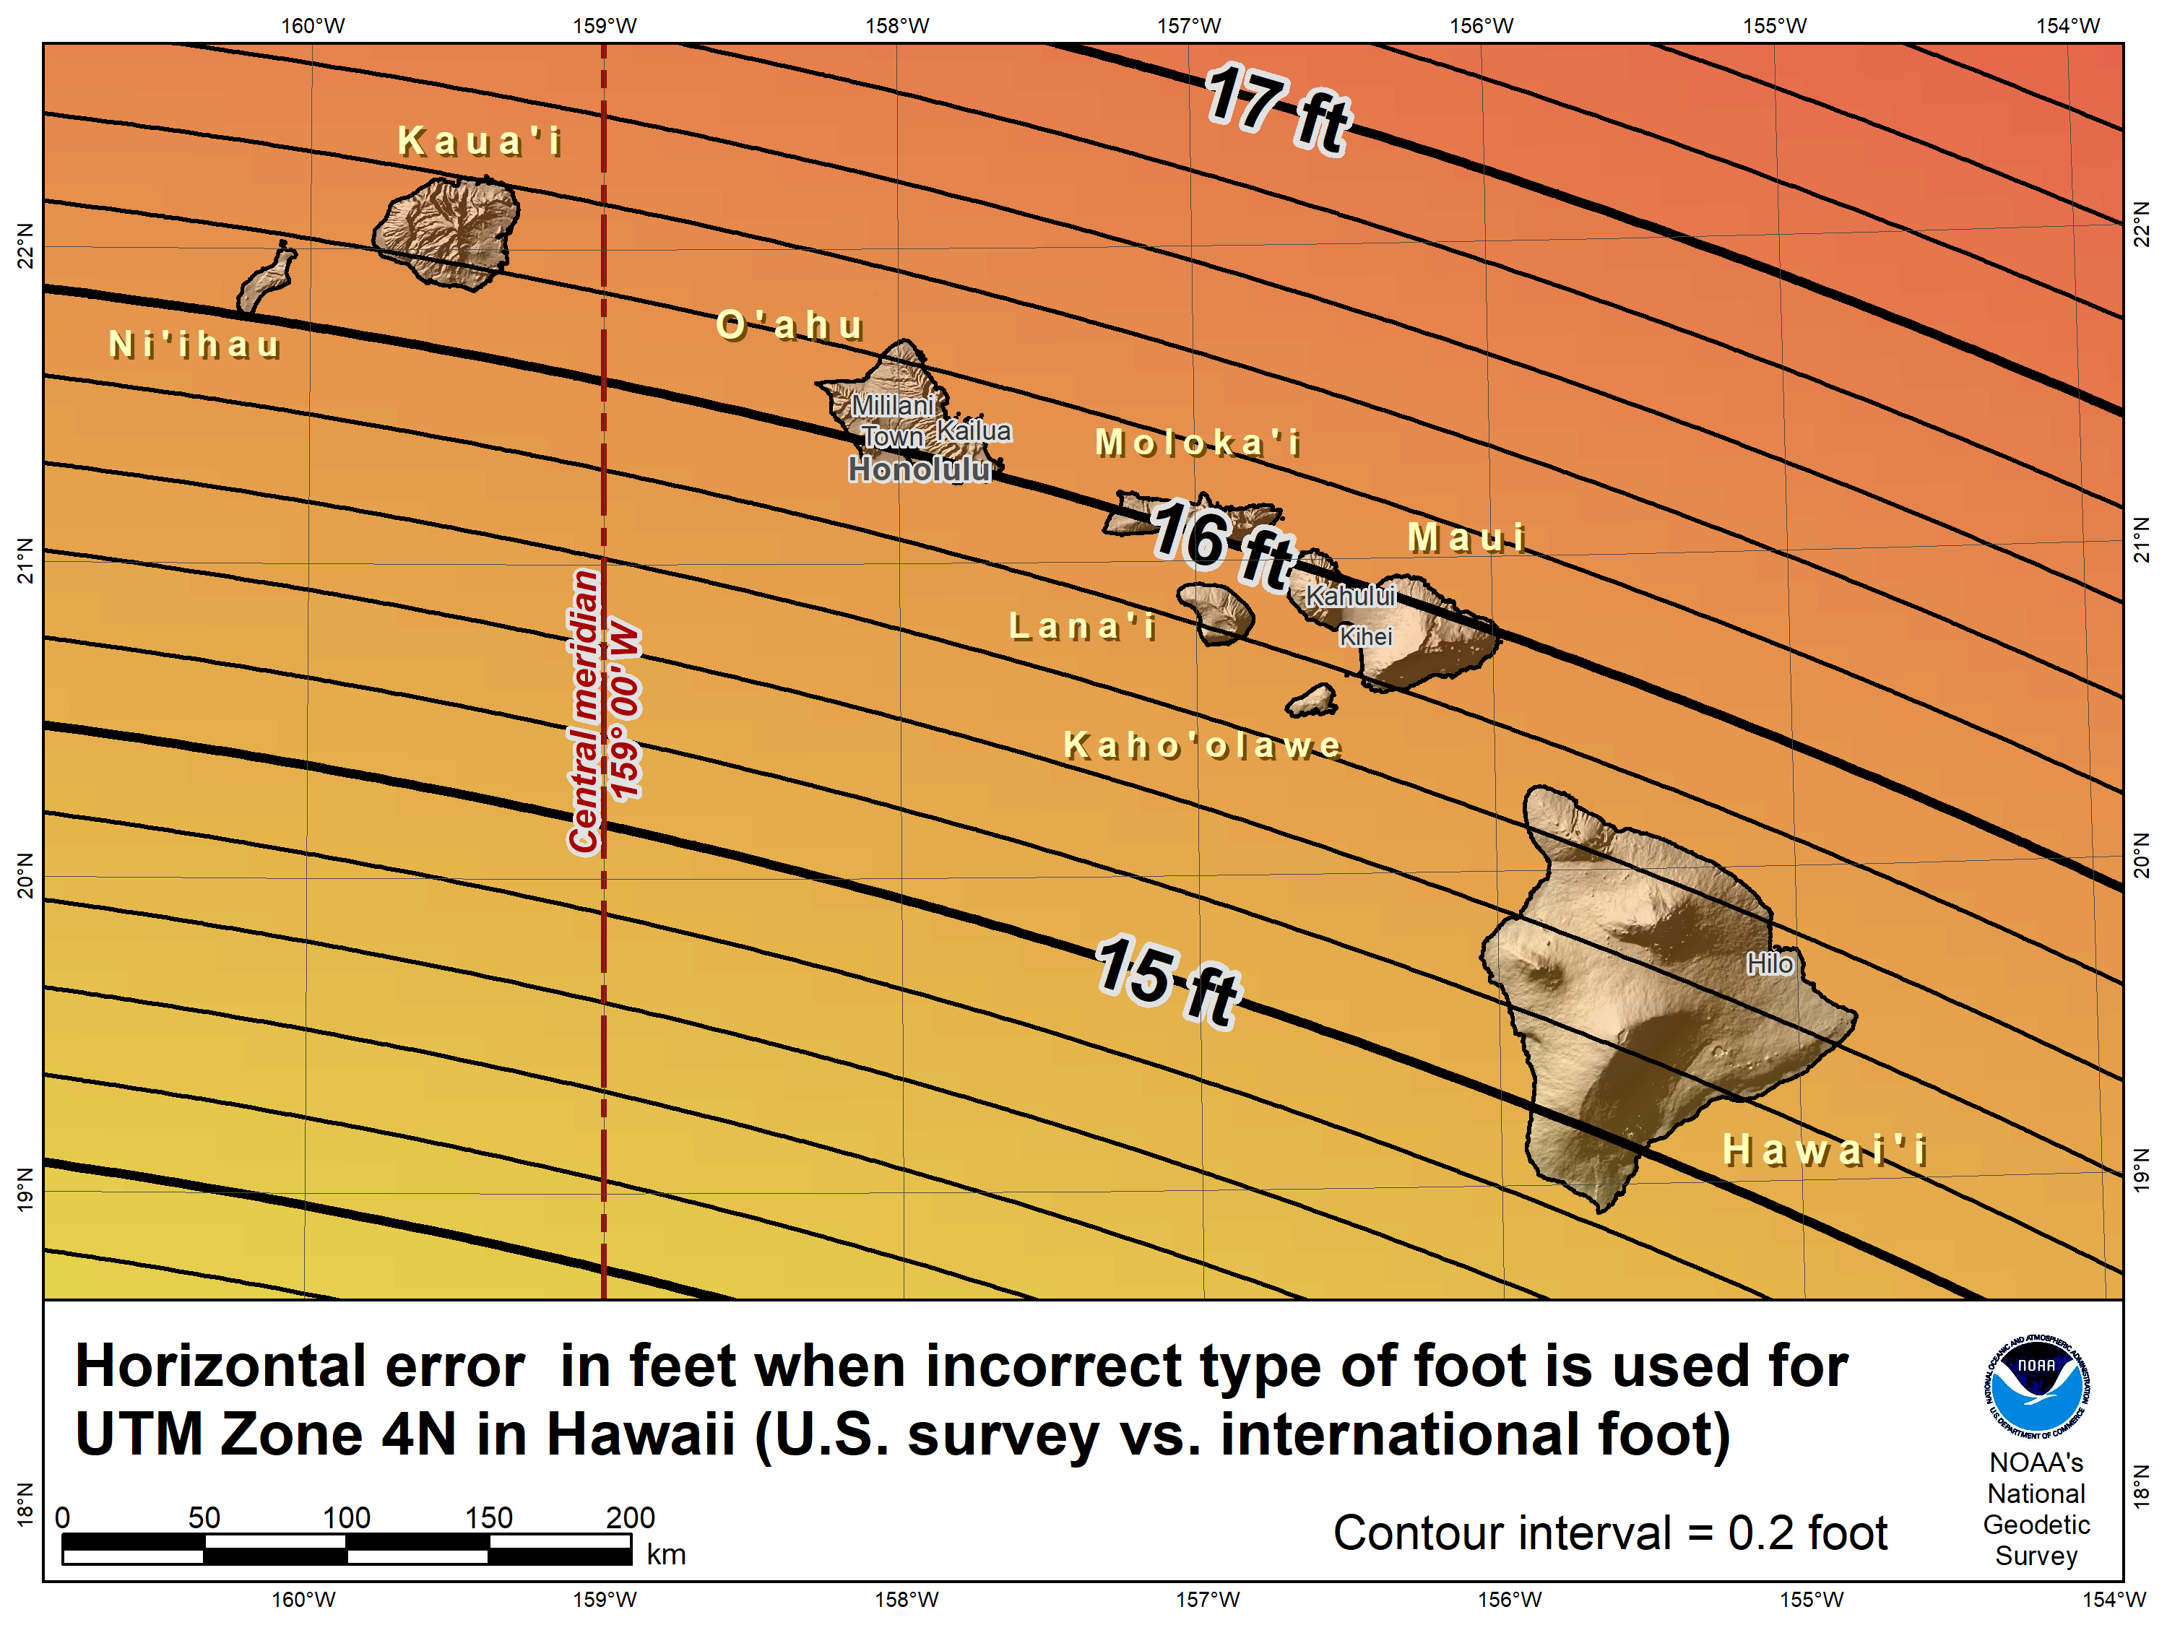

Slide 45
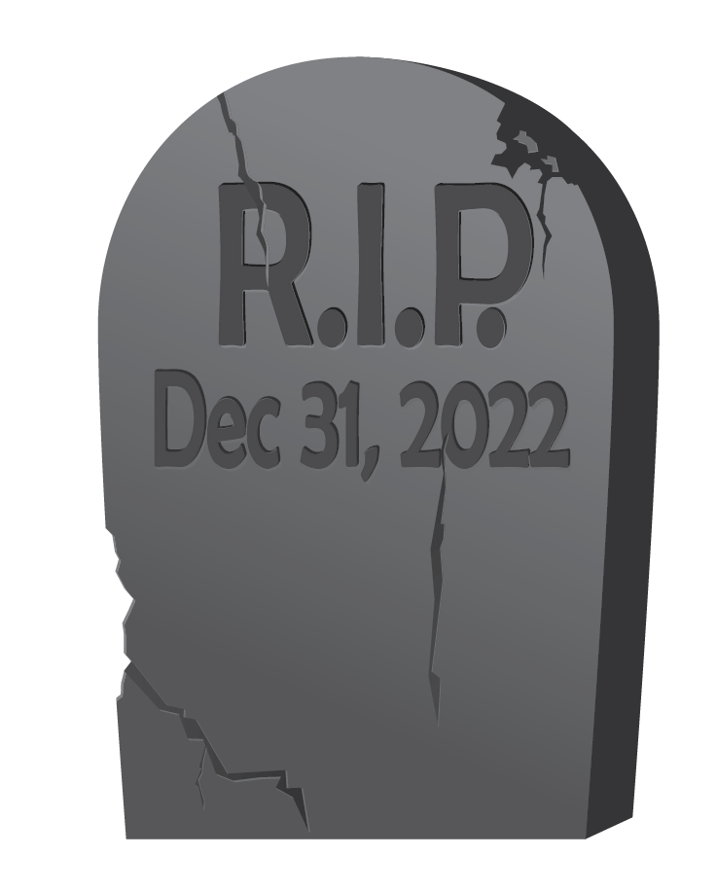
End of an era for the U.S. survey foot
U.S. survey foot has been “deprecated” (retired)
Not supported for State Plane Coordinate System of 2022 (or any part of modernized NSRS)
Only international foot will be supported by NGS
Effective December 31, 2022
But U.S. survey foot will still be supported for legacy products (e.g., existing State Plane)
However, NGS will NOT support NAD 83 after NSRS Modernization complete
NGS will always support U.S. survey foot for SPCS 83 and 27
Thank you.

Slide 46
Mahalo!
Questions? Comments?

