Slide 1


Much Ado about 2022
Collaboratively Redefining State Plane for the Future
2018 ASCE/ICEA Land Survey Conference
Scheman Building | Ames, Iowa
October 24, 2018
Michael Dennis, RLS, PE
Geodesist
michael.dennis@noaa.gov

Slide 2
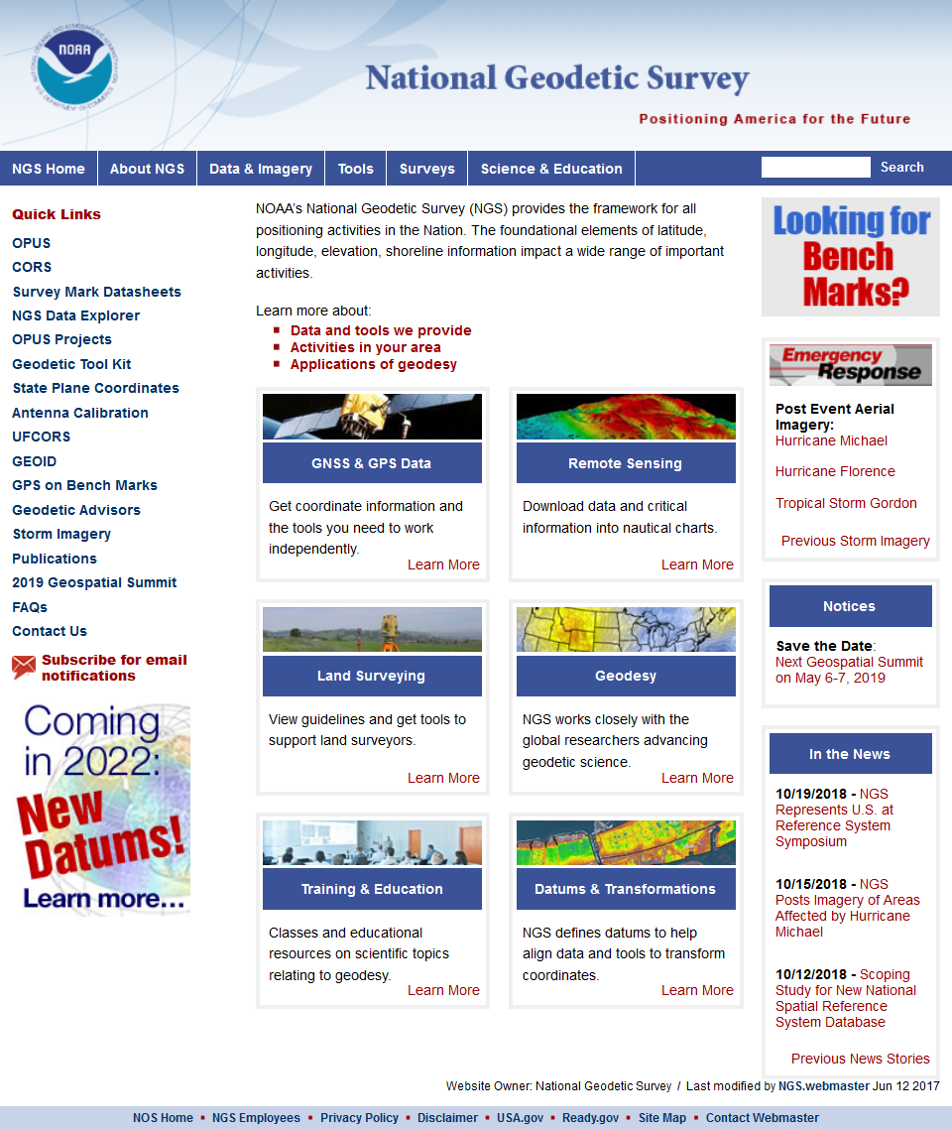

geodesy.noaa.gov

Slide 3
Latitude
Longitude
Northing (y)
Easting (x)
It’s easy! Just click this button!
Projected
Coordinates
Projected
Coordinates

Slide 4
The End
Questions?
APPLAUSE

Slide 5
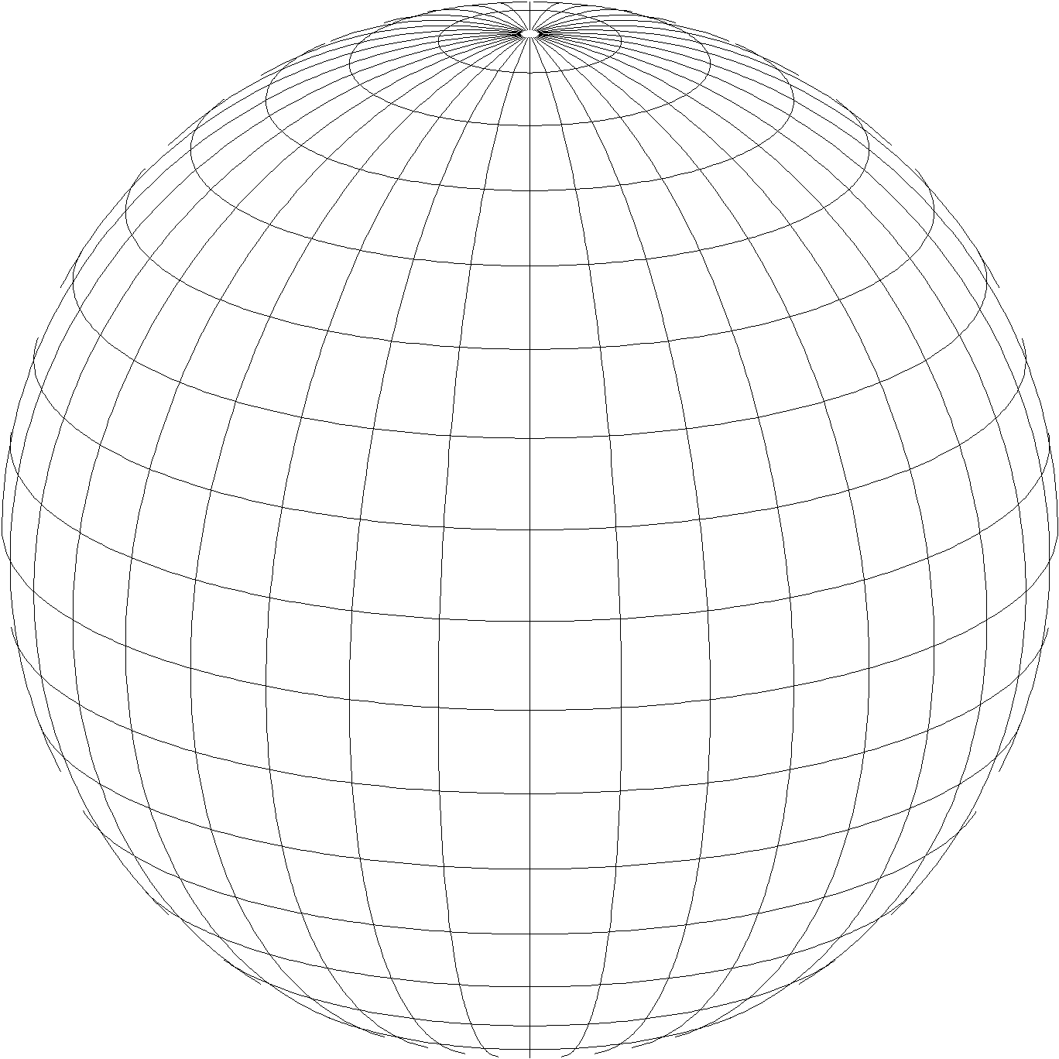
A New State Plane Coordinate System
State Plane Coordinate System of 2022 (SPCS2022)
  Referenced to 2022 Terrestrial Reference Frames (TRFs)
  Based on same reference ellipsoid as SPCS 83 (GRS 80)
  Same 3 conformal projection types as SPCS 83 and 27:
Lambert Conformal Conic (LCC)
Transverse Mercator (TM)
Oblique Mercator (OM)

Slide 6
The Plan
Background
  Recent NGS activity on SPCS2022
  A bit of SPCS history
Overview of draft SPCS2022 policy & procedures
  Cover main characteristics
  Explain concepts, give examples
Responses to the SPCS2022 Federal Register Notice
  Summarize nationwide input
  Responses & desires from Iowa (and others)
Objective is to have a dialogue about SPCS2022!

Slide 7
Recent SPCS2022 project activity
Publish State Plane history report: March 6
Webinars (available for viewing and download)
  State Plane history and future directions: March 8
  Building State Plane for the future: April 12
Launch new SPCS web pages: March 19
Publish Federal Register Notice (FRN) and draft SPCS2022 Policy & Procedures: April 18
FRN response deadline: August 31
Provide preliminary design maps: October 11
Finalizing policy & procedures: Right now!
  Goal is completion in January 2019

Slide 8
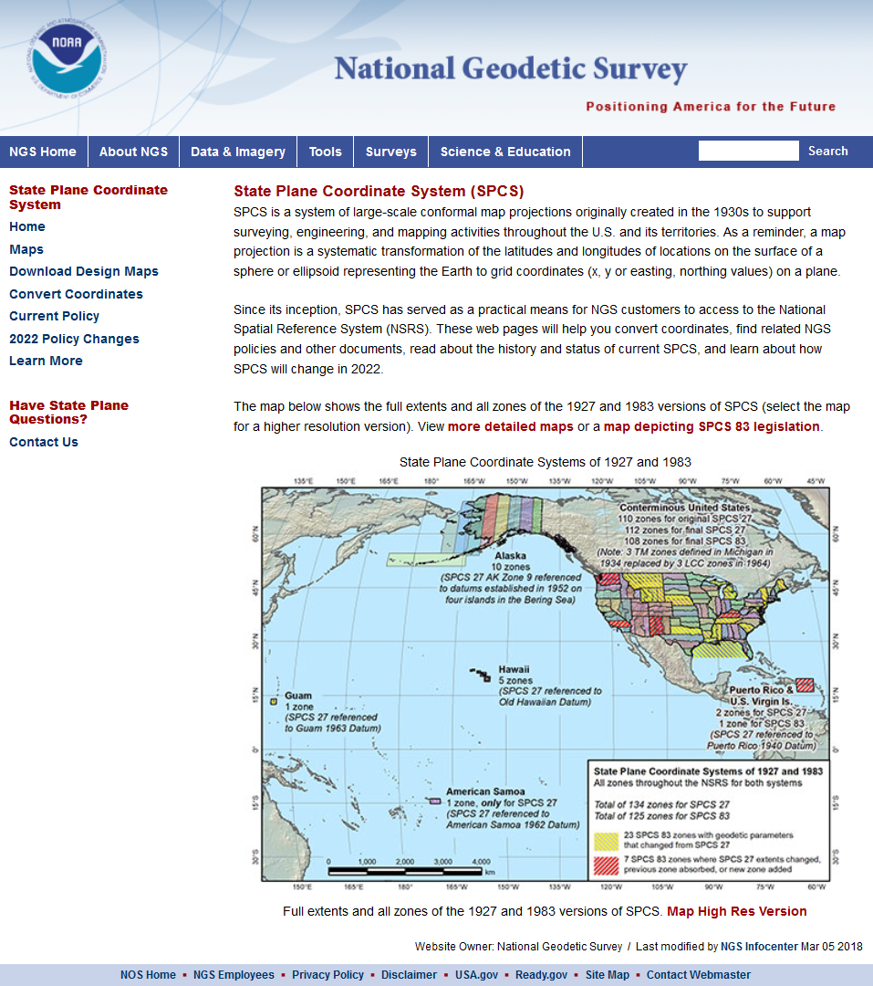
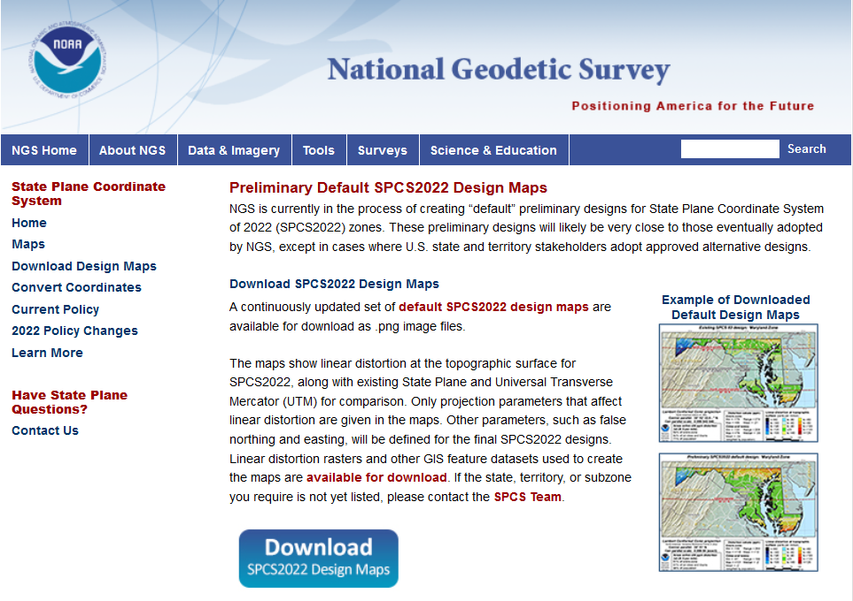
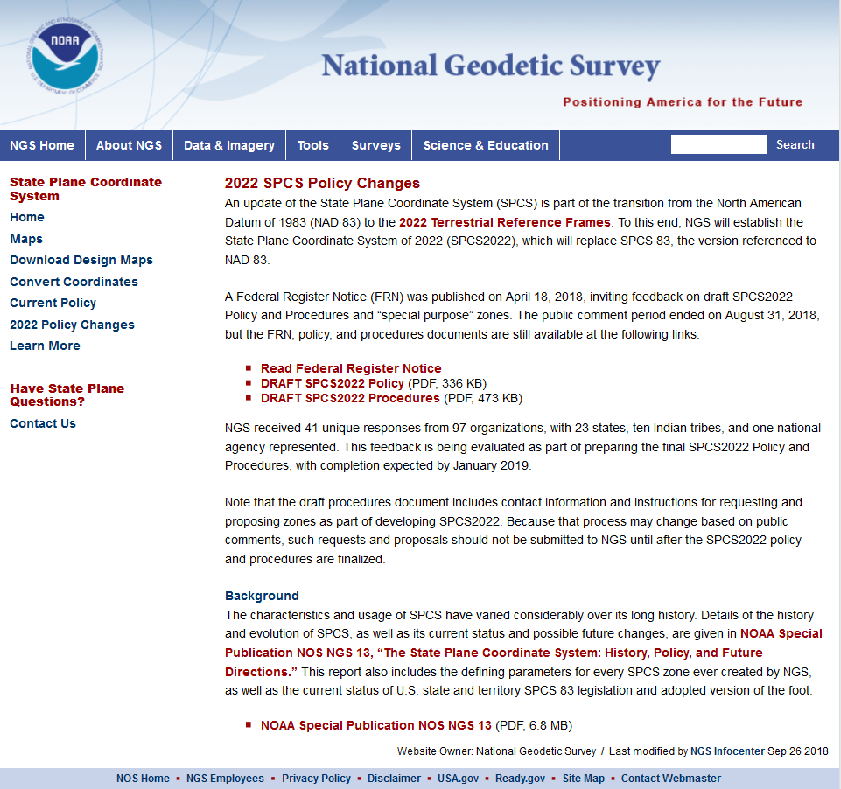
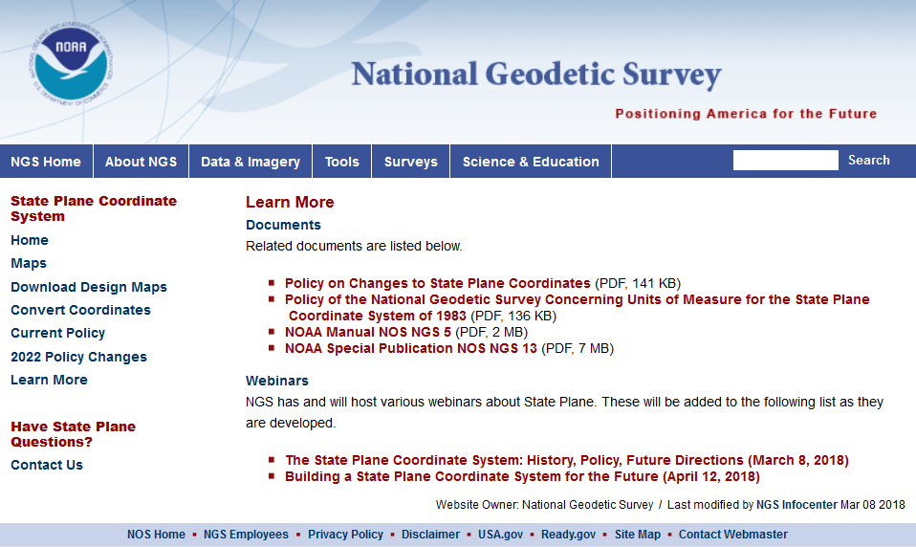
geodesy.noaa.gov/SPCS/

Slide 9
Who attended the SPCS2022 webinars?
Location | Mar 8 | Apr 12 | Location | Mar 8 | Apr 12 | Location | Mar 8 | Apr 12
Alabama | 7 | 8 | Maryland | 25 | 20 | Rhode Island | 0 | 1
Alaska | 26 | 20 | Massachusetts | 1 | 1 | South Carolina | 7 | 6
Arizona | 48 | 42 | Michigan | 34 | 57 | South Dakota | 7 | 4
Arkansas | 1 | 1 | Minnesota | 124 | 34 | Tennessee | 1 | 1
California | 35 | 30 | Mississippi | 8 | 6 | Texas | 20 | 16
Colorado | 17 | 25 | Missouri | 7 | 11 | Utah | 2 | 9
Connecticut | 4 | 11 | Montana | 16 | 13 | Vermont | 0 | 3
Delaware | 1 | 2 | Nebraska | 16 | 11 | Virginia | 8 | 5
Florida | 52 | 44 | Nevada | 5 | 1 | Washington | 12 | 16
Georgia | 8 | 3 | New Hampshire | 1 | 1 | West Virginia | 1 | 0
Hawaii | 5 | 6 | New Jersey | 4 | 1 | Wisconsin | 9 | 27
Idaho | 12 | 11 | New Mexico | 12 | 7 | Wyoming | 3 | 2
Illinois | 15 | 12 | New York | 4 | 5 | American Samoa | 0 | 0
Indiana | 4 | 7 | North Carolina | 10 | 8 | District of Columbia | 2 | 1
Iowa | 6 | 7 | North Dakota | 33 | 13 | Guam and CNMI | 0 | 0
Kansas | 5 | 3 | Ohio | 31 | 24 | Puerto Rico | 2 | 3
Kentucky | 5 | 5 | Oklahoma | 3 | 1 | U.S. Virgin Islands | 0 | 1
Louisiana | 13 | 10 | Oregon | 53 | 23 | International | 8 | 13
Maine | 1 | 1 | Pennsylvania | 23 | 18 | Unknown location | 45 | 26

Slide 10
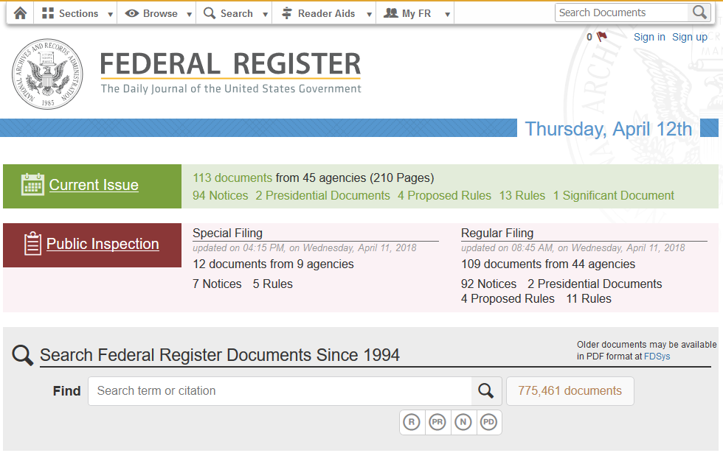
Federal Register Notice
https://www.federalregister.gov/
Announced draft SPCS2022 Policy and Procedures
Also asked for input on “special purpose” zones
Public comment period ended Aug 31, 2018

Slide 11
History and Future of State Plane
SPCS created 85 years ago
  SPCS 27: 1933 – 1986 (53 years, with some changes)
  SPCS 83: 1986 – 2022 (36 years, with some changes)
  SPCS2022: 2022 – ? (at least a few decades…)
SPCS2022 will likely be around for a long time
  Honor the history and legacy of SPCS…
  …while building a system for the future

Slide 12
SPCS Special Publication
History of NGS projections (1853 to present)
SPCS policies and legislation
Departures from policy and convention
Recent developments in projected coordinate systems
Appendices
  Defining parameters for ALL zones of ALL versions of SPCS, plus additional information
  Status of SPCS 83 legislation and foot conversions

Slide 13
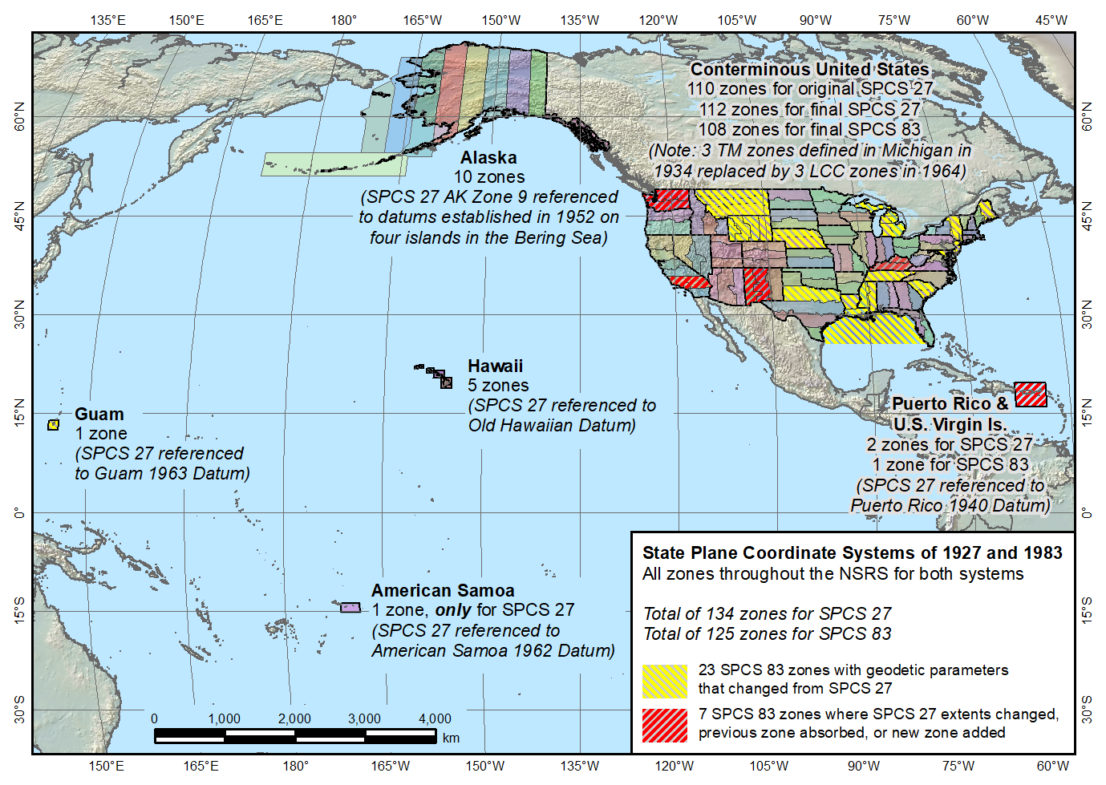
State Plane Coordinate Systems of 1927 (134 zones) and 1983 (125 zones)
Guam SPCS 83 zone added in 1995
Guam SPCS 27 zone a non-conformal projection
Two zones in SPCS 27, one in SPCS 83
American Samoa only in SPCS 27, not SPCS 83

Slide 14
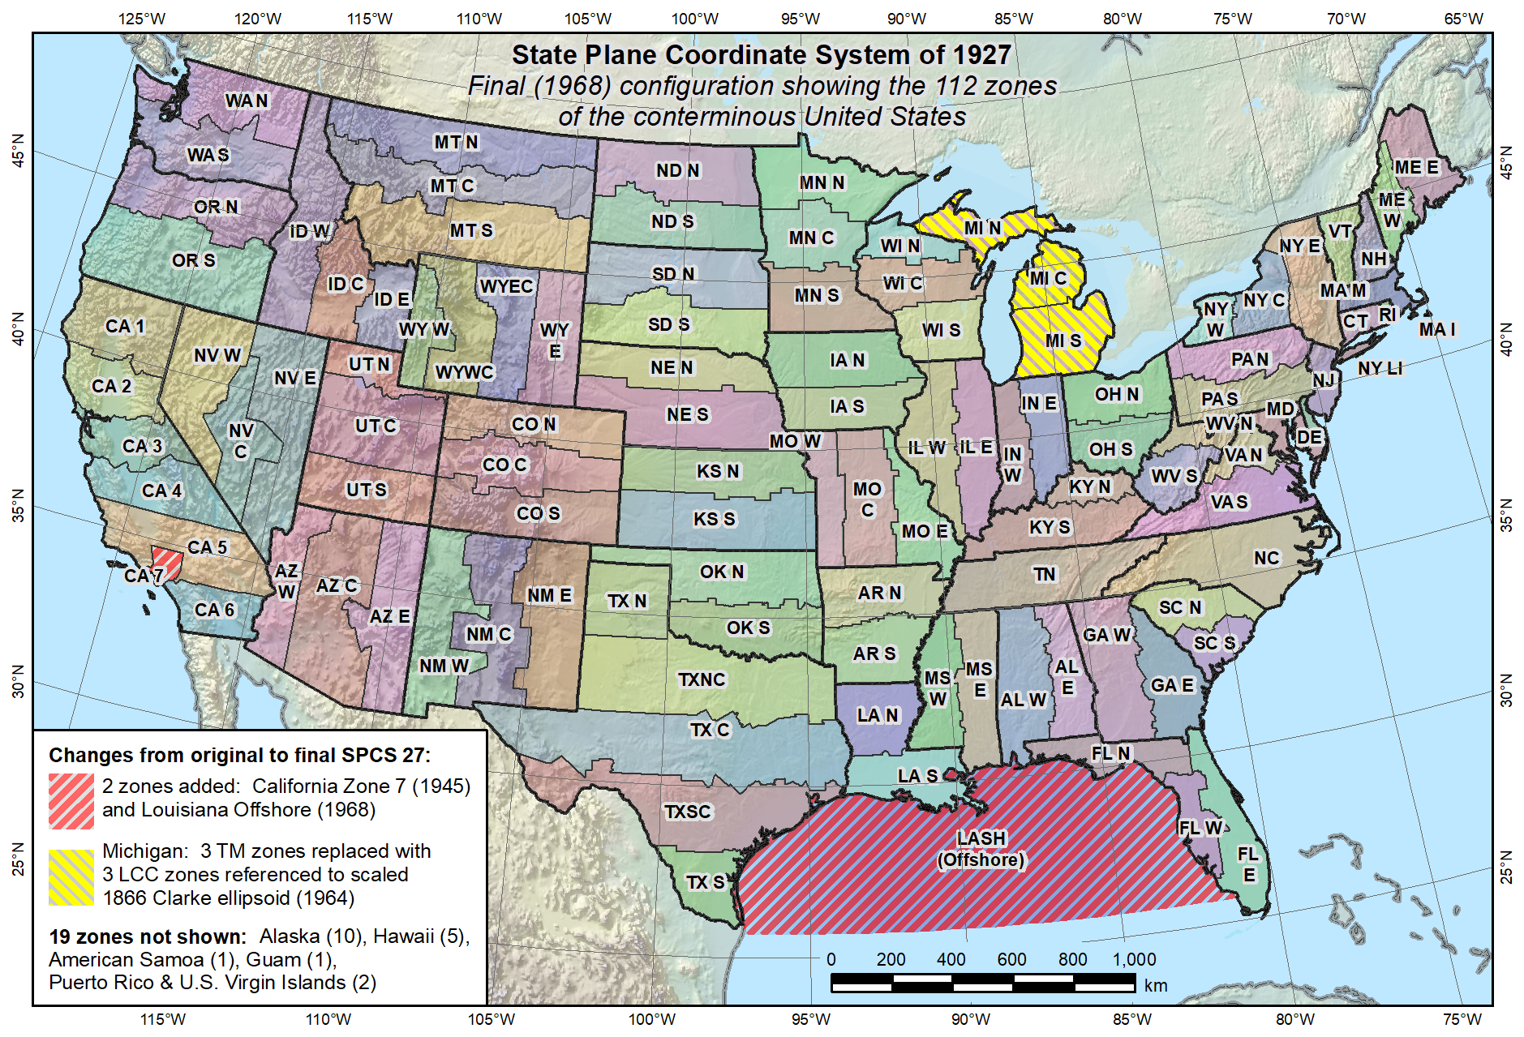
Final SPCS 27, as of 1968 (112 zones in CONUS, 131 zones total)
Reduced distortion zones added: CA 7 (1945)
MI (1964)

Slide 15
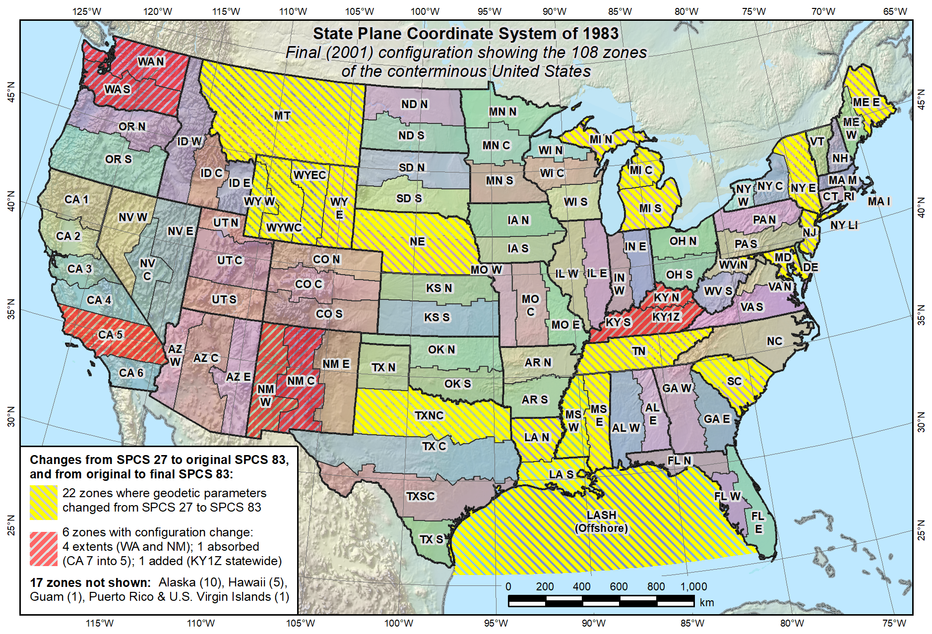
Final SPCS 83, as of 2001 (108 zones in CONUS, 125 zones total)
KY statewide zone added in 2001

Slide 16
Draft SPCS2022 Policy & Procedures
Policy (7 pages): 4 main sections
  General policy
  Technical characteristics and requirements
  Zones and consistency with statute
  Default SPCS2022 definitions
Procedures (15 pages): 5 main sections
  NGS contact information, criteria for stakeholder input, deadlines
  Requirements for stakeholder requests and proposals of designs
  Requirements for submittal of designs by contributing partners
  NGS role and responsibilities for SPCS2022 reviews and designs
  Technical specifications for SPCS2022 design and implementation
Both:
  Background and definitions
  Embedded “remarks” (blue italicized text) to aid in review

Slide 17
Why are the documents so long?
SPCS2022 is fairly complex and requires detail
  Tried to keep draft versions as short as possible
  Later versions will be shorter
After public comment period (ended August 31, 2018):
  “Remarks” removed from final approved version
  Stakeholder requirement lists moved to online forms
  Technical specifications moved to design manual
By official release of SPCS2022 (sometime in 2022):
  Deadlines for requests, proposals, submittals removed
  Default SPCS2022 design approach removed
Final versions will be < half current length

Slide 18
Definitions in Policy & Procedures
Stakeholders. State organizations that can give input on SPCS2022: DOTs, GIS offices, surveying & engineering societies, professional geospatial organizations, and universities that perform geospatial education or research.
Contributing partners. Organizations or individuals that design SPCS2022 zones for stakeholders and in cooperation with NGS.
Zone. The region where a projected coordinate system is used.
Linear distortion. Amount a map projection distance differs from “true” horizontal distance at the ground surface.
Conformal map projection. Linear distortion is unique (same in every direction) at a point.
Projection axis. The line along which linear distortion is minimum and constant with respect to the reference ellipsoid.

Slide 19
Overview: Policy, Procedures, and FRN
Linear distortion at topographic surface
One-parallel Lambert Conformal Conic projections
Default SPCS2022 zone designs
Statewide and “layered” zones
Linear distortion design criteria
  Maximum and minimum zone size and distortion
  Low distortion projections (LDPs)
“Special purpose” zones (in FRN only)
Linear units
Submittal process and deadlines
  For Federal Register Notice comments
  For requests, proposals, and submittal of designs

Slide 20
Linear distortion at topo surface
Policy§II.C and Procedures§5.c.
Distortion for design evaluated at topo surface
  Minimize range and mean distortion in zone
  Account for cities with distortion weighted by population
Design not evaluated at the ellipsoid surface
  Nobody lives or works on the ellipsoid
  Likely used in past because it is easier
Projection scaled to topo surface (“ground”)
  Reduces difference between “grid” and “ground”
  Topographic ellipsoid height not part of definition

Slide 21
Linear distortion with respect to ellipsoid
Projection
axis
Ellipsoid surface
Ellipsoid distance
Projection surface (secant)
Grid distance > ellipsoid distance
This design approach
used for SPCS 27 and 83 (minimizes distortion with respect to ellipsoid)
Ellipsoid distance
Grid distance <
ellipsoid distance

Slide 22
Linear distortion with respect to topographic surface
Horizontal ground distance
> ellipsoid distance
and
> grid distance
Topographic surface
Projection
axis
Ellipsoid surface
Ellipsoid distance
Projection surface (secant)
Grid distance
> ellipsoid distance
< ground distance
This design approach
used for SPCS 27 and 83 (minimizes distortion with respect to ellipsoid)
Ellipsoid distance
Grid distance
< ellipsoid distance
< ground distance

Slide 23
Linear distortion with respect to topographic surface
Horizontal ground distance
> ellipsoid distance
and
> grid distance
Topographic surface
Projection
axis
Ellipsoid surface
Ellipsoid distance
Grid distance
> ellipsoid distance
≈ ground distance
Projection surface (non-intersecting)
This design approach
will be used for SPCS2022 (minimizes distortion with respect to topography)

Slide 24
Linear distortion magnitudes ppm = parts per million (mm/km)
±20 ppm = 2 cm/km = 0.1 ft/mile = 1 : 50,000
  Often used as “low distortion” design criterion (at ground)
±50 ppm = 5 cm/km = 0.3 ft/mile = 1 : 20,000
  Minimum design criterion for SPCS2022 designs by NGS (at ground)
±100 ppm = 10 cm/km = 0.5 ft/mile = 1 : 10,000
  “Nominal” maximum State Plane value (on ellipsoid)
  Can be much greater at topo surface
±400 ppm = 40 cm/km = 2.1 ft/mile = 1 : 2,500
  Maximum design criterion for SPCS2022 zones (at ground)
  Maximum UTM value (on ellipsoid)
Nominal distortion criterion (on ellipsoid) for SPCS 27 and 83 zones (although greatly exceeded for some zones in SPCS 83).

Slide 25
Linear distortion magnitudes ppm = parts per million (mm/km)
±20 ppm = 2 cm/km = 0.1 ft/mile = 1 : 50,000
  Often used as “low distortion” design criterion (at ground)
±50 ppm = 5 cm/km = 0.3 ft/mile = 1 : 20,000
  Minimum design criterion for SPCS2022 designs by NGS (at ground)
±100 ppm = 10 cm/km = 0.5 ft/mile = 1 : 10,000
  “Nominal” maximum State Plane value (on ellipsoid)
  Can be much greater at topo surface
±400 ppm = 40 cm/km = 2.1 ft/mile = 1 : 2,500
  Maximum design criterion for SPCS2022 zones (at ground)
  Maximum UTM value (on ellipsoid)
Distortion range (at ground) for zones designed by NGS, as proposed in draft SPCS2022 policy and procedures.

Slide 26
Linear distortion magnitudes ppm = parts per million (mm/km)
±20 ppm = 2 cm/km = 0.1 ft/mile = 1 : 50,000
  Often used as “low distortion” design criterion (at ground)
±50 ppm = 5 cm/km = 0.3 ft/mile = 1 : 20,000
  Minimum design criterion for SPCS2022 designs by NGS (at ground)
±100 ppm = 10 cm/km = 0.5 ft/mile = 1 : 10,000
  “Nominal” maximum State Plane value (on ellipsoid)
  Can be much greater at topo surface
±400 ppm = 40 cm/km = 2.1 ft/mile = 1 : 2,500
  Maximum design criterion for SPCS2022 zones (at ground)
  Maximum UTM value (on ellipsoid)
Distortion criterion (at ground) often used for “low distortion projection” (LDPs); designed by others for SPCS2022 (not by NGS)

Slide 27
Overview: Policy, Procedures, and FRN
Linear distortion at topographic surface
One-parallel Lambert Conformal Conic projections
Default SPCS2022 zone designs
Statewide and “layered” zones
Linear distortion design criteria
  Maximum and minimum zone size and distortion
  Low distortion projections (LDPs)
“Special purpose” zones (in FRN only)
Linear units
Submittal process and deadlines
  For Federal Register Notice comments
  For requests, proposals, and submittal of designs

Slide 28
Why only a 1-parallel LCC?
Policy§II.A.1-2 and Procedures§5.a.i.
Consistency
  Explicitly define projection scale (same as TM and OM)
  Can use same number of parameters as TM
  Applicable to both “secant” and “non-intersecting” cases
Simplicity
  Easier to design with respect to topography
  Scale due to separation of 2 standard parallels not obvious
  Can more readily use “clean” values for parallels
Mathematically identical to 2-parallel
  Any 2-parallel LCC can be recast as 1-parallel that behaves exactly the same

Slide 29
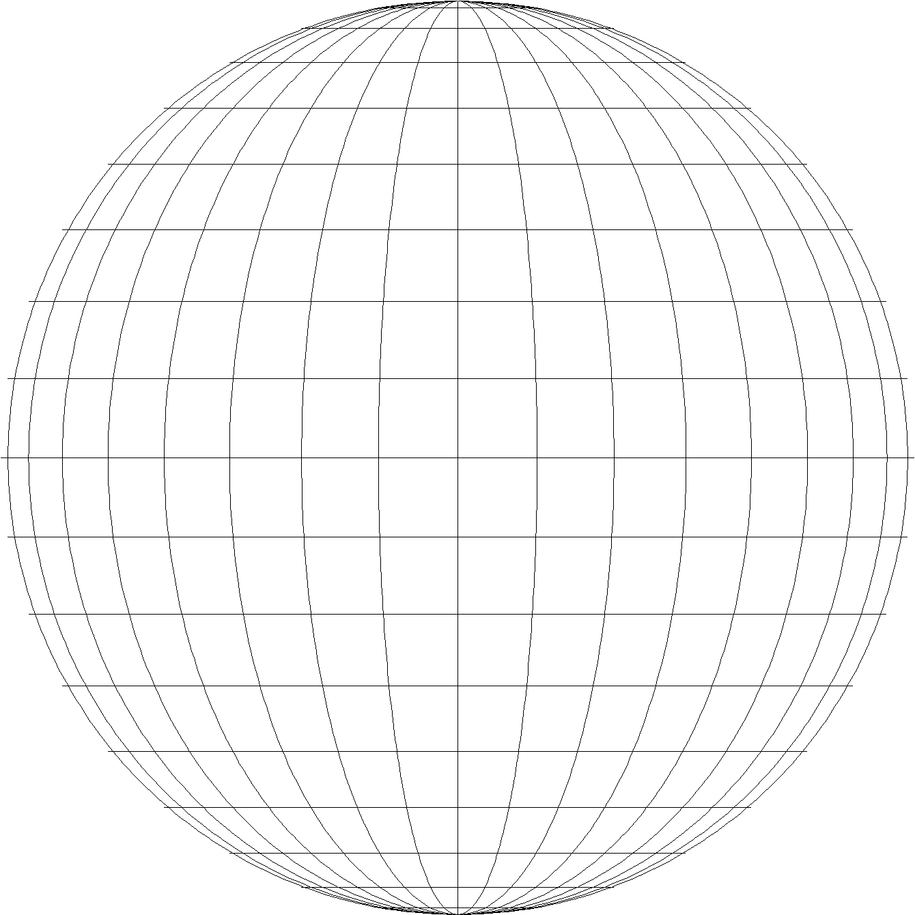
Consider Iowa North SPCS 83 Zone
Secant Lambert Conformal Conic projection, 2-parallel definition:
Standard parallels
North = 43°16’N (exact)
South = 42°04’N (exact)
It is EXACTLY the same as this 1-parallel definition:
Central standard parallel
42°40’03.52543.…”N
Scale = 0.9999 45368…
Ellipsoid
Scale = 1
North standard parallel
Scale =
0.9999 45368…
Central “standard” parallel
(1:18,304)
(projection axis)
Scale = 1
South standard parallel
An LCC projection is defined by its projection axis, which is ALWAYS the central standard parallel

Slide 30
Overview: Policy, Procedures, and FRN
Linear distortion at topographic surface
One-parallel Lambert Conformal Conic projections
Default SPCS2022 zone designs
Statewide and “layered” zones
Linear distortion design criteria
  Maximum and minimum zone size and distortion
  Low distortion projections (LDPs)
“Special purpose” zones (in FRN only)
Linear units
Submittal process and deadlines
  For Federal Register Notice comments
  For requests, proposals, and submittal of designs

Slide 31
Default SPCS2022 designs
Policy§IV and Procedures§5.g.
For complete system even with no stakeholder input
  To ensure coverage of all states and U.S. territories
Nearly same as SPCS 83 but with some modifications
  Almost all zone projection types and extents the same
  Modified to align with SPCS2022 policy and procedures
  Small number of zones may change projection type, extents
Modifications to align with SPCS2022 policy:
  Scale redefined with respect to topographic surface
  One-parallel Lambert and local Oblique Mercator

Slide 32
Examples of combined characteristics
Characteristics for default design examples:
  Designs are “SPCS 83-like”
  But minimize linear distortion at “ground”
    Minimize distortion range and mean for entire zone
    Also mean distortion of cities (weighted by population)
  Define LCC projections with 1 standard parallel
Example default zones:
  Arizona Central Zone (Transverse Mercator)
  Colorado South Zone (Lambert Conformal Conic)

Slide 33
“Non-intersecting” conformal map projection
Topographic surface
Grid distance = ground distance at a point
Projection
axis
Grid distance = ground distance at a point
Non-intersecting
Grid distance ≈ ground distance over finite distance
Purpose is to reduce linear distortion at “ground” (topographic surface).
But distortion can vary considerably across area of interest.
Ellipsoid surface

Slide 34
“Non-intersecting” conformal map projection
Topographic surface
Projection
axis
Non-intersecting
Ellipsoid surface

Slide 35
Changing projection axis to reduce distortion variation
Topographic surface
Grid distance = ground distance at many points
Projection
axis
Ellipsoid height of surface not constant:
h₁ ≠ h₂
h₂
Non-intersecting
h₁
Only way to reduce variation in distortion is to change projection axis location.
IMPORTANT: For large areas, there is no single defining ellipsoid height, h, for scaling the projection.
Ellipsoid surface

Slide 36
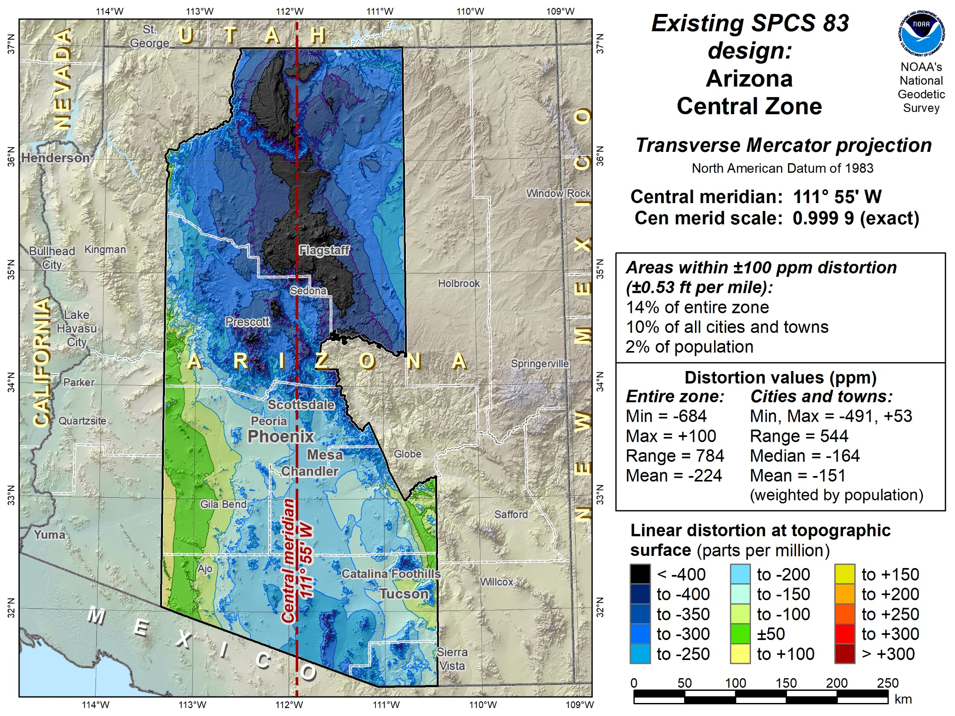

Slide 37
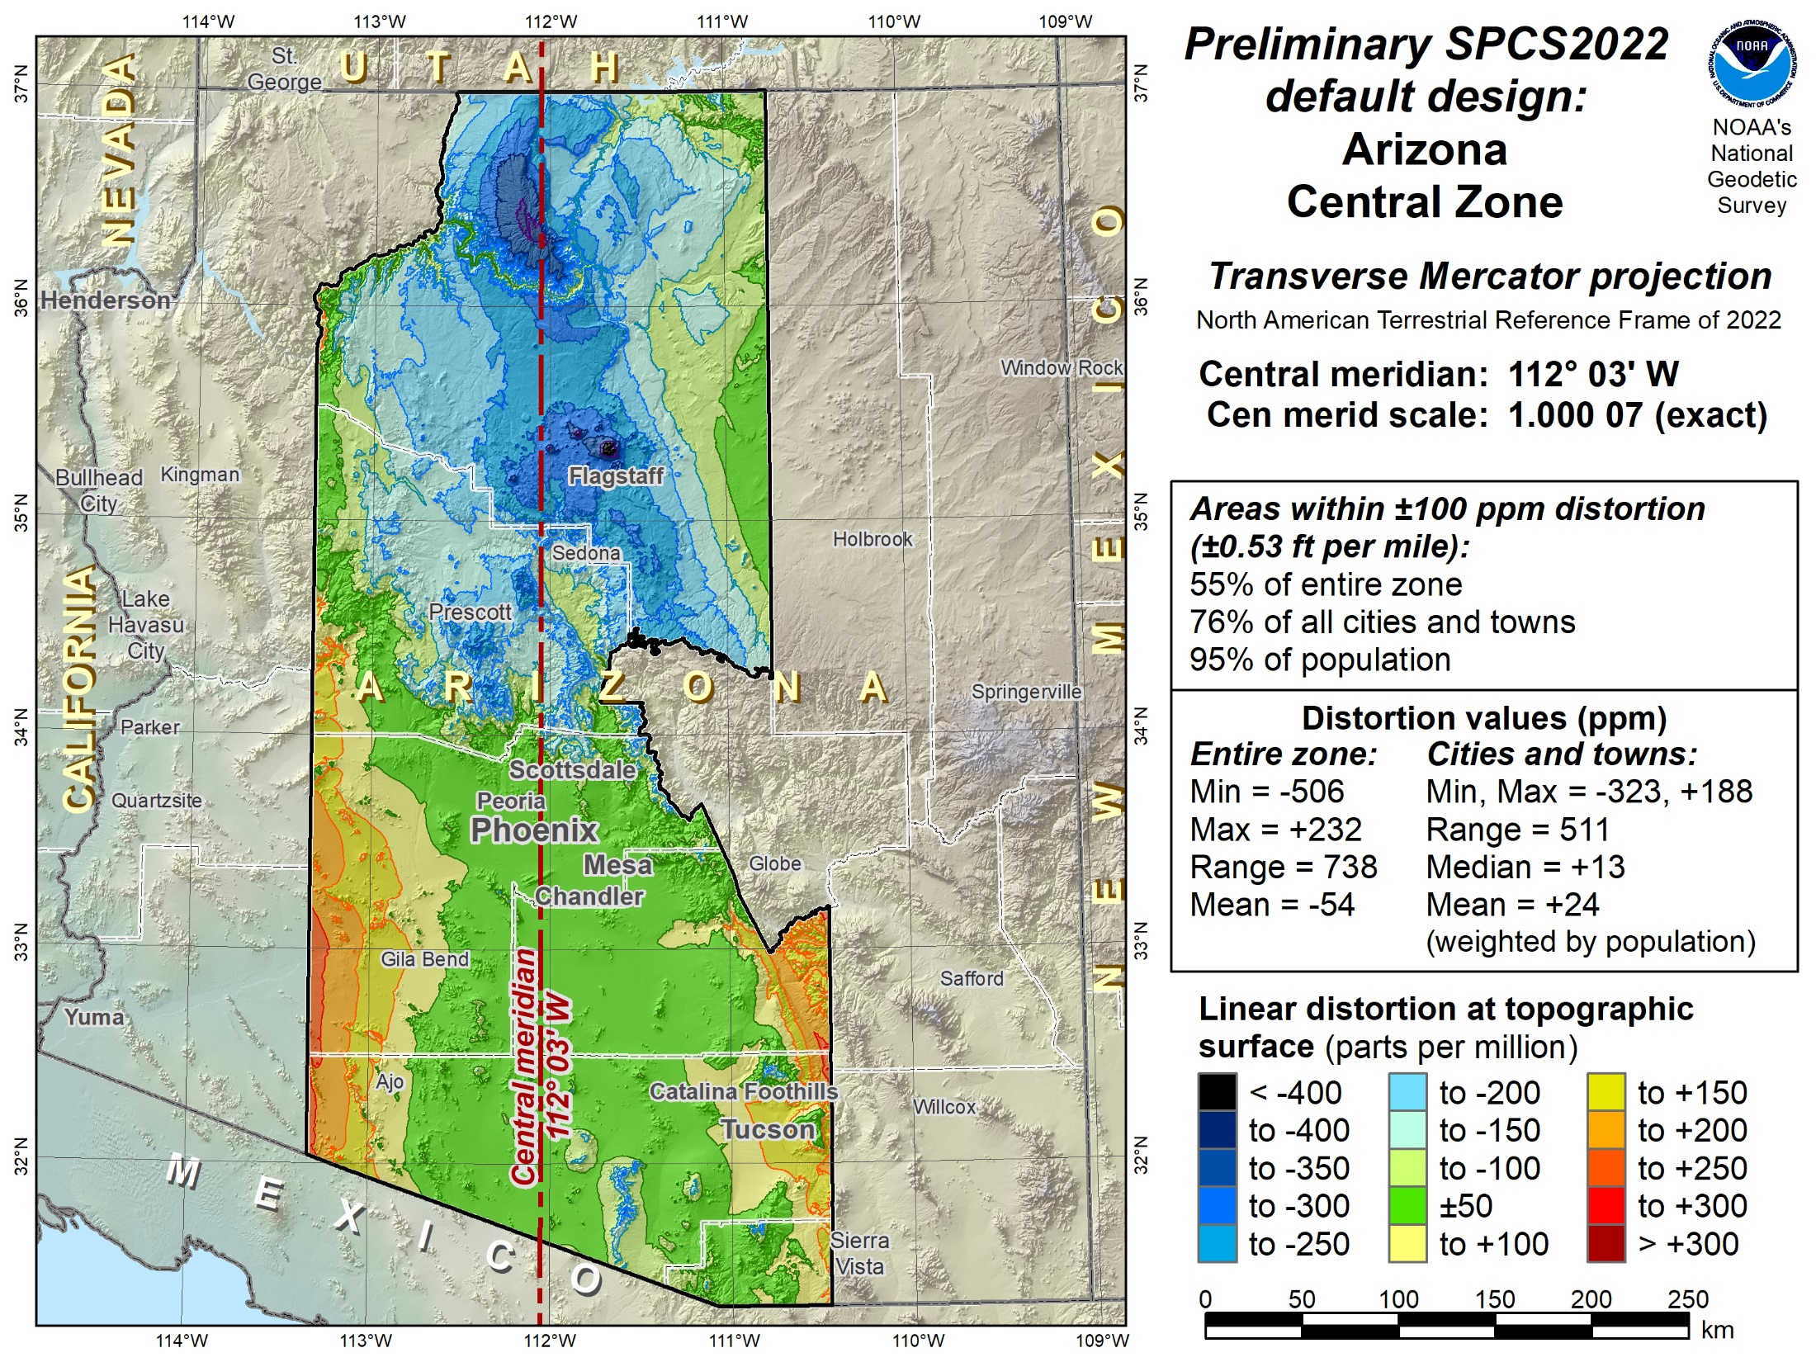

Slide 38
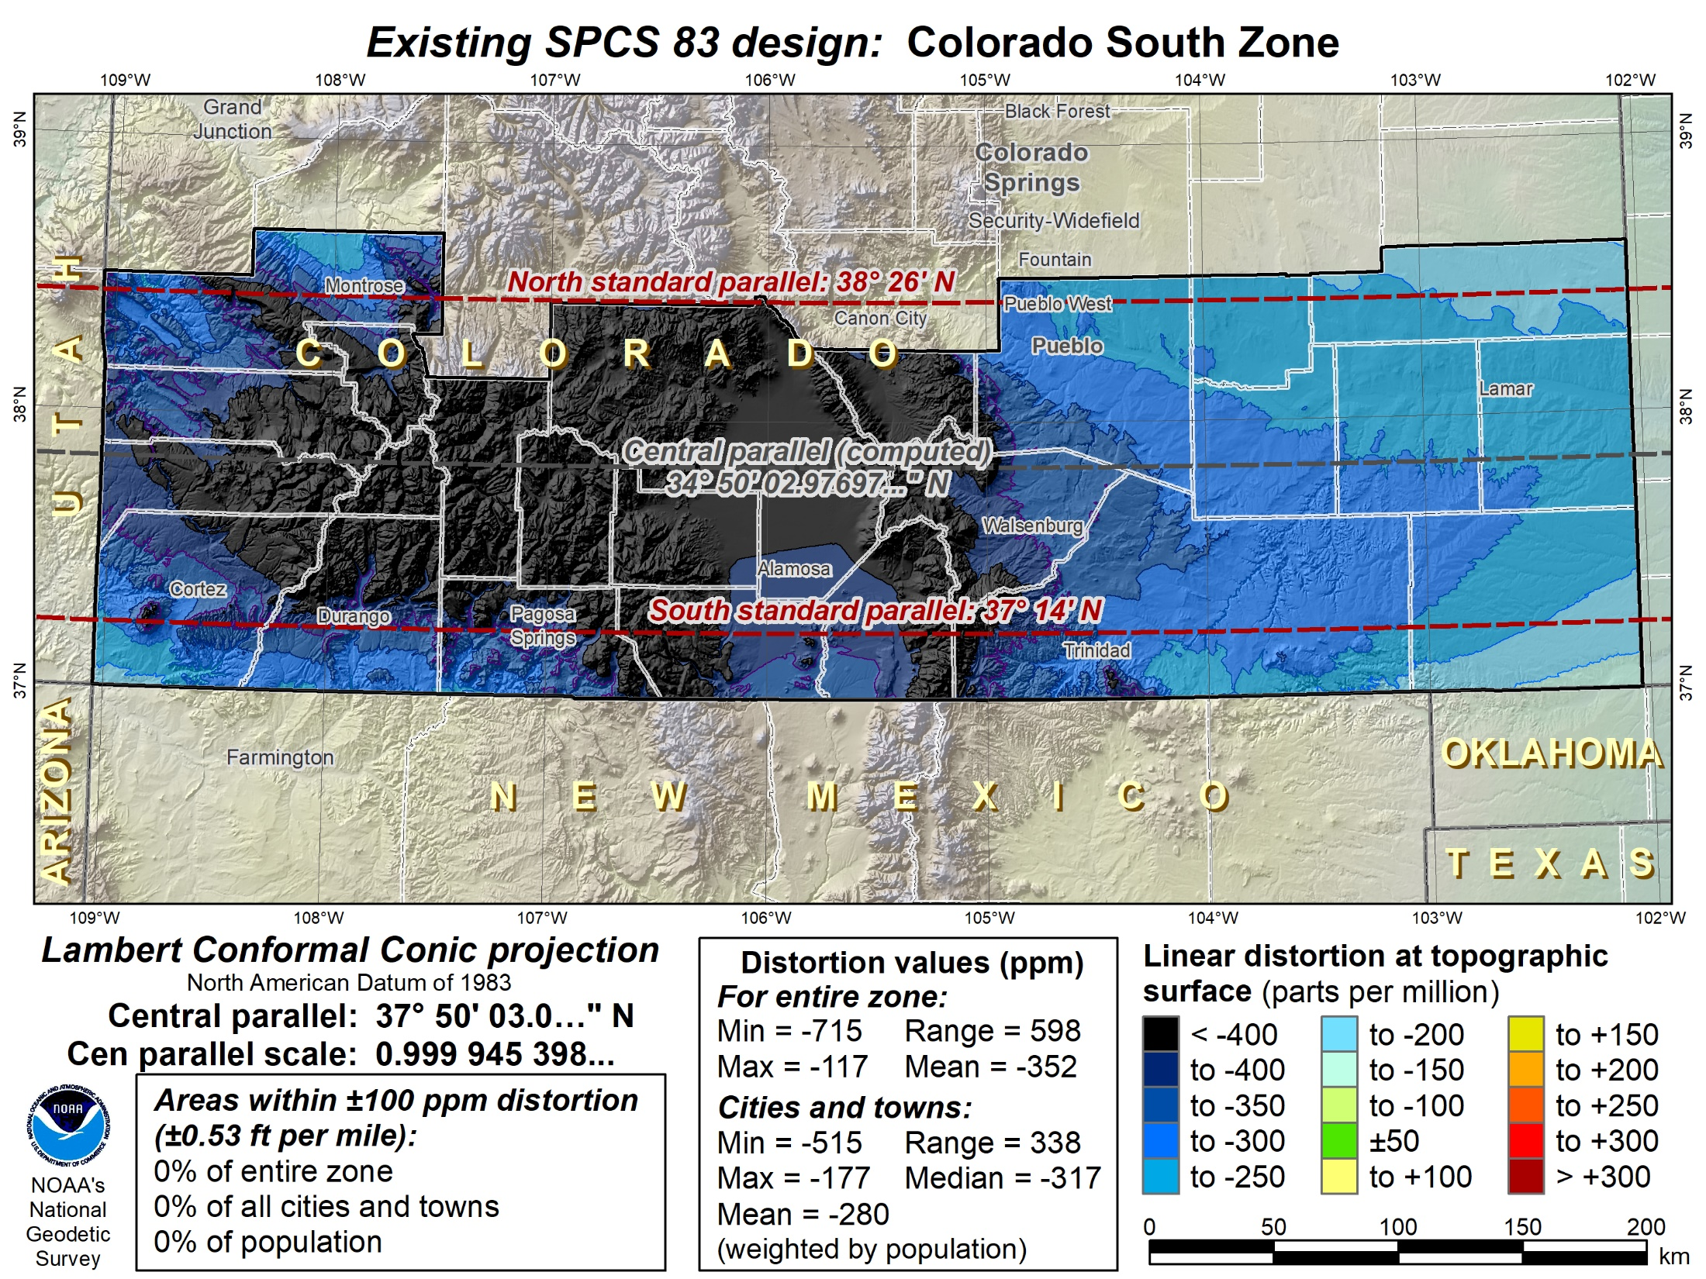

Slide 39
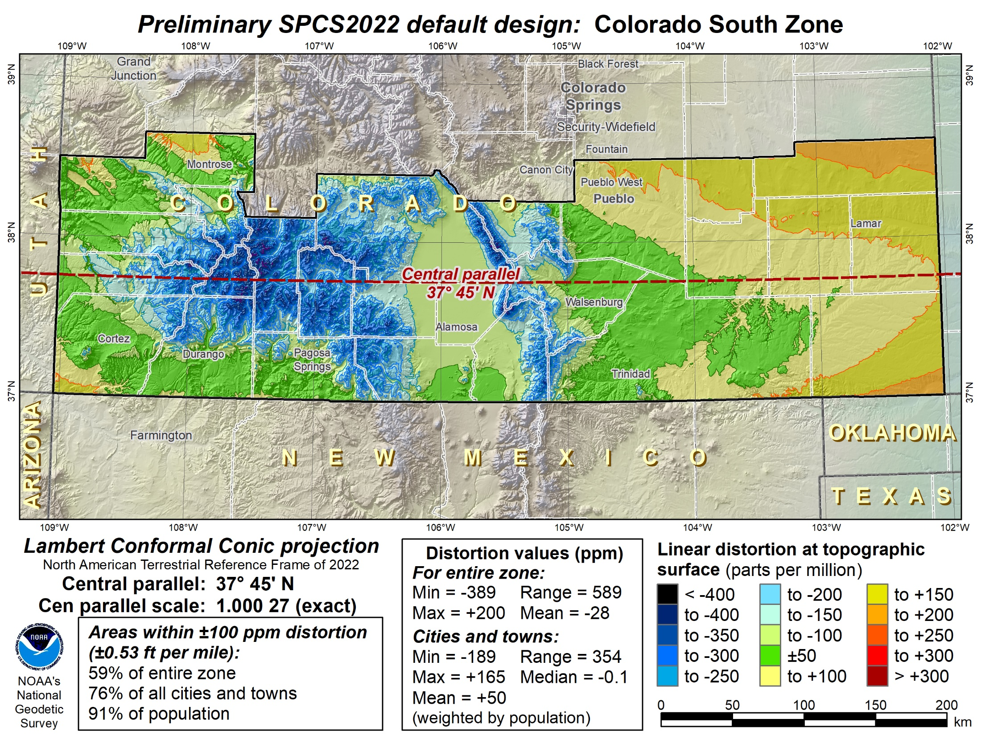

Slide 40
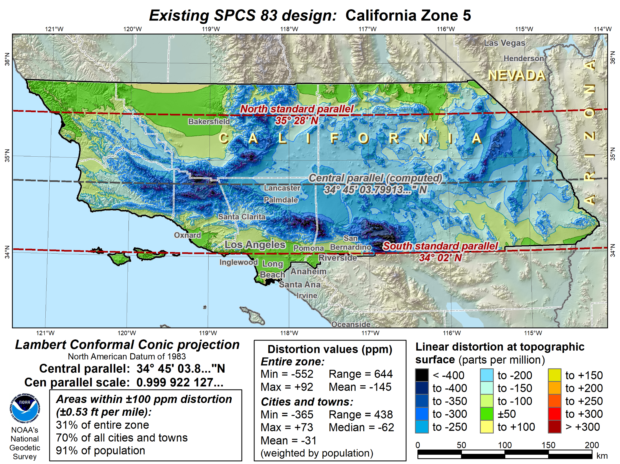

Slide 41
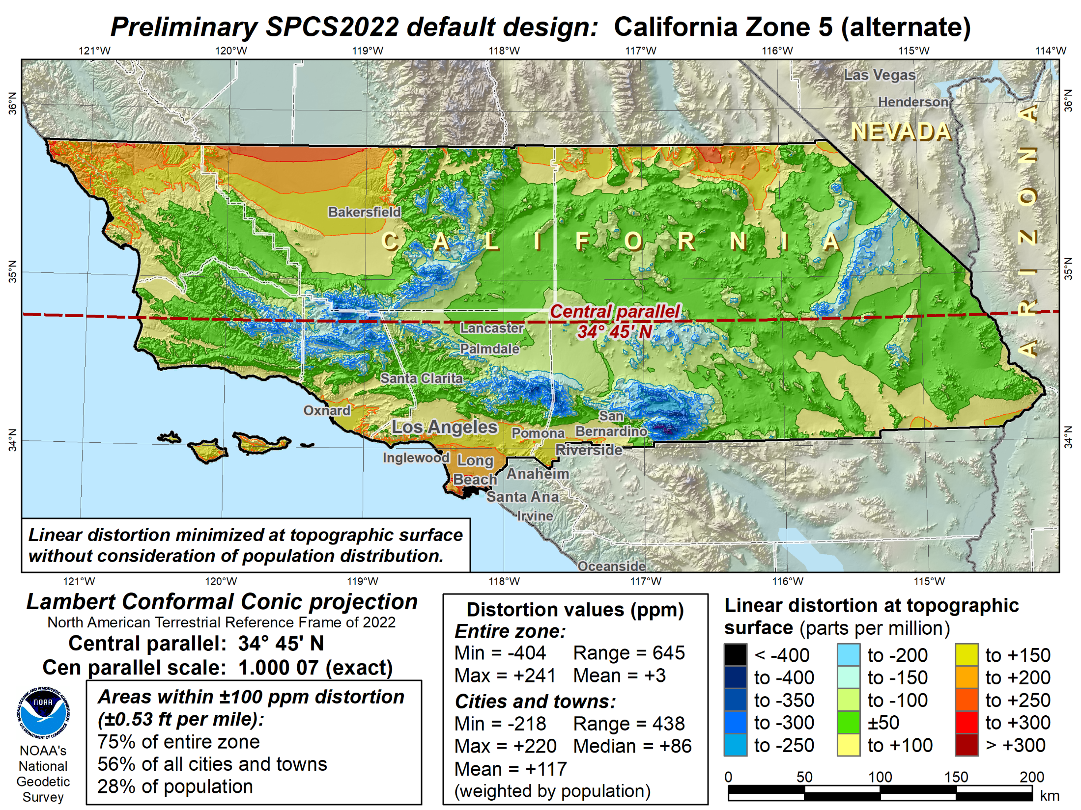

Slide 42
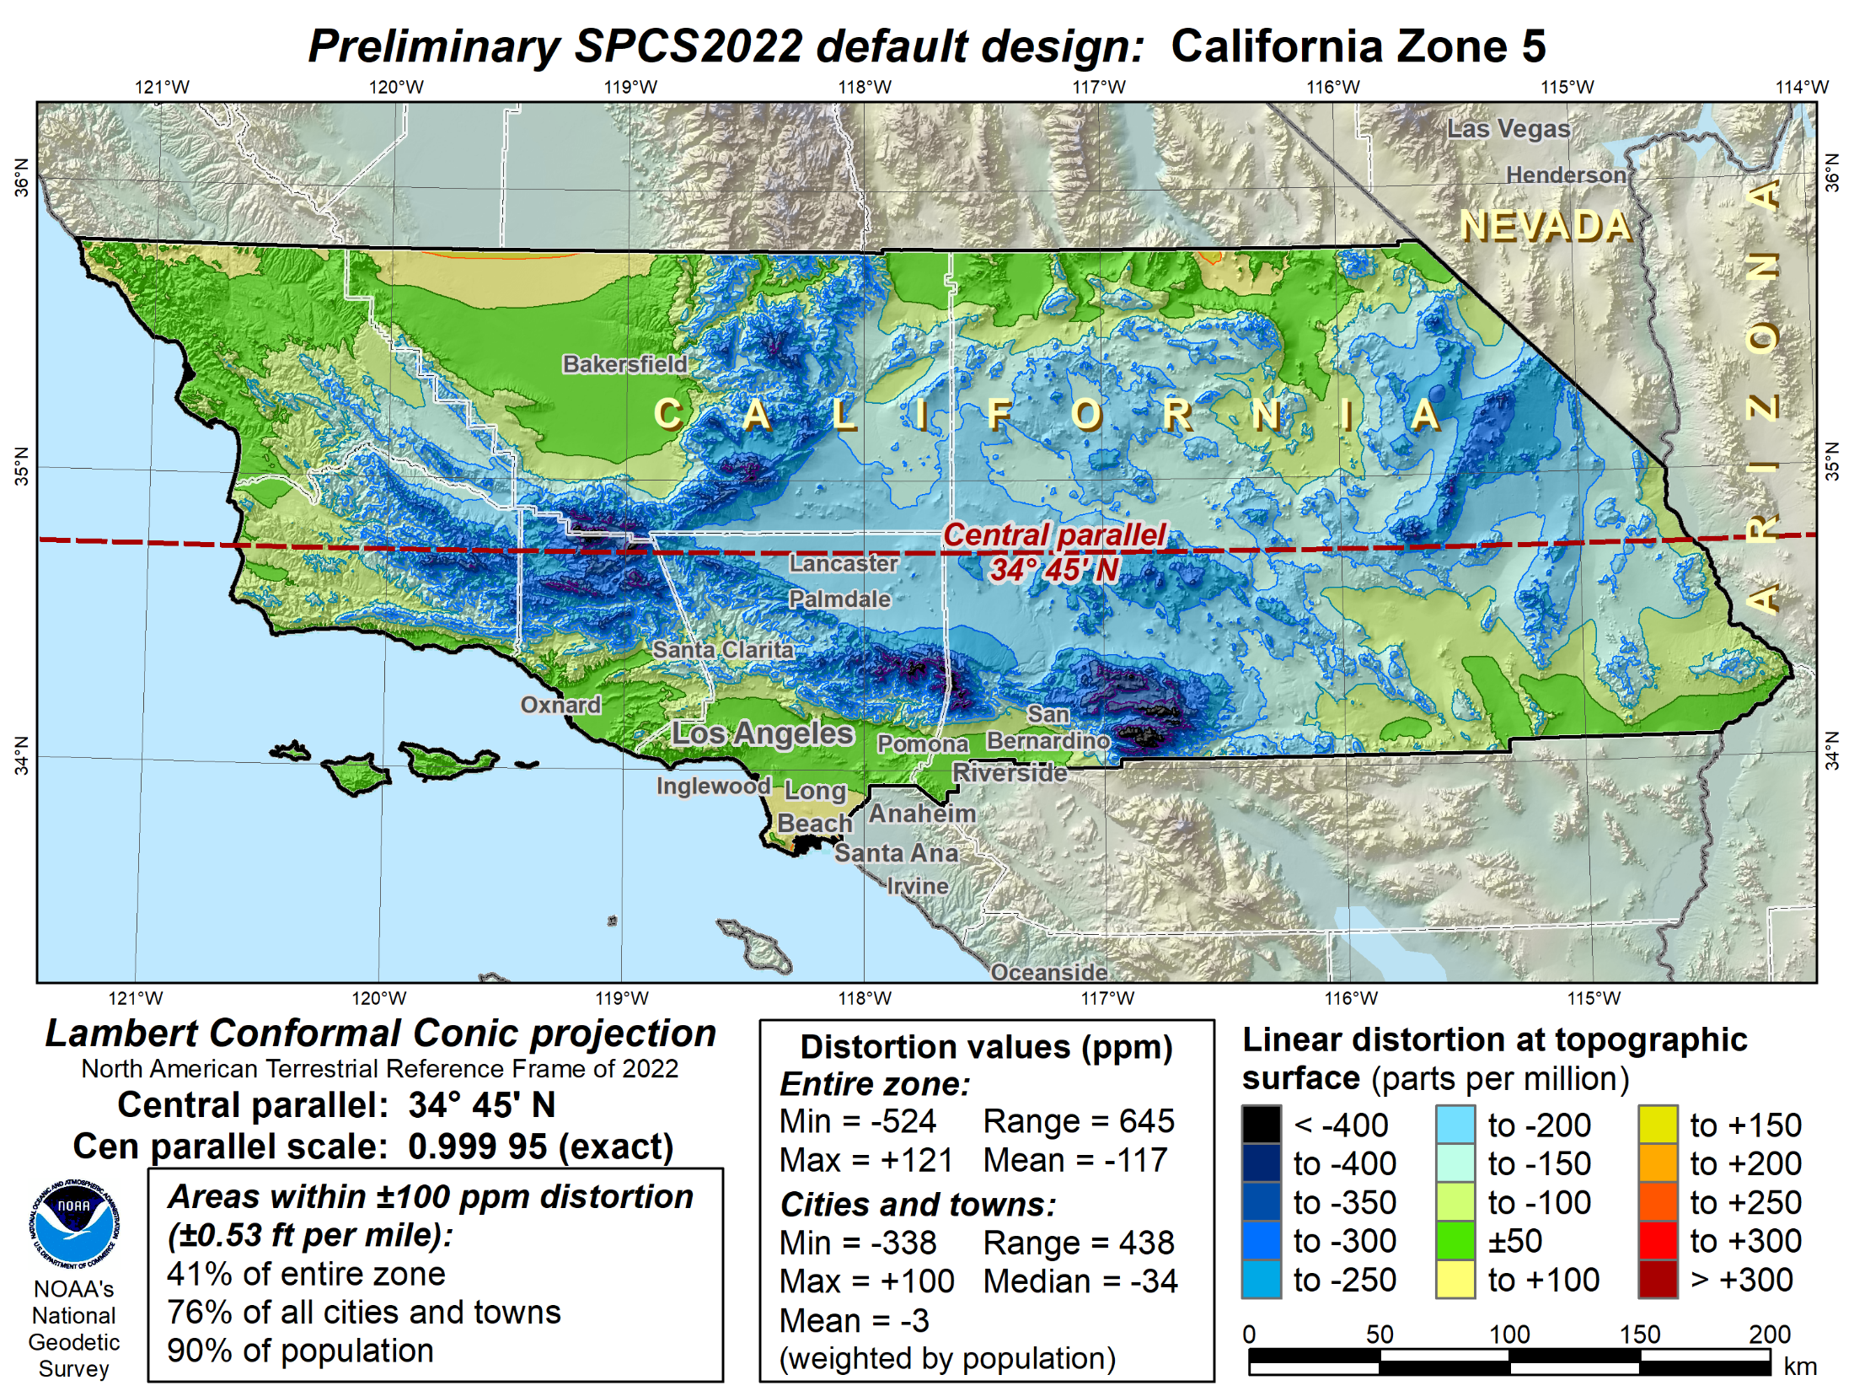

Slide 44
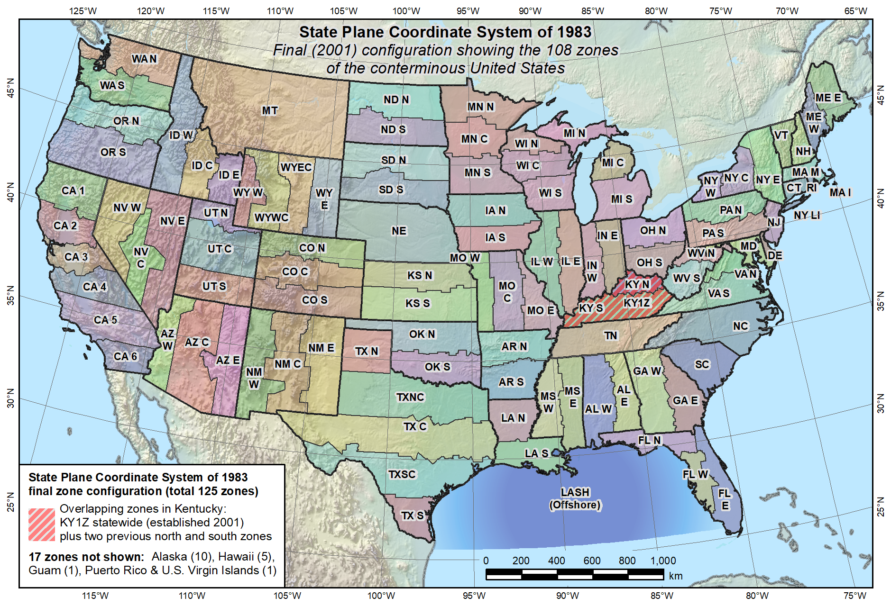
Default SPCS2022 would look a lot like SPCS 83…

Slide 45
What changes for default designs?
Most zones will keep same extents and projection type
Possible changes in projection types and zone extents
  1 or 2 OM zones for FL peninsula (currently 2 TM zones)
  1 OM zone for Hawaii (replaces 5 TM zones)
  Include Guam and CNMI in 1 TM zone (currently only Guam)
  Define LCC zone for American Samoa (no SPCS 83 zone)
  Redefine AK zones to better correspond to land use
  Add zone for Washington D.C.
Examples follow of zones where proposed projection type and/or extents change.

Slide 46
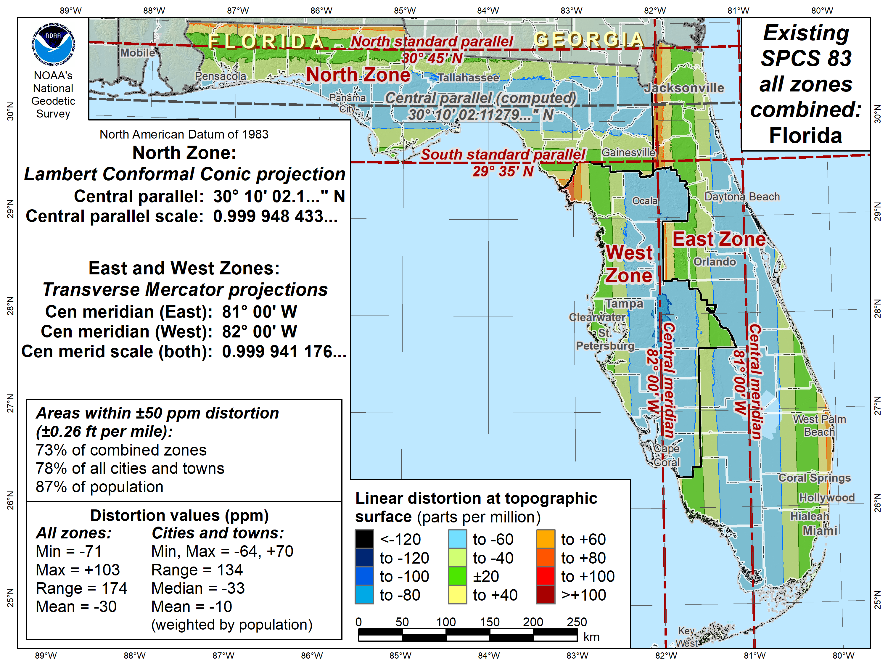

Slide 47
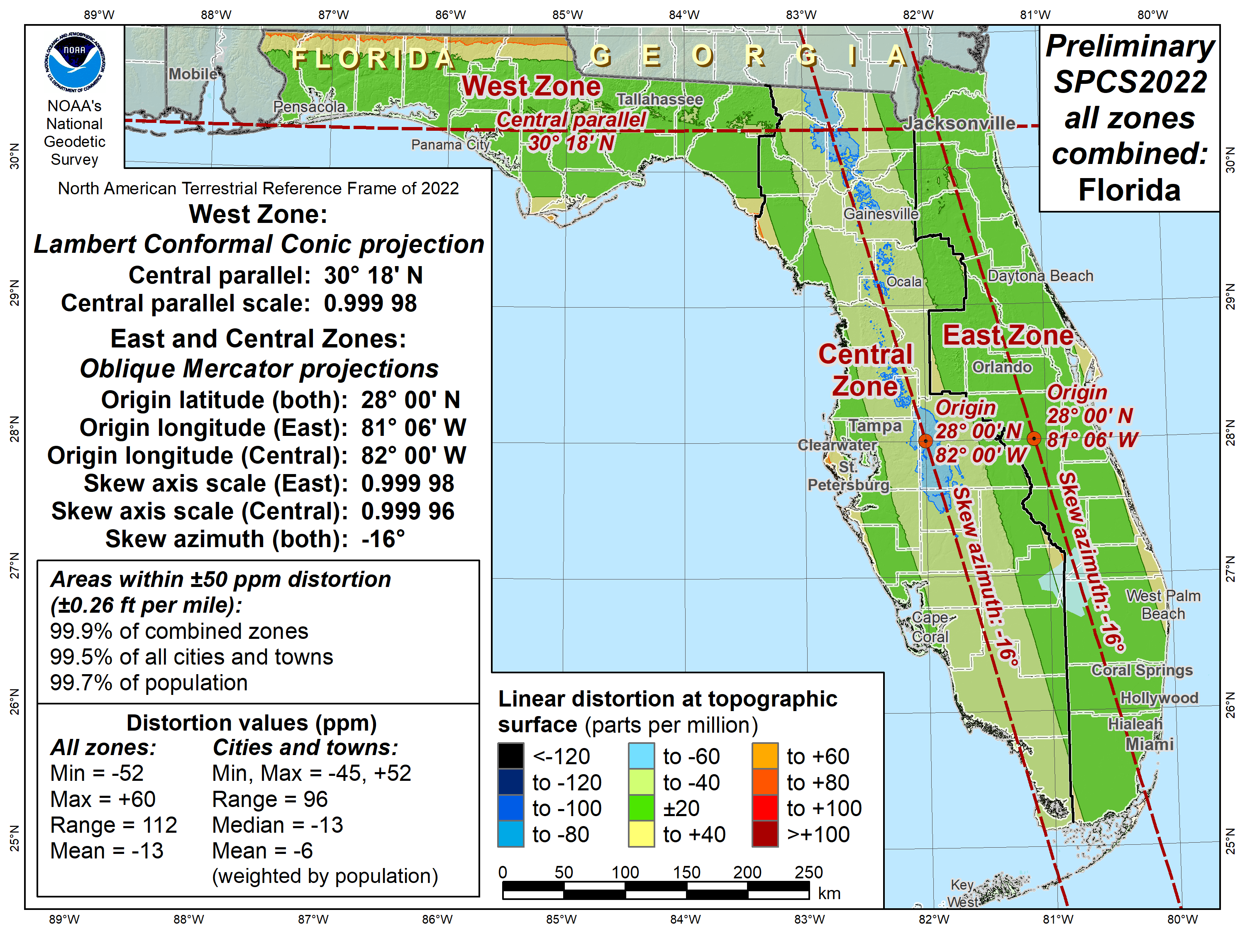

Slide 48
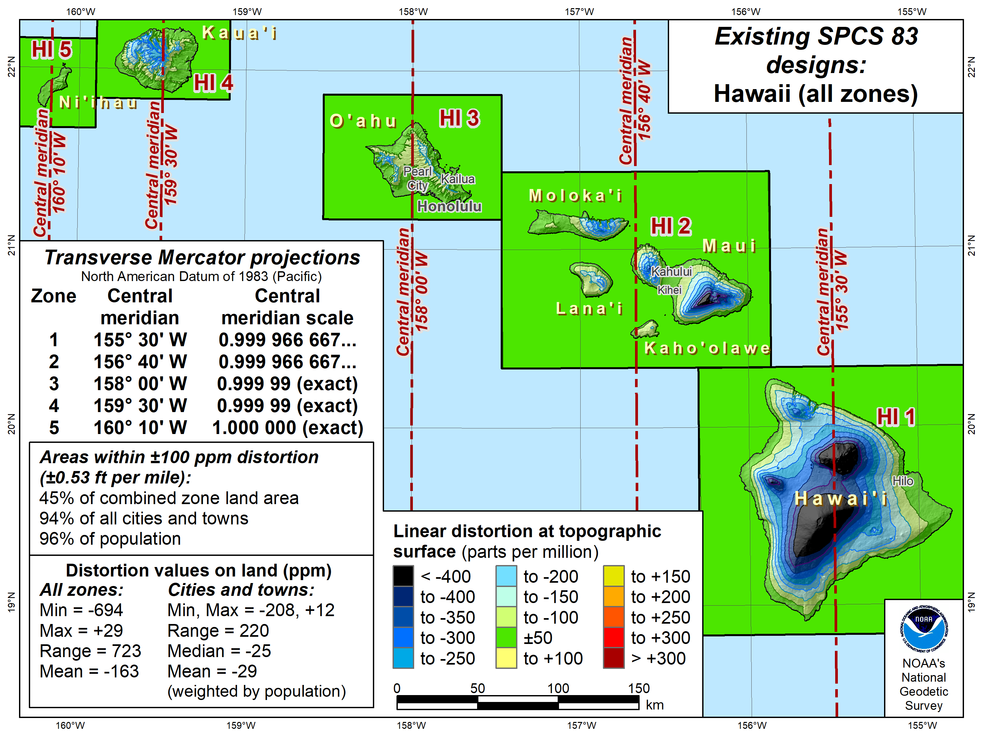

Slide 49
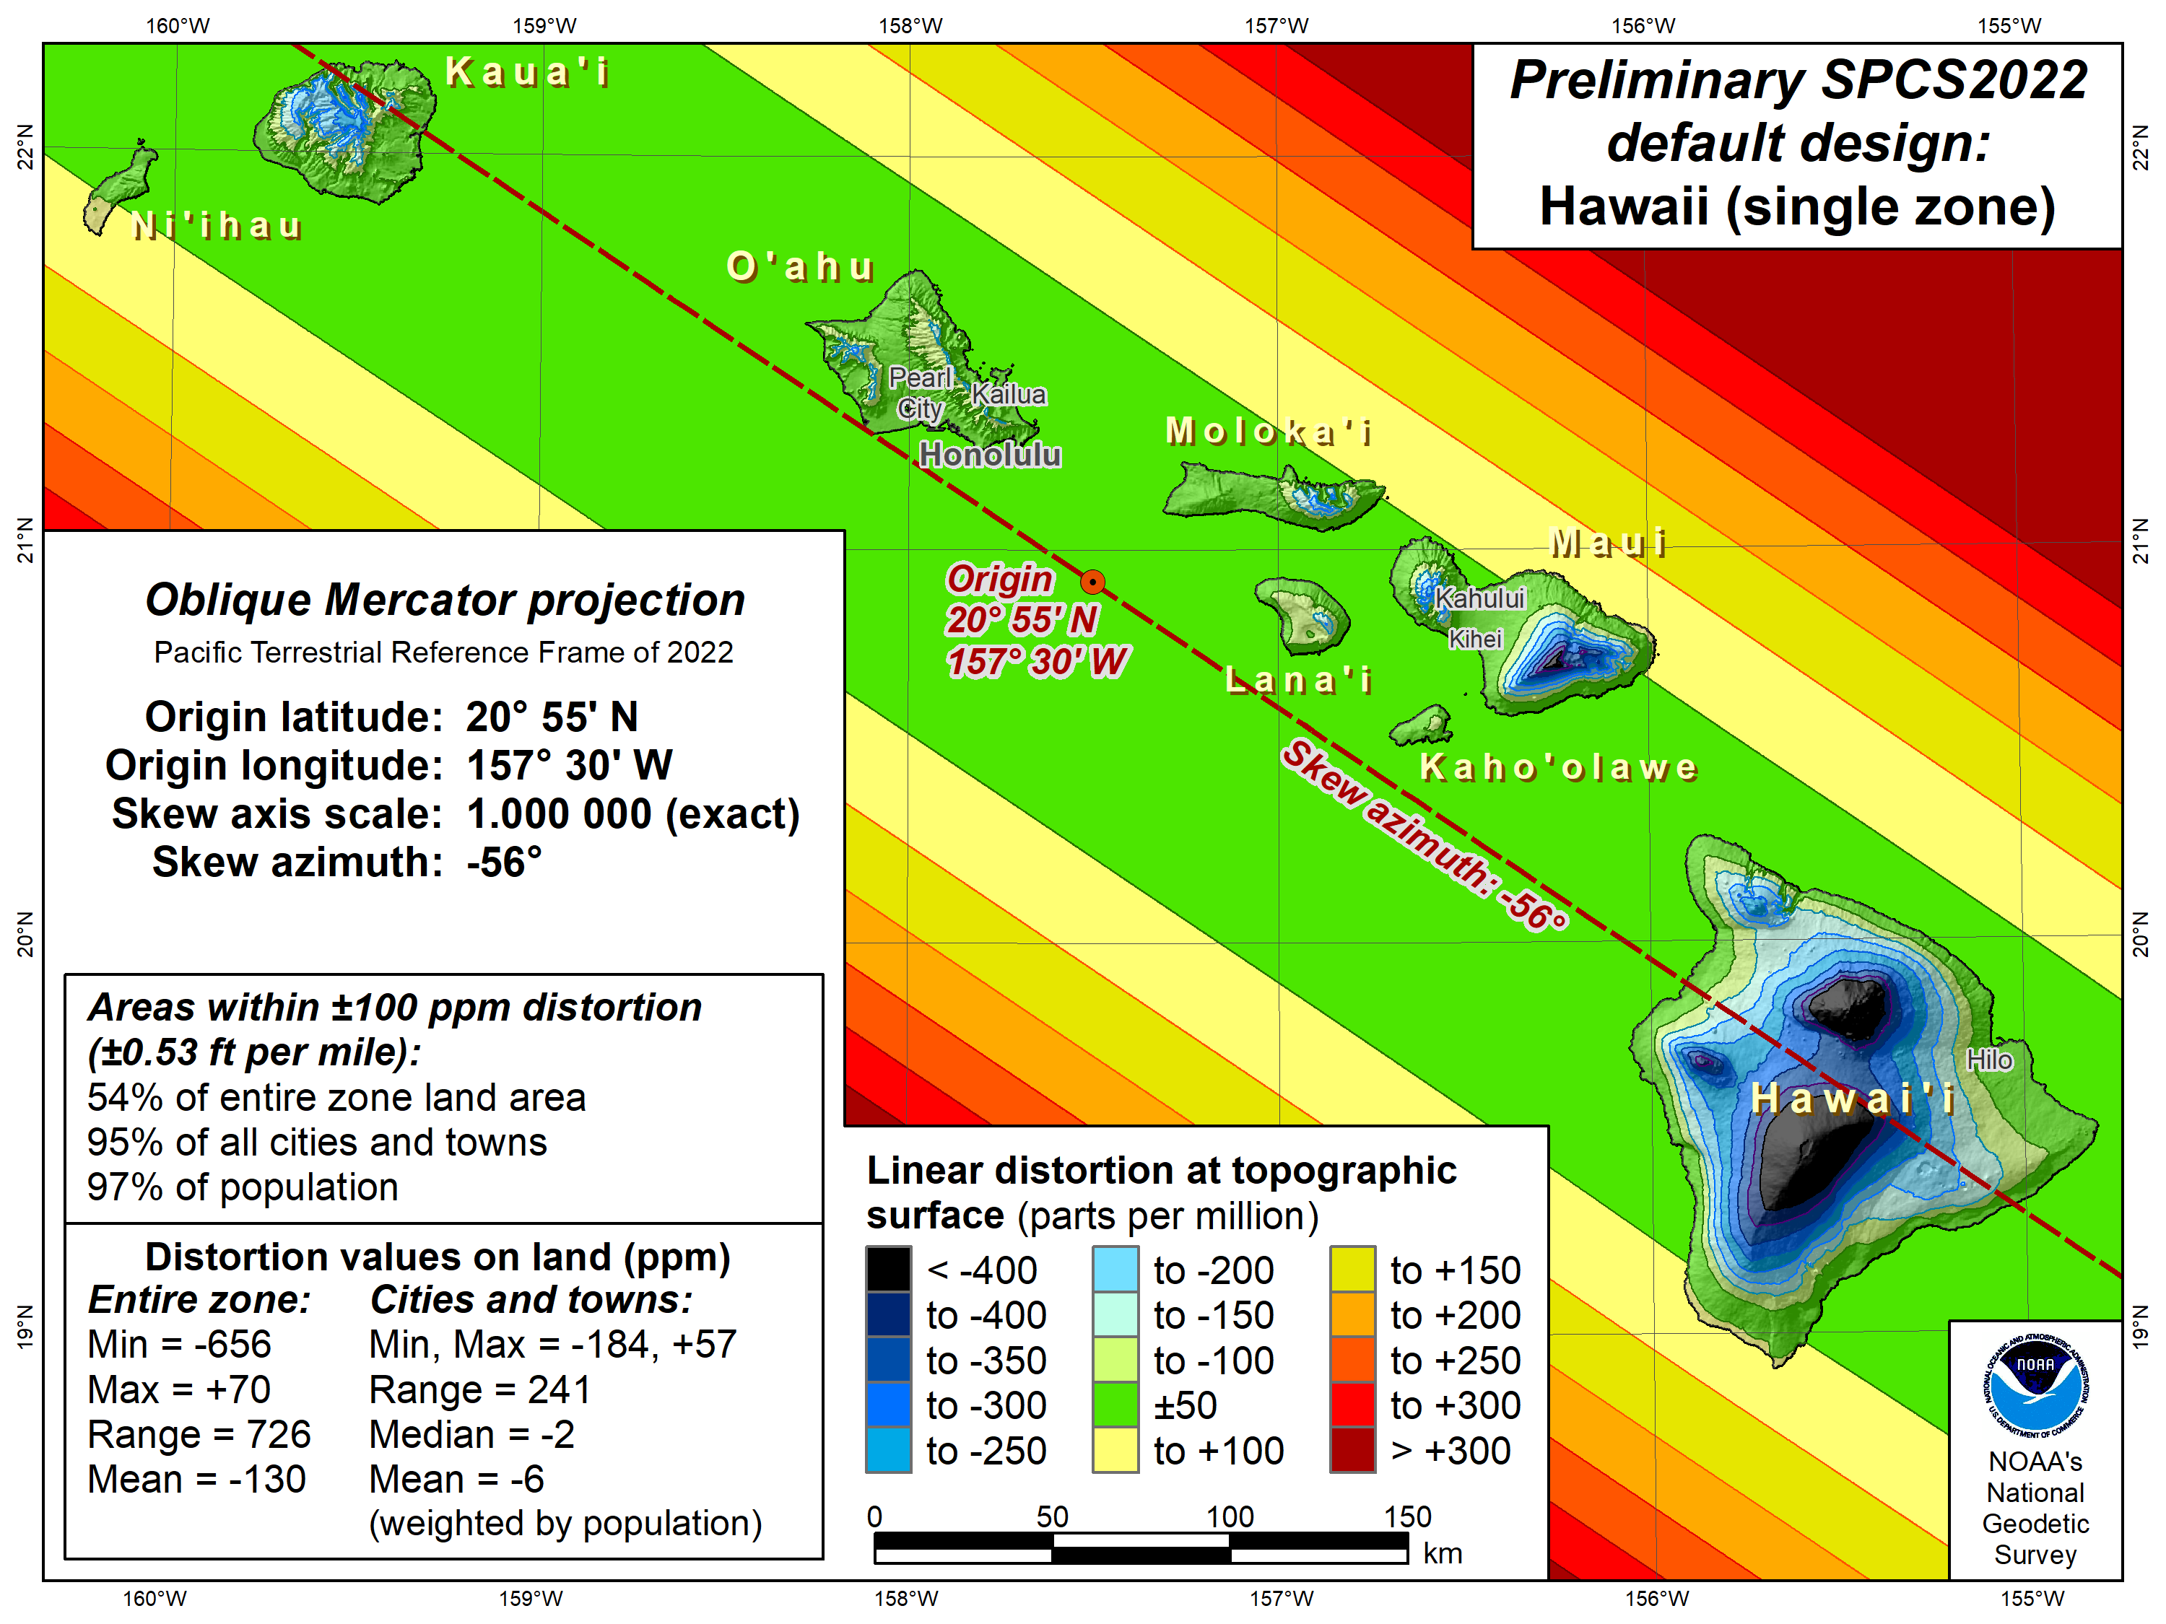

Slide 50
Overview: Policy, Procedures, and FRN
Linear distortion at topographic surface
One-parallel Lambert Conformal Conic projections
Default SPCS2022 zone designs
Statewide and “layered” zones
Linear distortion design criteria
  Maximum and minimum zone size and distortion
  Low distortion projections (LDPs)
“Special purpose” zones (in FRN only)
Linear units
Submittal process and deadlines
  For Federal Register Notice comments
  For requests, proposals, and submittal of designs

Slide 51
Statewide and “layered” zones
Policy§III.A.2.
Limitations
  Max of TWO layers: Statewide and sub-zones
  If two layers, one MUST be statewide
  Minimum subzone dimension > 50 km
States often want statewide and small zones
  Statewide: Single geometry required for state GIS
  Sub-zones: Lower distortion for surveying/engineering
Accommodates state needs, but with restrictions
  Prevent poor design choices for statewide zones
One already exists in SPCS 83…

Slide 52
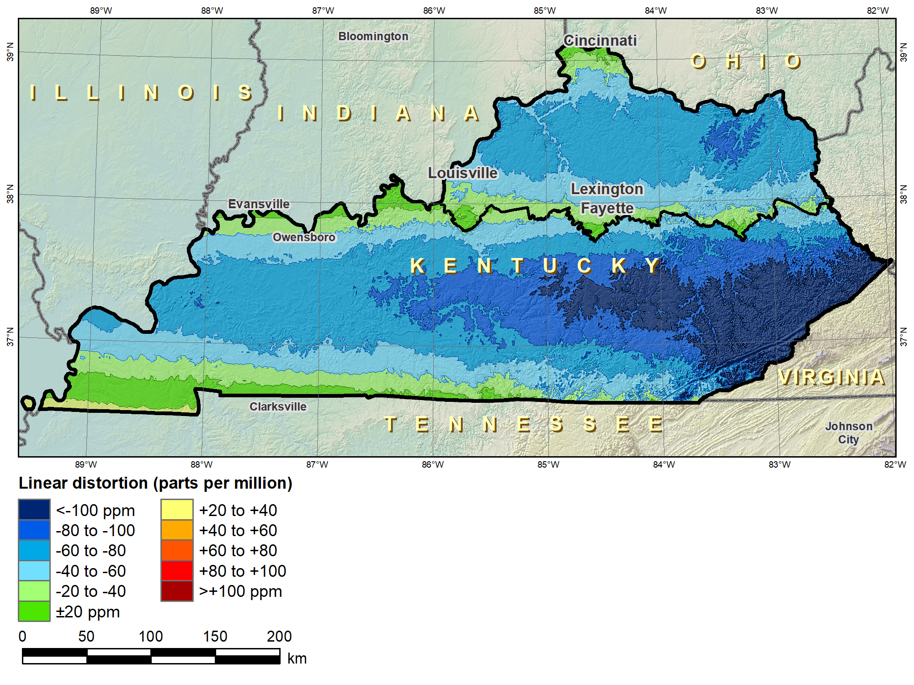
Kentucky layered zones
“Layered” zones
SPCS 83 Kentucky N and S zones (Lambert Conformal Conic)
 |  | North | South
N parallel |  | 38°58’N | 37°56’N
S parallel |  | 37°58’N | 36°44’N
 |  | Distortion (ppm)
Min |  | -93 | -211
Max |  | +17 | +42
Mean |  | -56 | -67

Slide 53
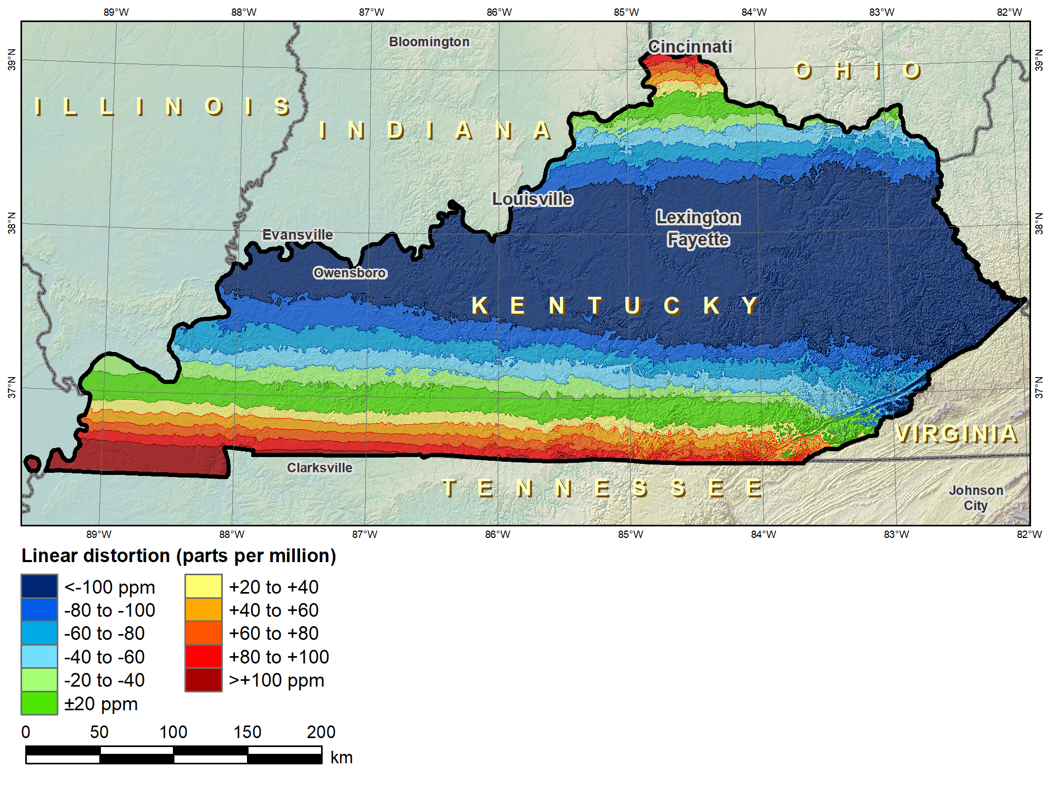
Kentucky layered zones
“Layered” zones
SPCS 83 Kentucky statewide zone (Lambert Conformal Conic)
 |  | North | South | Statewide
N parallel |  | 38°58’N | 37°56’N | 38°40’N
S parallel |  | 37°58’N | 36°44’N | 37°05’N
 |  | Distortion (ppm)
Min |  | -93 | -211 | -166
Max |  | +17 | +42 | +181
Mean |  | -56 | -67 | -58

Slide 54
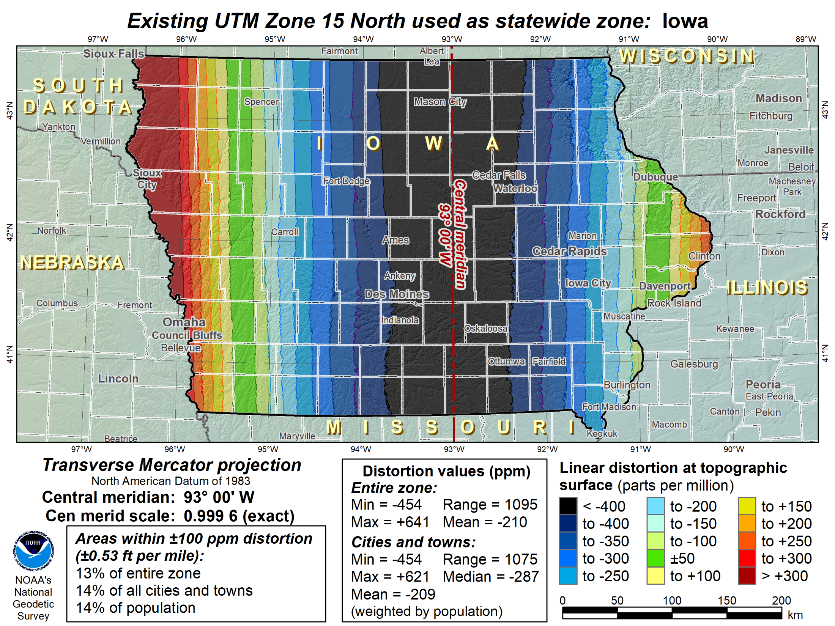

Slide 55
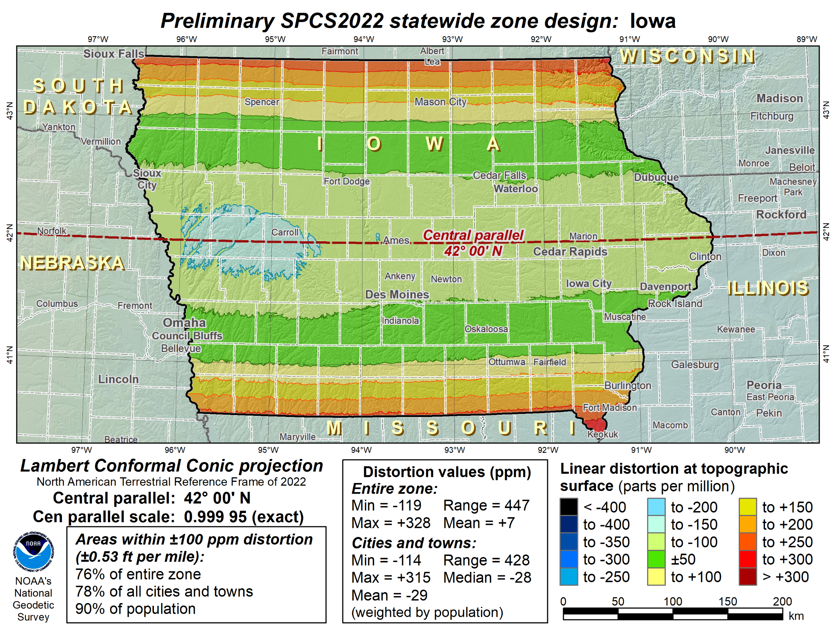

Slide 56
Overview: Policy, Procedures, and FRN
Linear distortion at topographic surface
One-parallel Lambert Conformal Conic projections
Default SPCS2022 zone designs
Statewide and “layered” zones
Linear distortion design criteria
  Maximum and minimum zone size and distortion
  Low distortion projections (LDPs)
“Special purpose” zones (in FRN only)
Linear units
Submittal process and deadlines
  For Federal Register Notice comments
  For requests, proposals, and submittal of designs

Slide 57
Linear distortion design criteria
Procedures §4.b.i-ii and§5.c.i.
NGS design of zones requested by stakeholders
  Limited to zones with 50-400 ppm distortion criterion
    50 ppm = 5 cm/km = 0.3 ft/mi = 1:20,000
    400 ppm = 40 cm/km = 2.1 ft/mi = 1:2,500
Design criterion < 50 ppm (i.e., “low distortion”)
  Low distortion projections (LDPs)
  Must be designed by others (not by NGS)
  Proposed and final design reviewed by NGS

Slide 58
Linear distortion magnitudes
Procedures§5.c.ii
Linear distortion (ppm = parts per million) | Corresponding zone dimension and height limits
 | Zone width perpendicular to projection axis (no variation in topo height) | Topographic height range (independent of zone width)
±5 ppm (1:200,000) | 57 km (35 miles) | 64 m (209 ft)
±10 ppm (1:100,000) | 81 km (50 miles) | 127 m (418 ft)
±20 ppm (1:50,000) | 114 km (71 miles) | 255 m (836 ft)
±50 ppm (1:20,000) | 180 km (112 miles) | 637 m (2,090 ft)
±100 ppm (1:10,000) | 255 km (158 miles) | 1,274 m (4,180 ft)
±400 ppm (1:2,500) | 508 km (316 miles) | 5,097 m (16,722 ft)

Slide 59
Linear distortion magnitudes
Parts per million | Centimeters per kilometer | Feet per mile | Dimensionless ratio
20 ppm | 2 cm/km | 0.1 ft/mile | 1:50,000
50 ppm | 5 cm/km | 0.3 ft/mile | 1:20,000
100 ppm | 10 cm/km | 0.5 ft/mile | 1:10,000
400 ppm | 40 cm/km | 2.1 ft/mile | 1:2,500

Slide 60
Minimum LDP distortion & zone size
Procedures§5.c.ii
Create largest zone that meets distortion criterion
  To avoid creating excessive number very small zones
Minimum distortion design criterion
  20 ppm = 2 cm/km = 0.1 ft/mi = 1:50,000
  Nominal zone width of 114 km (71 miles)
  Nominal height change of 255 m (836 ft)
Minimum allowable zone width 50 km (31 miles)
  Exception: if height change in zone > 250 m (820 ft)
  Note: 50 km corresponds to approx ±5 ppm distortion

Slide 61
Zone widths for distortion due to curvature
Nominal SPCS 83 and 27 zone width
±100 ppm (±0.5 ft/mile)
255 km (158 miles)
Projection surface
Projection surface
Ellipsoid surface
Max SPCS2022 distortion; also UTM zone width
±400 ppm (±2.1 ft/mile)
508 km (316 miles)

Slide 62
Zone widths for distortion due to curvature
NOTE: Change in height of 255 m (836 ft) causes 20 ppm change in distortion
Distortion due to height changes at rates of:
  15.7 ppm per 100 m
  4.8 ppm per 100 ft
Minimum distortion criterion for LDP designs
±20 ppm (±0.1 ft/mile)
114 km (71 miles)
Projection
surface
Ellipsoid surface
Minimum distortion criterion for NGS designs
±50 ppm (±0.3 ft/mile)
180 km (112 miles)

Slide 63
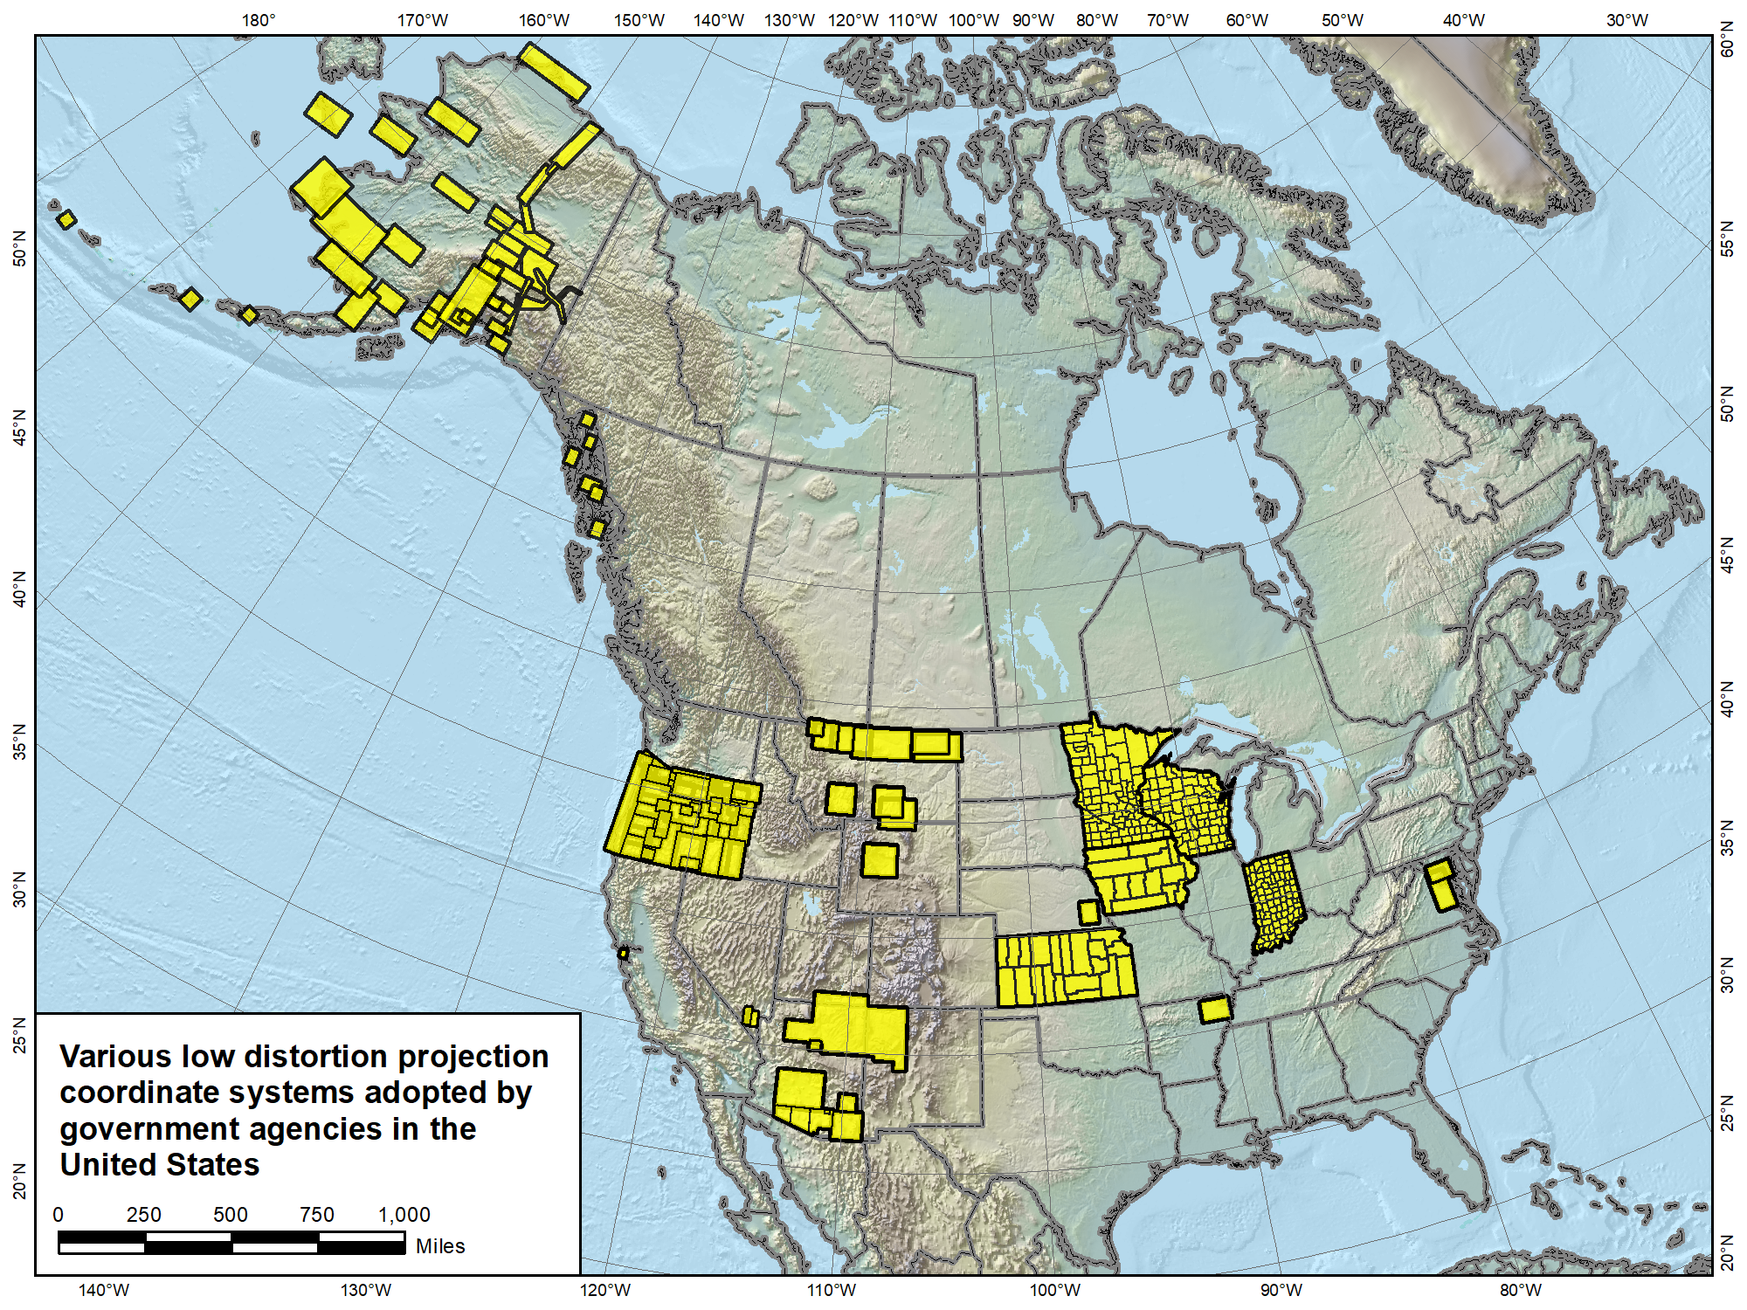

Slide 64
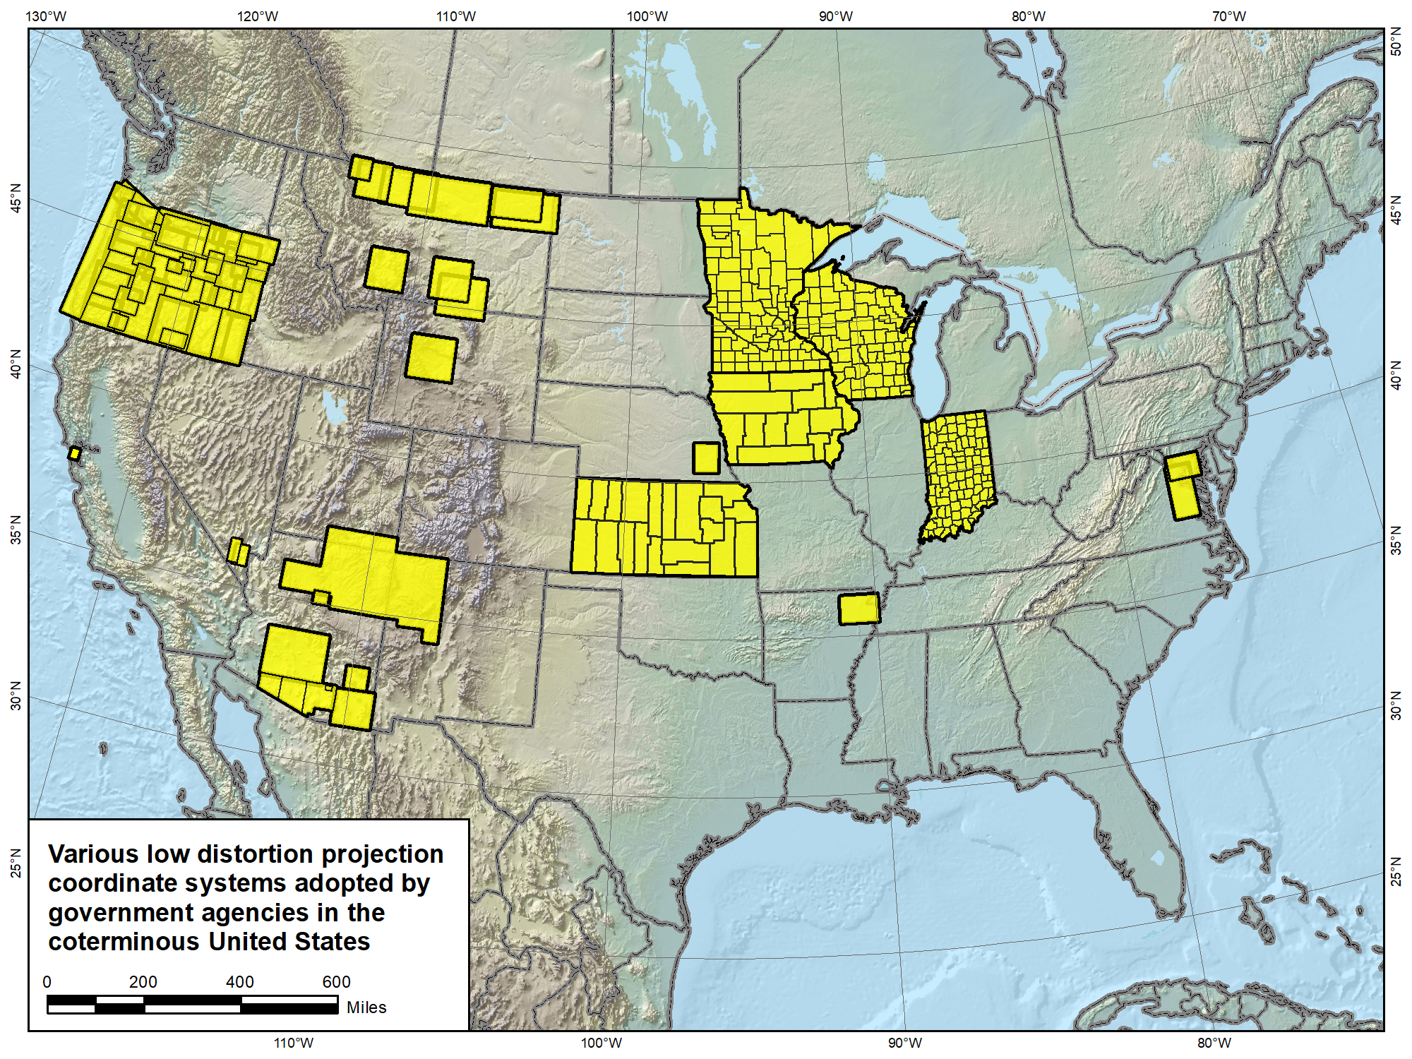

Slide 65
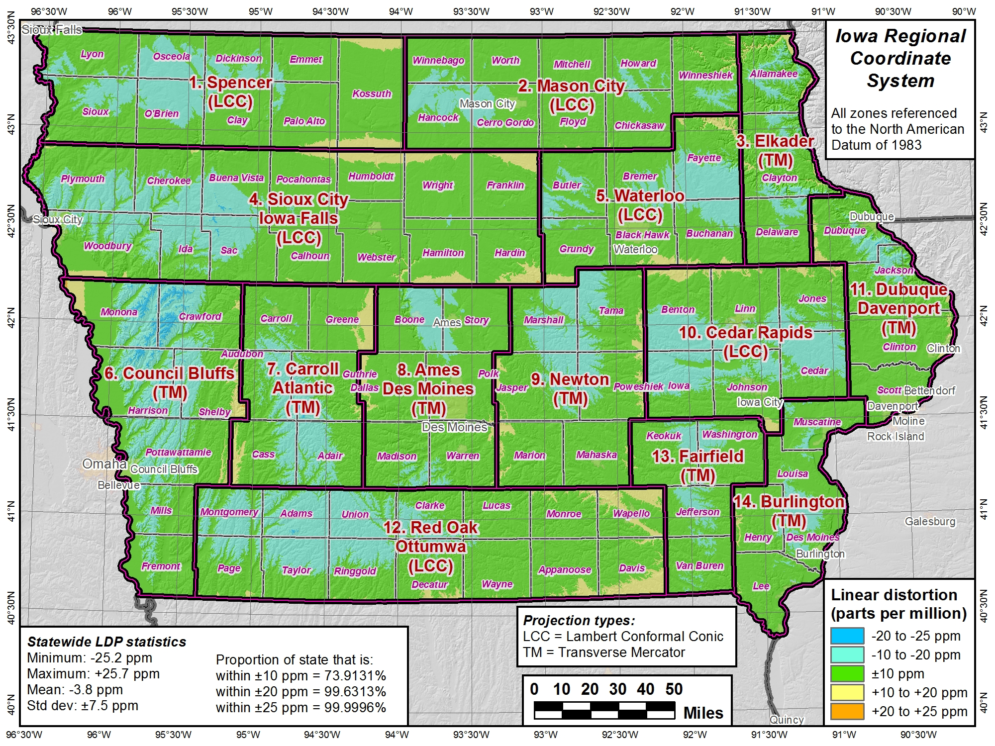

Slide 66
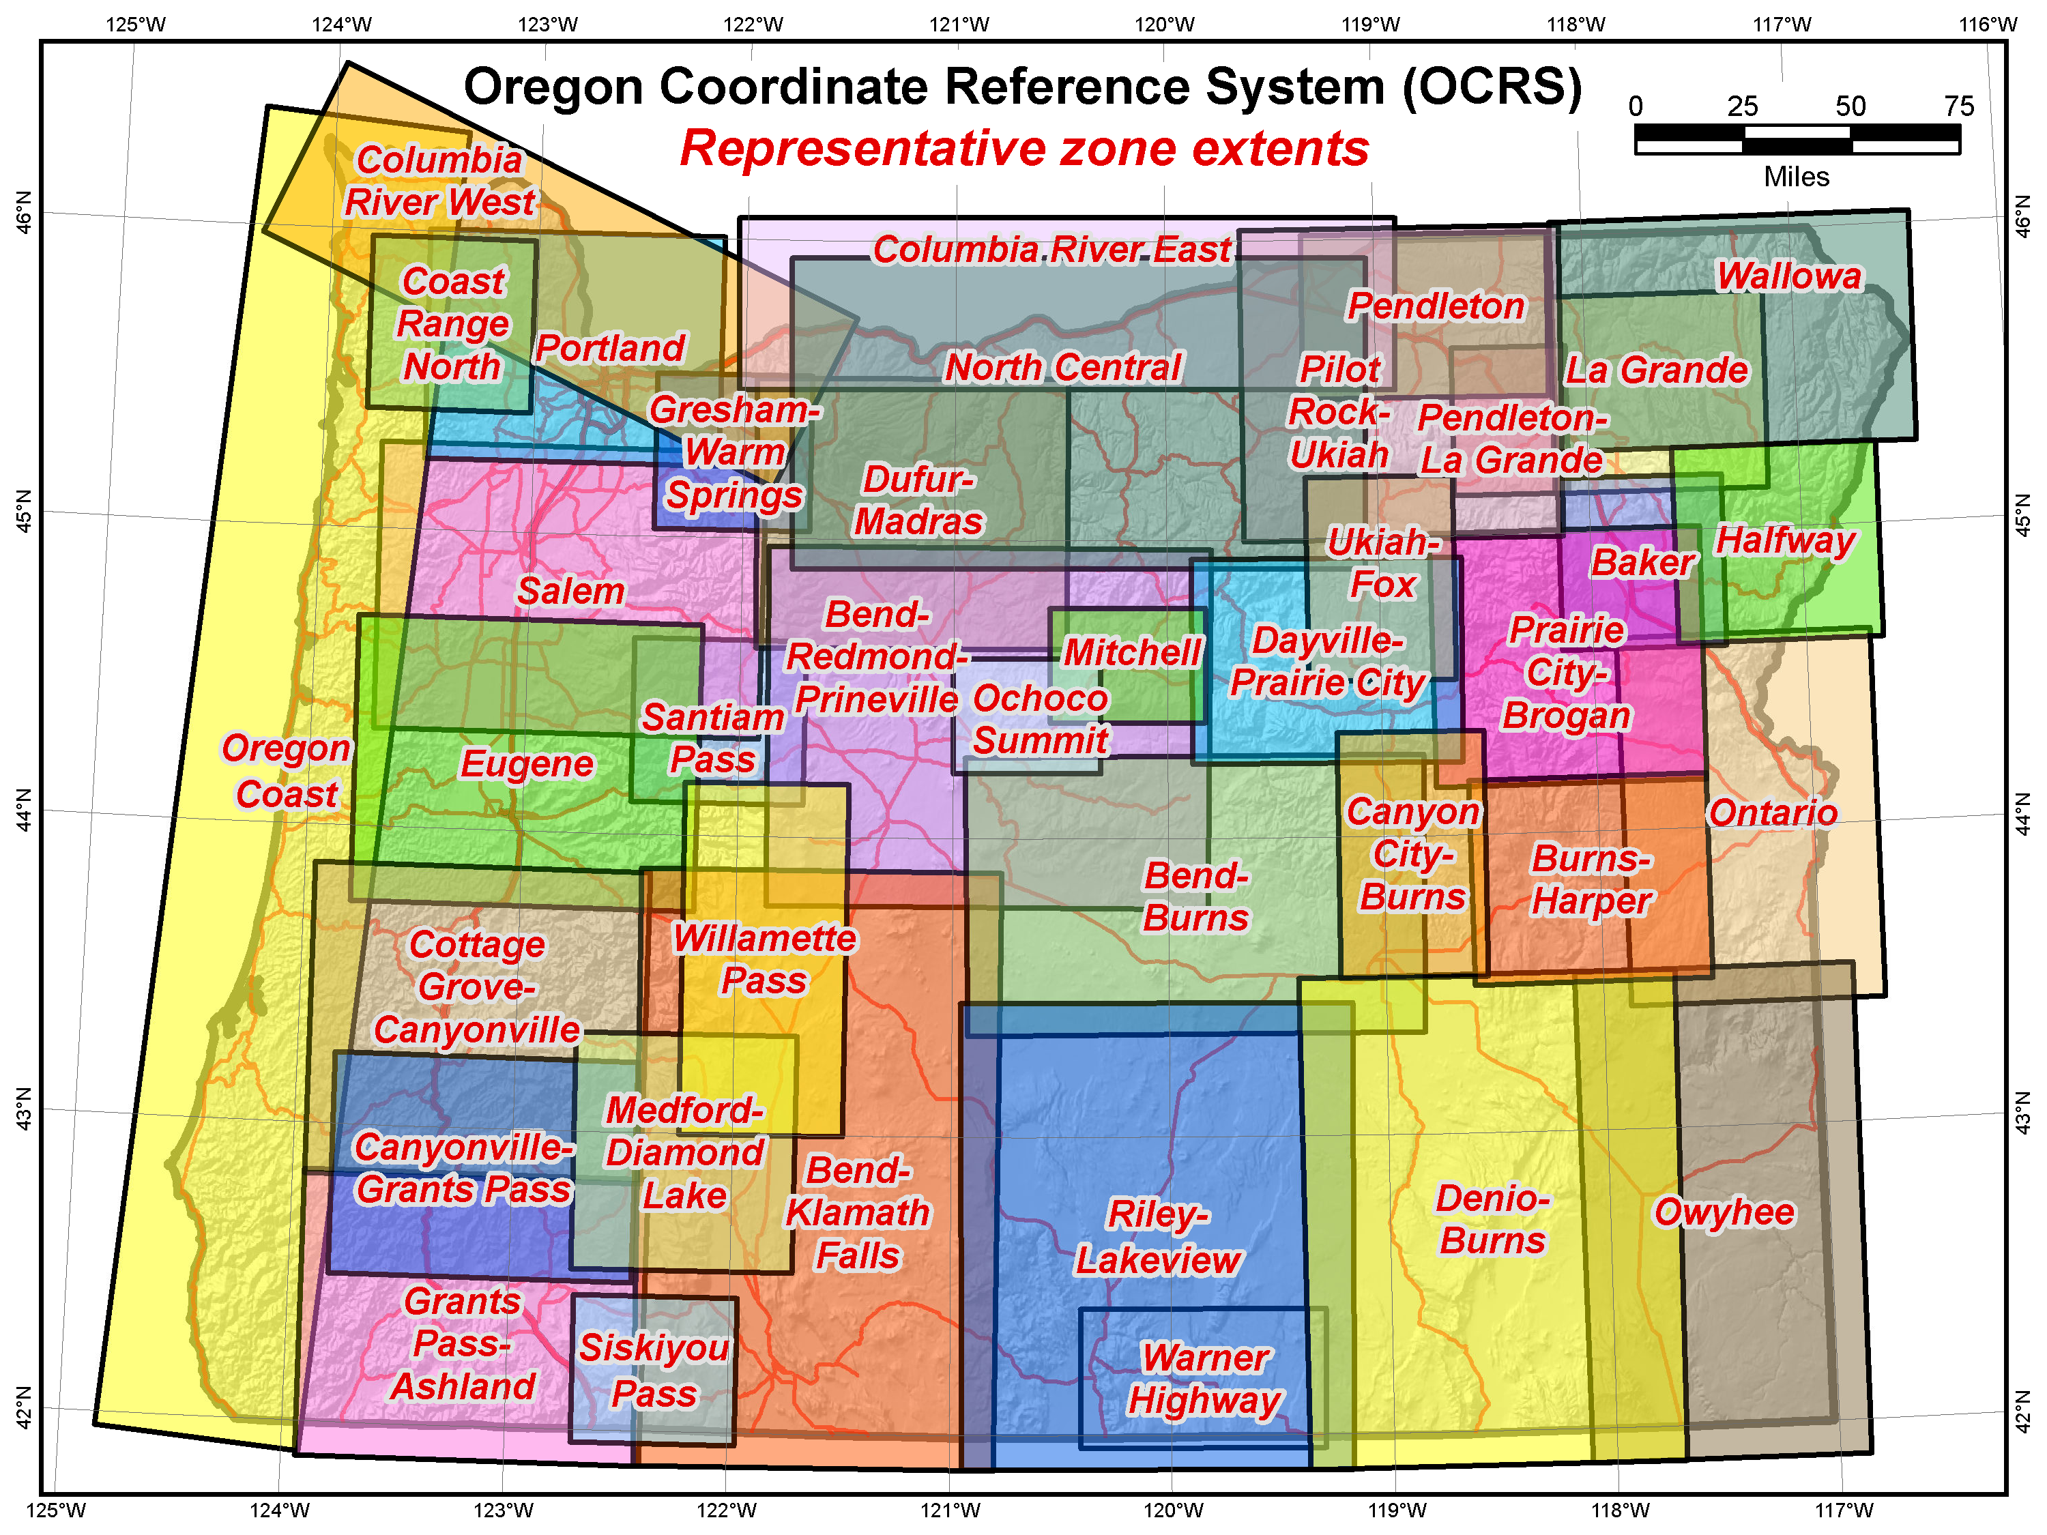

Slide 67
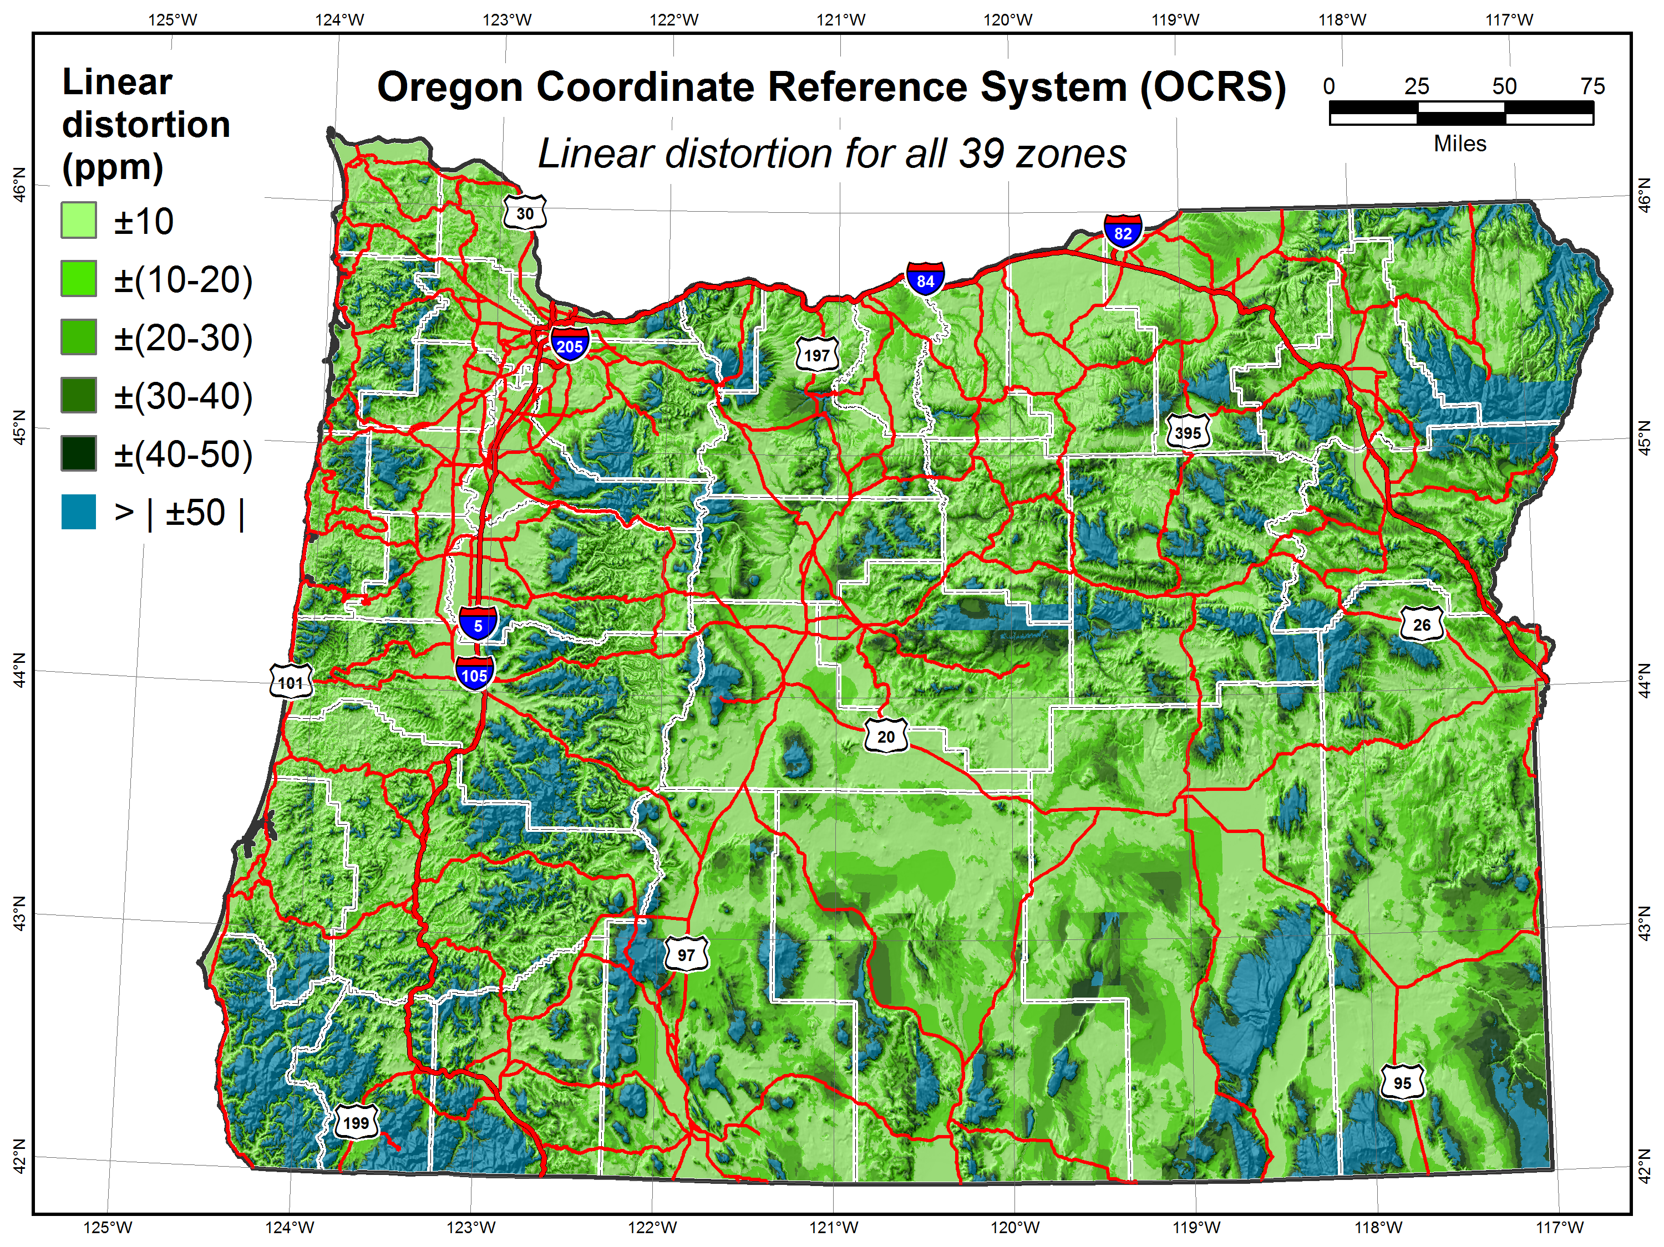
Area of state within:
±10 ppm = 38%
±20 ppm = 60%
±30 ppm = 73%
±40 ppm = 81%
Cities within:
±10 ppm = 77.8%
±20 ppm = 94.0%
±30 ppm = 96.2%
±40 ppm = 98.6%
Population within:
±10 ppm = 96.76%
±20 ppm = 99.79%
±30 ppm = 99.85%
±40 ppm = 99.87%

Slide 68
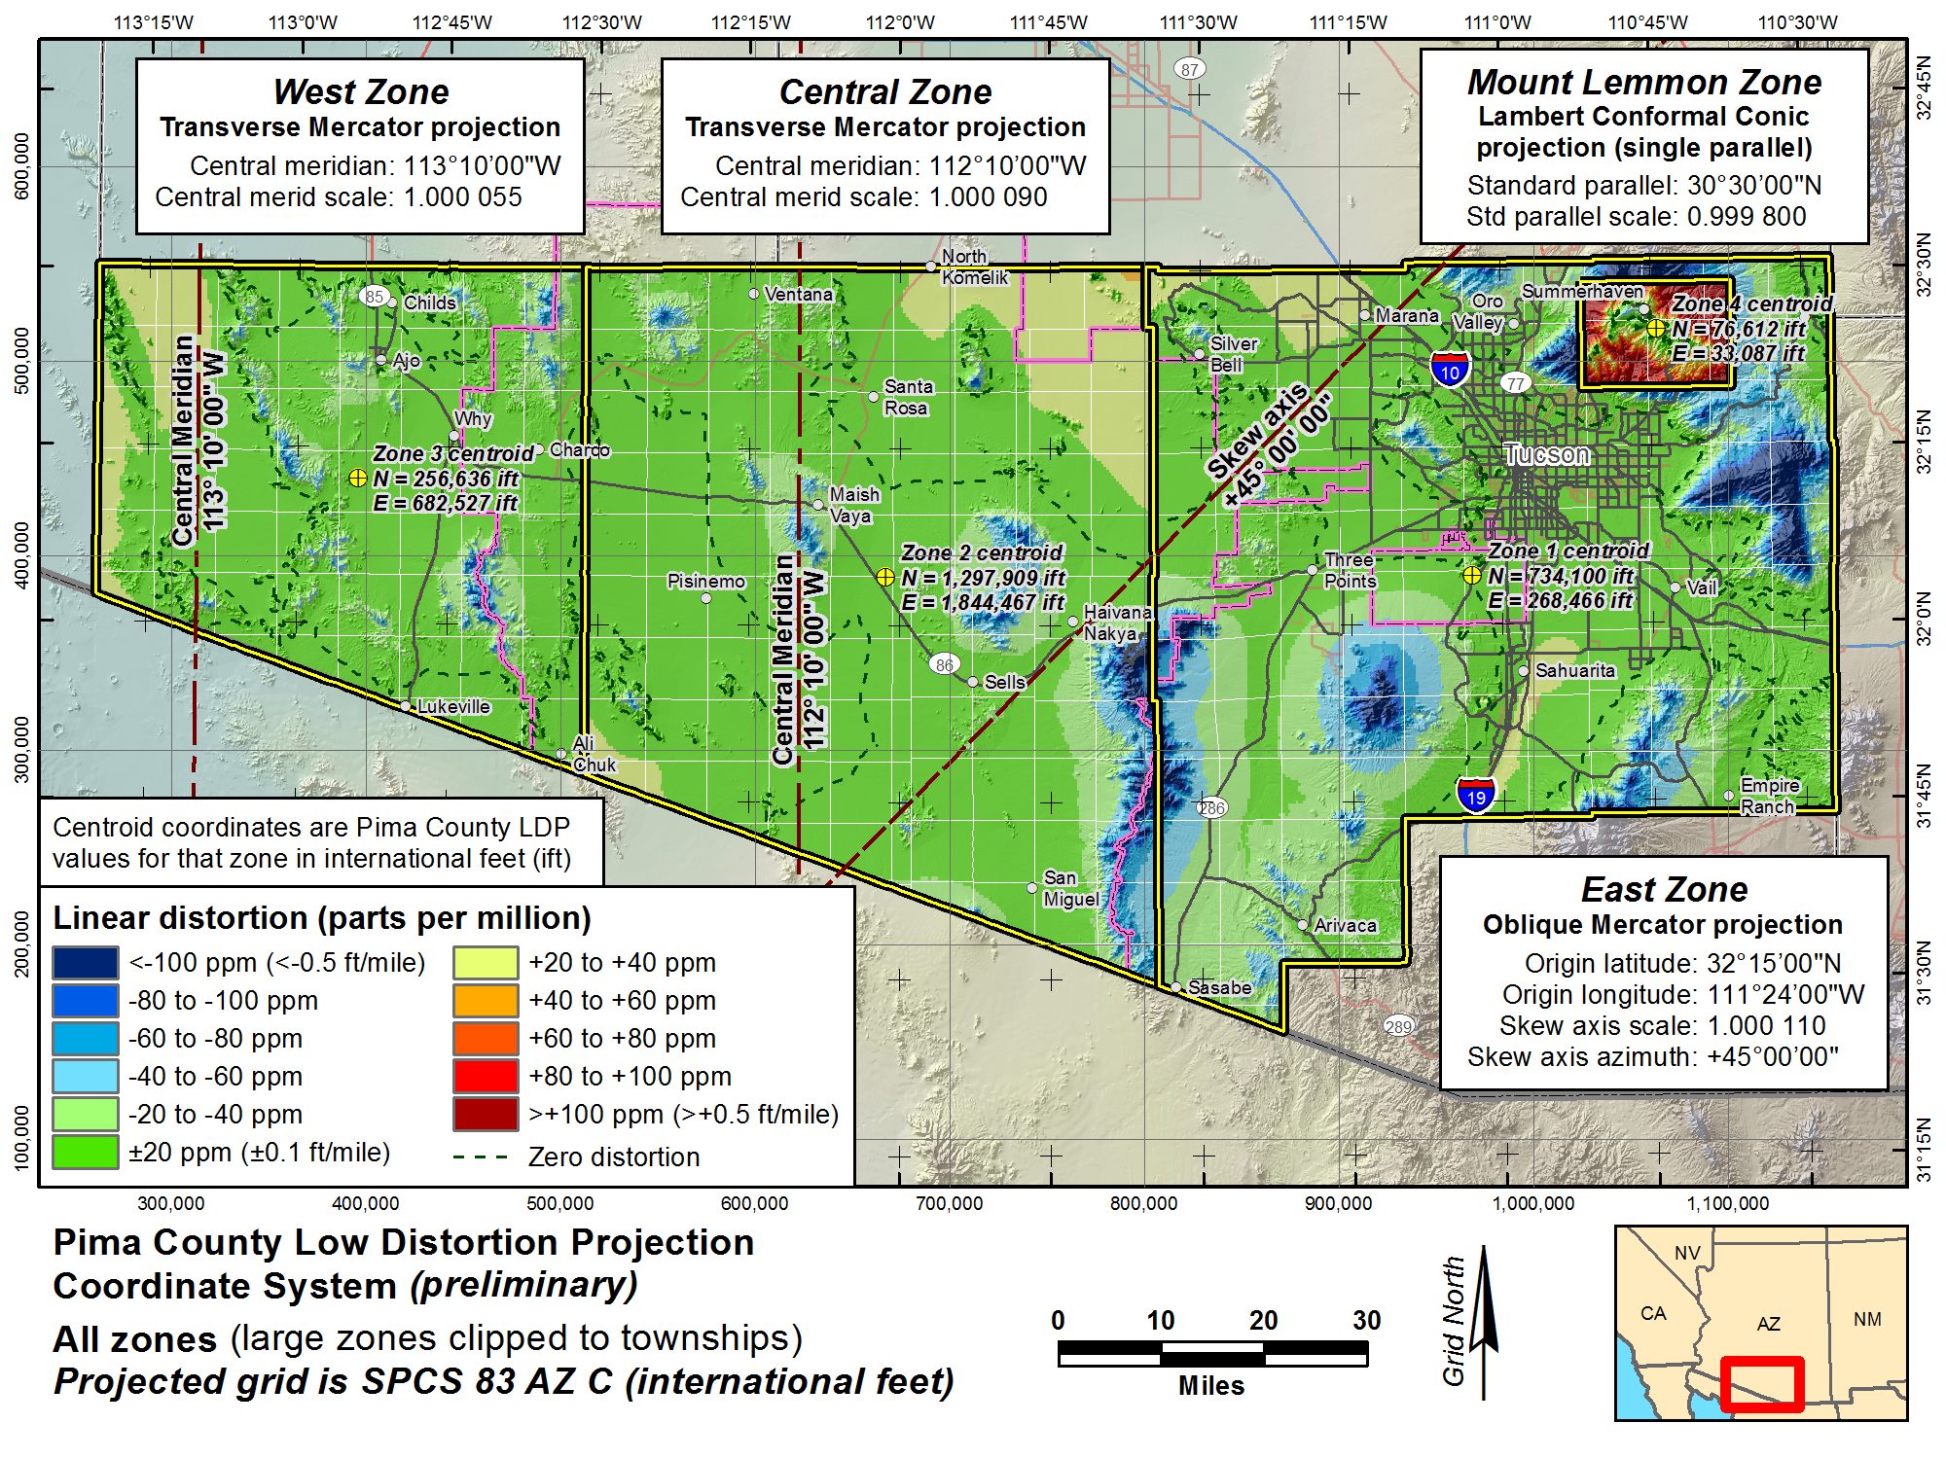

Slide 69
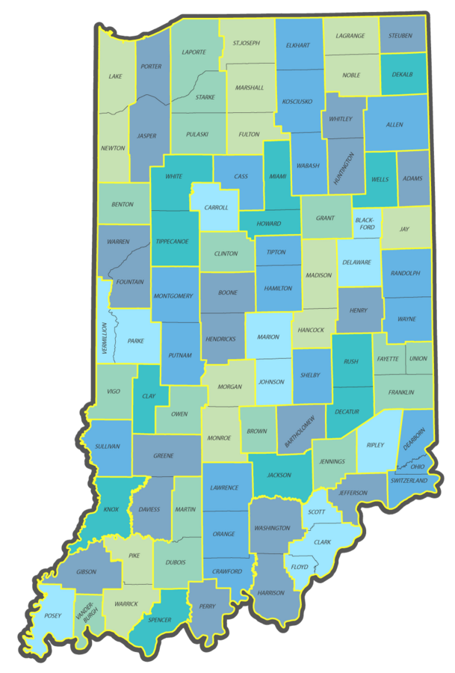
Indiana Geospatial Coordinate System
InGCS
92 zones (by county)
57 unique definitions (some counties share projections)
Transverse Mercator used for all zones
www.in.gov/indot/InGCS.htm
Does NOT meet draft SPCS2022 policy (zones too small)

Slide 70
Why restrictions on LDP design?
Avoid excessive number of very small zones
  Objective: Largest area that meets distortion criterion
  20 ppm (0.1 ft/mile) reasonable design criterion
    Typically ~70% of area will be within 10 ppm anyway
  Reduces occurrences of projects in more than one zone
Consistency needed for nationwide implementation
  Some sort of design criteria are necessary
  Counties cannot be used as LDP zones throughout U.S.
Should be optimal system for long-term usage
  Based on good design practice
  Should choose best approach, not because already created
  Prevent “buyer remorse”

Slide 71
Other considerations for zones
NGS receiving wide variety of requests
  One zone per county vs. multiple counties per zone
  Multiple zones per county vs. ignore counties entirely
  Coordinates same as existing NAD 83-based systems
  Non-conformal projections
Represents major change for NGS
  Much more flexible approach than SPCS 83
  Currently supported by NGS leadership
Other possibilities for accommodating very small zones…?
  Maybe require same projection everywhere in state (e.g., Indiana)
  Policy & procedures still DRAFT, so can change
Remember: Can always create non-SPCS2022 zones
  There may be way to support these in future

Slide 72
What states want LDPs?
Following 20 states have LDP systems and/or expressed interest in having them in SPCS2022:
Alaska
Arizona
Colorado
Illinois
Indiana
Iowa
Kansas
Kentucky
Maine
Minnesota
Missouri
Montana
Nebraska
New Mexico
North Dakota
Oklahoma
Texas
Utah
Wisconsin
Wyoming
Public letter on LDPs from Oklahoma…

Slide 73
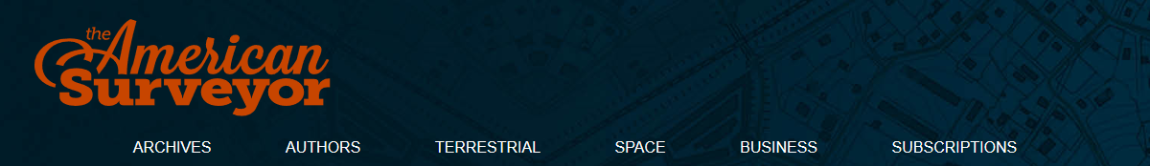
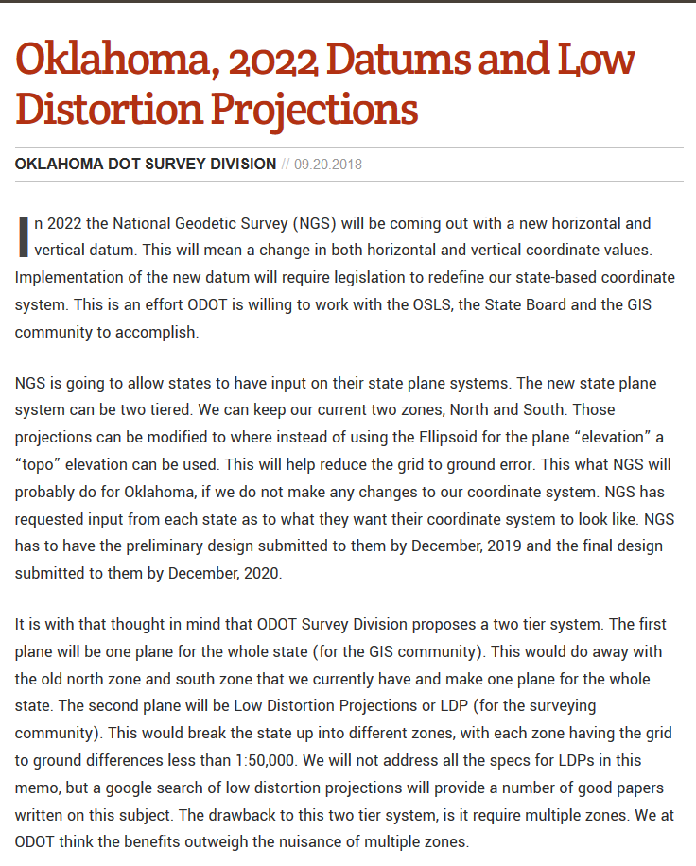
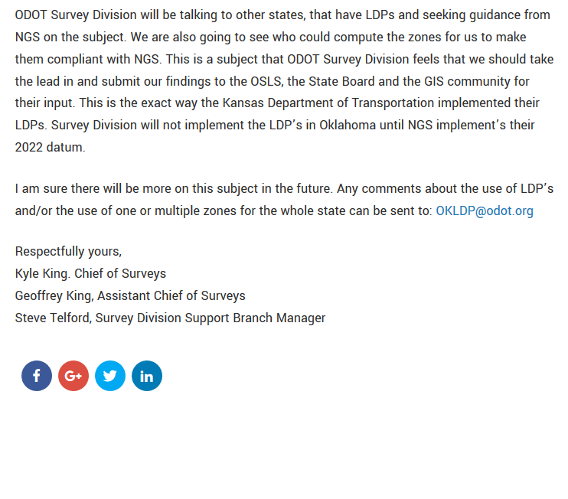
https://amerisurv.com/2018/09/20/oklahoma-2022-datums-and-low-distortion-projections/

Slide 74
Overview: Policy, Procedures, and FRN
Linear distortion at topographic surface
One-parallel Lambert Conformal Conic projections
Default SPCS2022 zone designs
Statewide and “layered” zones
Linear distortion design criteria
  Maximum and minimum zone size and distortion
  Low distortion projections (LDPs)
“Special purpose” zones (in FRN only)
Linear units
Submittal process and deadlines
  For Federal Register Notice comments
  For requests, proposals, and submittal of designs

Slide 75
“Special purpose” zones
In Federal Register Notice (not in policy & procedures)
For areas with inadequate SPCS zone coverage
  Usually areas that are in more than one zone
Categories:
  Major urban areas (e.g., New York, Chicago, St. Louis, Denver)
  Large Indian reservations (e.g., Navajo Nation)
  Federal applications covering large areas (e.g., coastal mapping of Atlantic Coast; Grand Canyon National Park)
Permitted for metro areas in 1977 policy (but never used)
Only in FRN, not in draft policy & procedures

Slide 76
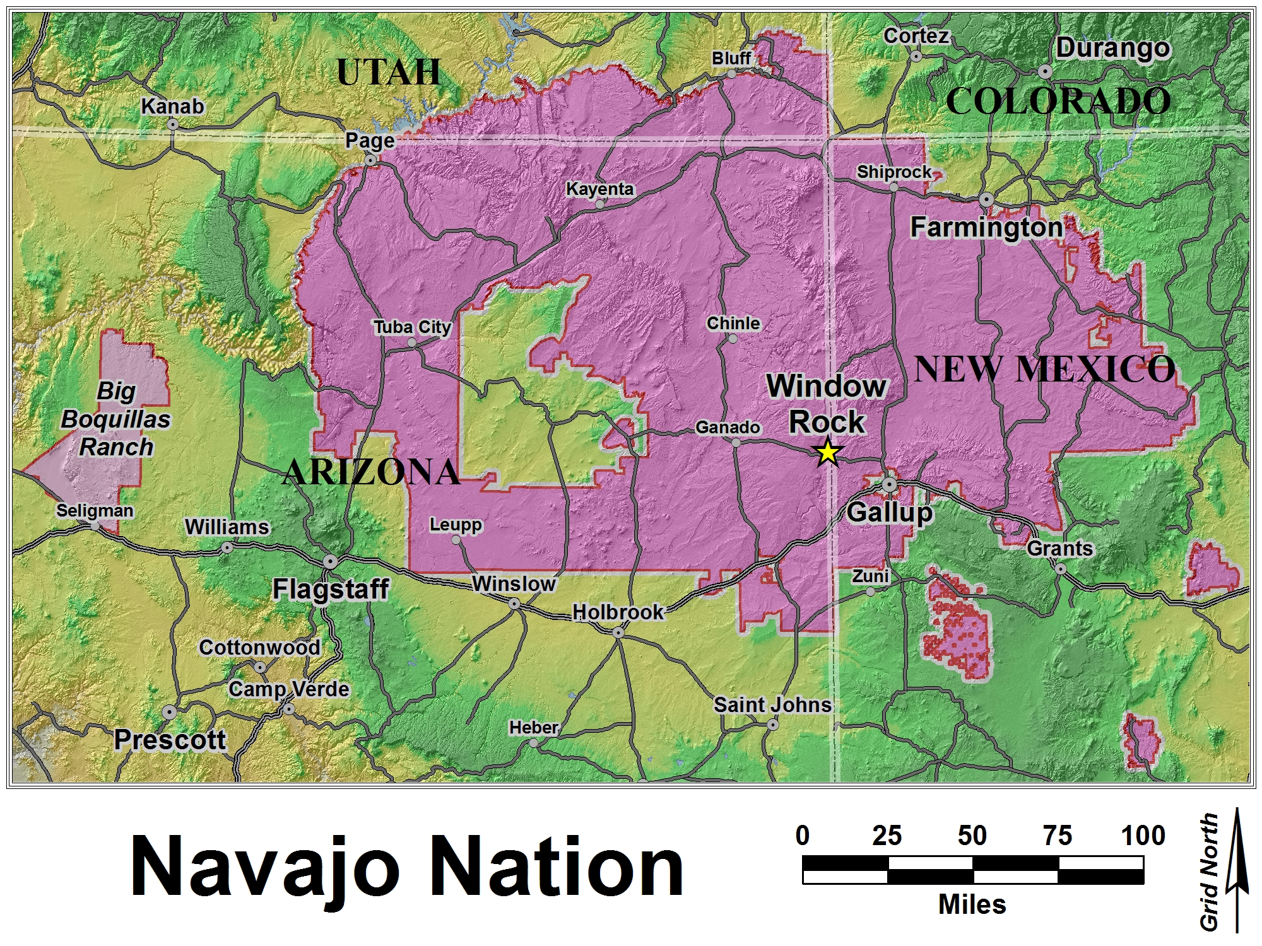
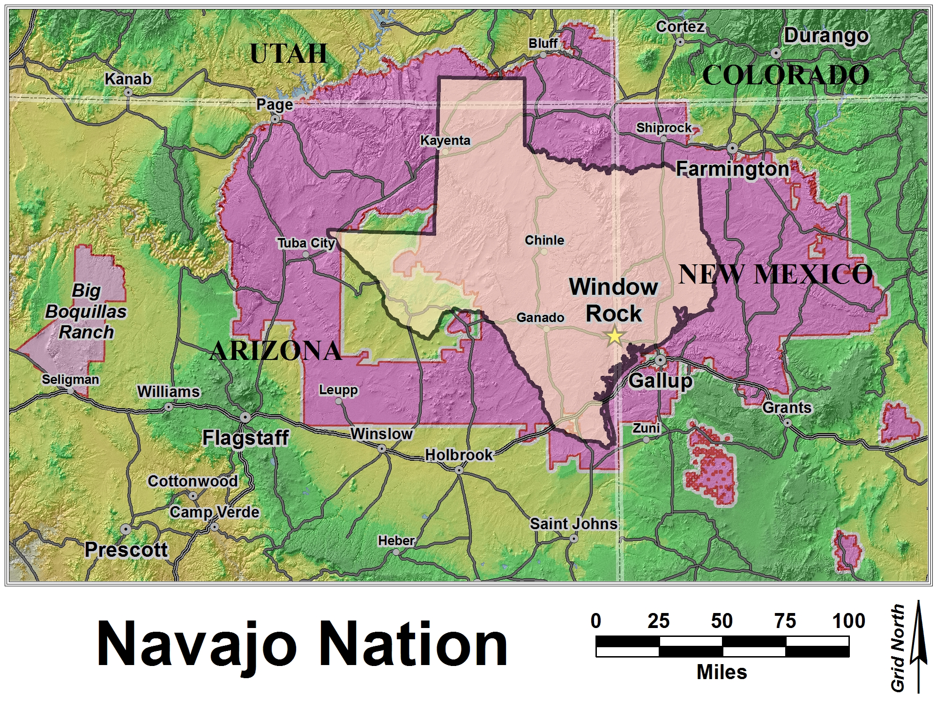
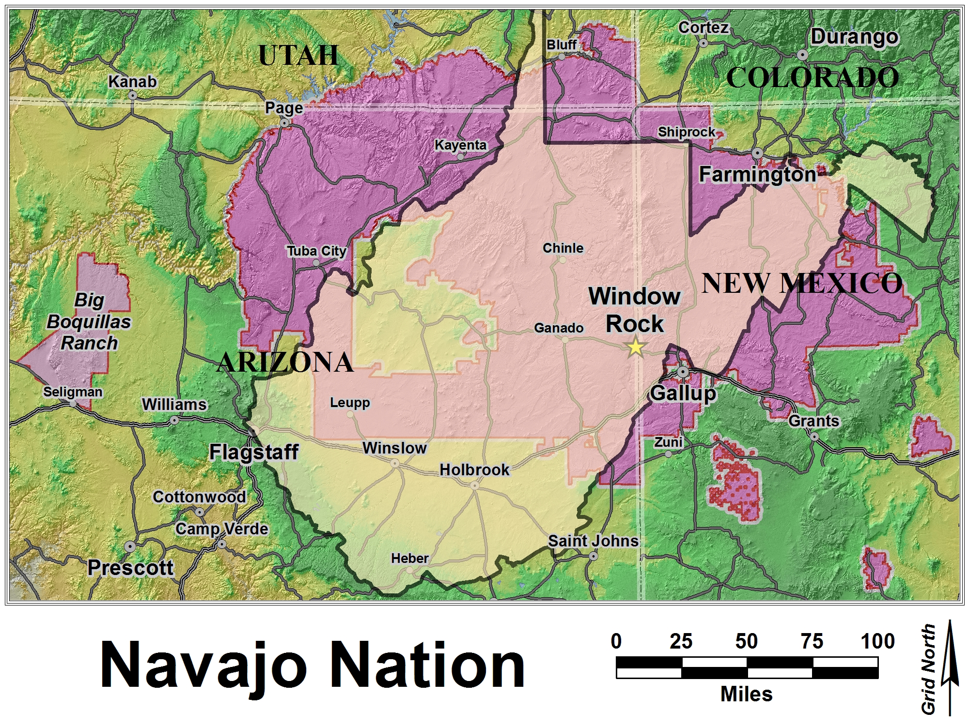
Navajo Nation

Slide 77
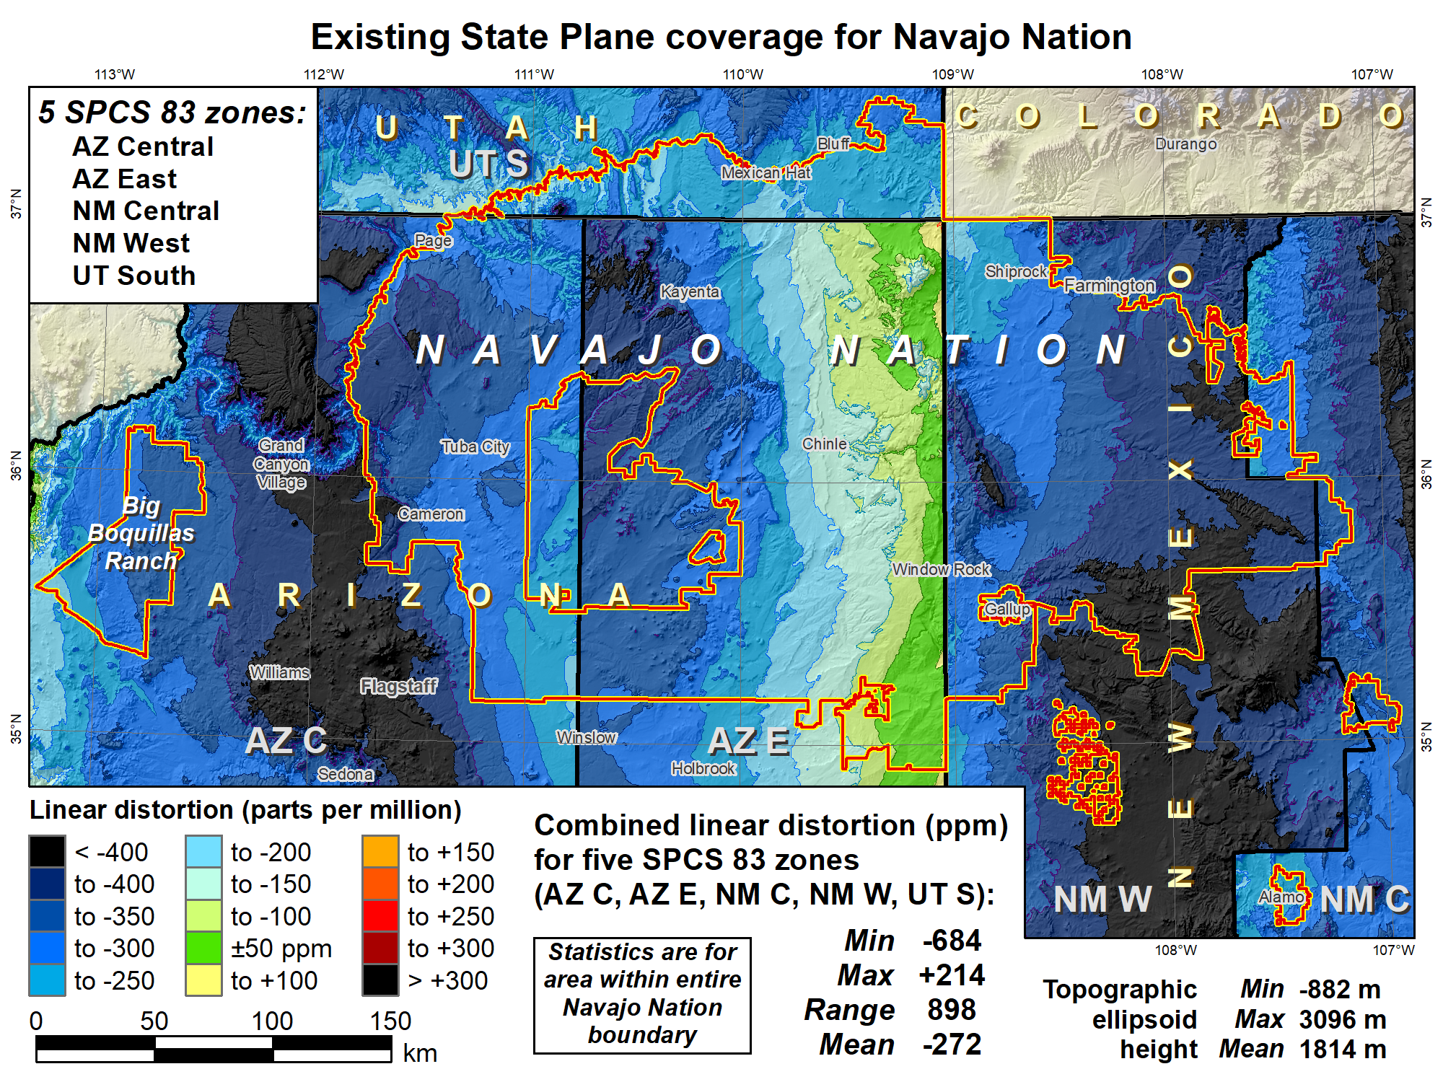

Slide 78
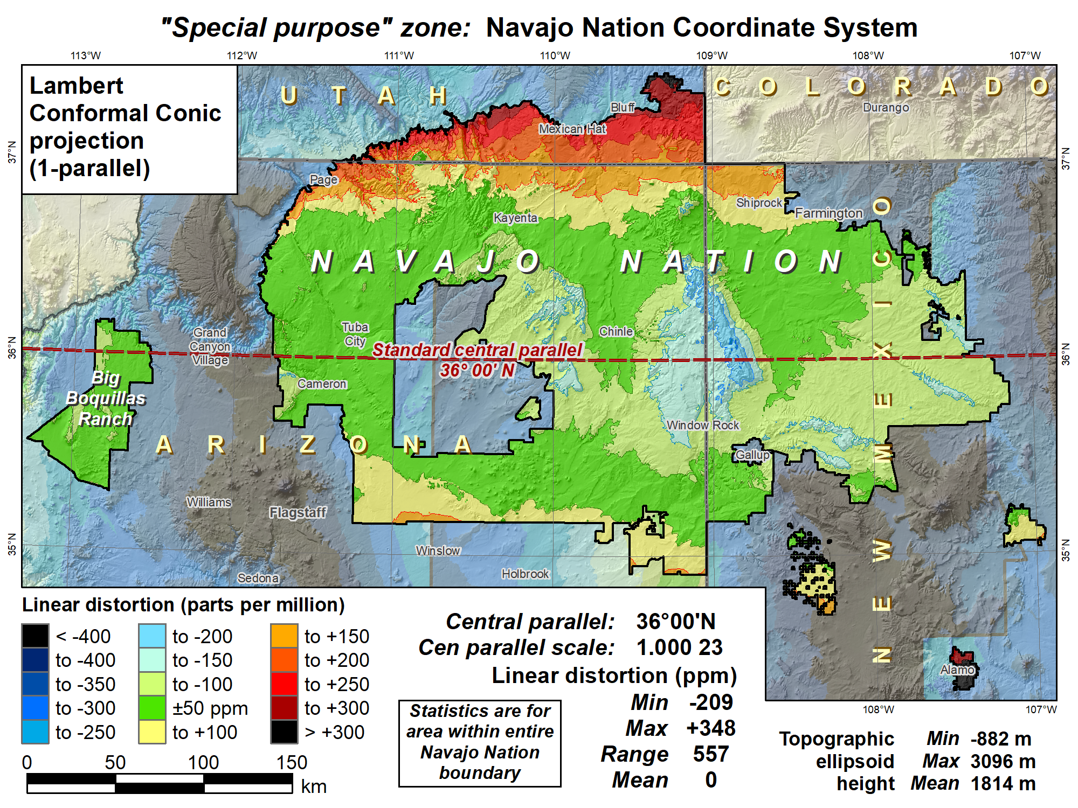

Slide 79
Overview: Policy, Procedures, and FRN
Linear distortion at topographic surface
One-parallel Lambert Conformal Conic projections
Default SPCS2022 zone designs
Statewide and “layered” zones
Linear distortion design criteria
  Maximum and minimum zone size and distortion
  Low distortion projections (LDPs)
“Special purpose” zones (in FRN only)
Linear units
Submittal process and deadlines
  For Federal Register Notice comments
  For requests, proposals, and submittal of designs

Slide 80
Linear units
Policy§II.D and E
All linear parameters defined in meters
Will also give output in feet version if specified by state
Policy§IV.C (for default zones only)
Will use foot as defined currently for SPCS 83
  Appendix C of NOAA Special Publication NOS NGS 13
(P.S. Don’t ask me what I think of US survey feet, because you probably won’t like the answer)

Slide 81
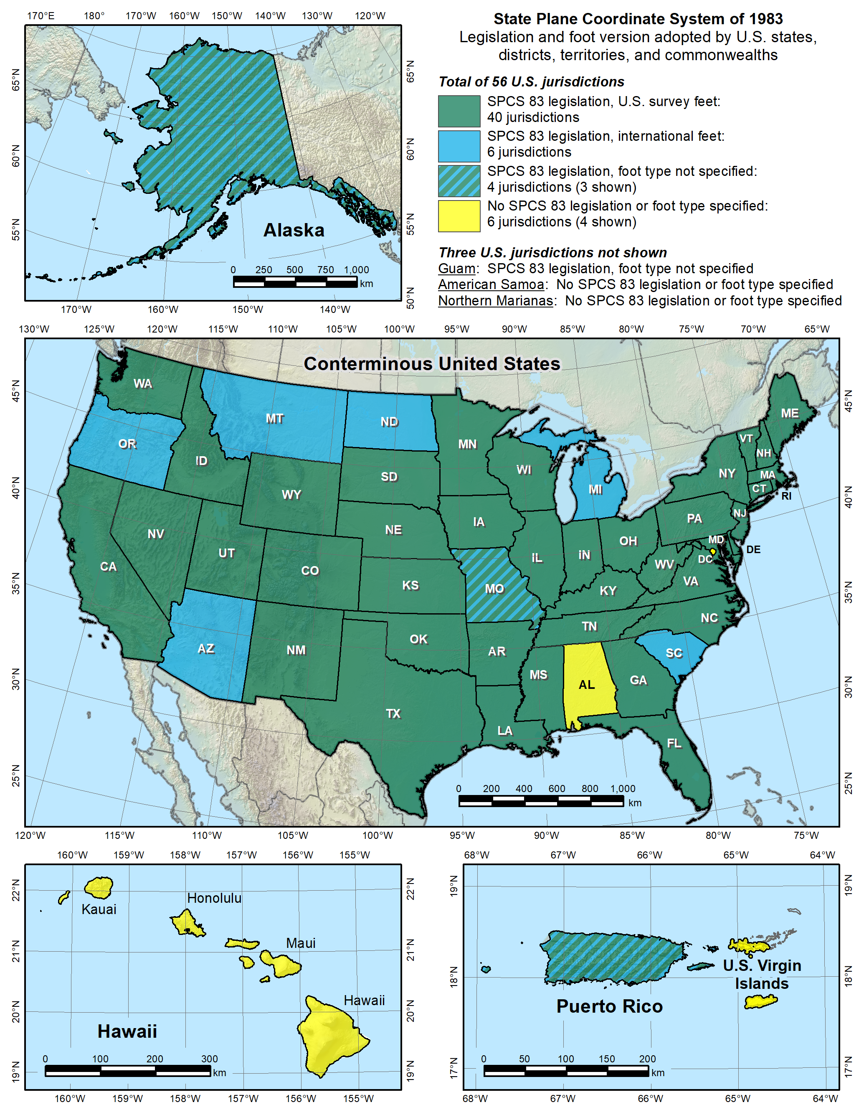

Slide 82
Overview: Policy, Procedures, and FRN
Linear distortion at topographic surface
One-parallel Lambert Conformal Conic projections
Default SPCS2022 zone designs
Statewide and “layered” zones
Linear distortion design criteria
  Maximum and minimum zone size and distortion
  Low distortion projections (LDPs)
“Special purpose” zones (in FRN only)
Linear units
Submittal process and deadlines
  For Federal Register Notice comments
  For requests, proposals, and submittal of designs

Slide 83
Procedures for SPCS2022 input
Procedures§1
NGS contact information
CONSENSUS stakeholder input is REQUIRED
Stakeholders should first agree, then collectively provide input
Procedures§2
Stakeholder requests for designs by NGS
Stakeholder proposals of designs by contributing partners
Procedures§3
Submittal of approved designs by contributing partners
Procedures§4
NGS role and responsibilities for SPCS2022 reviews
Limitations for zones designed by NGS
If no input is received from a state, or if input is not unanimous, DEFAULT design will be used for state zones

Slide 84
Deadlines for SPCS2022 requests
SPCS2022 Procedures (draft)
Consensus input per SPCS2022 procedures
  Requests for designs done by NGS
  Proposals for designs by contributing partners
Submittal of approved designs
  Proposal must first be approved by NGS
  Designs must be complete for NGS to review
Later requests will be for changes to SPCS2022
NGS.SPCS@noaa.gov
by December 31, 2019 for requests and proposals
by December 31, 2020 for submittal of approved designs

Slide 85
Overview of FRN feedback
FRN public comment period April 18-Aug 31
  For draft SPCS2022 policy & procedures
  Wide variety of formats and content
  Individuals, organizations, and groups of organizations
Received 41 unique responses:
  4 national in scope (3 from USGS)
  3 for Native American tribes
  1 regional (3 states)
  33 from states
105 people represented by name
97 organizations represented

Slide 86
Organizations represented
1 federal agency (USGS)
10 Native American tribes
23 states (includes state and private organizations)
  17 state DOTs
  12 state GIS/GIO/cartographer offices
  21 state professional societies (surveying and GIS)
  12 universities and colleges
  6 city and county groups
  7 private companies
  10 other state organizations

Slide 87
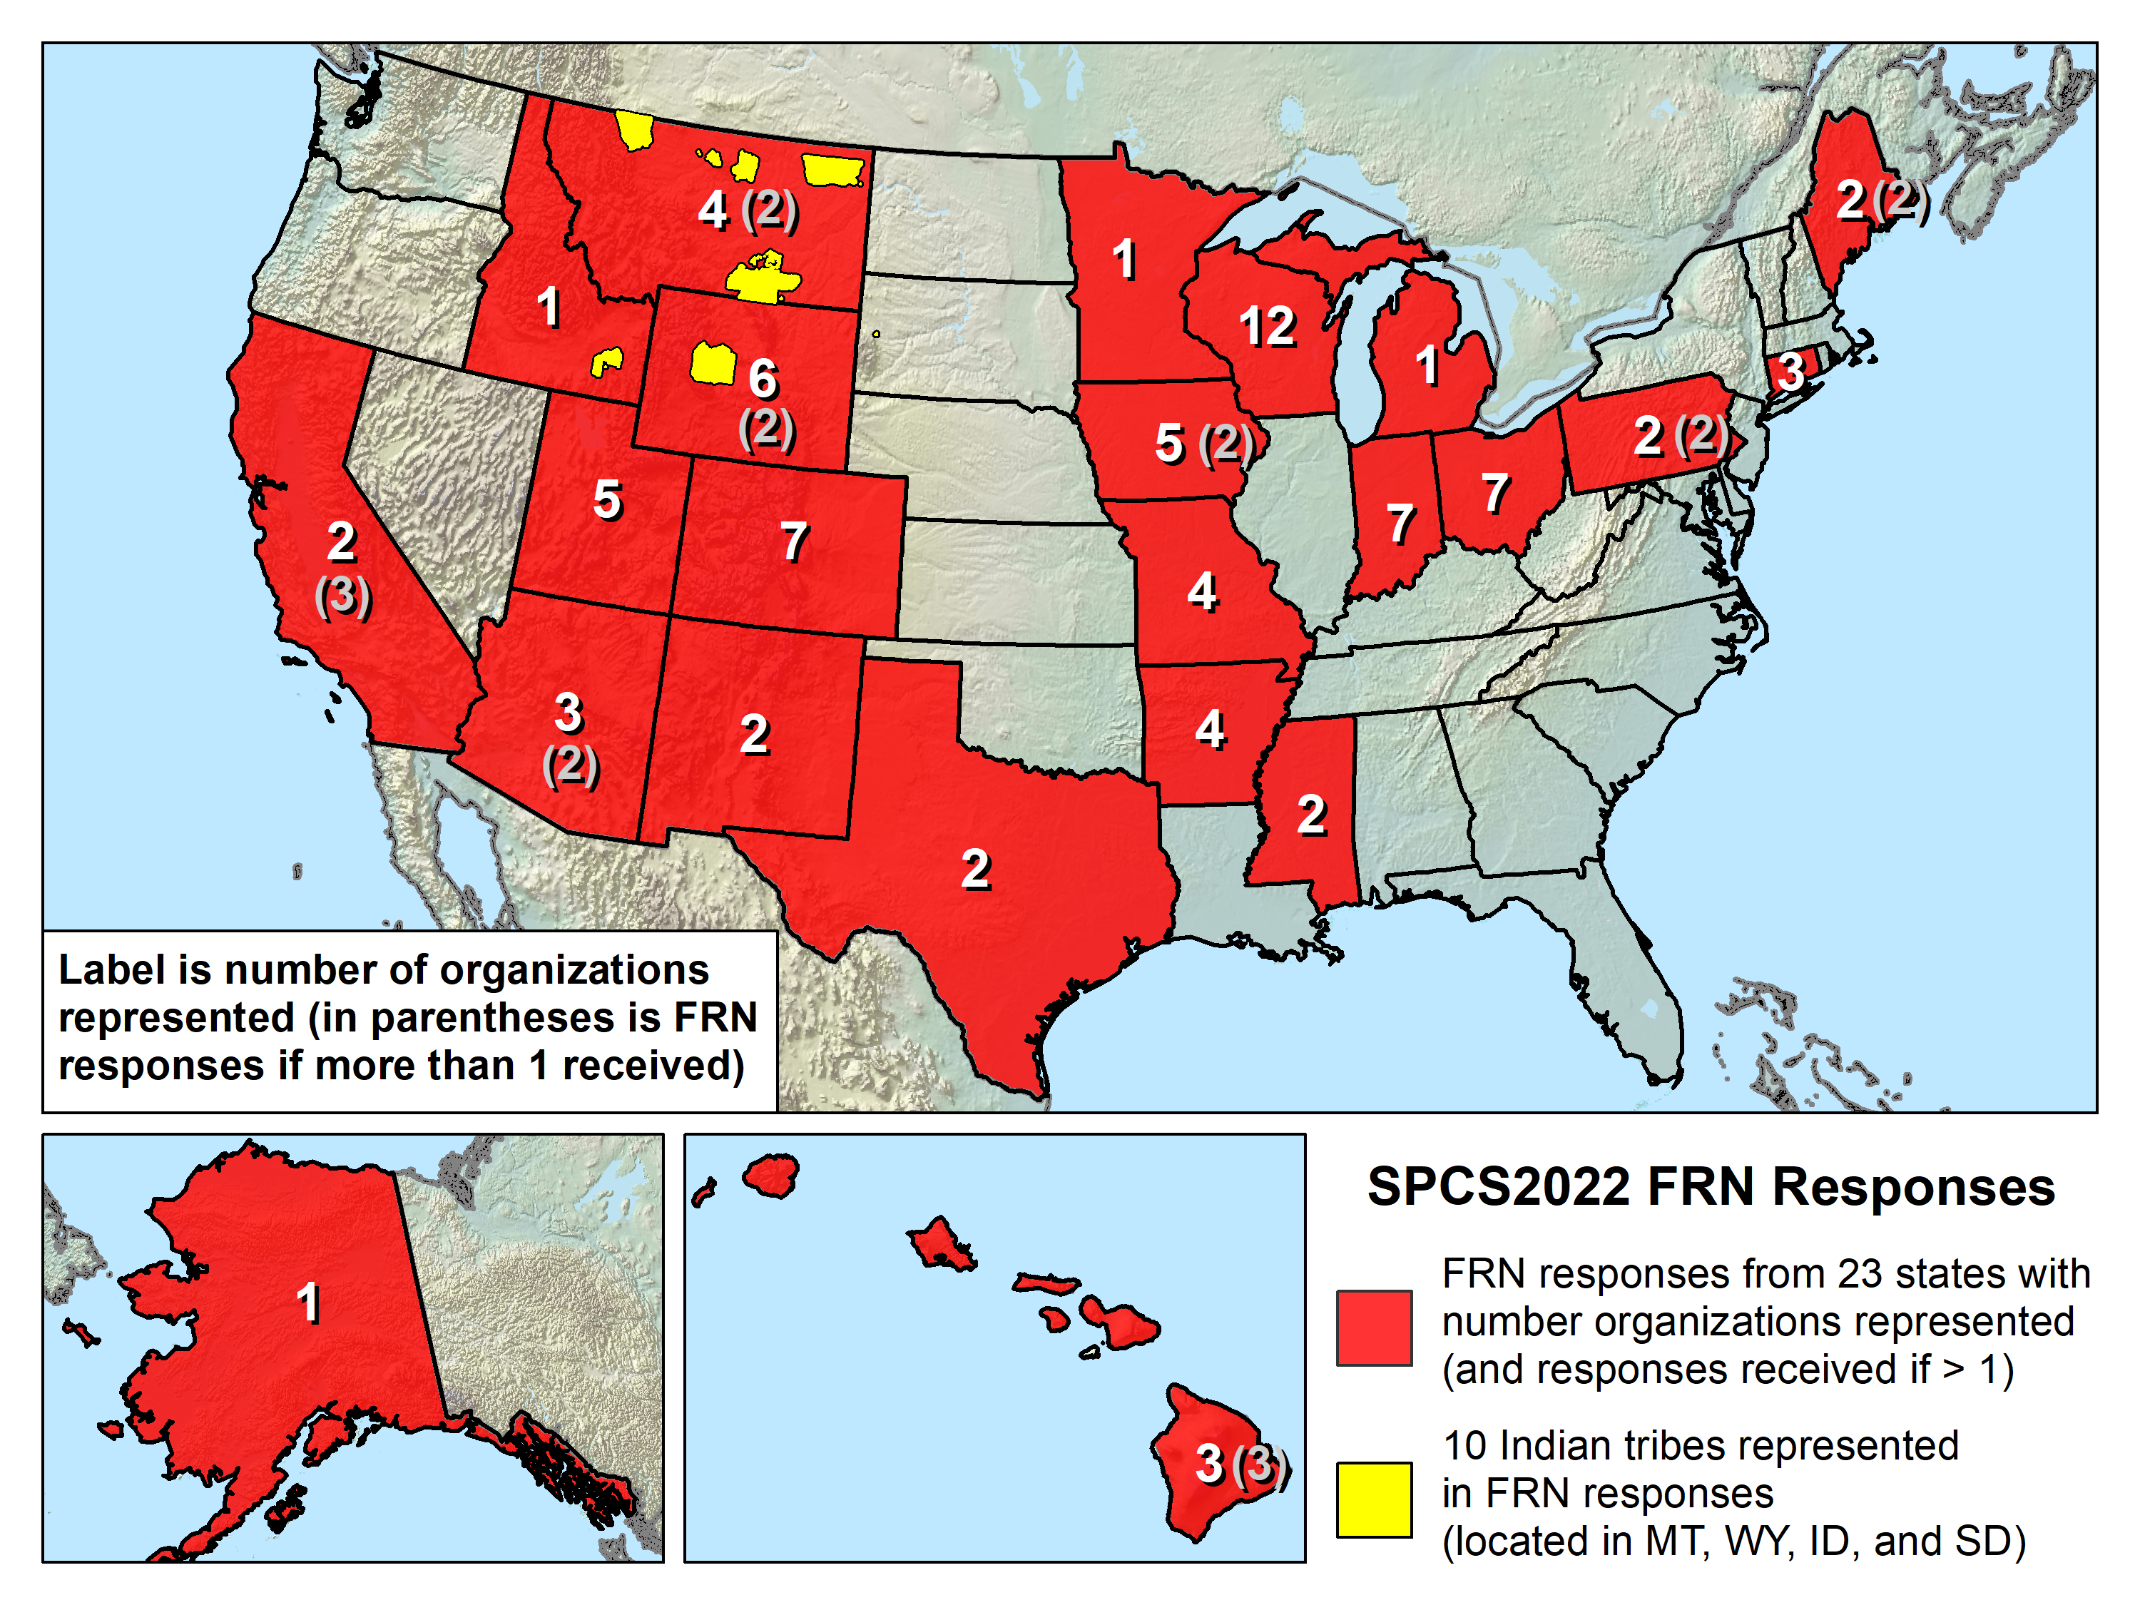

Slide 88
States that did NOT respond to FRN
Expected following states, based on other correspondence:
Alabama
Florida
Georgia
Illinois
Kansas
Kentucky
Louisiana
Maryland
Massachusetts
Nebraska
North Carolina
North Dakota
Oklahoma
Oregon
Puerto Rico
Washington
Non-responses mean satisfied with draft policy & procedures for some, but maybe not all…?

Slide 89
The 5 FRN questions
Usage of current SPCS in your organization.
Whether default SPCS2022 definitions impose hardship or are beneficial.
Whether there is sufficient flexibility in SPCS2022 characteristics.
Whether the SPCS2022 deadlines are acceptable.
Whether “special purpose” zones in SPCS2022 would be beneficial, problematic, or irrelevant.

Slide 90
Reminders about SPCS2022 stuff
Default zone designs
  Created by NGS if get no input; similar to SPCS 83
Special purpose zones
  For regions that span multiple states/zones
  e.g., Navajo Nation (3 states, 5 SPCS 83 zones)
Layered zones: Max 2 layers (e.g., Kentucky)
  A statewide zone plus 1 layer of multiple subzones
Low distortion projections (LDPs)
  Can be part of SPCS2022, but with min size limits
  Must be designed by others (not by NGS)

Slide 91
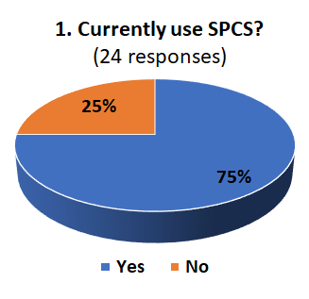
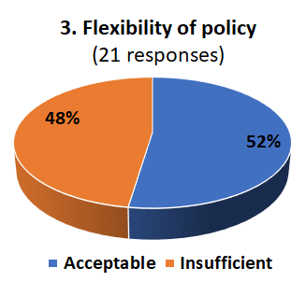
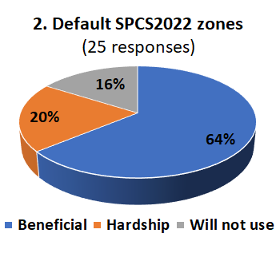
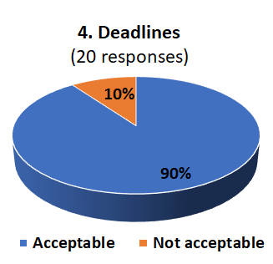
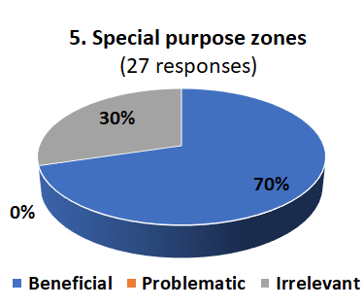
Responses to the 5 FRN questions

Slide 92
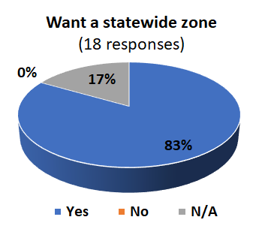



Summary of other FRN input

Slide 93
The Iowa FRN feedback
Received two responses:
  Norm Miller (for IaDOT)
  Gary Brown (for SLSI, county engineers, GIS users, private engineering and surveying firms)
Summary of feedback
  IaRCS is used almost exclusively in place of SPCS 83
  Default designs of no benefit, since want IaRCS
  Sufficient flexibility if IaRCS adopted for SPCS2022
  Deadlines acceptable
  Special purpose zones not relevant

Slide 94
Compare existing to proposed policy
Characteristic | Existing SPCS 83 | Proposed (draft) SPCS2022
Exceptions | None stated | At discretion of NGS Director
Zone extent definition | County boundaries (with a few exceptions) | “Well-defined geographic regions” within state; no other requirement
Design method | With respect to ellipsoid surface | With respect to topographic surface
*Distortion design criterion | Nominally 100 ppm (many exceptions; actual ~10-625 ppm) | Range 50-400 ppm for designs by NGS
*Low distortion projections | Infer as not allowed (although can exist in small states) | Allow min 20 ppm, but must be designed by others if < 50 ppm
*Layered zones | Not allowed (one exception in Kentucky) | Maximum of 2, and if so 1 must be a statewide zone
*Minimum zone width | Not specified (but inferred as ~250 km for multi-zone states) | Must be > 50 km if elevation range < 250 m
*Special purpose zones | Allowed for large urban areas on zone boundaries (but not used) | Excluded from policy (but NGS requested feedback in FRN)
*Denotes SPCS2022 policy item with feedback

Slide 95
Feedback that impacts SPCS2022 policy
FRN / policy / procedure item | Feedback pro | Feedback con
Statewide zones | 83% (17% N/A) | 0% opposed
Zone layers (includes statewide) | 64% say 2 layers OK | 36% want 3 or more layers
Special purpose zones | 70% (30% no opinion) | 0% opposed
Deadlines | 85% | 15% (for their LDP designs)
Flexibility in policy & procedures | 52% say acceptable as written | 48% (due to spec purpose, number layers, min zone size)
Free-form feedback | Summary of comments
Distortion design and zone size minimum limits | IN, OH, WI want to keep existing small zones (IN willing to compromise); WY expressed similar generic concern
Assistance with design | Several want more help/guidance with LDP design; AZ requested NGS provide a design tool
Accounting for topography | West states want 3 layers to better handle topography
NGS responses time | PA concerned about delay due to slow NGS responses
Support other projection types | 2 individuals want other projection types

Slide 96
Projecting desire
What does Iowa want?
  The IaRCS as part of SPCS2022
  2 layers? (IaRCS plus statewide only)
  Defining parameters in US survey feet?
What does Minnesota want?
  2 layers (new regional LDPs plus statewide only)
What does Wisconsin want?
  3 layers (WISCRS, statewide, plus 3 existing)
  Non-unique zones? Replicate existing WISCRS coordinates?
What do other states want?

Slide 97
Things to contemplate…
NGS wants to accommodate state desires
  But SPCS2022 is a national system
  There is a need for some consistency
  Promote best design practices
Approach in spirit of compromise, for example:
  Allow 3 layers, but special purpose must be multi-state
  Allow exceptions (“grandfathering”) of small zones
  Reduce IN zones from 92 to 57, WI from 72 to 59
  Relax deadlines on case-by-case basis
Support non-SPCS2022 zones?
  e.g., give coordinates in OPUS and datasheets
  Possible with standardized formats (e.g., WKT)
How much design assistance is needed?

Slide 98
Summary
SPCS2022 Policy & Procedures
  Standardized definitions and computations
  Designed with respect to “ground”
  Default designs similar to existing SPCS 83
Things yet to decide on SPCS2022 Policy & Procedures
  Layers: 1 statewide zone + 1 or 2 multizone layers?
  Allow special purpose zones? Only if in 2 or more states?
  Minimum zone width 50 km (for elevation range < 250 m)?
  Unique defining geodetic parameters for all zones?
  More assistance/guidance from NGS on LDP design?
  Support of non-SPCS zones in NGS products & services?
Consensus state stakeholder input
  Required for SPCS2022 zone requests, proposals, and designs

