Slide 1


State Plane 2022
A Tale of Change, Collaboration,
and Redemption
2018 AGIC Education and Training Symposium
Prescott, Arizona
September 19-21, 2018
Michael Dennis, RLS, PE
Geodesist
michael.dennis@noaa.gov

Slide 2
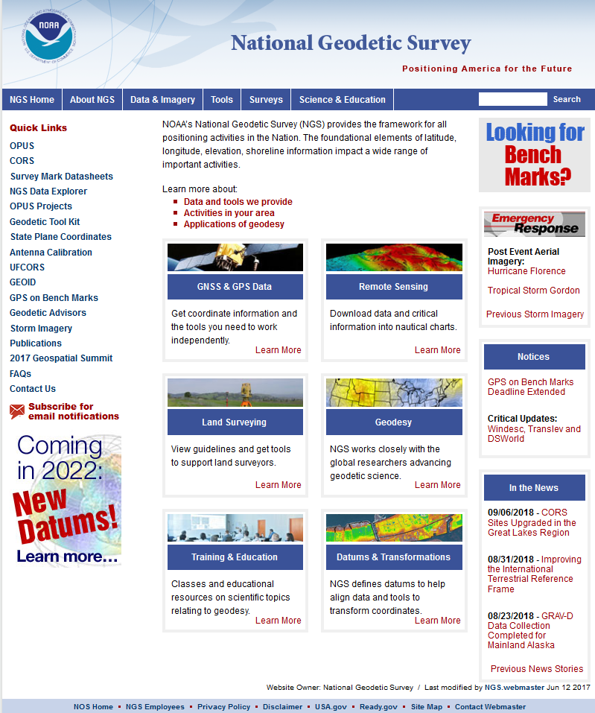
geodesy.noaa.gov

Slide 3
Latitude
Longitude
Northing (y)
Easting (x)
It’s easy! Just click this button!
Projected
Coordinates
Projected
Coordinates

Slide 4
The End
Questions?
APPLAUSE

Slide 5
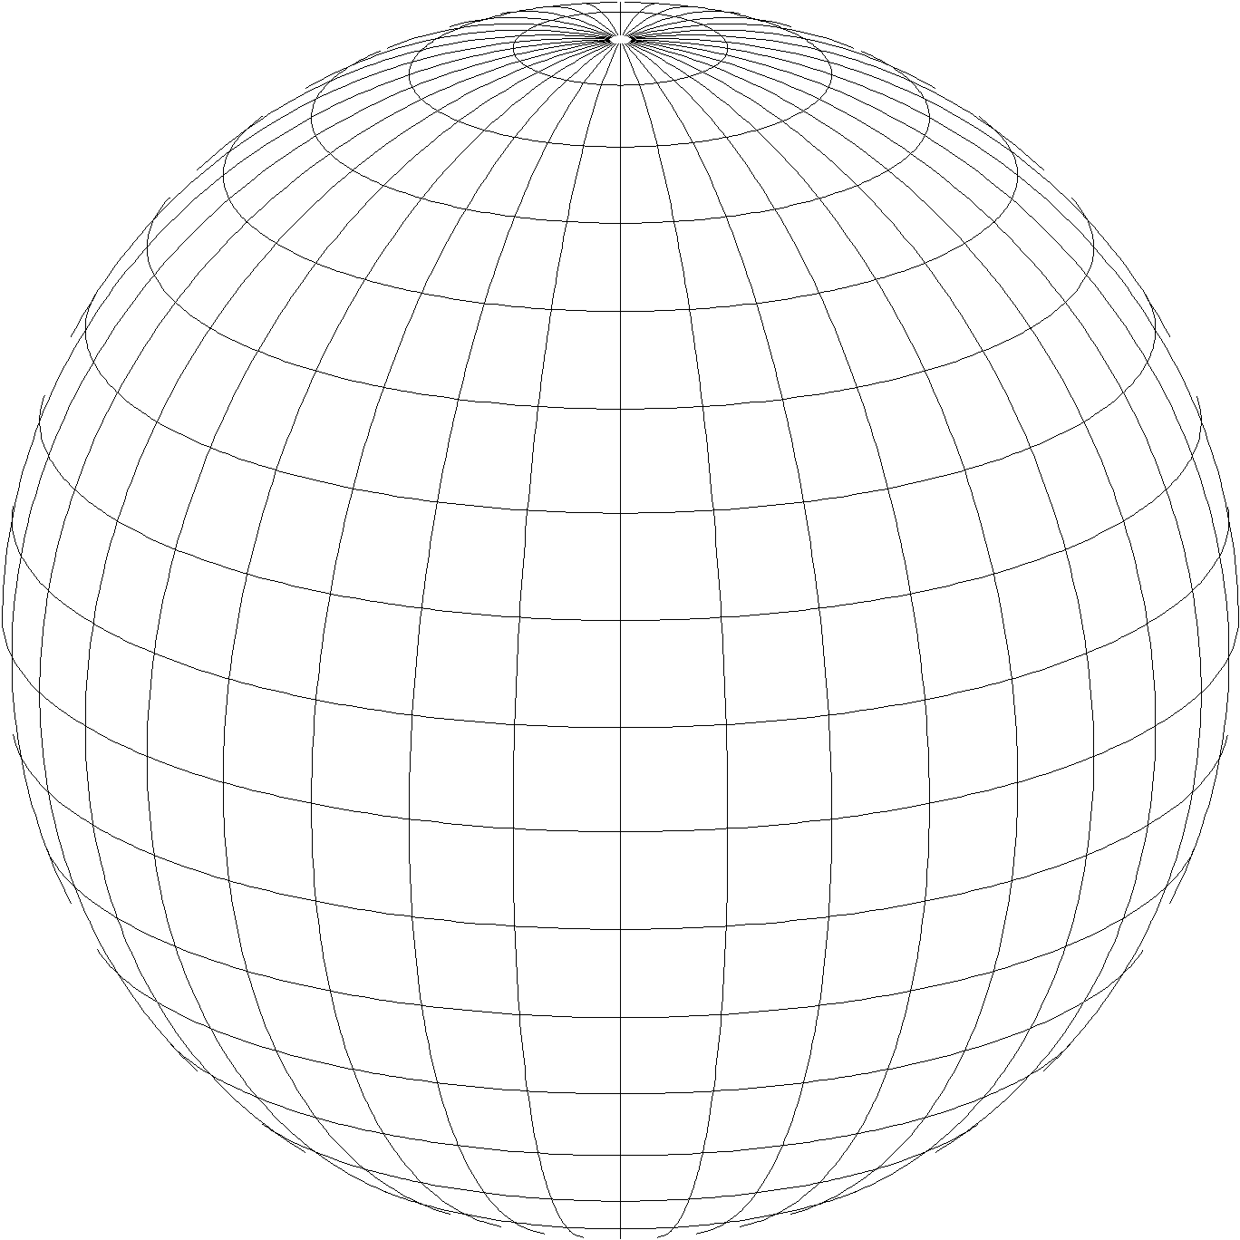
A New State Plane Coordinate System
State Plane Coordinate System of 2022 (SPCS2022)
  Referenced to 2022 Terrestrial Reference Frames (TRFs)
  Based on same reference ellipsoid as SPCS 83 (GRS 80)
  Same 3 conformal projection types as SPCS 83 and 27:
Lambert Conformal Conic (LCC)
Transverse Mercator (TM)
Oblique Mercator (OM)

Slide 6
About SPCS2022…
State Plane will change in the 2022
NGS will collaborate with stakeholders
  Input on SPCS2022 policy and procedures (DONE!)
  Can submit requests and proposals for their state
As for redemption…
  Make SPCS2022 more useful than previous SPCS
  Will try to accommodate what stakeholders want
  May require compromise and soul-searching, to save both NGS and stakeholders from error…

Slide 7
The Plan
Background
  Recent NGS activity on SPCS2022
  A bit of SPCS history
Overview of draft SPCS2022 policy & procedures
  Cover main characteristics
  Explain concepts, give examples
Responses to the SPCS2022 Federal Register Notice
  Summarize nationwide input
  The Arizona response
See SPCS2022 poster on display!

Slide 8
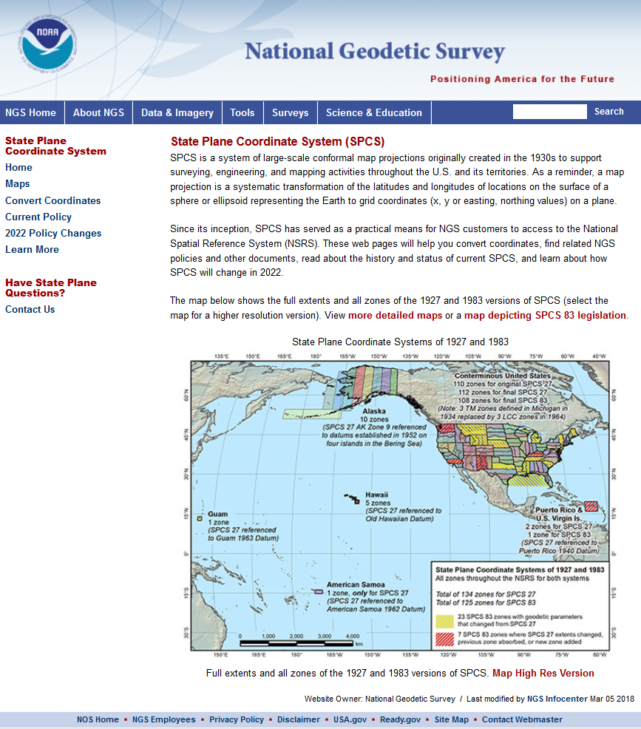
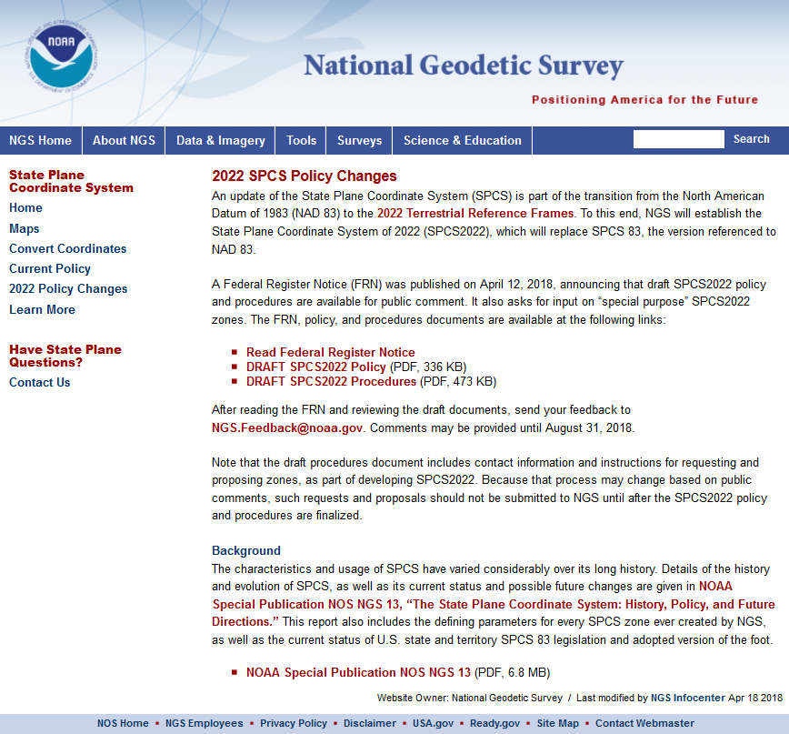
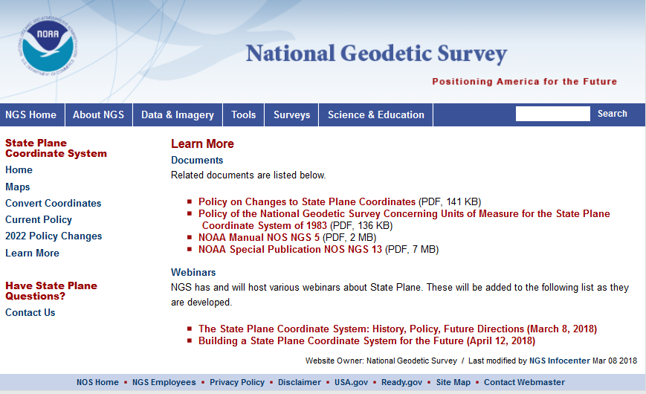
geodesy.noaa.gov/SPCS/

Slide 9
Who attended the SPCS2022 webinars?
Location | Mar 8 | Apr 12 | Location | Mar 8 | Apr 12 | Location | Mar 8 | Apr 12
Alabama | 7 | 8 | Maryland | 25 | 20 | Rhode Island | 0 | 1
Alaska | 26 | 20 | Massachusetts | 1 | 1 | South Carolina | 7 | 6
Arizona | 48 | 42 | Michigan | 34 | 57 | South Dakota | 7 | 4
Arkansas | 1 | 1 | Minnesota | 124 | 34 | Tennessee | 1 | 1
California | 35 | 30 | Mississippi | 8 | 6 | Texas | 20 | 16
Colorado | 17 | 25 | Missouri | 7 | 11 | Utah | 2 | 9
Connecticut | 4 | 11 | Montana | 16 | 13 | Vermont | 0 | 3
Delaware | 1 | 2 | Nebraska | 16 | 11 | Virginia | 8 | 5
Florida | 52 | 44 | Nevada | 5 | 1 | Washington | 12 | 16
Georgia | 8 | 3 | New Hampshire | 1 | 1 | West Virginia | 1 | 0
Hawaii | 5 | 6 | New Jersey | 4 | 1 | Wisconsin | 9 | 27
Idaho | 12 | 11 | New Mexico | 12 | 7 | Wyoming | 3 | 2
Illinois | 15 | 12 | New York | 4 | 5 | American Samoa | 0 | 0
Indiana | 4 | 7 | North Carolina | 10 | 8 | District of Columbia | 2 | 1
Iowa | 6 | 7 | North Dakota | 33 | 13 | Guam | 0 | 0
Kansas | 5 | 3 | Ohio | 31 | 24 | Mariana Islands | 0 | 0
Kentucky | 5 | 5 | Oklahoma | 3 | 1 | Puerto Rico | 2 | 3
Louisiana | 13 | 10 | Oregon | 53 | 23 | US Virgin Islands | 0 | 1
Maine | 1 | 1 | Pennsylvania | 23 | 18 | International | 8 | 13

Slide 10
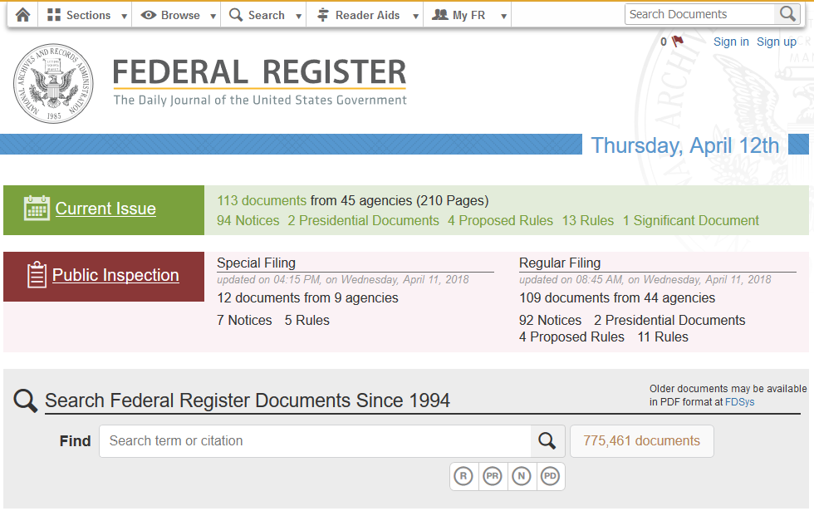
Federal Register Notice
https://www.federalregister.gov/
Announced draft SPCS2022 Policy and Procedures
Also asked for input on “special purpose” zones
Public comment period ended Aug 31, 2018

Slide 11
History and Future of State Plane
SPCS created 85 years ago
  SPCS 27: 1933 – 1986 (53 years, with some changes)
  SPCS 83: 1986 – 2022 (36 years, with some changes)
  SPCS2022: 2022 – ? (at least a few decades…)
SPCS2022 will likely be around for a long time
  Honor the history and legacy of SPCS…
  …while building a system for the future

Slide 12
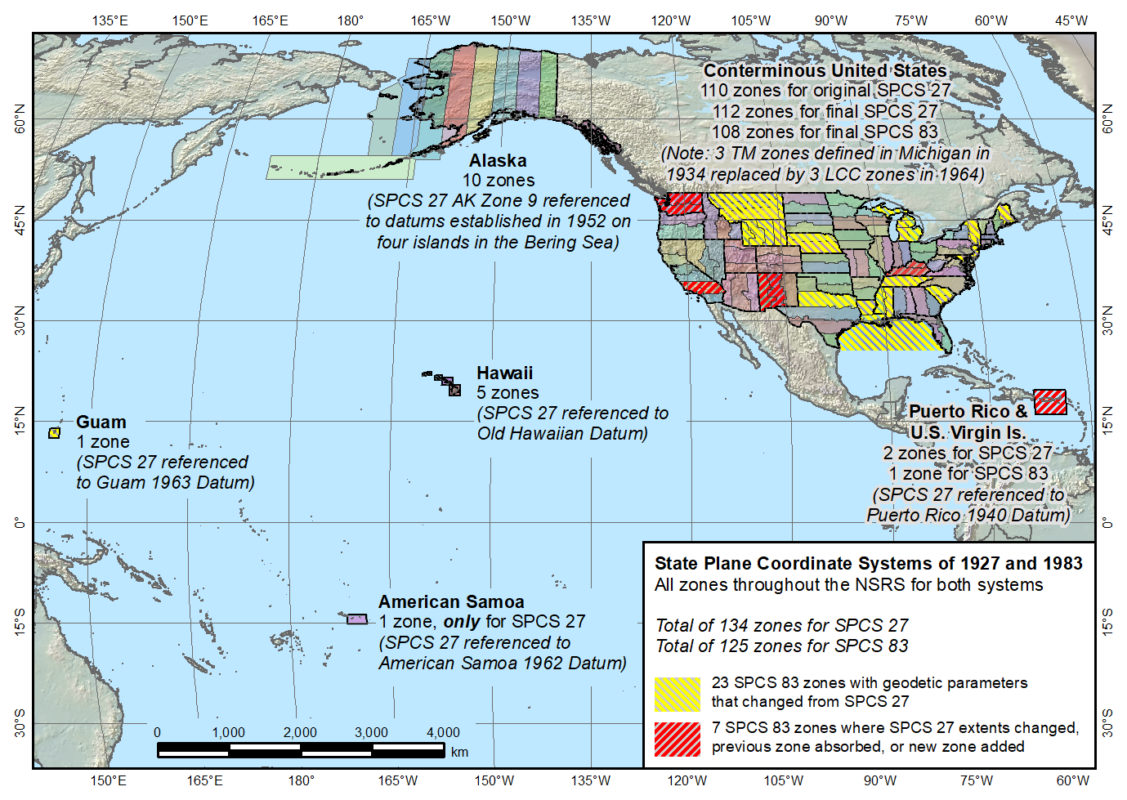
State Plane Coordinate Systems of 1927 (134 zones) and 1983 (125 zones)
Guam SPCS 83 zone added in 1995
Guam SPCS 27 zone a non-conformal projection
Two zones in SPCS 27, one in SPCS 83
American Samoa only in SPCS 27, not SPCS 83

Slide 13
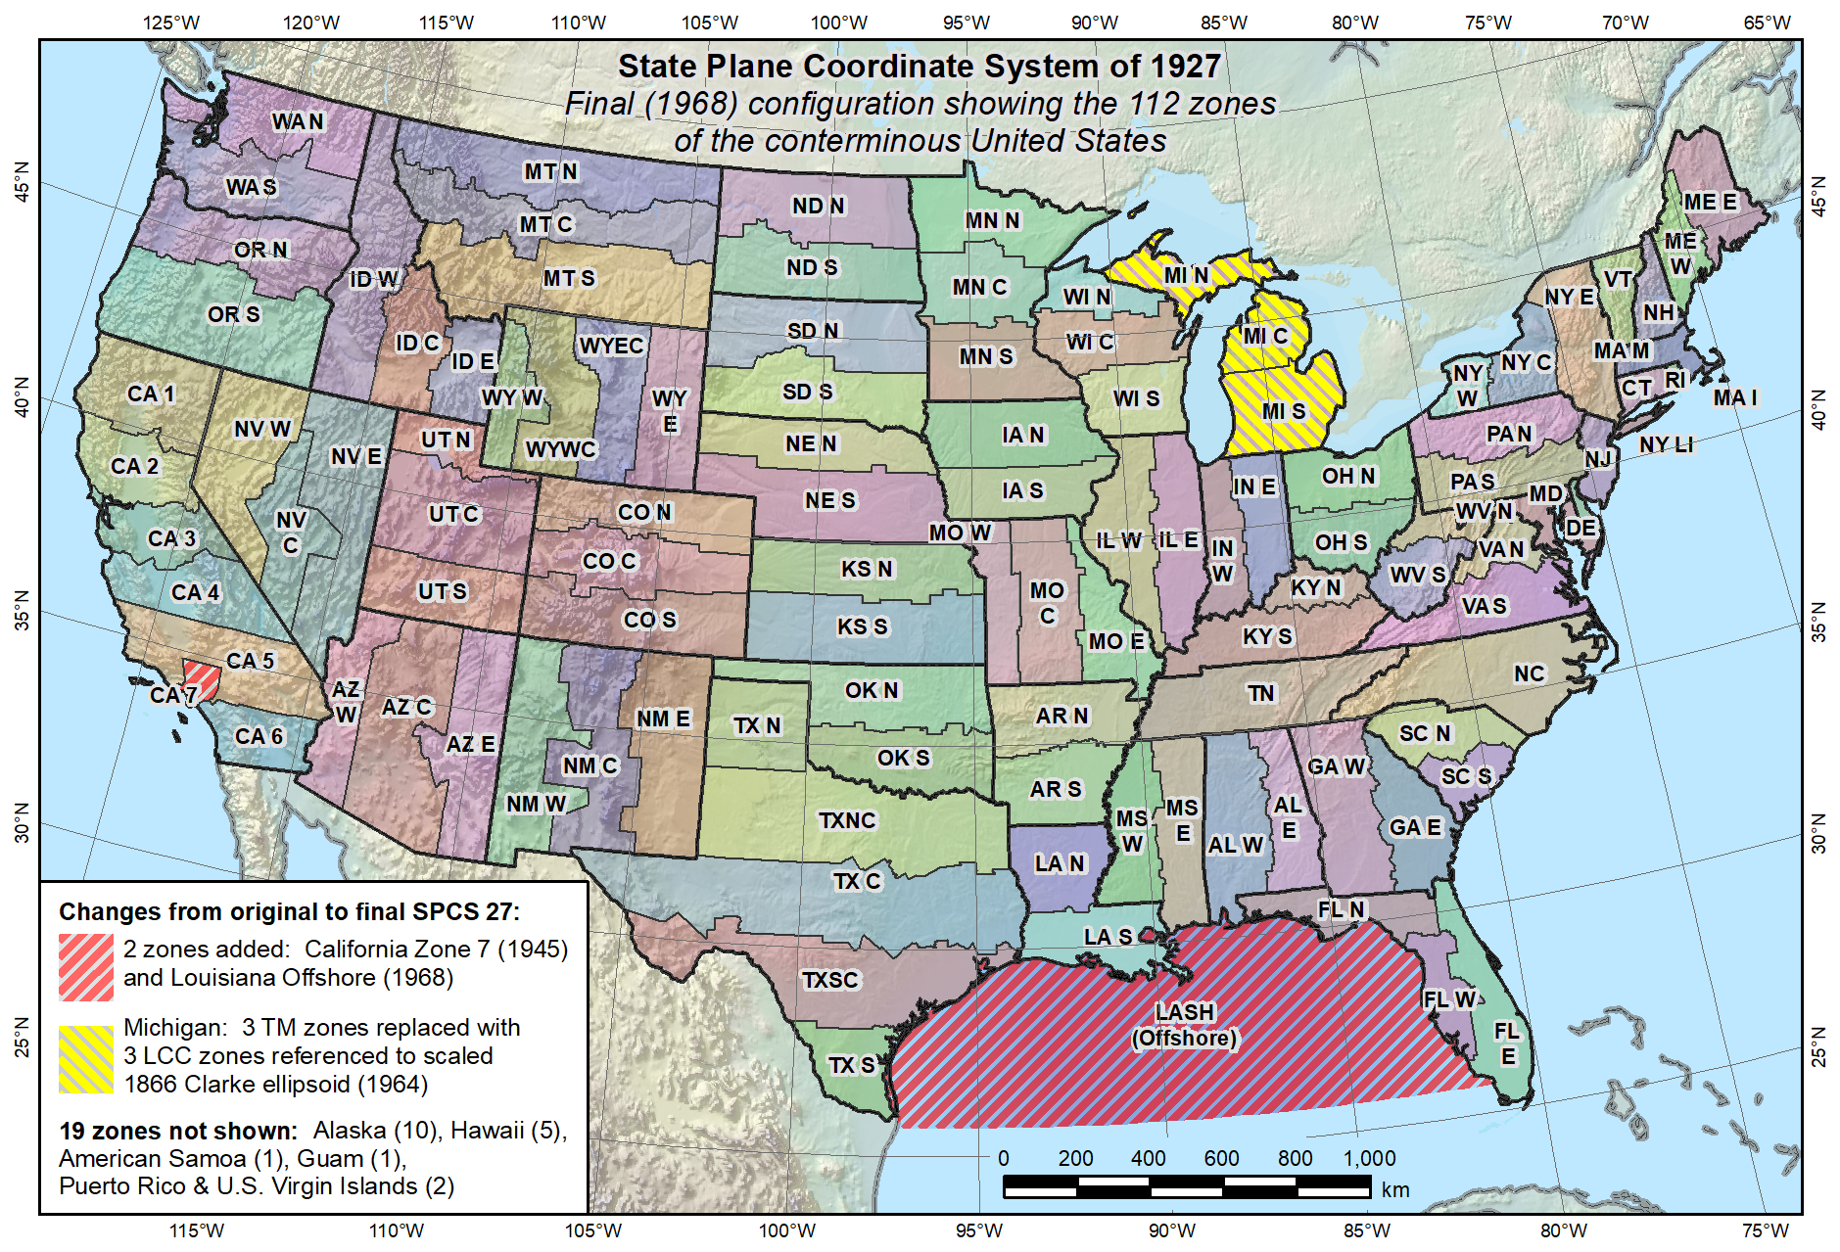
Final SPCS 27, as of 1968 (112 zones in CONUS, 131 zones total)
Reduced distortion zones added: CA 7 (1945)
MI (1964)

Slide 14
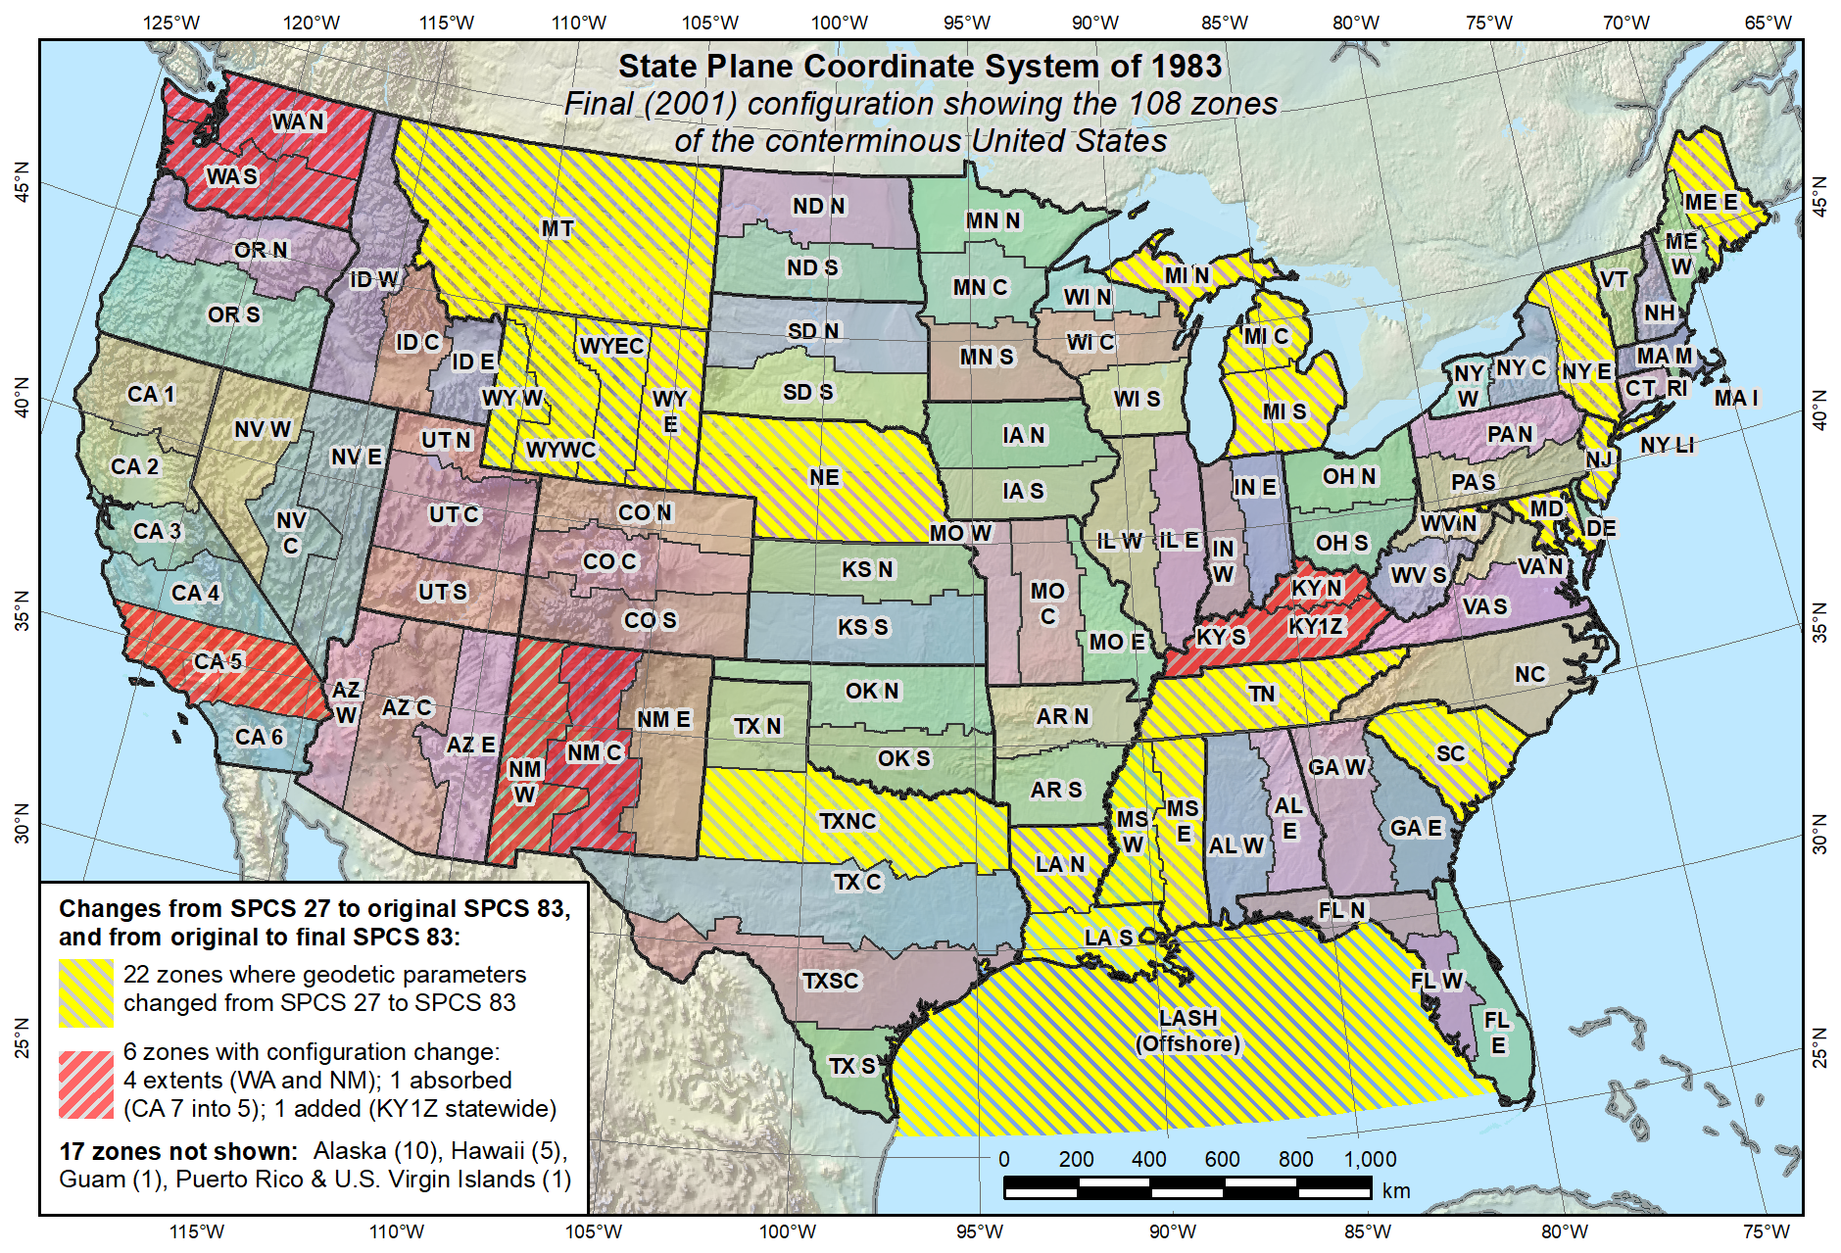
Final SPCS 83, as of 2001 (108 zones in CONUS, 125 zones total)
KY statewide zone added in 2001

Slide 15
Overview: Policy, Procedures, and FRN
Linear distortion at topographic surface
One-parallel Lambert Conformal Conic projections
Default SPCS2022 zone designs
Statewide and “layered” zones
Linear distortion design criteria
  Maximum and minimum zone size and distortion
  Low distortion projections (LDPs)
“Special purpose” zones (in FRN only)
Linear units
Submittal process and deadlines
  For Federal Register Notice comments
  For requests, proposals, and submittal of designs

Slide 16
Linear distortion at topo surface
Policy§II.C and Procedures§5.c.
Distortion for design evaluated at topo surface
  Minimize range and mean distortion in zone
  Account for cities with distortion weighted by population
Design not evaluated at the ellipsoid surface
  Nobody lives or works on the ellipsoid
  Likely used in past because it is easier
Projection scaled to topo surface (“ground”)
  Reduces difference between “grid” and “ground”
  Topographic ellipsoid height not part of definition

Slide 17
Linear distortion with respect to ellipsoid
Projection
axis
Ellipsoid surface
Ellipsoid distance
Projection surface (secant)
Grid distance > ellipsoid distance
This design approach
used for SPCS 27 and 83 (minimizes distortion with respect to ellipsoid)
Ellipsoid distance
Grid distance <
ellipsoid distance

Slide 18
Linear distortion with respect to topographic surface
Horizontal ground distance
> ellipsoid distance
and
> grid distance
Topographic surface
Projection
axis
Ellipsoid surface
Ellipsoid distance
Projection surface (secant)
Grid distance
> ellipsoid distance
< ground distance
This design approach
used for SPCS 27 and 83 (minimizes distortion with respect to ellipsoid)
Ellipsoid distance
Grid distance
< ellipsoid distance
< ground distance

Slide 19
Linear distortion with respect to topographic surface
Horizontal ground distance
> ellipsoid distance
and
> grid distance
Topographic surface
Projection
axis
Ellipsoid surface
Ellipsoid distance
Grid distance
> ellipsoid distance
≈ ground distance
Projection surface (non-intersecting)
This design approach
will be used for SPCS2022 (minimizes distortion with respect to topography)

Slide 20
Linear distortion magnitudes ppm = parts per million (mm/km)
±20 ppm = 2 cm/km = 0.1 ft/mile = 1 : 50,000
  Often used as “low distortion” design criterion (at ground)
±50 ppm = 5 cm/km = 0.3 ft/mile = 1 : 20,000
  Minimum design criterion for SPCS2022 designs by NGS (at ground)
±100 ppm = 10 cm/km = 0.5 ft/mile = 1 : 10,000
  “Nominal” maximum State Plane value (on ellipsoid)
  Can be much greater at topo surface
±400 ppm = 40 cm/km = 2.1 ft/mile = 1 : 2,500
  Maximum design criterion for SPCS2022 zones (at ground)
  Maximum UTM value (on ellipsoid)
Nominal distortion criterion (on ellipsoid) for SPCS 27 and 83 zones (although greatly exceeded for some zones in SPCS 83).

Slide 21
Linear distortion magnitudes ppm = parts per million (mm/km)
±20 ppm = 2 cm/km = 0.1 ft/mile = 1 : 50,000
  Often used as “low distortion” design criterion (at ground)
±50 ppm = 5 cm/km = 0.3 ft/mile = 1 : 20,000
  Minimum design criterion for SPCS2022 designs by NGS (at ground)
±100 ppm = 10 cm/km = 0.5 ft/mile = 1 : 10,000
  “Nominal” maximum State Plane value (on ellipsoid)
  Can be much greater at topo surface
±400 ppm = 40 cm/km = 2.1 ft/mile = 1 : 2,500
  Maximum design criterion for SPCS2022 zones (at ground)
  Maximum UTM value (on ellipsoid)
Distortion range (at ground) for zones designed by NGS, as proposed in draft SPCS2022 policy and procedures.

Slide 22
Linear distortion magnitudes ppm = parts per million (mm/km)
±20 ppm = 2 cm/km = 0.1 ft/mile = 1 : 50,000
  Often used as “low distortion” design criterion (at ground)
±50 ppm = 5 cm/km = 0.3 ft/mile = 1 : 20,000
  Minimum design criterion for SPCS2022 designs by NGS (at ground)
±100 ppm = 10 cm/km = 0.5 ft/mile = 1 : 10,000
  “Nominal” maximum State Plane value (on ellipsoid)
  Can be much greater at topo surface
±400 ppm = 40 cm/km = 2.1 ft/mile = 1 : 2,500
  Maximum design criterion for SPCS2022 zones (at ground)
  Maximum UTM value (on ellipsoid)
Distortion criterion (at ground) often used for “low distortion projection” (LDPs); designed by others for SPCS2022 (not by NGS)

Slide 23
Overview: Policy, Procedures, and FRN
Linear distortion at topographic surface
One-parallel Lambert Conformal Conic projections
Default SPCS2022 zone designs
Statewide and “layered” zones
Linear distortion design criteria
  Maximum and minimum zone size and distortion
  Low distortion projections (LDPs)
“Special purpose” zones (in FRN only)
Linear units
Submittal process and deadlines
  For Federal Register Notice comments
  For requests, proposals, and submittal of designs

Slide 24
Overview: Policy, Procedures, and FRN
Linear distortion at topographic surface
One-parallel Lambert Conformal Conic projections
Default SPCS2022 zone designs
Statewide and “layered” zones
Linear distortion design criteria
  Maximum and minimum zone size and distortion
  Low distortion projections (LDPs)
“Special purpose” zones (in FRN only)
Linear units
Submittal process and deadlines
  For Federal Register Notice comments
  For requests, proposals, and submittal of designs

Slide 25
Default SPCS2022 designs
Policy§IV and Procedures§5.g.
For complete system even with no stakeholder input
  To ensure coverage of all states and U.S. territories
Nearly same as SPCS 83 but with some modifications
  Almost all zone projection types and extents the same
  Modified to align with SPCS2022 policy and procedures
  Small number of zones may change projection type, extents
Modifications to align with SPCS2022 policy:
  Scale redefined with respect to topographic surface
  One-parallel Lambert and local Oblique Mercator

Slide 26
Examples of combined characteristics
Characteristics for default design examples:
  Designs are “SPCS 83-like”
  But minimize linear distortion at “ground”
    Minimize distortion range and mean for entire zone
    Also mean distortion of cities (weighted by population)
  Define LCC projections with 1 standard parallel
Example default zones:
  Arizona Central Zone (Transverse Mercator)
  Colorado South Zone (Lambert Conformal Conic)

Slide 27
“Non-intersecting” conformal map projection
Topographic surface
Grid distance = ground distance at a point
Projection
axis
Grid distance = ground distance at a point
Non-intersecting
Grid distance ≈ ground distance over finite distance
Purpose is to reduce linear distortion at “ground” (topographic surface).
But distortion can vary considerably across area of interest.
Ellipsoid surface

Slide 28
“Non-intersecting” conformal map projection
Topographic surface
Projection
axis
Non-intersecting
Ellipsoid surface

Slide 29
Changing projection axis to reduce distortion variation
Topographic surface
Grid distance = ground distance at many points
Projection
axis
Ellipsoid height of surface not constant:
h₁ ≠ h₂
h₂
Non-intersecting
h₁
Only way to reduce variation in distortion is to change projection axis location.
IMPORTANT: For large areas, there is no single defining ellipsoid height, h, for scaling the projection.
Ellipsoid surface

Slide 30
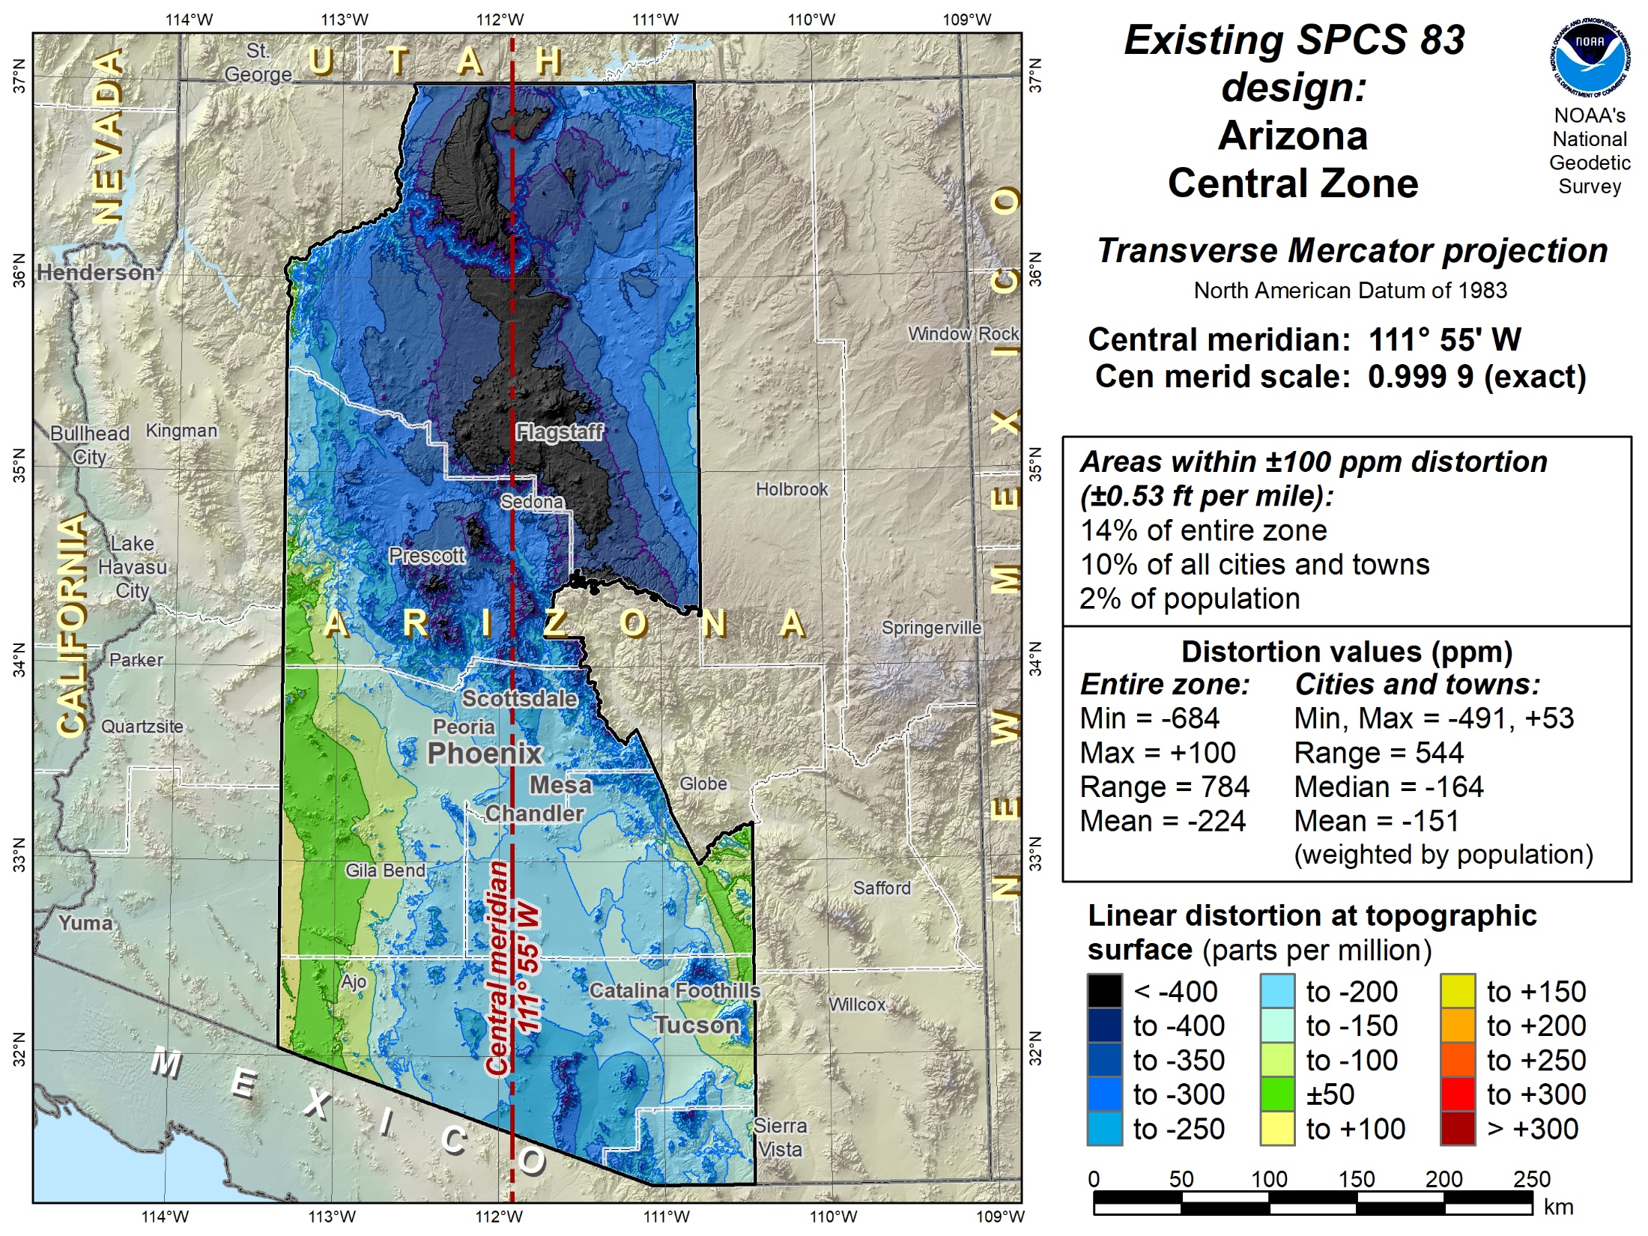

Slide 31
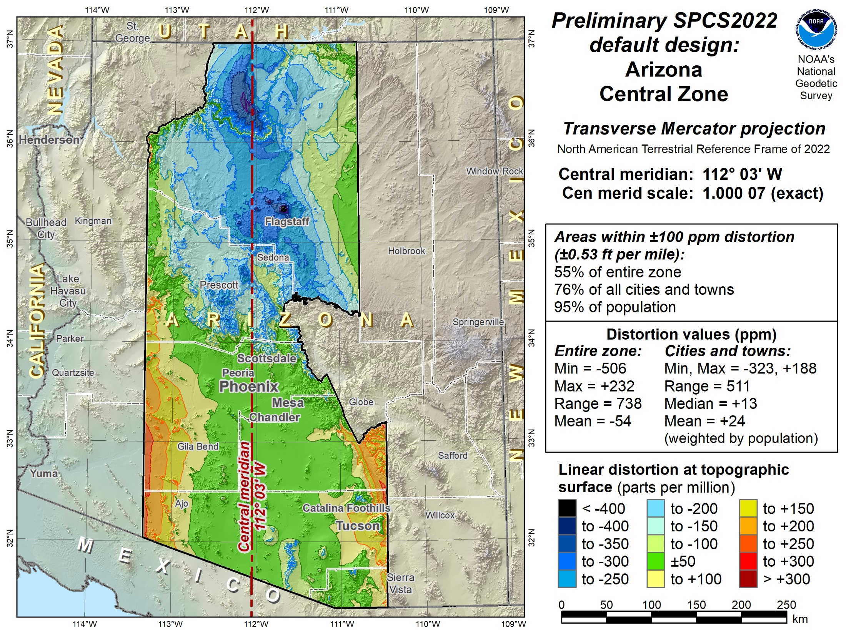

Slide 32
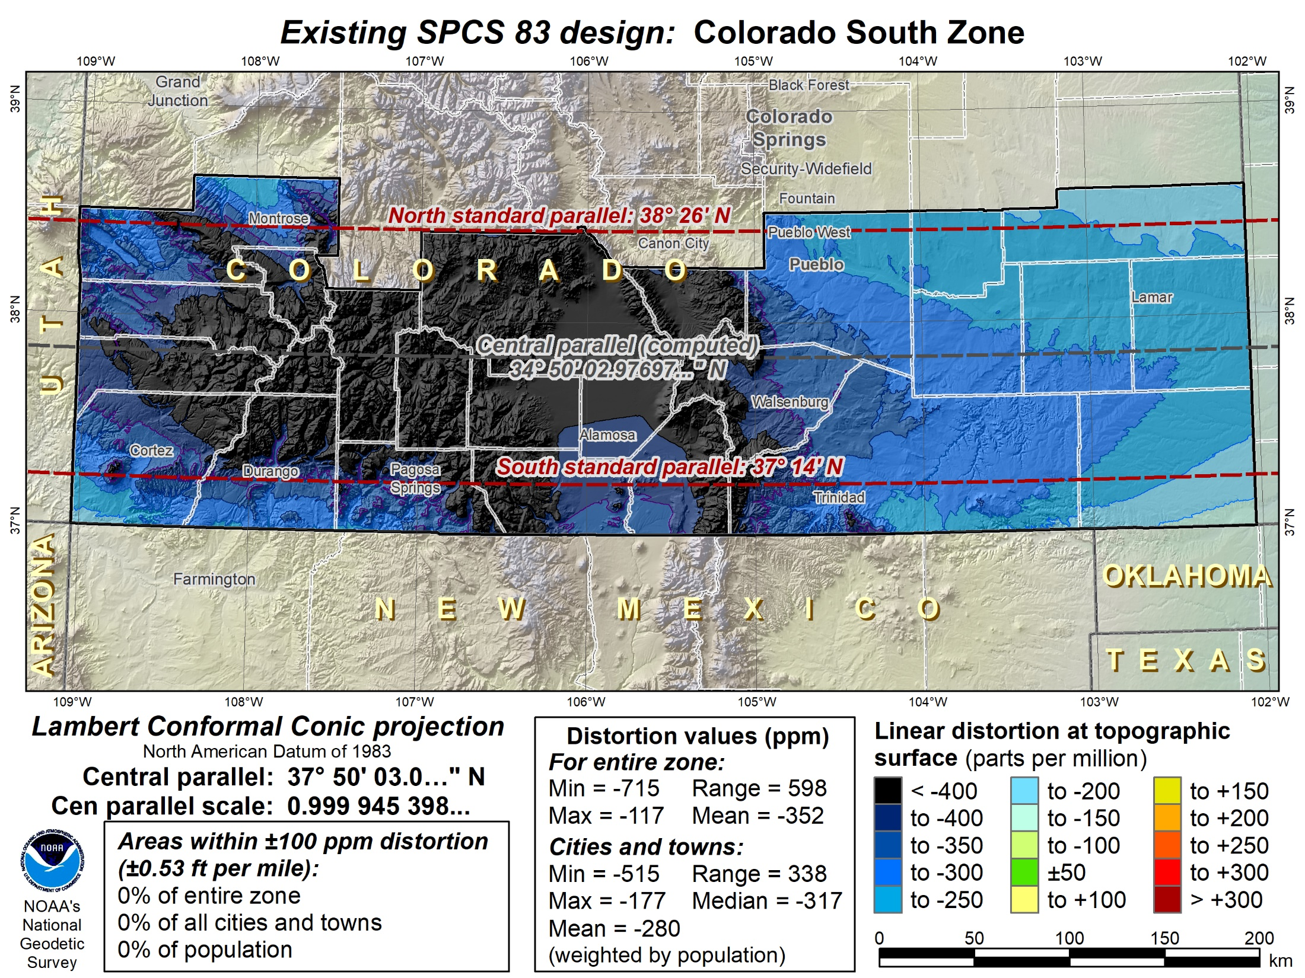

Slide 33
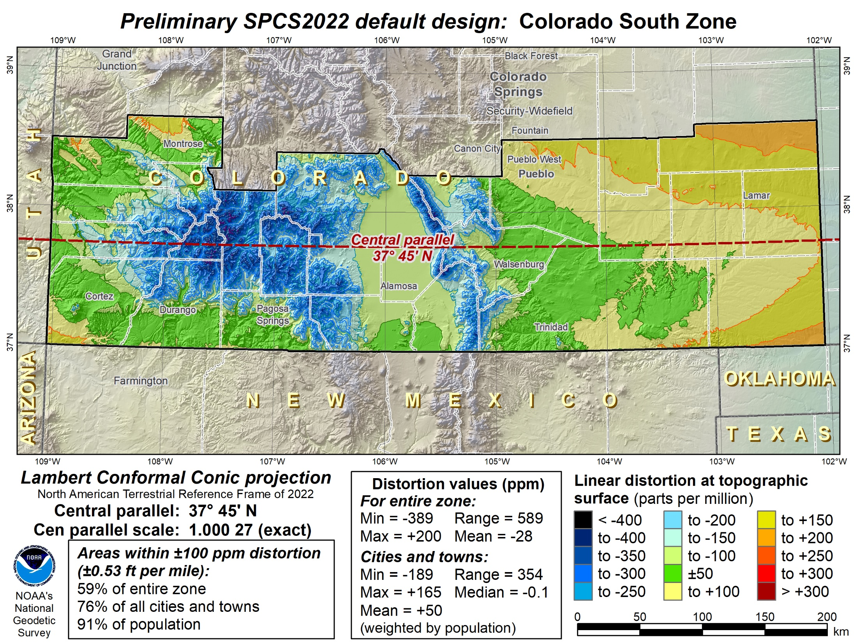

Slide 34
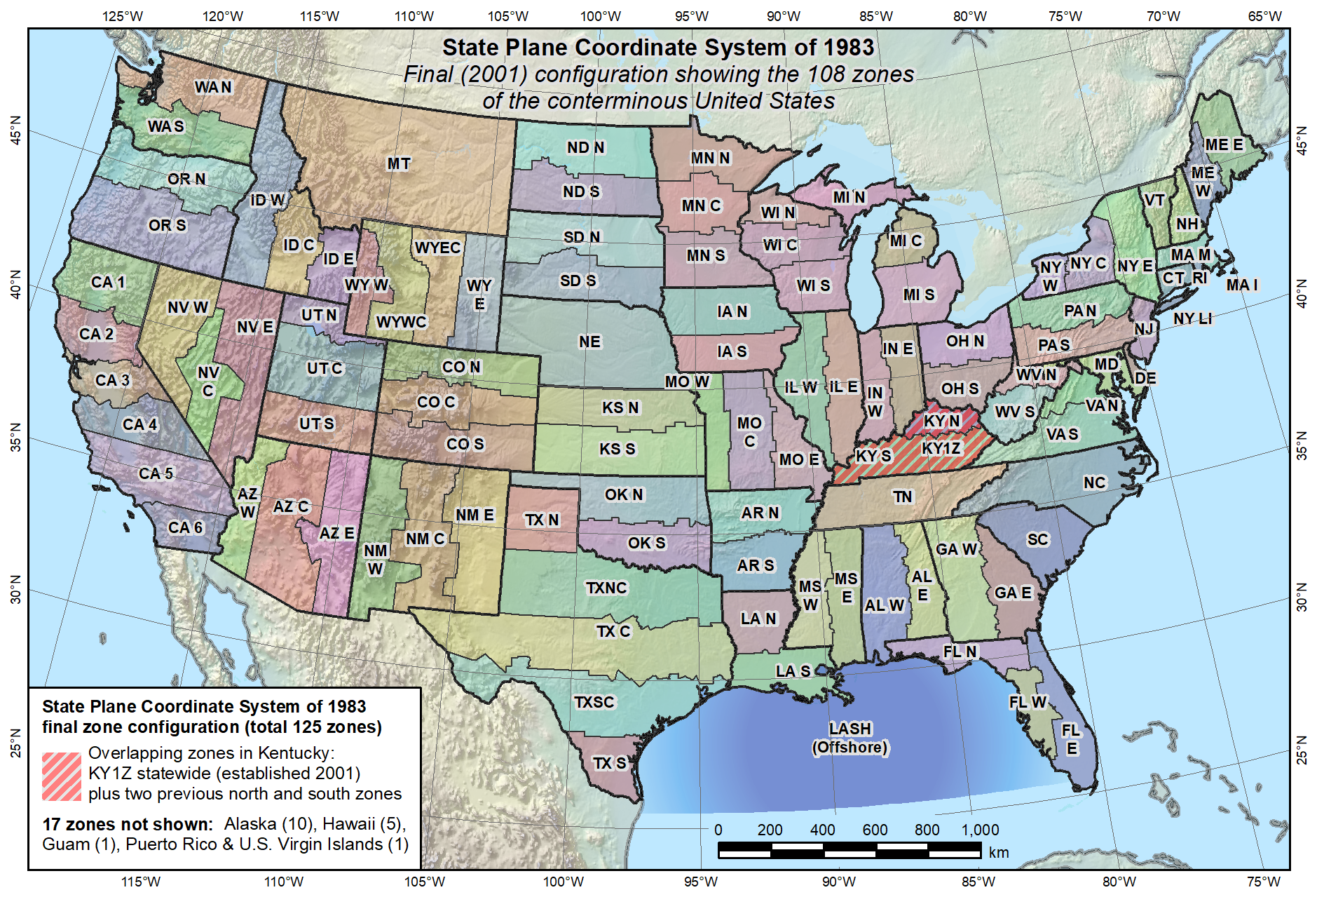
Default SPCS2022 would look a lot like SPCS 83…

Slide 35
What changes for default designs?
Most zones will keep same extents and projection type
Possible changes in projection types and zone extents
  1 or 2 OM zones for FL peninsula (currently 2 TM zones)
  1 OM zone for Hawaii (replaces 5 TM zones)
  Include Guam and CNMI in 1 TM zone (currently only Guam)
  Define LCC zone for American Samoa (no SPCS 83 zone)
  Redefine AK zones to better correspond to land use
  Add zone for Washington D.C.
Examples follow of zones where proposed projection type and/or extents change.

Slide 36
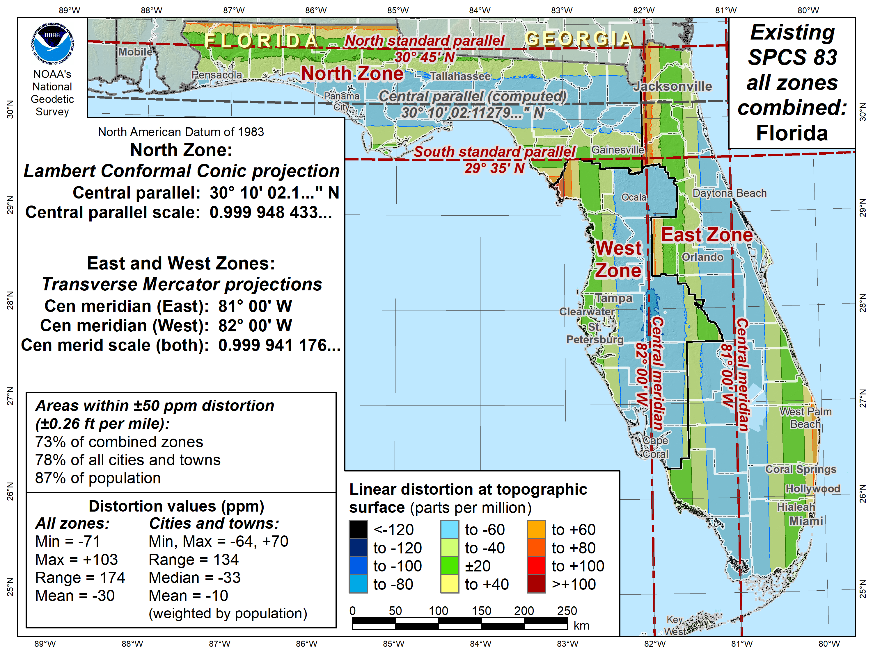

Slide 37
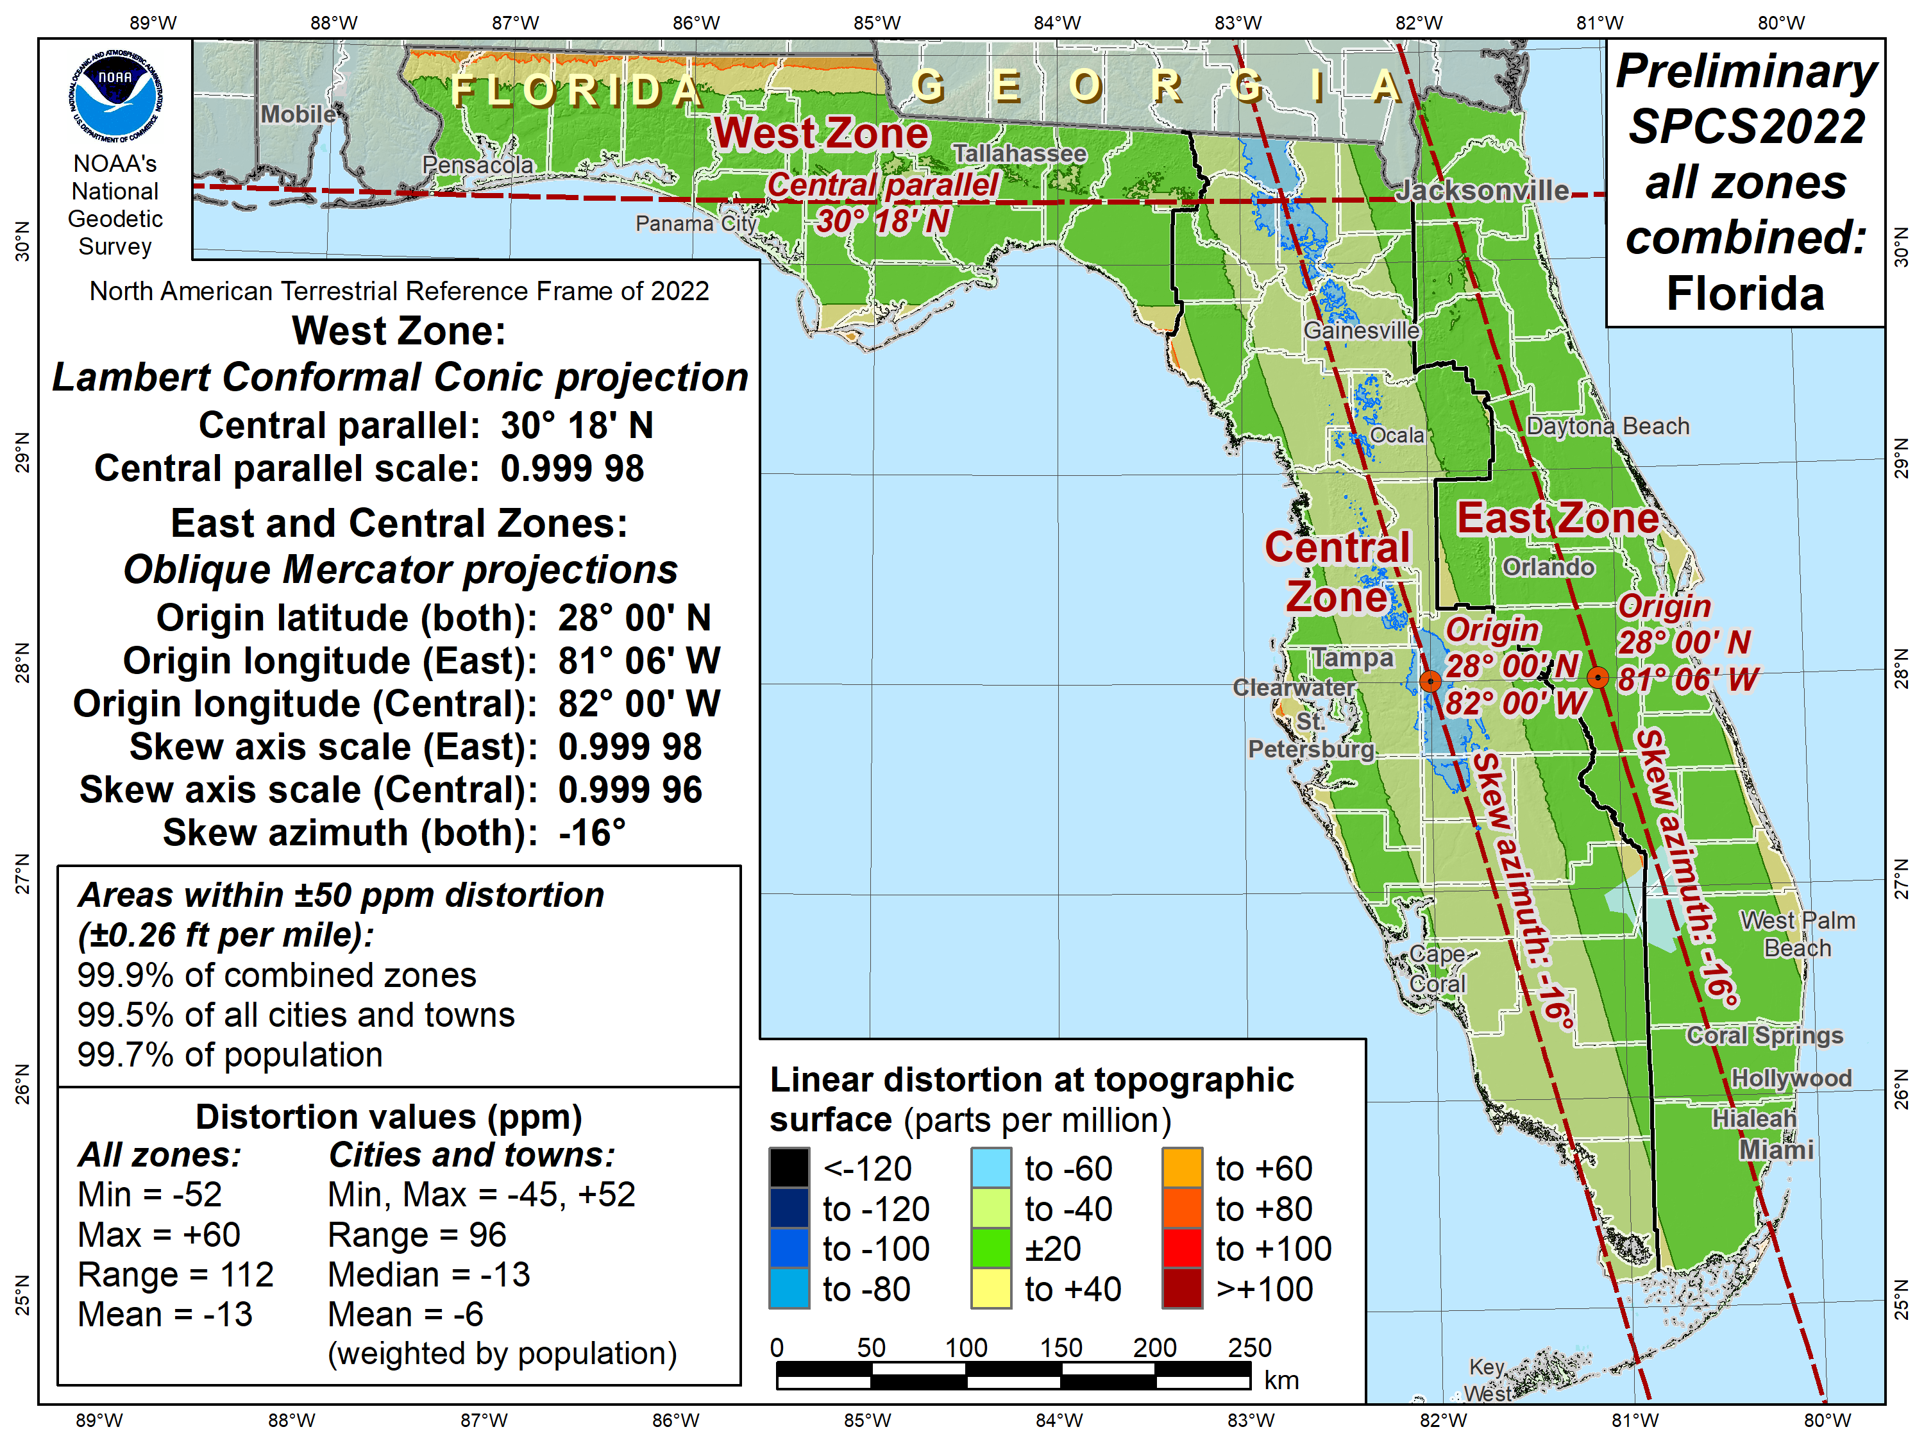

Slide 38
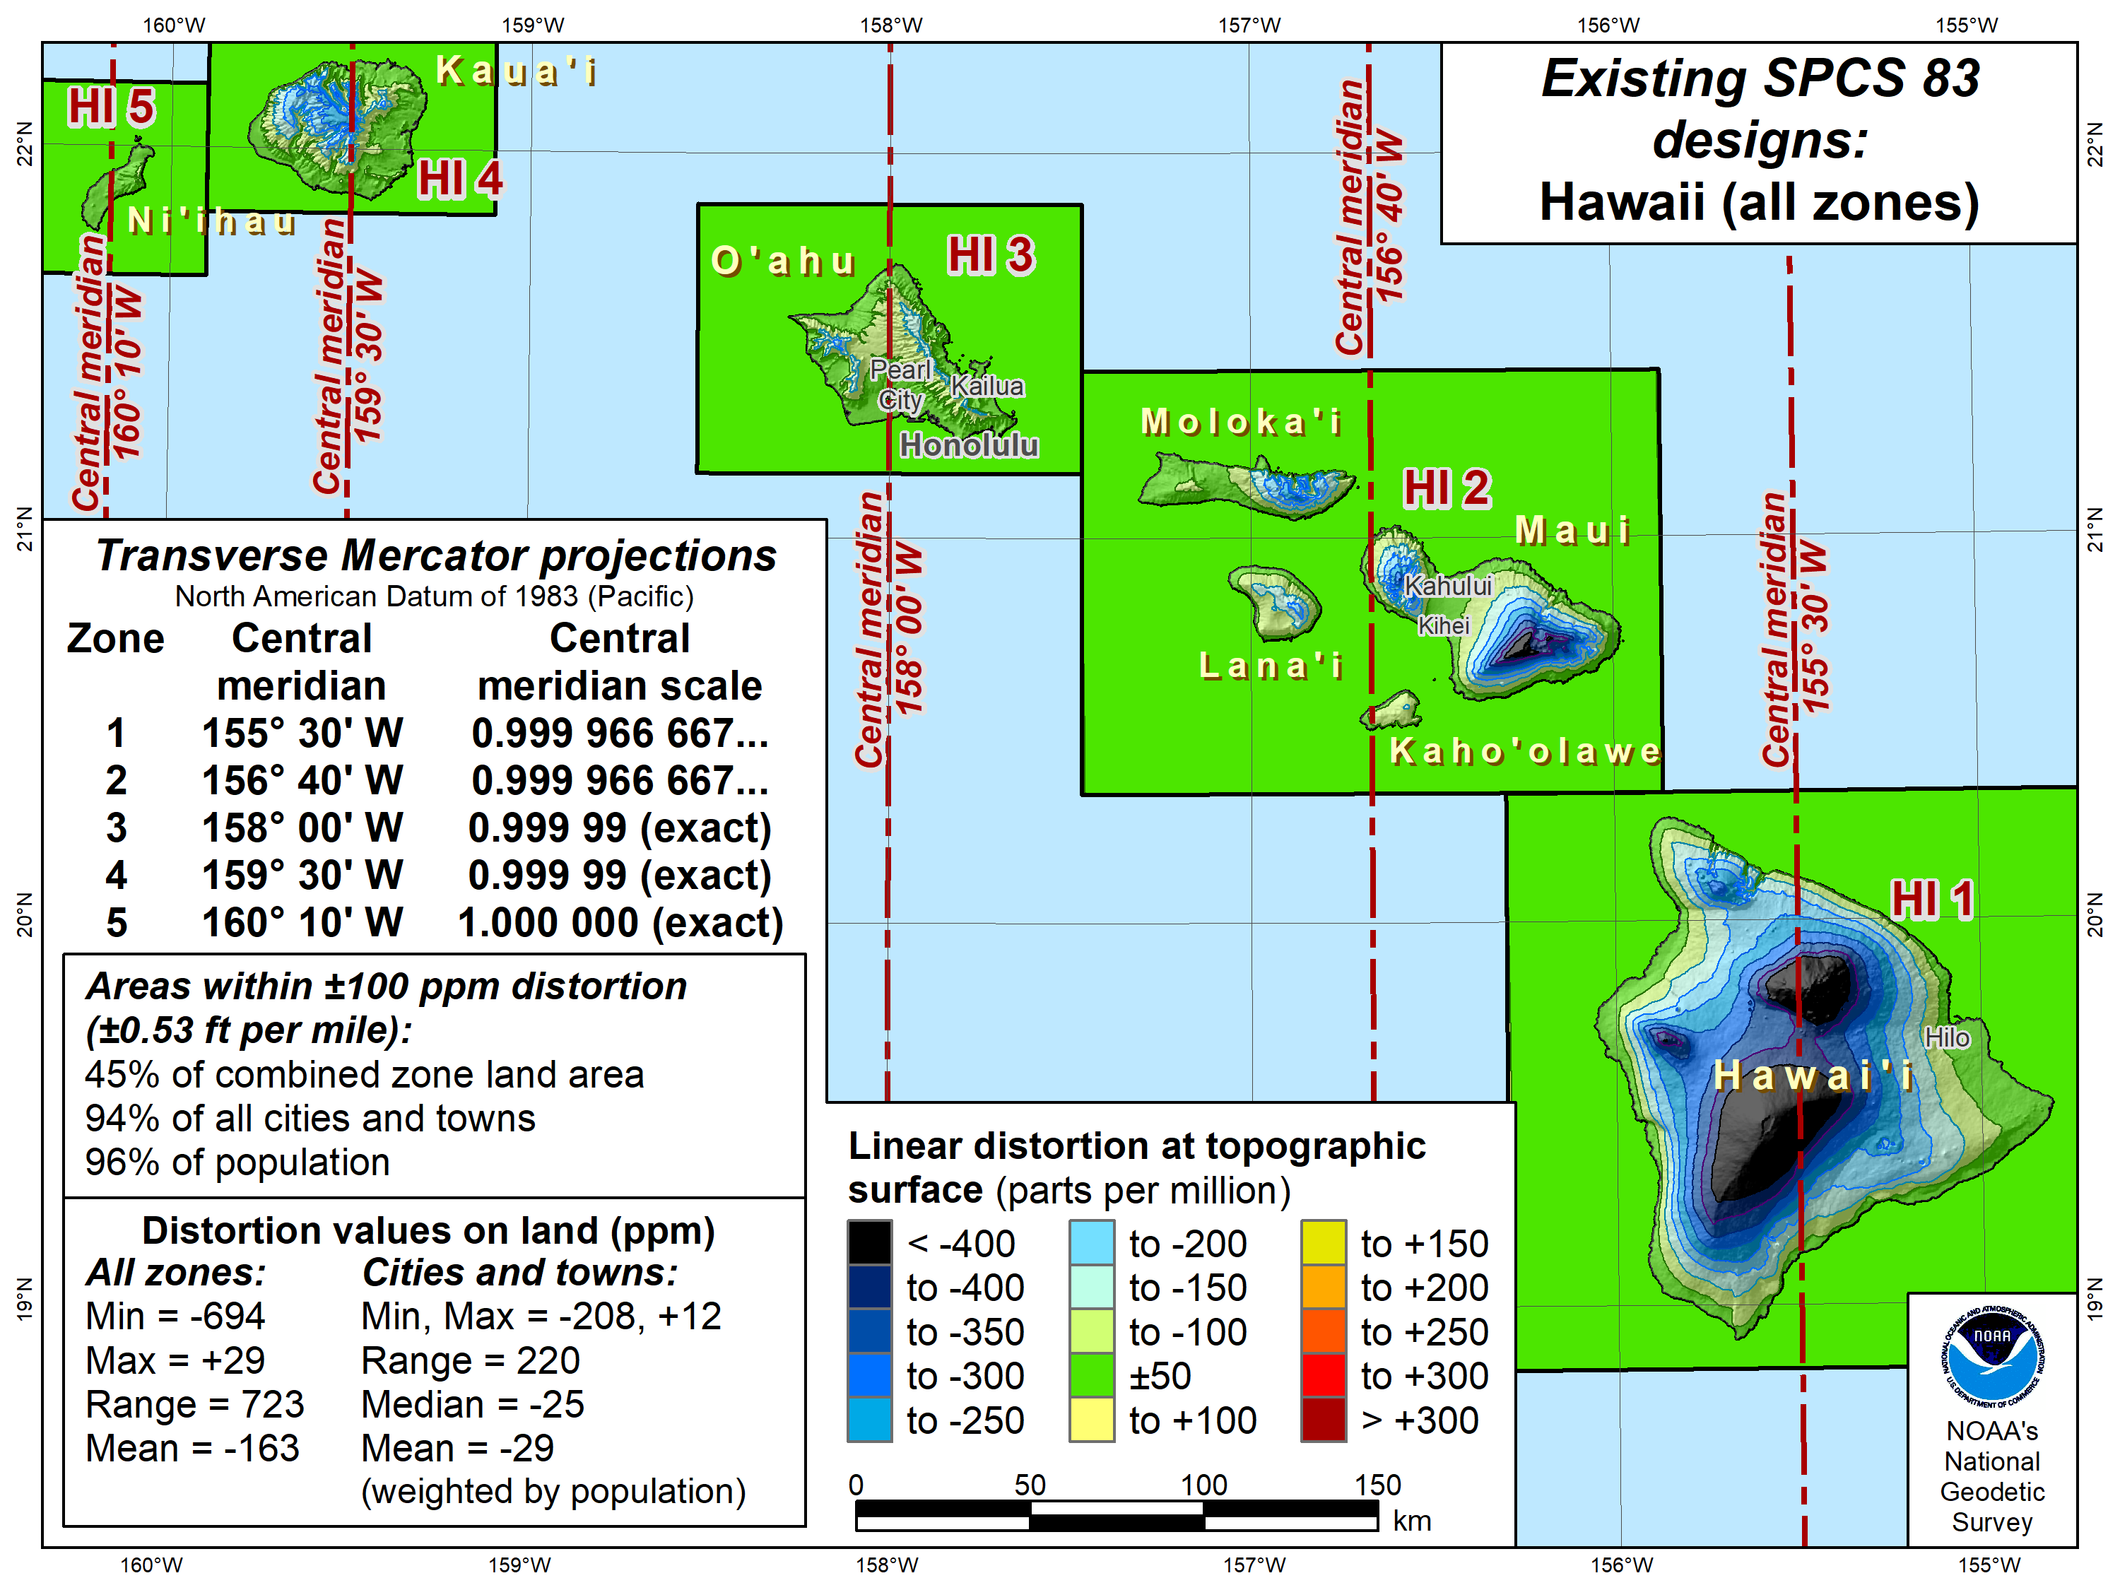

Slide 39
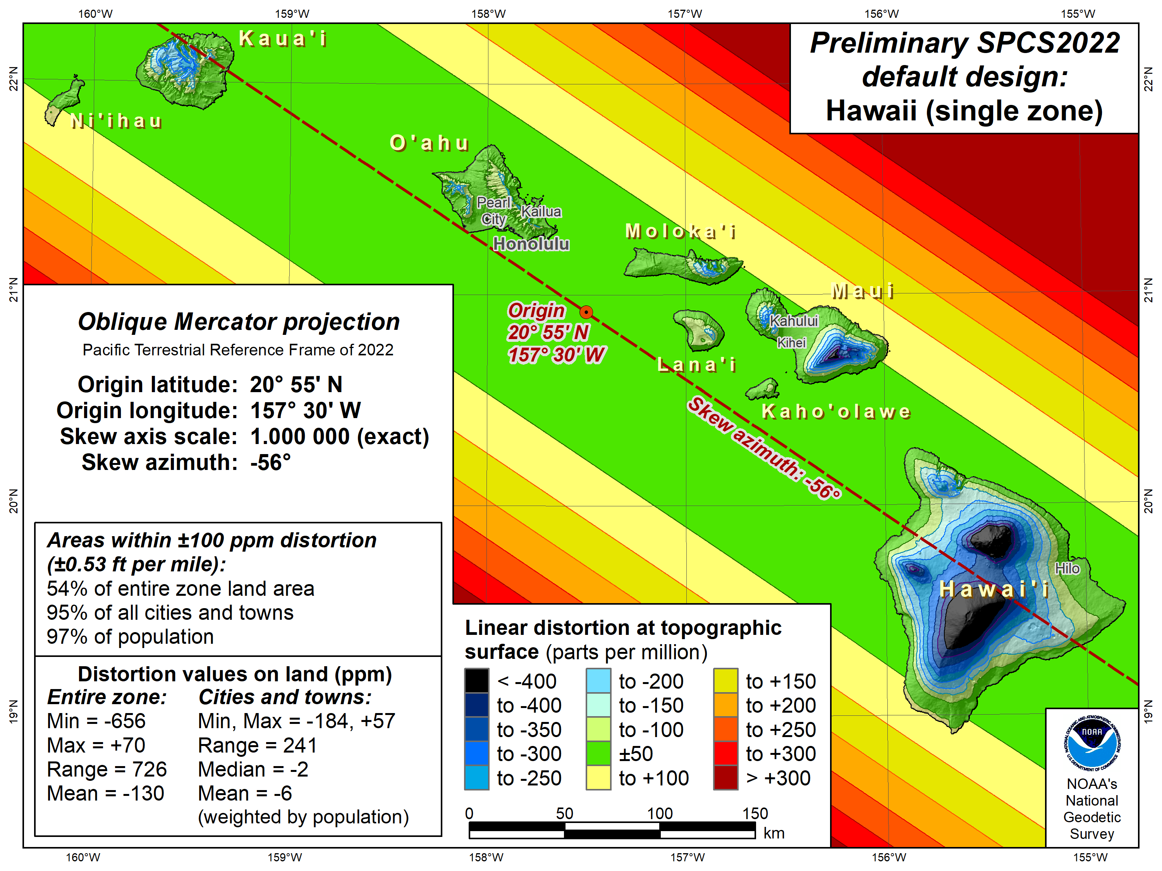

Slide 40
Overview: Policy, Procedures, and FRN
Linear distortion at topographic surface
One-parallel Lambert Conformal Conic projections
Default SPCS2022 zone designs
Statewide and “layered” zones
Linear distortion design criteria
  Maximum and minimum zone size and distortion
  Low distortion projections (LDPs)
“Special purpose” zones (in FRN only)
Linear units
Submittal process and deadlines
  For Federal Register Notice comments
  For requests, proposals, and submittal of designs

Slide 41
Statewide and “layered” zones
Policy§III.A.2.
Limitations
  Max of TWO layers: Statewide and sub-zones
  If two layers, one MUST be statewide
  Minimum subzone dimension > 50 km
States often want statewide and small zones
  Statewide: Single geometry required for state GIS
  Sub-zones: Lower distortion for surveying/engineering
Accommodates state needs, but with restrictions
  Prevent poor design choices for statewide zones
One already exists in SPCS 83…

Slide 42
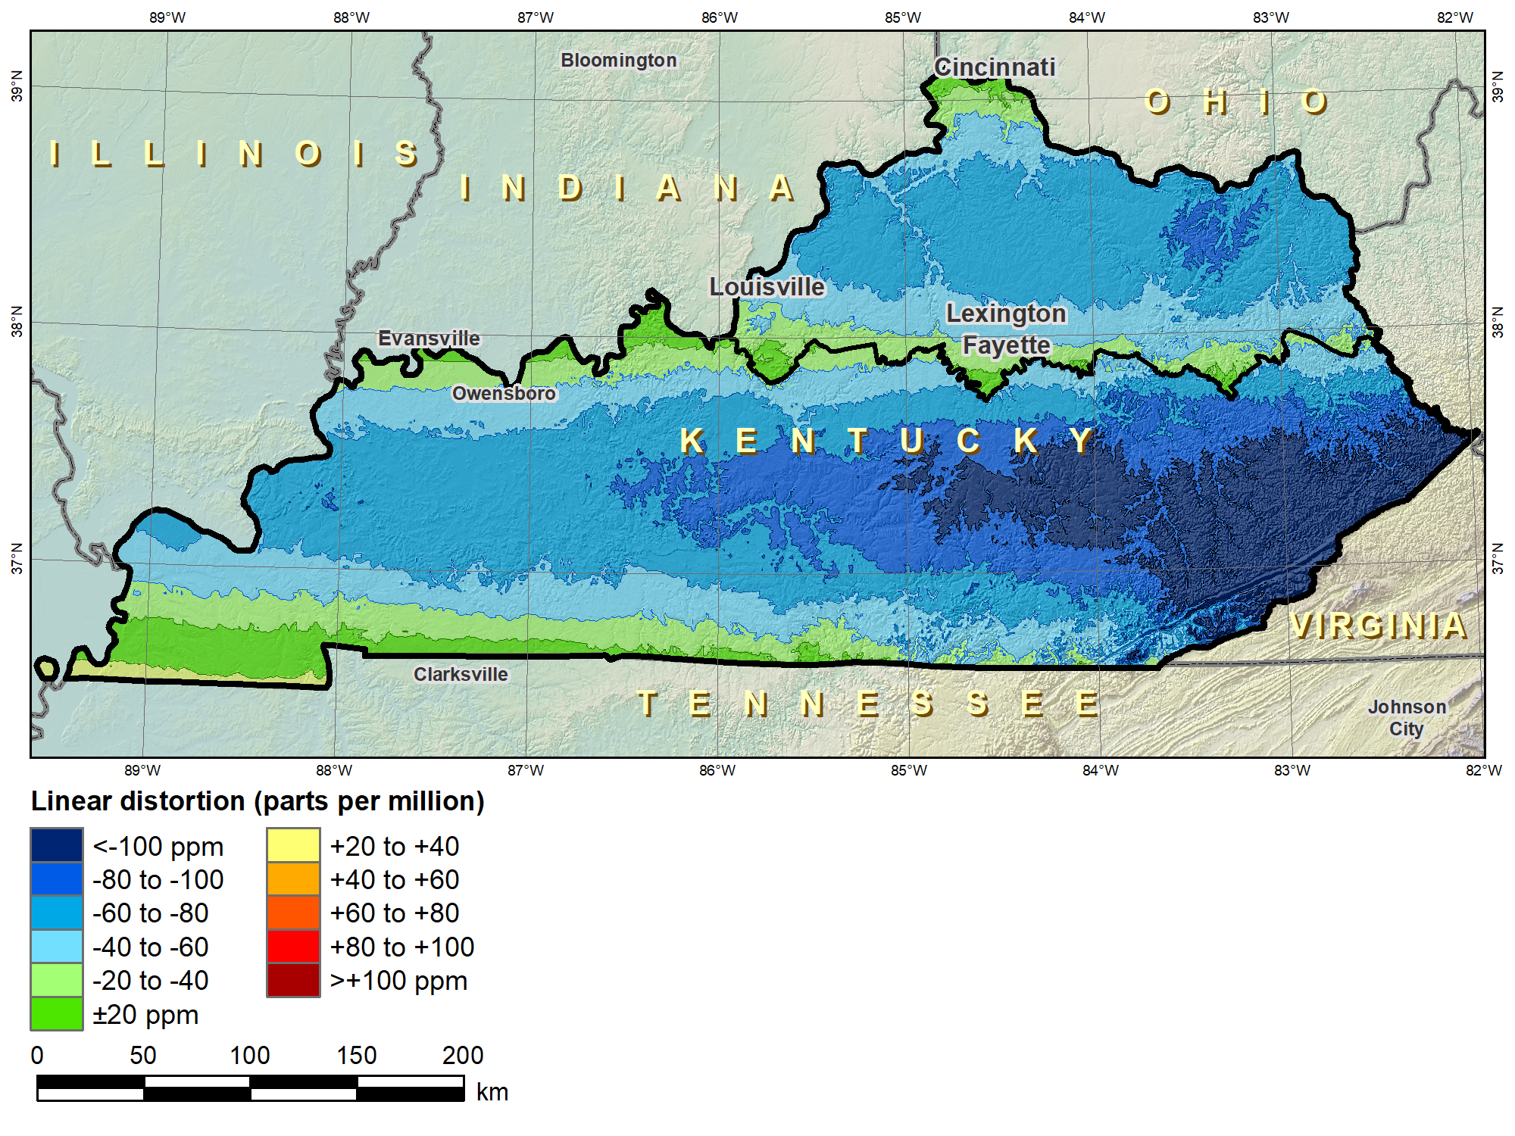
Kentucky layered zones
“Layered” zones
SPCS 83 Kentucky N and S zones (Lambert Conformal Conic)
 |  | North | South
N parallel |  | 38°58’N | 37°56’N
S parallel |  | 37°58’N | 36°44’N
 |  | Distortion (ppm)
Min |  | -93 | -211
Max |  | +17 | +42
Mean |  | -56 | -67

Slide 43
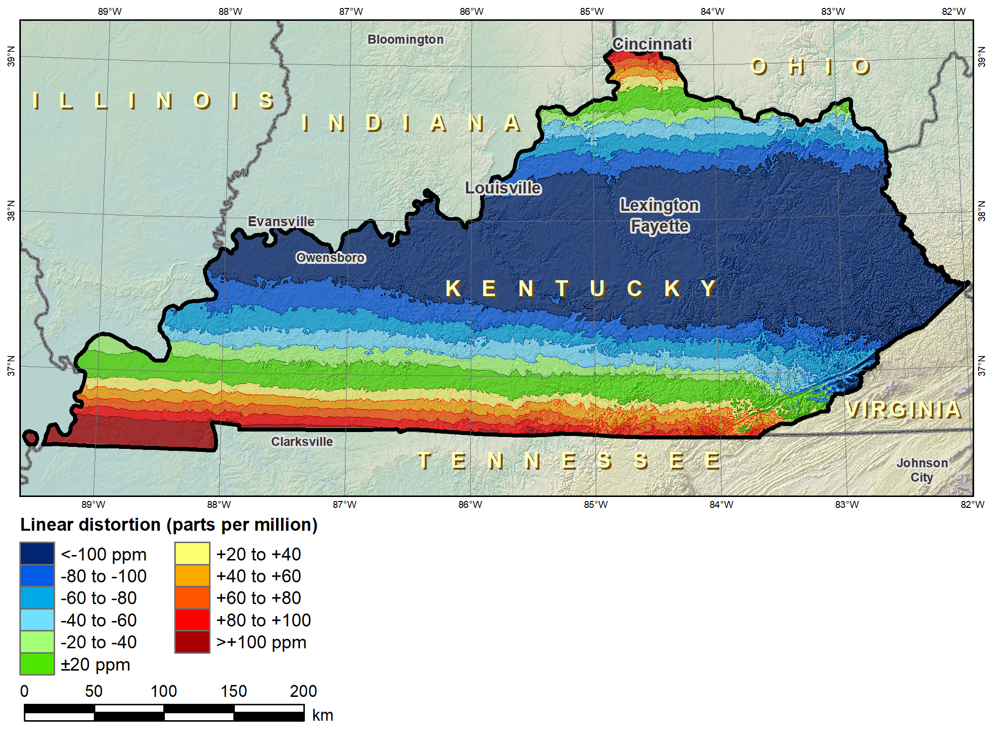
Kentucky layered zones
“Layered” zones
SPCS 83 Kentucky statewide zone (Lambert Conformal Conic)
 |  | North | South | Statewide
N parallel |  | 38°58’N | 37°56’N | 38°40’N
S parallel |  | 37°58’N | 36°44’N | 37°05’N
 |  | Distortion (ppm)
Min |  | -93 | -211 | -166
Max |  | +17 | +42 | +181
Mean |  | -56 | -67 | -58

Slide 44
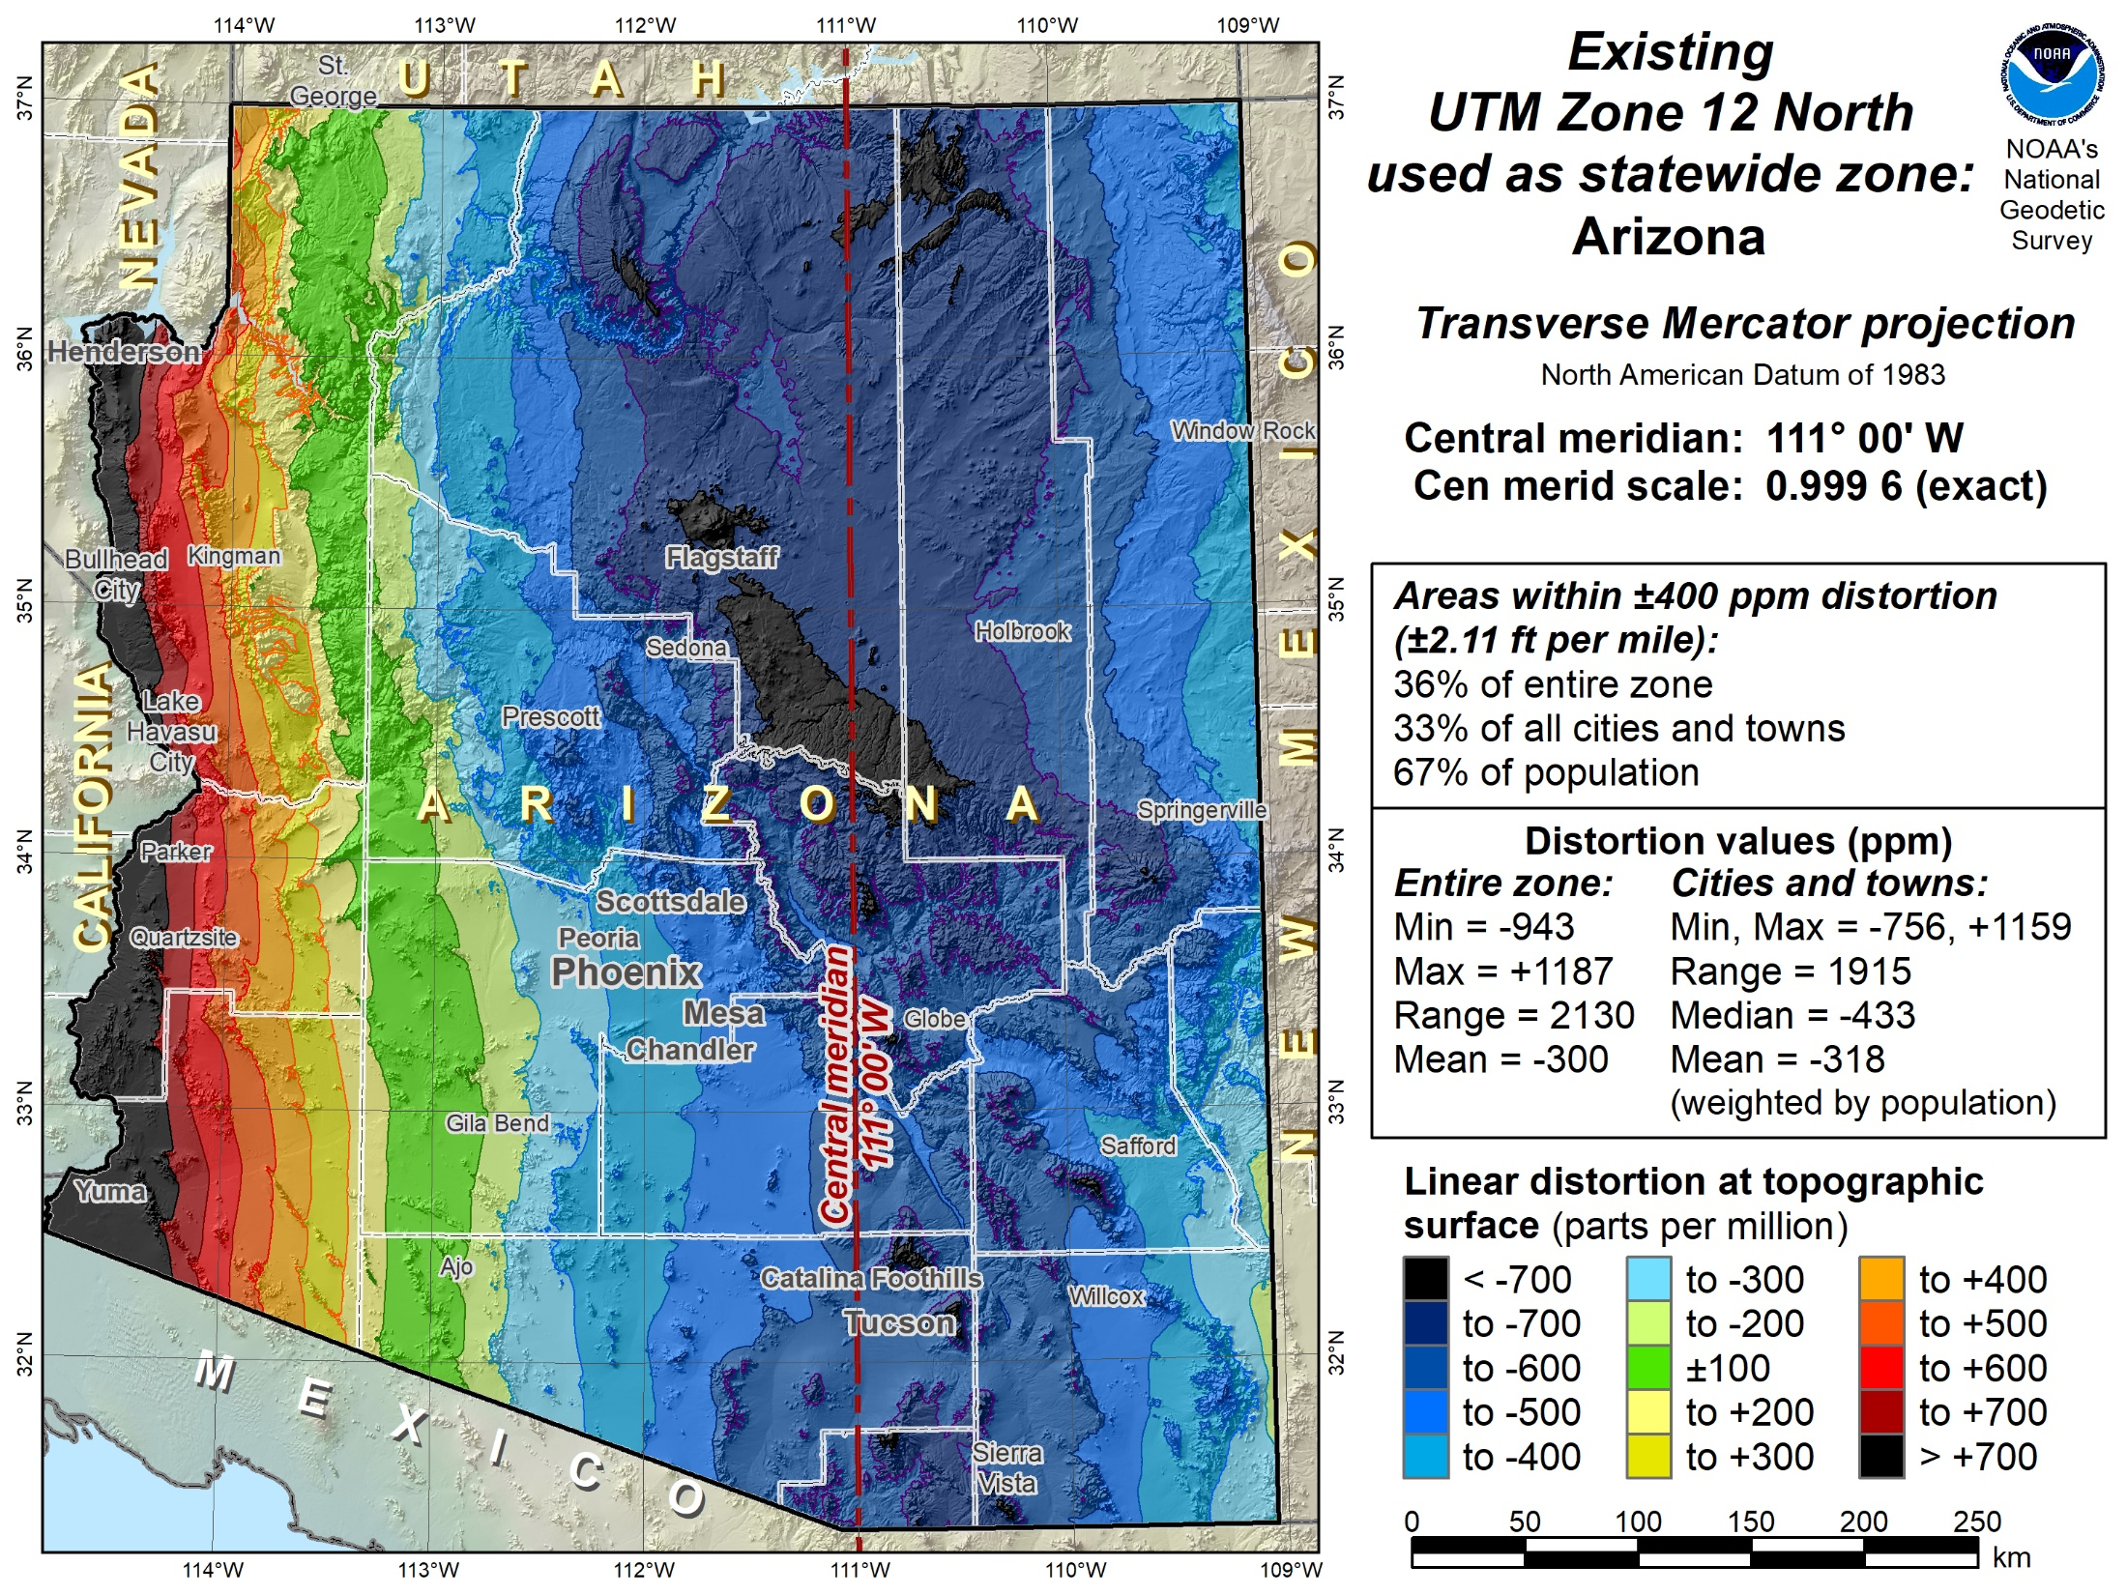

Slide 45
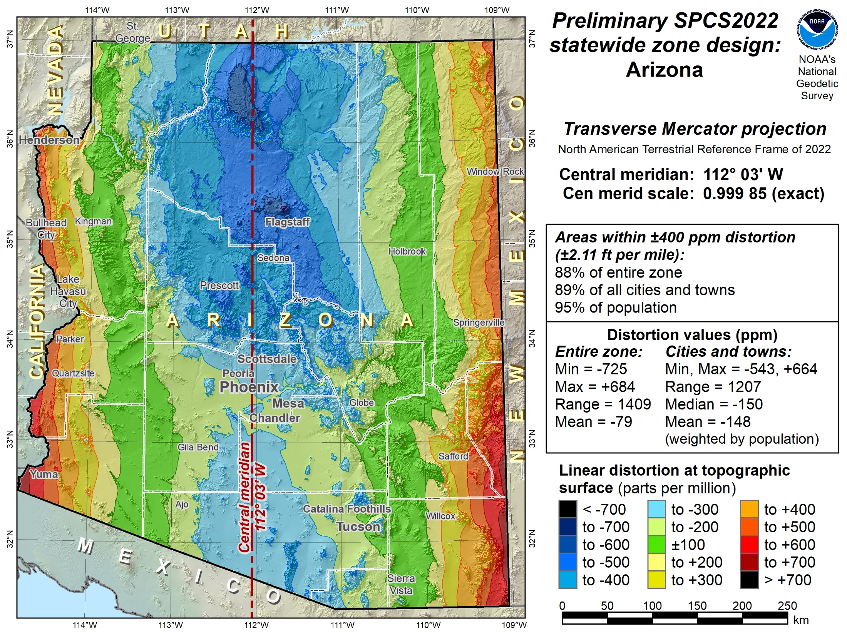

Slide 46
Overview: Policy, Procedures, and FRN
Linear distortion at topographic surface
One-parallel Lambert Conformal Conic projections
Default SPCS2022 zone designs
Statewide and “layered” zones
Linear distortion design criteria
  Maximum and minimum zone size and distortion
  Low distortion projections (LDPs)
“Special purpose” zones (in FRN only)
Linear units
Submittal process and deadlines
  For Federal Register Notice comments
  For requests, proposals, and submittal of designs

Slide 47
Linear distortion design criteria
Procedures §4.b.i-ii and§5.c.i.
NGS design of zones requested by stakeholders
  Limited to zones with 50-400 ppm distortion criterion
    50 ppm = 5 cm/km = 0.3 ft/mi = 1:20,000
    400 ppm = 40 cm/km = 2.1 ft/mi = 1:2,500
Design criterion < 50 ppm (i.e., “low distortion”)
  Low distortion projections (LDPs)
  Must be designed by others (not by NGS)
  Proposed and final design reviewed by NGS

Slide 48
Minimum LDP distortion & zone size
Procedures§5.c.ii
Create largest zone that meets distortion criterion
  To avoid creating excessive number very small zones
Minimum distortion design criterion
  20 ppm = 2 cm/km = 0.1 ft/mi = 1:50,000
  Nominal zone width of 114 km (71 miles)
  Nominal height change of 255 m (836 ft)
Minimum allowable zone width 50 km (31 miles)
  Exception: if height change in zone > 250 m (820 ft)
  Note: 50 km corresponds to approx ±5 ppm distortion

Slide 49
Zone widths for distortion due to curvature
Nominal SPCS 83 and 27 zone width
±100 ppm (±0.5 ft/mile)
255 km (158 miles)
Projection surface
Projection surface
Ellipsoid surface
Max SPCS2022 distortion; also UTM zone width
±400 ppm (±2.1 ft/mile)
508 km (316 miles)

Slide 50
Zone widths for distortion due to curvature
NOTE: Change in height of 255 m (836 ft) causes 20 ppm change in distortion
Distortion due to height changes at rates of:
  15.7 ppm per 100 m
  4.8 ppm per 100 ft
Minimum distortion criterion for LDP designs
±20 ppm (±0.1 ft/mile)
114 km (71 miles)
Projection
surface
Ellipsoid surface
Minimum distortion criterion for NGS designs
±50 ppm (±0.3 ft/mile)
180 km (112 miles)

Slide 51
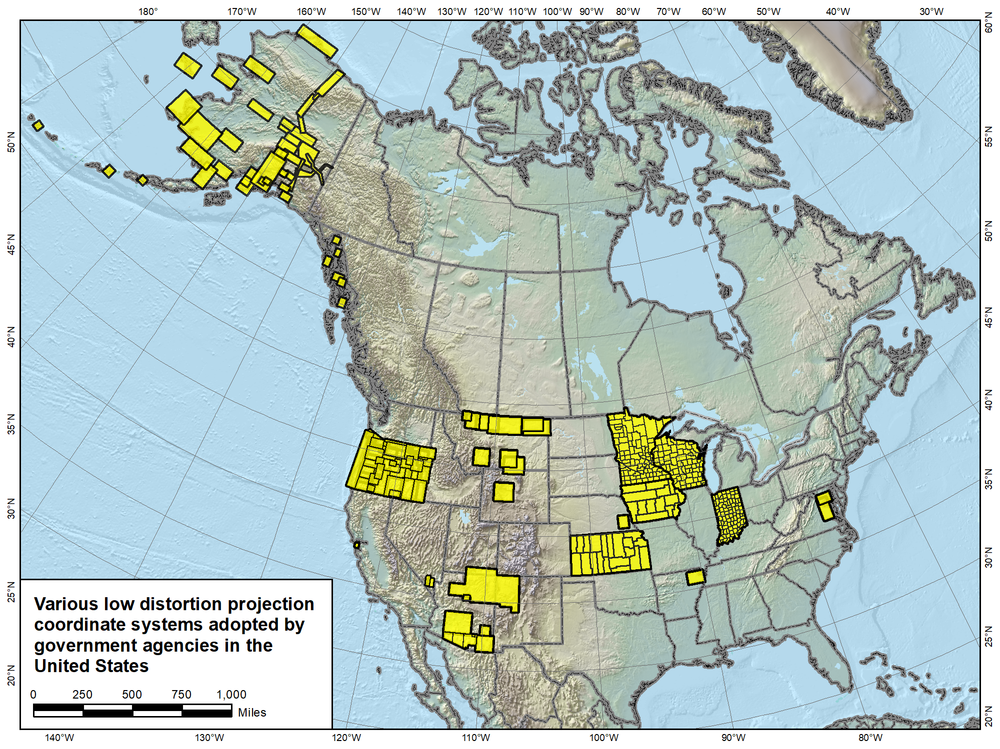

Slide 52
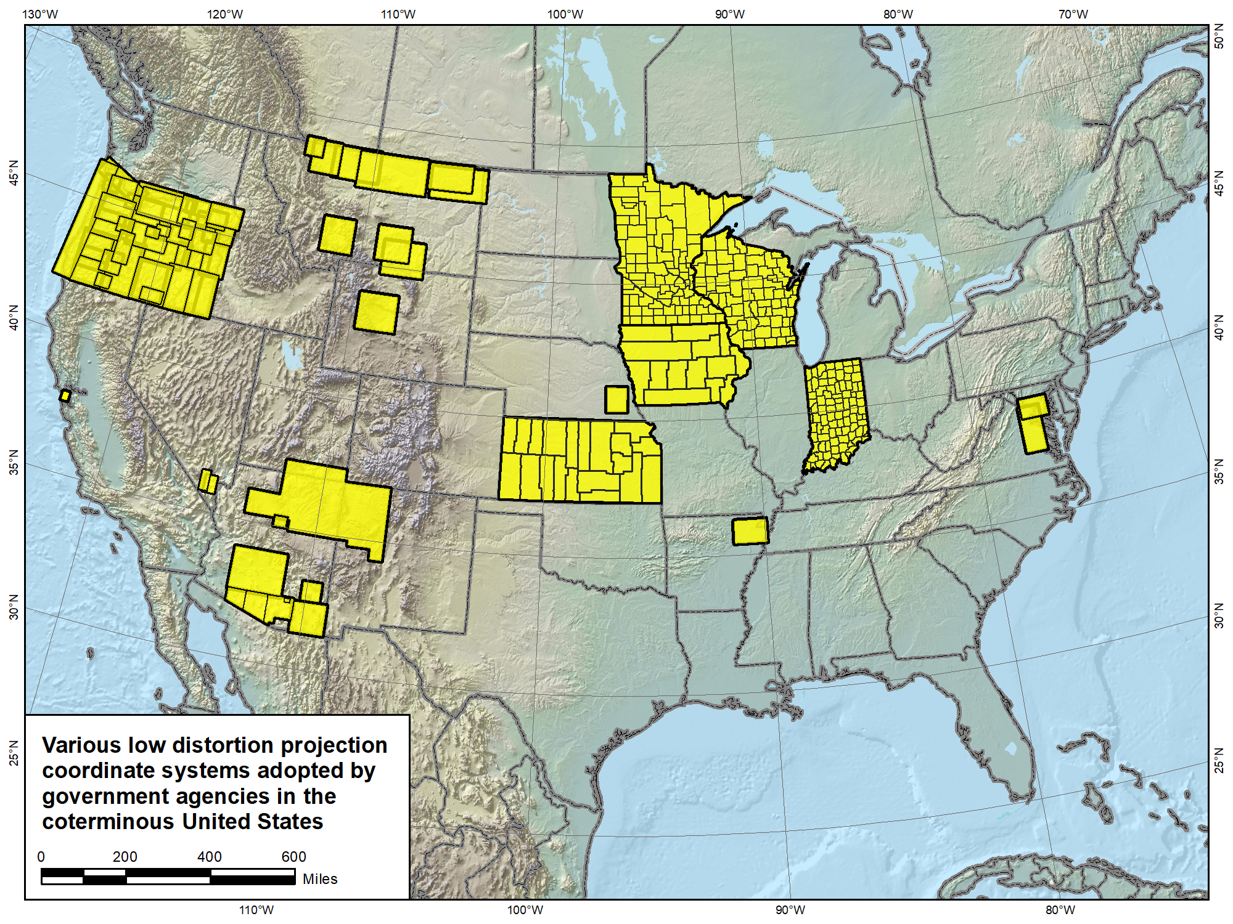

Slide 53
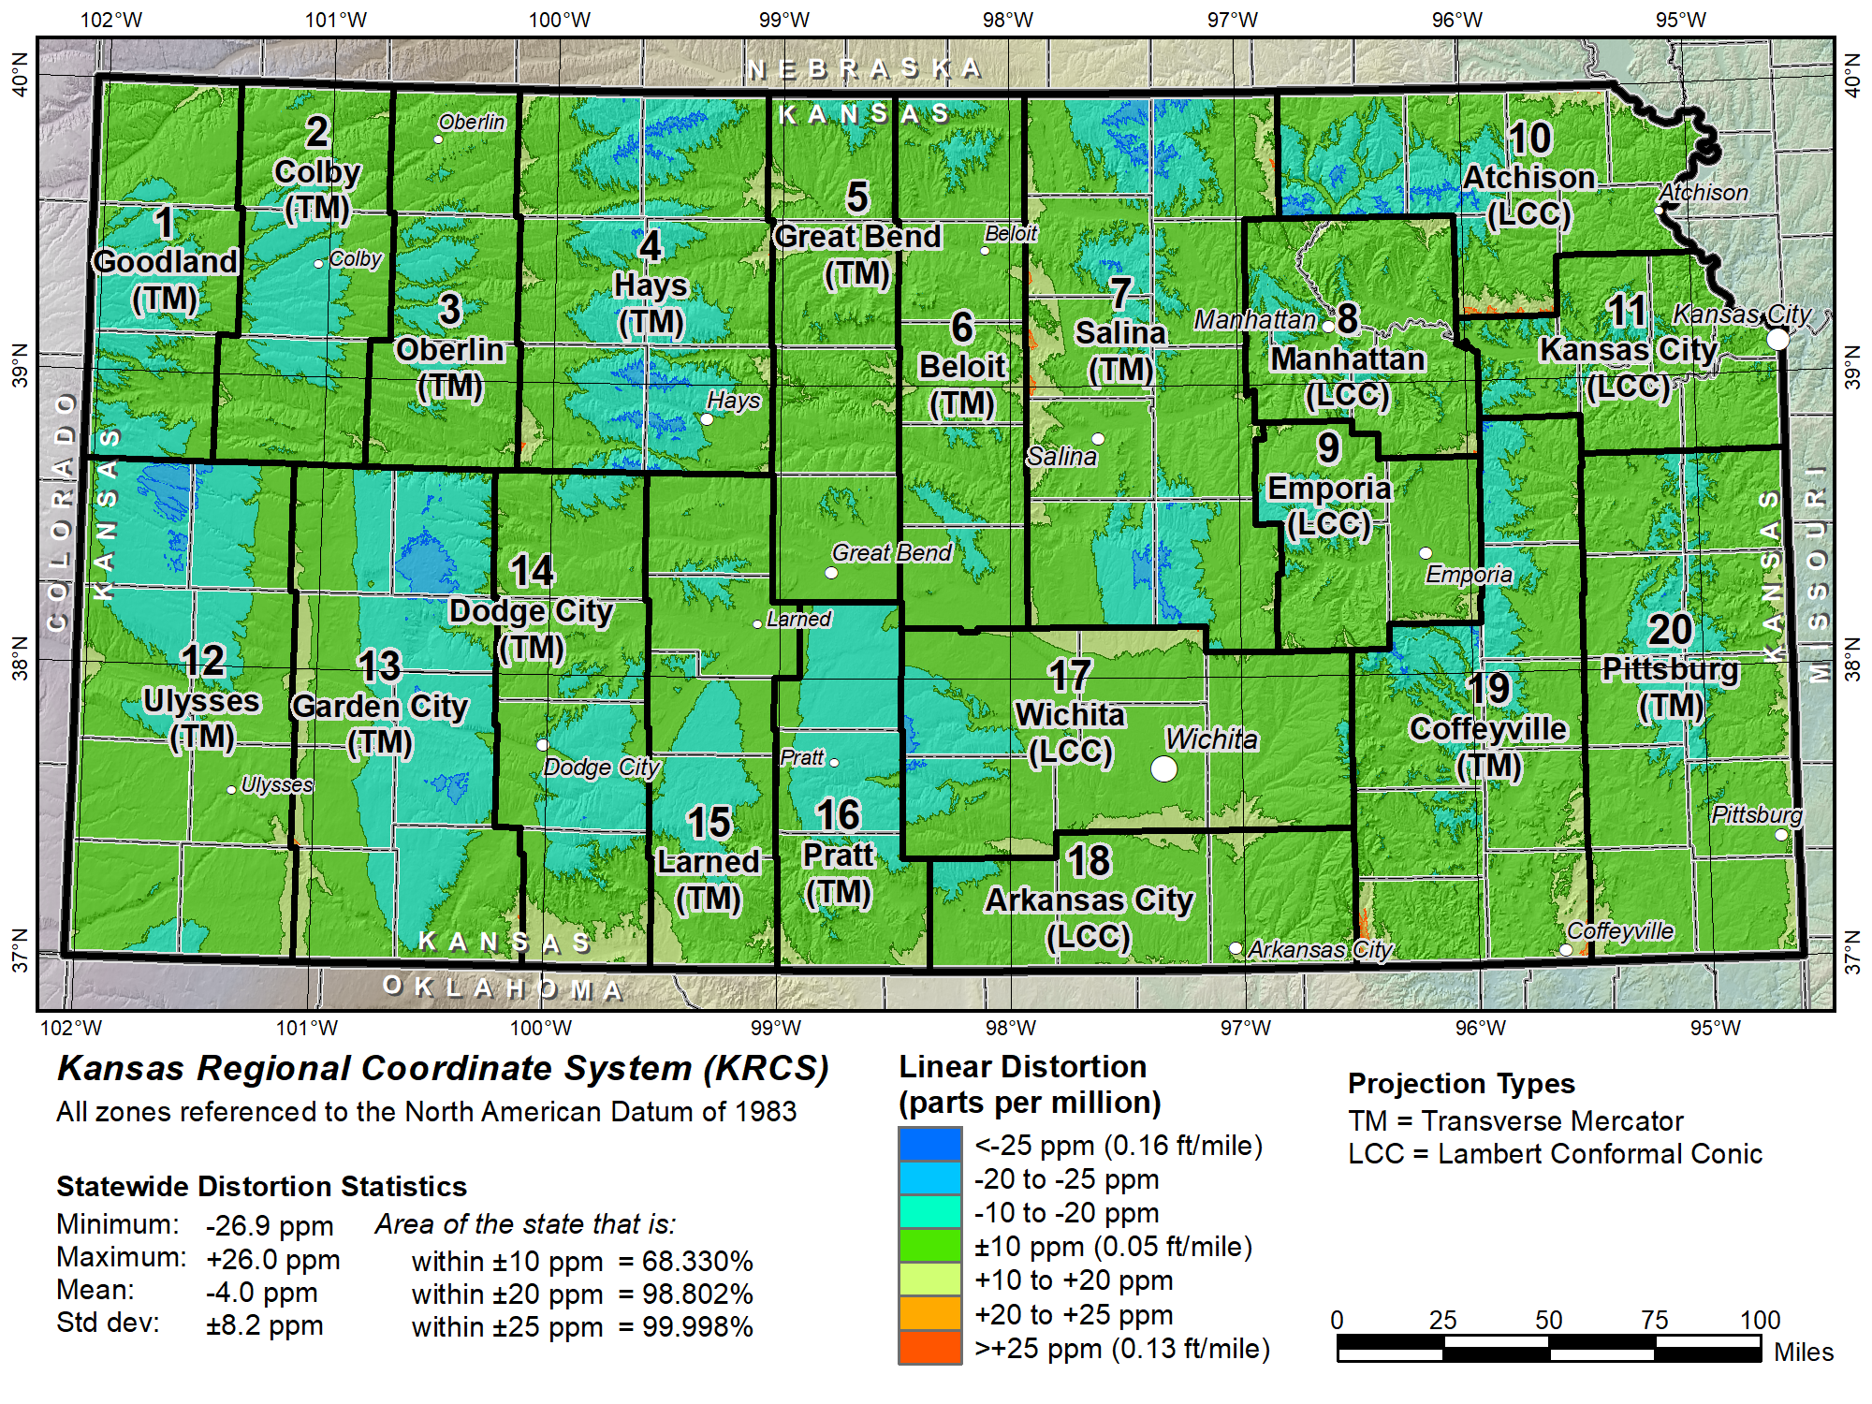

Slide 54
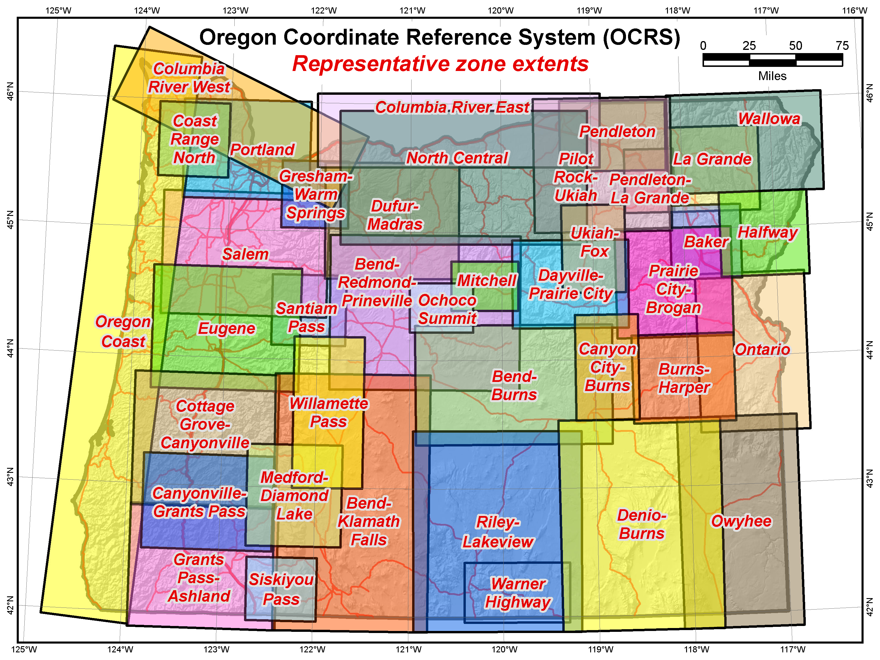

Slide 55
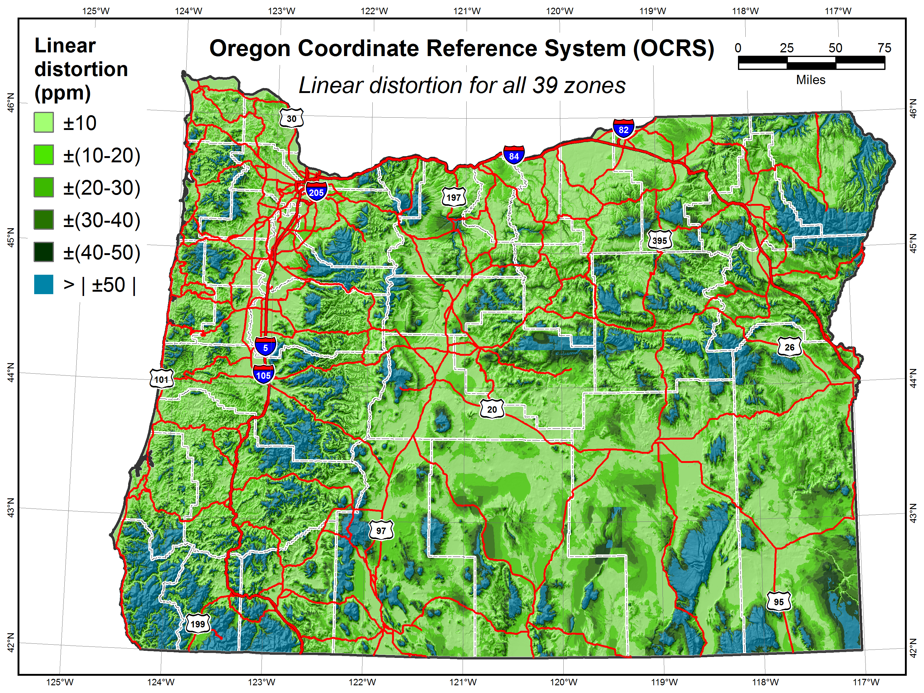
Area of state within:
±10 ppm = 38%
±20 ppm = 60%
±30 ppm = 73%
±40 ppm = 81%
Cities within:
±10 ppm = 77.8%
±20 ppm = 94.0%
±30 ppm = 96.2%
±40 ppm = 98.6%
Population within:
±10 ppm = 96.76%
±20 ppm = 99.79%
±30 ppm = 99.85%
±40 ppm = 99.87%

Slide 56
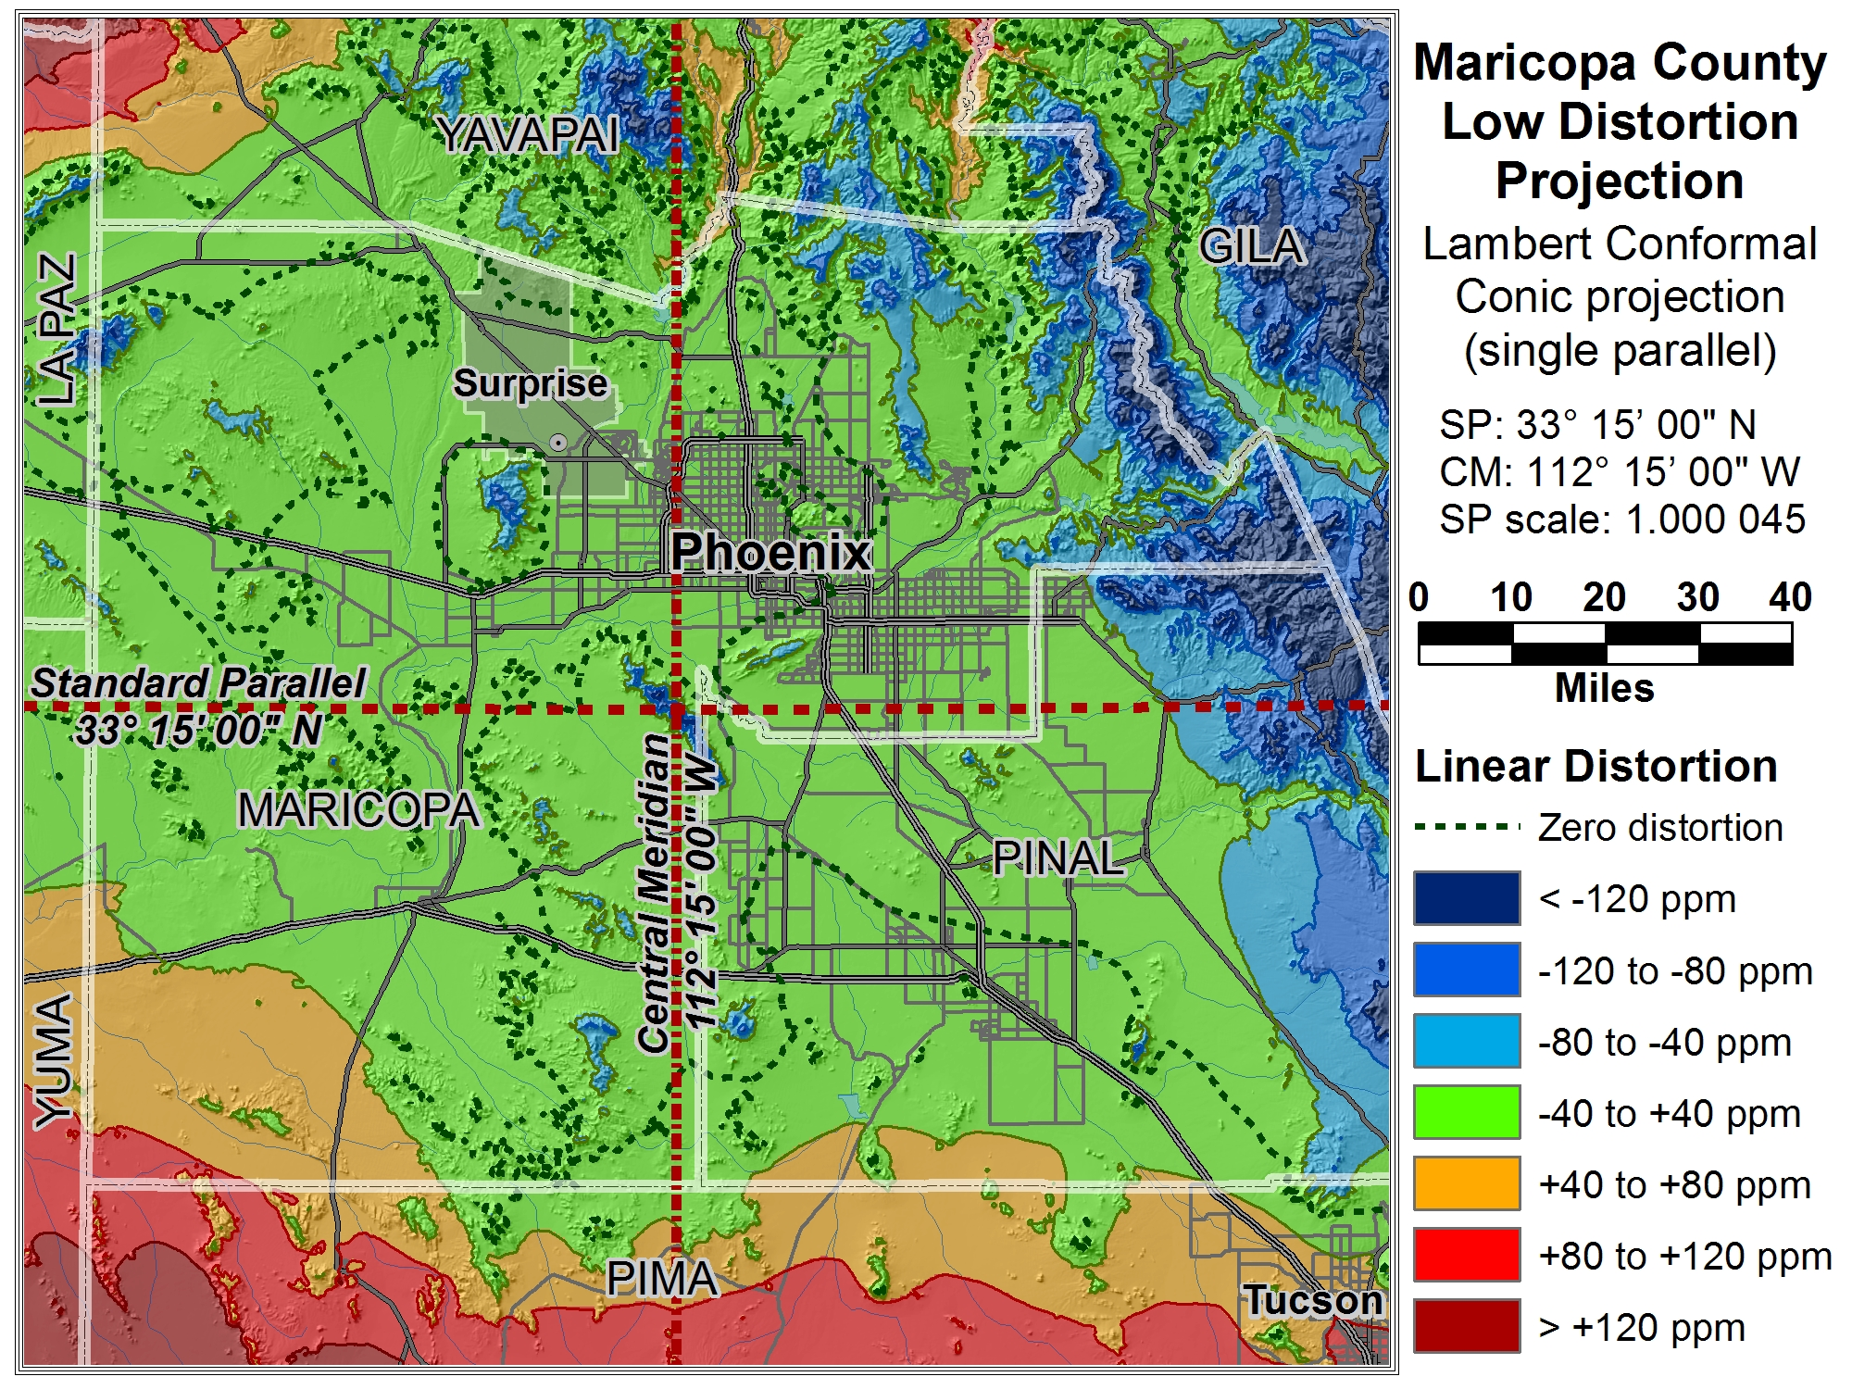
Maricopa County

Slide 57
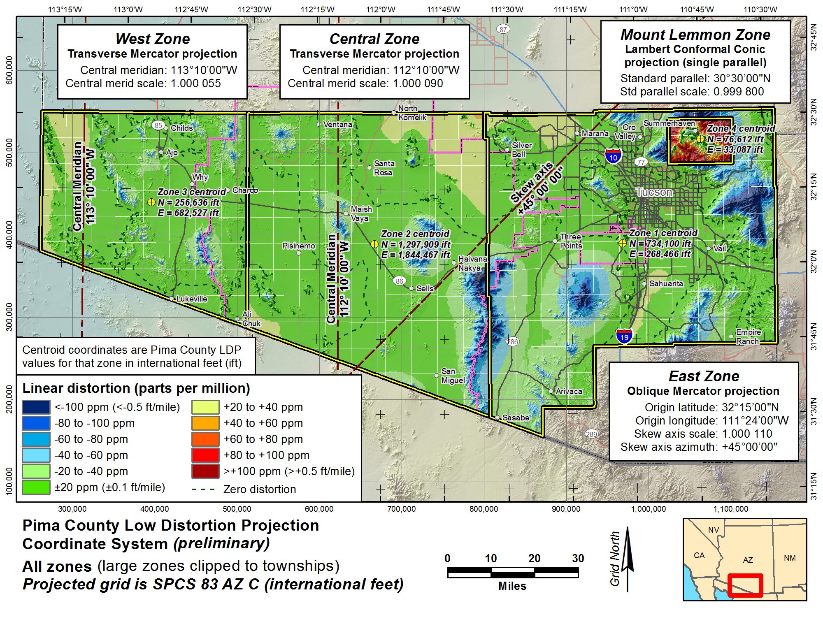

Slide 58
Overview: Policy, Procedures, and FRN
Linear distortion at topographic surface
One-parallel Lambert Conformal Conic projections
Default SPCS2022 zone designs
Statewide and “layered” zones
Linear distortion design criteria
  Maximum and minimum zone size and distortion
  Low distortion projections (LDPs)
“Special purpose” zones (in FRN only)
Linear units
Submittal process and deadlines
  For Federal Register Notice comments
  For requests, proposals, and submittal of designs

Slide 59
“Special purpose” zones
In Federal Register Notice (not in policy & procedures)
For areas with inadequate SPCS zone coverage
  Usually areas that are in more than one zone
Categories:
  Major urban areas (e.g., New York, Chicago, St. Louis, Denver)
  Large Indian reservations (e.g., Navajo Nation)
  Federal applications covering large areas (e.g., coastal mapping of Atlantic Coast; Grand Canyon National Park)
Permitted for metro areas in 1977 policy (but never used)
Only in FRN, not in draft policy & procedures

Slide 60
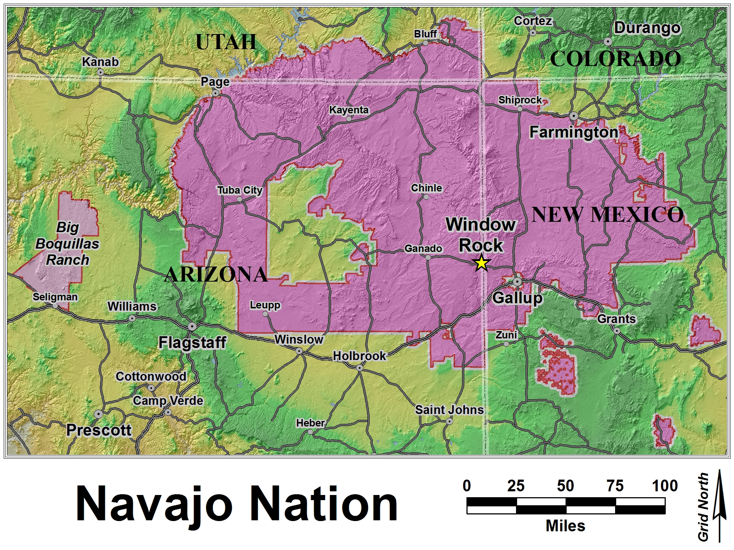
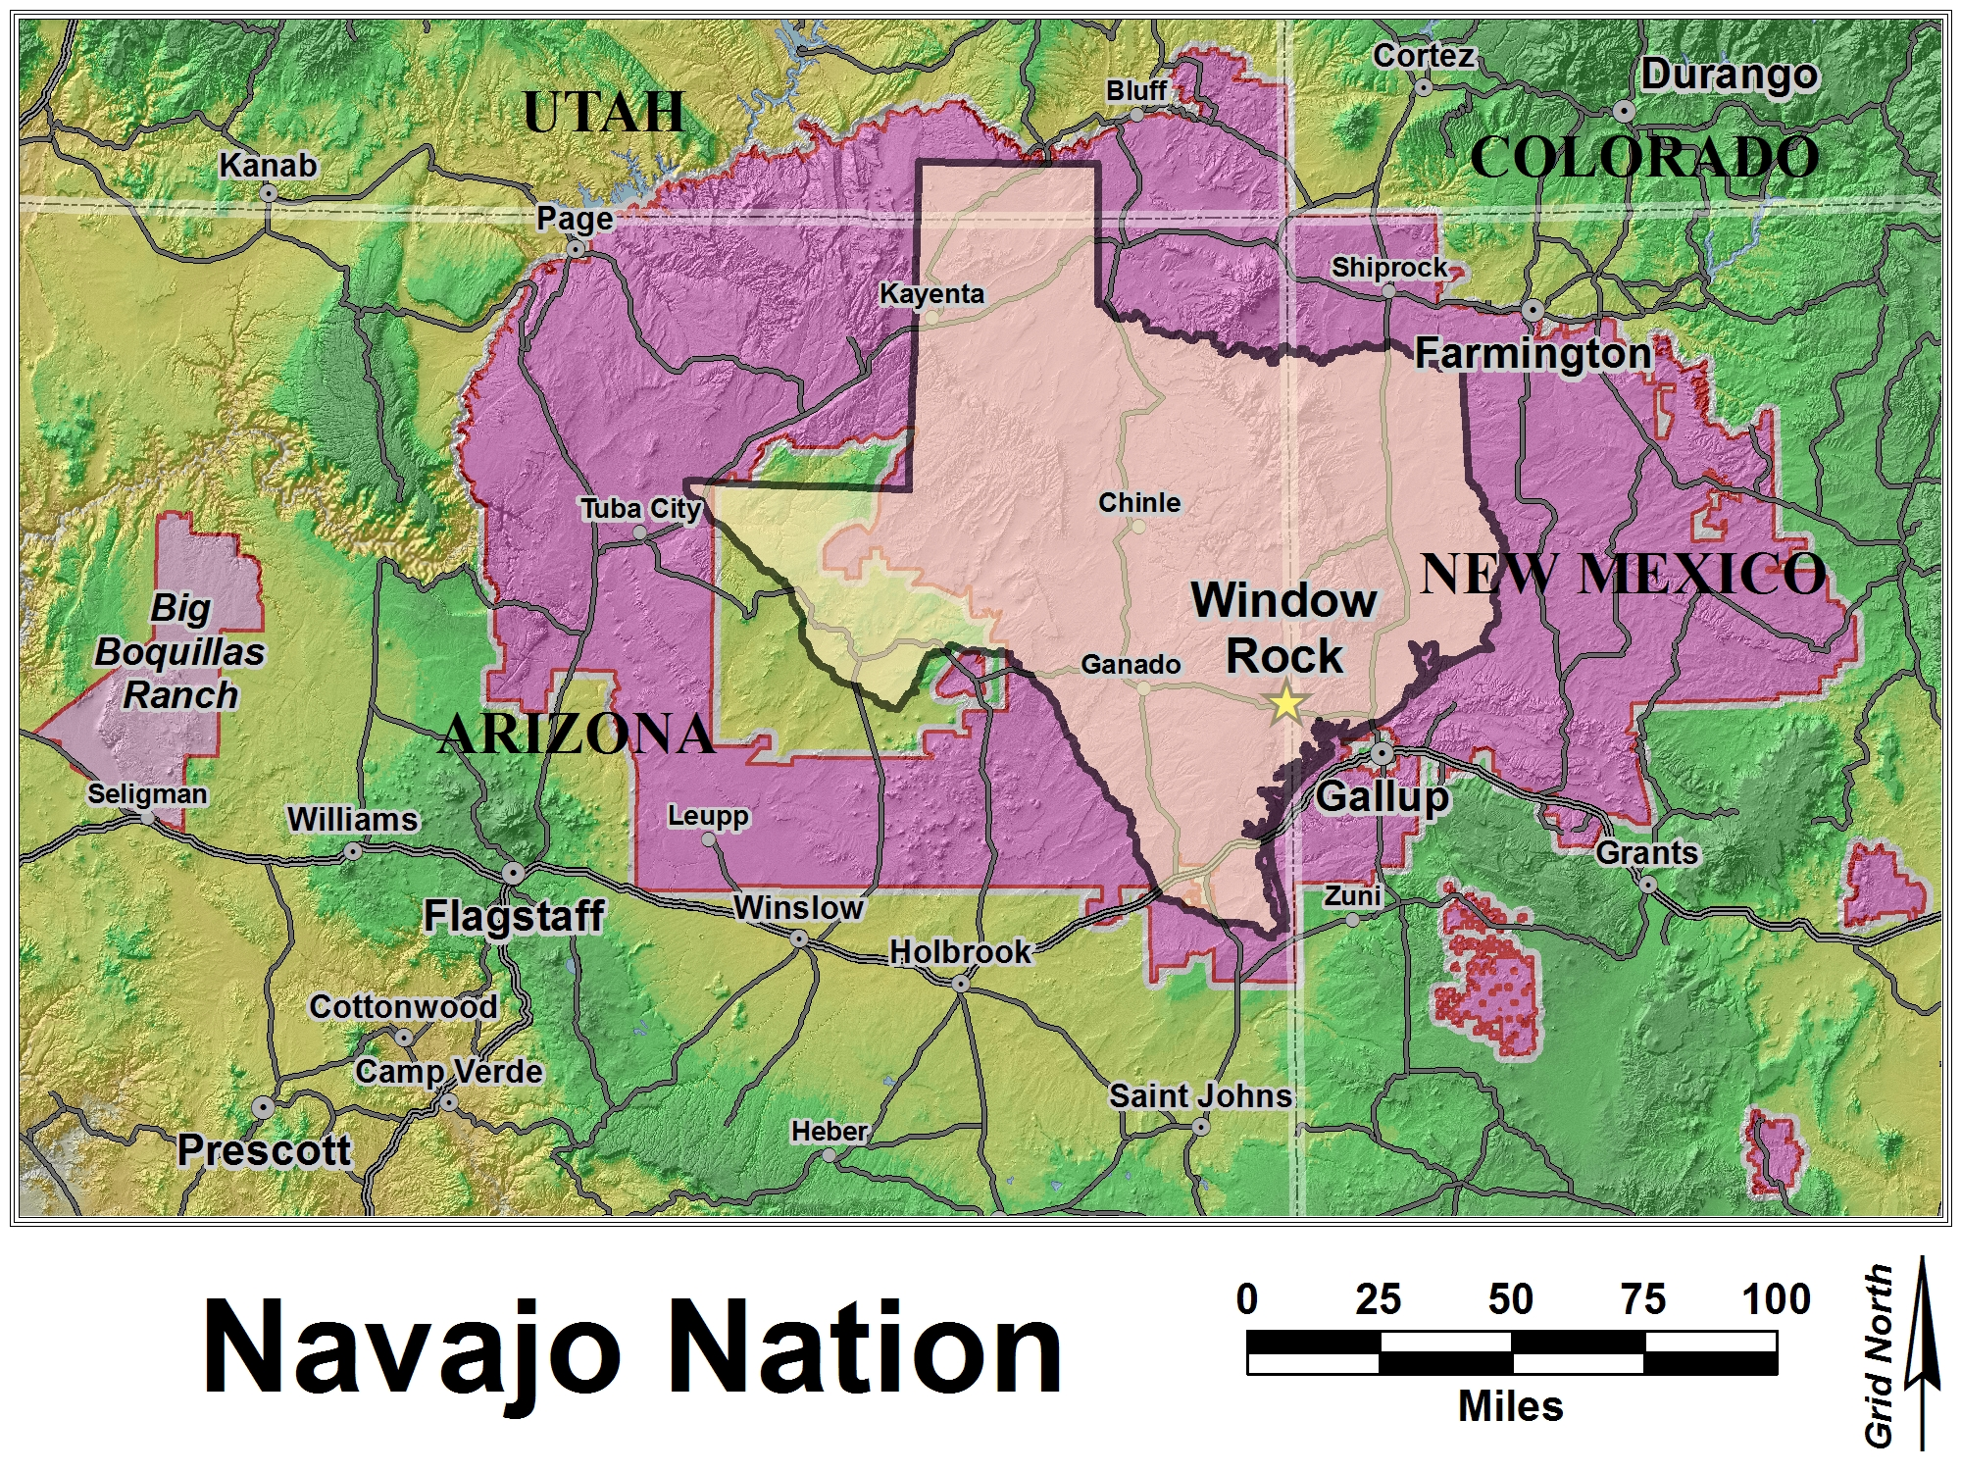
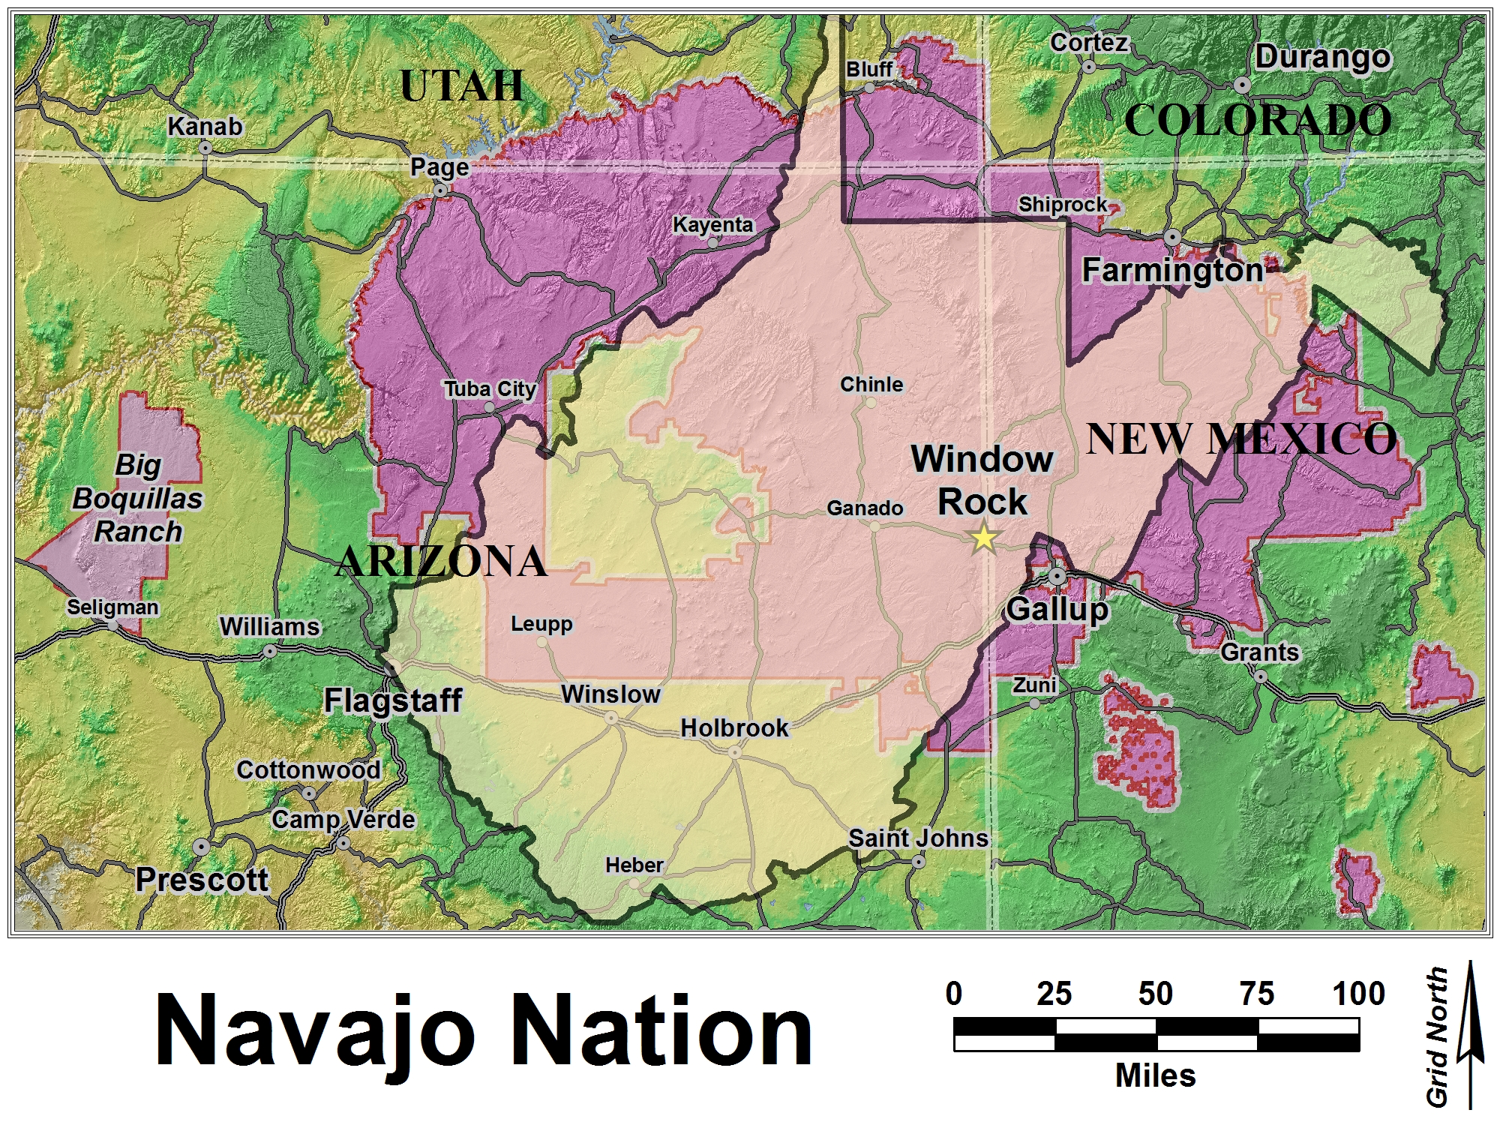
Navajo Nation

Slide 61
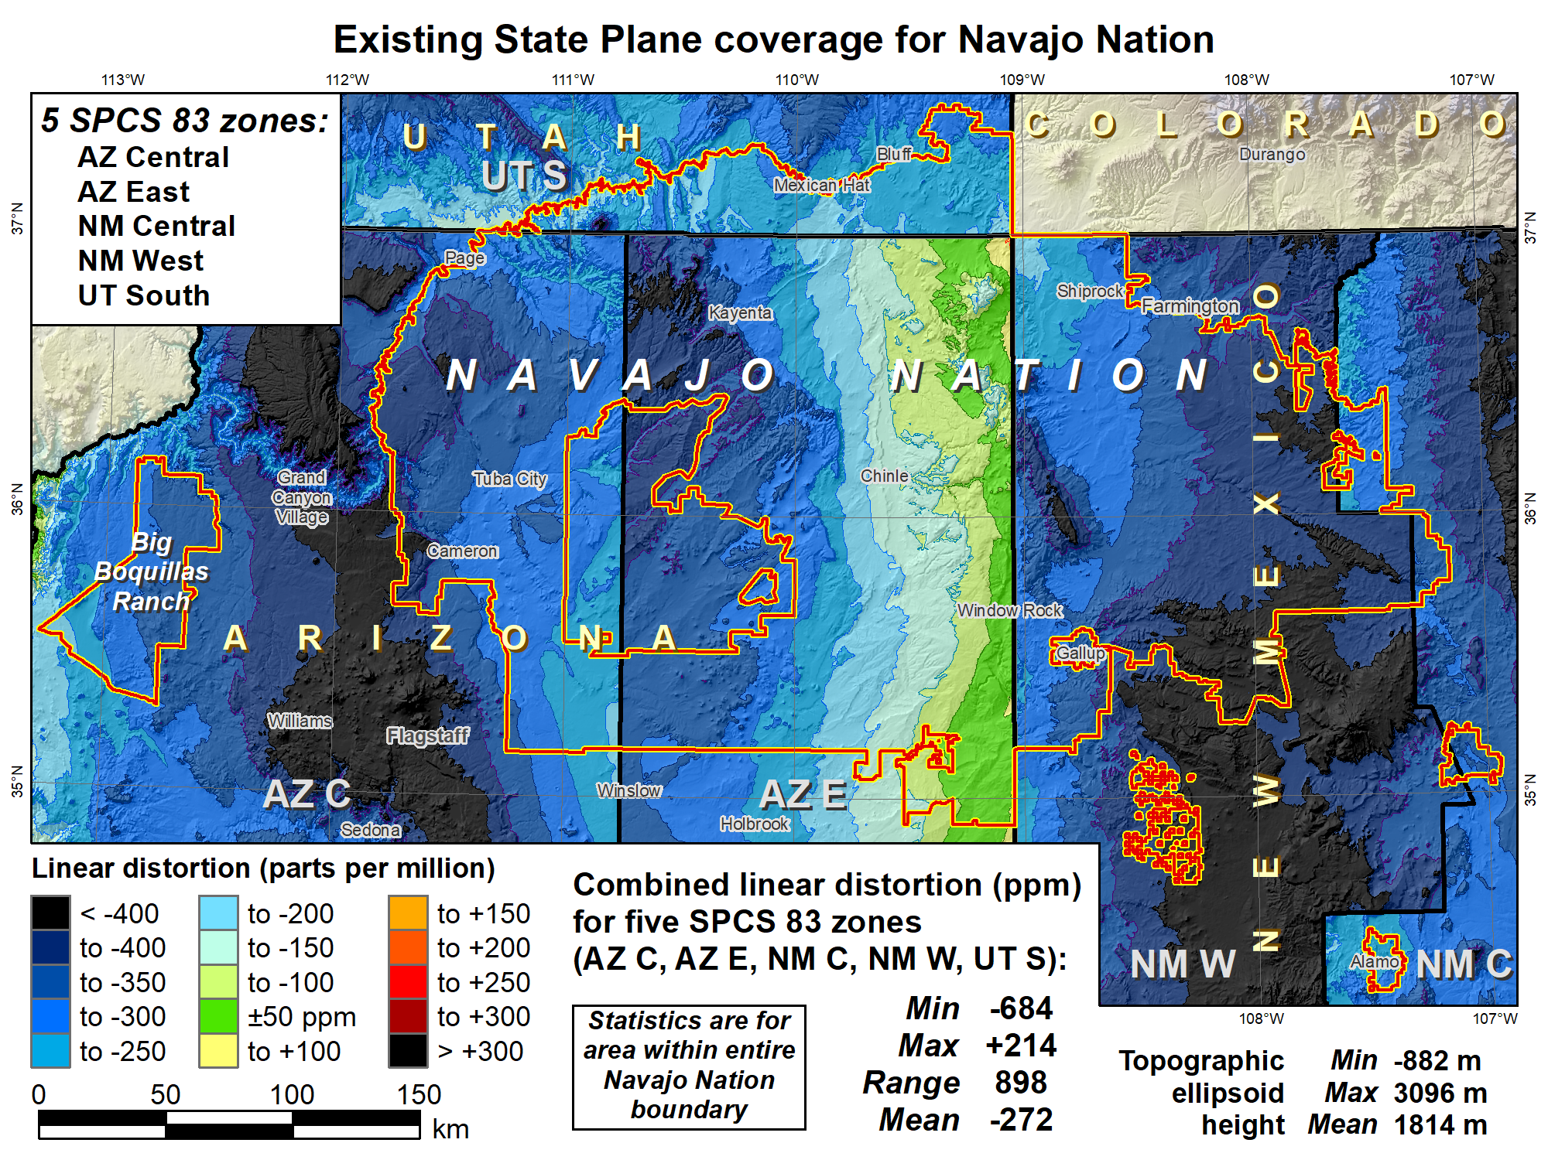

Slide 62
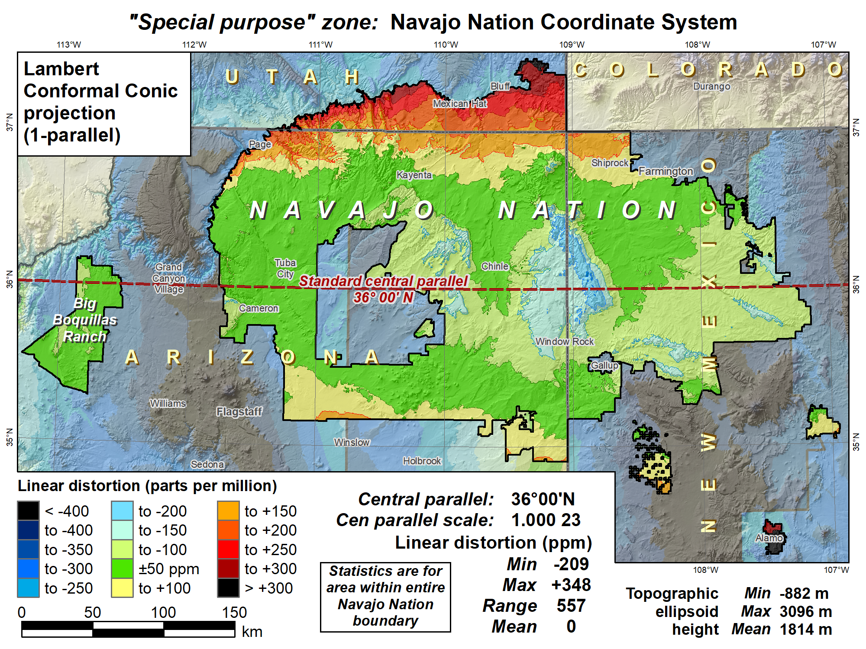

Slide 63
Overview: Policy, Procedures, and FRN
Linear distortion at topographic surface
One-parallel Lambert Conformal Conic projections
Default SPCS2022 zone designs
Statewide and “layered” zones
Linear distortion design criteria
  Maximum and minimum zone size and distortion
  Low distortion projections (LDPs)
“Special purpose” zones (in FRN only)
Linear units
Submittal process and deadlines
  For Federal Register Notice comments
  For requests, proposals, and submittal of designs

Slide 64
Linear units
Policy§II.D and E
All linear parameters defined in meters
Will also give output in feet version if specified by state
Policy§IV.C (for default zones only)
Will use foot as defined currently for SPCS 83
  Appendix C of NOAA Special Publication NOS NGS 13

Slide 65
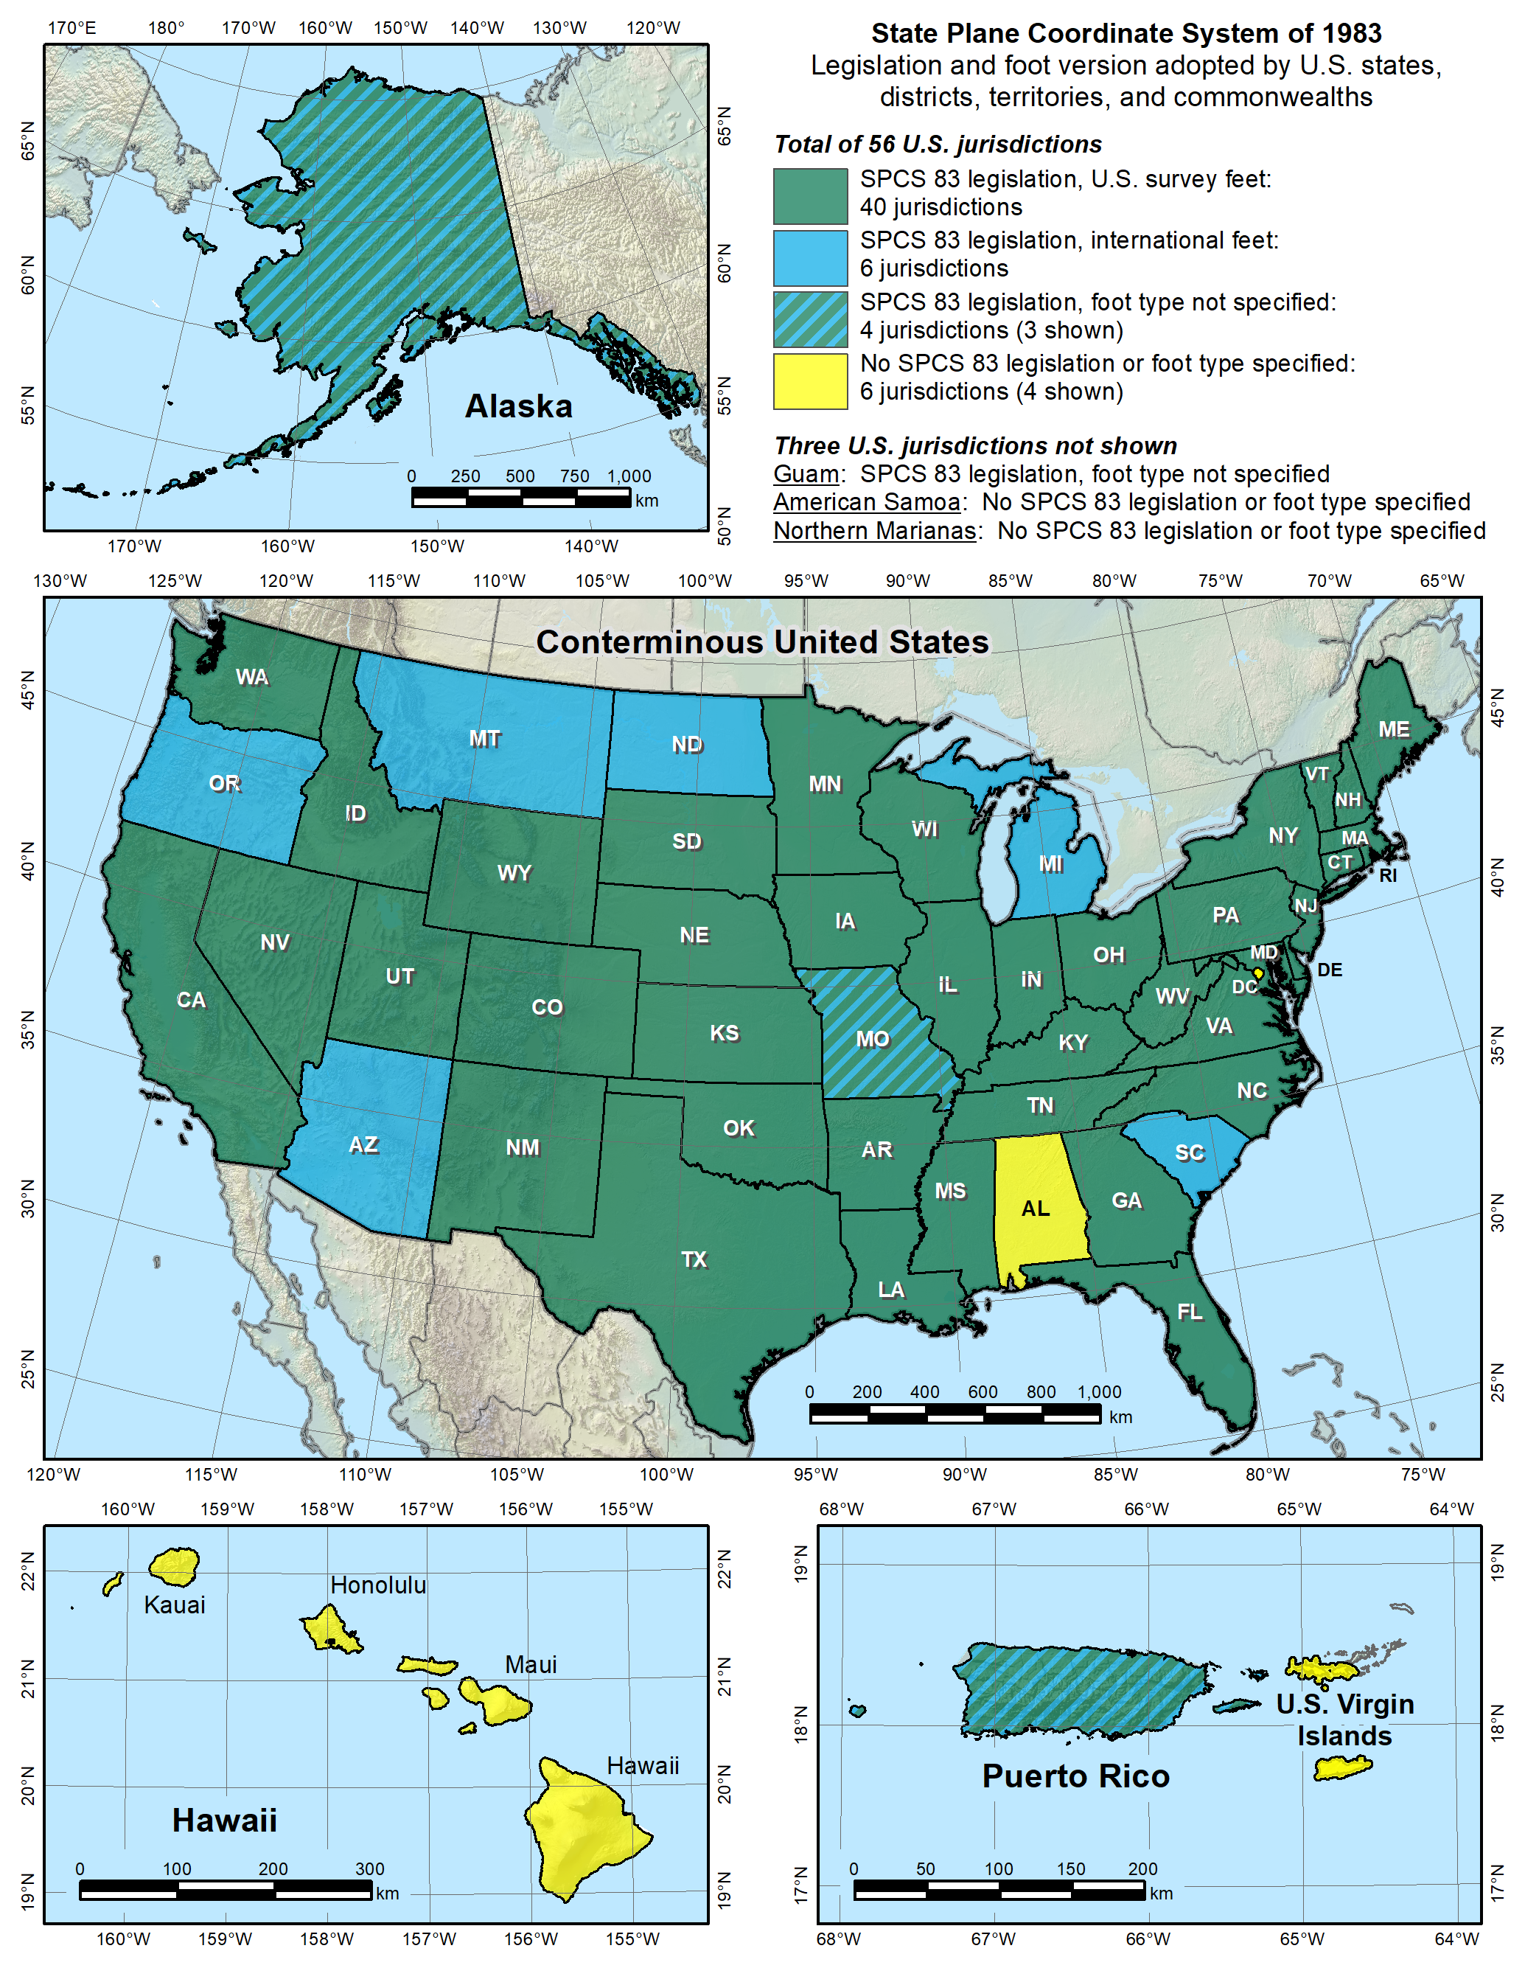

Slide 66
Overview: Policy, Procedures, and FRN
Linear distortion at topographic surface
One-parallel Lambert Conformal Conic projections
Default SPCS2022 zone designs
Statewide and “layered” zones
Linear distortion design criteria
  Maximum and minimum zone size and distortion
  Low distortion projections (LDPs)
“Special purpose” zones (in FRN only)
Linear units
Submittal process and deadlines
  For Federal Register Notice comments
  For requests, proposals, and submittal of designs

Slide 67
Overview of FRN feedback
FRN public comment period April 18-Aug 31
  For draft SPCS2022 policy & procedures
  Wide variety of formats and content
  Individuals, organizations, and groups of organizations
Received 41 unique responses:
  4 national in scope (3 from USGS)
  3 for Indian tribes
  1 from NGS Rocky Mountain Regional Advisor
  33 from states
105 people represented by name
97 organizations represented

Slide 68
Organizations represented
1 federal agency (USGS)
10 Indian tribes
23 states (includes state and private organizations)
  17 state DOTs
  12 state GIS/GIO/cartographer offices
  21 state professional societies (surveying and GIS)
  12 universities and colleges
  6 city and county groups
  7 private companies
  10 other state organizations

Slide 69
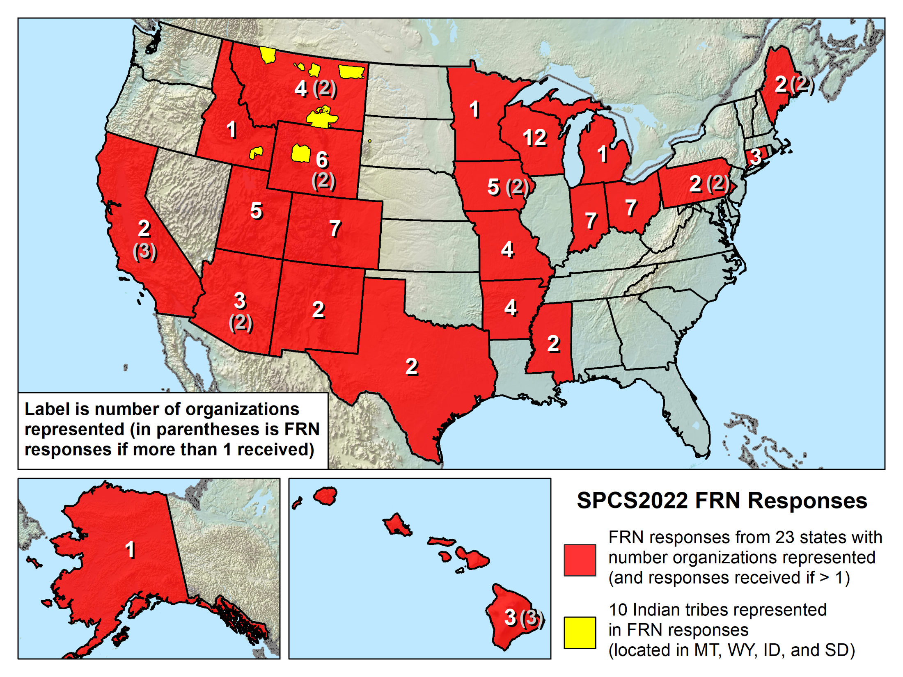

Slide 70
The 5 FRN questions
Usage of current SPCS in your organization.
Whether default SPCS2022 definitions impose hardship or are beneficial.
Whether there is sufficient flexibility in SPCS2022 characteristics.
Whether the SPCS2022 deadlines are acceptable.
Whether “special purpose” zones in SPCS2022 would be beneficial, problematic, or irrelevant.

Slide 71
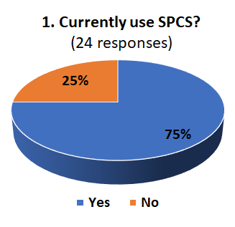
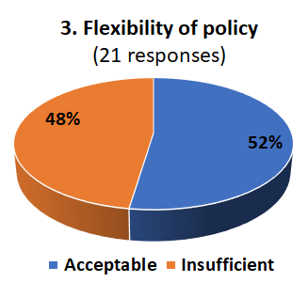
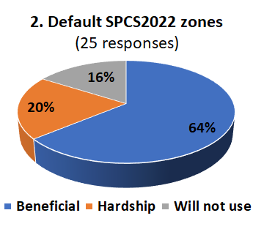
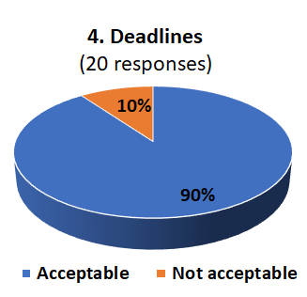
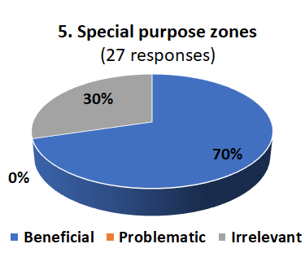
Responses to the 5 FRN questions

Slide 72
The Arizona FRN response
From AGIC, APLS, and NAU
Response to FRN questions
  SPCS 83 in statute and used, along with regional LDPs
  Update is opportunity to go beyond default design
  Insufficient flexibility: lack of special purpose zones and no design tools
  Deadlines acceptable if design support provided
  Special purpose zones in SPCS2022 beneficial
    Navajo Nation, Grand Canyon, DOT & utility corridors
    Gives opportunity to explore options for SPCS2022 zones

Slide 73
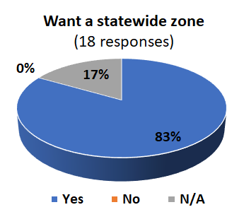
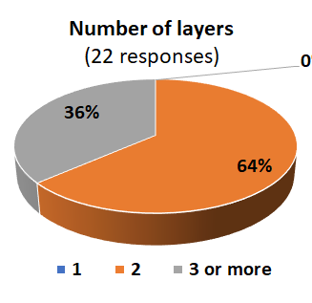
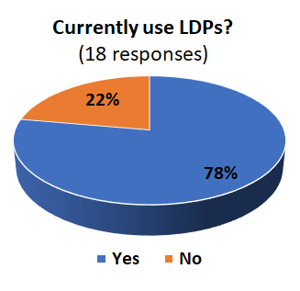
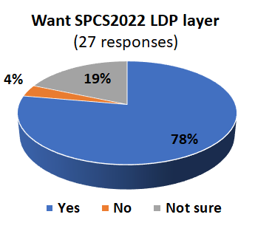
Summary of other FRN input

Slide 74
Deadlines for SPCS2022 requests
SPCS2022 Procedures (draft)
Consensus input per SPCS2022 procedures
  Requests for designs done by NGS
  Proposals for designs by contributing partners
Submittal of approved designs
  Proposal must first be approved by NGS
  Designs must be complete for NGS to review
Later requests will be for changes to SPCS2022
NGS.SPCS@noaa.gov
by December 31, 2019 for requests and proposals
by December 31, 2020 for submittal of approved designs

Slide 75
Summary
Draft SPCS2022 policy and procedures
  Standardized definitions and computations
  Designed with respect to “ground”
  Default designs similar to existing SPCS 83
  Can include a statewide zone plus one subzone layer
  LDPs can be used but must be designed by others
Federal Register Notice (FRN) input received
  On SPCS2022 policy & procedures
  On “special purpose” zones
Consensus state stakeholder input required for SPCS2022 zone requests, proposals, and designs
P.S. Default and statewide zones design maps available for download at ftp://www.ngs.noaa.gov/pub/SPCS/DistortionMaps/

