Slide 1
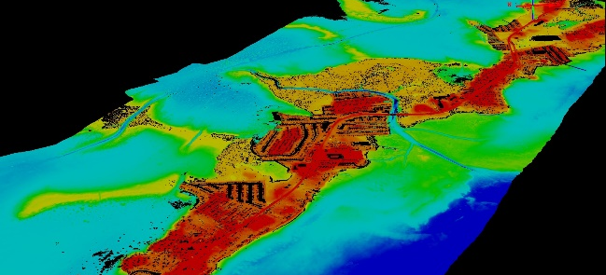
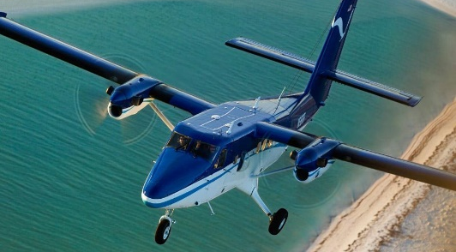
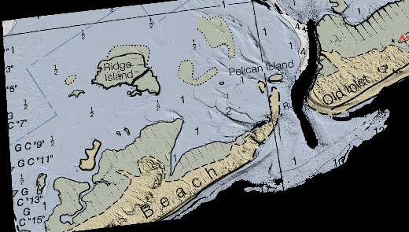
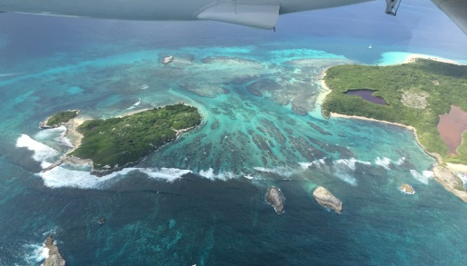
Improved Lidar Technology Supports Safety of Navigation, Coastal Intelligence and Resiliency
Mike Aslaksen
Chief, Remote Sensing Division
National Geodetic Survey
December 10, 2015

Slide 2
Outline
Background
Recent developments and interest in topobathy lidar
NGS’s use of topobathy lidar
Current projects and coordination
Sandy Supplemental Contract
Applications and access to the data
  Digital Coast
Questions

Slide 3
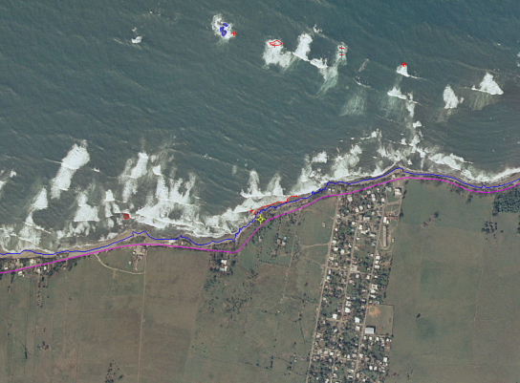
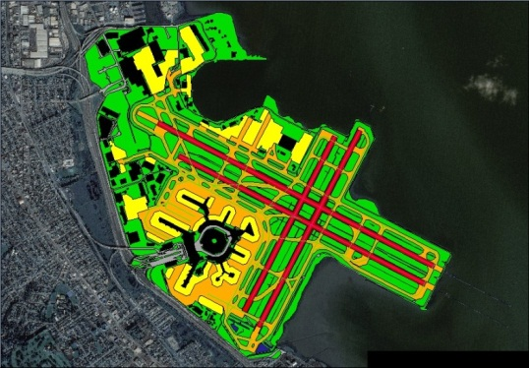
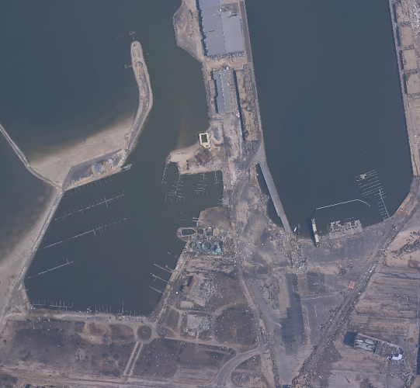
Background
U.S. Department of Commerce
  National Oceanic Atmospheric Administration (NOAA)
    National Ocean Service
      National Geodetic Survey
        Remote Sensing Division
Primary programs
  Coastal Mapping Program
  Aeronautical Survey Program
  Emergency Response
Notes:
Background on how we fit under the NOAA umbrella
Coastal Mapping - we provide shoreline for NOAA’s nautical charts. This is the legal shoreline for the U.S. and its territories. Its important that this line be mapped as accurately as possible because this is the shoreline that can be brought to court to resolve boundary disputes and mineral rights case.
Aeronautical Survey Program - we are part of a reimbursable program with the FAA to provide Airport Obstruction Charts. This means we provide accurate positional info (X,Y, and Z) to the FAA on obstructing features within FAA surfaces and runway ends, Nav Aids, most airport features.

Slide 4
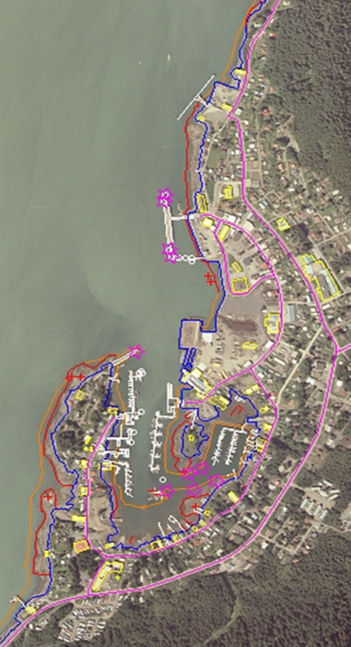
NOAA’s Coastal Mapping Program
Define the National Shoreline and nearshore elevation data
NOAA nautical charts
Other important applications:
  Used in defining the United States’ territorial limits
  Coastal resource management
  Storm surge and coastal flooding modeling
  GIS analysis
  Benthic habitat mapping
Coastal Intelligence and Resiliency…

Slide 5
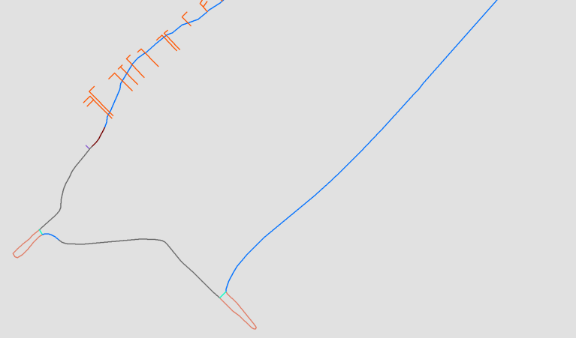
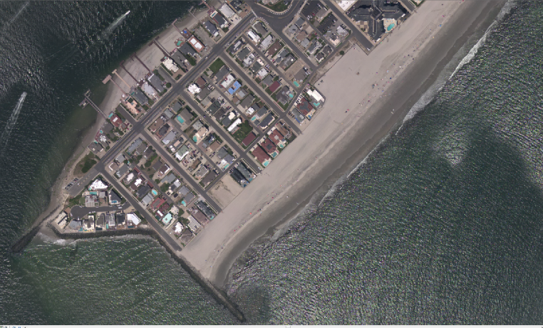
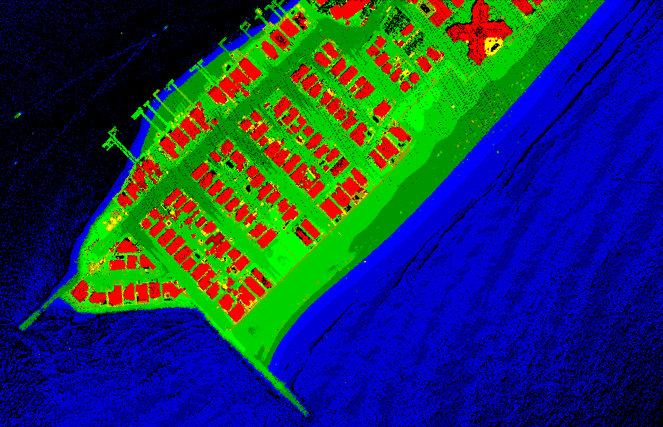
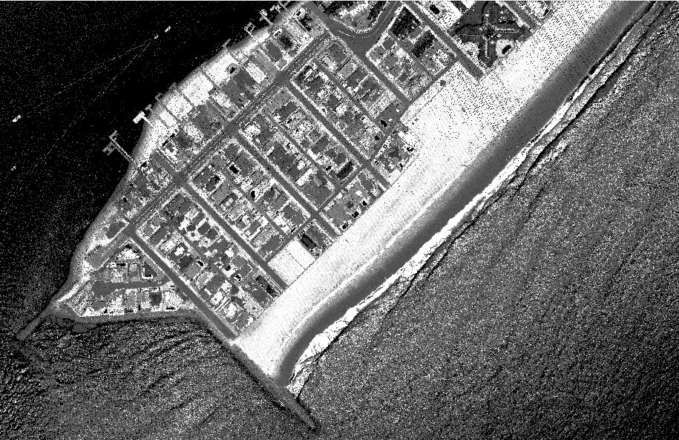
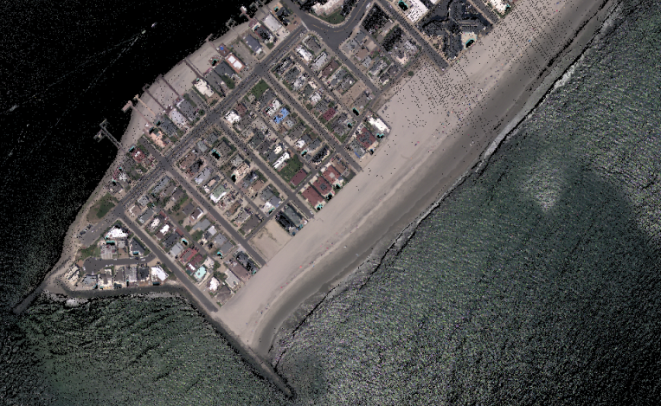
Products NGS delivers and derivatives
Shoreline
Ortho Mosaic Imagery
Lidar Point Cloud and DEMs
(elevation)
Lidar Point
Cloud
(intensity)
Map once use many times!
RGB
Colorized Lidar
Point Cloud

Slide 6
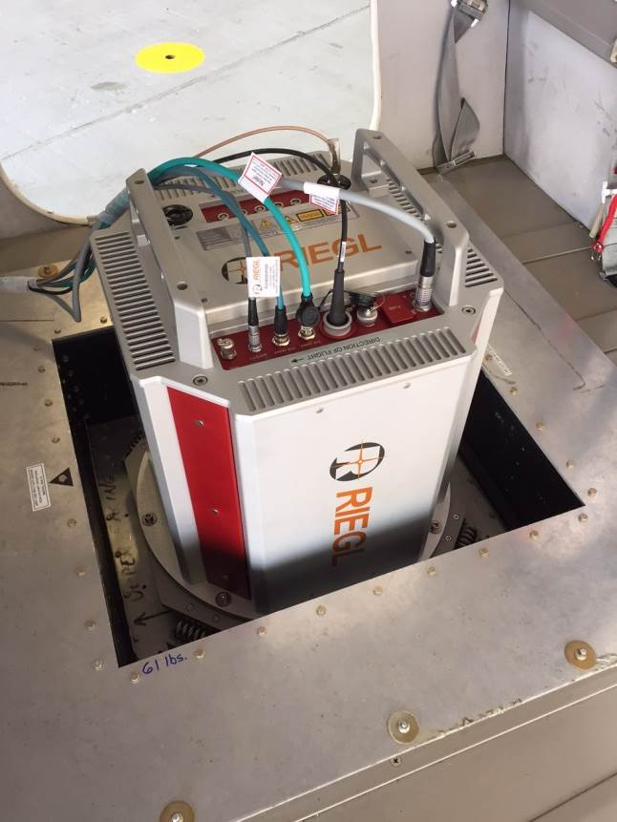
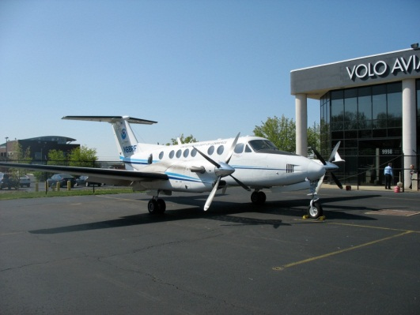
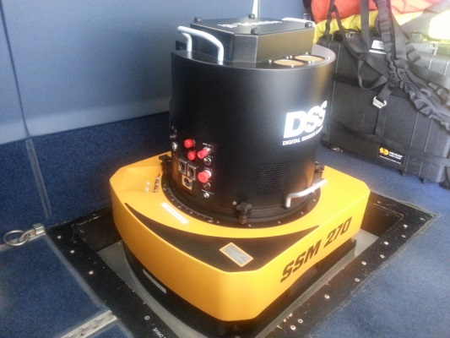

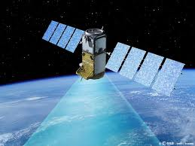
How do we do it?
King Air 350ER Aircraft
  Extended Range: 8 hour endurance
  180kt survey & 250kt transit speed
DHC-6 Twin Otter
  Slow stable, low flying
  80-160kt survey speed
Trimble DSS580 Dual Cam & DSS500 Dual Oblique Cam
  RGB & NIR cameras (NIR in DSS580 only)
  35cm GSD at 10,500’ flying height
  In-flight image processing
RIEGL LIDARs
  Topographic LIDAR (LMS-Q680i)
  Topobathymetric System (VQ-880G)
Commercial and National Satellite Imagery
Private sector contracts
Notes:
King Air – Long endurance for greater efficiency (fewer flights to acquire large area). Fast acquisition speed means more miles mapped per flight hour. Fast transit speed allows us to quickly move from one acquisition area to another.
Applanix DSS – Digital camera. Two cameras mounted fore and aft. One collects color (RGB – red, green, blue) imagery, the other collects Near Infrared (NIR). The sensor resolution is 80 megapixels. We map to a Ground Sample Distance (GSD) of 35cm. This is achieved when flying at an altitude of 10,500’ above ground level (AGL). We process the raw imagery in the air which saves time on the ground post flight. We also have a DSS 500 Oblique Camera system with dual oblique cameras (one port and one starboard) with look angles of 40 degrees. Total swath width of the DSS580 and DSS500 at 10,500 feet is around 8km.
LIDAR – Topographic LIDAR maps above water level only.

Slide 7
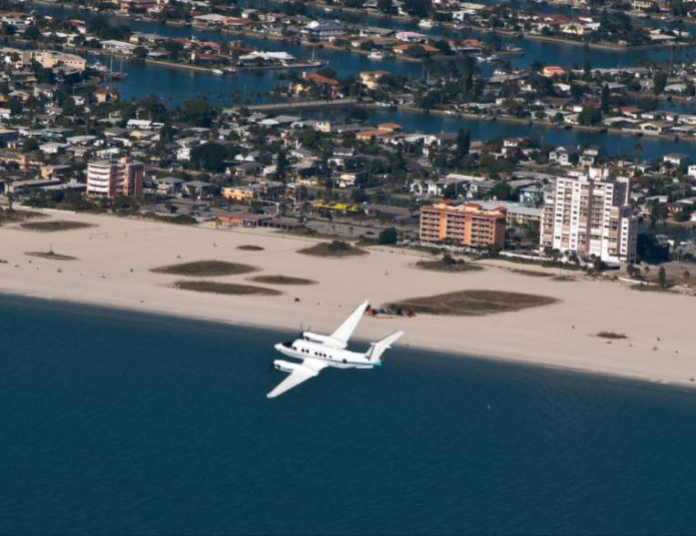
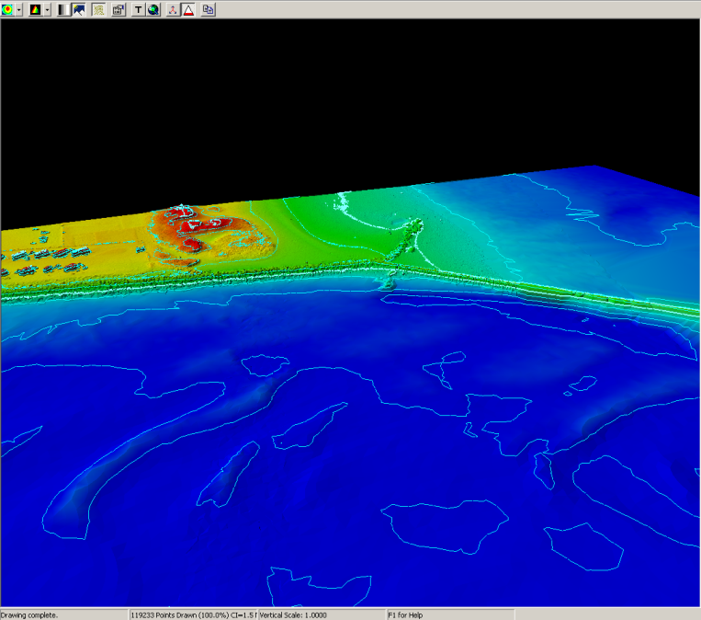
Topo-bathy lidar system
  Occupies middle ground between conventional topographic and bathymetric systems:
    Narrow beam, low power, small FOV, very high sampling rates
    Focus is on shallow water and environmental applications
Why of interest to NOAA & partners?
  Uniquely suited for shoreline mapping
    Seamless, high-resolution data across backshore, intertidal, and nearshore marine zones
  Fill in shallow water gap (shoreward of NALL line)
  SLR analysis, inundation modeling
  Habitat mapping
  Riverine mapping
  Coastal zone management, coastal science => IOCM! Map Once-Use Many Times!

Slide 8
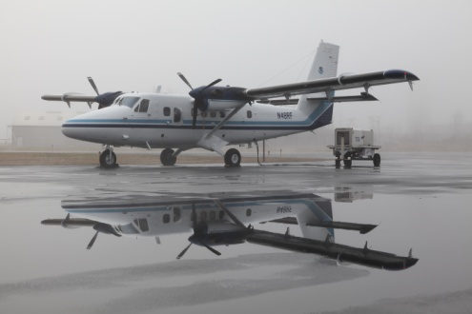
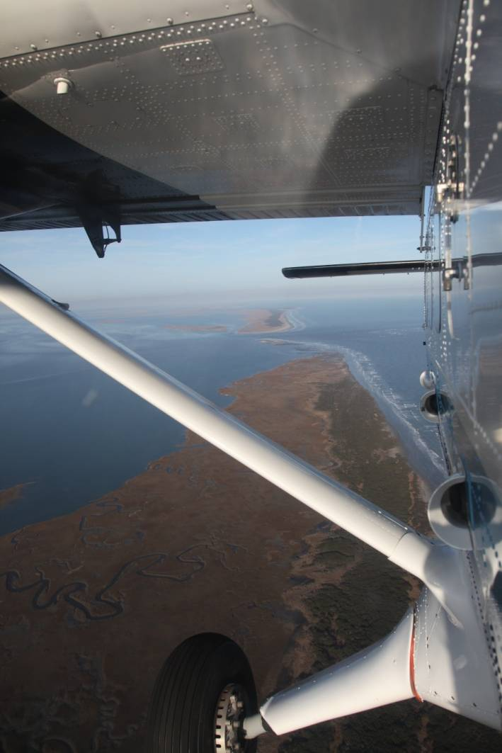
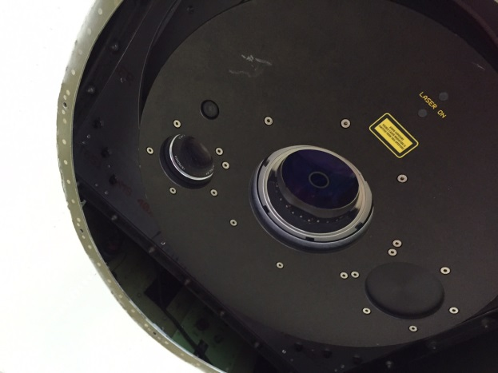
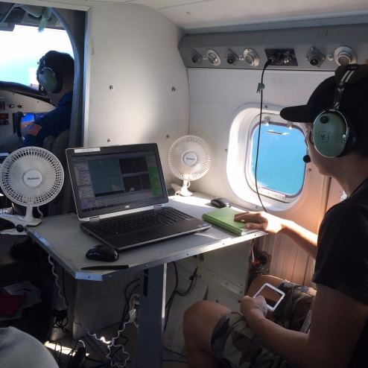
Riegl VQ-880G Upgrade – Sandy Supplemental

Slide 9

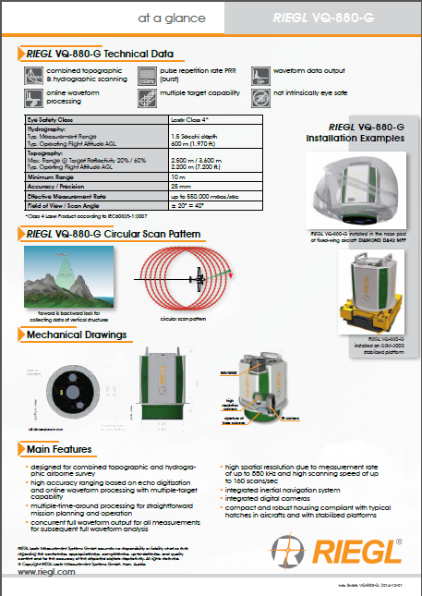

Slide 10
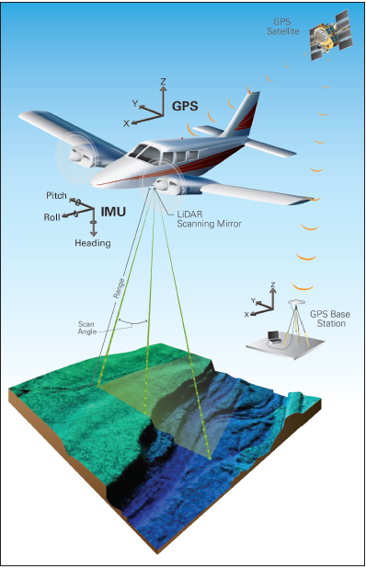
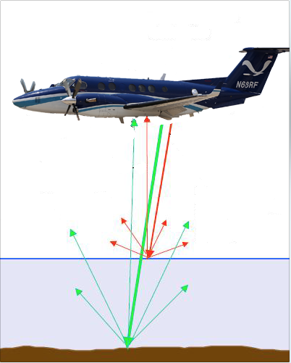
Details of topobathy lidar systems
Image credit USGS

Slide 11
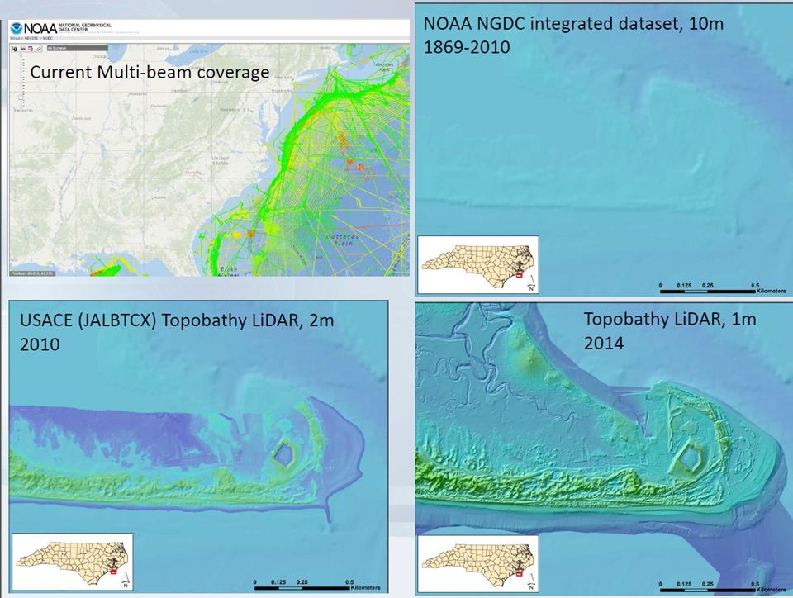
Slide credit: Quantum Spatial
Notes:
Credit Colin Cooper from Quantum Spatial

Slide 12
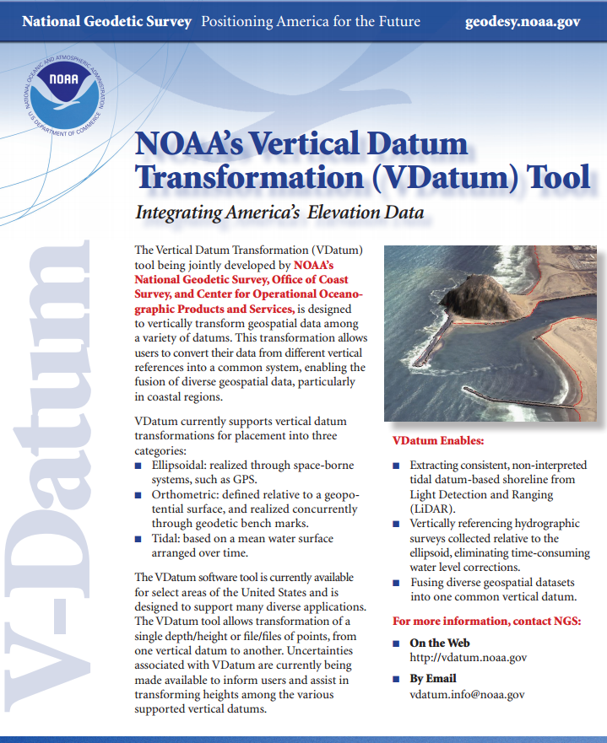
Topobathy lidar products and derivatives
are dependent on VDatum to perform the
required transformations for various
applications:
Charting – MHW and MLLW shorelines;
MLLW for shallow water bathymetry
Inundation/SLR – typically MHHW in order to forecast maximum possible inundation
Sediment transport – NAVD88 to compare with previous datasets
Numerous others…
vdatum.noaa.gov

Slide 13
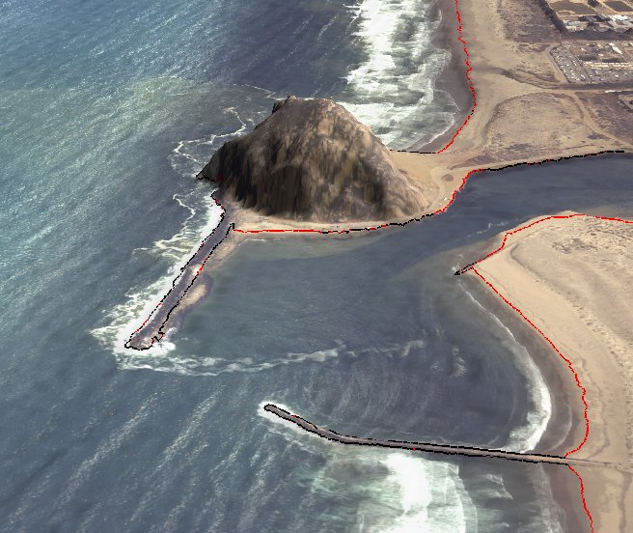
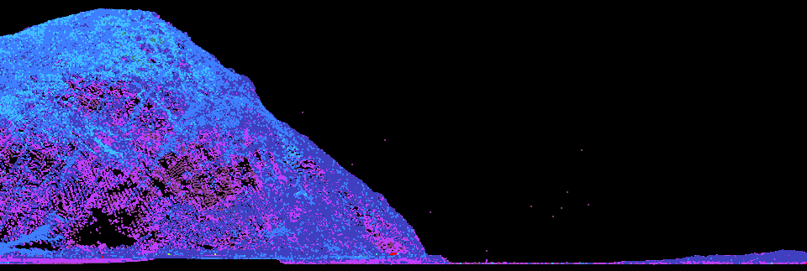
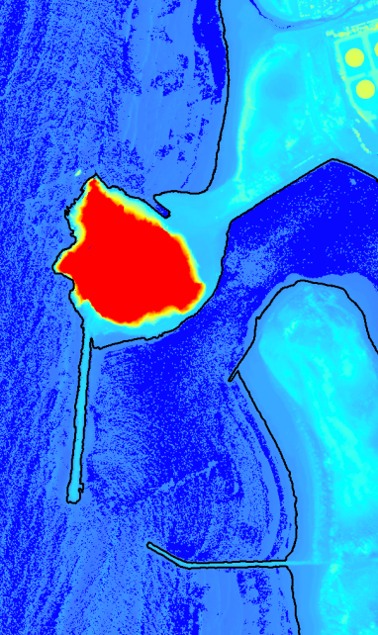
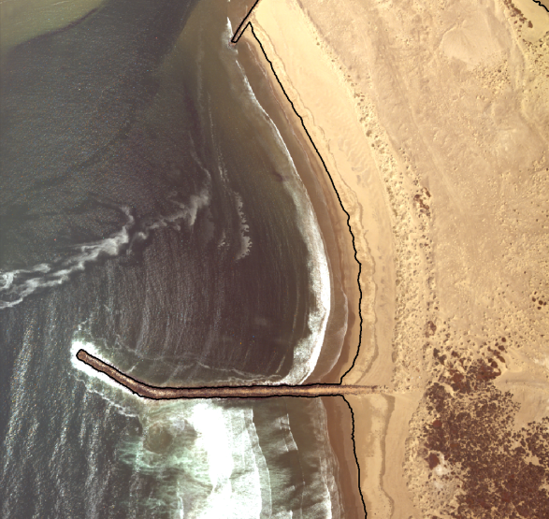
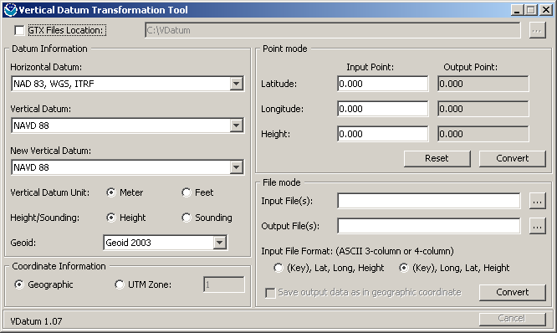
Lidar Shoreline Extraction
Edit Lidar Point Cloud
VDatum
Contour Shoreline from DEM
Quality Control &
Feature Attribution

Slide 14
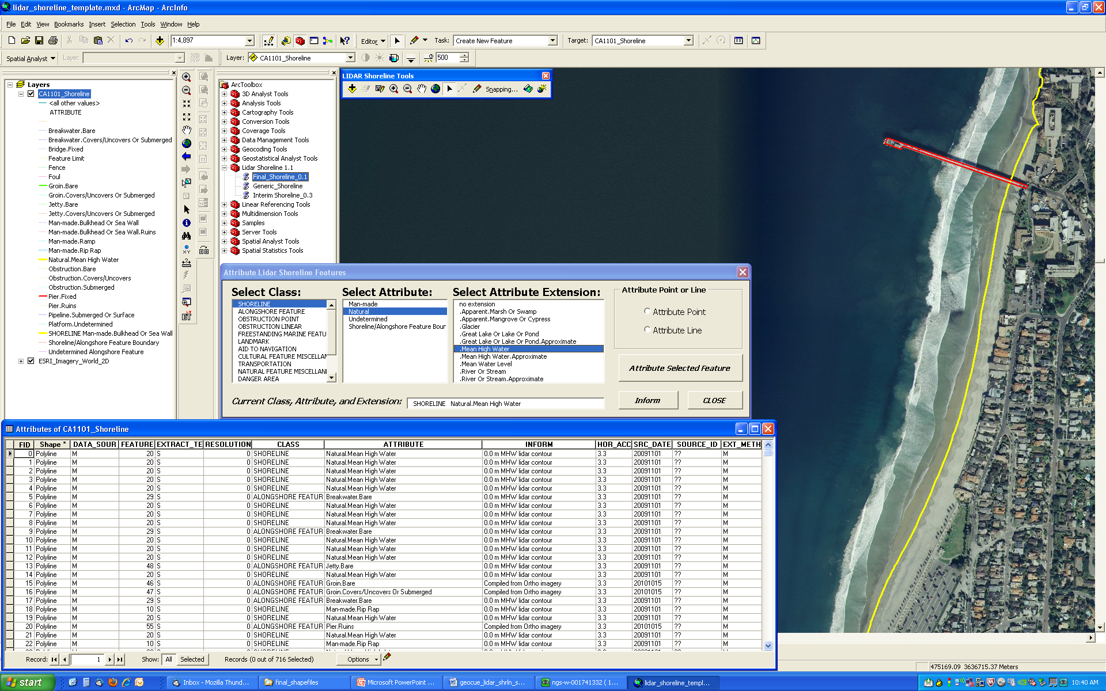
Final Shoreline Shapefile Format

Slide 15
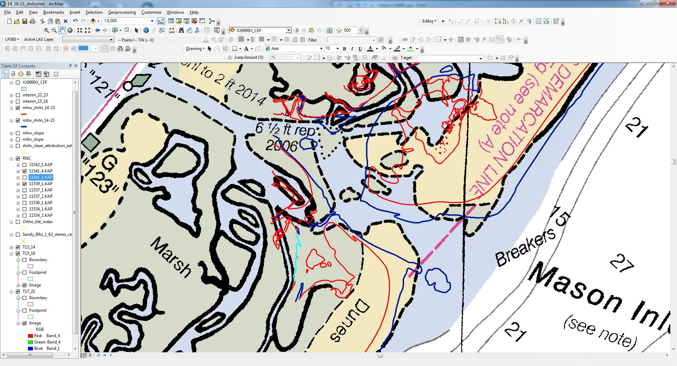
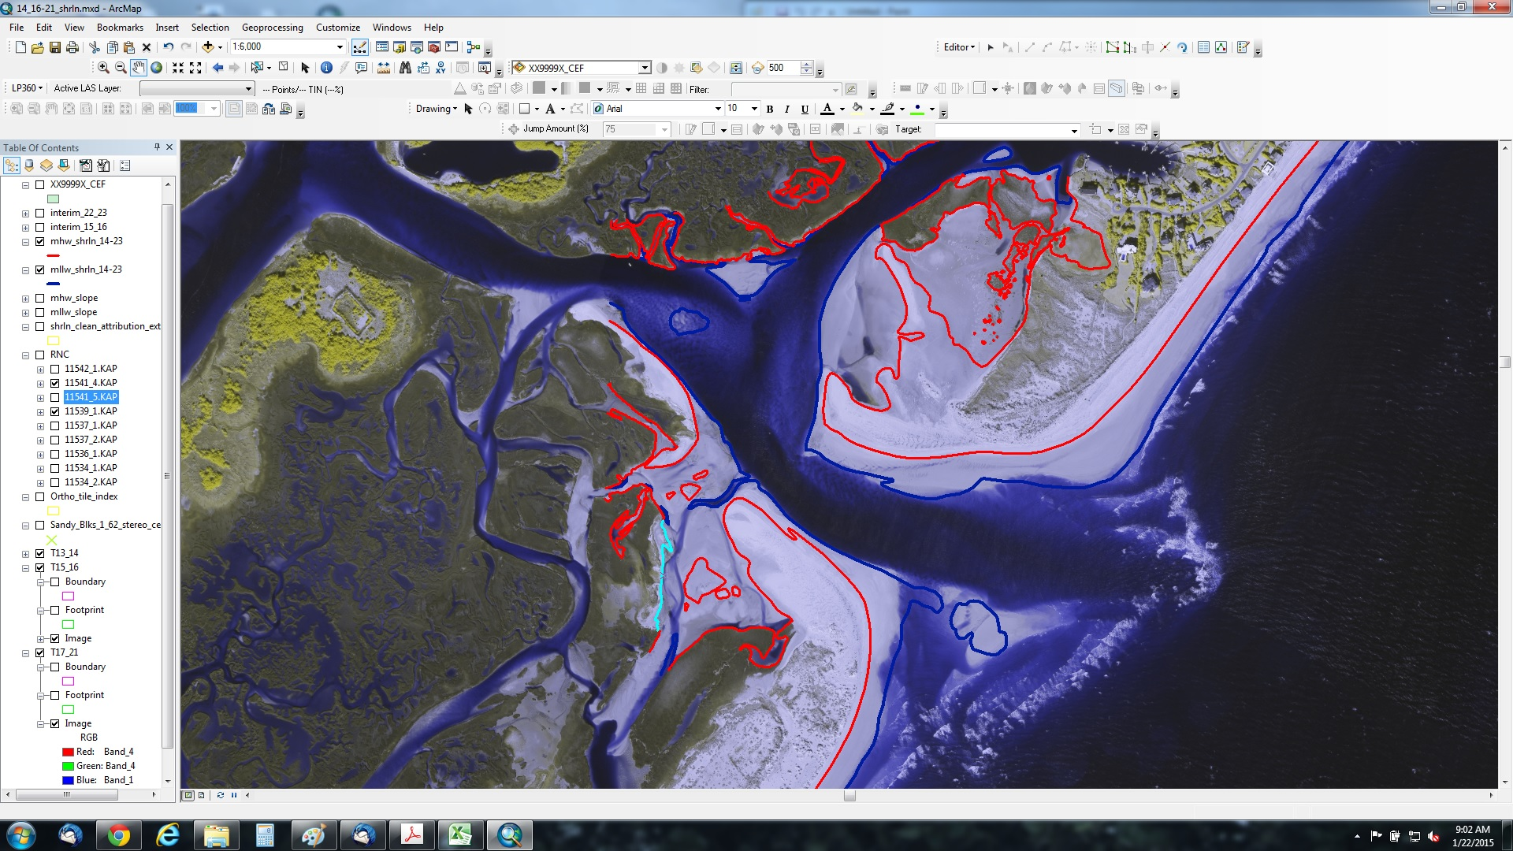
Update NOAA Nautical Charts – new shoreline Mason Inlet, NC

Slide 16
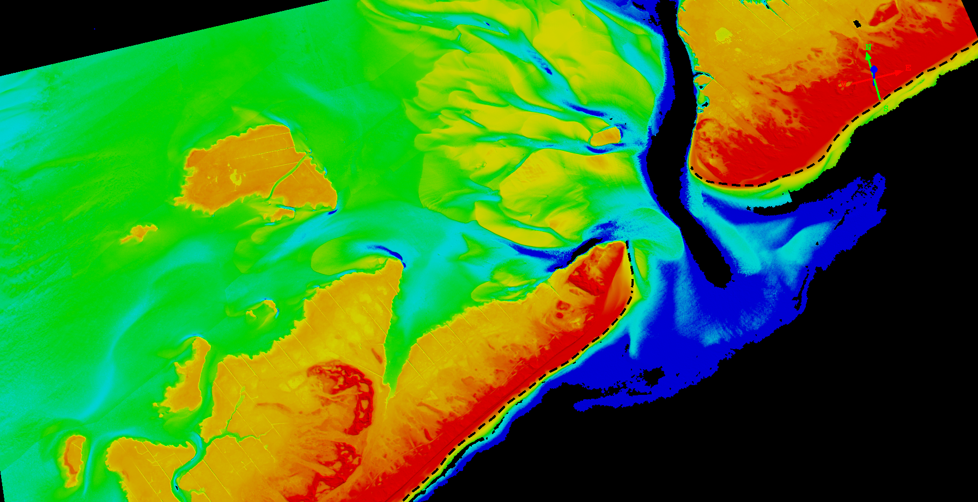
Southern Long Island
Sandy Supplemental
Notes:
Sandy lidar - Long Island

Slide 17
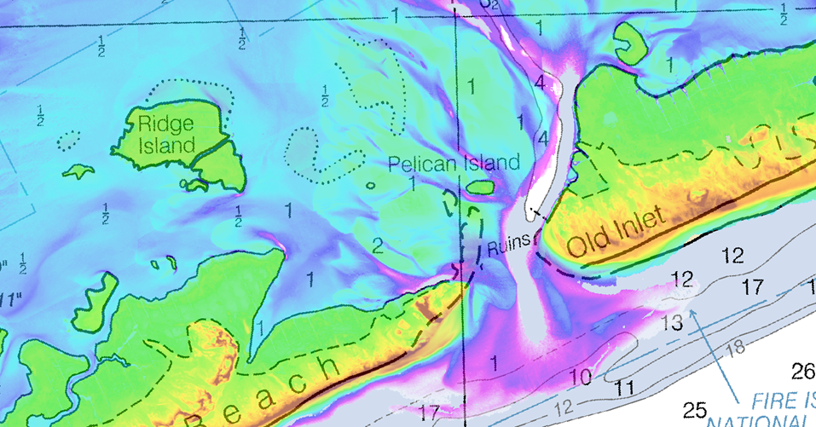
Southern Long Island
Sandy Supplemental

Slide 18
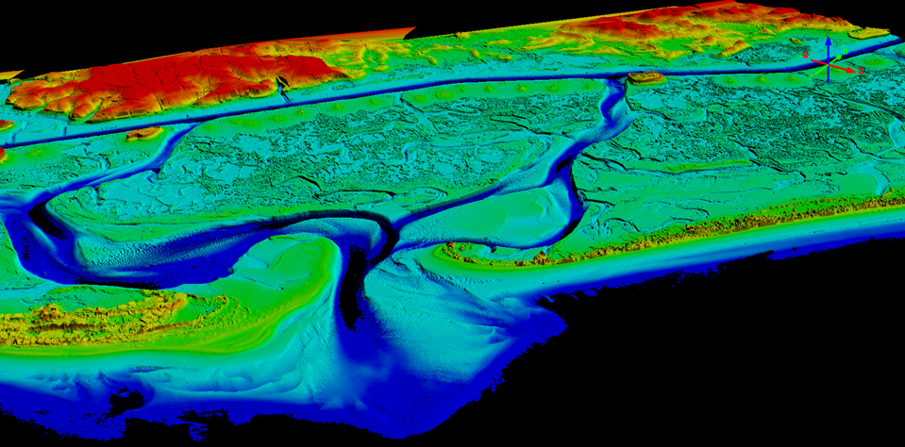
Topsail Island, NC
Sandy Supplemental

Slide 19
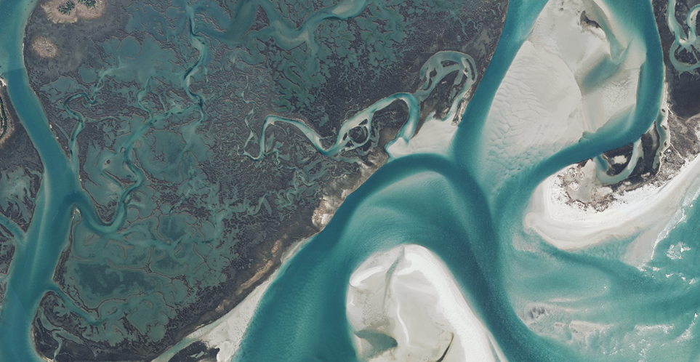
Topsail Island, NC
Sandy Supplemental
Notes:
imagery near topsoil area

Slide 20
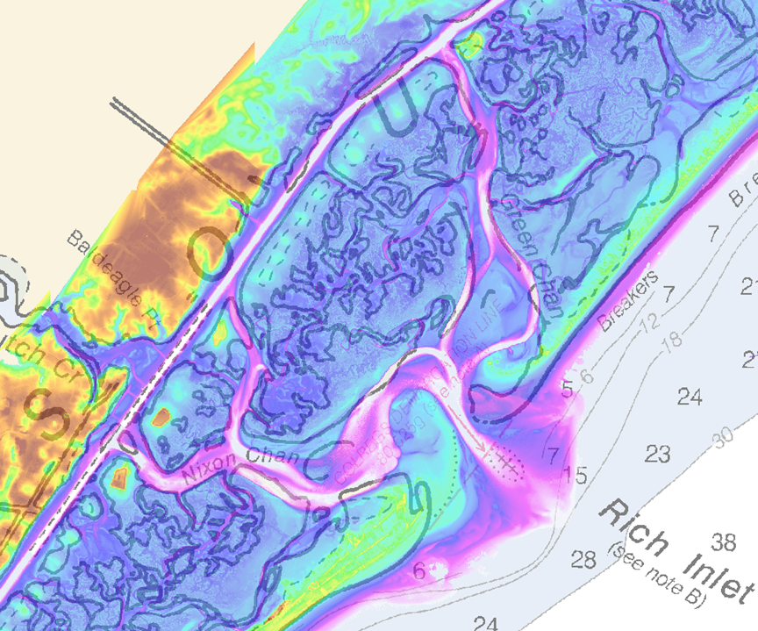
Topsail Island, NC
Sandy Supplemental

Slide 21
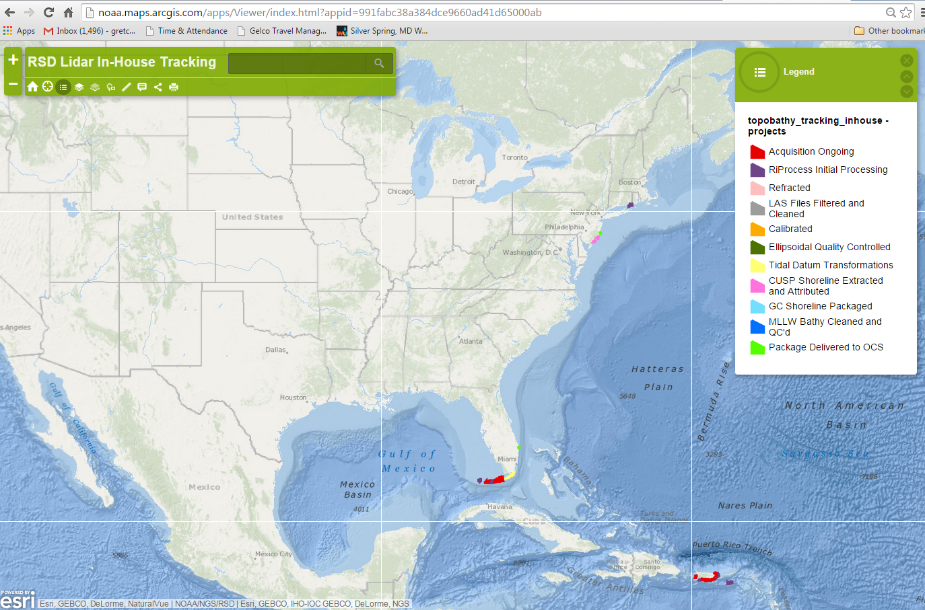
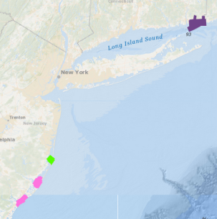
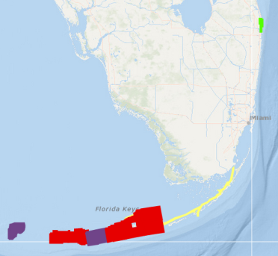
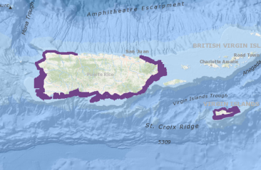
FY14/15 NGS Lidar Operations
Total: ~1210nm² acquired
Notes:
Starting in the NE: the project areas in and around Fisher Island Sound (CT1401) were collected as a collaboration effort between OR&R, OCS, and NGS and equate to ~75nm². The Barnegat Bay, NJ project was flown in support of Hurricane Sandy and covers ~17.5nm². Little Egg Inlet was flown in support of Hurricane Sandy and covers 35.0nm². Great Egg Inlet was flown in support of Hurricane Sandy and covers 30.0nm² (Hurricane Sandy support flights = 82.5nm²).
In the SE NGS flew the Lake Worth, FL project that supported a new chart. This new chart is a 1:5,000 scale product that would support not only commercial shipping but the growing recreational demand for chart products. The Lake Worth project covered 14nm². NGS has flown and is currently in the process of acquiring the Florida Keys. This area is very conducive to collection by the RIEGL TBL sensor suite and was chosen as a project area after acquiring the ICW that runs from the mainland down to the southern tip of the Keys. The combination of these project areas accounts for a planned 1110nm²; NOAA has acquired 450nm² in the Florida Keys. This project is currently underway and will continue once RSD gains access to the survey aircraft.
The remaining projects that have been acquired are in Puerto Rico and the USVI. The inset has been updated to reflect the most recent survey season. To date RSD has acquired 602nm² of TBL data in PR and the USVI.
RSD also has an additional 450nm² planned on the Gulf Coast of Florida, Louisiana, and Texas. We are currently able to acquire ~3.4nm² per flight hour with our VQ-880-G (On the Twin Otter). Without any aircraft, mechanical, logistic, weather, etc issues we/RSD should be able to acquire the remaining areas in around 350-400 hours (does not include repositioning time). We have 500 hours requested for FY16.
Total: ~1210nm² acquired in house

Slide 22
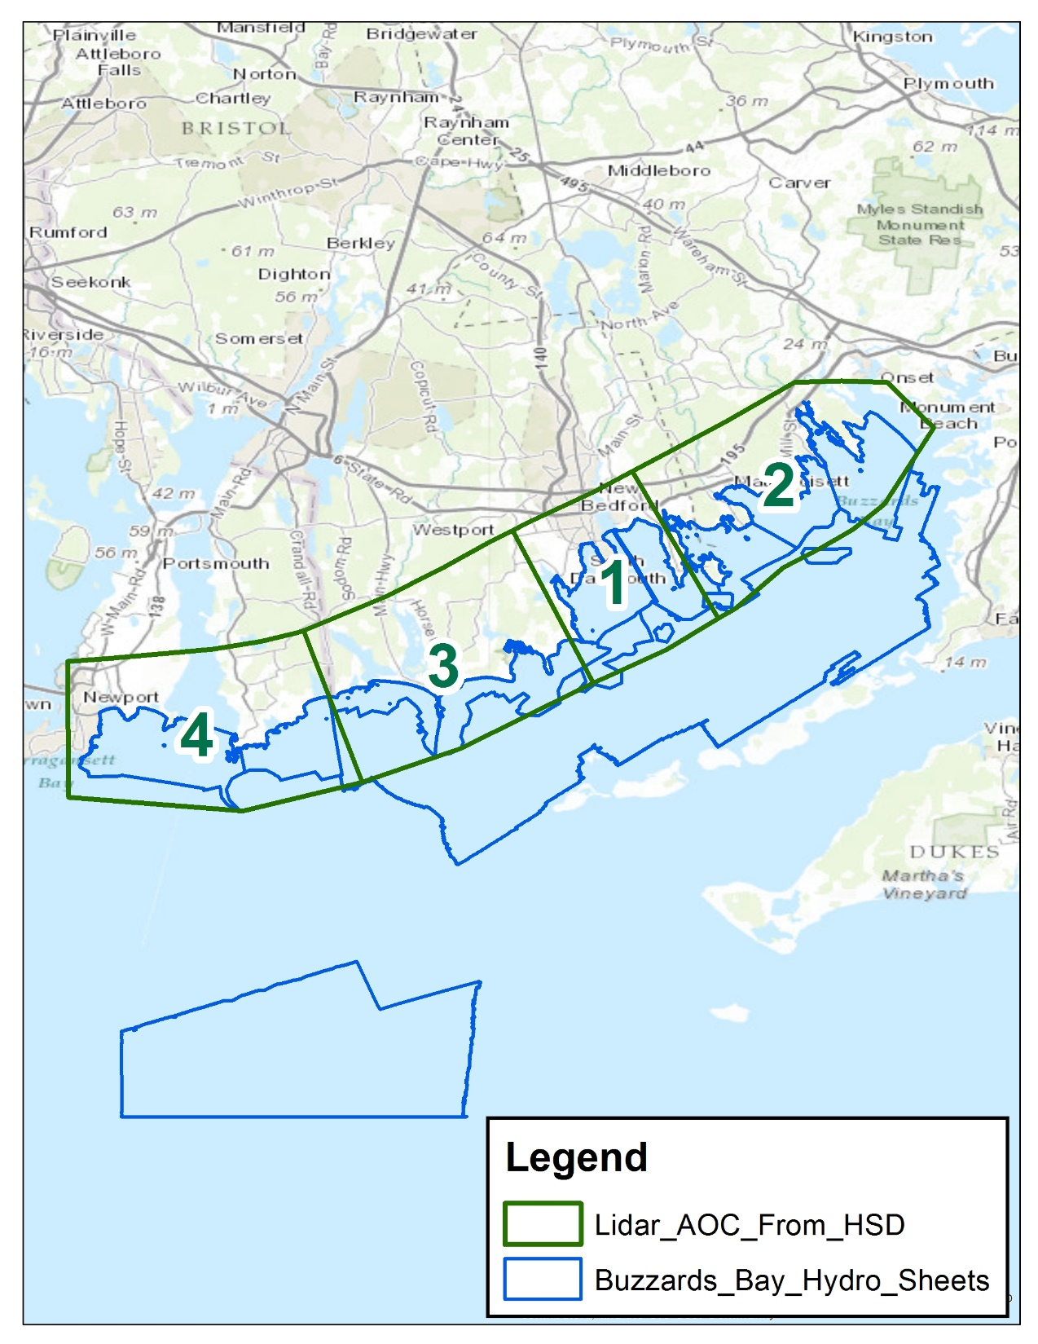

Slide 23
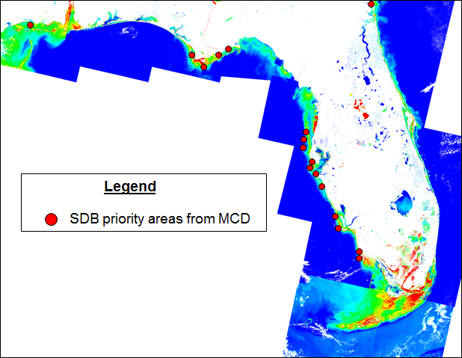

Slide 24
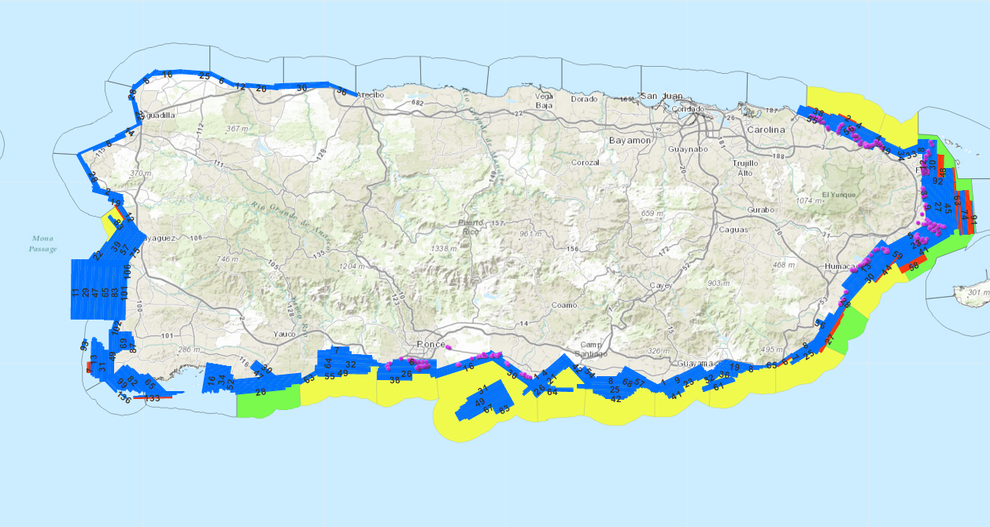
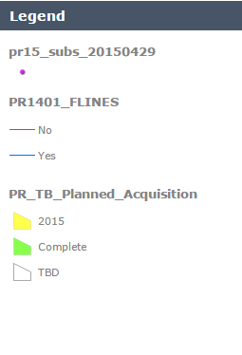

Slide 25
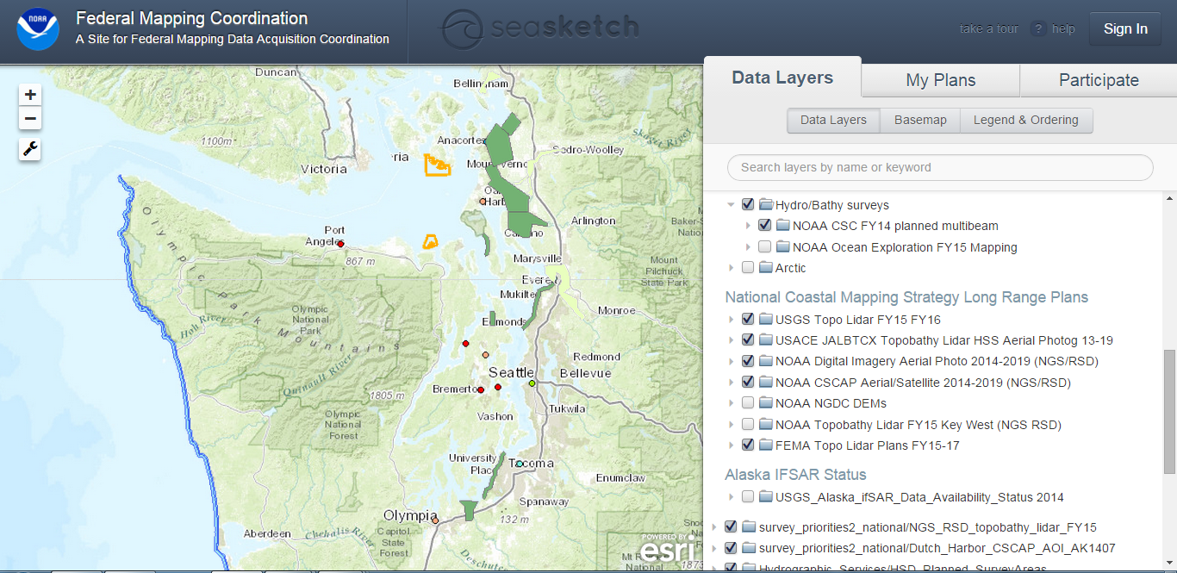
Seasketch and Mapping Coordination
Great visualization tool for understanding requirements, plans
Eg. NOAA/USGS/USACE and partners worked to maximize Sandy topobathy lidar data collects
USACE worked with USGS and WA stakeholders to discuss overlap requirements, modify plans for best outcome

Slide 26

National Mapping Coordination
IWG-OCM and 3DEP agencies have agreed to use Seasketch tool to share info on acquisition plans
Additional tools available for use
Notes:
[Blank templates for others to use]

Slide 27

http://www.seasketch.org/#projecthomepage/5272840f6ec5f42d210016e4

Slide 28



Post-Sandy Topobathymetric LiDAR along the Eastern Atlantic Seaboard
Slide Credit NOAA & Dewberry

Slide 29




Acquisition Overview
November 2013 to July 2014
140 Acquisition Blocks
304 Flight Missions
Average Mission Length = 3.4 hours
~6,700 flight lines
> 32,000 flightline miles (excluding reflights)

Slide 30
Point Density Statistics
Average* Points per square meter (ppsm) | All returns | Ground and bathy only (classes 2 and 26)
Topo-only | 19.1 | 8.3
Topo-bathy | 91.9 | 5.3
Bathy only | 72.0 | 4.5
* Determined using representative tiles for each category
Water column noise
Bottom

Slide 31

Final Accuracy Results
RMSE_{z} in urban / open terrain is 7.8 cm
RMSE_{z} in submerged topography is 16.5 cm

Slide 32

Oceanside and Backbay Performance
Good backbay bathymetry
Limited Oceanside bathymetry
Cape Lookout
Next 2 slides
Slide Credit NOAA & Dewberry

Slide 33


Ocean Side Performance
Cape Lookout (NC)
Depth Range: ~7.5 m
Extent: 1.2km offshore
Slide Credit NOAA & Dewberry

Slide 34



Backbay Performance
6.5 m
Slide Credit NOAA & Dewberry

Slide 35


Backbay Marshes
Bathymetry in stream networks
No bathy in ICW
Bear Inlet
Slide Credit NOAA & Dewberry

Slide 36



Backbay Marshes
Bear Inlet
Slide Credit NOAA & Dewberry

Slide 37


Level of Detail
Slide Credit NOAA & Dewberry

Slide 38


Fisherman Island NWR
Slide Credit NOAA & Dewberry

Slide 39

Identifying submerged features in topobathy Lidar – Oyster beds
Green (Seamless) topobathy DEM
Slide Credit NOAA & Dewberry

Slide 40


Access to the data
Shoreline vector data
http://www.ngs.noaa.gov/NSDE/

Slide 41



NGS topobathy lidar, dems, orthoimagery, and oblique imagery
https://coast.noaa.gov/digitalcoast/

Slide 42

Applications: Digital Coast Tools

Slide 43

Applications: Digital Coast SLR Viewer

Slide 44
Access to NGS Data in Digital Coast
Data Registry (Imagery and Lidar)
  https://coast.noaa.gov/dataregistry/search/collection
Data Access Viewer (Imagery and Lidar)
  https://coast.noaa.gov/dataviewer/#
Coastal Lidar Datasheet
  https://coast.noaa.gov/htdata/lidar1_z/geoid12a/data/

Slide 45


Data Registry

Slide 46

Select Dataset
Type “NGS”
Zoom to AOI in map
Select Apply to Search
NGS

Slide 47

Select Dataset
Type “NGS”
Zoom to AOI in map
Select Apply to Search
Click the Cloud Icon
Select Custom Download to view the dataset
Notice that only the datasets that cover the mapped area are listed.
NGS

Slide 48

Select Dataset
Type “NGS”
Zoom to AOI in map
Select Apply to Search
Click the Cloud Icon
Select Custom Download to view the dataset
This opens the Data Access Viewer
Click on ftp to download all the images in the blue box
To download mosaic with custom projection, click on the Draw Area button

Slide 49




Select Dataset
Type “NGS”
Zoom to AOI in map
Select Apply to Search
Click the Cloud Icon
Select Custom Download to view the dataset
This opens the Data Access Viewer
Click on ftp to download all the images in the blue box
To download mosaic with custom projection, click on the Draw Area button.
Under Data Provider, Select NOAA National Geodetic Survey (IOCM) and Apply
Click on “Add to Cart” after a dataset has been identified
Click on the Checkout Button

Slide 50





Checkout
Dataset warnings and system messages will be displayed
Check the “Let me edit Choices” to change the projection and Datum Options
Click Next
Enter an Email address and Optional Information
Click Next
Receive Summary Confirmation
Click Next to submit order

Slide 51


Data Access Viewer
Use the Draw Area button to draw a box around the U.S.
Under Data Type select “Elevation” and “Imagery”
Under Data Provider, select “NOAA National Geodetic Survey (IOCM)”

Slide 52

Use the Draw Area button to define an area of interest
Click on the “Add to Cart” button
Click on Checkout

Slide 53
Checkout
Dataset warnings and system messages will be displayed
Check the “Let me edit Choices” to change the projection and Datum Options
Click Next
Enter an Email address and Optional Information
Click Next
Receive Summary Confirmation
Click Next to submit order

Slide 54


Coastal Lidar Datasheet
Click arrow to sort by name

Slide 55
Questions?
Mike Aslaksen
Chief, Remote Sensing Division
NOAA National Geodetic Survey
mike.aslaksen@noaa.gov

