Slide 1

The National Geodetic Survey
Dr. Dru Smith
Chief Geodesist
NOAA’s National Geodetic Survey

Slide 2

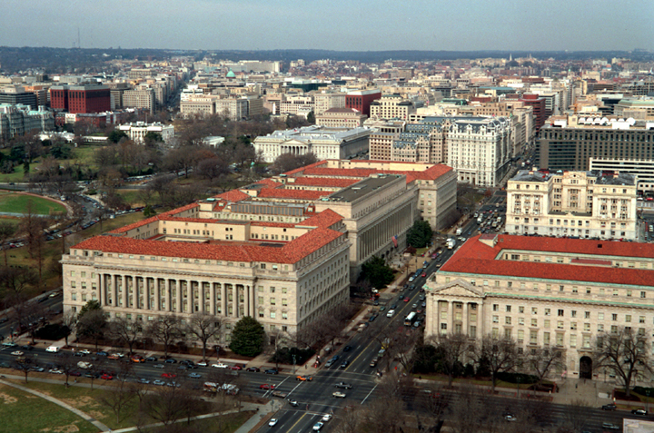
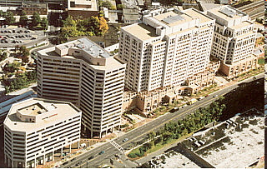



About the National Geodetic Survey
Executive Branch
Department of Commerce (DOC)
National Oceanic and Atmospheric Administration (NOAA)

Slide 3

About the National Geodetic Survey
National Oceanic and Atmospheric Administration (NOAA)
National Ocean Service (NOS)
National Geodetic Survey (NGS)

Slide 4
NGS’s Mission and Role
  NGS Mission: “To define, maintain, and provide access to the National Spatial Reference System to meet our nation’s economic, social, and environmental needs”
  “The National Spatial Reference System is the fundamental geodetic control for the United States.”
    NAD 83
    NAVD 88
    IGLD 85
    Official Shoreline
  The Elevator Speech…
    We’re the people who define latitude, longitude and height for everything in the country

Slide 5
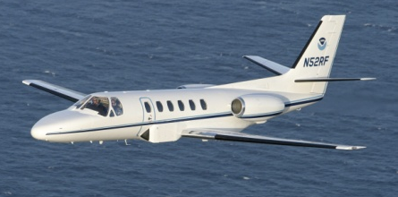
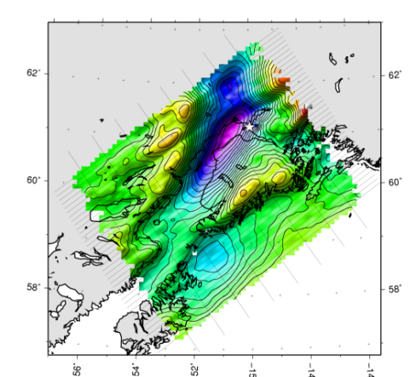
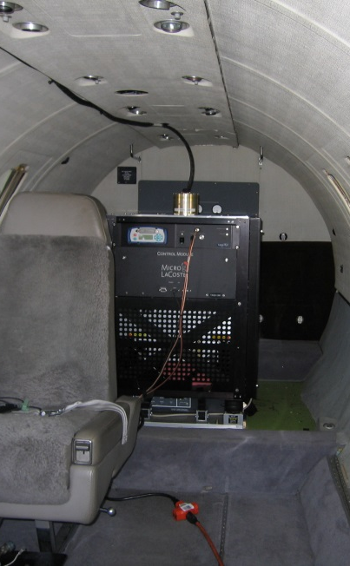
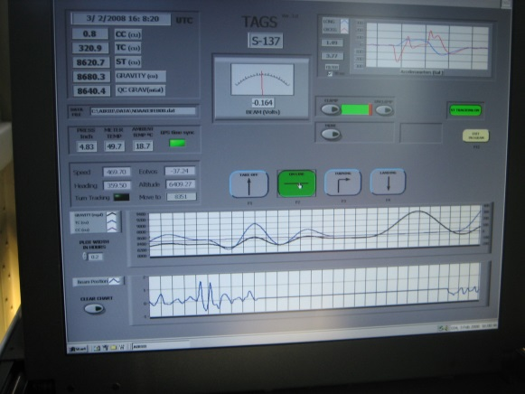
What do we do?
We are performing a 15 year long airborne
gravity survey of the entire USA (“GRAV-D”)

Slide 6
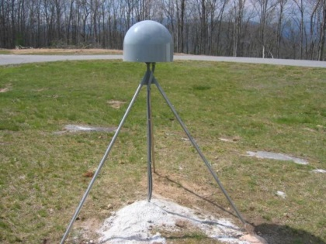
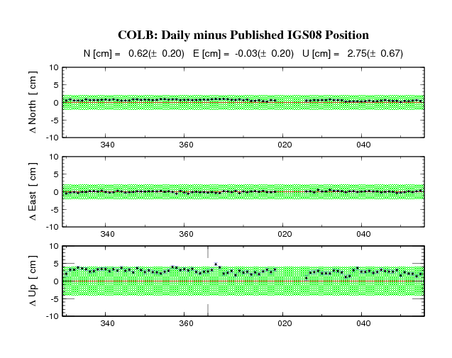
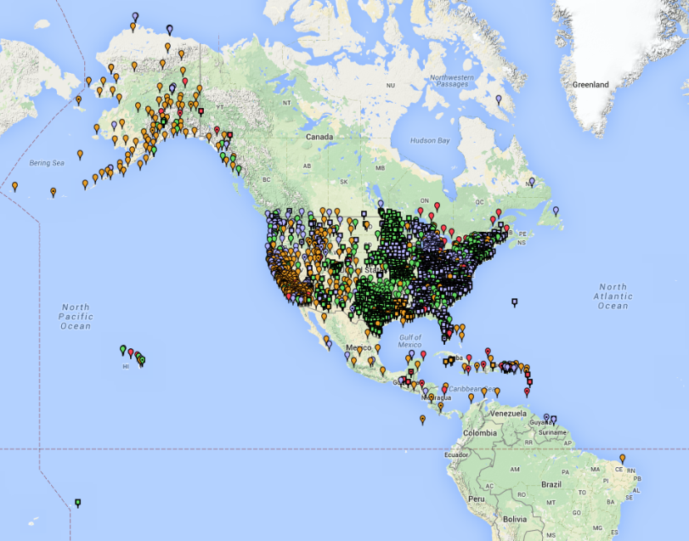
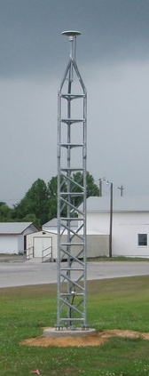
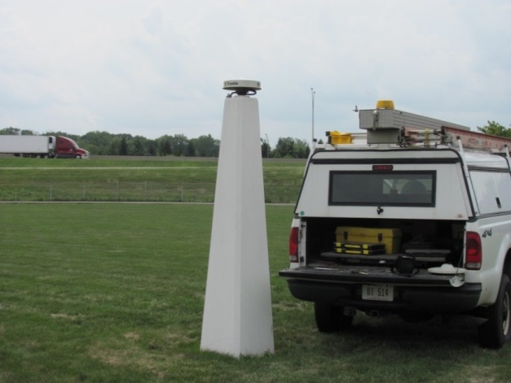
What do we do?
We manage (store, analyze, disseminate) data from over 2000 GNSS stations in the CORS network

Slide 7
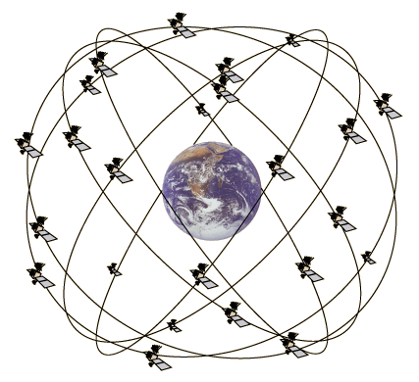
What do we do?
We compute orbits of GPS satellites, accurate to centimeters.
NGS relative to IGS ~ 1 cm

Slide 8
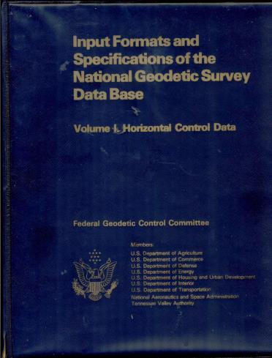
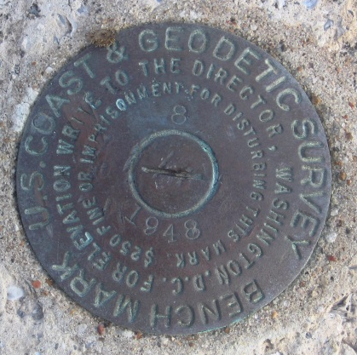
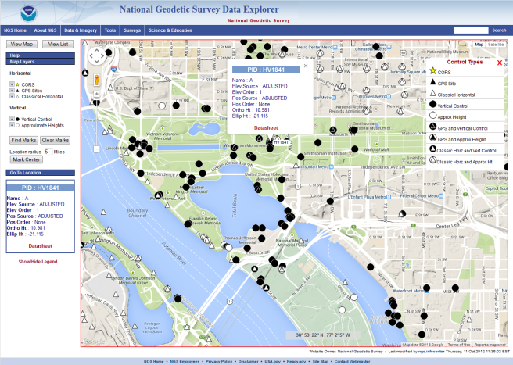
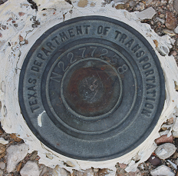
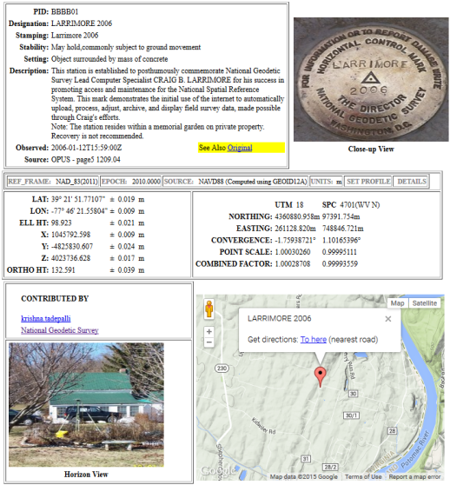
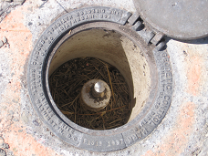

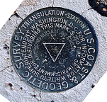
What do we do?
We maintain the official geodetic control database for the nation with over 1,000,000 passive geodetic control marks.

Slide 9
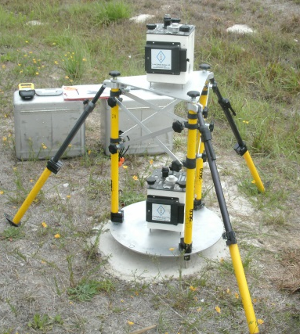
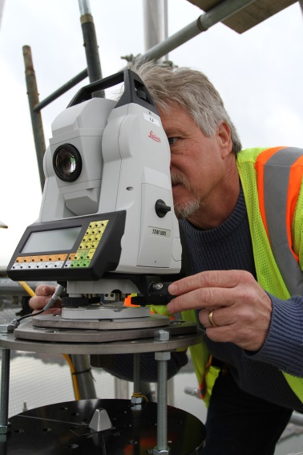
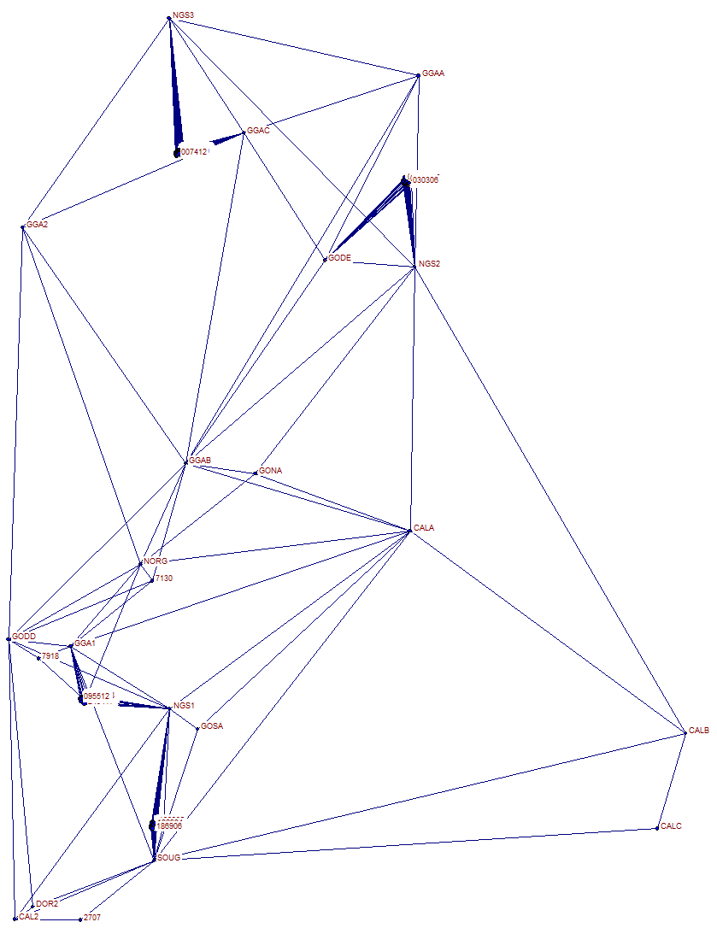
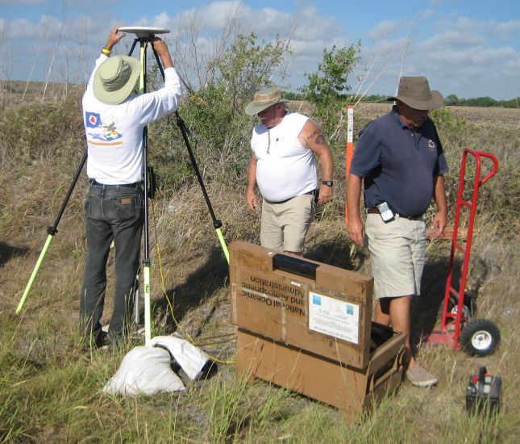
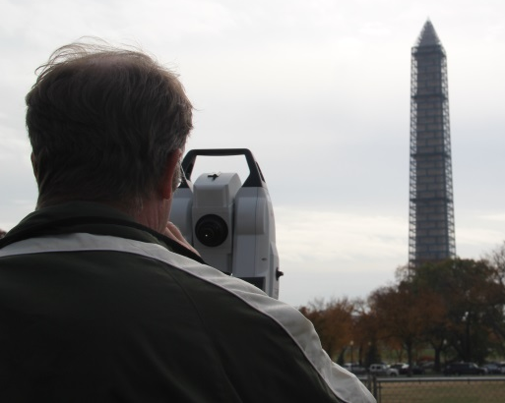
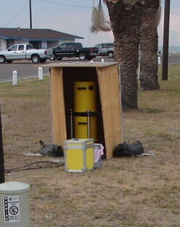
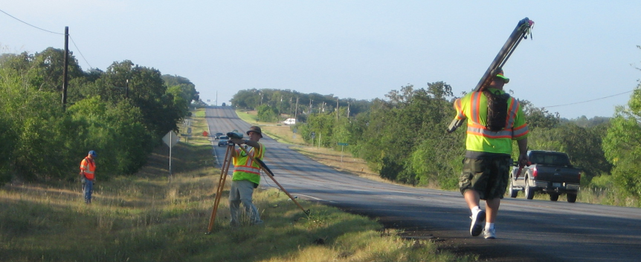
What do we do?
We perform the highest accuracy geodetic surveys in the nation.
Gravity Gradients
GPS
Traverse
Absolute Gravity
Leveling

Slide 10
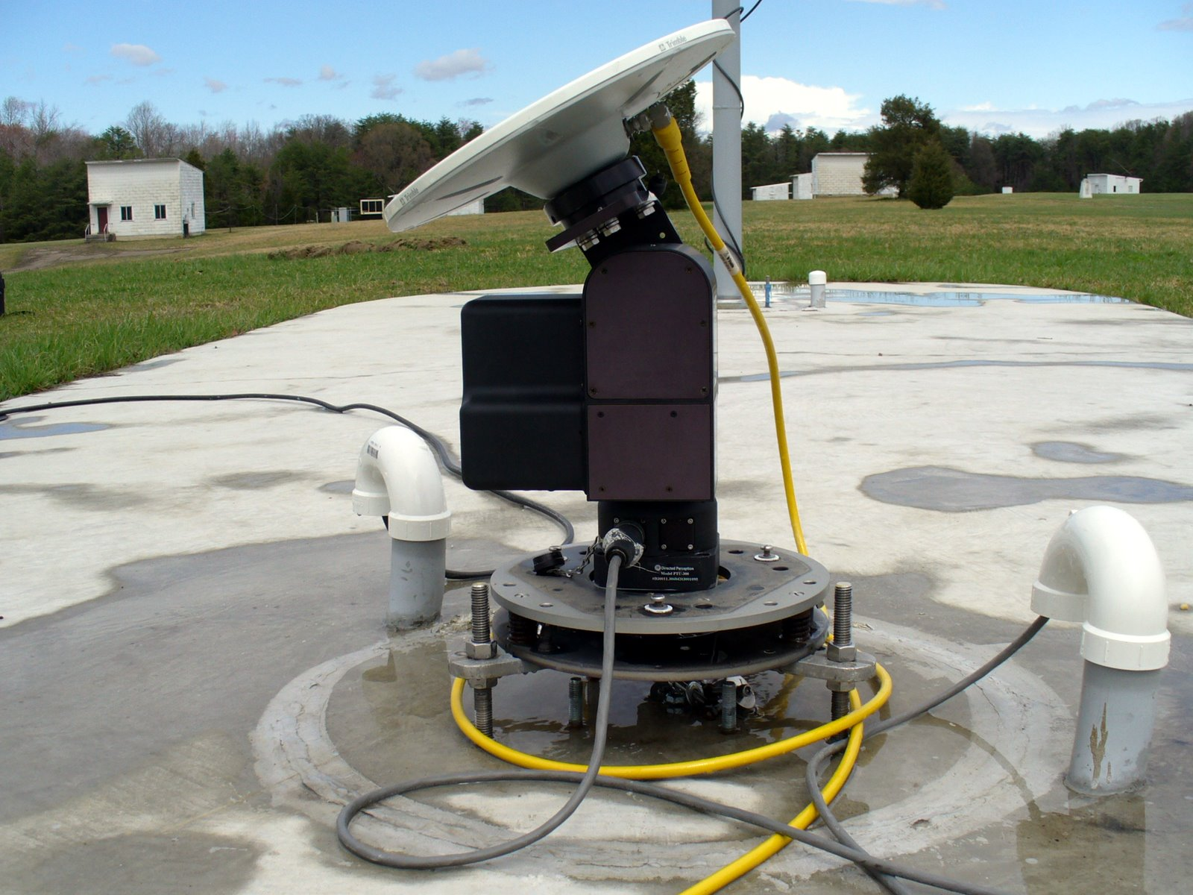
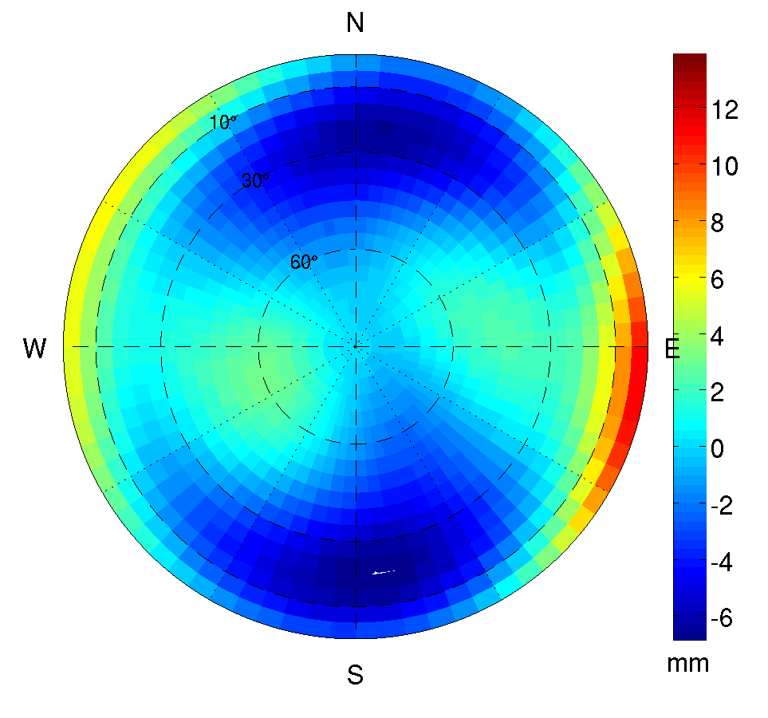
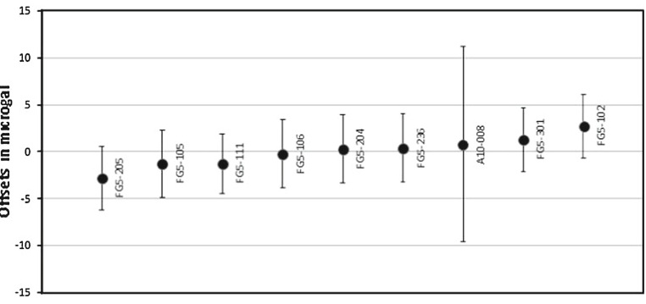
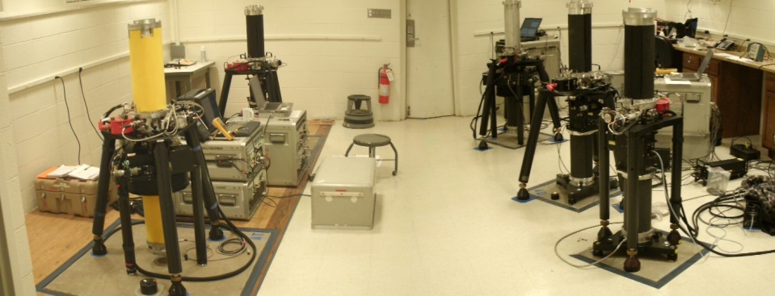
What do we do?
We calibrate GNSS antennae, gravimeters and EDM baselines.

Slide 11
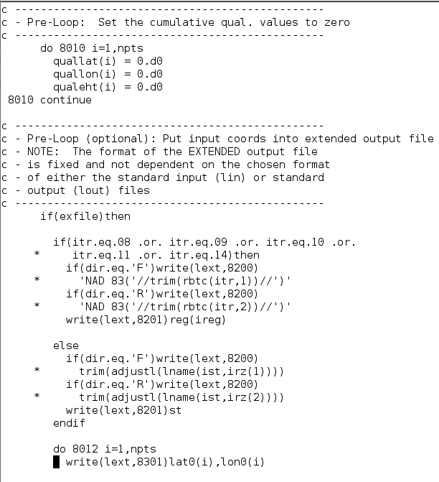
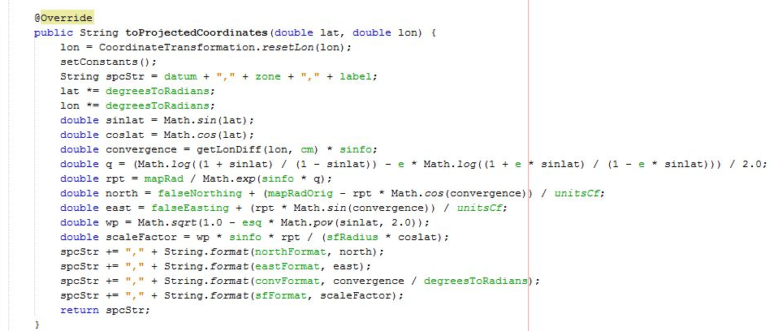
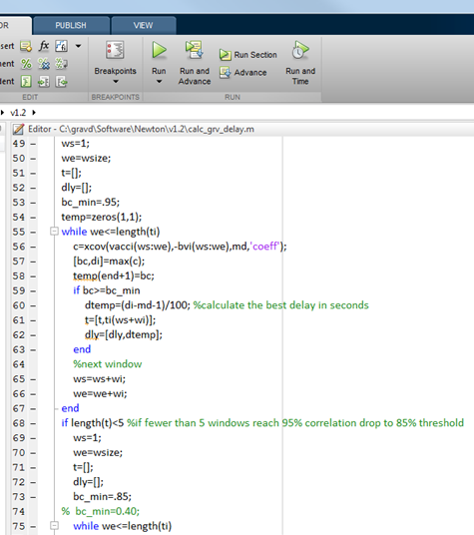
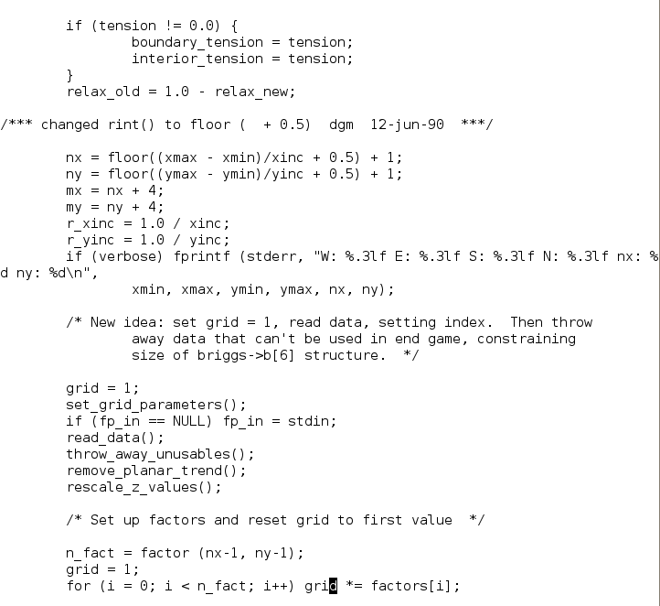
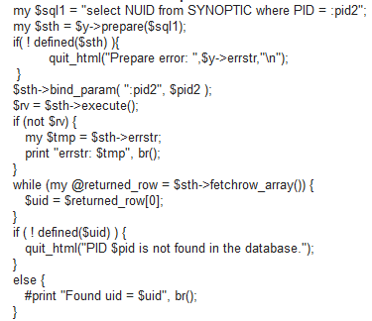
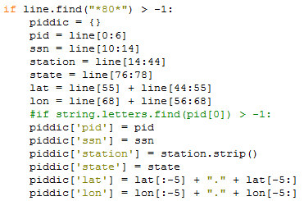
What do we do?
We write and maintain hundreds of computer programs for the NSRS user community.
FORTRAN
Java
C++
Perl
Python
SQL
MATLAB
Visual BASIC
---------
UNIX
PC

Slide 12
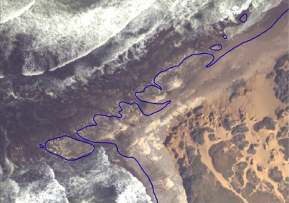
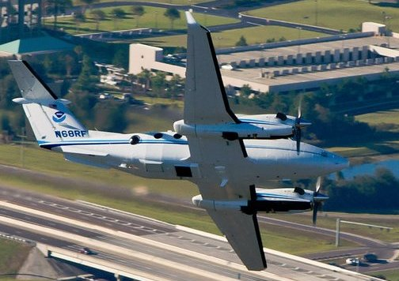
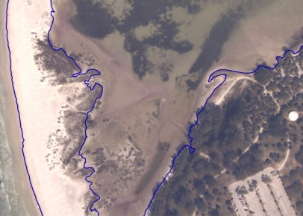
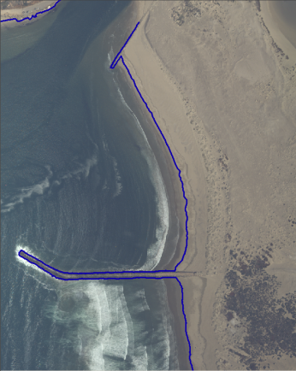
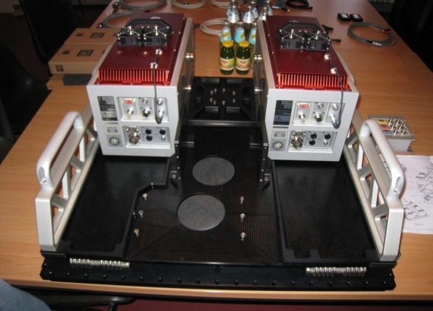
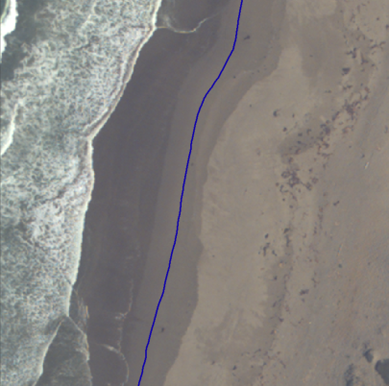
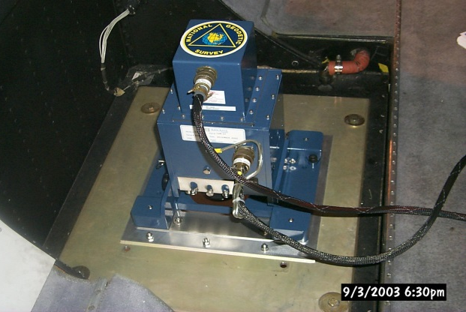
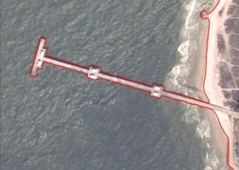
What do we do?
We fly airborne LIDAR and imagery missions to delineate the official shoreline of the nation.

Slide 13
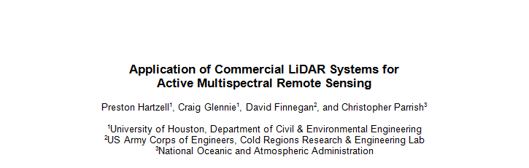
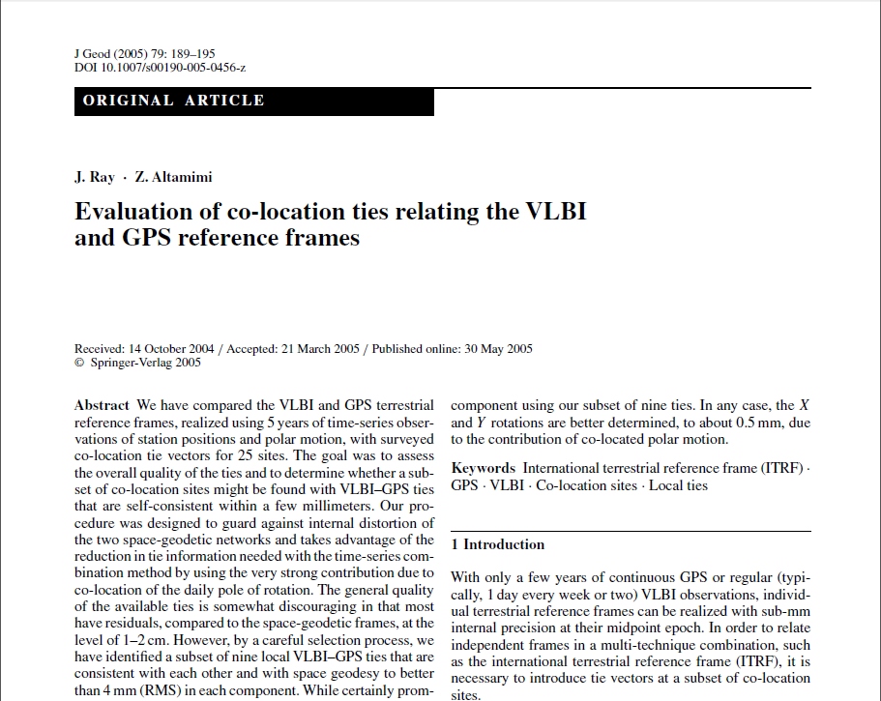
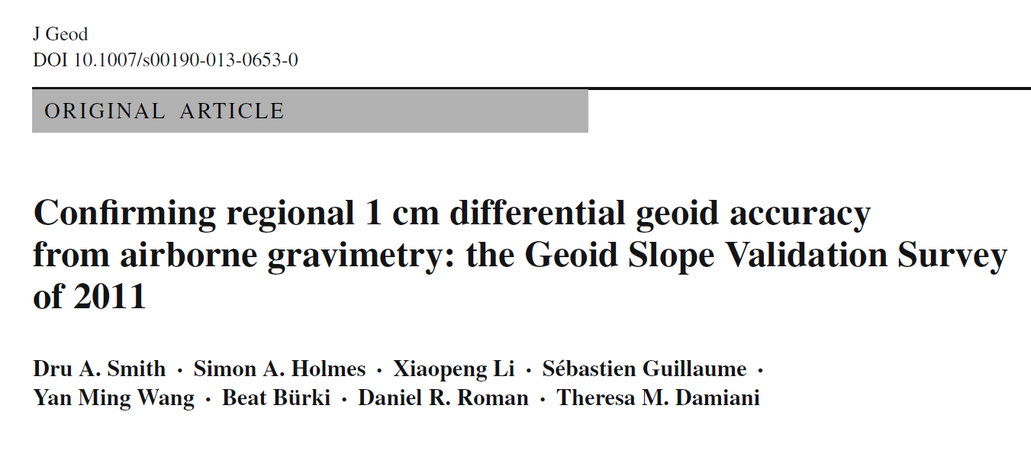
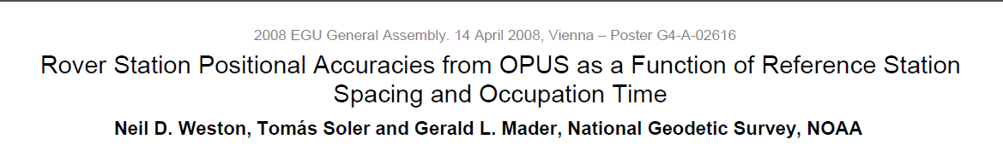
What do we do?
We perform research on everything related to geodesy, surveying and remote sensing.

Slide 14
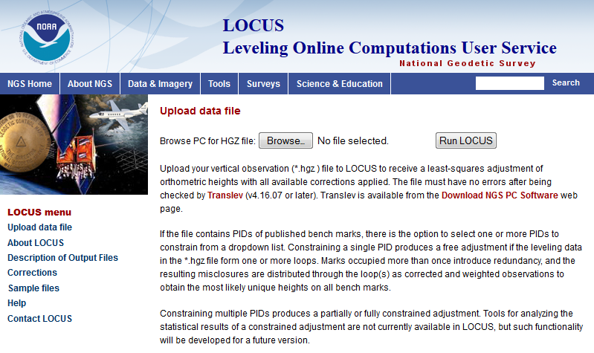
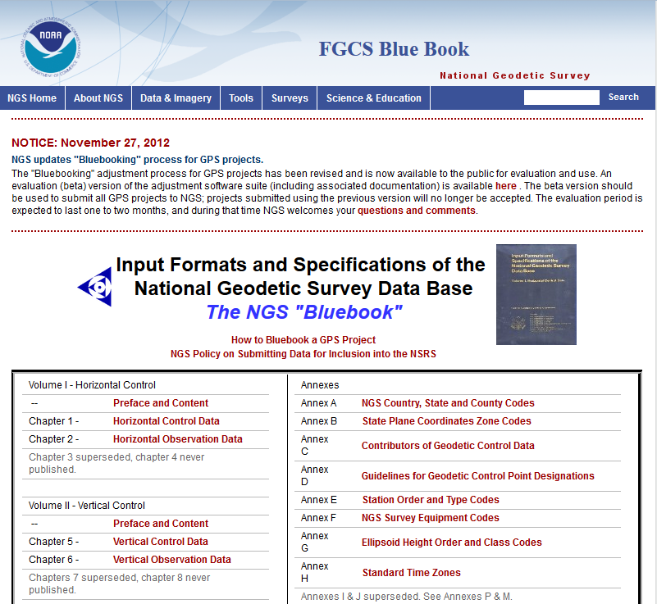

What do we provide?
We provide services for users to process GPS or Leveling data and submit it to NGS.

Slide 15




What do we provide?
We provide software for users to transform coordinates between datums and across epochs

Slide 16



What do we provide?
We provide data to users free of charge in the form of RINEX files, datasheets, geoid grids, etc

Slide 17




What do we provide?
We provide education to users free of charge including an online library, presentation archive, instructional videos and hands-on training classes

Slide 18







Some surprising responsibilities
We provide emergency response imagery after major events
Hurricane Isabel
9/11
Deepwater Horizon
Hurricane Katrina

Slide 19



Some surprising responsibilities
We survey or quality control every survey of every airport in the country

Slide 20
Upcoming cool stuff
Recognizing modern tools, technology and knowledge, NGS is changing how perform our mission
NAVD 88, NAD 83 and IGLD 85 are all being replaced in 2022
  Geocentric , Geoid-based positioning

Slide 21










Old vs New Datums
The old way
The new way
Text based datasheets
Modern datasheets
Observed changes viewed as
“corrections” not “movement”
CORS
RTN
Fragile, unchecked passive control
Geoid
Temporal Geoid Change

Slide 22


Why isn’t NAVD 88 good enough anymore?
NAVD 88 suffers from use of bench marks that:
  Are almost never re-checked for movement
  Disappear by the thousands every year
  Are not funded for replacement
  Are not necessarily in convenient places
  Don’t exist in most of Alaska
  Weren’t adopted in Canada
  Were determined by leveling from a single point, allowing cross-country error build up
PID: EZ0840

Slide 23

Why isn’t NAVD 88 good enough anymore?
Approximate level of geoid mismatch known to exist in the NAVD 88 zero surface:

Slide 24
Terminology
Horizontal Datum
  Geometric Reference Frame
    Geocentric X, Y, Z
    Latitude, Longitude, Ellipsoid Height
Vertical Datum
  Geopotential Reference Frame
    Geoid undulation
    Orthometric height
    Gravity
    Deflection of the Vertical

Slide 25

Approximate extent of
2022 geoid model used
for the “North American”
part of the new
geopotential reference
frame.

Slide 26

Hawaii
Many US Pacific Territories
(not Guam, CNMI nor American Samoa)

Slide 27

Alaska, including
entire Aleutian
Island Chain
Canada
CONUS (USA)

Slide 28

Bermuda
Mexico
All Caribbean
Countries
All Central
American Countries

Slide 29


Bermuda
Mexico
All Caribbean
Countries
All Central
American Countries

Slide 30

No official
Vertical datum
CGVD2013*
NAVD 88
No official
Vertical datum
* geoid/GNSS based datum

Slide 31



Canada Height Modernization - 2013
The geoid model:
1. Entire coverage of the
Canadian territory
(land, lakes and oceans)
2. Compatible with space-
based positioning
(e.g., GNSS, altimetry)
3. Less expensive for
maintenance
4. Fairly stable reference
surface
Levelling Networks:
1. Established over the
last 100 years
2. 120,000 km of levelling
lines
3. Some 80,000
benchmarks
1. Time consuming
2. Expensive
3. Limited coverage
4. BMs are unstable
5. BMs disappear
6. Local networks
H = h_{GNSS} – N_{Model}

Slide 32

?
PRVD02
VIVD09
?
?
⁽¹⁾
?
?
?
?
?
Santo Domingo⁽¹⁾
?
Puerto Cortéz⁽¹⁾
?
?
Corinto 1952⁽¹⁾
?
?
San José⁽¹⁾
?
?
La Unión 1960⁽¹⁾
Puntarenas⁽¹⁾
Cristóbal⁽¹⁾
⁽¹⁾ Información cortesía de David Avalos

Slide 33
Old vs New Datums
Step 1: Do the best scientific positioning work we can in ITRF
  Before any discussion of “plate fixed” or “map projections”
  NGS’s core goal must be the scientific integrity of positions
  New database
  Replacement of static vector-based GNSS processing

Slide 34
Old vs New Datums
Step 2: Consider the question of “plate fixed”:
  Why do users want this?
    Fixed latitude and longitude?
  Nothing is “fixed” though
    Plate is not just rotating; more than 1 plate
  Who wins? Who defines “fixed”? Must all points maintain zero change?
    Model and remove all real motion? (aka “HTDP”)
      If not removing all motion, why remove any motion?
        ITRF minus plate rotation vs just ITRF

Slide 35

Simplified Concept of NAD 83 vs. ITRF
Earth’s Surface
h_{NAD83}
h_{ITRF}
h_{NAD83} – h_{ITRF} varies
smoothly by latitude
and longitude
ITRFxx origin
~1.6 m
NAD 83 origin

Slide 36
Datasheets
2.350
2.300
2.250
2.200
H
2.150
2.100
2.050
On a point with 4 historic surveys, they
would be used to model and predict change
2.000
1975
1980
1985
1990
1995
2000
2005
2010
2015
2020
2025
2030
time

Slide 37

2015 Geospatial Summit
April 13-14, 2015, in the Washington, DC Area
As part of a broader “conference of conferences” with National Society of Professional Surveyors and Management Association for Private Photogrammetric Surveyors (MAPPS)
Follows the successful 2010 Geospatial Summit. More info at the 2015 Geospatial Summit website.
http://www.geodesy.noaa.gov/2015GeospatialSummit/

Slide 38
Summary (1)
NGS is the oldest scientific agency in the nation (1807)
Although times change, the mission is still one of providing geodetic control to all surveys, maps and charts in the nation
Science and customer service

Slide 39
Summary (2)
NGS engages in scientific research and applications in:
  Geodesy
  Remote Sensing
  Surveying
  Geophysics
  Mathematics

Slide 40
Summary (3)
NGS is in a major transitional phase
  Need new, talented people who are educated in
    Geodesy, Remote Sensing, Surveying
    Traditional computational programming (Fortran/C++)
    Modern programming languages (Java, Perl, Objective-C) and platforms (ArcGIS, Google Earth)
  BS, MS, PhD all are needed!

Slide 41

Working for NGS
Jobs in Maryland, Virginia and Colorado
Job openings in USAJOBS
Make an account
  Search “geodesy” and
  sign up for notifications

Slide 42
Questions

Slide 43
Thank you!

Slide 44
Extra Slides

Slide 45

Expected GRAV-D airborne gravity coverage by 2022
Alaska
“CONUS”
Guam / Northern Marianas
Hawaii
Puerto Rico / Virgin Islands
American Samoa
GRAV-D
Planned
Coverage

Slide 46

The “secular” geoid change from the monthly GRACE models (2002-2008)
Deglaciation
The solution represents the effect due to total mass changes.
The solution uses a 400-km Gaussian filter.
Glacial Isostatic
Adjustment
Drought

Slide 47

GSVS11: Proving why we need GRAV-D
Geoids without new GRAV-D data: 1-3 cm differential accuracy
over distances from 0.4 to 325 km
Geoids with new GRAV-D data:
1 cm differential accuracy over distances from 0.4 to 325 km

Slide 48
Old vs New Datums: Origin
NAD 83 was theoretically “geocentric”
  Primarily based on pre-GNSS satellite geodesy
    Doppler, etc
  Off from ITRF2008 origin by ~ 1.5 meters
New geometric reference frame will all be “geocentric” to IGS frame circa 2020.00 or so

Slide 49
Old vs New Datums: Access
Old datums used passive control as the primary access
  CORS / OPUS helped, but “datasheets” remain the largest download, far and away more than OPUS is used

Slide 50
Old vs New Datums: Access
New datums
  Primary access: GNSS + geoid model
  Secondary access: Passive control
Fixed:
  CORS + geoid (coords and velocities both)

Slide 51
Old vs New Datums: Passive Control
Roll of passive control in the future:
  Control for projects
    Depending on accuracy needs, new coordinates should be determined, rather than relying on published coordinates based on old surveys
  Monitoring sites for motion
  Calibrating RTNs

Slide 52
Tools: Improvements
NADCON, VERTCON, SPCS, UTM, USNG, Vdatum, HTDP, VTDP will be merged into a single tool
Tool will be web-services based
  Online browser-based computations
  GIS-plug-in

