Slide 1

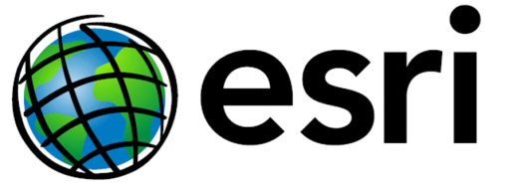
NOAA’s National Geodetic Survey
Update
Esri Survey Summit
July 6-9, 2013 ● San Diego, CA
®
Michael Dennis, RLS, PE
michael.dennis@noaa.gov

Slide 2
Since last we met…
Improvements to the National Spatial Reference System
  Update and refinement of North American Datum of 1983
  New geoid and deflection of vertical models
Facilitating user contribution of data
  OPUS Data Base, OPUS-Projects, updating “Bluebooking” process
Embracing GIS at NGS
  NGS Data Explorer web app and updated datasheet shapefiles
  New GIS tools and datasets
New software
  NAD 83 coordinate transformations (GEOCON and GEOCON11)
Looking toward the future
  New Ten Year Strategic Plan
  GRAV-D status and Geoid Slope Validation Surveys
Emergency response: Hurricane Sandy
Recent retirements: The NGS family getting smaller
Many changes and challenges, but our mission remains the same

Slide 3
At NOAA’s NGS, location is our mission
National Spatial Reference System
NSRS
Define
Maintain
Access

Slide 4
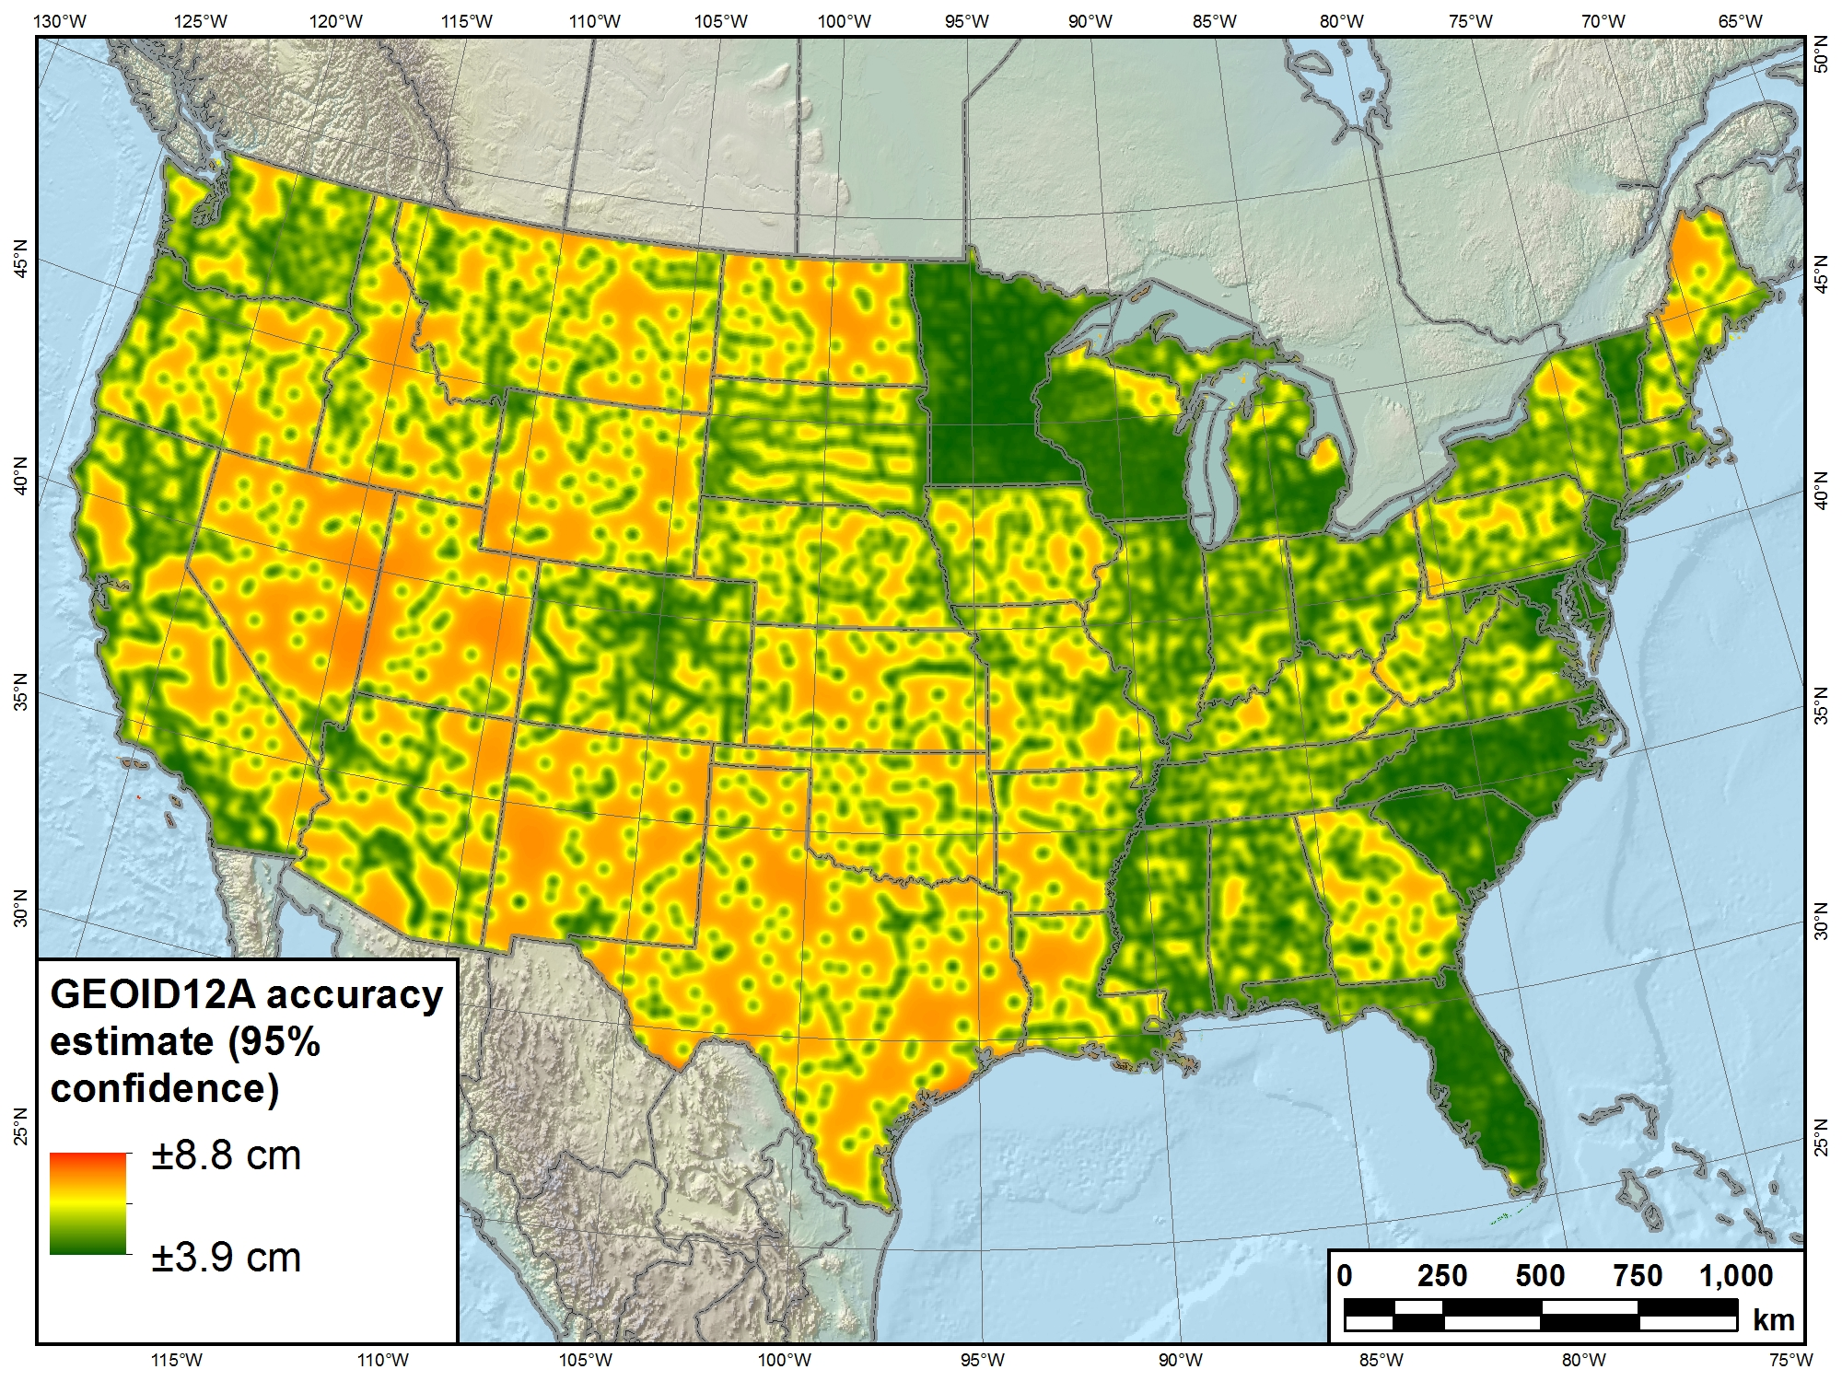
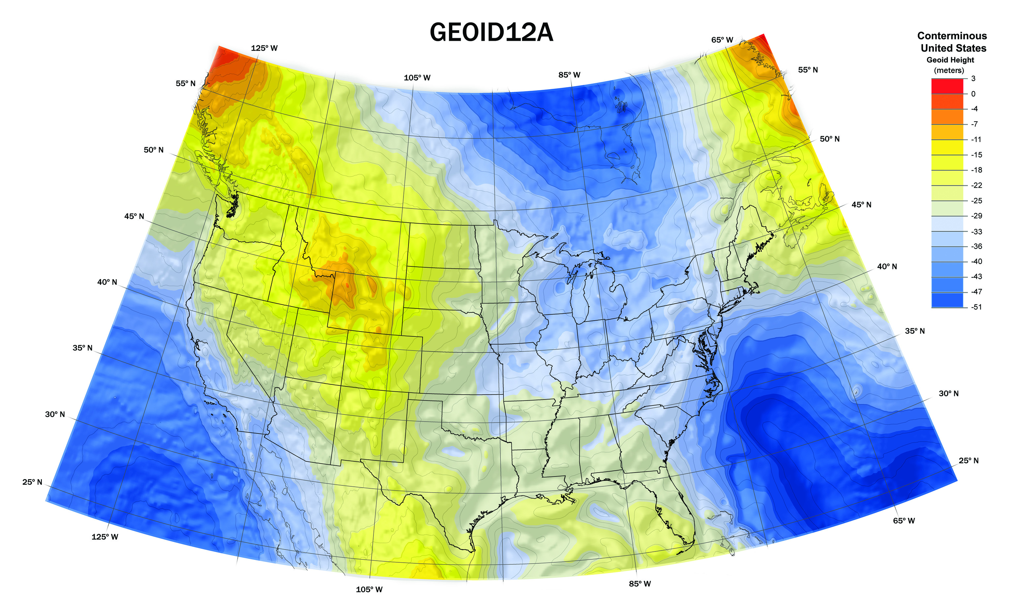
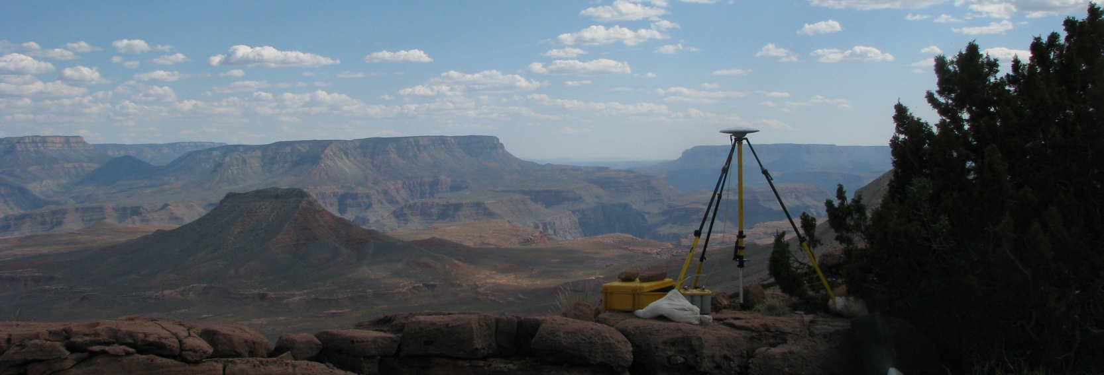
Improvements to the NSRS
Update and refinement of North American Datum of 1983
  NAD 83 (2011/PA11/MA11) epoch 2010.00
  Passive control results released June 30, 2012
New geoid and deflection of the vertical models
  Hybrid models based (in part) on new passive control
  GEOID12A released Sep 2012
  DEFLEC12A and USDOV2012 released Oct 2012
  New GEOID12A accuracy
  estimate model

Slide 5
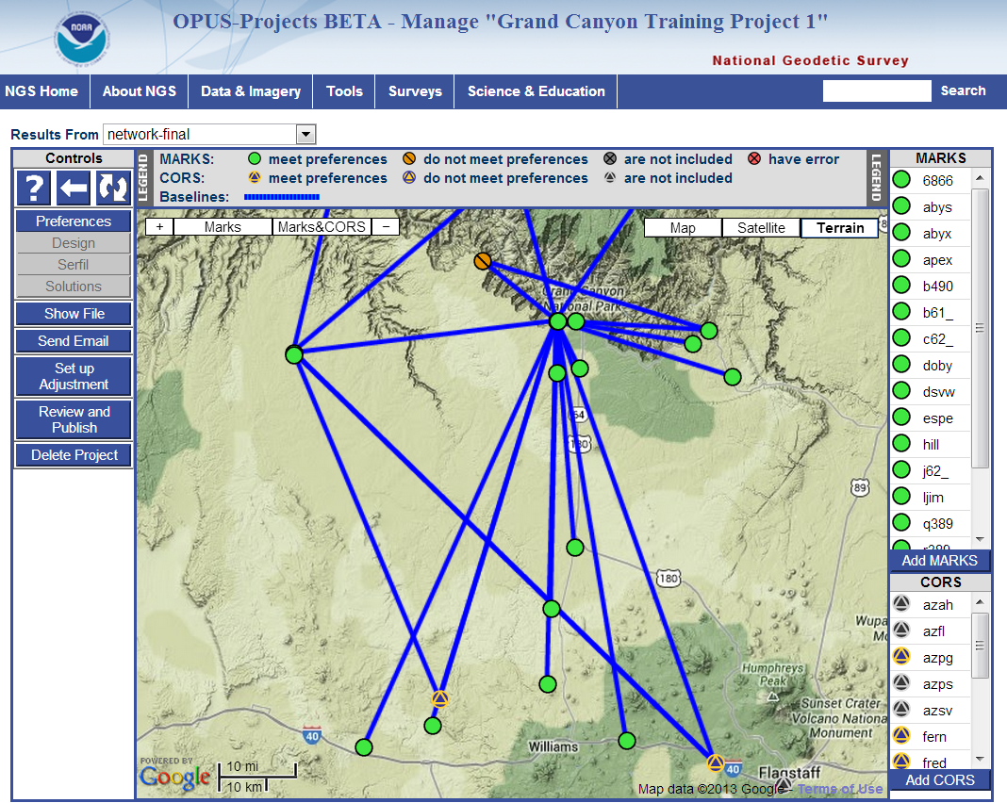


Facilitating user contribution of data
Online Positioning User Service (OPUS)
  Over 5000 OPUS Data Base coordinates updated to NAD 83(2011/PA11/MA11)
  OPUS-Projects will be released by late July 2013
Updating the “Bluebooking” process
  This is how users submit data to NGS Integrated Data Base (NGSIDB)
  Improving software, workflow, and tools (including GIS!)
  Will be able to use OPUS-Projects results for Bluebooking
NGSIDB

Slide 6
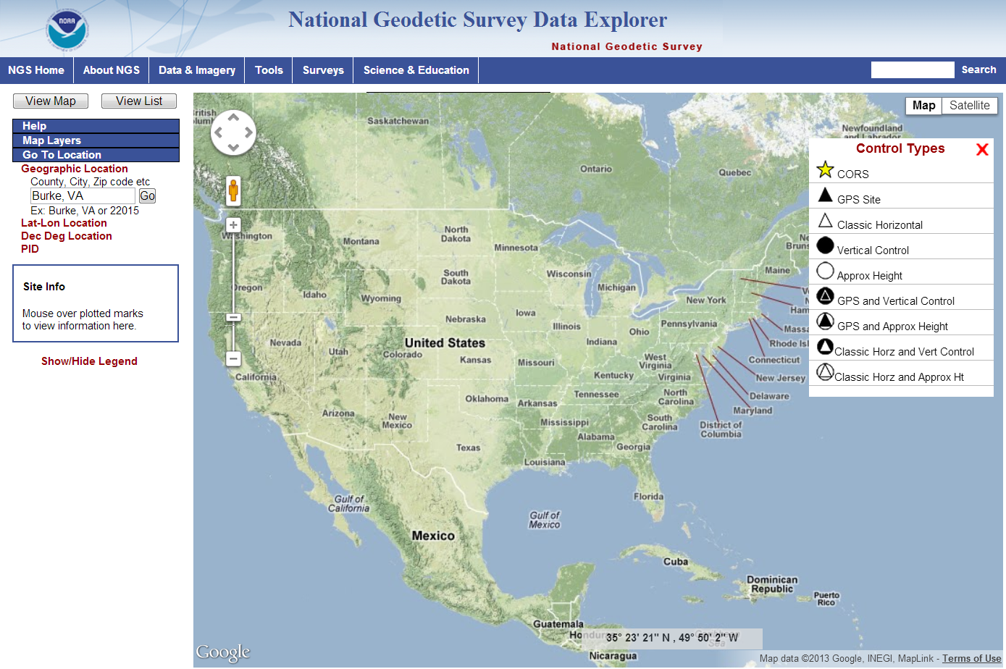
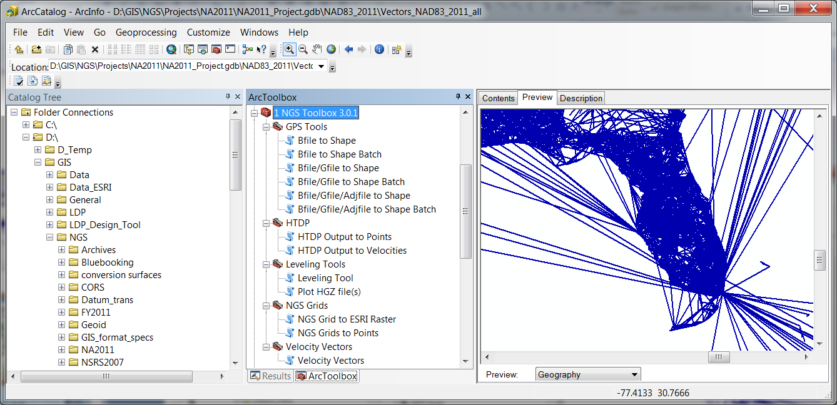
Embracing GIS at NGS
NGS Data Explorer web application
  Browse interactively to geodetic control with map interface
Updated datasheet shapefiles available (beta)
  Many new attributes added
New GIS tools and datasets under development
  NGS GIS Toolbox creates GIS features from NGS software output
  Products in GIS format

Slide 7
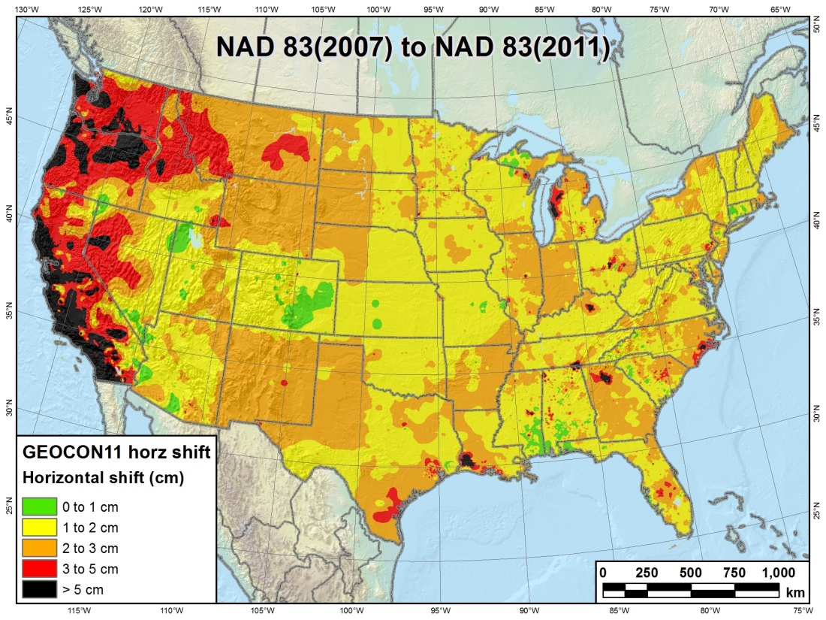
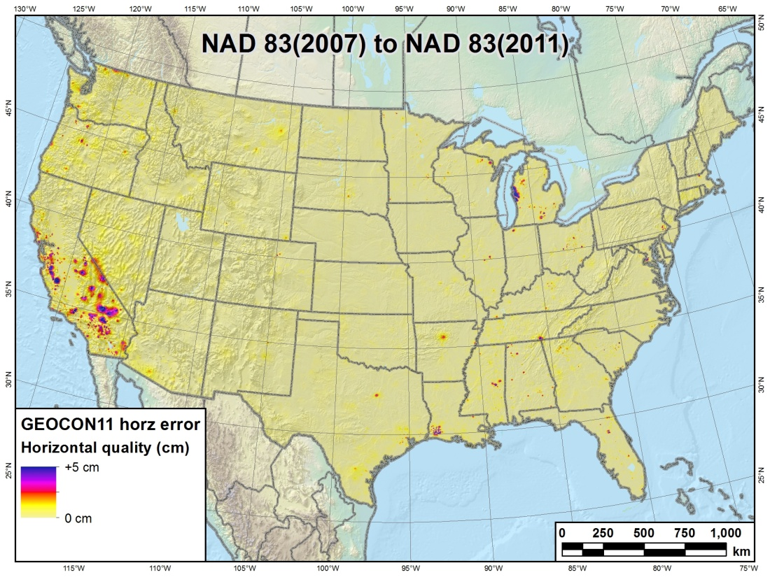
New and updated software
New 3-D NAD 83 coordinate transformation software
  GEOCON: NAD 83(“HARN”) ←→ NAD 83(NSRS2007)
  GEOCON11: NAD 83(NSRS2007) ←→ NAD 83(2011)
  Both horizontal AND “vertical” (i.e., ellipsoid height)
  Include output that indicates quality of transformation
  New input data format will soon be available

Slide 8

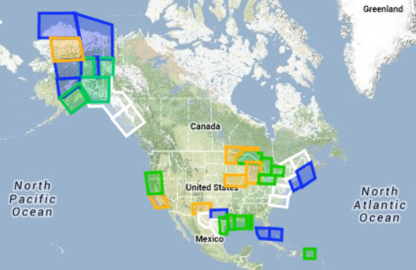
Looking toward the future
New Ten Year Strategic Plan released Jan 2013
GRAV-D status: Data collection over 25% complete
Geoid Slope Validation Surveys
  2011 survey results available (TX); 2014 fieldwork work started (IA)
Green: Available data and metadata
Blue: Data being processed
Orange: Data collection underway
White: Planned for data collection

Slide 9
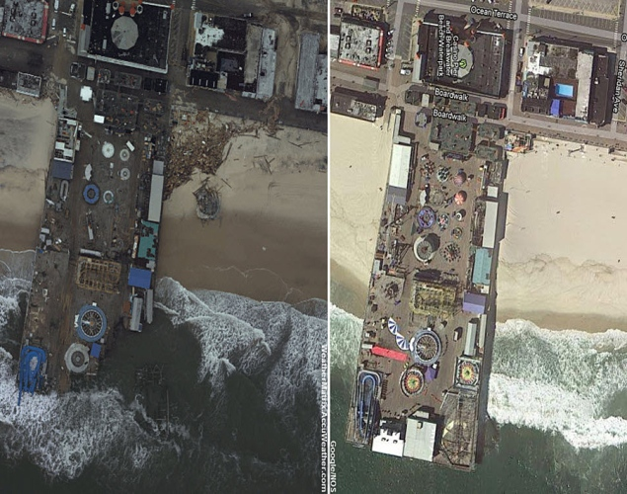
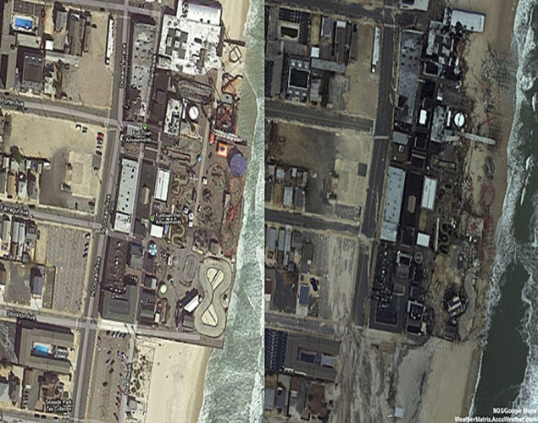
Emergency response
Seaside Heights, NJ
Damage assessment flights
  Collect imagery of effects of disasters
  Such as hurricanes, tornados, earthquakes
Hurricane Sandy
  12,664 images across 6 states
  Over 33 million visits to NGS emergency response website
  Downloaded 7.6 TB of data in less than a month
  Data used by other agencies to assess damage (e.g., FEMA)
Before
2012 Google Earth®
After
NOAA Imagery 30 Oct 2012

Slide 10
The NGS family getting smaller
Feeling the impact of recent retirements
  Dave Doyle
  Marti Ikehara
  Renee Shields
  Bill Henning
  Ronnie Taylor
  Gilbert Mitchell
  and others…
Currently under a hiring freeze
  But plan to hire new employees as quickly as we can
The NSRS mission shall not be compromised!
Define
Maintain
Access

