Slide 1

NGS Update
Much ado about 2022
Geospatial Control Subcommittee
of the
Geospatial Data Acquisition Technologies in Design and Construction Committee (AFB80)
Transportation Research Board
97th Annual Conference
Washington, DC
January 8, 2018
Michael Dennis, RLS, PE
Geodesist
michael.dennis@noaa.gov

Slide 2
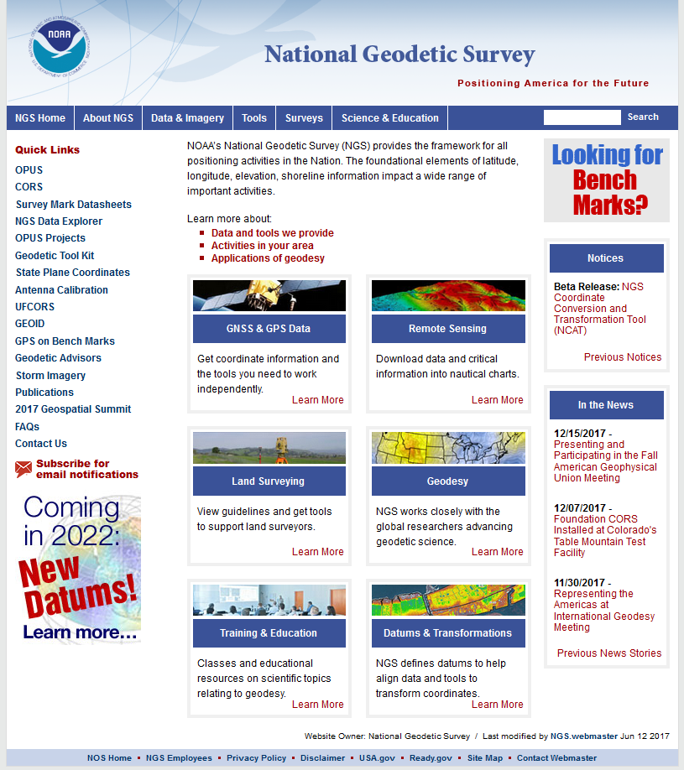
geodesy.noaa.gov

Slide 3
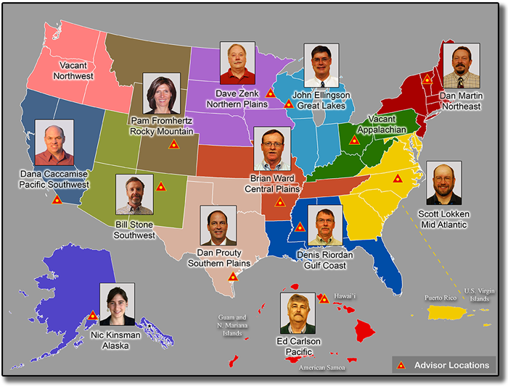
NGS Advisors

Slide 4
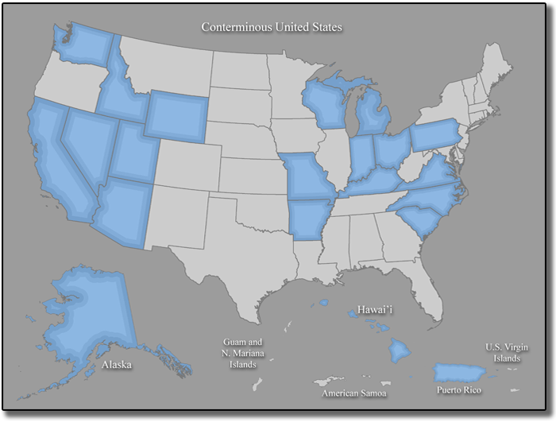
State Coordinators

Slide 5
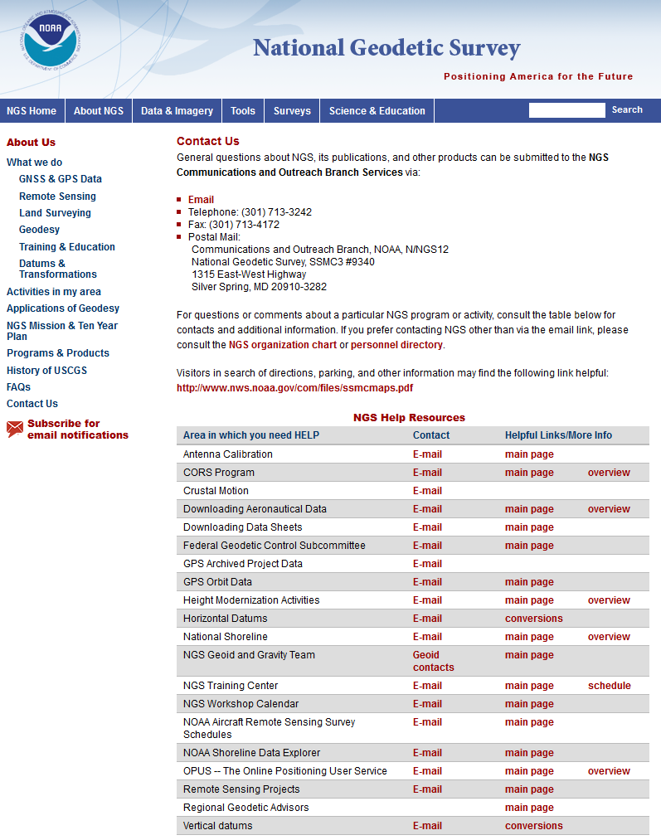
geodesy.noaa.gov

Slide 6
Much ado about what’s new in 2022
Modernizing the National Spatial Reference System (NSRS)
New “datums” for 2022!
  Four (4) new Terrestrial Reference Frames of 2022
  North American-Pacific Geopotential Datum of 2022
New publications!
  Geometric and geopotential blueprints (parts 1 and 2)
  NADCON 5.0 report
  History and status of State Plane
New projects, products, and services!
  GPS on Bench Marks project
  NGS Coordinate Conversion & Transformation Tool (NCAT)
  OPUS for Bluebooking (…and “OPUS for Everything”)
  New experimental geoid models
New State Plane Coordinate System of 2022!

Slide 7
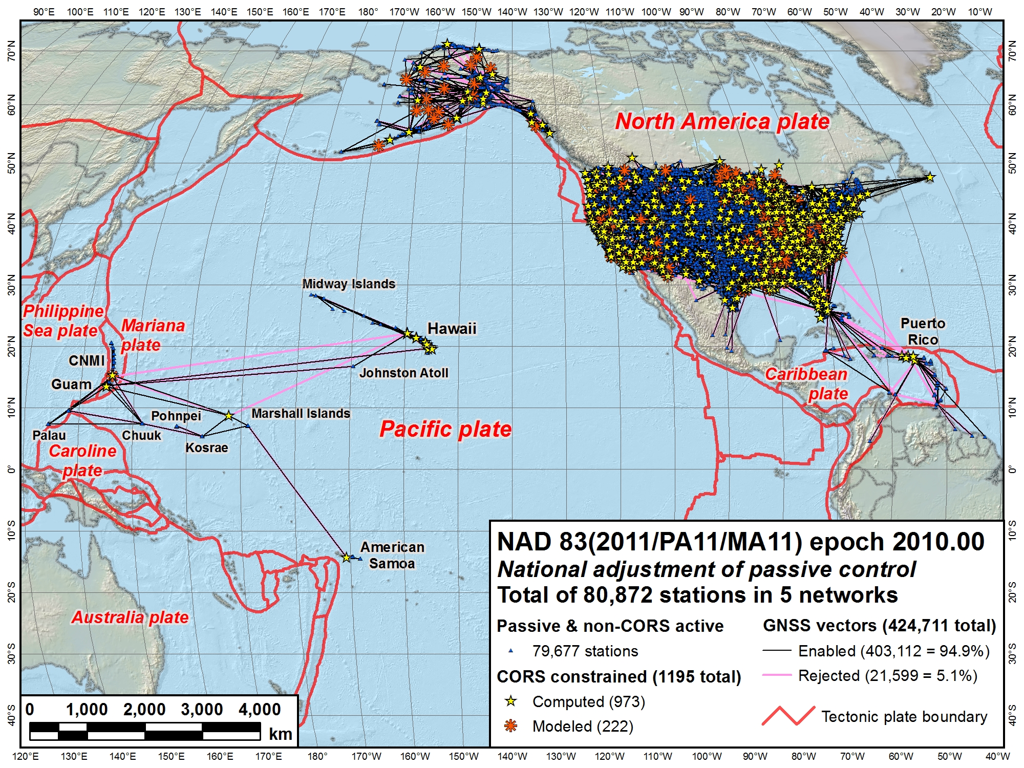
NAD 83 (2011)
NAD 83
(MA11)
NAD 83 (PA11)
North American Datum of 1983
Three frames:
NAD 83 (2011): North America and Caribbean plates
NAD 83 (PA11): Pacific plate
NAD 83 (MA11): Mariana plate

Slide 8
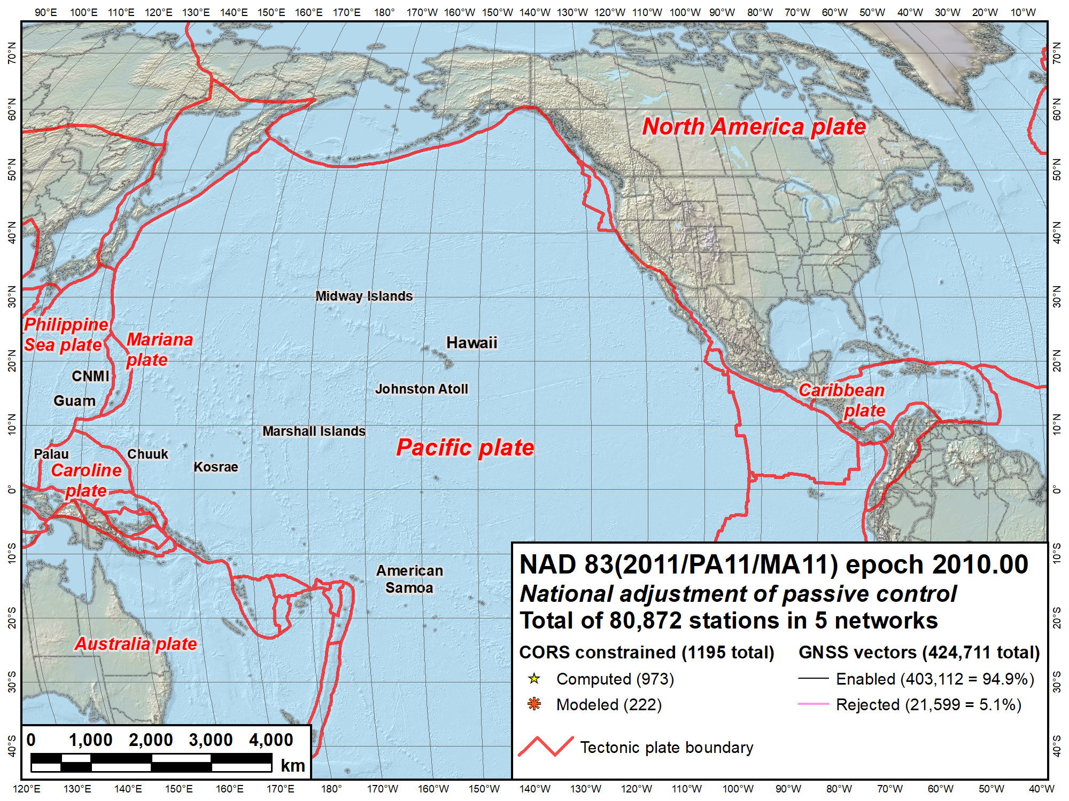
NAVD 88
IGLD 85
NAVD 88
PRVD02
NMVD03
VIVD02
GUVD04
Current vertical datums of the NSRS
ASVD02
NA and Caribbean
NAVD 88
IGLD 85
PRVD02
VIVD09
Pacific
GUVD04
NMVD03
ASVD02

Slide 9
Why replace NAD 83 and NAVD 88?
Main driver: Global Navigation Satellite System (GNSS)
ACCESS!
  GNSS equipment is fast, inexpensive, reliable (and improving)
  Reduces reliance on finding survey control (“bench marks”)
ACCURACY!
  Insensitive to distance-dependent errors; reliable
  Immune to bench mark instability (referenced to CORS)
CONSISTENCY!
  Eliminates systematic errors in current datums
  Aligned with global reference frames
  Integrated system for both positions and heights (“elevations”)

Slide 10
Geometric: Out with the old, in with the new
The Old:
NAD 83(2011)
NAD 83(PA11)
NAD 83(MA11)
The New:
North American Terrestrial Reference Frame of 2022
(NATRF2022)
Caribbean Terrestrial Reference Frame of 2022
(CATRF2022)
Pacific Terrestrial Reference Frame of 2022
(PATRF2022)
Mariana Terrestrial Reference Frame of 2022
(MATRF2022)
4 plate-fixed frames
North America, Caribbean, Pacific, Mariana

Slide 11
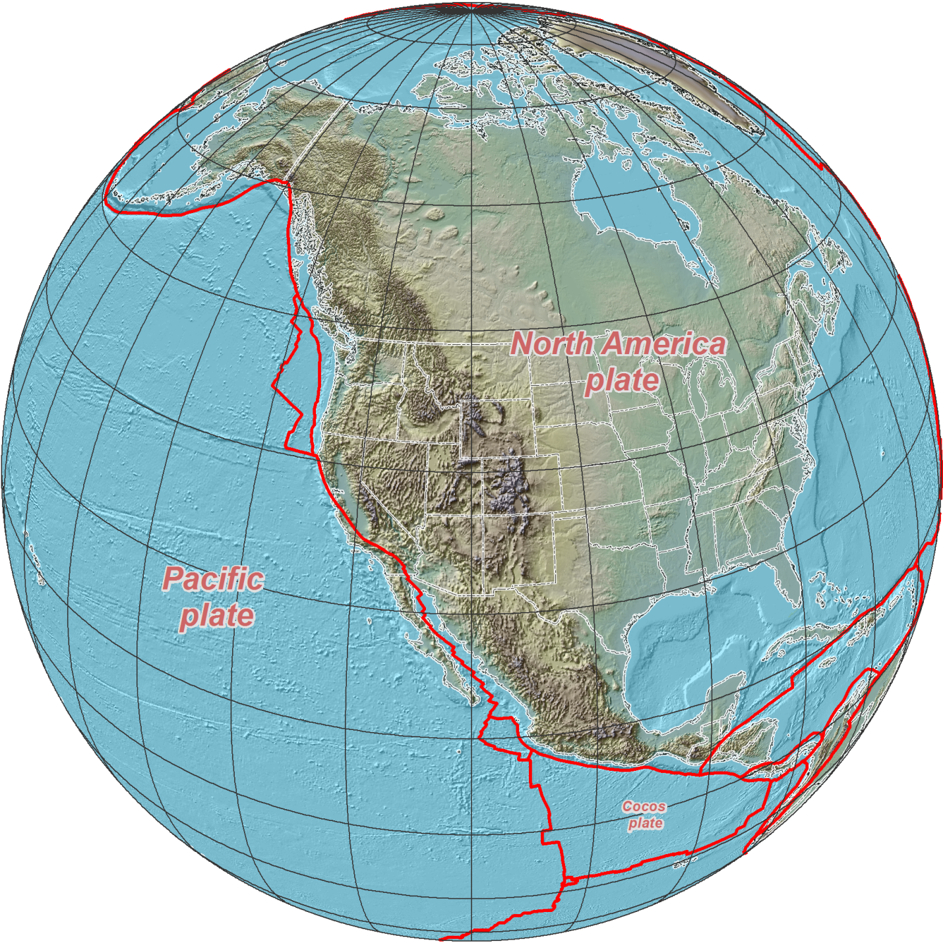
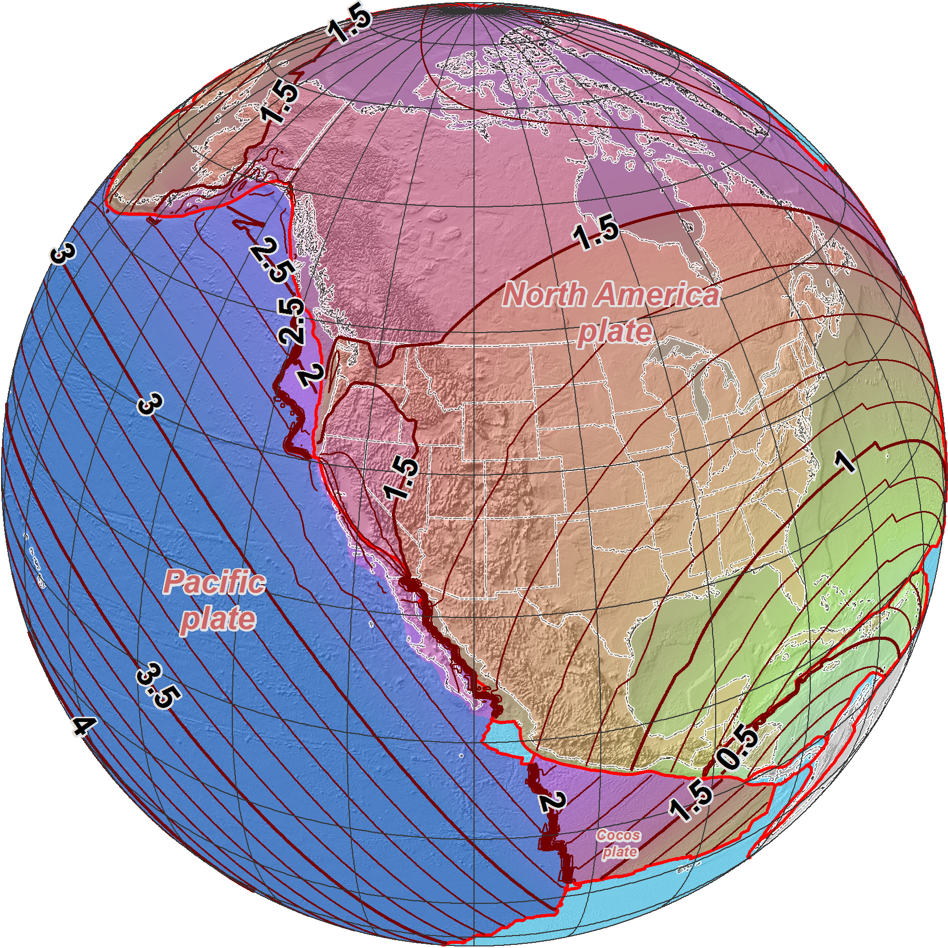
NAD 83 (2011/PA11/MA11) epoch 2010.00 →
2022 Terrestrial
Reference Frames
Horizontal change at epoch 2022.00
(contours in meters)
NATRF2022
PATRF2022
CATRF2022

Slide 12
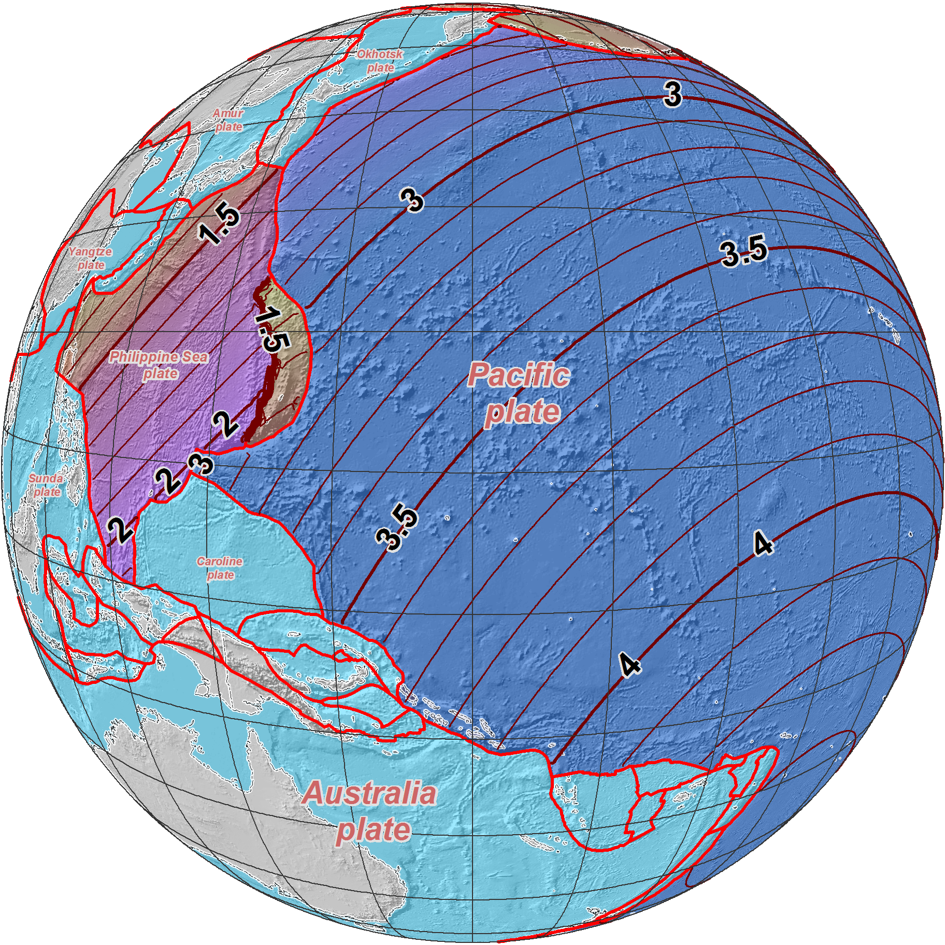
NAD 83 (2011/PA11/MA11) epoch 2010.00 →
2022 Terrestrial
Reference Frames
Horizontal change at epoch 2022.00
(contours in meters)
MATRF2022
PATRF2022

Slide 13
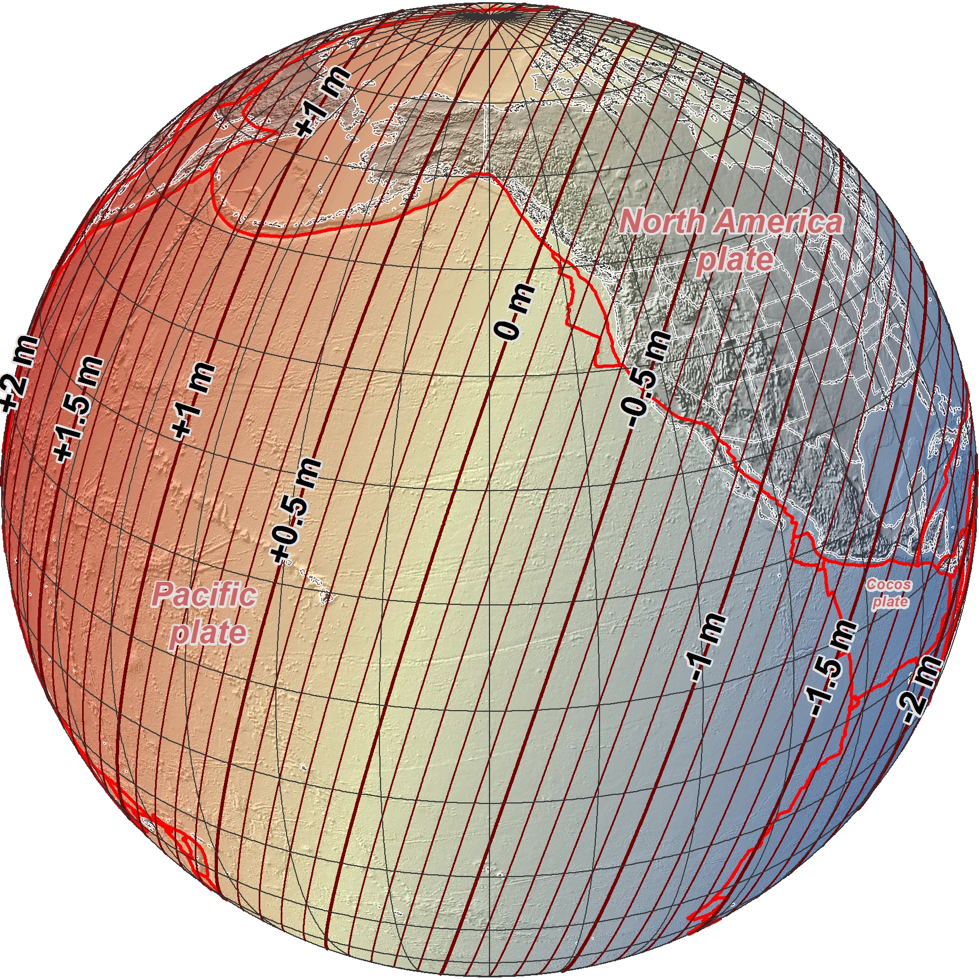
NAD 83 (2011/PA11/MA11) epoch 2010.00 →
2022 Terrestrial
Reference Frames
Change in ellipsoid heights at epoch 2022.00
(contours in meters)

Slide 14
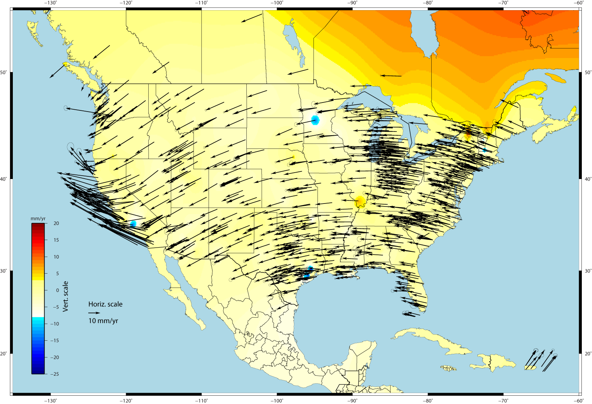
U.S. CORS Velocity Field – ITRF2008 (IGS08 epoch 2005.0)

Slide 15
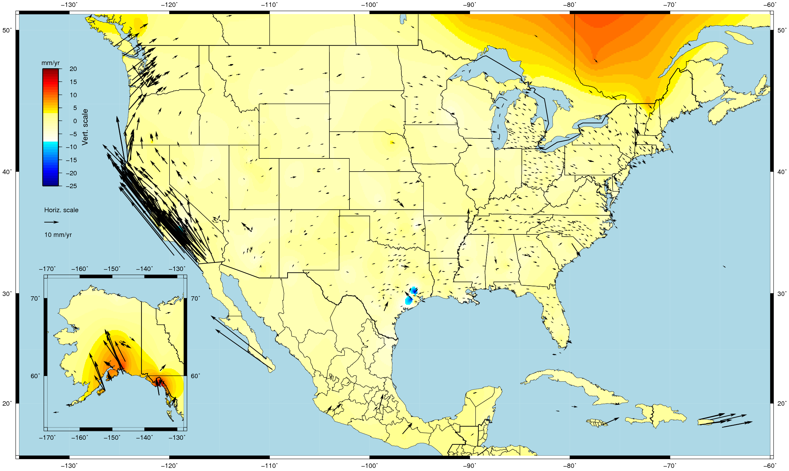
U.S. CORS Velocity Field - NAD83(2011) epoch 2010.00

Slide 16
“Vertical”: Out with the old, in with the new
  The Old:
  NAVD 88
  PRVD 02
  VIVD09
  ASVD02
  NMVD03
  GUVD04
  IGLD 85
  IGSN71
  GEOID12B
  DEFLEC12B
Orthometric
Heights
  The New:
  The North American-Pacific Geopotential Datum of 2022 (NAPGD2022)
  Will include GEOID2022
  DEFLEC2022
  SGRAV2022
one vertical datum
pole-to-equator
Normal
Orthometric
Heights
Dynamic
Heights
Gravity
Geoid Heights
Deflections of
the Vertical

Slide 17
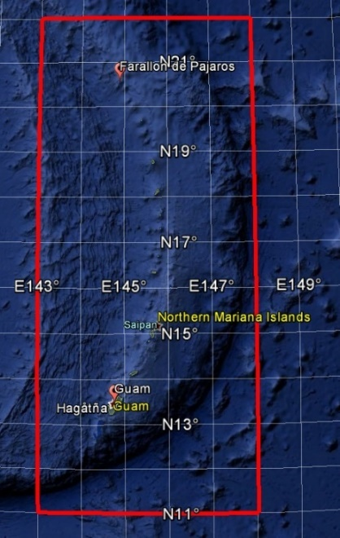
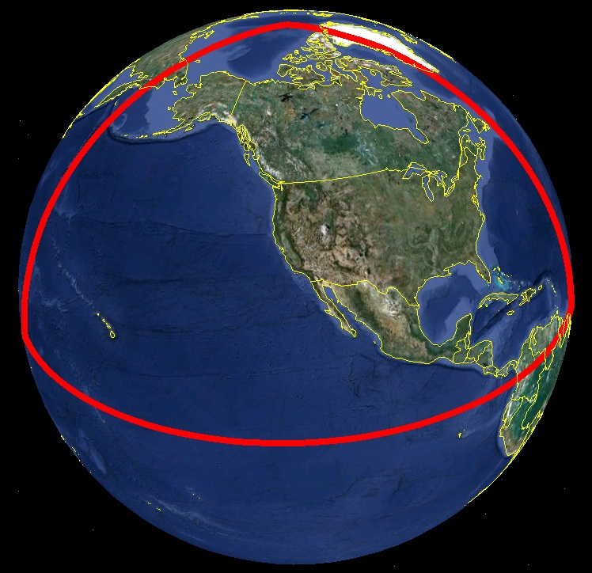
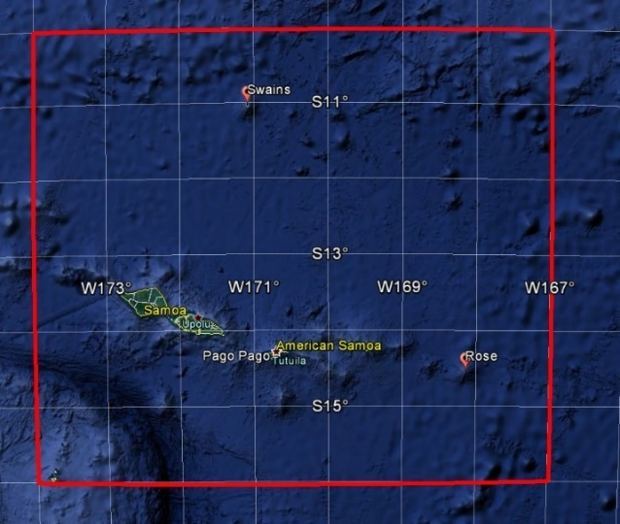
Extent of NAPGD2022 gravimetric geoid model
Guam and Northern Marianas Islands
American Samoa

Slide 18
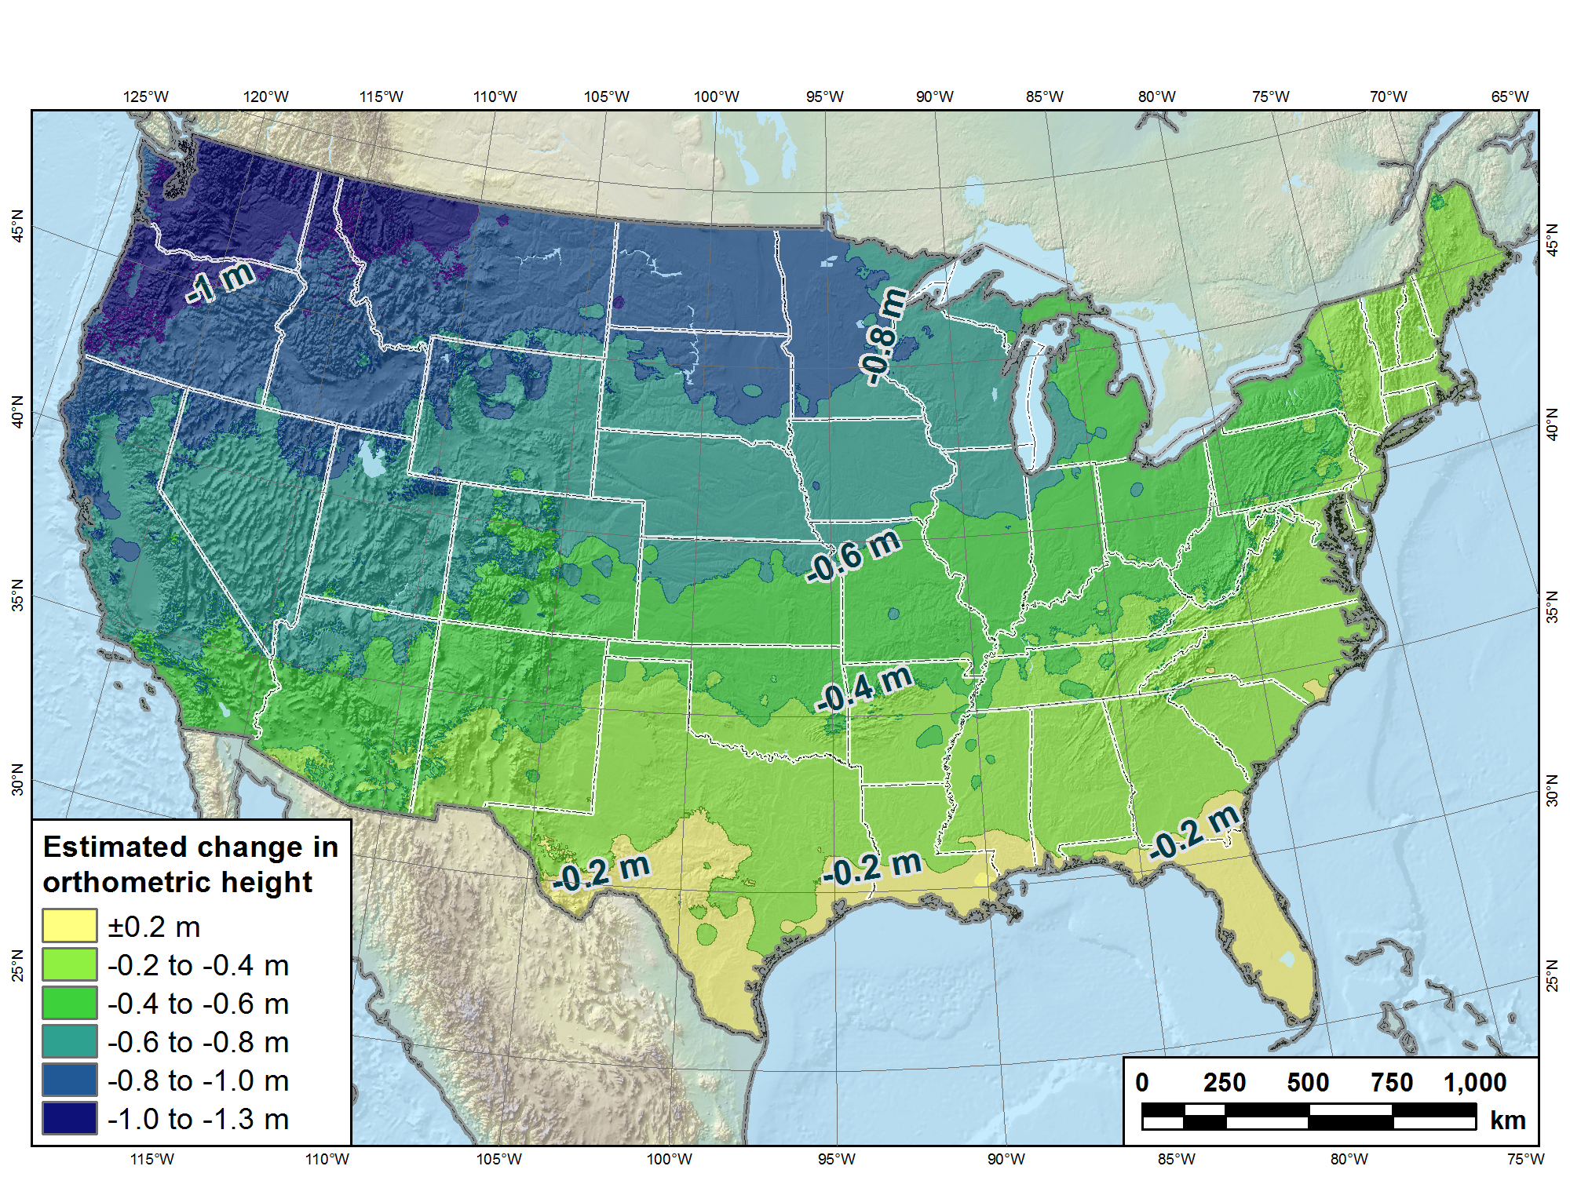
Estimated change in orthometric heights from NAVD 88 to NAPGD2022
NAPGD2022 approximated using xGEOID16B

Slide 19
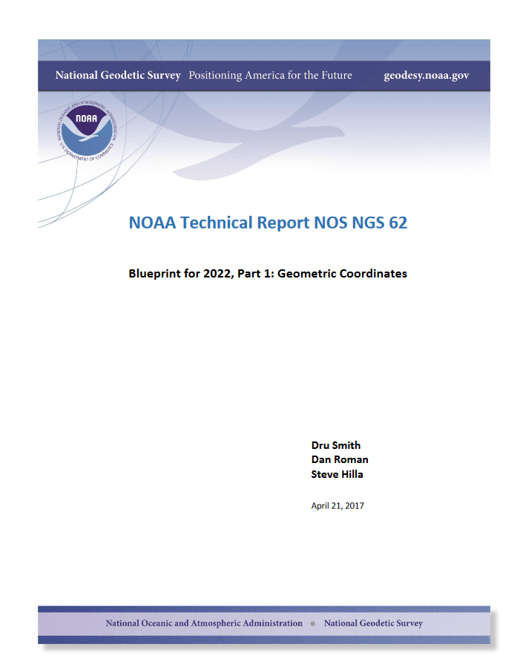
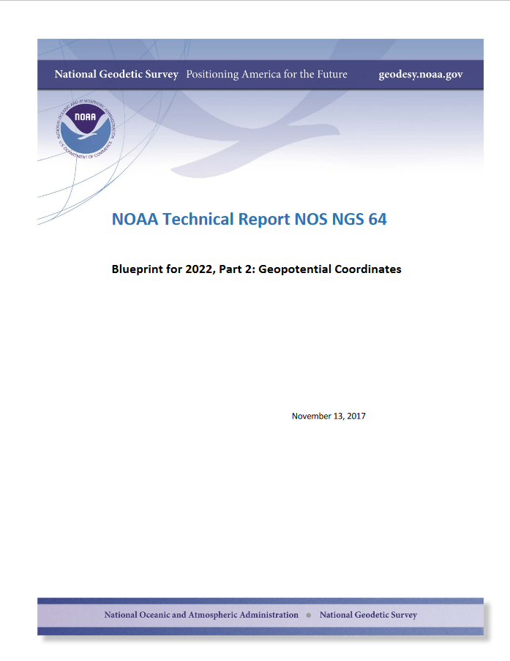

Slide 20

GPS on Bench Marks

Slide 21
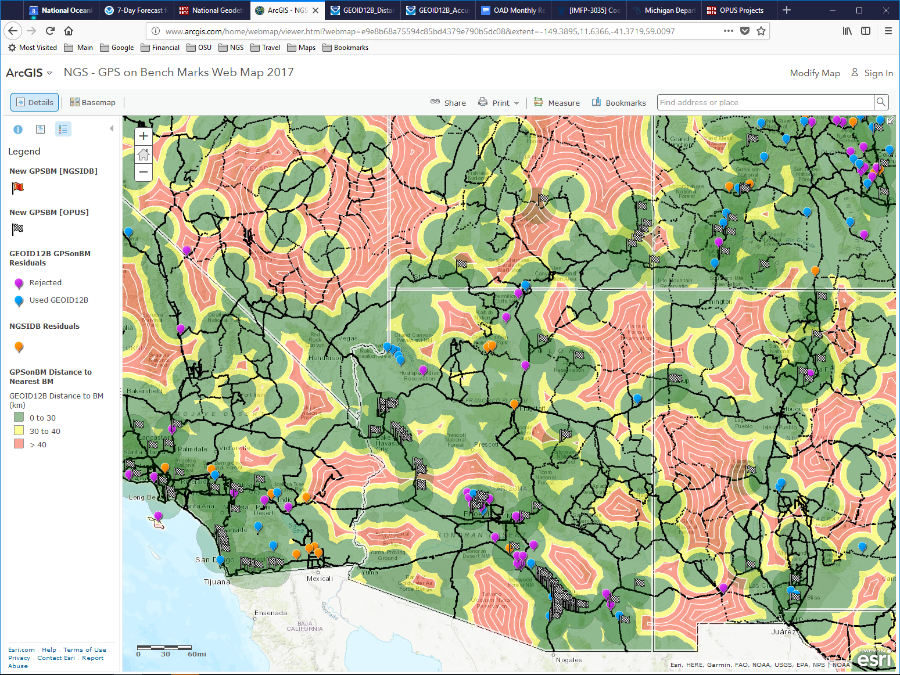
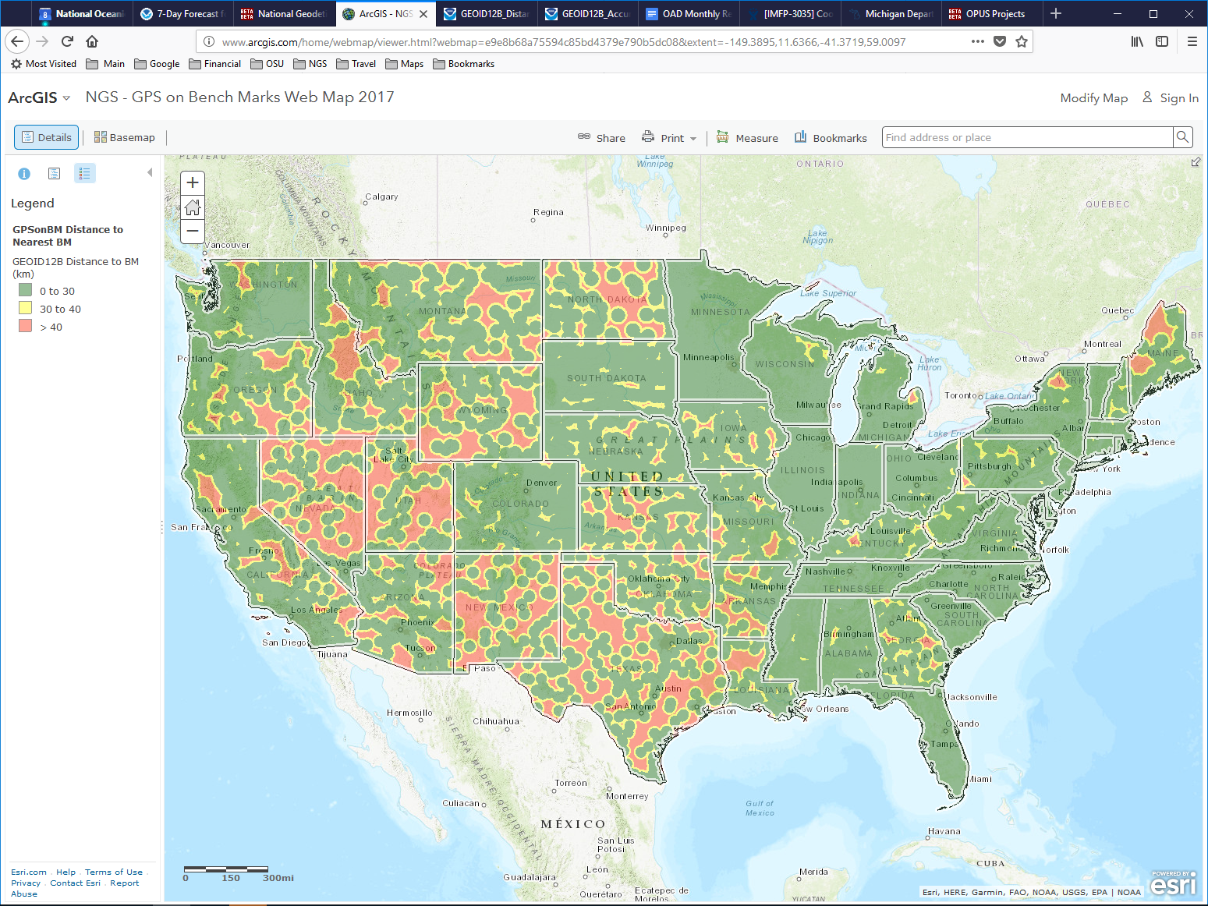
NGS GIS Map - GPS on Bench Mark

Slide 22
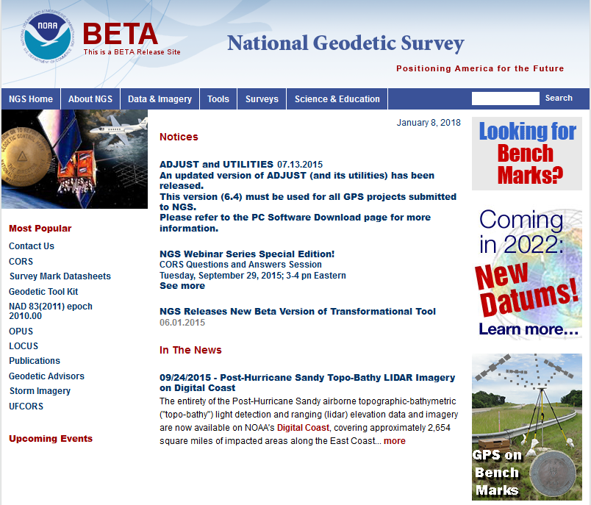
beta.ngs.noaa.gov

Slide 23
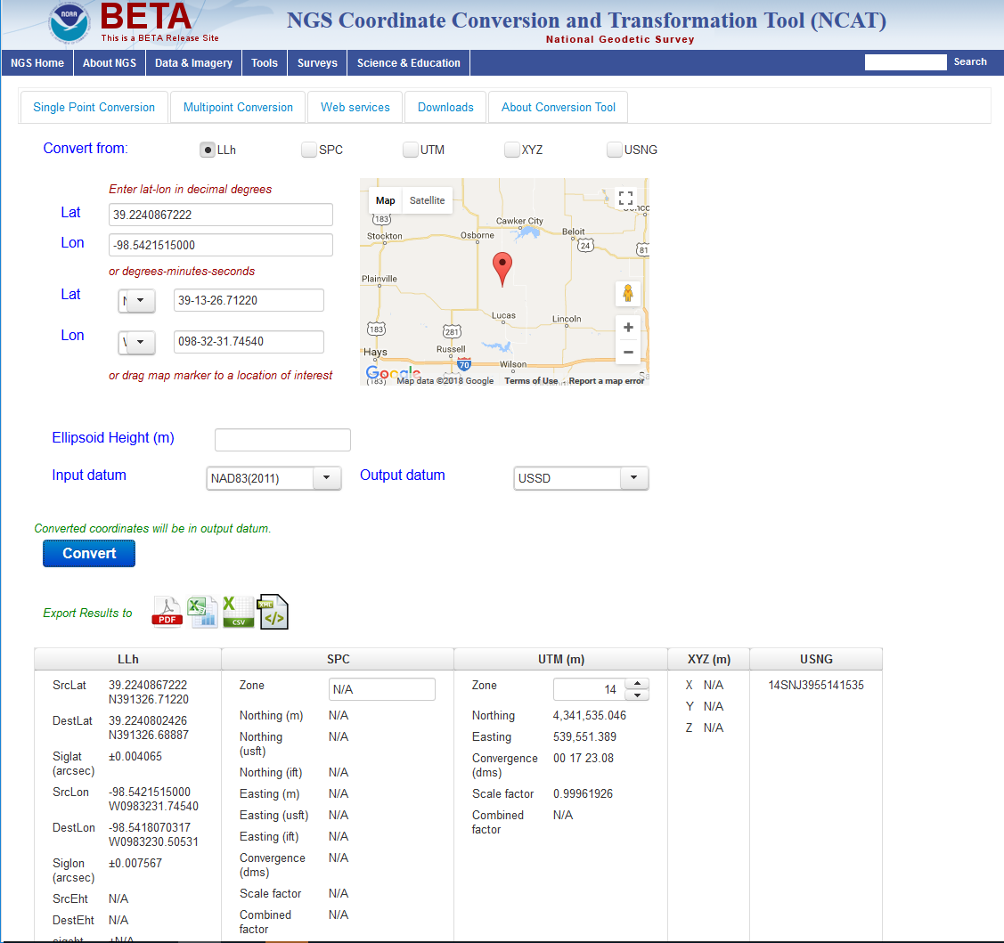
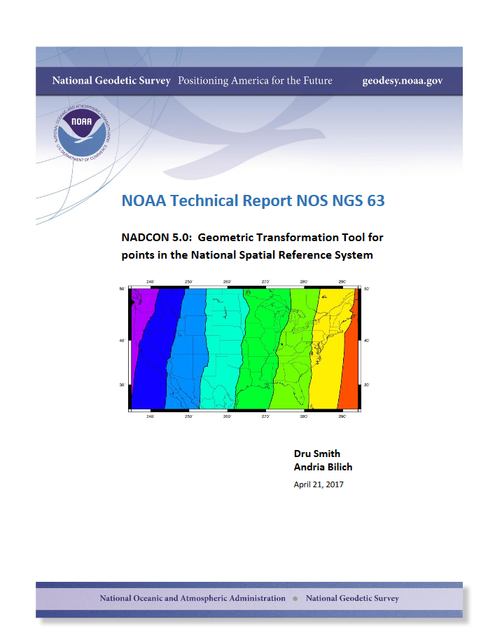
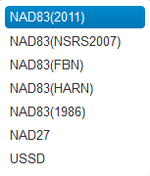
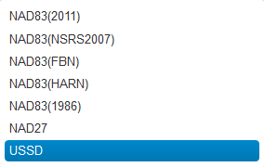
beta.ngs.noaa.gov/NCAT

Slide 24
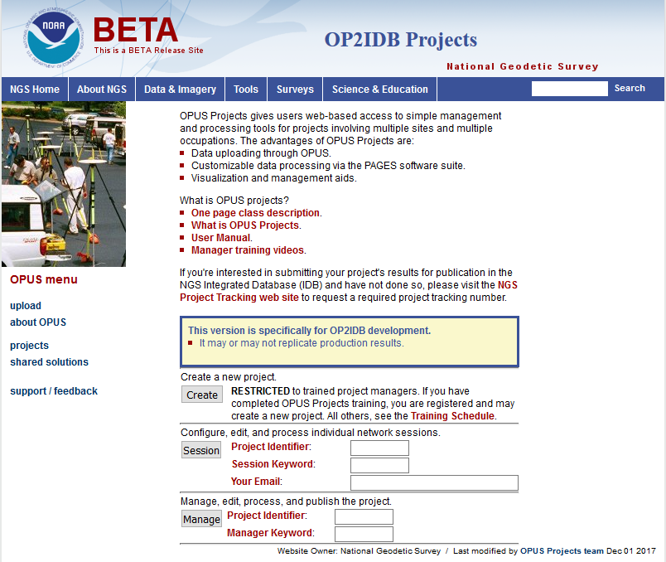

Slide 25
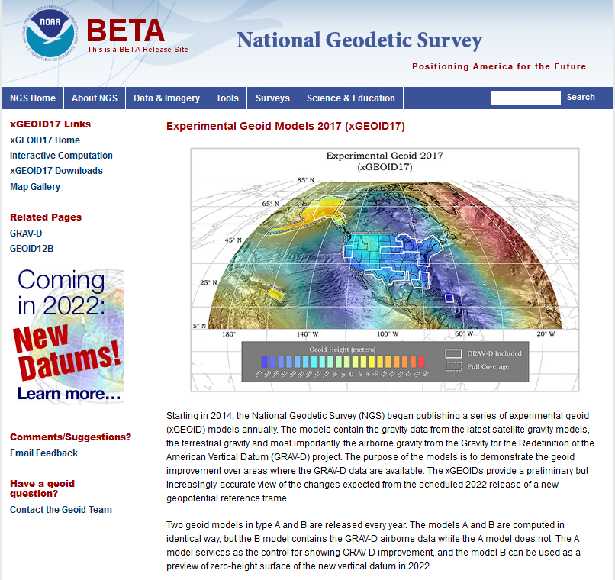
beta.ngs.noaa.gov/GEOID/xGEOID17

Slide 26
New State Plane Coordinate System
State Plane Coordinate System of 2022 (SPCS2022)
  Referenced to new 2022 TRFs
  Based on same reference ellipsoid (GRS 80)
  Same 3 conformal projection types
    Lambert Conformal Conic (LCC)
    Transverse Mercator (TM)
    Oblique Mercator (OM)
NGS in process of specifying SPCS2022 characteristics
  Draft policy and procedures for public comment
  Federal Register Notice on policy and procedures
  New report on State Plane history, policy, and future
NOTE: SPCS2022 characteristics currently in review
  Approved version may differ from what is presented here

Slide 27
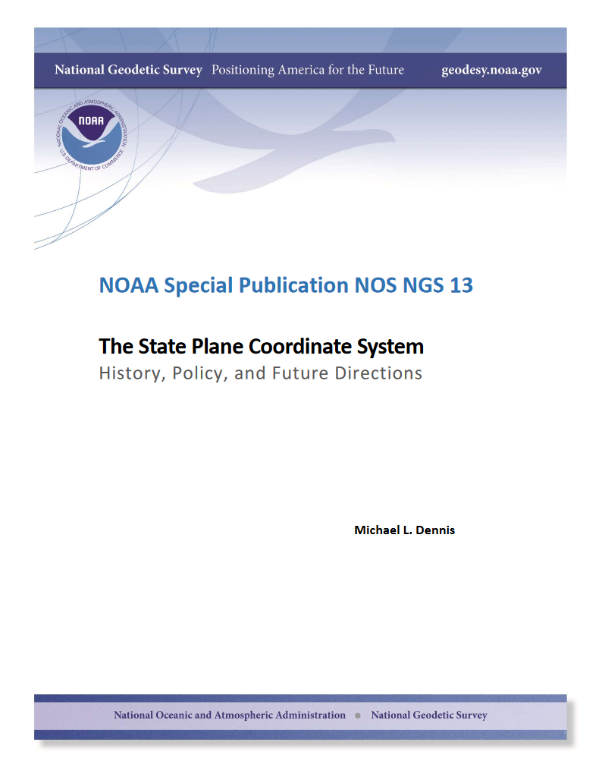
SPCS Special Publication
History of NGS projections (1853 to present)
SPCS policies and legislation
Departures from policy and convention
Recent developments in projected coordinate systems
Appendices
  Defining parameters for ALL zones of ALL versions of SPCS, plus additional information
  Status of SPCS 83 legislation and foot conversions

Slide 28
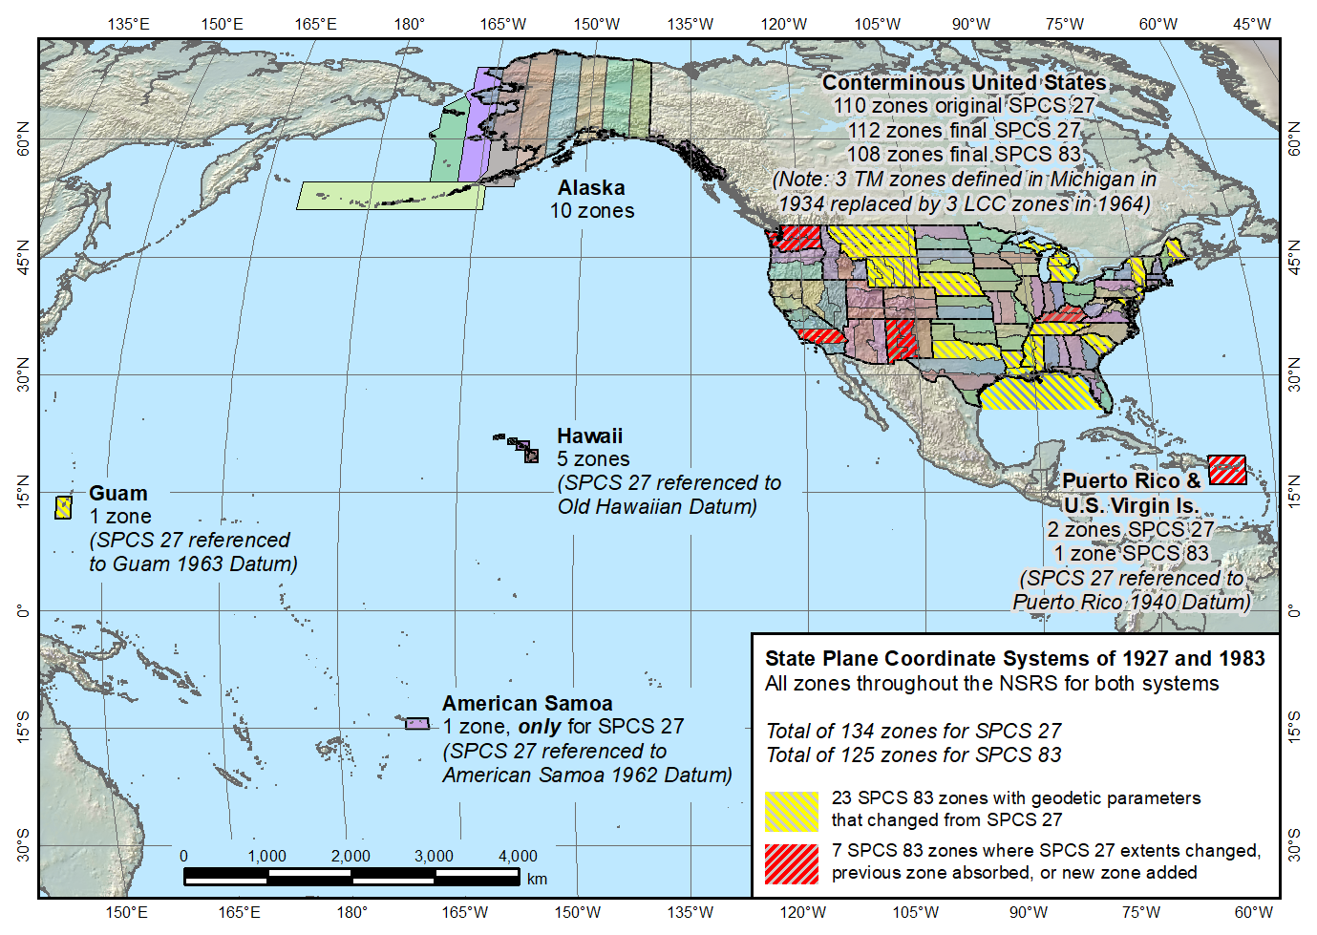
State Plane Coordinate Systems of 1927 (134 zones) and 1983 (125 zones)
Guam SPCS 83 zone added in 1995

Slide 29
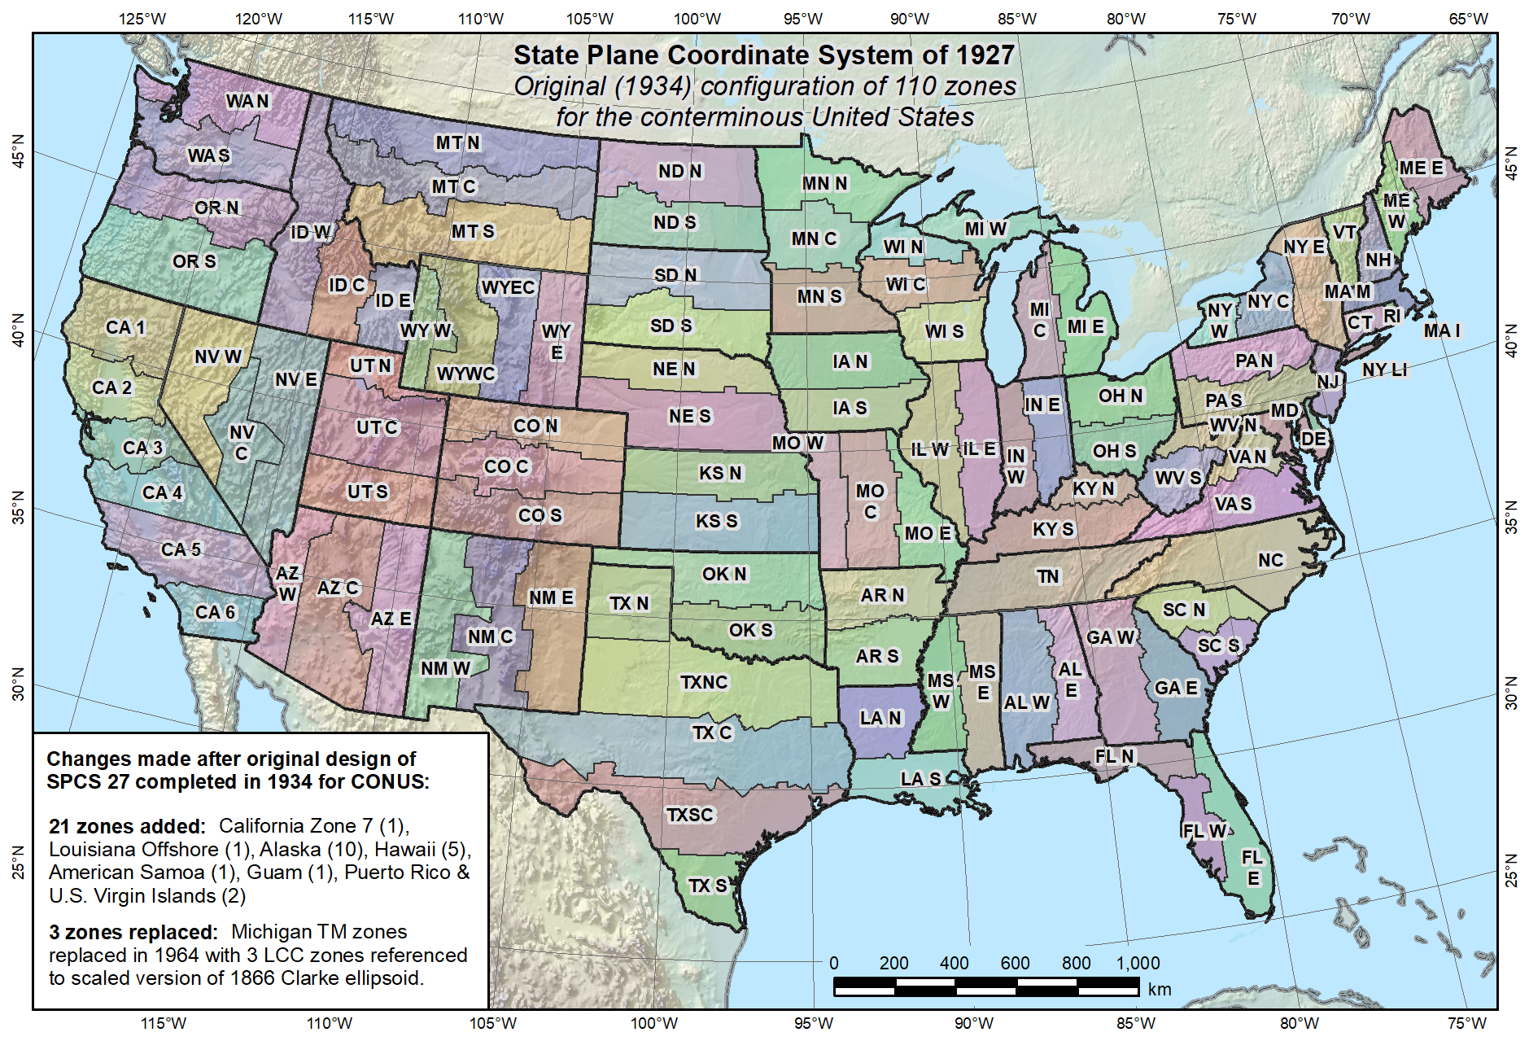
Original SPCS 27, as of 1934 (110 zones total)

Slide 30
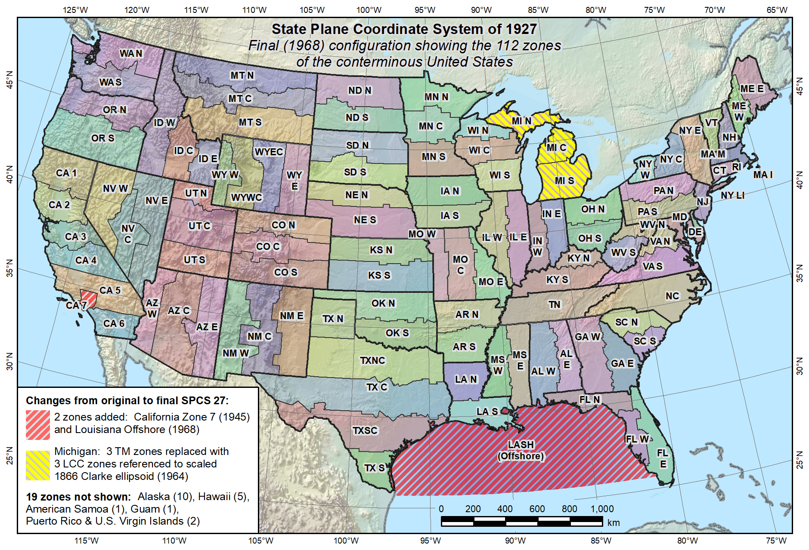
Final SPCS 27, as of 1968 (112 zones in CONUS, 131 zones total)
Reduced distortion zones added: CA 7 (1945)
MI (1964)

Slide 31
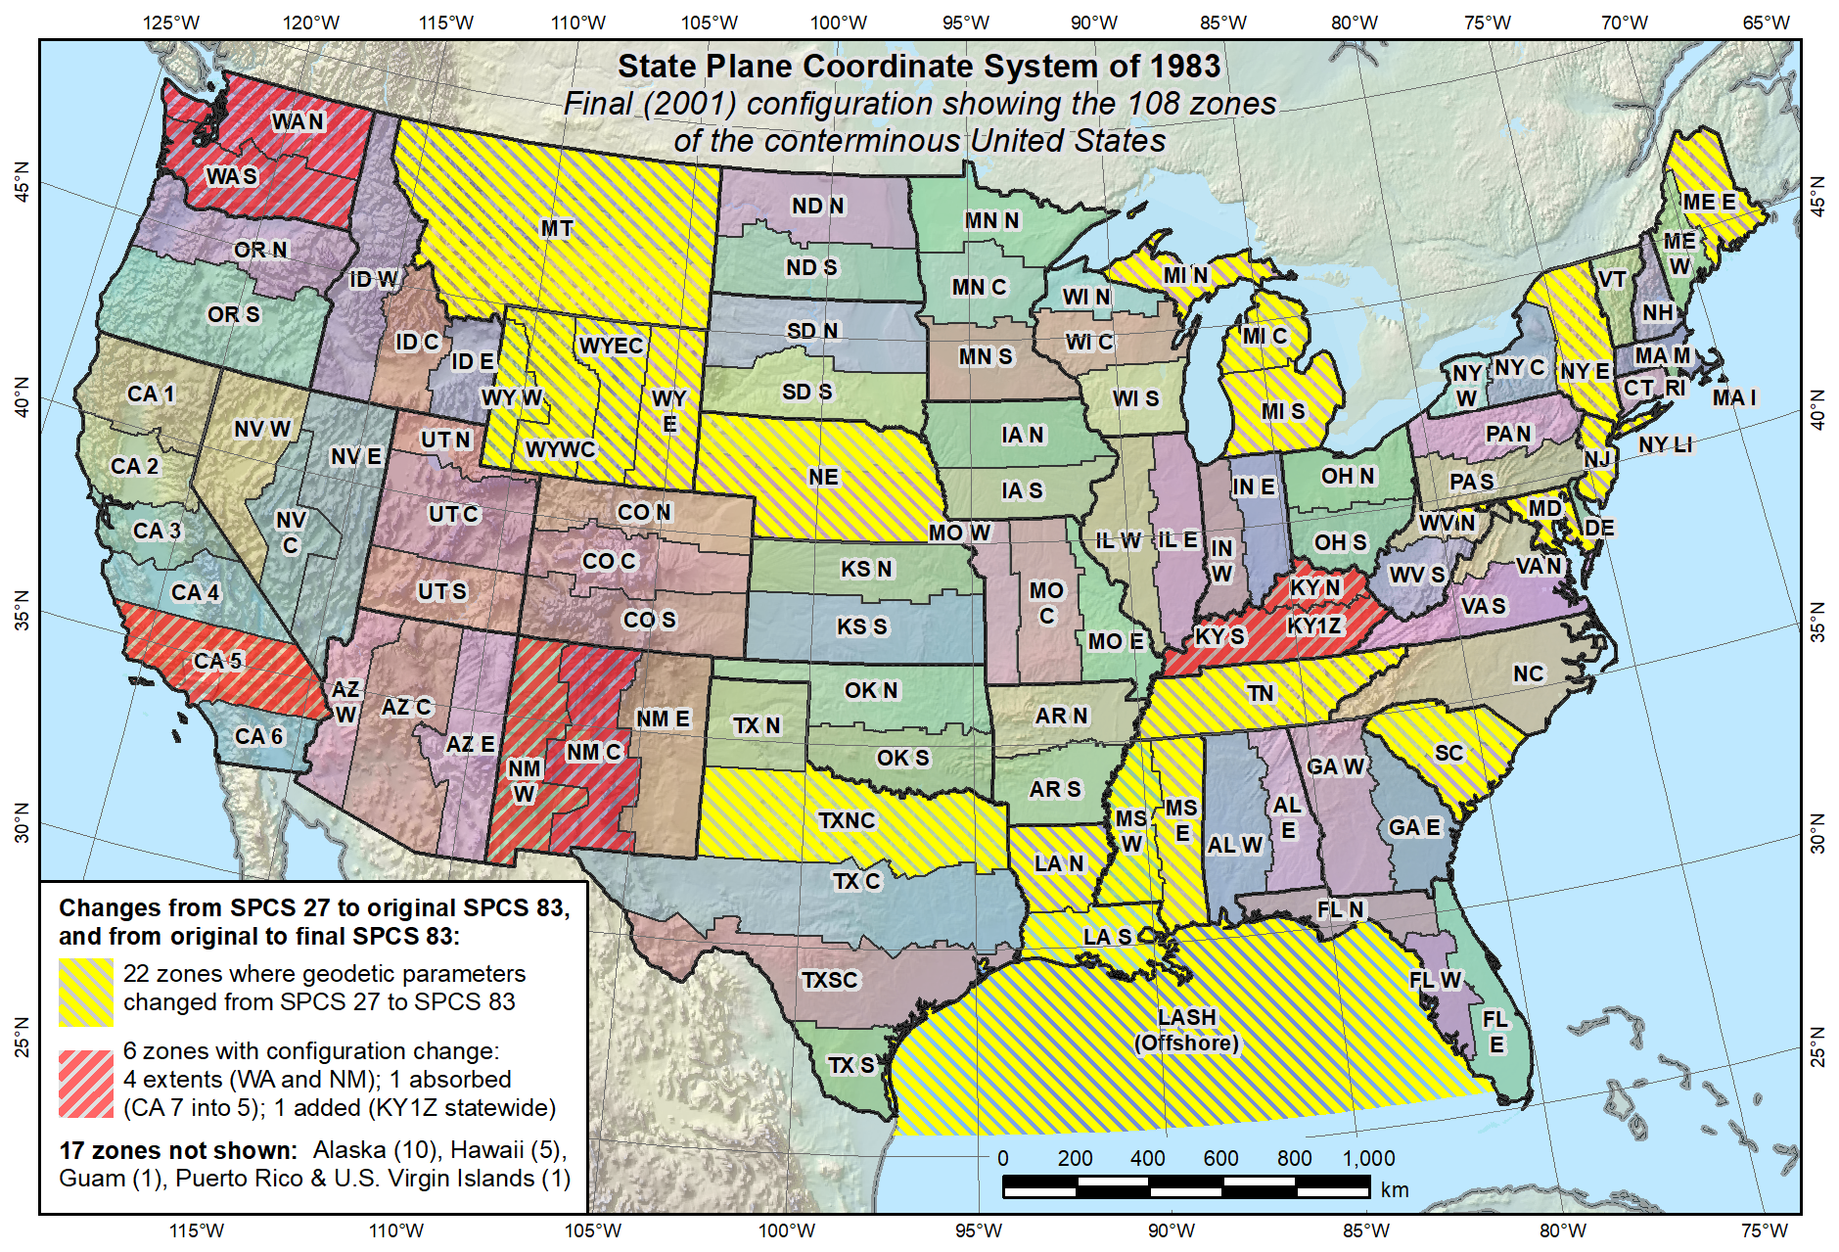
Final SPCS 83, as of 2001 (108 zones in CONUS, 125 zones total)
KY statewide zone added in 2001

Slide 32
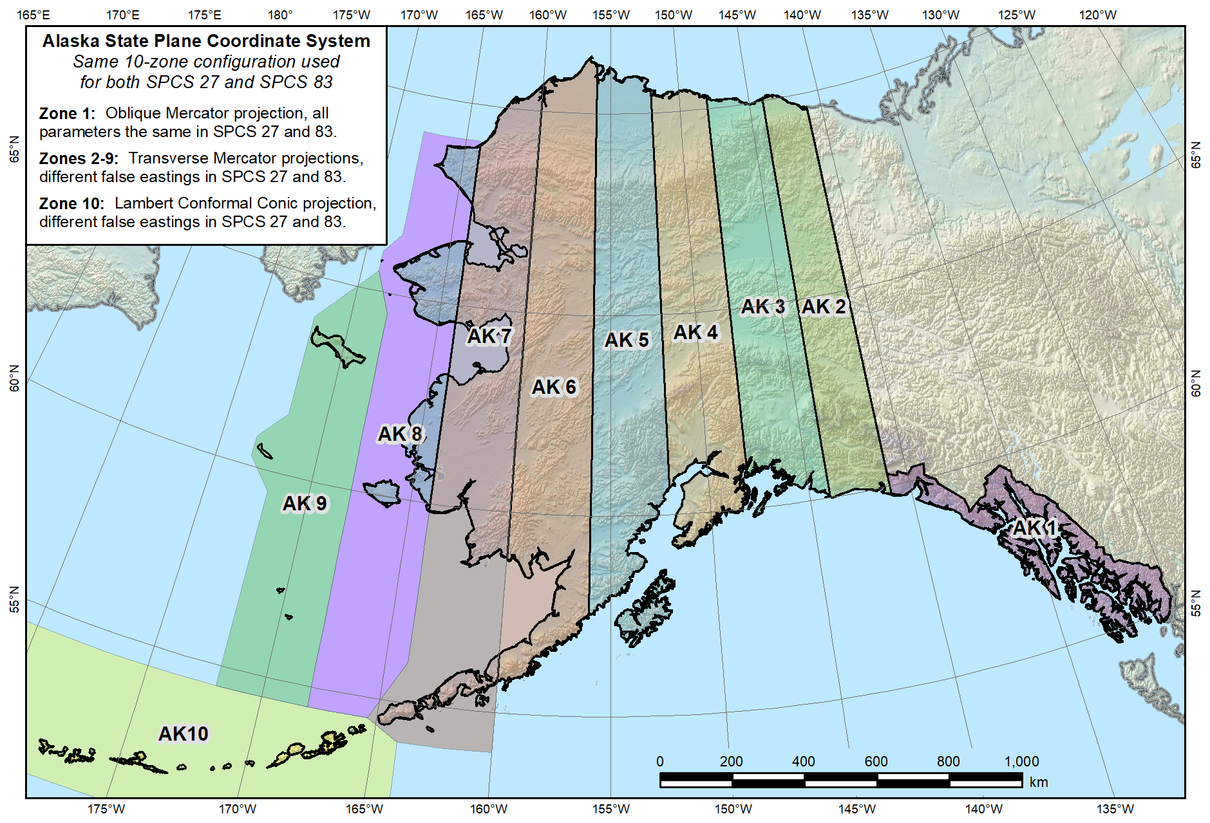
Alaska State Plane Coordinate Systems of 1927 and 1983 (10 zones)

Slide 33
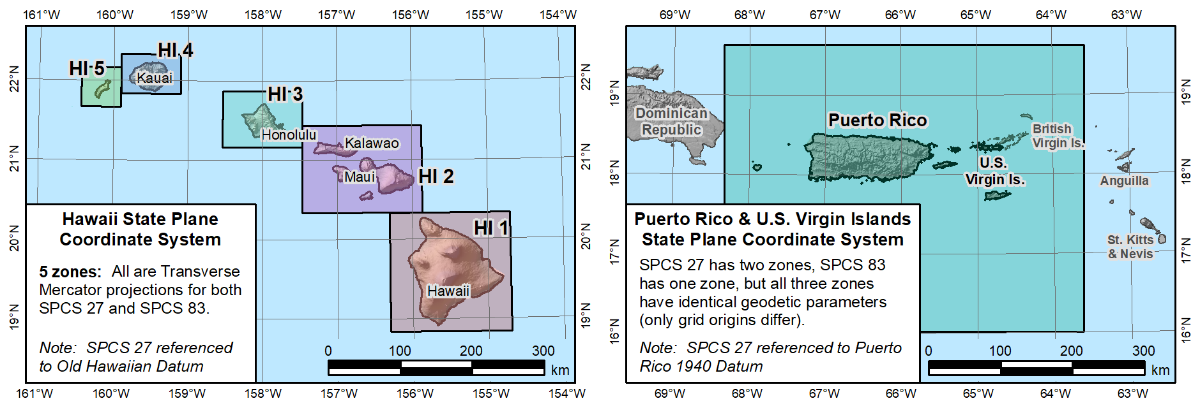
Hawaii State Plane
Coordinate Systems
of 1927 and 1983 (5 zones)
“SPCS 27” version referenced to
Old Hawaiian Datum
Puerto Rico and U.S. Virgin Islands
State Plane Coordinate Systems
of 1927 (2 zones) and 1983 (1 zone)
“SPCS 27” version referenced to
Puerto Rico 1940 Datum

Slide 34
Draft SPCS2022 Policy & Procedures
Release for 6-month public comment period
  Deadline for comments set at July 31, 2018
Stakeholder input on what they want for their zones
  DOTs, GIS offices, professional societies, universities
  Deadlines (draft):
    Dec 31, 2019 for requests and proposals
    Dec 31, 2020 for submitted designs
Includes SPCS2022 characteristics & requirements
  Projection types and parameters
  Default designs (if no consensus stakeholder input)
  “Layered” zones and low-distortion projections (LDPs)
  Linear distortion design criteria
    Difference in distance between “ground” and “grid” (projected)

Slide 35
Linear distortion magnitudes
±20 ppm = 2 cm/km = 0.1 ft/mile = 1 : 50,000
  Often used as “low distortion” design criterion (at ground)
±50 ppm = 5 cm/km = 0.3 ft/mile = 1 : 20,000
  Minimum design criterion for SPCS2022 designs by NGS (at ground)
±100 ppm = 10 cm/km = 0.5 ft/mile = 1 : 10,000
  “Nominal” maximum State Plane value (on ellipsoid)
  Can be much greater at topo surface
±400 ppm = 40 cm/km = 2.1 ft/mile = 1 : 2,500
  Maximum UTM value (on ellipsoid)
  Maximum design criterion for SPCS2022 zones (at ground)

Slide 36
Default SPCS2022 designs (draft)
Most zones will keep same extents and projection type
Modifications to align with SPCS2022 policy:
  Scale redefined with respect to topographic surface
  One-parallel Lambert and local Oblique Mercator
Some possible changes in projection types and zones:
  Single OM zone for FL peninsula (replaces 2 TM zones)
  Single OM zone for Hawaii (replaces 5 TM zones)
  Group RI, CT, MA into one zone (reduces number zones by 3)
  Include Guam and CNMI in a single TM zone
  Define LCC zone for American Samoa
  Redefine AK zones to better correspond to land use
  Zone added for Washington D.C.

Slide 37
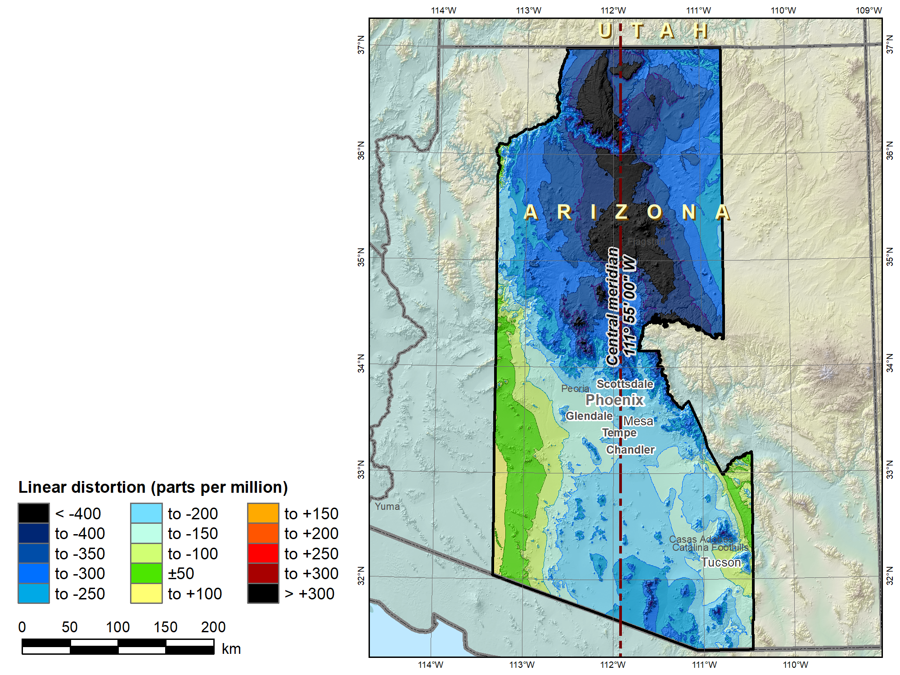
SPCS 83
Arizona Central Zone (Transverse Mercator)
 | Height (m)
Min | 96
Max | 3607
Mean | 1177
 |  | SPCS 83 AZ C
C.M. |  | 111°55’W
Scale |  | 0.9999
 |  | Distortion (ppm)
Min |  | -660
Max |  | +102
Mean |  | -224

Slide 38
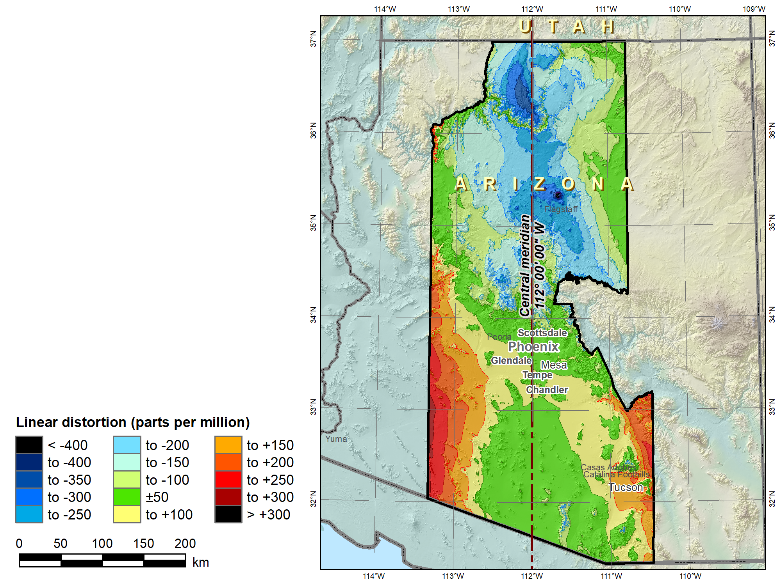
SPCS2022 “default” Arizona Central Zone (Transverse Mercator)
No change in projection type or zone extents
 | Height (m)
Min | 96
Max | 3607
Mean | 1177
 |  | SPCS 83 AZ C | SPCS2022
C.M. |  | 111°55’W | 112°W
Scale |  | 0.9999 | 1.0001
 |  | Distortion (ppm)
Min |  | -660 | -455
Max |  | +102 | +277
Mean |  | -224 | -24

Slide 39
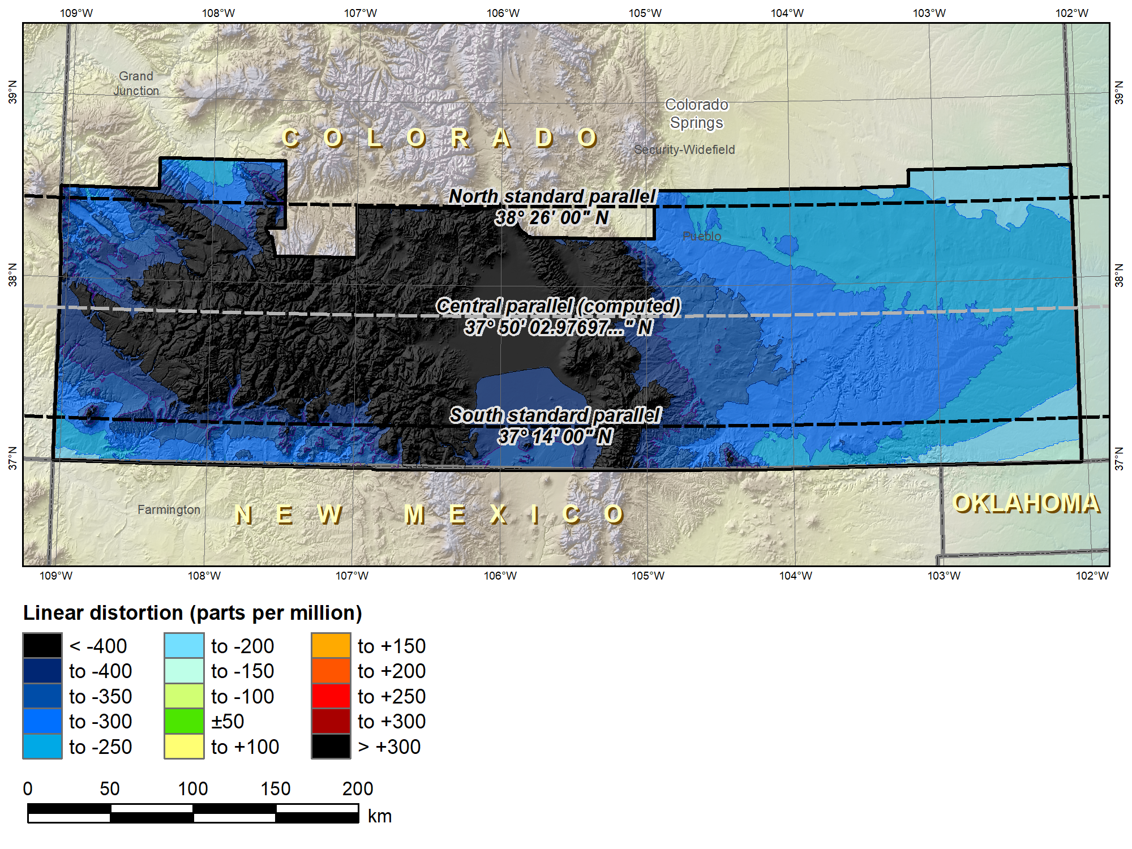
SPCS 83 Colorado South (Lambert Conformal Conic 2-parallel)
 |  | SPCS 83 CO S
Central parallel |  | 37°50’02.98…”N
Cen parallel scale |  | 0.9999453985…
 | Height (m) | Distortion (ppm)
Min | 998 | -697
Max | 4106 | -117
Mean | 2091 | -352

Slide 40
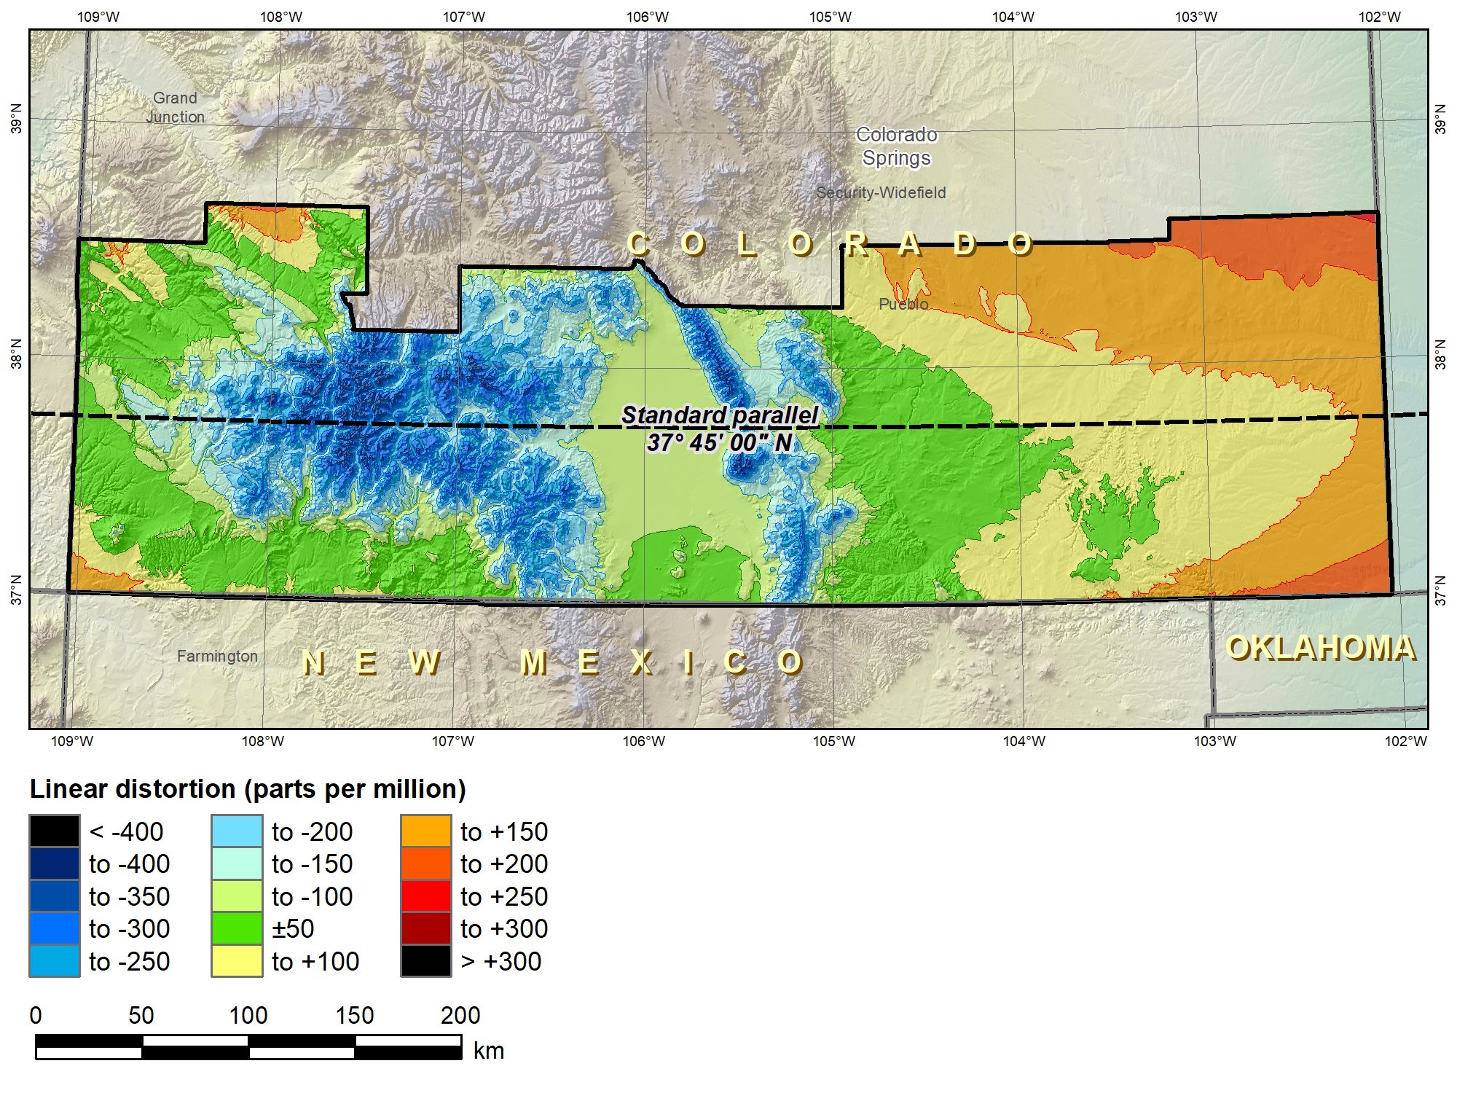
SPCS2022 “default” CO S (Lambert Conformal Conic 1-parallel)
No change in projection type or zone extents
 |  | SPCS 83 CO S | SPCS2022
Central parallel |  | 37°50’02.98…”N | 37°45’N
Cen parallel scale |  | 0.9999453985… | 1.00028
 | Height (m) | Distortion (ppm)
Min | 998 | -697 | -360
Max | 4106 | -117 | +209
Mean | 2091 | -352 | -19

Slide 41
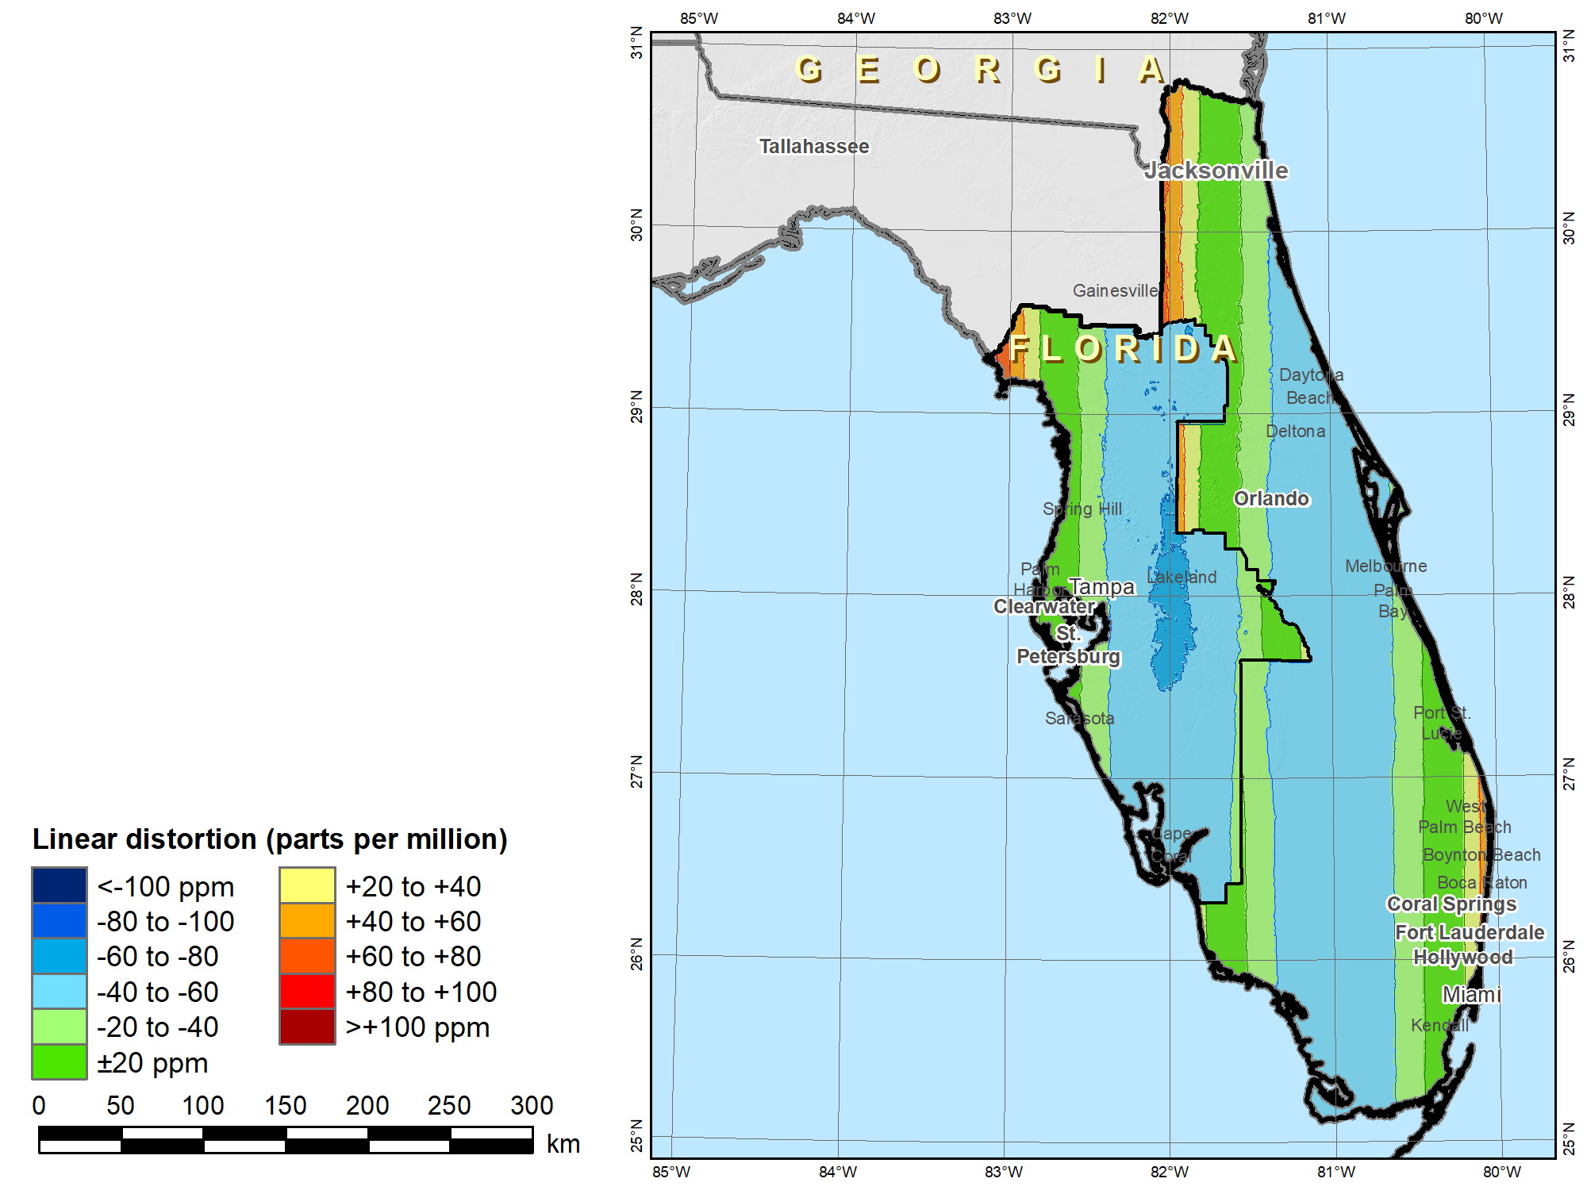
SPCS 83 Florida
East & West zones
(Transverse Mercator)
 | Height (m)
Min | -31
Max | +63
Mean | -9
 |  | SPCS 83 FL EW
Scale |  | 0.999941176…
 |  | Distortion (ppm)
Min |  | -68
Max |  | +100
Mean |  | -32

Slide 42
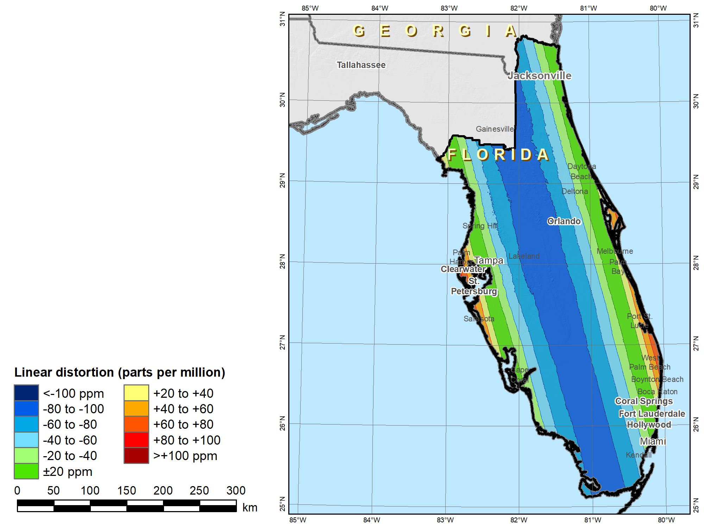
SPCS2022 “default” Florida peninsula (Oblique Mercator)
 | Height (m)
Min | -31
Max | +63
Mean | -9
 |  | SPCS 83 FL EW | SPCS2022
Scale |  | 0.999941176… | 0.99991
 |  | Distortion (ppm)
Min |  | -68 | -99
Max |  | +100 | +97
Mean |  | -32 | -50
Change projection type and replace two zones with one

Slide 43
“Layered” zones (draft)
Limitations
  Max of TWO layers: Statewide and sub-zones
  If two layers, one MUST be statewide
  Minimum sub-zone dimension > 50 km
States often want statewide and small zones
  Statewide: Single geometry required for state GIS
  Sub-zones: Lower distortion for surveying/engineering
  But not all states will want or need both types
Accommodates state needs, but with restrictions
  Prevent poor design choices for statewide zones
  And one already exists in SPCS 83…

Slide 44
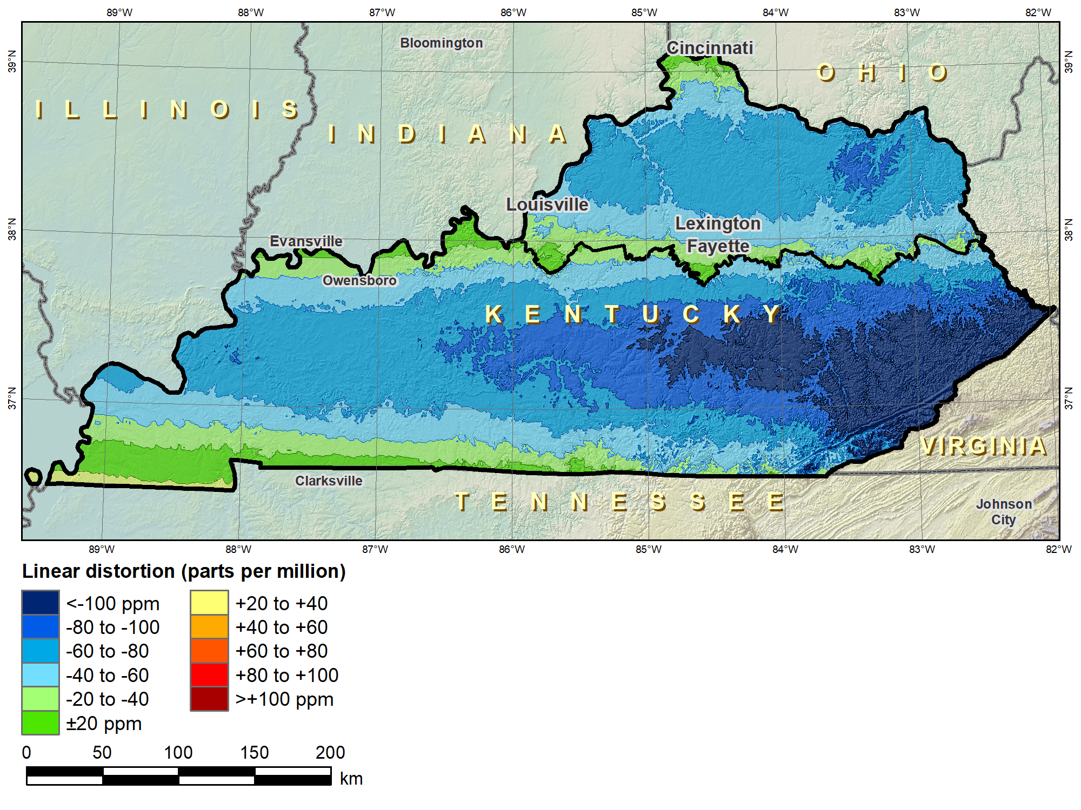
Kentucky layered zones
“Layered” zones
SPCS 83 Kentucky N and S zones (Lambert Conformal Conic)
 |  | North | South
N parallel |  | 38°58’N | 37°56’N
S parallel |  | 37°58’N | 36°44’N
 |  | Distortion (ppm)
Min |  | -93 | -211
Max |  | +17 | +42
Mean |  | -56 | -67

Slide 45
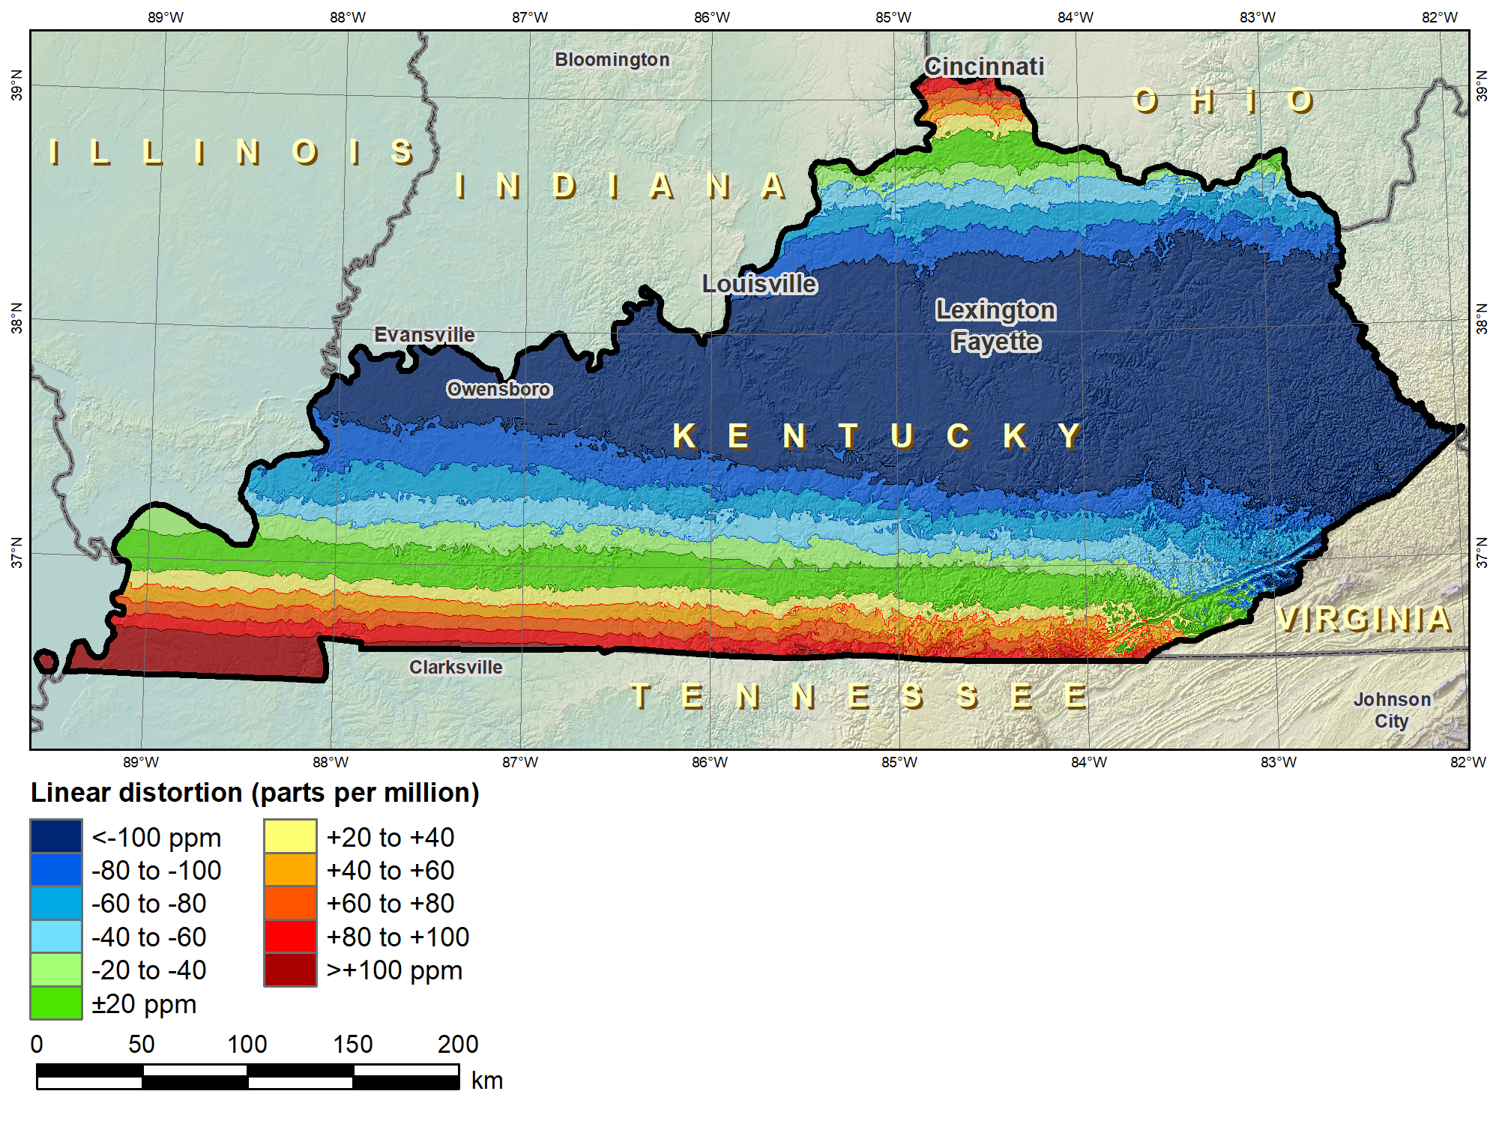
Kentucky layered zones
“Layered” zones
SPCS 83 Kentucky statewide zone (Lambert Conformal Conic)
 |  | North | South | Statewide
N parallel |  | 38°58’N | 37°56’N | 38°40’N
S parallel |  | 37°58’N | 36°44’N | 37°05’N
 |  | Distortion (ppm)
Min |  | -93 | -211 | -166
Max |  | +17 | +42 | +181
Mean |  | -56 | -67 | -58

Slide 46
Linear distortion design criteria
NGS design of zones requested by stakeholders
  Limited to zones with 50-400 ppm distortion criterion
    50 ppm = 5 cm/km = 0.3 ft/mi = 1:20,000
    100 ppm = 10 cm/km = 0.5 ft/mi = 1:10,000
    400 ppm = 40 cm/km = 2.1 ft/mi = 1:2,500
Design criterion < 50 ppm (“low distortion”)
  Min criterion 20 ppm = 2 cm/km = 0.1 ft/mi = 1:50,000
  Must be designed by others (not by NGS)
  Proposed and final design reviewed by NGS
What is the current situation with “low distortion” projected coordinate systems?

Slide 47
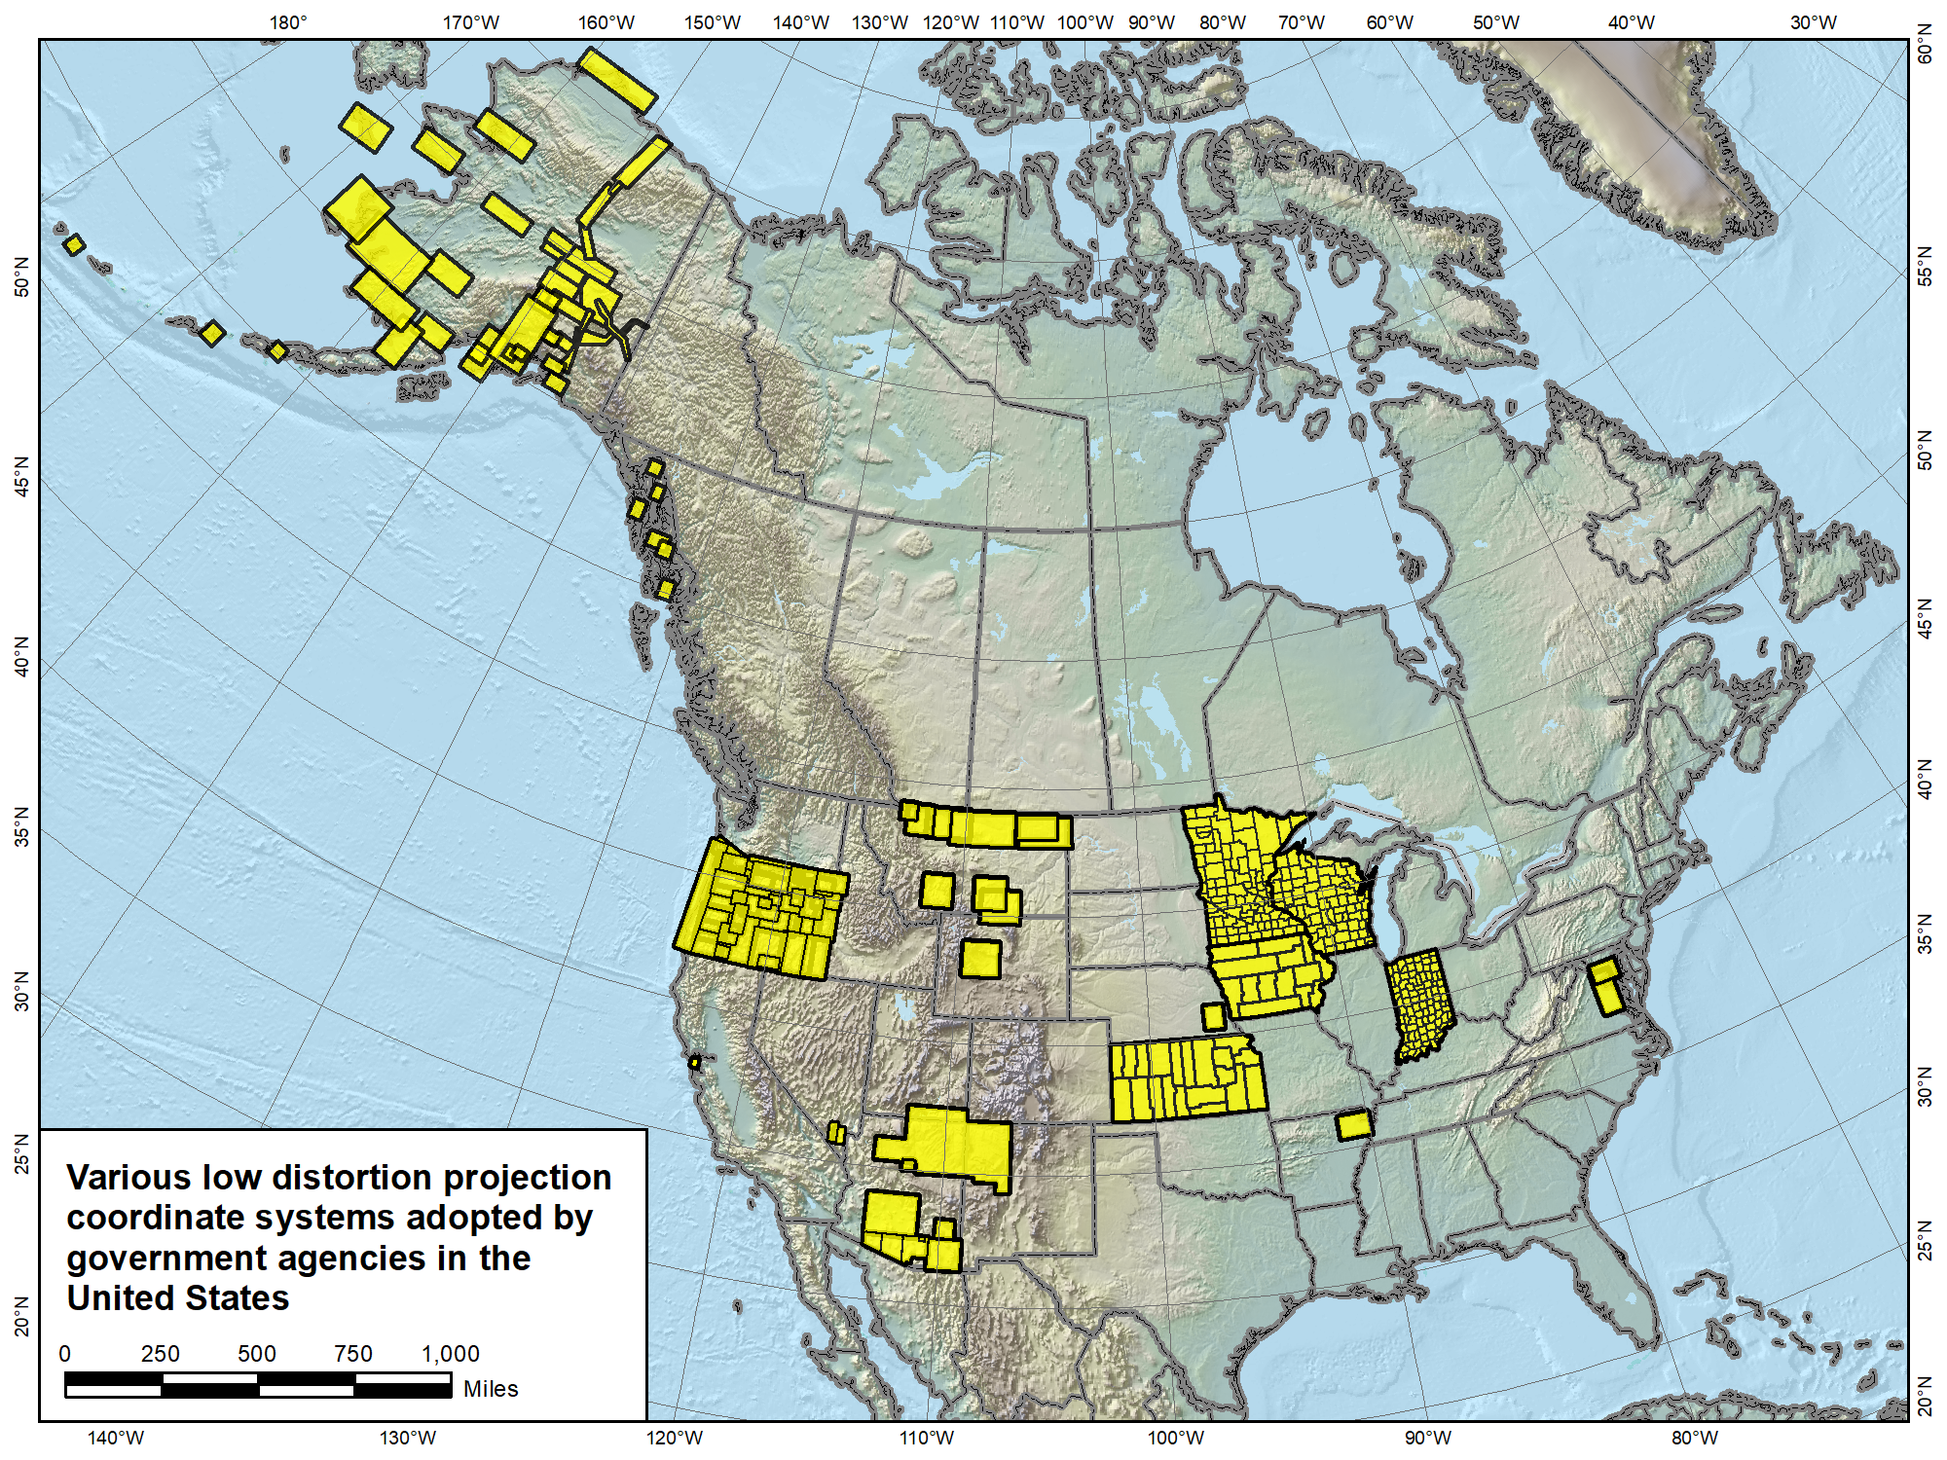

Slide 48
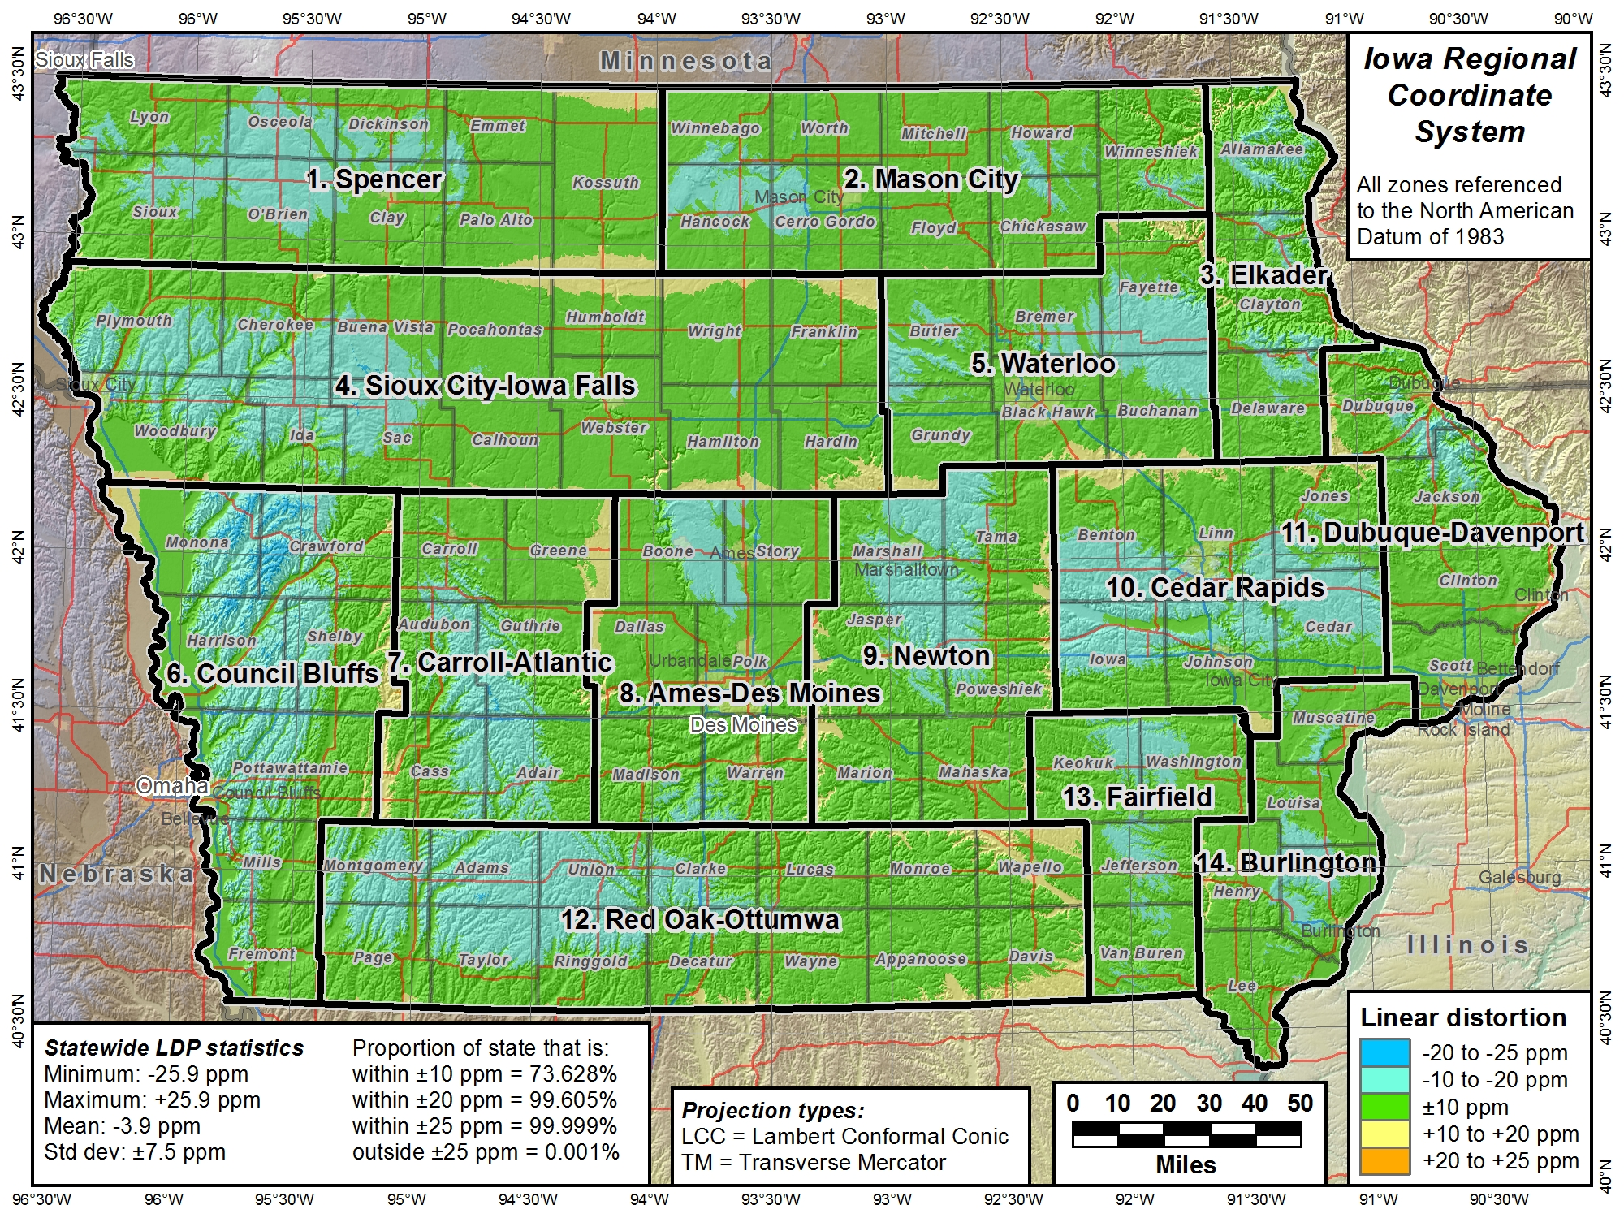
Iowa has already requested this system be part of SPCS2022

Slide 49
Summary: NSRS Modernization
New “datums” for 2022
  Four new Terrestrial Reference Frames
  New Geopotential Datum (NAPGD2022)
New publications
  New datums, NADCON 5, State Plane
New products and services
  GPS on BMs, NCAT, OPUS for Bluebooking, xGEOID17
State Plane Coordinate System of 2022
  Designed with respect to “ground”
  Default designs similar to existing State Plane
  Can include a statewide zone plus a sub-zone layer
  Stakeholder input on zones for their states (including LDPs)
  NGS webinar on March 8 – register at:
  https://geodesy.noaa.gov/web/science_edu/webinar_series/Webinars.shtml
All of this is currently in review, not yet finalized

